Slide 1
Thomas Jefferson National Accelerator Facility is managed by Jefferson Science Associates, LLC, for the U.S. Department of Energy's Office of Science
Discussion of Reliability at CEBAF
Andrew Kimber
StayTreat 2017
2nd August
Notes:
I want to set the stage for the reliability day and provide some context for the group activities we have planned after this talk. I am going to talk in general terms about reliability for most of this presentation but everything here is applicable to CEBAF.

Slide 2
For high performance accelerators, reliability engineering must be:
introduced right at the inception of the project, and
maintained as a central theme throughout.
We are always on the technology frontier
StayTreat 2017, Andrew Kimber, 2nd August 2017
Slide 2/14
Notes:
I want to set the stage for the reliability day and provide some context for the group activities we have planned after this talk. I am going to talk in general terms about reliability for most of this presentation but everything here is applicable to CEBAF.

Slide 3
StayTreat 2017, Andrew Kimber, 2nd August 2017
Slide 3/14
Notes:
One could say that we are in the “production” phase but we engineer or reengineer new systems all the time. We also sometimes introduce more layers to a design which serve to add complexity and decrease reliability.

Slide 4
Each sub-system should be designed to maximize reliability.
Don’t be proud!
It is important to evaluate every aspect of the design, particularly the risks.
It is even more important to build prototypes and check the theory.
StayTreat 2017, Andrew Kimber, 2nd August 2017
Slide 4/14
Notes:
It is only with this two pronged approach that it is possible to gain confidence in the design and estimate the safety margin.

Slide 5
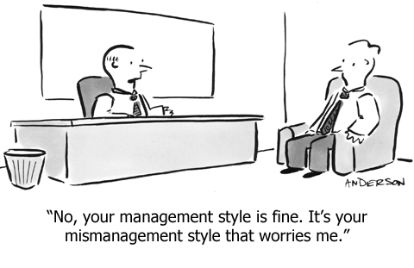
Motivation
Make every member of the team feel like a vital part of the success of the whole project.
Instill a common vision and provide the tools necessary to evaluate his or her success in reaching the goals.
Quality cannot be imposed. It takes a dedicated and motivated team that understand that quality is of paramount importance
StayTreat 2017, Andrew Kimber, 2nd August 2017
Slide 5/14
Notes:
The emotional commitment, “buy in” of the project team is vital to the success of the project. This should be accomplished by:
Delegating to each person the responsibility of designing and building their own system within the context of the global machine optimization
Giving them authority over the resources necessary to carry out the task
They must all work together as part of a team for the benefit of the whole project.

Slide 6
All the components of the system must contribute to the system, not exist for their individual gains.
For example, the travel department in a company is not there to save money on travel, but to serve the whole company, so the job of the travel department should be to put a passenger down at her destination, physically fit for the job, even if the travel department has to pay a premium rate to put her there. Every component must serve the whole system.
W. Edwards Deming
StayTreat 2017, Andrew Kimber, 2nd August 2017
Slide 6/14

Slide 7
Everyone working on the project should be trying to build the best possible accelerator with the resources available, not trying to build the best subsystem to the possible detriment of the whole project
StayTreat 2017, Andrew Kimber, 2nd August 2017
Slide 7/14
Notes:
Deming uses the word “sub-optimize” to describe the process where individual groups optimize their sub-system rather than the whole project. It is easy to see that this always leads to an inferior overall result, but not so easy to see how to avoid it.

Slide 8
Everyone “Just doing their best”
“Aligning the arrows”
StayTreat 2017, Andrew Kimber, 2nd August 2017
Slide 8/14
Notes:
The creation of strong cohesive teams is the best guarantee of a reliable accelerator
The teams must have a common goal
Our strength has always been in our individual people and sometimes, they are not all aimed in the same direction

Slide 9
Reliability engineering
Provide a global reliability analysis of the entire project to assign a reliability ‘budget’ for each system.
Provide reliability analysis of each sub-system.
Construct a probabilistic model of the project to derive the optimum decisions.
Assigning a reliability goal ensures that everyone understands that reliability is vital to the project.
StayTreat 2017, Andrew Kimber, 2nd August 2017
Slide 9/14
Notes:
Arne has started to implement this at the system level, but it needs some run time of the machine to see if this is working. Also, we have debated whether reliability should be considered outside of physics run times… with the current issues facing the cryo group, clearly failures that happen outside of a run period can have massive impacts on the overall reliability of CEBAF.

Slide 10
Reliability engineering
The reliability budget allows the performance of each subsystem to be quantified.
Stress testing prototypes:
Electronics tested at higher temperatures, vibration, magnets and power supplies tested at higher currents, water circuits over-pressured etc.
A subsystem should not exceed the reliability goal by a large factor (over investment of scarce resources).
StayTreat 2017, Andrew Kimber, 2nd August 2017
Slide 10/14
Notes:
<1st bullet>This type of prototype testing can identify weaknesses which can be removed by design changes or help to define the test program for the production units to ensure that the weakest link will meet specification.
<2nd bullet> The obvious result is that some other sub-system will be under funded and the reliability of the whole project will suffer (sub-optimization)

Slide 11
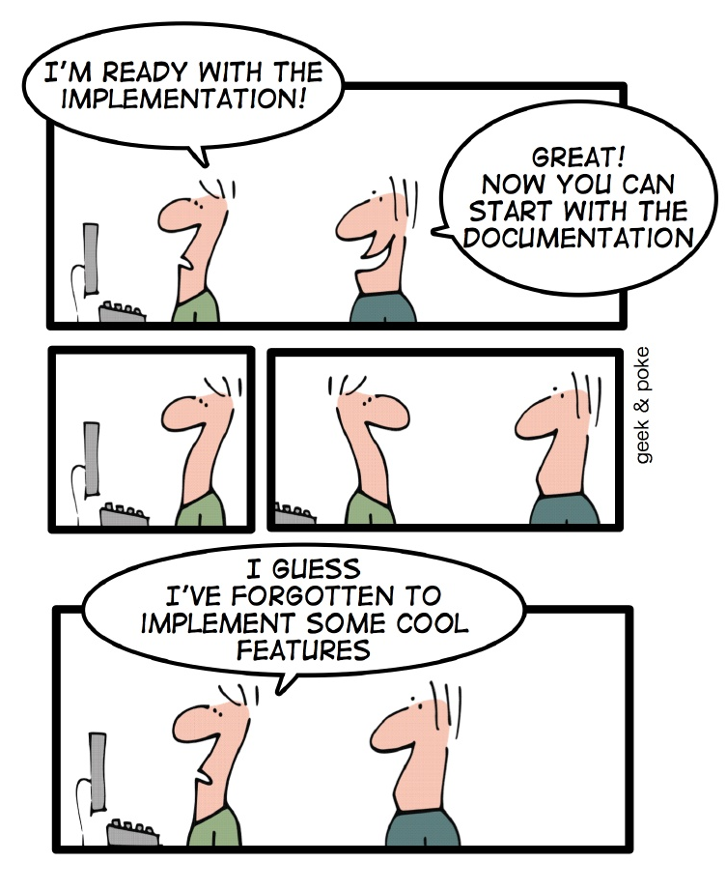
Data management
All equipment should be tracked in a database, mechanical, electrical, services, instrumentation and controls.
Initial specifications, procurement tracked, acceptance test data logged, calibration and alignment data stored, information about installation recorded and, later, maintenance history kept up to date.
StayTreat 2017, Andrew Kimber, 2nd August 2017
Slide 11/14
Notes:
This is often overlooked, or put on hold while we put out the next fire or start on the next interesting project.
<slide> Do we have the systems in place to be able to do this well? Are there off the shelf systems that we haven't considered that will make this information easier to store and access?

Slide 12
Requirements for ‘ideal’ information management system
The system must be comprehensive
Must be so easy to use that no-one will be tempted to bypass the system and keep information only in notebooks.
Information must be up-to-date
Updating information must be easy so that the latest version is correct. Particularly important for maintenance history. Older versions archived but available
Information must be filed coherently
Interface must be easy and self-evident. It must be easier to get the latest version from the system than to find a hard copy of an old version in your office.
Information must be available
While it is desirable that only an authorized person enter information into the system, it is vital that anyone be able to access the information.
StayTreat 2017, Andrew Kimber, 2nd August 2017
Slide 12/14

Slide 13
What should we be doing?
Fix things that break
We do this pretty well, but are frequently in overload
Look for repeat offenders
Some is done to determine root causes by analyzing failure patterns
Install hardware/software diagnostics to help identify source of problems
Often nothing available, those that do exist are not used (lack of knowledge)
Apply increased resources to problem areas
Often not generously offered nor well received
Record keeping
We put a description of each failure in a database
Task the person doing the work to complete the task professionally
We do this pretty well, but are often in overload
Frequently insufficient time/resources to do proper check-out
Fails when job involves several groups
Discover problems during recovery from maintenance periods
Wastes beam time, increases frustration and leads to excessive call-in
StayTreat 2017, Andrew Kimber, 2nd August 2017
Slide 13/14
Notes:
<2nd bullet> Downtime manager

Slide 14
Summary
The most cost effective way to make a reliable machine (or upgrade) is to invest heavily in the concept and design phases.
The consequence of failure, and its impact on the system availability, should be minimized by careful design
Downtime should be minimized by an integrated information management system to assist in diagnosis and repair.
The cost of a reliable machine is less than the cost of an unreliable one
StayTreat 2017, Andrew Kimber, 2nd August 2017
Slide 14/14
Notes:
We may have missed the boat on this but we still have new designs, upgrades and reengineering that we can incorporate this into.
Will leave you to define cost! Might not just be in dollars.

Slide 15
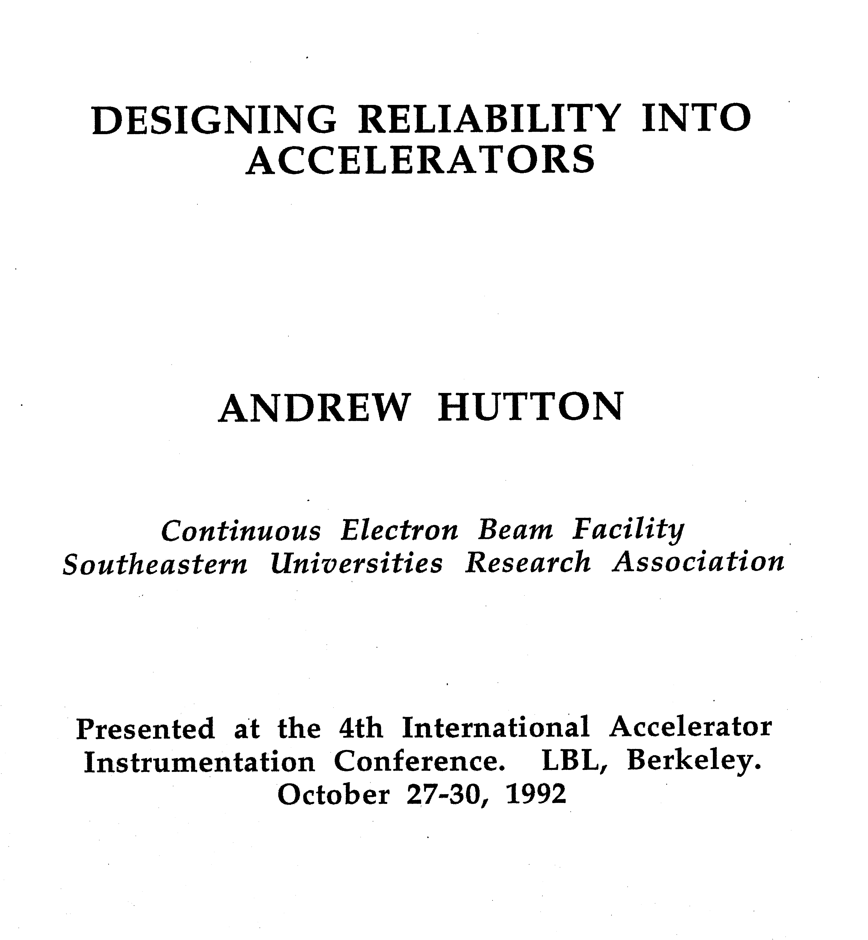
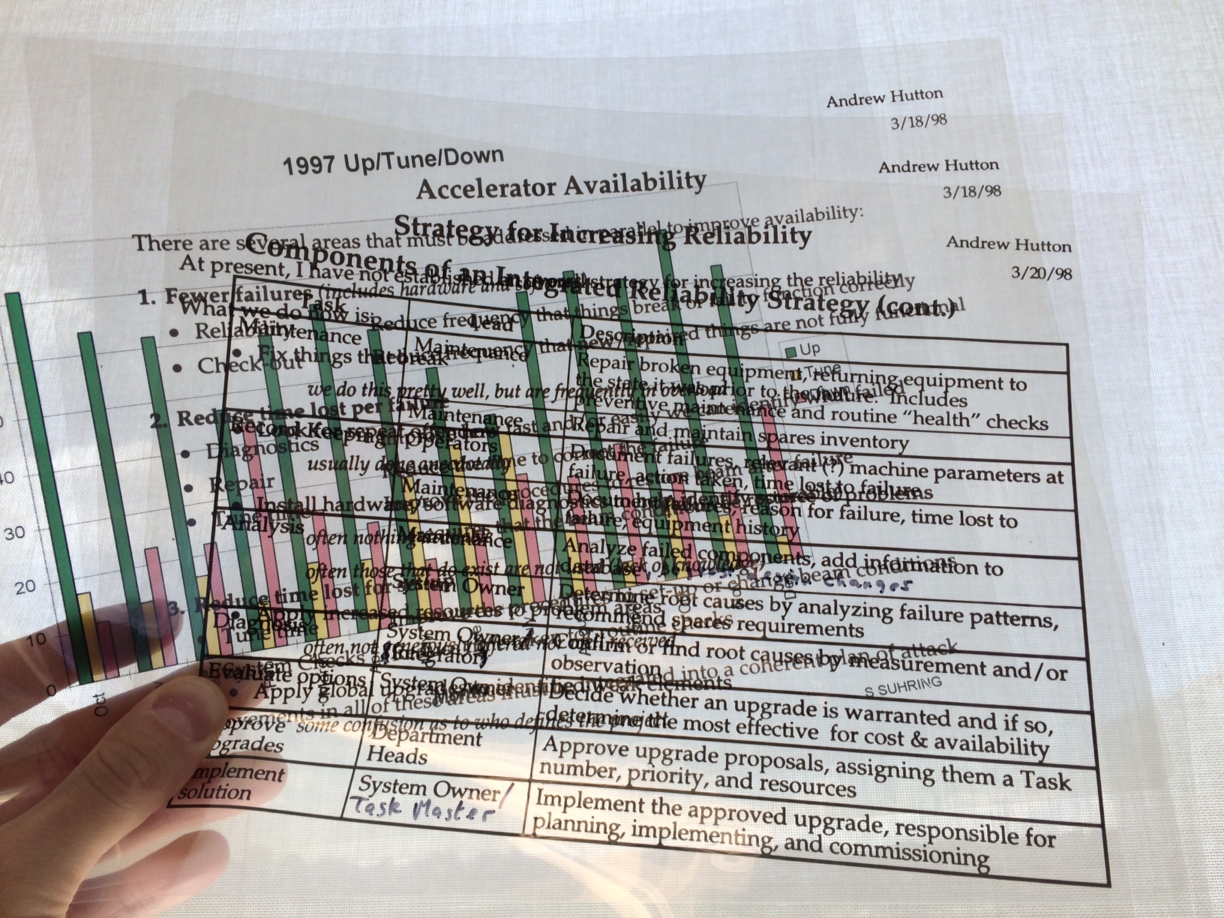
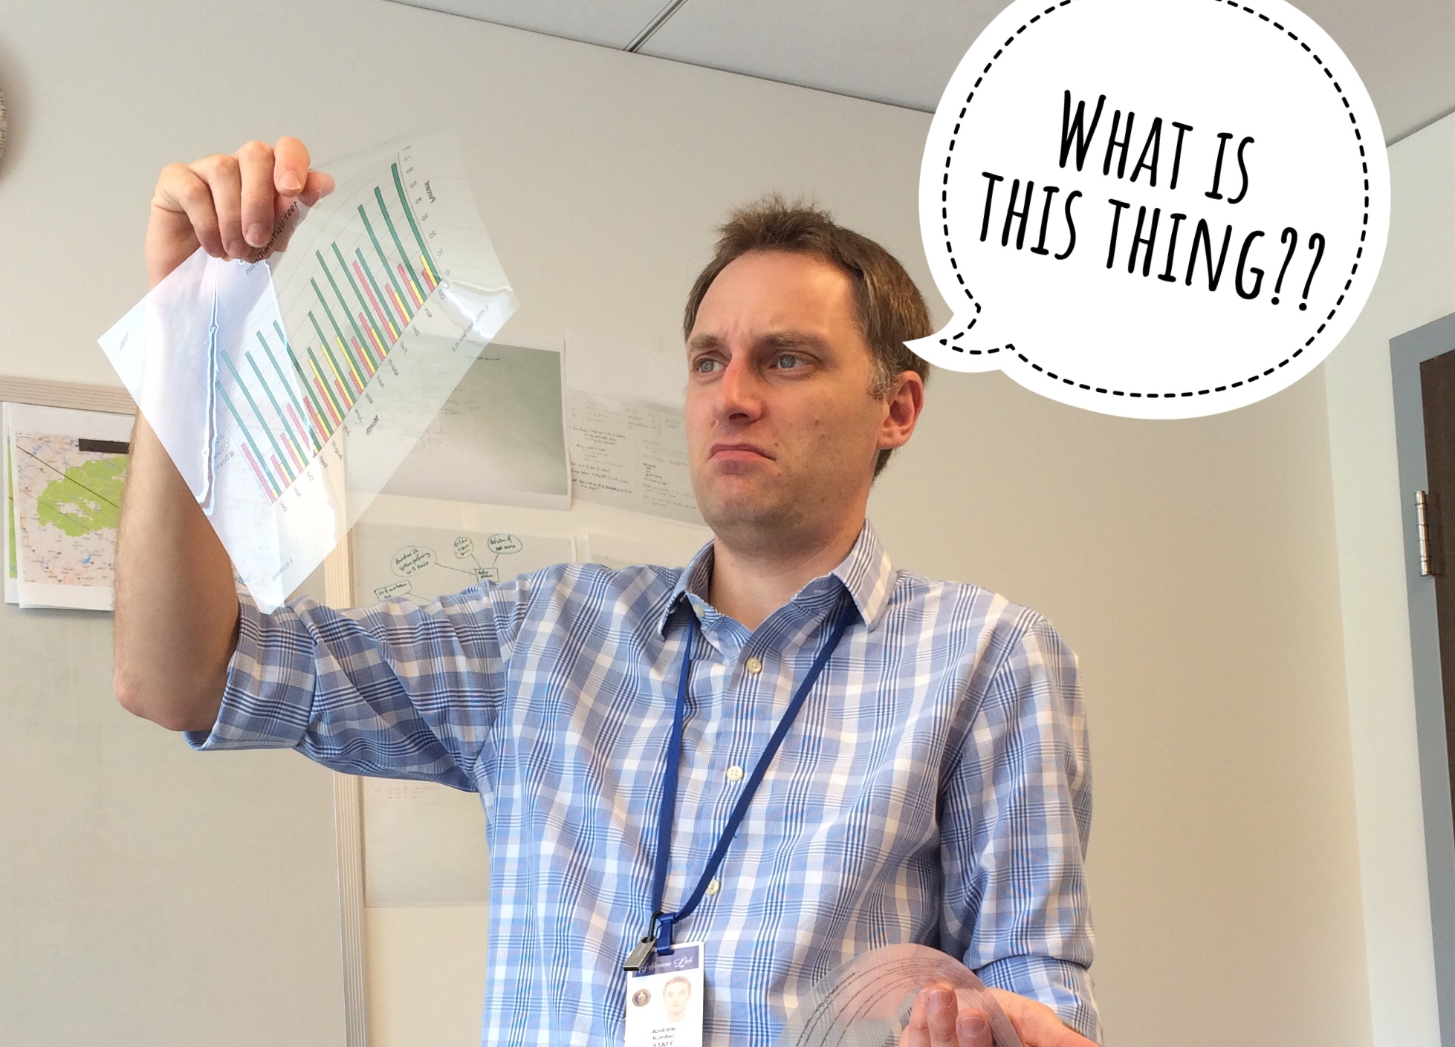
3/20/98 ~19 yrs ago!
~25 years ago!
StayTreat 2017, Andrew Kimber, 2nd August 2017
Slide 15/14
Notes:
This stuff is hard! It takes commitment, time, effort, organization, funding, management, teamwork.

Slide 16
Group work
Organize into 6 groups, each will be assigned one topic listed below
20 mins to discuss and make notes
Nominate a speaker and take 5 mins to present top 2 ideas and why
With an emphasis on reliability, or factors that effect reliability
List out things that we do well (or have improved upon over time)
List out things that need improvement (or have degraded with time)
How would you reduce equipment/system repair times? (MTTR)
How would you lengthen lifetime of equipment? (Increase MTBF)
How would you improve human performance?
What are the major risks to running CEBAF reliably for the next 20 years?
StayTreat 2017, “Group Therapy”, 2nd August 2017
Slide 1/7
Notes:
With that, one the face of it, how can a presentation from 25 years ago still be relevant today? Why have we note solved all of the problems from back then?

Slide 17
Group work (1)
With an emphasis on reliability, or factors that effect reliability
List out things that we do well (or have improved upon over time)
StayTreat 2017, “Group Therapy”, 2nd August 2017
Slide 2/7

Slide 18
Group work (2)
With an emphasis on reliability, or factors that effect reliability
List out things that need improvement (or have degraded with time)
StayTreat 2017, “Group Therapy”, 2nd August 2017
Slide 3/7

Slide 19
Group work (3)
With an emphasis on reliability, or factors that effect reliability
How would you reduce equipment/ system repair times? (MTTR)
StayTreat 2017, “Group Therapy”, 2nd August 2017
Slide 4/7

Slide 20
Group work (4)
With an emphasis on reliability, or factors that effect reliability
How would you lengthen lifetime of equipment? (Increase MTBF)
StayTreat 2017, “Group Therapy”, 2nd August 2017
Slide 5/7

Slide 21
Group work (5)
With an emphasis on reliability, or factors that effect reliability
How would you improve human performance?
StayTreat 2017, “Group Therapy”, 2nd August 2017
Slide 6/7

Slide 22
Group work (6)
With an emphasis on reliability, or factors that effect reliability
What are the major risks to running CEBAF reliably for the next 20 years?
StayTreat 2017, “Group Therapy”, 2nd August 2017
Slide 7/7

