Slide 1
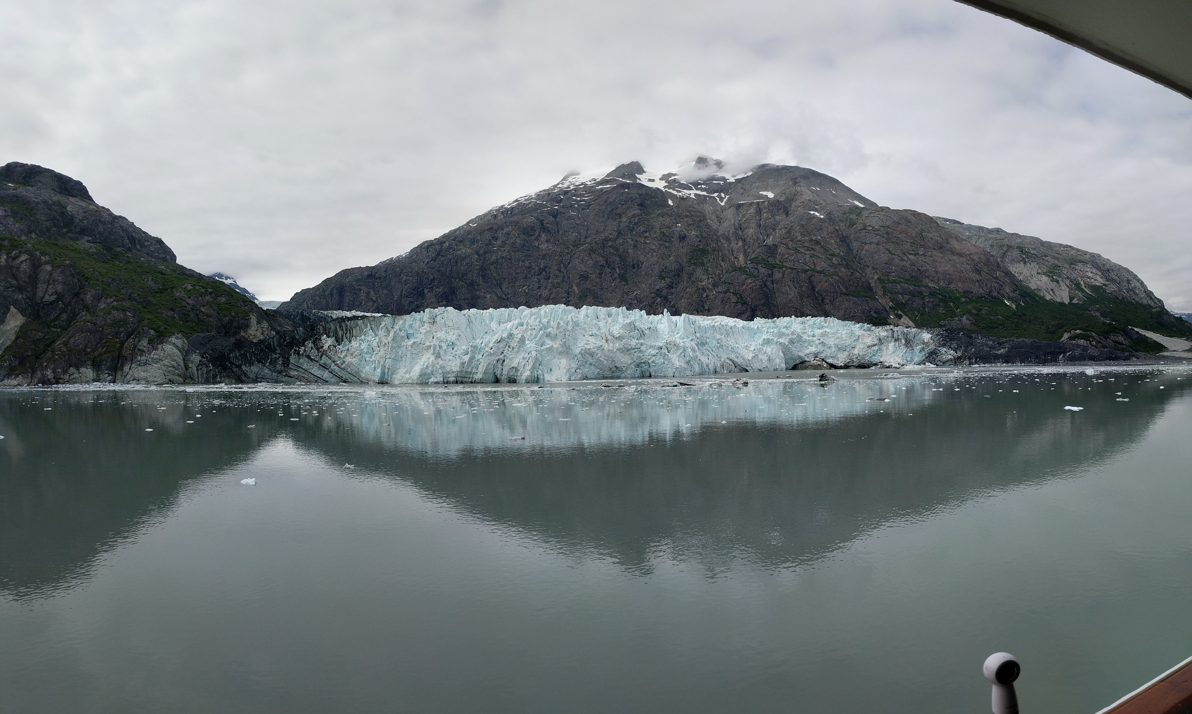
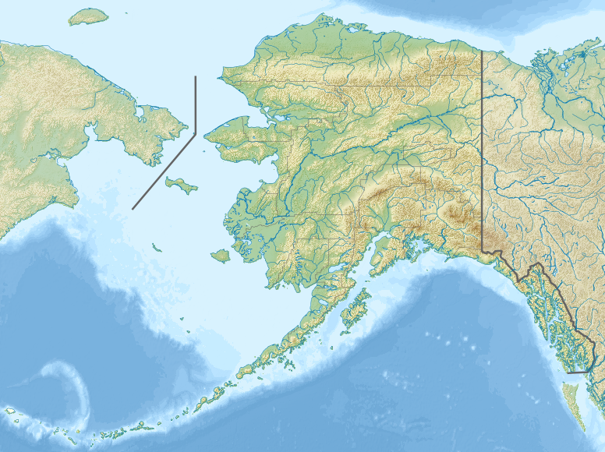
Closeout
OPS 2017 StayTreat

Slide 2
Glacier
A glacier (US: /ˈɡleɪʃər/ or UK: /ˈɡlæsiə/) is a persistent body of dense ice that is constantly moving under its own weight
Our staff is persistent
Our staff is dense (with knowledge!)
Are we constantly moving?
Take the interest and focus from this workshop to ensure you address CEBAF reliability and energy reach
Every day ask yourself, what am I doing to ensure the success of CEBAF?
StayTreat 2017 Closeout
<number>

Slide 3
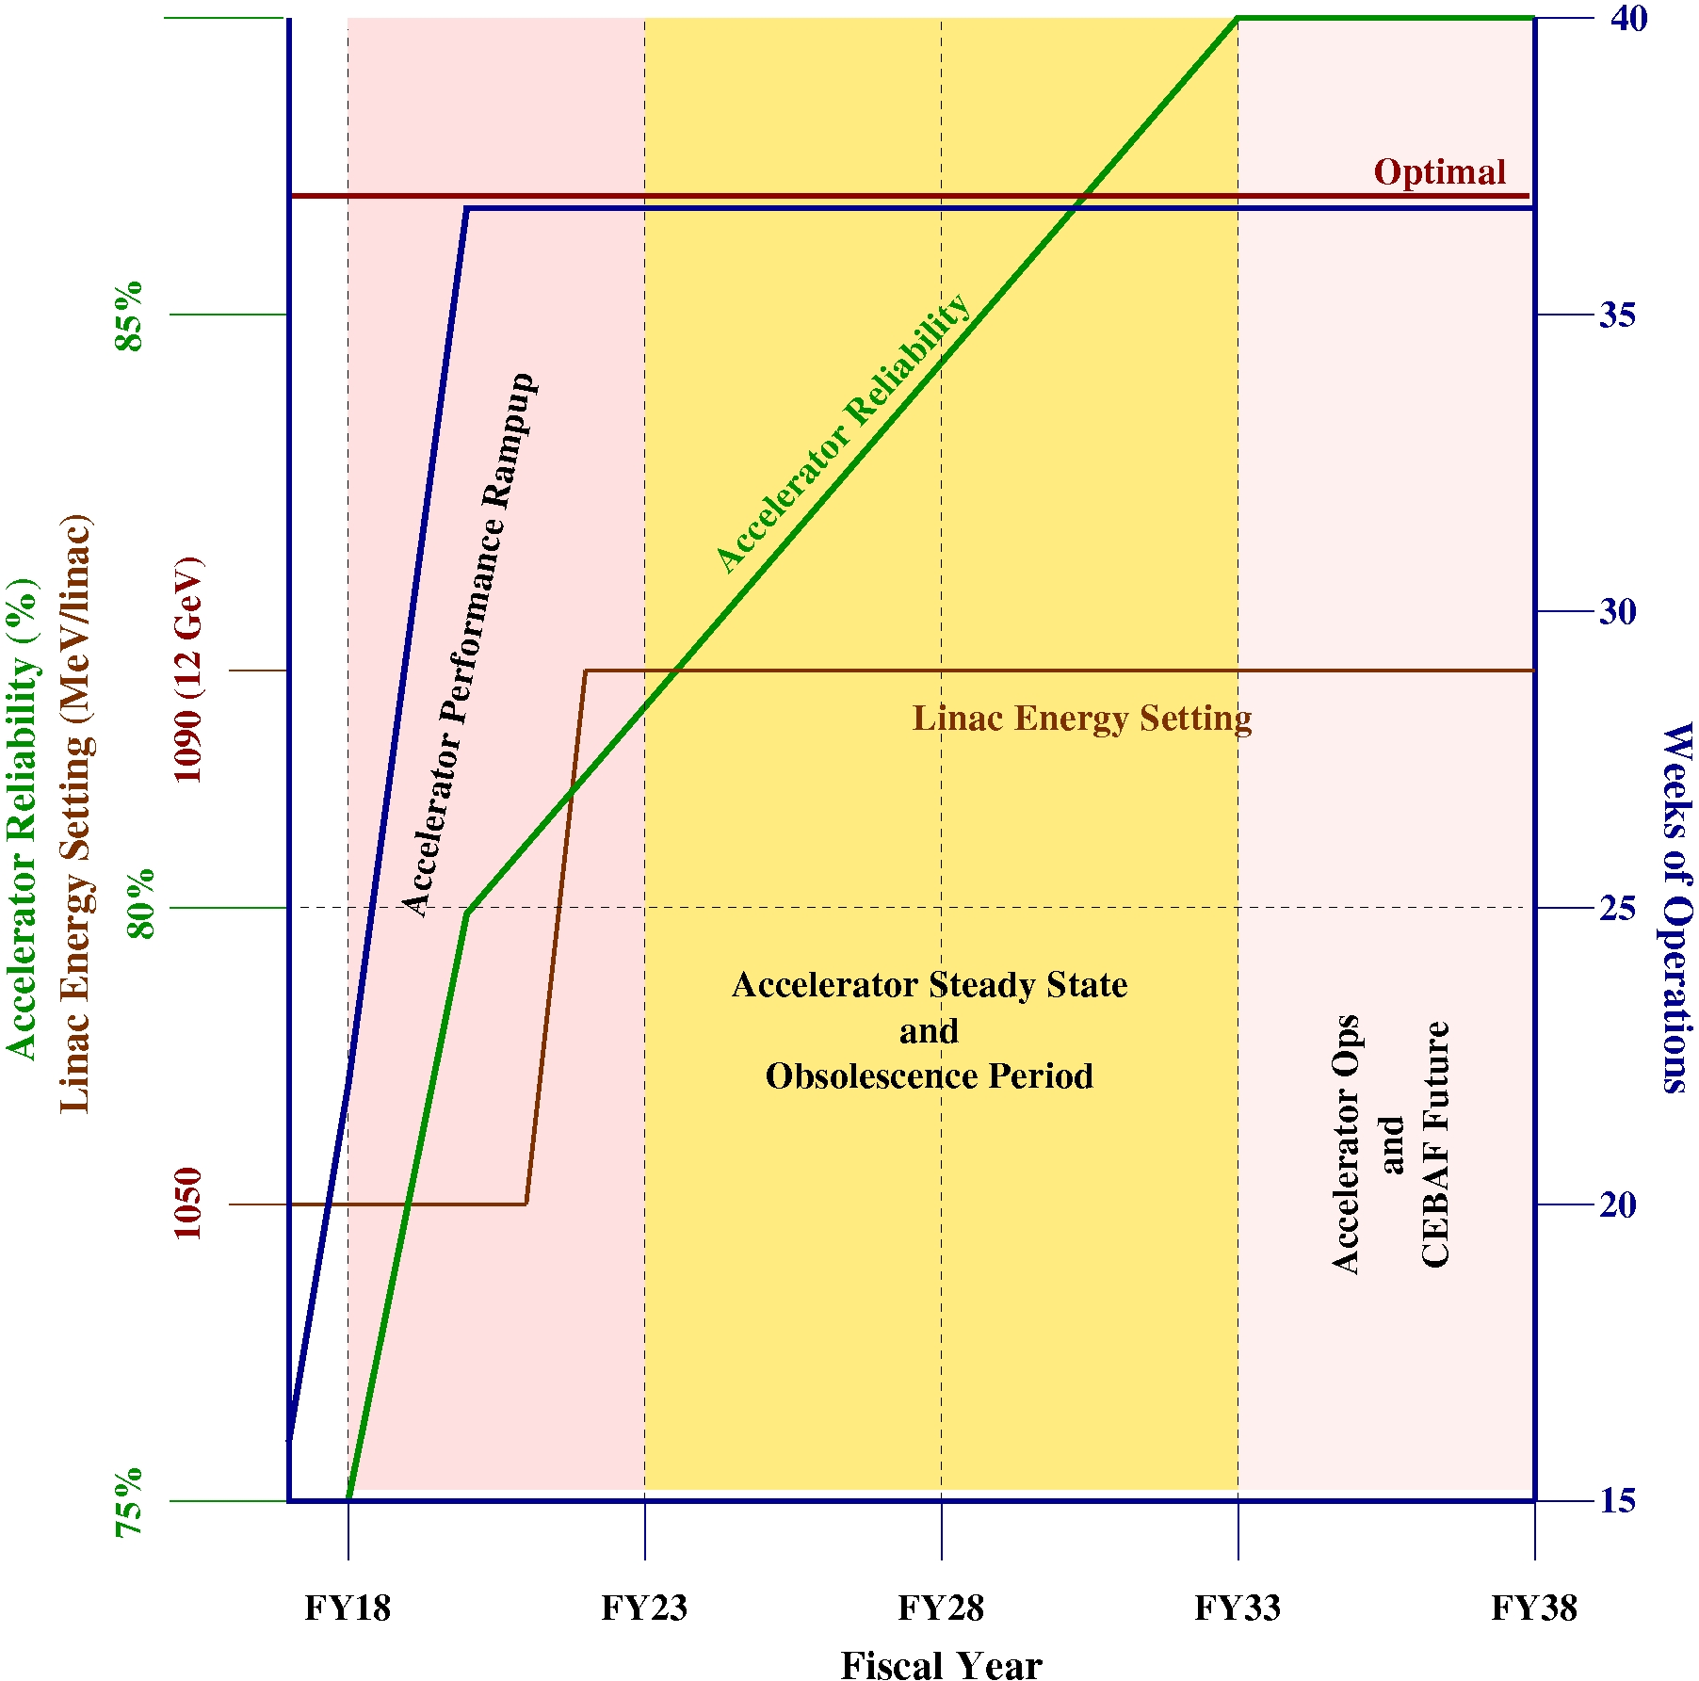
CEBAF 20 year view

Slide 4
Operating CEBAF as promised
Is the highest priority of Jefferson Lab
Requires the people in this room for success
Unless we change how we work we will not achieve this goal
Funding allocation (within lab, within NP)
New hardware, tools and processes
Different collaborations and working groups
StayTreat 2017 Closeout
<number>

Slide 5
Workshop Overview
Excellent participation
2 Days, 4 sessions/day (plus lunch open mic)
31 Presentations (not including open mic)
25 Presenters
75 Registrants
Excellent engagement
Everyone cares about solving the problems
Many solutions or avenues for investigation discussed
StayTreat 2017 Closeout
<number>

Slide 6
StayTreat Next Steps
Workshop review meeting on Monday
Prompt summary of sessions → tech note
Action items and other follow-ups will be coming
StayTreat 2017 Closeout
<number>

Slide 7
Thanks
Participants: everyone very engaged, discussions were positive
Presenters: Talks kept focus on each day’s theme, triggered our discussions
Chairs: Sessions were timely
Management: Funding for room and refreshments
Crystal Baker: Organization and setup
StayTreat 2017 Closeout
<number>

