Slide 1
Microphonics and Energy Jitter
Tom Powers
Aug 2017
(With lots of help from George Biallas, and Natalie Brock)

Slide 2
We Do Understand Many of the Natural Modes of the C100s (Kirk Davis and Joe Metalevich, ~2002)
C100 cryomodule cavity string 10 Hz mode.
Hammer strike point cryogenic U-tube ALL.
Upper row is top of tuner stack
Lower row is the end of each cavity
Note tuner stack participates in mode.
C100 cryomodule cavity string 19.5 Hz mode.
Lower row is the end of each cavity
A few tuner stacks participates in mode.
C100 cryomodule cavity string 43.5 Hz mode.
Lower row is the end of each cavity
A most tuner stacks participates in mode.
C100 cryomodule cavity string 33 Hz mode (x1.1 for cold). Note that cavities 1 and 8 see the majority of the detuning forces.

Slide 3
Why Are Modal Resonances Important? (Think pushing a child in a swing)
If even a small excitation is at the same frequency as the modal resonance it can excite the mode and effectively amplify the effect of the external vibrational source. (Think of pushing a swing right at or near the top of the arc of motion.)
The microphonics will “phase lock” with the diving term even if is just near the resonance.
In CEBAF we had the 10 Hz string mode of 4 out of 5 cryomodules in the north linac lock to a 10.75 Hz vibration produced by a failing motor in a cooling tower that was 50 m from the linac. The remaining cryomodule had a resonance at 9.75 Hz which was to far away.
Random noise will come both in phase and out of phase with the vibration created at the mode of the structure and the microphonics will build up and down over time. (Think of pushing a swing at random times.)

Slide 4
Microphonics Induced Trip in 0L04
A 30/40 Hz vibration starts in cavities 1 or 8 and shortly thereafter cavity 4 or 5 trips.
DeltaF Cavity 8
DeltaF Cavity 5

Slide 5
CEBAF C100 Hardening Waveguide Ceiling and Strut Bracing/Damping
Ceiling bracing improved
provides 3-axis constraint.
Has 1/8” 50 durometer Sorbothane® to damp vertical motion and to a lesser extent EW/NS motion.
Waveguide struts back to existing bolts on the cryomodule
Provides 3-axis constraint of upper end of waveguides.
Waveguide bracket uses ¼” Sorbothane to damp EW and NS motion and to a lesser extent vertical motion.

Slide 6
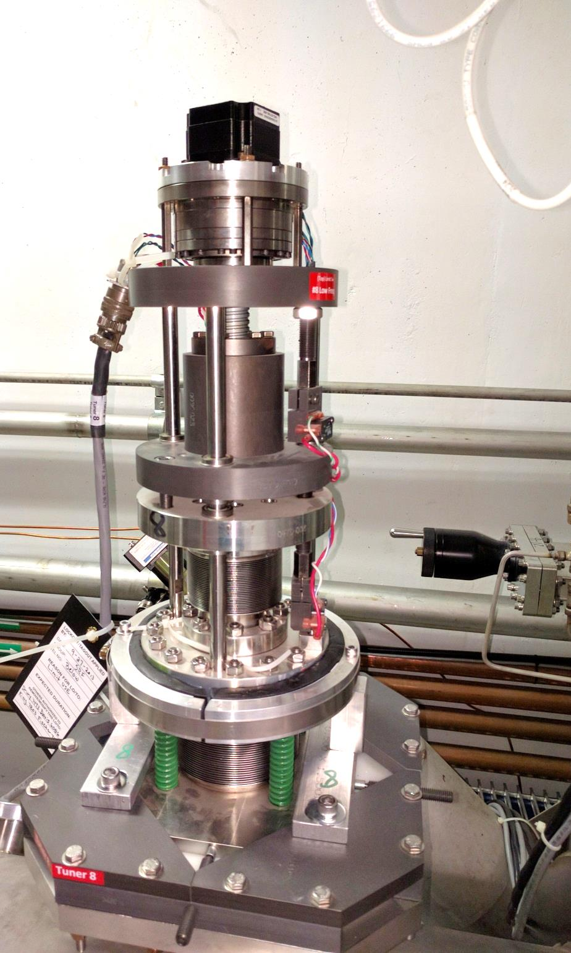
CEBAF C100 Tuner Damper Ring
Lower tuner flange 6” OD, 1.5” thick.
30 durometer, 1/2” x 1” sorbothane with polyethylene tape on the inner surface in order to allow vertical motion.
Split ring with a nominal ID of 7” and with two 3/8” gaps for adjustment.
Compression adjustment made by tightening the hose clamp while measuring the OD of the short axis of the split ring.
Damper compression setting was tuned to minimize the transfer function from striking the cryomodule end can near the beam pipe to 10 Hz cavity vibration.
Green springs adjusted to relaxed state after cavity is cold and tuned.
Mounting plates fixed in place after compression adjustment insuring minimum lateral forces on tuner.

Slide 7
SL24 With and Without Tuner Damper, Waveguide struts Installed
Reduction in the Q of the mode reduces susceptibility of the mode both transient and random excitation.
Tuner damper compression “tuned” to reduce the Q of the 10 Hz mode.
Reducing the 20 Hz mode was an unexpected bonus.

Slide 8
Floor Vibrations During truck Drive-By
Service Building Floor Motion in 8 to 22 Hz Band
Accelerator Tunnel Floor Motion in 8 to 22 Hz Band
Upper graph vertical scale is 5-times larger.
Differential motion between service building and tunnel.

Slide 9
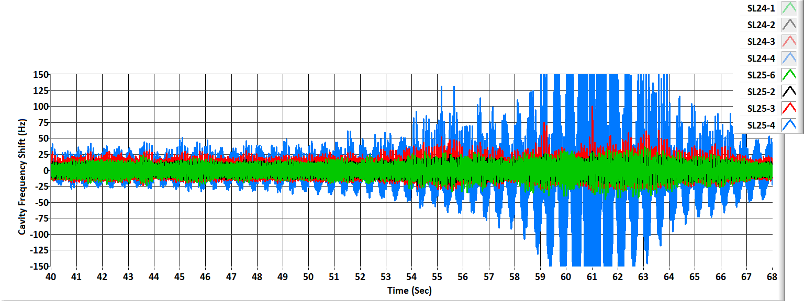
Comparison of a Hardened (SL24) and Zone With No Improvements (SL25) During Truck Drive By
SL 24 Hardened Cryomodule
SL25 No Improvements
A liquid nitrogen truck drove down the south linac service road at about 15 mph passing the zone at time equals about 60 seconds.
Cavities operated in GDR mode at 3 MV/m in order to avoid trips.
Improved both steady state microphonics and response to transient excitation.
Vertical scale +/- 150 Hz of detune frequency, typical controls bandwidth 25 Hz.
The truck was a problem because it produced ground vibrations at the same frequency as the 10 Hz string mode and 20 Hz half string modes.

Slide 10
Background Floor Motion in CEBAF Tunnel
Fortunately the cryomodules do not have any strong resonances below 10 Hz
Dangerous modes as the cryomodules and adjacent beam line components have overlapping resonances. For example, 21, 30, 41 and 120 Hz are observed driven modes.

Slide 11
Tuner Motor Induced Transients
Operation of multiple tuners at the same time causes transient microphonics
We were blind to this on SL24 until after the microphonics hardening was implemented
Still not addressed

Slide 12
Current Status
SL24, has tuner dampers and waveguide struts/dampers installed.
SL22 has waveguide struts/dampers installed
NL23 has a 2x4 attached to the waveguides with foam rubber padding.
NL2? Has bead bags attached taped to the tuner stacks.
0L04 has tuner dampers installed and struts on waveguide 2.
Recommend install tuner dampers and waveguide struts on all 11 C100 zones.
As a minimum adjust tuner algorithm to only operate one tuner at a time in each zone.

Slide 13
Decay Rates for Different Arcs

Slide 14
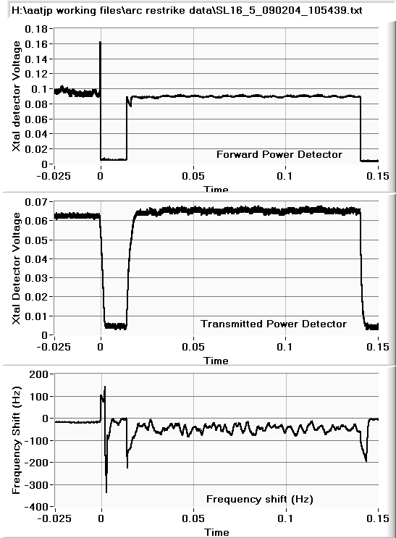
Micrphonics due to Waveguide Side Arc and Cavity Side Arc C20
Arc on waveguide side of cold window
Arc on waveguide Cavity side of cold window

Slide 15
Hall A Energy Jitter Implications of FFB System in SL26

Slide 16
Lorentz Force Induced Frequency Shifts M=1.5 Hz/(MV/m)^2

Slide 17
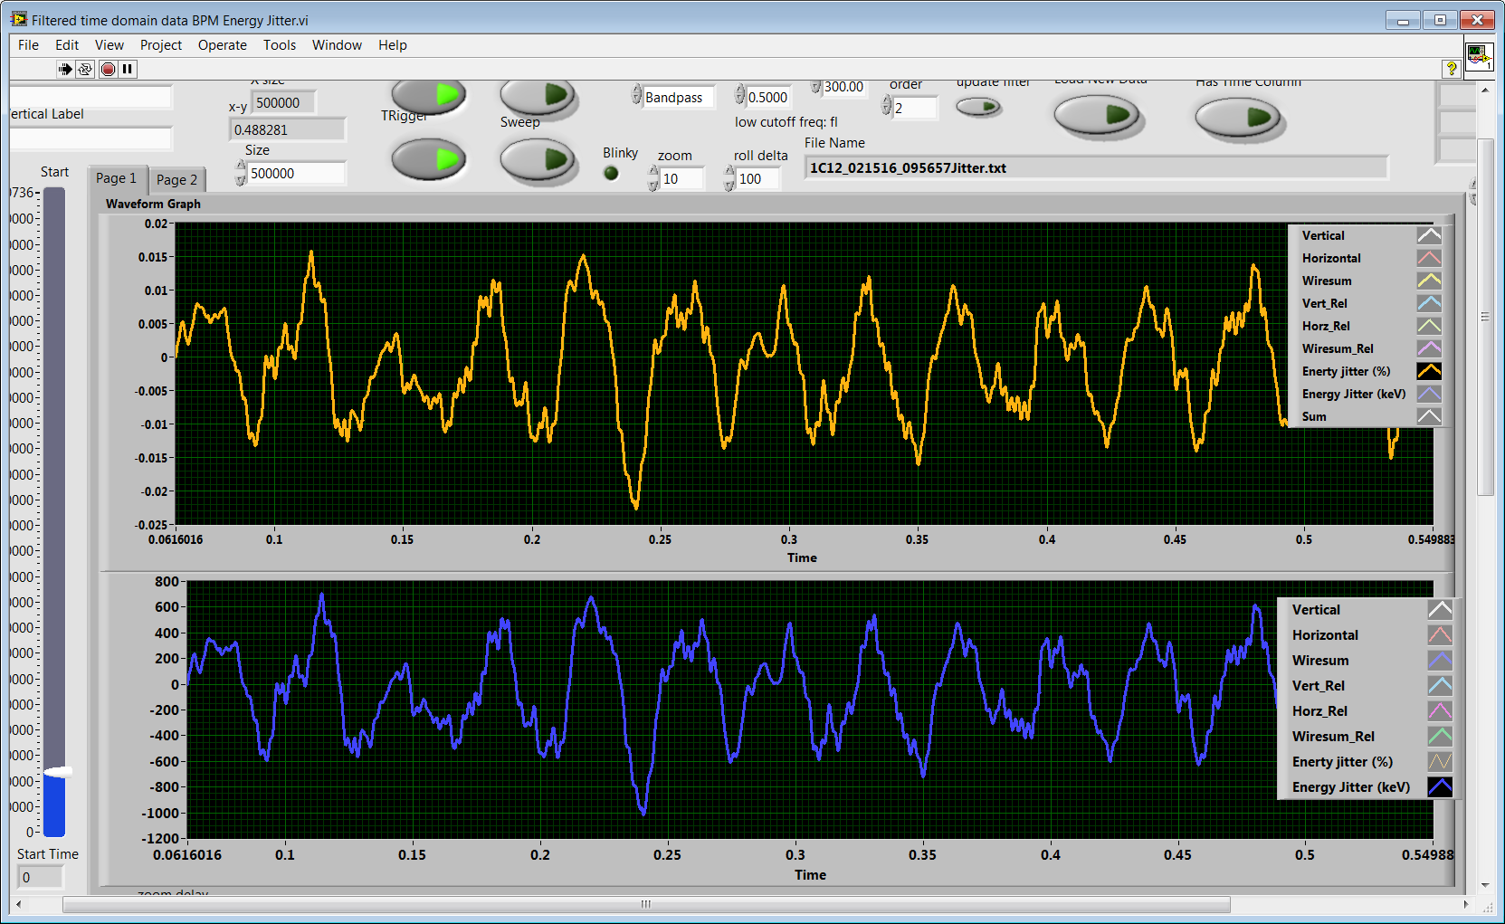
Hall A Energy Jitter With MO Problem
Divide this among 4 C100 cavities with a nominal gradient of 14 MV/m 250 keV per cavity is about 2.5 % peak gradient change. Expected Lorentz driven frequency shift is about +/-15 Hz.
Percent
keV

Slide 18
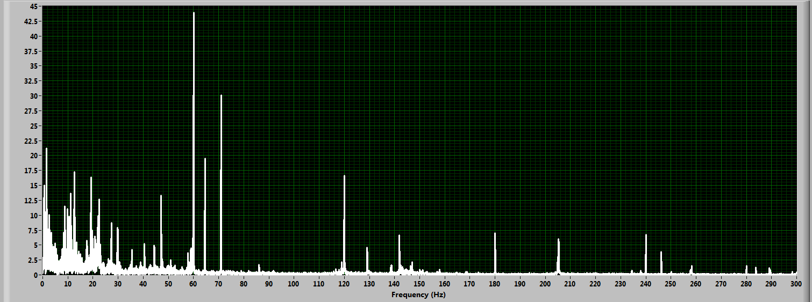
Nominal Hall A Energy Jitter
Divide this among 4 C100 cavities with a nominal gradient of 14 MV/m 100 keV per cavity is about 1 % peak gradient change. Expected Lorentz driven frequency shift is about +/-5 Hz.
keV
These Modes are due to C100 resonances
There is a concern that we are creating a feedback loop and could amplify these modes in 2L26.
RMS keV

