Slide 1
Cryomodule (C20, C50, C100)
Field Emission Performance to Date
Rongli Geng
August 2-3, 2017
2017 CEBAF OPS Staytreat

Slide 2
Acknowledgement
Bob Legg, for his work on FE studies with ion chambers placed in 1L25 and 1L26 zones, allowing cross-calibrating existing BLMs, for his assistance and advices.
Riad Suleiman, for providing fast DAQ, old Mott PMT detector, radiation detection expertise, for collaborating with me and teaching me on many aspects of CEBAF injectors.
Arne Freyberger, for collaborating and stimulating discussions, for this encouragement and support.
Sasha Zhukov of SNS for loaning me the SNS BLM PMT.
Alan Fisher of SLAC for collaboration on FE detectors and testing at CEBAF 1L26.
Many other JLAB colleagues for their help in this effort and teaching me many aspects of the CEBAF machine.

Slide 3
Outline
Introduction
Detectors for FE monitor in CEBAF
Preliminary analysis results
Conclusion

Slide 4
Introduction
Detection of FE from CEBAF cavities in operando necessary to probe the root cause of FE degradation
  Placement of loaner SNS PMT at DS 0L04 since Jan. 2016
    First result presented at Wed 13:30 Ops PD Weekly meeting on Nov. 16, 2016
    Also presented at Dec. 5, 2016 PIT meeting
  Testing of SLAC diamond detectors and high-rad optical fiber at 1L26 Jan. 18-23, 2017
    A joint JLab/SLAC tech note pending
  Placement at US 0L04 a second PMT (old Mott PMT from Injector Group) and laying of 12-m SLAC fiber over CM 0L04 since Feb. 2, 2017

Slide 5
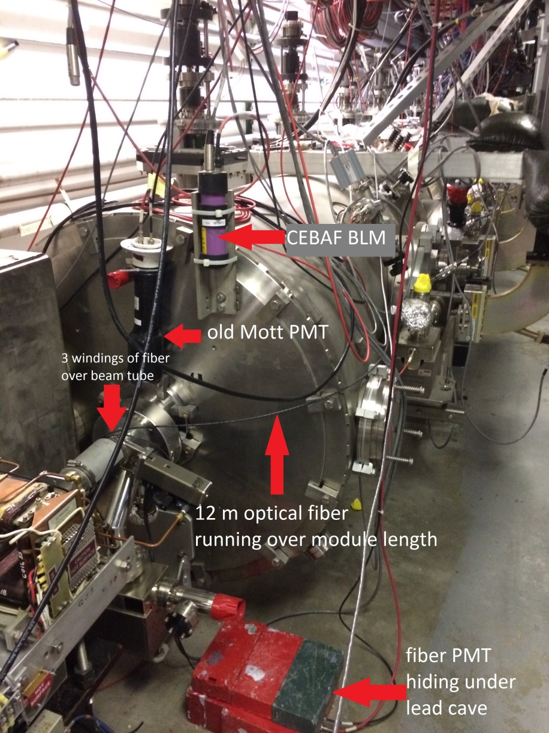
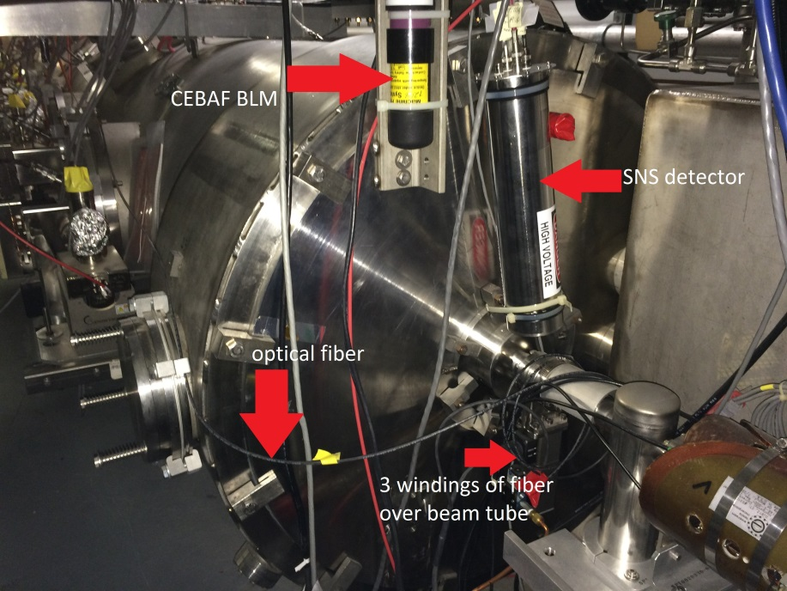
Fast FE Detectors at 0L04 since Feb. 2, 2017

Slide 6
BLMs as Permanent FE Detectors
“Discovery” of BLM sensitivity to FE
  First thought occurred to RG in summer 2016 while he was in NL tunnel for 1L12 removal
    Special interest in BLM at US 1L24 for its use in correlating FE with fast vacuum pressure burst in VIP1L24A pursued by Jim Kortze
  Initial action by random checking several BLMs while RG was serving as PD Aug. 10-24, 2016
    Encouraging first result
  Systematic check of BLM sensitivity to FE in all C100 zones plus 1L12 (latest C50 module C50-12) on Nov. 12 and 15, 2016, aided by CEBAF operators
    Sensitive BLM confirmed except 1L22, 2L25

Slide 7
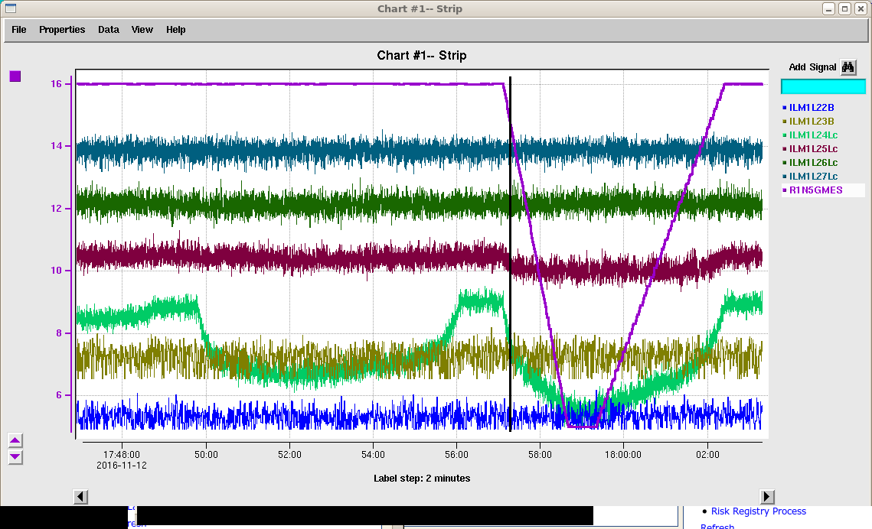
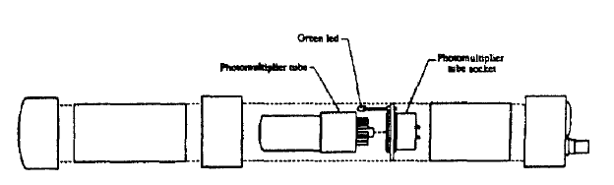
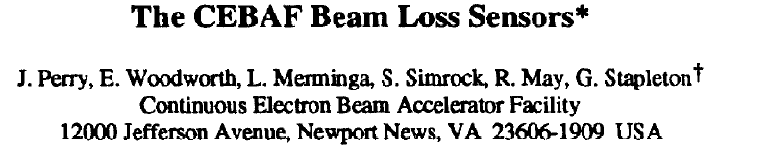
Sensitive BLMs and Correlated Module
Pattern: BLM at zone N -> cryomodule at zone (N-1)
PAC 1993 Proc. pp2184-2186
Thanks Tommy Michaelides for pointing the right PVs

Slide 8
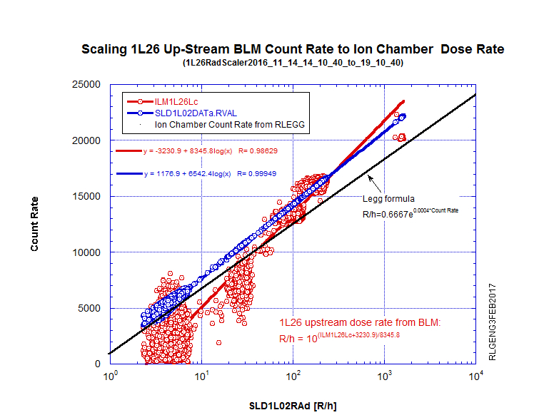
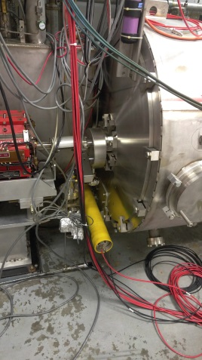
Estimate FE Dose Rate from BLM Output Signal
In Summer 2016, Bob Legg placed four calibrated high-radiation ion chambers in 1L25 and 1L26 zones
These ion chambers stayed in tunnel over physics run of Fall 2016
As BLMs and Legg chambers ran concurrently, the Fall 2016 run provides an opportunity for cross-calibrating BLMs to ion chambers
US 1L26 Legg ion chamber (yellow tube) and BLM ILM1L26Lc (purple tube)
See 6/7/17 Tech Note JLAB-TN-17-030 for more details

Slide 9
Preliminary Analysis Results
Data mining all C100 CMs plus C50-12 at 1L12
  Exception 1L22 & 2L25
Multi-year trend analysis starting Oct. 1, 2014
  Figure of merit defined:
  FE index = Rad/(sum Grad)
Searching for direct evidence of new field emitter activation/arrival
  Correlating beamline vacuum and CEBAF beam current data etc with rapid “FE turn-on events”

Slide 10
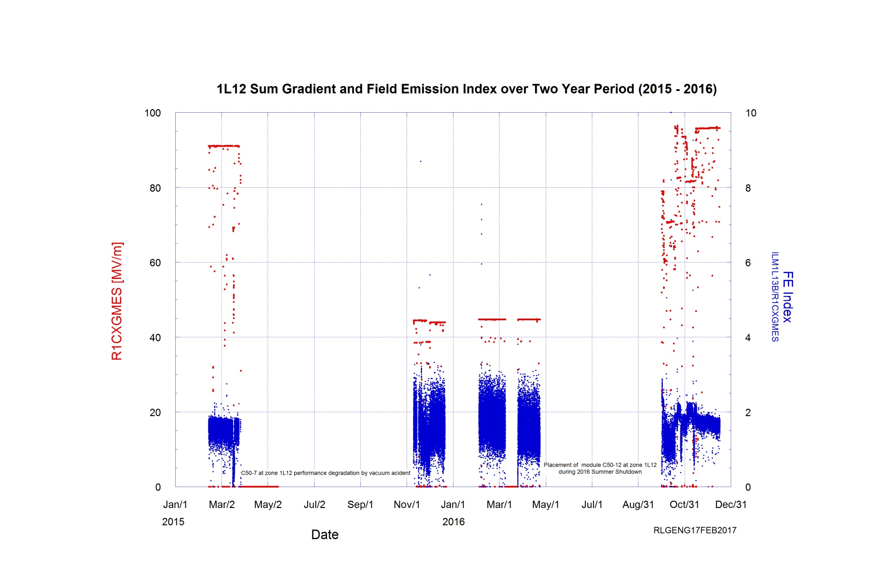
C50-7 and C50-12 at 1L12
C50-12 placed at 1L12 SAD 2016
Smaller FE for restored sum gradient (95 MV/m)
C50-7 @ 1L12 degradation by vacuum accident
Larger BLM output signal for much lower sum gradient (45 vs 90 MV/m)
Visible decrease of BLM signal with RF-on
Processing effect!

Slide 11
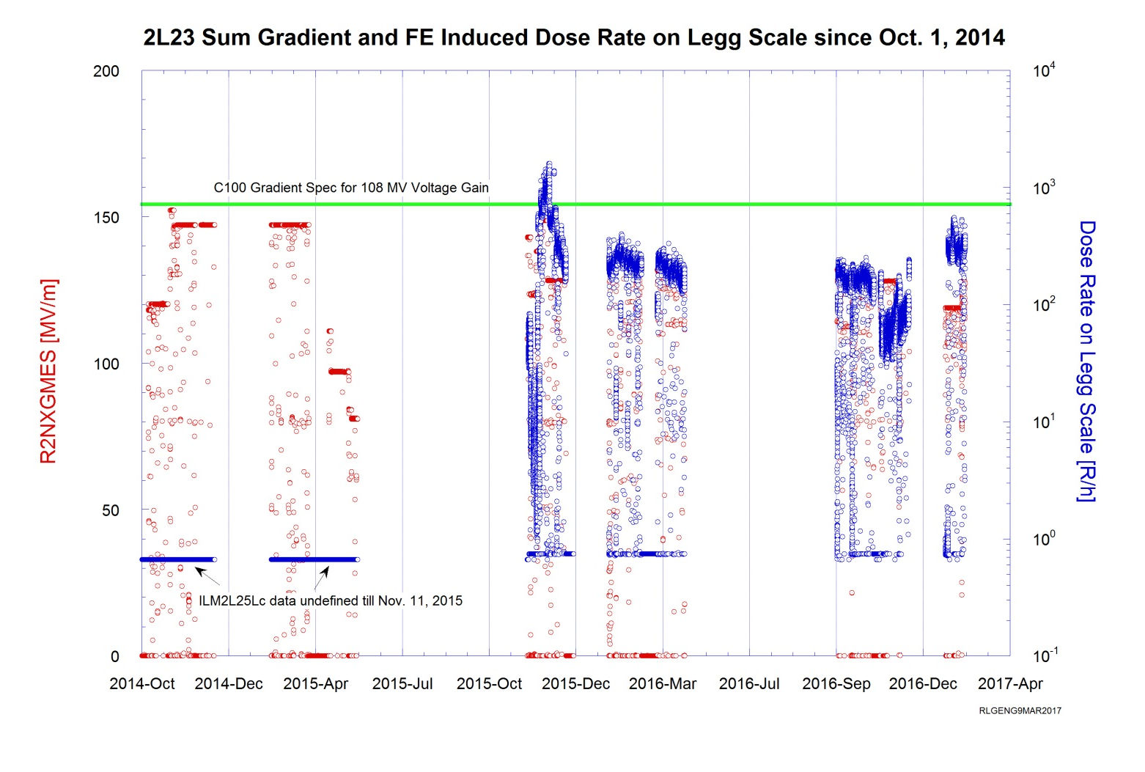
2L23 (C100-5) – Long term FE

Slide 12
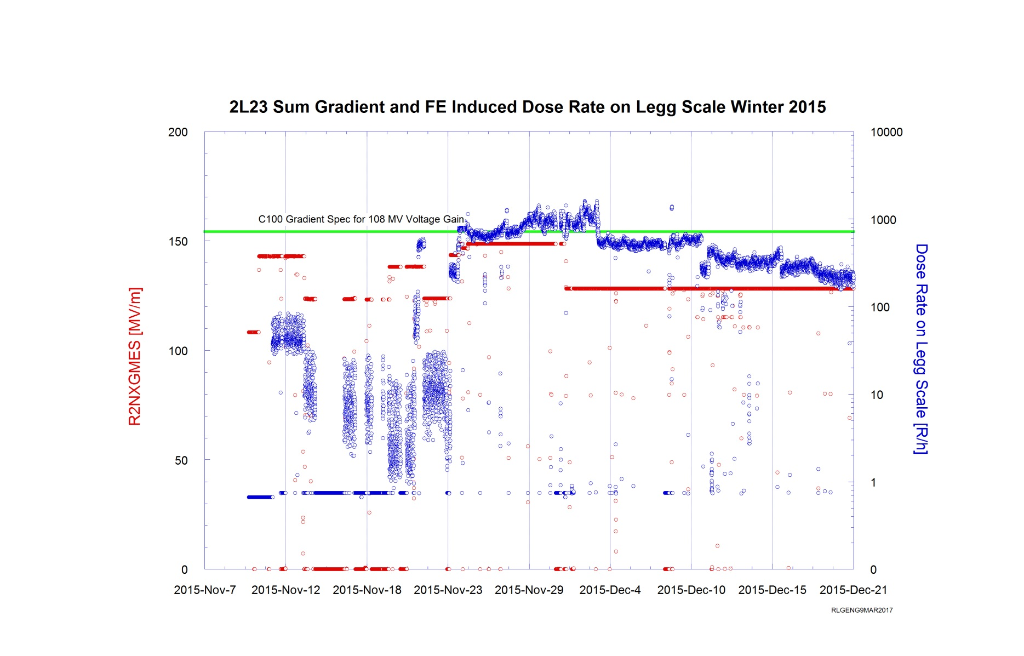
2L23 (C100-5) – cont.
Beneficial "RF/beam processing effect" is observable for the Fall 2015 and Spring 2016 runs

Slide 13
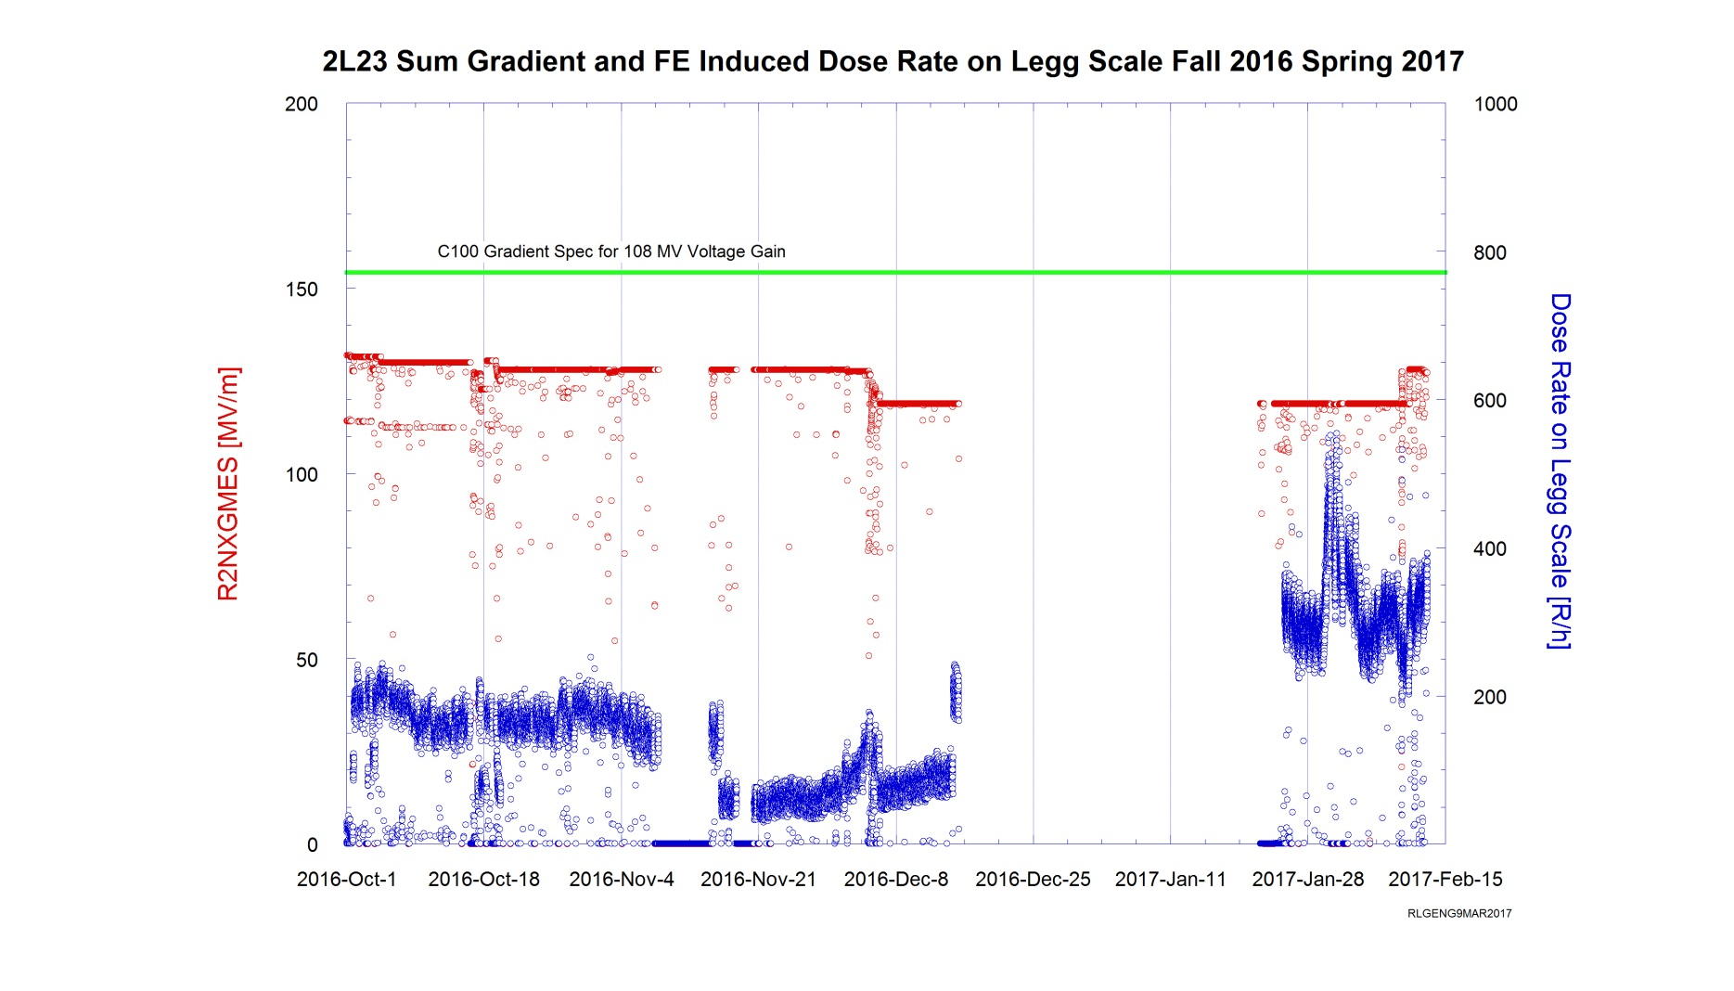
2L23 (C100-5) – cont.
FE deterioration since Nov. 21, 2016
a sudden jump shortly before the Fall 2016 run ended
FE performance in CM 2L23 further lost its ground after past winter break

Slide 14
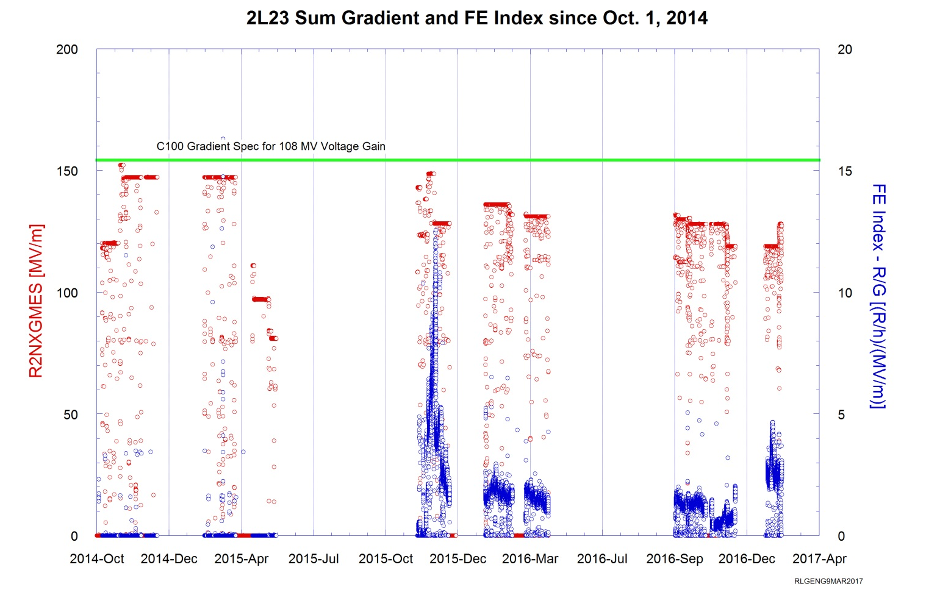
2L23 (C100-5) – FE index

Slide 15
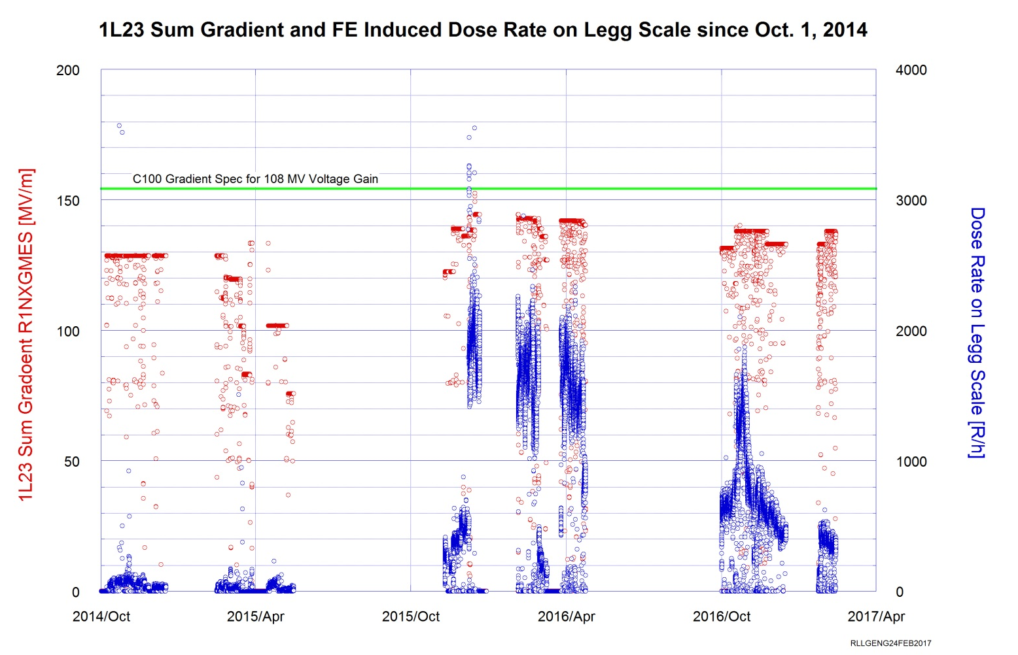
1L23 (C100-6) – Long term FE

Slide 16
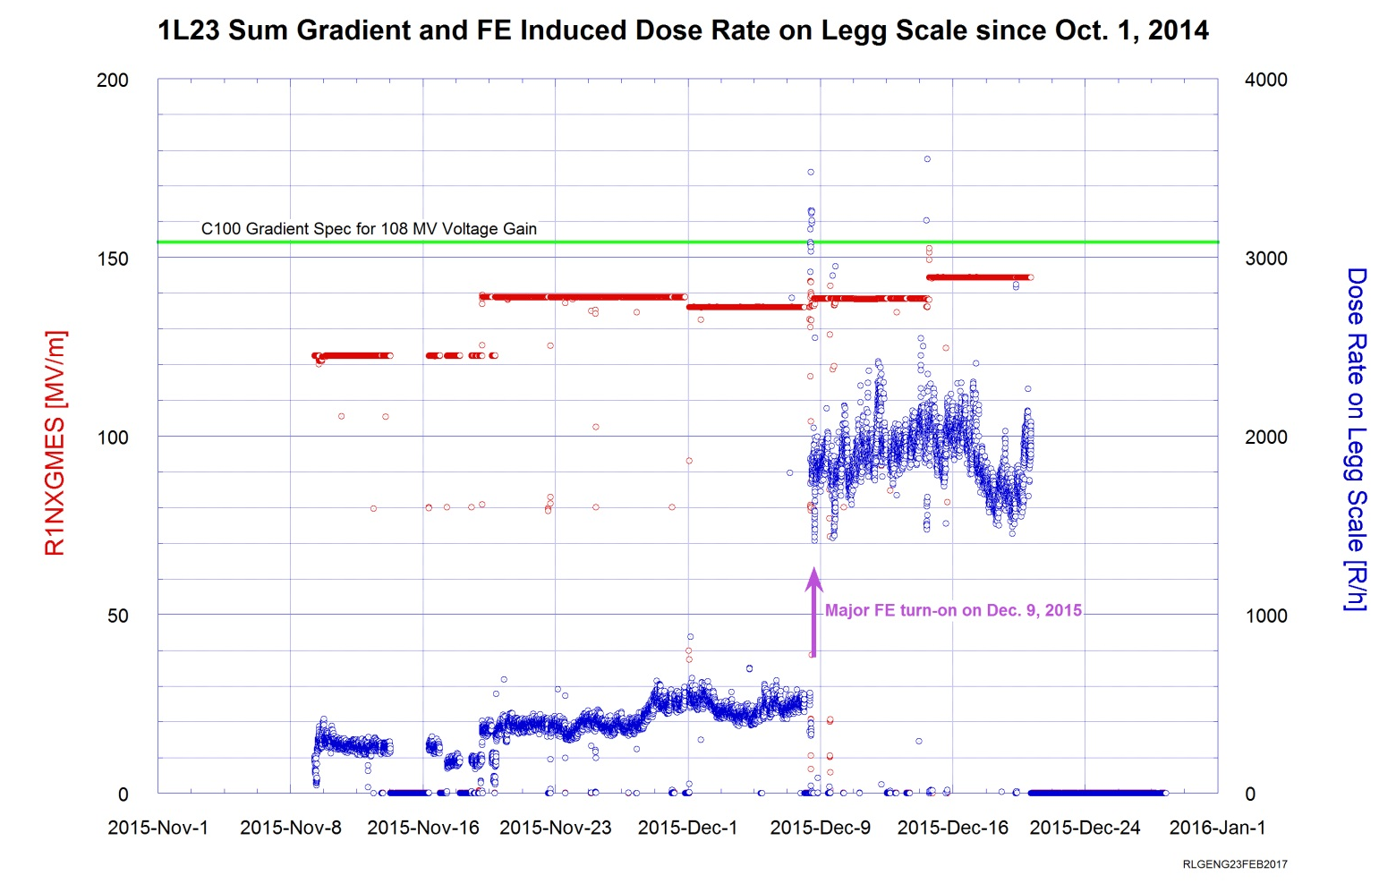
1L23 (C100-6)- cont.

Slide 17
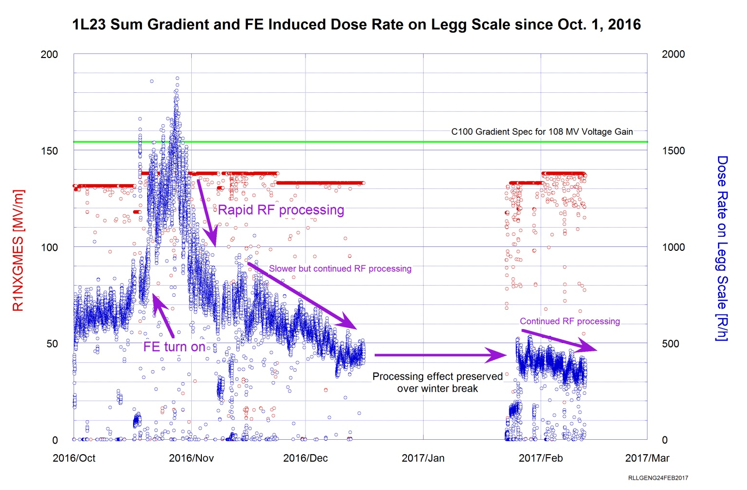
1L23 (C100-6)- cont.

Slide 18
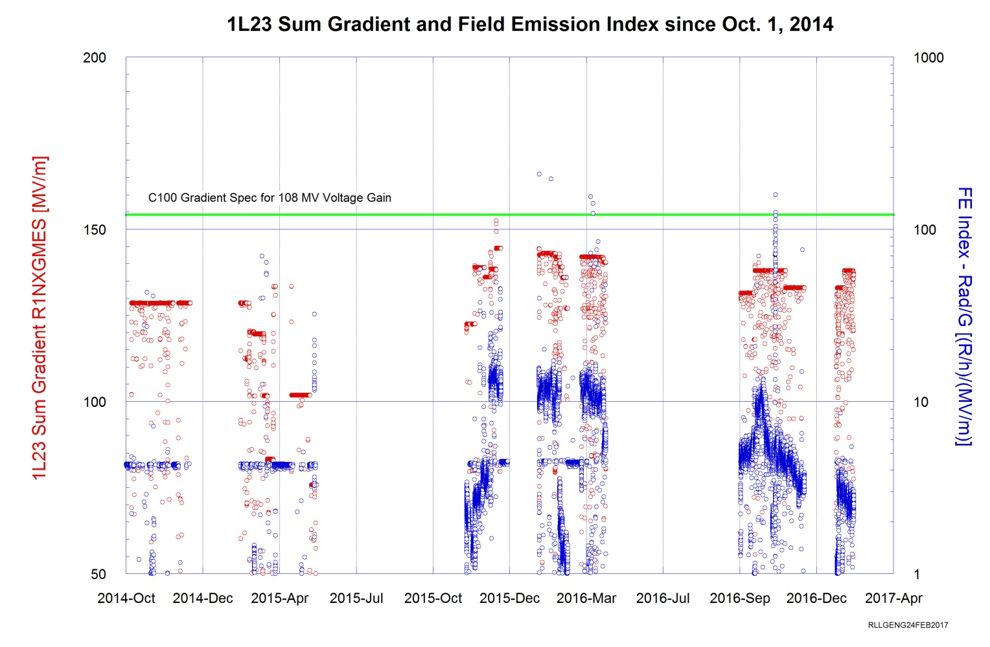
1L23 (C100-6)- FE Index

Slide 19
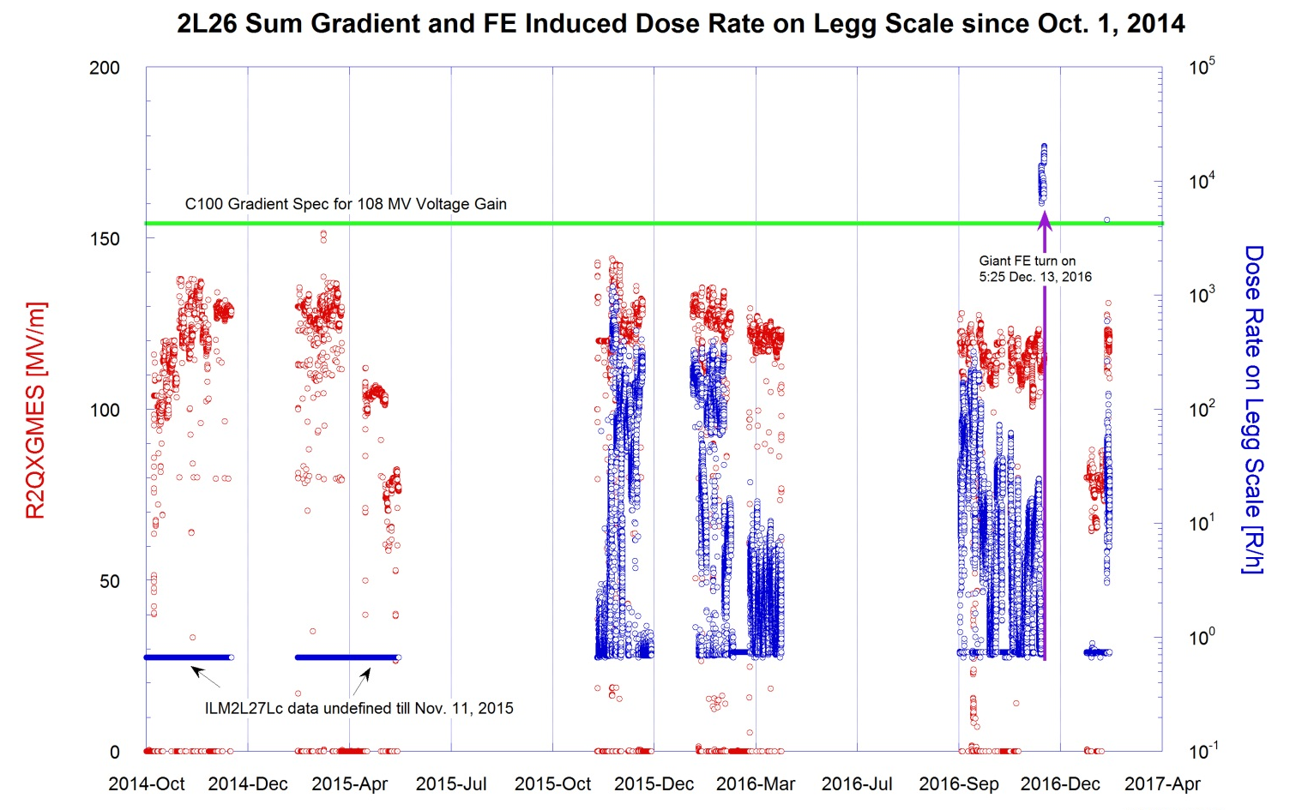
2L26 (C100-8)- Long term FE

Slide 20
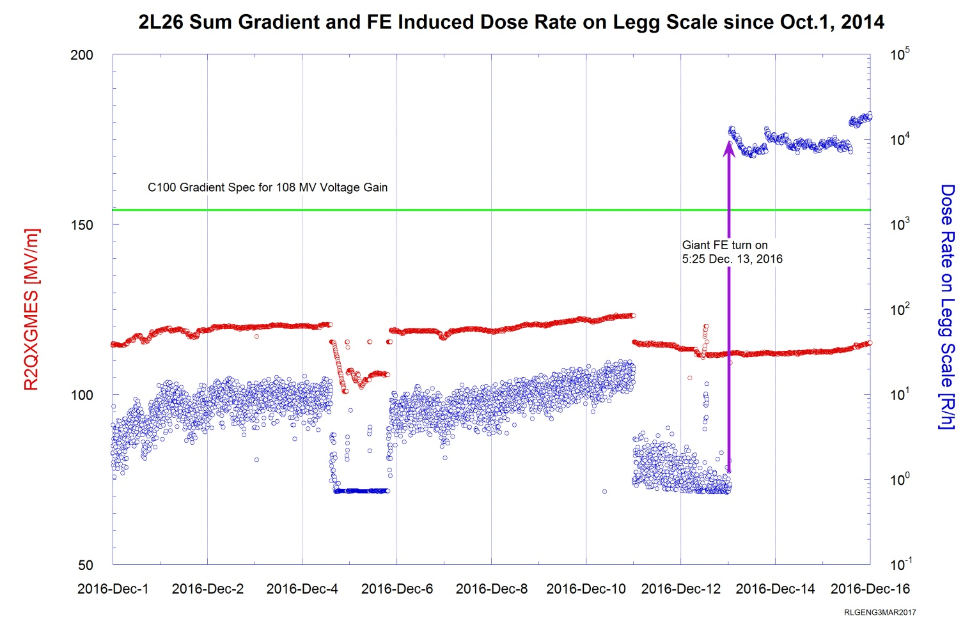
2L26 (C100-8) – cont.

Slide 21
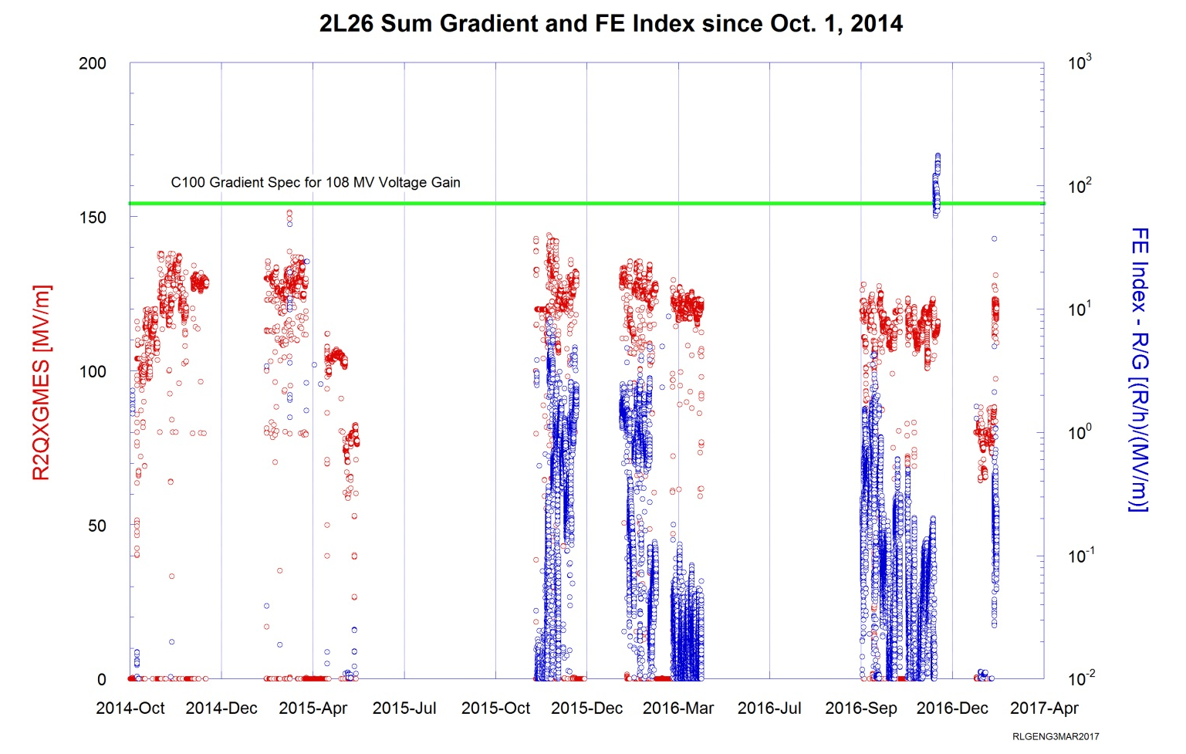
2L26 (C100-8)- FE Index

Slide 22
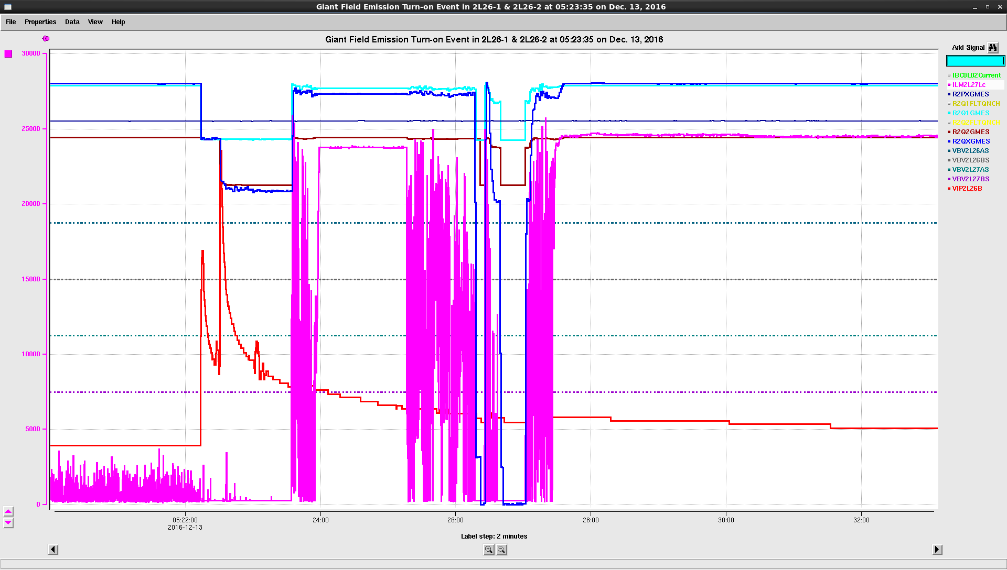
2L26:Correlation Between FE Turn-on & Beamline Vacuum

Slide 23
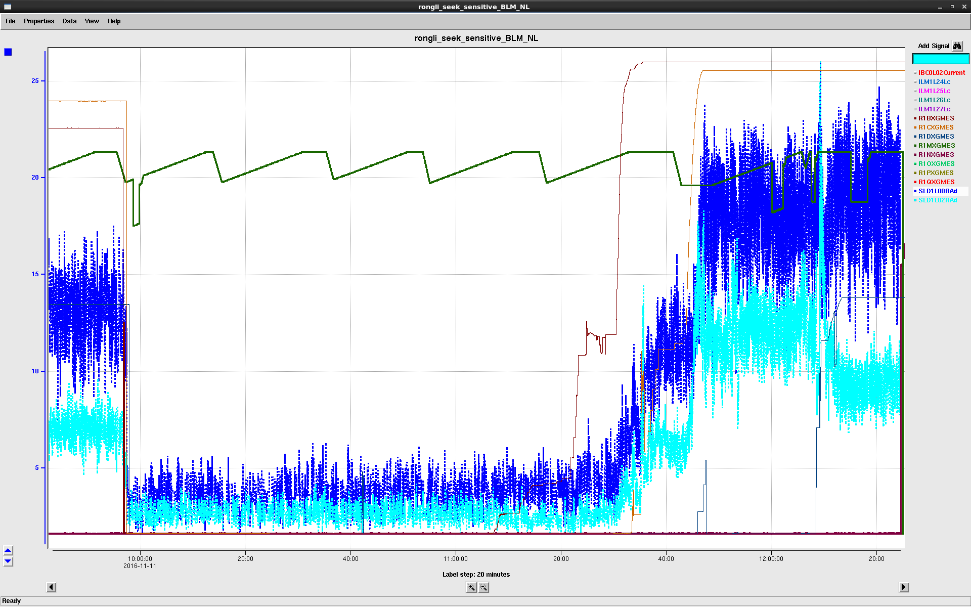
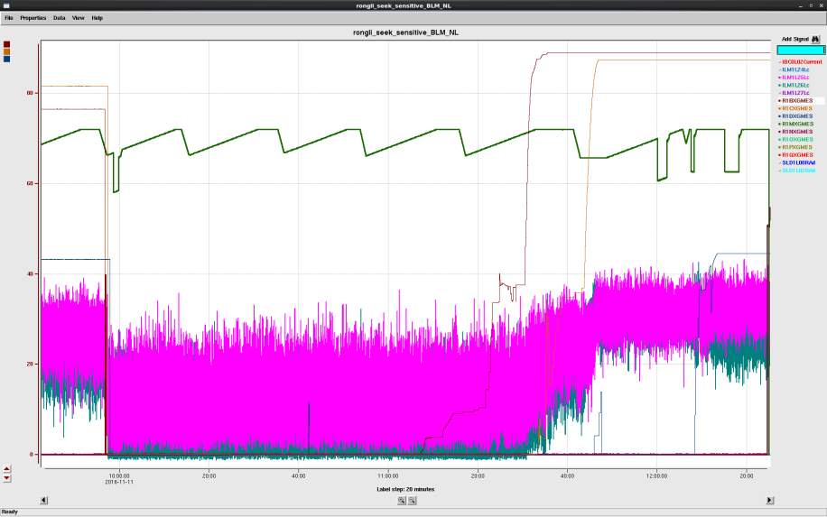
FE Electron Transportation Over 15 Cryomodules
Direct evidence observing long distance (more than 100 m) transportation of captured field emitted electrons over multiple (15) modules!
Observations suggest that the field emission detection is subjected to collective effect due to cryomodule local to AND remote to detector.
1L12 Gradient
1L11 Gradient
1L22 Gradient
Ion chamber
US 1L25
US 1L16
BLM
US 1L25
US 1L16
See 11/11/16 elog entry for more details https://logbooks.jlab.org/entry/3438208

Slide 24
Conclusion
CEBAF BLM sensitivity to FE “discovered” and “calibrated”.
Permanent BLMs provided opportunity for looking backward and maybe forward (predict) on FE behaviors.
  Also enable real-time learning, for example FE impact from ion pump cycling or benefit of proposed room temperature warm up.
FE trending observed, allowing to observe “RF/beam processing” effect in C100 modules (5/6 of inspected).
Sudden FE turn-on major feature in C100 (6/6 inspected).
  One turn-on correlated w/ beamline vacuum spikes.
2K to 4K warm up from SAD may degrade or improve FE performance.
Fast FE detection seems to be useful and we aim to explore and establish optical fiber as a future FE detector for operational SRF linacs.

Slide 25
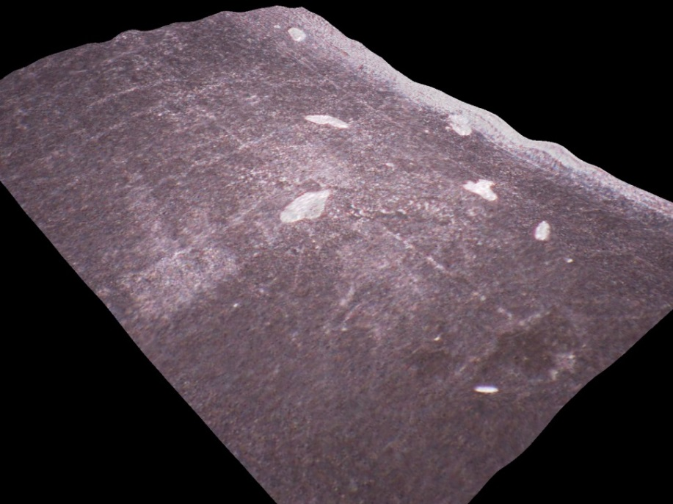
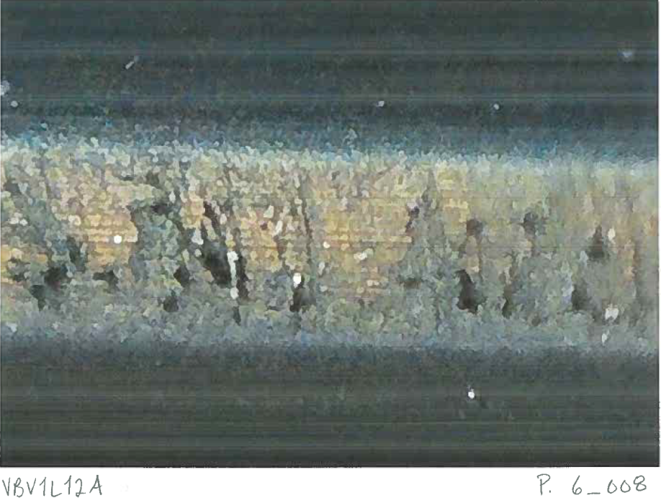
Viton Sealing Path Injury by Metallic Particulates
Consistent picture revealed by optical inspection of known leaky gate vales
4 GVs (DS 1L11, US & DS 1L12, US 1L13) from 1L12 removal in summer 2016
Module was C50-7, refurbished, short service period
Leaking caused by particulate injury (as opposed to radiation hardening)
Injured sealing path
particulate
particulate
Injured sealing path
See 3/7/17 elog entry for more details https://logbooks.jlab.org/entry/3467842

Slide 26
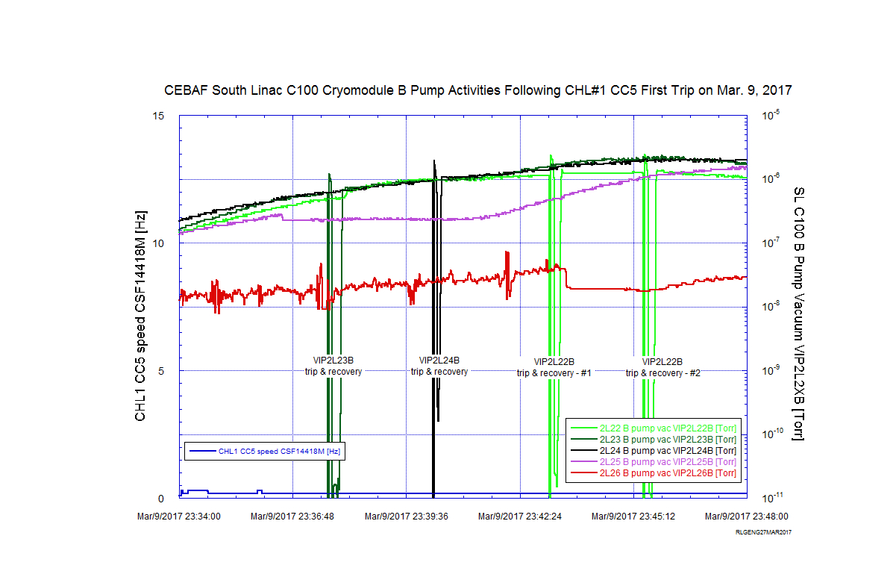
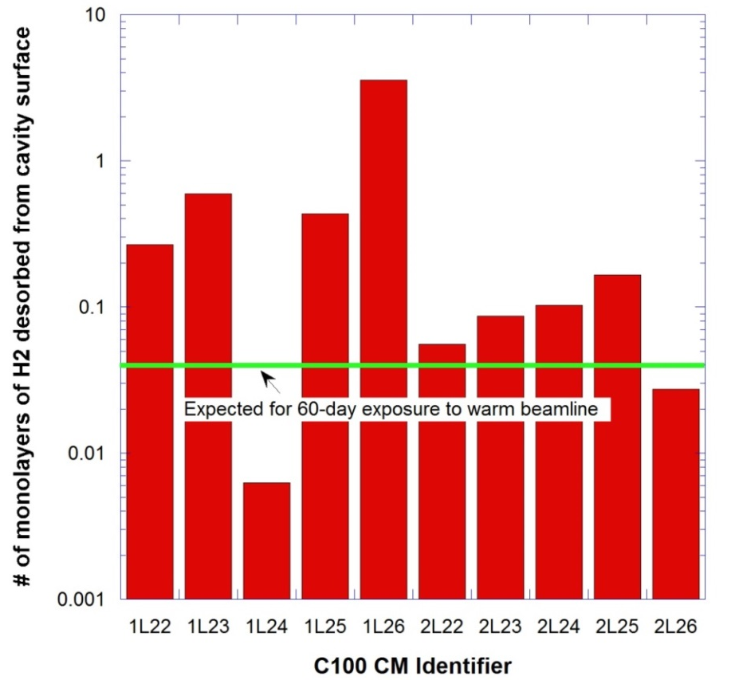
Frozen Gases on Cold Surface in C100 Modules
Unexpected large quantity of hydrogen condensation onto C100 cold surface
Source for enhanced FE if surface “dirty”; potential to degrade Q0
Particulate generation: ion pump trip/restart at > 1E-6 Torr as beamline pressure detreated
CHL failure has consequence impacting cavity FE performance (recent CHL events 3/9/17 & 7/27/17)
>>> mitigation via improved CEBAF beamline UHV system
See 5/30/17 Tech Note JLAB-TN-17-027 for more details

