Slide 1



12 GeV Program Overview
You already heard about, or will hear about:
    12-GeV project progress
    Accelerator operations progress
    Hall A
    Hall B
    Hall C
    Hall D
  Seems complete, so …
  JLEIC progress and activities
Rik Yoshida & Rolf Ent
JLab PAC45 Meeting
July 10, 2017

Slide 2
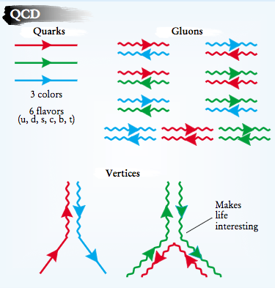
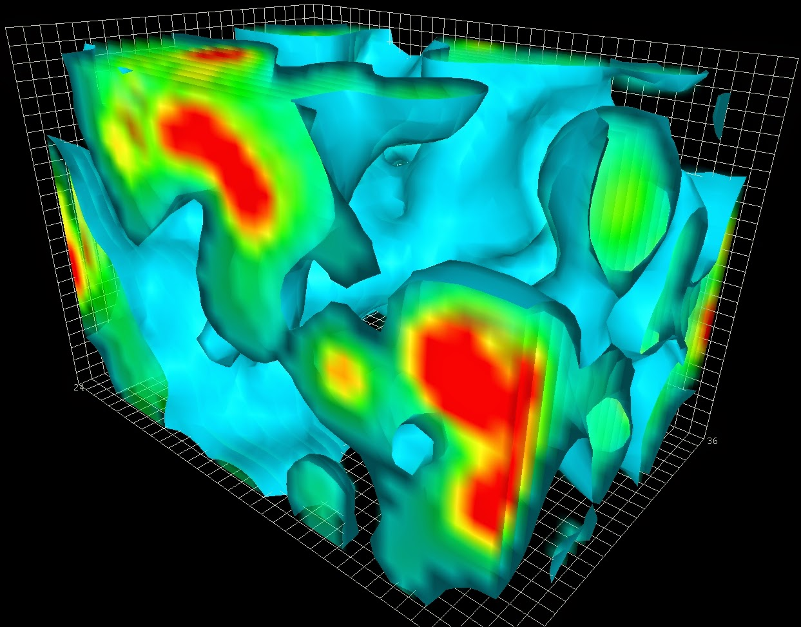

Cold Matter is Unique
Structure and Interaction are entangled
because of gluon self-interaction.
EIC needed to explore the gluon dominated region
JLAB 12 to explore the valence quark region
2

Slide 3
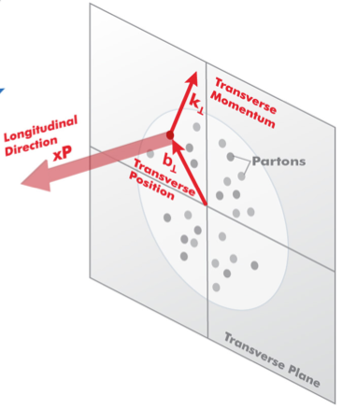

3D Structure of Nucleons and Nuclei
EIC is a machine to completely map the 3D structure of the nucleons and nuclei
We need to measure positions and momenta of the partons transverse to its direction of motion.
These quantities (k_{T}, b_{T}) are of the order of a few hundred MeV.
Also their polarization!
k_{T}, b_{T} (~100 MeV)
Proton and Ion Beam
Need to keep [100 MeV]_{T}/E_{proton,Ion} manageable (~ >10⁻³) ➔ E_{proton} ~< 100 GeV
3

Slide 4
JLEIC Realization
8-100 GeV
3-10 GeV
8 GeV
Use existing CEBAF for polarized electron injector
Figure 8 Layout: Optimized for high ion beam polarization  polarized deuterons
Energy Range: √s : 20 to 65 - 140 GeV (magnet technology choice)
Fully integrated detector/IR
JLEIC achieves initial high luminosity, with technology choice determining initial and upgraded energy reach

Slide 5
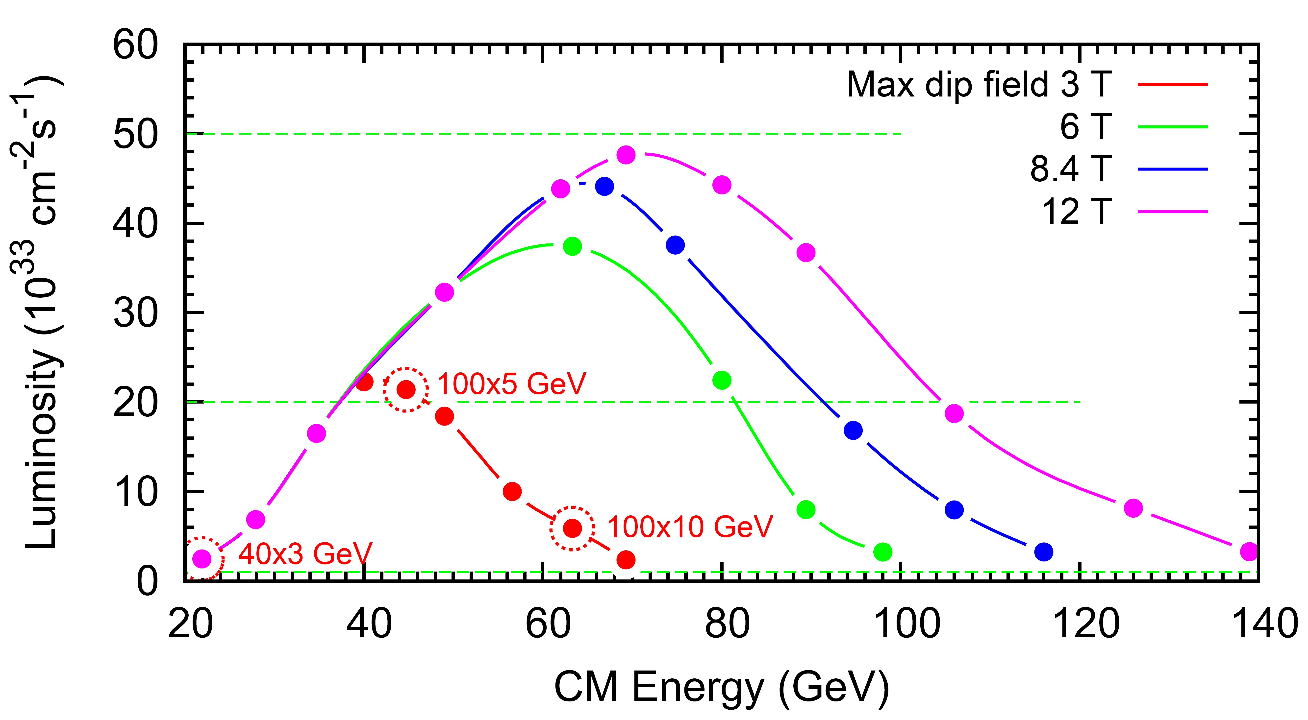
JLEIC Luminosity and Energy technical choice
LHC technology
FCC magnet R&D

Slide 6
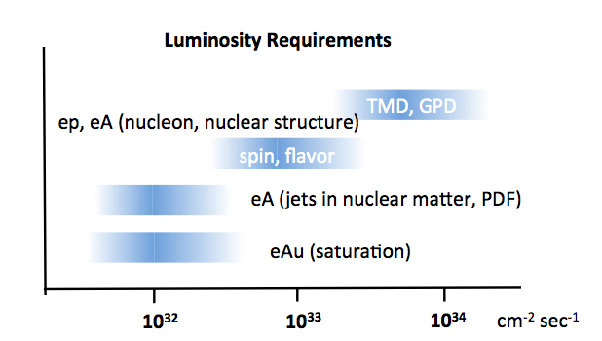
EIC: a high luminosity machine
EIC has unprecedented flexibility
  Variable energies of both beams.
  L polarization of electron beams.
  L & T polarization of p/ion beams
  Many different ion species.
Many run configuration for any given topic.
Even a “low luminosity physics topic”
will mean e.g. ep, ed, e³He, e⁴He, e⁹Be, e¹²C,e⁴⁰Ca, e⁴⁸Ca…etc. + polarization so they are high luminosity in practice.
Need to have high luminosity (10³⁴) from Day 1. The project will not work if 80% of the physics objectives are unreachable until the “ultimate upgrade” 15 years later.
JLEIC Design
Need also good (100%) acceptance: Polarized luminosity and the capability to measure physics of interest is what counts
6

Slide 7
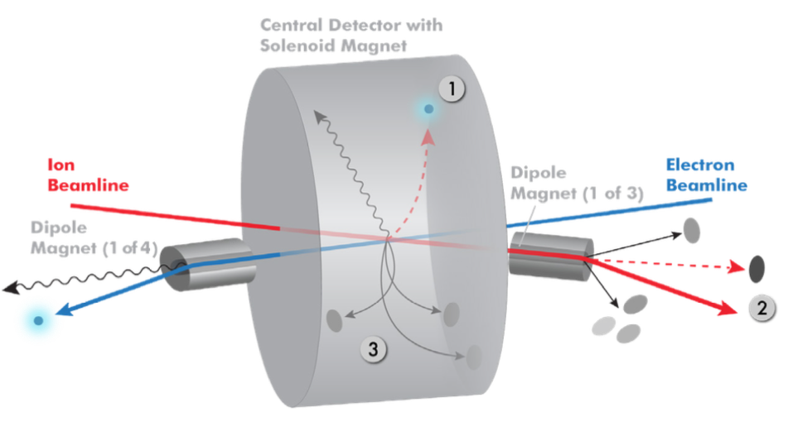
Integration IR: JLEIC total acceptance detector
Possible to get ~100% acceptance for the whole event
Scattered electron
Particles associated with struck parton
Particles Associated with Initial Ion
Relatively large crossing angle (50 mr) combined with large aperture final focus magnets,
and forward dipoles are keys to this design - this crossing angle creates room for forward dipoles and gives a space for detectors in the forward regions

Slide 8
JLEIC Detector Documentation
Given that a JLEIC detector is still far away in years, we decided to take a different approach to documentation, and concentrate more on short high-level introductory documents such that new interested parties can get up to speed fast
What do we have, is ongoing, and have planned, each as 5-10 page documents?
  Overall strategy of integration of detector in JLEIC collider interaction region (Rik Yoshida, Markus Diefenthaler, Yulia Furletova)
      https://jleic-docdb.jlab.org/DocDB/0000/000001/001/JLEIC-InteractionRegionDetectorDesign.pdf
  Three documents on
    Forward Electron Detection Region (Dave Gaskell)
    Central Detector Region (Markus Diefenthaler, Yulia Furletova)
    Forward Ion Detection (Vasiliy Morozov, Charles Hyde et al.)
  Two further documents, on
    Hadron identification (Rachel Montgomery, Patrizia Rossi)
    Calorimetry (Tanja Horn)
  Perhaps next Tracking?

Slide 9
JLab and User involvement in EIC
Taking Leadership Roles in EIC community (examples):
  Key roles in EIC Users Group organization (help inception, Steering Committee)
  Many JLAB invited talks on EIC at both Nuclear and High-Energy Physics international conferences.
  Multiple workshops on EIC topics organized by JLab.
  International outreach: Rik Yoshida, Abhay Deshpande, Jianwei Qiu visited multiple Japanese Labs & Universities to discuss EIC in Aug. 2016 (Tohoku, Riken-Wako, J-Parc)
  International outreach: EICUG Satellite Meeting at INPC in Adelaide (Sep. 2016)
  International outreach: Fulvia Pilat presents EIC accelerator designs at EIC events at INFN Genova (Jan. 2017) and Frascati (Mar. 2017).
9

Slide 10
JLab and User involvement in EIC
Many JLab Users and Staff actively involved in EIC Detector R&D Program
Calorimeter Consortium
    PbWO4 Crystal R&D (synergy with JLab/NPS) CUA, Orsay, Giessen
    Readout (new) INFN Genova
Tracking Consortium Saclay, Temple, UVA
Particle Identification Consortium
    DIRC ODU, CUA, GSI, …
    Dual RICH Duke, INFN, W&M
    Modular RICH INFN, …
    Sensors in high B field USC, JLab
Compton Polarimetry Electron Detector JLab, W&M
(collaborating w Kansas)
Software Consortium JLab, ANL, BNL, …
GEM-Based TRD (new) JLab, Temple, UVA
Background Simulations (new) JLab, UConn, SLAC, …
+…
List likely incomplete …
10

Slide 11
EIC Detector R&D Meeting @ JLab
11

Slide 12
Summary
EIC Program aim: Revolutionize the QCD understanding of nucleon and nuclear structure and associated dynamics. Explore new states of QCD.
EIC will enable us to embark on a precision study of the nucleon and the nucleus at the scale of sea quarks and gluons, over all of the kinematic range that are relevant. JLab12 will have set the foundation at the scale of valence quarks!
What we learn at JLab12 and later EIC, together with advances enabled by FRIB and LQCD studies, will open the door to a transformation of Nuclear Science.
JLEIC parameters are designed to enable all of the physics in the whitepaper on Day 1.
  The beam energy of 10 GeV (electron) and 100 GeV (proton) are chosen as an optimization for all EIC physics topics and ideal starting point.
  High luminosity and polarization performance is mandatory in order to start the nucleon nuclear structure measurements on Day 1.
JLEIC IR and Detector concepts are designed to best enable the physics of the EIC whitepaper—and made in close collaboration with the accelerator design.
12

Slide 13
Acknowledgements
  JLEIC Collaboration
  With acknowledgement to many accelerator scientists from JLab and collaborations.
  JLEIC Detector Study Group
  With acknowledgement to Markus Diefenthaler, Yulia Furletova, Tanja Horn, Charles Hyde, Vasiliy Morozov, Pawel Nadel-Turonski, and Rik Yoshida who all were instrumental folding in the ideas to fully integrate a detector into an e-p/A collider interaction region.
  Also with acknowledgement to Elke Aschenauer and Alexander Kiselev for healthy exchange of work & ideas.
13

Slide 14
14

Slide 15
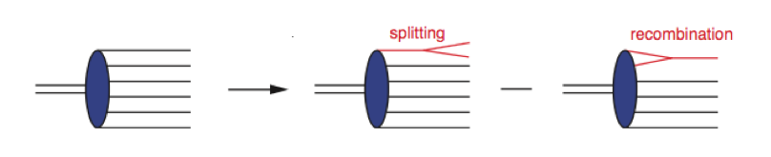
QCD at Extremes: Parton Saturation
HERA discovered a dramatic rise in the number of gluons carrying a small fractional longitudinal momentum of the proton (i.e. small-x).
This cannot go on forever as x becomes smaller and smaller: parton recombination must balance parton splitting, i.e. Saturation
The Q value where the protons (or ions) enters the saturation regime is called Q_{s} and a function of x: Q_{s}(x).
We ideally want to access saturation at a reasonably high Q_{s} (a few GeV at least) for pQCD interpretation.
Maximum accessible Q_{s}^{max} is a very weak function of √s
To double the scale Q_{s}^{max} accessible at an EIC (for eAu, ~1.2 GeV) needs an LHeC, to triple it needs an FCC-eh.
EIC will investigate saturation in the non-pert/pert boundary.
Balance this with measurability of transverse structure to start.
(i.e. [100 MeV]_{T}/E_{p} >10 ⁻³)
JLEIC (3T) 10 GeV x 100 GeV ✔
15

Slide 16

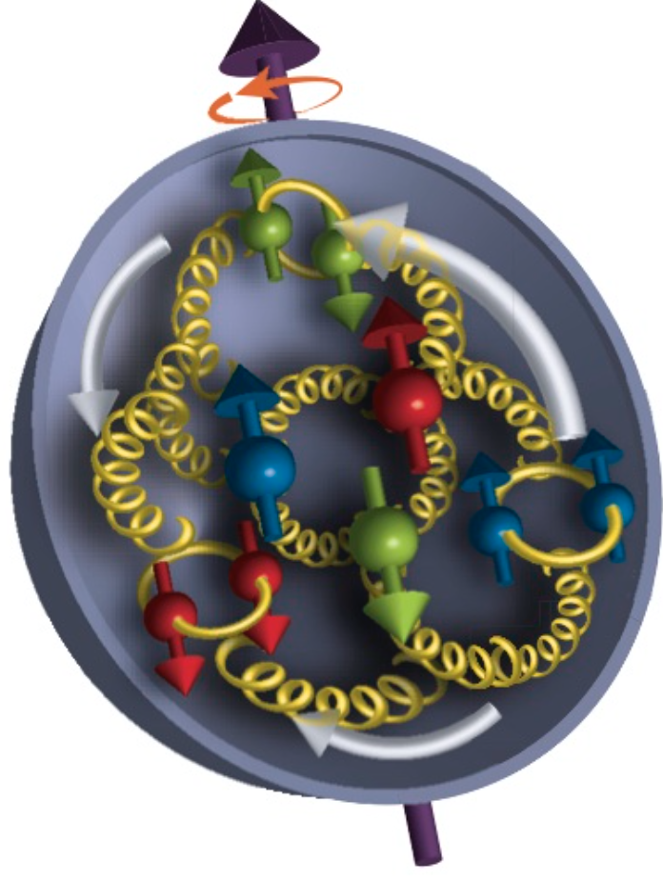
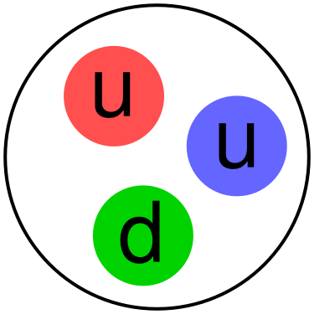
Where EIC Needs to be in x (nucleon)
Saturation
Regime:
Needs to be
accessed via Ions
Collective
Regime
Many-body
Regime
Few-body
Regime
(JLab 12)
10⁻⁴
10⁻³
10⁻²
10⁻¹
1
x (for proton)
QCD Radiation Dominated
(Studied at HERA)
Hadron Structure Dominated
Spin,TMD, GPD…
Main interest for EIC Nucleon/Nuclear Program
Notes:
16

Slide 17
Where EIC needs to be in Q²
x > 10⁻³,10⁻² to 1
Non-perturbative
Regime
Perturbative
Regime
Transition
Region
HERMES, COMPASS, JLAB 6 and 12
EIC
HERA high-x
Q²
10⁻¹
1
10
10²
10³
[GeV²]
Include non-perturbative, perturbative and transition regimes
Provide long evolution length and up to Q² of ~1000 GeV² (~.005 fm)
Overlap with existing measurements
Disentangle Perturbative/Non-perturbative, Leading Twist/Higher Twist
Notes:
17

Slide 18
Physics vs. EIC Design Requirements
What drives the EIC design is versatility!
Flexibility in energies
Polarization – e⁻ and p/d/³He
Range of nuclei – H to Pb/U
Excellent (100%) acceptance
Good particle identification and resolution
Polarized luminosity and the capability to measure physics of interest is what counts

Slide 19
EIC Requirements
Requirements from Physics:
High Luminosity: 10³³⁻³⁴ cm⁻²s⁻¹ and higher → nucleon/nuclei imaging
Flexible center of mass energy → wide kinematic reach
Electrons (0.8) and protons/light nuclei (0.7) highly polarized
→ study of spin structure
Wide range of nuclear beams (D to Pb/U) → high gluon densities
Room for a wide acceptance detector with good PID (e/h & π, K, p)
→ flavor dependence
Full (or large) acceptance for tagging, exclusivity, protons from elastic reactions, neutrons from nuclear breakup → target/nuclear fragments
The “sweet spot” for the EIC parameters is a balance of
  High enough energies to reach high Q² (up to ~1000 GeV²)
  Low enough proton energy to measure transverse scale of ~100 MeV well.
  High enough energy to explore collective effects towards saturation.
  High enough luminosity for the nucleon/nuclei imaging.
  IR and Detector with acceptance and performance to fully measure the relevance processes

