Slide 1
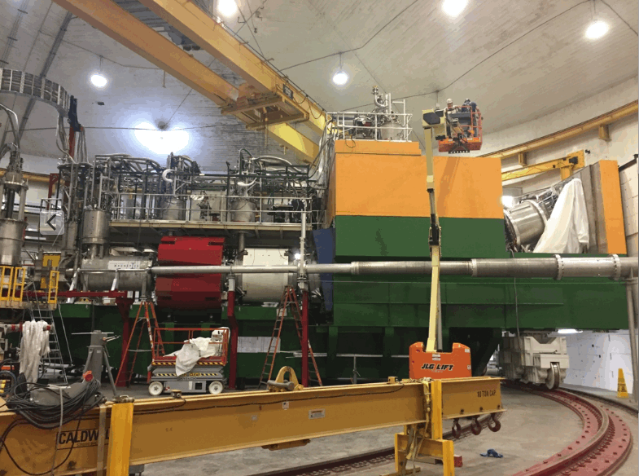
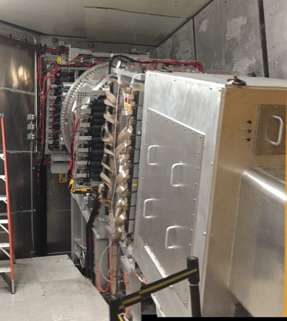

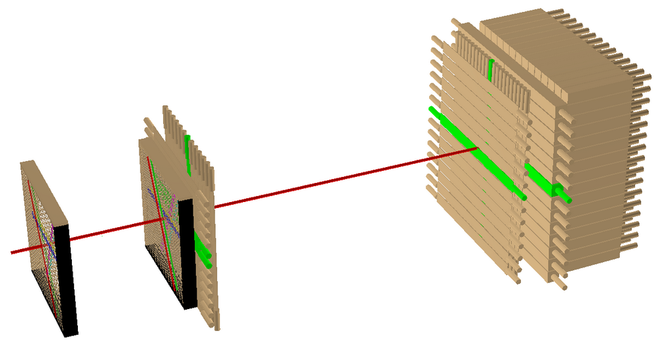
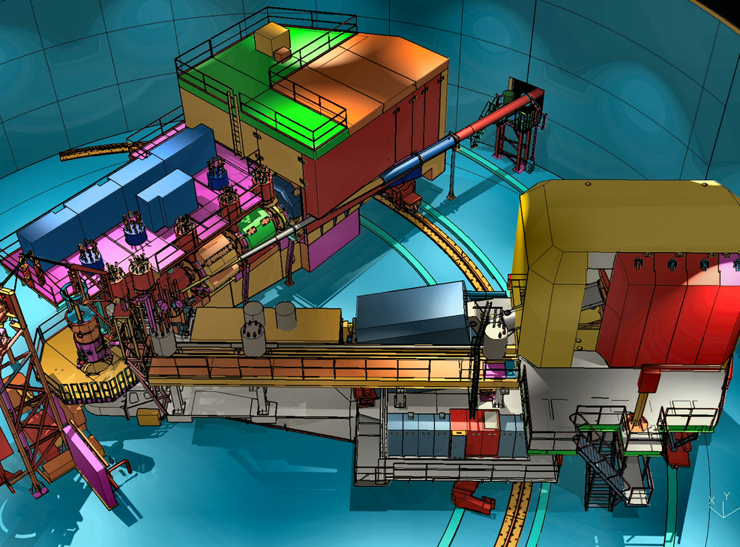
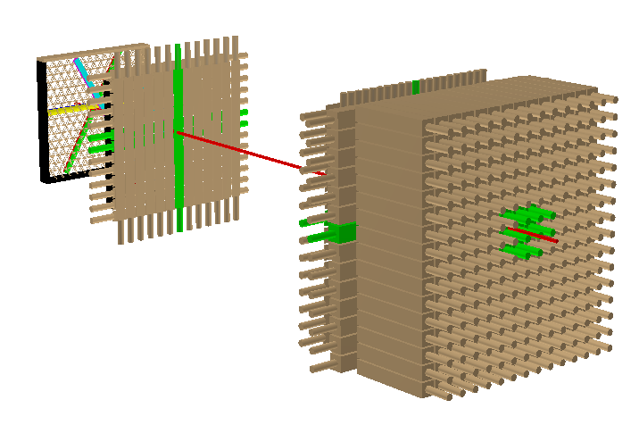
PAC 45
July 10, 2017
S2y
S1y
Preshower
S1x
S2x
Shower
Wire Chambers

Slide 2
Publications, Students, Postdocs
Spectroscopy of neutron-rich hypernucleus, ⁷_{Λ}He by electron beam
Phys. Rev. C 94, 021302 (2016) (E05-115)
The Aerogel Cherenkov Detector for the SHMS magnetic spectrometer in Hall C at Jefferson Lab
Nucl. Instum. Meth. A426, 405 (2017)
A test of local Lorentz invariance with Compton scattering asymmetry
Mod. Phys. Lett. A 31, 1650220 (2016) (Compton Polarimeter)
A novel comparison of Møller and Compton electron-beam polarimeters
Phys. Lett. B 766, 339 (2017)
Measurements of the Separated Long. Structure Function F_{L} from Hydrogen and Deuterium Targets at low Q²
ArXiv:1606.02614 (E00-002)
Comparison of the Struct. Func. F2 as Measured by Charged Lepton and Neutrino Scattering from Iron Targets.
ArXiv:1706.02002
Upcoming 6 GeV publications: Qweak + ancilliary, SANE, SuperRosenbluth, Inclusive/SF/EMC
PhD’s in last year: Qweak: Siyuan Yang (W&M), Martin McHugh
Postdocs: Eric Pooser, Holly Szumila-Vance (starts August 2017)
New Hall A/C Staff: Simona Malace
Notes:
]

Slide 3
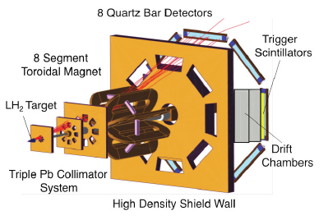
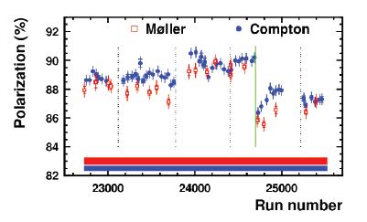
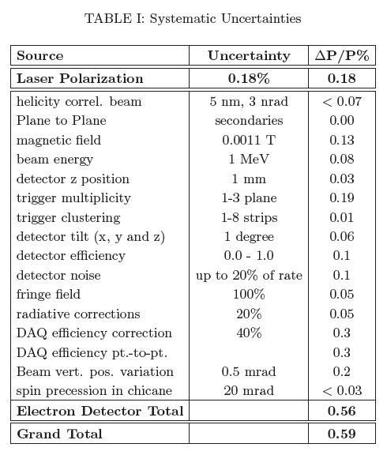
Qweak Status
Ratio (Compton/Moller) = 1.007 +/- 0.003, within systematic uncertainties
All systematic corrections completed and finalized
Full Qweak data set has been un-blinded
Un-blinded results from run 1 and 2 agree well!!!
Invited to publish in Nature – expect to submit late Summer
Scheduled Qweak presentations:
  JLab Release Talk: Mark Pitt
  PANIC Plenary Release Talk Roger Carlini
  DNP Invited Talk Greg Smith
  Hadrons Invited Talk Paul King

Slide 4
12 GeV Project – Hall C Completion
Late 2016: Remaining SHMS magnets (Q2, Q3, Dipole) delivered
Early 2017: Magnet final magnet assembly/installation.
All magnets exercised to 11 GeV currents
Beamline installed
March 2017: Beam to Hall C
Demonstrated “Key Performance Parameters” – only ~2 day run!
Detector timing
Tracking
Particle ID
S2y
S1y
Preshower
S1x
S2x
Shower
Wire Chambers

Slide 5
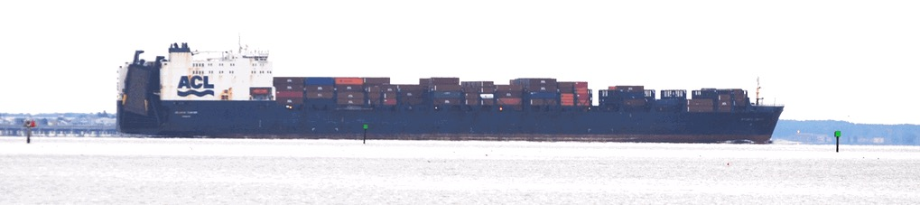
Final 6-Mo. of 12GeV Project in Hall C: Fall/Spring 2016/2017
The Atlantic Cartier, carrying Q3, Entering Hampton Roads en-route to Norfolk on Dec. 4, 2016

Slide 6
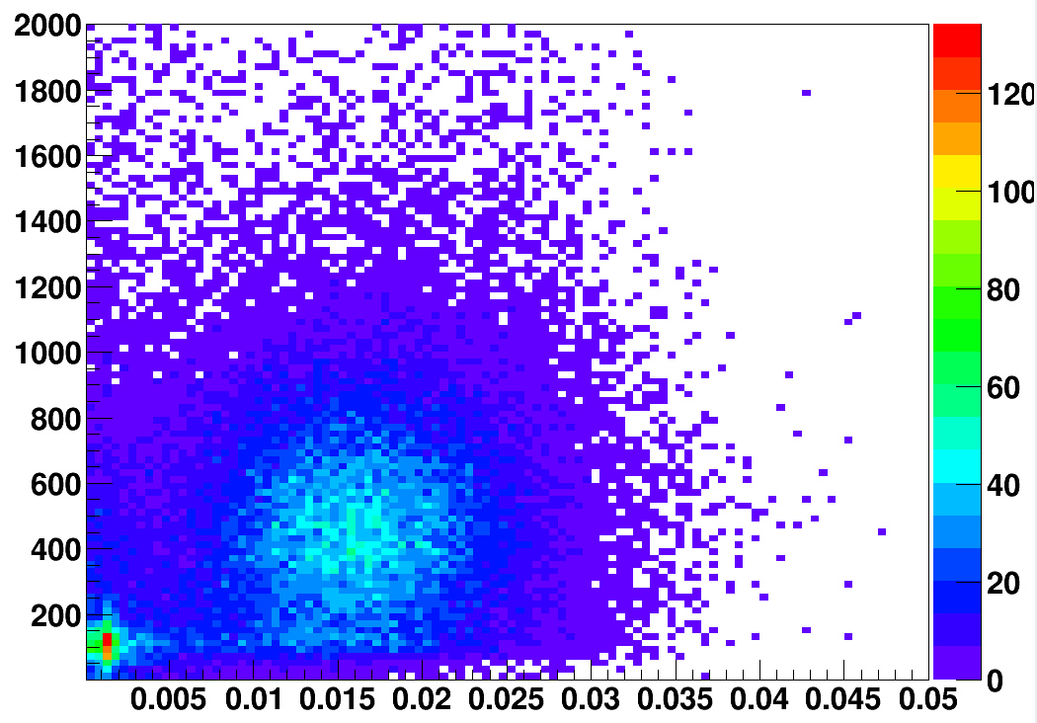
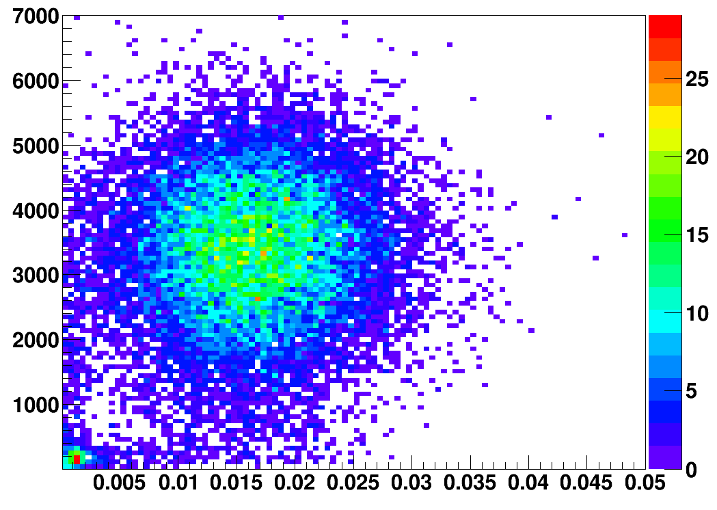
Particle ID
Particle identification using signals from calorimetry and Cerenkov detectors.
HGC vs PSh
Electrons
HGC Signal (arb. units)
NGC vs PSh
NGC Signal (arb. units)
Preshower Energy (arb. units)
Pions
Preshower Energy (arb. units)
arb. = arbitrary

Slide 7

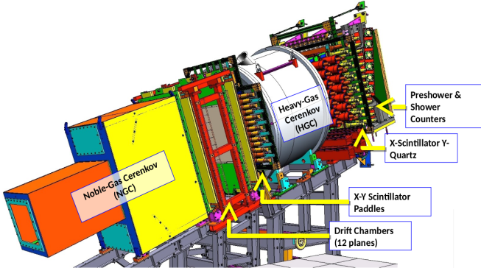
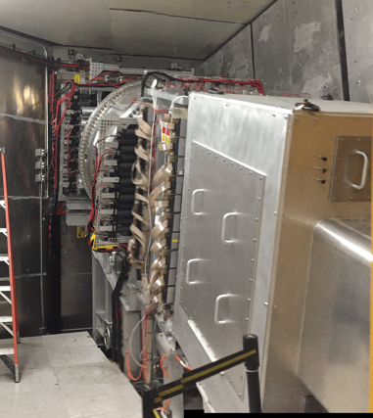
KPP Demonstration
Track Reconstruction
Run 488, Event 16
S2y
S1y
Preshower
S1x
S2x
Shower
Wire Chambers

Slide 8
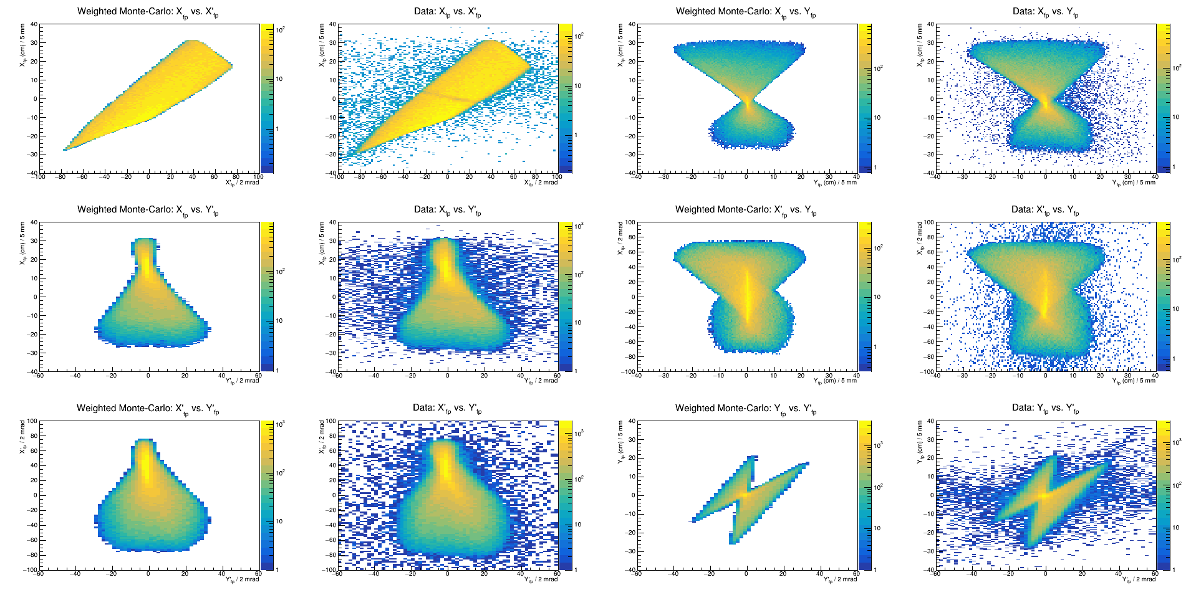
SHMS Monte Carlo vs Data
MC
Data
MC
Data
Notes:
No tuning/optimization of quad settings.

Slide 9
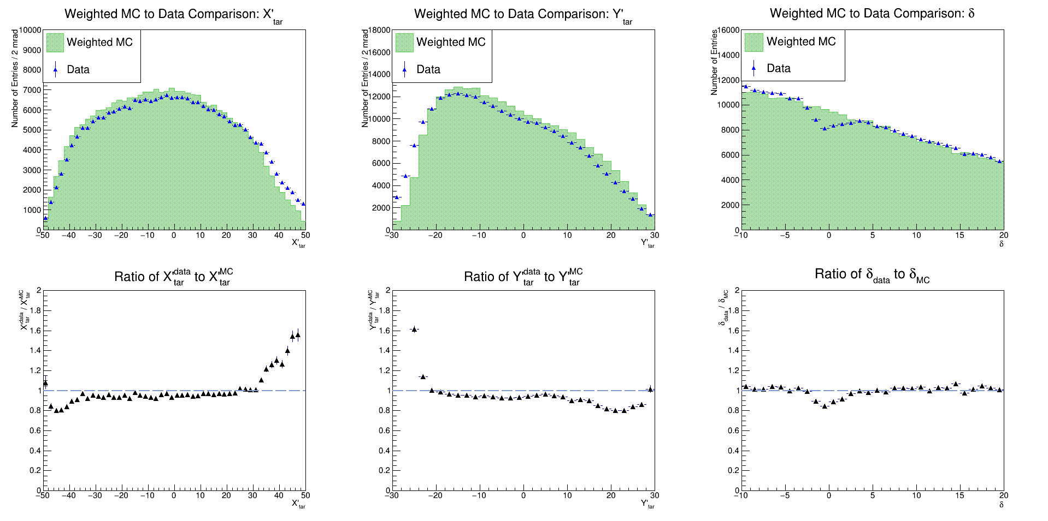
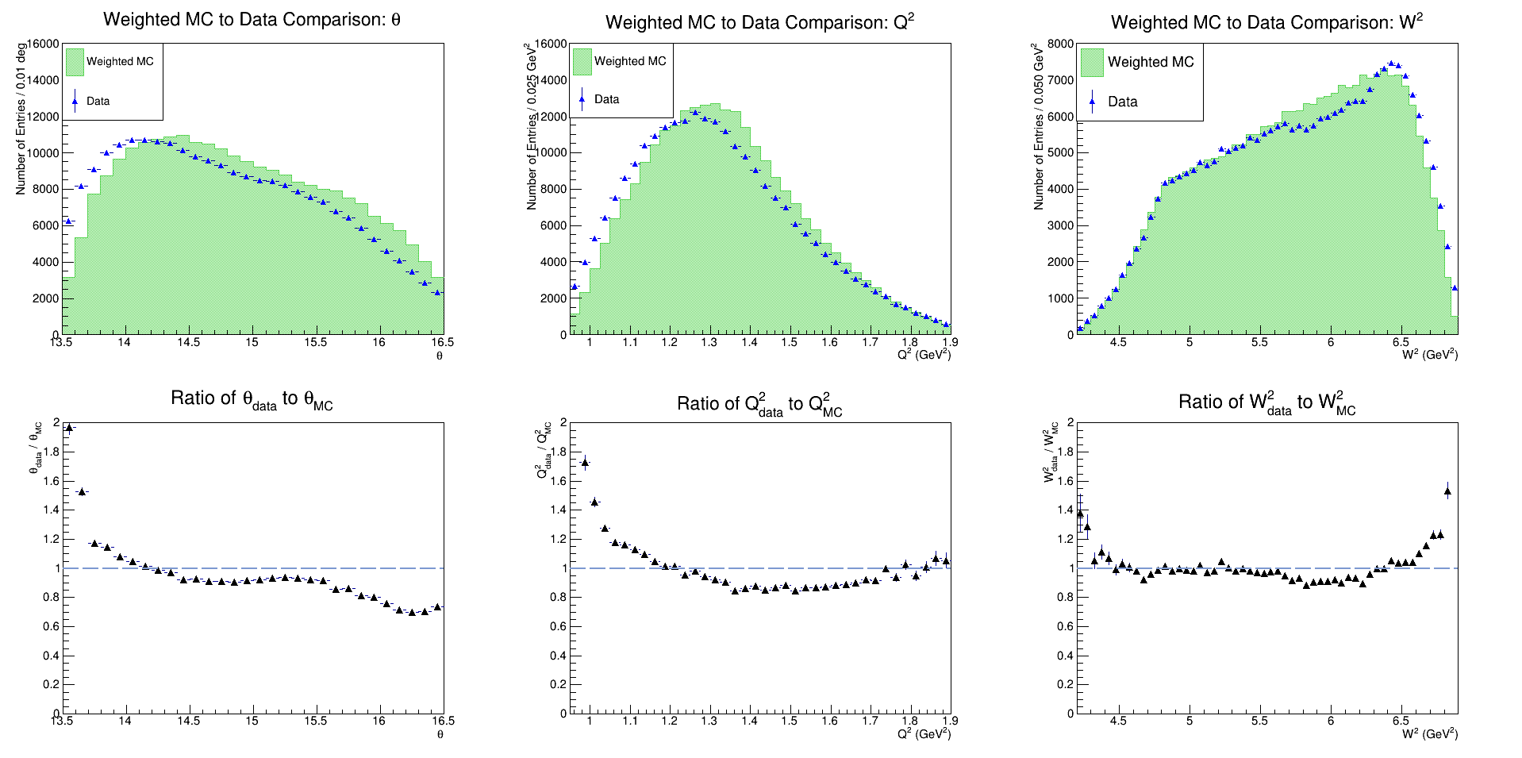
Target/kinematics reconstruction
“Dead-reckoning” of kinematics variables.
Reconstruction matrices from SHMS design optics.
Notes:
Dead reckoning. Reconstruction parameters from design optics, no sieve slit data.

Slide 10
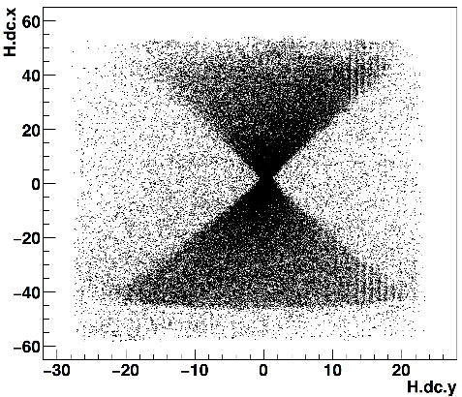
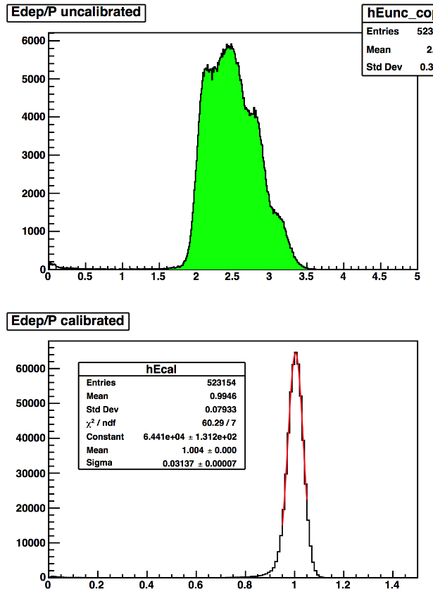
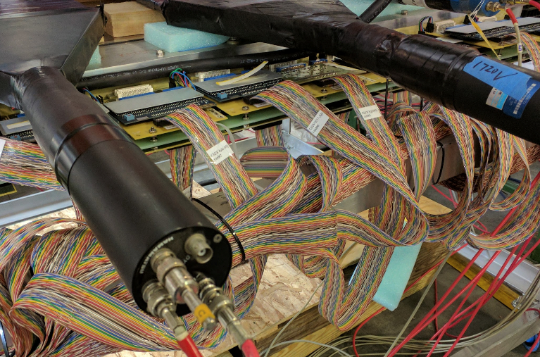
High Momentum Spectrometer
Legacy HMS not used since 2009
Magnets, detectors, DAQ (new) restored to nominal operation
Short run taken during March 2017 KPP run. All detectors performed as expected.
New HMS drift chambers have been fabricated to replace original HMS chambers
Same style as SHMS chambers
Full chamber tests started
Plan to install for fall run
Expected “hourglass” shape at focal plane
Lead Glass Calorimeter
Δp/p = 3.1% @ 3

Slide 11
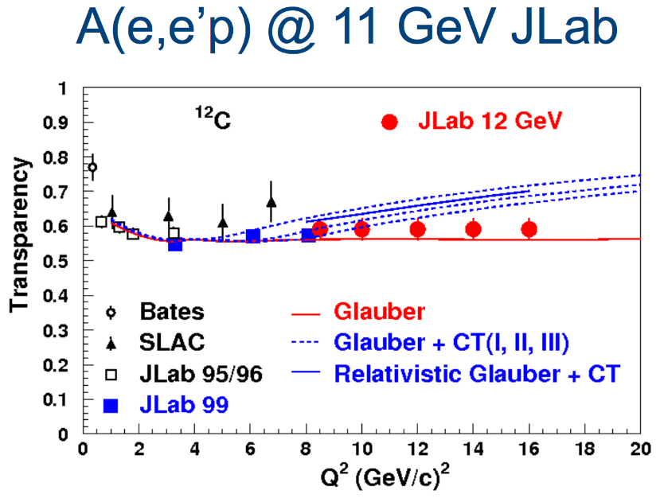
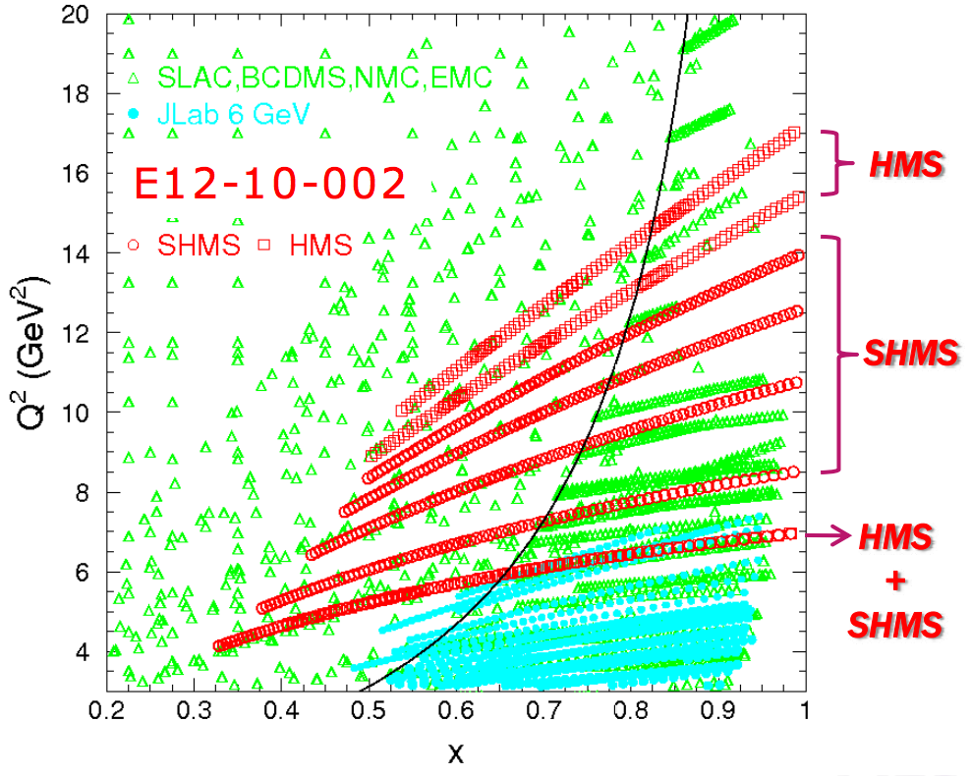
Moving Forward: Commissioning/Early Experiments
Fall 2017 – Phase I (Fits into “10 weeks”)
~25 PAC days – Commissioning “Experiment”
  E12-06-107 search for color transparency
  A(e,e’p) only – “easy” coincidence measurement
  E12-10-002 F₂^{p,d} structure functions at large x
  Momentum scans help understand acceptance
  ~2 days E12-10-108 EMC Effect
  Integrate light nuclei with F₂ run,
  Point target helps acceptance studies.
  ~ 1.5 days of E12-10-003 d(e,e’p)
  Push to lower cross sections
2018/? – Phase II
E12-09-017 P_{t} dependence of basic SIDIS cross sections
Push particle ID capabilities of SHMS
E12-09-002 Precise π⁺π⁻ ratios in SIDIS – Charge Symmetry Detector efficiencies
E12-09-011 L/T separated p(e,e′K⁺) factorization test
Easiest L/T separation
Notes:
* Does not show on posted schedule, will appear when updated.

Slide 12
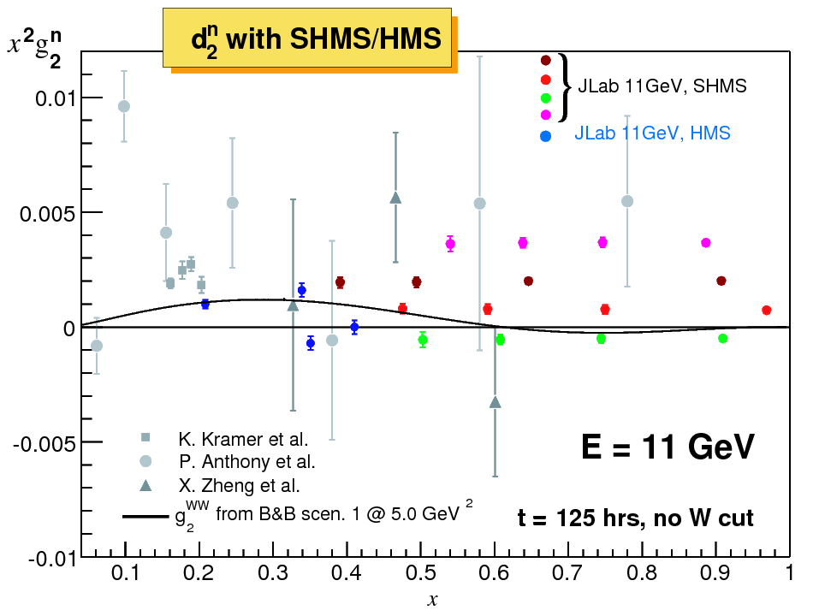
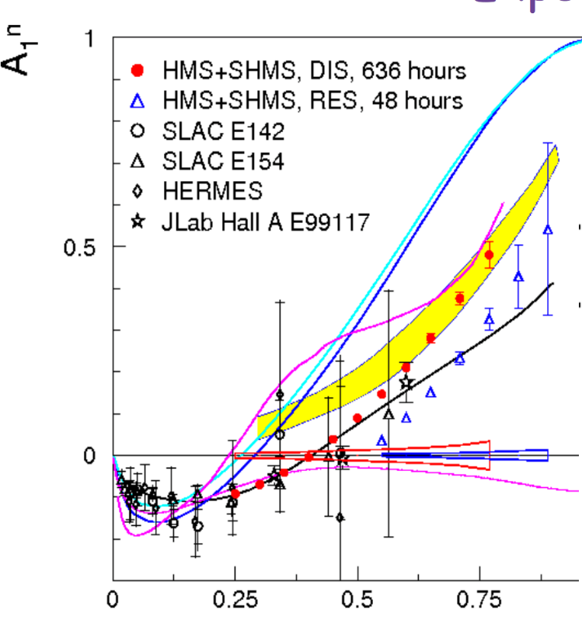
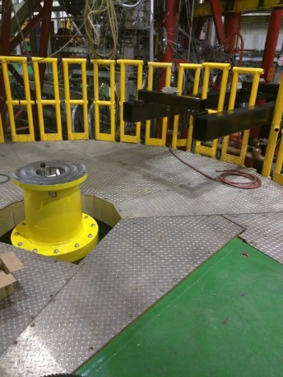
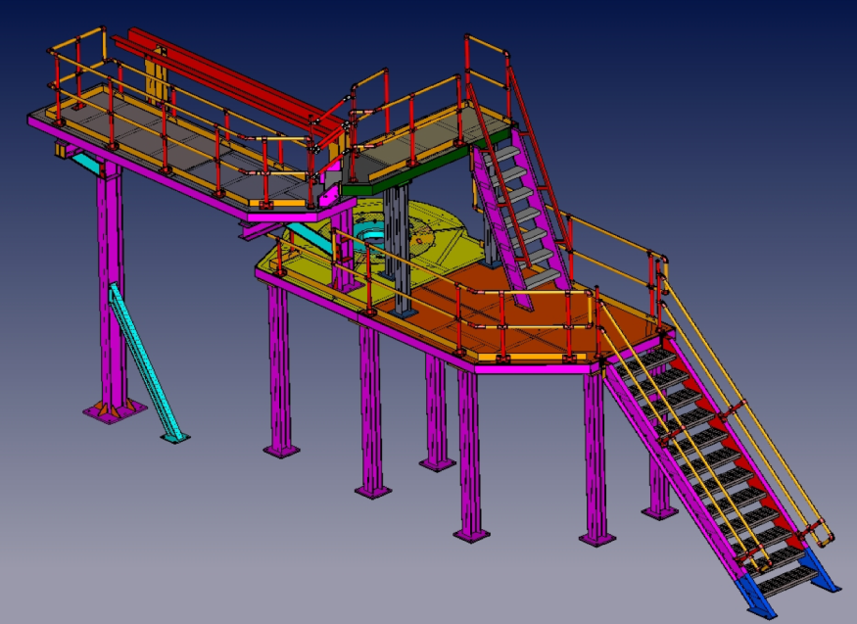
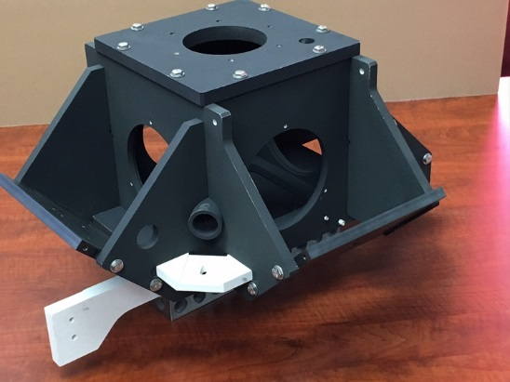
Polarized ³He
A₁^{n} (E12-06-110) and g₂^{n}/d₂^{n} (E12-06-121)
Preparations for polarized ³He target in Hall C
Cut and reassembled pivot post
Access platform parts received
First oven received

Slide 13
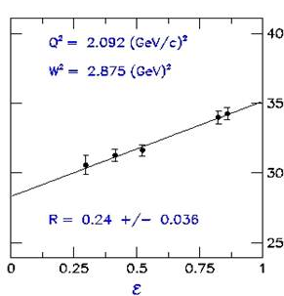
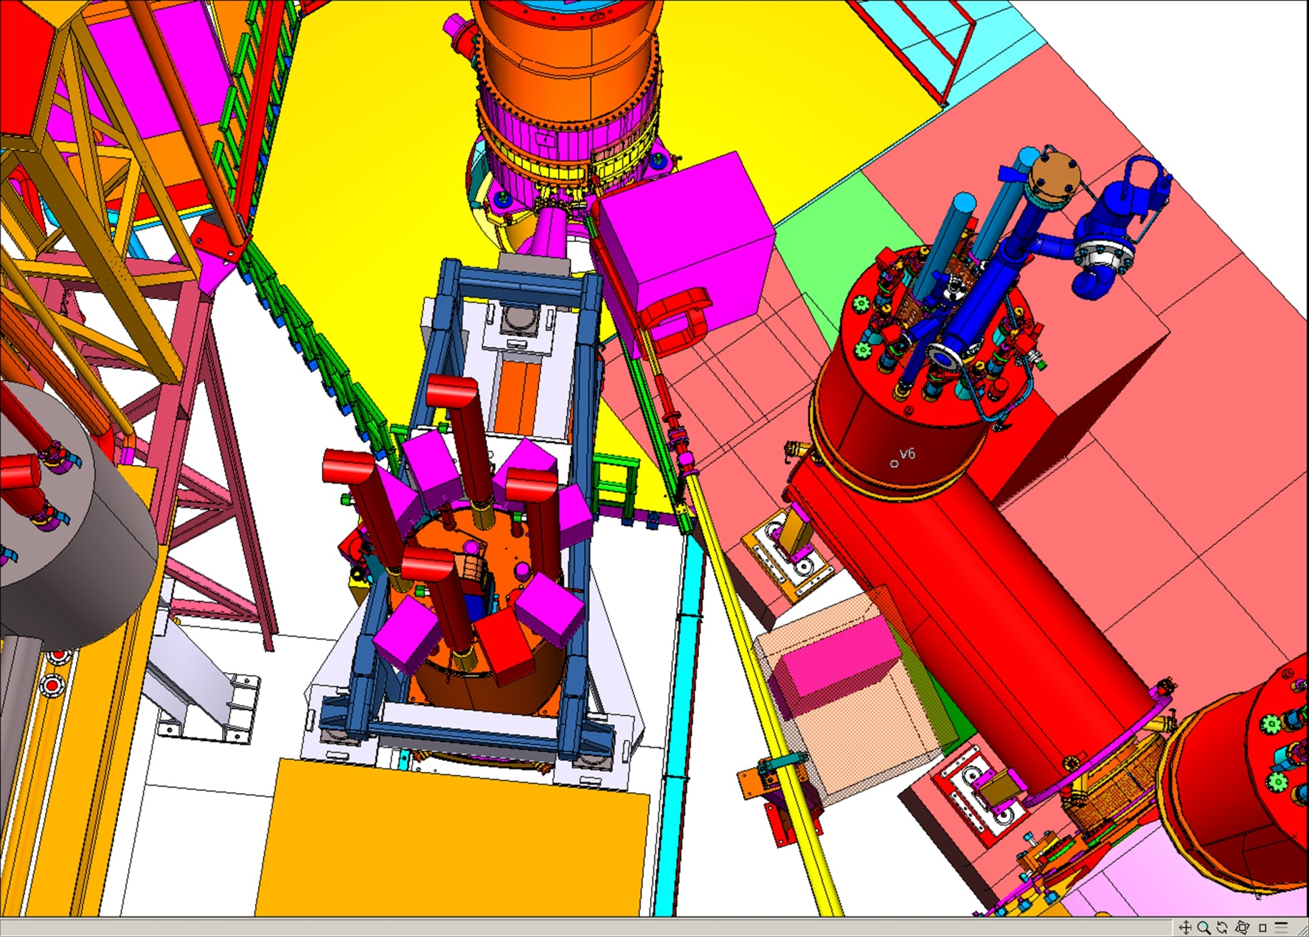
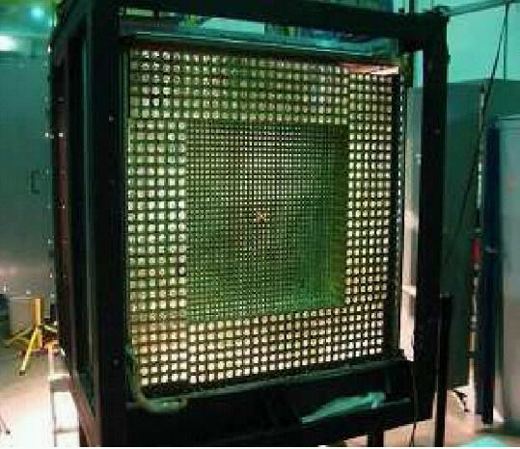

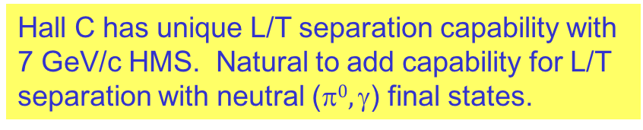
Neutral Particle Spectrometer (π⁰/γ)
Hall C has unique L/T separation capability with 7 GeV/c HMS. Natural to add capability for L/T separation with neutral ($0, $) final states.
Beam direction
target
5 Experiments approved
E12-13-007: $$⁰ SIDIS
E12-13-010: DVCS and pi0 cross sections
E12-14-003: WACS at 8 and 10GeV
E12-14-005: Wide angle exclusive π⁰
E12-14-006: Initial state helicity correlation in WACS
HMS
Notes:
Requires SHMS superstructure, now under construction

Slide 14
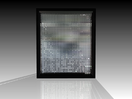
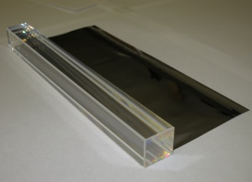
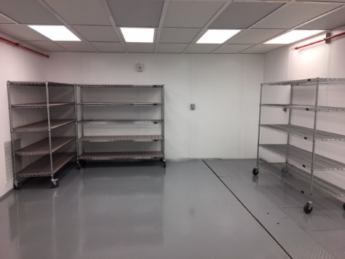
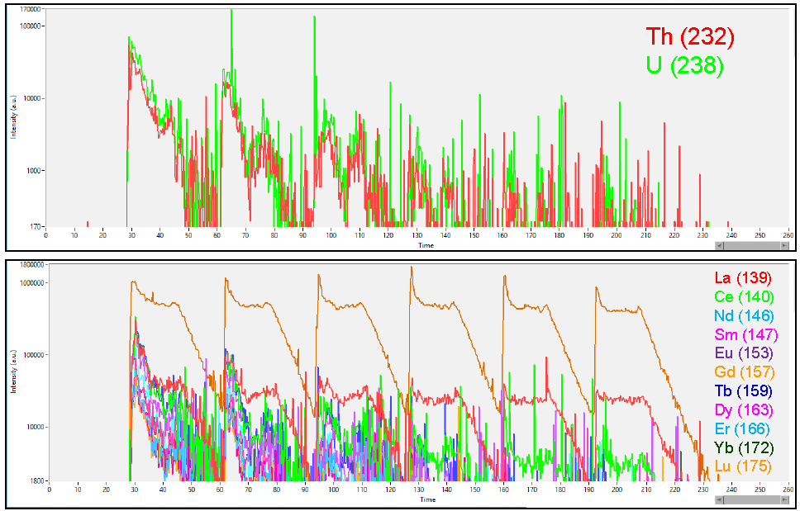
NPS Project Status
NPS
PbWO₄
Five approved experiments, supported by NSF MRI PHY-1530874 (CUA, OU, ODU), International (IPN-Orsay, Glasgow, Yerevan), and JLab
The NPS PbWO4-based calorimeter
Magnet: corrector and main coil construction complete, yoke steel cutting ongoing
Example of coil winding
PMT and HV bases: design drawings final, prototyping, procurements to start soon
Frame and integrated systems: concepts and initial design complete, detailed drawings anticipated end of the year
The crystal clean room at JLab
Crystals: 460 crystals procured from SICCAS, full crystal testing facilities at CUA and IPN-Orsay, chemical analysis and crystal growth in collaboration with the VSL, synergy with EIC crystal calorimeter R&D, cleanroom ready
Results of La-ICP-MS chemical analysis

Slide 15
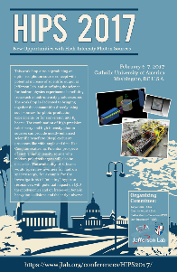
Opportunities with NPS and High-Intensity Photon Sources in Halls A/C & K_{L}/Hall D
Novel concept allows high photon intensity and low radiation in the hall
https://www.jlab.org/conferences/HIPS2017/
Physics: WACS (PAC45), K_{L} (PAC45), and also: WACS photoproduction, TCS, SRC, photoproduction of few body systems (see HIPS2017 Workshop)
Basic CPS design concept for Halls A/C
CPS in Hall D Tagger Vault
Concept similar, but need more space to achieve 60 kW beam power
Distance to target ~200 cm
photon beam diameter on the target ~ 0.9 mm
200 cm
2mm opening
(< 30 kW)
2.5 µA e⁻
γ
11 GeV
B ~ 2T
e⁻
3cm NH₃
10%X0 radiator
Beam Dump in the magnet
Benchmarking of simulations, initial radiation calculations and engineering aspects complete, optimization and engineering concepts ongoing

Slide 16
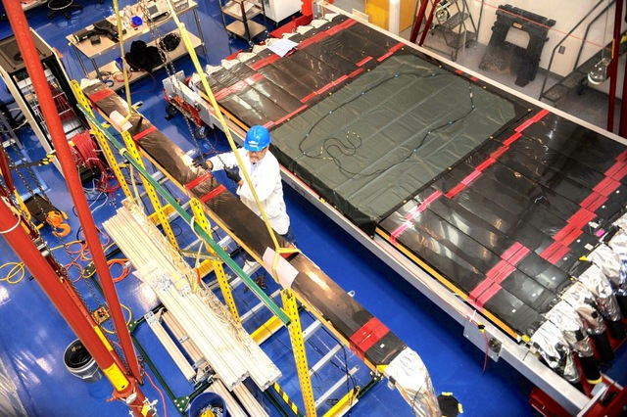
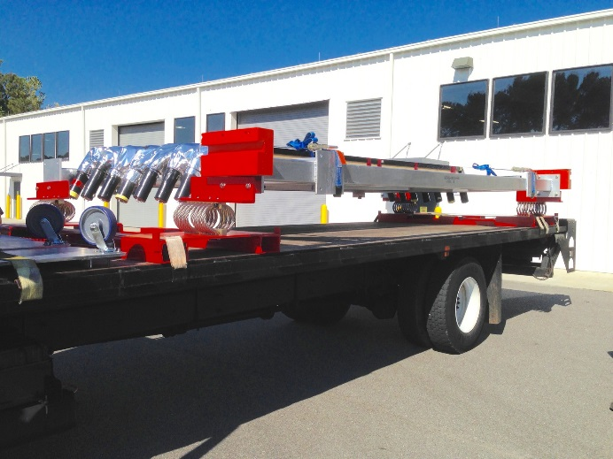
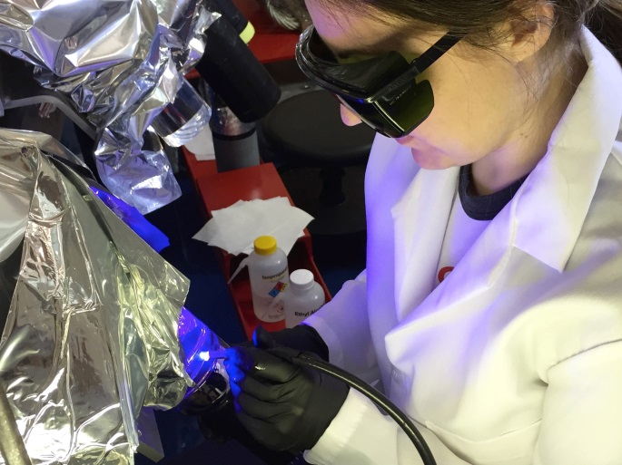
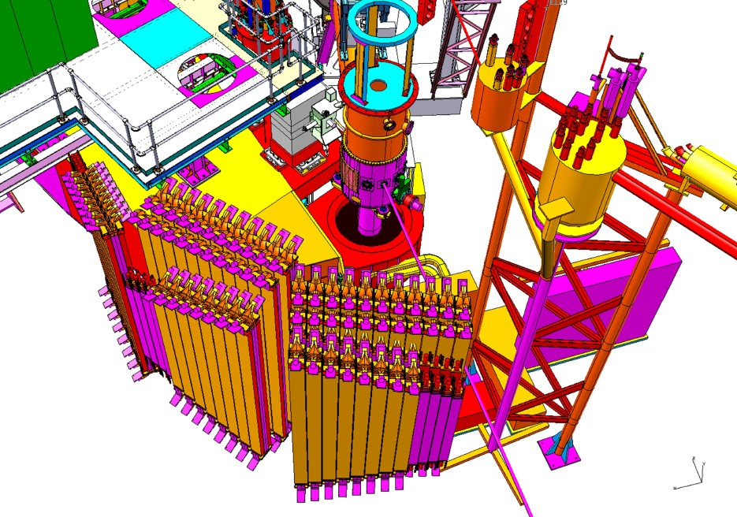
LAD – Large Acceptance Detector
E12-11-007: Deuteron EMC – d(e,e’ backward p)
Very large solid angle for L = 10³⁶ cm⁻² s⁻¹ and θ > 90º
Optimized for medium momentum nucleons
Needs 5 scintillator planes which are built from old CLAS-6 TOF scintillators.
Four planes refurbished @ODU by ODU, KSU, TAU, MIT, GWU. Last plane in progress.
Notes:
How many have been refurbished.

Slide 17
Summary
Aggressive 12-GeV End-game plan was implemented
  Result of extraordinary efforts of many people
  Finished installation a few days early
Hall-C 12-GeV Upgrade completed
Efficient!! (short) Spring 2017 Run
  Demonstrated KPP, completing the 12GeV Scope
  Confirmed that the HMS still works
  Provided data to feed calibration procedure
Additional projects in parallel development
  Polarized target development, NPS, CPS, LAD
We are Anxious to Commission and Use the Upgraded Hall C for Physics!

