Slide 1
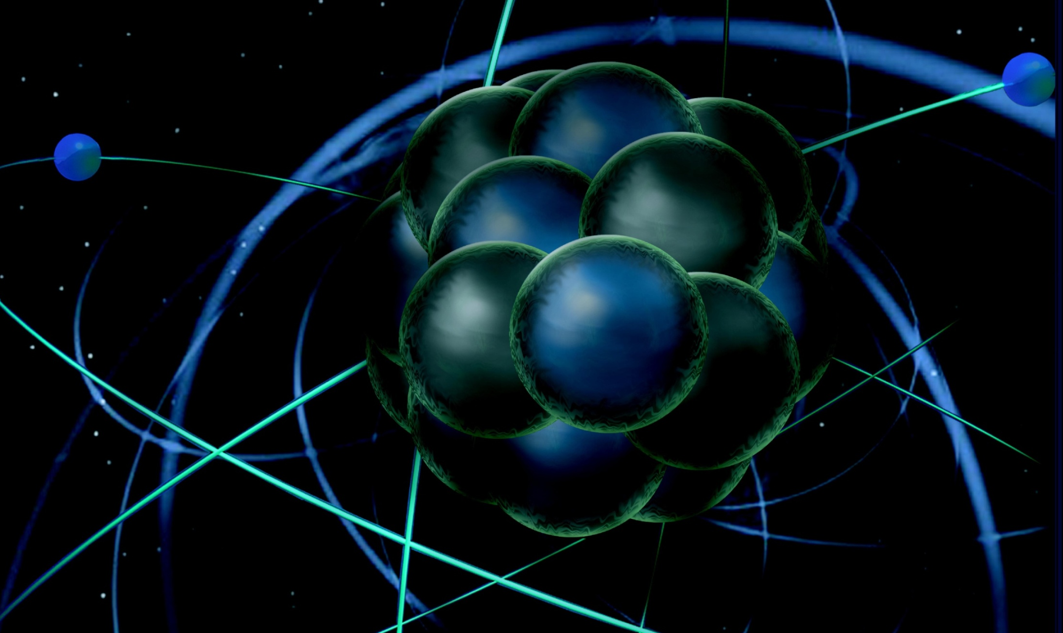
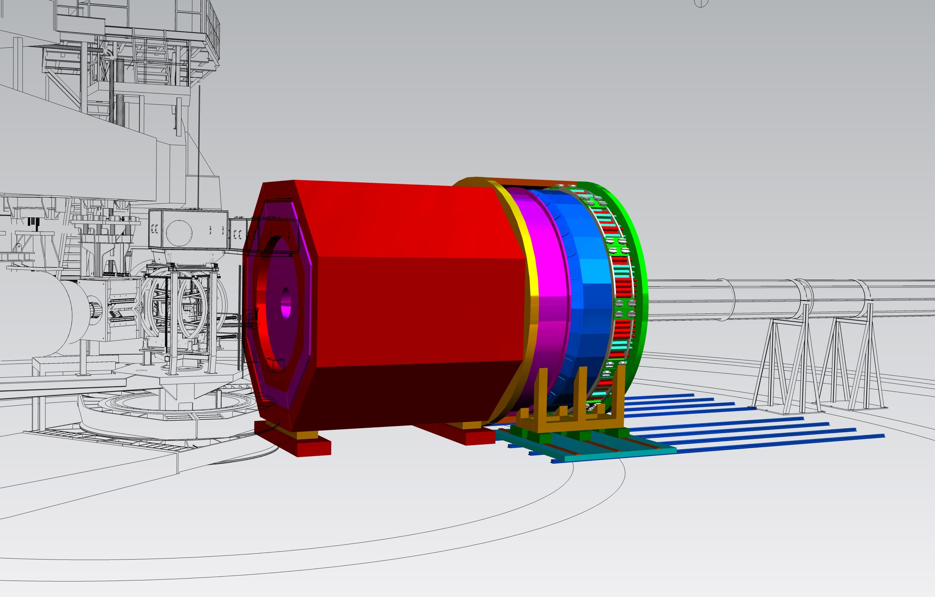
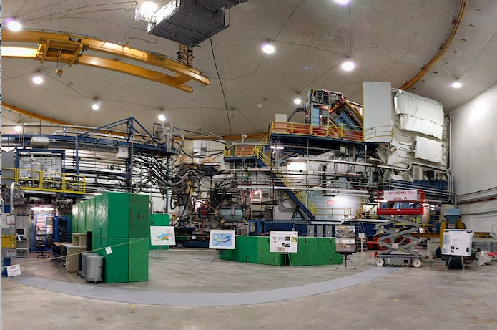
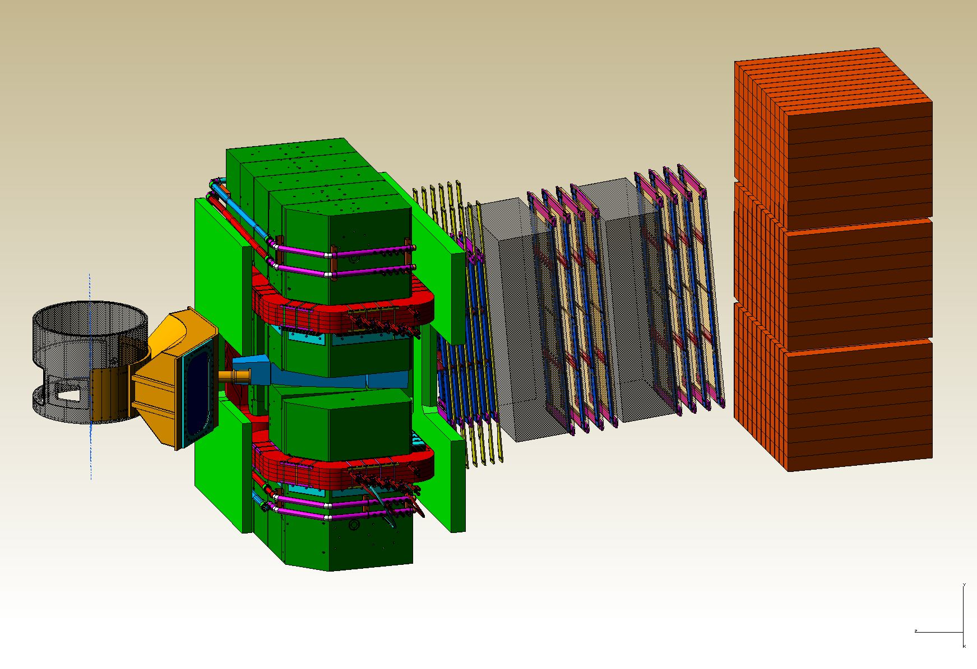
Hall A Update
Thia Keppel
PAC 45
July 2017

Slide 2
Hall A Projected Experiment Schedule from 1/2017 Experiments in red represent PAC42 “high impact” experiments
Spring | Fall | Spring | Fall | Spring | Fall
DVCS –I/ GMp | DVCS –I/ GMp
 |  | Ar(e,e’p) | ³H/³He group
 |  |  |  | ³H/³He group | TBD: APEX PREXII CREX A₁^{n} DVCSII
CY
2016
CY 2017
CY
2018
run period perhaps to be cancelled
schedule NOT final
SBS 2019?
MOLLER, SoLID →
2

Slide 3
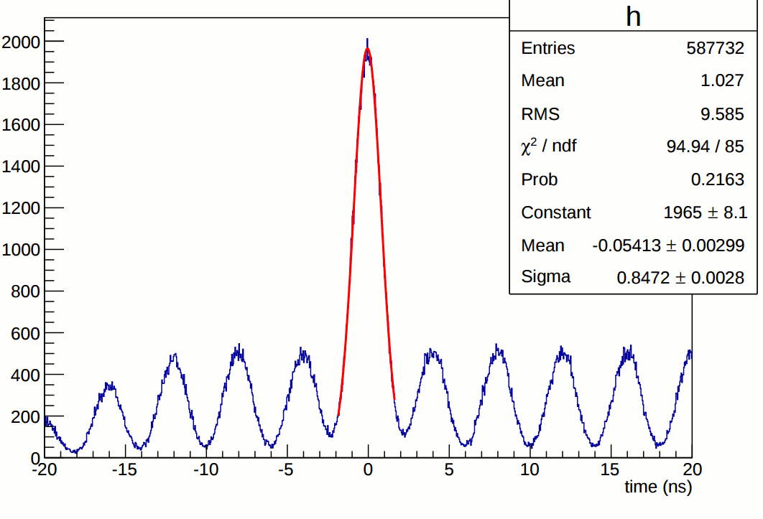
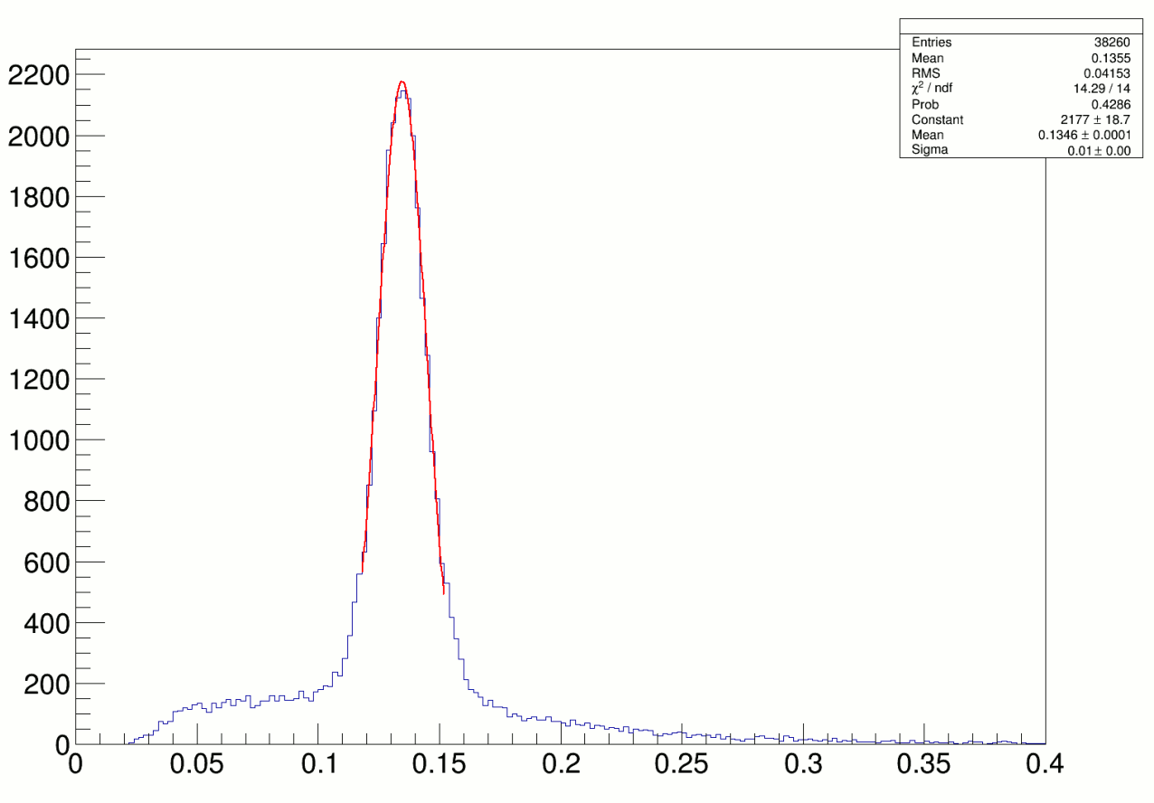
E12-06-114 DVCS Experiment
100 PAC days approved:
High impact experiment for nucleon 3D imaging program
High precision scaling tests of the DVCS cross section at constant x_{B}
CEBAF12 will allow first time exploration of the high x_{B} region
Excellent coincident time resolution:
250 MHz beam structure
Planned 50% of experiment completed in 2014-2016
π⁰ ’s reconstructed in DVCS calorimeter
Analysis path:
Jun’17: Report at JLab Summer Meeting.
Jan’18: Preliminary results on π⁰ at x_{B}=0.36
Apr’18: Preliminary results on DVCS
Jul’18 : Short paper submitted to PRL on π⁰
Jan’19: Letter to PRL on DVCS
Jul’19: Long paper to PRC (DVCS & pi0)
10 MeV
resolution
Notes:
Suggested rework
Add bullet on What we are doing
Rolf to find another plot

Slide 4
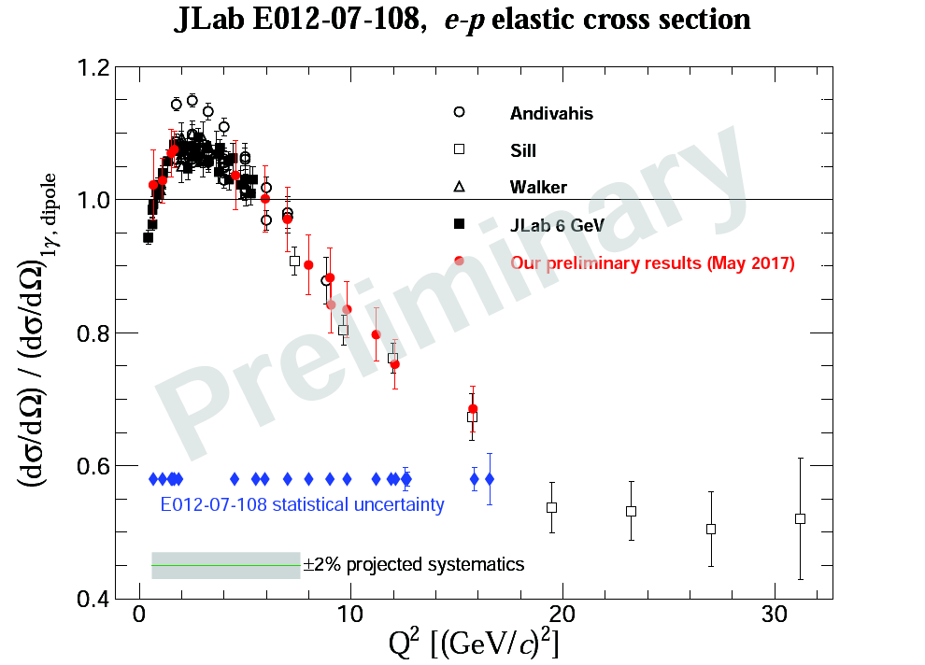
E012-07-108 Experiment
Precision Measurement of the Proton Elastic Cross-Section at High Q²
Precision e-p elastic cross-section is necessary to:
Determine GEp, GMp and TPE contributions at high Q², in combination with polarization measurements
Find absolute form factor values for 12-GeV era (SBS) JLab experiments
Preliminary cross-section results are presented below with 5% uncertainty (total)
Final results will be available by spring 2018 with better than 2% systematic uncertainty

Slide 5
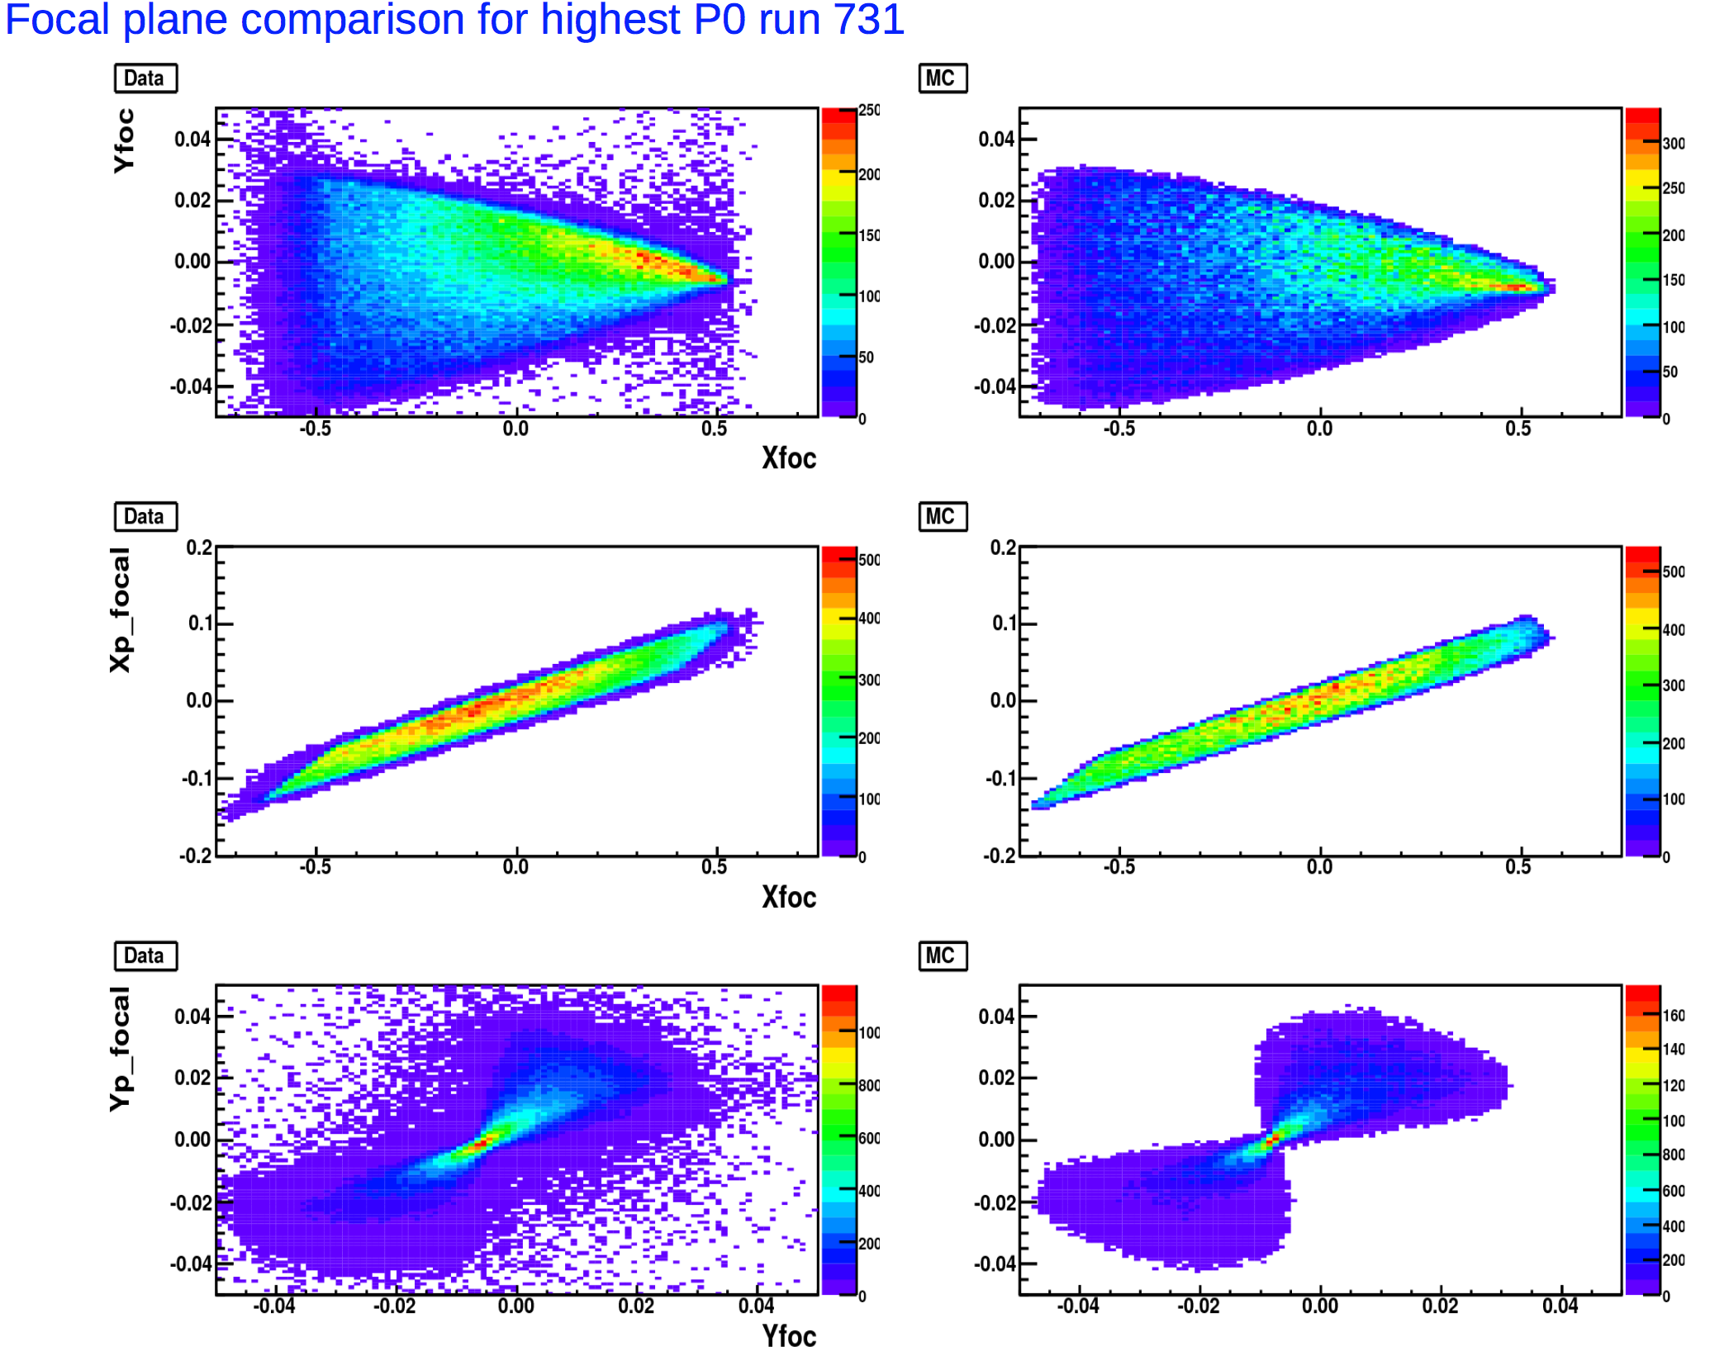
Jefferson Lab Experiment E12-14-012
A measurement of the Argon spectral function
Fundamental nuclear physics observable critical to new generations of neutrino experiments such as DUNE and MicroBooNE
Collaboration of 31 physicists, from 8 institutions, based in USA, Europe and Japan
Spokesman: O. Benhar (INFN), D. Day (UVA), D. Higinbotham (JLAB), C. Mariani (VT)
A multi-disciplinary effort that promotes a synergy between nuclear theorist, experimentalists and neutrino physicists.
Approved in July 2014
Scientific Grade A-
Data taking started in Feb. 2017
Data taking completed Mar. 2017
First publication expected Fall 2017
Data
Simulation

Slide 6
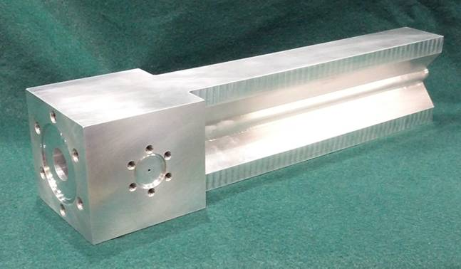
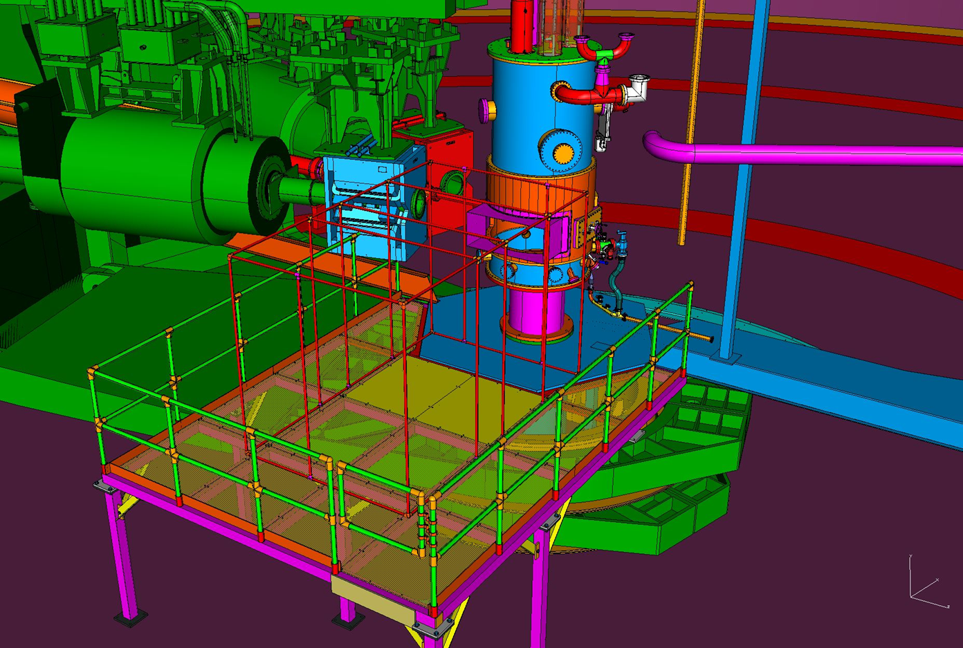
Tritium Experiment Group Preparations
Four experiments approved
2 PAC 40 “high impact”
Ar(e,e’p) a test run for target
Preparing now for Fall 2017 run
Graduate students, postdocs on site and ready
Installation currently underway
Target vent system
Target and safety systems
Scattering chamber rotation
Target installation platform
6

Slide 7
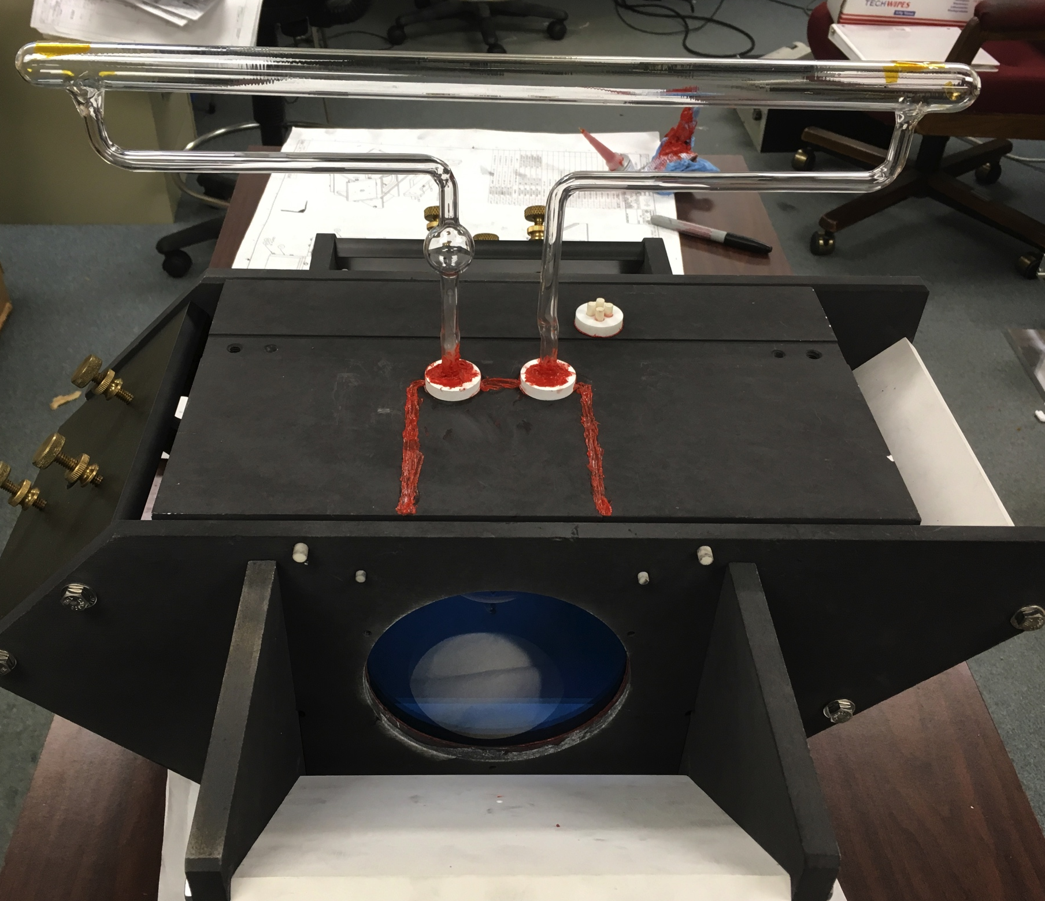
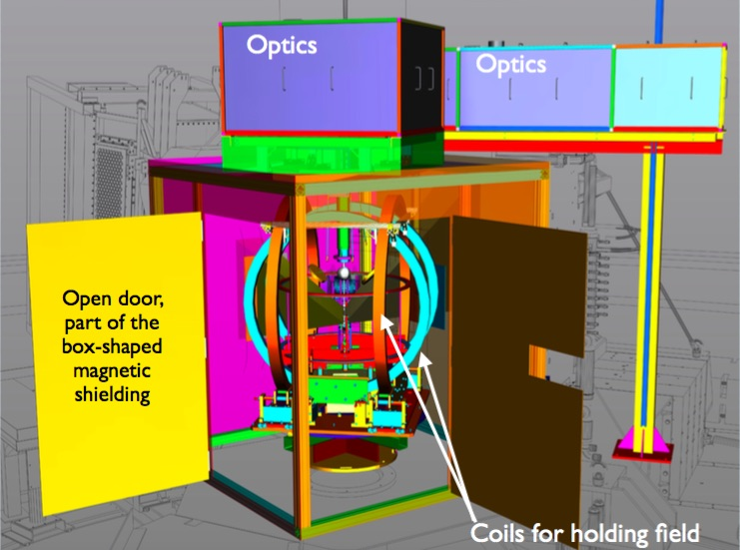
Beyond ³H
Polarized ³He target improvements and continued development
Two capital equipment projects
Phase I upgrade of existing target
Implementable in either Hall
Convection cell
Phase I could be installed with ~6 month notice
Phase II (SBS GEn type) design frozen as of Summer 2016
Convection cell
Dual pumping
60 cm
Metal end windows for high current
Phase II (SBS Gen type) ready by June 2019
7

Slide 8
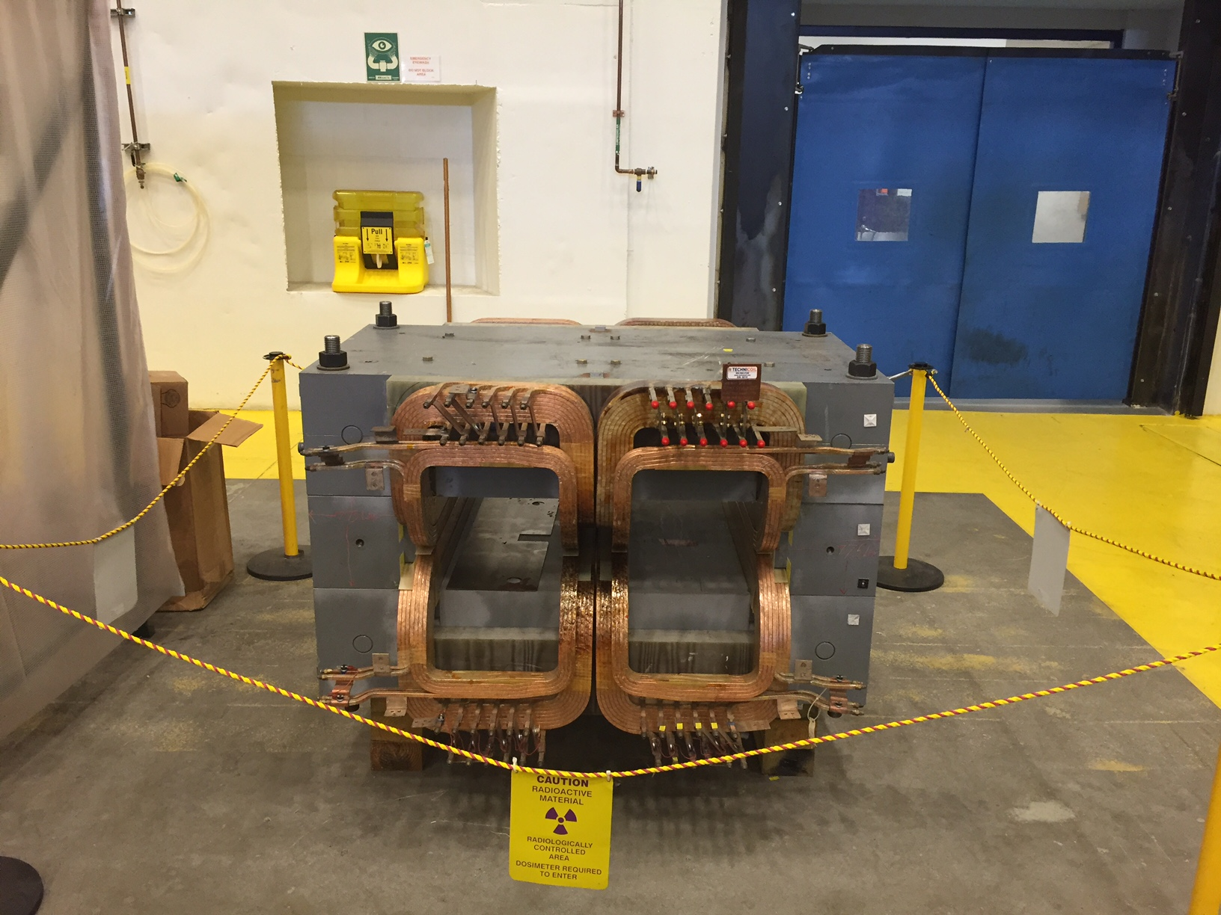
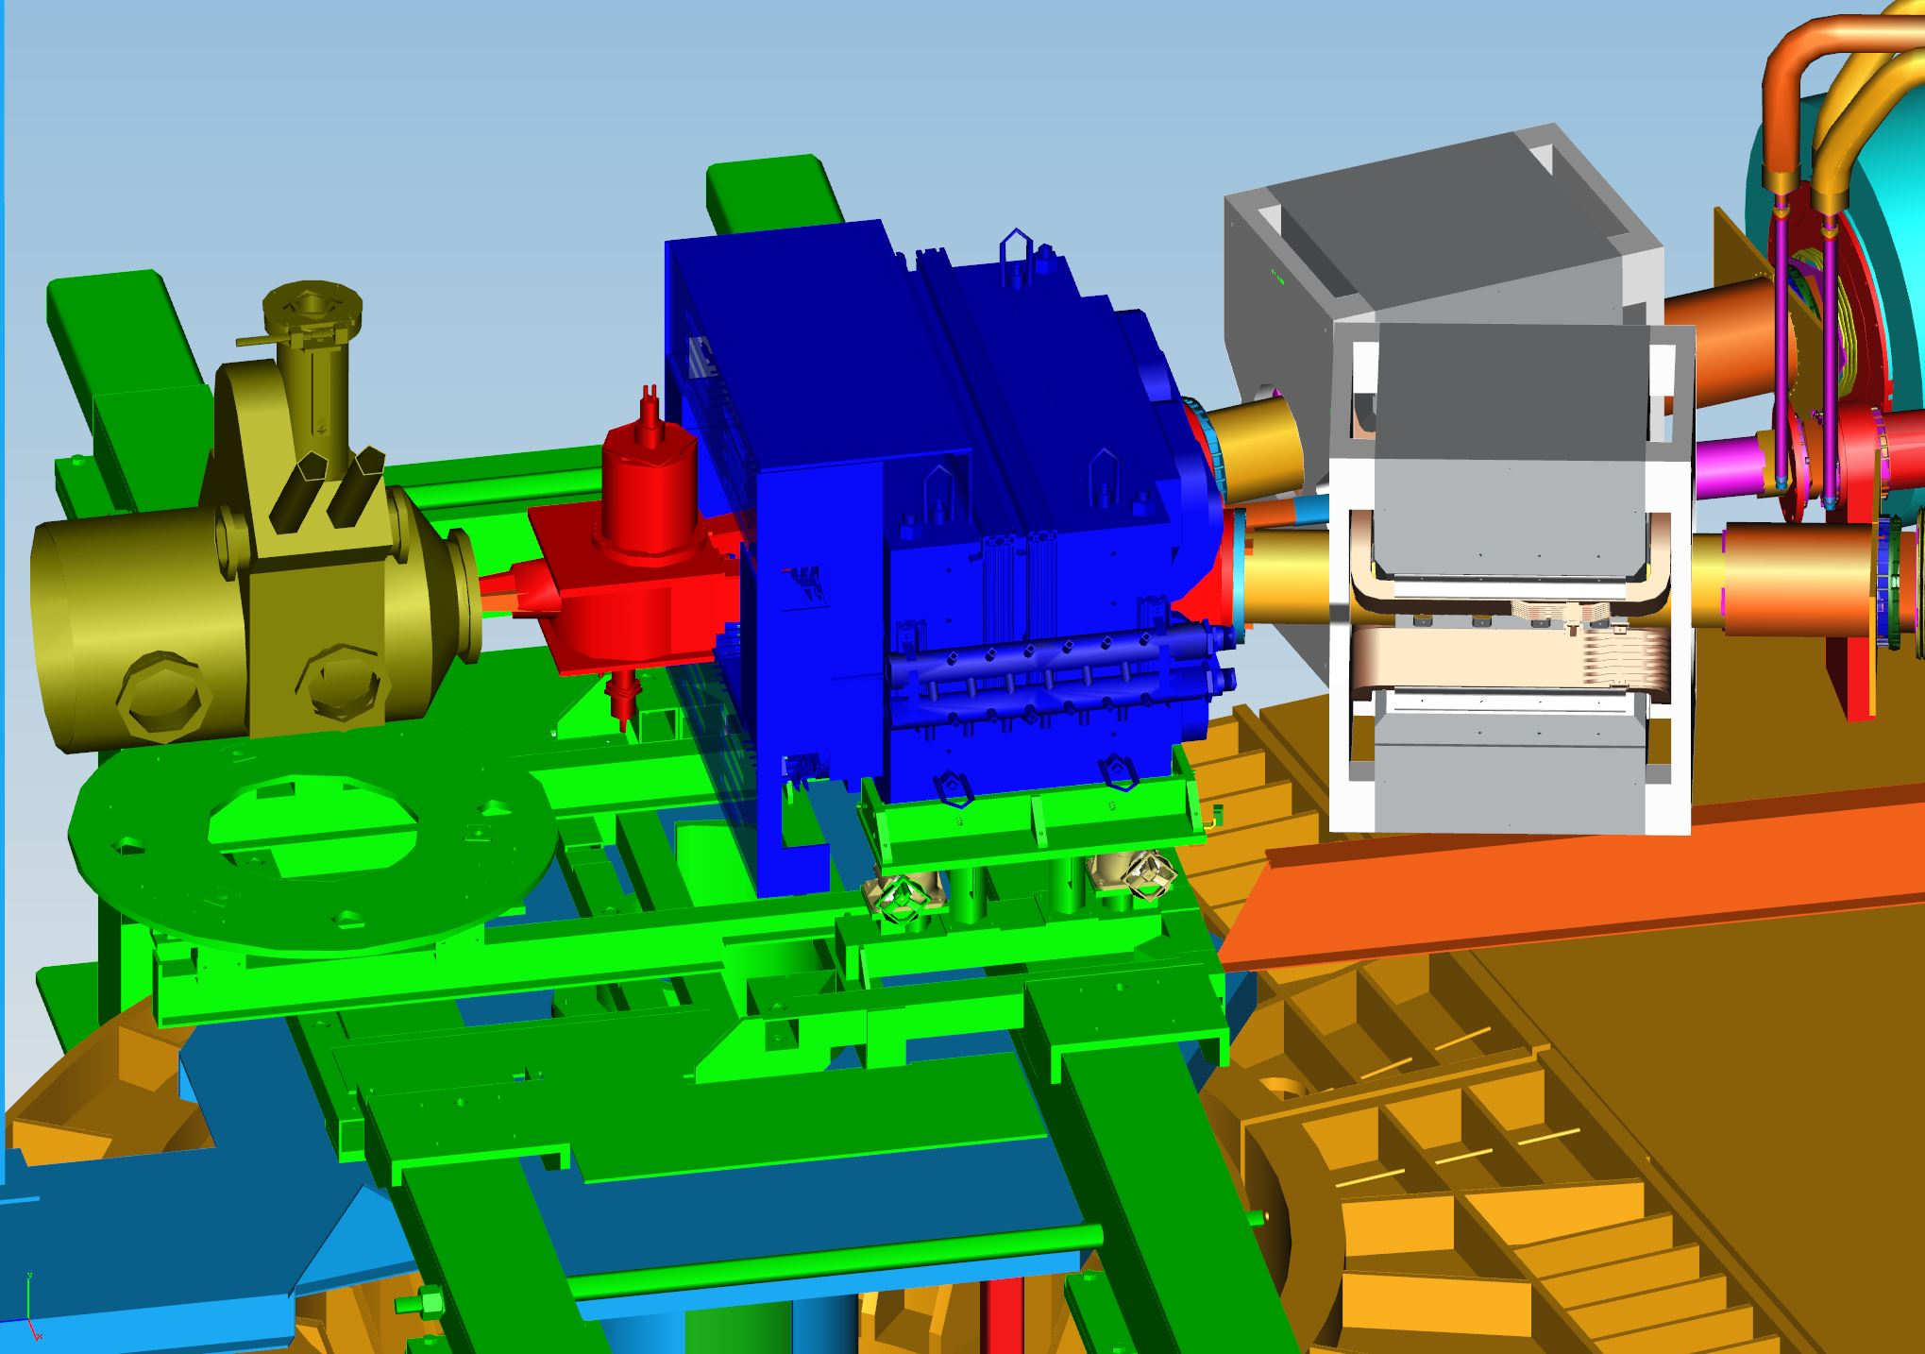
Beyond ³H
PREX2/CREX
Successful ERR May 2017
Combined target chamber, shielding design, new target position reduced current in septum
Computation fluid dynamics for target design
Parity beamline diagnostic tests during DVCS/GMp
Polarimetry – Moller now removed from Hall for Kerr effect measurements, new target ladder design and installation (Temple)
Regular parity quality beam meetings continue (led by R. Suleiman, accelerator)
Scattering Chamber
Resistive Q1 Magnets
Collimator
Septum
Septum Support
7

Slide 9
APEX
- The septum magnet is in the Hall, ready to install vacuum channels and field test.
- Last part of the vacuum system - the extension box - to ship this week
- Computation fluid dynamics for target design, target heating tests planned

Slide 10
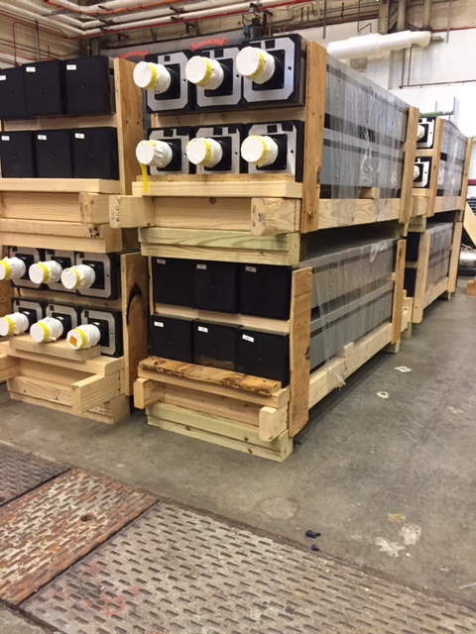
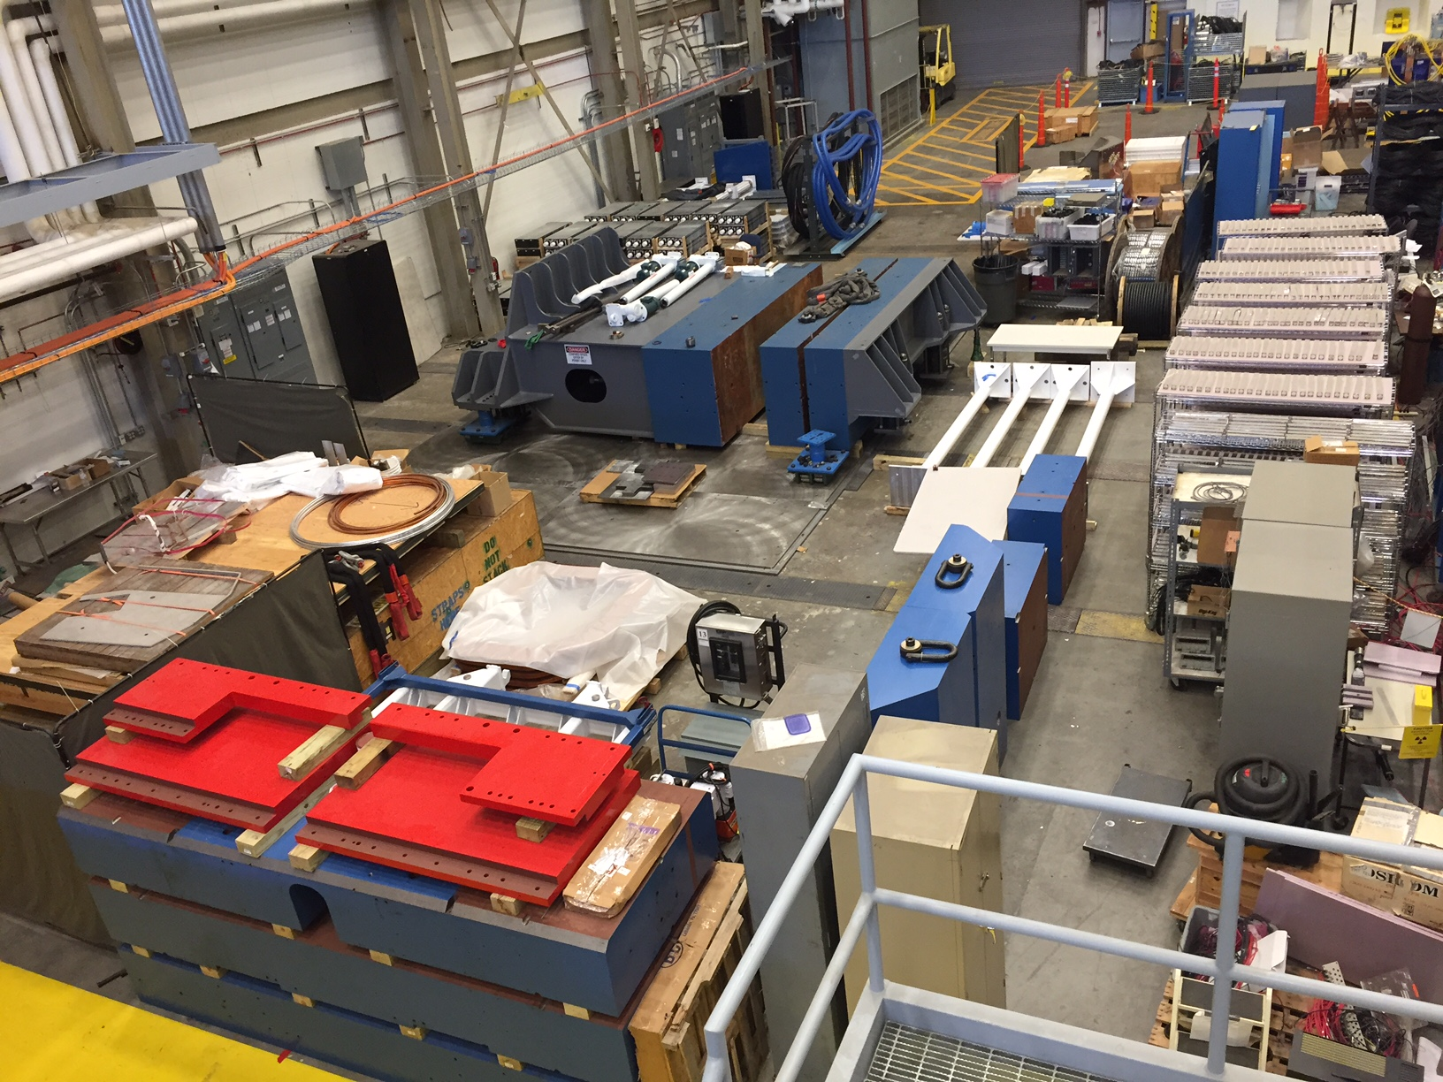
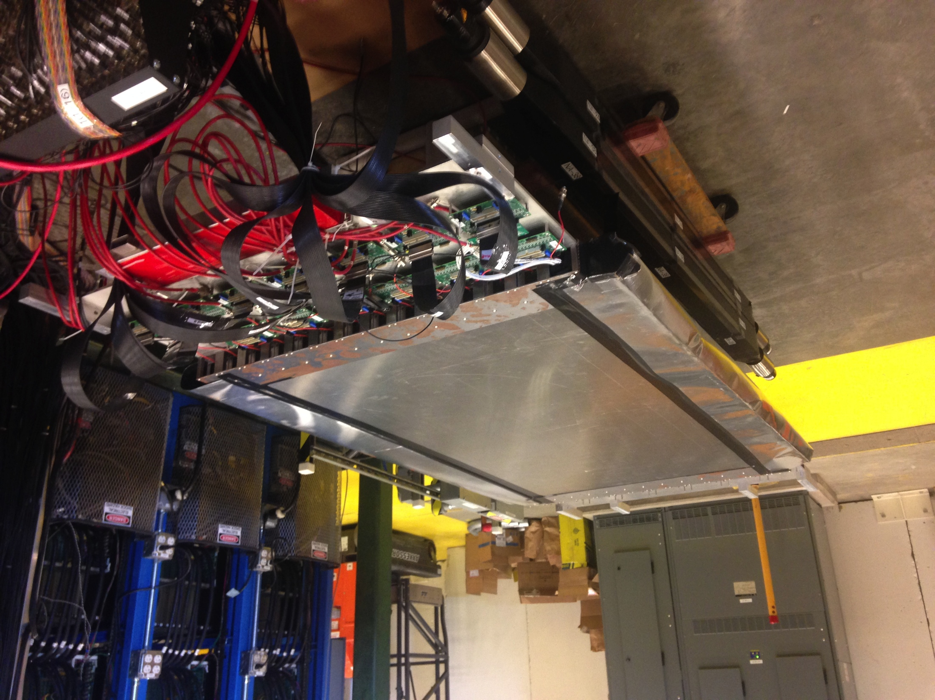
SBS
Successfully closed out on time, in budget June 2017!!
GMn ERR June 15-16, 2017
GEM construction at UVA, INFN and HCAL Hadron calorimeter from CMU now at/arriving at JLab
Coordinate detector from Idaho State, CNU on site at JLab
BigBite upgrades at JLab (Glasgow, William and Mary)
ECAL work at JLab, StonyBrook, NCCU
Just approved a new run group proposal, Measurement of Kaon Structure Function through Tagged Deep Inelastic Scattering (K. Park, T. Horn, R. Montgomery)
Hadron Calorimeter modules at JLab
CDET module constructed at JLab
SBS equipment in JLab test lab
8

Slide 11
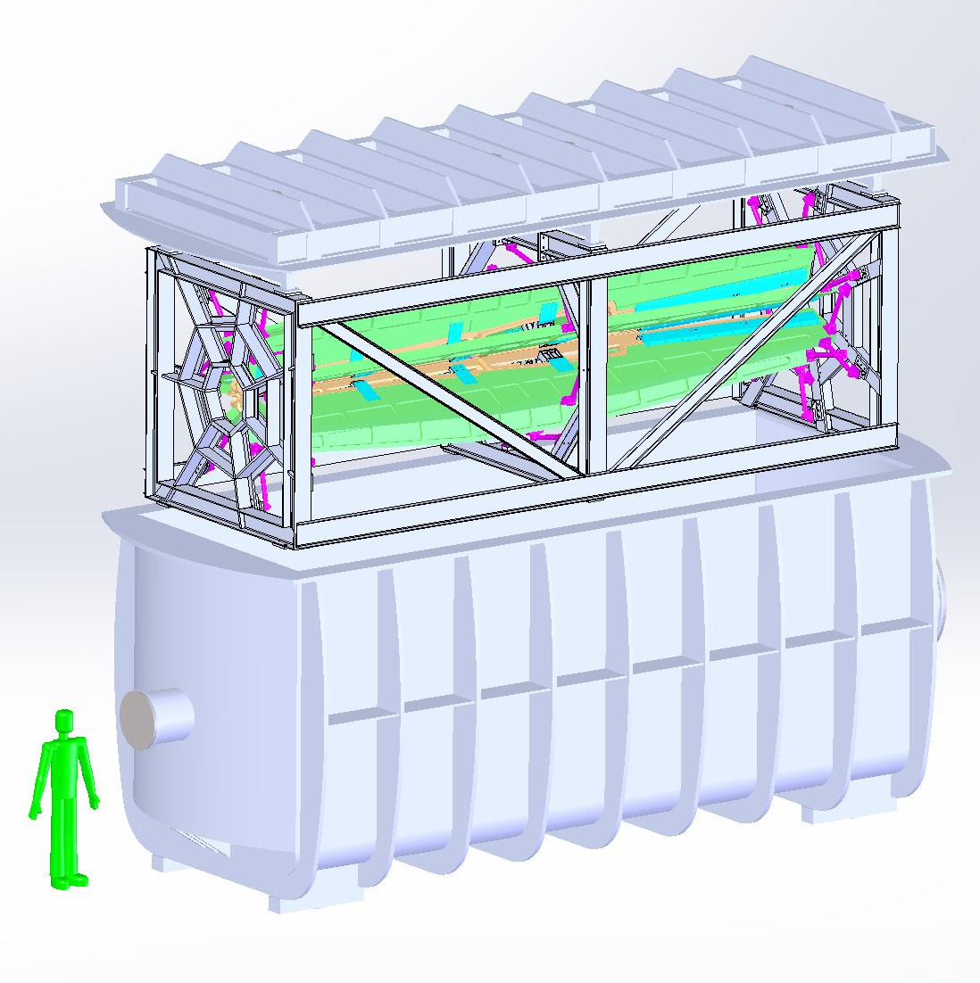
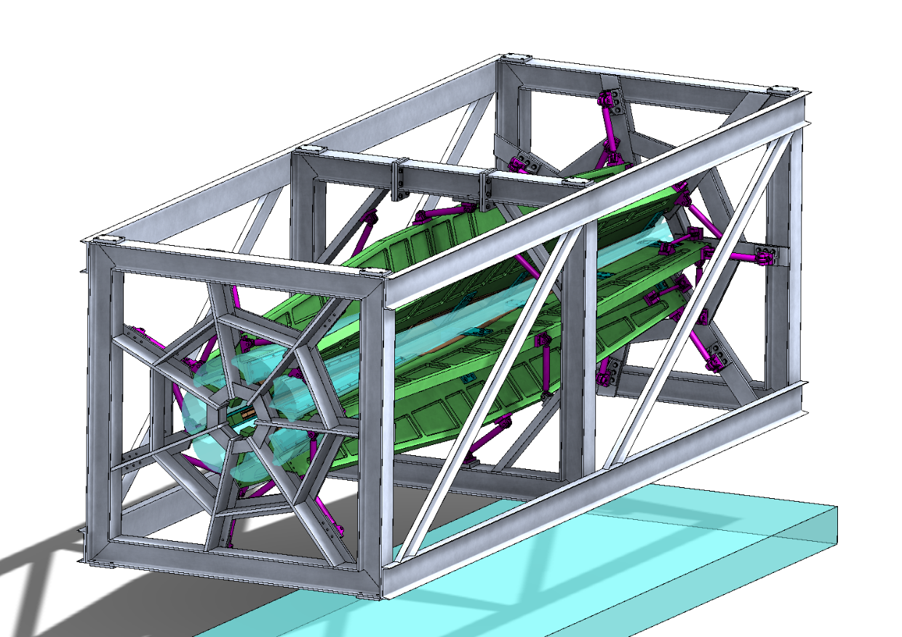
MOLLER
Successful Science Review September 2014
Director’s cost, schedule, technical review December 2016
CD0 January 2017, but project “paused”
Supporting ongoing magnet and collimator development work at MIT
Some polarimetry and parity beamline instrumentation was tested symbiotically to Hall A DVCS/GMp running
Detector pre-R&D at user institutions
9

Slide 12
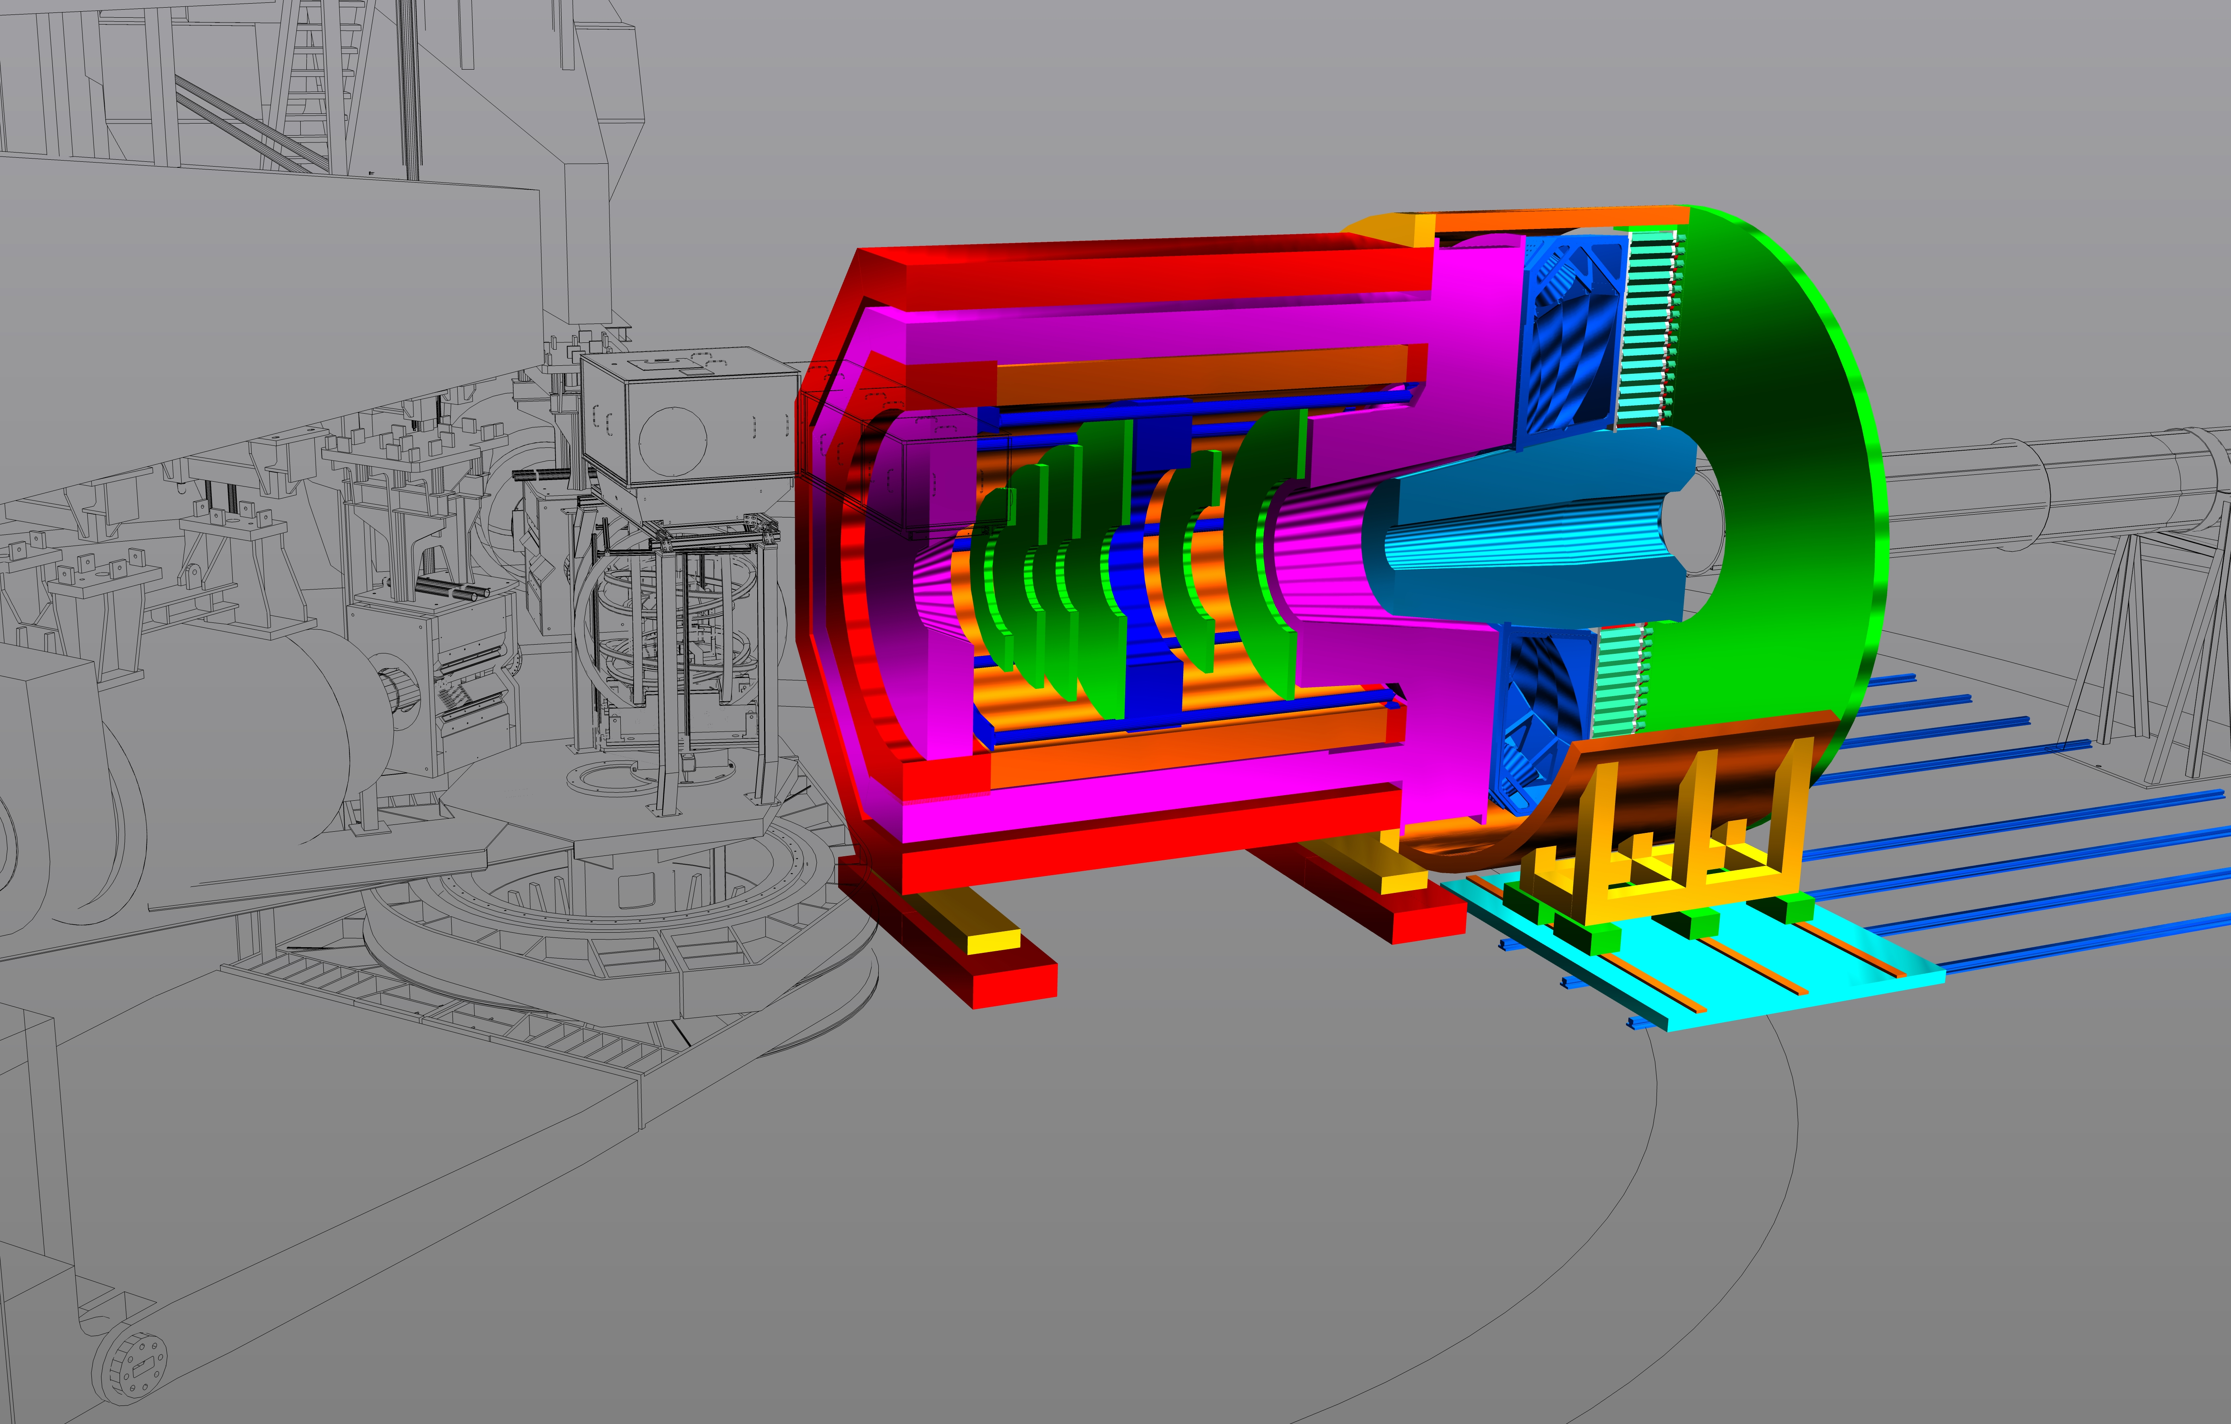
SoLID
Director’s Review Feb. 2015
Updated pCDR submitted to JLab Director’s Office May 2017
Currently under consideration
Science presentation to new Director May 2017
Looking towards Science Review late in CY 2017, CD0 in 2020
Continued optimization
Magnetic field analysis
Support structures
Data acquisition
Backgrounds and simulation
Detector pre-R&D
Just approved a new run group proposal, Transverse Target Single-Spin Asymmetry in Exclusive Pi- Production (G. Huber)
submitted a similar proposal last year
10

Slide 13
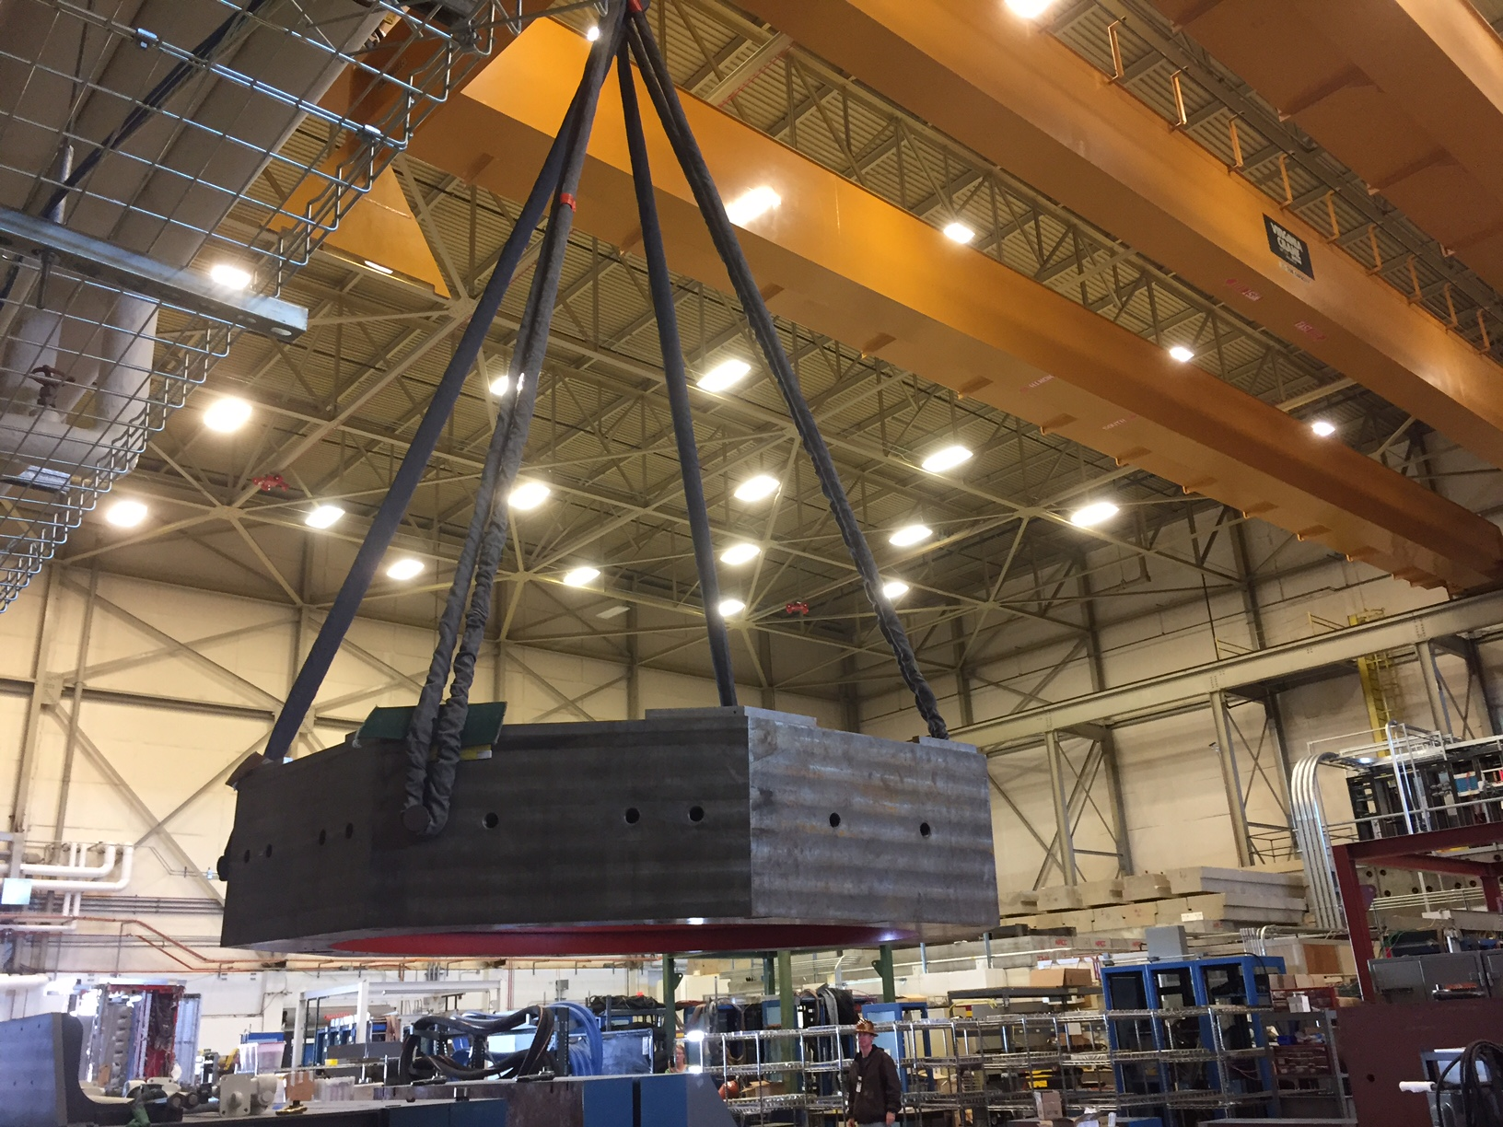
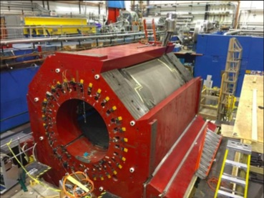
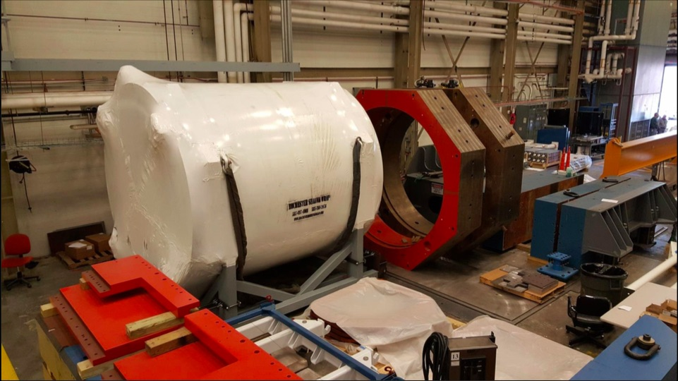
SoLID
The CLEO magnet has arrived at JLab!
Cryostat and coil collars in JLab test lab high bay
1,000 tons of steel removed
13

Slide 14
Hall A Publications in 2016, 2017
(Hall results only – more from other staff activities)
Rosenbluth separation of the p⁰ electroproduction cross section, M. Defurne et al., Phys. Rev. Lett. 117 (2016) no.26, 262001
Measurements of d2n and A1n: Probing the neutron spin structure, D. Flay et al., Phys. Rev. D 94 (2016) no.5, 052003
Electroexcitation of the D+(1232) at low momentum transfer, A. Bloomberg et al., Phys. Lett. B 760 (2016) 267-272
Proton radius from electron scattering data, D. Higinbotham et al., Phys. Rev. C 93 (2016) 5, 055207
Studies of relative gain and timing response of fine-mesh photomultiplier tubes in high magnetic fields, V. Sulkosky et al., Nucl. Instrum. Meth. A 827 (2016)
Beam Position Reconstruction for the g2p Experiment in Hall A at Jefferson Lab, Pengjia Zhu et al., Nucl. Instrum. Meth. A 808 (2016)
Rosenbluth Separation of the pi0 Electroproduction Cross Section off the Neutron, M. Mazouz et al., Phys. Rev. Lett. 118 (2017) no.22, 222002
First Measurement of Unpolarized SIDIS Cross Section and Cross Section Ratios from a 3He target, X. Yan et al., Phys.Rev. C95 (2017) no.3, 035209
Extraction of the Neutron Electric Form Factor from Measurements of Inclusive Double Spin Asymmetries, V. Sulkosky et al., arXiv:1704.06253, submitted for publication
A Glimpse of Gluons through Deeply Virtual Compton Scattering on the Proton, M. Defurne et al., arXiv:1703.09442, submitted for publication
JLab Measurements of the 3He Form Factors at Large Momentum Transfers, A. Camsonne et al., arXiv:1610.07456, submitted for publication

Slide 15
Other information of note:
New Hall A/C Staff Scientist Simona Malace started June 2017
New Hall A Postdoctoral Fellow, Marco Carmignotto, to start this month
Summary
First JLab 11 GeV science programs (DVCS/GMp) complete!
Ar(e,e’p) experiment also completed!
Dynamic science program planned moving forward
Ready for tritium run group in Fall
Supporting extensive and diverse activities requisite to 11 GeV era science program

