Slide 1



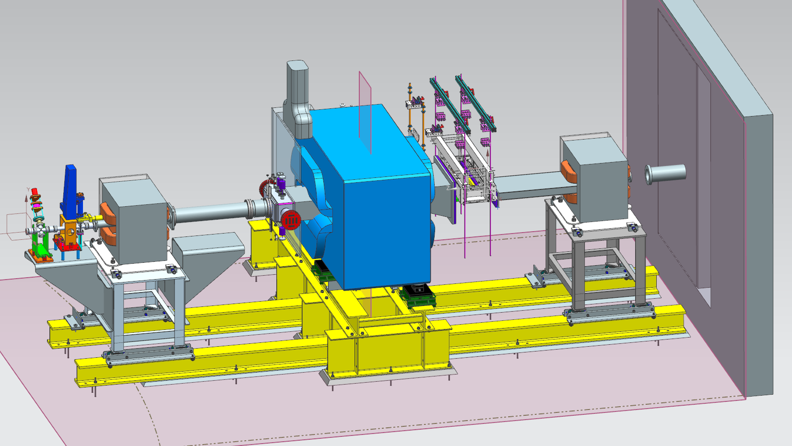
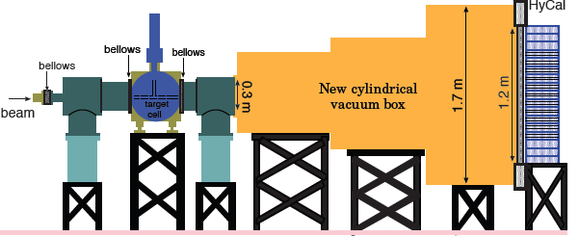
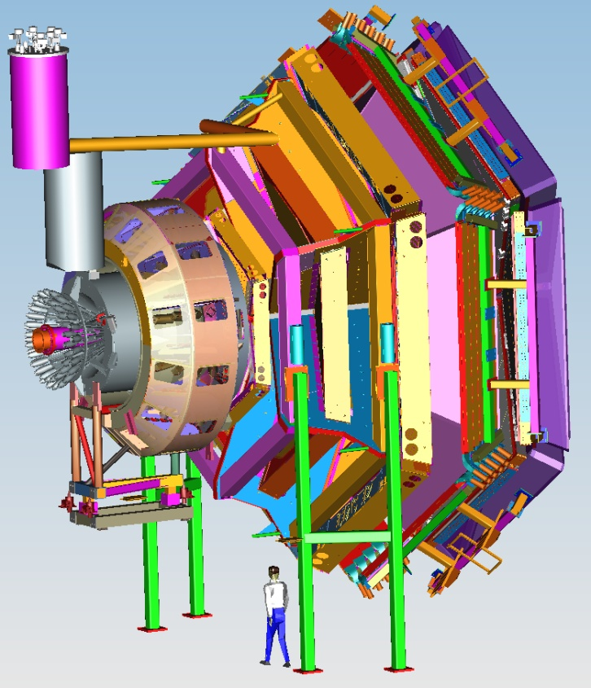


Status of Hall B
Volker D. Burkert
CLAS12
CLAS12 equipment
Physics highlights
HPS & PRad update
Proposals & RG-A
Summary
PAC45 Meeting
July 10, 2017

Slide 2

Equipment
CLAS12
Hall B
Forward Detector (FD)
TORUS magnet
HT Cherenkov Counter
Drift chamber system
LT Cherenkov Counter
Forward ToF System
Pre-shower calorimeter
E.M. calorimeter
Forward Tagger
RICH detector
Central Detector (CD)
Solenoid magnet
Silicon Vertex Tracker
Central Time-of-Flight
Central Neutron Detector
  - MicroMegas
Beamline
Photon Tagger
Shielding
Targets
Polarimeter
MM
CND
FT
Number of readout channels : 111, 832
RICH
https://www.jlab.org/Hall-B/clas12-web/

Slide 3
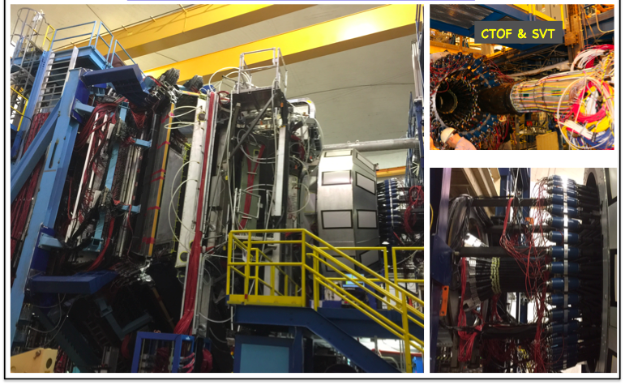
CLAS12
KPP-Equipment
Hall B
CLAS12
02/03/2017

Slide 4

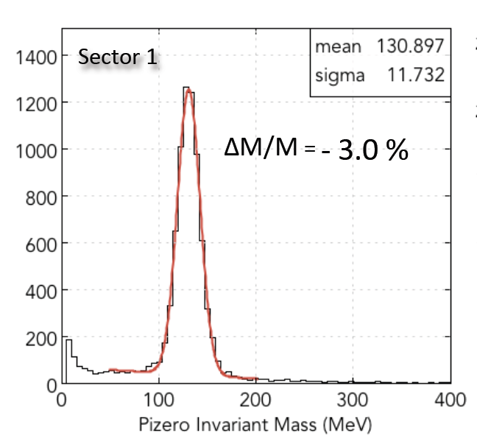
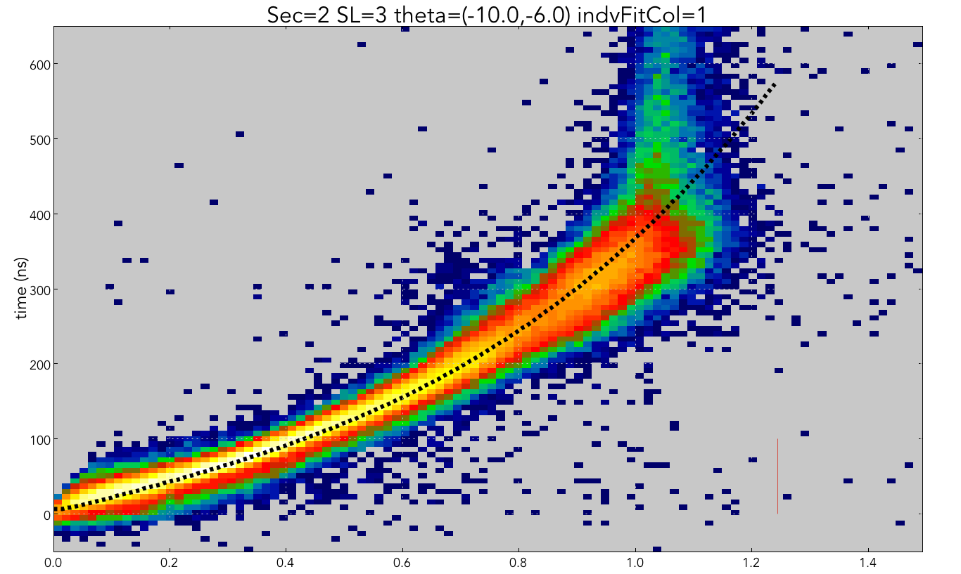
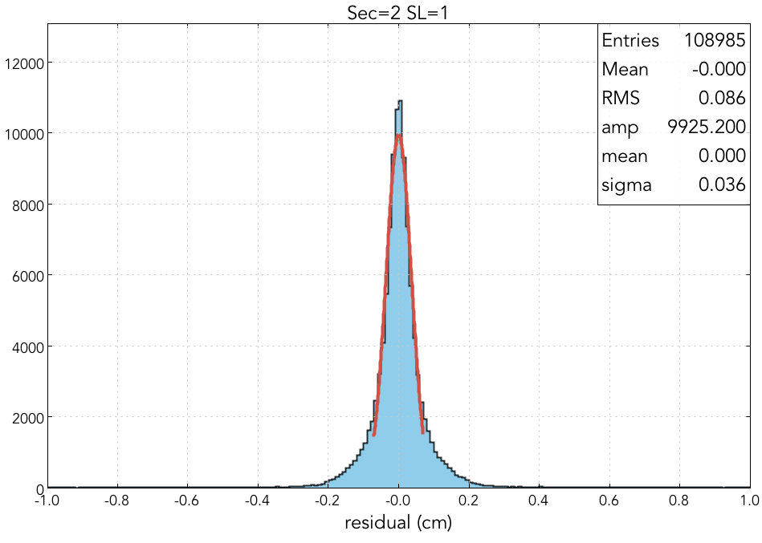
Calibration with KPP Data
CLAS12
DC calibration
Superlayer 1
σ = 360μm
ECAL calibration
Distance (cm)
KPP Run 2/3-2/6 – DOE approval 2/7
FTOF calibration:
Beta vs. p and mass distribution

Slide 5
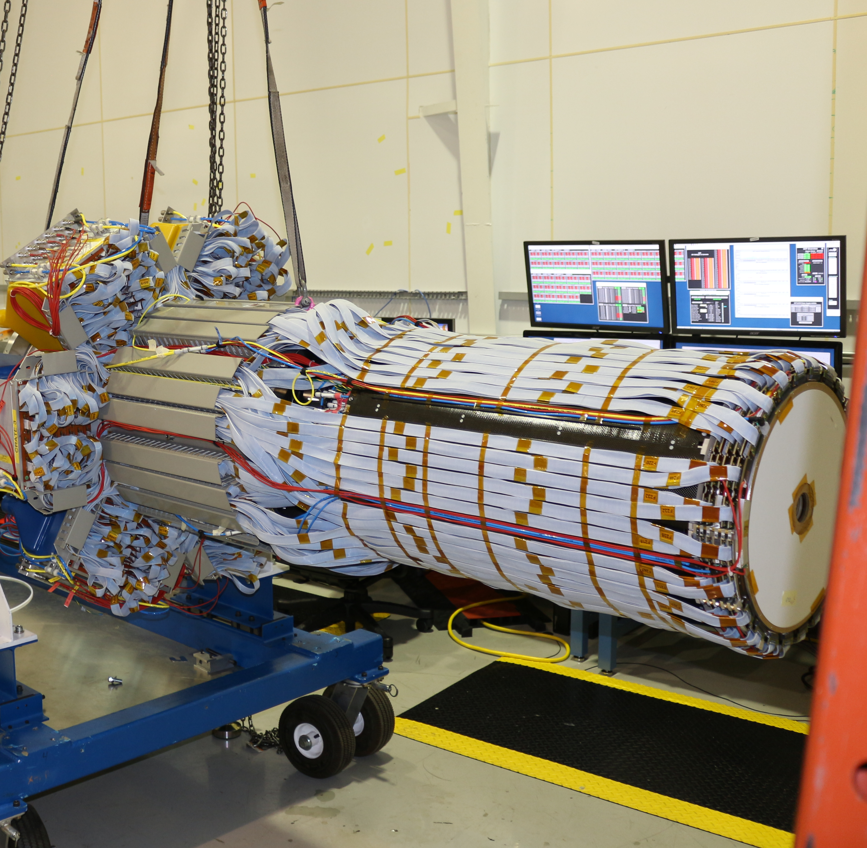
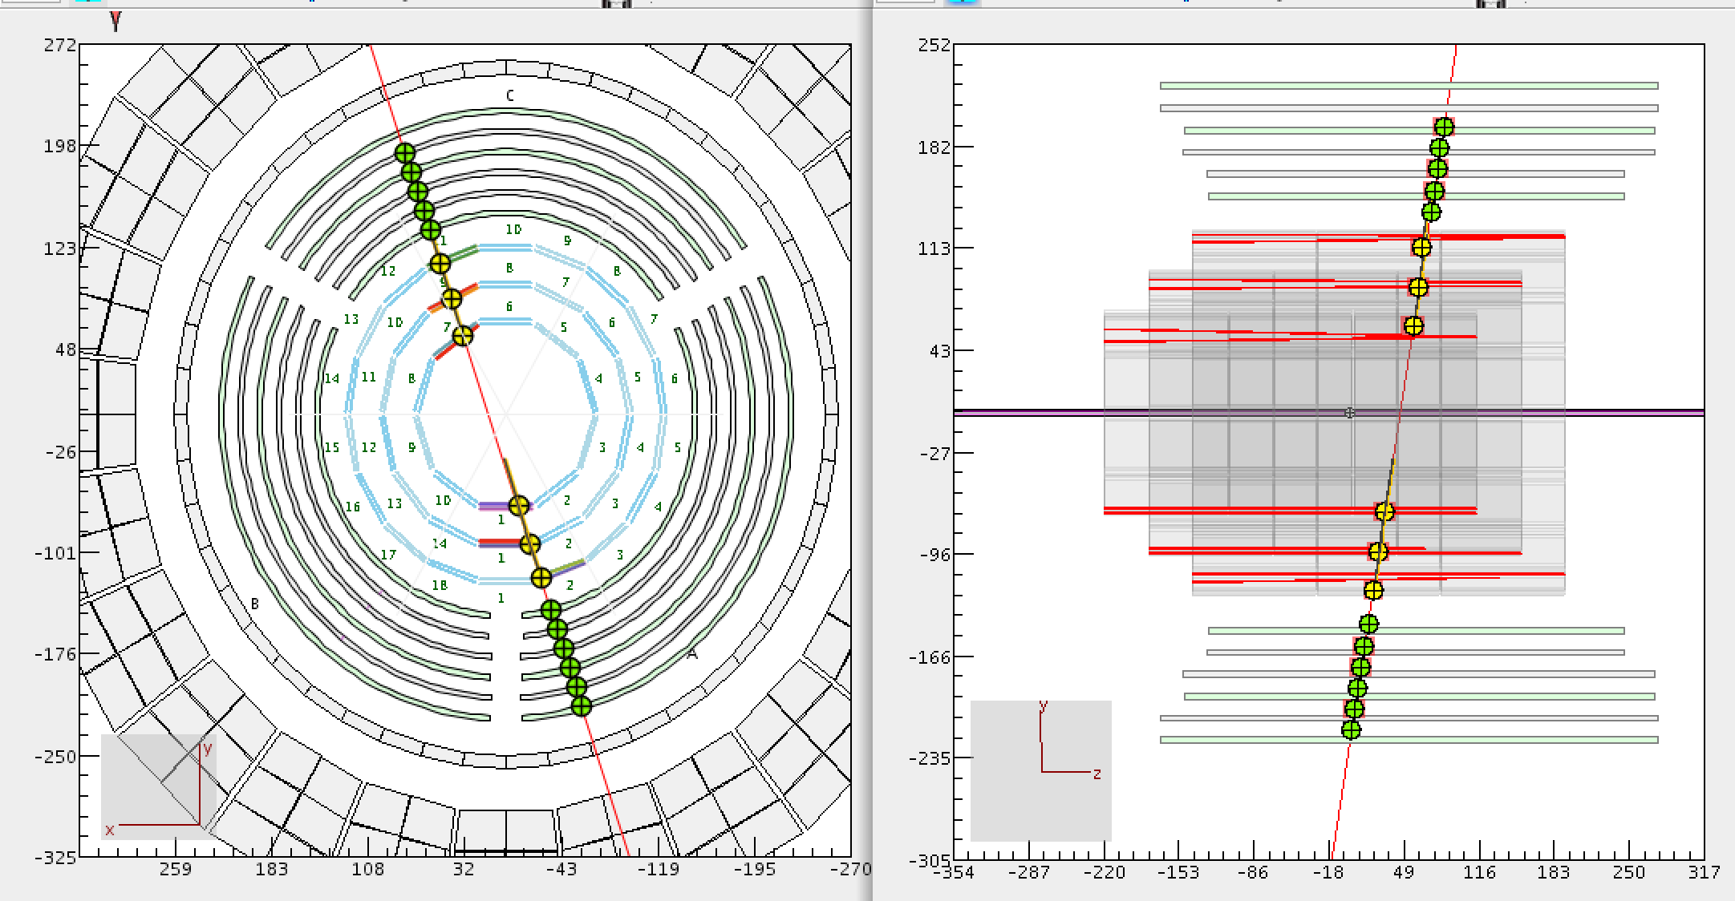
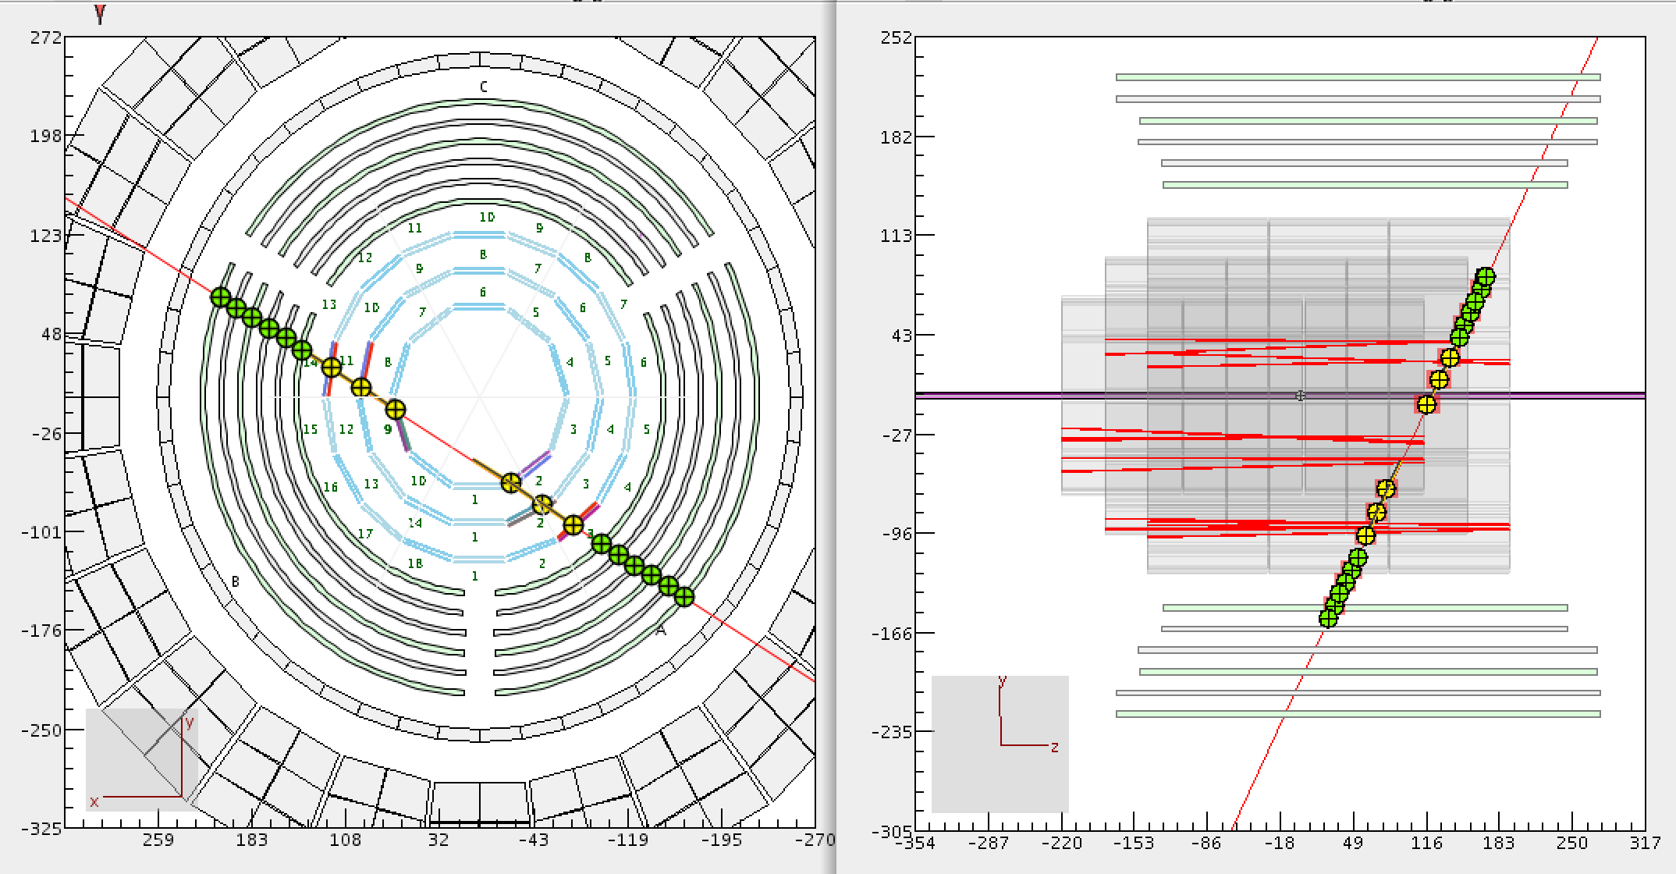
CLAS12
Central Vertex Tracker
Hall B
Silicon-VT + Barrel-MT + Forward-MT
Cosmic ray tracks in CVT
SVT (6 layers BMT (6 layers)
FMT (6 layers)

Slide 6
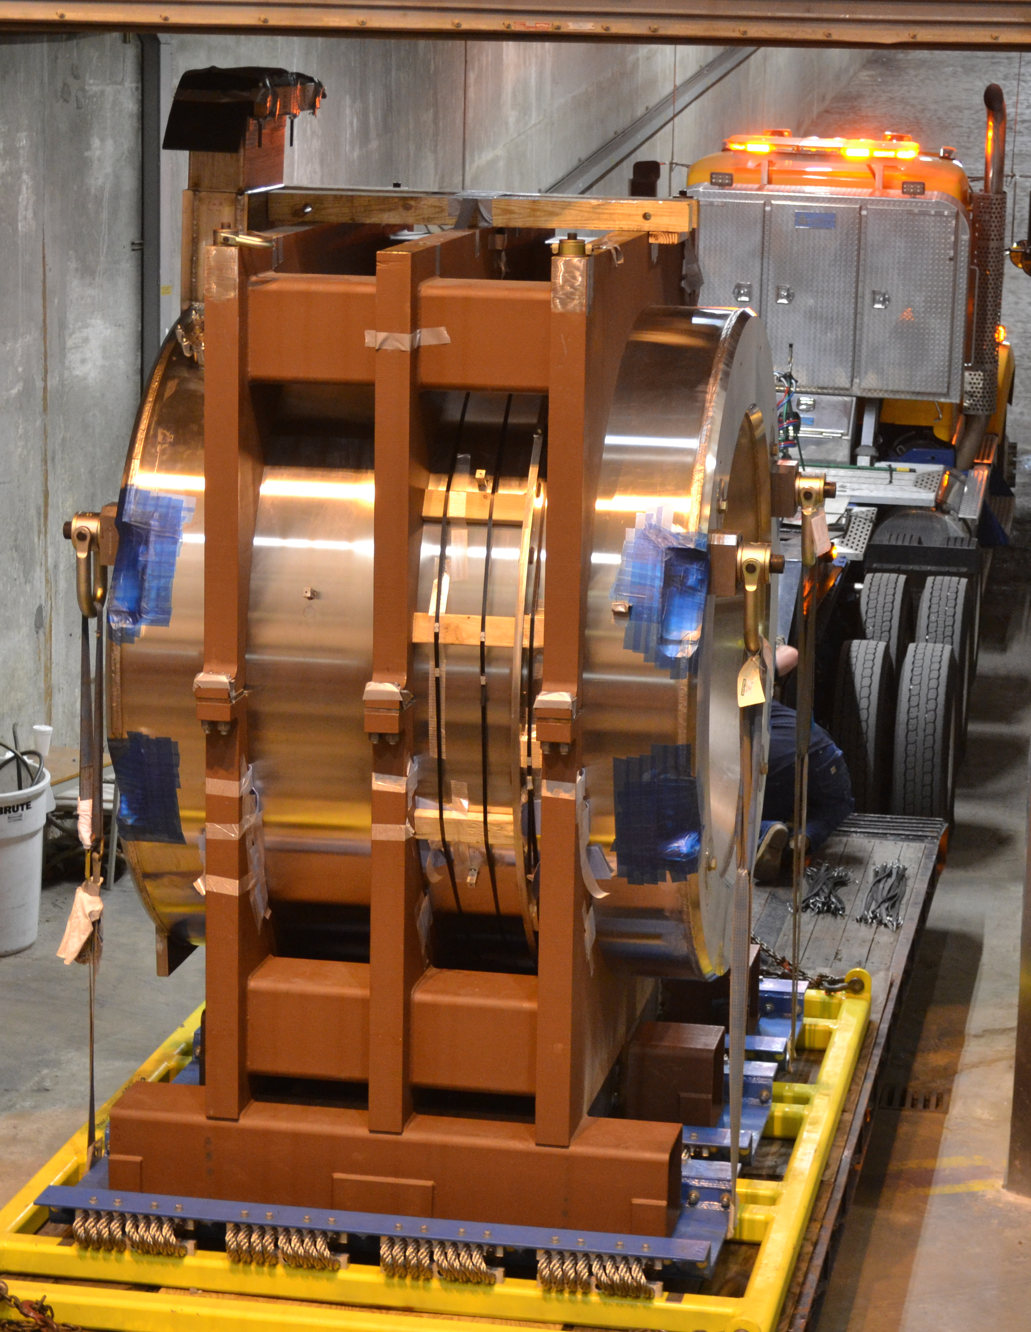
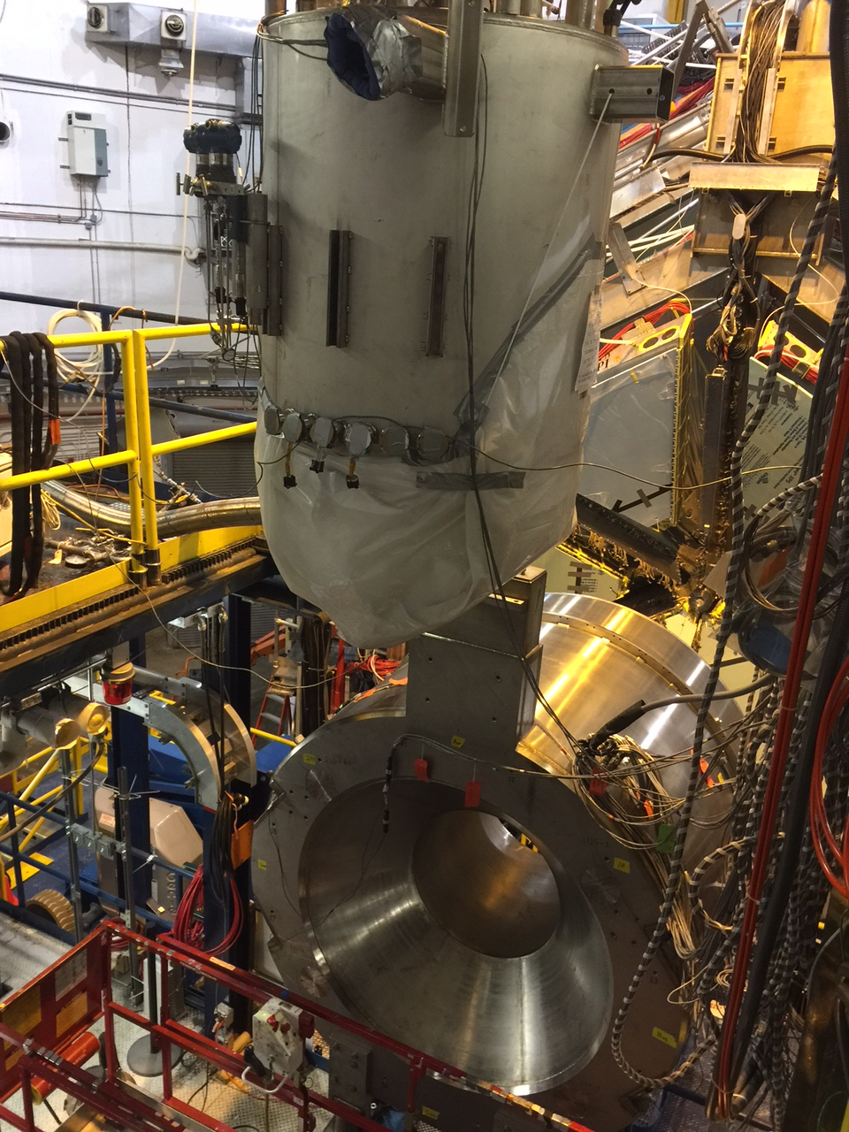
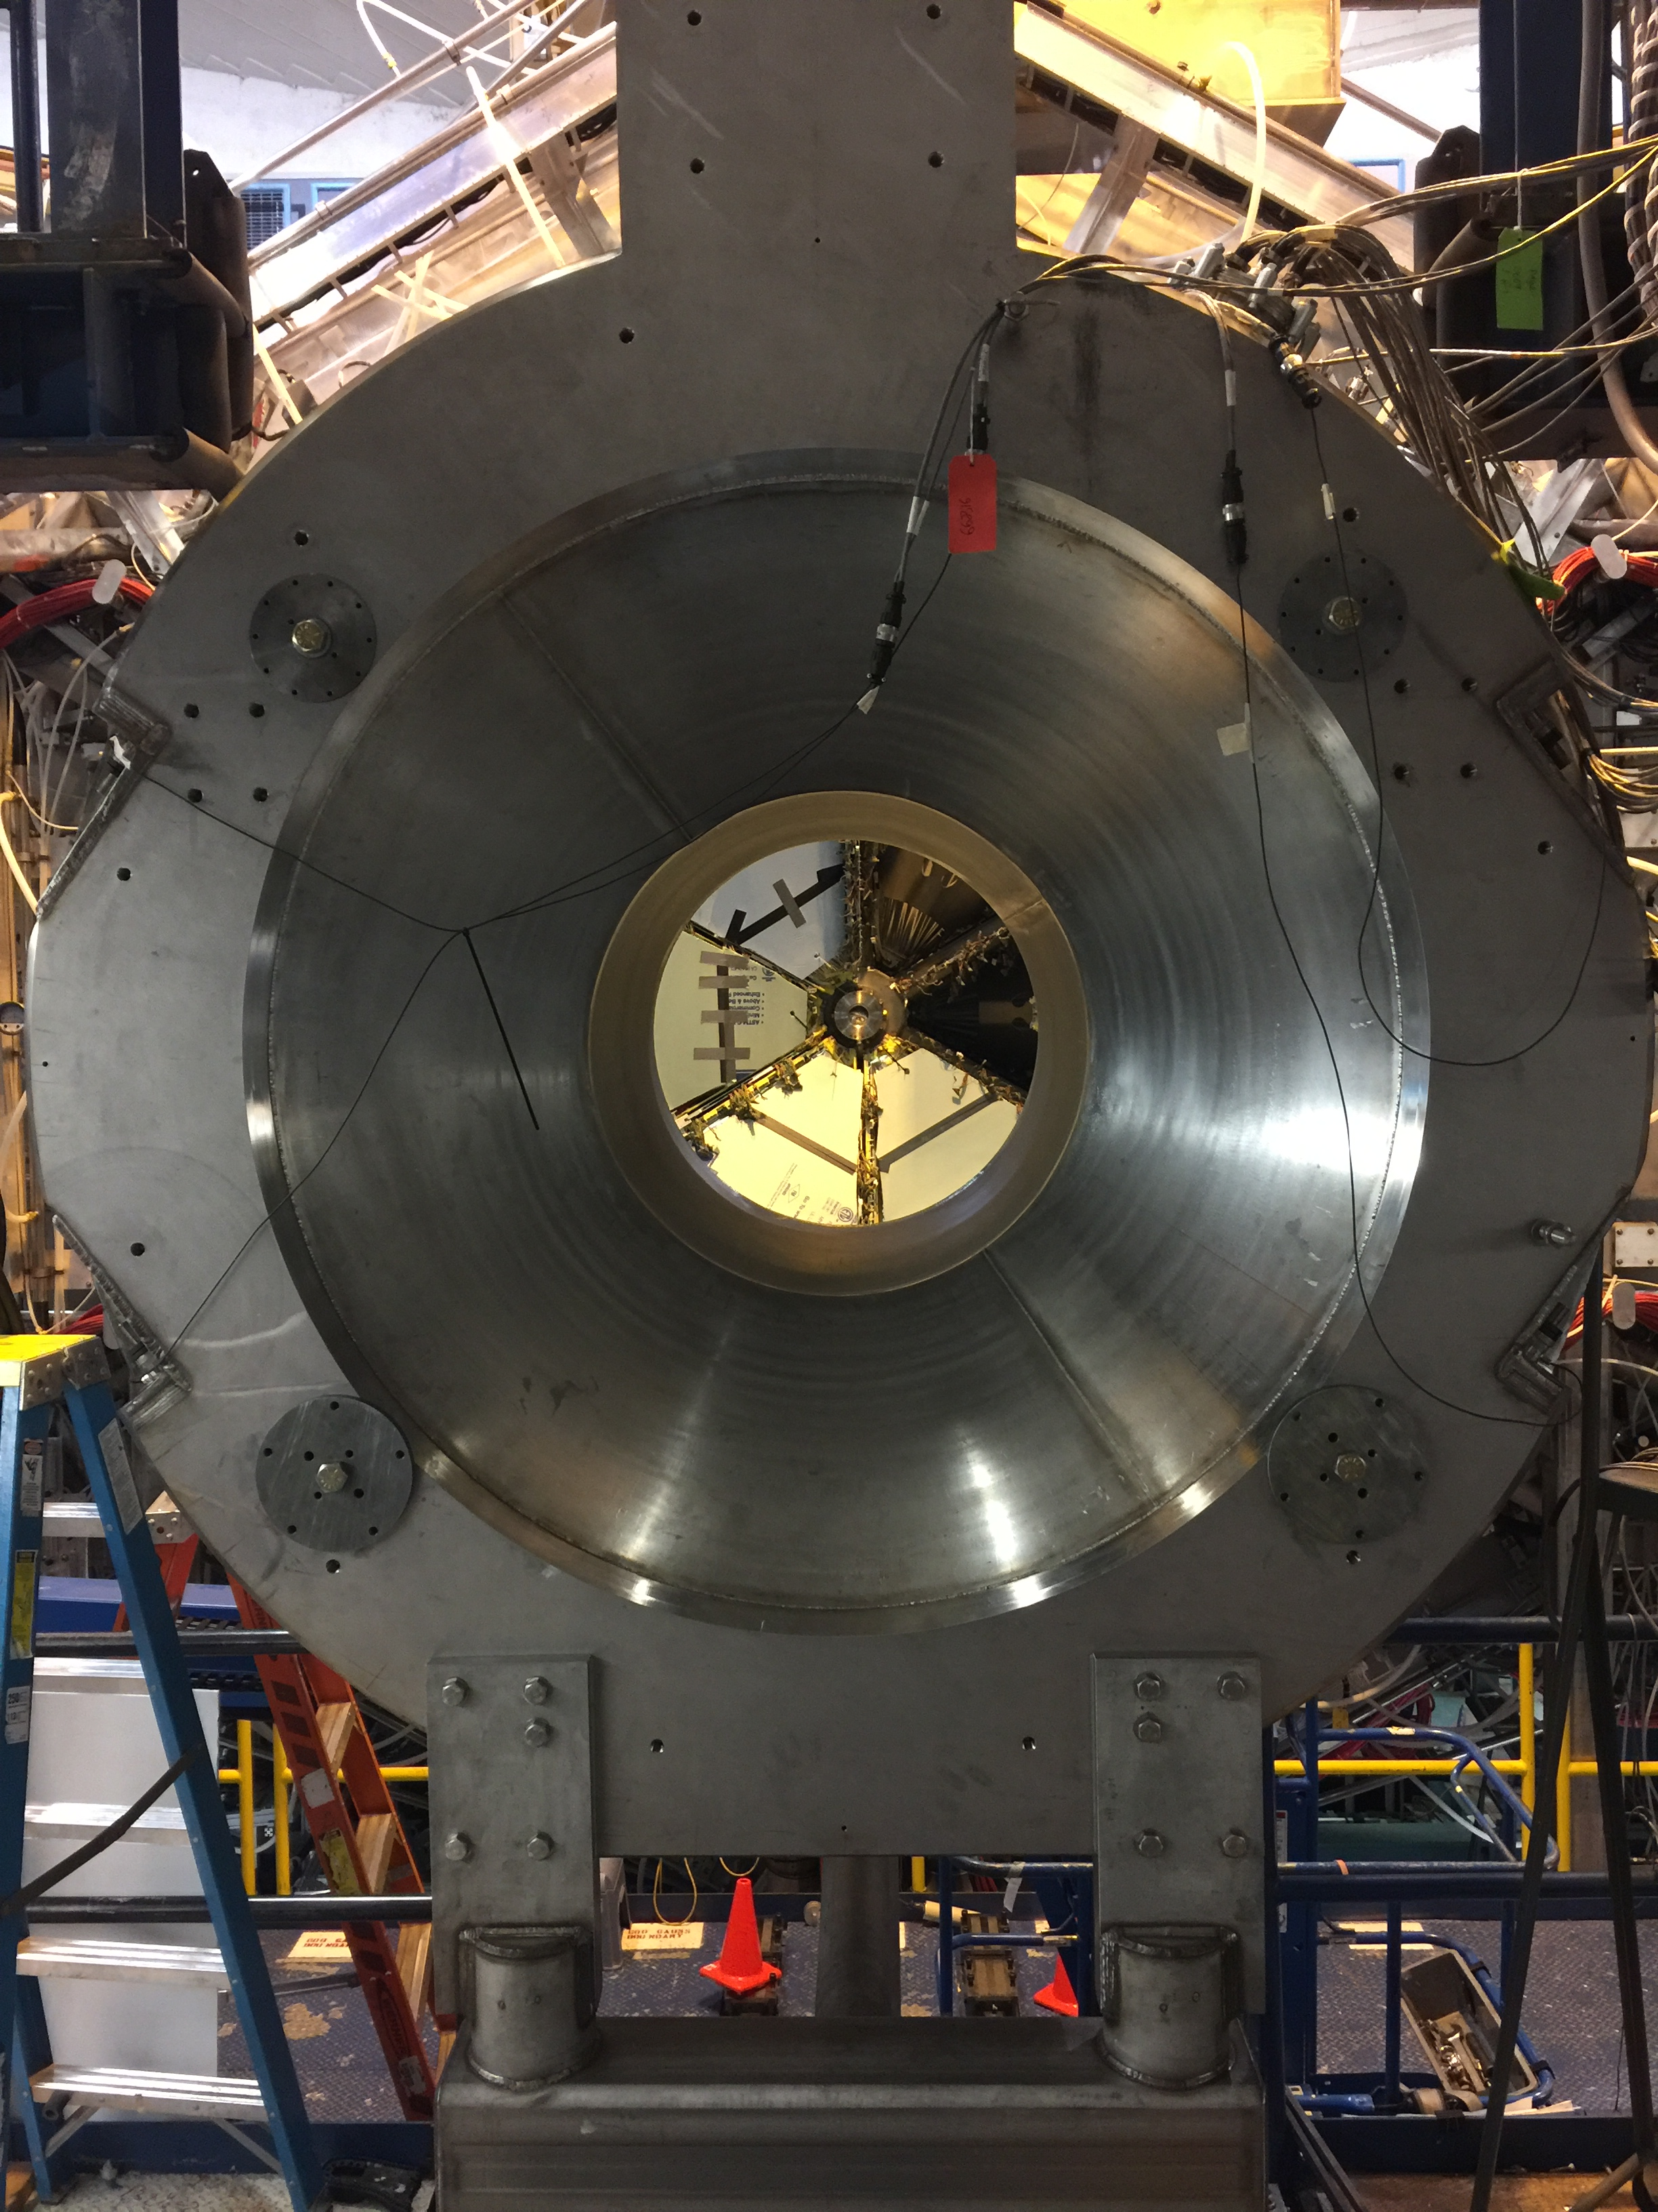
5T Solenoid Magnet
CLAS12
Hall B
6/27/2017
6/28/2017
7/6/2017

Slide 7
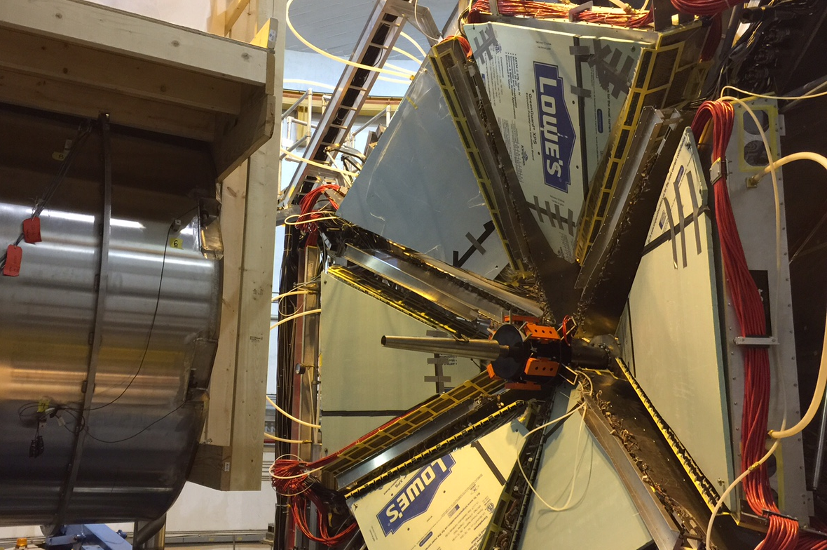
Solenoid & Forward Tagger
CLAS12
Møller Shield
Solenoid
7/7/2017
Forward Tagger

Slide 8
Hall B -
Physics Publications in refereed Journals
 | Spectroscopy | Deep Inel. Scatt. | Nuclear Physics | ALL
2000 | - | 1 | 1 | 2
2001 | 2 | 3 | - | 5
2002 | 3 | - | 1 | 4
2003 | 7 | 4 | 1 | 12
2004 | 3 | 3 | 4 | 10
2005 | 7 | 3 | 2 | 12
2006 | 8 | 4 | 3 | 15
2007 | 7 | 2 | 3 | 12
2008 | 4 | 6 | 2 | 12
2009 | 8 | 7 | 4 | 19
2010 | 4 | 2 | 4 | 10
2011 | 3 | 1 | 4 | 8
2012 | 6 | 3 | 2 | 11
2013 | 8 | 6 | 2 | 16
2014 | 5 | 6 | 1 | 12
2015 | 4 | 5 | 3 | 12
2016 | 7 | - | - | 7
2017 | 5+2 | 6+2 |  | 11+4
SUM | 91 +2 | 62 +2 | 37 | 190+4
5
10
15
publ
subm.
updated
9 July2017

Slide 9
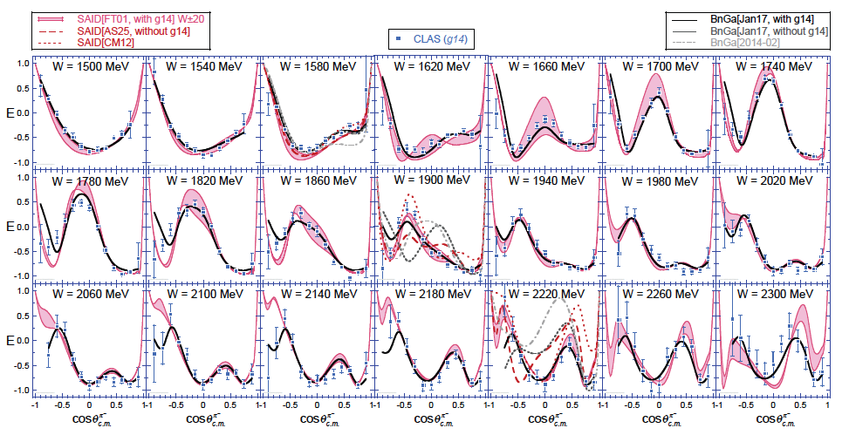
First E asymmetry on neutrons
H.
D.
ice
γn -> p π⁻
D. Ho et al., PRL. 118 (2017)
Neutron asymmetry data lead to revision of resonance photocoupling amplitudes, and strong evidence of a nucleon state N(2040)3/2⁺.

Slide 10
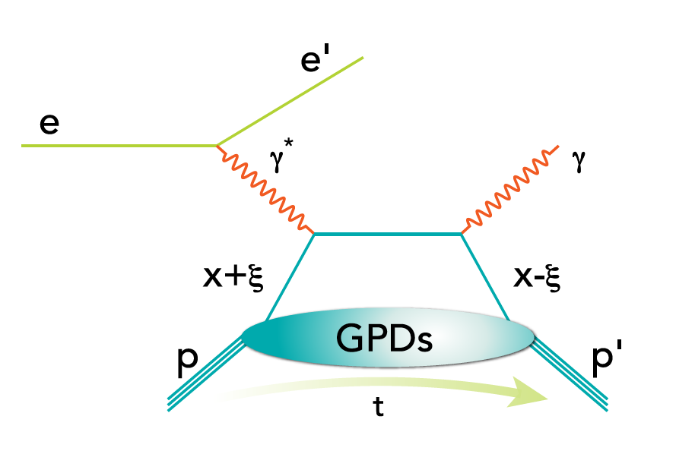
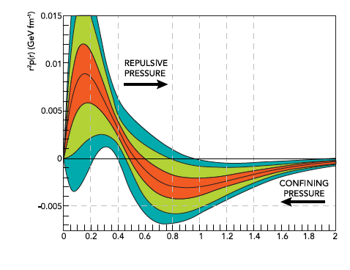
Unraveling Confinement in the Proton
Pressure distribution in the proton
Preliminary results 6 GeV
E12-016-019B
DVCS with CLAS12 will address one of the most fundamental unresolved problems in physics: How is confinement and the stability of visible matter in the universe realized?
Like to address this by direct measurement of the confinement forces.
r(fm)
Extract the confinement form factor d₁(t) and through a Fourier transform the radial shear force and pressure distribution.

Slide 11

Heavy Photon Search
Hall B
HPS engineering runs were run at 1.05 GeV and 2.3 GeV.
A new reach estimate includes upgraded SVT and the trigger setup with the new hodoscope.
For the next run the plan is to use 4.4 GeV beam.
With minor changes to the beamline and a new energy regime HPS will increase reach especially with vertex reconstruction.
Total of 40 PAC days at 4.4 GeV will be requested for the next run in 2018

Slide 12
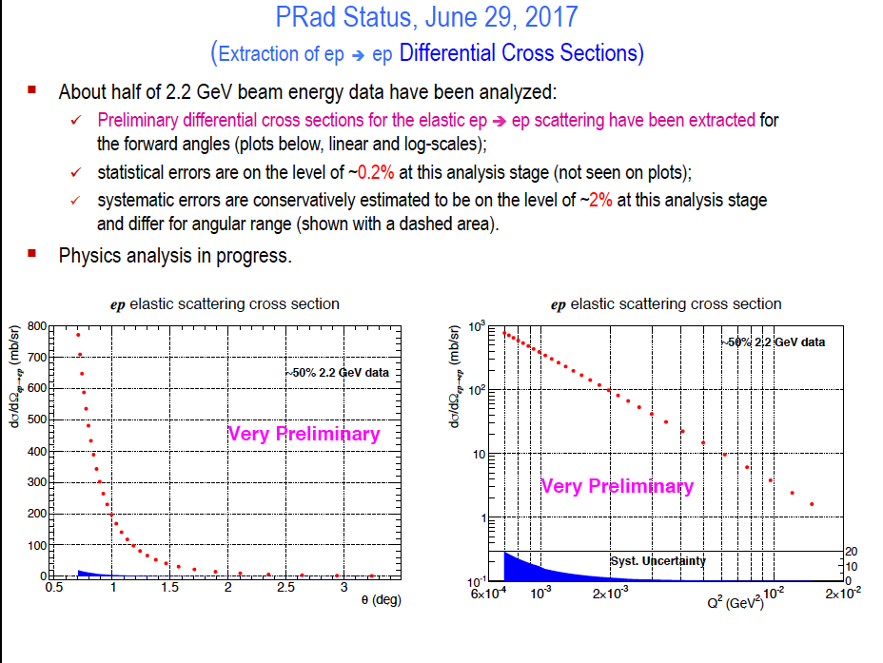
PRad Experiment
Hall B
About half of 2.2 GeV beam energy data have been analyzed:
  Preliminary differential cross sections for the elastic ep ➔ ep scattering have been extracted for the forward angles;
  statistical errors are on the level of ~0.2% at this analysis stage;
  systematic errors are conservatively estimated to be on the level of ~2% at this analysis stage and differ for angular range.
Physics analysis in progress.

Slide 13
PAC45 – Hall B Proposed Experiments
Proposals Physics Topic Contact Days
PR12-17-006 Critical Neutrino-Nucleus Issues Hen 41
PR12-17-009 Deuteron Charge Radius with Elastic eD Scattering Gasparian 39
New RG Proposal RG-L
PR12-17-012 Partonic Structure of Light Nuclei Meziani
PR12-17-012A Tagged EMC measurements on Light Nuclei Dupre
PR12-17-012B Spectator-Tagged DVCS on Light Nuclei Armstrong
PR12-17-012C Other Physics Opportunities w/ ALERT Hafidi
Beam Time Requested 55
RG Experiment RG-A
E12-12-001A Near threshold J/ψ production – LHCb pentaquark Stepanyan
Letters of Intent
LOI12-17-001 Study of J/ψ Photoproduction off Deuteron Ilieva
LOI12-17-002 Search for a φN bound state at Hall B Gao
New beam time request for Hall B Proposals: 135

Slide 14
Summary
Successful KPP run in February – data currently employed for detector calibration & event reconstruction
Analysis preparations for the fall run are in high gear
CLAS data continue to deliver important science in many areas – first results from polarized HD target run published in PRL
First HPS results of 2015 run presented - upgrade planned for next 4.4 GeV run with enlarged reach
PRad presents preliminary cross section data of 2.2 GeV data
New proposals cover new research areas

Slide 15
Additional slide

Slide 16
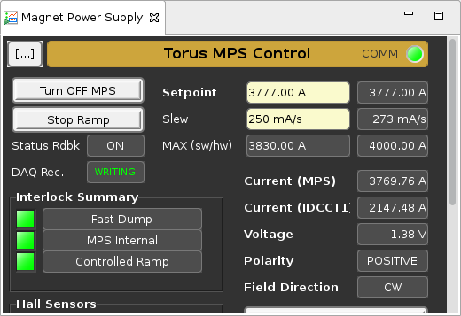
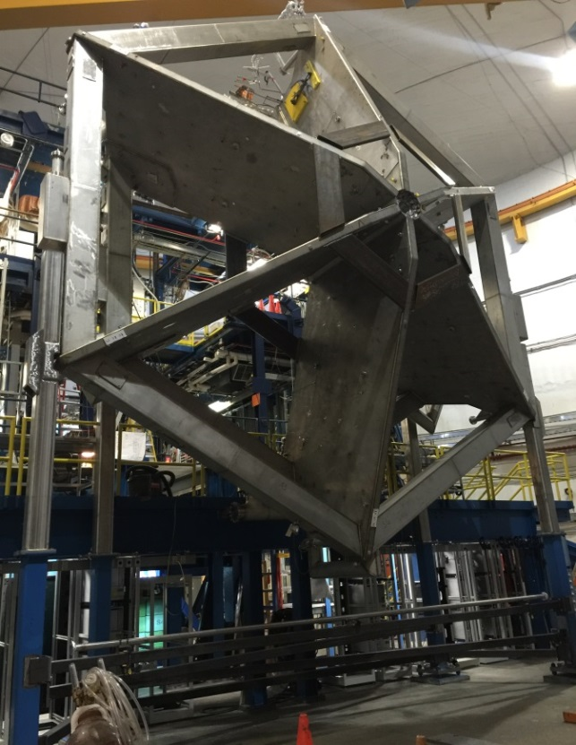
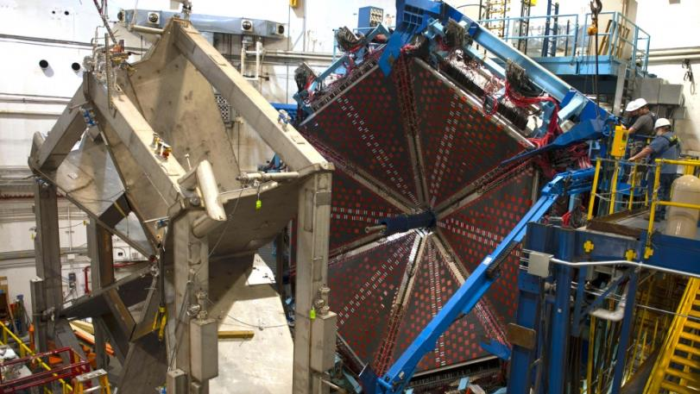
Torus Construction & Commissioning COMPLETE
Installation completed May 2016
High Power Tests COMPLETE
Nov 4, 2016
at 13:55
TORUS
Used Successfully in KPP Beam Run
Feb 2017

Slide 17

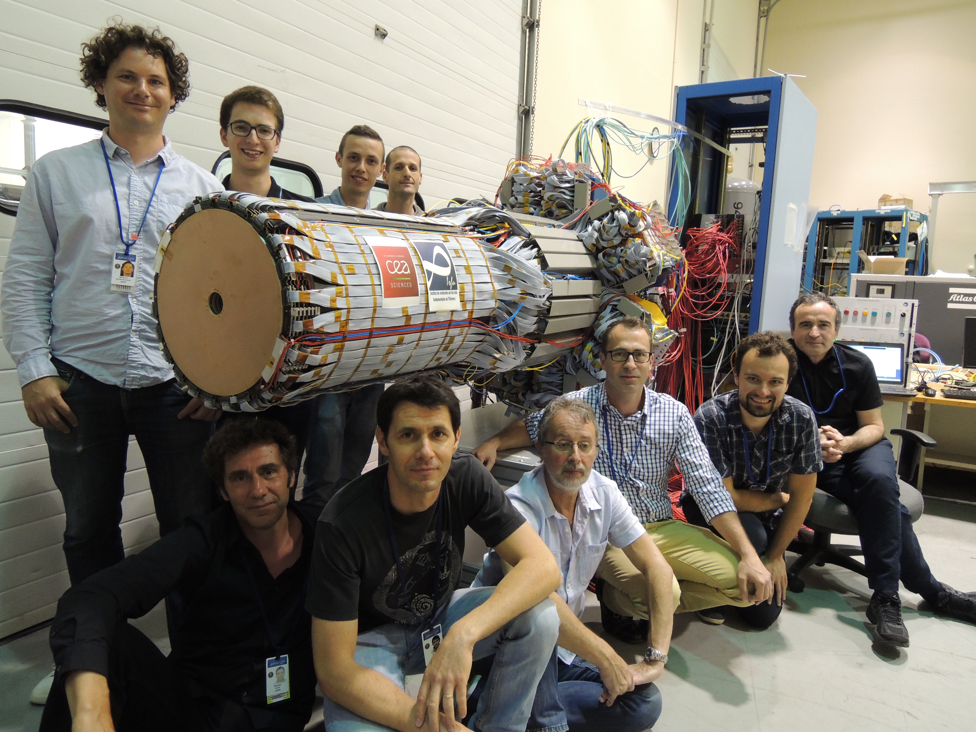
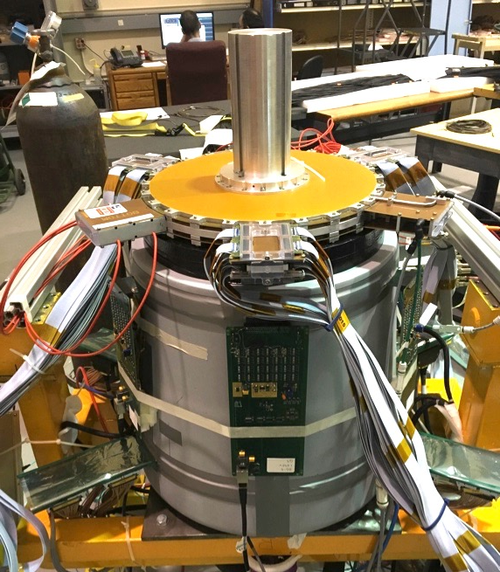

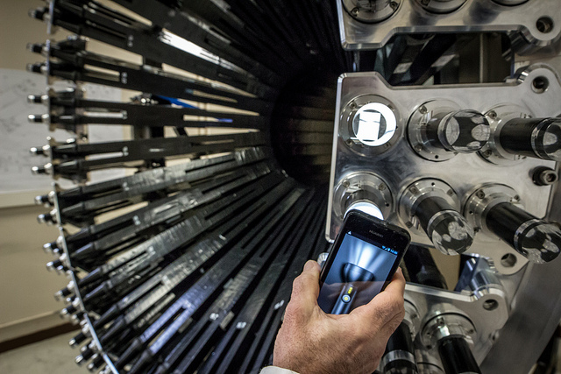

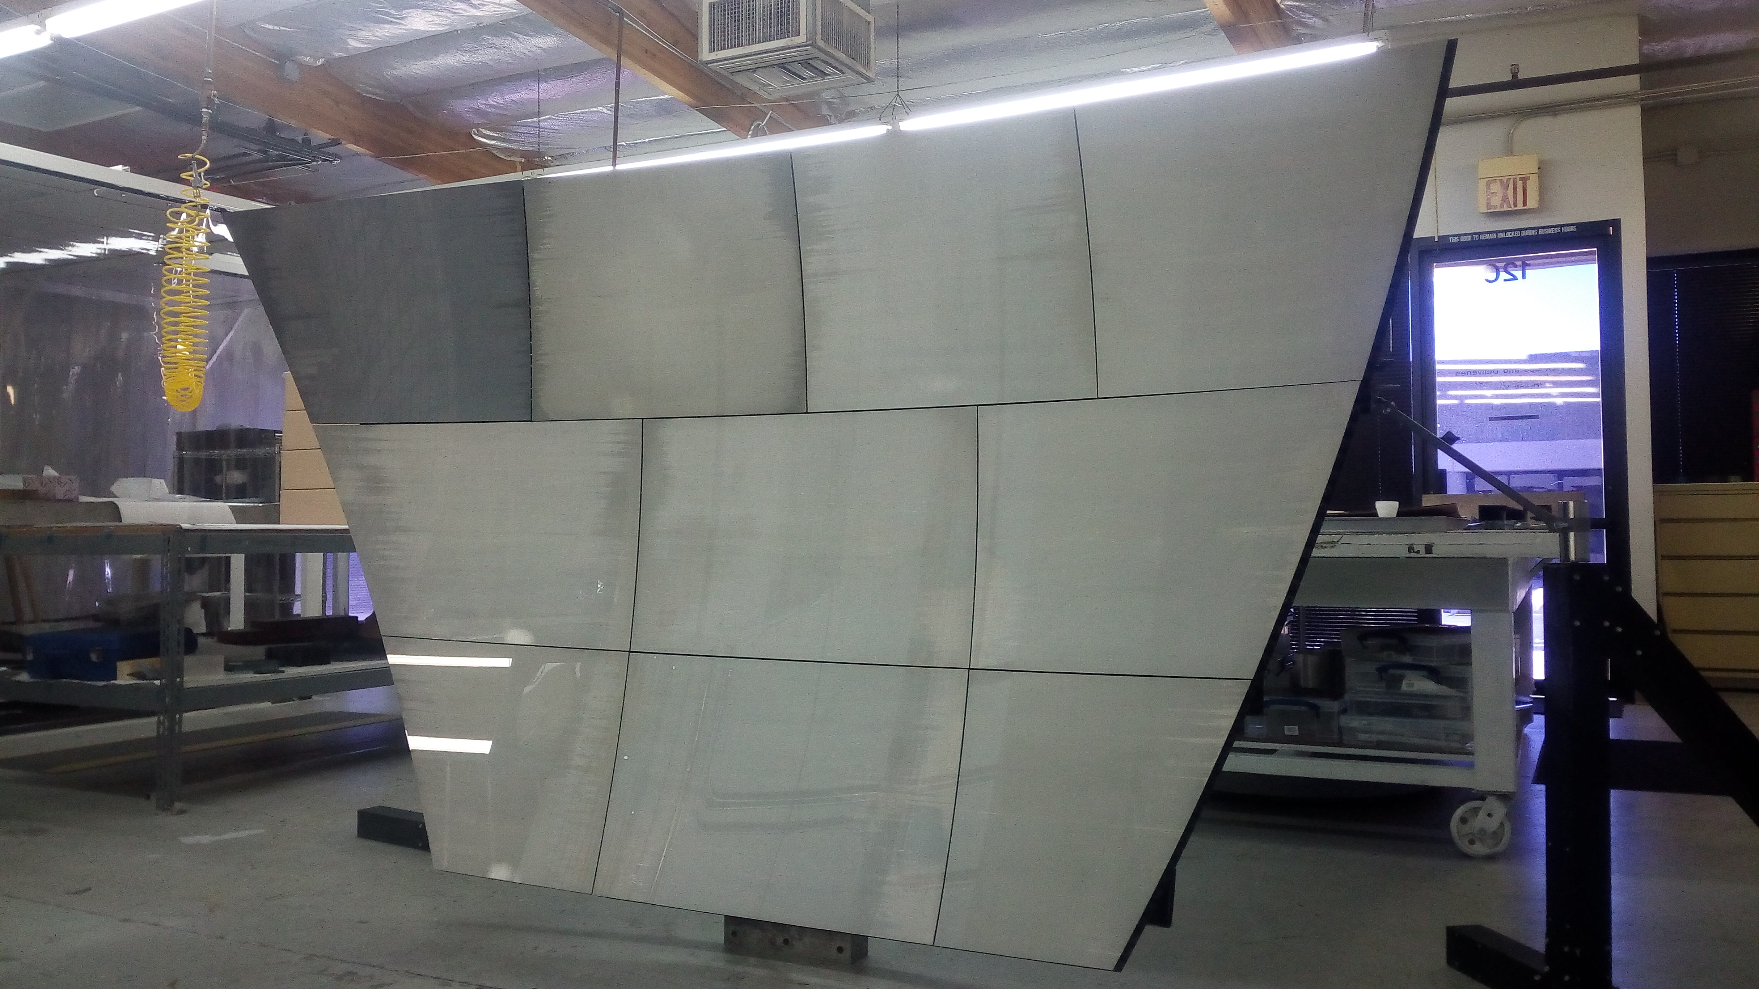
Detector Upgrades
CLAS12
Hall B
Micromegas (Saclay)
Ready for Installation
Forward Tagger (Genova)
Installation in process
Neutron Detector (Orsay)
Ready for installation
RICH Detector (Frascati)
Being assembled

