Slide 1
12 GeV Project Status
Glenn R. Young
12 GeV Project Status
CLAS Collaboration Meeting
Jefferson Lab
June 14, 2017

Slide 2
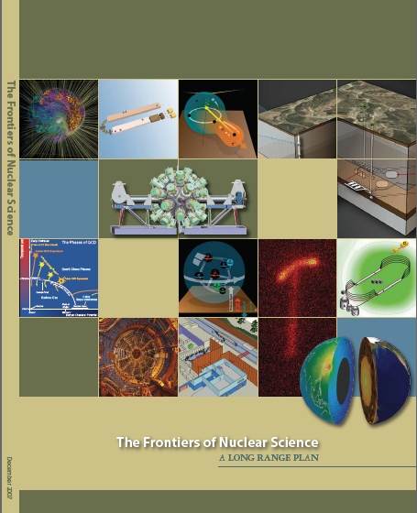
12 GeV Upgrade Project
Completion of the
12 GeV CEBAF Upgrade was ranked the highest priority in the 2007 NSAC Long Range Plan.
Upgrade is designed to build on existing facility: vast majority of accelerator and experimental equipment have continued use.
New Hall
Upgrade arc magnets
and supplies
Add 5 cryomodules
20 cryomodules
CHL upgrade
Add arc
20 cryomodules
TPC = $338M
ETC = $1.1M
Add 5 cryomodules
Project Scope (~99.7% complete)
Doubling the accelerator beam energy - DONE
New experimental Hall D and beam line - DONE
Civil construction including Utilities - DONE
Upgrades to Experimental Hall C - DONE
Upgrades to Experimental Hall B - ~99.1%
Enhanced capabilities
in existing Halls
Maintain capability to deliver lower pass beam energies: 2.2, 4.4, 6.6….

Slide 3
Physics Progress Overall
Detectors and Electronics - Complete
DAQ/Computing (software/firmware) - Complete
Beamline - Complete
Infrastructure - 99%
Hall C, D - Complete
Hall B - Install Solenoid magnet
Magnets – 99%
Hall C, D – Complete
Hall B Torus – Complete
Hall B Solenoid – 94%
Key Performance Parameter Runs – 100%

Slide 4
Hall C SHMS Magnets All Delivered
HB: 6-MAR-2015
Q1: 14-JAN-2015
Q2: 6-OCT-2016
Q3: 6-DEC-2016
Dipole Rigging
2-NOV-2016
D: 31-OCT-2016
Dipole CCR

Slide 5
Hall C 12GeV Detectors All Installed
Shower Counter
(within wall)
Pre-Shower Counter
Heavy-Gas Cerenkov (HGC)
Noble-Gas Cerenkov (NGC)
S2XY Hodoscope
Drift Chambers
S1XY Hodoscope

Slide 6
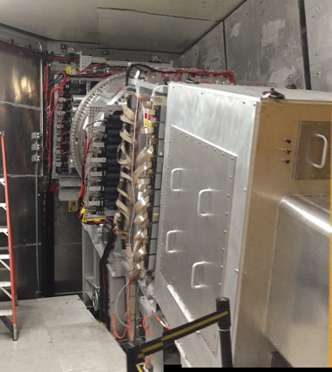
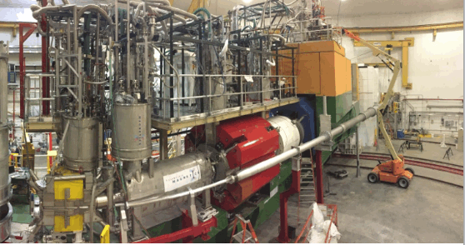
Hall C KPP Run
HB
Q1
Q2
Q3
D
March 7–10, 2017
Beam
~ 5 μA CW
Target
BeO, Carbon

Slide 7
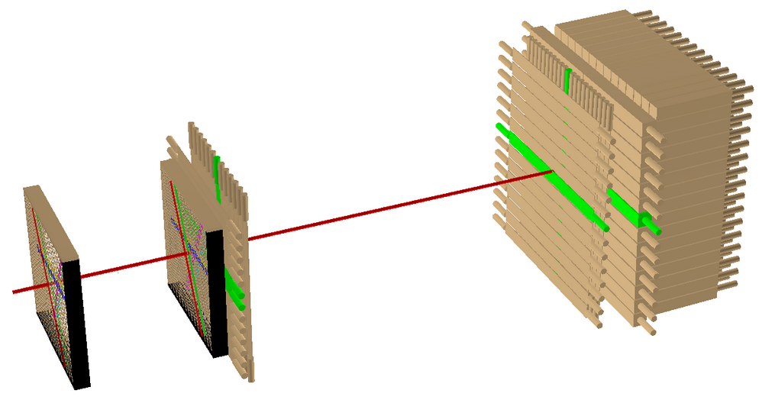
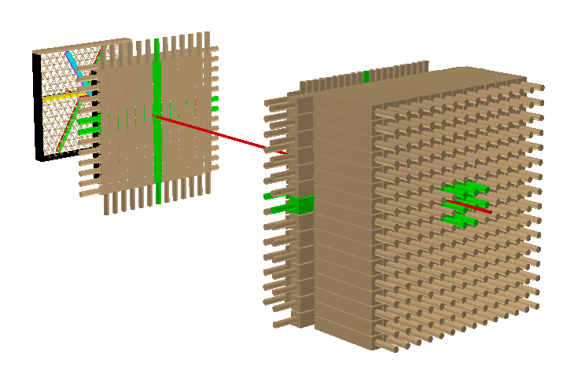
Hall C : Detector Performance
4. Figures demonstrating charged-particle tracks from position-sensitive detectors.
Run 488, Event 16
S2y
Tracking / Event Display
Two perspectives on the same event shown in Hall C event display.
Red track generated by Wire Chamber data only
Visual confirmation that the other detector elements along the track do indeed see the same particle
S1y
Preshower
S1x
S2x
Shower
Wire Chambers

Slide 8
Hall C KPP Demonstrated
Detector operational: events recorded with a > 2nA electron beam at > 6 GeV beam energy (3 pass).
KPP Demonstration Criteria:
Detector running for 8 hours recording data from all subsystems.
Screenshots of beam status and/or accelerator e-log entries demonstrating electron beam current and energy.
Data showing relative timing of trigger, tracking, and particle identification in detector subsystems.
Figures demonstrating charged-particle tracks from position-sensitive detectors.
Particle identification plots using signals from calorimetry and Cerenkov detectors.
Accepted by DOE March 14 2017

Slide 9
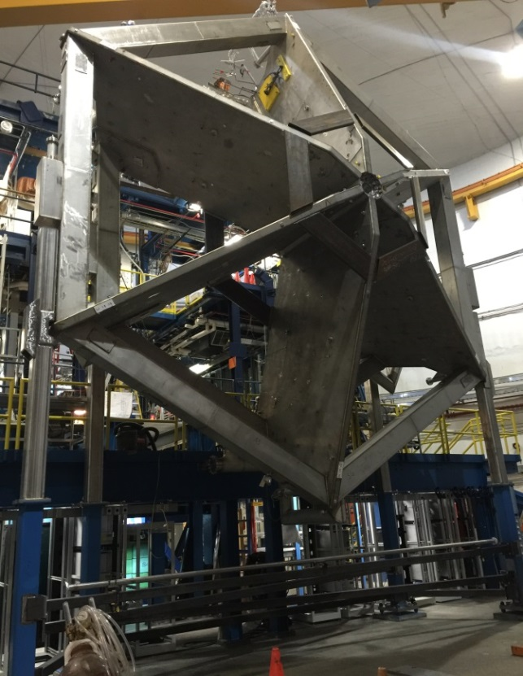
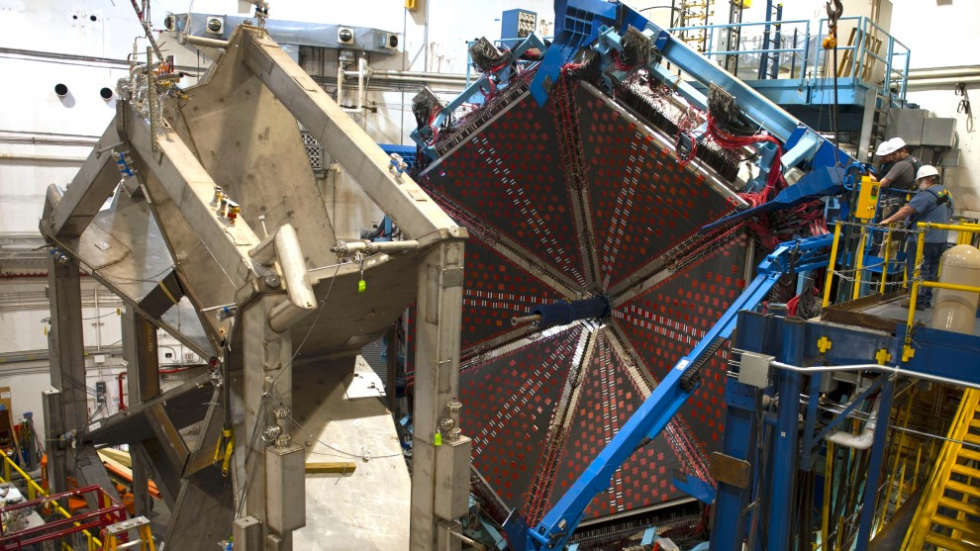
Hall B Torus at Full Current 11/4/2016
Installation completed in May 2016
Power tests reached 3770A

Slide 10
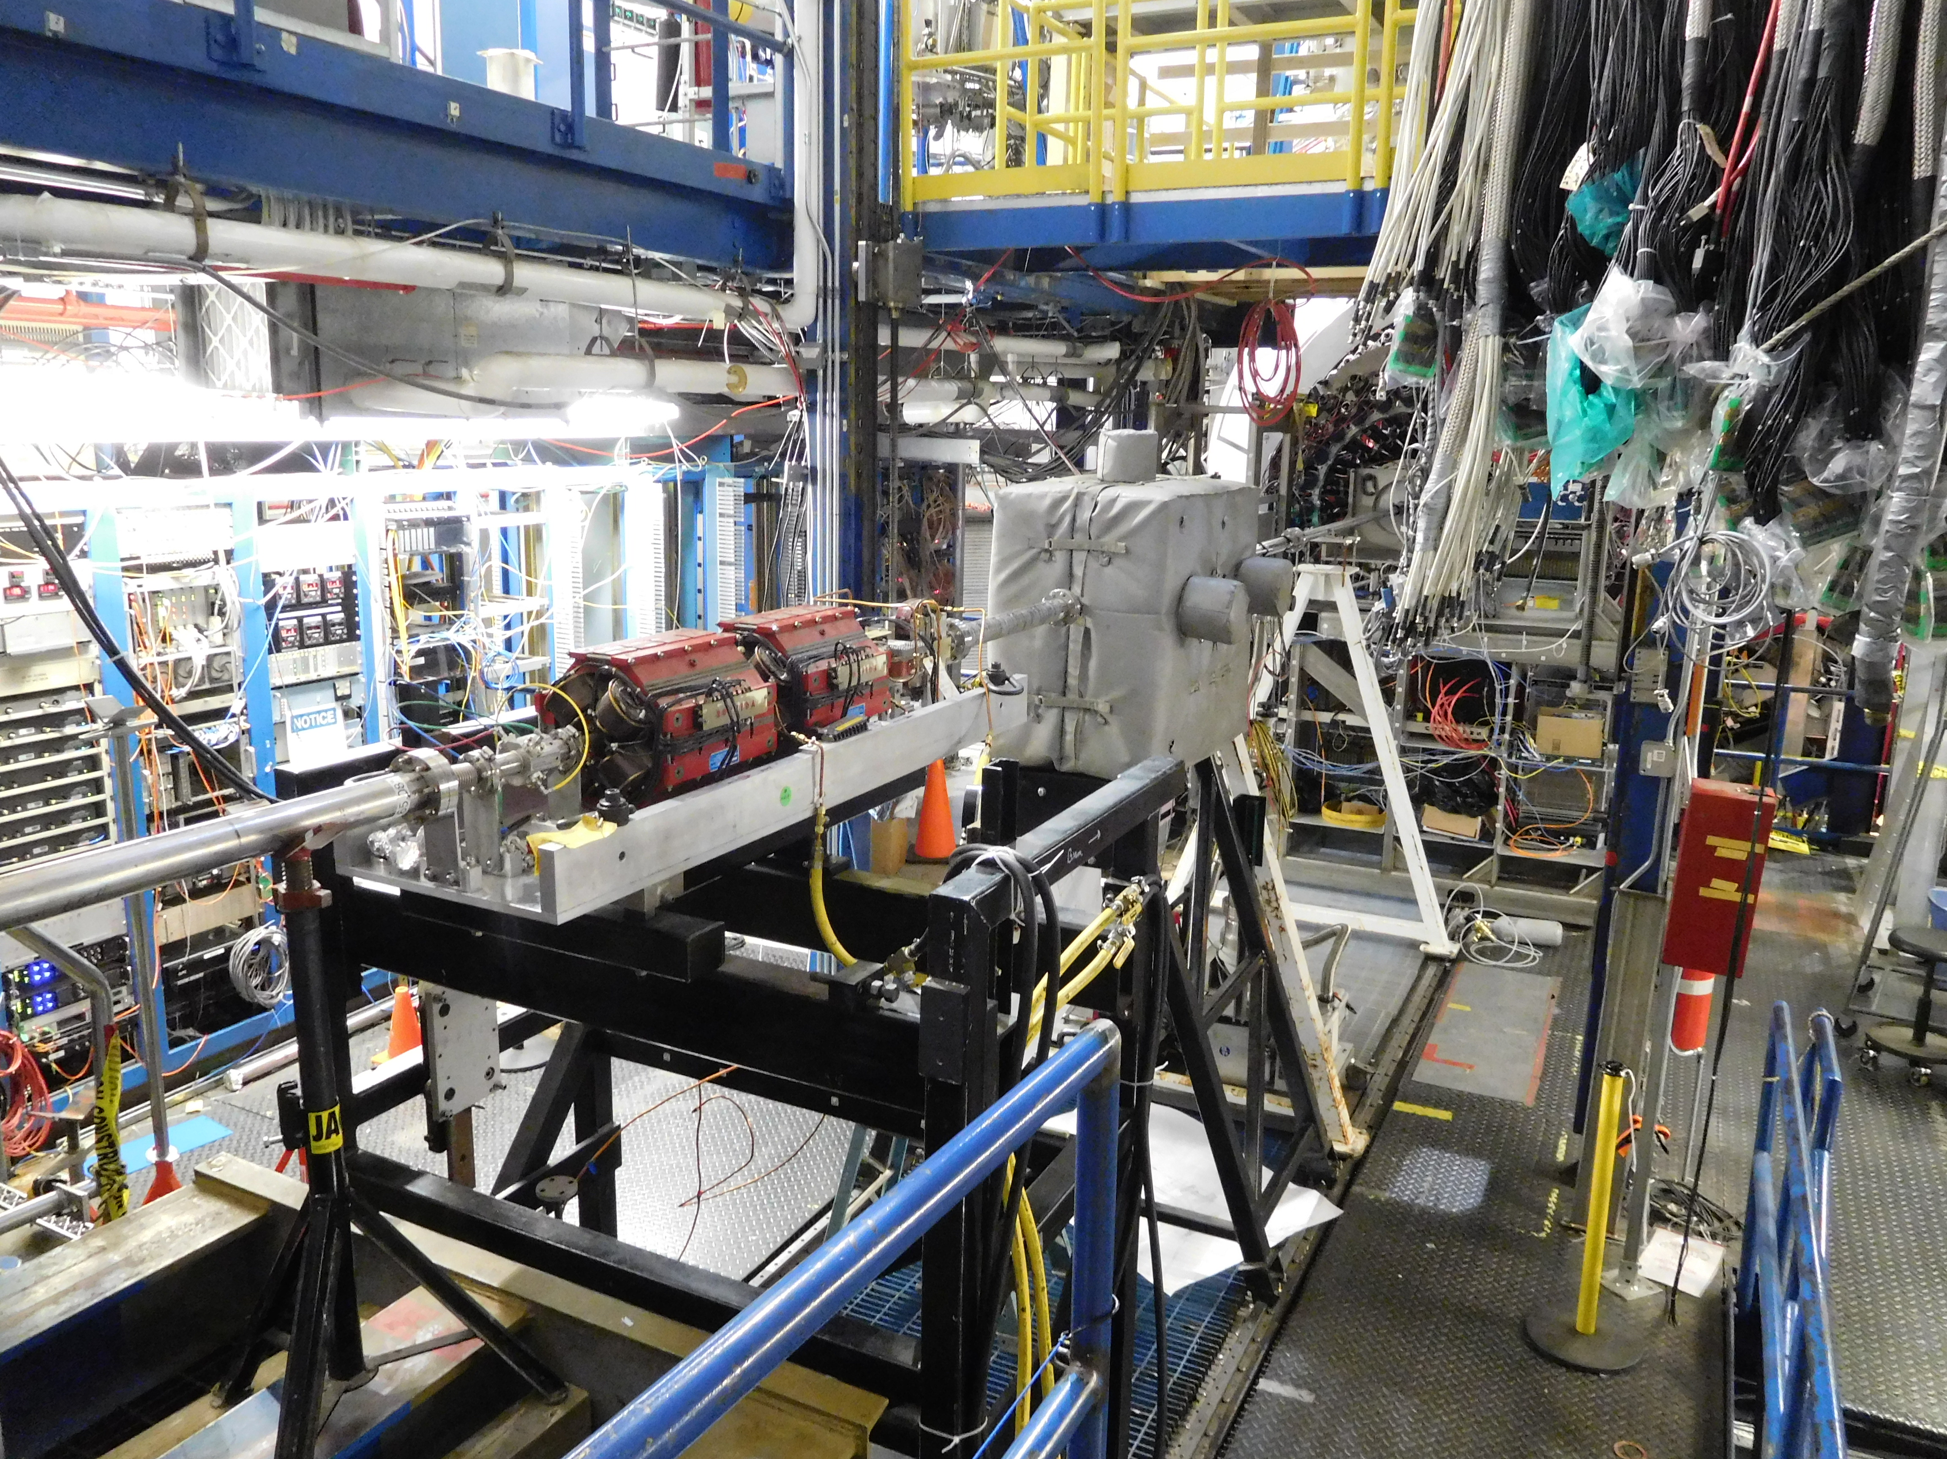
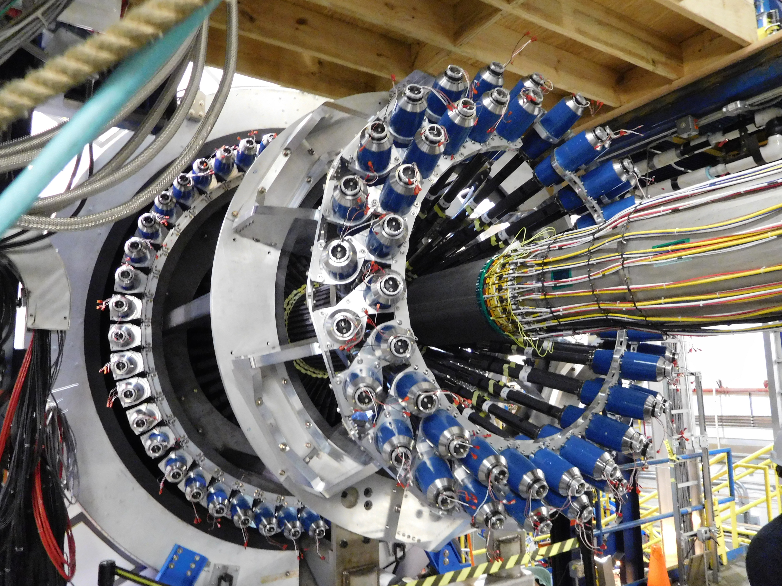
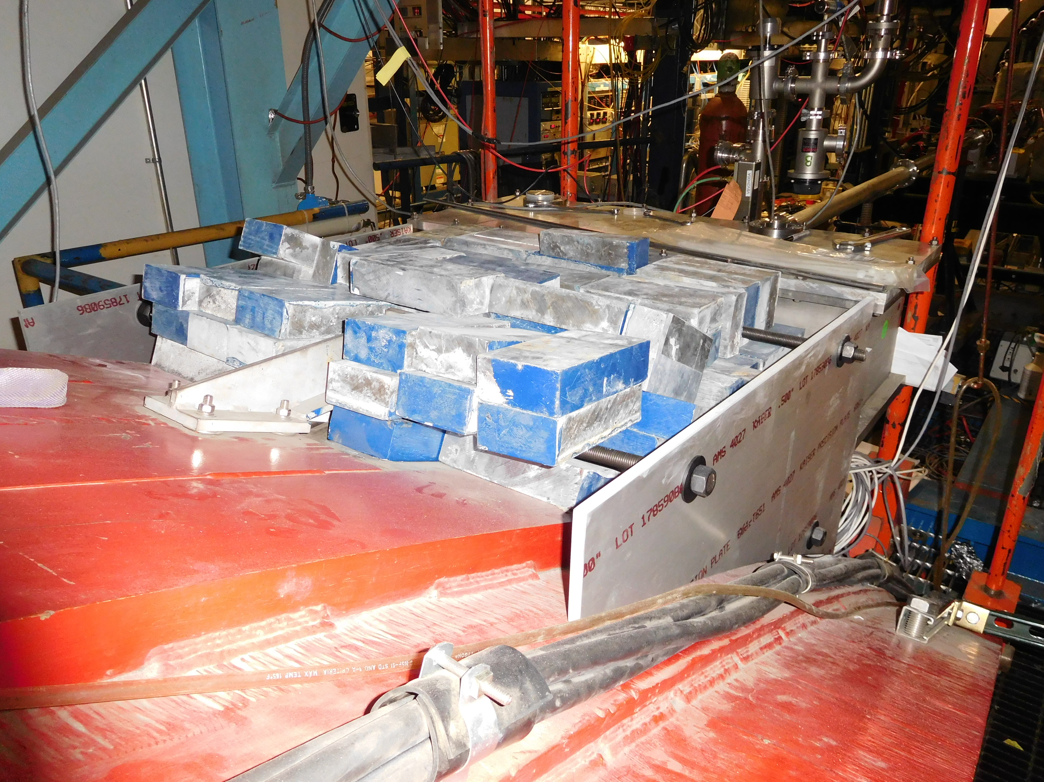
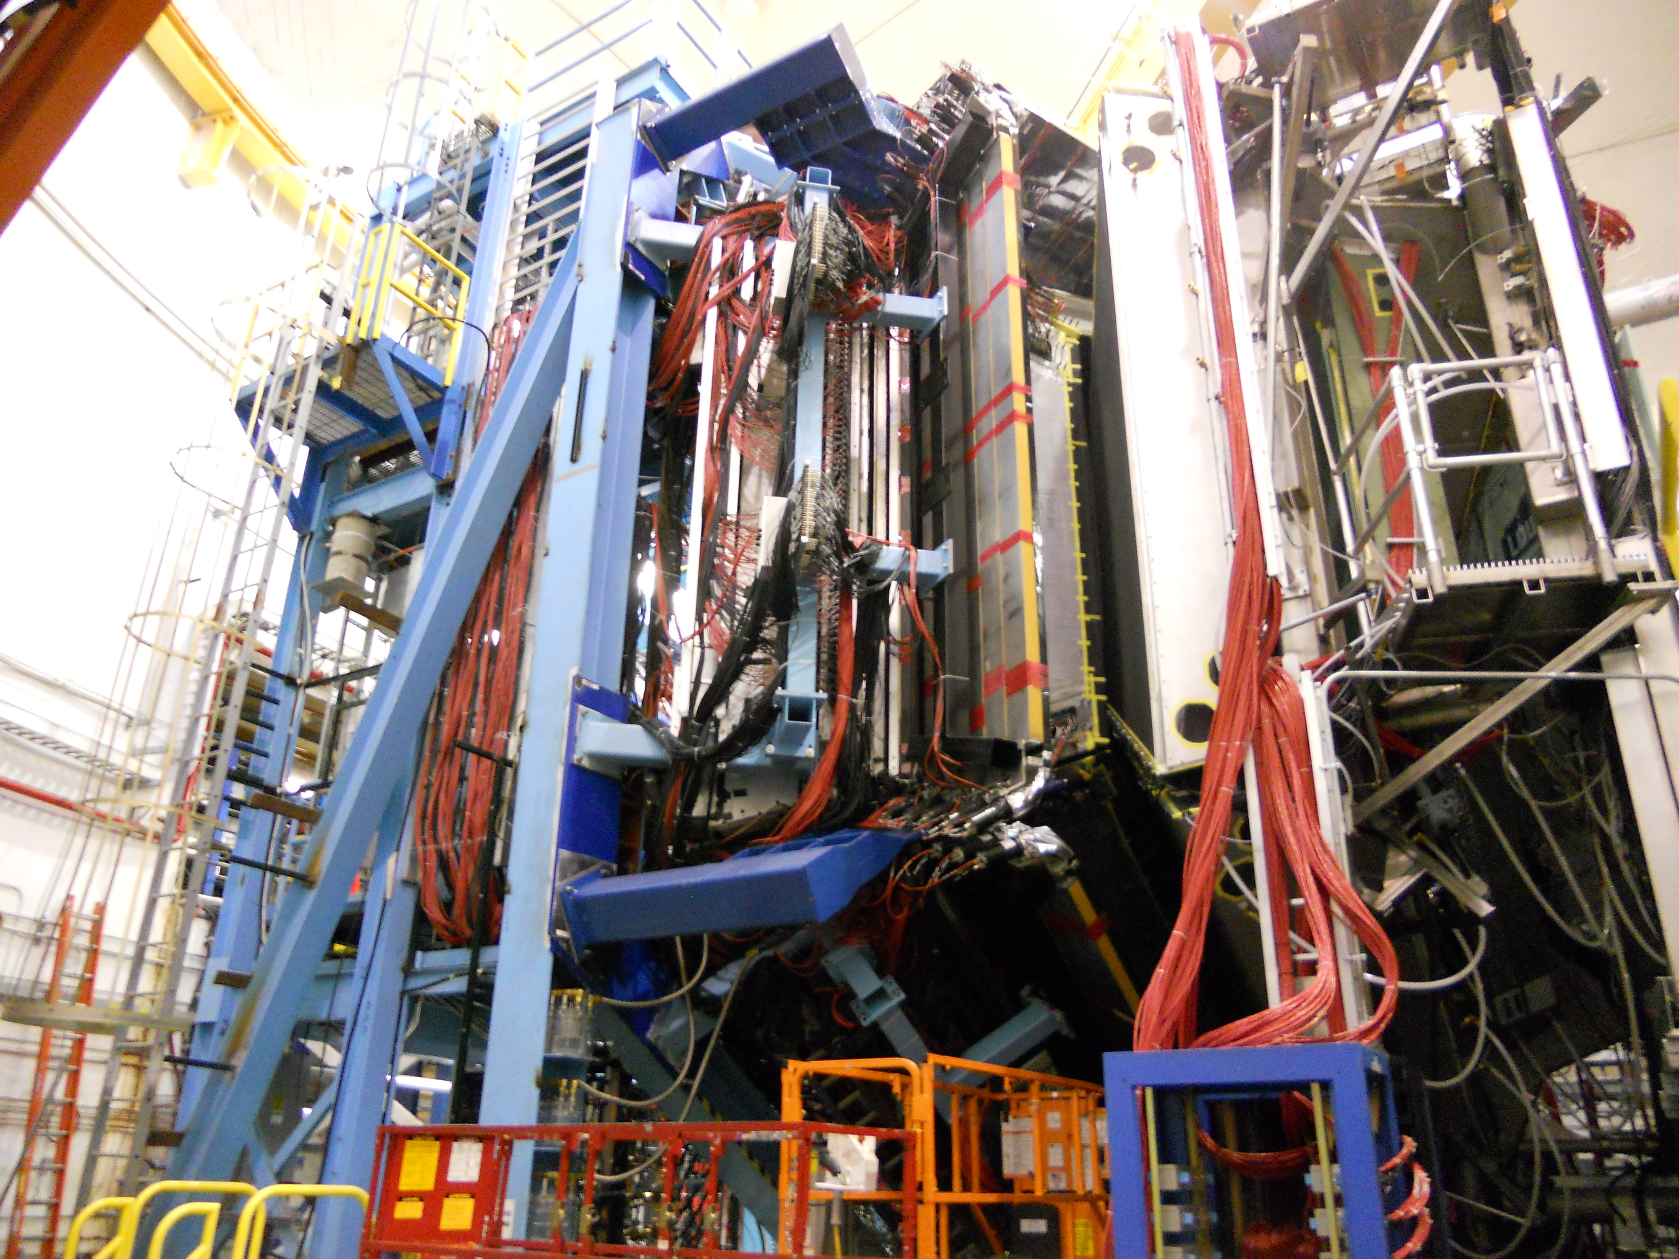
Hall B KPP Configuration
Beamline
CTOF and SVT
Tagger Shielding
Forward Carriage

Slide 11
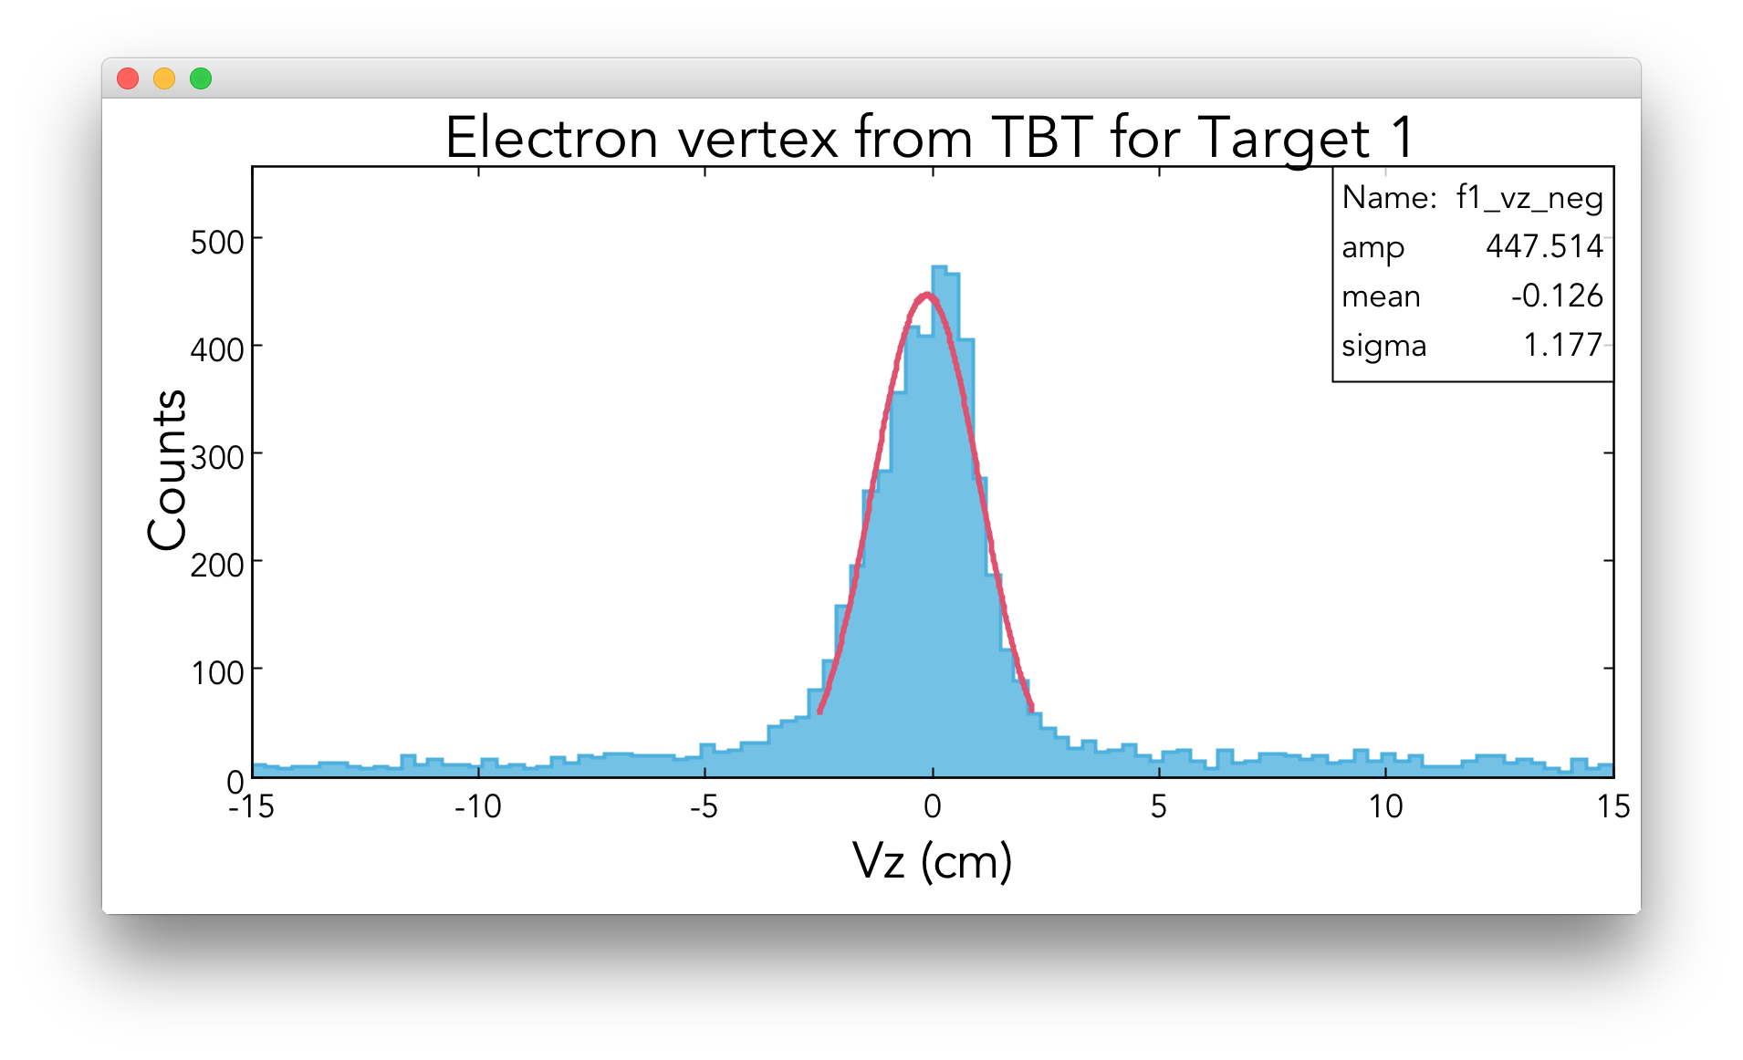
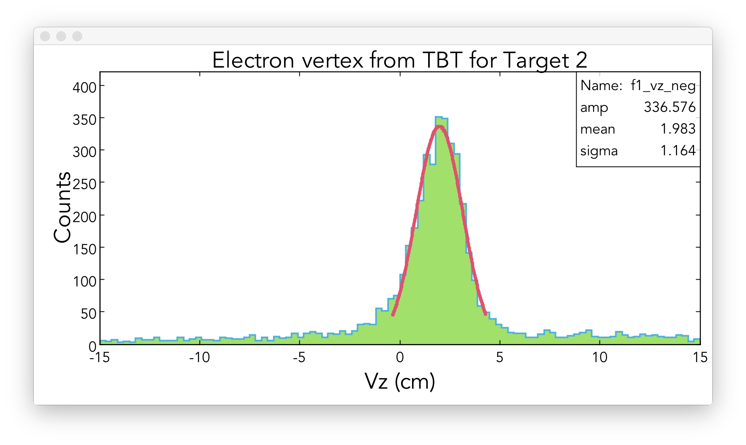
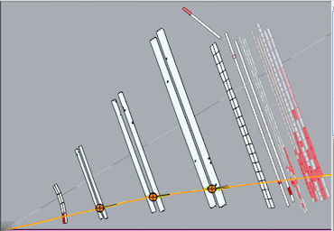
Hall B : Reconstructed Particle Trajectories
Target #1
Target #2
<σ>=1.2 cm
Two 0.5 mm ¹²C wires mounted 2.1 cm apart along beamline (Vz)

Slide 12
HALL B KPP Demonstrated
Detector operational: events recorded with a > 2nA electron beam at > 6 GeV beam energy (3 pass).
KPP Demonstration Criteria:
1. Detector running for 8 hours recording data from all subsystems.
2. Screenshots of beam status and/or accelerator e-logs entries demonstrating electron beam current, beam energy, and beam profiles.
3. Plots showing relative timing of calorimetry, time-of-flight, and Cerenkov detectors.
4. Event displays showing correlated particle hits in the forward detectors.
5. Plots of particle trajectories showing target position.
6. Particle identification plots using signals from calorimetry and Cerenkov detectors.
Accepted by DOE February 7 2017

Slide 13
DOE OPA Review May 10-11, 2017
Major “annual” review of 12 GeV Project
From the Report of the Review:
The Installation of all detectors and detector subsystems is complete. Satisfactory operation of all detectors in Halls B, C, and D is confirmed.
All CD-4b Key Performance Parameters (KPPs) are complete.
Installation, cool-down, and power-up of all magnets in Halls B, C, and D, with the exception of the Hall B solenoid magnet, is complete. All delivered magnets are operating satisfactorily.
The Hall B solenoid magnet assembly is continuing at the vendor site.
The project team completed all activities necessary to support installation, cool-down, and power-up of the Hall B solenoid magnet when it arrives from the vendor.
However, continued schedule delays with the solenoid magnet vendor have affected schedule contingency to the point that project completion by September 30, 2017 remains uncertain.

Slide 14
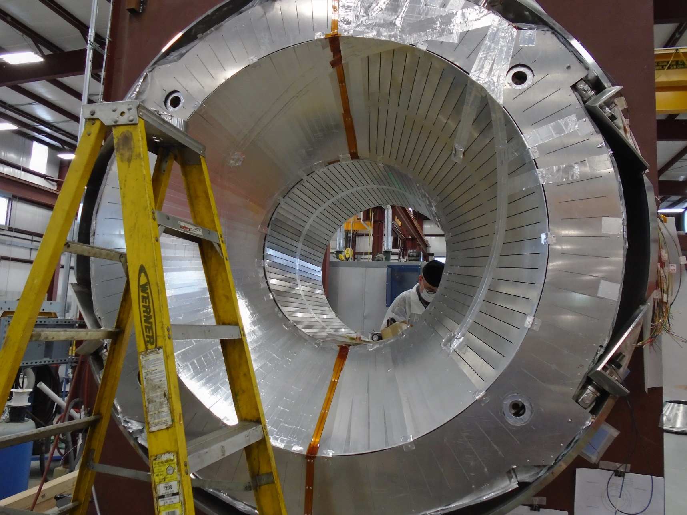
Solenoid Radiation Shield Installed 6/1/2017

Slide 15
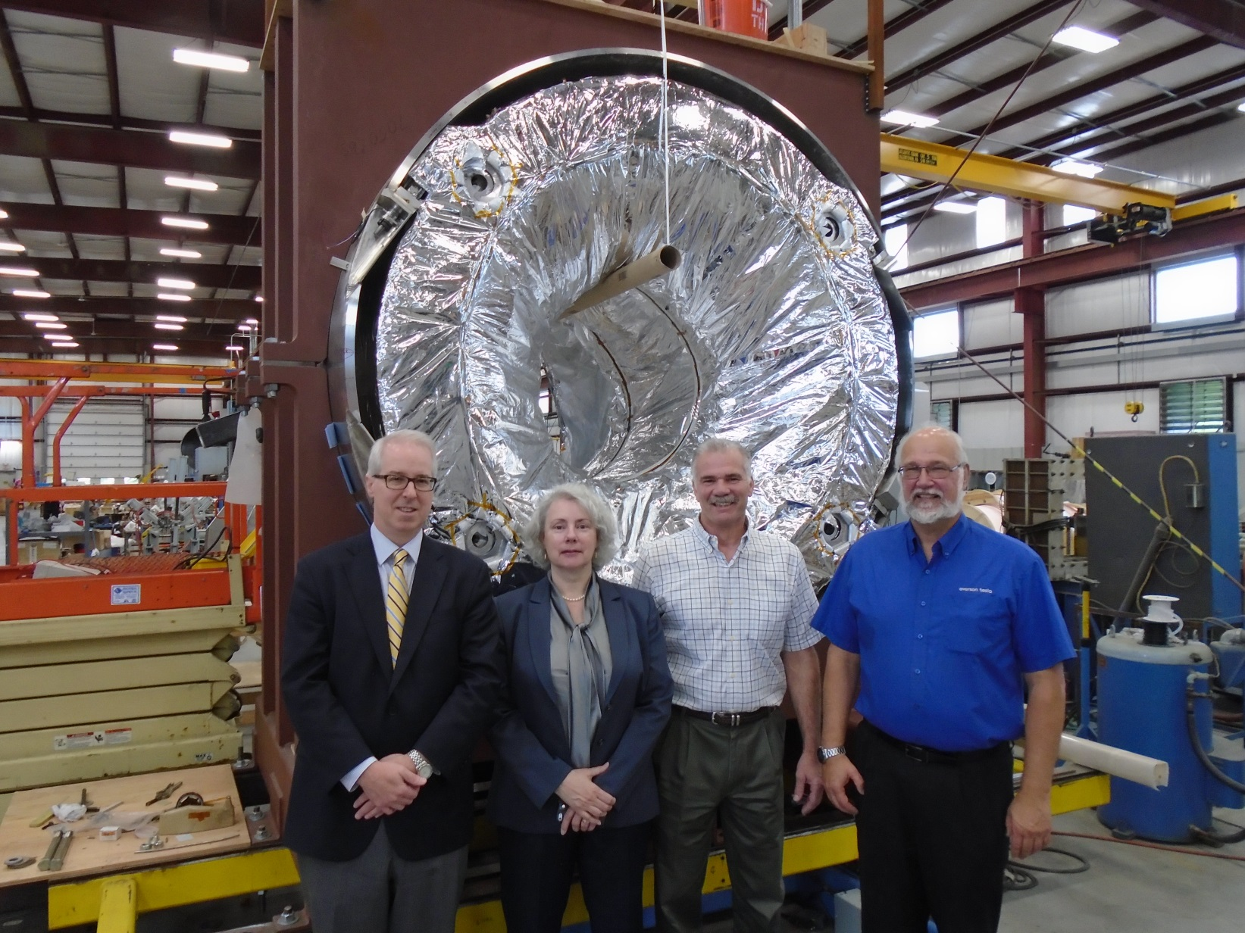
High Level Visitors 6/7/2017

Slide 16
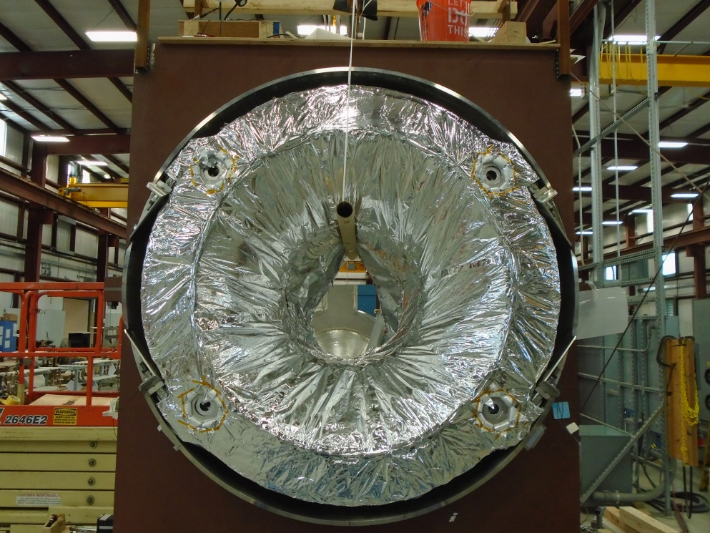
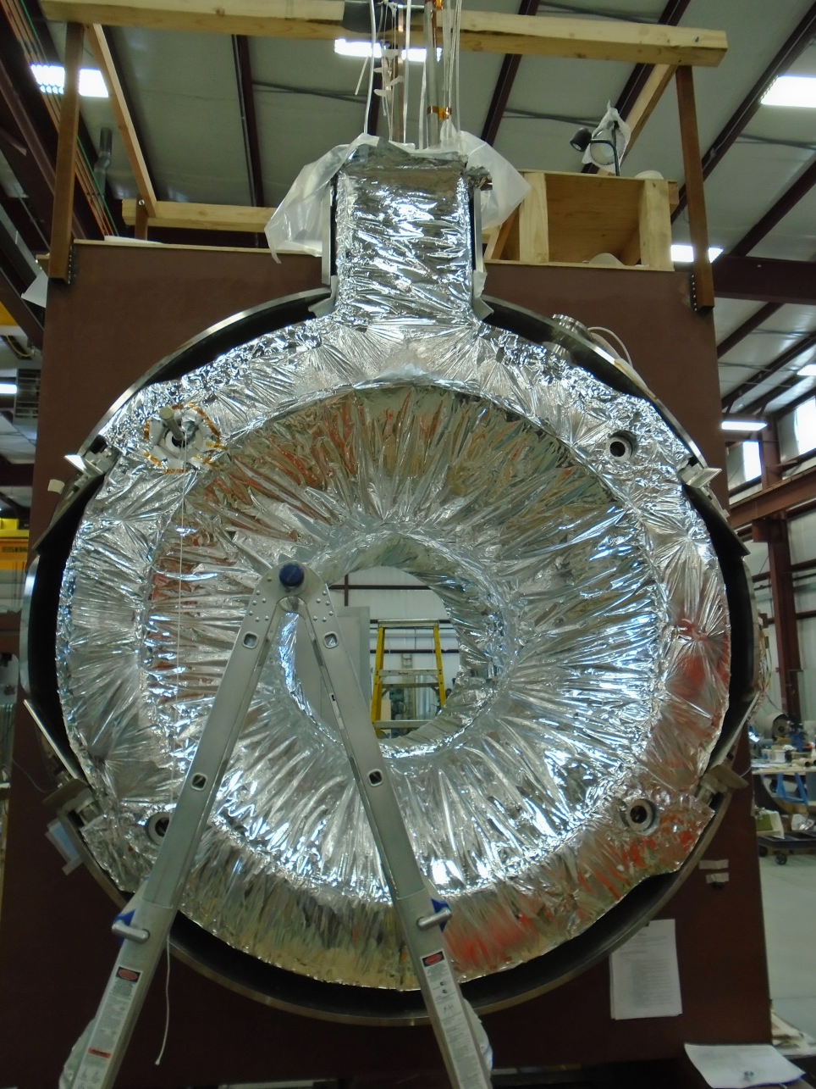
MultiLayer Insulation Installed 6/9/2017

Slide 17
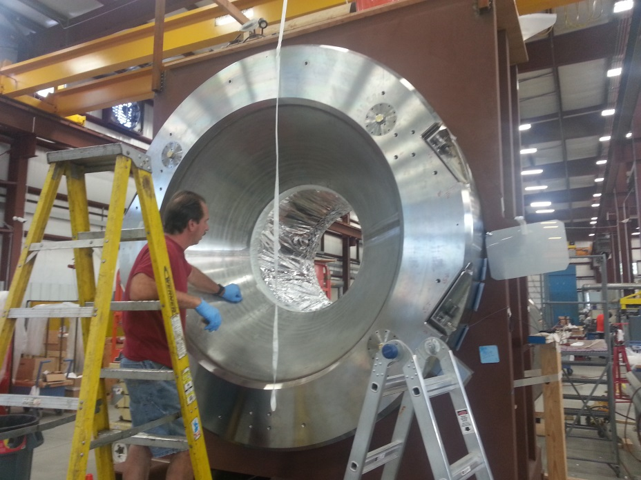
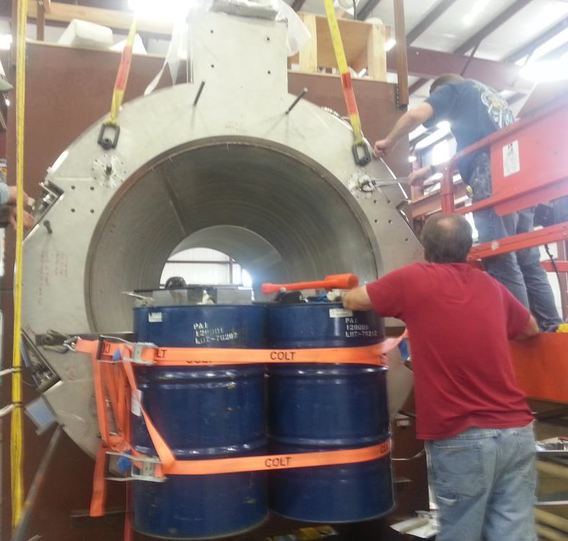
Outer Vacuum Cryostat Ends Installed 6/12/2017

Slide 18
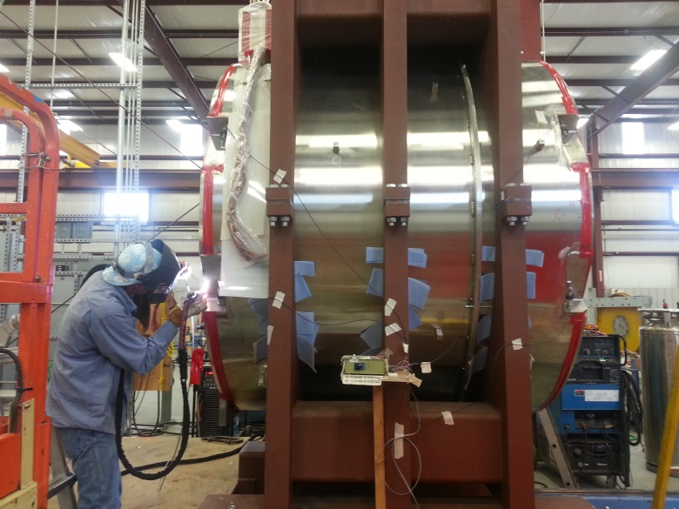
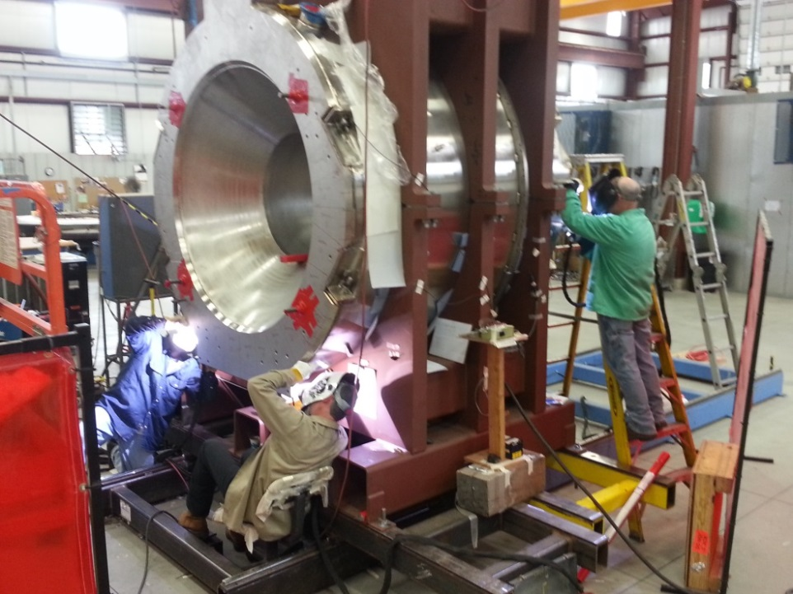
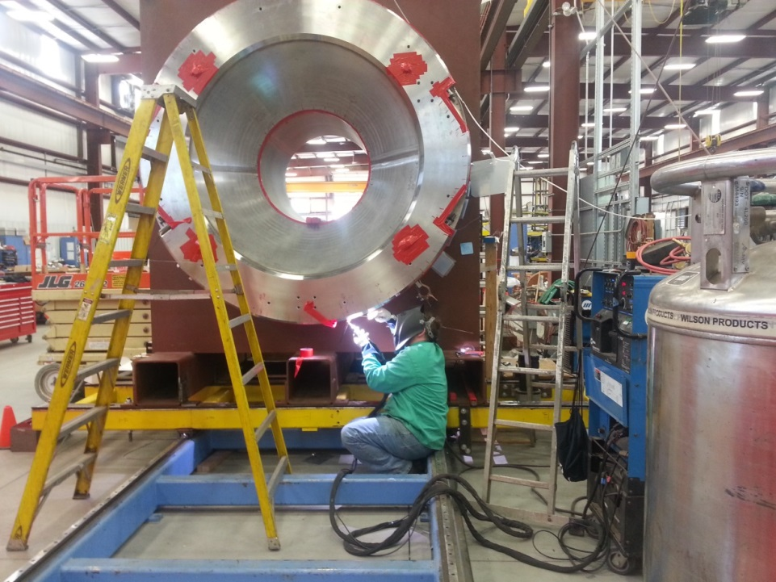
June 2017 Solenoid Cryostat Welding Party

Slide 19
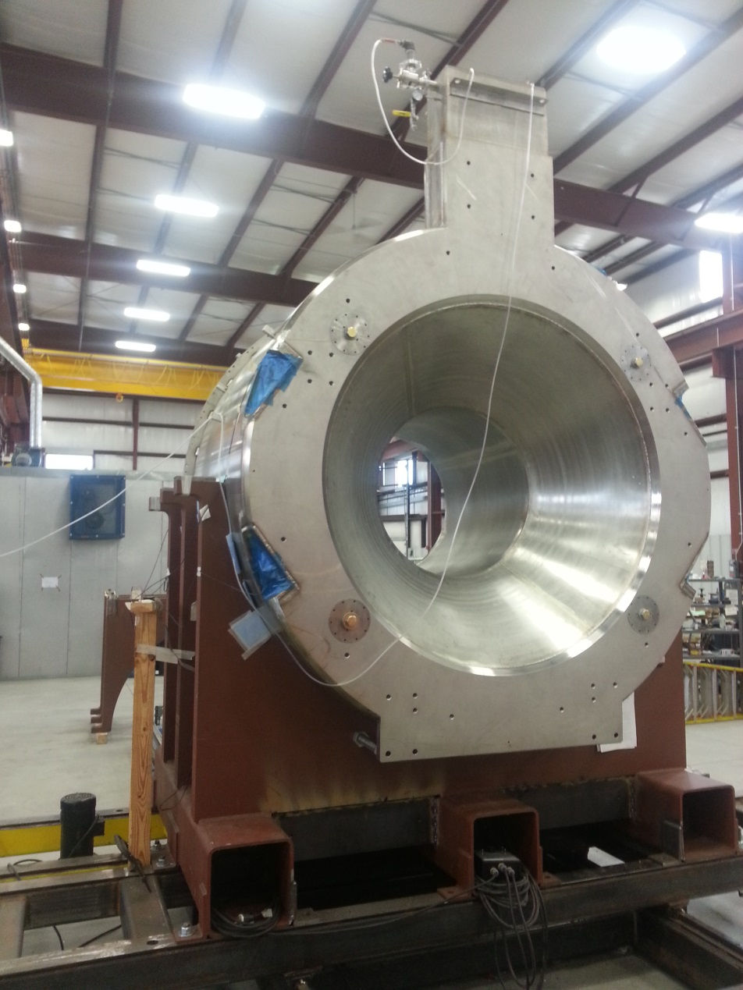
Solenoid Ready to Ship 6/23/2017

Slide 20
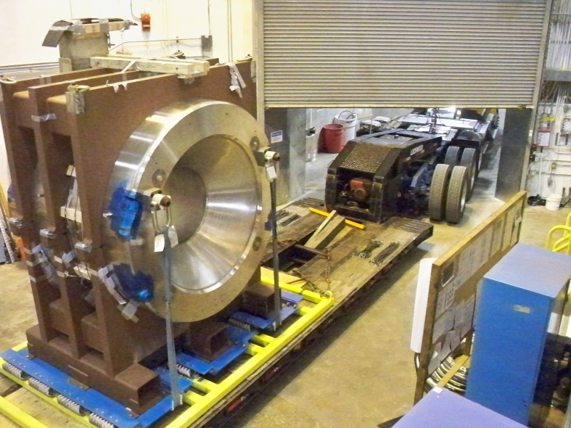
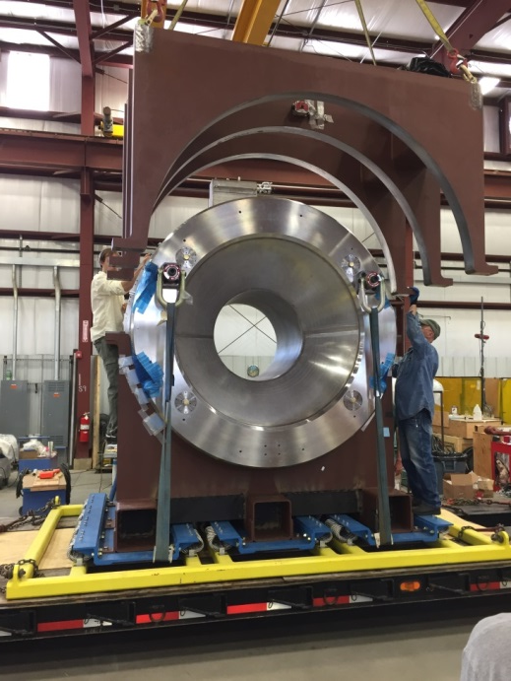
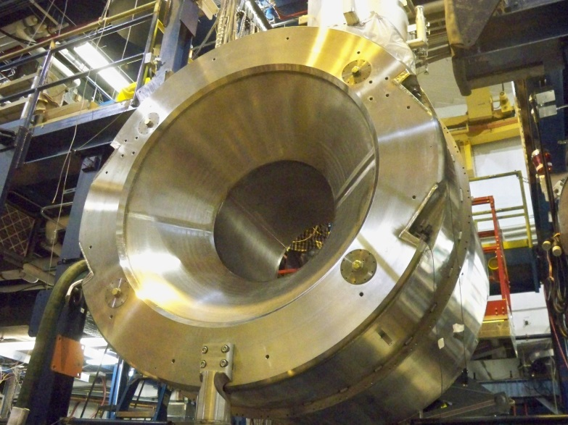
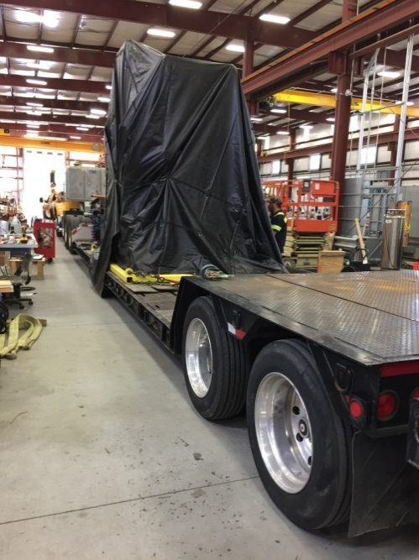
Loading and Unloading
6/26/2017
6/27/2017
Hall B
ETI
June 27 2017
6/27/2017
6/28/2017
Hall B
ETI

Slide 21
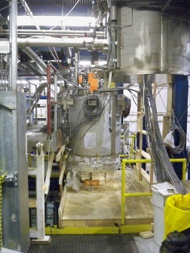
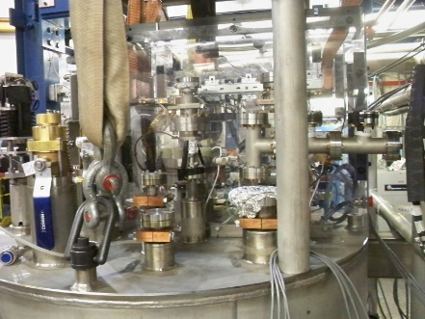
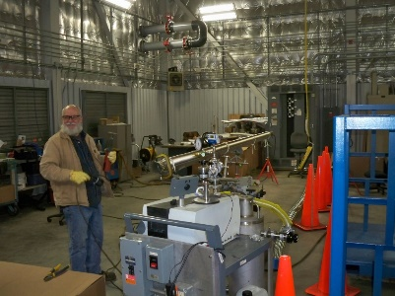
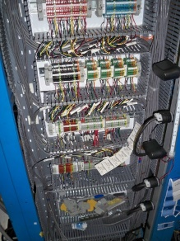
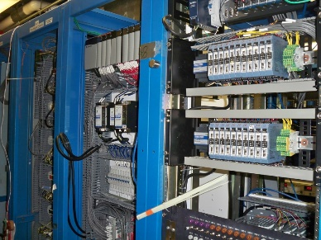
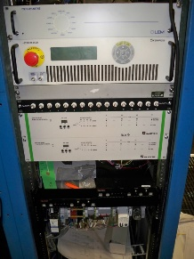
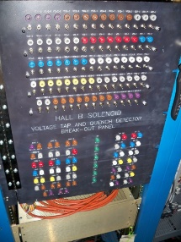
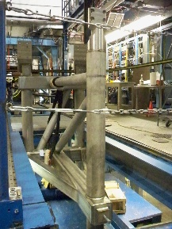
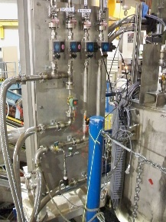
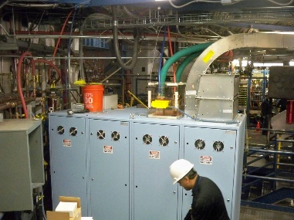
Solenoid Infrastructure at JLab - Ready
Solenoid Service Tower & U-tubes – Complete
Solenoid I&C Construction – Complete
Solenoid Hall B Infrastructure – Complete
SST Installed
U-tube
Instrumentation and Controls Installed
Solenoid Stand
He Vaporizer
Magnet Power Supply

Slide 22
Work at JLab after Solenoid Arrival
Arrival Checks
Receiving inspection (vacuum, electrical, instrument), place on stand
Remove shipping restraints, survey
Cryogenics SST Attachment
Place SST, weld SST cryostat bottom plate to solenoid, add lower thermal shield plate, splice power leads, complete piping, add radiation shield and MLI, close cryostat, attach vacuum pumping system
I&C Attachment/Setup
Add final internal sensors to SST, hook up all cables, hook up main Magnet Power Supply, test all I&C items
Cryogenic Operation Setup
Leak / Pressure / Reverse Leak checks, add U-tubes, circulate Helium
Pump-down
Cool-down – mid-August, one month
Power test

Slide 23
Summary
All 12 GeV Project Scope is complete except Solenoid
All 12 GeV Project KPPs Demonstrated
Solenoid Installation in Hall B underway
Physics Division ERRs were held for Solenoid Cool-Down (July 6) and Power-up (July 7)
Plan to complete Solenoid Commissioning by September 30

Slide 24
Appendix

Slide 25
Key Activities: Path to CD-4B
Level 2 Milestones (PEP)
Number | Milestone Description | Baseline | Projected | Actual | Status
2-12 | Hall D Equipment Installation Completed | Sep-14 |  | Oct-14 | CD-4B
2-13 | Hall D Beam Commissioning Completed | Dec-14 |  | Dec-14 | CD-4B
2-27 | Hall C Q1 Magnet Delivered | Oct-14 |  | Jan-15 | CD-4B
2-28 | Hall C HB Magnet Delivered | Mar-15 |  | Mar-15 | CD-4B
2-34 | Hall B Torus Cold Mass Delivered | Apr-15 |  | Apr-15 | CD-4B
2-38 | Conventional Facilities Complete | Dec-15 |  | Nov-15 | CD-4B
2-29 | Hall C Dipole Magnet Delivered | Dec-15 |  | Nov-16 | CD-4B
2-30 | Hall C Q2 Magnet Delivered | Dec-15 |  | Oct-16 | CD-4B
2-31 | Hall C Q3 Magnet Delivered | Mar-16 |  | Nov-16 | CD-4B
2-35 | Hall B Solenoid Cryostated Coil Delivered | Mar-16 |  | Jun-17 | CD-4B
2-32 | Hall C Equipment Installation Complete | Jul-16 |  | Feb-17 | CD-4B
2-33 | Hall C Beam Commissioning Complete | Aug-16 |  | Mar-17 | CD-4B
2-36 | Hall B Equipment Installation Complete | Oct-16 | Sept-17 |  | CD-4B
2-37 | Hall B Beam Commissioning Complete | Dec-16 |  | Feb-17 | CD-4B

Slide 26
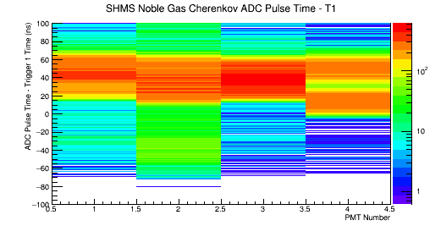
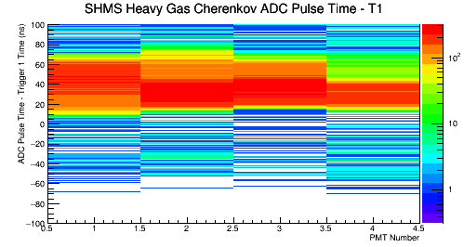
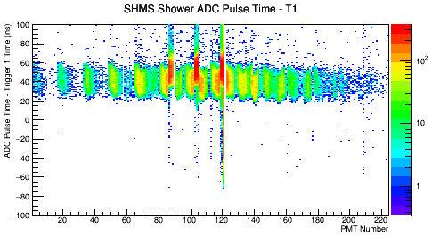
#3: Detector Performance
3. Data showing relative timing of trigger, tracking, and particle identification in detector subsystems.
HGC, NGC Timing
Horizontal axis is PMT #
Shower Timing
Horizontal axis is PMT #
Pre-shower Timing
Horizontal axis is PMT #
HGC Timing
NGC Timing
Time [ns]
Time [ns]
PMT Number
PMT Number
Shower Timing
Time [ns]
PMT Number
PreShower Right Timing
PreShower Left Side Timing
Time [ns]
Time [ns]
PMT Number
PMT Number

Slide 27
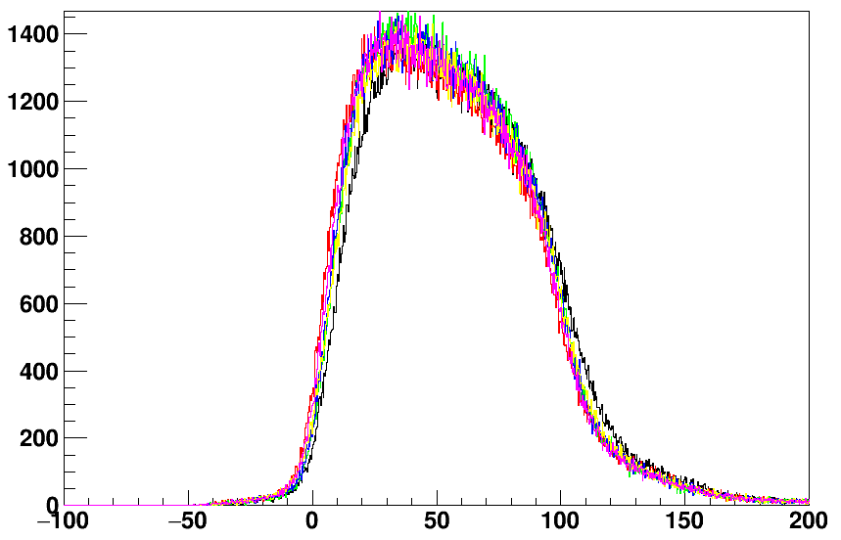
#3: Detector Performance
3. Data showing relative timing of trigger, tracking, and particle identification in detector subsystems.
Wire Drift Chambers
2 wire drift chambers provide tracks for charged particles
6 wire planes per chamber
Figure shows time distribution histograms of particles passing by the wires in all 6 planes
All planes have similar timing structure, minimal background
All planes have similar counts indicating equal detection efficiencies
Wire Drift Chamber Timing
Timing relative to Trigger [ns]

Slide 28
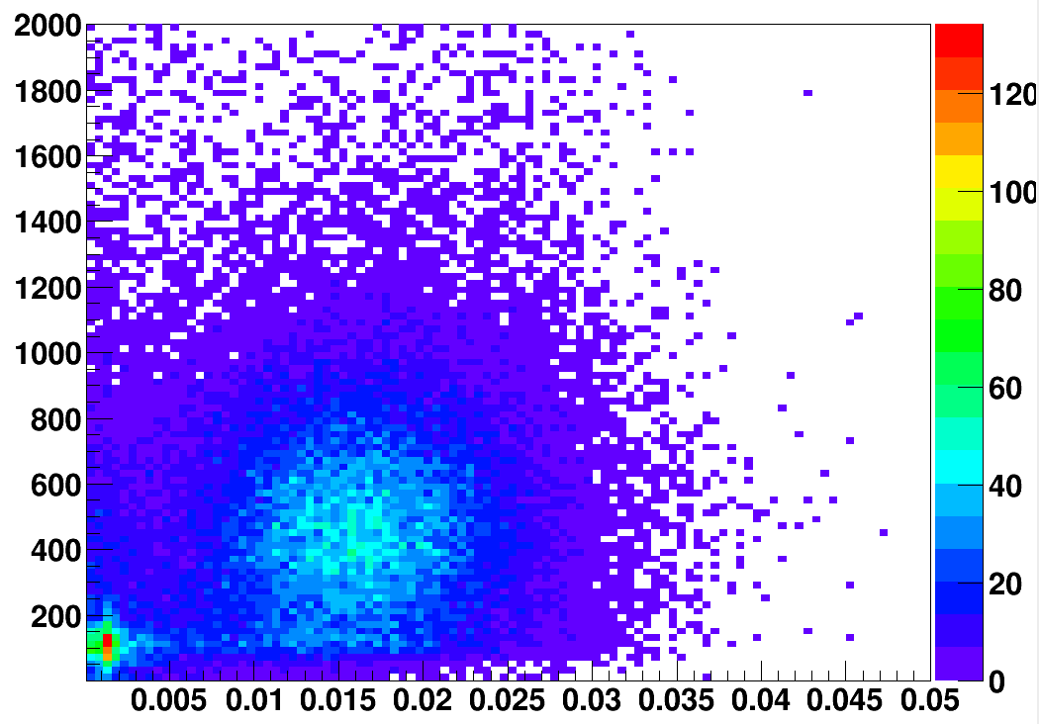
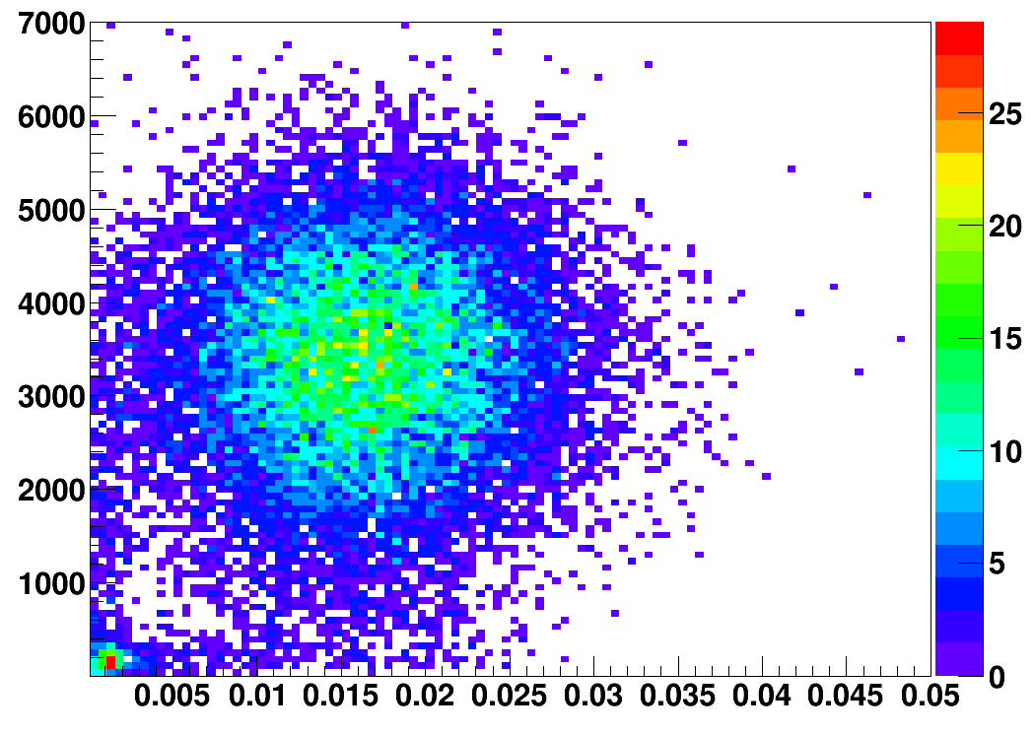
Hall C : Particle ID
5. Particle identification plots using signals from calorimetry and Cerenkov detectors.
HGC vs PSh
Electrons
HGC Signal (arb. units)
NGC vs PSh
NGC Signal (arb. units)
Preshower Energy (arb. units)
Pions
Preshower Energy (arb. units)
arb. = arbitrary

