Slide 1


Jefferson Lab Status
Stuart Henderson
Presentation to PAC45
July 10, 2017

Slide 2
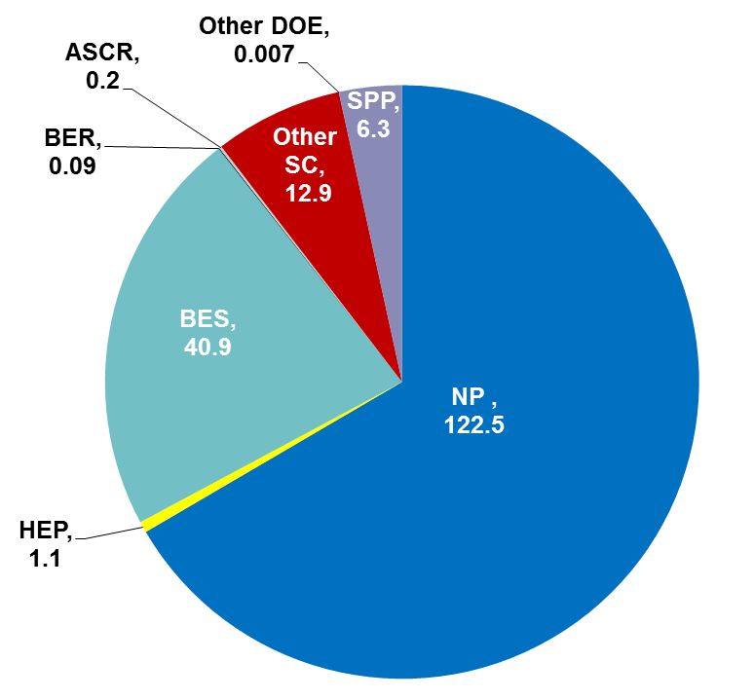
Jefferson Lab At-A-Glance
Created to build and operate the Continuous Electron Beam Accelerator Facility (CEBAF), world-unique user facility for Nuclear Physics: Mission is to gain a deeper understanding of the structure of matter Through advances in fundamental research in nuclear physics Through advances in accelerator science and technology In operation since 1995 1,530 Active Users 181 Completed Experiments to-date (3 full, 3 partial from 12 GeV era) Produces ~1/3 of US PhDs in Nuclear Physics (562 PhDs granted to-date; 200 in progress) Managed for DOE by Jefferson Science Associates, LLC (JSA) Human Capital: 699 FTEs 26 Joint faculty; 28 Post docs; 9 Undergraduate students; 39 Graduate students K-12 Science Education program serves as national model Site is 169 Acres, and includes: 72 Buildings & Trailers: 880K SF Replacement Plant Value: $415M
FY 2016:
Total Lab Operating Costs: $184.1M
Non-DOE Costs: $6.3M
Notes:
Note from Dry Run – verbalize that early science of the 12 GeV-era research program has begun.

Slide 3
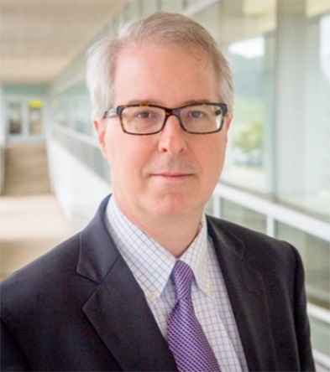
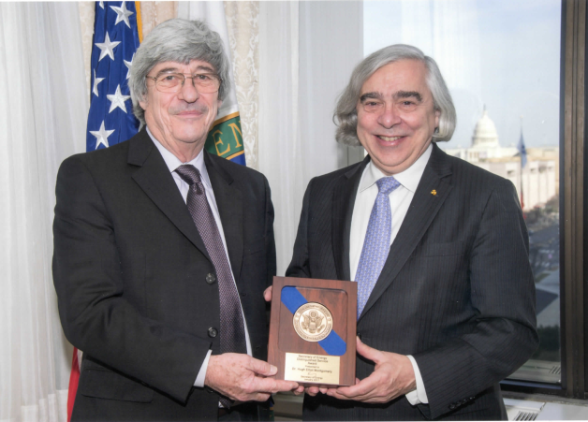
Laboratory Director Transition
Stuart Henderson:
During last tenure served as Director of the Advanced Photon Source Upgrade Project at Argonne National Lab
Prior: Assoc. Lab Director for Accelerators at Fermilab
Prior: ORNL, SNS, Director of Research Accelerator Division
Prior: Cornell Electron Storage Ring
Started Monday, April 3rd
Hugh Montgomery:
Jefferson Lab Director, September 2008 – April 2017
Received Secretary’s Distinguished Service Award in January 2017
Thanks for 8 years of effective leadership of Jefferson Lab, and for successfully shepherding the Lab during construction of the 12 GeV upgrade of CEBAF.

Slide 4
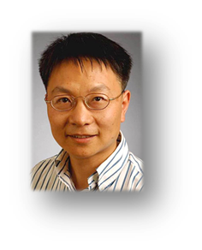
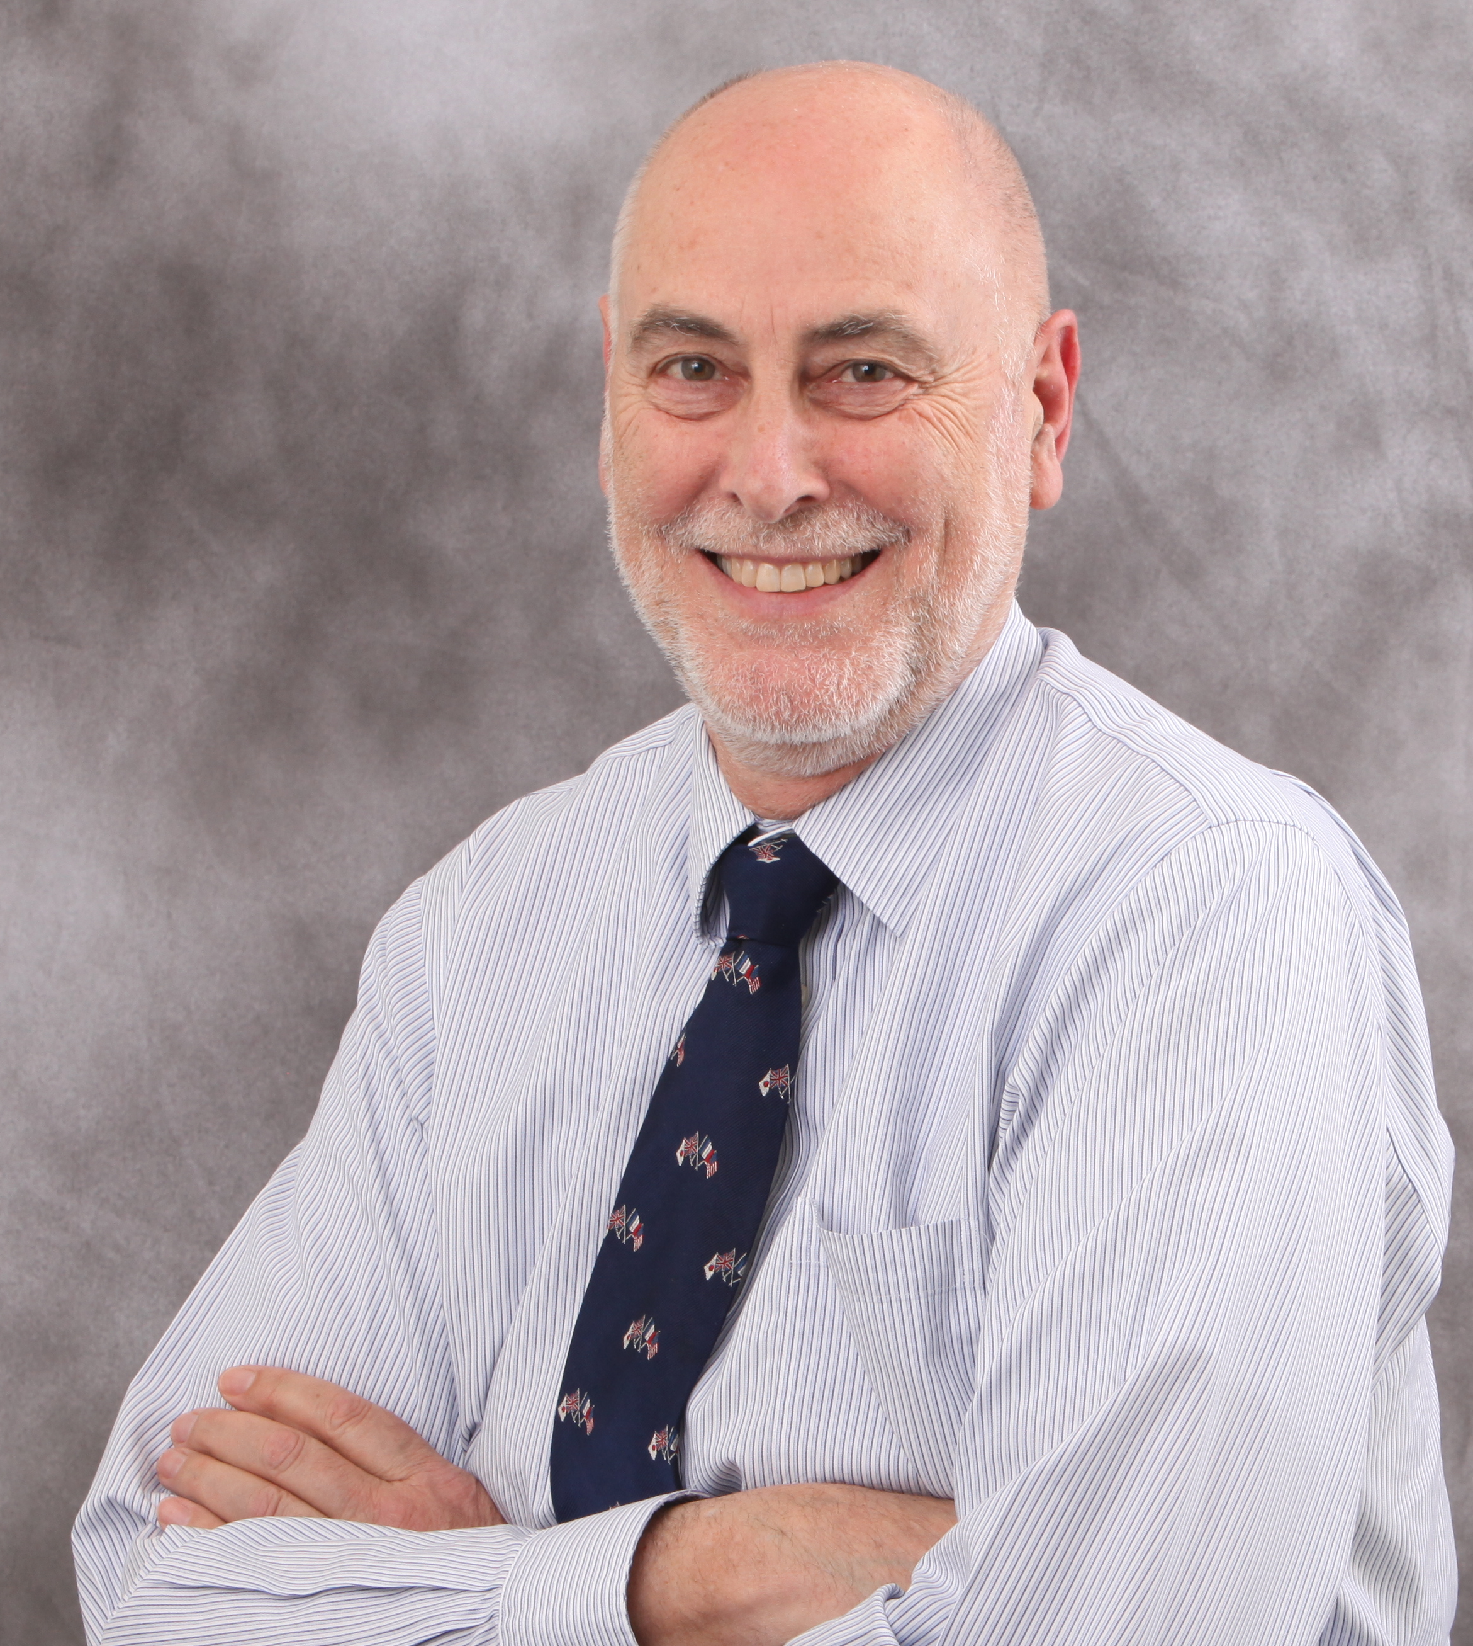

Transitions
Jianwei Qiu selected as AD for Theory and Computation
  Started Oct. 2, 2016
  Ph. D Columbia U. with Al Mueller
  Most recently, Theory Group Leader BNL 2014-16
Andrew Hutton (Associate Director for Accelerator) stepped down April 28, after 25 years
  Thanks for your dedicated service!
  Search Committee: S. Henderson (Chair), S. Holmes (FNAL), K. Kumar (Stony Brook), P. Rossi (Expt. Phys), R. Yoshida (Expt. Phys.), G. Neil (AD), M. Logue (ESH&Q), R. Barbosa (HR)
Fulvia Pilat is serving as Acting Accelerator AD
  Fulvia has accepted position at ORNL, effective in the Fall
  Thanks for your dedicated service!

Slide 5
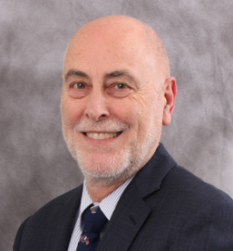
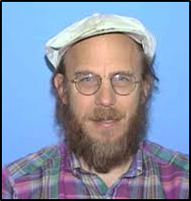
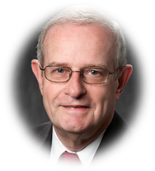



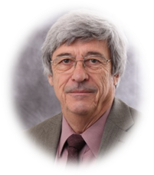
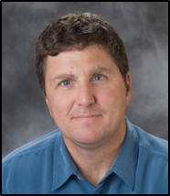
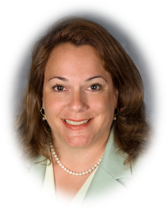
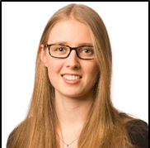

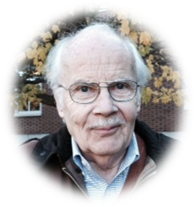
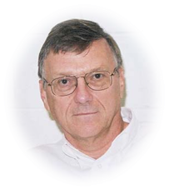
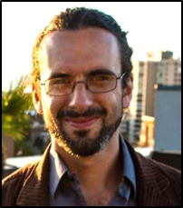
Jefferson Lab Staff and Users Continue to be Recognized for their Accomplishments
APS FELLOW
APS FELLOW
AAAS FELLOWSHIP
…for extensive technical contributions to accelerators world-wide as designer and adviser…
…for invaluable contributions to unraveling the structure of the proton and neutron …
…for his distinguished contributions to the field of Nuclear Theory and Computational Physics…
Andrew Hutton
(Jefferson Lab)
Peter Bosted
(Jefferson Lab/W&M)
Jerry Draayer
(President, SURA)
DOE SECRETARIAL DISTINGUISHED SERVICE AWARD
DOE SECRETARY’S ACHIEVEMENT AWARD
FORBES ’30 Under 30’ in SCIENCE
FRANCES G. SLACK AWARD
…in recognition of over three decades of leadership, distinguished service, and exceptional contributions to research…
…for his role in the LOB General Purpose Infrastructure Crosscut Committee…
‘One of top 30 under 30’ - she investigates gluons, fundamental particles of matter, found in neutrons and protons.
…for her excellence in service to Physics…
Hugh Montgomery
(as Jefferson Lab Director)
Bill Rainey
(Jefferson Lab)
Phiala Shanahan
(Jefferson Lab/W&M)
Cynthia Keppel
(Jefferson Lab )
2017 OUTSTANDING
NUCLEAR PHYSICIST PRIZE
2017 TOM W. BONNER PRIZE IN NUCLEAR PHYSICS
2017 KENNETH G. WILSON AWARD
…for groundbreaking measurements of nucleon structure…
embargoed until 6/23/17
…for his crucial development of polarized electron beam technology…
…for Excellence in Lattice Field Theory: For groundbreaking contributions to the study of resonances using lattice QCD…
2017 OUTSTANDING
NUCLEAR PHYSICIST PRIZE
Charles Sinclair
(Jefferson Lab/Cornell – Retired )
…for his pioneering implementation of polarization transfer …
Raul Briceno
(Jefferson Lab)
Charles Perdrisat
(College of W&M)

Slide 6
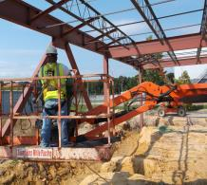
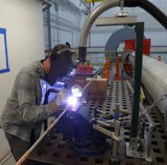
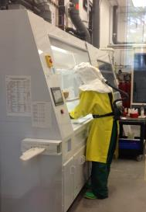
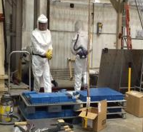
Getting Work Done Safely is Our Highest Priority
Low Injury rates attributable to effective work planning & control
Last DART - December 2016; last subcontractor TRC – 2012
Focus on student safety has been a priority
Recent events point to need for continued vigilance on balanced priorities

Slide 7

Jefferson Lab is an Integral Part of the NSAC Long Range Plan
RECOMMENDATION II
We recommend the timely development and deployment of a U.S.-led ton-scale neutrinoless double beta decay experiment.
RECOMMENDATION III
We recommend a high-energy high-luminosity polarized EIC as the highest priority for new facility construction following the completion of FRIB.
Jefferson Lab EIC (JLEIC) development
RECOMMENDATION IV
We recommend increasing investment in small-scale and mid-scale projects and initiatives that enable forefront research at universities and laboratories.
· MOLLER, SoLID
· Operate 12 GeV CEBAF

Slide 8
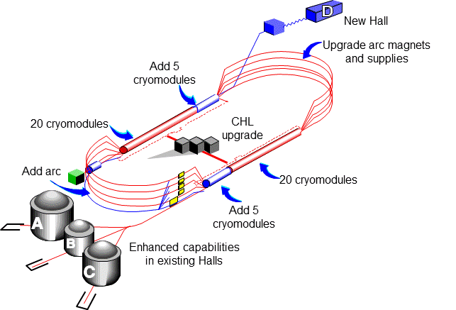
12 GeV CEBAF Upgrade
Completion of the 12 GeV CEBAF Upgrade was ranked the highest priority in the 2007 NSAC Long Range Plan.
Total Project Cost = $338M
Estimate to Complete = $1.2M
Double maximum Accelerator energy to 12 GeV
  Ten new high gradient cryomodules
  Double Helium refrigerator plant capacity
  Civil construction and upgraded utilities
Add 10th arc of magnets for 5.5 pass machine
Add 4th experimental Hall D
New experimental equipment in Halls B, C, D

Slide 9
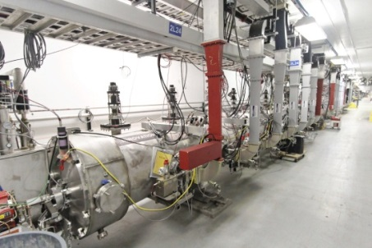
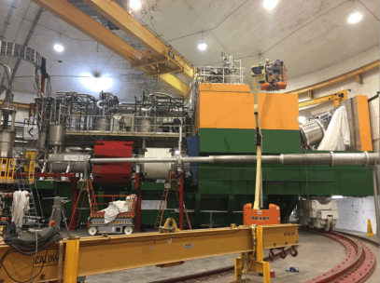
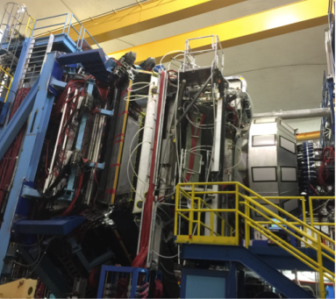
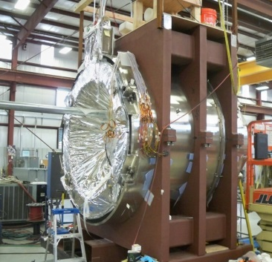
12 GeV Upgrade – Path to Completion
Project (99.7% complete):
Doubling the accelerator beam energy – DONE
Civil construction including utilities – DONE
New experimental Hall D and beam line – DONE
Upgrade to Experimental Hall C – DONE
Upgrade to Experimental Hall B – 99%
Accelerator
  Full 12 GeV energy achieved
  Full luminosity demonstrated
  Simultaneous multi-hall beam delivery achieved
Hall C – Key Performance Parameter demonstrated
  SHMS installed, commissioned with beam
  March 2017
Hall B – Key Performance Parameter demonstrated
  CLAS12 installed, commissioned with beam
  February 2017
Remaining Scope = Solenoid Magnet for Hall B
  Final phase of assembly at vendor completed in June 2017
  June delivery to Jefferson Lab
  Installation and acceptance tests underway
Project Completion September 2017

Slide 10
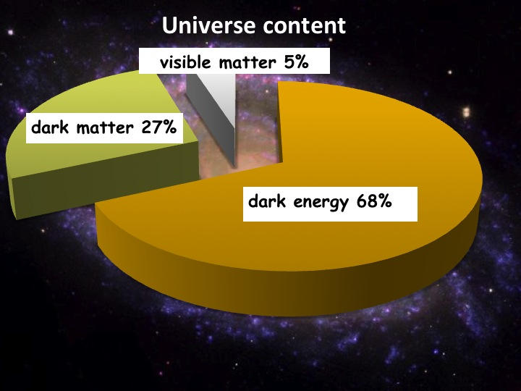
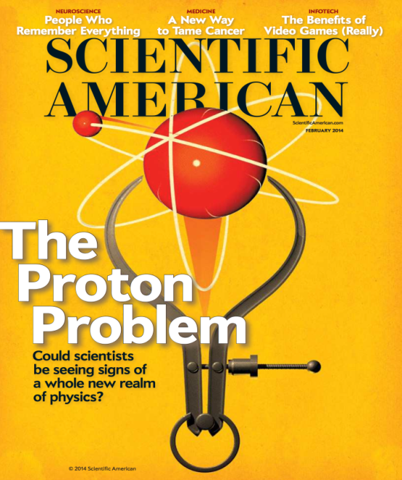
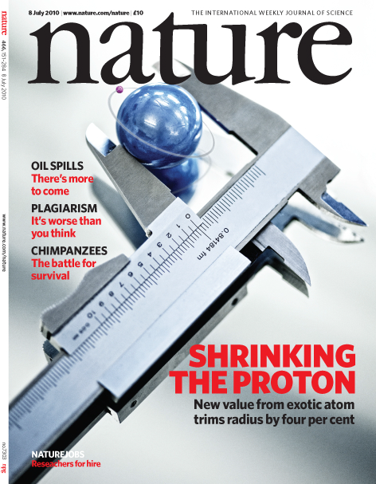
12 GeV Science Era has Begun!
Quark confinement: Hall D (GlueX) started physics operations
  Engineering Run Complete: Basis for > dozen papers at APS DNP Fall 2016 Meeting
  First 12 GeV era publication: 24 April, 2017!
  First physics run: 50 Billion events in Spring 2017
Nucleon Structure(I): Hall A in physics operations
  GMp experiment completed in Fall 2016
  First phase of DVCS experiment completed
Nuclear Structure: First experiment completed
  Argon Spectral Function experiment completed in Hall A in Spring 2017
Fundamental Symmetries: Hall B Heavy Photon Search
  First results of 2015 engineering run presented
Nucleon Structure (II): Hall B Proton Radius (PRad)
  Experiment run and completed Summer 2016
Starting to exploit the Upgrade for Physics

Slide 11
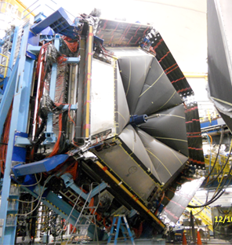
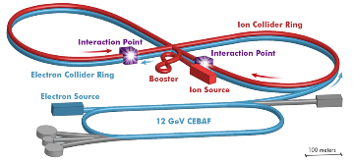
Long-term Vision for Jefferson Lab
Jefferson Lab is a world-leading center for fundamental nuclear science and associated technologies, serving the nuclear physics user community, in support of DOE Office of Science Mission
Enable Community to Deliver Science
Support Larger DOE Mission and Societal Needs
Develop a Path to the Future
1. Providing unique, world-leading facilities and capabilities that enable the nuclear physics user community to successfully deliver scientific discoveries
2. Providing a path - in terms of future facilities and capabilities - that allows the field to realize its long-term scientific ambitions
3. Providing technology solutions that support the NP community, the larger DOE mission and societal needs
Laboratory Operations

Slide 12
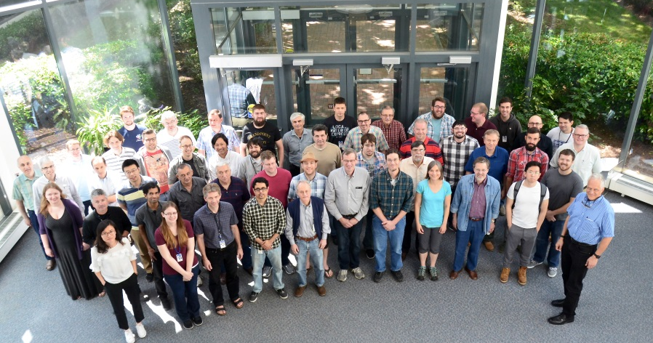
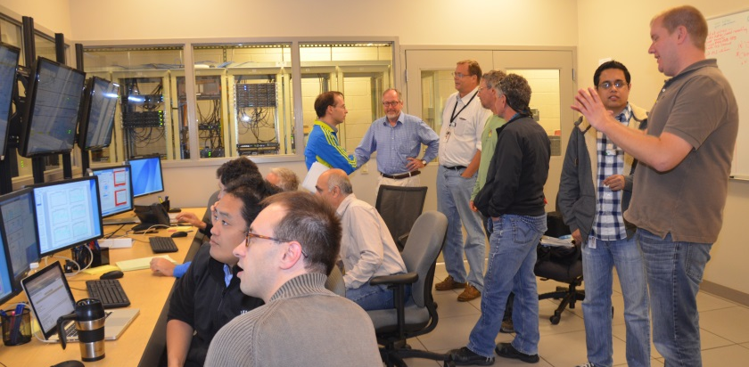
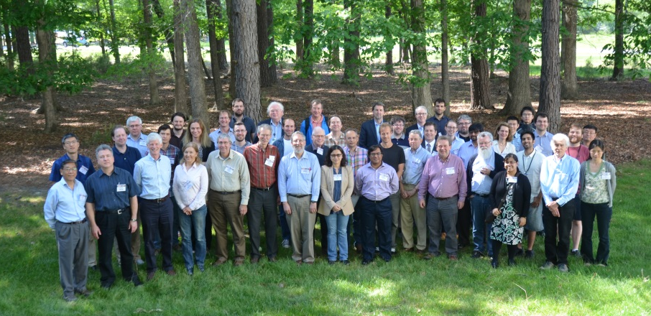
Enabling the Scientific Community to be Successful in Delivering Results
Deliver on the promise of the 12 GeV Upgrade
Successful, efficient and safe operation of the facility
      12 GeV must work as promised and deliver results
Ensure that experimental measurements translate into scientific knowledge
      Provide the community the tools needed to be successful
      Vibrant theory capabilities
      Computational sciences capabilities
Serve as an indispensable partner to the international scientific community
Get the most out of 12 GeV investment through future initiatives: MOLLER and SoLID
Delivering the 12 GeV Science Program is Job One

Slide 13
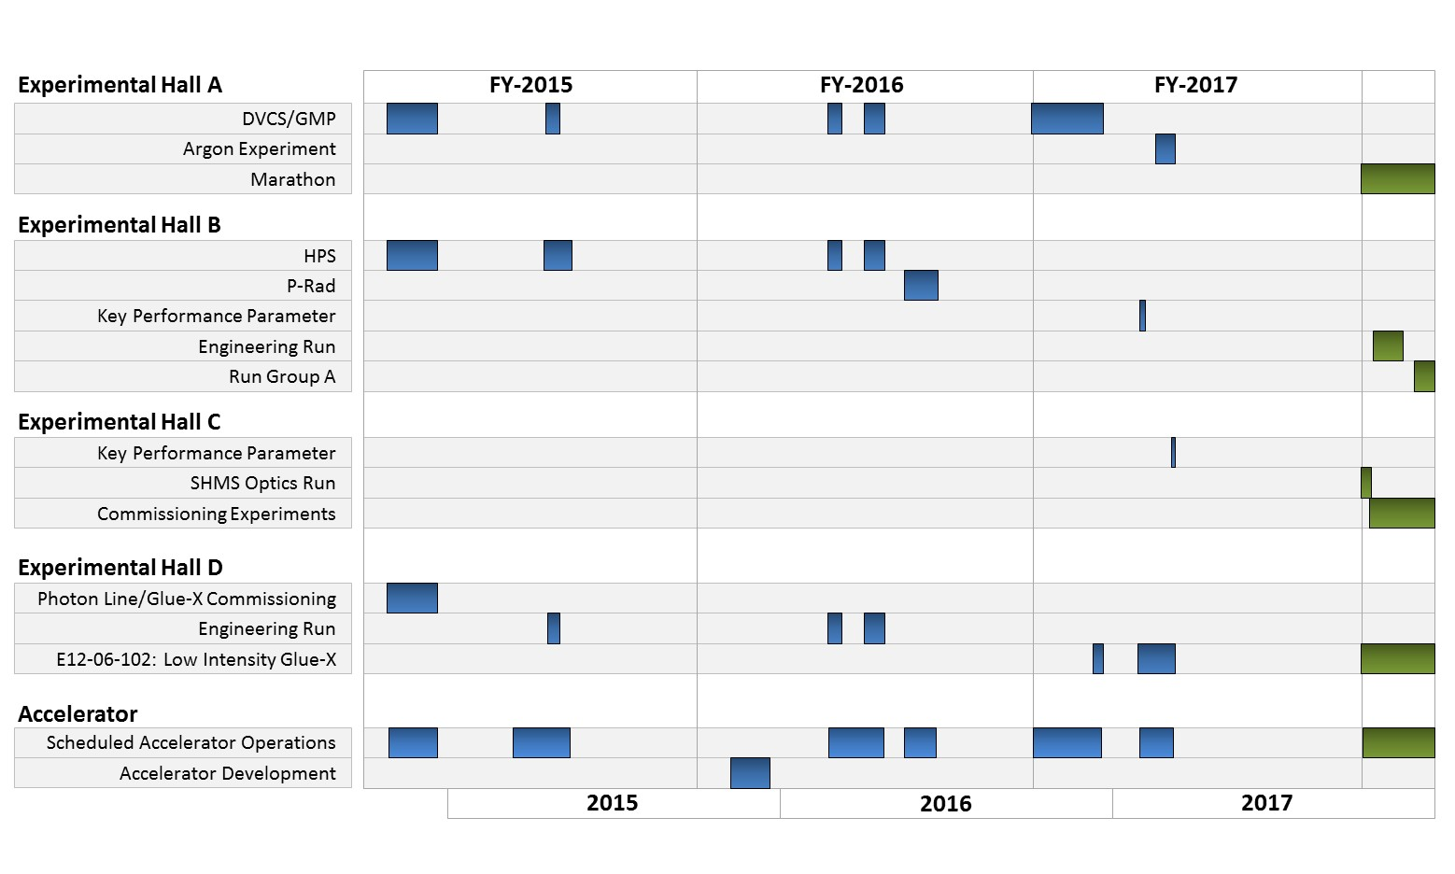
CEBAF Program FY15-17

Slide 14
Planning for Sustainable Long-term CEBAF Operation
12 GeV Upgrade Project provides important capabilities for the future
However, many components and systems are “original equipment”
  Some are difficult to maintain, require adequate spare parts, will reach obsolescence
We have initiated an activity to develop a Reference CEBAF Operations Plan to:
  Define set of performance goals (e.g. reliability, energy, …), informed by scientific objectives, vs. time
  Analyze what it takes to ramp up performance and operate and maintain the facility to serve the needs of the community in both the near and long term.
  Assess, in particular, single-point failures, spares planning, …
  Scope includes accelerator, experimental and site operations
In response to specific challenges with the CHL1 sub-atmospheric cold box, we have formed a Cold Compressor Advisory Committee to advise on the recovery path forward
  The FY17 appropriations includes funding for a new 2K cold-box to remedy this severe vulnerability in the long term
We have augmented the Accelerator Advisory Committee membership and will hold the next meeting Sept. 13-15, 2017

Slide 15

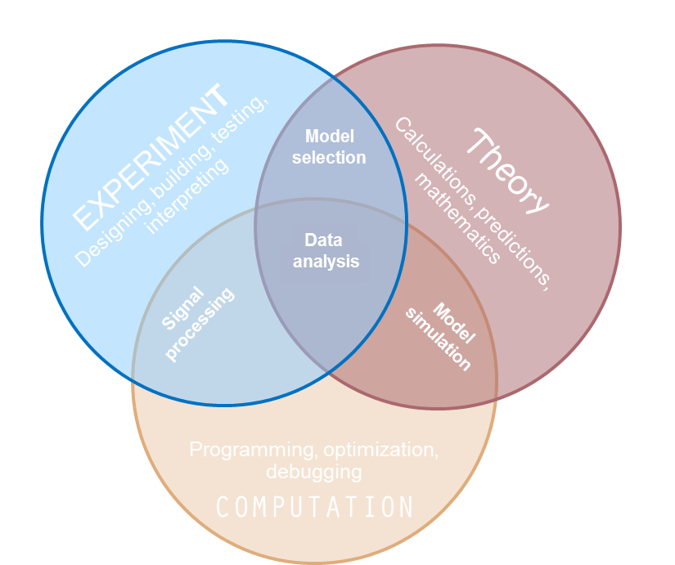
Scientific Computation
Computation is central to all aspects of our NP Program
  Lattice QCD – a traditional strength at JLab
    Dedicated LQCD machine at JLab
      #397 fastest computer in the
      world & #10 Green500
    ASCR: Exascale
  Experimental/computation
    Best in class multi-threaded
    framework
    Balance hardware investments
    (processors and storage)
  Accelerator
    Integrated controls
    Beam simulations
  3D Nucleon Tomography –
  the intersection of Experiment, Theory
  and Computation – a major
  computational challenge!
Parallel
Computing Center
Towards the development of a new Core Capability

Slide 16

Providing a Path that Allows the Field to Realize its Long-term Scientific Ambitions
The NSAC Long-Range Plan presents a vision for a future Electron-Ion Collider in the U.S.
Jefferson Lab must provide leadership to build a plan and the support to carry it out:
Strong community-driven scientific vision and support
Credible, cost-effective technical and project plan
A team capable of delivering the vision
Working with the nuclear physics community and our national laboratory partners
Working in lockstep with ONP, the nuclear physics community and our national laboratory partners

Slide 17

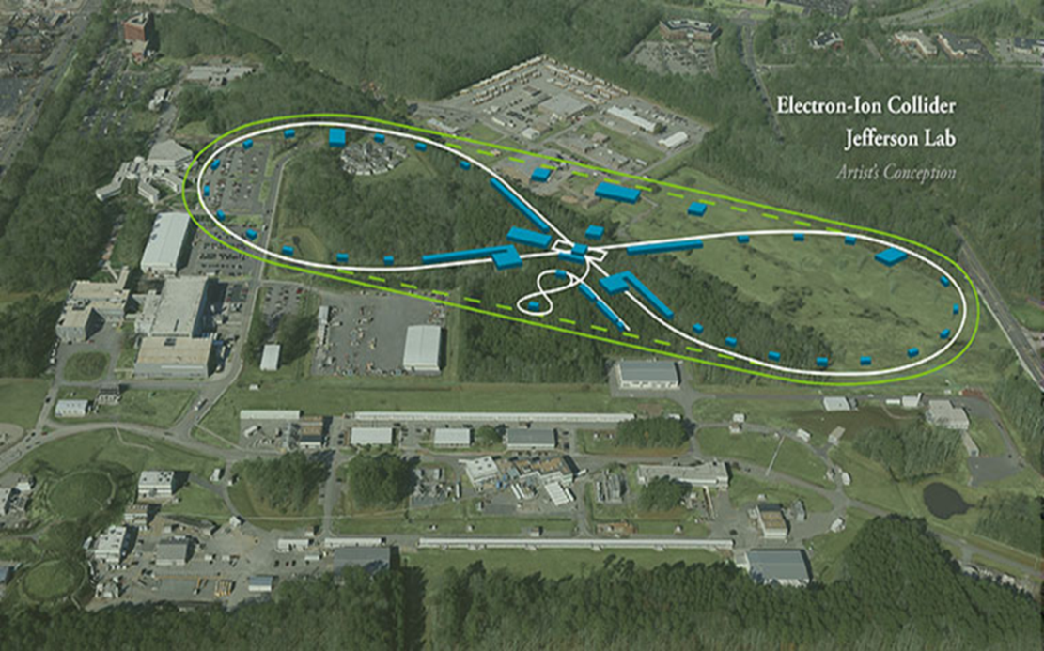

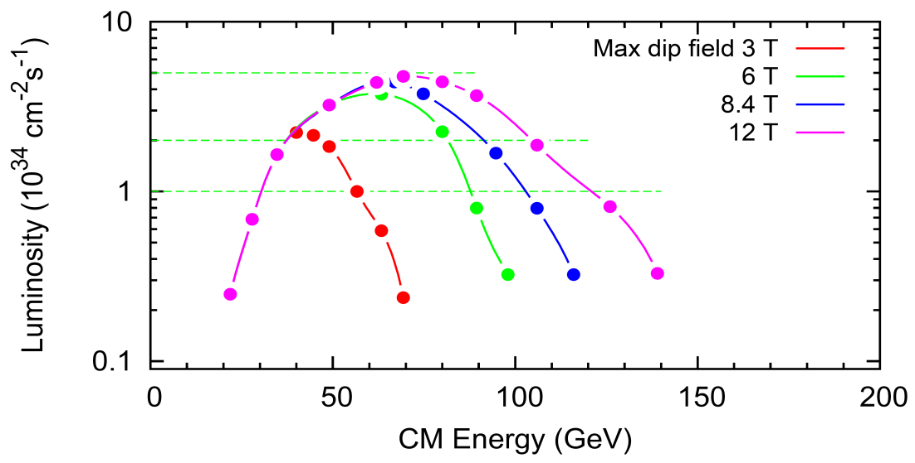
EIC at Jefferson Lab
JLab EIC Figure 8 Concept
    High Polarization
    High Luminosity
    Low technical risk
    Flexible timeframe for construction
    consistent w/running 12 GeV CEBAF
    Cost effective operations
    Fulfills White Paper Requirements
Collaboration with SLAC, LBNL, ANL, BNL
Site evaluation (Virginia funds)
10³⁵
LHC
User group organizing (charter, meetings)
NAS study underway
DOE-NP accelerator R&D program
(FY17-18)
(
10³⁴
10³³

Slide 18
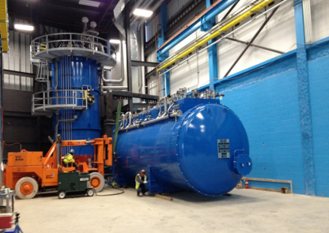
Technology Solutions Supporting the NP Community, Larger DOE Mission and Societal Needs
Build upon TJNAF position as the “go to” lab for Superconducting RF technology, cryogenics and sources
Deliver on Jefferson Lab’s commitment to LCLS-II and FRIB and lay the groundwork for future SRF projects
LCLS-II Prototype Cryomodule
Aggressively explore opportunities to make a difference in society, partnering with federal and industry partners where appropriate
FRIB Refrigerator Installation
Jefferson Lab strives to be an indispensable partner to Office of Science while pursuing opportunities beyond

Slide 19
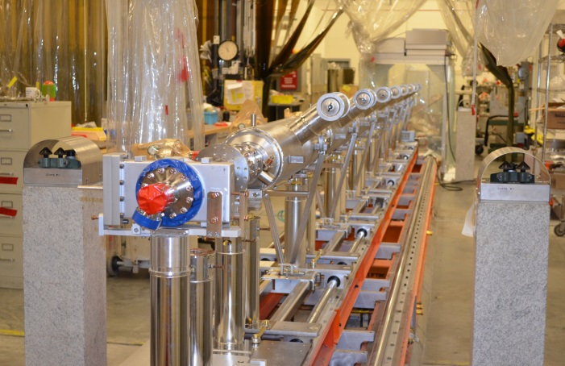
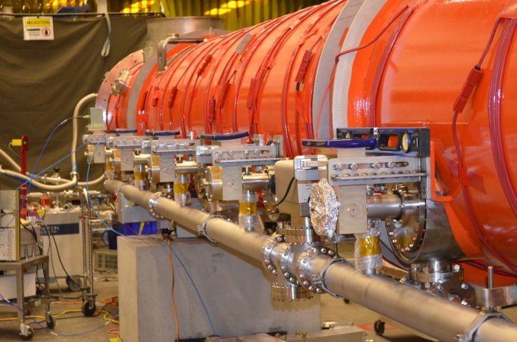
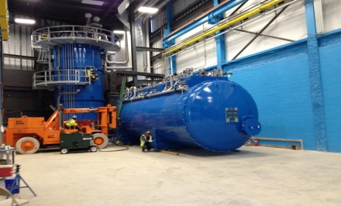
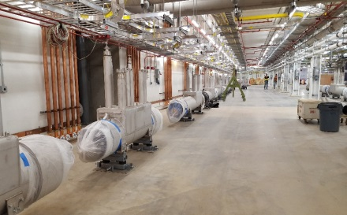
Technology Partnerships – LCLS II and FRIB
Jefferson Lab Scope | Cryogenic plant design and acquisition Cryomodule and cavities for half of linac Qo R&D, LLRF, machine physics | Cryogenic refrigerator and distribution system design, procurement, fabrication, and integration Engineering and design finalization for two cryomodule styles of six required for FRIB
Status | Cryomodule production underway Preparations for additional cryomodule production – procurements and assembly Cryoplant and CP installation design is nearing completion Final Design Review completion and closeout this summer Major Cryogenic equipment arriving at SLAC | Warm compressor systems installed and cycled 4.5K coldbox installed and warm piping complete All linac transfer lines delivered including sections built by JLab with installation continuing. 2K coldbox design being finalized by FRIB Cryomodule designs completed All FRIB scope complete; available for consulting
LCLS-II Project
FRIB Project
LCLS II 1.3 GHz cavity string
LCLS II Cryomodule
4K Coldbox Installation
Tunnel Transfer Lines

Slide 20
Budget Summary
On May 23, 2017 the President’s FY18 Budget Request to Congress was released
  DOE Office of Science funding is reduced by $900M
Budget Request - Office of Nuclear Physics:
Budget Request - Jefferson Lab NP Funding (w/o 12 GeV Upgrade Project)
Congress is responsible for appropriations:
  House E&WD appropriations subcommittee draft bill holds DOE Office of Science ~flat at $5.4B
FY16
FY17
FY18
18.5% reduction
$617 M
$622 M
$503 M
FY16
FY17
FY18
11.5% reduction
$107.6 M
$109.3 M
$96.8 M

Slide 21
Summary
12 GeV CEBAF is a unique world-leading facility for nuclear physics research
  Powers a very exciting Physics program spanning the breadth of nuclear physics with many opportunities for discovery
  Early high-impact physics underway - results emerging
  We are eager to start full-blown 12 GeV operations!
Electron Ion Collider is the next-generation facility for nuclear physics
  Strong and growing community interest, national and international
  Strong JLEIC design based on CEBAF as injector
Jefferson Lab plays a unique and central role in technology serving the larger DOE mission
  FRIB, LCLS-II, and strong potential for future opportunities
Jefferson Lab is in a very strong position going forward, with great promise for scientific and technical advances

Slide 23
FY18 President’s Budget Request Narrative
Full narrative on DOE website. Excerpts follow:
Research:
  “Initial experimental and theoretical exploitation of the new capabilities enabled by the 12 GeV CEBAF Upgrade to unravel the mechanism of quark confinement”
  “The funding decrease results in an overall reduction in laboratory and university research in the FY 2018 Request”
Facility Operations:
  “CEBAF operates for 1,070 hours (~10 weeks) to launch the highly anticipated science program of the newly constructed 12 GeV machine and associated experimental instrumentation.”
  “Investments in maintaining and/or improving operational reliability and new facility capabilities, such as capital equipment and accelerator improvement projects, are paused, and efforts are redirected to operation of the facility to enable world-class science and the optimization of existing capabilities.”
  “Reduced accelerator R&D efforts at TJNAF focus on high priority activities.”
  “Reductions in facility staff are expected.”
Theory
  “…an overall reduction of approximately 27% in laboratory and university research staff.”
  “Funding will also support the second year of SciDAC-4 grants and the third year of the theory topical collaborations initiated in FY 2016.”

Slide 24
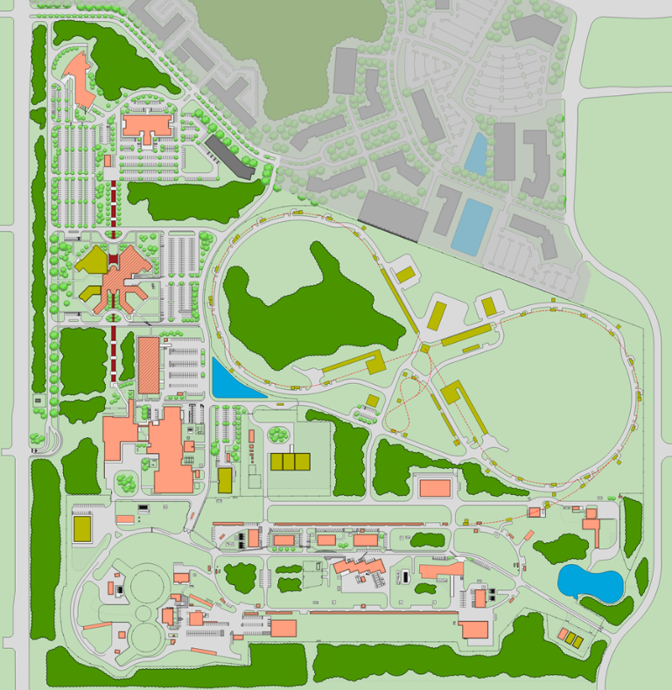
Campus Plan – 2028
Tech Center One
CEBAF Center Renovation
and Wing D
JLEIC Site
EEL
Storage Building
Shipping and Receiving Building
Facility Operations Building
ESH&Q Building
Physics Technical Support Building
ESR 2
CHL Cold Box Replacement

