Slide 1

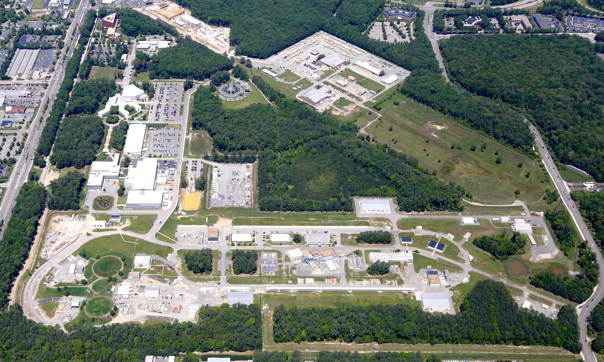
PAC45 Charge
R. D. McKeown
Jefferson Lab
PAC45
July 10, 2017

Slide 2
12 GeV Approved Experiments by Physics Topics
Topic | Hall A | Hall B | Hall C | Hall D | Other | Total
Hadron spectra as probes of QCD | 0 | 3 | 1 | 3 | 0 | 7
Transverse structure of the hadrons | 5 | 4 | 3 | 1 | 0 | 13
Longitudinal structure of the hadrons | 2 | 3 | 6 | 0 | 0 | 11
3D structure of the hadrons | 5 | 9 | 7 | 0 | 0 | 21
Hadrons and cold nuclear matter | 7 | 3 | 7 | 0 | 1 | 18
Low-energy tests of the Standard Model and Fundamental Symmetries | 3 | 1 | 0 | 1 | 1 | 6
Total | 22 | 23 | 24 | 5 | 2 | 76
Total Experiments Completed | 2.5 | 1.1 | 0 | 0.4 | 0 | 4.0
Total Experiments Remaining | 19.5 | 21.9 | 24 | 4.6 | 2 | 72.0

Slide 3
12 GeV Approved Experiments by PAC Days
Topic | Hall A | Hall B | Hall C | Hall D | Other | Total
Hadron spectra as probes of QCD | 0 | 319 | 11 | 540 | 0 | 870
Transverse structure of the hadrons | 145.5 | 185 | 110 | 25 | 0 | 465.5
Longitudinal structure of the hadrons | 65 | 230 | 165 | 0 | 0 | 460
3D structure of the hadrons | 409 | 872 | 212 | 0 | 0 | 1493
Hadrons and cold nuclear matter | 208 | 175 | 201 | 0 | 14 | 598
Low-energy tests of the Standard Model and Fundamental Symmetries | 547 | 180 | 0 | 79 | 60 | 866
Total Days | 1375 | 1961 | 699 | 644 | 74 | 4753
Total Days - Without MIE Days | 556.5 | 1961 | 699 | 644 | 28 | 3889
Total Approved Run Group Days (includes MIE) | 1375 | 926 | 637 | 424 | 74 | 3436
Total Approved Run Group Days (without MIE) | 556.5 | 926 | 637 | 424 | 28 | 2572
Total Days Completed | 83 | 30 | 0 | 48 | 0 | 161
Total Days Remaining | 473.5 | 896 | 637 | 376 | 28 | 2411
“A Decade of Experiments” – could be 6 or 15+ pending budgets etc.

Slide 4
PAC45
2 returning C2
11 new proposals
1 new run group (Hall B)
3 run group additions
3 LOI’s
Charge:
Review new proposals, previously conditionally approved proposals, and letters of intent for experiments that will utilize the 12 GeV upgrade of CEBAF and provide advice on their scientific merit, technical feasibility and resource requirements.
Identify proposals with high-quality physics that, represent high quality physics within the range of scientific importance represented by the previously approved 12 GeV proposals and recommend for approval.
Also provide a recommendation on scientific rating and beam time allocation for proposals newly recommended for approval.
Identify other proposals with physics that have the potential for falling into this category pending clarification of scientific and/or technical issues and recommend for conditional approval. Provide comments on technical and scientific issues that should be addressed by the proponents prior to review at a future PAC.

Slide 5
Conditional Approval
Two types:
C1 – Approval pending technical review,
no need to return to PAC
C2 – Approval pending further review by
future PAC

Slide 6
Proposals with Parallel Running
Parallel running procedure
  Intent is to encourage new proposals of “run groups”
– Summary only of additions to existing run group (PAC to comment)

Slide 7
Policy on Equipment Availability
Categories for resource availability:
– Stage I: resources need to be identified/obtained
– Stage II: resources are essentially available
This will be considered a Laboratory issue
(not for PAC).

Slide 8
High Impact
For newly approved Stage II proposals, PAC should consider if any of these should be included in the “High Impact” category to receive priority for scheduling in the early (first 3-5 years) running.

Slide 9
PAC Report
Draft report text must be complete before closeout on Friday. We will review all the draft text Friday morning before the closeout.
Susan Brown will assemble the draft text into a report for a final round of edits by email during 2 weeks following the PAC meeting.

Slide 10
Role of User Chair on PAC
Monitor communications between PAC and spokespersons – identify issues.
Monitor PAC meeting proceedings for conflicts of interest.
Monitor PAC meeting proceedings to identify issues of fairness and ethical behavior.
Participate in all scientific discussions to provide additional expertise (except where there is a conflict of interest)

Slide 11
Communication with PAC
Communication with PAC members should be limited to:
Submission of proposal before the deadline
Presentation/discussion at PAC meeting, must be in-person (not remote connection)
Responses from spokespersons and/or contact person to inquiries from PAC for further information or clarification
Note: TAC reports are not public documents – please do not distribute beyond your collaboration.

Slide 12
New Proposals for PAC45
002, 003, 004, 005, 006, 007, 010, 011 would be Stage II if approved

Slide 13
New Run Group Proposals
This would be Stage I if approved

Slide 14
Conditional Returning for Approval
These would be Stage I if approved

Slide 15
Parallel Running Additions
These run in parallel with previously approved or conditionally approved proposals. So they are considered already approved (or conditional) and are presented by collaborations – the PAC will provide a written comment for each of these in the report.

Slide 16
Letters of Intent
Letters of intent will be given the same “rights” to their scientific ideas as are
currently afforded to deferred experiments: LOI has established a claim to a physics measurement that lasts for the next two successive PAC meetings.

Slide 17
Jeopardy
Process
Requested a proposal from UGBOD at January 2016 meeting. UGBOD gave some guidance, but not consensus.
Generated a proposal in April, sent to hall leaders and UGBOD. Got email feedback from UGBOD.
Added explanatory text to address feedback from UGBOD.
May 2016 – reached consensus on present draft for discussion at user meeting.
Rationale
Use normal yearly PAC for ~4 years to address all presently approved proposals that have not been scheduled, plus new proposals in the next few years. Estimate ~5-10 proposals per meeting
Will start in 2019 to reach steady state in 2024 - proposals that have been approved for 4 years or more but are not scheduled will be considered in Jeopardy.

