Slide 1
PAC45
Hall B Run Group Additions
Volker Burkert
Jefferson Lab
Organization of Hall B Run Groups
PAC45 Proposals
Run group experiment review procedure
Experiment E12-012-001A
Statement from CLAS Collaboration Review Committee

Slide 2
Hall B – Run Groups
Hall B
Proposal | Physics | Contact | Rating | Days | Group | New equipment | Energy | Run Group | Target
E12-06-108 | Hard exclusive electro-production of π⁰, η | Stoler | B | 80 | 139 | RICH (1 sector) Forward tagger | 11 | A F. Sabatié | liquid H₂
E12-06-108A | Exclusive N*->KY Studies with CLAS12 | Carman |  | (60)
E12-06-108B | Transition Form Factor of the η’ Meson with CLAS12 | Kunkel |  | (80)
E12-06-112 | Proton’s quark dynamics in SIDIS pion production | Avakian | A | 60
E12-06-112A | Semi-inclusive Λ productiuon in target fragmentation region | Mirazita |  | (60)
E12-06-112B | Colinear nucleon structure at twist-3 | Pisano |  | (60)
E12-06-119(a) | Deeply Virtual Compton Scattering | Sabatie | A | 80
E12-09-003 | Excitation of nucleon resonances at high Q² | Gothe | B+ | 40
E12-11-005 | Hadron spectroscopy with forward tagger | Battaglieri | A- | 119
E12-11-005A | Photoproduction of the very strangest baryon | Guo |  | (120)
E12-12-001 | Timelike Compton Scatt. & J/ψ production in e+e- | Nadel-Turonski | A- | 120
E12-12-001A | J/ψ Photoproduction & study of LHCb pentaquarks | Stepanyan |  | (120)
E12-12-007 | Exclusive φ meson electroproduction with CLAS12 | Stoler, Weiss | B+ | 60
E12-07-104 | Neutron magnetic form factor | Gilfoyle | A- | 30 | 90 | Neutron detector RICH (1 sector) Forward tagger | 11 | B K. Hafidi | liquid D₂ target
E12-09-007(a) | Study of partonic distributions in SIDIS kaon production | Hafidi | A- | 30
E12-09-008 | Boer-Mulders asymmetry in K SIDIS w/ H and D targets | Contalbrigo | A- | 56
E12-09-008A | Hadron production in target fragmentation region | Mirazita |  | (60)
E12-09-008B | Colinear nucleon structuer at twist-3 | Pisano |  | (60)
E12-11-003 | DVCS on neutron target | Niccolai | A | 90
E12-11-003A | In medium structure functions, SRC, and the EMC effect | Hen |  | (90)
Beam time partial sum |  |  |  | 765 (1475) | 229
Experiment ending with A or B are run group experiments approved by the CLAS collaboration. They are running parallel to the experiments with same experiment number. Experiments ending with (a) and (b) take data with both run groups.

Slide 3
Hall B – Run Groups
Hall B
E12-06-109 | Longitudinal Spin Structure of the Nucleon | Kuhn | A | 80 | 185 | Polarized target RICH (1 sector) Forward tagger | 11 | C S. Kuhn | NH₃ ND₃
E12-06-109A | DVCS on the neutron with polarized deuterium target | Niccolai |  | (60)
E12-06- 119(b) | DVCS on longitudinally polarized proton target | Sabatie | A | 120
E12-07-107 | Spin-Orbit Correl. with Longitudinally polarized target | Avakian | A- | 103
E12-09-007(b) | Study of partonic distributions using SIDIS K production | Hafidi | A- | 80
E12-09-009 | Spin-Orbit correlations in K production w/ pol. targets | Avakian | B+ | 103
E12-06-106 | Color transparency in exclusive vector meson production | Hafidi | B+ | 60 | 60 |  | 11 | D
E12-06-117 | Quark propagation and hadron formation | Brooks | A- | 60 | 60 |  | 11 | E | Nuclear
E12-06-113 | Free Neutron structure at large x | Bueltman | A | 42 | 42 | Radial TPC | 11 | F | Gas D₂
E12-14-001 | EMC effect in spin structure functions | Brooks | B+ | 55 | 55 | Pol. LiH target | 11 | G | _{LiH}
TOTAL CLAS12 run time (approved experiments) |  |  |  | 1466 (2238) | 631
Proposal | Physics | Contact | Rating | Days | Group | Equipment | Energy | Group | Target
C12-11-111 | SIDIS on transverse polarized target | Contalbrigo | A | 110 | 110 | Transverse target | 11 | H | HD
C12-12-009 | Transversity w/ di-hadron on transvere target | Avakian | A | 110
C12-12-010 | DVCS with transverse polarized target in CLAS12 | Elouadrhriri | A | 110
All CLAS12 transverse target proposals |  |  |  | 330 | 110
E12-11-006 | Heavy Photon Search at Jefferson Lab (HPS) | Jaros | A | 180 | 180 | Setup in alcove | 2.2, 6.6 | I | Nuclear
E12-11-106 | High Precision Measurement of the Proton Charge Radius | Gasparian | A | 15 | 15 | Primex | 1.1, 2.2 | J | H2 gas
Beam time request from CLAS12 C1 experiments + non-CLAS12 experiments |  |  |  | 525 | 305
Beam time from approved CLAS12 experiments (from previous table) |  |  |  | 1466 (2238) | 631
Beam time for Hall B experiments table 1 + table 2 (incl. 110 days of C1 approved exp.) |  |  |  | 1991 (2763) | 936

Slide 4
Hall B – Run Groups
Hall B
Proposal | Physics | Contact | Rating | Days | Group | Equipment | Energy | Group | Target
E12-16-010 | A search for Hybrid Baryons in Hall B with CLAS12 | D’Angelo | A- | 100 | 100 | Forward Tagger | 6.6, 8.8 | K Confinement & Strong QCD | lH2
E12-16-010A | Nucleon Resonances in exc. KY electroproduction | Carman | A- | (100)
E12-16-010B | DVCS with CLAS12 at 6.6 and 8.8 GeV | Elouadrhiri | A- | (100)
Total Beam time of Run Group K |  |  |  | 100 (300) | 100
Beam time of approved & C1 approved CLAS12 experiments from table 1 + table 2 |  |  |  | 1991 (2763) | 936
Beam time for Hall B experiments table 1 + table 2 + table 3 |  |  |  | 2091 (3063) | 1036
Proposal Count | Experiment Days | Run Groups | RG days | Compression
37 | 3063 | 11 | 1036 | 0.34
Ideally we expect experiment schedule:
- 35 weeks per year ≈ 35/2 = 17.5 PAC weeks = 122.5 PAC days
- With 0.8 Hall multiplicity => 122.5 x 0.8 = 98 PAC days
- To run 3063 PAC days of individual experiments = 30 years
- Run 3063 PAC days as run groups = 1036/98 = 10.5 years

Slide 5
PAC45 – Hall B Proposed Experiments
Proposals Physics Topic Contact Days
PR12-17-006 Critical Neutrino-Nucleus Issues Hen 41
PR12-17-009 Deuteron Charge Radius with Elastic eD Scattering Gasparian 39
New RG Proposal ALERT (RG-L)
PR12-17-012 Partonic Structure of Light Nuclei Meziani 35
PR12-17-012A Tagged EMC measurements on Light Nuclei Dupre 45
PR12-17-012B Spectator-Tagged DVCS on Light Nuclei Armstrong 45
PR12-17-012C Other Physics Opportunities w/ ALERT Hafidi 55
Total Beam Time Requested 55
RG Experiment RG-A
E12-12-001A Near threshold J/ψ production – LHCb pentaquark Stepanyan
Letters of Intent
LOI12-17-001 Study of J/ψ Photoproduction off Deuteron Ilieva
LOI12-17-002 Search for a φN bound state at Hall B Gao
New beam time request for Hall B Proposals: 135

Slide 6

Run Group Review Procedure
Experiment will use already approved beam time
Run conditions are identical to the already approved experiment (beam & target conditions, magnetic fields, detector settings, etc.)
Chair of PWG assigns review committee
Committee reviews the proposal, communicates with proponents and with contact person of possibly affected approved experiment
If committee is satisfied it issues report to the working group chair
Working group chair informs CLAS chair about result of the review
Internal CLAS review aims to address the subject with same rigor as a PAC review would, both in terms of science and feasibility

Slide 7
New Run Group proposal – JLAB PAC45
and the
CLAS collaboration
* Co-spokespersons
Extend measurements of approved CLAS12 experiment E12-12-001 “Time-like Compton scattering and J/ψ production in e⁺e⁻”
Includes J/𝜓→𝜇⁺𝜇⁻ decay mode
Study charmed pentaquarks, P_{c}(4380) and P_{c}(4450).

Slide 8
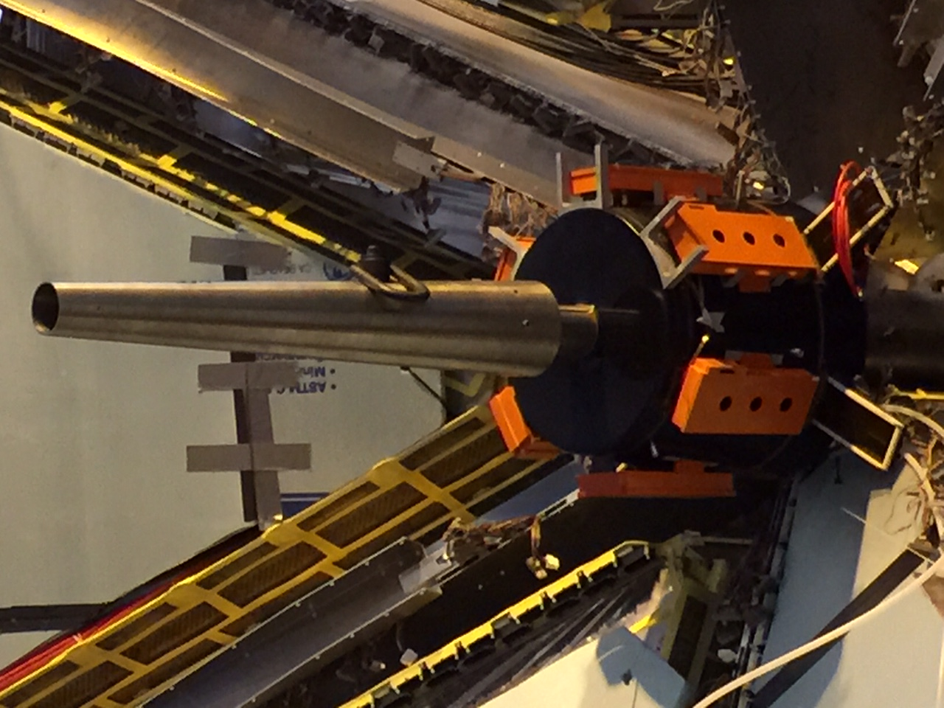
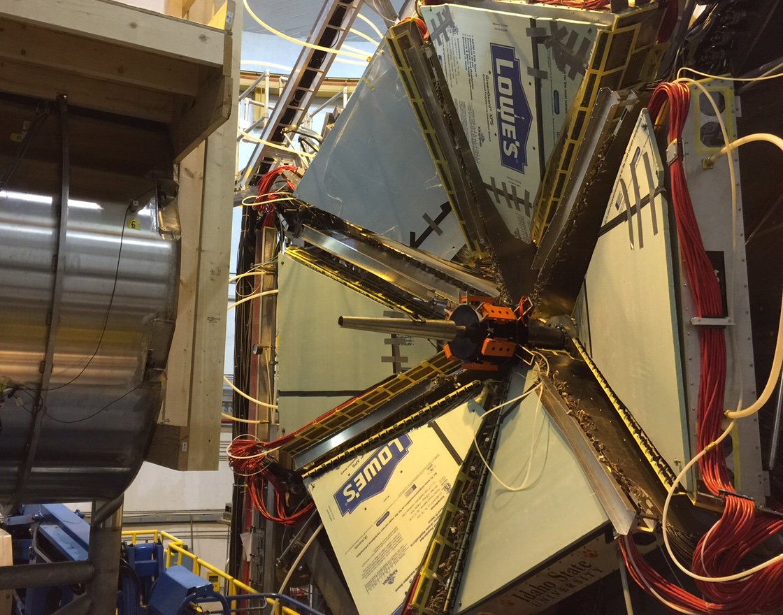
Hall-B CLAS12 experiment
Untagged photoproduction – à la CLAS and proposed E12-12-001 analysis:
  Recoil proton and decay leptons will be detected in CLAS12 FD
  Kinematics of the scattered electron will be reconstructed in the missing momentum analysis
Tagged photoproduction – as CLAS12 MesonX:
  Scattered electron will be detected in the CLAS12 FT, Q² < 0.02 GeV²
  Multiple combination of hadronic final state (the recoil proton and the J/𝜓 decay leptons) will be detected in CLAS12 FD
Forward Tagger calorimeter
Forward Tagger
Forward Detector (FD)
(𝜇⁺)
(𝜇⁻)
Moller shield

Slide 9

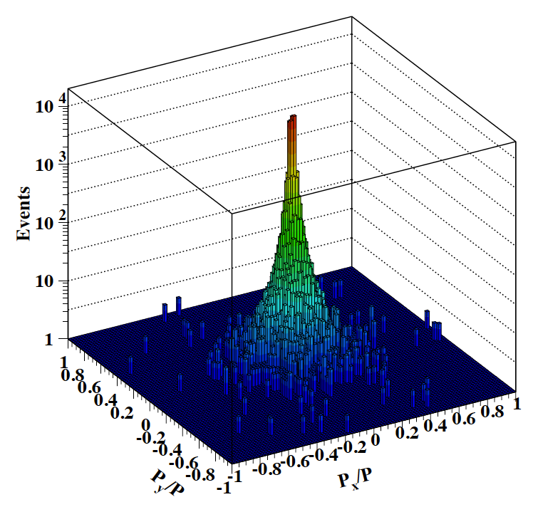

CLAS12 performance – untagged photoproduction
Recoil proton and decay leptons are detected
Kinematics of the scattered electron will be reconstructed in the missing momentum analysis - requires missing transverse momentum to be ~0
Acceptance covers the mass range of charmed pentaquarks
Missing electron transverse momentum
$$P_{c}$$

Slide 10
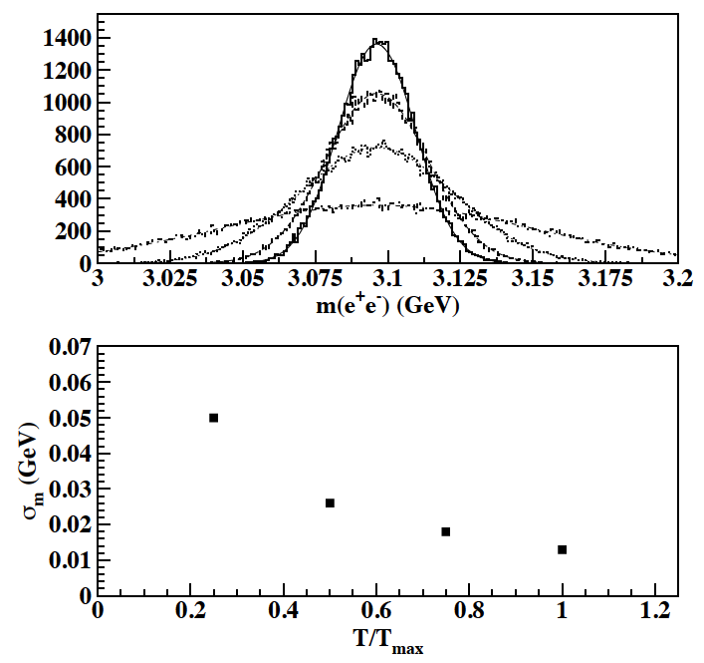
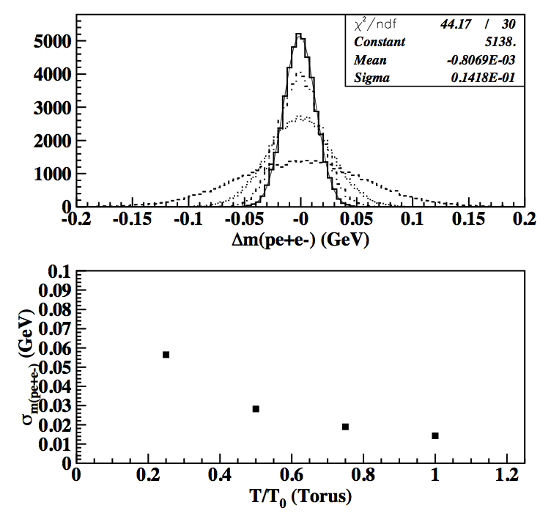
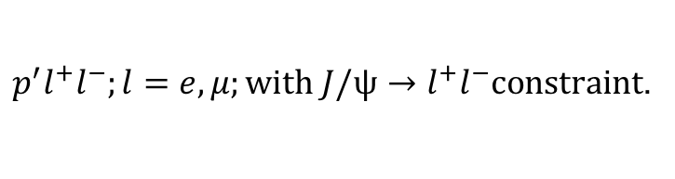
Mass resolutions
J/𝜓 will be identified in the lepton pair invariant mass analysis.
Charmed pentaquarks, P_{c}(4380) and P_{c}(4450), will be identified in the invariant mass of
$p^{′}l^{+}l^{−};l=e,μ;with J/ψ→l^{+}l^{−}constraint$.
J/ψ mass resolution
P_{c} mass resolution

Slide 11

CLAS12 performance – tagged photoproduction
About x10 lower photon flux
Multiple final states to measure J/𝜓 photoproduction
Excellent mass resolutions:
  J/𝜓 as sharp peak either in the invariant mass of decay leptons or in the electron-proton missing mass
  Pentaquarks will be reconstructed in the missing mass analysis of the scattered electron (W-distribution)
$$ep→{e′p}^{′}l^{+(−)}{(l}^{−(+)});l=e,μ$$
Detection efficiency ~28%
$$ep→e^{′}l^{+}l^{−}\left(p^{′}\right);l=e,μ$$
Detection efficiency ~18%

Slide 12
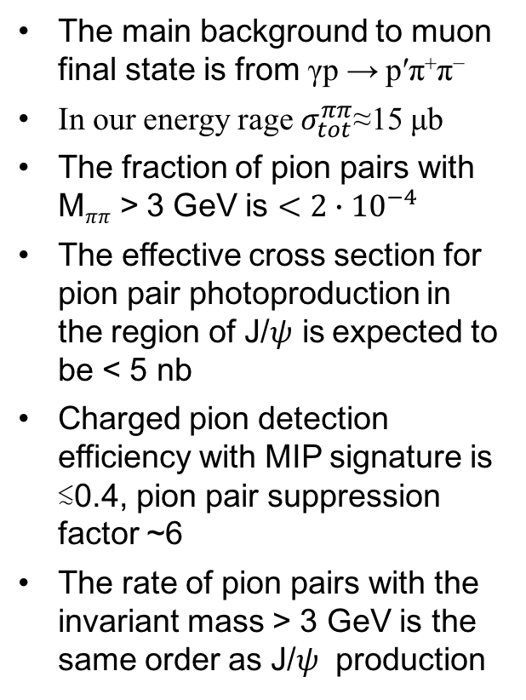

Muon final state
𝜌
K. Abe et al., Phys. Rev. Lett. 53, 751 (1984)
The main background to muon final state is from γp → p′π⁺π⁻
In our energy rage $σ_{tot}^{ππ}$≈15 μb
The fraction of pion pairs with M_{𝜋𝜋} > 3 GeV is $<2∙{10}^{−4}$
The effective cross section for pion pair photoproduction in the region of J/𝜓 is expected to be < 5 nb
Charged pion detection efficiency with MIP signature is ≲0.4, pion pair suppression factor ~6
The rate of pion pairs with the invariant mass > 3 GeV is the same order as J/𝜓 production
$$ρ′′$$
EC-total energy < 200 MeV
EC-outer energy < 100 MeV

Slide 13
J/𝜓 Triggers
The final states that will have an electron or a positron in CLAS12 FD will be a subset of events recorded using the CLAS12 electron trigger
For final states with muons
  two charged particles detected in CLAS12 FD with 0.3 − 3 GeV electron cluster in the FT
  three charged particles in CLAS12 FD
ª subset of trigger #1

Slide 14
CLAS12 expected results
From the two gluon exchange prediction for cross section, we expect total of 45 J/𝜓 detected per day in the full energy range
Expected total number of charmed pentaquarks 98 per day
Compared to -
The Hall-C E12-16-007 with the same cross section formalism will detect 70 pentaquarks per day
With current luminosity Hall-D GlueX experiments expects 5-10 J/𝜓 per day
The Hall-A experiment E12-12-006 with future SoLID detector expects ~42 J/𝜓 per day

Slide 15
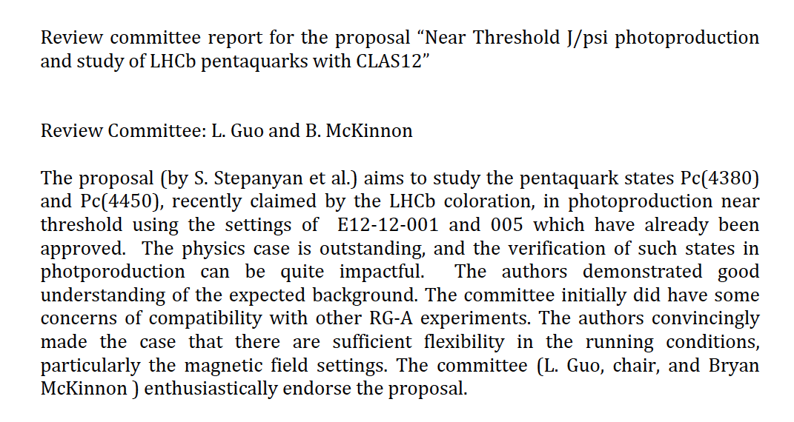
Review Committee Statement

Slide 17
Report from Review Committee
From: Marco Battaglieri <battaglieri@ge.infn.it
Subject: Fwd: CLAS12 Jpsi-P Pentaquark proposal review
Date: May 15, 2017 at 5:30:48 PM EDT
To: Gerald Gilfoyle <gilfoyle@jlab.org>
Cc: Lei Guo <lguo@jlab.org>, Bryan McKinnon <Bryan.McKinnon@glasgow.ac.uk>, Stepan Stepanyan stepanyan@jlab.org
Dear Jerry,
Lei and Brian, just finished the WG review of the pentaquark proposal (S.Stepanyan et al.) providing full endorsement to run as a part of RG-A.
Thanks to Lei and Brian: their thorough review improved the proposal a lot!
We should be ready to send the proposal to the whole collaboration. All exchanged documents between authors and the committee are available here: https://www.jlab.org/Hall-B/shifts/index.php?display=admin&task=paper_review&rid=4284893&operation=view.
Let me know if you need any further information/material.
Cheers, Marco (chair of HSWG)

Slide 18
