Slide 1
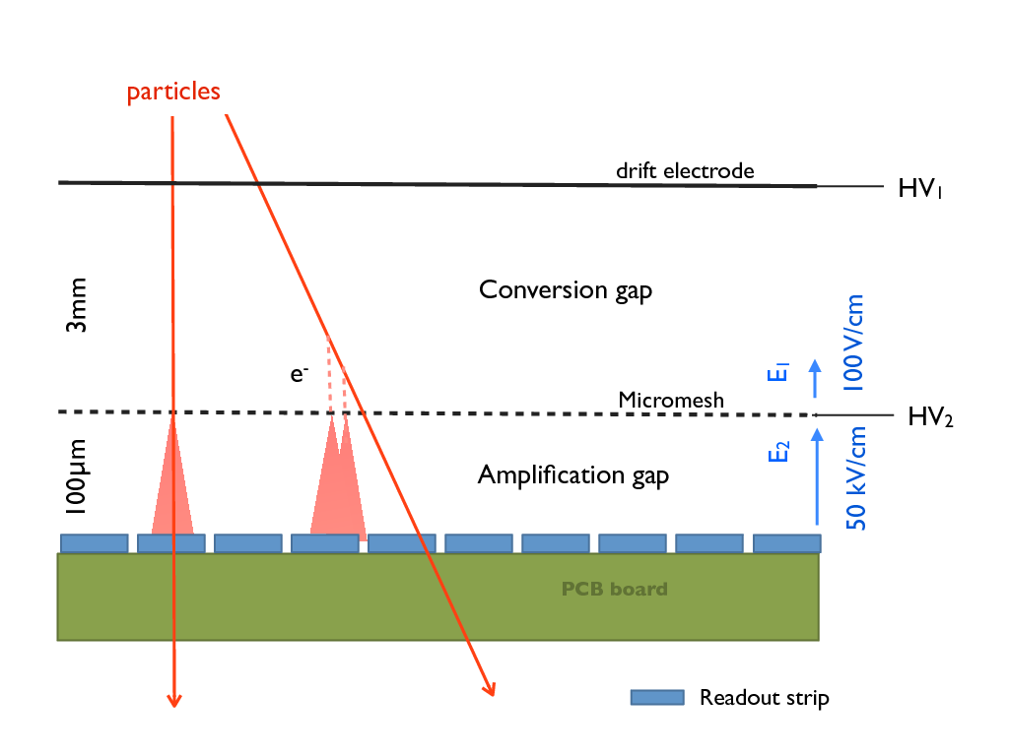
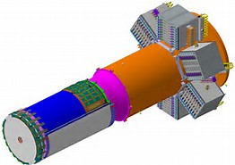
Micromegas Vertex Tracker Status
Beam
Z-detector because strips along Z-axis
13 June 2017 / CLAS collaboration meeting, MVT@Jlab / M.Defurne
C-detector because strips are curved

Slide 2
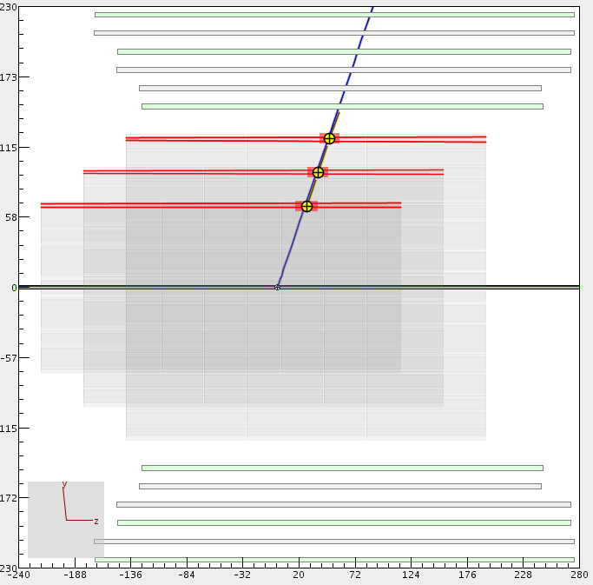
Micromegas Vertex Tracker
The MVT is composed of 6 layers of micromegas, providing either an information along z or azimuthal angle.
It will be placed in the solenoid around the target and the SVT. SVT+MVT= CVT
Micromegas
In December 2015, the outer layers were brought and integrated with SVT. We took cosmics data but some detectors needed to be fixed.
Only the mechanical structure for this 2-layer configuration was left at JLab.
CED view of the central detectors

Slide 3
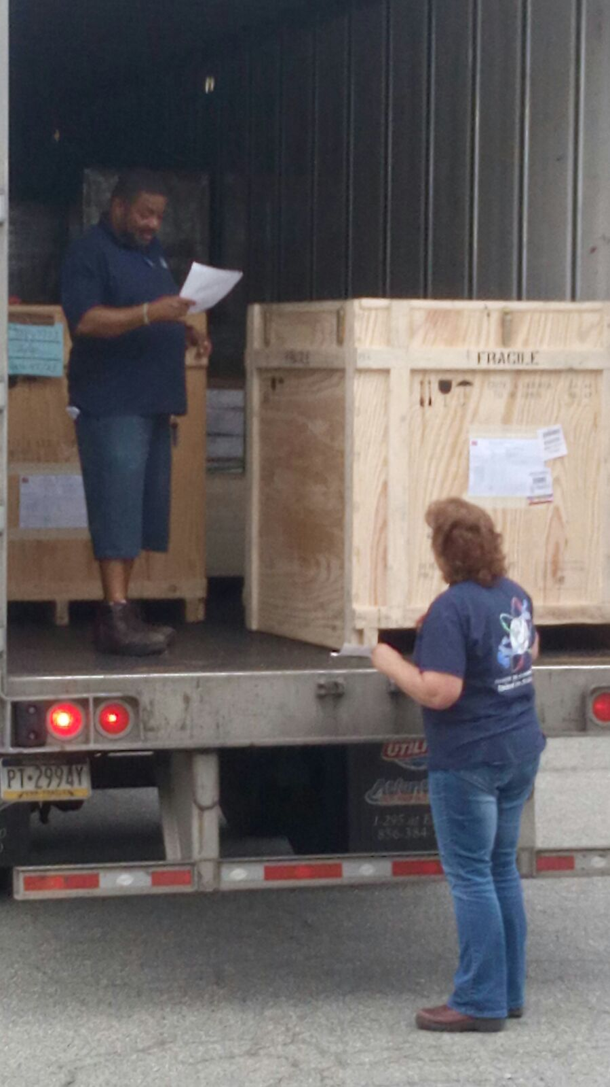
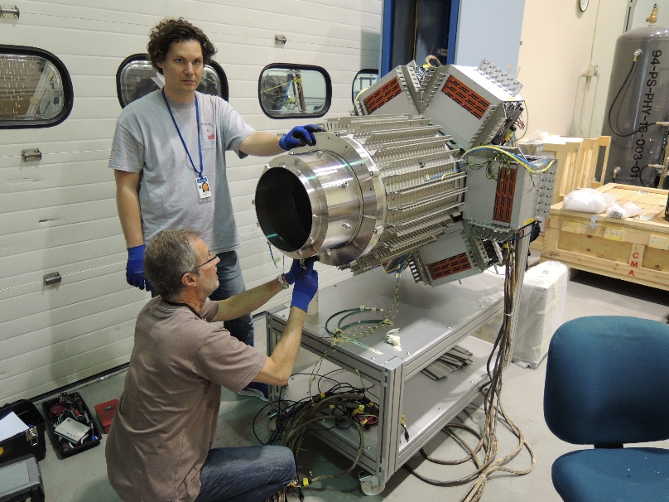
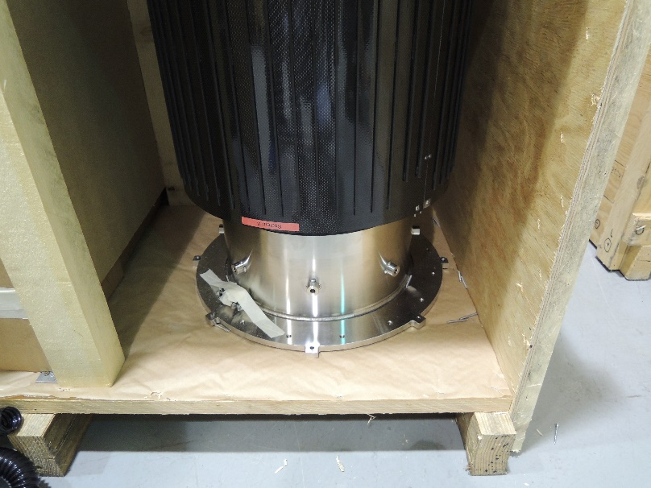
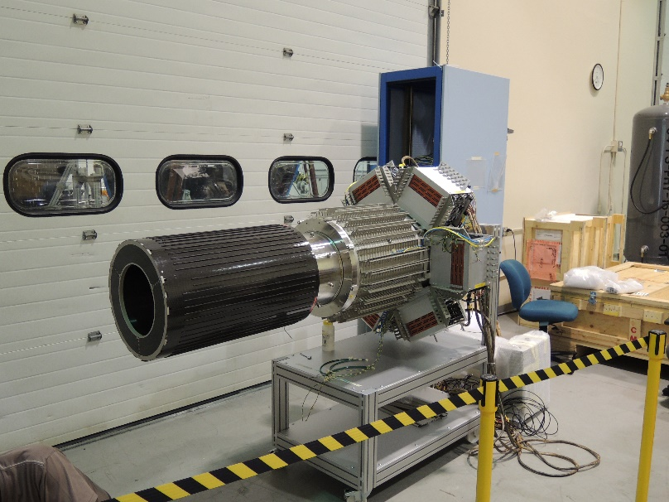
Arrival at Jlab two weeks ago
2 unpack
4 dismount B2 structure
1 delivery
3 inspect
5 mount B6 carbon structure

Slide 4
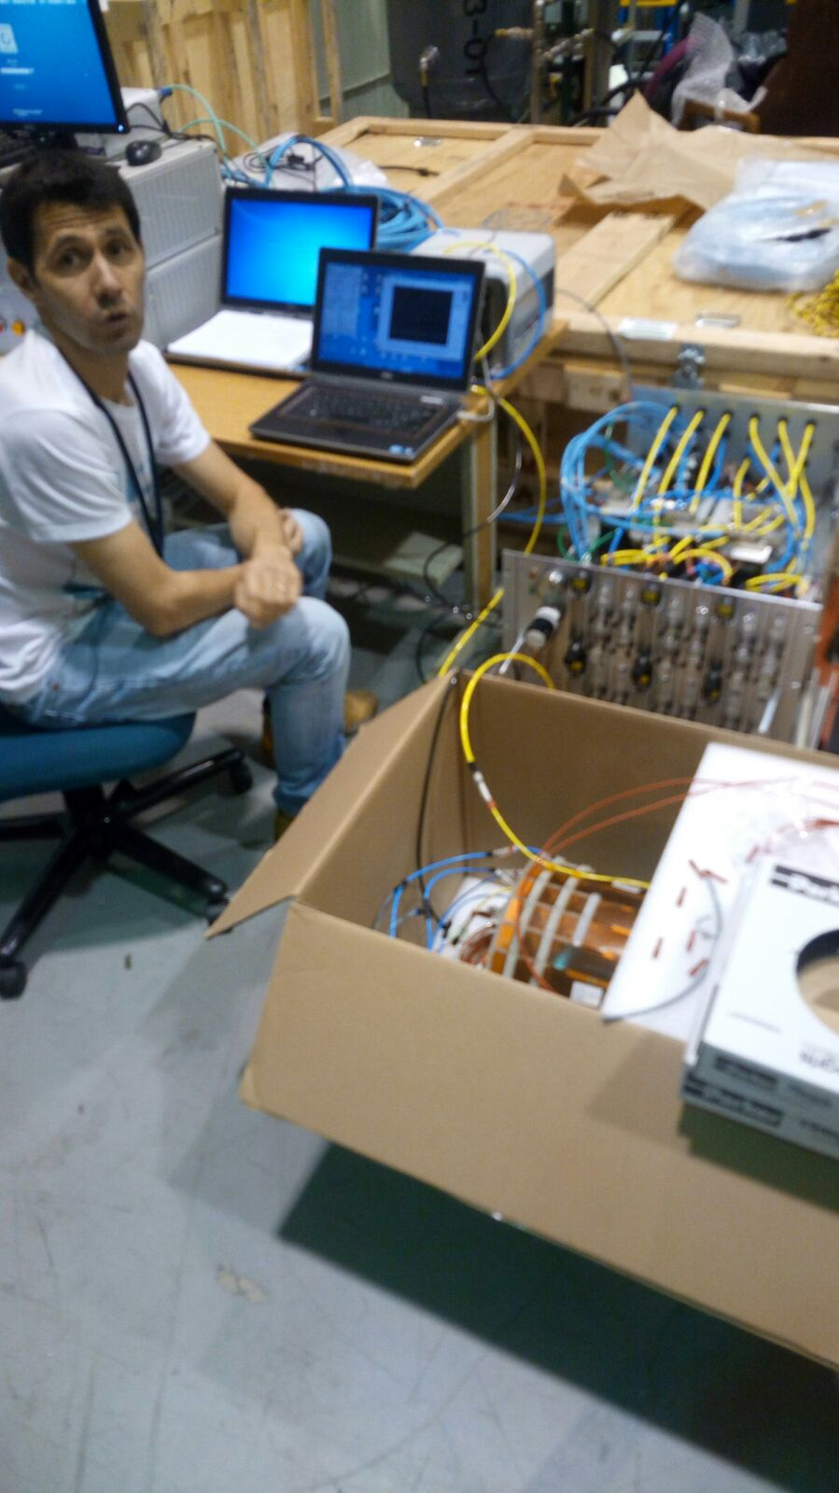
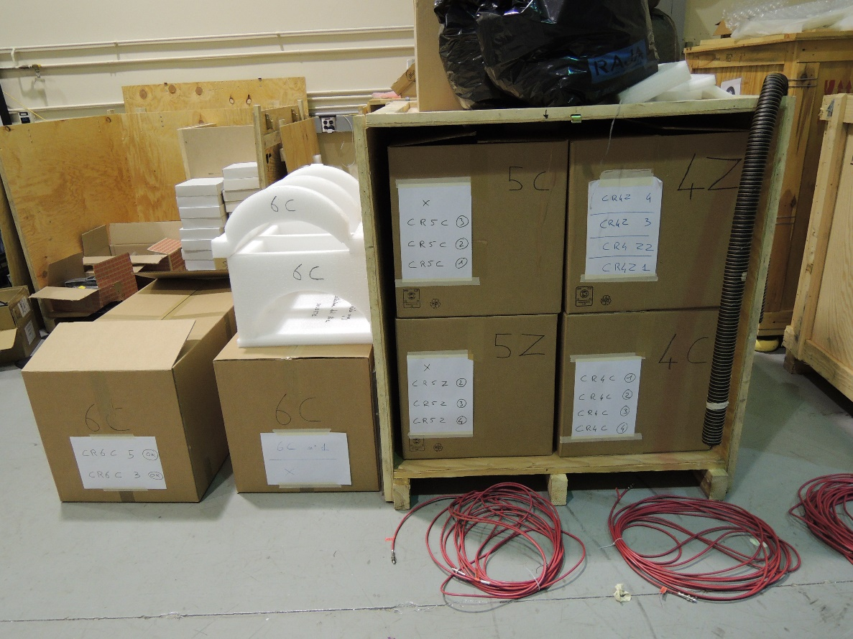
Detector test prior mounting
Each of the 18 Micromegas tiles is inspected and test with Argon (leak search due to transport)
Rémi
Flowmeter box + PC
Micromegas Tile under Ar leak test (max leak 0,03 l/h)
Tile in foam + cardboard box and wooden box
Special thanks to Bob and Matt for having Ar in grey room

Slide 5
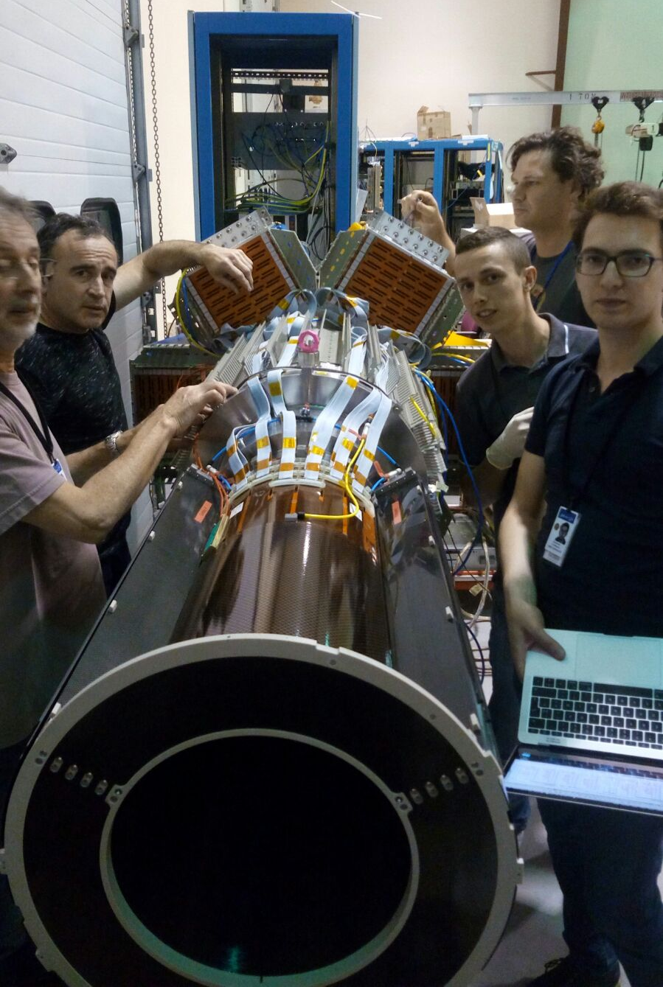
MVT Barrel assembly
The Barrel is composed of 6 layers, each layers is made of three 120° Micromegas curved detector (tile).
Layers: CR4C (circular stip), CR4Z (beam axis), CR5Z, CR5C, CR6Z, CR6C
Each layer is mounted in the barrel carbon structure and tested
Gas leak < 0,05 l/h,
HV drift and strip with I < 50nA,
Pedestal noise very low
Dead strips < 1/1000
First Tile, cabling and mapping of connector/cable/FEU slot

Slide 6
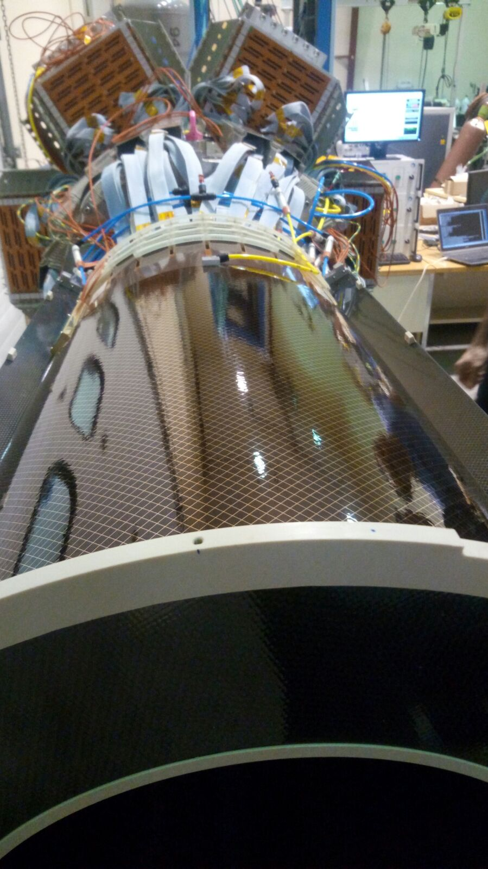
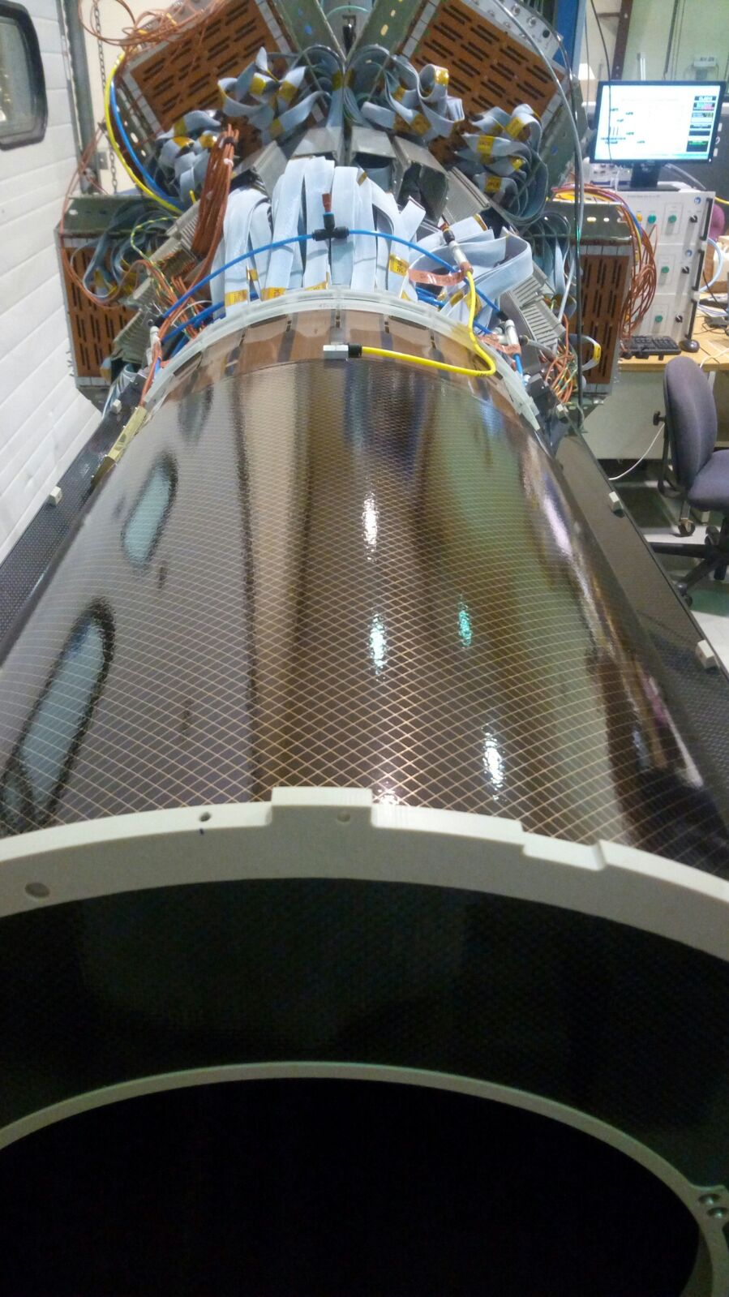
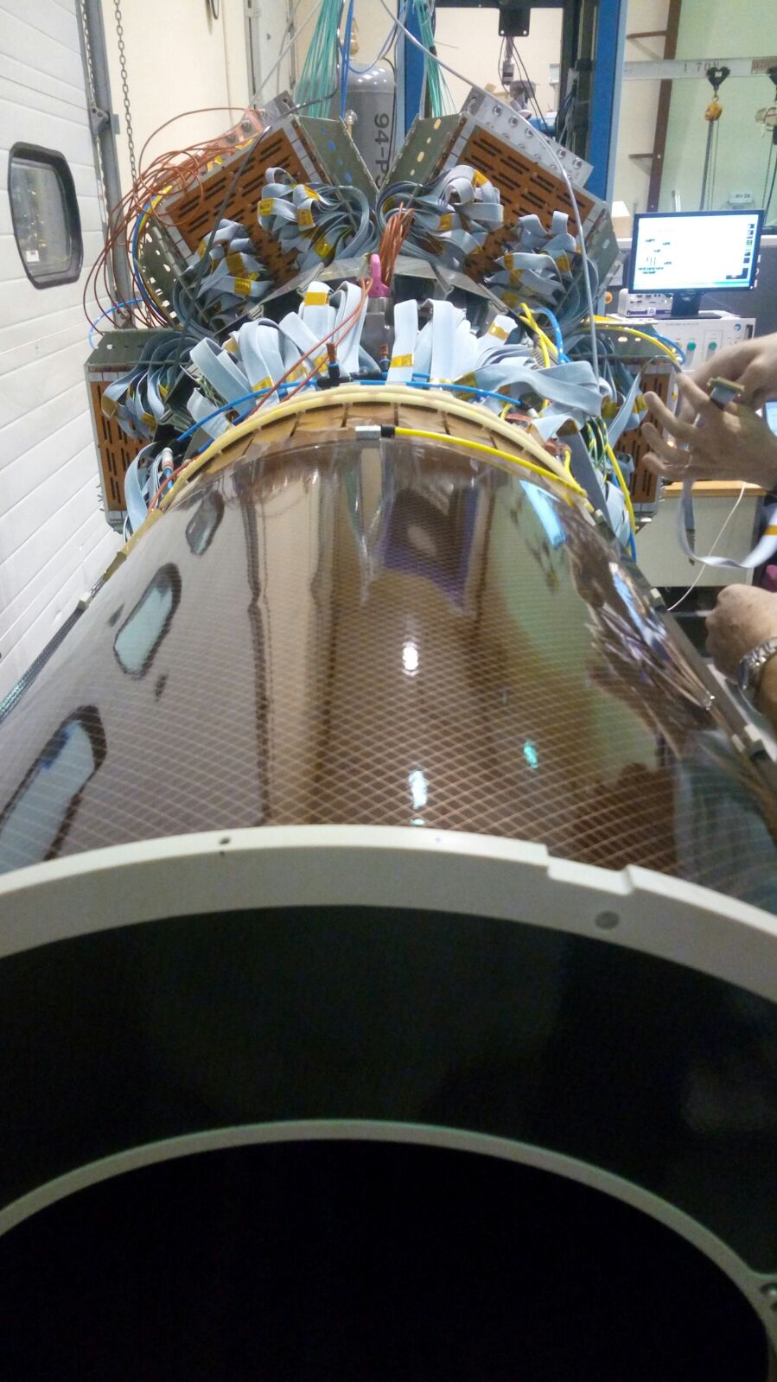
MVT Barrel assembly
#1, CR4-C
#3 CR5-C
# 4, CR4-Z
#6, CR6-C
For (int i=1 ; i<6; i++){
install_detector(i); Gas_Test(i); DAQ_Test(i);
}

Slide 7
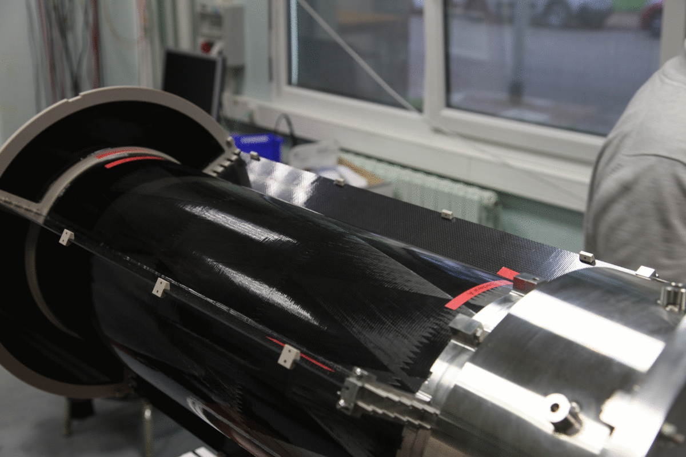
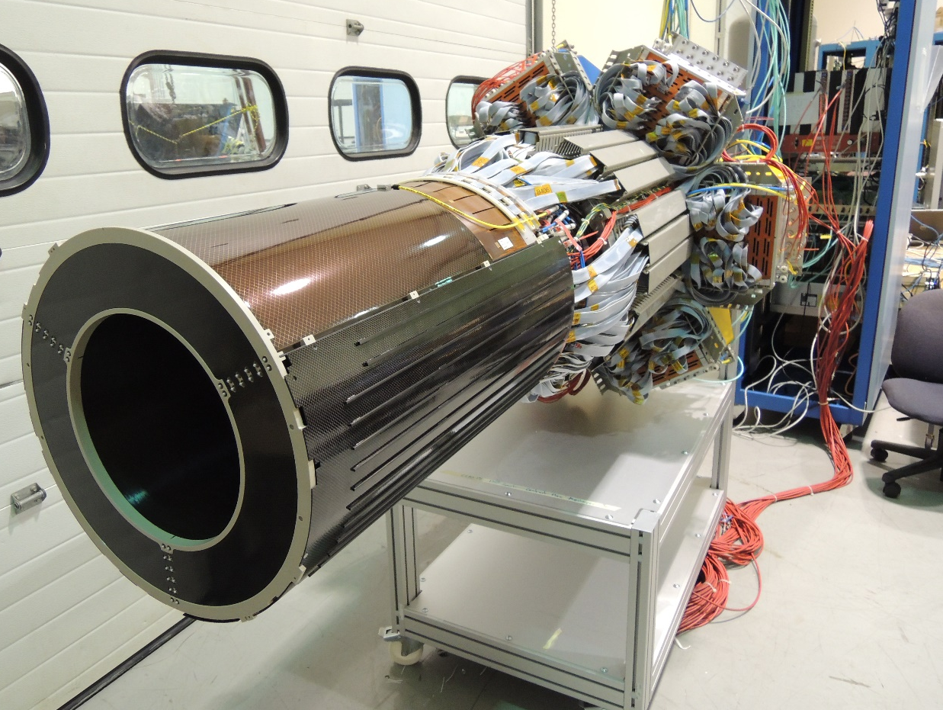
MVT Barrel assembly, last layer
Last layer on Saturday 6/3/17 at 13h12 ☺☺☺☺☺☺ (In 6 days)
Barrel auto mounting in Saclay
Barrel finished at Jlab

Slide 8
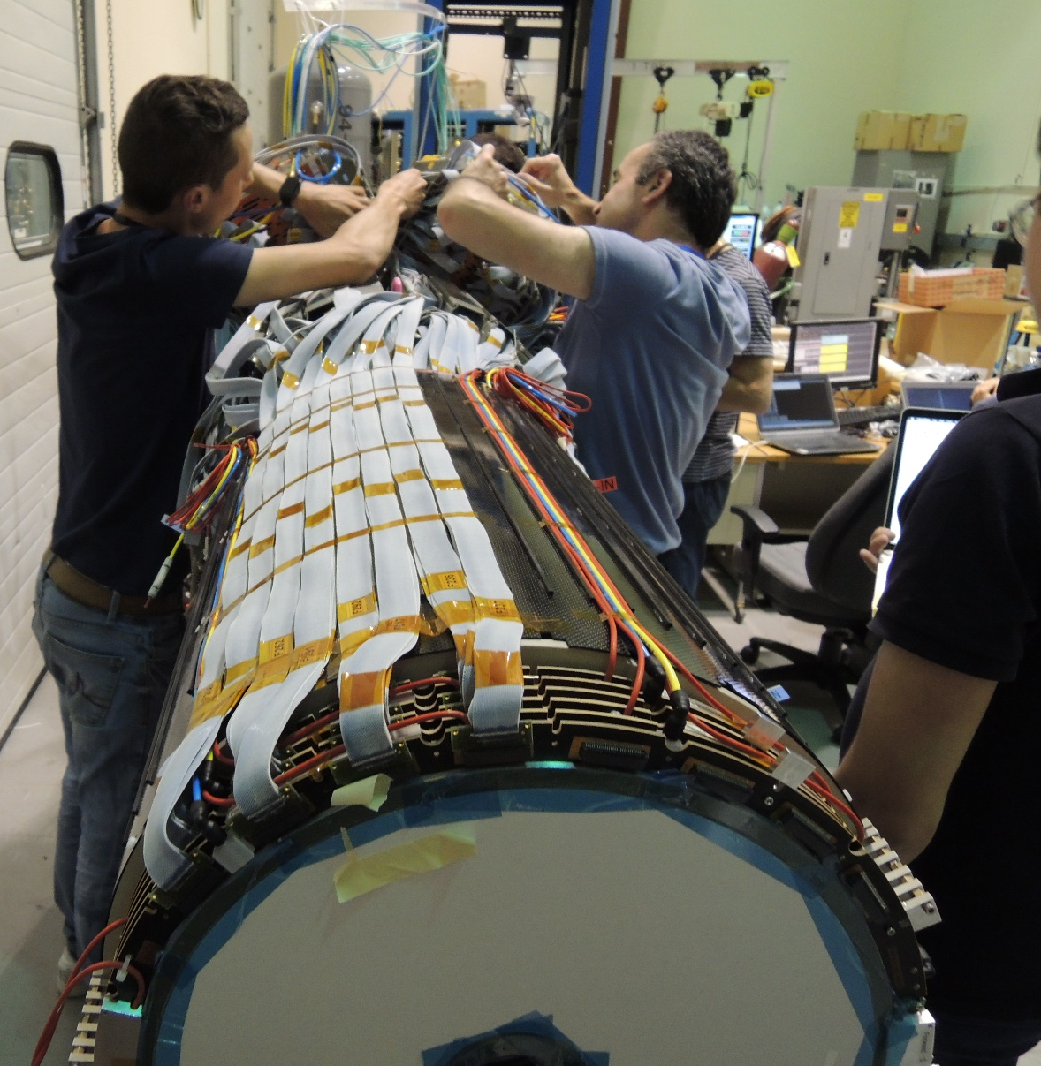
Forward Tracker
Forward, Stack of 6 Micromegas disk
HV test, leak test = OK
Downstream the target, there are 6 micromegas disks.
Each disk is made of 1024 strips, providing a 1D-information. Each disk is rotated by 60 degrees compared to the previous one.
The 6-disks information will be coupled to the drift chambers to add constrains on the scattered electron track. (especially on the azimuthal angle.)
Forward cabling on Barrel

Slide 9
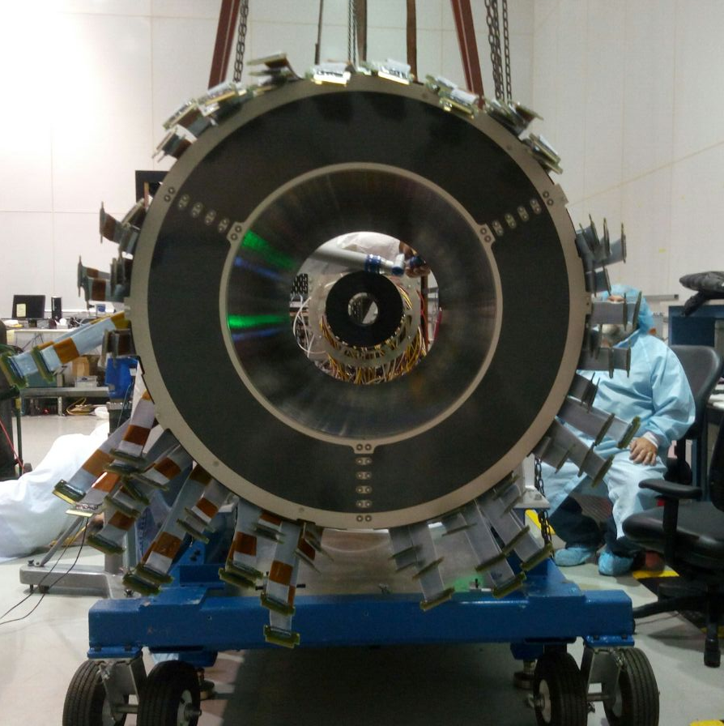
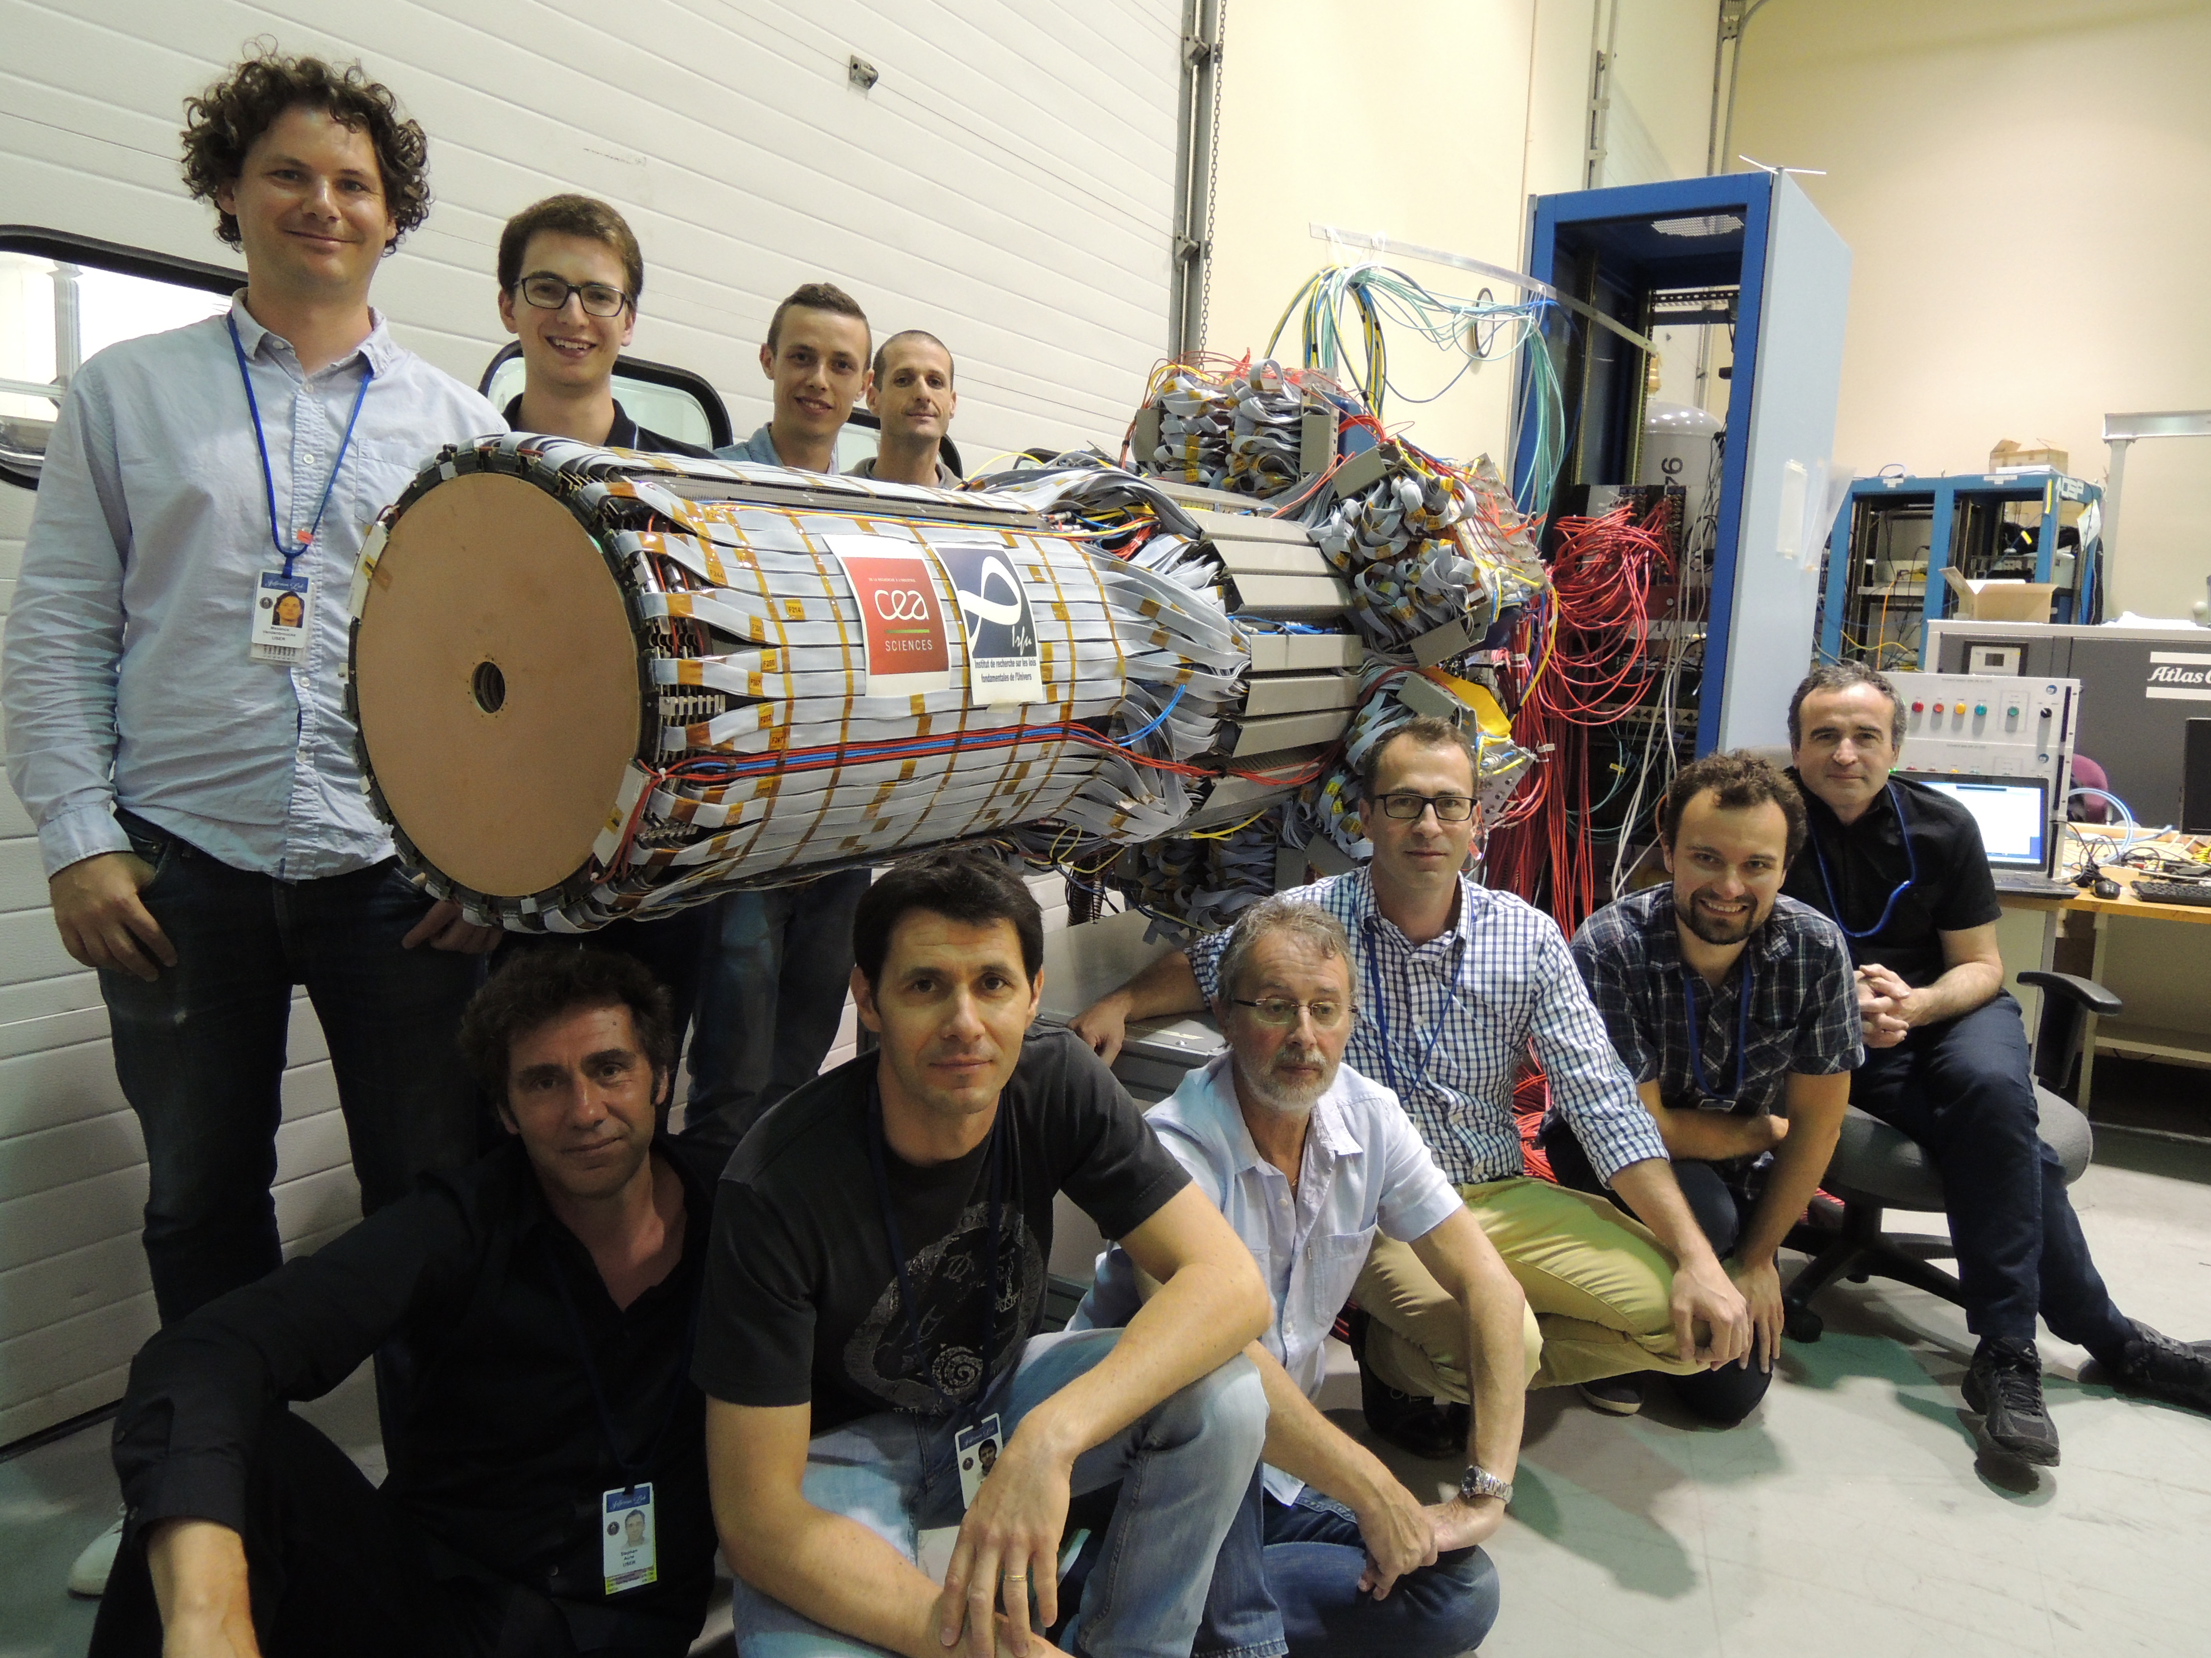
Micromegas Vertex Tracker
The MVT was delivered at Jlab 2 weeks ago. 10 French guys in the eel buiding for two weeks assembled the MVT.
MVT integrated with SVT in the clean room
6 layers of tiles per sector
MVT assembled in the EEL by CEA Saclay
Thank you to Detector support group and electronics group for their help!

Slide 10
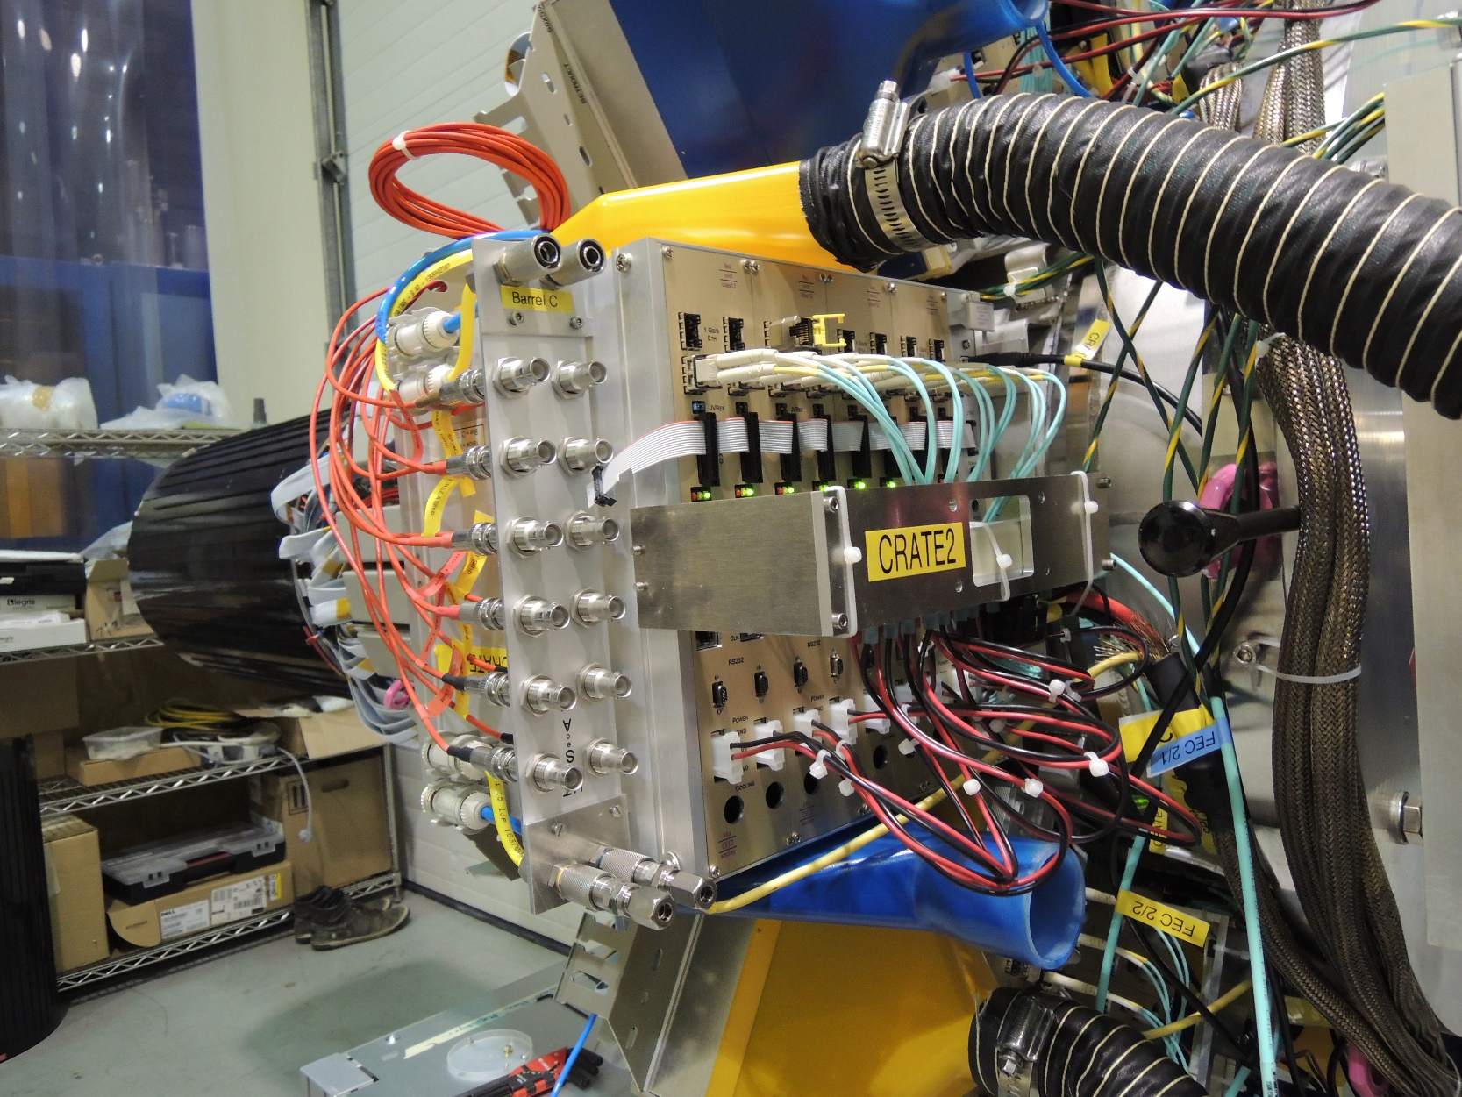
The DAQ system
Each of the 6 front crate is dismounted and refurbished:
Filled with 8 Front End Unit
Air cooling and air extraction
LV connector mechanics
HV connectors
Gas connectors
Each front end unit is composed of 8 DREAM-ASICs. Each DREAM is connected to 64 strips.

Slide 11
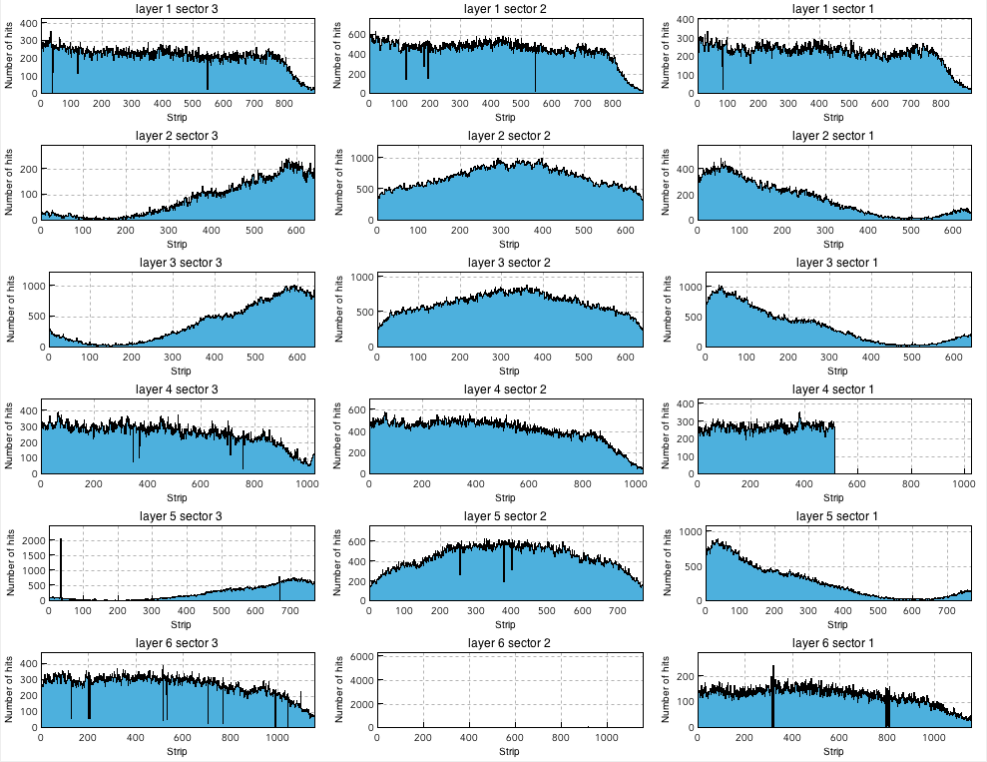
BEU, FEU and CODA…
Thanks to their awesome work, we are currently taking cosmics data in the clean room (Started Friday last week.)
Work on test of front end electronics, back end electronics and CODA., by Yassir and Irakli.
-Last layer will be changed this Fall
-1 FEU will be replaced this summer

Slide 12
Integration in the Hall B
Cosmics data will be collected for fine tuning this summer in the clean room (calibration/alignement)
Integration of CVT in the Hall in September (depending on solenoid’s arrival).
A liter version of the gas system will be installed in the Hall and the detector will work with premix bottles.

Slide 13
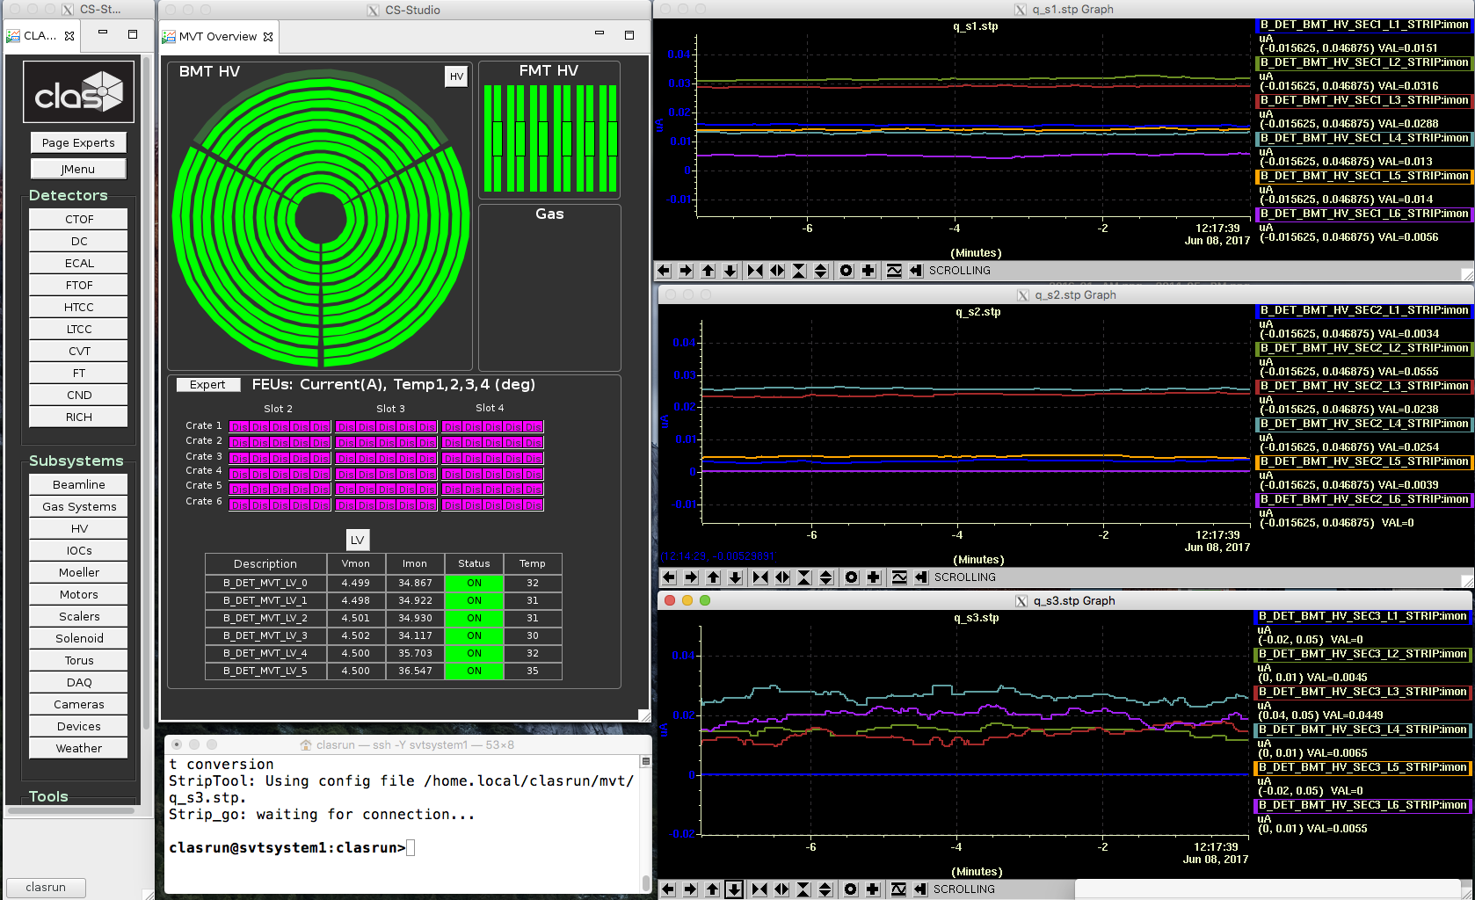
Micromegas Slow Control
HV and LV slow control: OK
Gas slow control: Soon to come
DAQ slow control: OK
Thank you to Nathan Baltzell , Wesley Moore and Ken Livingston

Slide 14
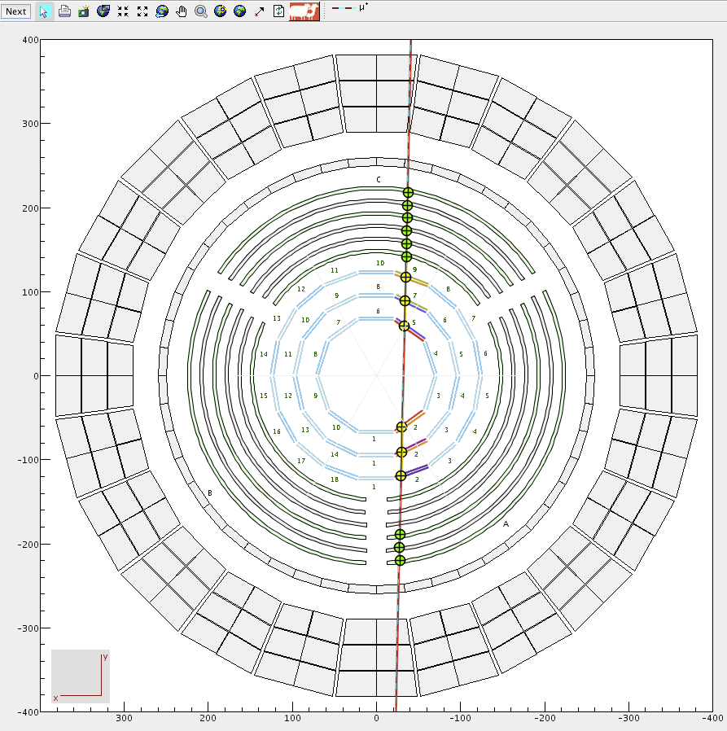
MVT in tracking
Final geometry of MVT = BMT+FMT implemented in GEMC and CED.
Tracking code for cosmics and physics including the barrel currently under development (see Veronique’s talk).
(Simulated cosmic ray, not event display… but coming soon)
What remains to be done: - Monitoring/calibration codes with latest coatjava version
- Fine tuning of reconstruction with cosmics during summer.
Notes:
Cliquez sur Insertion puis En-tête/Pied pour saisir les champs « Evènement – Date » et « Service » ; puis cliquer sur Appliquer partout.

Slide 15
THANK YOU!

