Slide 1
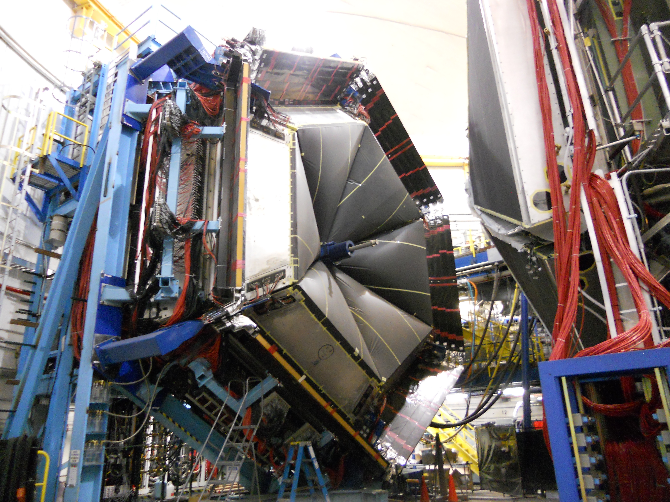
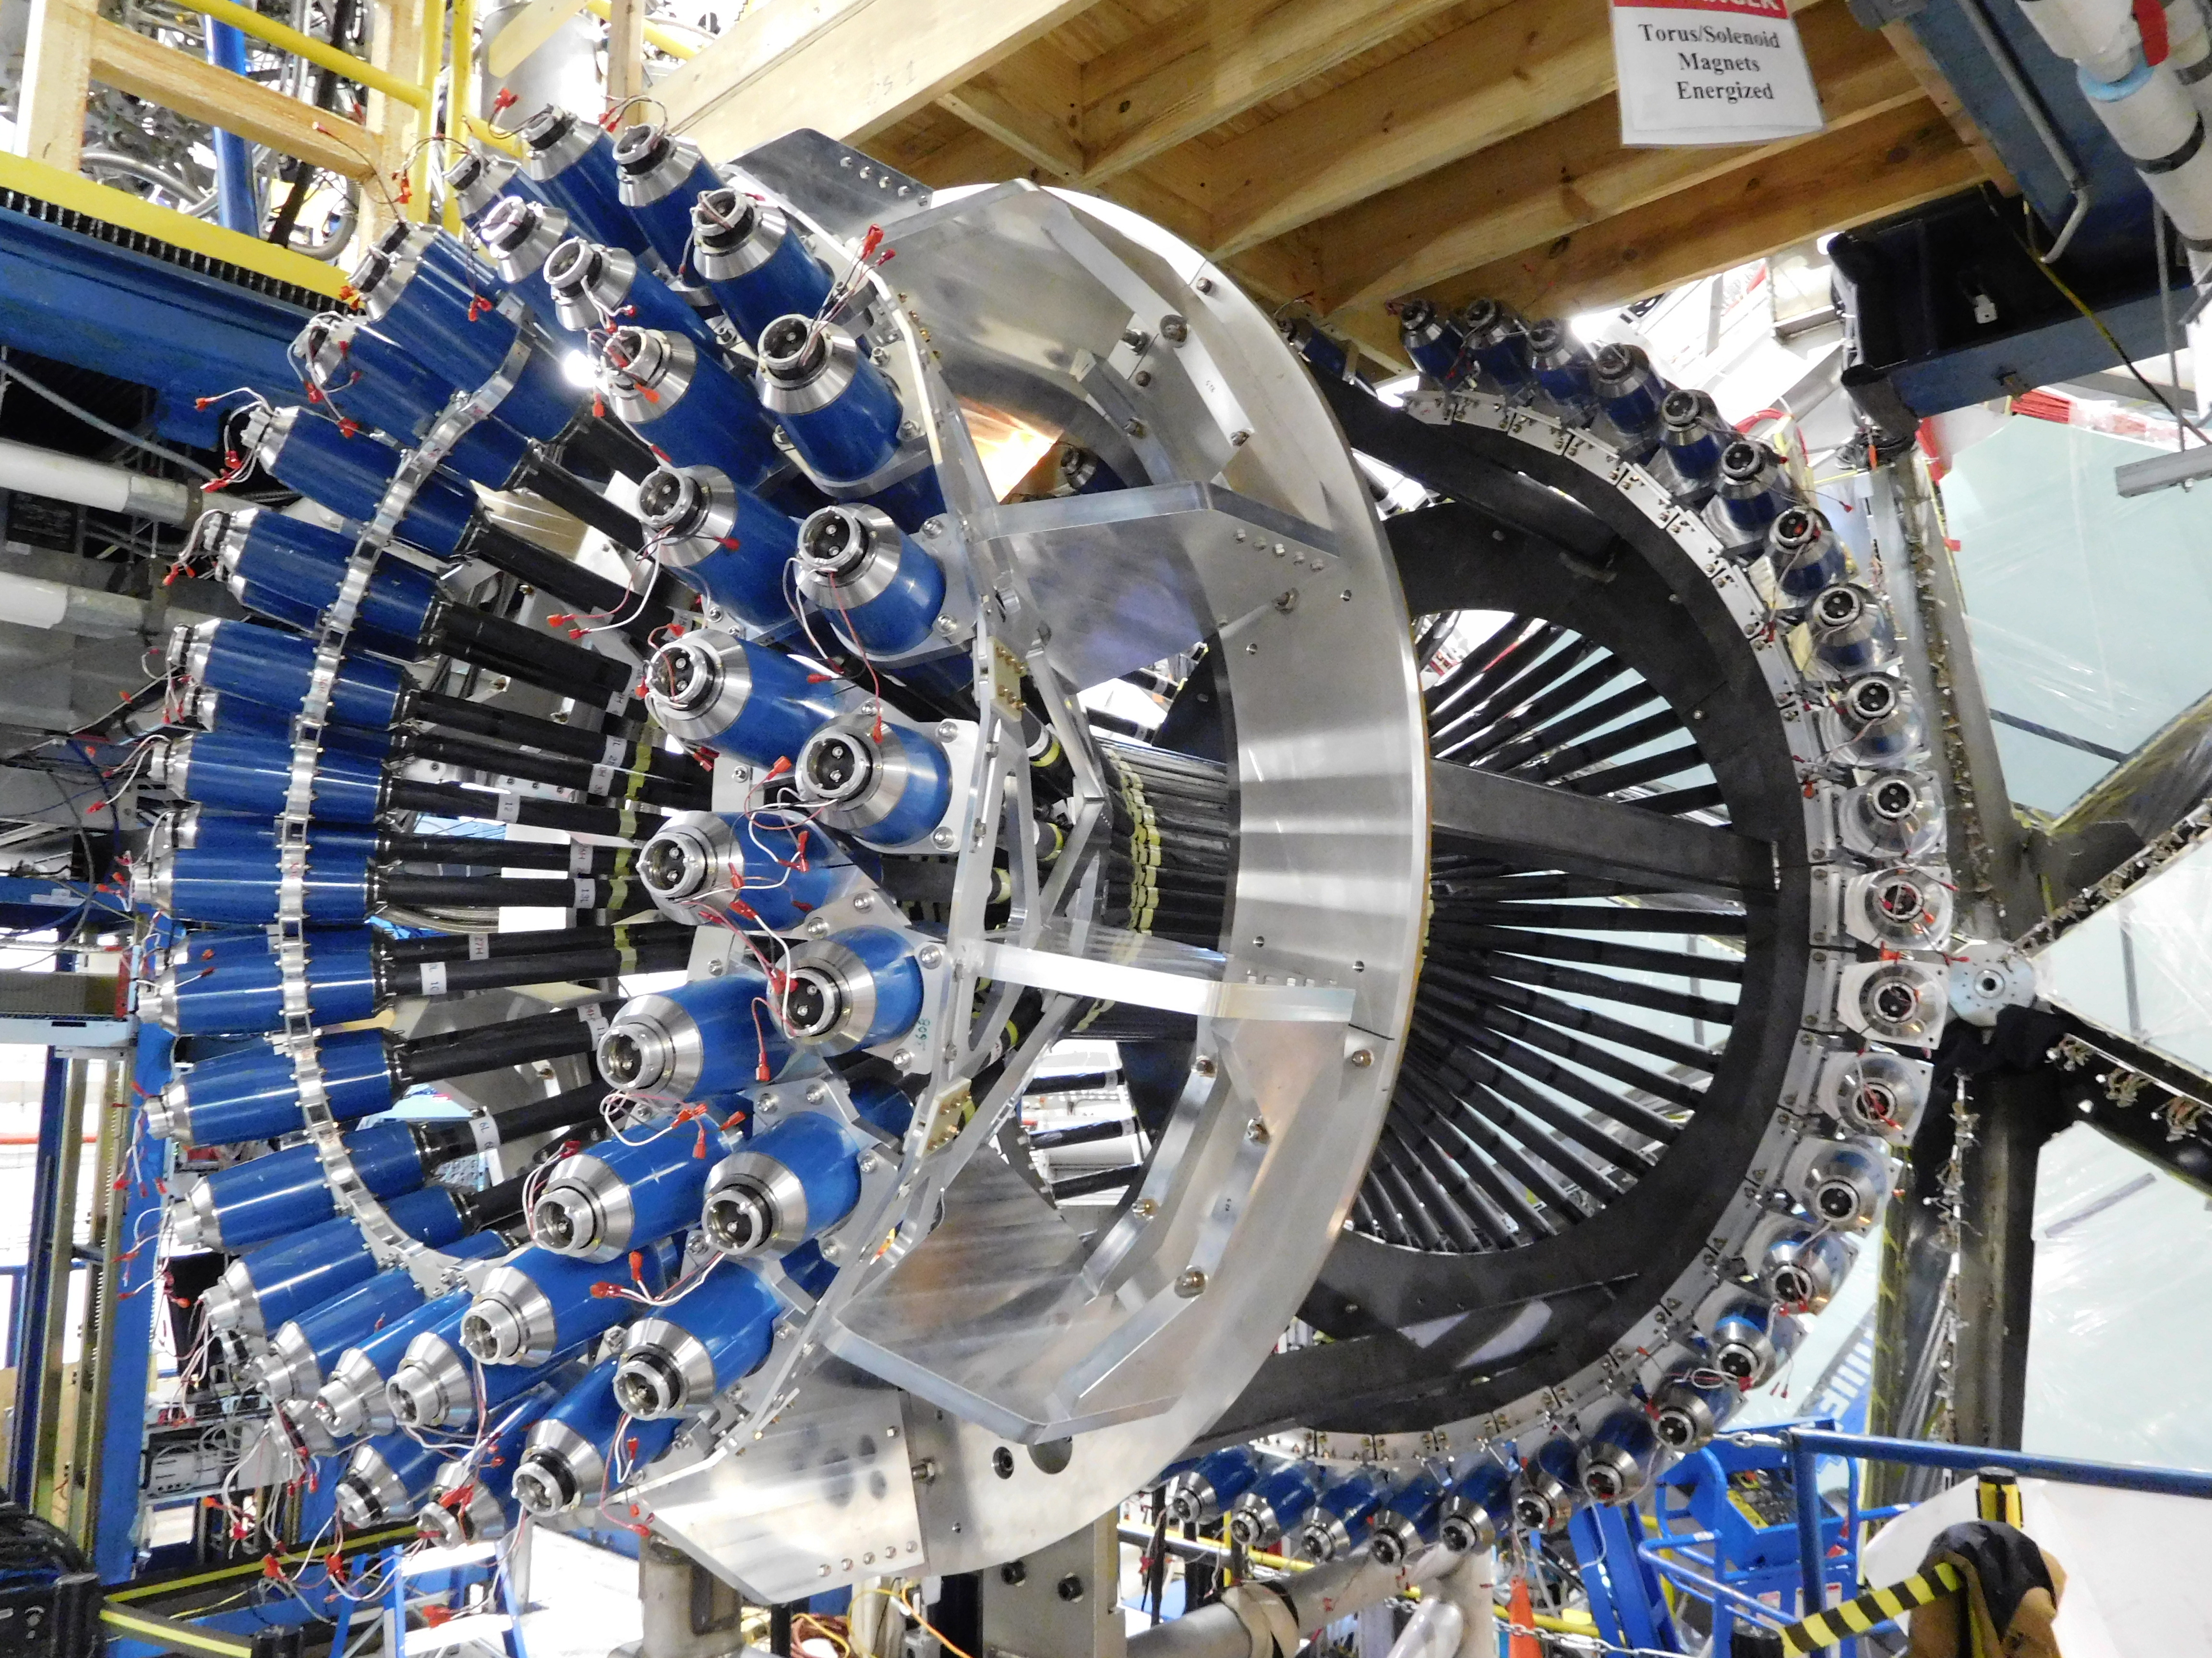
FTOF and CTOF Status Update
Daniel S. Carman
Jefferson Laboratory

Slide 2
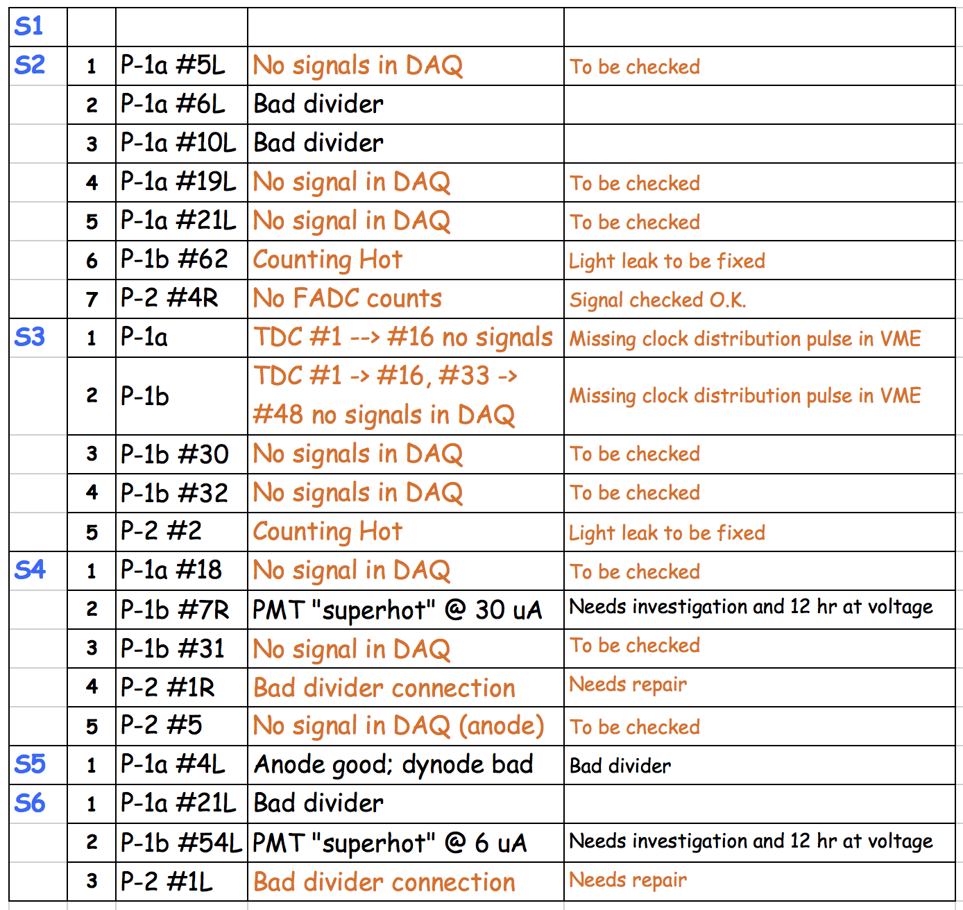
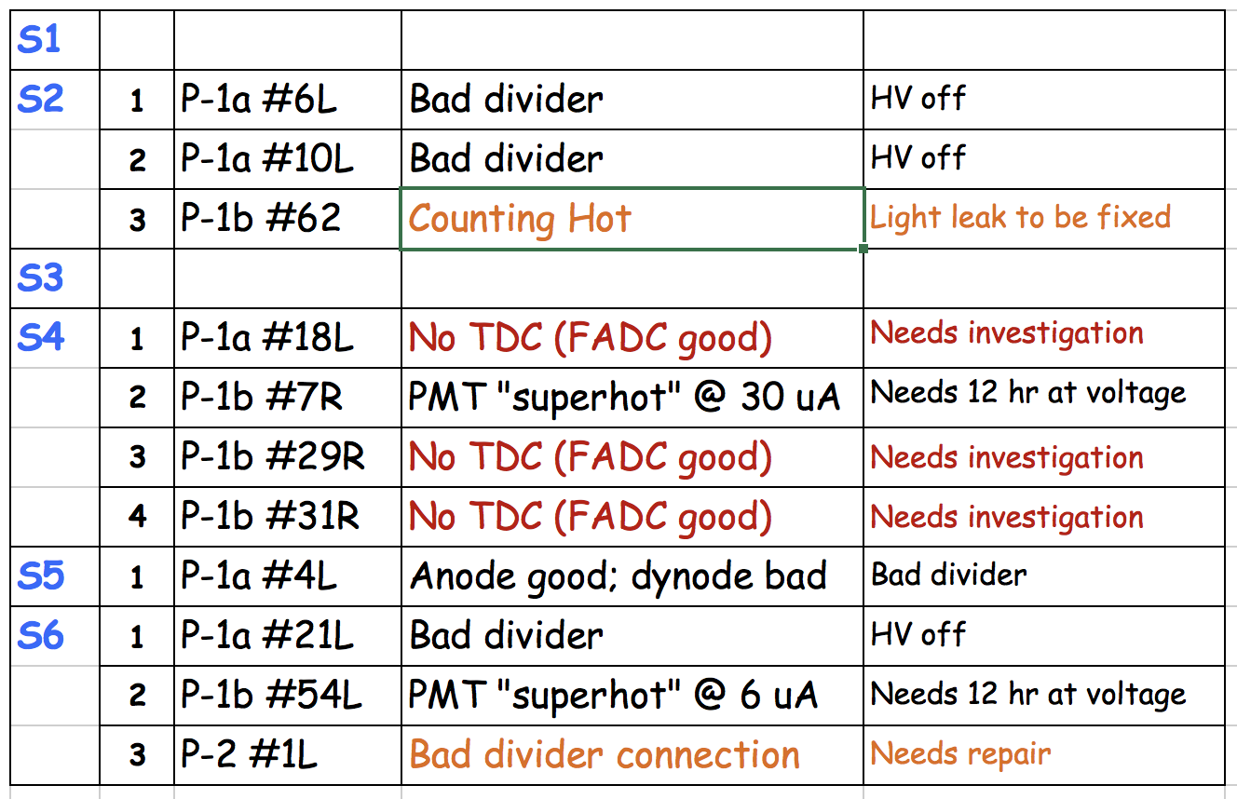
FTOF Hardware Status
Post-KPP Run Status
May 2017 Status
Further repairs will take place after Forward Carriage is moved back to service position this summer

Slide 3
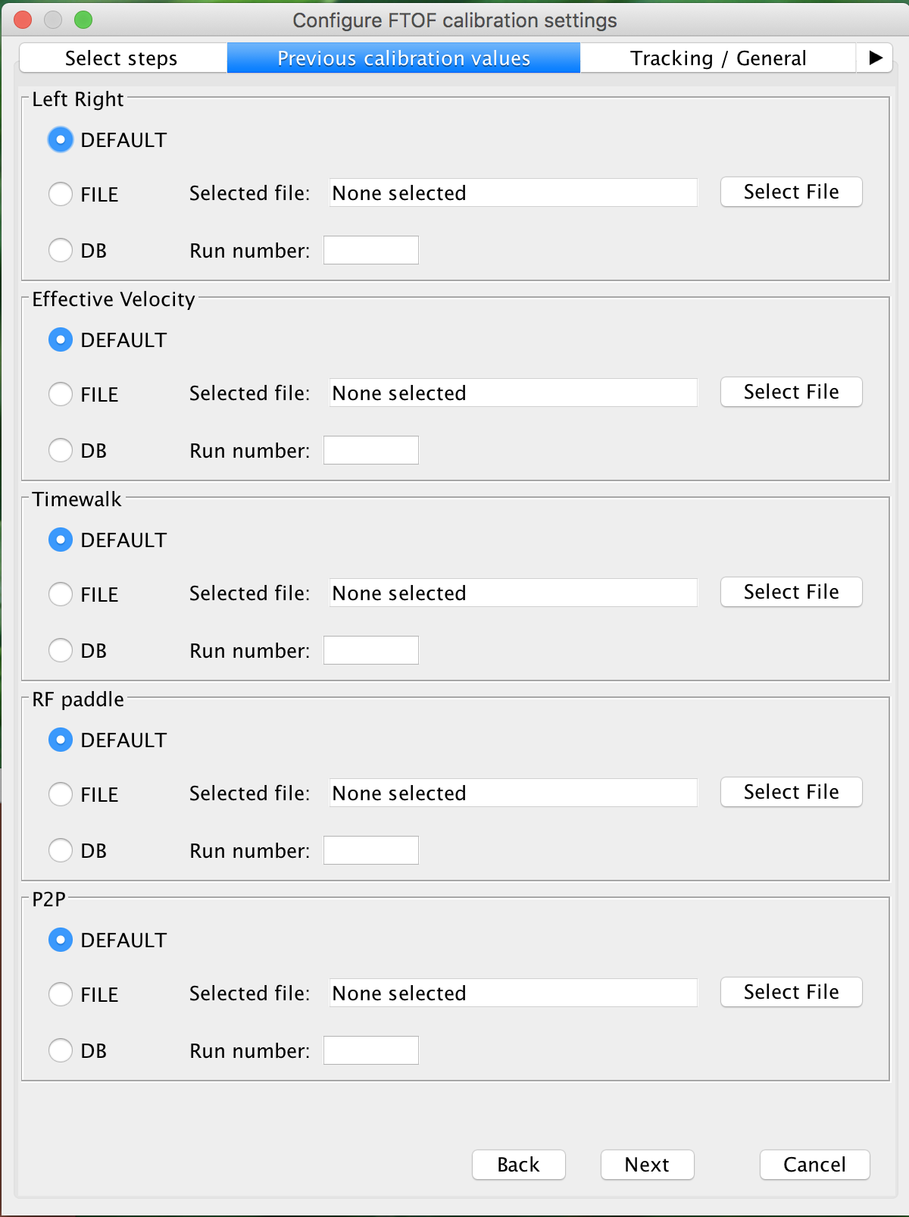
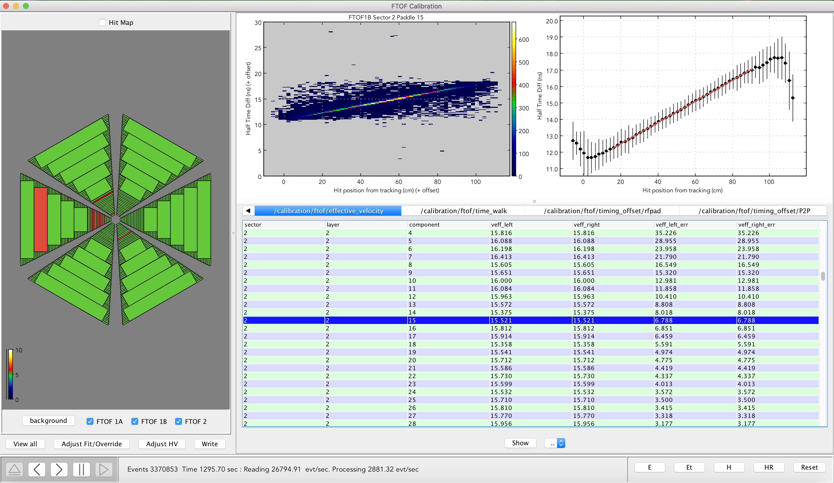
FTOF Calibration Suite
All calibration steps developed and tested
- β-version of the code
Louise Clark

Slide 4
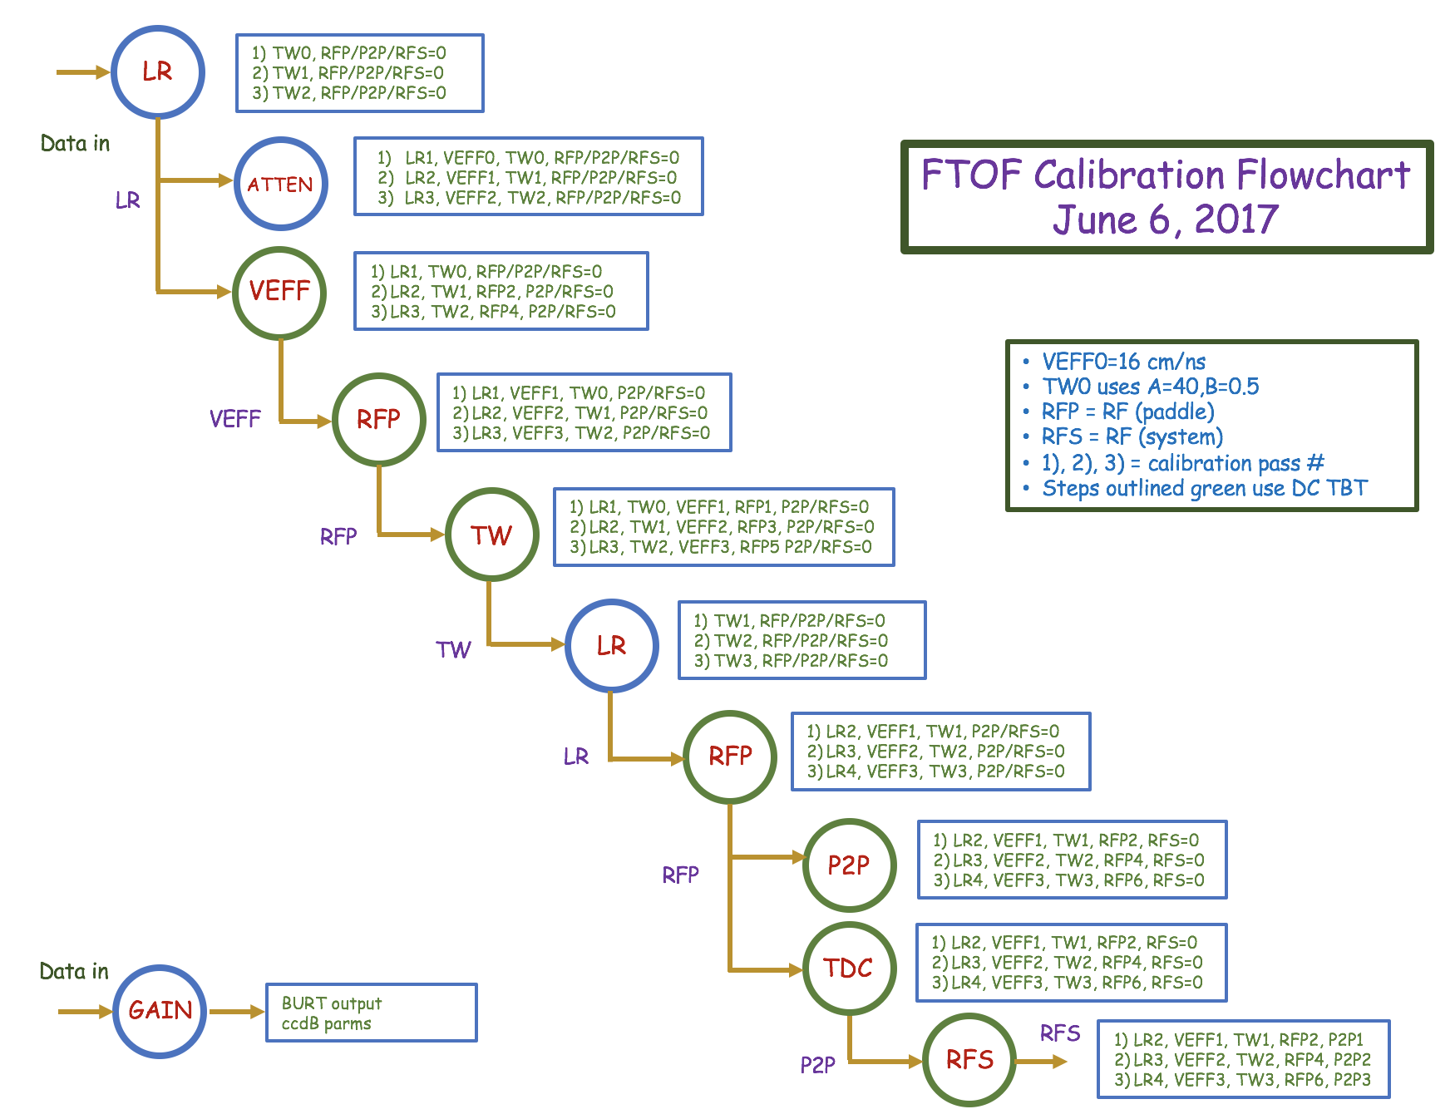

Slide 5
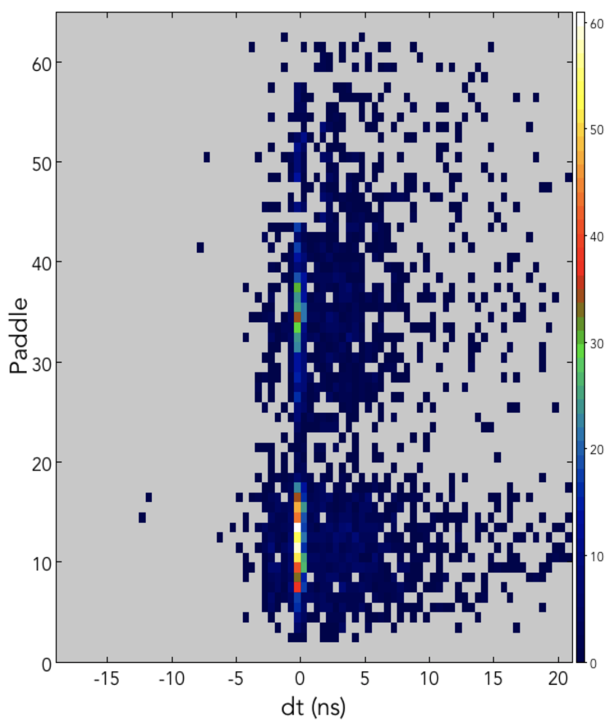
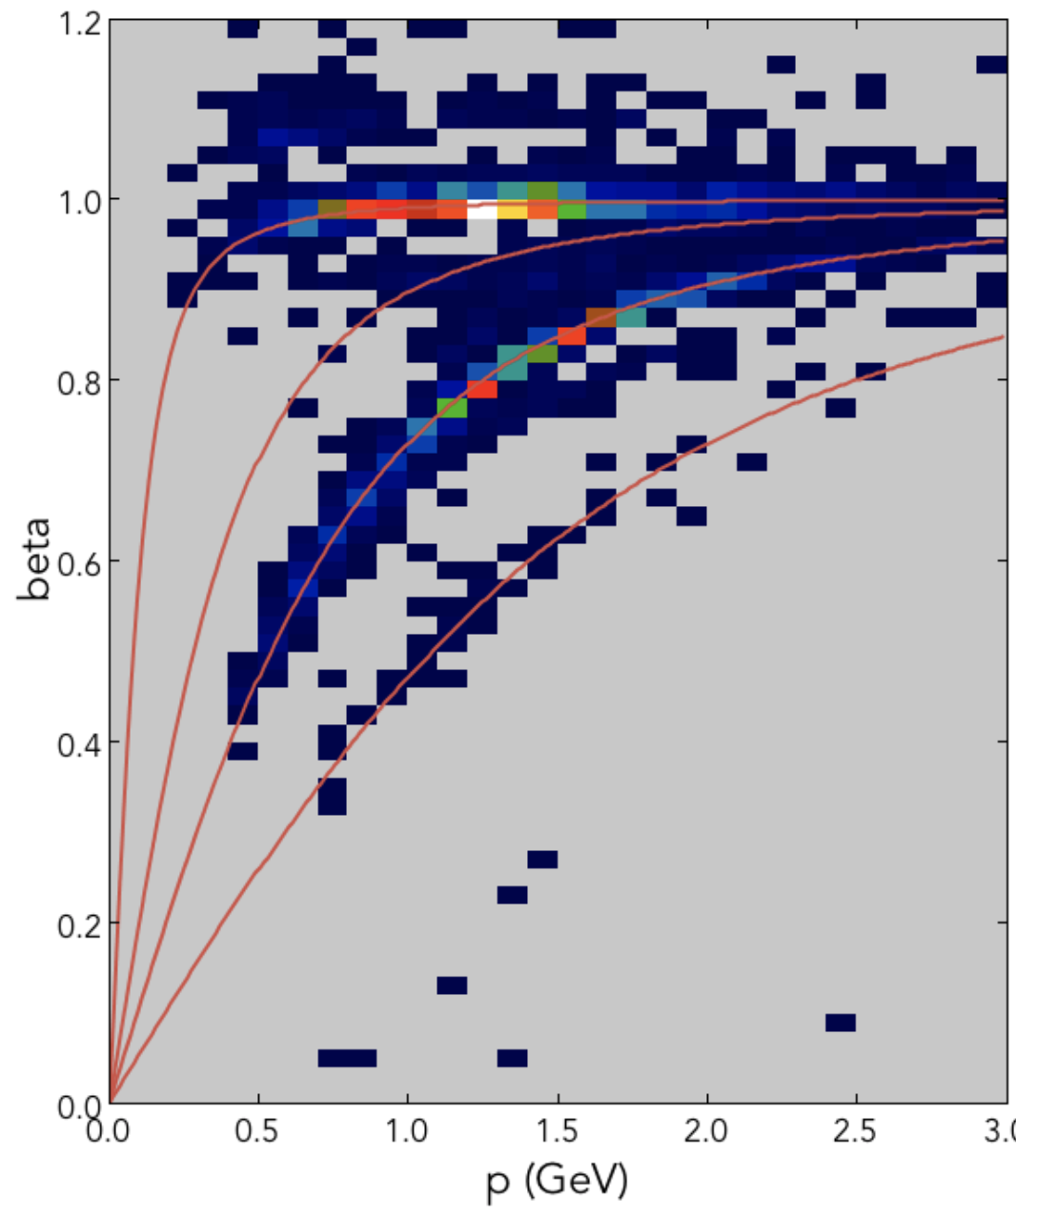
Calibration Status
HV/Gain Calibration
Step # | Action
1 | Gain Calibration
Timing Calibration
1 | PMT Timing Diff.
2 | Attenuation Length
3 | Effective Velocity
4 | Time-Walk
5 | P2P
6 | RF Offset
Counter
Δt_{v} (ns)
While the KPP data is limited (low statistics, S2 only), it has allowed for important developments and verifications related to the FTOF calibrations

Slide 6
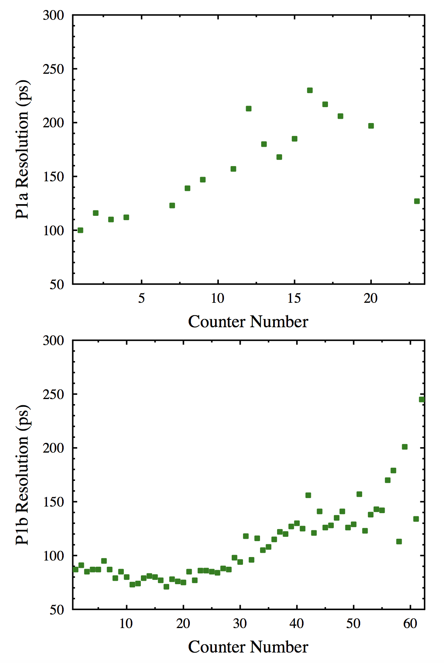
FTOF Timing Resolutions
Counter timing resolutions still higher than values determined from cosmic ray bench tests:
P1a: 80 – 150 ps
P1b: 30 – 80 ps
However, timing resolutions are still limited by:
TW corrections
Position-dependent TW
TDC calibrations
TDC non-linearities
Non-optimized tracking
Geometry offsets

Slide 7
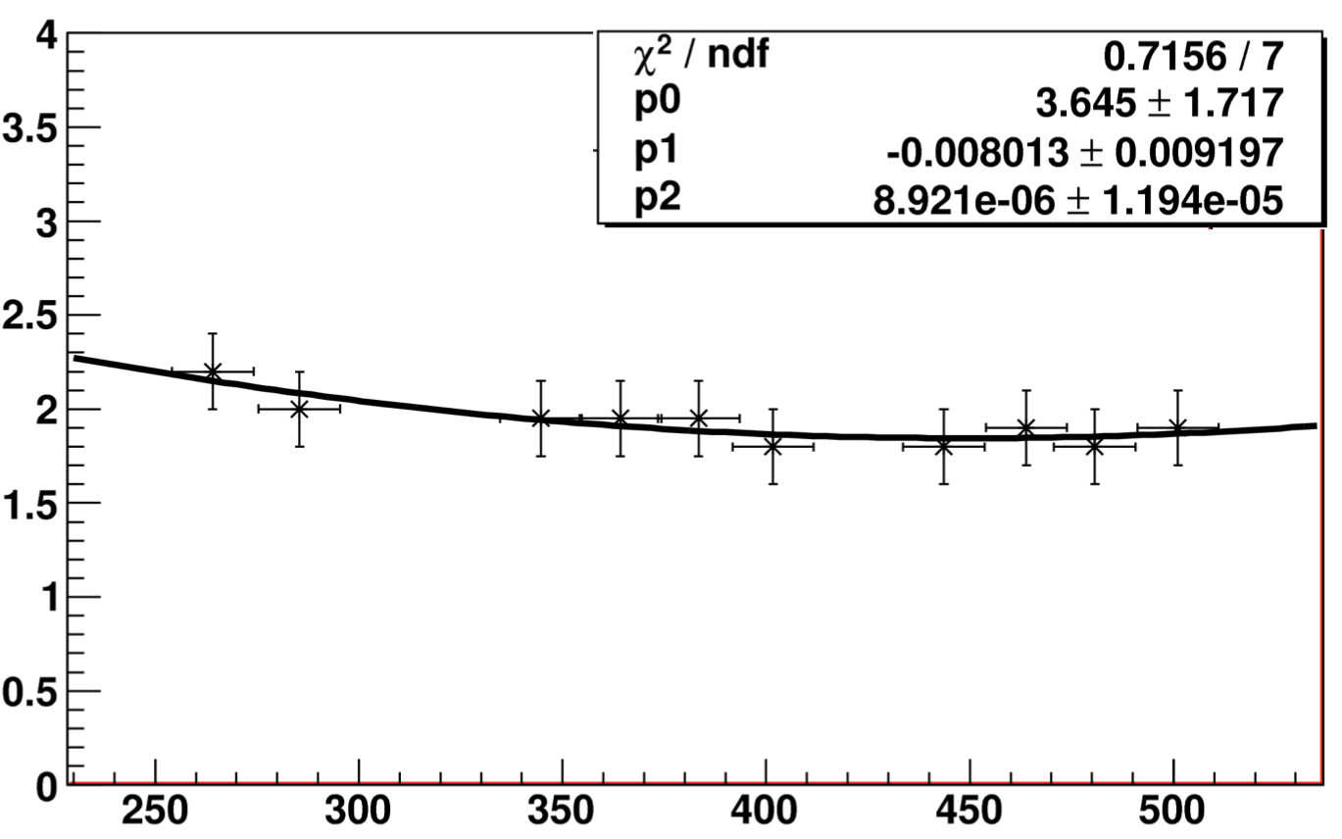
hit position (cm)
FTOF Timing Resolutions
TW Algorithm:
Strong correlations between TW parameters and VEFF value
Implementation of proper slice fitter for VEFF improves TW fits
TW functional not independent of position along bar
ΔT (FTOF-RF) (ns)
ADC
time-walk parameter
USC bench studies
hit position (cm)

Slide 8
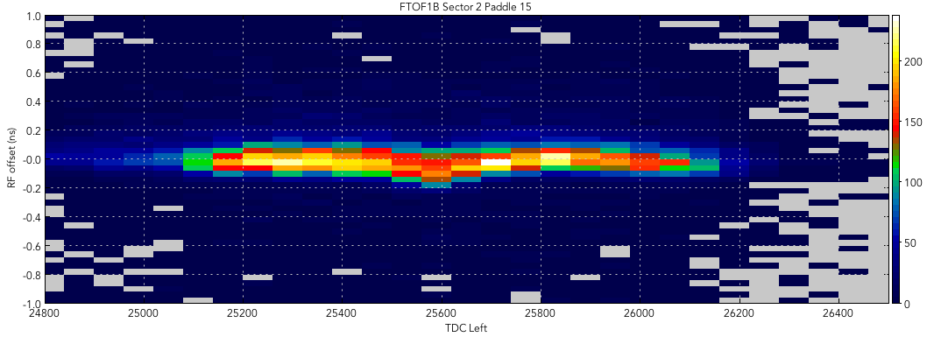
FTOF Timing Resolutions
TDC Response:
Improper calibration ⇒ correlations of timing residual with TDC
Add TDC calibration step for all FTOF channels into calibration suite
TDC DNL/INL effects seen in timing response – update compensation table in firmware for Eng. Run
ΔT (FTOF-RF) (ns)
TDC
Geometry:
Survey data being analyzed to determine geometry offsets for each FTOF panel: (Δx,Δy,Δz,θ_{x},θ_{y},θ_{z})
Andrey Kim is modifying the geometry service to include these shifts
Tracking:
DC time → dist calibrations for TBT are still 0th order and crude
FTOF calibrations will be redone when improved tracking information is available

Slide 9
FTOF Calibration Work List
Continue systematic studies of KPP data calibrations and system response
Develop position-dependent TW correction
Add step to determine hardware status
Update code to calibrate around hardware failures
Streamline code to improve reliability and automation
Color code fit parameters to highlight those out of range
Develop code release structure and put into github repository
Update suite documentation and develop tutorials
FTOF Calibration Code Development Group:
Louise Clark, Raffaella de Vita, Ralf Gothe, DSC

Slide 10
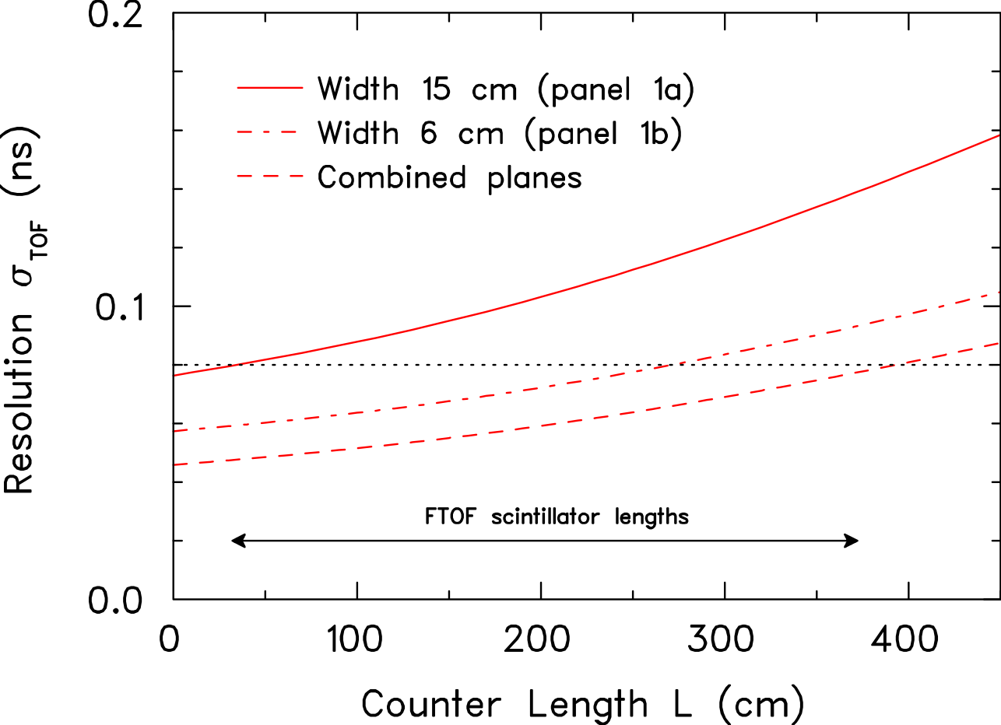
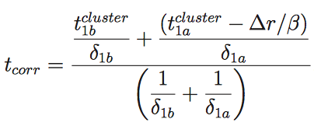
Optimizing System Time Resolution
TDR
Combine the measured times from the FTOF panel-1a and panel-1b to optimize the resolution
GEMC Studies with cluster=1
Algorithms for cluster > 1:
use hit with t_{min}
use hit with E_{max}
use weighted average
(20% gain) | e | p | π⁺ | π⁻
FTOF 1A | 152 ps | 164 ps | 160 ps | 151 ps
FTOF 1B | 62 ps | 67 ps | 65 ps | 61 ps
FTOF 1A+1B | 49 ps | 54 ps | 54 ps | 51 ps
Evgeny Golovach

Slide 11
FTOF Raw Signals
threshold crossing
KPP conditions:
2 μs TDC time window
10 mV disc. threshold, 20 ns output width
Led to a sizeable number of entries in TDC hit list. To keep data size/event from FTOF reasonable, TDC time window should be reduced to a few hundred ns and discriminator threshold/width should be set appropriately
Cole Smith

Slide 12
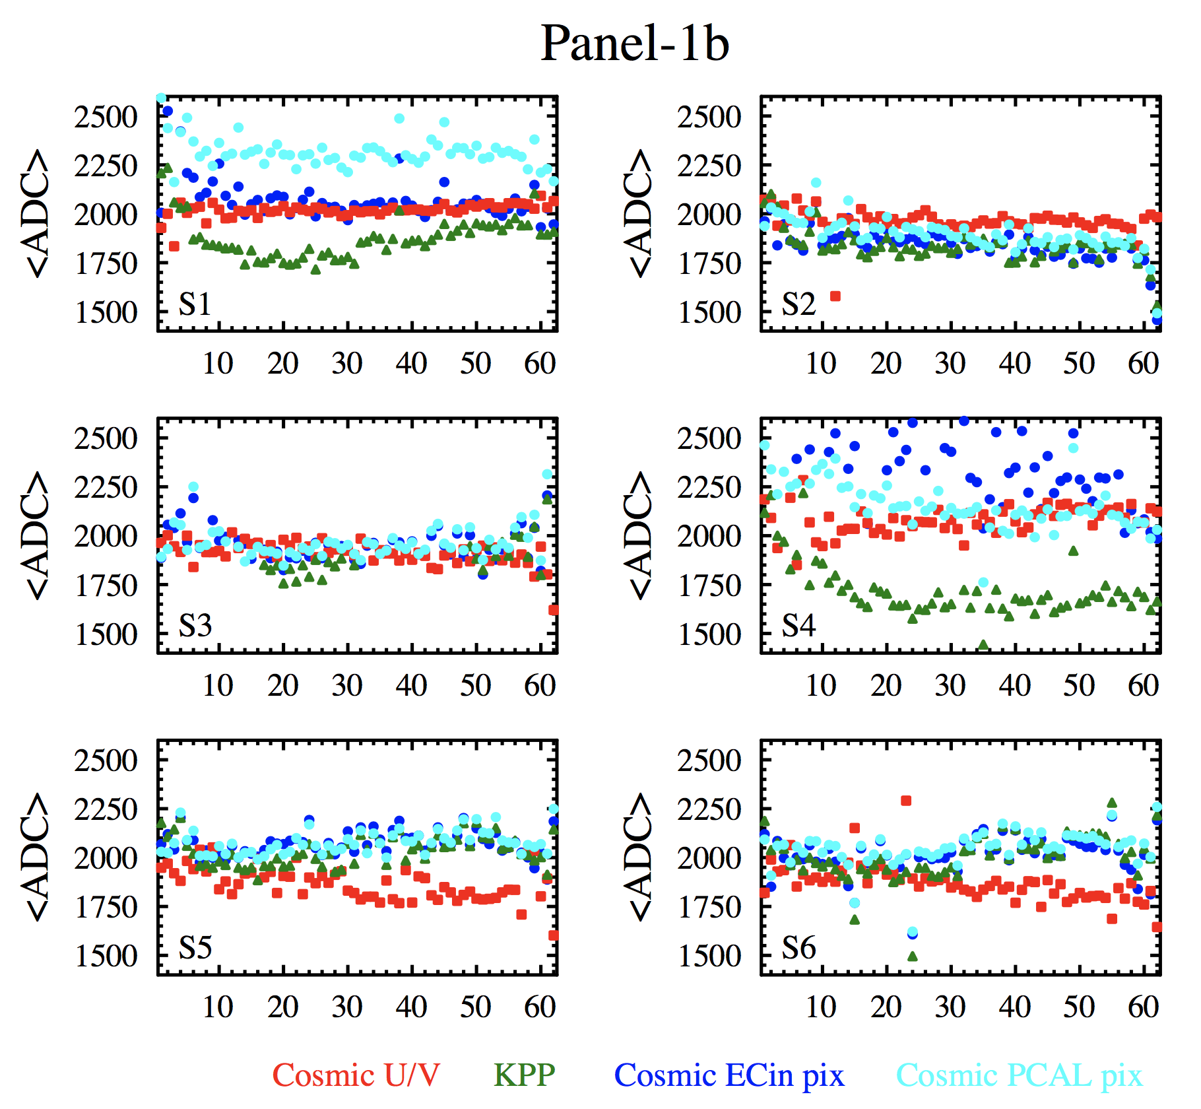
Spring Cosmic Ray Run
Cosmic ray studies with Forward Carriage detectors in progress:
Study FTOF gain calibrations with ECAL pixel trigger variants:
PCAL pixel trigger
ECin pixel trigger
Compare gain response to that from earlier cosmic calibrations (2016) and KPP data
Some anomalies present that are due to trigger bias and hardware problems
Strongly desire match between beam and cosmic calibrations
Final gain calibrations for fall running later this summer

Slide 13
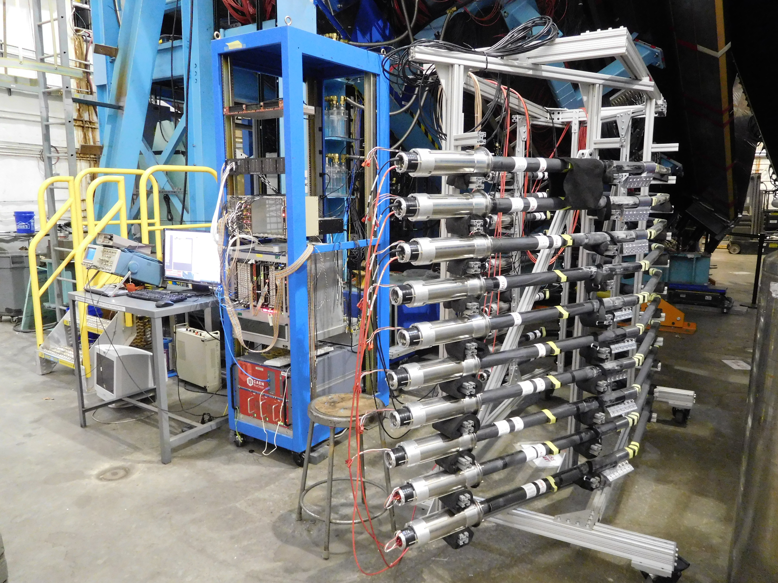
CTOF Counter Testing
CTOF counters are fragile and were not intended to be installed multiple times
After removal from KPP solenoid mockup, test counters before fall installation period
Set up test stand in Hall B to check:
Gain calibrations
Timing resolution
Counter response
Triplet rate: 0.25 Hz

Slide 14
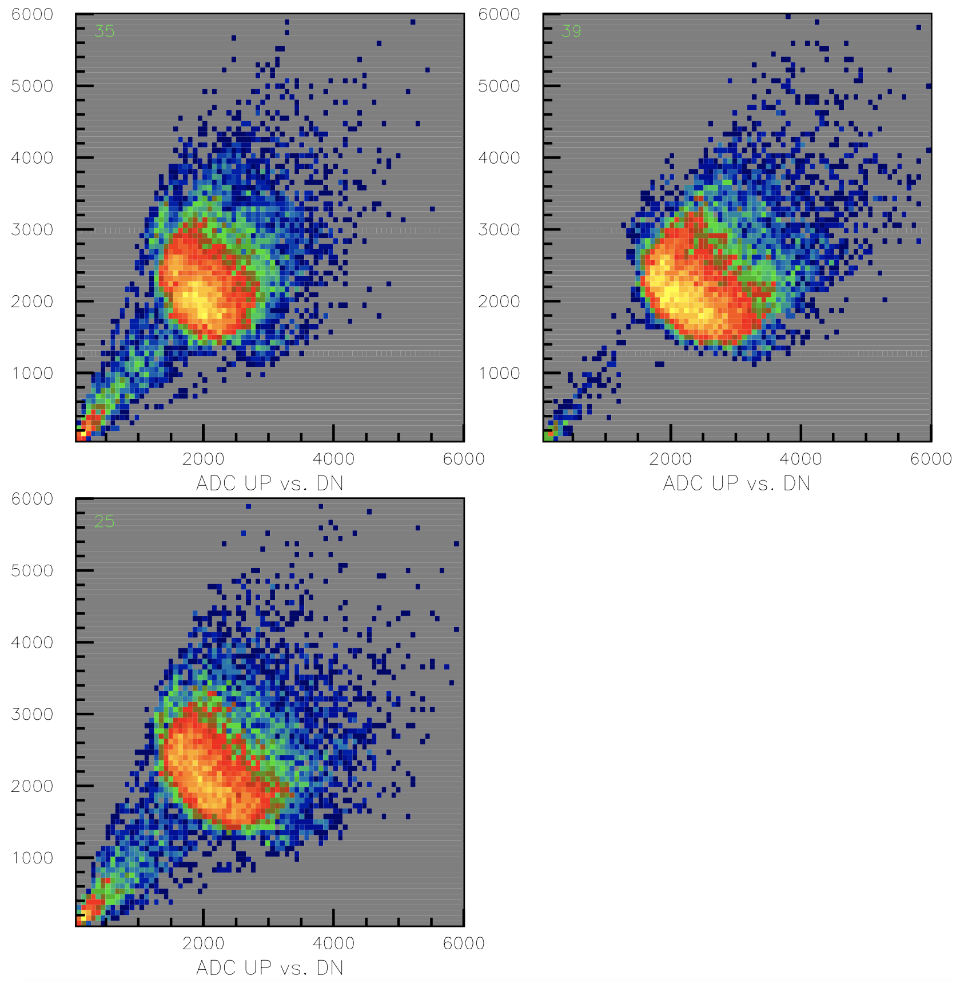
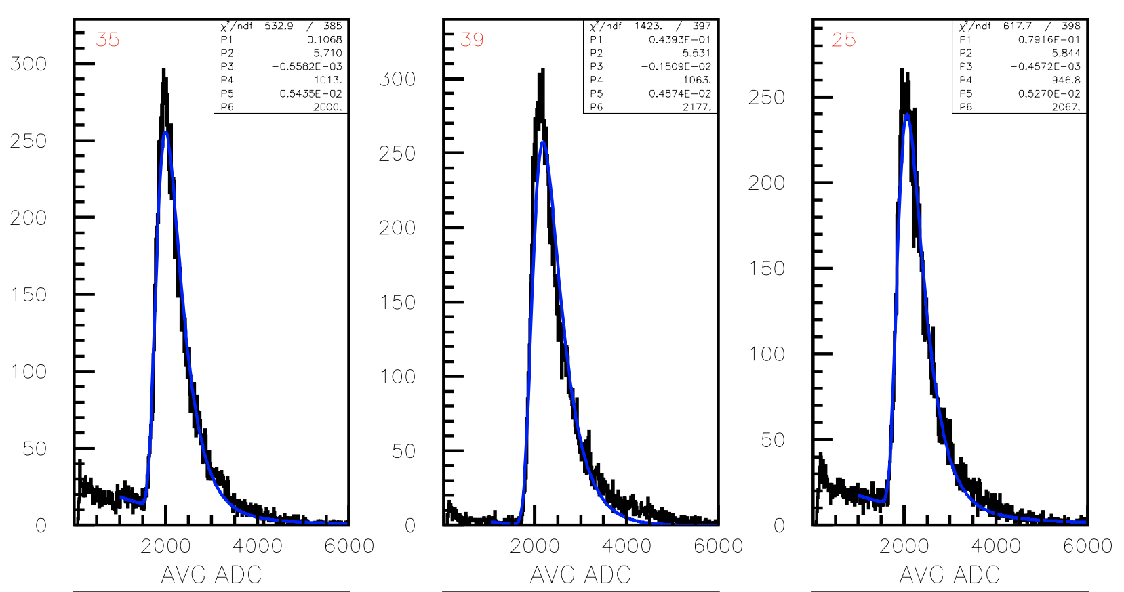
CTOF Counter Testing

Slide 15
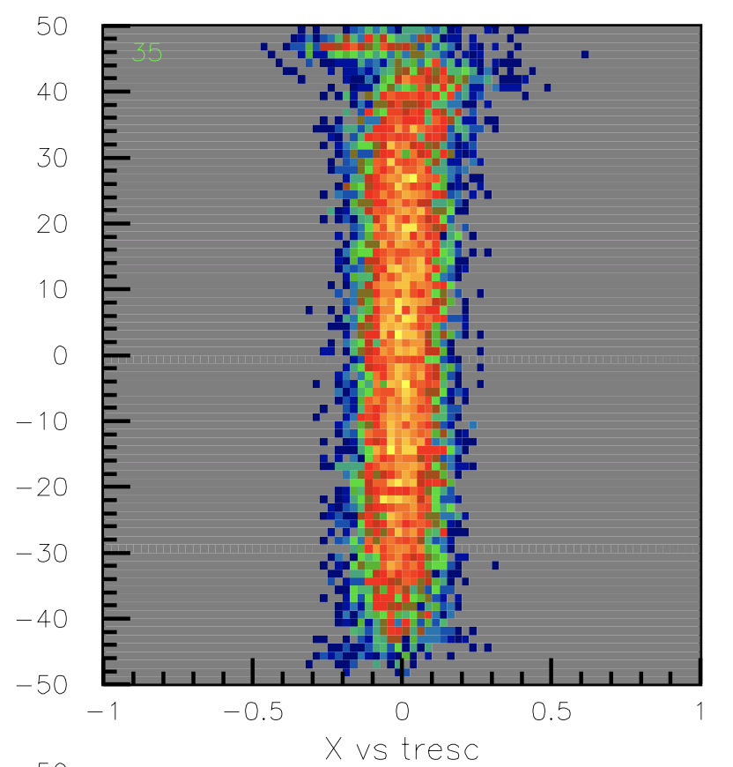
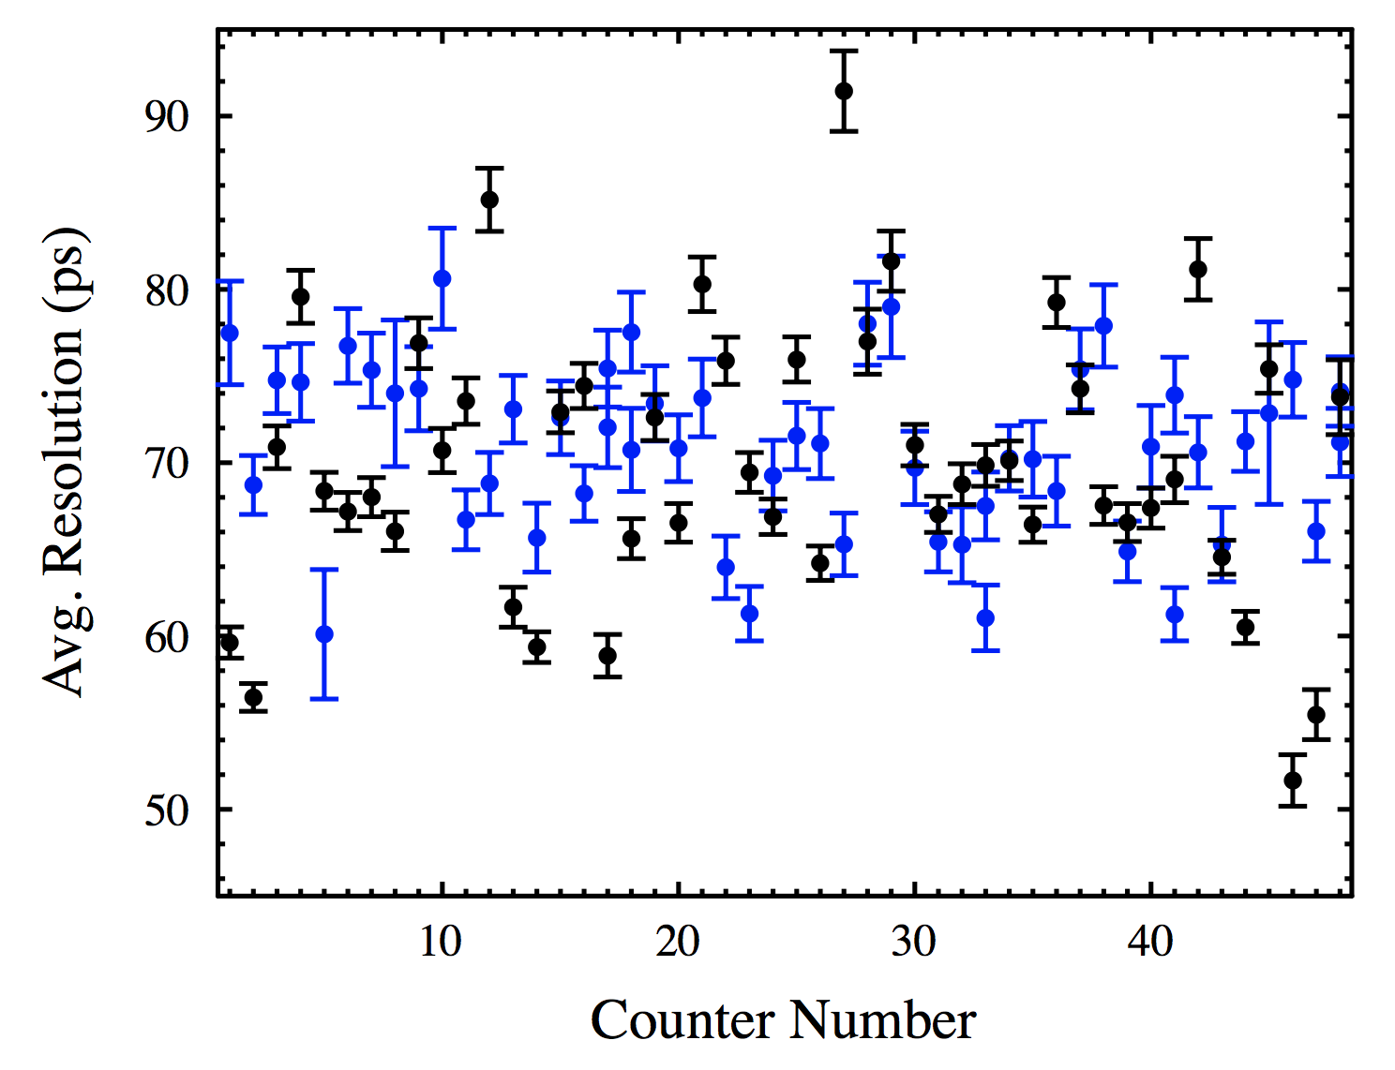
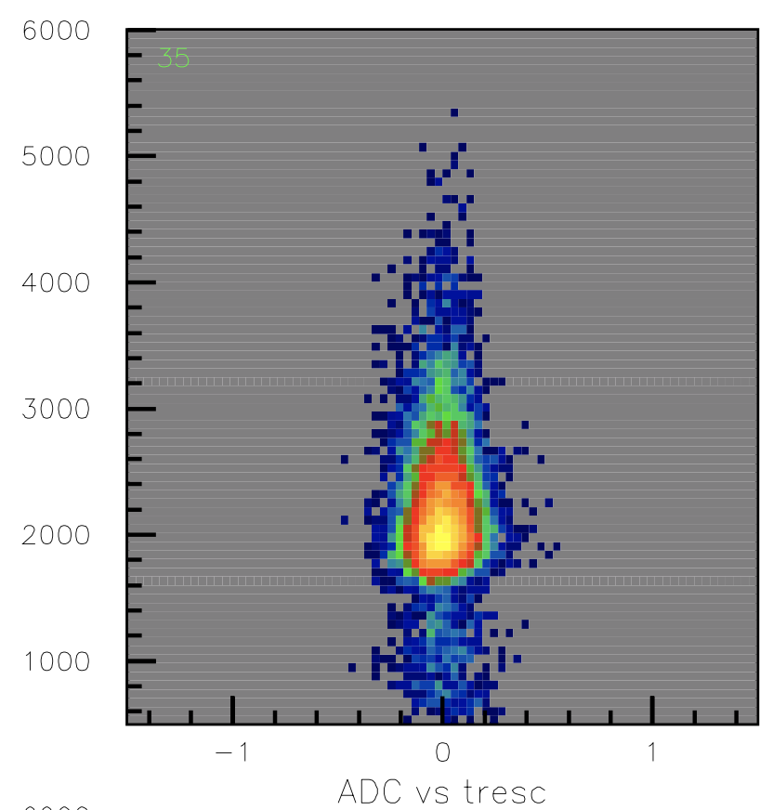
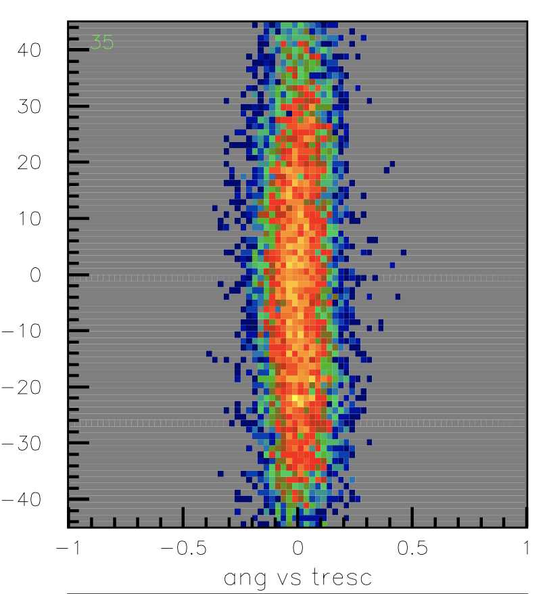
CTOF Counter Testing
coor
ADC
Good match to Sep. 2016 data
angle
Black: CTOF Assembly Area data:
Blue: Hall B May 2017:
69.9 +/- 7.9 ps
70.8 +/- 4.9 ps

Slide 16
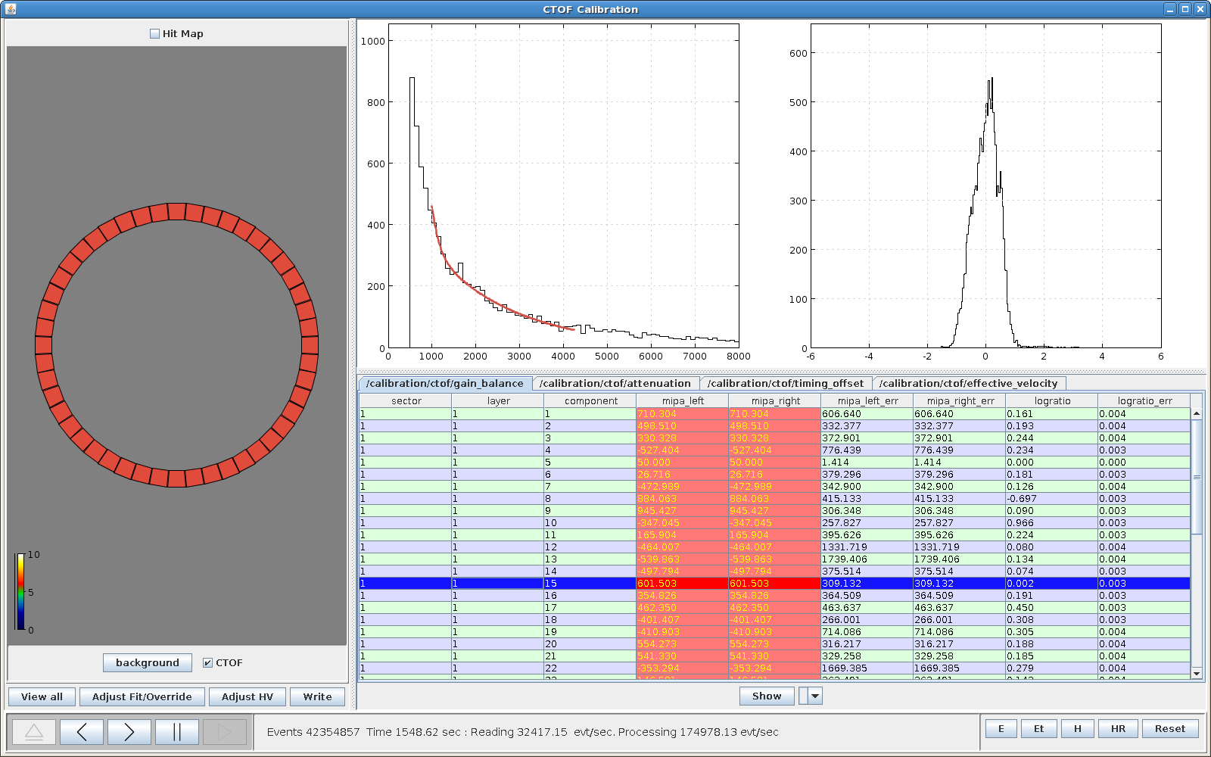
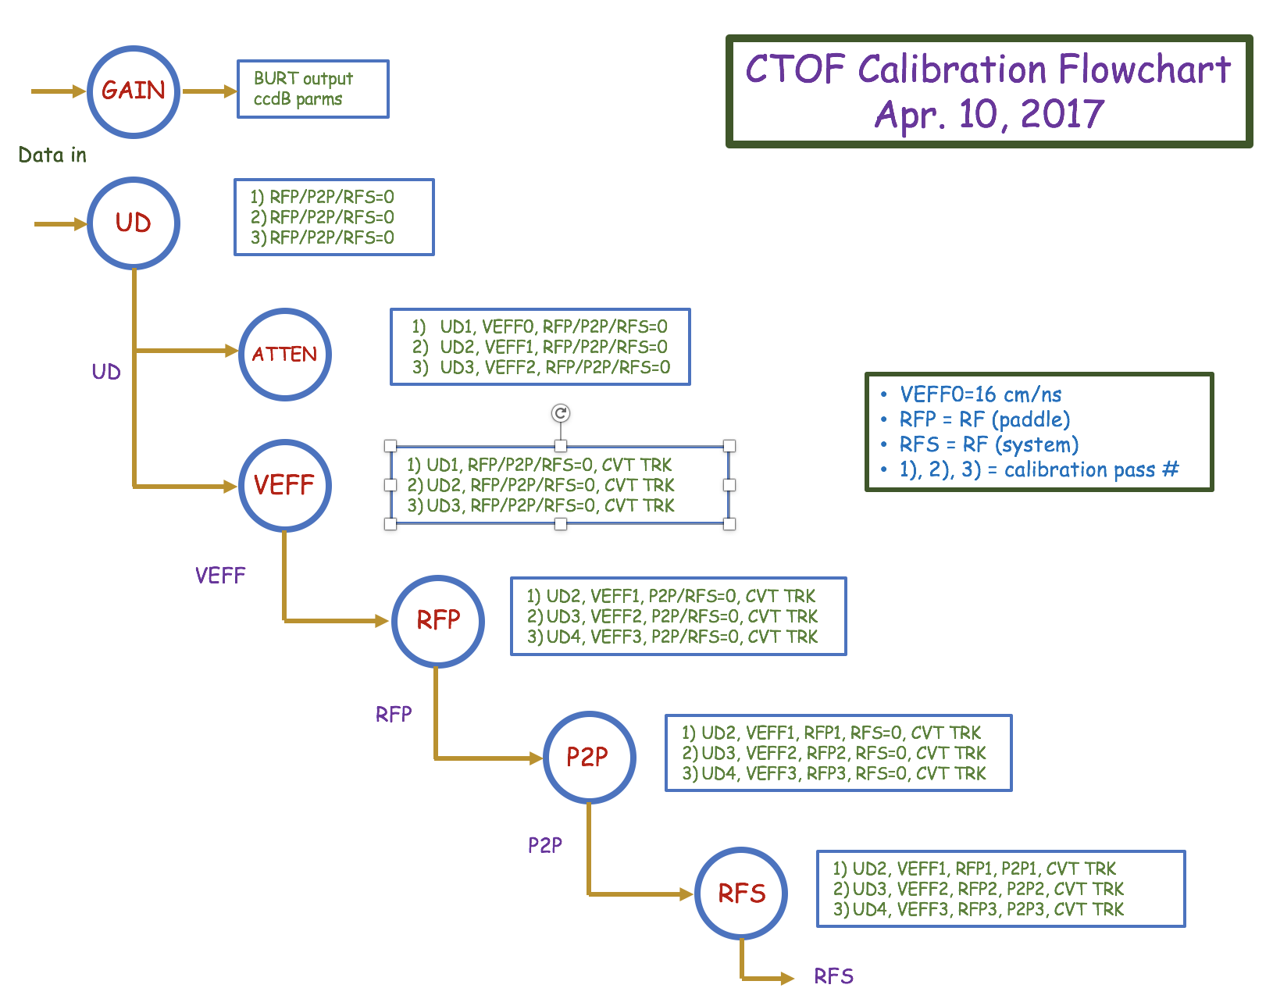
CTOF Calibrations
Louise Clark
Full CTOF calibrations are not possible with the KPP data
CTOF calibration suite development is based on work done for FTOF
Current CTOF calibration suite from Mar. 2017 tested on KPP/MC data
Updates to suite in June/July
More testing during July CALCOM Calibration Challenge

Slide 17
FTOF/CTOF Summary
The FTOF/CTOF calibration suites are becoming mature codes:
FTOF calibration suite has been used to calibrate KPP beam data
CTOF calibration suite will be studied with MC data this summer
The FTOF reconstruction code has been validated through detailed systematic studies of Monte Carlo and KPP beam data:
All aspects of code functionality studied
Some minor work remains on combining hit times for FTOF
Work is underway to build in survey data for FTOF detectors into geometry database
FTOF hardware in great shape
CTOF hardware: Significant effort in fall to install in solenoid and test
All installation procedures tested during KPP installation
Cosmic ray testing necessary before start of Engineering Run

