Slide 1
MgB₂ Thin Films on Metallic and Dielectric Substrates for Microwave Electronic and SRF applications
D. E. Oates
MIT Lincoln Laboratory, Lexington MA
Y. D. Agassi
Naval Surface Warfare Center, Carderock Division, Bethesda MD
B. H. Moeckly and C. Yung
STI Inc. Santa Barbara, CA
G. Carpenter and F. Niu
SVT Associates, Eden Prairie, MN
This work was sponsored by the Defense Threat Reduction Agency, the Office of Naval Research, and the Naval Surface Warfare Center, Carderock Division
Notes:
The Lincoln Laboratory portion of this work is sponsored by the Naval Surface Warfare Center, Carderock Division under Air Force Contract #FA8721-05-C-0002. Opinions, interpretations, conclusions, and recommendations are those of the author and are not necessarily endorsed by the United States Government.

Slide 2
MgB₂
Discovered to be superconducting in 2001 with a T_{c} = 39 K
  J. Nagamatsu, N. Nakagawa, T. Muranaka, Y. Zenitani and J. Akimitsu,“Superconductivity at 39K in Magnesium Diboride,” Nature 410, 63 (2001)
Believed to be BCS superconductor
Bulk and thin films
No isostructural compounds show high T_{c}

Slide 3
Outline
Introduction to MgB₂ and Motivation
Film deposition
Measurements of surface impedance
Physics of MgB₂ from microwave measurements
Summary

Slide 4
Motivation
RF applications of MgB₂ thin films
T_{C} = 40 K
  Operating T ≈ 20 K
Low surface resistance
  Comparable to niobium at 4 K
Long coherence length
  ξ = 4 – 8 nm
  Polycrystalline films with good RF properties
  Grain boundaries are not weak links
High Critical Field
  H_{c} ≥ 1.5 T
  Good power handling
Crystal structure
  AlB₂ (Hexagonal)
  Stable, stoichiometric

Slide 5
Applications
RF cavities coated with MgB₂ for accelerator applications
  Improvement on niobium technology
  Films on metallic substrates
  High Q at high power
  H_{C} → RF breakdown
Passive microwave electronics
  Films on dielectric substrates
  Inexpensive polycrystalline substrates
  High Q at low to medium power
  Low-loss delay lines – dispersive delay lines
  Miniature filters
  Intermodulation distortion possible issue

Slide 6
Outline
Introduction to MgB₂ and Motivation
Film deposition
Measurements of surface impedance
Physics of MgB₂ from microwave measurements
Summary

Slide 7
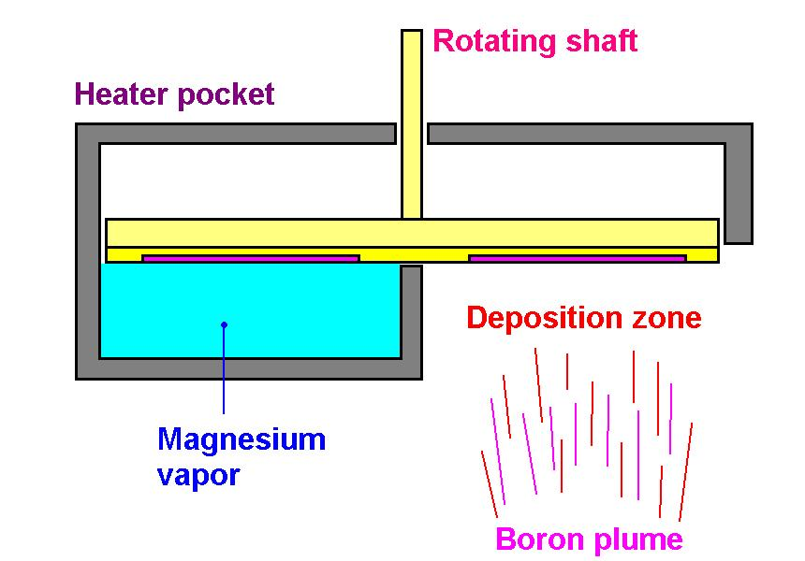
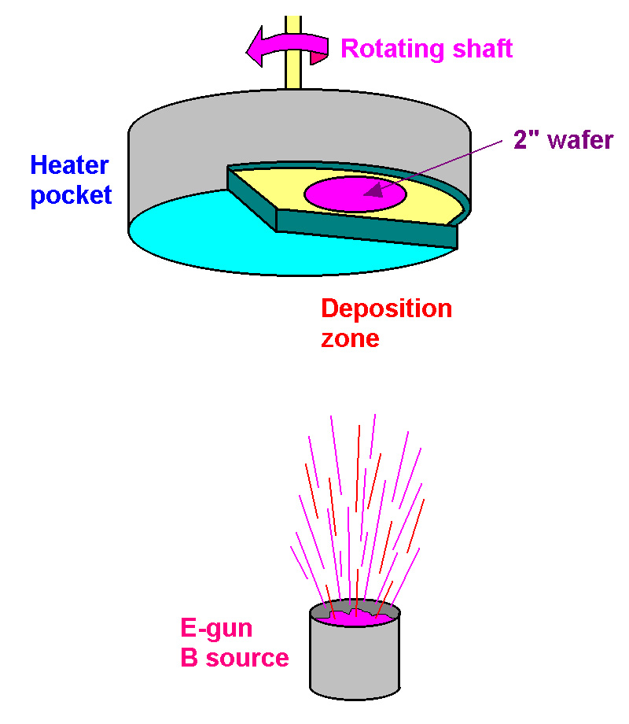
Reactive Evaporation Film Deposition
Solves MgB₂ Film-growth Difficulties: Mg Volatility, Oxidation
Rotating blackbody heater
Advantages:
Localized Source of High-Pressure Mg Vapor
Different Mg and Substrate Temperatures
Films:
T_{C} ≅ 39K, ΔT_{C} ≅ 1K, Resistivity(T_{c}) ≅ 2μΩ-cm
4” Wafers, scale up possible
RMS roughness = 4.4 nm
B. H. Moeckly et al., Supercond. Sci. Technol. 19, L21 (2006)
Notes:
Schematic view of the film growth by reactive evaporation. Using the growth technique of reactive evaporation in which a localized source of Mg vapor is maintained near the substrate by using a rotating pocket heater, we have been able to grow films completely in situ.

Slide 8
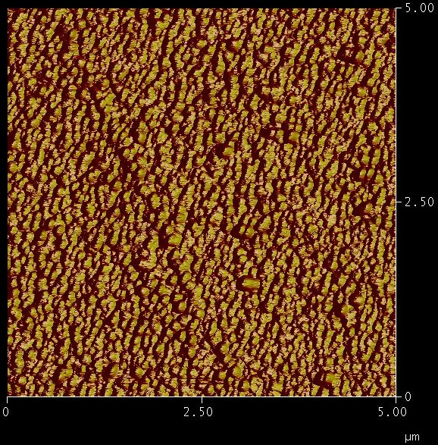
MgB₂ Thin-Film Properties
0.5-μm film on sapphire
40 >T_{c} > 39.5
Low resistivity
Sharp transition
AFM surface scan
500-nm MgB₂ film on Nb
RMS surface roughness = 3.0 nm
Notes:
AFM of the polished niobium substrate on the left and the deposited MgB₂ film on the right. Roughness increases slightly but the result is quite smooth.

Slide 9
Atomic Layer Deposition of MgB₂
Joint Program with SVT Associates
Developing ALD process and system for MgB₂ deposition
  B₂H₆ and Mg(CpEt)₂, or Mg(thd)₂
  Plasma enhanced
Conformal coating method
Needed for cavity coating
Progress to date: thin films of MgB_{x}
  Still developing the process parameters

Slide 10
Outline
Introduction to MgB₂ and Motivation
Film deposition
Measurements of surface impedance
  Small samples 1 cm x 1cm
  2-inch diameter wafers
Physics of MgB₂ from microwave measurements
Summary

Slide 11
Stripline Resonator for Measurements on Dielectric Substrates
Stripline resonator
f₁
IMD measurement
Patterned
Capacitive
center line
Resonator
Spectrum
Analyzer
150 μm
+
coupling
f₂
Input Spectrum
Output Spectrum
Power
f₁
f₂
Frequency
2f₁ - f₂
f₁
f₂
2f₂- f₁
Fundamental
Ground
planes
Output power (dBm)
Intermod
Used for measurement of Z_{S}(I_{rf} ,T, f), intermodulation distortion, and 3rd harmonic generation.
Input power (dBm)
Notes:
The left panel shows the stripline resonator. The films are patterned and packaged as stripline resonators for the characterization of the microwave properties. This device is used for measurement of Z_{S}(I_{rf},T,f), intermodulation distortion, and 3rd harmonic generation.
The right panel is the IMD system. Shown at the top is the block diagram for the measurements of intermodulation distortion. The second line shows the input and output spectra. We apply two closely spaced tones of equal amplitude. The tones are within the 3-dB bandwidth of the resonator. At the output, measured in the spectrum analyzer, we see the third-order mixing products resulting form the nonlinear impedance of the device under test. We measure the power in the intermodulation products as a function of the output power at the fundamental.
At the bottom right is the typical plot of the measured data showing the fundamental as well as the third order intermodulation signal.

Slide 12
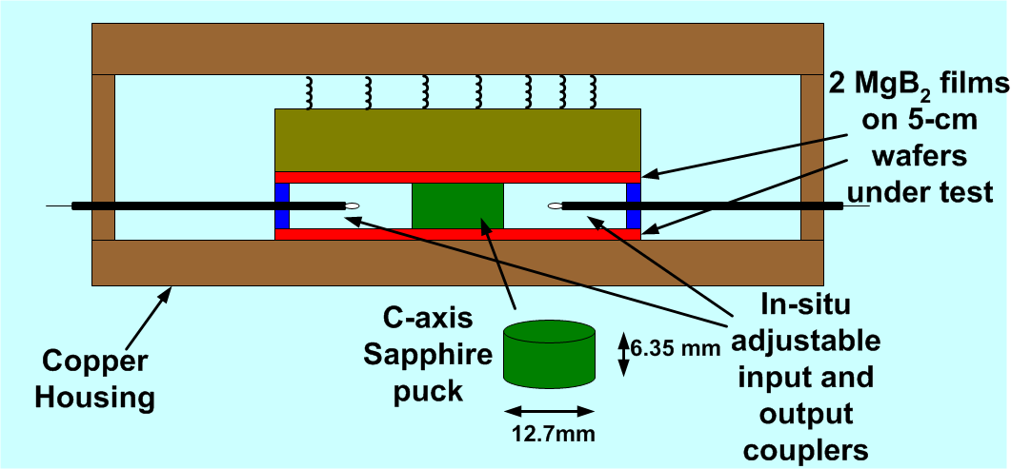
Dielectric Resonator for Films on Metallic Substrates
Can be used with metallic or dielectric substrates
Designed for high-power measurements
Fundamental frequency = 10.7 GHz
TE₀₁₁ mode
Notes:
Cross-section view of the dielectric resonator that is used to measure the microwave surface resistance of MgB₂ films on metallic substrates. The stripline resonator cannot be used with conducting substrates.

Slide 13
Resonators
Stripline vs. Dielectric
Stripline Resonator: Side View
Dielectric Resonator: Top View
rf magnetic
field directions
150 μm
Conductor Cross Section
Cross
section
|J(x)/J_{max}|
|J(x)/J_{max}|
Position from Center (μm)
Position from Center (mm)
J_{max} ~ 1.6 x 10⁸ A/cm²
J_{max} ~ 4.0 x 10⁶ A/cm²
Notes:
The differences in current distribution in the dielectric resonator and the stripline resonator are shown. These resonators have been used to compare Z_{S}(H_{rf}) for films both patterned and unpatterned. The stripline resonator has a much higher and narrower peak than the dielectric resonator.

Slide 14
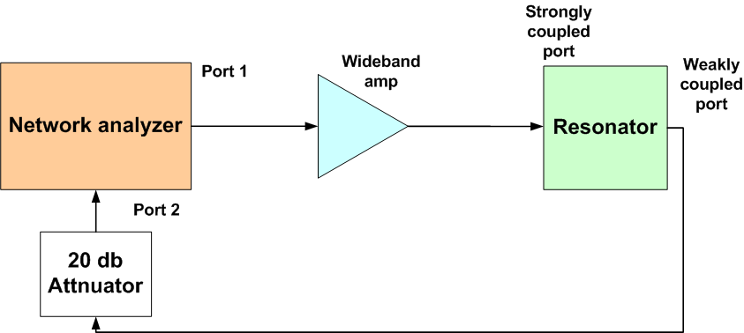
CW Measurement

Slide 15
CW Measurement
Insertion loss (dB)
Data
Fit
Frequency (Hz)

Slide 16
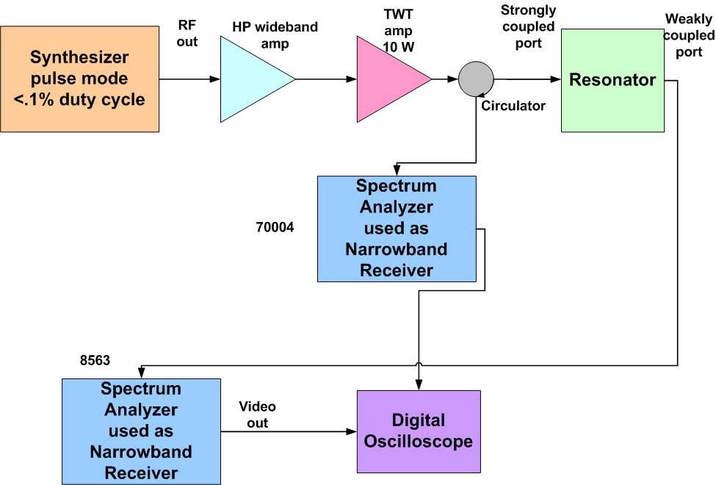
Time-Domain Pulsed Tests

Slide 17
Pulsed Measurement

Slide 18
Low Power Fit

Slide 19
Low-Power R_{S}(T): MgB₂ and Nb
MgB₂ on
bulk Nb
Dielectric resonator
Niobium film on sapphire
stripline
MgB₂ on
sapphire
Stripline resonator
R_{S} extrapolated to 2.2 GHz by f ²
Notes:
Low power surface resistance vs temperature for MgB₂, and niobium. At 4 K the MgB₂ on sapphire shows surface resistance comparable to or better that of niobium deposited at Lincoln Laboratory. This niobium is comparable to the best polycrystalline niobium films grown elsewhere.

Slide 20
R_{S} vs H_{RF}
Dielectric and Metallic Substrates
Dielectric res.
Stripline res.
Stripline res.
Notes:
Measurements of the power dependence of the surface resistance for films on various substrates in stripline and dielectric resonators. Also included are results for a niobium film. The films on sapphire and on niobium substrates are superior to the niobium film. The dielectric-resonator results are limited by the available power amplifier.

Slide 21
Breakdown Fields
MgB₂ on niobium substrate
Measured in dielectric resonator
T | Max Pwr dBm | Q_{L} (low pwr) | H_{rf max}
4.2 | 28.7 | 7.8x10⁶ | 278
7.5 | 38.2 | 5.5x10⁶ | 697
11 | 38.2 No breakdown | 2.5x10⁶ | 470 Max power available
Breakdown most likely due to thermal effects
Amplifier with +45 dBm output power recently installed

Slide 22
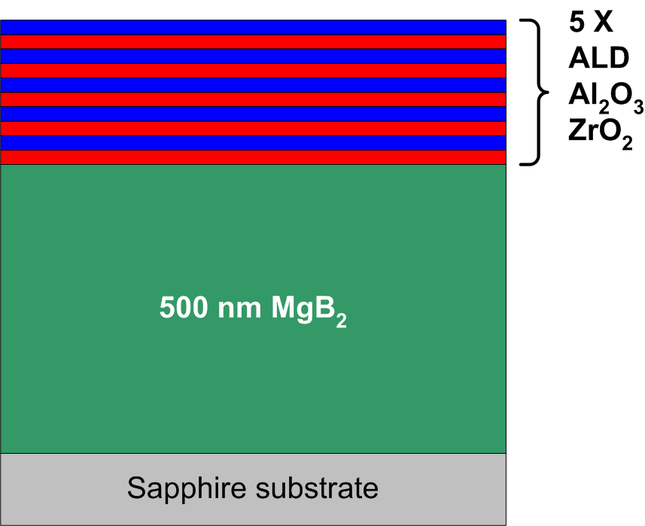
Passivation
Success at Film-Stabilization
MgB₂ Degrades in Air
Passivation with 5 X (2.5 nm Al₂O₃ and 2.5 nm ZrO₂) by ALD
Over 6 Months & 5 Temperature Cycles R_{s} Unchanged. Q (f = 1. GHz) ∼ 1. ×10⁸ (Measured in a 2” Dielectric Resonator.)
R_{S}(1 GHz ) = 2 x 10⁻⁷ Ω
Notes:
The graph shows the resonance curve measured in the dielectric resonator for a pair of wafers of MgB₂ on a sapphire substrate with Al₂O₃ / Zro₂ passivation deposited by atomic layer deposition. The Lorentzian fit yields a Q of 9.59 x 10⁶. This is a R_{s} = 2.3 x 10⁻⁵ at 10.76 GHz, extrapolated by f² to R_{s} = 2 x 10⁻⁷ at 1 GHz.

Slide 23
Outline
Introduction to MgB₂ and Motivation
Film deposition
Measurements of surface impedance
Physics of MgB₂ from microwave measurements
Summary

Slide 24
IMD and R_{s} vs Circulating Power
MgB₂ Resonator
f₁
Resonator
Spectrum
Analyzer
+
Normalized IMD (dBm)
Surface resistance (Ω)
f₂
T = 20 K
T = 2.5 K
Circulating power (dBm)
Similar plot for X_{S}
Notes:
This shows the surface resistance and changes in surface reactance as a function of the circulating power at 2.5 and 20 K.. On the same graph referenced to the right hand scale is the measured IMD for the same temperatures. At the circulating power of interest for the IMD it is seen that the surface impedance measurements are not sensitive enough to resolve the nonlinearities. This illustrates the sensitivity of the IMD measurements.

Slide 25
IMD vs T: MgB₂ and YBCO
MgB₂ samples
t = 150 nm
MgB₂
t = 500 nm
YBCO
t = 600 nm
YBCO → d-wave order parameter → 1/T ² at low T
MgB₂ → 6-fold symmetry → 1/T ² at low T
Notes:
IMD vs T for YBCO and two typical MgB₂ samples. Both show the characteristic 1/T² dependence at low temperature. This is an indication of an order parameter with nodes giving rise to low-lying excitation. In YBCO it is d-wave symmetry and in MgB₂ it is a six-fold symmetry compatible with the hexagonal crystal group.

Slide 26
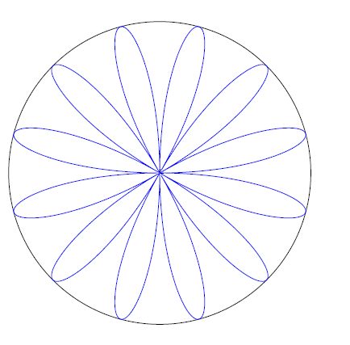
Order Parameter
ℓ = 6 MgB₂
ℓ = 2 Cuprates
-
+
+
-
-
Notes:
On the left is the proposed order parameter for MgB₂. This is the lowest order nodal symmetry allowed for a hexagonal crystal type. On the right for comparison is the accepted order parameter for the cuprates.

Slide 27
Summary
MgB₂ is promising for applications
Polycrystalline films with good RF properties
  Epitaxy not needed
Low surface resistance and good power handling on dielectric and metallic substrates
Microwave accelerator cavities – upgrade for niobium
  Remaining challenges
    Deposition on copper
    Conformal coating method
      Atomic layer deposition (ALD)
    Demonstrate H_{rf} > 2000 Oe
Electronics applications on inexpensive substrates

Slide 28
Summary (Physics)
Experimental evidence incompatible with s-wave symmetry
  Temperature dependence of intermodulation distortion (IMD)
  Increase of penetration depth at low temperatures
Theory based on extension of constitutive relation (London theory) and ℓ = 6 symmetry of order parameter
  Nonlinear Meissner effect for IMD
  Andreev bound states for Δλ(T)/λ
Conclusion: π gap has nodal order-parameter symmetry
ℓ= 6
Implications for applications
  Linear low-T surface resistance
  Intermodulation distortion greater than s-wave

Slide 30
Low-T Penetration Depth and ℓ = 6 π-Gap Symmetry
● Good fits with plausible parameters for all sapphire cuts and for LAO
Notes:
This shows the fit of the theory to the data of the earlier slide of Δλ/λ vs temperature.
The fit to the data is excellent.
30

Slide 31
Nonlinear Meissner Effect
Result of theory – nonlinear penetration depth
Intrinsic Nonlinearity: From Pair Breaking by the RF Current
IMD power
Temperature dependence at low temperature
For s-wave energy gap
For energy gap with nodes
For MgB_{2,} hexagonal symmetry rules out d-wave
Best fit is with 6-fold symmetry
D. Agassi and D. E. Oates, PRB 72, 014538 (2005), PRB 74, 024517 (2006)
D. E. Oates, Y. D. Agassi and B. H. Moeckly, PRB 77, 214521 (2008) and Physica C 2012 in press
Notes:
This summarizes the nonlinear Meissner effect. We conclude from our measurements that MgB₂ has unconventional symmetry of the energy gap.

Slide 32
Resistive Transition
Notes:
Resistance vs temperature for a film on c-plane sapphire. The inset shows the region around T_{c}. The transition is very sharp and the resistivity low in agreement with other high-quality films.

Slide 33
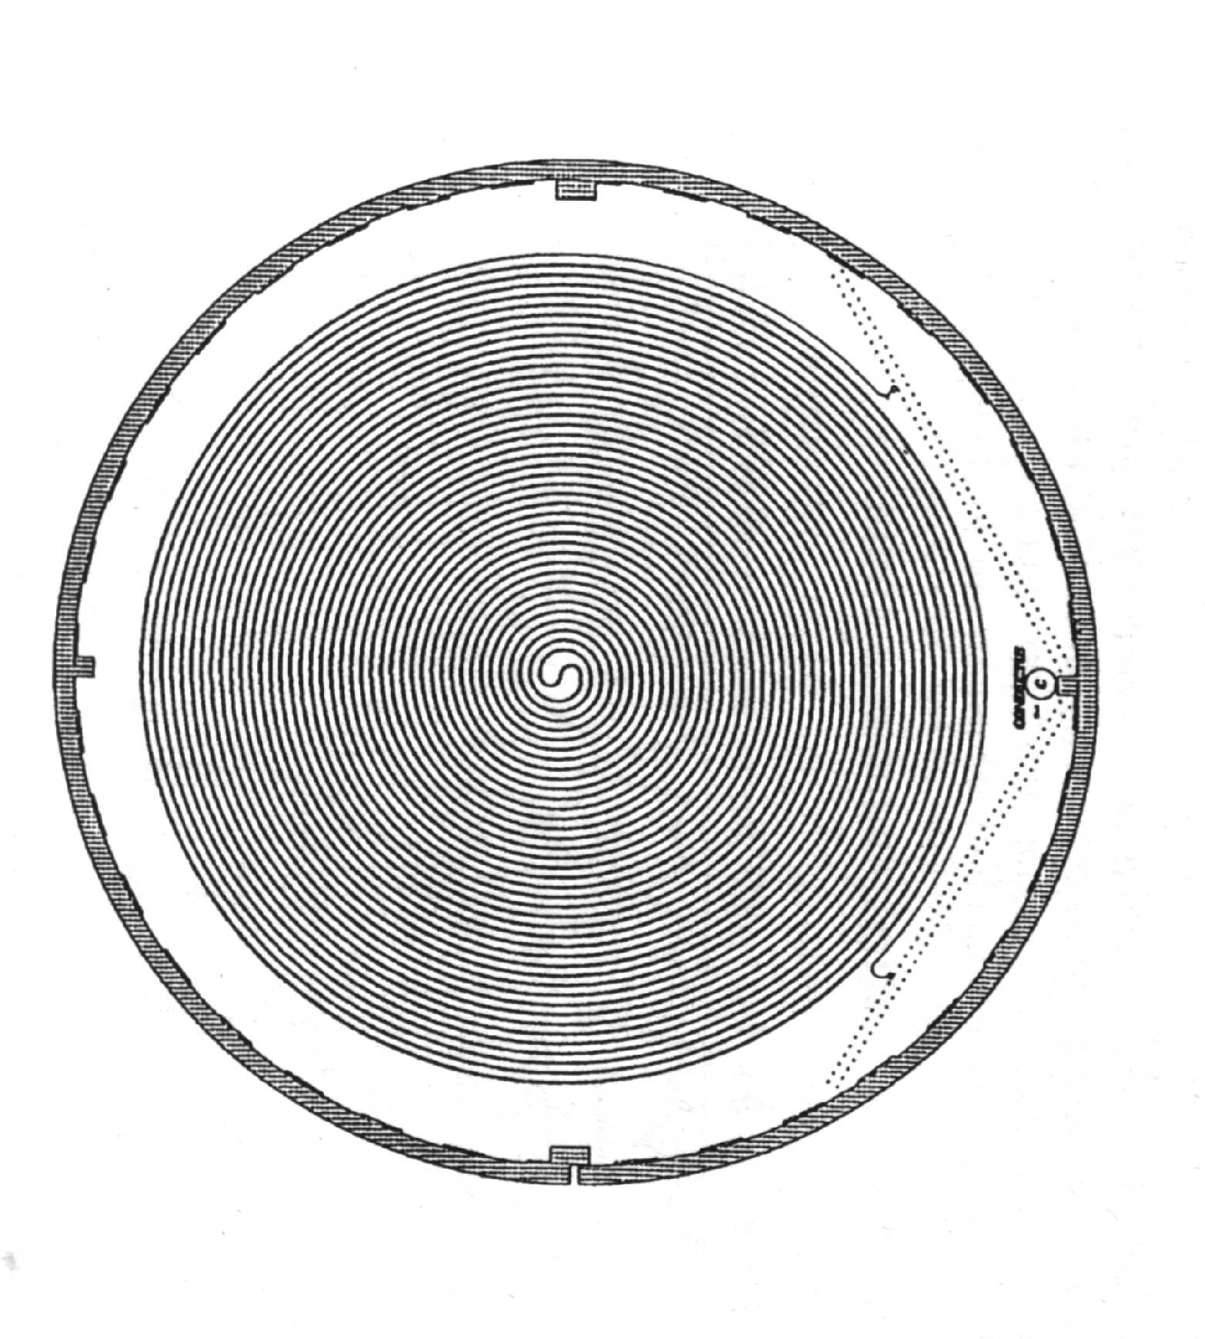
Long E-M Delay Lines
YBCO on 5-cm diameter LaAlO₃
44-ns delay
Output
Replace YBCO
Inexpensive substrate
No epitaxy
Larger substrates for much longer delays
500 ns possible
Input
Also dispersive-delay lines
G. C. Liang et al. Trans MTT vol. 44, 1289, (1996)
Notes:
This is a photograph, extracted from the referenced publication, of a 44-ns delay line. This was implemented using YBCO. Such delay lines could be made less expensively and with far better yield using MgB₂ because inexpensive substrates can be used and larger substrates can be used equally inexpensively for longer delays.

