Slide 1




Nb Coatings for SRF Cavities Produced by High Power Impulse Magnetron Sputtering
Rueben J. Mendelsberg^{1,2},
Alex Dzyuba³, Joe Wallig¹, Lance Cooley³, André Anders¹, Thomas Proslier², and many others

Slide 2
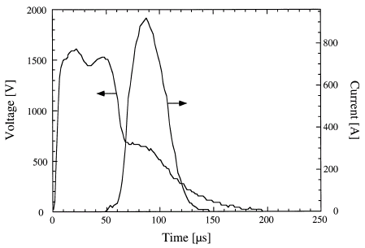
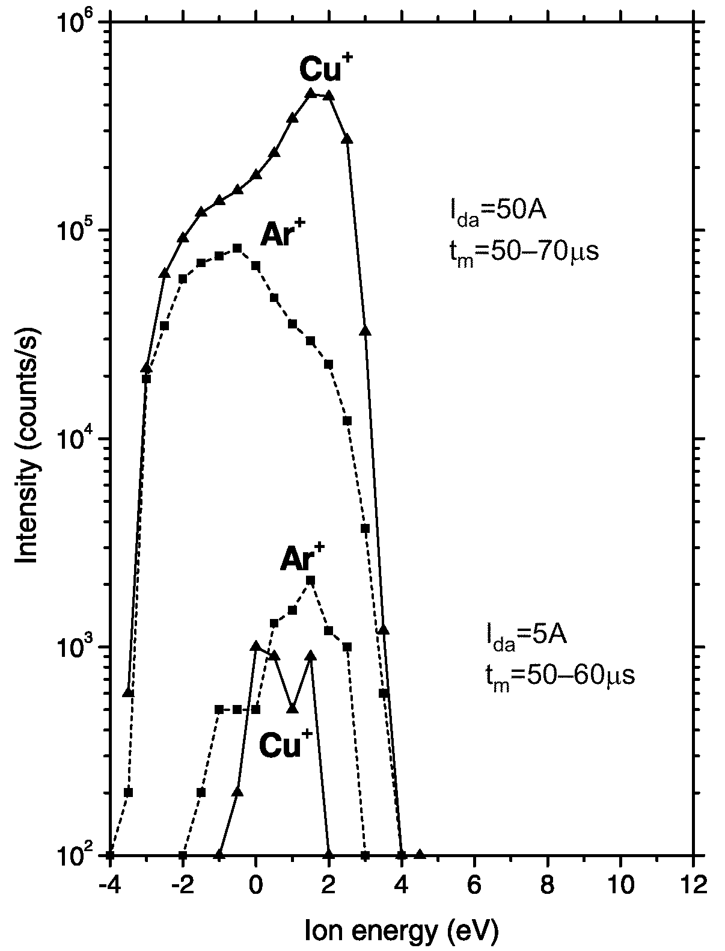
High Power Impulse Magnetron Sputtering
Ionize the Sputtered Atoms!!!!!!!!
500 kW Peak Power
300-550 W/cm²
Cu target in 65 mPa Ar
V. Kouznetsov, et al., Surf. Coat. Technol. 122, 290-293 (1999)
21-25 W/cm²
“HIPIMS is pulsed sputtering where the peak power exceeds the average power by typically two orders of magnitude.”
J. Vlcek, A. D. Pajdarova, and J. Musil, Contrib. Plasma Phys. 44, 426 (2004)

Slide 3
Dual HiPIMS of Nb at LBNL
+
-
+
-
± 750 V
± 750 V
± 200 A
± 200 A
4000 μF
4000 μF

Slide 4
Dual HiPIMS of Nb at LBNL
+
-
+
-
± 1000 V
± 1000 V
± 200 A
± 200 A
4000 μF
4000 μF

Slide 5
Dual HiPIMS of Nb at LBNL
+
-
+
-
+
-
+
-
± 1000 V
± 1000 V
± 1000 V
± 1000 V
± 200 A
± 200 A
± 200 A
± 200 A
4000 μF
4000 μF
4000 μF
4000 μF

Slide 6
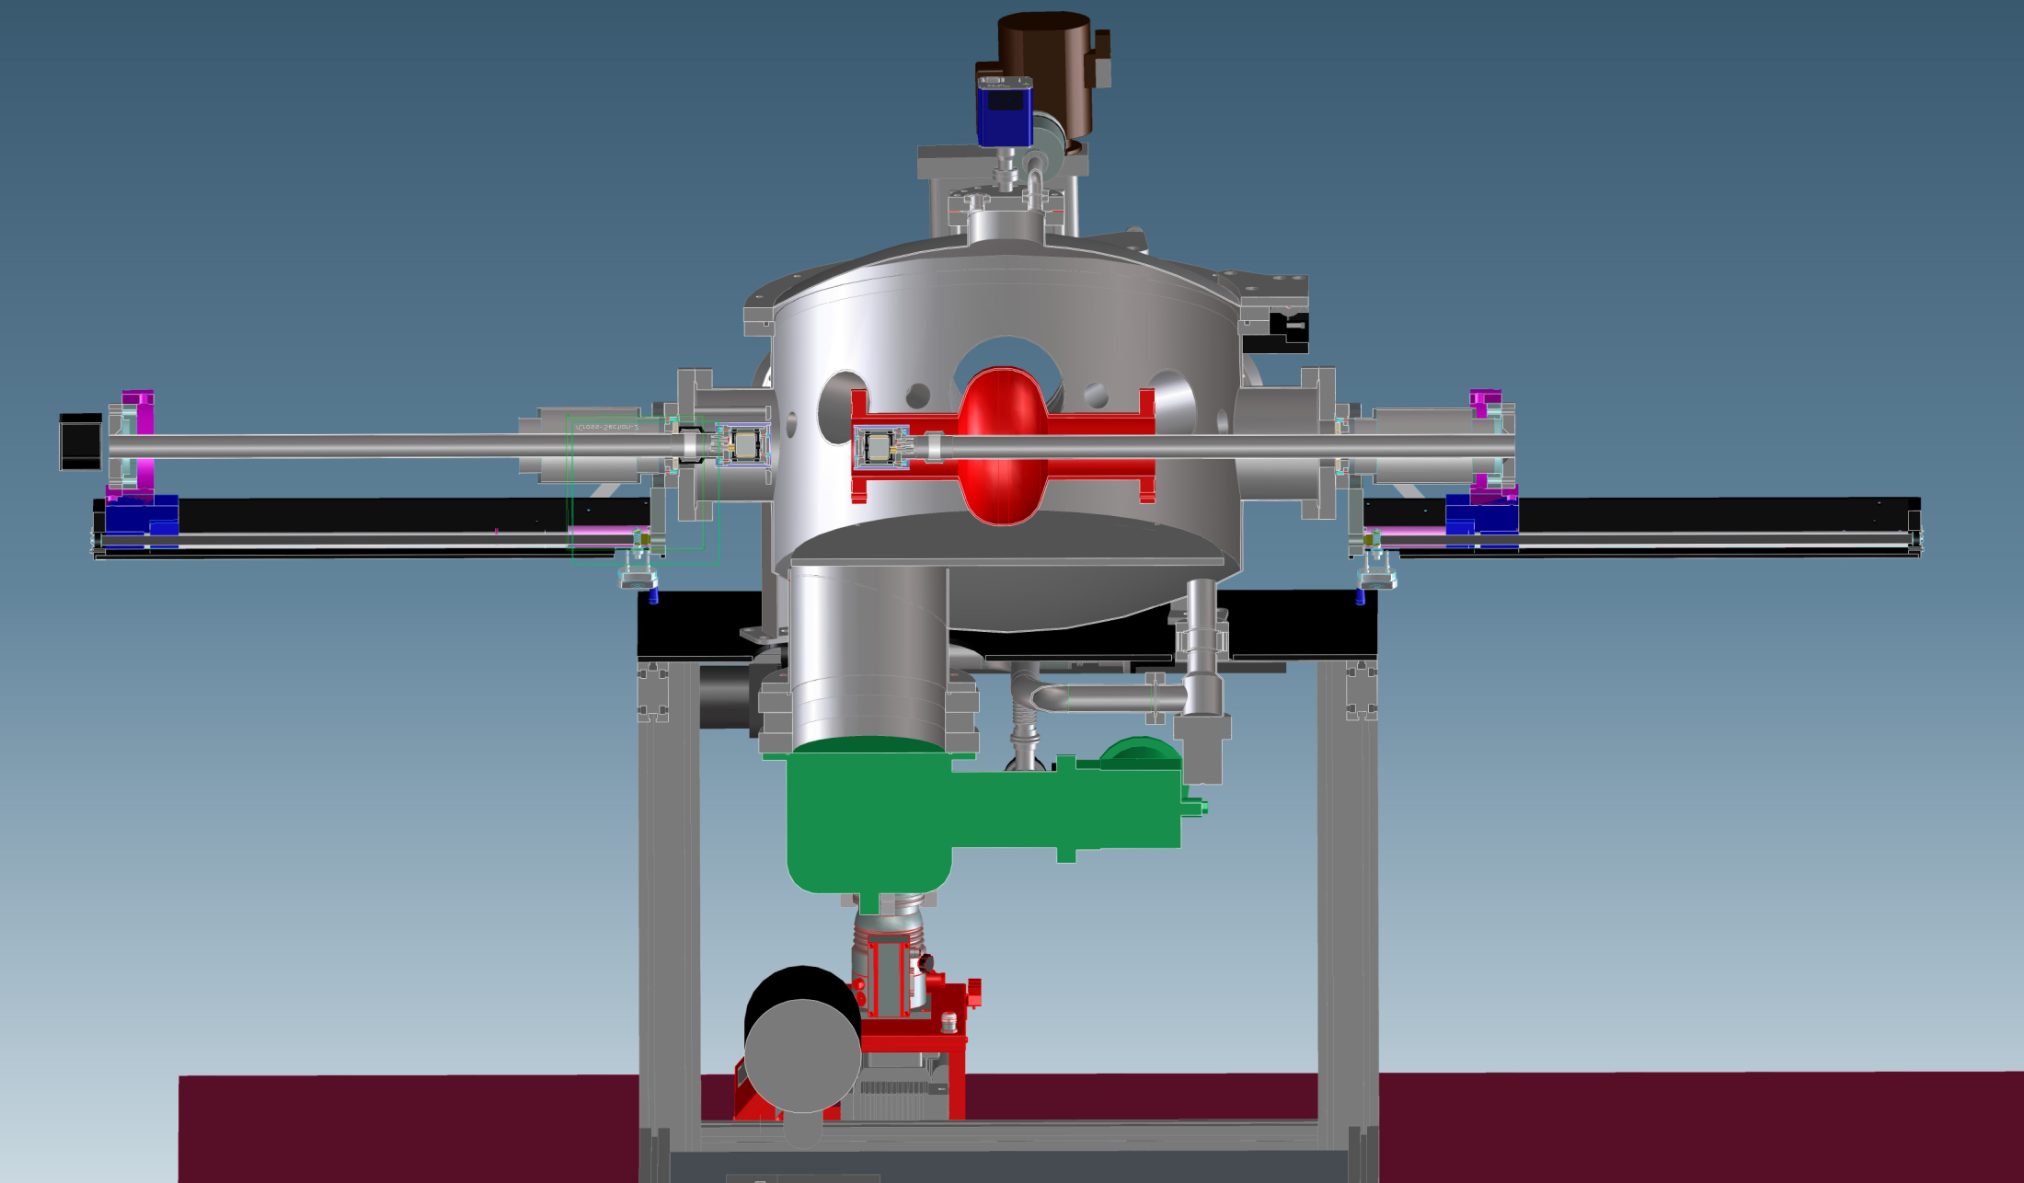

Slide 7
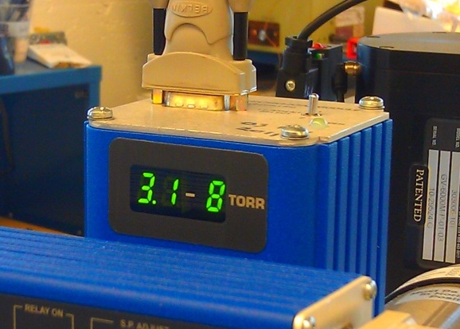
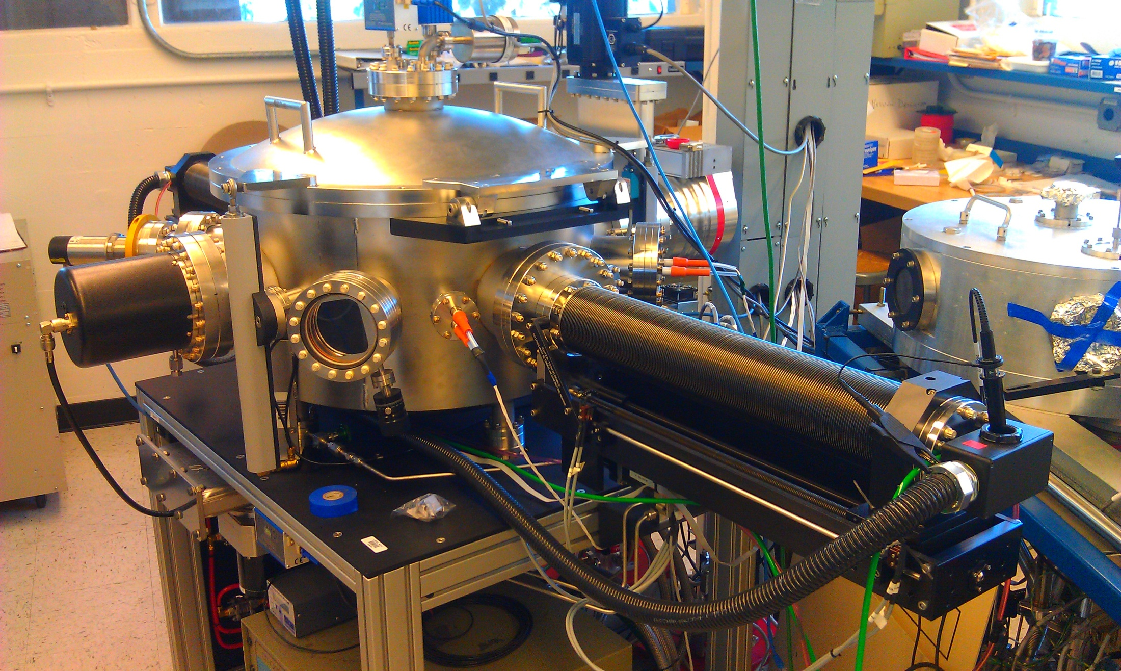

Slide 8
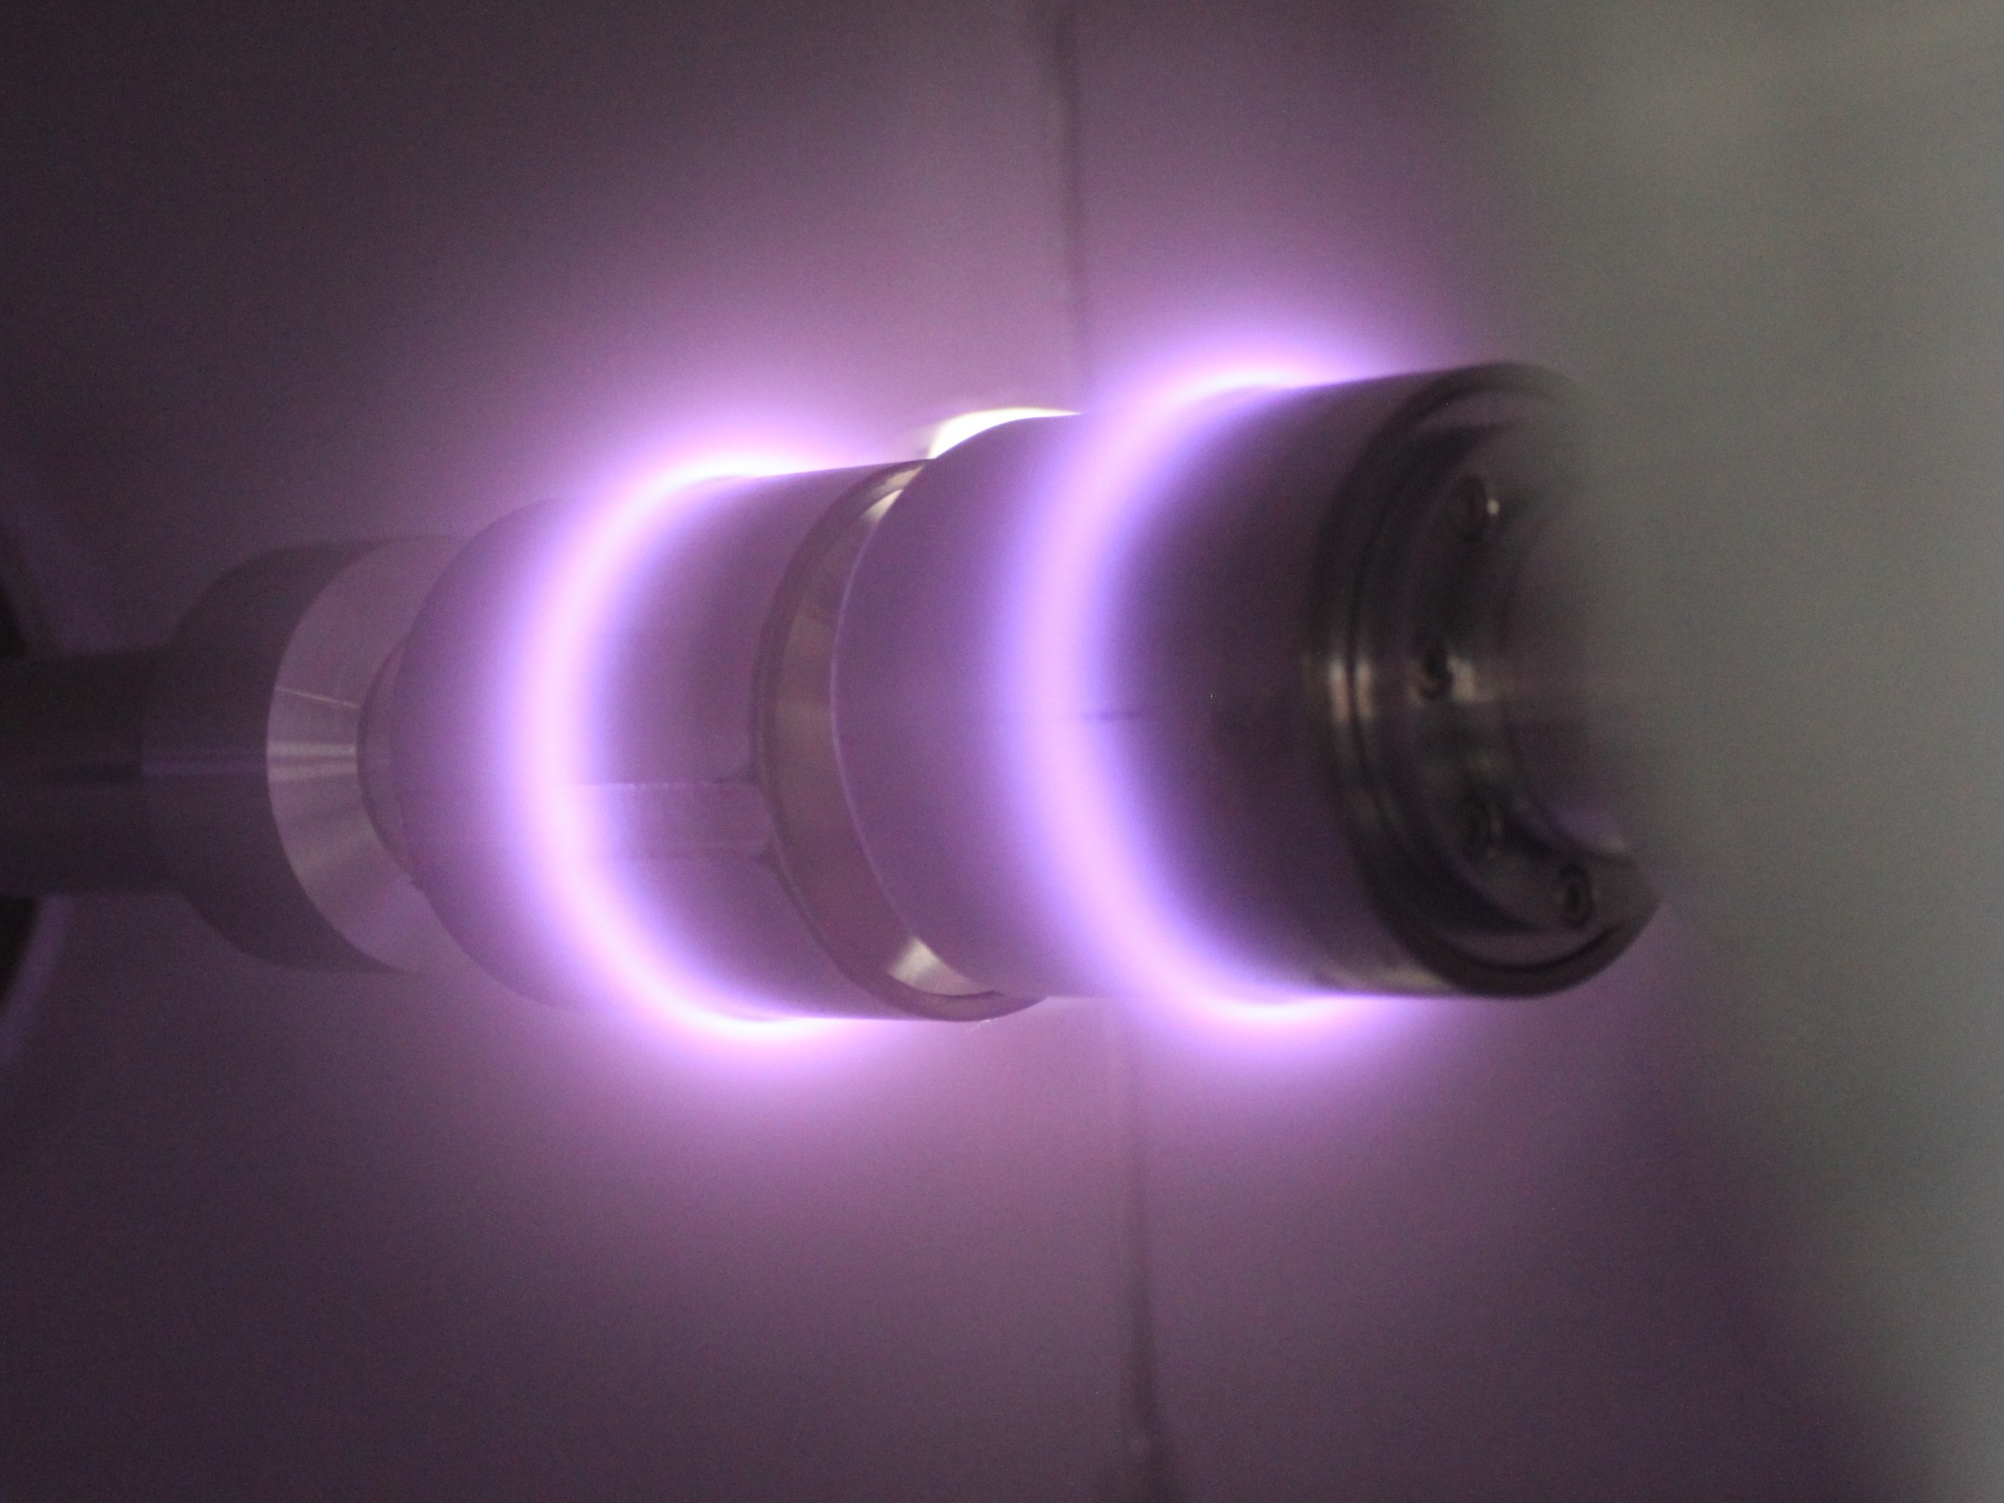

Slide 9
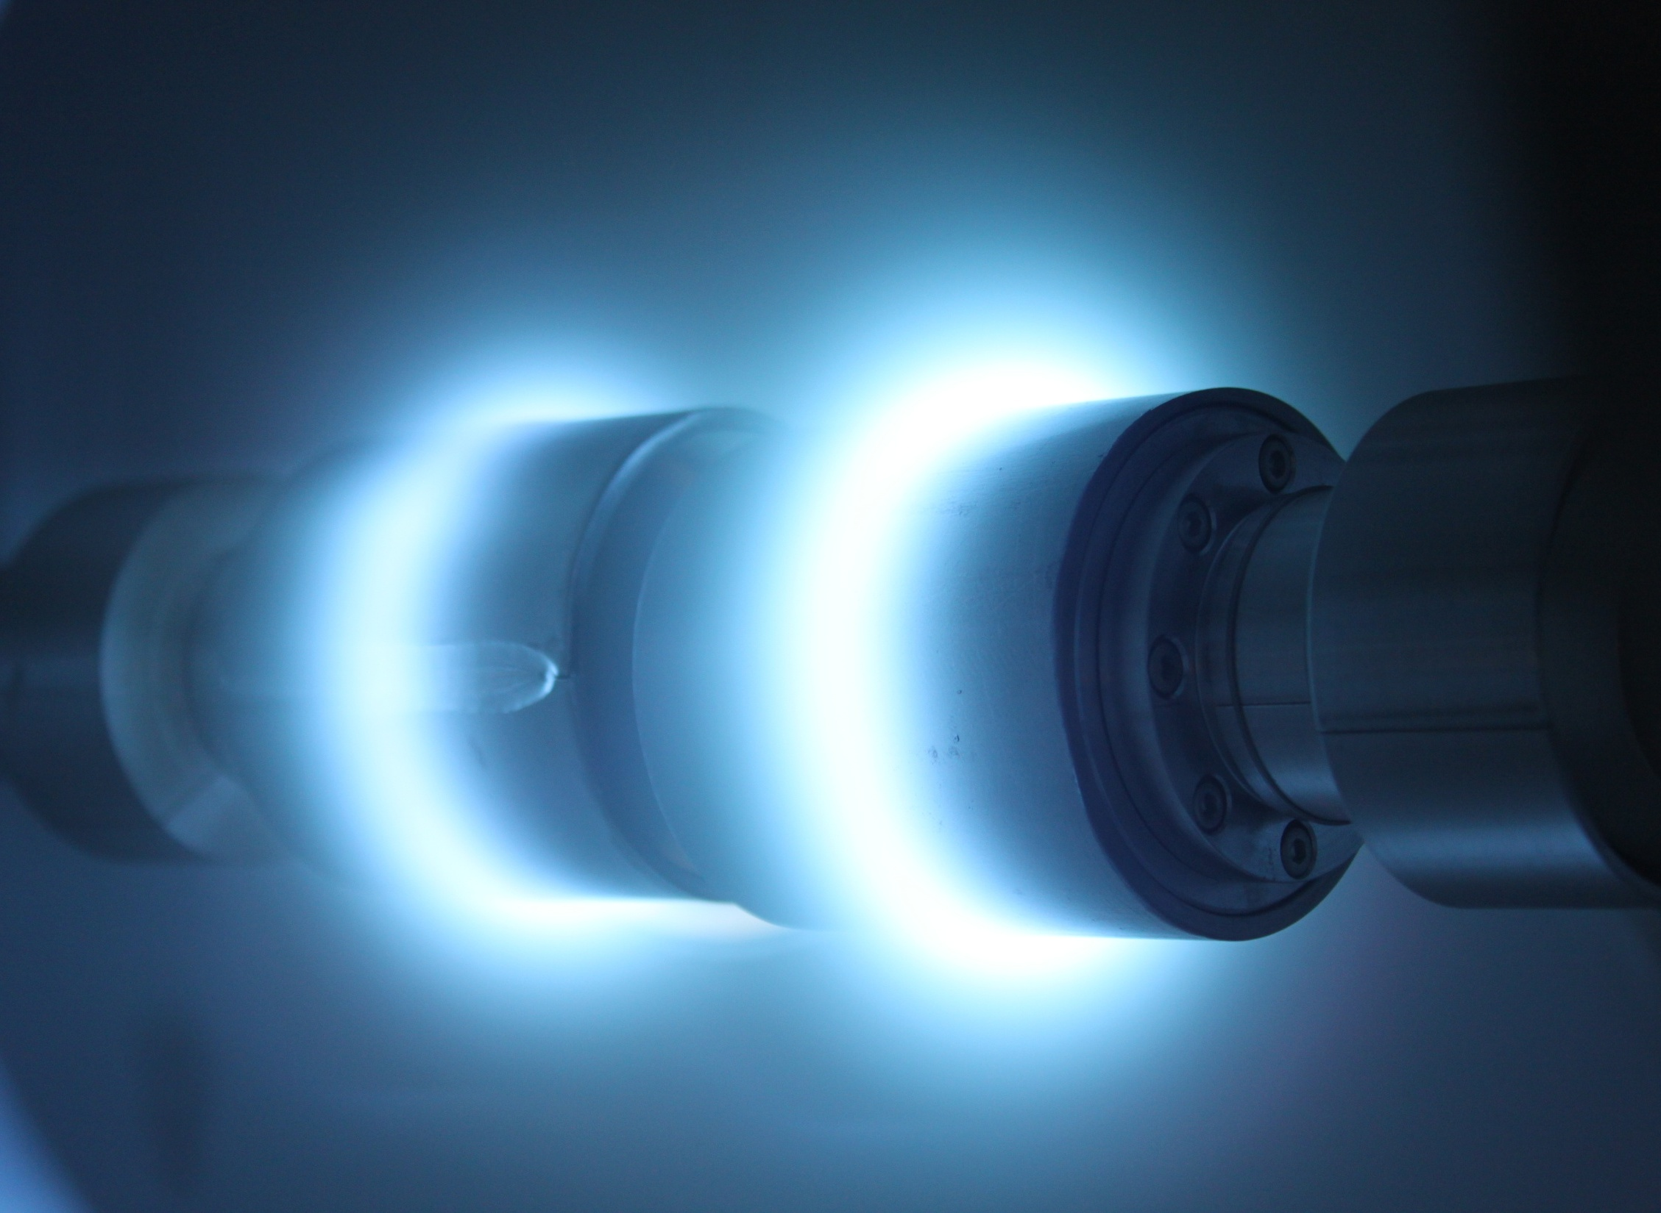

Slide 10
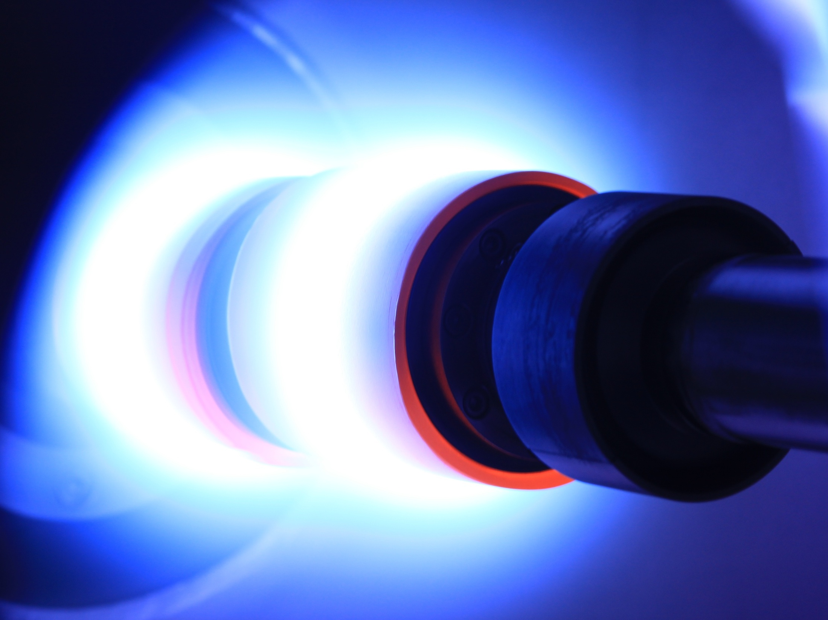

Slide 11
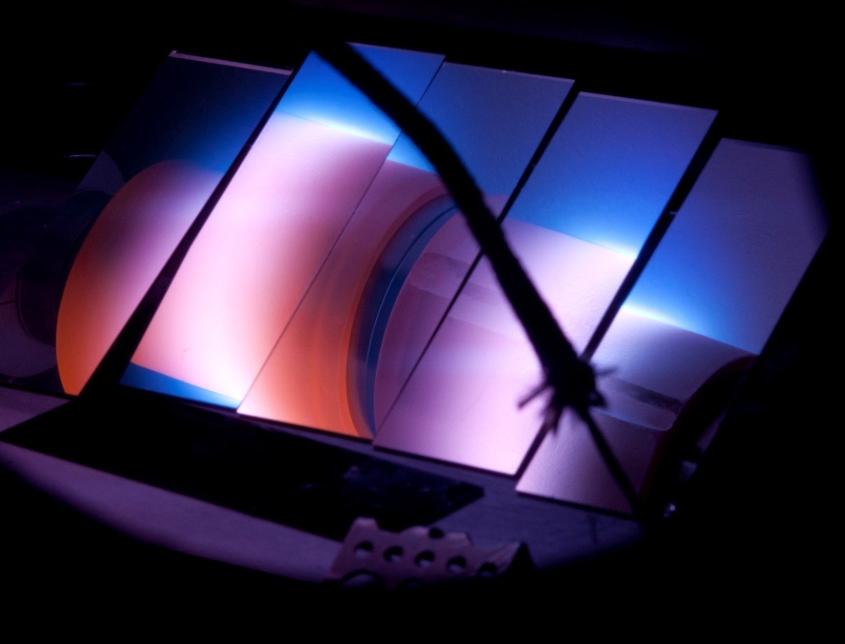
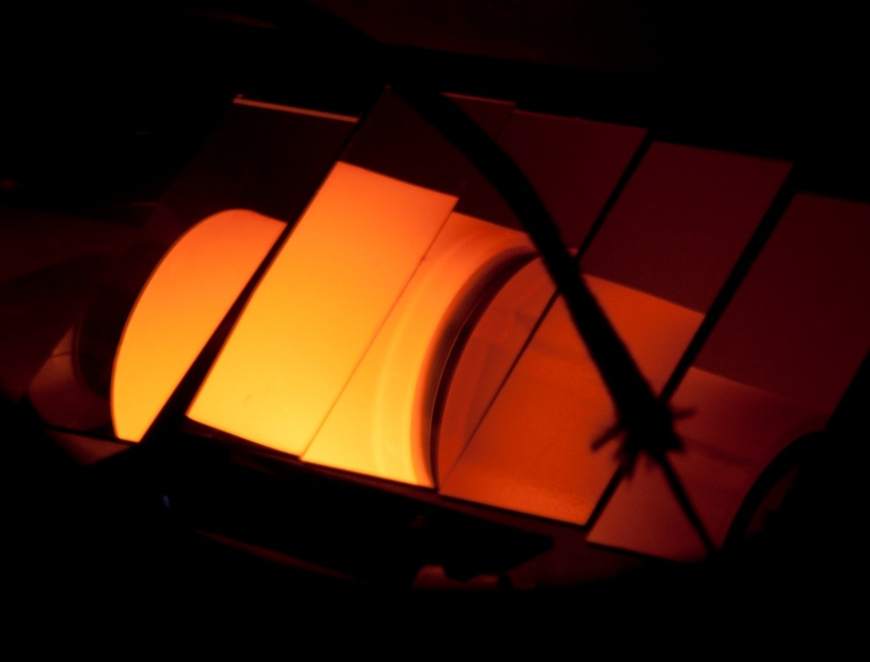
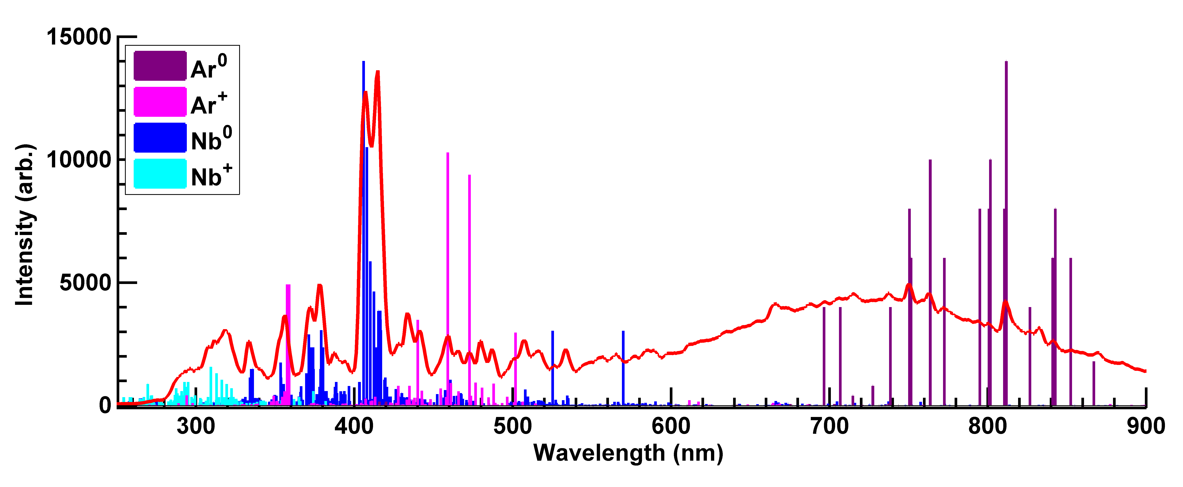
1050 K !!!

Slide 12
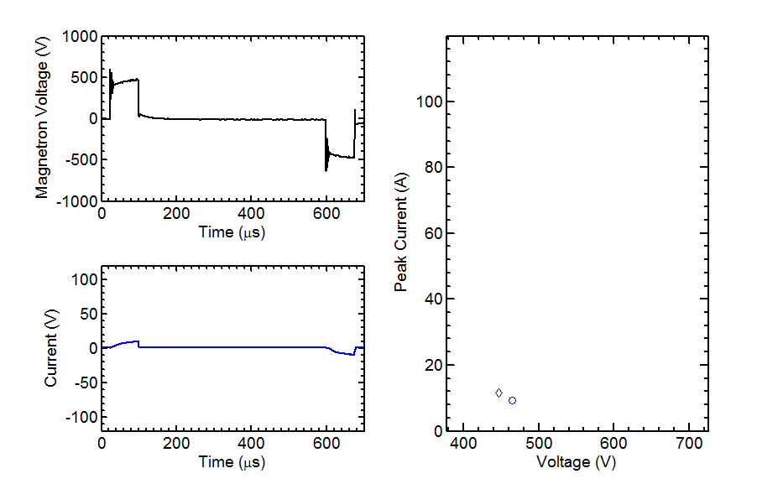
Power Balance

Slide 13
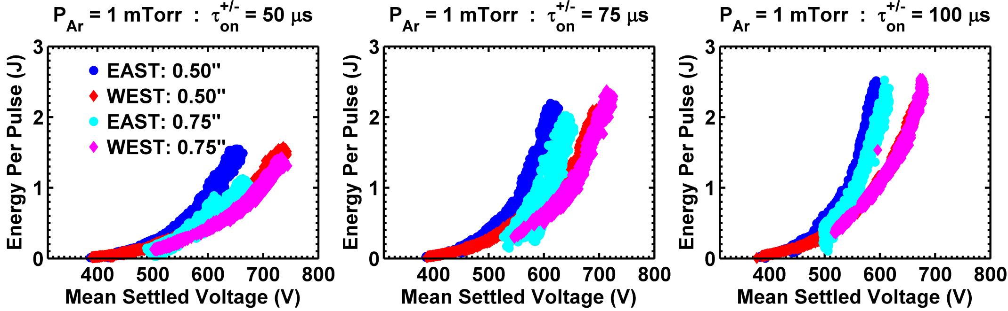
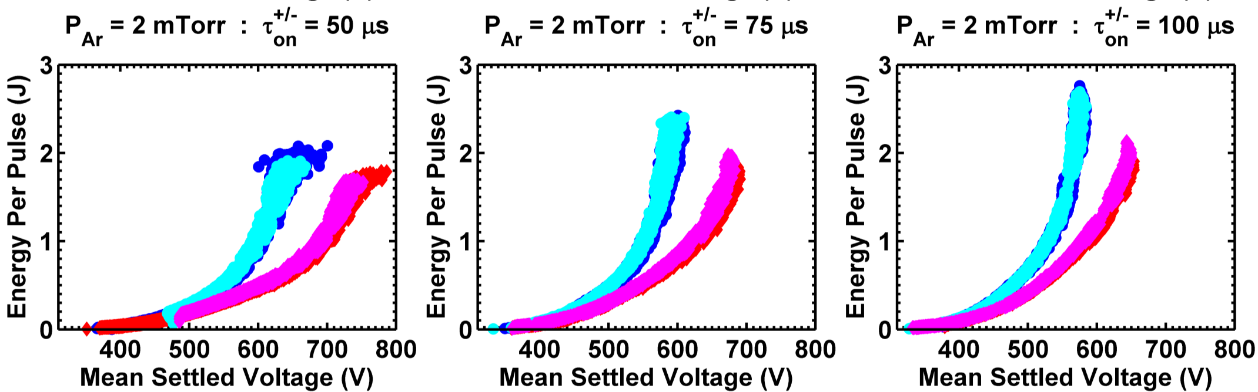
Power Balance

Slide 14
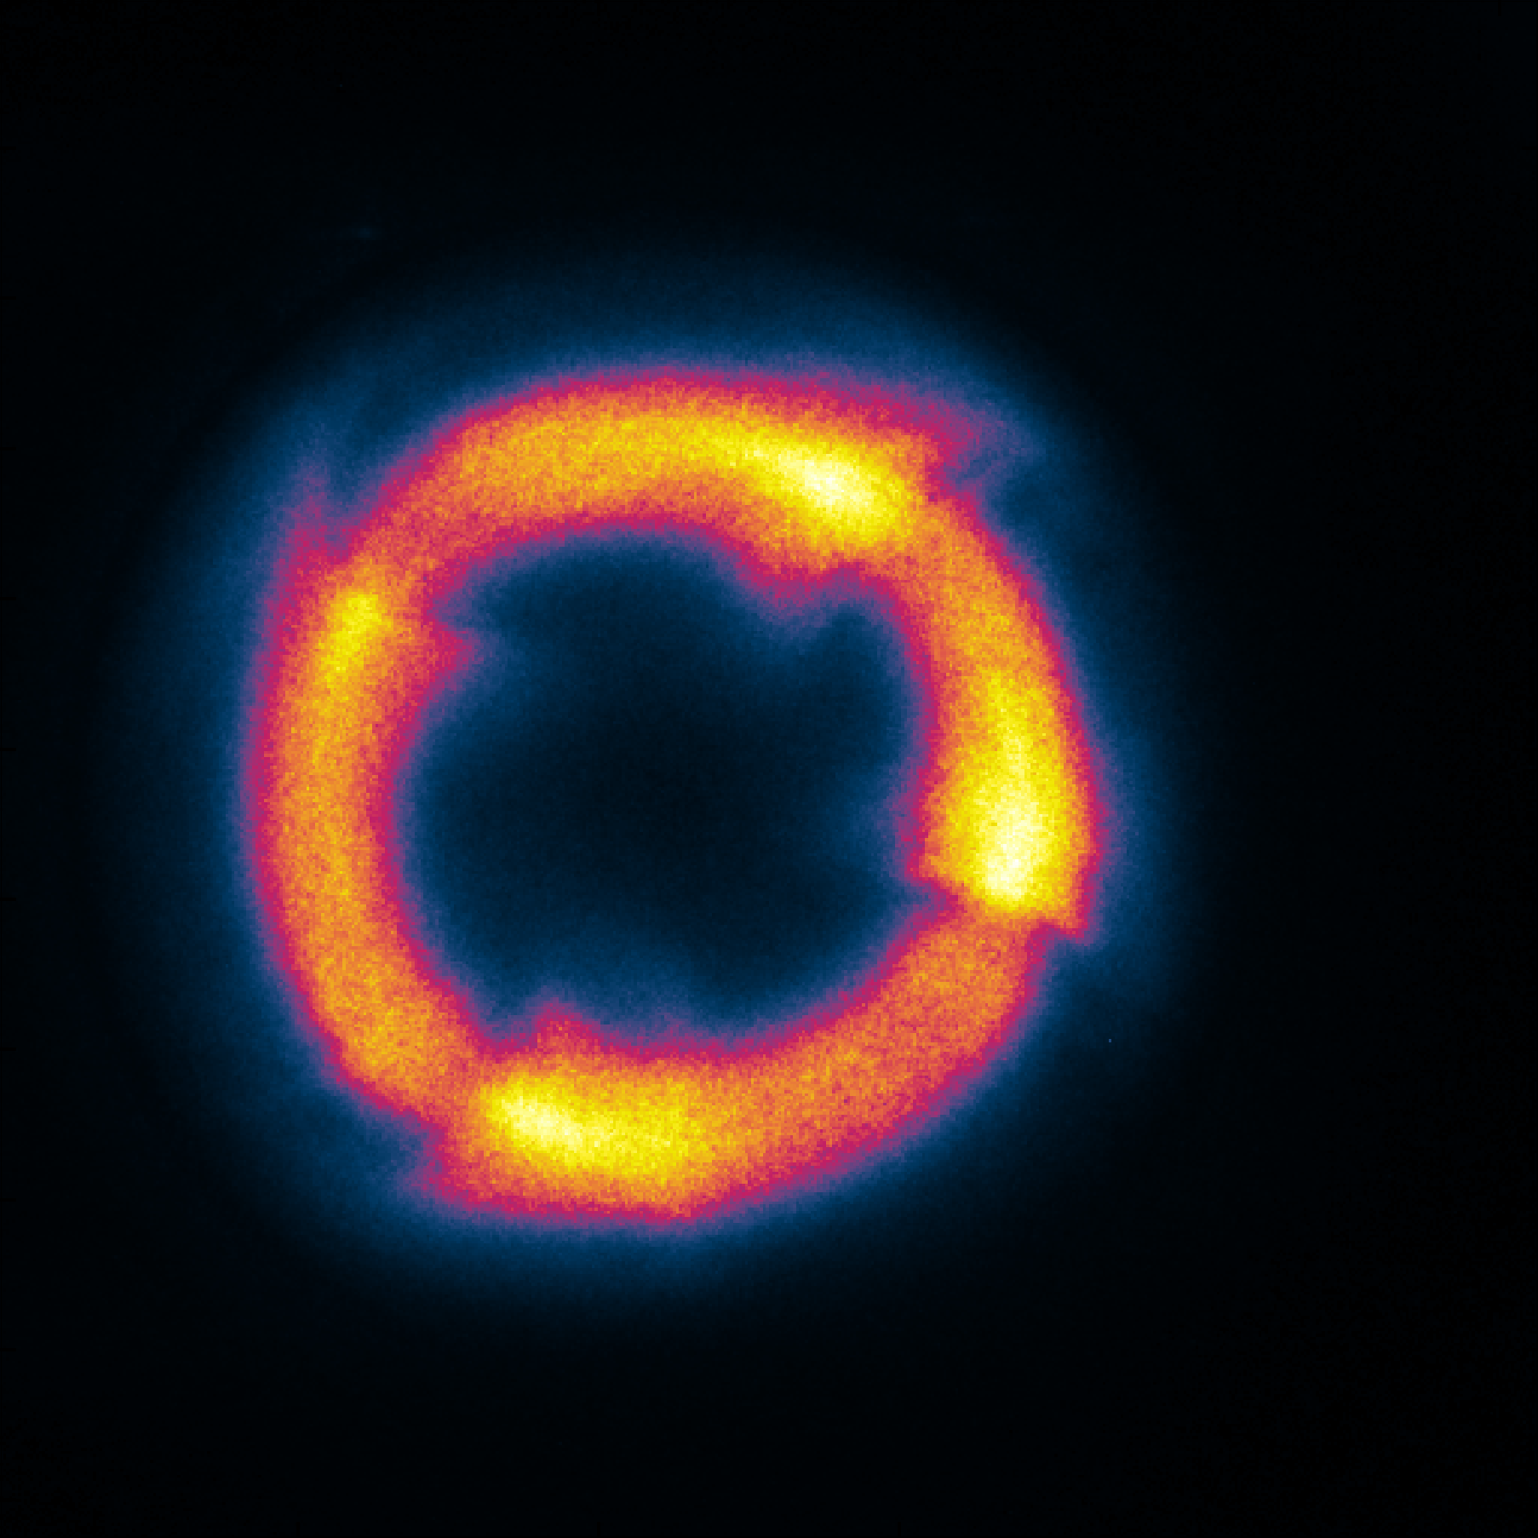
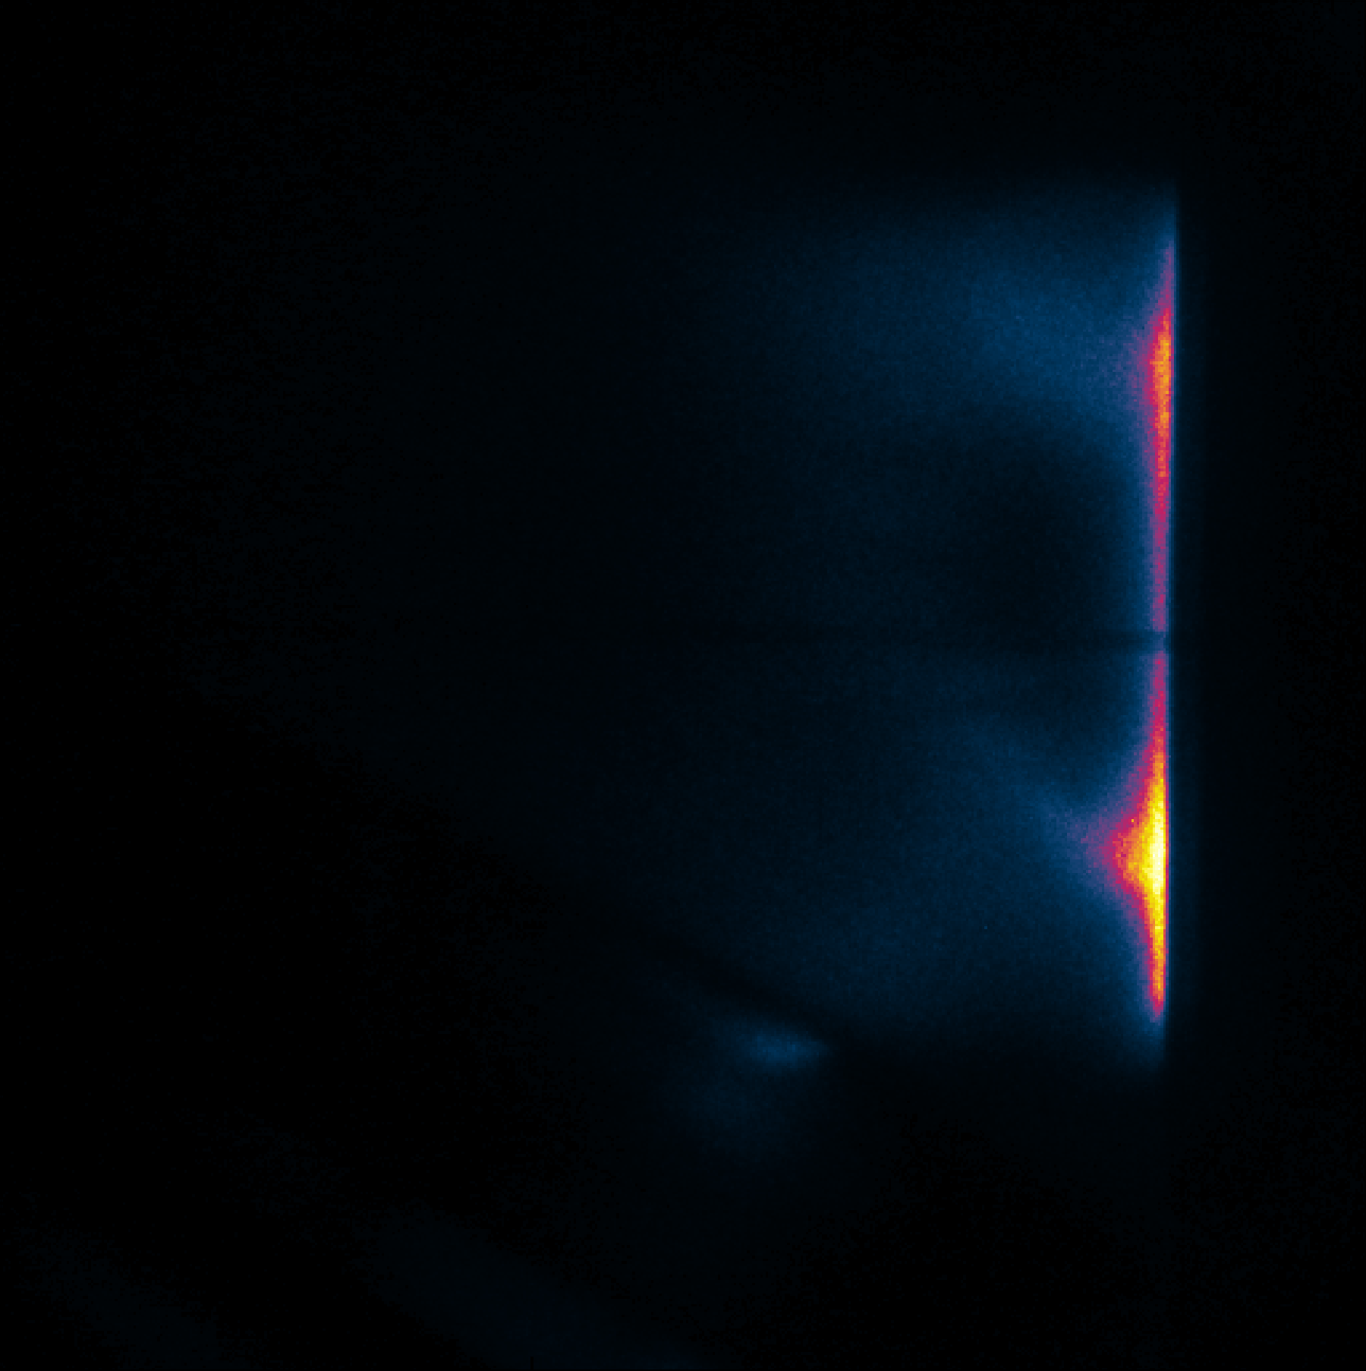
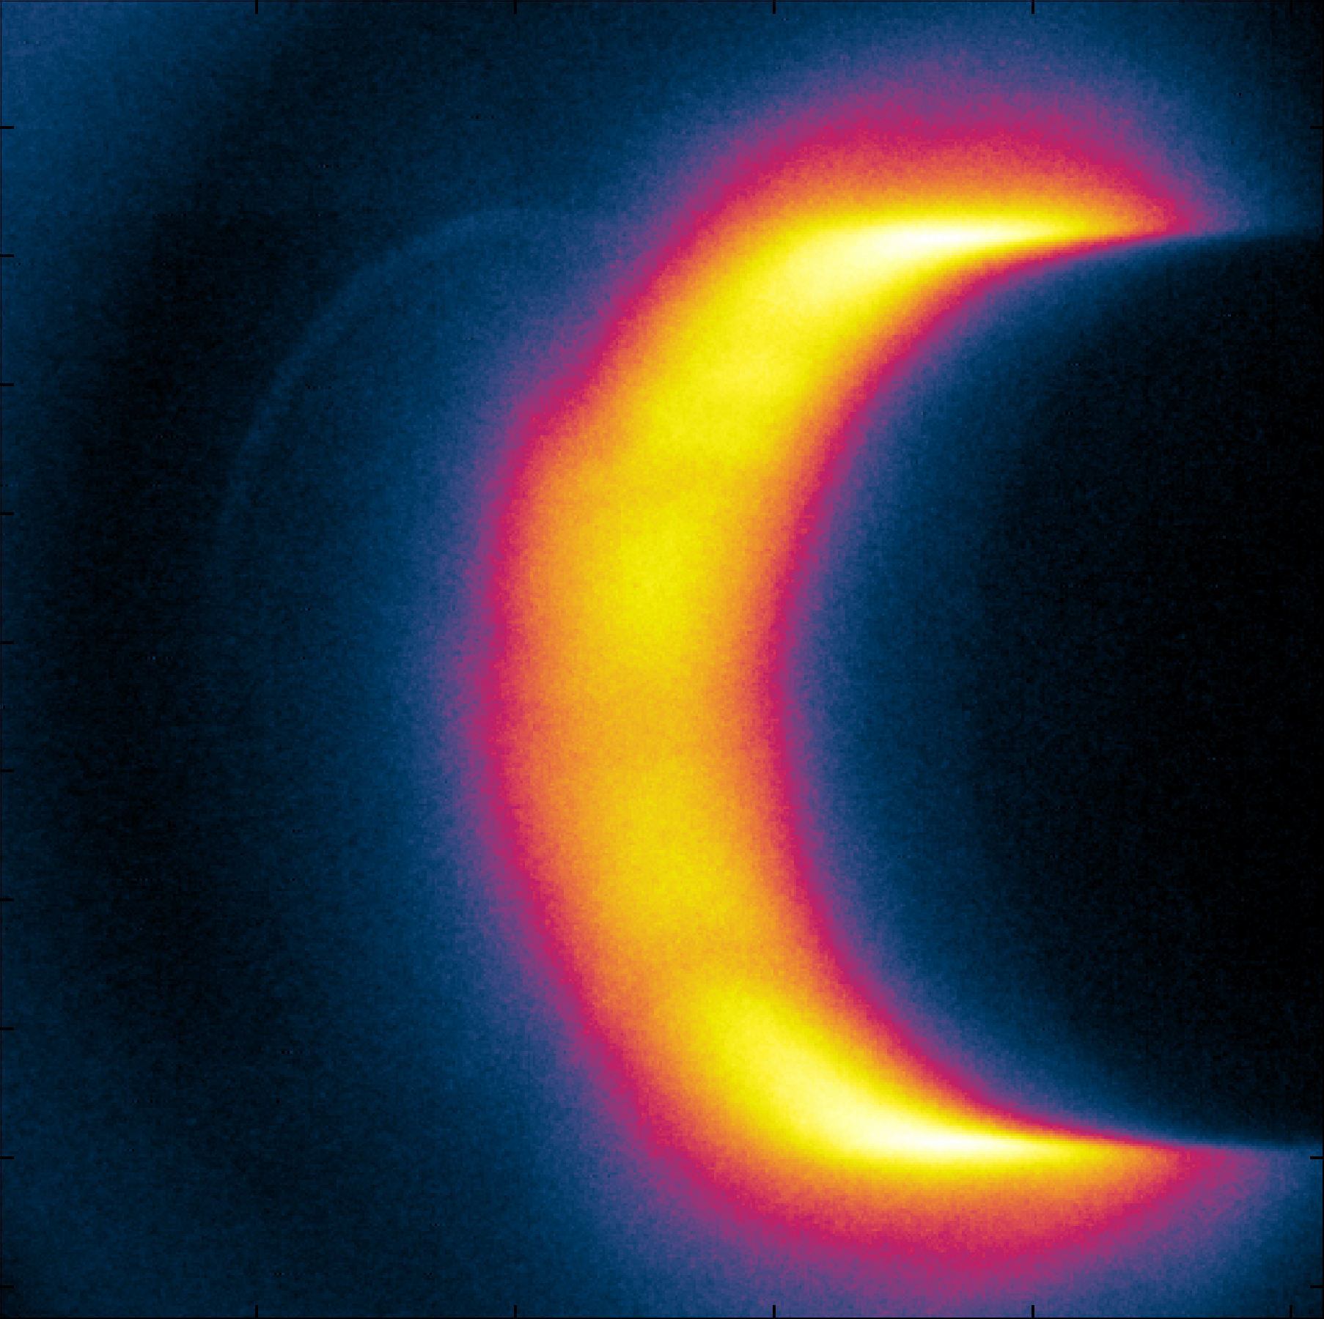
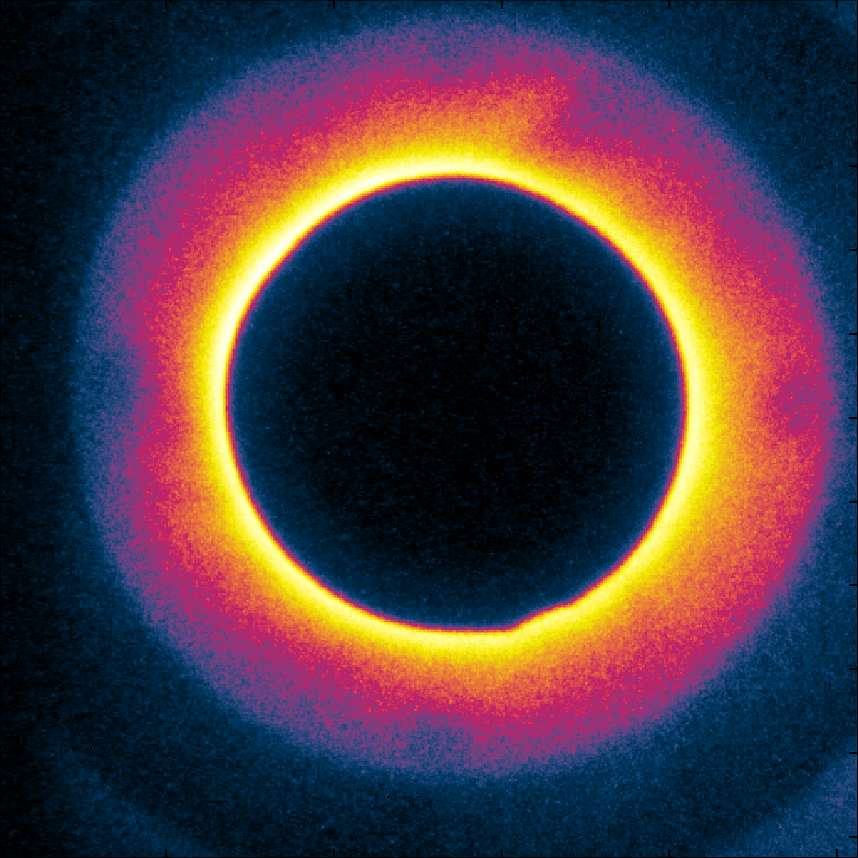
10 ns Framing Camera Images
3” Planar Magnetron
Linear Color Scale
Logarithmic Color Scale
Cylindrical Magnetrons

Slide 15
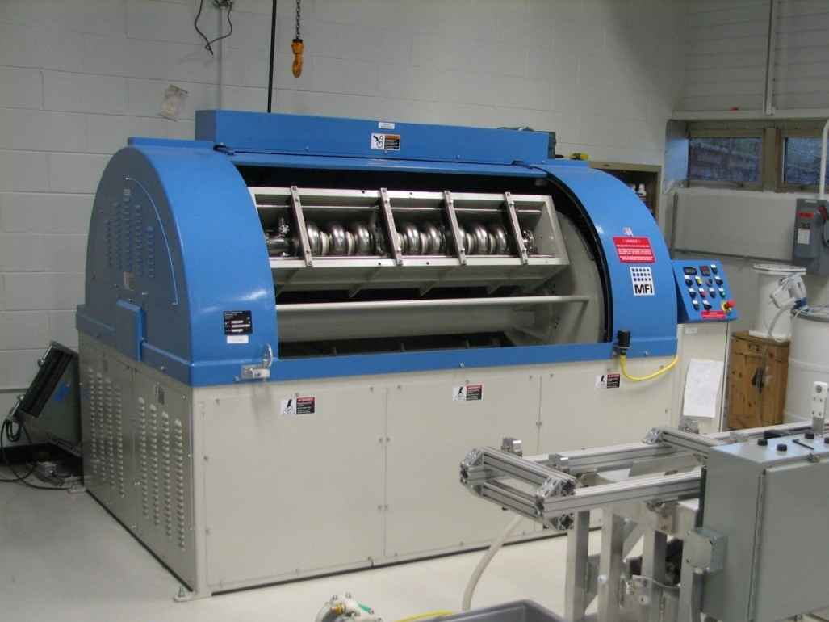
Extended Mechanical Polishing
115 RPM
R&D led by Dr. Charlie Cooper, FNAL

Slide 16
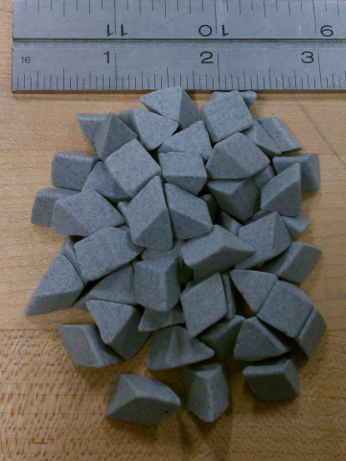
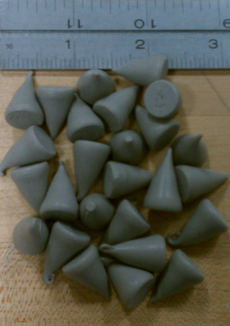
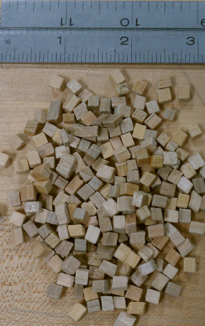
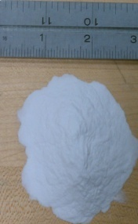
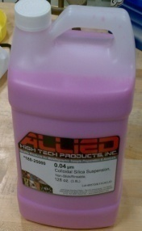
Extended Mechanical Polishing
Grinding
Micro-machining
De-laminating
Step 1
Step 2
Step 3
Step 4
Step 5
+ Soap & Water
+ Soap & Water
Chemical Buffer Polish
20 μm Alumina and Water
10 μm Alumina and Water
(0.05 µm)
Colloidal Silica

Slide 17
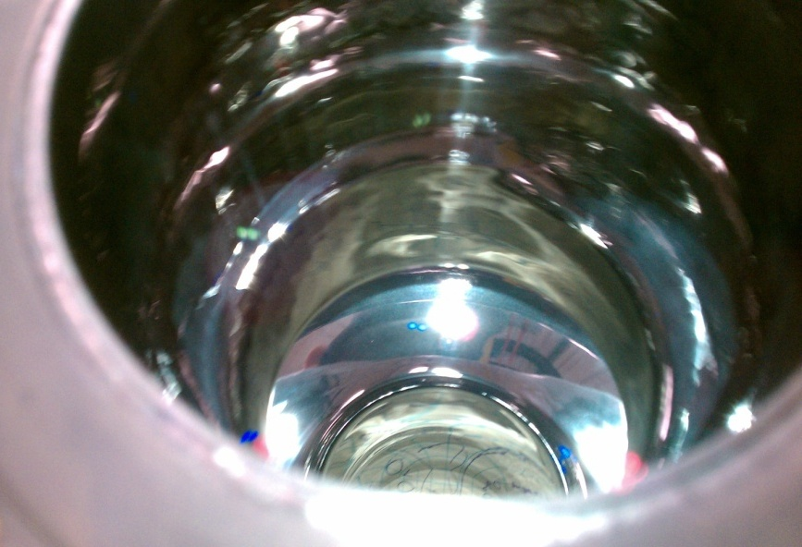
1 mm x 1 mm:
Ra = 0.014 µm +/- 0.002 µm
Rz = 0.014 µm +/- 0.002 µm
Courtesy C. Cooper, TTC Milan slides

Slide 18
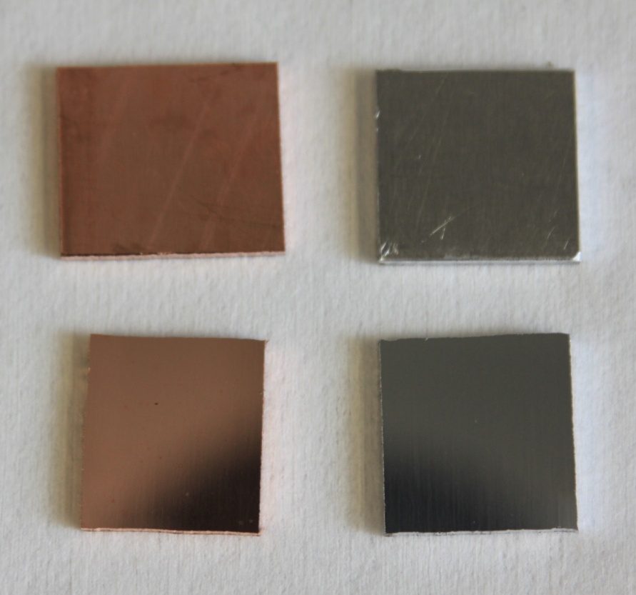
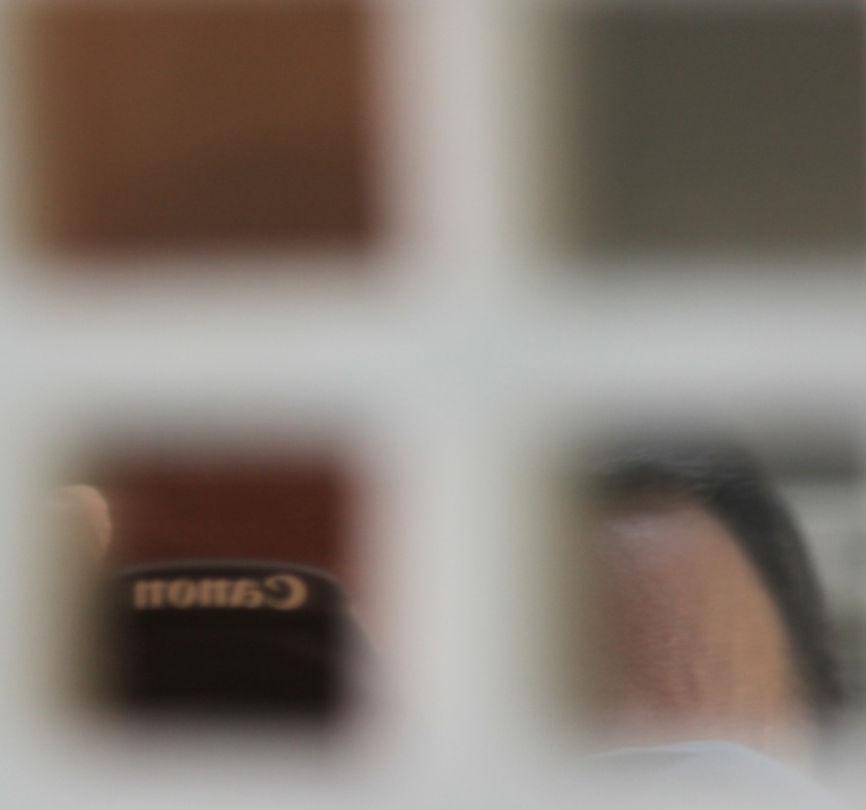
EMP Cu and Al Substrates
Before Polishing
Before Polishing
After Polishing
After Polishing
Focused on Surface
Focused on Reflection

Slide 19
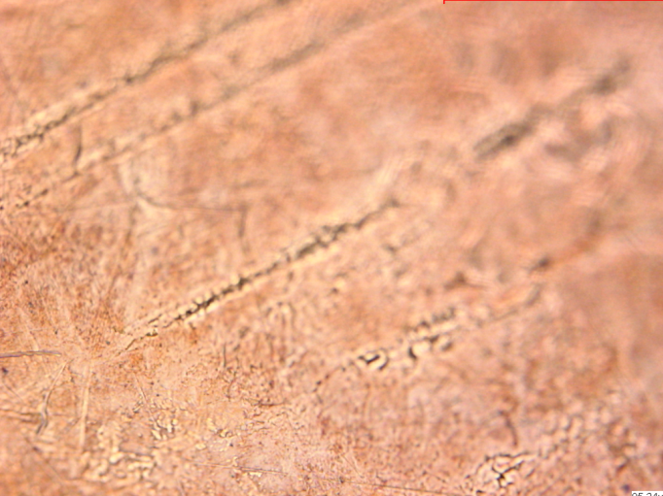
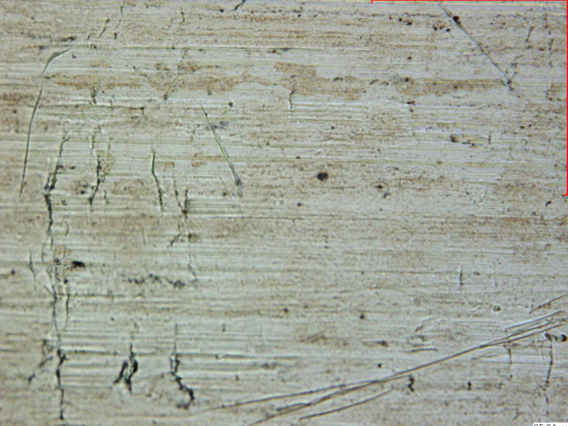
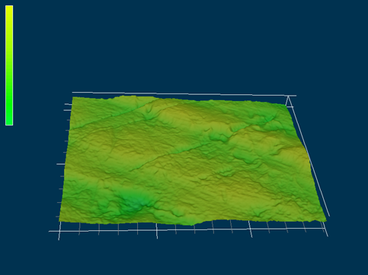
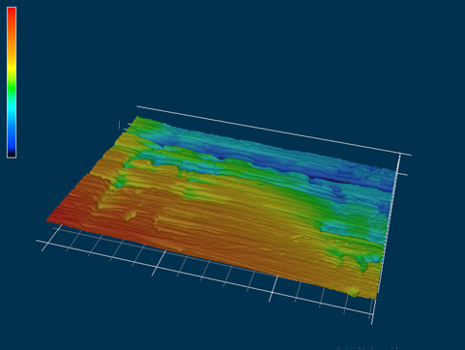
Extended Mechanical Polishing
Copper
Aluminum
2.1 μm
2.4 μm
2.1 μm
200 μm
200 μm
2.4 μm
0
0
100 μm
0 μm
0 μm
100 μm
100 μm
200 μm
200 μm

Slide 20
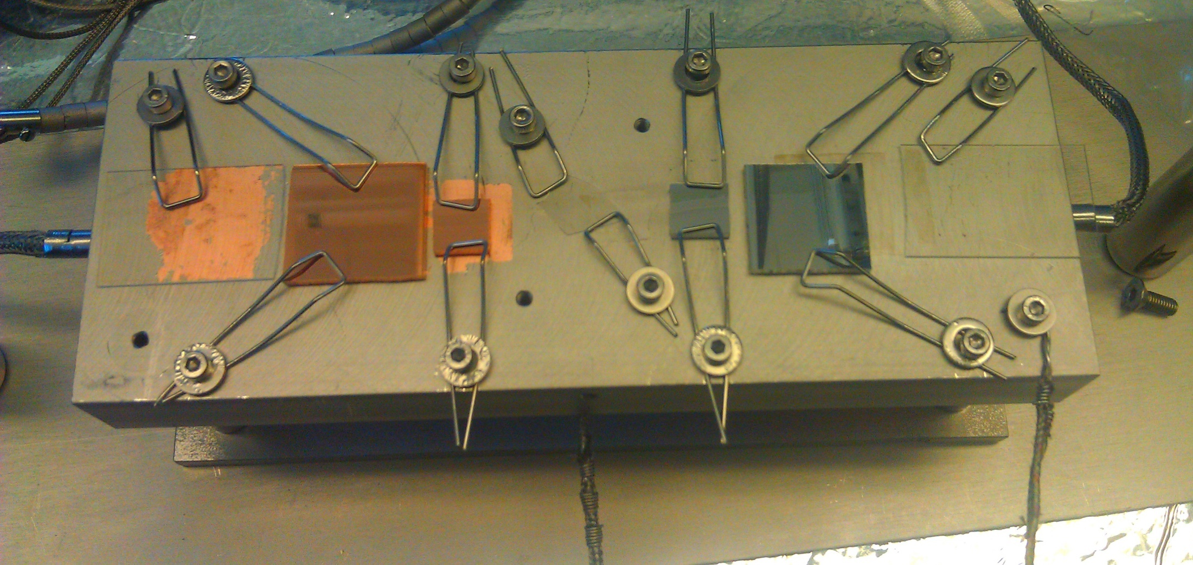
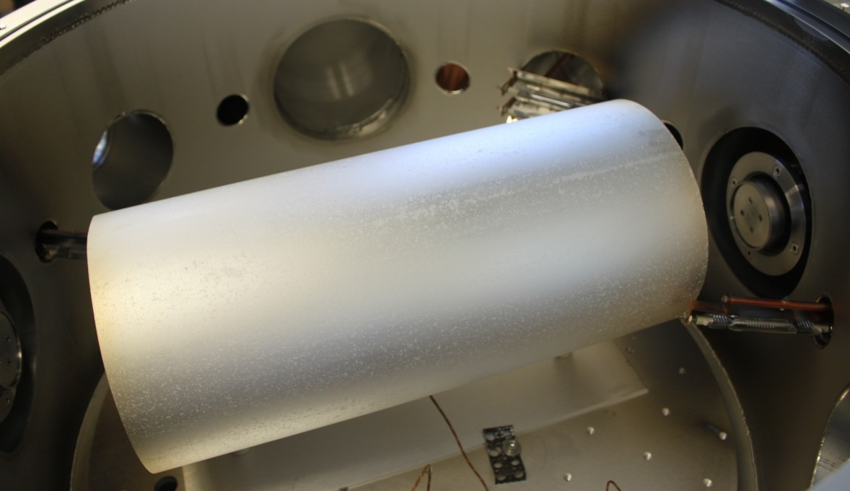
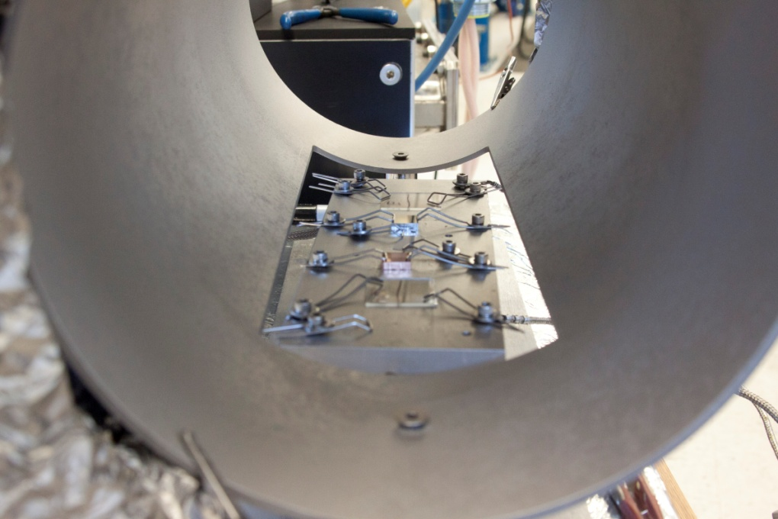
Electrically Isolated Substrate Heater (9” x 3”) for up to 750 °C

Slide 21
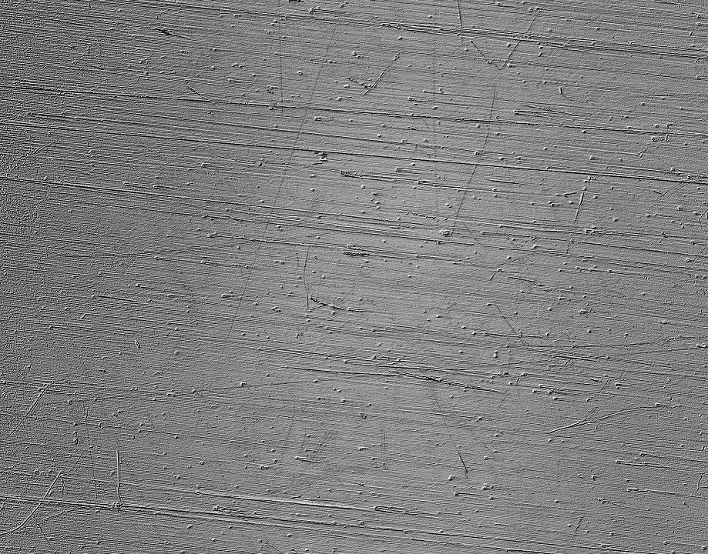
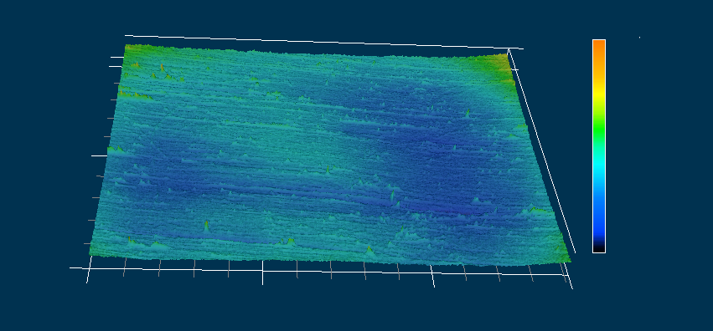
Optical Microscopy
100 μm
Nb on Cu
500 μm
3.4 μm
3.4 μm
0 μm
0 μm
700 μm

Slide 22
SEM
Copper
Aluminum
5 μm

Slide 23
SEM
Nb / Cu
Nb / Al
5 μm

Slide 24
SEM
Nb / Sapphire

Slide 25
Superconductivity

Slide 26
XRD
Cu (111)
Cu (200)
Nb (110)
Al (200)
Nb (110)
Cu (200)
Al (220)
Nb (211)
Al (111)

Slide 27
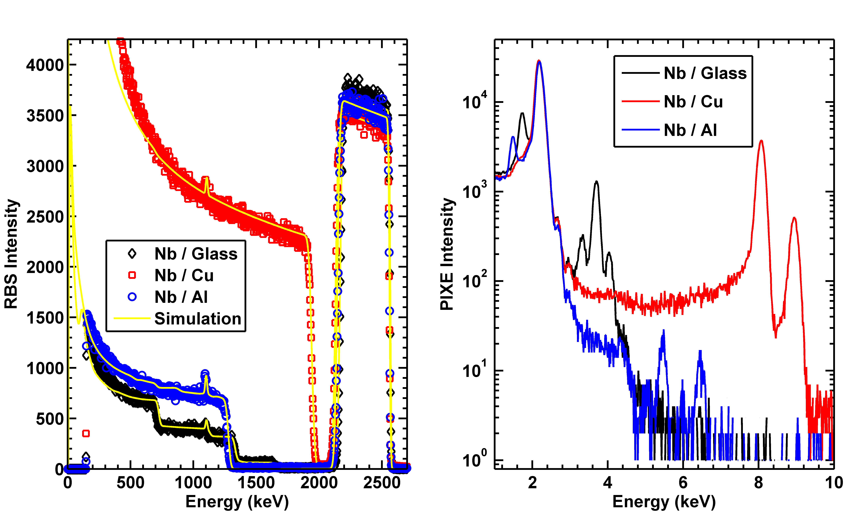
Ion Beam Analysis
Nb
Si
Al
Cu
Ca
Cu
Nb
K
Sc
Ar
Cr
Fe
Ti

Slide 28
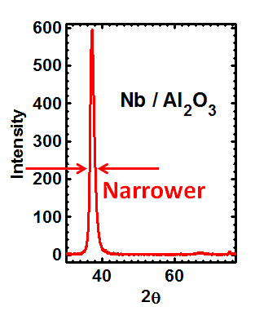
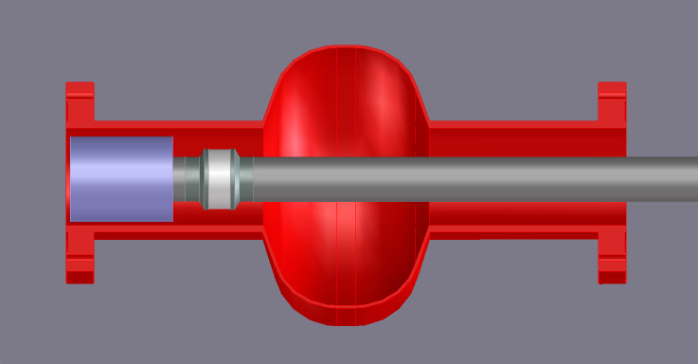
The Next Steps
x 10 or more
More Advanced Pulse Patterns

Slide 29
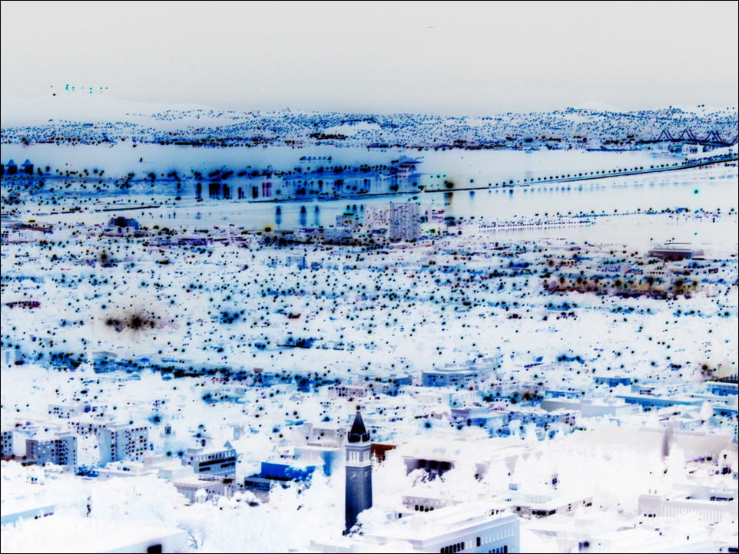



Acknowledgements
MOLECULAR
FOUNDRY
Kin Man Yu
Delia Milliron
Nick Groll
Alex Nollau
Arno Godeke
Matthijs Mentink
Lots of others

