Slide 1
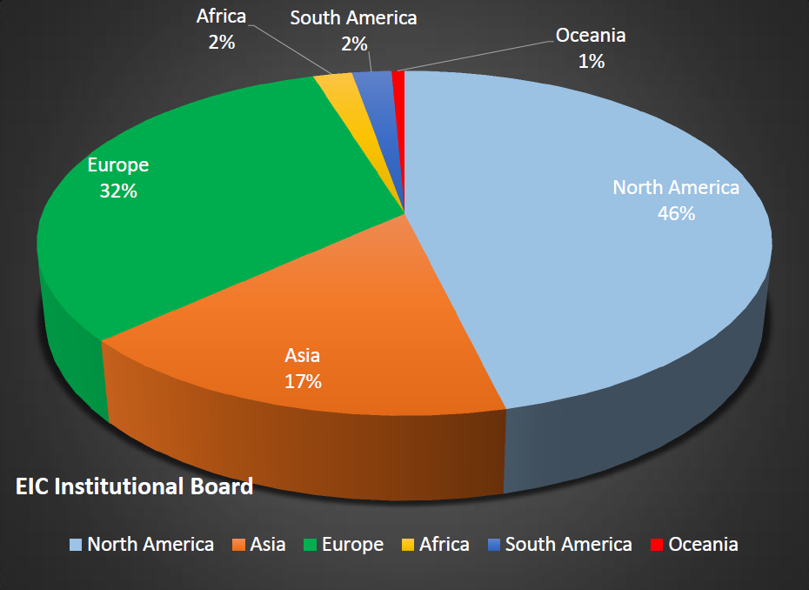
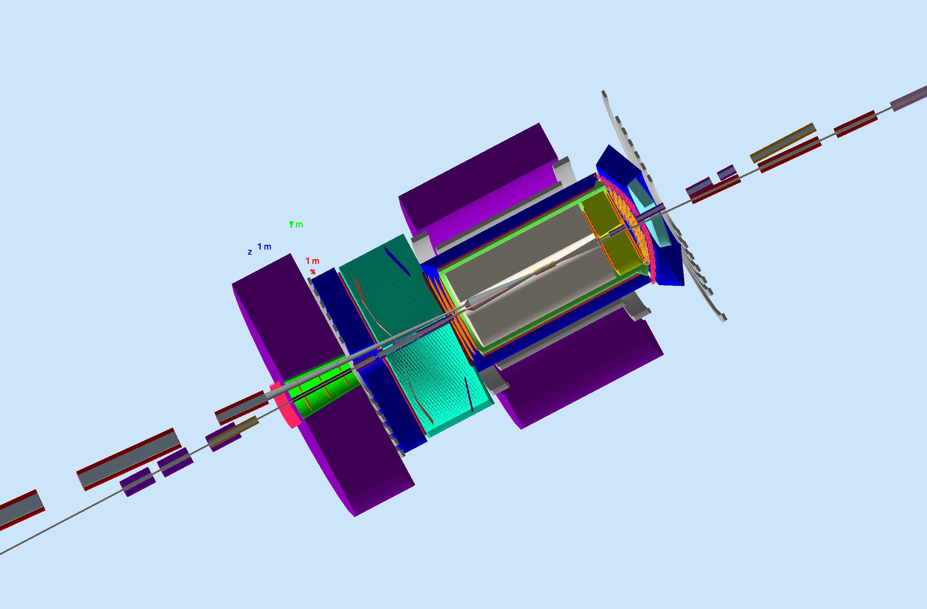
Electron-Ion Collider – NP Computing
Electron-Ion Collider (EIC): next-generation U.S. facility to study quarks and gluons in strongly interacting matter
Driven by precision to access the multi-dimensional and multi-channel problem space of Nuclear Physics
Novel integrated (80 meter long…) detector and interaction region to measure everything leading to multitude of analysis, linking multitude of detector systems
Diverse worldwide scientific community
The EIC Users Group: EICUG.ORG
Computing Challenges at the EIC:
Extremely broad science program requiring a flexible analysis ecosystem / toolkit
Success of scientific goals strongly influenced by analysis efficiency, apply user-centered given the lessons learned from LHC
Era of high-precision non-perturbative QCD requiring strong interplay of data analysis, MC calculations and Lattice QCD effort
Era of exascale computing changing the paradigm for I/O, Storage and Compute
Strong role of machine learning and smart detectors (IoT) to enhance scientific productivity

