Slide 1



DASPOS
Data and Software Preservation
Trends in Nuclear Science Computing
G. Watts (UW/Seattle)
@SeattleGordon
For the DASPOS Collaboration
2017-05-04

Slide 2
The Environment Before DASPOS
The Tevatron had recently finished running
DPHEP was up and running and looking at data preservation, but… calm….
Per-Experiment solutions had appeared, and were always after-the-fact.
DASPOS: Could we do better?

Slide 3
The Environment After DASPOS
See Kyle Cranmer’s Talk (Weds)

Slide 4
D A S P O S
ata
nd
Acknowledgement that you can’t just preserve data.
You must preserve software to read and interpret it as well.
oftware
reservation
pen
Open Data, Open Methadology, Open Source, Open Peer, Open Access
cience

Slide 5
Published
Simple Data, Common Format
Processed Data, Software
Raw Data, All Software
Tier 1
Tier 2
Tier 3
Tier 4
DPHEP Definition

Slide 6

DASPOS Organization
How to catalogue and share data
How to curate and archive large digital collections
Digital Librarian Expertise
Computer Science Expertise
How to build databases and query infrastructure
How to develop distributed storage networks
Science Expertise
What does the data mean?
How was it processed?
How will it be re-used?

Slide 7
Array of Sciences
Biology
Astrophysics
HEP/DPHEP
Multi-disciplinary
Physicists
Digital Librarians
Computer Scientists

Slide 8
Meta-data descriptions of archived data
What is in the data.
How can it be used?
Politics of sharing and making datasets public
Politics of external data access on preservation infrastructure
Impact of preservation on analysis tool chain
Computation Description
What steps were done to produce the data?
Can the steps be replicated?

Slide 9

Find where the most pressing problems are
Find/suggest some solutions
Needs of Analyst
Physics Query Test System
Meta-Data Specification
Goal:
A template architecture to preserve data, knowledge, and software.
Build a test infrastructure to test out some of these ideas
Tevatron Data Preservation

Slide 10
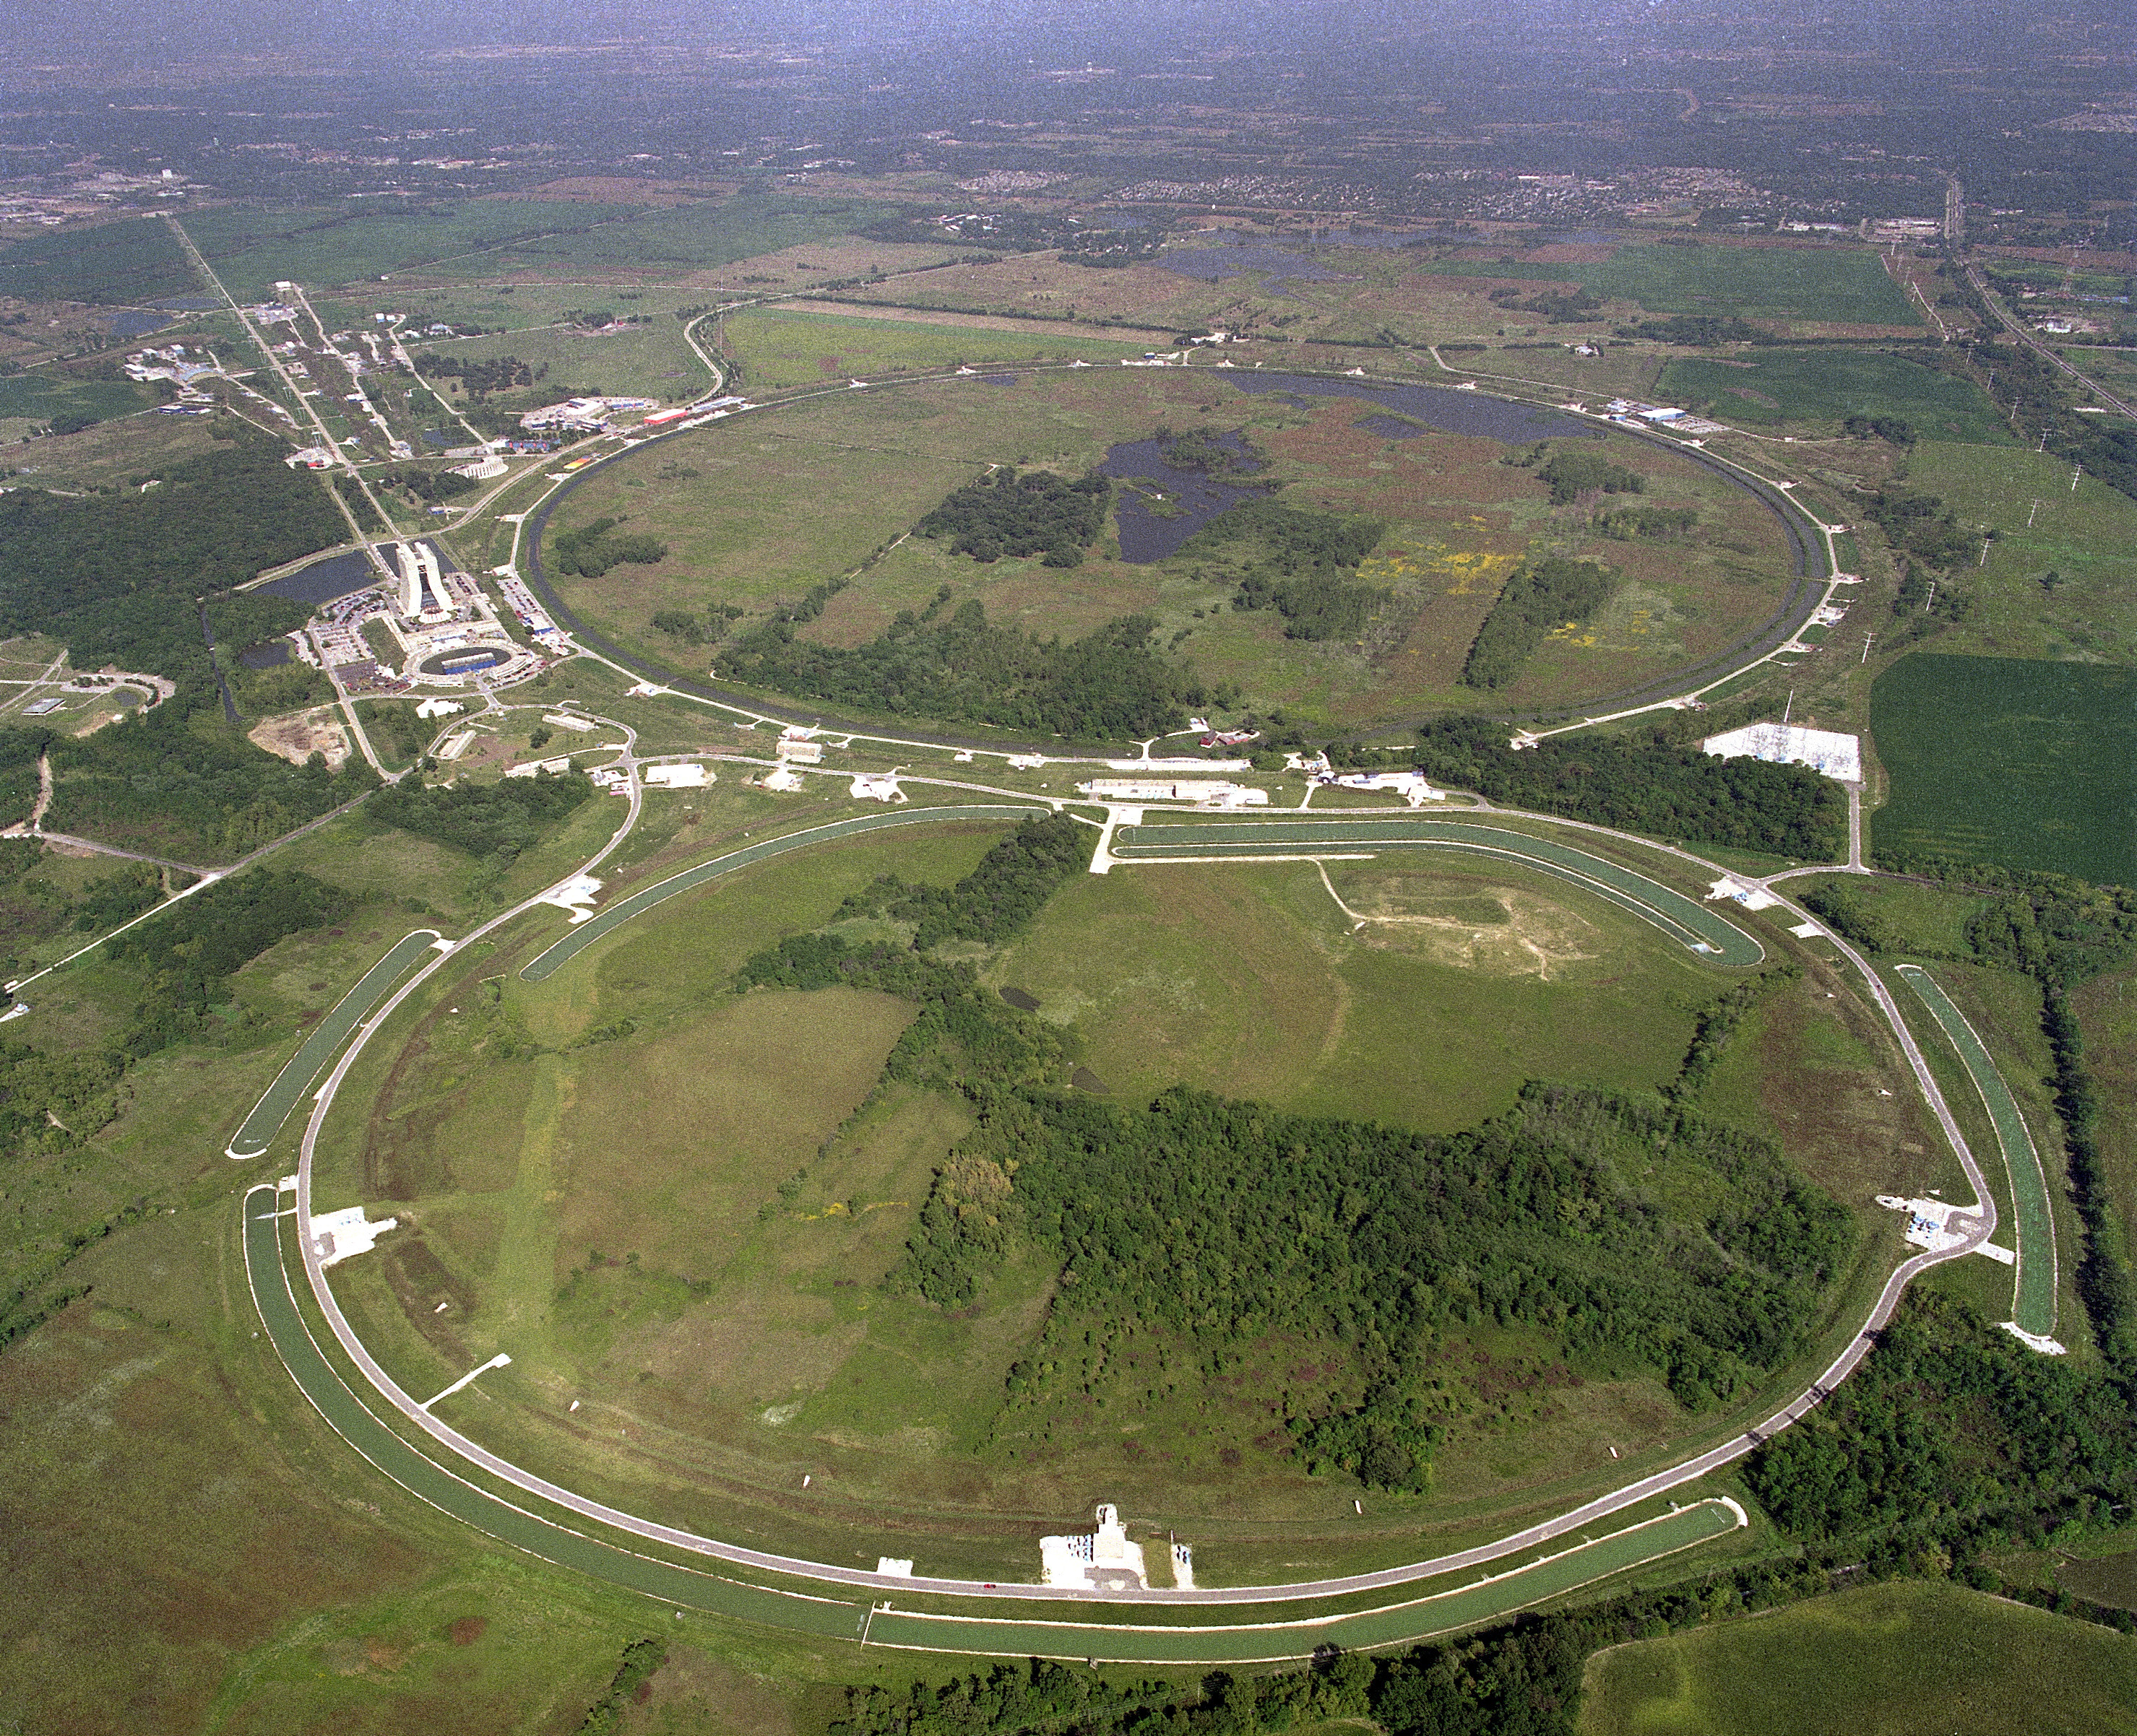


Tevatron Data Preservation
2014 – DASPOS Awarded
1985 – Turns on
2011 – Turns off
This project started after last data collected!
Limit scope of preservation: to at least 2020
Liberating!!!
Linux will still work
VM’s will still work
Fermilab will still be around
Fermilab’s Computing Division will still be around
Software frozen
Distribute software and calibration data via CVMFS
VM’s contain the DZERO working environment and software
Fermilab’s OpenStack cloud management software to control VMs
Commit to running modernized version of data distribution infrastructure
Used for modern experiments at Fermilab

Slide 11

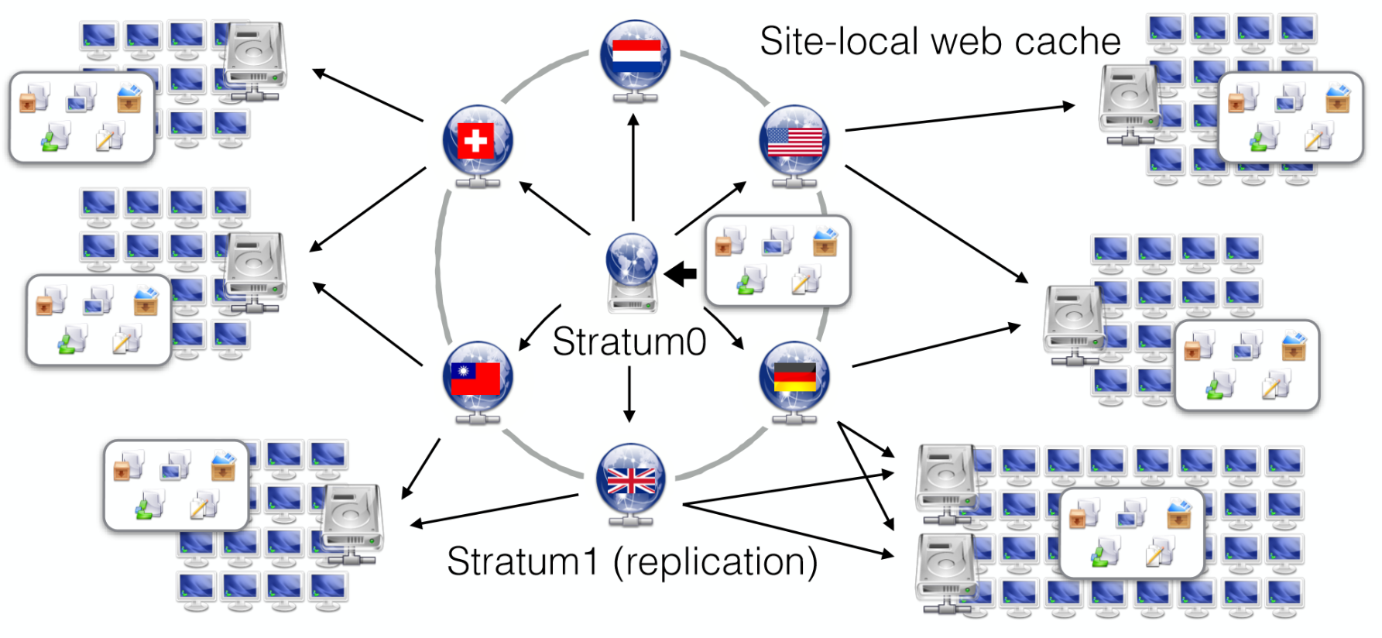
“A highly capable cached, read-only filesystem that makes use of modern web protocals”
Pro
Your VM only fetches specific files it needs
Has all files available
Caches so you don’t have to reload
Can use standard web caches to store data locally
Con
More infrastructure
Must have network availible
Example of a modern tool that can enable a task like data preservation

Slide 12

Did the Tevatron Data Preservation Project Work?
Yes:
All remaining analyses are running on the system now
$t\overline{t}$ asymmetry, W mass, some B physics analyses…
Resource use is quite flexible and can be adiabatically turned down as less and less analyses continue

Slide 13
How can you make data available to the outside world?

Slide 14
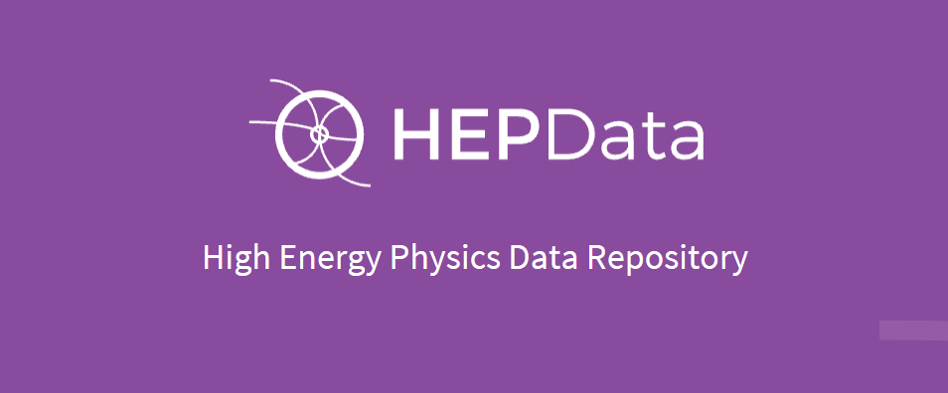
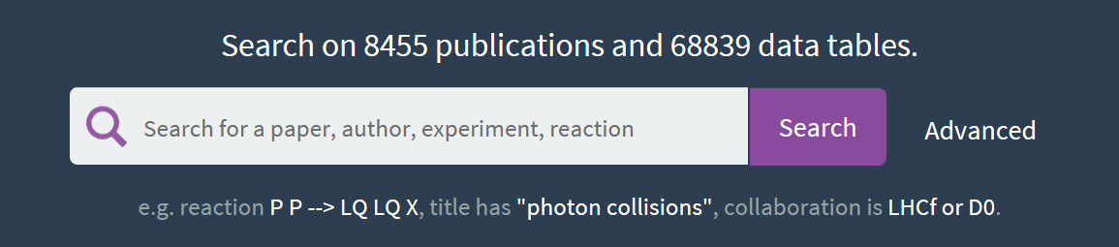
Tier 1 Preservation
Digitize the paper level results (tables and figures) for easy machine use
Is this good enough?

Slide 15
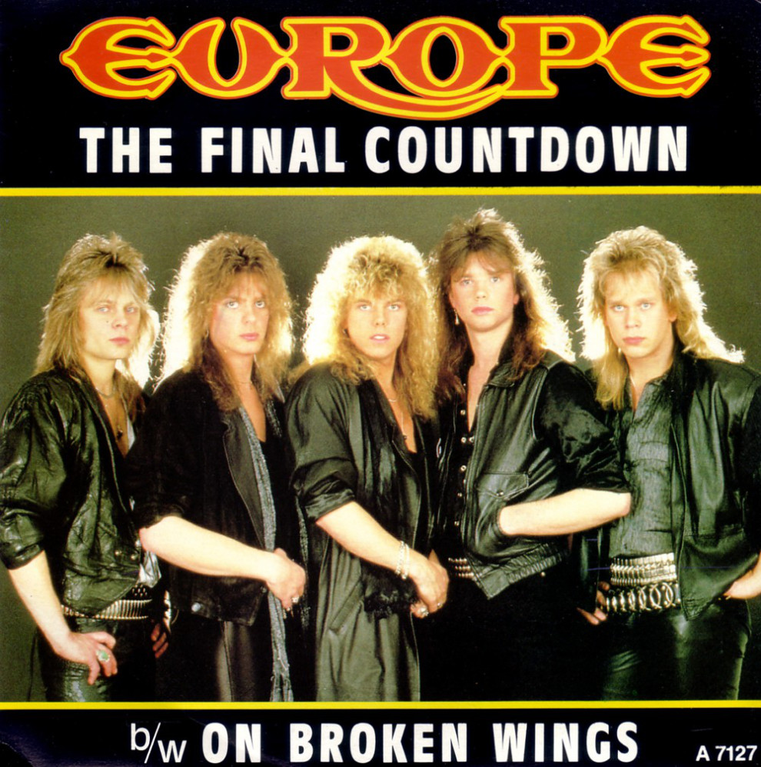

$$pp→LQ LQ X$$
This is about the physics
J1 L1 J2 L2 X
This is about the data – the “image” in the detector
The Final State

Slide 16
Ask a data repository of papers and analyses:
J1 (anti-kt-0.4): et>60 GeV, abseta < 2.5, EMF < 0.02, -1 ns < ArrivalTime < 5 ns;
J2 (anti-kt-0.4): et>40 GeV, abseta < 2.5, EMF < 0.02, -1 ns < ArrivalTime < 5 ns;
Veto: J3 (anti-kt-0.4): et>40 GeV, abseta < 2.5, EMF < 0.02, -1 ns < ArrivalTime < 5 ns;
PV1 (primary-vertex): NTrack >= 3, pT>1 GeV;
NTrack(J1, DR=0.2, pT>1) = 0;
NTrack(J2, DR=0.2, pT>1) = 0;
ETMiss (atlas-ref) < 50 GeV
Get back:
List of papers that looked at that dataset (theory re-interpretation)
List of internal notes based on data like that (someone else search for what I searched for?)
List of datasets that would contain this data (start an analysis)
Explicitly not designed to capture all cuts having to do with an analysis!

Slide 17
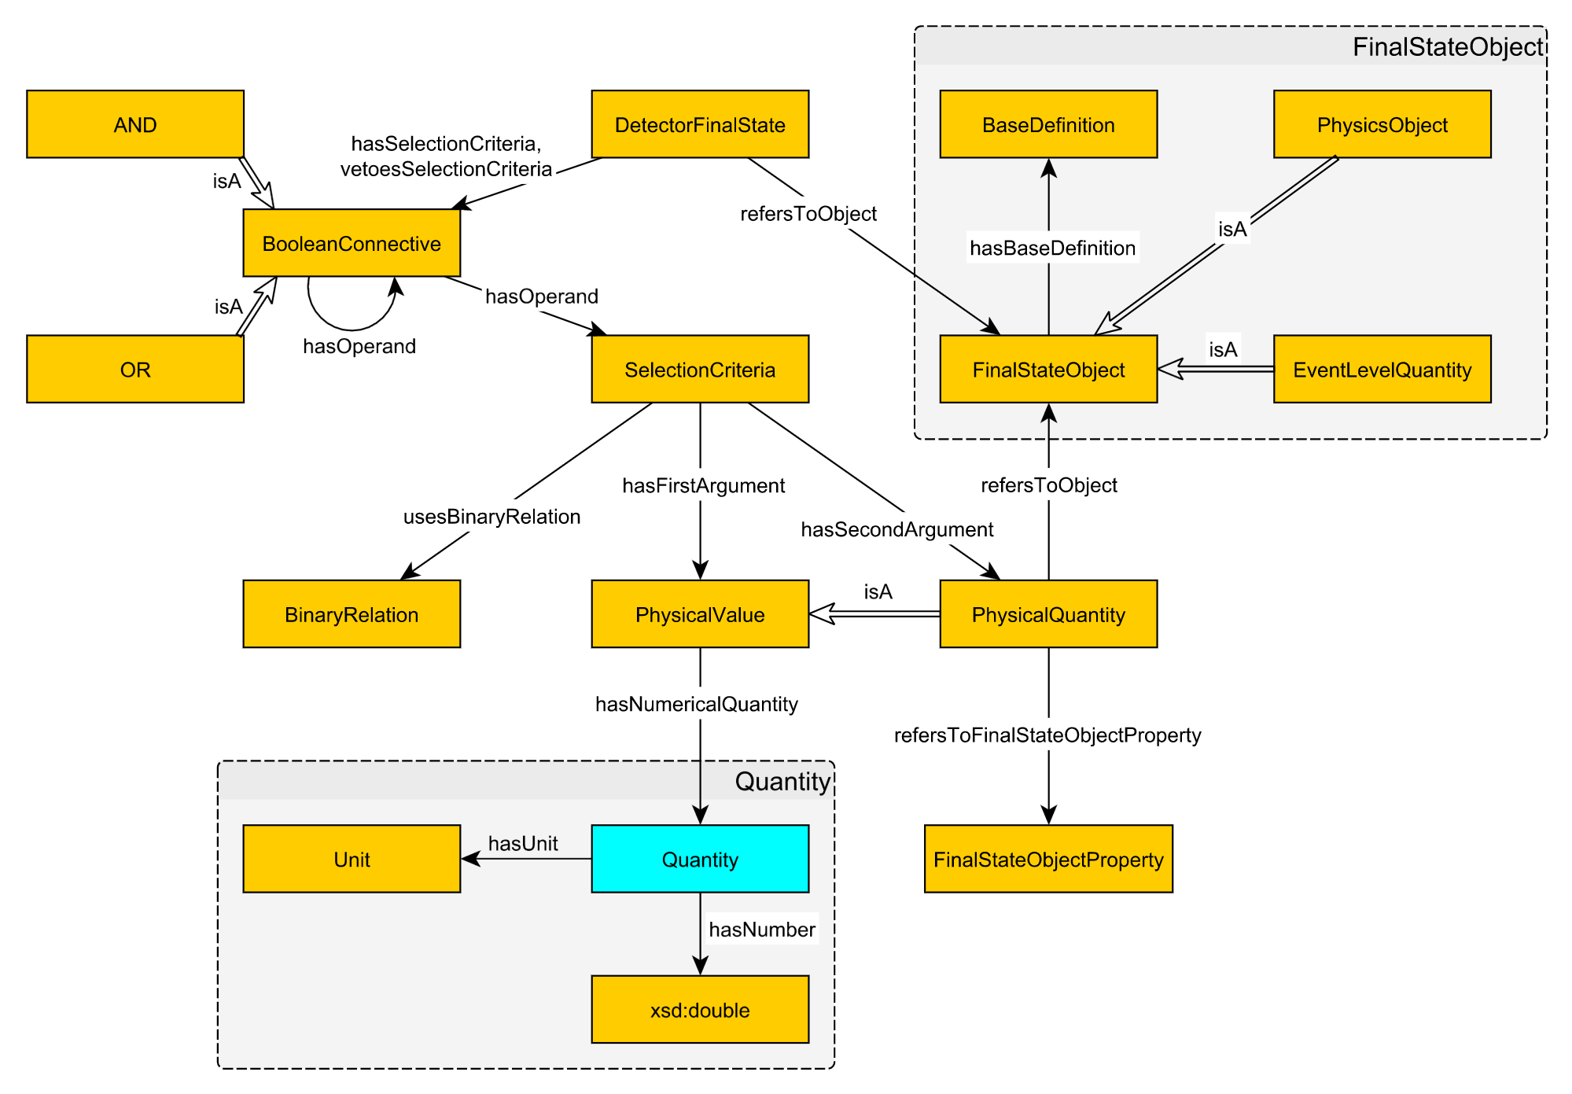
The Detector Final State Pattern
Ontology
http://ekaw2016.cs.unibo.it

Slide 18

OWL
The Web Ontology Language
Defines entities and relationships between entities
Published repository of various ontologies
(measurement, colors, etc.)
Part of the semantic web
Allow you to reason about relationships
Using common tools (search engines, etc.)

Slide 19
Did it work?
Technically: Yes
But…
Who does the work of adding each analysis?
Not really part of a normal analysis workflow
Need a lot of papers, O(100), to explore possible broad scale uses
And thus judge the completeness of the ontology

Slide 20
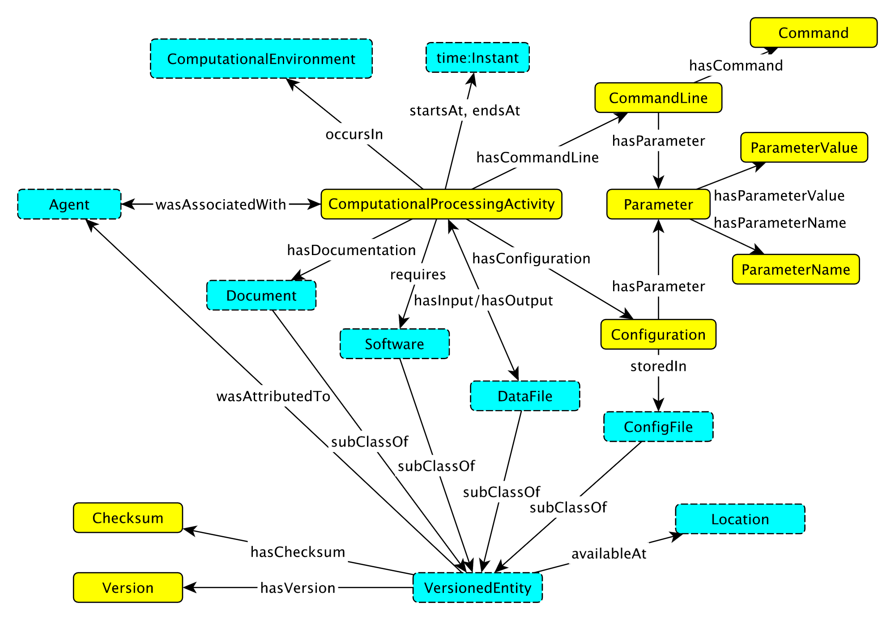

Slide 21
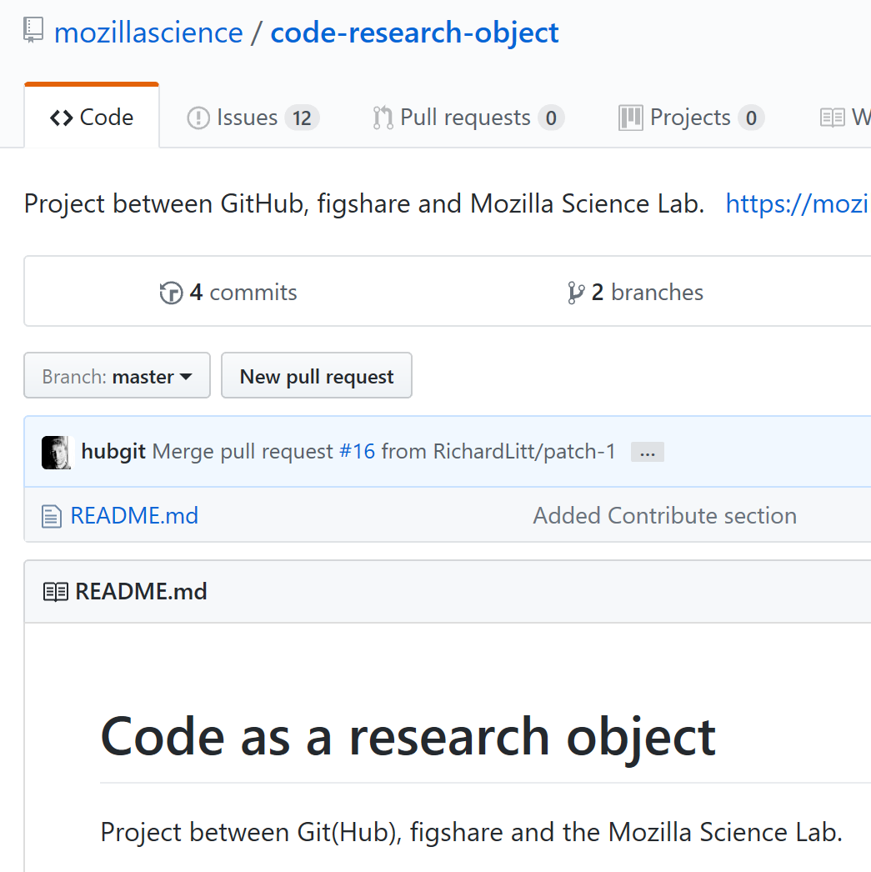
OWL For Computation
https://github.com/Vocamp/ComputationalActivity
Ongoing work
Turns out that many more people other than HEP are interested in code as a research object!

Slide 22
Populating the Computing OWL
1
Have the computer watch the steps the user executes
Naturally part of workflow – who hasn’t wanted this for the logbook?
Lots of noise gets captured
Typical analysis runs on multiple machines and batch system
2
User enters the steps into a tool explicitly
User enters only data and command that have to be run
Hard to do after analysis is designed, run, reviewed
Will take a significant extra commitment in time
What if we re-engineered so this was part of the natural steps?
(A great deal of work took place exploring these under DASPOS – Umbrella, Prune, etc.)

Slide 23
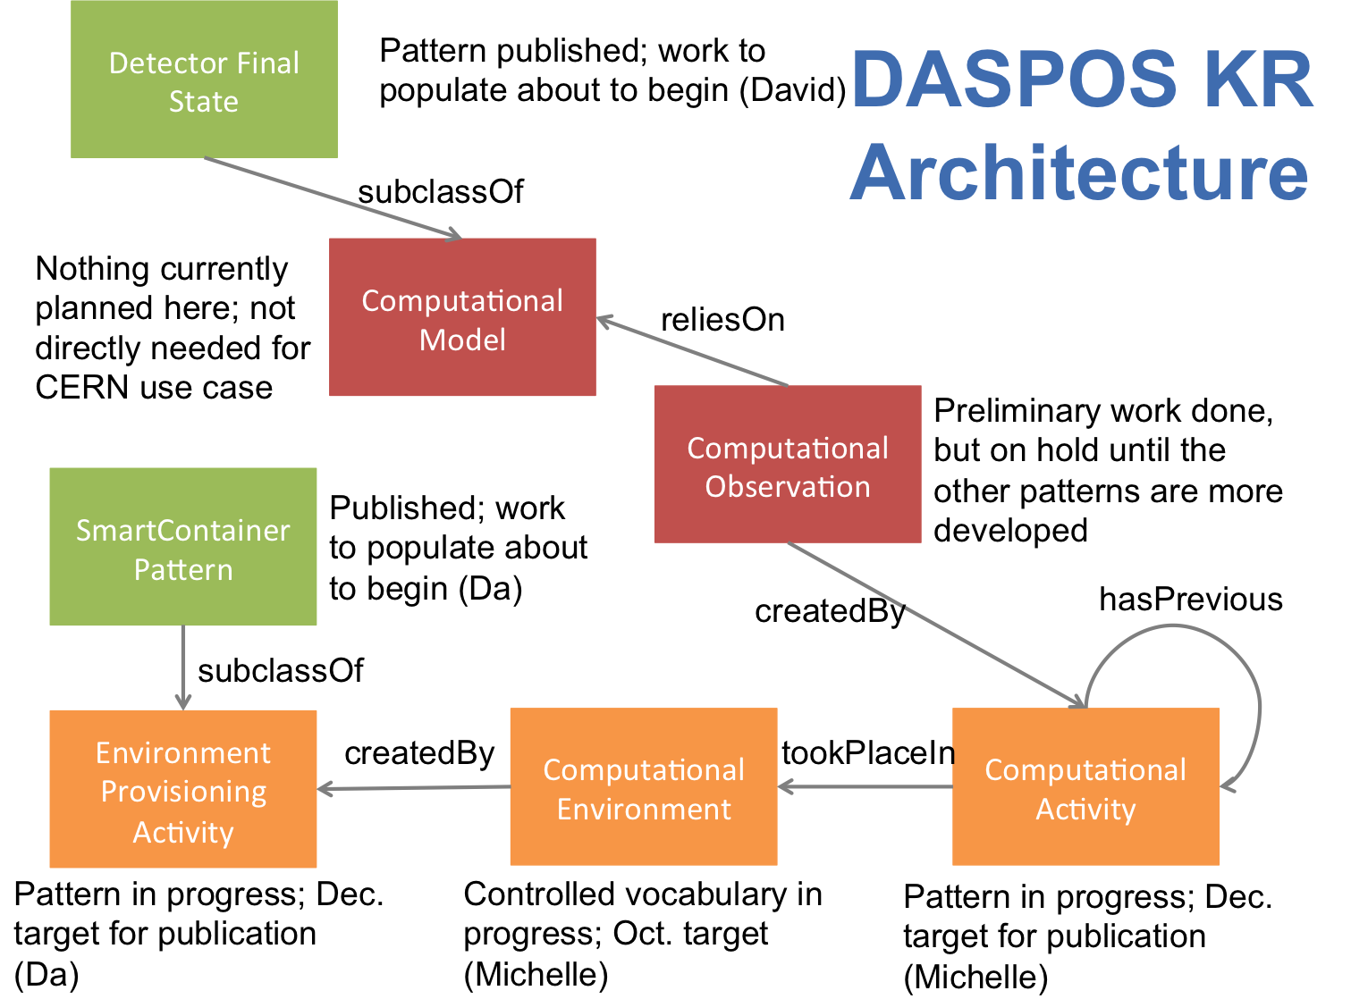
Complete Meta Data Relationships

Slide 24
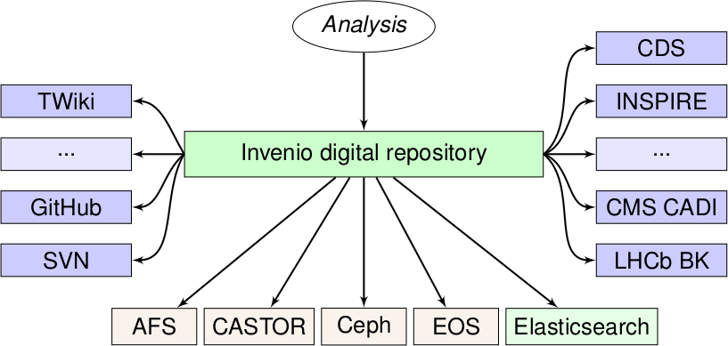
CERN Analysis Preservation Portal
Tools:
Run containers/workflows
“Containerizer Tools”
PTU, Parrot scripts
Used to capture processes
Deliverable: stored in DASPOS git
Preservation Archive
Metadata
Container images
Workflow images
Instructions to reproduce
Data?
Container Cluster
CERN OpenStack
run
store
Data Archive
Metadata
Data
Linked by meta-data!

Slide 25
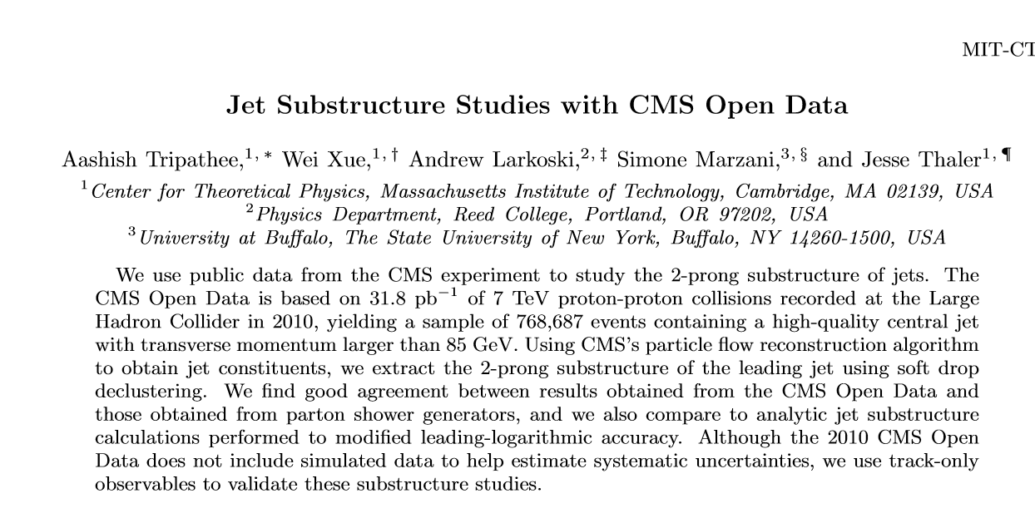
CMS Published Simple Data (Tier 1)
https://arxiv.org/abs/1704.05842

Slide 26
Recommendations for Future Open Data Releases
Continue to release research-grade public data
Continue to provide unique reference event interpretations
Provide validation samples
Provide detector response information
Cull the data set
Speed up the development cycle
If you are thinking about a data release – it might be good to read the conclusions of this paper!

Slide 27
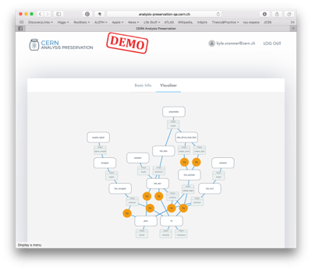
RECAST – Integrated with Analysis Portal
See Kyle’s talk yesterday for more information…
Workflow

Slide 28
NSF Connection
The NSF is updating its Data Management Plan requirements for grant submissions
Ongoing study:
PI’s, post-docs, students, etc.
3rd Party Data Archives
Societies (e.g. American Physical Society, Division of Particles and Fields)
Universities
National Labs
Instrument Makers
Work to encourage data preservation of results at increasing levels

Slide 29

Data Preservation as a goal in and of itself
Cost
  Politics of releasing data
  Packing up data and releasing the software
  Releasing a workflow system (depending on Tier)
  Supporting users
  Dealing with papers claiming black hole discovery in far forward $η$ region of detector
Usefulness
  Theory community support/interest
  Uniqueness of data
  Ease of use
Cost
Usefulness of data

Slide 30
Data Preservation as a goal in and of itself
Cost
  Politics of releasing data
  Packing up data and releasing the software
  Releasing a workflow system (depending on Tier)
  Supporting users
  Dealing with papers claiming black hole discovery in far forward $η$ region of detector
Usefulness
  Theory community support/interest
  Uniqueness of data
  Ease of use
Cost
Usefulness of data

Slide 31
Conclusion
This work had many spin offs: RDA (Preservation/Reproducibility), Open Science Framework (campus interactions), Domain Ontology specialists @ Wright state, National Data Service interaction, DIANA (collaboration on goals, some preservation efforts)
  Hopefully affecting the environment we all work in!
  And some tools everyone can take advantage of.
Many solutions that seem cool at first…
  Require a lot of overhead
  Or real change in sociology
Tools that enable analysis preservation can enable analysis
  Getting buy-in is hard!
  Some tools are so obvious (e.g. CERNVM)
  Most attractive when it becomes part and parcel of the analysis

