Slide 1


  Synergies of Computing and the Next Generation of Nuclear Physics Experiments
  Rolf Ent (Jefferson Lab)
  With acknowledgement to Amber Boehnlein, Markus Diefenthaler and Graham Heyes for their help
Future Trends in Nuclear Physics Computing
May 2, 2017

Slide 2
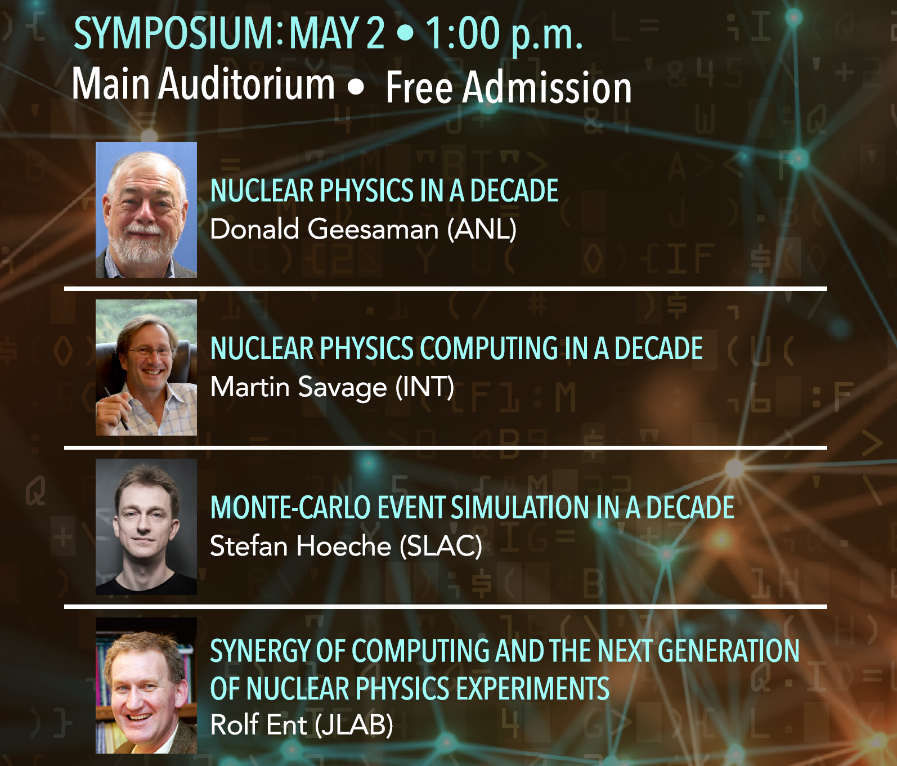
Future Trends in Nuclear Physics Computing
Notes:
2

Slide 3
Outline
Computing challenges in nuclear physics
Nuclear physics data in the advanced computing era
Trends in data acquisition
Next generation of nuclear physics experiments – where do they point us?
Notes:
3

Slide 4
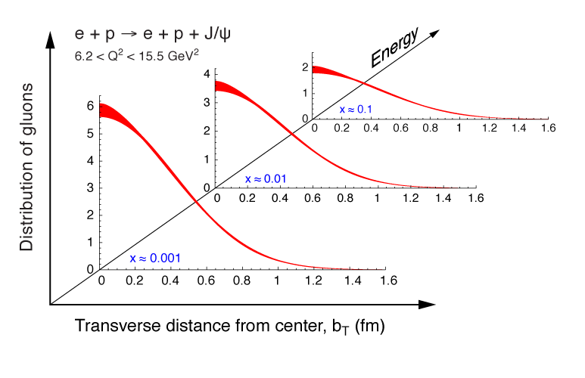
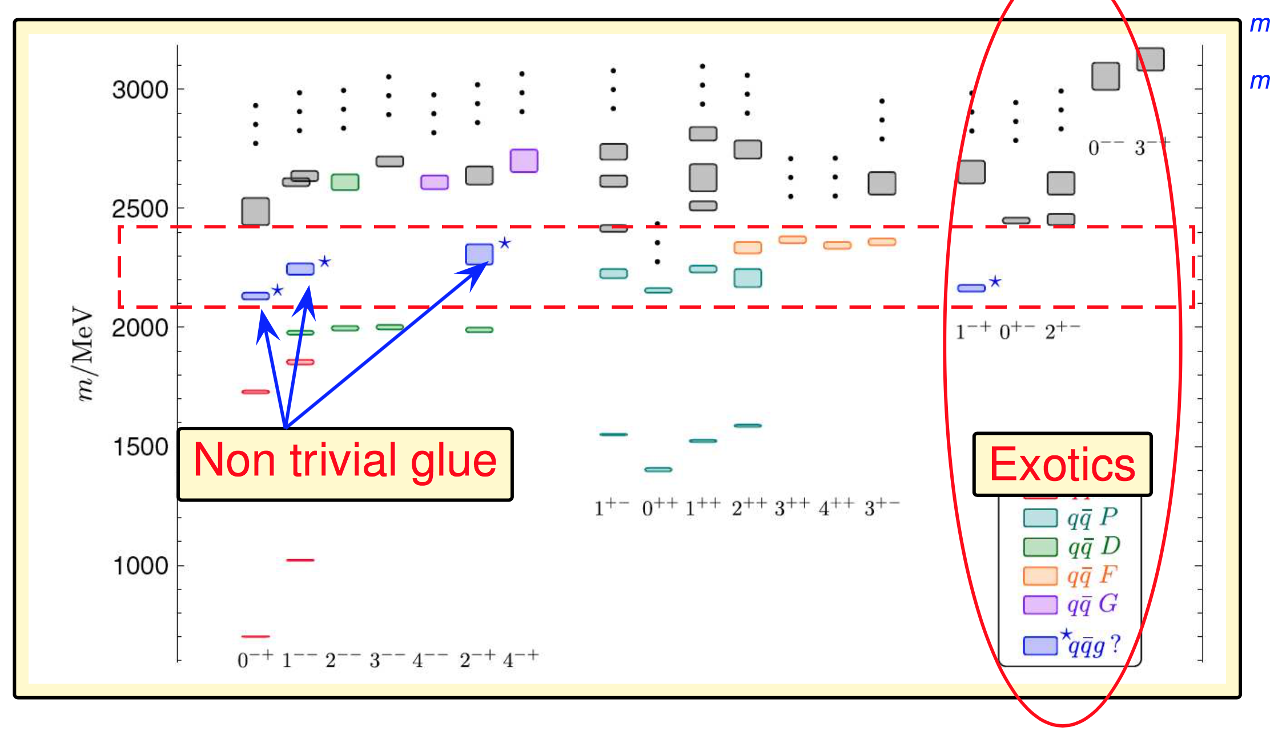
Computing Challenges in Nuclear Physics
Nuclear Physics experiments driven by beam intensity, beam polarization, exquisite control of background and systematic
multi-dimensional, e.g.,
3D imaging of quarks and gluons
multiple channels, e.g., discovery search of gluon-based exotic particles (PWA, 1000s of waves)
high statistics in five or more dimensions and multiple particles
strongly iterative analysis for reliable, model-independent analysis
Notes:
4

Slide 5
Analysis environments
Developments of analysis environments:
new projects starting (JLab 12 GeV) and on the horizon (EIC)
likely explosion of data even at the small nuclear experiments
think about the next generation(s) of analysis environments that will maximize the science output
LHC experiments: tremendous success in achieving their analysis goals and producing results in timely manners
Lesson learned at LHC experiments:
as the complexity and size of the experiments grew
the complexity of analysis environment grew
time dealing with the analysis infrastructure grew
Anecdote from LHC
a typical LHC student or post-doc spends up to 50 % of his/her time dealing with computing issues

Slide 6
Challenges for Nuclear Physics Data Analysis
Our Goal: All scientists of all levels, worldwide, should be enabled to actively participate in the nuclear physics data analysis
Regardless what experiment the data came from
Easy moves from n-dimensional data to (n-1)-dimensional data analysis
To achieve this goal, we must develop analysis toolkits using modern and advanced technologies while hiding that complexity.
Resolving this tension means putting a priority on the user experience and functionality
We must put stress ’Data’ as much as ‘Analysis’
Experimental Data must be open access, readily accessible and in a self-describing formats
Data must be trackable and linked to publications

Slide 7
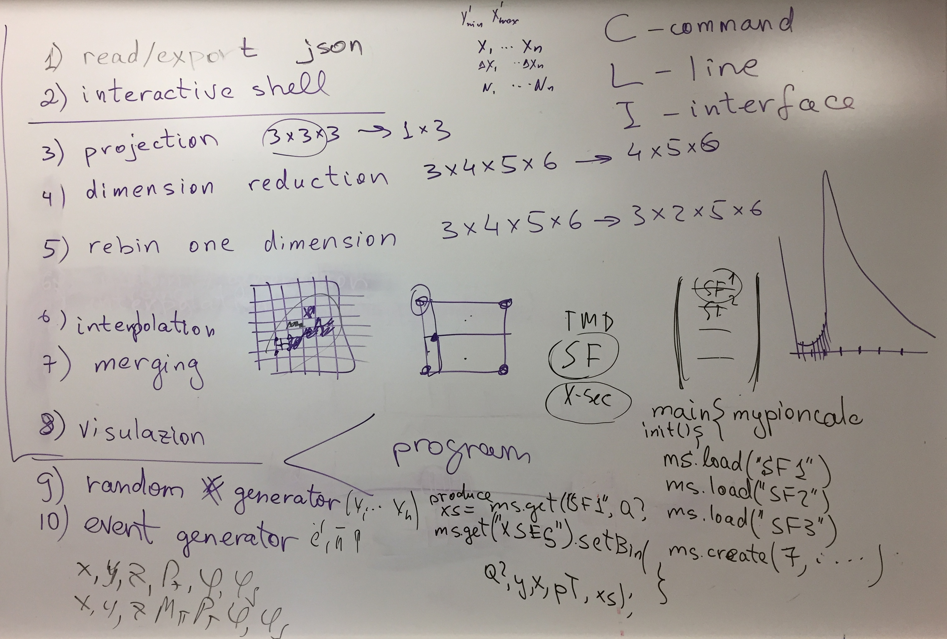
Planning for Multi-Dimensional, Multi-Experiment Data Analysis
Notes:
7

Slide 8
New analysis environments
User centered design
understand the user requirements first and foremost
engage wider community of physicists in design whose primary interest is not computing
make design decisions solely based on user requirements
  web-based user interfaces, e.g. interactive analysis in Jupyter Notebook
Future compatibility (both hardware and software)
most powerful future computers will likely be very different from the kind of computers currently used in Nuclear Physics (Exascale Computing)
structures robust against likely changes in computing environment
apply modular design: changes in underlying code can be handled without an entire overhaul of the structure
Think out of the box
the way analysis is done has been largely shaped by kinds of computing that has been available
computing begins to grow in very different ways in the future, driven by very different forces than in the past (Exascale Computing)
think about new possibilities and paradigms that can and should arise

Slide 9
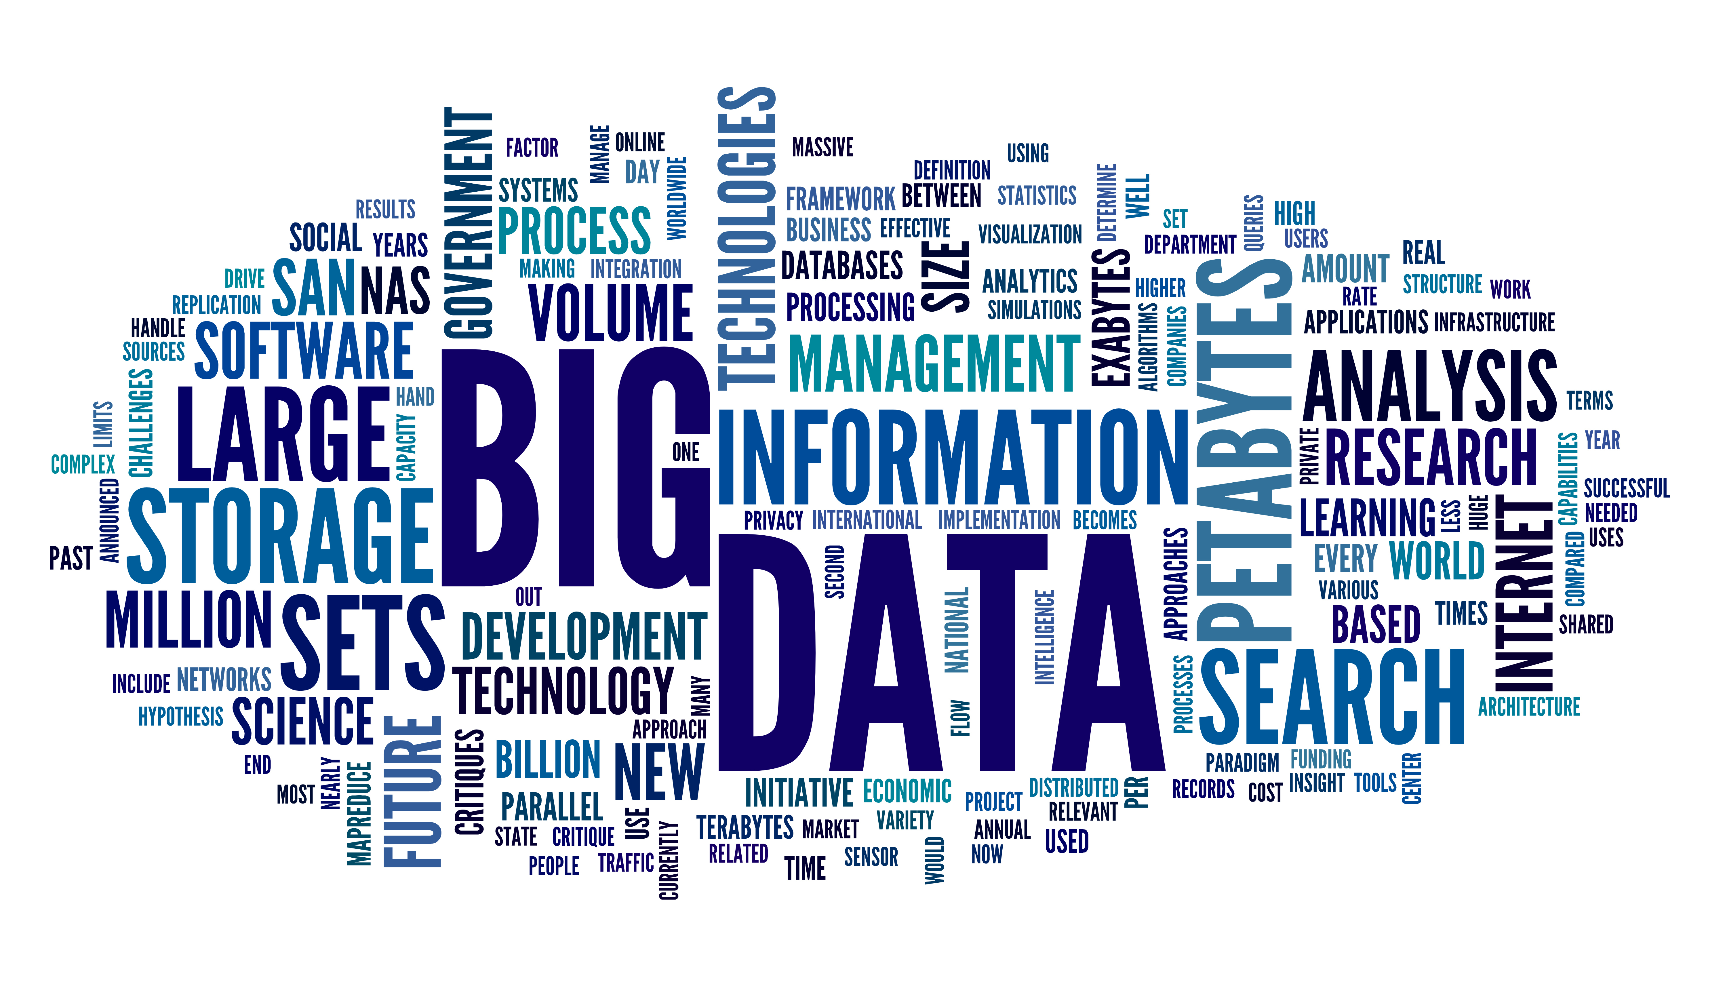
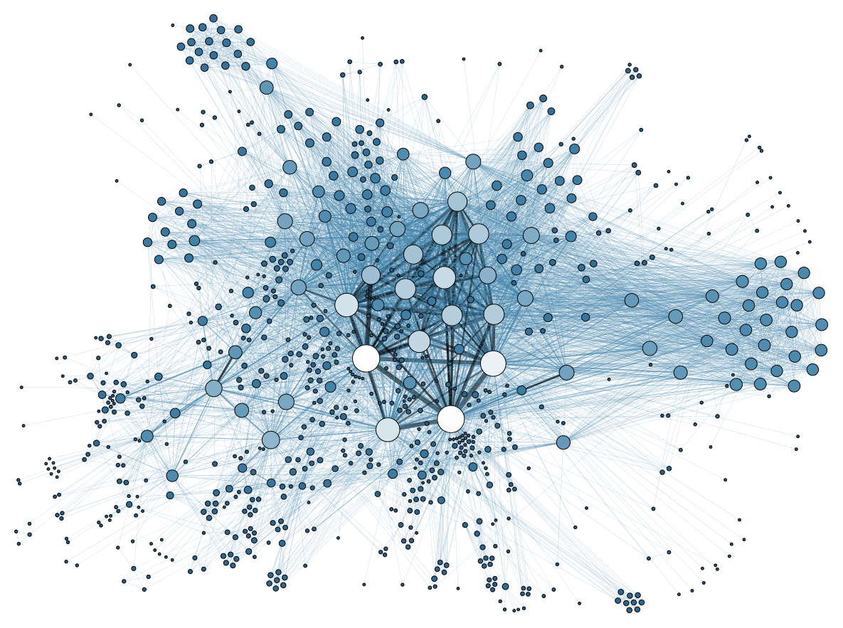
Computing trends beyond NP
Big Data
  ability to quickly analyze large amounts of data
  more efficient use of computational resources
  fast data (re)processing and analysis
  analysis taking all correlations into account
Data science beyond ROOT
  Julia statistical analysis on super computers
  python large collection of scientific computing libraries
  R - the leader in statistical languages for Big Data
  Jupyter – human-readable, interactive, web-based analysis
Databases approaches
  NoSQL more flexible, better scaleable databases
  ideal for metadata, indexing data

Slide 10
Interplay of data and theory
Feedback loop between data and theory
Comparison to:
analytical calculations
Monte Carlo (MC) simulations
Lattice-QCD calculations
Data-theory comparison: relies on
open access to data-theory tools
standardization of data-theory tools
comparison tools for quick turnaround
MC event generator:
faithful representation of QCD dynamics
based on QCD factorization and evolution equations
Usage by experimentalists:
detector corrections
analysis prototyping
comparing to theory
Usage by theoreticians:
easy off-the-shelf state-of-the-art tool that looks like data
validate against and investigate theoretical improvements
predictions
simulations
data
theory
new phenomena
test

Slide 11
Trends in Nuclear Physics Experiments
Look at historical trigger and data rates.
At JLab
  mid 1990’s CLAS, 2 kHz and 10-15 MB/s
  mid 2000’s CLAS, 20 kHz and 50 MB/s
  mid 2010’s
    HPS, 50 kHz and 100 MB/s
    GLUEX, 35 kHz and 700 MB/s
    (last run)
LZ Dark matter search 1.4 GB/s
FRIB - GRETA 4000 channel gamma detector with 120 MB/s per channel
(2025 timescale)
RHIC PHENIX 5kHz 600 MB/s – current design goal is 15 kHz
RHIC STAR - Maximum rate = 2.1 GB/s, average = 1.6 GB/s
Looking at the historical trends the highest trigger rate experiments increase rate by factor of ~10 every 10 years.
(goal)

Slide 12
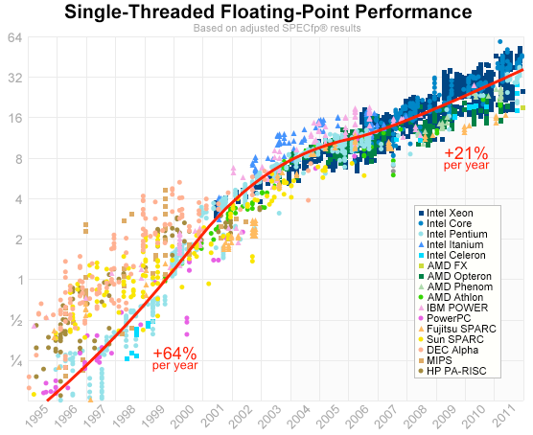
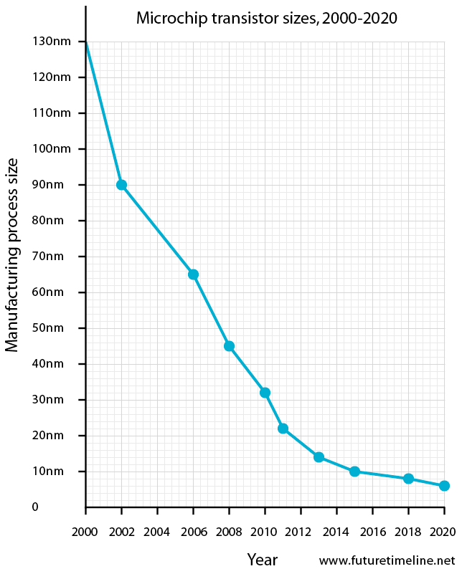
Trends in Electronics Speeds
Famous Moore’s Law: transistor count doubles every two years.
Clock speed plateaued ten years ago!
Advances by squeezing more cores per chip and improved architectures.
Manufacturers are struggling to shrink transistors.
How much further can Moore’s law continue?
When does this trickle down affect the performance of other DAQ electronics?

Slide 13
Trends in Data Transport

Slide 14
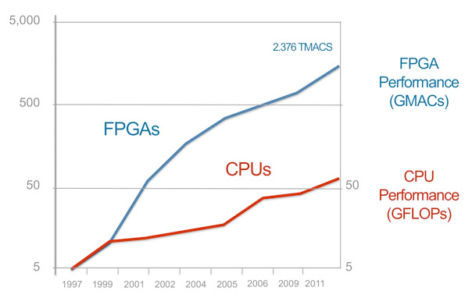
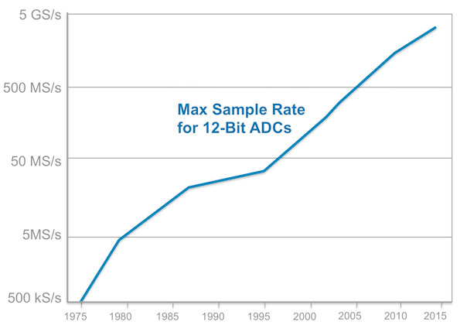
Trends in Trigger and Electronics
FPGA performance is increasing faster than CPU performance. There is a delay between when technology is developed and when it becomes affordable for use in custom electronics. So there is room for growth over the next ten years.
Current trend is to push some functionality currently performed in software running on embedded processors into firmware on custom electronics. This will probably continue.

Slide 15
Challenges in Data Acquisition
The precision of the science depends on statistics which leads to :
  Development of detectors that can handle high rates.
  Improvements in trigger electronics - faster so can trigger at high rates.
Beam time is expensive so data mining or taking generic datasets shared between experiments is becoming popular.
  Loosen triggers to store as much as possible.
  Think about sharing datasets from the start.
  Science is global – so distribute and share data handling
Some experiments are limited by event-pileup, overlapping signals from different events, hard to untangle in firmware.
  Leads to different readout schemes, often trigger-less
A minor detail: Often the limiting factor in DAQ design is available technology vs budget, a constraint shared by all experiments at the various facilities.

Slide 16
Challenges for Nuclear Physics Experiments
Where do the next generation of nuclear physics experiments point us to?

Slide 17
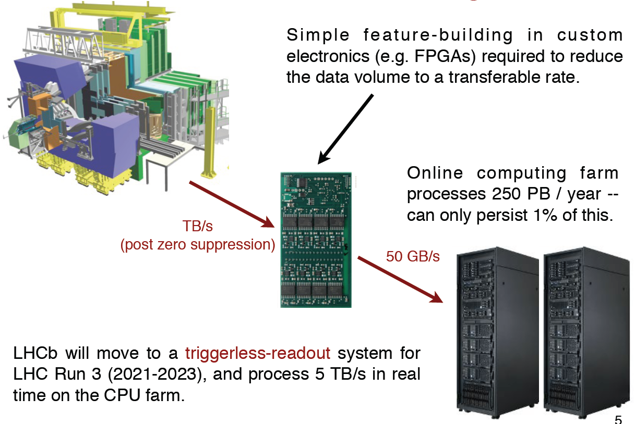
LHCb – Real-Time Analysis
Mike Williams (MIT)

Slide 18
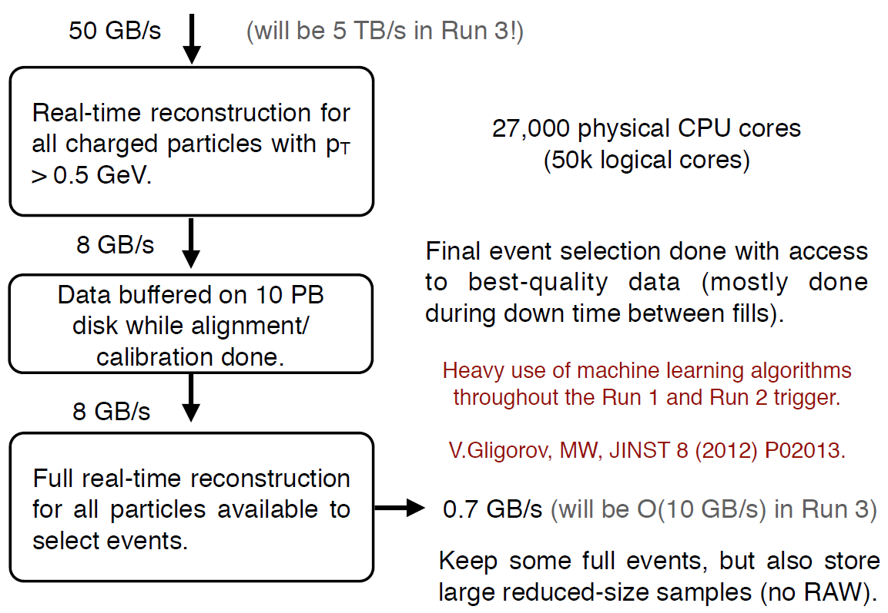
LHCb – Towards Triggerless Readout
LHCb already does the full data calibration in the online system in near real time, and the final software trigger stage uses the final calibrated data → run reconstruction in real time in the online system at the full 40 MHz rate (now 1 MHz). Software trigger will also allow which info is kept from each event, allowing super high-rate events.
(2021-2023)

Slide 19
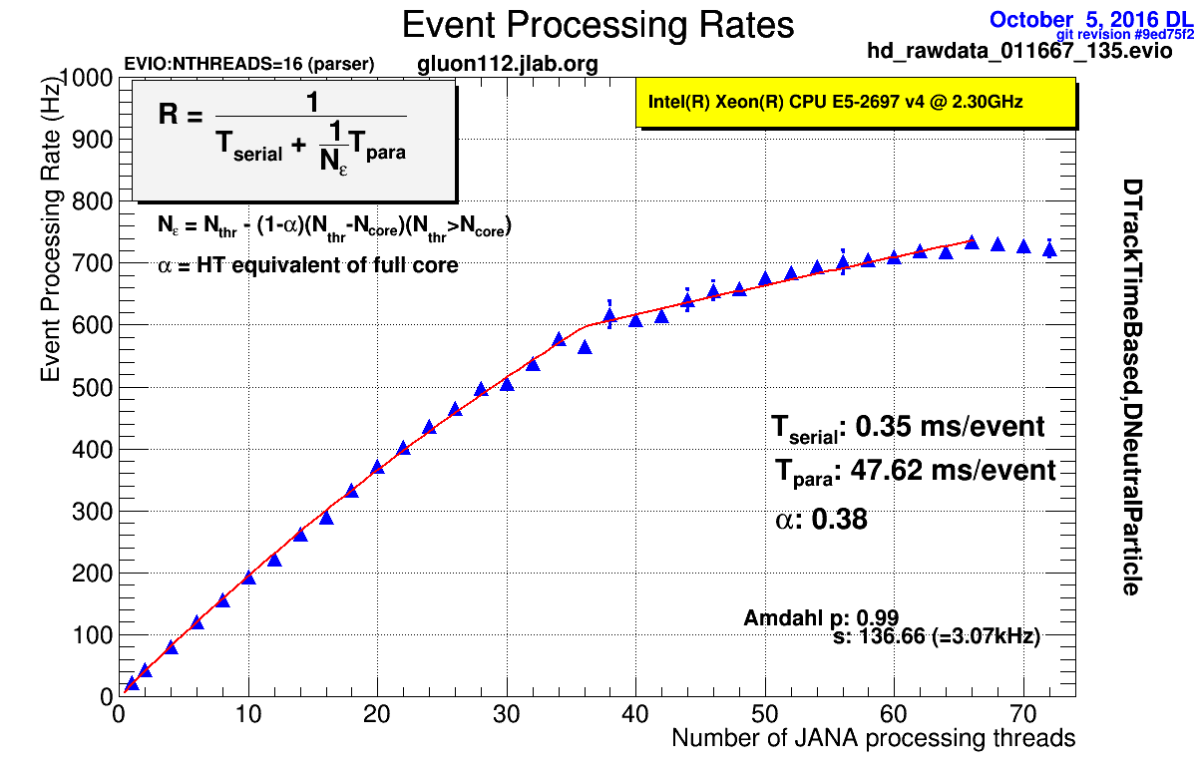
JLab – Towards Multi-threading & User-centric
The CLAS12 experiment in Jefferson Lab’s Hall B is designed to carry out the core program for the study of internal dynamics and 3D imaging of the nucleon.
CLARA is the CLAS12 analysis and reconstruction framework. CLARA enables custom data-processing tools to be presented as services and be integrated into the data-processing workflow in a fraction of the time previously required.
Elasticity of CLARA makes efficient use of multi-core architecture systems, as well as commercial cloud resources.
The GlueX experiment in Jefferson Lab’s Hall D was designed to look for exotic hybrid mesons.
The experiment will produce as much as 10 PB of data a year.
JANA is the GlueX event reconstruction framework for leveraging the parallel computing power of modern day many-core processors. This plot shows the excellent scaling of the system, even through the hyperthreading region.
In future: Quantized data format with smart indexing and descriptive metadata embedded, for multi-threaded applications.

Slide 20
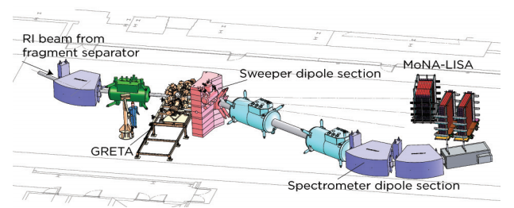
GRETA – Gamma-Ray Tracking Array Readout
One of the foreseen workhorses at the Facility for Rare Isotope Beams
Gamma Ray Spectrometer (~2025)
Instrumented by 4000 x 100 MHz 16-bit ADCs.
Maximum I/O rate 120 MB/s per channel, 480 GB/s aggregate.

Slide 21
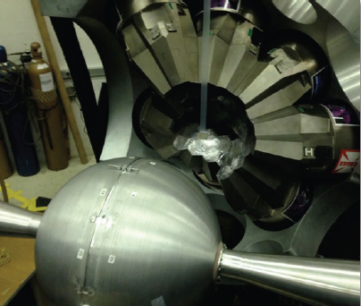
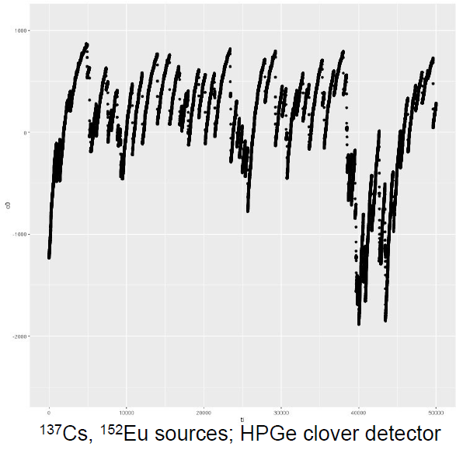
GRET(IN)A – Gamma-Ray Tracking Array Readout
Mario Cromaz (LBNL)
Waveform at 50 kHz
High-Purity Germanium crystals
Gamma-ray tracking to find interaction point: drifting charge induces charge on segments → use flash ADC trace during charge collection (~400 ns)
Gamma-ray energy determination utilizes very high intrinsic energy resolution (< 0.1%) of HPGe, over long integration times (~10 μs)
@high rate (50 kHz), most signals overlap and erratic baseline → difficult to maintain energy resolution → streaming readout of the waveform

Slide 22
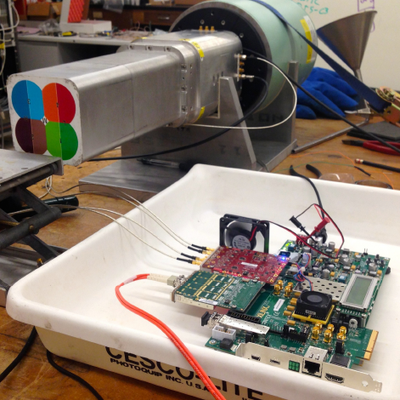
GRETA - Streaming Readout of Waveform
At the highest rates most of the waveform is now needed for accurate energy determination, and the algorithms for extracting energy are progressing towards complex fits rather than simple filters → Extract all waveforms in their entirety and perform real-time processing using high-performance computing resources.
Prototype streamer with HPGe Clover Detector
4-channel system constructed from evaluation boards
Xilinx Kintex 7 evaluation board with quad 10 Gb interface and 4DSP FMC104 4-channel ADC board
ADC: 14 bit 200 Mhz, declocked to 100 MHz, 1 in 4 samples taken (effective 40 ns/sample)
UDP packets sent via 10 Gb interface to workstation, energy filters in real-time
Generalized framework for streaming → Electronics will be designed to support future streaming model.
Full streaming of flash ADC data from large detector systems (1000’s of waveforms) is now a tractable problem, signal processing algorithms in high-performance computing system

Slide 23
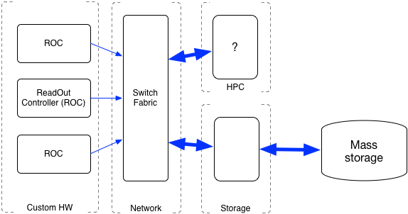
Nuclear Physics Expts - Large I/O Requirements
Example: GRETA (~2025)
Instrumented by 4000 x 100 MHz 16-bit ADCs.
Maximum I/O rate 120 MB/s per channel, 480 GB/s aggregate.
Drives towards new (streaming) DAQ solution
Stream the data directly to temporary storage.
HPC system processes the data online implementing a software trigger.
Run several different trigger algorithms in parallel?
Fast feedback for calibration.
Data surviving trigger or output from online processing migrates to long term storage - filtered and unfiltered data lingers until space needed.
Much simpler architecture - more stable and flexible - but needs affordable versions of :
  Reliable high performance network accessible storage with file management.
  High bandwidth network + protocols.
  Tera to peta scale computing.

Slide 24
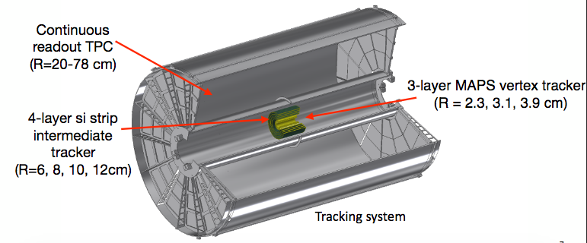
sPHENIX – Time Projection Chamber Readout
sPHENIX Tracker
Why Continuous - Streaming - Readout?
Martin Purschke (BNL)
TPCs are usually considered slow devices – 1-2 KHz event rate
Long drift time for primary electrons to gain stage
Longer time to “drain” positive ions
“Classic” TPCs operate with a gating grid to stop Ion Back Flow (IBF)
But want to take data at ~15KHz!
Need IBF control → high mobility gas (Ne), tuning of gain stages
Can’t have a gating grid! → Streaming readout

Slide 25
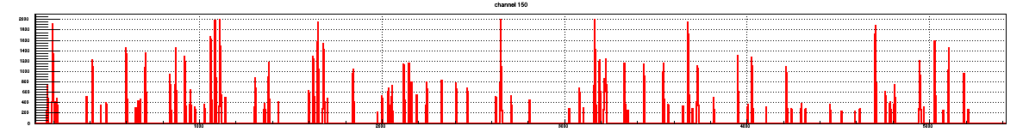



Streaming Readout Concept
Impossible to read out TPC in the traditional event-by-event way → the TPC data is streamed to temporary storage, to then extract the parts of the stream that match up with traditional triggers from the rest of the detector.
The streaming data are recorded all the time, and broken up in chunks above threshold
25
Only chunks correlated with triggered events are then kept
✖
✖
✖
✖
This results in a greatly reduced data stream
The real-time processing demands are very high

Slide 26
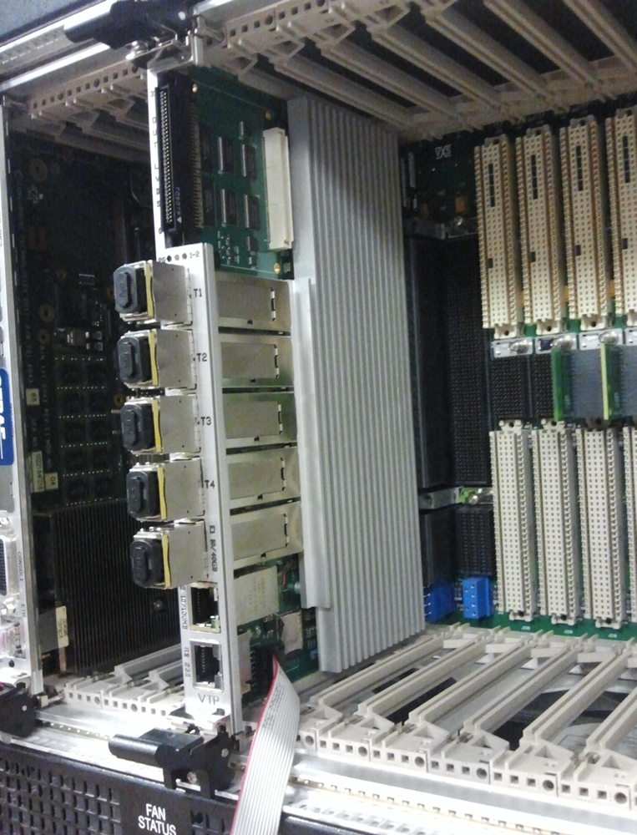
JLab – VTP (VXS Trigger Processor)
CTP, developed for GLUEX evolved into VTP for CLAS12.
Has the ability to read data from payload modules at faster than VME speeds using VXS serial lanes.
FPGA supports trigger algorithms, zero suppression etc.
Virtex 7 FPGA
Logic and Algorithm Engine.
Data transfer, pattern recognition, zero suppression etc.
Zynq SoC Processor running Linux OS & Coda ‘ROC’
VXS Data path
10Gb/s from
each ‘payload’ slot
Front panel parallel fiber links to/from other VTP or SSP.
(4 Tx/4Rx 6.25Gb/s/fiber)
VXS Trigger Path
10Gb/s from
each ‘payload’ slot
Readout data path.
(40 Gb/s Fiber Ethernet
as 4 x 10 Gb/s).
Control
(10/100Mb Ethernet)
Console [RS232]
VXS
Switch slot
4 serial lanes from
each ‘payload’ slot

Slide 27
JLab – VTP (VXS Trigger Processor)
The serial backplane has more than enough bandwidth for readout of the whole crate with high occupancy in standard pipeline mode.
There are enough serial lines on the backplane to deliver trigger and readout data at the same time.
The front panel network can handle the full bandwidth from a crate. Ethernet is simple to integrate into CODA with little modification to existing software.
The VERTEX chip reads the trigger info and the full data stream. It can be programmed for pattern recognition, zero suppression, complex trigger algorithms etc.
  This allows for a vertex-based trigger to operate for CLAS12
The Zynq “System on a Chip” SoC runs Linux and has already been ported to the CODA ROC (CODA = CEBAF Online Data Acquisition; ROC = Read-Out Controller) to run on it for control and monitoring.

Slide 28
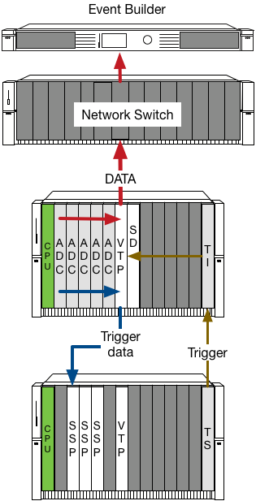
VTP – Pipeline Readout
ADC data used by the trigger is read by the VTP and passed to trigger crates to take part in the global trigger (blue lines).
The full data to be read out is buffered in the ADCs.
Once the trigger decision is made the global trigger is distributed to back to the VTPs (brown lines).
The data read by the VTP, zero suppressed and formatted then passed via a network switch to the event builder running on a Linux server (red line).
Readout in this mode has the advantages of :
  Zero or very low deadline.
  High speed since the VME bus and CPU (green) are no longer in the data path.
  Flexibility, since the system is built from standardized components that differ only in firmware and programming.

Slide 29
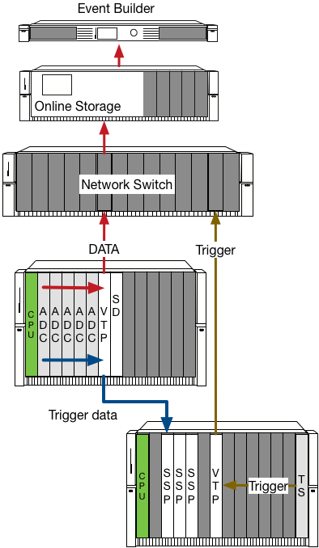
VTP – Streaming Readout
ADCs are clocked at a constant rate and continuously read by the VTP, zero suppressed and formatted then passed via a network switch to temporary storage (red line).
Any ADC data used by the trigger is read by the VTP and passed to trigger crates to take part in the global trigger (blue lines).
The trigger is treated as it’s own data stream.
Triggers and data are associated offline in software.
Readout in this mode has the advantages of :
  Zero or very low deadline.
  High speed since the VME bus and CPU (green) are no longer in the data path.
  Simpler overall design.
  Deterministic data flow, clock driven not trigger.
  No data is lost, trigger is folded in using software or even not at all.

Slide 30
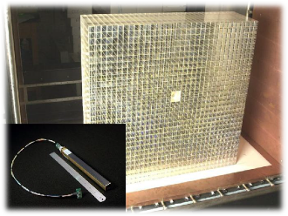
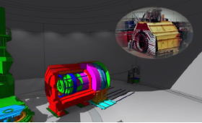
Future Experiments: JLab NPS & SoLID
Neutral Particle Spectrometer:
1000+ channel electromagnetic PbWO4 calorimeter in high background area
SoLID:
Large Acceptance Detector operable at High (10³⁷⁻³⁹) Luminosity
Sweeping magnet before EM calorimeter to reduce background rates and achieve up to 10³⁹ luminosity
Readout with PMT and HV divider linear to within 2% for up to 2 MHz/crystal.
Plan to use flash ADCs to read full wave form
vertex
tracking
PID
EMCAL
HCAL
muon
e
γ
K/π/p
The detector has two configurations. In the PVDIS configuration electrons are scattered of a fixed target at high luminosity.
The detector is split into 30 sectors with a single track event topology.
Current proposal 30 DAQ systems to be run in parallel at rates of 1 GByte/s each with custom electronics to deal with tracks that cross sector boundaries.
Complex system relying on coordination of the semi-independent DAQs
absorber
jets
μ
ν
P_{T}miss
Prediction: all calorimeter readout will start using full wave forms

Slide 31
Blurring of Online and Offline
Traditional model of online vs offline environments very distinct
With calibration and Level-3 (L3) triggering somewhere in-between.
Driven by a combination of the physics being studied and detector technologies the offline-online distinction is being blurred, and in some cases removed:
  Detectors such as TPCs (sPHENIX) that are difficult to integrate into the traditional online data flow - defer integration processing until later.
  Level 3 triggers requiring partial or complete reconstruction to deduce the rate to mass storage.
  Reconstruction and data compression to reduce rates to tape (sPHENIX, LHCb).
  Trigger rates and detector topologies that are hard/expensive to deal with in electronics, defer to software (SoLID, GRETA).

Slide 32

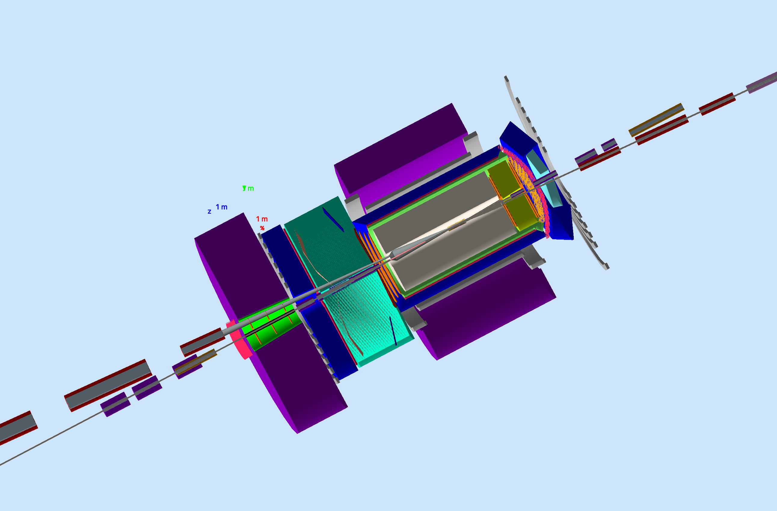
Electron-Ion Collider – NP Computing
Electron-Ion Collider (EIC): next-generation U.S. facility to study quarks and gluons in strongly interacting matter
  Driven by precision to access the multi-dimensional and multi-channel problem space of Nuclear Physics
  Novel integrated (80 meter long…) detector and interaction region to measure everything leading to multitude of analysis, linking multitude of detector systems
  Diverse worldwide scientific community
The EIC Users Group: EICUG.ORG
Computing Challenges at the EIC:
  Extremely broad science program requiring a flexible analysis ecosystem / toolkit
  Success of scientific goals strongly influenced by analysis efficiency, apply user-centered given the lessons learned from LHC
  Era of high-precision non-perturbative QCD requiring strong interplay of data analysis, MC calculations and Lattice QCD effort
  Era of exascale computing changing the paradigm for I/O, Storage and Compute
  Strong role of machine learning and smart detectors to enhance scientific productivity

Slide 33

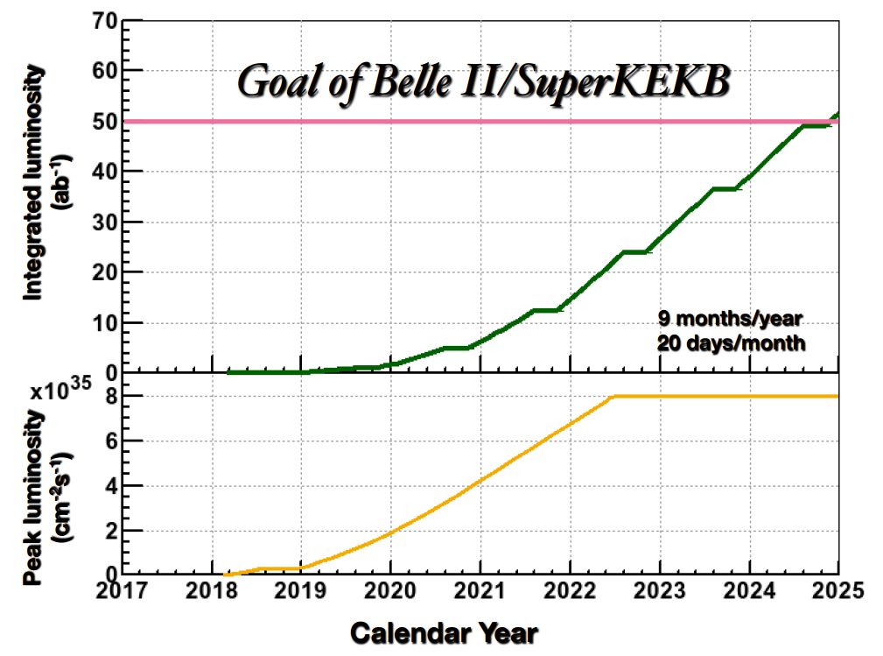
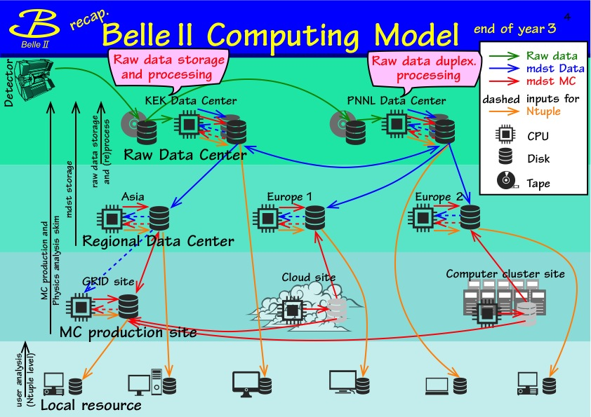
BELLE II – Distributed Computing
Belle II detector will record e⁻e⁺ collisions from Japan’s SuperKEKB
50x the data volume, 40x rate of collisions of previous Belle experiment
Event rate of 6 kHz, corresponds to 11 PetaBytes/year starting in 2022
100 PetaBytes raw data volume by 2024, total data volume ~190 PB
Processed data samples will be distributed worldwide (Asia, North America, Europe)
Resource needs depend upon luminosity, event size, replicas, MC samples, etc.
Malachi Schram (PNNL)

Slide 34
BELLE II Example – Monte Carlo Production
NP computing is built around standardized tools, ROOT, GEANT for example but also libraries of track followers, pattern recognition, filters.
  Immediate payoff to improving ROOT and GEANT4
  Bulk of compute is simulation, bulk of simulation is GEANT4
  MC production are critical exercises to test software, scalability, analysis samples
BELLE II Monte Carlo #7 from Nov. 1st 2016 to Feb. 7th 2017
  Approximately 27 billion events simulated
  Reached 25k concurrent jobs (>200 kHEPSpec)
Monte Carlo #8 started on Feb 16th and is ongoing
  New Belle II computing record 300kHEPSpec

Slide 35
Conclusion
Nuclear Physics Experiments driven by high statistics, multi-dimensional analysis, multi-channel reaction mechanisms, “many-body physics” analysis
A blurring of online and offline computing
  Intense interest in both advanced computing at the beam line and access to advanced computing via high speed networking
  Seamless access/usability of a range of resources (local and distributed)
  Network viewed as a resource
Many developments towards streaming at DAQ
Offline need to plan both ‘short’ and long term
  Immediate pay-off to improving GEANT4 and Root - Bulk of compute is simulation
  Move past event level parallelization for the longer term - Look beyond “in-house” HEPNP solutions, especially for analysis
Data management, preservation, workflows – much can be done here
  Knowledge capture
  Workflow communication
Need for an analysis toolkit with user-centered design
Also large role for machine learning and real time simulation for accelerators
  CEBAF and FRIB operations
  EIC design and simulations
Notes:
35

Slide 36
Conclusion
Nuclear Physics Experiments driven by high statistics, multi-dimensional analysis, multi-channel reaction mechanisms, “many-body physics” analysis
A blurring of online and offline computing
  Intense interest in both advanced computing at the beam line and access to advanced computing via high speed networking
  Seamless access/usability of a range of resources (local and distributed)
  Network viewed as a resource
Many developments towards streaming at DAQ
Offline need to plan both ‘short’ and long term
  Immediate pay-off to improving GEANT4 and Root - Bulk of compute is simulation
  Move past event level parallelization for the longer term - Look beyond “in-house” HEPNP solutions, especially for analysis
Data management, preservation, workflows – much can be done here
  Knowledge capture
  Workflow communication
Need for an analysis toolkit with user-centered design
Also large role for machine learning and real time simulation for accelerators
  CEBAF and FRIB operations
  EIC design and simulations
Very, very strong hints of synergy between advanced computing and the next-generation of nuclear physics experiments!
Notes:
36

Slide 38
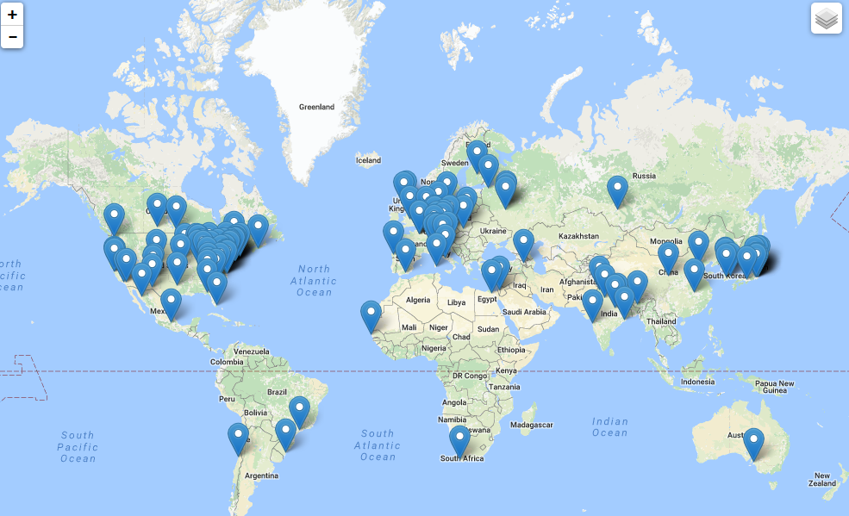
Worldwide Interest in EIC Physics
The EIC Users Group: EICUG.ORG
(no students included as of yet)
670 collaborators, 28 countries, 150 institutions... (December, 2016)
Map of institution’s locations

