Slide 1

Welcome
Future Trends in Nuclear Physics Computing Workshop
Stuart Henderson
May 2, 2017

Slide 2
Introduction
Welcome to Jefferson Lab!
It is a very exciting time at the Lab as we begin the 12 GeV era
At Jefferson Lab it is essential that we provide the tools needed to enable the scientific community to be successful: accelerator complex, experimental capabilities, vibrant theory and computational capabilities
It is essential that we do all we can to ensure that experimental measurements translate into scientific knowledge – computing plays a central role
Computing and computational science capabilities are critical for enabling our user community, maximizing scientific output of Jefferson lab, and the scientific impact of our field

Slide 3
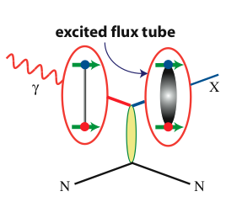
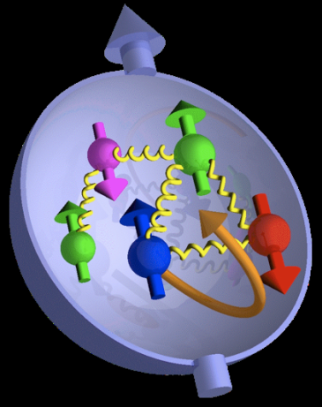

Jefferson Lab @ 12 GeV Science Questions
excited gluon field
What is the role of gluonic excitations in the spectroscopy of light mesons?
Where is the missing spin in the nucleon?
Role of orbital angular momentum?
Can we reveal a novel landscape of nucleon substructure through 3D imaging at the femtometer scale?
Can we discover evidence for physics
beyond the standard model
of particle physics?

Slide 4
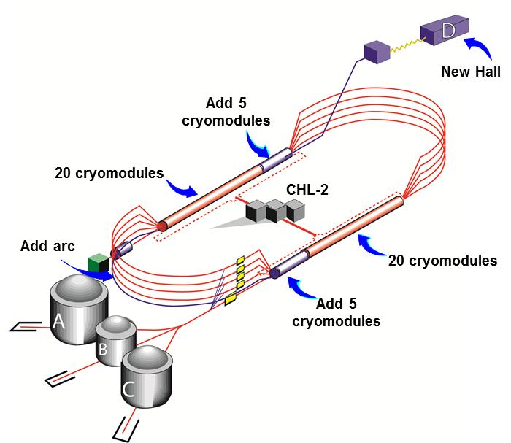
CEBAF Upgrade

Slide 5
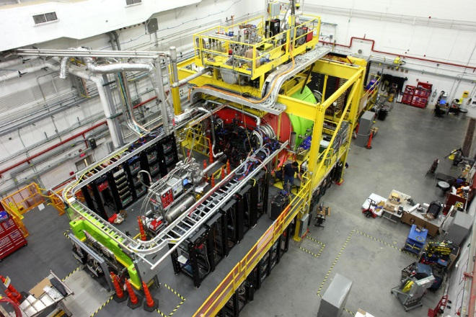
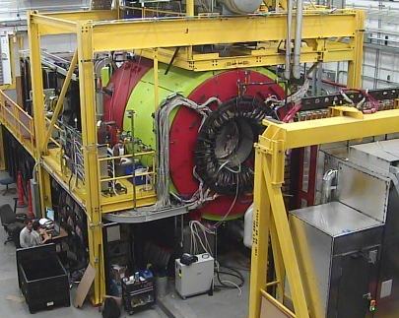
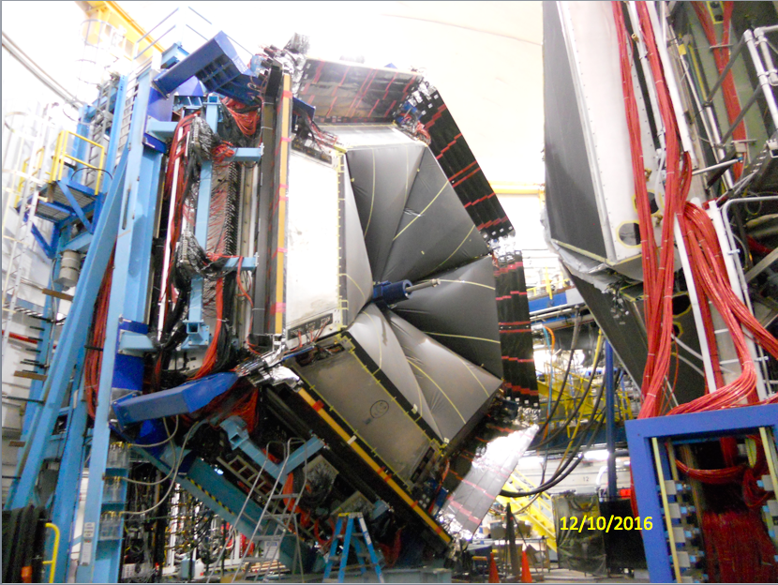
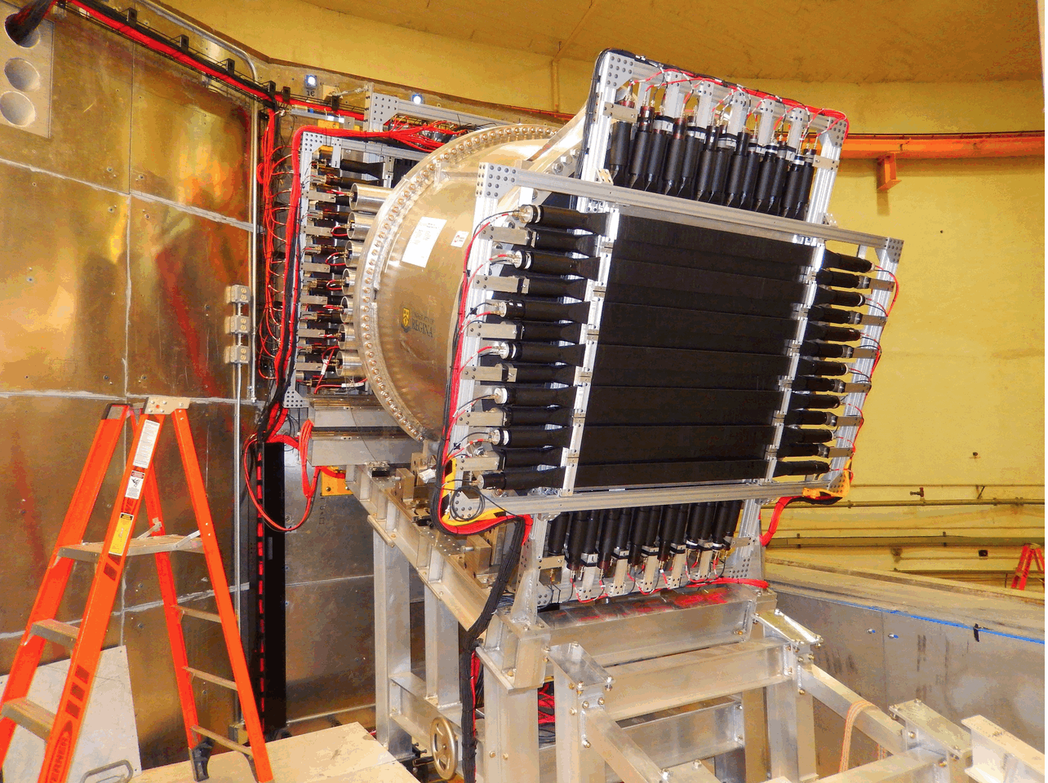
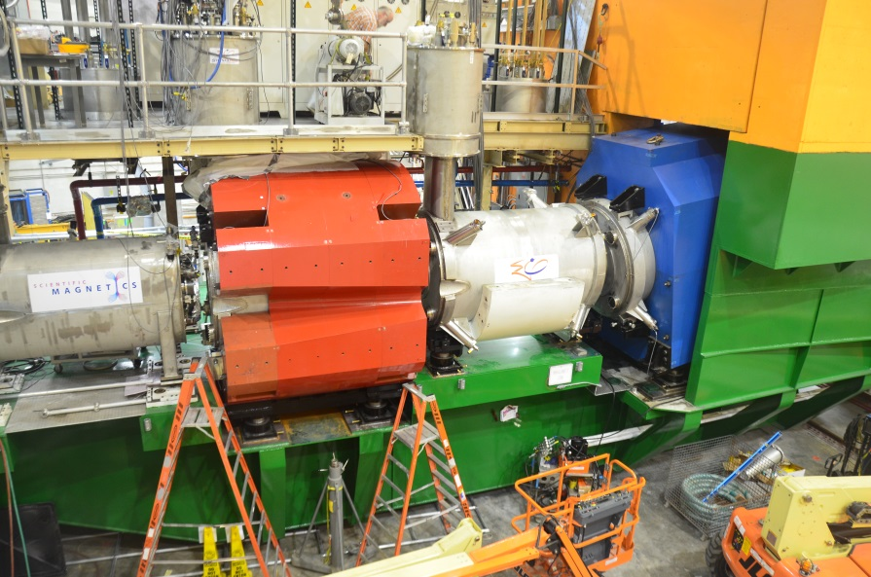
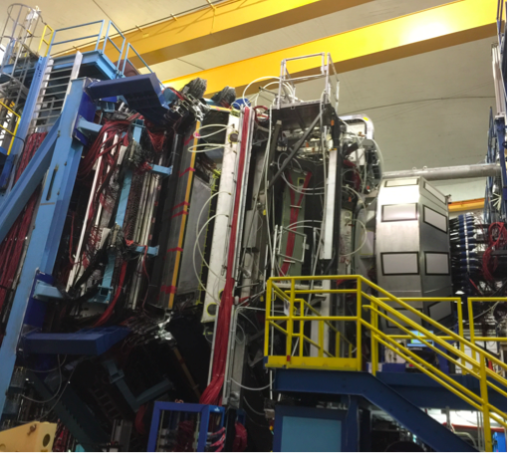
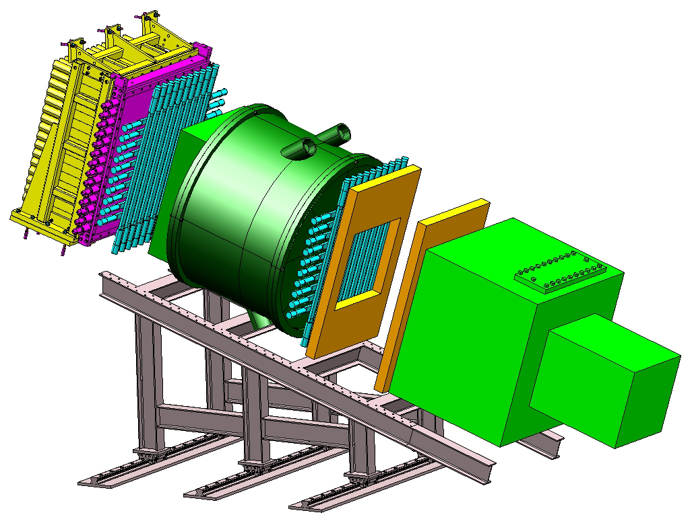
12 GeV Upgrade Project
TPC = $338M
ETC < $2M
Project Scope (~99.7% complete):
Doubling the accelerator beam energy – DONE
New experimental Hall D and beam line – DONE
Civil construction including utilities – DONE
Upgrade to Experimental Hall C – DONE
Upgrade to Experimental Hall B – 99%
  Solenoid only scope remaining

Slide 6
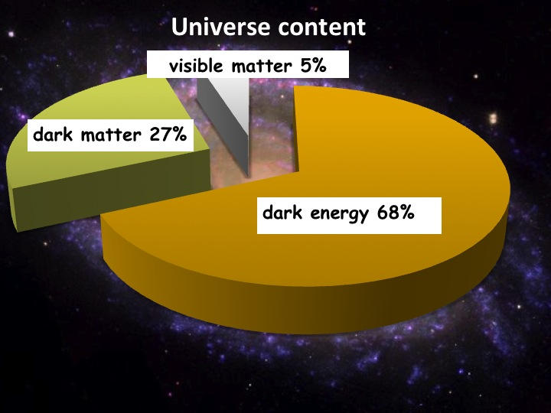
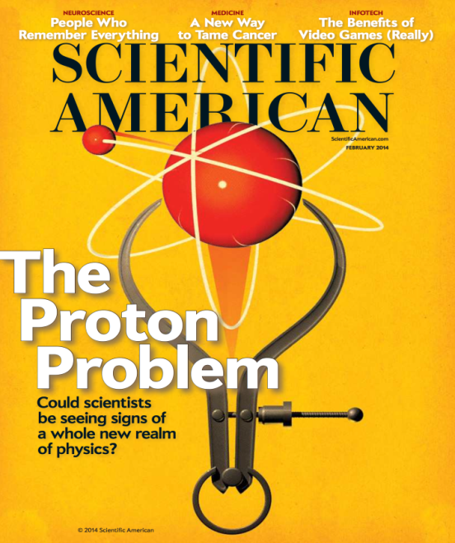
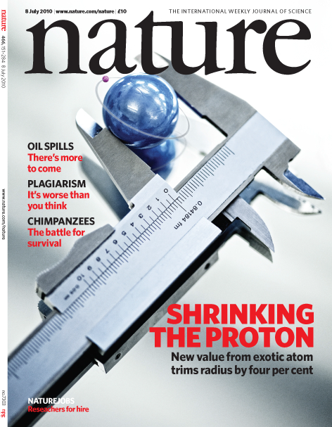
Physics Operation with 12 GeV Facility
Quark confinement: Hall D (GlueX) engineering and 1st physics run completed
  Basis for more than a dozen papers at APS DNP (Oct 2016)
  50 Billion events in Spring 2017
Nucleon structure: Hall A started physics operations
  Two experiments: G_{M}^{p} and DVCS in Fall 2016
  One Experiment, Argon Spectral Function complete, Spring 2017
Dark matter: Hall B Heavy Photon Search engineering run
  Results of 2015 data-taking expected soon
Proton Radius: Hall B PRad experiment physics run
  Experiment run and completed Summer 2016
Starting to exploit the Upgrade for Physics

Slide 7
Closing Thoughts
The science must remain at the forefront—the drivers for computing for NP are unique; it is very important to articulate the unique needs and world-leading opportunities that are afforded
Interplay of experimental results, theoretical calculations and simulations are the key to progress in Nuclear Physics—advanced computation is essential for all three
  This linkage and interplay provide a powerful and compelling storyline, similar storylines have been used to great advantage by other fields
Computing, Computer Science, Computational Science, Data Science are moving quite rapidly—we have to find ways to stay up to date and find partners for collaboration—with NP, HEP, ASCR and the NSF funded projects

Slide 8
Welcome!

