Slide 1
JLEIC R&D Overview NP EIC R&D Panel Review and Report
Fulvia Pilat (JLab)

Slide 2
Overview
Overview of JLEIC R&D as presented at the NP Review Panel at the end November 2017
Review Panel Report and R&D Priorities
EIC JLAB-BNL Common R&D
NP EIC R&D FoA
Overall strategy for FOA
Discussion at the Collaboration meeting today/tomorrow
→ Summary plans Wednesday before closing

Slide 3
JLEIC R&D areas
R&D activities Higher priority topical areas for EIC R&D funding | Electron Cooling ECL 8 CTE | Magnets MAG 6 CTE | SRF R&D SRF 3 CTE
Bridge design and R&D Executed on base, LDRD and selected EIC R&D funding | Injectors R&D INJ 6 CTE | Interaction Regions IRS 3 CTE | Beam dynamics and diagnostics BDD 8 CTE
Guiding principles
Adopt mature technology where applicable
Focus R&D in critical areas (i.e electron cooling)
look at a 4-5 years timeline
move technical readiness from “low” to “medium” in critical areas
properly identify high priority R&D (judgment call based on technology readiness and impact on performance and cost)

Slide 4
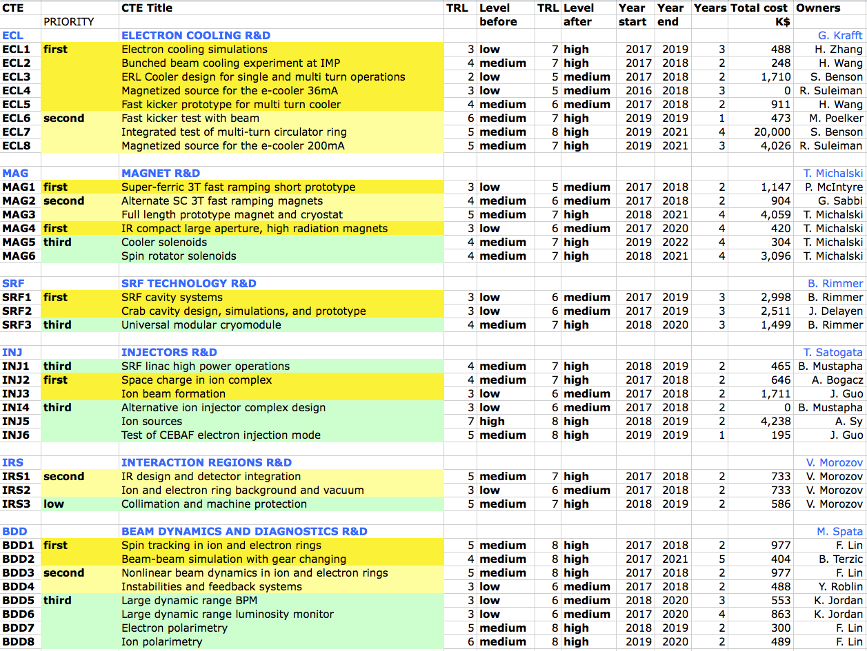
Overview of R&D
JLAB LDRD
ANL LDRD

Slide 5
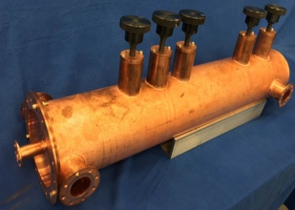
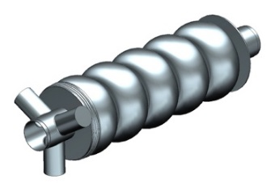
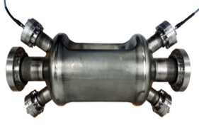
JLEIC R&D progress
ECL1 e-cooling simulation, beta-cool and new code development
ECL2 bunched beam electron cooling at IMP, demo in May 2016
ECL3 cooler design, preliminary design single-turn cooler
ECL4 magnetized source, first magnetized beam by early 2017
ECL5 fast harmonic kicker – ½ size prototype tested successfully
MAG1 short prototype, mock up winding for 1.2m
MAG 3 IR magnets, initial designs started
SRF1 ERL cavity, design completed, prototype started
SRF2 crab cavity, design started
BDD1 spin tracking, p and e simulations validating Figure-8
BDD2 beam beam, GHOST code development progressing

Slide 6
Schedule and Funding Profile
2017
2018
2019
2020
2021
Electron cooling:
ECL first
ECL second
ECL re-circulator ring test
Magnets
MAG first
MAG second
MAG third
SRF R&D
SRF first
SRF second
First priority
10 M$
Second priority
5 M$
Third priority
Multi-turn circulator cooler
JLEIC R&D Panel Review 30-Nov-2016
6

Slide 7
Funding profile
R&D areas | FY17 k$ | FY18 k$ | FY19 k$ | FY20 k$ | FY21 k$
ECL | 1,500 | 1,673 | 8,056 | 7,085 | 9,439
MAG | 1,123 | 4,190 | 3,623 | 4,154 | 2,491
SRF | 1,806 | 2,623 | 2,923 | 374 | 0
TOTAL | 3,710 | 8,487 | 14,603 | 11,614 | 11,930
TOTAL – ECL7 | 3,710 | 8,487 | 9,162 | 5,561 | 3,524
TOTAL FIRST | 3,539 | 4,426 | 4,109 | 1,353 | 0
Cost profile for the R&D areas e-cooling, magnets and SRF
Total is compared to the total minus the most expensive item ( ECL7: Integrated test of multi-turn circulator ring , with total cost ~20M$)
The total for the first priority elements only highlighted yellow.
Cost are fully burdened, labor and procurements

Slide 8
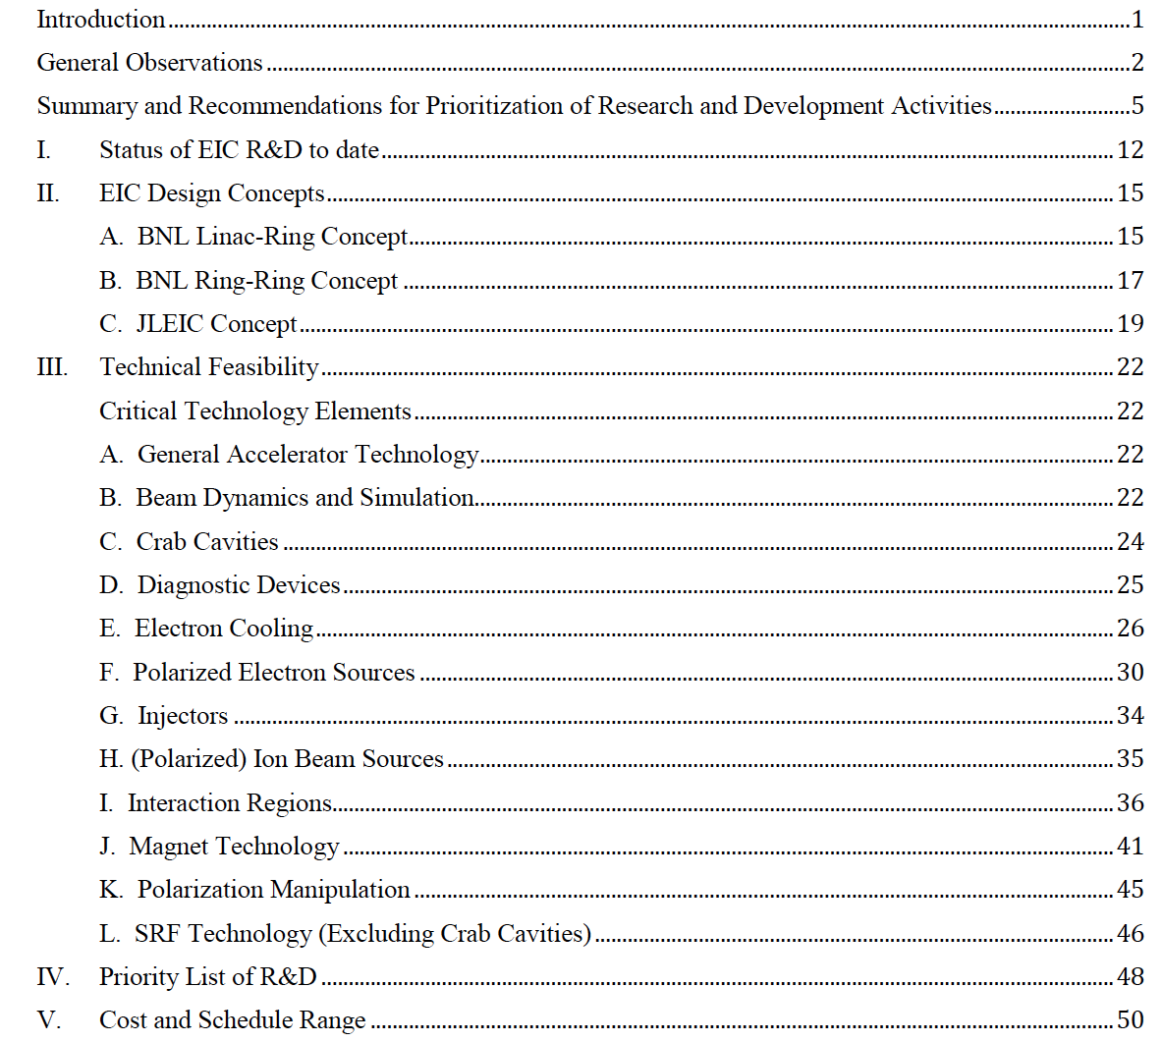
NP Panel Report contents

Slide 9
Report of the Community Review of EIC accelerator R&D
Rockville, November 29- December 2 2016
Key academic institutions are engaged in EIC R&D, but the program may benefit from broadening such engagement. Many National Laboratories and Universities have substantial infrastructure and expertise in accelerator science and technology, and NP is encouraged to promote strong collaborations between the proponent laboratories and these resources to improve concept development and solve technical challenges. In particular, complex-wide opportunities exist for collaboration between national laboratories and interested and capable universities to further refine EIC concepts in the following topical areas:
Hadron cooling techniques
Polarized electron sources
Ring magnet demonstrations
Interaction region magnets design and prototyping
Machine-detector interfaces
Super-conducting RF technology
Large scale cryogenics technology
High-current SC linacs
Crab cavity design, fabrication and testing (with beam)
Beam and spin dynamics, benchmarking of simulation tools
Electron cloud mitigation technique

Slide 10
Panel priorities for R&D common to all EIC designs:
The panel reviewed all Critical Technology Elements presented by JLAB and BNL and compiled priorities for :
R&D common to all designs
Project-specific R&D

Slide 11
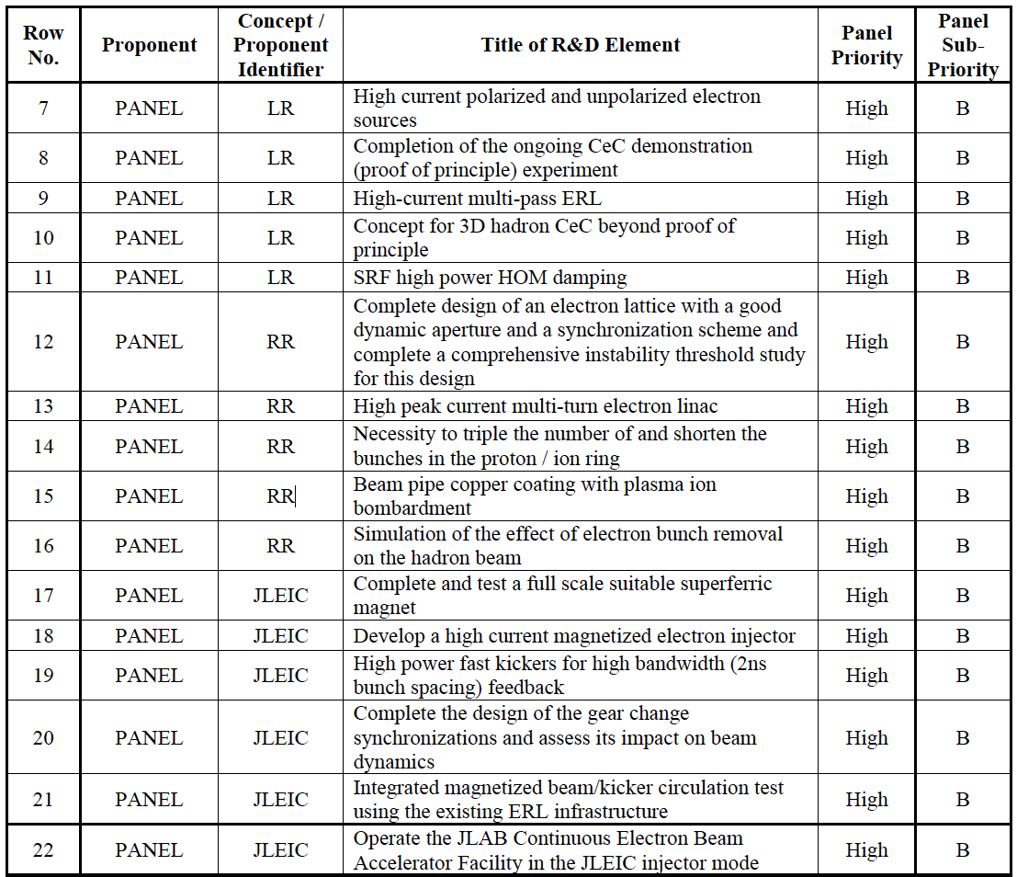
Panel priorities for project–specific R&D

Slide 12
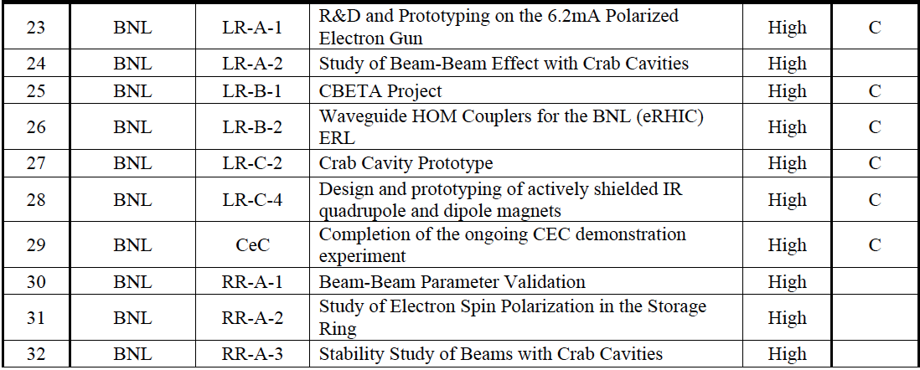
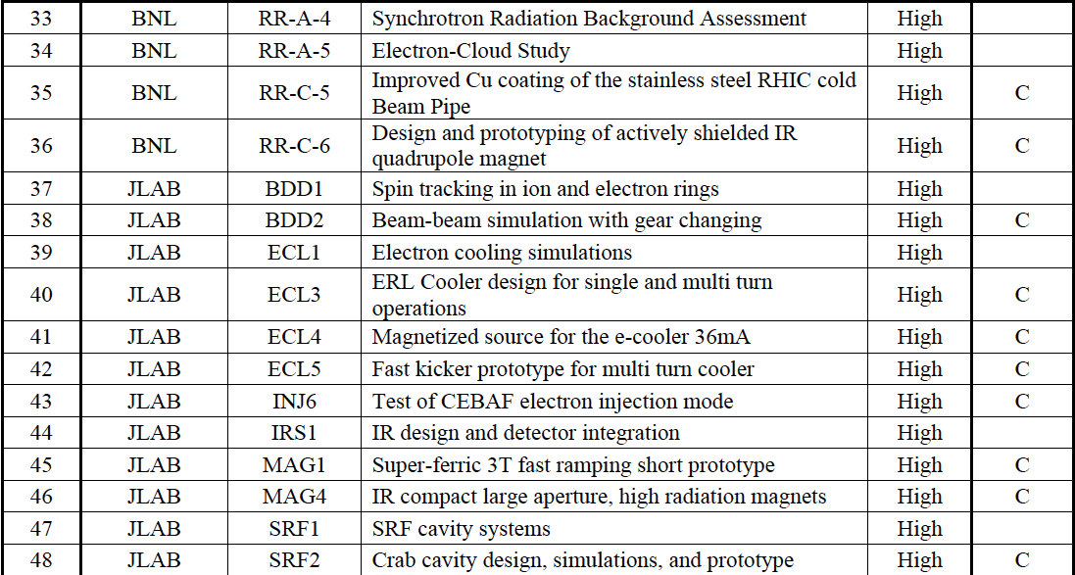
Priority for lab proposed CTE’s: HIGH

Slide 13
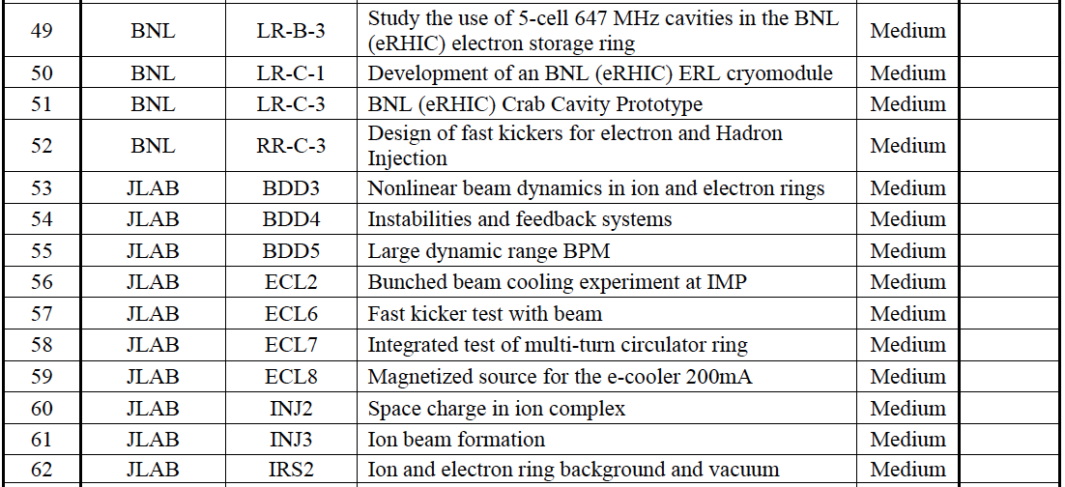
Priority for lab proposed CTE’s: MEDIUM

Slide 14
Common EIC R&D topics (discussions JLEIC-eRHIC)

Slide 15
Cooling Conceptual Design Study
Possible PI | Alexei Fedotov (BNL) Yuhong Zhang (Jlab)
Topics | Collaborative Task Force: Work out EIC designs with both magnetized electron cooling (BBeC) and coherent electron cooling (CeC), Develop a common simulation platform
Main deliverable | Establish limits of cooling (BBeC and CeC), suite of simulation tools
FOA proposal | Yes
Interest | High
Comments | High priority from review panel. Questions: does CeC work for JLEIC? does BBeC work for eRHIC? A Collaborative Task Force to explore limits of strong cooling and improve simulation tools

Slide 16
Beam-Beam Simulation Tools Development and Application to eRHIC and JLEIC
Possible PI | Yue Hao (BNL), Yves Roblin (JLab)
Topics | Collaborative Task Force: Comparing and benchmarking available beam-beam codes, make improvements and apply the codes to electron ion collisions
Main deliverable | Improved codes simulation results with JLEIC & eRHIC beam parameters
FOA proposal | Yes
Interest | High
Comments | High priority from review panel. Beam-beam combined with space charge? LBL as a possible collaborator/subcontractor. Put beam-beam workshop on funding scope, travel support. Include crabbing effects.

Slide 17
Study of Electron Beam Polarization During Acceleration and Beam Storage
Possible PI | Francois Meot (BNL) and Fanglei Lin (JLab)
Topics | Collaborative Task Force: Perform systematic simulations of electron beam polarization during acceleration and store assuming realistic errors and study mitigations of any issues
Main deliverable | Study Report
FOA Proposal | Yes
Interest | High
Comments | Spin tracking already in progress for protons and electrons at JLab. Existing informal collaboration with Francois already in place, Scope could be widened and formalized. Focus on the electron spin.

Slide 18
Design and Prototype of IR Magnets
Possible PI | Brett Parker (BNL), Tim Michalski (JLab)
Topics | Collaborative Task Force: Study the feasibility of a common IR magnet design for JLEIC and eRHIC and develop prototype
Main deliverable | Design and prototype IR magnet
FOA Proposal | Yes
Interest | High
Comments | Design led by Brett Parker with collaboration of JLAB magnet engineers. Consider to engage LBL as collaborators/subcontractors

Slide 19
Electron Source Development
Possible PI | Erdong Wang (BNL), Matt Poelker (JLab)
Topics | R&D for eRHIC ERL-ring and ring-ring polarized sources Improve the JLAB polarized gun and start performing systematic measurements to clarify source of ion bombardment
Main deliverable | Report on systematic measurements with the JLAB Gun
FOA Proposal | Yes
Interest | High
Comments | Relevant also to JLab electron cooler design with high current and high charge, positron production

Slide 20
Crabbing Integration, Dynamics, and Demo in RHIC
Possible PI | (BNL) , Bob Rimmer and Vasiliy Morozov(JLab)
Topics | Plan and execute crabbing demo in a hadron machine
Main deliverable | Crabbing test
FOA Proposal | Yes
Interest | High
Comments | Demonstration of crabbing in an existing machine, possibly at RHIC. Mitigating strategy if SPS test delayed orunsuccessful JLab could provide study and cavities/cryostat. 336 MHz needed to work in RHIC. Initially we can propose a feasibility study for a test.

Slide 21
Study of Electron Cloud Effects in EICs
Possible PI | Michael Blaskiewicz (BNL) , Rui Li (JLab)
Topics | Study the electron cloud effect in eRHIC and JLEIC, and develop countermeasures, improve on in situ CU and C coating
Main deliverable | Report and Analysis and plan on countermeasures
FOA Proposal | Yes
Interest | Medium
Comments

Slide 22
Design & Simulation of ERL for CeC & BBeC
Possible PI | Wencan Xu (BNL) , Bob Rimmer, Steve Benson (JLab)
Topics | Designing the SRF, lattice and return loops for the electron cooling energy recovering
Main deliverable | Design of the SRF, lattice and return loops for e-cooling ERL
FOA proposal | Yes
Interest | Medium
Comments | JLEIC already working on this for the BBeC cooler, we could leverage this. BNL possibly to contribute to design. beam break-up. HOM coupling.

Slide 23
Performance Study of He-3 Ion Source
Possible PI | Anatoli Zelenski (BNL) , Amy Sy (JLab)
Topics | Performing systematic measurements on existing He-3 ion source
Main deliverable | Test report on He-3 Performance
FOA proposal | Yes
Interest | Medium
Comments | We could have Amy Sy joining the proposal. Consider engaging ANL as collaborator/subcontractor

Slide 24
Head-on IR Design and Dispersive Crabbing
Possible PI | Christoph Montag (BNL) , Vasiliy Morozov (JLab)
Topics | Study alternatives to IR design with no crabbing scheme
Main deliverable | alternative luminosity scheme
FOA proposal | Yes
Interest | Medium
Comments | High priority from Committee. We do not believe it is feasible for high-luminosity

Slide 25
Broadband Kicker for Feedback Systems
Possible PI | Michael Blaskiewicz (BNL) , Bob Rimmer (JLab)
Topics | Design kicker and feedback system
Main deliverable | Feedback system design and validation
FOA proposal
Interest | Medium
Comments | Priority from Committee high Consider engaging SLAC, ANL as collaborators/subcontractors

Slide 26
JLEIC specific FOA collaborative proposal
3T super-ferric prototype, fabrication and test (FoA)
High current magnetized e- injector (LDRD)
High power kickers for e- ring (FoA ?)
Gear change synchronization (FoA)
Integrated re-circulator test at LERF (VA–design/planning)
Operate CEBAF in JLEIC injector mode (?)
Re-circulator cooler design (FoA)
952 MHz prototype (VA)
Crab cavity prototype (VA)
Fast kicker prototype (FoA)
others……..→ discussion today/tomorrow

Slide 27
NP EIC Accelerator R&D FOA
FOA original announcement planned for March 10
take our R&D CTE’s, add missing elements and align to Panel priorities
coordinate R&D with collaborators, especially BNL for common elements
outline and submit LOI’s
LOI originally due end of March
Collaboration meeting session on April 5
Write and submit proposals
Proposals originally due at end of April
FOA presently on hold
Phone call with DoE is being planned

