Slide 1

JLEIC Collaboration Meeting Spring 2017
Berkeley Lab Modeling Tools for Electron Cloud Build-Up and Effects on Beam Transport
Jean-Luc Vay, Miguel Furman
April 5, 2017

Slide 2









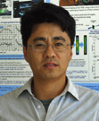



















LBNL ATAP home of Accelerator Modeling Program
Jean-Luc Vay (lead)
Ji
Qiang (deputy)
Chad
Mitchell
Greg
Penn
Rob
Ryne
Lucky
Cortez
Carlo
Benedetti
Stepan
Bulanov
Hiroshi
Nishimura
Changchun
Sun
Scientific Staff
ATAP Collab.
Admin. Support
BELLA
BELLA
ALS
ALS
Kilean Hwang
Rémi
Lehe
Olga Shapoval
Jaehong Park
Maxence
Thevenet
Henri
Vincenti
William
Fawley
Alex
Friedman
Miguel
Furman
Brendan
Godfrey
Postdocs
CEA
(M. Curie Fellow)
Affiliates
LBNL/SLAC
LLNL
LBNL
U. Maryland
Guillaume Blaclard
Patrick
Lee
Zhicong
Liu
Chuwen Luo
Yue
Tao
David
Grote
Axel
Huebl
Manuel
Kirchen
Steven
Lund
Students
U. Paris-Saclay
LLNL
U. Dresden
U. Hamburg
Michigan State U.
Notes:
Berkeley has a lot to offer with a unique collection of tools

Slide 3

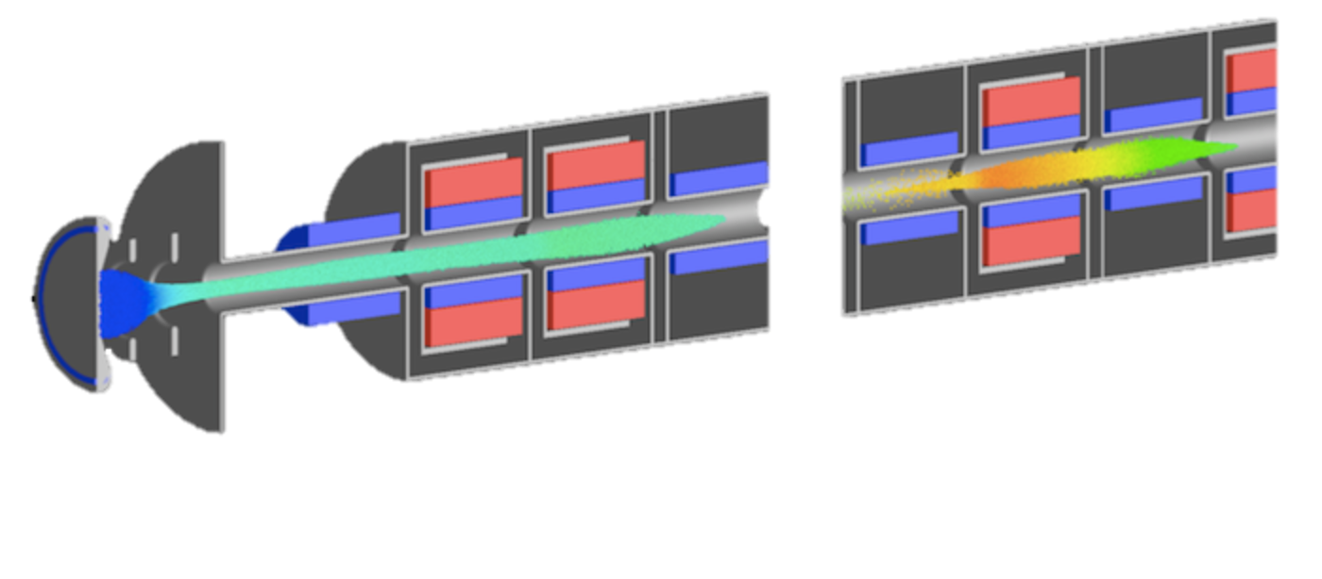
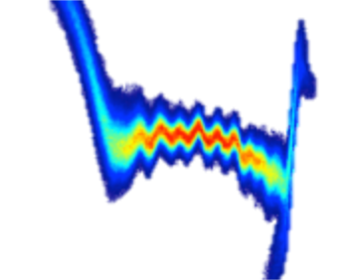

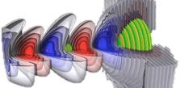

Maintains the “BLAST” simulation toolset for conventional & advanced concepts accelerators
State-of-the-art codes:
BEAMBEAM3D*, WARP, POSINST, IMPACT, FBPIC, INF&RNO, AMBER.
Wide set of physics & components:
beams, plasmas, lasers, structures, ...
linacs, rings, injectors, traps, …
Supporting many accelerators:
across U.S. DOE (HEP, BES, NP, FES, DNN) and beyond (CERN, DESY, KEK, …).
At the forefront of computing:
novel algorithms: boosted frame, etc.
part of SciDAC, NESAP & DOE Exascale.
blast.lbl.gov
*presentation Ji Qiang right after this talk.

Slide 4
Electron Cloud Effects for EIC*
Panel priority: high.
Electron-cloud effects will have quite different characteristics for each of the proposed options.
The JLEIC ion beam may trap and accumulate electrons liberated by gas ionization, possibly leading to a classical electron-proton two-stream instability that might be counteracted by feedback.
The BNL rings will create an electron cloud by beam-induced multipacting. Copper coating might mitigate this, but it is not obvious that copper will provide a lower secondary emission yield than stainless steel.
*Report of the Community Review of EIC Accelerator R&D for the Office of Nuclear Physics - Feb. 2017

Slide 5
The tools that we have at LBNL to study e-cloud effects
Posinst: build-up of e-cloud.
Warp: effect on beam dynamics.
Warp+Posinst: build-up & beam dynamics self-consistently.

Slide 6
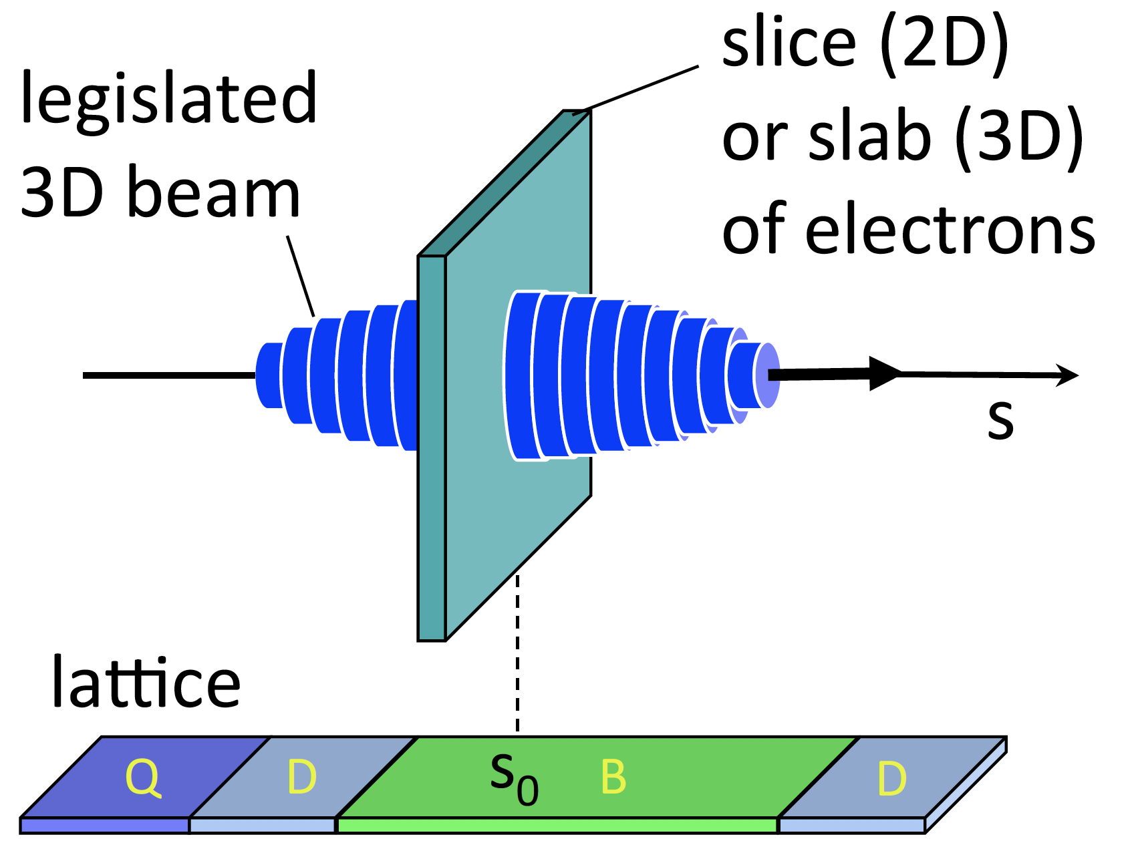
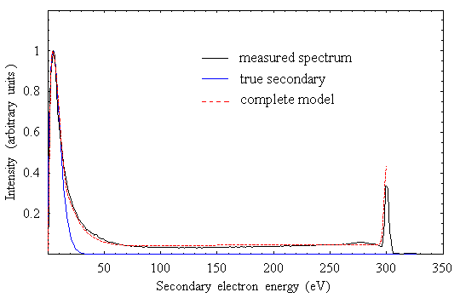
POSINST is a code for e- cloud build studies
  2-D electrostatic PIC.
  Advanced phenomenological SEY model with Monte Carlo generation of electrons with realistic energy-angle emission spectrum*.
  POSINST has been used to study electron cloud buildup in many accelerators around the world.
true sec.
    *SEY model is a self-contained module. It has been imported into other codes for study of electron clouds and spacecraft charging.
back-scattered
elastic
Monte-Carlo generation of electrons with energy and angular dependence.
re-diffused

Slide 7
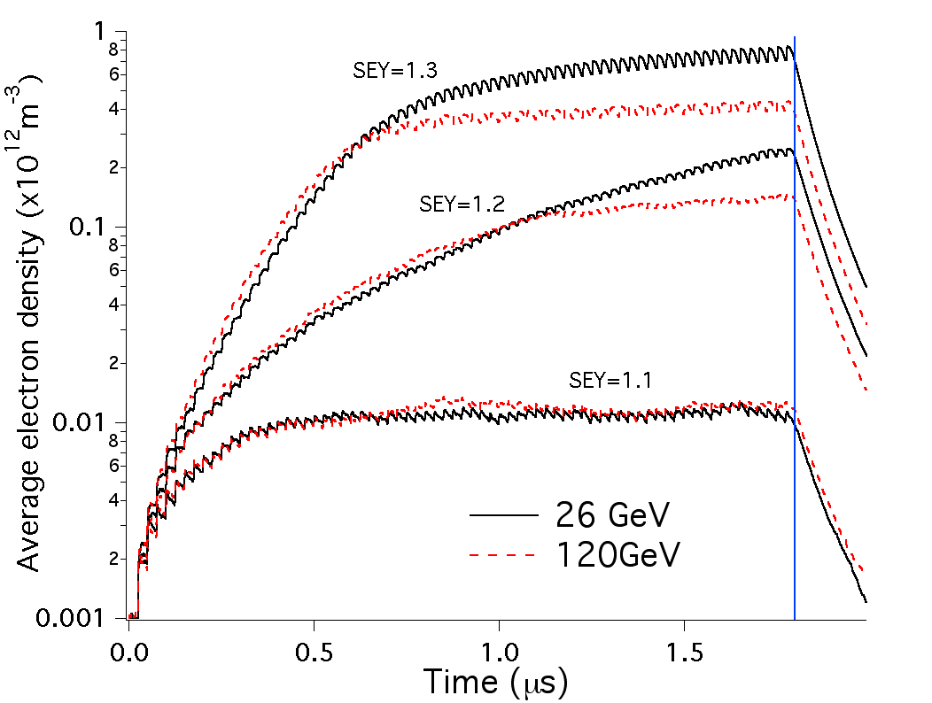
Example of simulation of e- buildup in CERN SPS
E-cloud distribution can be fed to a beam dynamics code.

Slide 8
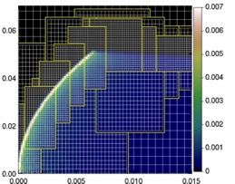
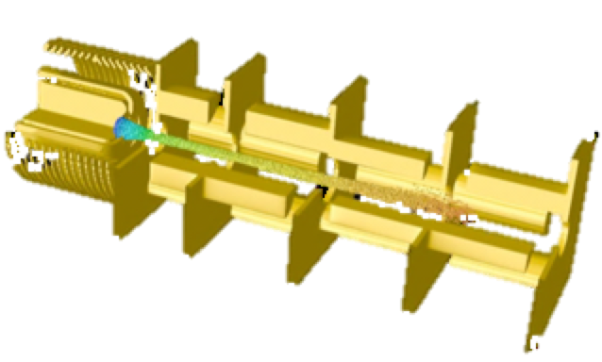
Warp: A Particle-In-Cell framework for accelerator modeling
Geometry: 3-D (x,y,z) axisym. (r,z) + FFT(θ) 2-D (x,z) 2-D (x,y)
Reference frame: lab moving-window Lorentz boosted
        z z-vt γ(z-vt); γ(t-vz/c²)
Field solvers
electrostatic/magnetostatic - FFT, multigrid; AMR; implicit; cut-cell boundaries
Fully electromagnetic – Yee/nodal mesh, arbitrary order, spectral, PML, MR
Accelerator lattice: general; non-paraxial; can read MAD files
  solenoids, dipoles, quads, sextupoles, linear maps, arbitrary fields, acceleration.
Particle emission & collisions
  particle emission: space charge limited, thermionic, hybrid, arbitrary,
  secondary e- emission (Posinst), ion-impact electron emission (Txphysics) & gas emission,
  Monte Carlo collisions: ionization, capture, charge exchange.
x
y
z
Versatile conductor generator accommodates complicated structures
Automatic meshing around ion beam source emitter
R (m)
Z (m)

Slide 9
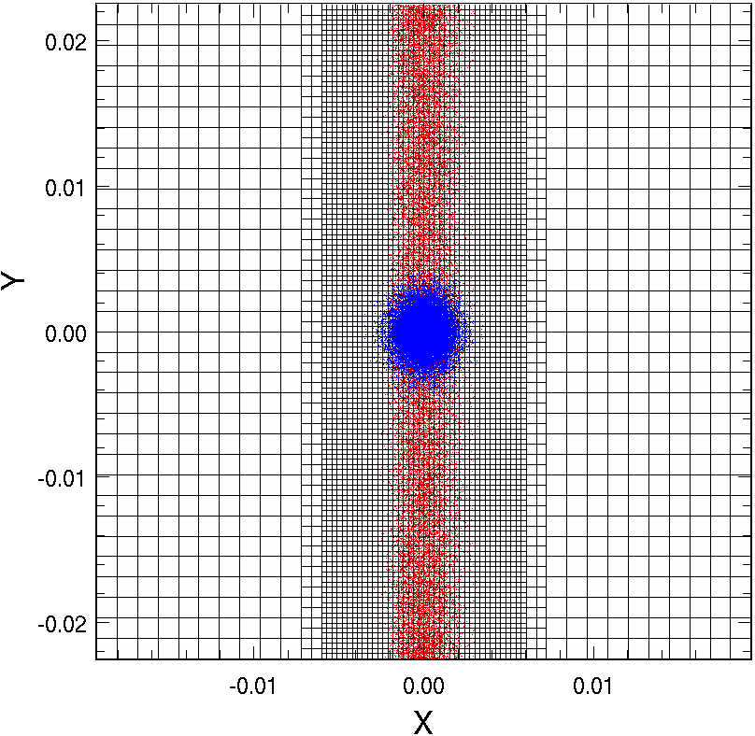
Warp quasi-static mode used for e-cloud studies
2-D slab of electrons
3-D beam
s
Warp quasi-static model similar to HEADTAIL, PEHTS, QuickPIC, CMAD.
Warp’s mesh refinement & parallelism provide efficiency
parallellized using pipelining
Beam ions
Electrons
proc 1 2 N/2 N/2+1 N-1 N
Station n n+1 n+N/2-1 n-N/2 n+N-2 n+N-1

Slide 10
Warp-POSINST integrated to model build-up & effect on beam
Warp quasistatic model similar to HEADTAIL, PEHTS, QuickPIC, CMAD.
2-D slab of electrons
parallellized using pipelining
proc 1 2 N/2 N/2+1 N-1 N
Station n n+1 n+N/2-1 n-N/2 n+N-2 n+N-1
3-D beam
s
Posinst provides advanced secondary electrons model
Warp’s mesh refinement & parallelism provide efficiency
true sec.
Beam ions
Electrons
back-scattered
elastic
Monte-Carlo generation of electrons with energy and angular dependence.
re-diffused
Spurious image charges from irregular meshing controlled via guard cells

Slide 11
Example of multi-bunch e-cloud simulation of SPS*
  Code WARP+POSINST: 3D, parallel, multibunch, with feedback
  SPS at E=26 GeV (injection)
  3 batches of 72 bunches each (t_{b}=25 ns, t_{batch}=200 ns)
  includes SEY model from POSINST (δ_{max}=1.18)
  Bunch-to-bunch feedback (g=0.1) in horizontal plane (no V feedback)
  Ecloud was reinitialized to 0 at the beginning of every turn
    Seed mechanism: ionization of residual gas
  But proton density was allowed to evolve continuously for all turns
  Full run was for 1000 turns
  9,600 CPUs on Franklin supercomputer (NERSC) in 2011-2012
  *J.-L. Vay, IPAC12-WEPPP076
11

Slide 12
Simulation parameters for SPS at injection, t=25 ns
  Bunch
    energy W=26. GeV
    population N_{p}=1.1×10¹¹
    RMS length σ_{z}=0.23 m (Gaussian profile)
    momentum spread δp/p=2×10⁻³
    transverse normalized emittance ε_{x}= ε_{y}=2.8 mm.mrad
    longitudinal normalized emittance ε_{z}=0.3 eV.s
  ⊥ : continuous focusing
    beta functions β_{x,y}= 33.85, 71.87
    betatron tunes ν_{x,y}= 26.13, 26.185
    chrom. Q_{x,y}=0.,0.
  // : continuous focusing
    momentum compaction factor α=1.92×10⁻³
    cavity voltage V = 2 MV
    cavity harmonic number h = 4620.
  assumed 100% dipole
  10 interaction stations/turns
12

Slide 13
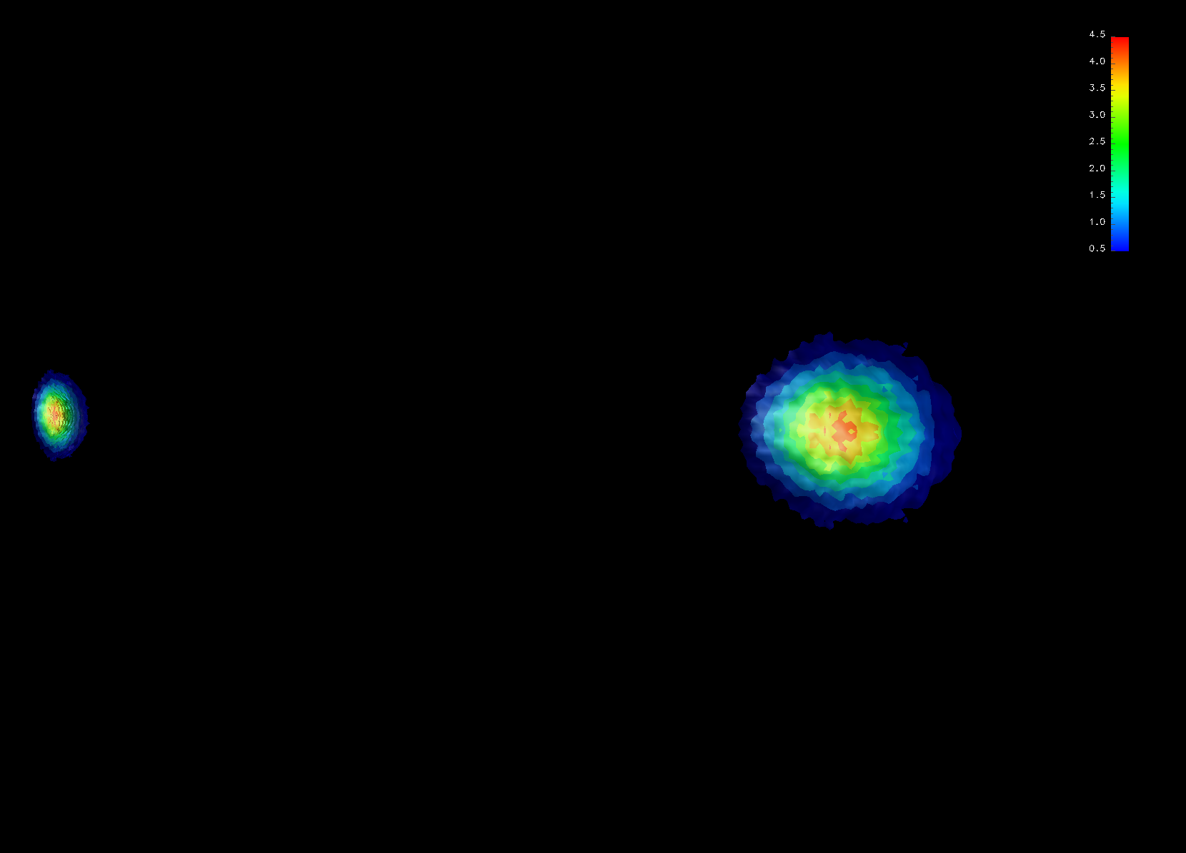
Simulation gives insight in e-cloud/bunch interactions
3D view
chamber wall
Bunch 35
Bunch 36
Beam direction
1. Electrons from previous bunch or injected here from Posinst dump
Beam density (x10¹⁵) at t=0 (bunches 35-36 = buckets 176-181)

Slide 14
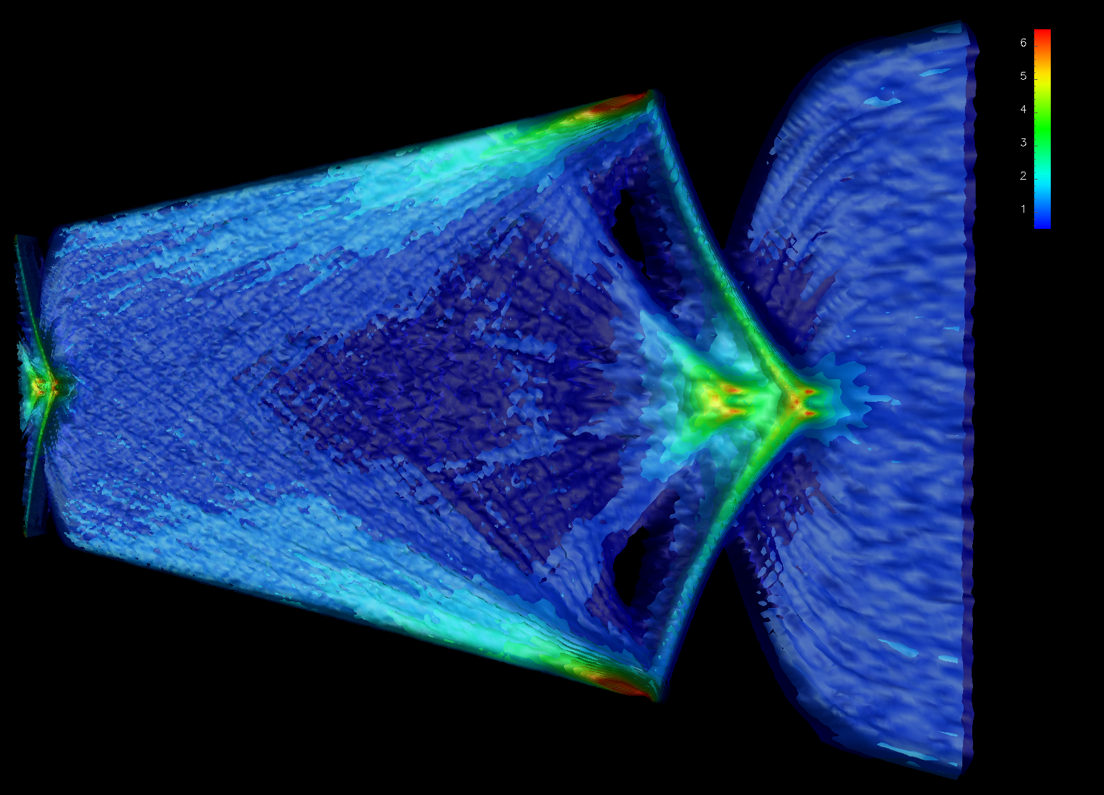
Simulation gives insight in e-cloud/bunch interactions
3D view
chamber wall
2. Electrons are focused by bunch
Electron density (x10¹²m⁻³) at turn 1 (bunches 35-36 = buckets 176-181)
14

Slide 15
Simulation gives insight in e-cloud/bunch interactions
3D view
chamber wall
3. High-density spikes eject electron jets
Electron density (x10¹²m⁻³) at turn 1 (bunches 35-36 = buckets 176-181)
15

Slide 16
Simulation gives insight in e-cloud/bunch interactions
3D view
4. Secondary emission from impact of e- jets on walls
chamber wall
Electron density (x10¹²m⁻³) at turn 1 (bunches 35-36 = buckets 176-181)
16

Slide 17
Simulation gives insight in e-cloud/bunch interactions
3D view
chamber wall
5. Electrons fill the chamber
Electron density (x10¹²m⁻³) at turn 1 (bunches 35-36 = buckets 176-181)
17

Slide 18
Simulation gives insight in e-cloud/bunch interactions
3D view
chamber wall
6. Electrons interact with next bunch
Electron density (x10¹²m⁻³) at turn 1 (bunches 35-36 = buckets 176-181)
18

Slide 19
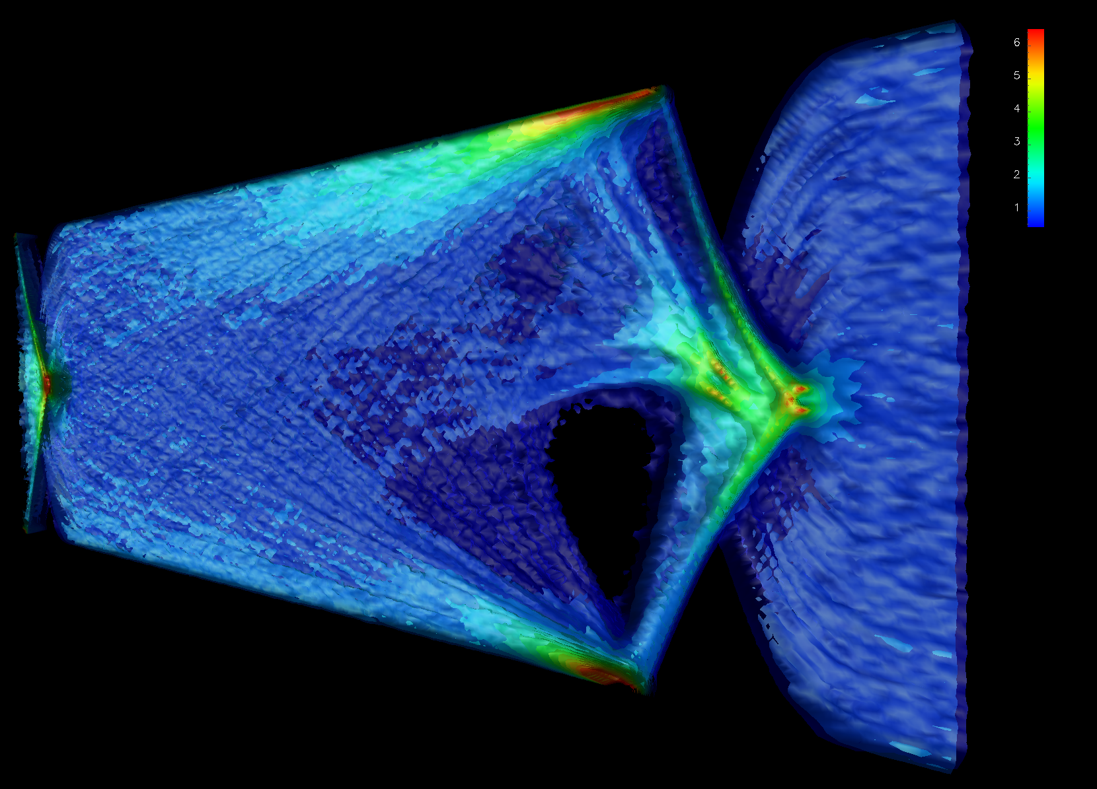
Simulation gives insight in e-cloud/bunch interactions
3D view
Electron density (x10¹²m⁻³) at turn 500 (bunches 35-36 = buckets 176-181)
19

Slide 20
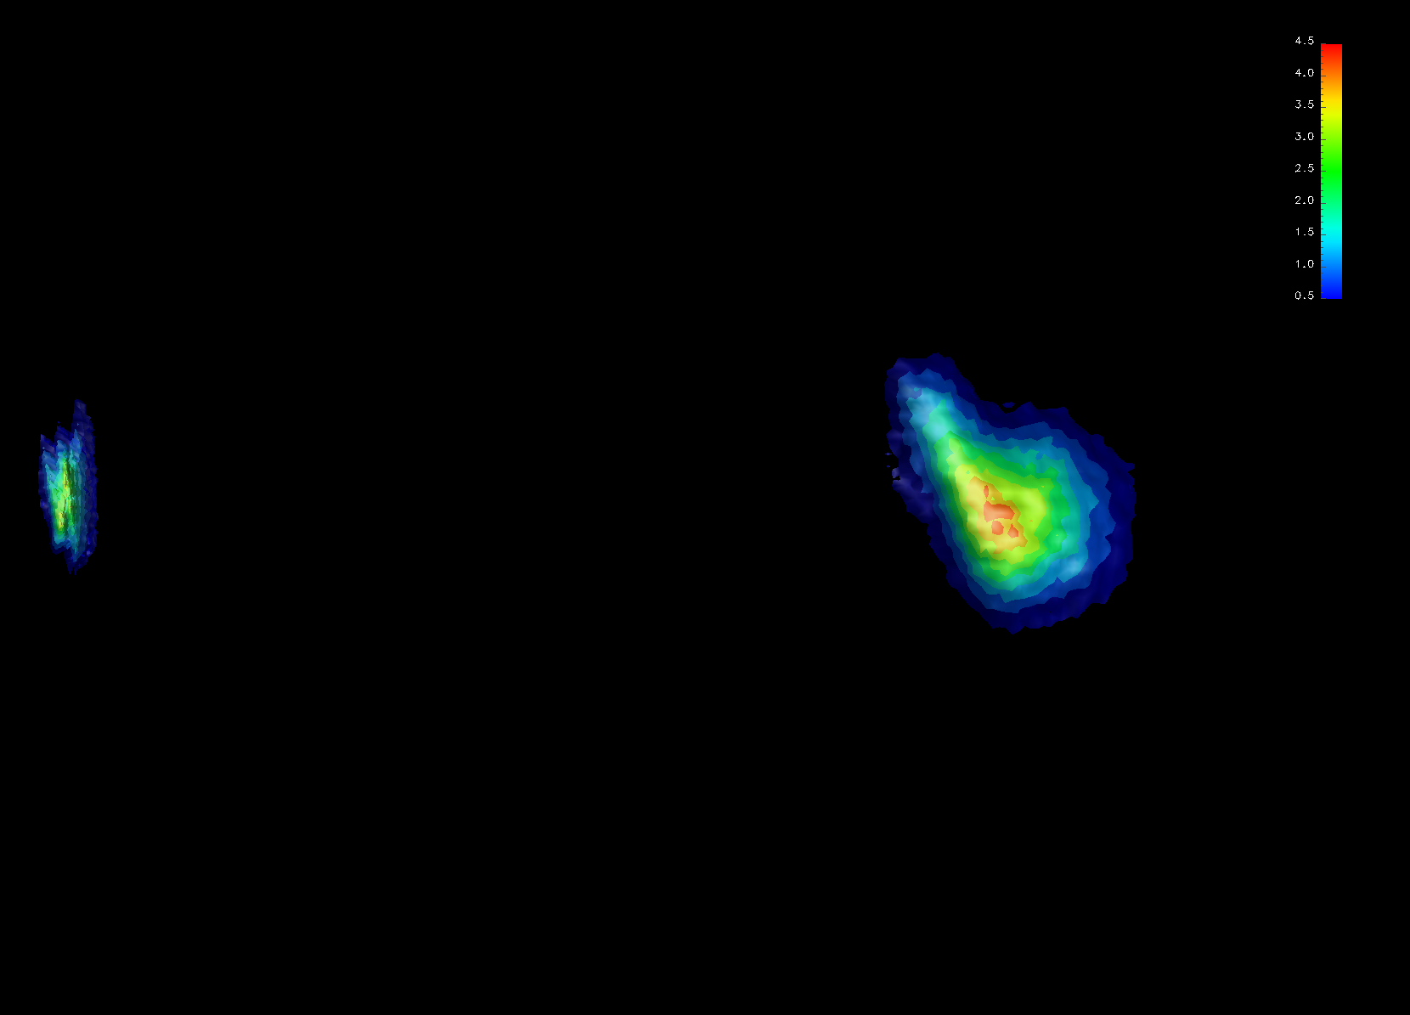
Simulation gives insight in e-cloud/bunch interactions
3D view
chamber wall
Bunch 35
Bunch 36
Beam density (x10¹⁵m⁻³) at turn 500 (bunches 35-36 = buckets 176-181)
20

Slide 21
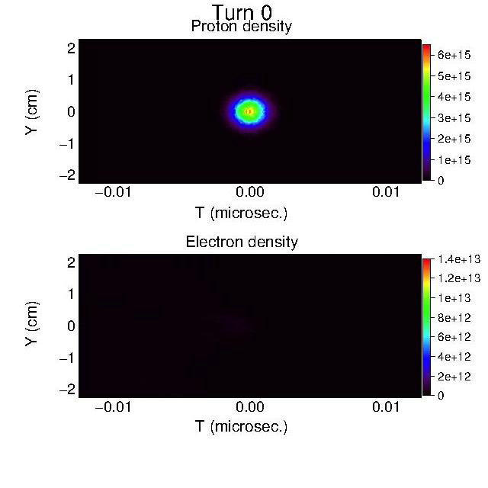

Self-consistent evolution of e-cloud buildup and effects for 3 consecutive beams of 72 bunches in SPS
Bunch by bunch evolution at fixed station
Turn 1
Proton density
Turn 600
Proton density
Electron density
Electron density

Slide 22

Electron density 50-100% larger with Warp+Posinst than with Posinst only
Average electron cloud density history at fixed station
Substantial density rise in
tails of batches between turns 0 and 800.
Conclusion: n_{e} is ~50-100% larger at end of batch than if
computed via a build-up code with “static” beam
J.-L. Vay, et al, IPAC12 Proc., (2012) TUEPPB006

Slide 23
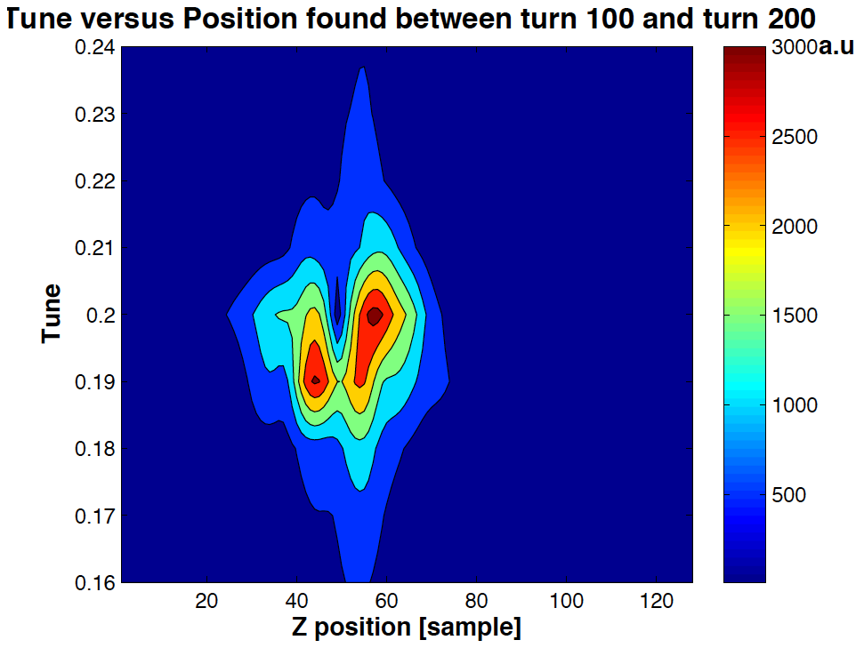
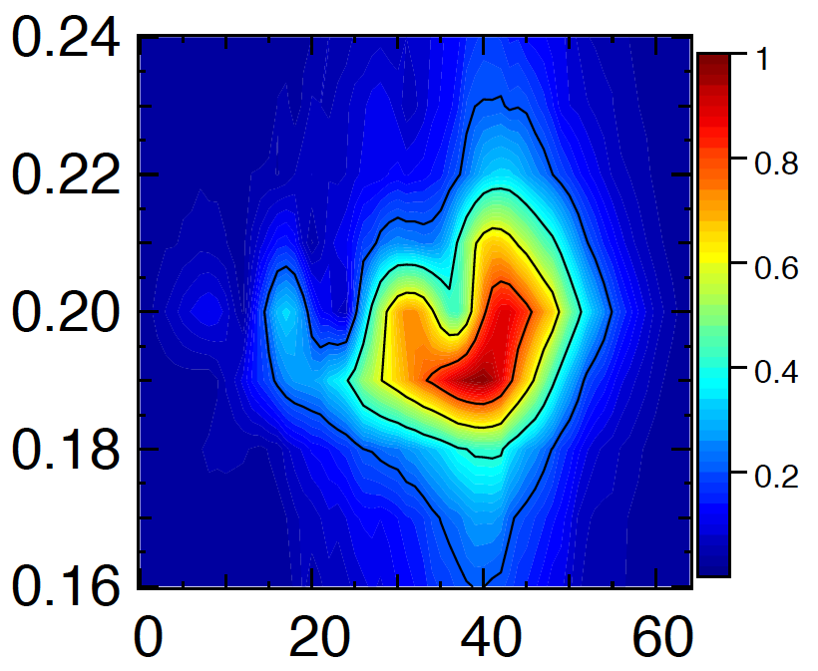
Comparison with experimental measurements
-- collaboration with SLAC/CERN
Experiment¹
Warp-Posinst²
Bunch 119, Turn 100-200
Bunch 29, Turn 100-200
Fractional tune
Fractional tune
head
tail
head
tail
Nominal fractional tune=0.185
Bunch slice
Bunch slice
¹J. Fox, et al, IPAC10 Proc., p. 2806 (2011)
²J.-L. Vay, et al, Ecloud10 Proc., (2010)
Good qualitative agreement: separation between core and tail with similar tune shift.
Warp also applied to study of feedback control system (R. Secondo in collaboration with SLAC)

Slide 24
Summary
Posinst can simulate build-up of e-cloud
Warp can simulate effect on beam dynamics
Warp+Posinst can simulate both self-consistently
Warp open source at warp.lbl.gov
Posinst available upon request
  Send email to MAFurman@lbl.gov or JLVay@lbl.gov.
Could also use IMPACT & Marylie-IMPACT in combination, for more detailed tracking in lattice.

