Slide 1
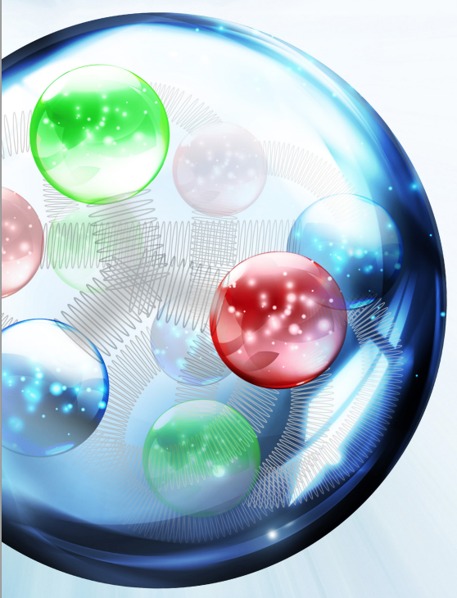
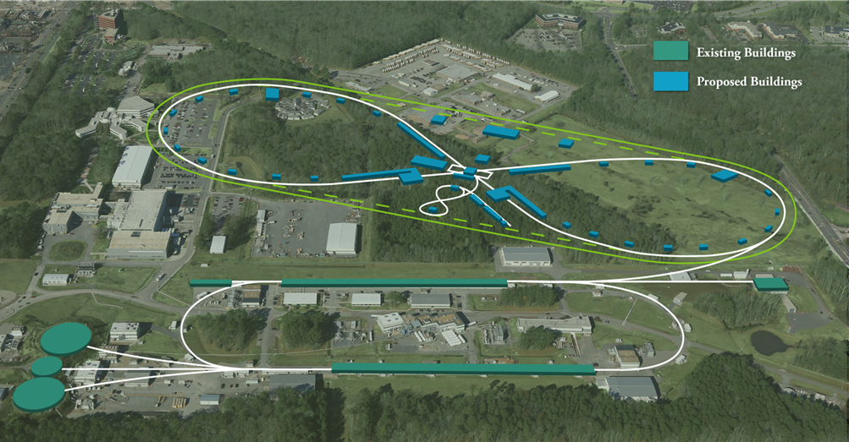
Electron Cooling R&D
Geoffrey Krafft
NP Community Panel Review of the EIC
Rockville, November 29 – December 2 2016

Slide 2
JLEIC Electron Cooling CTEs
R&D Item | Priority | Initial TRL | Final TRL | Performance Period | Burdened Cost
ECL1 – Electron Cooling Simulations | First | Low | High | 2017-2019 | 488k$
ECL2 – Bunched Beam Cooling Experiment at IMP | First | Med | High | 2017-2018 | 248k$
ECL3 – ERL Cooler Design for Single and Multi-turn Operations | First | Low | Med | 2017-2018 | 1710k$
ECL4 – Magnetized Source for the e-cooler 32mA | First | Low | Med | 2016-2018 | 0
ECL5 – Fast Kicker Prototype for Multi-turn Cooler | First | Med | Med | 2017-2018 | 911k$
ECL6 – Fast Kicker Test with Beam | Second | Med | High | 2019-2019 | 473k$
ECL7 – Integrated Test of Multi-turn Circulator Ring | Second | Med | High | 2019-2021 | 19899k$
ECL8 – Magnetized Source for the e-cooler 200mA | Second | Med | High | 2019-2021 | 4026k$

Slide 3
Talk Organization
JLEIC High Energy Collider Cooler
Development Plan
CTEs
ECL2: Bunched Beam Cooling Experiment at IMP
ECL1: Electron Cooling Simulation
ECL4: Magnetized Source for e-cooler at 32mA (LDRD)
ECL8: Magnetized Source for e-cooler at 200mA
ECL5: Fast Kicker Prototype for Multi-turn Cooler
ECL6: Fast Kicker Test with Beam
ECL3: ELR Cooler Design for Single and Multi-turn Operation
ECL7: Integrated Test of Multi-turn ERL Cooler
Schedule and Funding Profile (w/wo ECL7)

Slide 4
JLEIC Collider Electron Cooler
top ring: Circulating Cooler Ring (CCR)
magnetization
flip
ion beam
cooling solenoid (B<0)
cooling solenoid (B>0)
ion beam
linac
beam dump
injector
fast extraction kicker
fast injection kicker
circulating bunches
injected bunches
exchange
septum
extracted bunches
dechirper
vertical
bend
to CCR
rechirper
vertical
bend
into ERL
bottom ring: ERL
Baseline Concept: Multi-turn Cooler

Slide 5
Cooler Development Focus Areas
Beam Cooling Simulations and Benchmarking
Key Issue: Short Electron Pulse Cooling Rate
ECL2: Bunch Beam Cooling Experiment at IMP
ECL1: Electron Cooling Simulation
Hardware Development
Key Issue: Test Needed Hardware Elements
ECL4: 32 mA Magnetized Source/ECL8: 200 mA Magnetized Source
ELC5 and ECL6: Fast Kicker and Kicker Beam Test
Circulator Cooling Ring
ECL3: ELR Cooler Design for Single and Multi-turn Operation
ECL7: Integrated Test of Multi-turn ERL Cooler at LERF (Former JLAB FEL)

Slide 6
Hardware Development Plan
Magnetized
Gun-ECL4
Baseline Cooler
Develop and Test
CCR- ECL7
Multi-Turn CCR
Cooler
Fast Kicker
ECL5 and ECL6
Backup Cooler
High Current Magnetized
Gun-ECL8
Single Turn ERL
Cooler

Slide 7
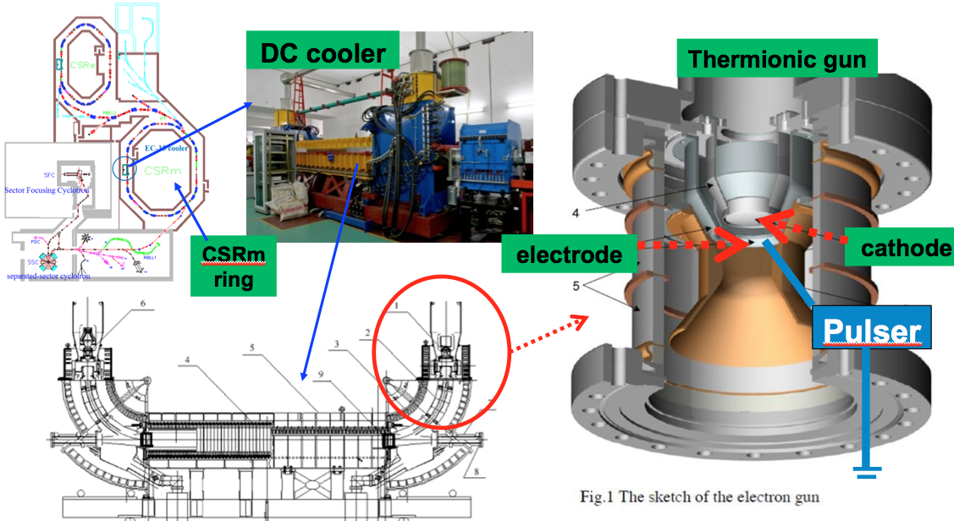
Cooling Simulations and Benchmarking
ECL2: Bunched Beam Cooling Experiment at IMP: the first non-DC electron cooling experiment cooling a ¹²C⁺⁶ ion beam at 7 MeV/u was performed in May 2016 at the IMP’s CSRm ring.
Initial: TRL4

Slide 8
ECL2: Bunched Beam Cooling Experiment
For the expected short electron pulses performing cooling in JLEIC cooler, the cooling rate will be reduced from that expected from a DC cooler (ions not in contact with cooling electrons at all times). Measurements with more control over the electron distribution, and with better diagnostics for the cooled ion beam will be supported through this proposal.
The total burdened cost of this project is 248k$, 195k$ for labor and 52k$ for non-labor items.
Final: TRL7 (Assuming Simulation Benchmark Success)

Slide 9
2nd Bunched Beam Cooling Experiment
Schedule: April 16 to 30, 2017, at Institute of Modern Physics (IMP) at China.
JLab Participating:
4 JLab staff will travel to IMP to participate this experiment, sharing the tasks of hardware improvement and software development, and data taking and analysis;
4 more staff have participated in studies and provided technical support
Experiment Scope: Bunched electron beam from 80 m to 3.4 m bunch length will cool a ¹²C⁺⁶ beam at 7 MeV/u and 30 MeV/u with a bunch length from coasting to 3.4 m.
Anticipated Improvements (over the 1st experiment):
Better beam diagnostics
More software support
Higher ion current (scheme to accumulate ions using DC electron cooling)
Planed Measurements
Momentum spread evolution over time, and longitudinal cooling rate
Transverse emittance evolution over time, and transverse cooling time
Cooling rate as a function of electron bunch length with fixed bunch current
Cooling rate as a function of electron bunch length with a fixed average current
Courtesy: Y. Zhang and H. Wang

Slide 10
ECL1: Electron Cooling Simulation
Electron cooling simulation is essential for a deep understanding of the electron cooling physics both qualitatively and quantitatively. Simulation study is also needed to optimize the parameters of the colliding ion beam and the cooling electron beam for better cooling. A new element to be understood is cooling with a pulsed (short duration) electron beam.
0.5 FTE for the first year, and 0.75 FTE for each year following. 2.0 FTE total. All the labor is Scientist labor. The total burdened cost of this project is 489k$, all of which is labor. This work previously supported by EIC R&D FOA.
Final: TRL7

Slide 11
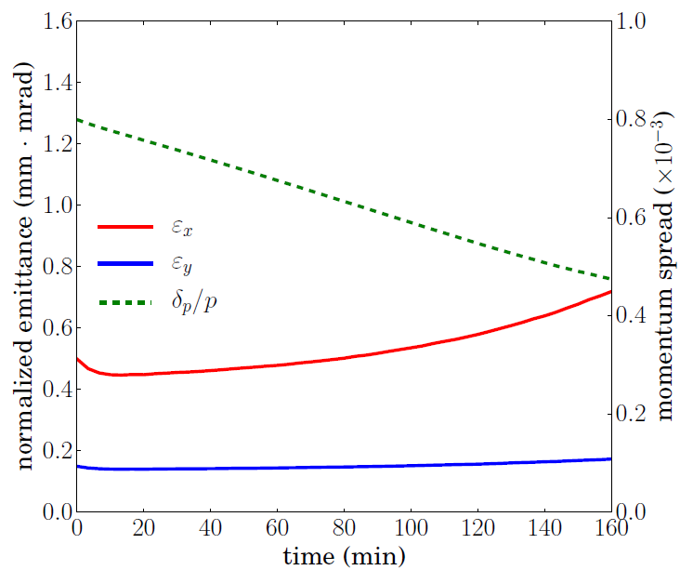
Simulation for the Strong Cooling Scheme
Strong cooling with electron current up to 3.2 nC/bunch
CM Energy 44.7 GeV
Cooling rate | 10⁻³ 1/s | -4.708 | -11.787 | -0.554
IBS rate | 10⁻³ 1/s | 12.894 | 0.669 | 0.992
Total rate | 10⁻³ 1/s | 8.186 | -11.118 | -0.455
Cooling rate and IBS rate with design parameters. The horizontal IBS rate is much higher than the cooling rate.
Revise the proton beam parameters to reduce IBS:
current reduced to 82%
emittance 0.5/0.1 $μ$m $→$ 0.5/0.15 $μ$m
bunch length 1.0 cm to 1.5 cm
transverse coupling 40%
Introduce dispersion at the cooler
We can maintain the emittance for about two hours, but the longitudinal overcooling will break the equilibrium..
Courtesy: H. Zhang

Slide 12
Turn-by-turn Tracking for Electron Cooling
Turn-by-turn tracking to check the accuracy of the RMS dynamic simulation
Cooler is modeled as a thin lens, which gives a momentum kick on each proton
Linear one-turn transfer map is used for proton transition.
Initially the protons have Gaussian distribution.
Calculate the relative errors of emittance in one second and 10 sends, and estimated the accumulated error for one hour.
Max Error of Emit. For One Step Size
 | N=10,000 | N=100,000
Δt=1s | 1.54×10⁻⁵ | 2.42×10⁻⁶
Δt=10s | 3.06×10⁻⁴ | 1.04×10⁻⁴
The smaller the time step is, the smaller the error we get.
The larger the number of particles is, the smaller the error we get.
If we use step size no more than one second, and number of particles no less than 100,000, the simulation results should be accurate enough (at least for now).
Up to 10 seconds, the proton beam maintains the Gaussian distribution.
Max Accu. Error of Emit. in One Hour
 | N=10,000 | N=100,000
Δt=1s | 5.70% | 0.88%
Δt=10s | 11.65% | 3.81%
Courtesy: H. Zhang

Slide 13
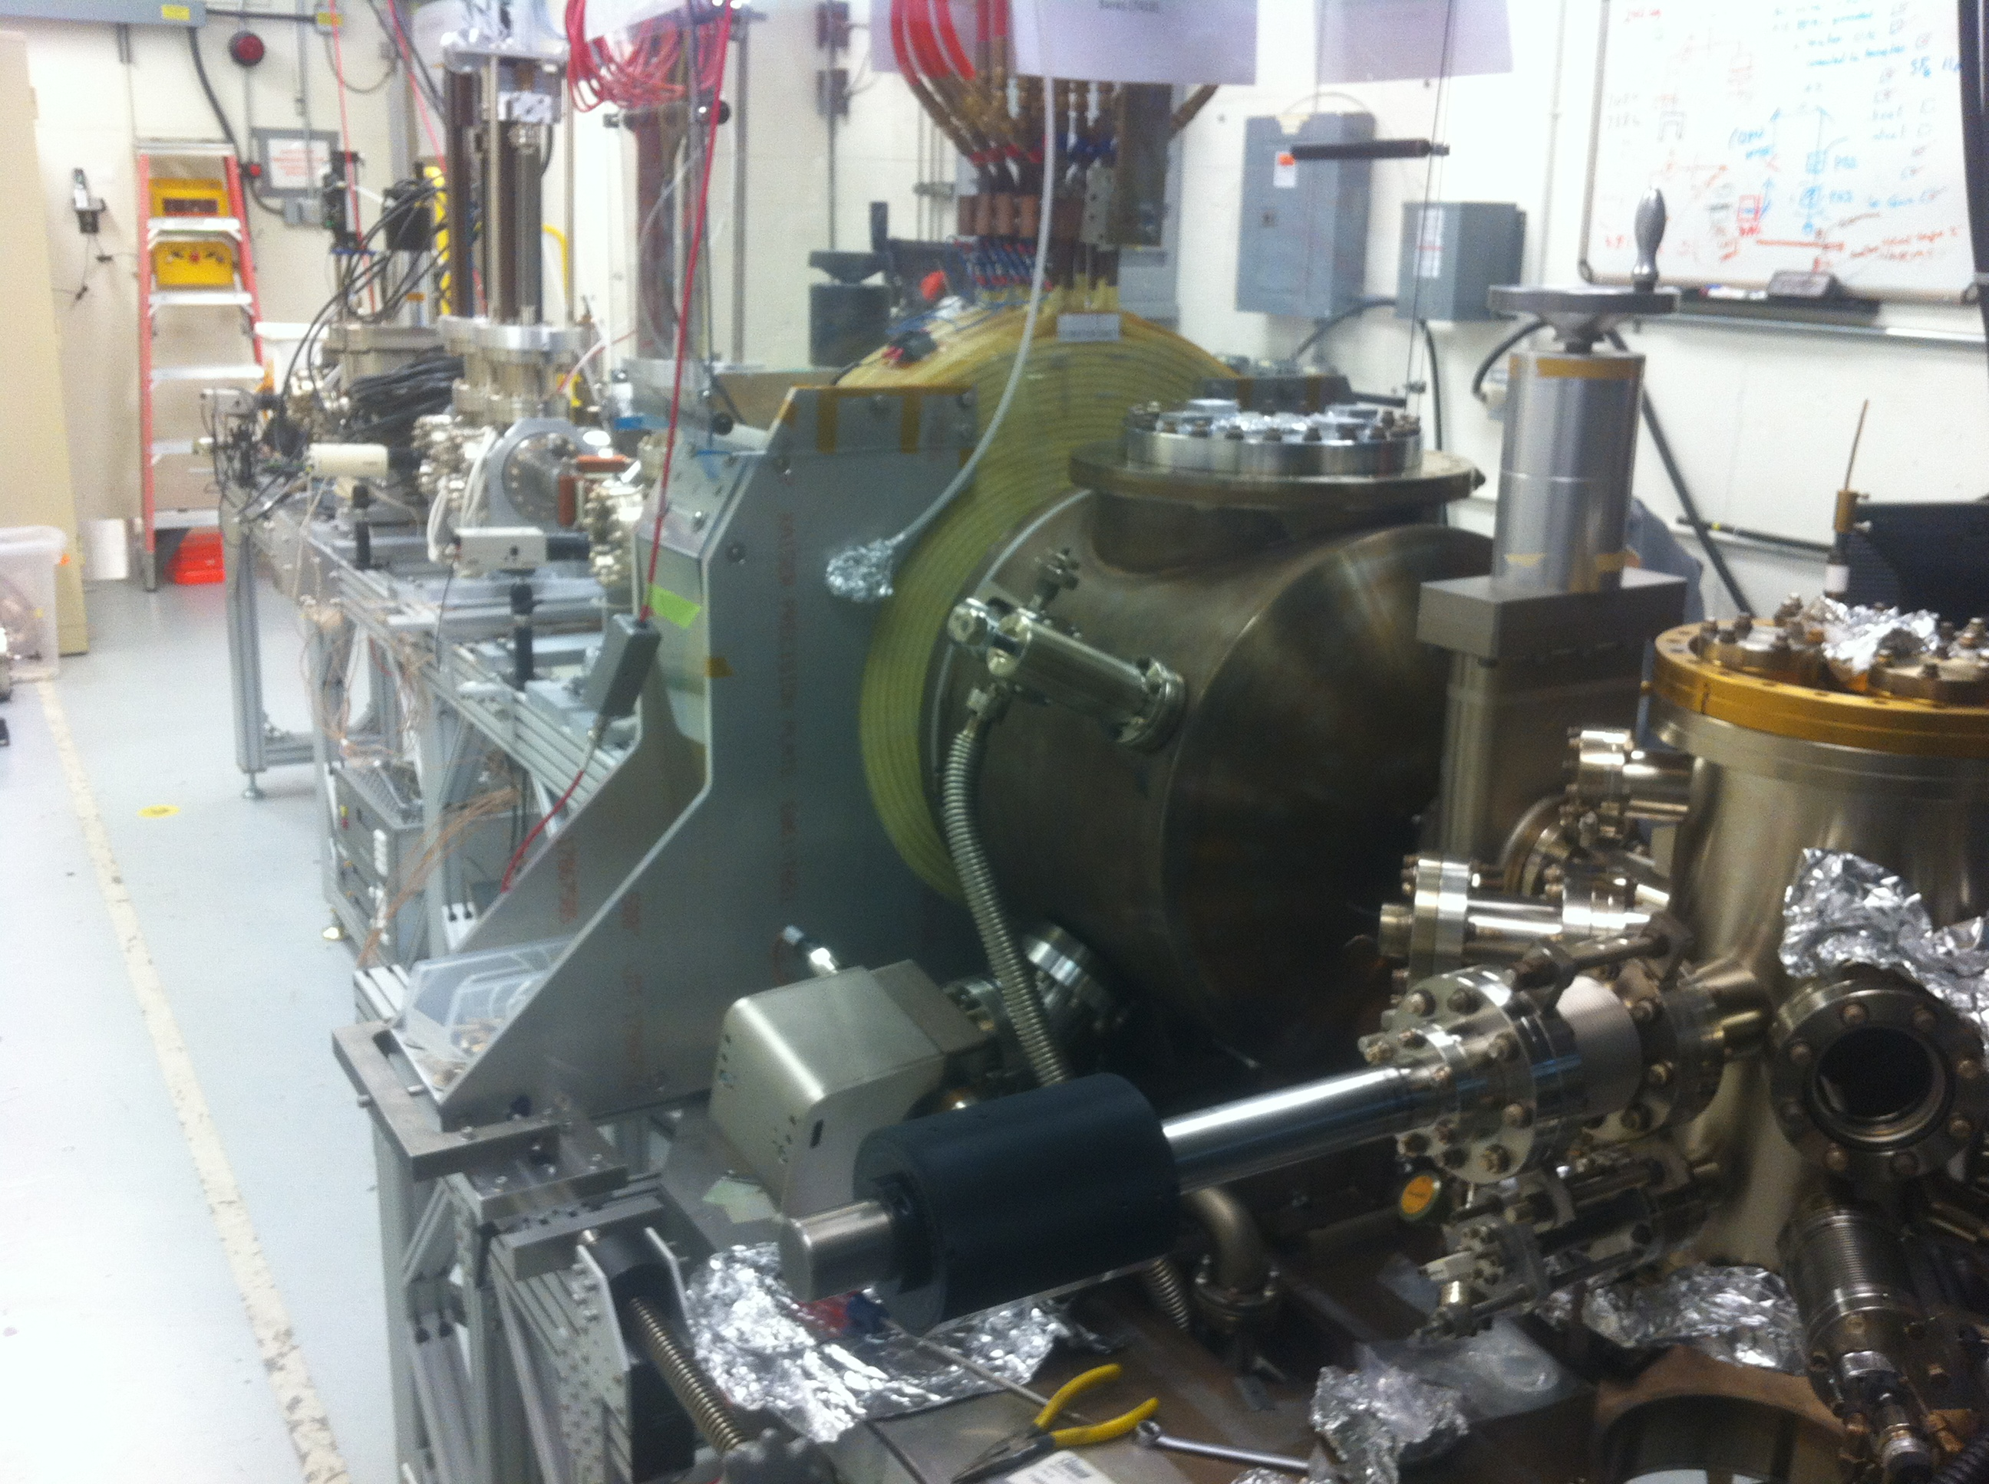
Hardware Development
ECL4: Magnetized Source for e-cooler at 32 mA: A high charge (420 pC) magnetized source is funded by the Jefferson Lab LDRD program that should operate up to 32 mA average current. This project concludes in 2018.
Final: TRL5
Magnetized beam parameters:
$a_{0}$ = 1 – 5 mm, B_{z} = 0 – 2 kG
Bunch charge: 1 – 500 pC
Frequency: 15 Hz – 476.3 MHz
Bunch length: 10 – 100 ps
Average beam currents up to 32 mA
Gun high voltage: 200 – 350 kV

Slide 14
ECL8: Magnetized Source at 200 mA
This R&D effort aims to demonstrate the full CW electron beam current (200 mA) required for a magnetized bunched electron beam weak cooler. This project required if the “backup” single turn ERL cooler is needed to build the JLEIC, or if the LDRD cooler cannot be upgraded to 75 mA.
The two main results to be demonstrated in this project are: (1) produce and control a suitable low emittance high average current electron beam and (2) demonstrate suitable photocathode lifetime in the magnetized source in case the photocathode gun is chosen. Work towards achieving 3.2 nC (strong cooling) performed.
Natural follow-on to ECL4 work.
Initial: TRL5

Slide 15
ECL8: Magnetized Source at 200 mA
Addressing concerns and solving problems associated with gun reliability will be a major focus of ECL4 and ECL8 preparing for the eventuality that a highly reliable magnetized electron source will be needed for any collider cooler.
8.5 FTE over the three years of the project, including 1 FTE of engineering. Over one half of the procurement budget is needed for a full current power supply. The total burdened cost of this project is 4,025k$, 2,077k$ for labor and 1,949k$ for non-labor items.
Final: TRL7

Slide 16
0 A
400 A
σ₁ = 3.7 mm
σ₂ = 4.9 mm
φ = 15°
$\left\langle L\right\rangle$ = 38 neV s
$eB_{z}a_{0}^{2}$ = 38 neV s

Slide 17
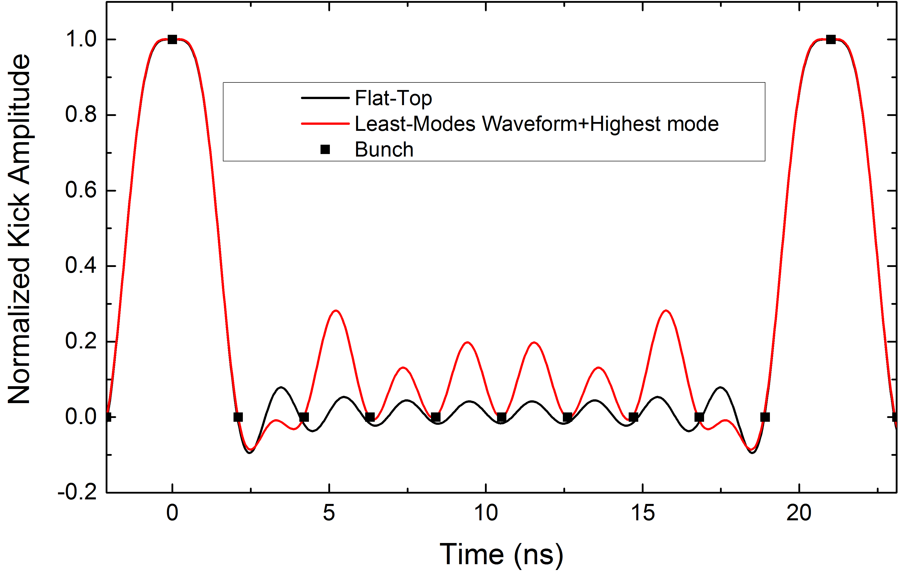
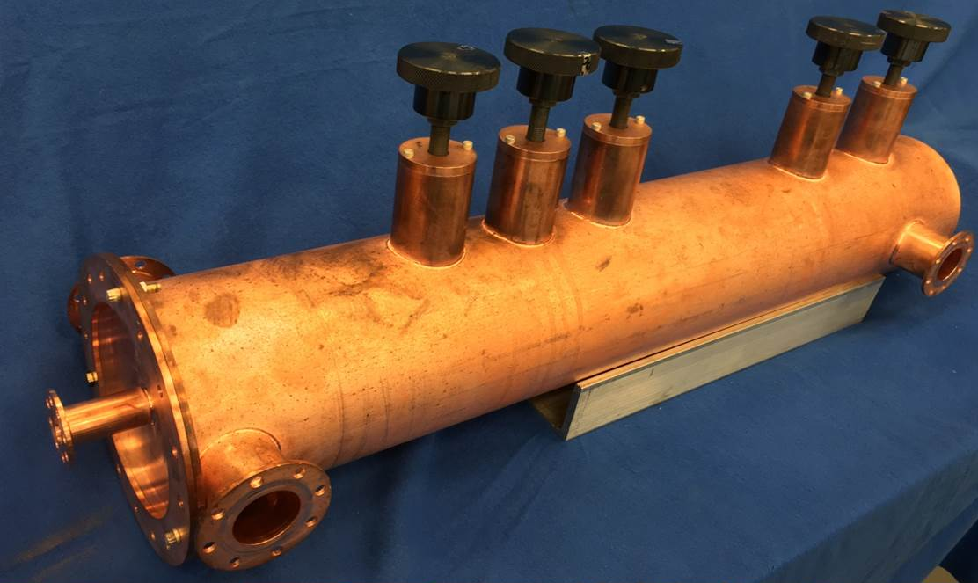
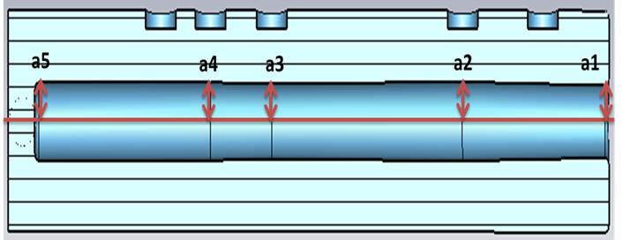
ECL5: Fast Kicker
ECL5: Fast Harmonic Beam Kicker. A first half-scale 476.3 MHz copper cavity has been prototyped, bench measured, and satisfies beam dynamic requirements for a Circular Cooler Ring design for the bunched electron cooler.
Initial: TRL4

Slide 18
ECL5: Fast Kicker
The main task in this proposal is to build a full size prototype which can be installed and tested with beam. The project will have a complete a set of three harmonic cavities with engineered vacuum attachments and beam line compatible with a high vacuum pump station and beam pipe gate valves.
This concept for the fast kicker and results of R&D work based on the half scale prototype have been published in two PRST-AB papers and documented in Ms. Y. Huang’s PhD thesis.
The total burdened cost of this project is 911k$, 611k$ for labor and 300k$ for non-labor items.
Final: TRL6

Slide 19
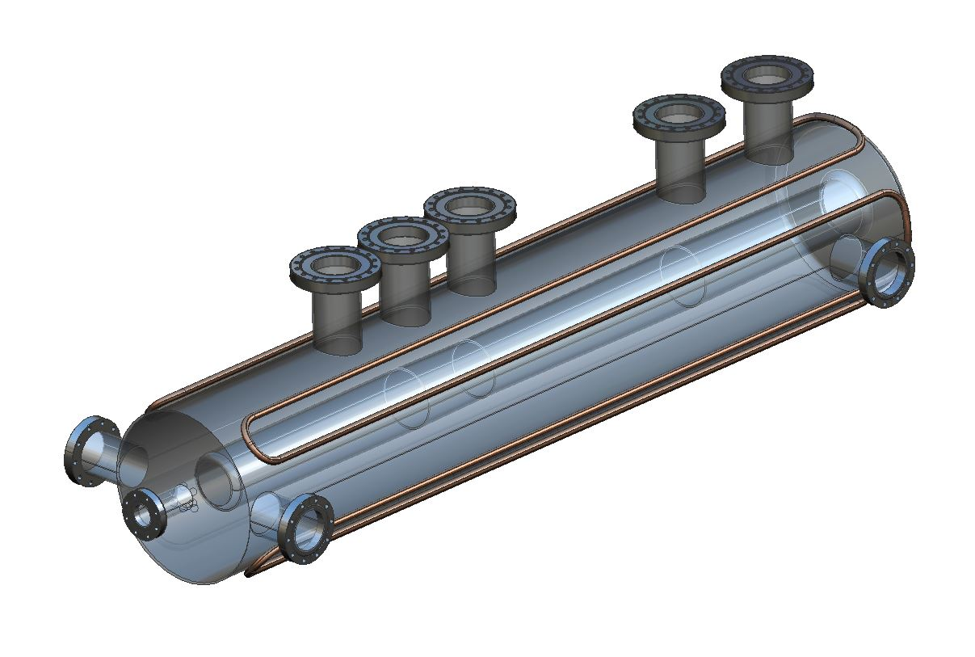
High-power Model
Vacuum model concept in progress
Can test in UITF, LERF or ???
Need to settle on a baseline kicking scheme (angle, frequency) to go to the next step.
Eagerly anticipating new postdoc position
Need to study multi-turn effects with magnetized beams
Courtesy: R. Rimmer and H. Wang

Slide 20
ECL6: Fast Kicker Test with Beam
This proposal covers a beam test of the kicker supported by ECL5 at Jefferson Lab’s Upgraded Injector Test Facility. Demonstrate fast beam kicking by altering the trajectory of one of every six bunches and measuring the deflected and un-deflected beam properties.
0.6 FTE for installation, operations, and scientific labor for performing tests. Procurements mainly related to beam-line modifications to install kicker and proper diagnostics. A new wide-band RF amplifier is needed to drive the kicker. The total burdened cost of this project is 472k$, 147k$ for labor and 326k$ for non-labor items.
Final: TRL7

Slide 21
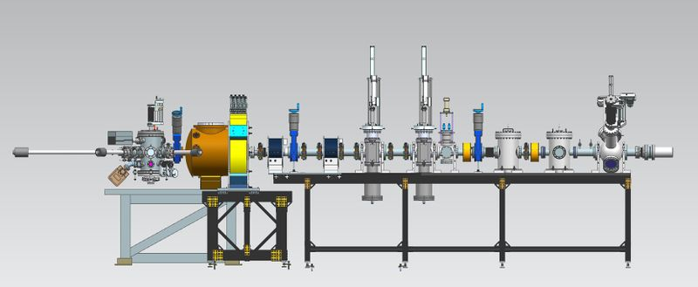
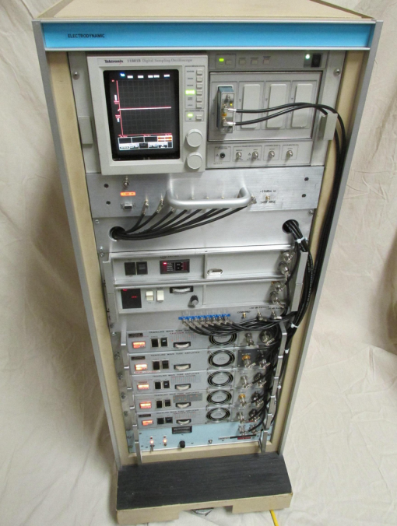
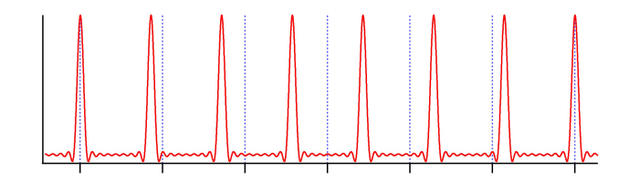
ECL6: Fast Kicker Test with Beam
Electrodynamic, Phase II sbir
Install here
Expected kicked beam on viewer, one out of six bunches
8-channel RF source

Slide 22
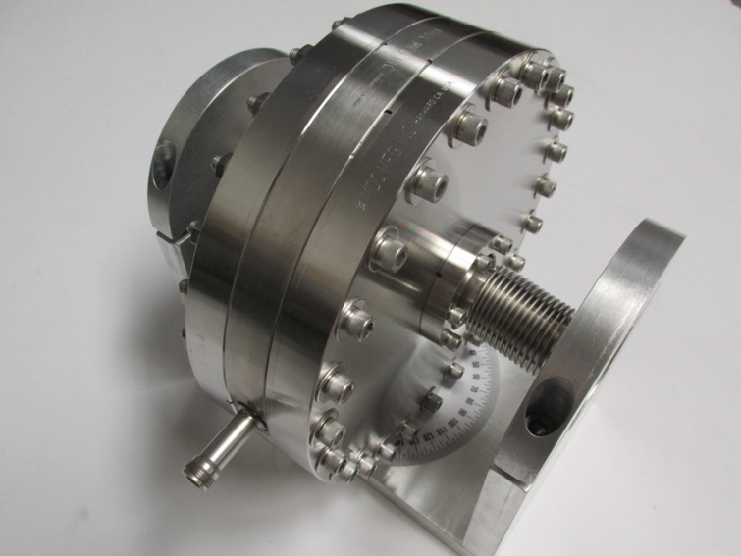
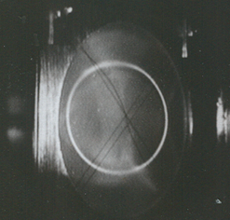
Harmonically resonant cavity as selective energy booster/kicker
Drive harmonically resonant cavity with RF to create powerful, short-lived E-field
Set laser rep rate to 1247.5 MHz, kicker driven at 1497 MHz plus harmonics
Use, Wien filter, chopper and/or 1D spectrometer to measure energy boost
Bunched beam on this circle,
No energy boost
On this circle,
energy boost
Harmonically resonant cavity
Courtesy: M. Poelker, B. Roberts, J. Grames

Slide 23
ECL3: Circulator Cooling Ring
ECL3: ERL Cooler Design for Single and Multi-turn Operation. This proposal offers developing software and methods, in the context of completing a full (front-to-end) cooler design for the JLEIC collider. Design elements including: (1) simulating magnetized beam formation and injection, (2) preserving the magnetized beam quality during acceleration, and (3) utilizing and simulating high repetition rate beam exchange between the driver ERL and the CCR will be investigated.
7.0 FTE Scientific and Engineering Design Labor. The total burdened cost of this project is 1,710k$, all of which is labor.
Final: TRL5

Slide 24
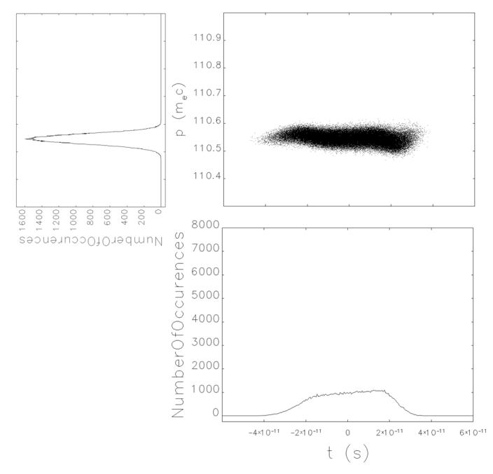
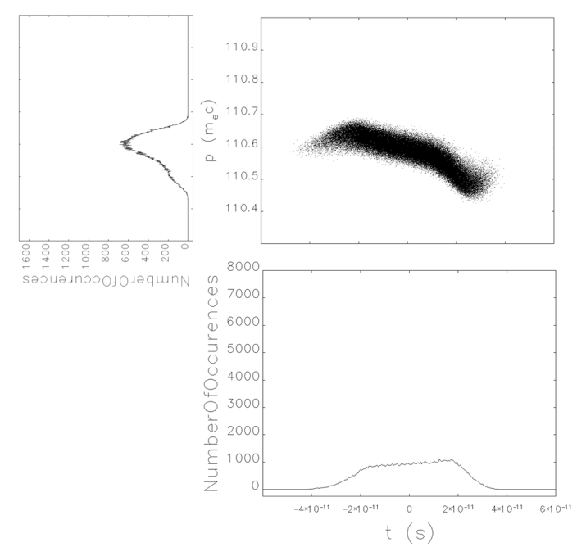
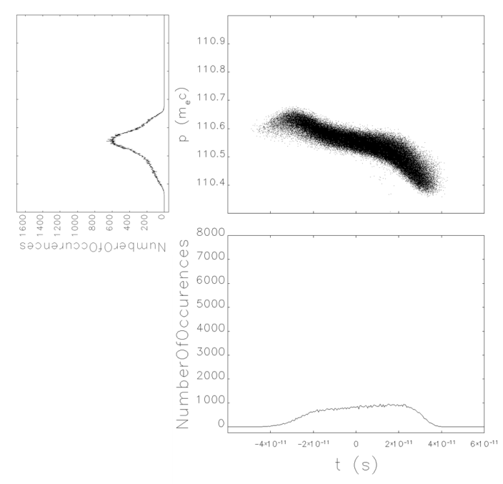
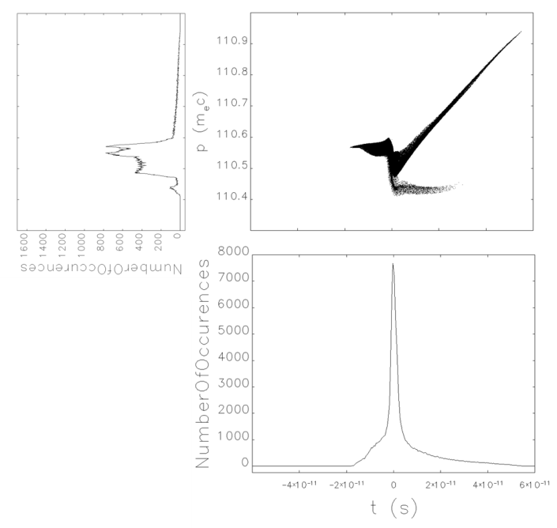
Longitudinal Behavior
420 pC ideal
420 pC ideal w/CSR
420 pC S2E
2 nC ideal
Courtesy: S. Benson and D. Douglas

Slide 25
Where Are We and Where Do We Go?
Have to partition the cooling to match IBS.
Can use globally symmetric transport.
Need to simulate CCR with CSR shielding
Need to add space charge to CCR simulations
Need injector design (subharmonic)
Might want to use emittance exchange for either the ion ring or the cooler linac.
Need to look at ion trapping and HOM damping in linac.
Have to study BBU
Need to look at Injection/extraction details (e.g. energy slew, apeture)
Courtesy: S. Benson and D. Douglas

Slide 26
ECL7: Integrated Circulator Ring Test
This proposed R&D covers a full beam test of the CCR concept in a ring constructed adjacent to the Jefferson Lab LERF.
R&D funding is required to construct the CCR, the transfer lines into and out of the ERL, install and integrate the magnetized source and fast beam kickers, and perform beam tests of the complete systems.

Slide 27
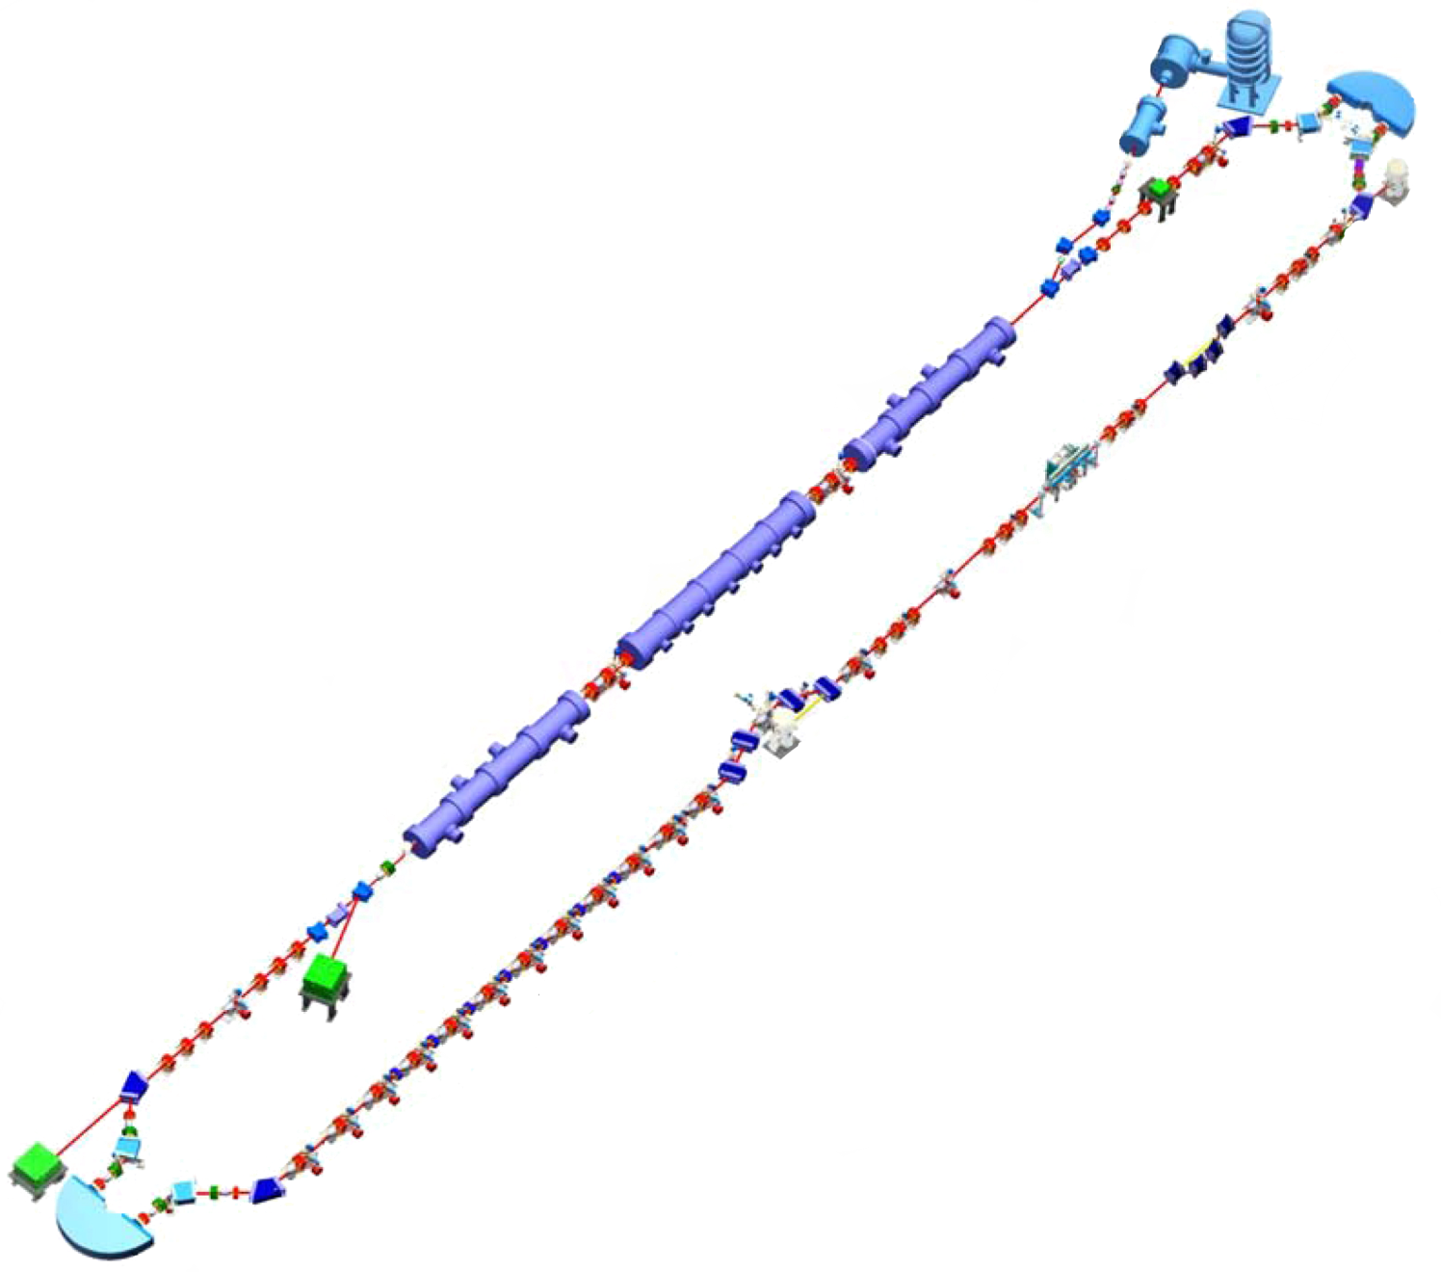
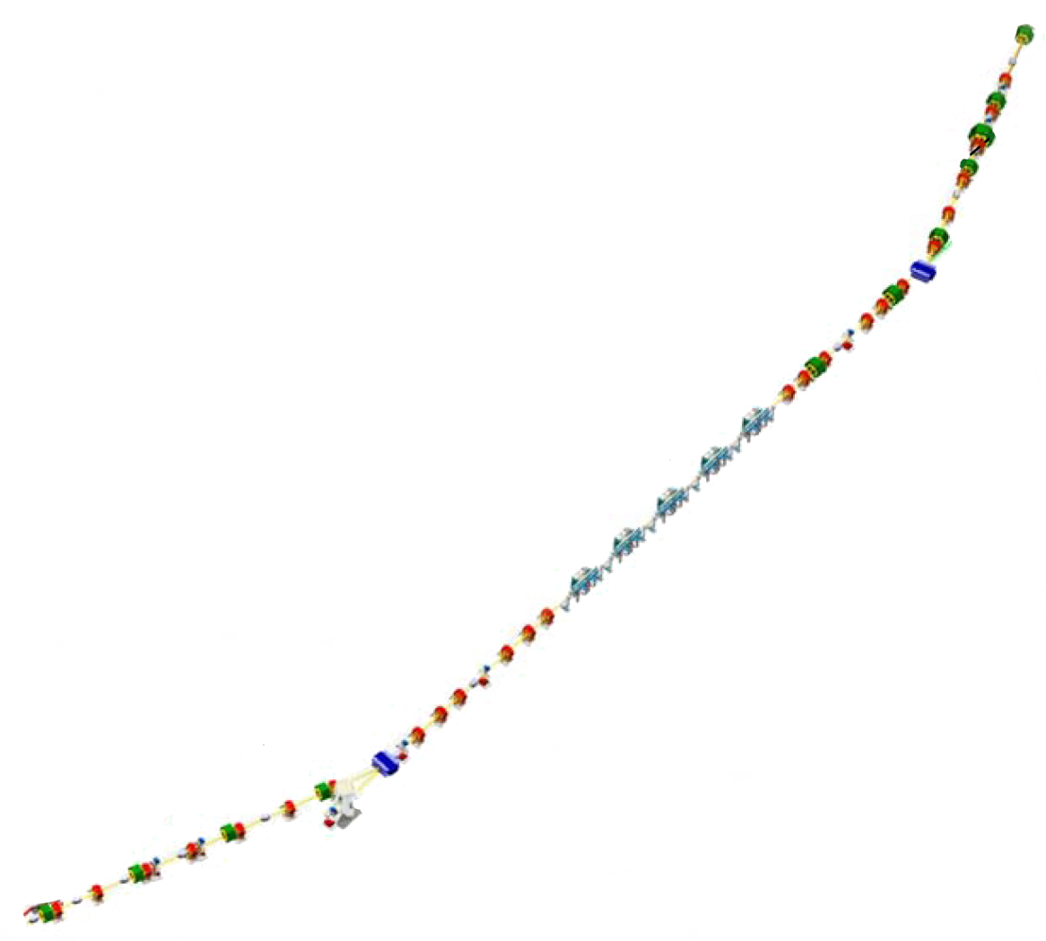
ECL7: CCR Ring Driven by LERF
Injector
ERL Arc
CCR Test Ring
IR Wiggler
SRF Linac
Bunching Chicane
Beam Exchange Test Insertion
Dump
Exchange Insertion Schematic
ERL Arc

Slide 28
ECL7: CCR Ring Driven by LERF
Significant First Demonstrations:
Acceleration and transport of a magnetized beam through an ERL.
Successful launch and stacking of bunches in the cooler ring.
Preserving beam brightness over multiple turns in a cooler ring.
In our present judgement a CCR test will take the readiness of the cooling ring to TRL8.
10.0 FTE for the first year, 12.5 FTE for the second, and 16.0 FTE the third, mainly technical/installation labor. Costs include LERF Operations. The total burdened cost of this project is 19,900k$, 9,407k$ for labor and 10,493k$ for non-labor items.
Final: TRL8 (for Circulator Ring)

Slide 29
Statement of Work
Graft a magnetized source onto the existing LERF injector.
Graft a magnetized-beam-appropriate merger into the existing LERF ERL.
Reconfigure the UV Driver ERL for operation as a CCR driver/recuperator (ERL will operate at ~55 MeV)
Modify the FEL back leg beam transport to serve as an ERL/CCR beam exchange region. The CCR will be vertically displaced, with a straight-line insertion lying directly above the FEL axis.
Rearrange existing components and install beam transfer elements (RF kickers, a septum, and a limited number of conventional beamline elements) along the FEL axis.
Fabricate and install CCR components.
Commission CCR.
Courtesy: S. Benson

Slide 30
Schedule and Funding
2017
2018
2019
2020
2021
Simulations and Benchmarking
ECL2: IMP Measurements
ECL1: Cooling Simulations
Hardware Development
ECL4:LDRL Magnetized Gun
ECL8: Extend to 200mA
ECL5: Kicker
ECL6: Kicker Test
Circulator Cooler Ring
ECL3: Cooler Design
ECL7: CCR Test
10 M$
8057k$
9439k$
7085k$
2615k$
1521k$
1654k$
1032k$
1032k$

Slide 31
Cooler Design Priorities (Reviewers)
Risk items:
The JLAB design requires a high-average-current magnetized beam source. They are proposing a novel multi-turn accumulator ring to “recycle” the ERL beam, which to date has not been tested. The alternate (Note added: single pass ERL) approach requires a much higher average current magnetized source.
To demonstrate technical feasibility need:
High current single-pass ERL for hadron cooling.
Benchmarking of realistic EIC simulation tools against available data
A high current magnetized electron injector
High power fast kickers for high bandwidth (2 ns bunch spacing) feedback
Integrated magnetized beam/kicker circulation test using the existing ERL infrastructure.

Slide 32
R&D High Priority List - (A) and (B) (Reviewers)
Items in Red are highest priority (A) because they are required for all projects. All others are rated High (B).
High current single-pass ERL for hadron cooling
Strong hadron cooling
Note that neither of these corresponds to a specific proposal and demonstrate the reviewers appreciate the need in EIC for the best cooling
For Jefferson Lab Cooler
High power fast kickers for high bandwidth (2 ns bunch spacing) feedback
Develop a high current magnetized electron injector (thermionic gun?)
Integrated magnetized beam/kicker circulation test using the existing ERL infrastructure

Slide 33
Cooler: R&D Priority (Reviewers)
The following are High (C) priorities (JLAB specific):
Electron cooling simulations
ERL Cooler design for single and multi turn operations
Magnetized source for the e-cooler 36 mA
Fast kicker prototype for multi turn cooler
The following are Medium priority:
Bunched beam cooling experiment at IMP
Fast kicker test with beam
Integrated test of multi-turn circulator ring
Magnetized source for the e-cooler 200 mA

Slide 34
Cooler Plans– Notes and Recommendations
Integrate approaches with the CCR proposal at JLAB, for understanding of recirculating and ERL concepts.
Define and perform a demonstration of adequate hadron cooling with clear, pre-defined demonstration goals
Continue to pursue development of the CCR proposal and other recirculating and high average current ERL demonstrations, for example at CBETA (N.B., not at LERF!)
Continue the development of fast cooling with bunched magnetized electron beams, while studying alternate approaches such as CeC
Ensure that ongoing tests of pulsed beam cooling are relevant to the goal of hadron cooling for JLEIC

Slide 35
Our Comments: Benson and Krafft
They recommend development of simulation tools but do not mention cooling simulations directly (taking broader view?)
The reviewers strongly stress the need to develop high current ERLs. This applies to JLAB and BNL and is significant common overlap. Cornell has the advantage for sources. JLAB has the advantage in ERL operation.
Can angular momentum affect BBU threshold? Probably not but we should think about it.
“The panel notes that an ex-parte communication obtained by a panel member following the panel’s meeting indicates that there could be significant challenges in achieving the required transverse cooling rates for one or more of the proposed designs” Clarification needed.
The panel mentions the use of emittance exchange in the CeC design. We might be using it as well.
Matching, injection, and extraction are considered risks. I would not place these high on the list of issues.
They want us to pursue CCR tests at LERF. How do we do this?
Can CeC work for JLEIC? (probably not but need to look at it)

Slide 36
Energy Recovered Loop Accelerator
High Energy Loop
Low Energy Loop
Energy Recovery Linac
Expansion Cooling: Temperature ratio between
beams is equal to the ratio of the β-functions! Can
easily be large by design. See F. Lin, et al., IPAC’16

Slide 37
Cooling Rates
Relative cooling time for N_{i}/N_{e} = 0 (tan, exact above), 0.08 (grey), 0.2 (blue), 0.5 (brown)

Slide 38
Emitance Exchange Using SRF Bunching
$$V_{1}$$
1
$$V_{2}$$
2
$$⟶$$
$$⟶$$
i
f
Pros:
Well established SRF technology
No need for magnetized injector
Simple and stable in operation and control
Minimum impedance
Free of radial aberration to beam (at large $γ)$
Cons (if any?...)
Instabilities in small emittance directions
Courtesy: S. Derbenev
Notes:
Pros:

Slide 39
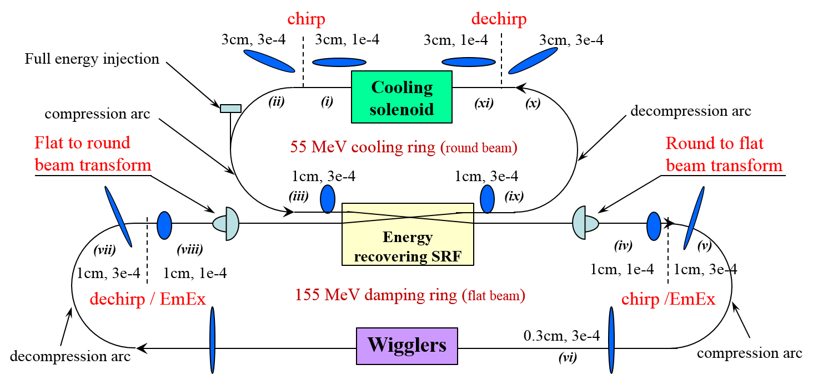
Storage Rings With Emitance Exchange
Storage ring – high energy cooler
Short period strong wigglers for radiative damping, minimum dispersion
EmEx to transplant energy spread to large horizontal transverse emittance
Flat to round beam transformers to match solenoid
Potential show-stopper (for both):
-intra-and inter-beam scattering
Two-energies storage ring –
high and medium energy cooler
Abstracts submitted to IPAC 2017
Courtesy: S. Derbenev
Notes:
Short period strong wigglers for radiative damping, minimum dispersion
EmEx to transplant energy spread to large horizontal transverse emittance
Flat to round beam transformers to match solenoid

Slide 40
Summary
High quality bunched beam electron cooling is fundamental for JLEIC to achieve high luminosity.
Jefferson Lab scientists are well positioned and thoroughly conversant with the technology and issues regarding electron coolers.
Jefferson Lab has begun developing some of the required technology through LDRD and the kicker work. With support, this work should be rapidly built on to yield significant tests and prototypes.
The CTEs ECL1-5, with highest priority, are needed to continue and extend collider cooler development.
We are all ready and itching* to advance.
*“strongly desiring or craving” (Urban Dictionary)

Slide 41
2nd Cooling Experiment: Technical Preparations
Completed software and hardware preparations for the beam diagnostic systems both on the electron cooler and on the CSRm ion ring.
Upgraded control of the DC gun by grid voltage in both DC and pulsed modes (as short as 100 ns) with the electron peak current ~70 mA. All control hardware are JLab made with PLC and Labview remote controls.
Developed a method to use multiple trigger signals provided by CSR control center to do ion beam injection, acceleration and cooling during synchronization. Labview software have been developed for the data acquisition triggering, signal delay, and data recording, on-line analysis, and post data processing.
Developed a method to measure the electron, ion bunch length by four-electrode BPMs installed in the CSRm ring and in cooler. BPM signal filtering and amplification for the fast oscilloscope data recording, FFT and bench length, charge and peak current measurement by the BPM signals.
Developed a method to measure the ion beam DC current by the IMP DCCT in the CSRm ring and to integrate this signal to the BPM signals by the Labview program in order to confirm the bunched beam rep rate and bunch charges.

Slide 42
2nd Cooling Experiment: Technical Preparations
To measure the ion beam DC current by the IMP DCCT in the CSRm ring and to integrate this signal to the BPM signals by the Labview program in order to confirm the bunched beam rep rate and bunch charges.
To measure the ion beam bunch energy spread as the function of the time by the CSRm's longitudinal Schottcky spectrum, using Labview/EPICs program to capture the fast data scans during one fill of beam cycle (~ 1sec time frame). So the beam cooling rate can be measured by fitting this triggered spectrum record data.
To measure the ion beam transverse size as the function of cooling time to capture the ion chamber's beam profile image by the local video camera. The fast CCD and its driver software and data image capture will be done at IMP.
To measure the RF cavity voltage and phase during the ion beam capture, acceleration and cooling times.

