Slide 1

JLEIC MDI Update
Michael Sullivan
Apr 4, 2017

Slide 2
Outline
Introduction
Last SR calculations
Beam pipe proposal of Charles Hyde
Suggested new beam pipe
SR calculations with new pipe
Summary and conclusions

Slide 3
Detector Layout
Ultra forward
hadron detection
Small angle
hadron detection
Low-Q²
electron detection
Central detector with endcaps
dipole
ion quads
Large aperture
electron quads
IP
dipole
dipole
Small diameter
electron quads
~50 mrad crossing
Ion dipoles with high beta functions mentioned previously

Slide 4
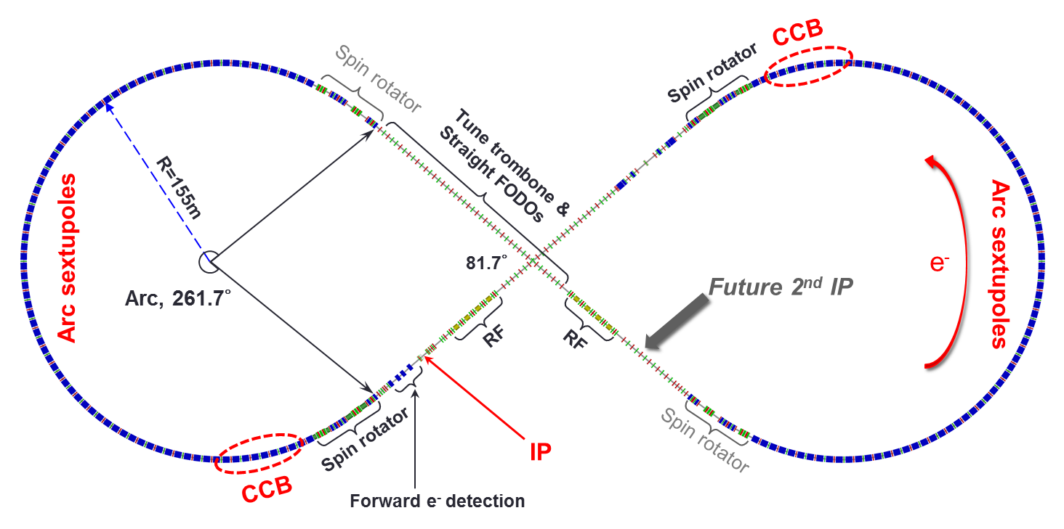
Ring layout
Chromaticity correction blocks

Slide 5
Synchrotron radiation backgrounds
The JLEIC design calls for a high-current (3-0.75 A) electron beam over a wide energy range (3-10 GeV)
This is unique and makes designing a single IR challenging
  The B-factories were fixed energy machines
Background masking designs have to work with different beam conditions

Slide 6
SR masking design for 5 GeV (3 A)
Photons/crossing >10 keV
1.3x10¹⁰ photons/bunch
3x10⁹ keV/bunch
90% <10 keV

Slide 7
10 GeV (0.7 A) needs a tighter mask
Photons >10 keV/crossing
Numbers are Watts

Slide 8
Beam parameters used
5 GeV beam
  β_{x}/β_{y} 10/2 cm
  ε_{x}/ε_{y} 5.5/1.1 nm-rad
  I 2.8 A
  BSC envelope is about 17σ_{x} and 45σ_{y}
  Maximum X BSC is ±22.3 mm at 4.075 m
  Maximum Y BSC is ±28.5 mm at 2.95 m
10 GeV beam
  β_{x}/β_{y} 10/2 cm
  ε_{x}/ε_{y} 22/4.4 nm-rad
  I 0.71 A
  BSC envelope is about 14σ_{x} and 22σ_{y}
  Maximum X BSC is ±36.9 mm at 4.075 m
  Maximum Y BSC is ±27.8 mm at 2.95 m

Slide 9
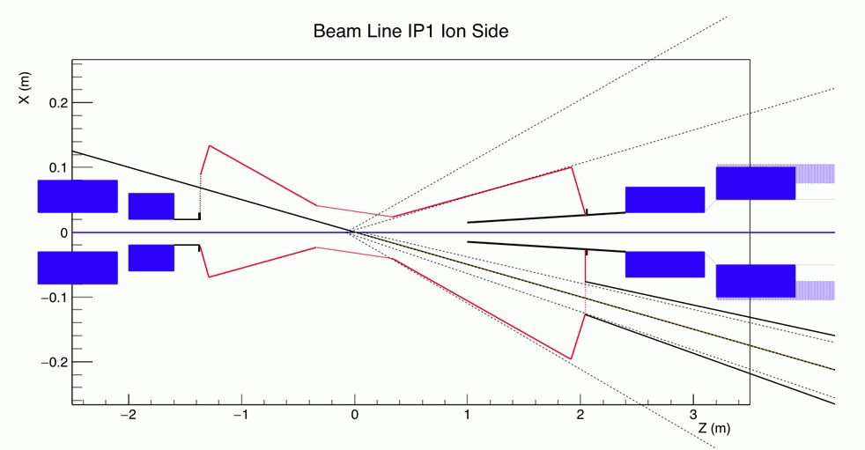
Initial pipe design with masking
Electron beam
Ion beam
Courtesy of C. Hyde (ODU)

Slide 10
Geometry rearranged

Slide 11
SR calculations general
For all of the following studies we use a SR mask located 1 m upstream of the IP on the e- beam line with a radius of 12 mm
  This aperture is about 50 σ_{x} in X and 50 σ_{y} in Y
  The mask picks up significant power and must be cooled
  We trace beam particles out to 15σ in X and 25σ in Y for the 5 GeV beam, fewer for the 10 GeV case
  There is a non-gaussian beam tail distribution
  We use a 3 cm radius for the central beam pipe

Slide 12
SR calculations (cont.)
For the initial design proposal:
  We have the central beam pipe going from +/-33 cm in Z
  The central pipe axis is between the two beams and hence is tilted 25 mrad wrt the electron beam
  This places the downstream part of the central beam pipe about 23 mm from the electron beam
  The mask taper on the upstream side is too shallow. The surface can scatter incident photons directly to the central chamber

Slide 13
SR calculations
We find that the SR rates on the central beam pipe can be tolerated for the 5 GeV beam
  We have a total of 4200 x-rays per beam bunch incident on the central chamber and only 64 of these γs/xing are >10 keV
However at 10 GeV the numbers increase
  Total incident is now 1.1x10⁵ and 3.3x10³ are >10 keV
  Probably not acceptable

Slide 14
Suggested new beam pipe
Have included as much of the Hyde design as possible
  Some changes in reduce HOM issues
    Will no doubt need to iterate the design with detector needs
  Steepened upstream part of the 1m mask
  Also need cooling to reach upstream e- mask
  Lengthened central chamber to +/-45 cm
  Central chamber is on axis with the e- beam

Slide 15
Suggested new beam pipe

Slide 16
New beam pipe with detector angles

Slide 17
Background rates
The new central chamber is easier to shield
  At 5 GeV we get ZERO hits on the central chamber
  We have to go down to a 25 mm radius before the hit rate becomes significant (58 hits/xing >10 keV)
  At 10 GeV we get 3400 hits on the central BP with 1200 hits > 10 keV
    Rates low enough? Perhaps not at 10 GeV?
    These hits are at the far end of the 90 cm BP similar to the place where the initial proposed beam pipe is hit

Slide 18
New β* values
We have taken a quick look at the new (Jan 2017) β* values
  Lattice is not fully matched
    Used a local lattice optimizer
  For 5 GeV the new βs are (x/y) 5/1.0 cm
    Max BSC (17σ_{x}/44σ_{y}) =33.3/39.7 mm at 3.85/2.775 m
  For 10 GeV we have 4/0.8 cm
    Max BSC (11σ_{x}/18σ_{y}) =50.1/36.0 mm at 3.85/2.775 m
  First order check
    Beam-stay-clear size significantly increases in the final focus quads even after decreasing number of sigmas
    Can we still make these magnets?

Slide 19
Preliminary backgrounds
5 GeV beam
  OK on central chamber with hits just starting at 45 cm (<.01 hits/xing)
10 GeV beam
  Hits on the central chamber starting at the IP (Z=0). 3.9x10⁴ hits/xing on downstream half of the central chamber. Most likely unacceptable.
  Would have to squeeze down mask aperture
    12 mm down to 10 mm radius lowers above rate to 7474 hits /xing
  Or perhaps the central chamber is too long?
    A ±30 cm central chamber with a 10 mm radius mask drops the hit rate to 1299 hits/xing

Slide 20
Background discussion
The detector background rates are coming from the non-gaussian tail distribution of the beam profile
  We do not know exactly what the tail distribution looks like
  We have chosen a somewhat conservative distribution that sets a beam lifetime of about 1 hour for a 15σ mask in X
  If we can move the mask in farther then the high sigma particle distribution must be lower in order to maintain the 1 hour lifetime
  Factors of 10 can happen either way

Slide 21
More background discussion
We should try to keep the IP design from being the luminosity limiter
This means trying to make as much room in the ff quads as we can so we can lower β*s
Both B-factories went beyond design lumi
  KEKB by x2
  PEP-II by x4
PEP-II beam pipe cooling was designed for 3A beams
  Allowed us to go to 10 GeV in the HER with 1.5A

Slide 22
Summary
More iterations are needed between masking designs, vacuum design issues and detector requirements before a feasible IR design can be completed
Also need to look at scattered photon rate from the tip of the SR mask at 1m
High order mode RF (HOM) power calculations also need to be included in the design iterations
Also need to find what beam pipe thicknesses can be tolerated by the detector (writeup by Charles) – smaller beam pipes can be thinner

Slide 23
Conclusions
Some progress – more to do
Try to keep IR design as flexible as possible
If anything, IR designers (detector, backgrounds, magnets) would probably be happier with a larger crossing angle rather than a smaller one

