Slide 1

JLEIC SRF and fast harmonic kicker update
Bob Rimmer for SRF team
04-3-2017

Slide 2
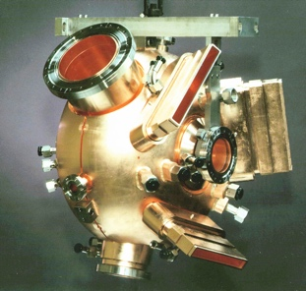
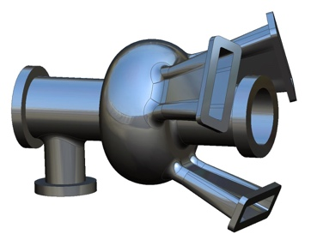
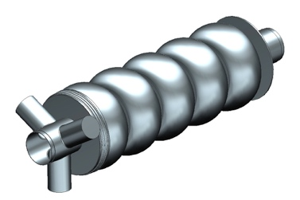
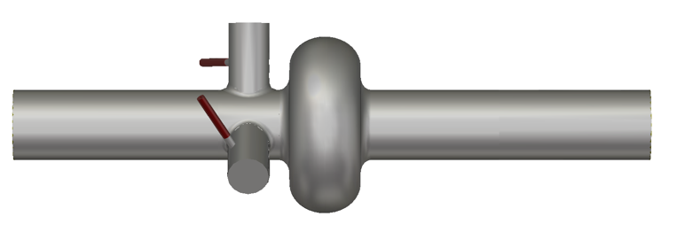
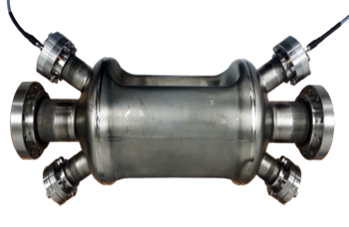
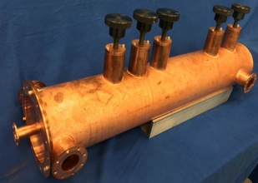
RF cavities for JLEIC
952.6 MHz i-ring
(SCRF)
JLEIC
Collider
Rings
i-SRF +
NCRF
Cooling
952.6 MHz cooler ERL (SCRF)
Crab
IP
e-RF
476.3 MHz e-ring
(NCRF PEP-II)
Crab
e-RF
Future IP
Booster
952.6 MHz booster
(SCRF)
ODU
SRF Linac
Ion Source
952.6 MHz crab
(SCRF)
Electron Injector
Hall D
12 GeV CEBAF
Harmonic Fast kicker for cooling ring
Halls A, B, C
Not including ion acceleration and bunch formation

Slide 3
Outline
Storage ring cavities
Gap transient mitigation
Cooler ERL Linac and injector
Harmonic fast kicker
Cooling experiment support (Geoff Krafft)
Ion bunch formation scheme (Todd Satogata)
Crab cavities (Jean Delayen, ODU)
Modular cryostat – no change

Slide 4
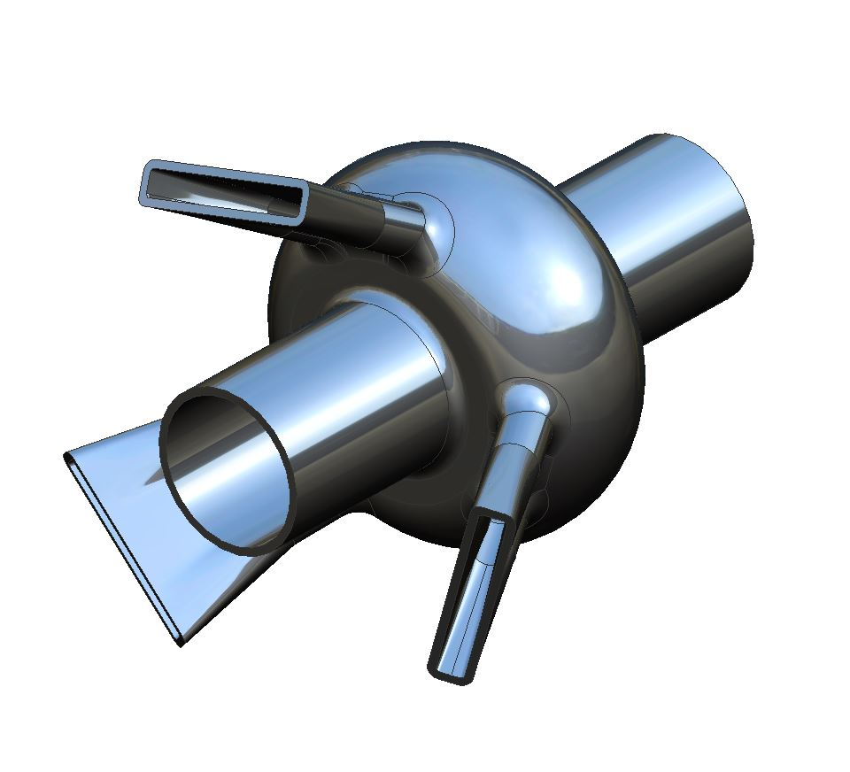
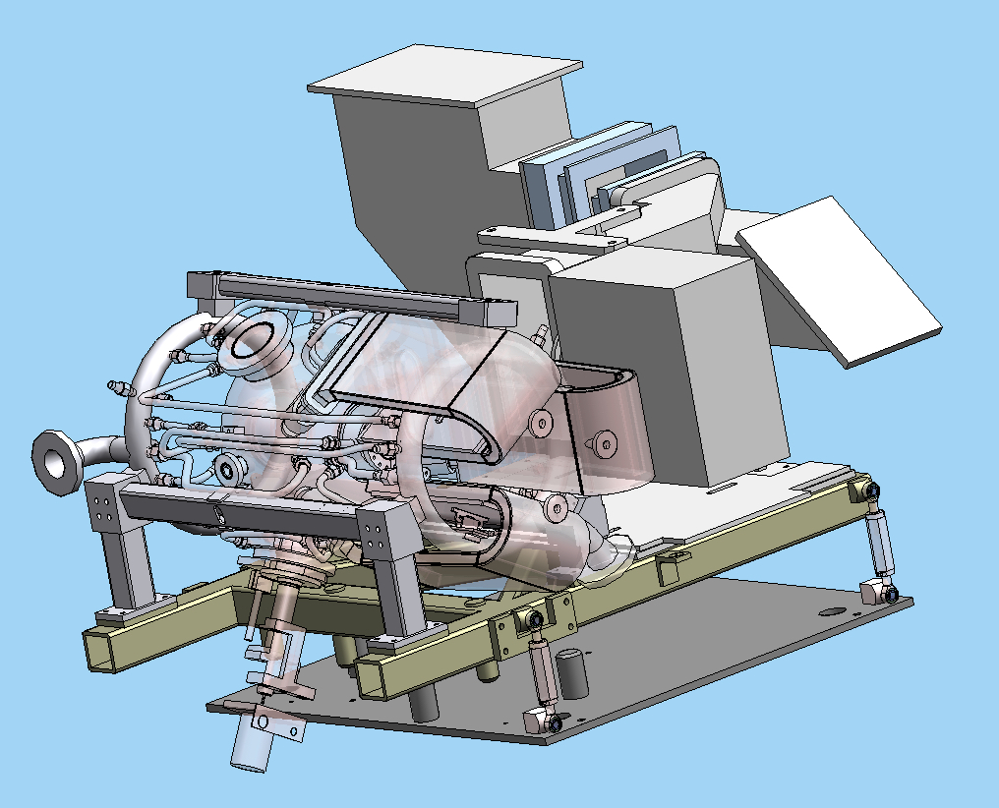
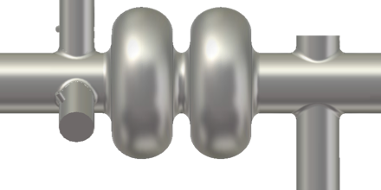
Storage ring cavities
e-ring based on PEP-II RF at 476.3 MHz
i-ring uses new SRF cavities at 952.6 MHz
Large contributions to impedance budgets
New on-cell damped cavity
or
PEP-II raft assembly from SLAC
2-cell end-group damped cavity

Slide 5
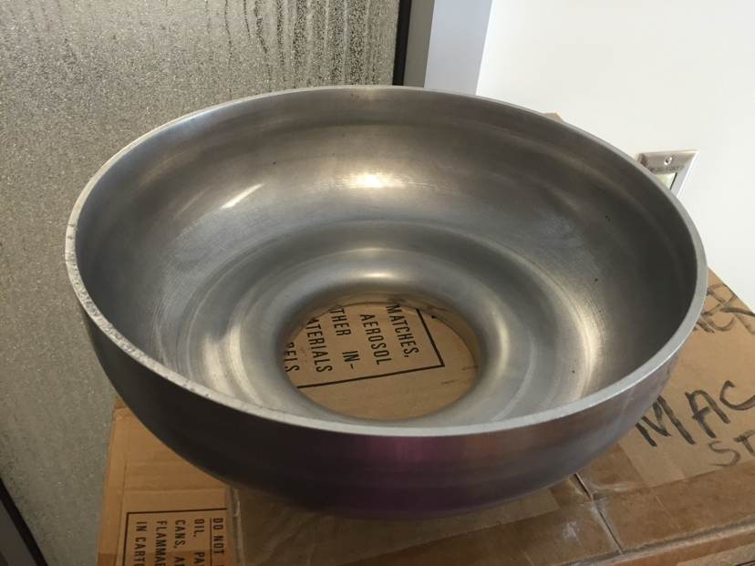
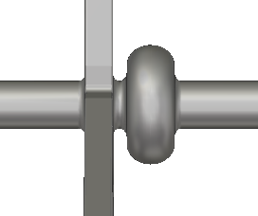
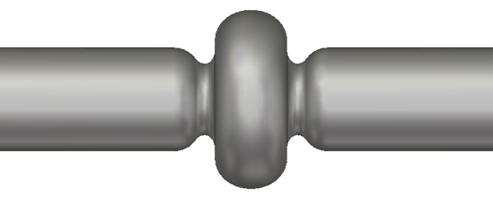
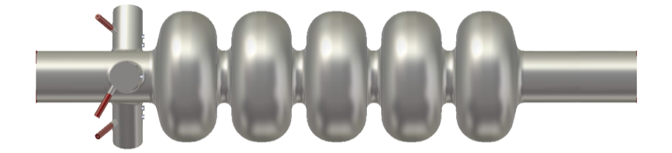
952.6 MHz SRF: Current status
New 952.6 MHz high-current cavity shape developed
1-cell prototype in progress on existing EIC R&D funds
HOM damping schemes under evaluation
Full RF system parameter tables defined
1) 3WG. 2) 3 x coax dampers. 3) enlarged beam pipes (ref) 4) on-cell dampers
Cooler needs 5-cells in the ERL, 1-cells in the injector.
Ion ring might use 2-cells

Slide 6
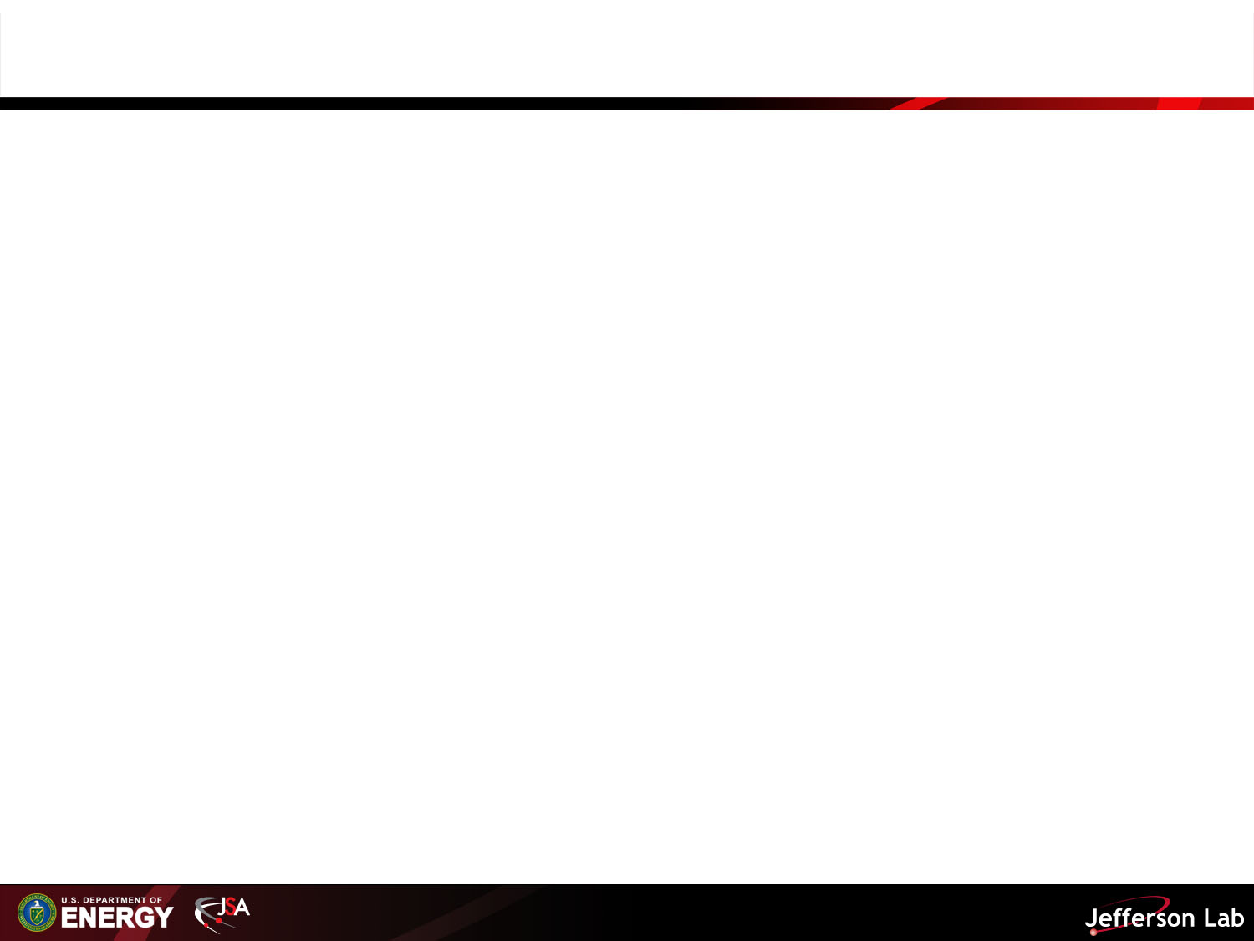
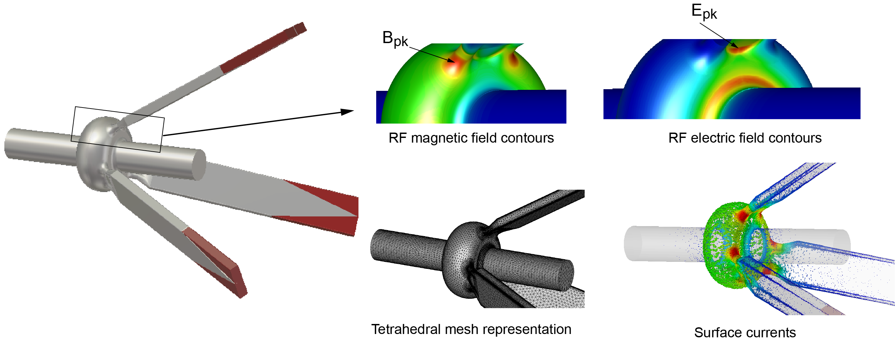
Heavily-Damped Collider Ring Cavity
Progress has been made to design of a heavily damped 952.6 SRF single-cell cavity with on-cell waveguide dampers
The effective and broadband HOM damping with a similar arrangement of three waveguide dampers is well proven with normal-conducing cavities (e.g. BESSY 500 MHz cavity and PEP-II 476 MHz cavity)
The magnetic field enhancement at the surface (openings) can be limited to a factor of ~2 compared to standard elliptical cavities, around ~15 MV/m are feasible
F. Marhauser, “Next Generation HOM-damping”, Special Issue on Superconducting RF for Accelerators, to be published

Slide 7
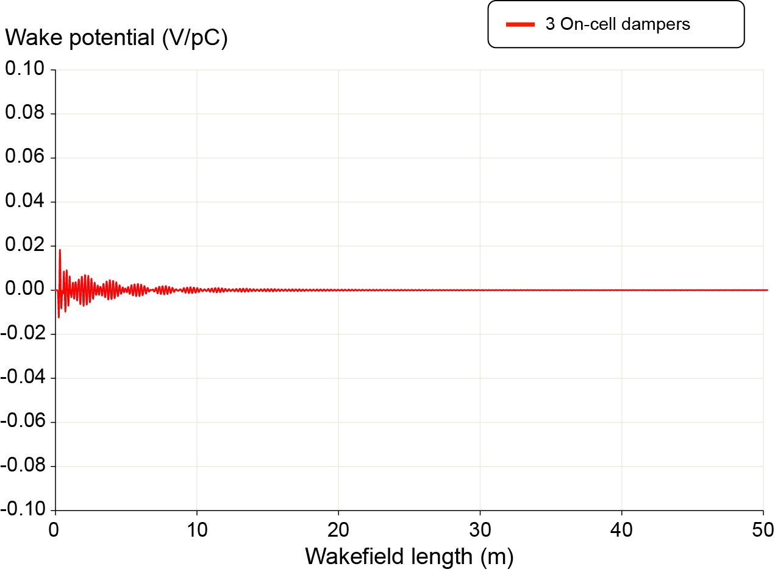
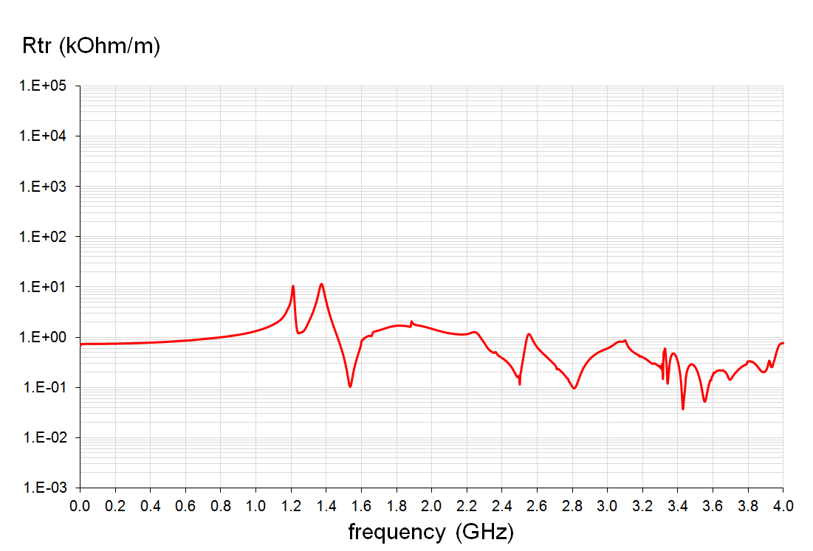
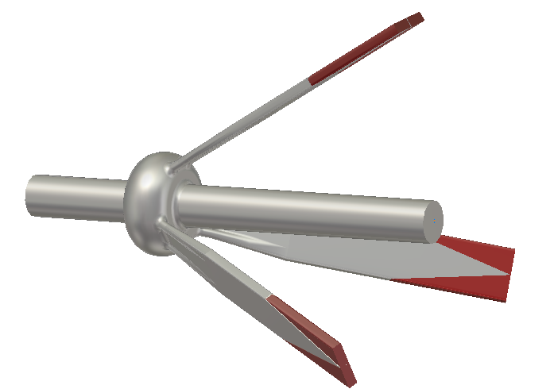
Example: Transverse Wakefield
Transverse wakefields are damped within ~15 m behind the leading bunch
Extremely small transverse impedances (several factors better than PEP-II or BESSY cavity)
well balanced dipole impedances
with highest Rtr
Fine-tuning of design is ongoing exploring a multi-dimensional parameter space
Goal: Finding compromise between longitudinal and transverse damping as well as the magnetic surface field enhancement, while accounting for ease of fabrication utilizing standard Nb sheet deep-drawing and port necking techniques

Slide 8
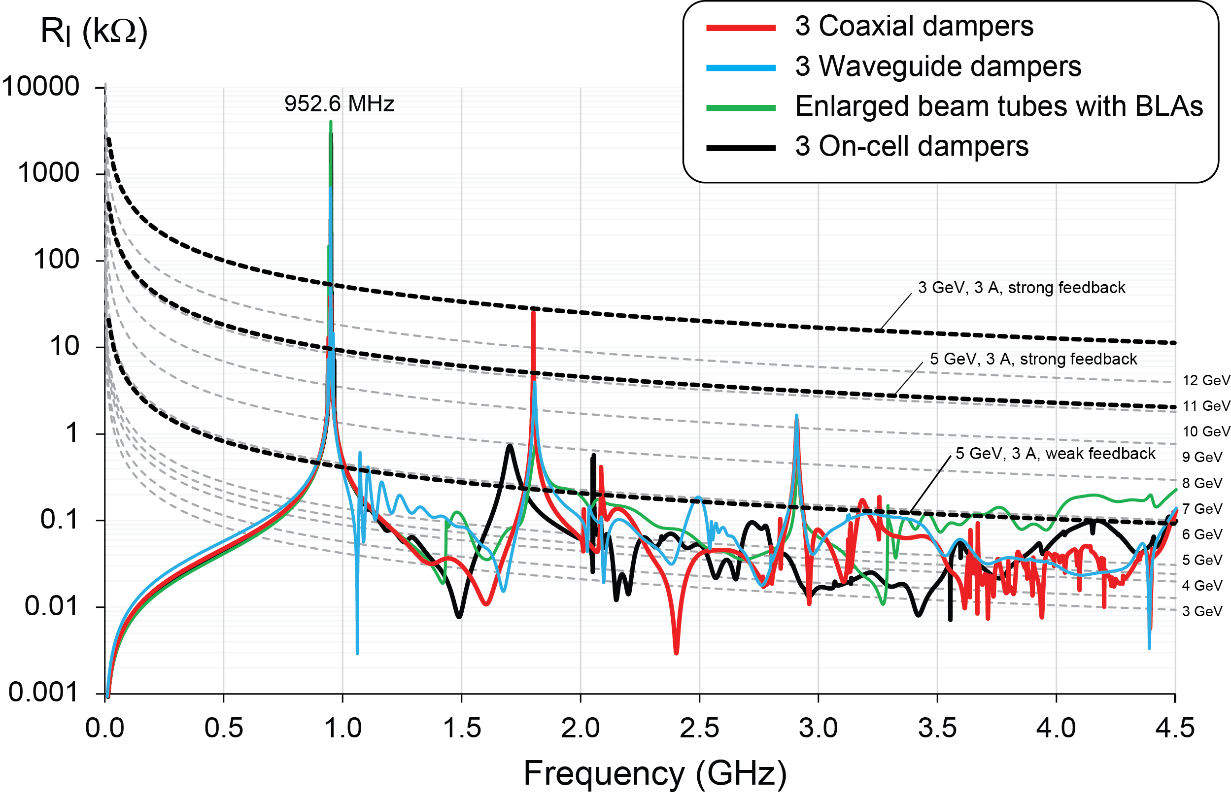
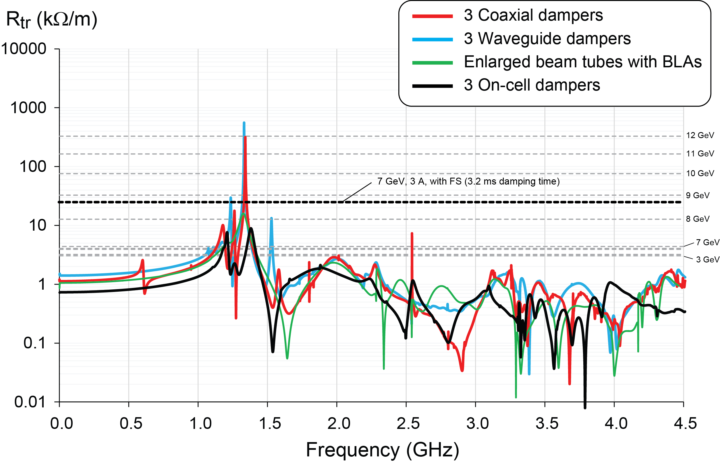
Collider Ring Impedance Thresholds
Broadband damping of HOMs with on-cell dampers better than with any other design including enlarged tubes to un-trap low frequency modes
No costly beam tube absorbers are needed between cavities (risk mitigation and real estate savings)
F. Marhauser, “Next Generation HOM-damping”, Special Issue on Superconducting RF for Accelerators, to be published

Slide 9
RF Transient Compensation Test at IHEP
BEPC-II Electron Positron Collider Synchrotron Storage Rings at IHEP, Beijing, China
H. Wang

Slide 10
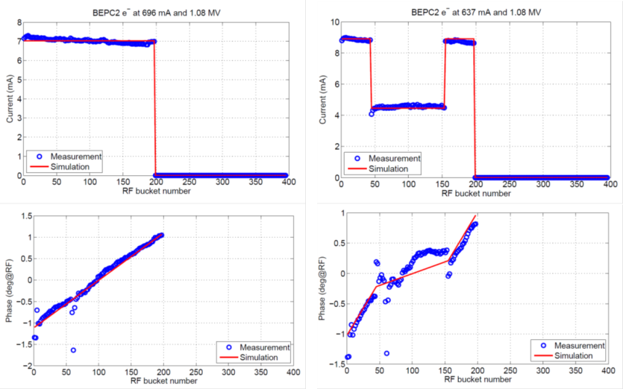
Transient beam loading
H. Wang
Beam Loading & Instability Study at BEPC-II by IHEP/JLab/LBNL/Dimtel Collaboration
gap
Compensation
Experimental beam based studies for the future EIC to study the luminosity loss caused by the transient beam/SRF system interaction
Using the bunch-by-bunch RF feedback system build by Dimtel for BECP-II, we have obtained preliminary data set of different filling patterns and compensation technique by modulating bunch charge around the gap
Additional tracking simulations using JLab/LBNL/Dimtel/IHEP codes are under the way. The benchmarked tools will be used for future EIC designs
Even fill
Modulated fill
gap
gap
Phase
transient
reduced
transient
preliminary

Slide 11
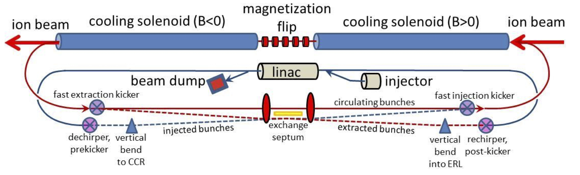

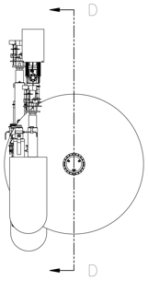
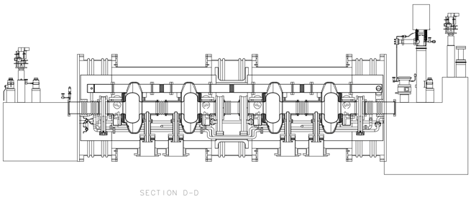
Harmonic fast kicker
Strong cooling now the baseline (see Steve Benson’s talk)
ERL supplies bunches to circulator ring with 10-20 turns
Reduces average current in ERL/Injector but not peak charge
Requires fast and clean exchange of bunches
Strong cooling scheme as imagined by Dave Douglas

Slide 12
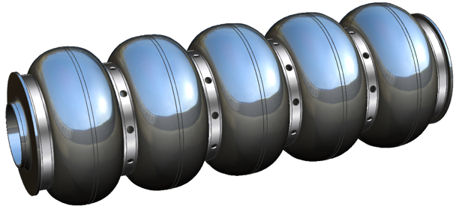
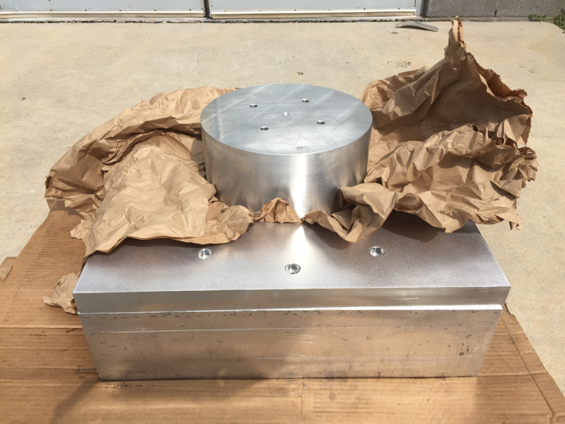
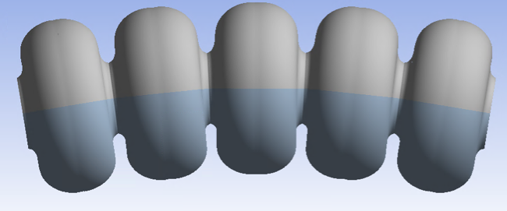
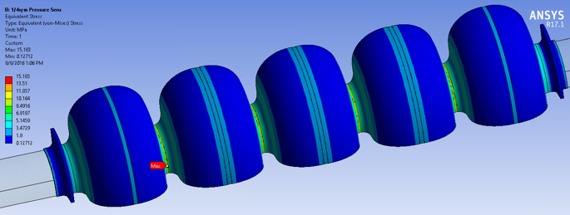
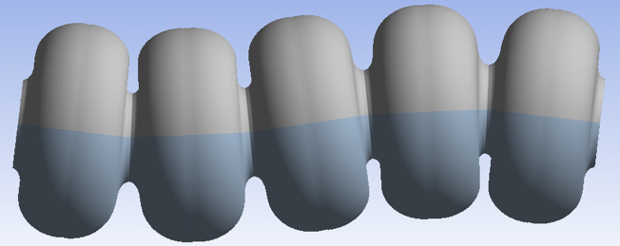
952.6 MHz cooler cavity prototype
Preliminary engineering analysis is complete
Cell and beam tube dies (110mm) have been fabricated
Test blanks have been pressed
End group design will be chosen based on simulations
Impedance requirements (Q spec)
HOM power (i-ring, e-ring, ERL)
Will produce single-cell first (possibly using ingot material)
J. Henry
L. Turlington
F. Fors
σ_{e,max} = 15.2 MPa
F. Fors
Notes:
Red Interior Page Design 1

Slide 13
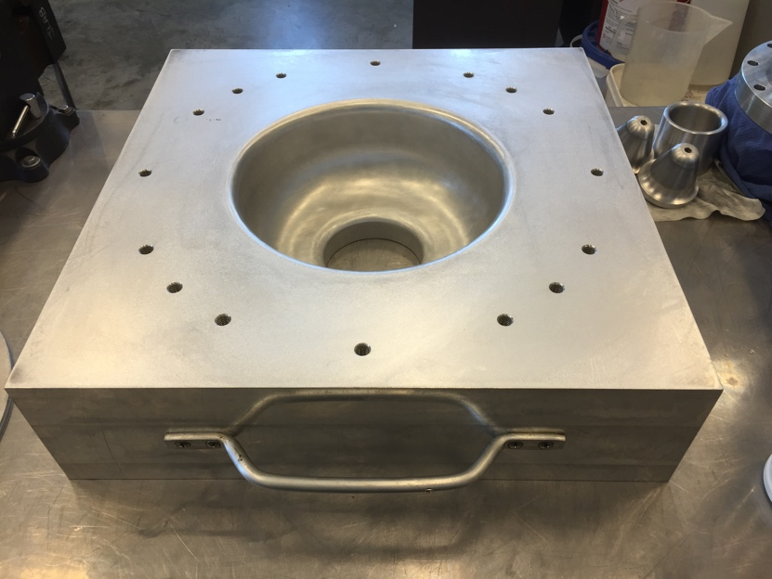
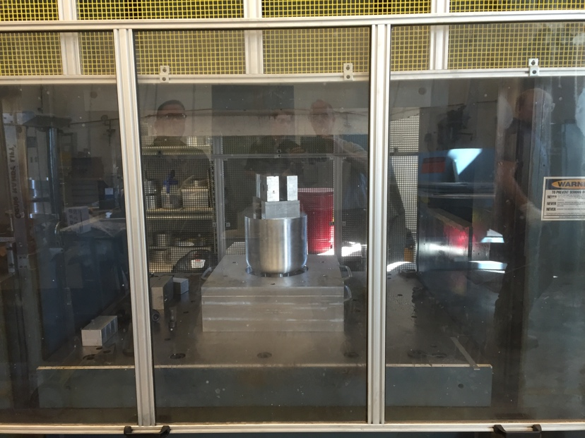
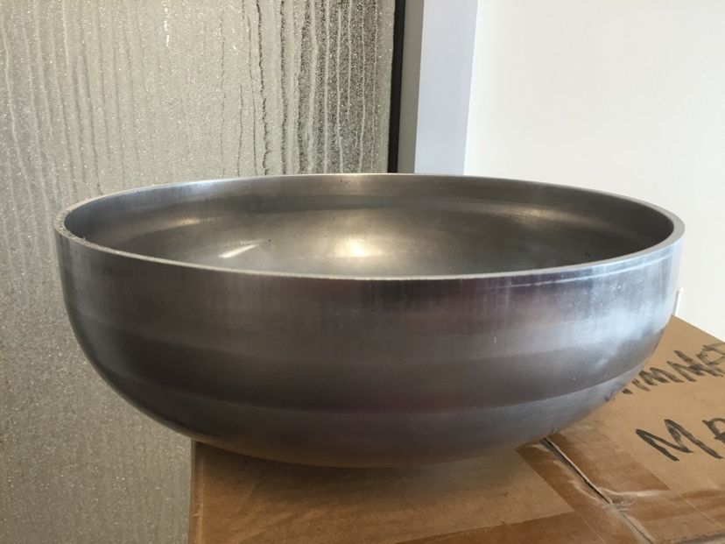
First test pressings

Slide 14
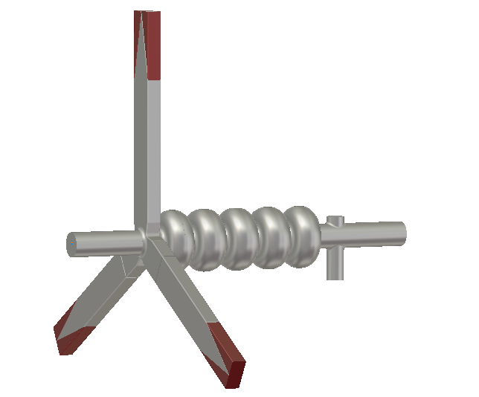
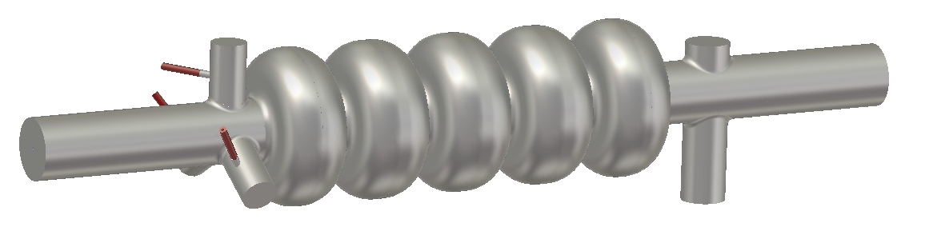
HOM Coupler Technology
F. Marhauser
The HOM power is distributed evenly among the coaxial couplers with the chosen Y-configuration
Some of the power is propagating through beam tubes, yet the HOM power level extracted by the coupler is still significantly high
At these power levels the inner HOM coupler hooks need to be cooled actively (not done for JLab/Tesla-type coaxial coupler), which requires R&D on the coaxial coupler design (synergy with CERN cavity project)
Waveguide dampers are adaptable to higher power levels, high current (HC) design exists
5-cell cavity with one endgroup
utilizing 3 coaxial dampers
5-cell cavity with one endgroup
utilizing 3 HC waveguide dampers

Slide 15
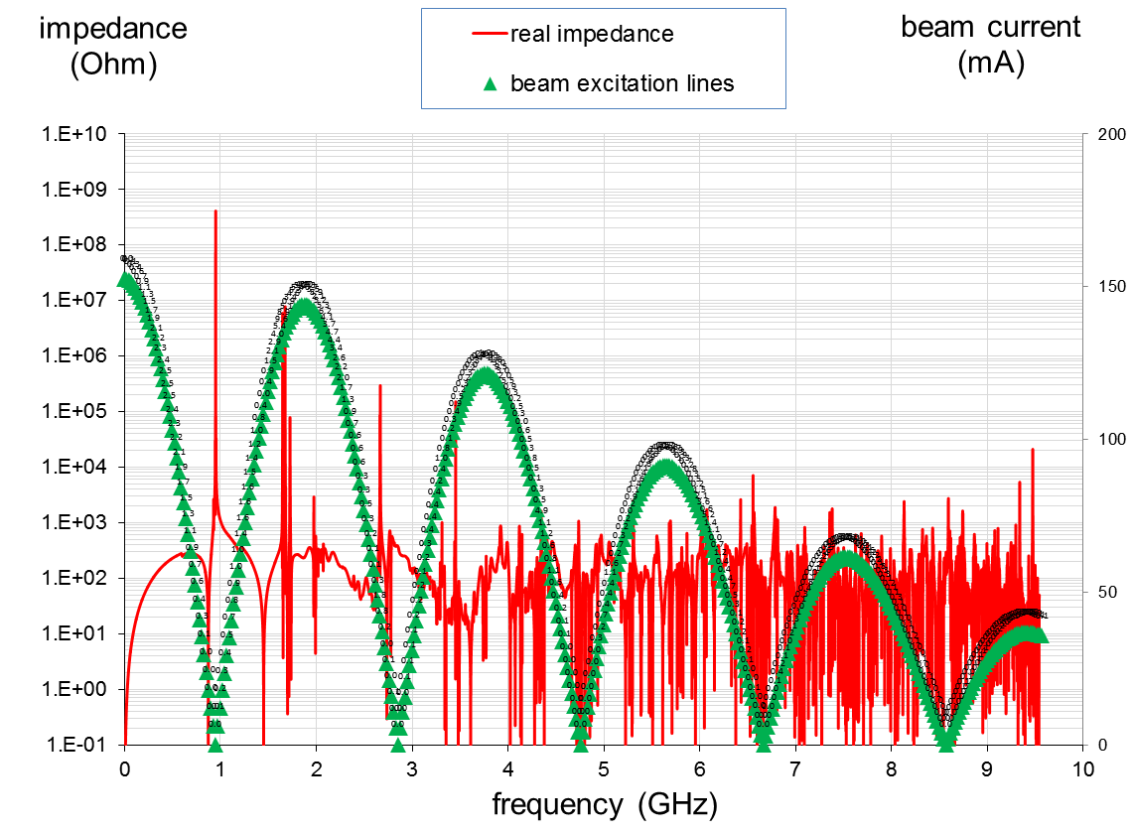
HOM Power in ERL Cooler Cavities
Note that the spectral lines are weighted by the nominal 20 mm flattop bunch length, which produces the roll-off at the high frequency end (beyond 10 GHz however there will be a ripples due to the beer-can distribution, i.e. peak currents will raise again to some extent)
The monopole HOM power up to 9.5 GHz is 137 Watts @ 2nC bunch charge.
The HOM power is 350 Watts @ 3.2nC bunch charge
952.6 MHz
Individual HOM power values
are summed up
F. Marhauser

Slide 16
Y. Huang
Harmonic fast kicker
Few mrad
Few kV
~ns
~10 of ns
CCR scheme required fast bunch swap out every 10-20 turns
Pulsed power supplies, especially with these characteristics are beyond state of the art.
An alternative driving method is summing simple cosine waves at sub-frequencies of the final beam repetition frequency to generate a continuous waveform.

Slide 17
Kick Waveforms to Kick Every 10th Bunch
10 Harmonics+DC offset
9 Harmonics+DC offset
Y. Huang, J. Guo

Slide 18
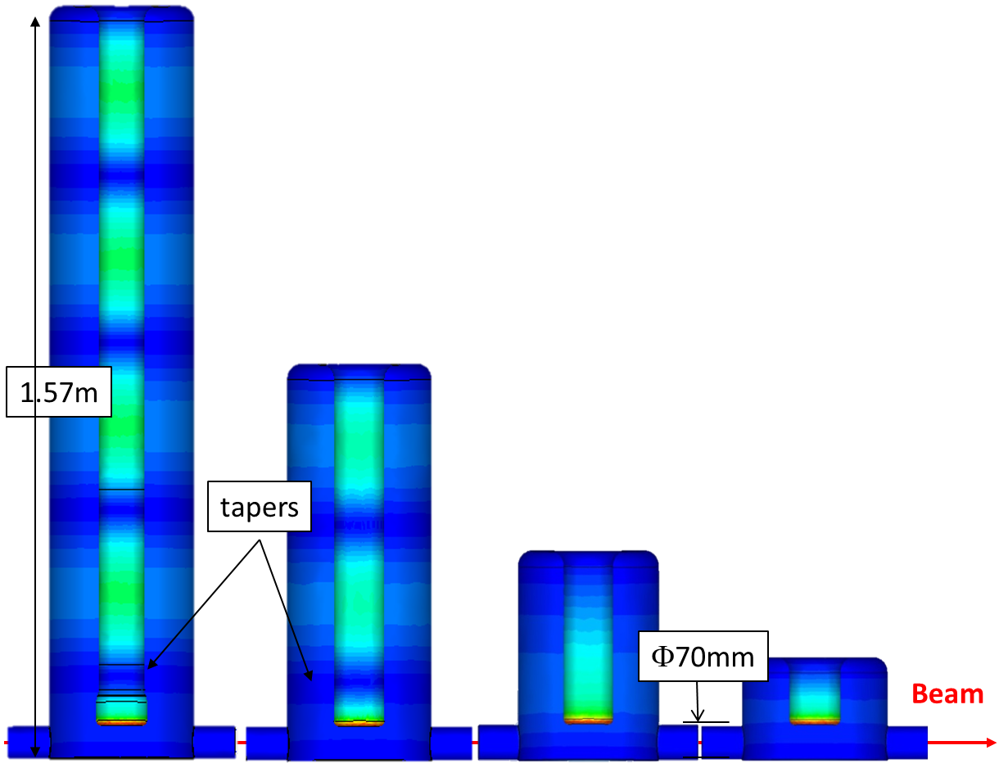
Kicker Cavity Model
Y. Huang
Mode (MHz) | FFT Kick Voltage (kV) | CST Trans. Shunt Impedance (Ω) | Dissipated Power (W)
47.63 | 13.711 | 7.13E6 | 26.37
95.26 | 12.462 | 1.14E7 | 13.62
142.89 | 10.532 | 4.09E6 | 27.12
190.52 | 8.1290 | 1.35E7 | 4.89
238.15 | 5.5030 | 3.14E6 | 9.64
285.78 | 2.9170 | 6.09E6 | 1.40
333.41 | 0.6300 | 2.65E6 | 0.15
381.04 | -1.2090 | 1.65E7 | 0.09
428.67 | -2.4320 | 2.40E6 | 2.46
476.3 | -3.0110 | 4.57E6 | 1.98
DC | 8.2760
Total | 55.508 | 3.56E7 | 87.72
5 harmonics 47.63MHz×1,3,5,7,9
3 harmonics 47.63MHz×2,6,10
1 harmonics 47.63MHz×4
1 harmonics 47.63MHz×8

Slide 19
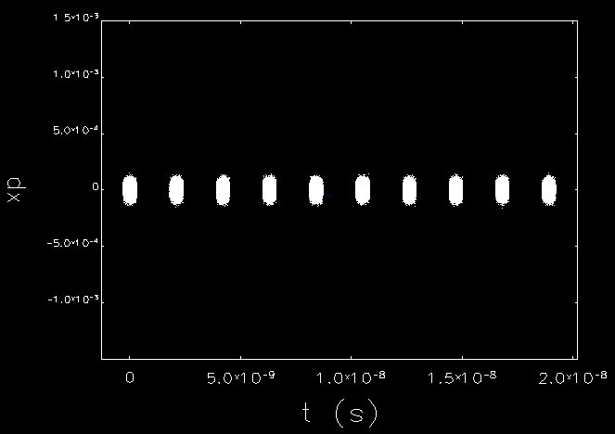
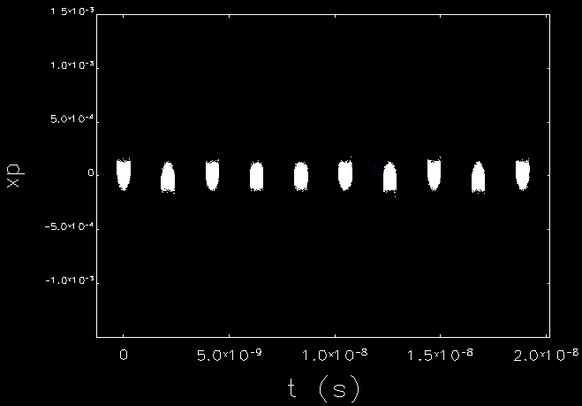

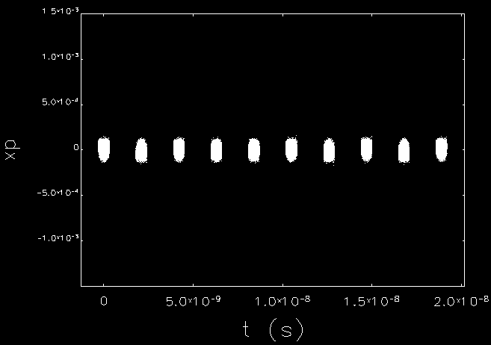
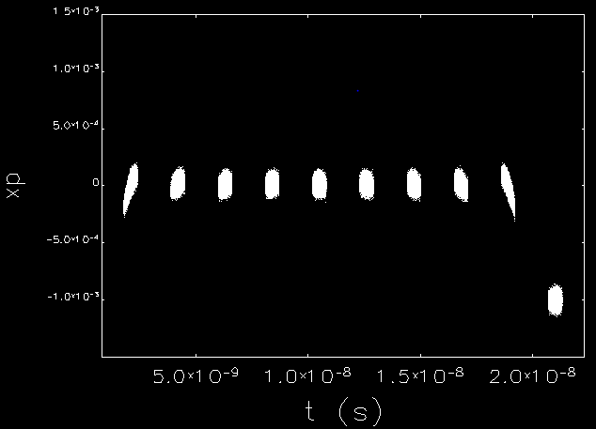

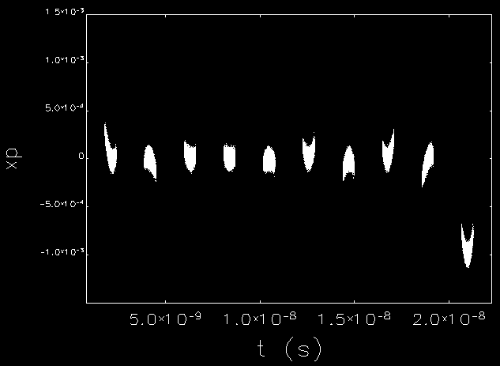

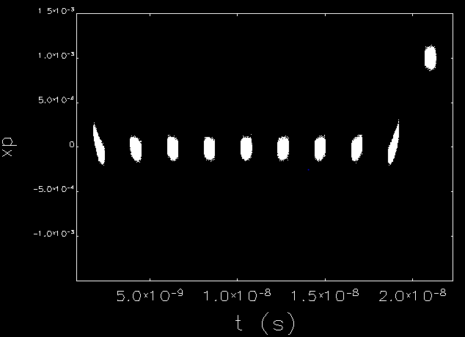
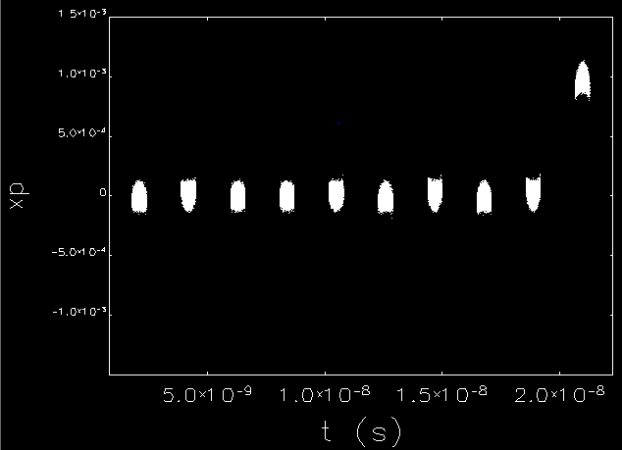

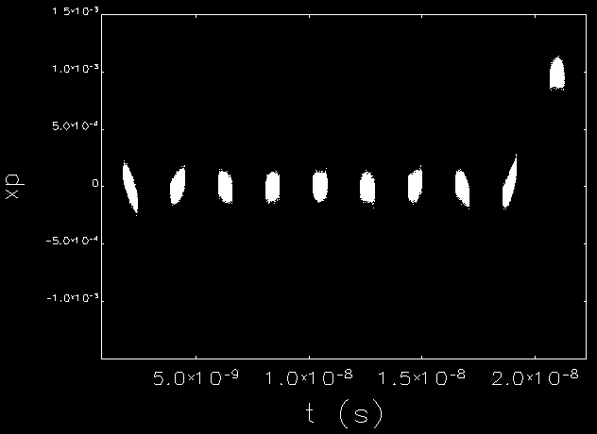
Two Kicker Tracking Result
Y. Huang
Flat-Top
Zero-Gradient
Equal-Amplitude
Least-Modes
Monitor 1
Monitor 1
Monitor 1
Monitor 1
Monitor 2
Monitor 2
Monitor 2
Monitor 2
Monitor 3
Monitor 3
Monitor 3
Monitor 3

Slide 20
Y. Huang
Emittance Growth During Recirculation

Slide 21
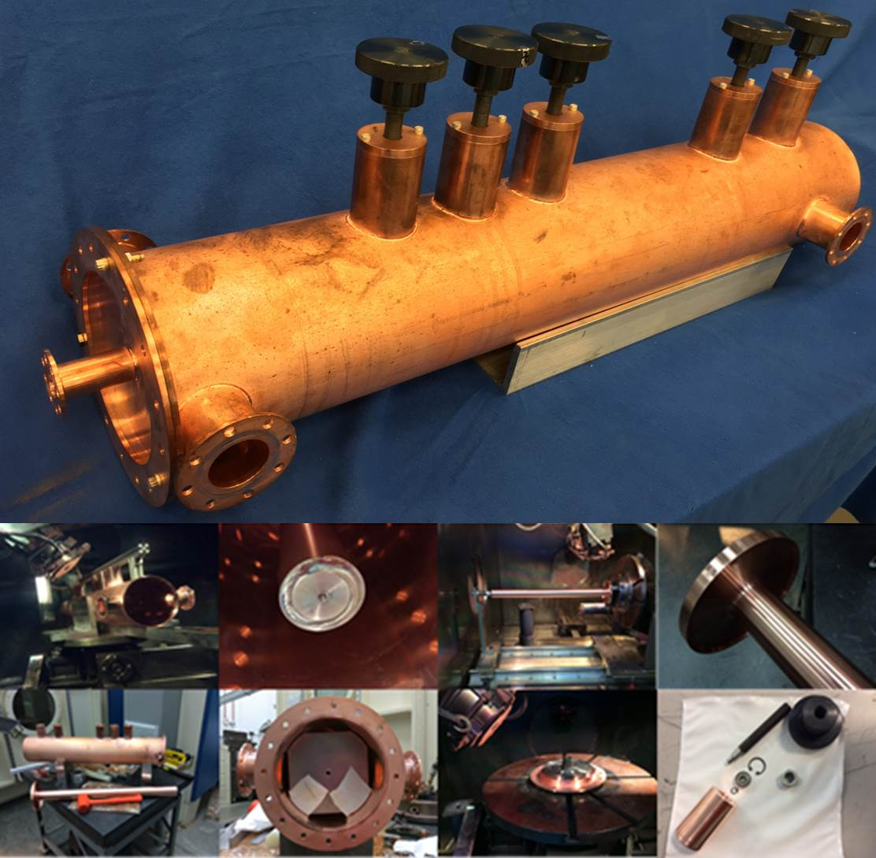
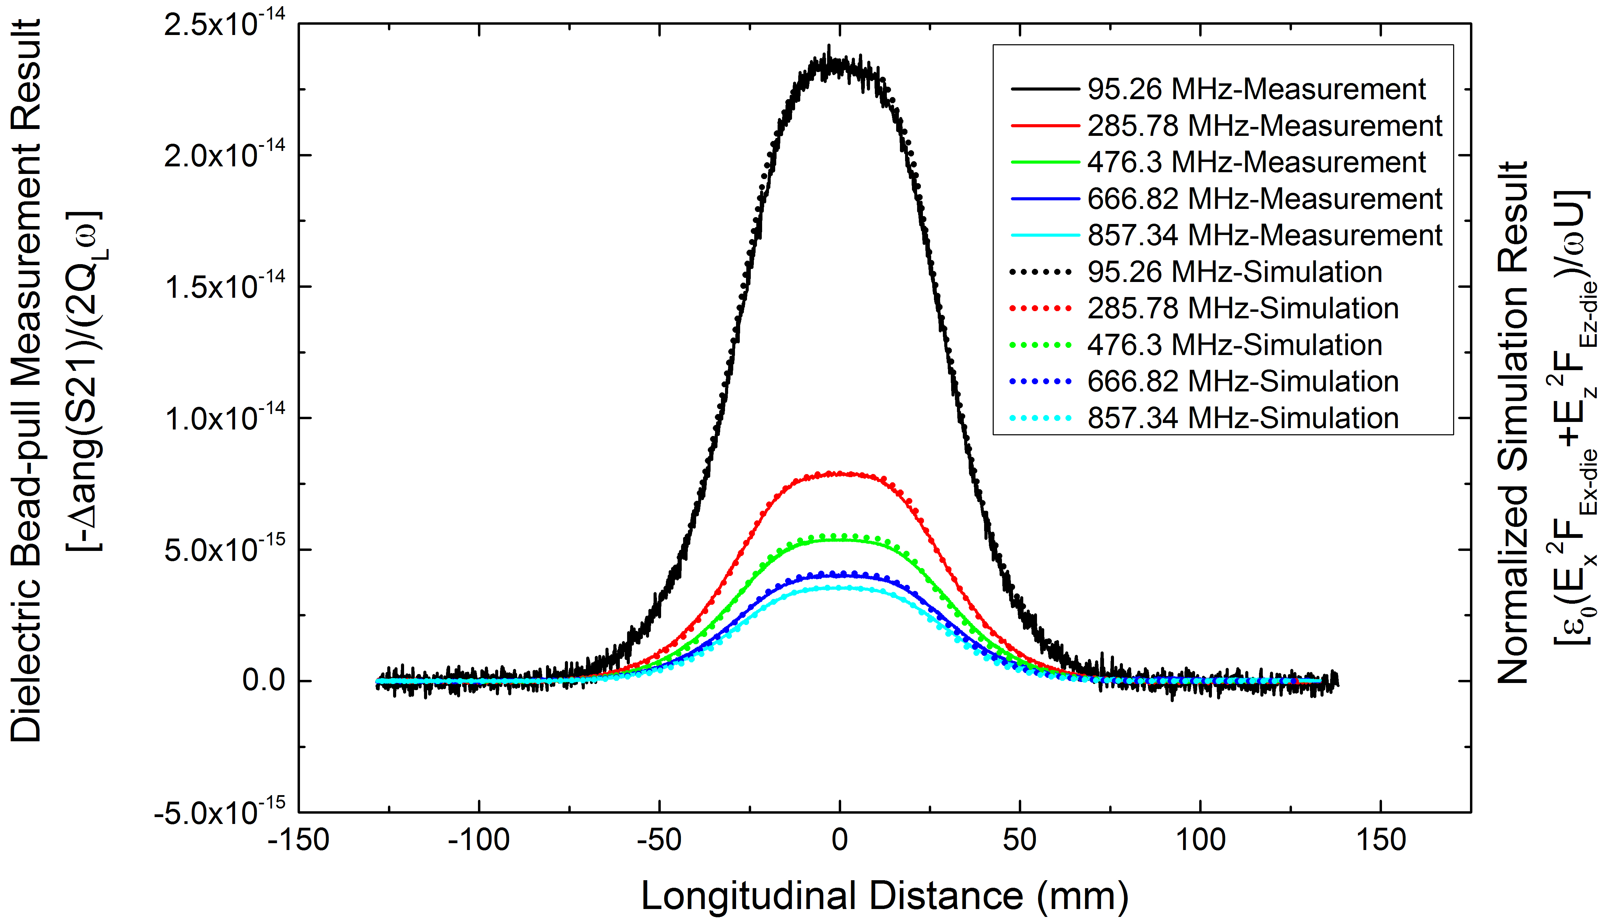
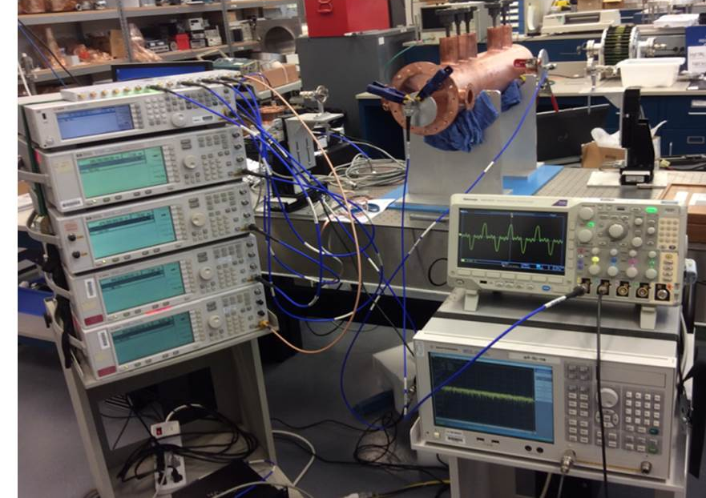
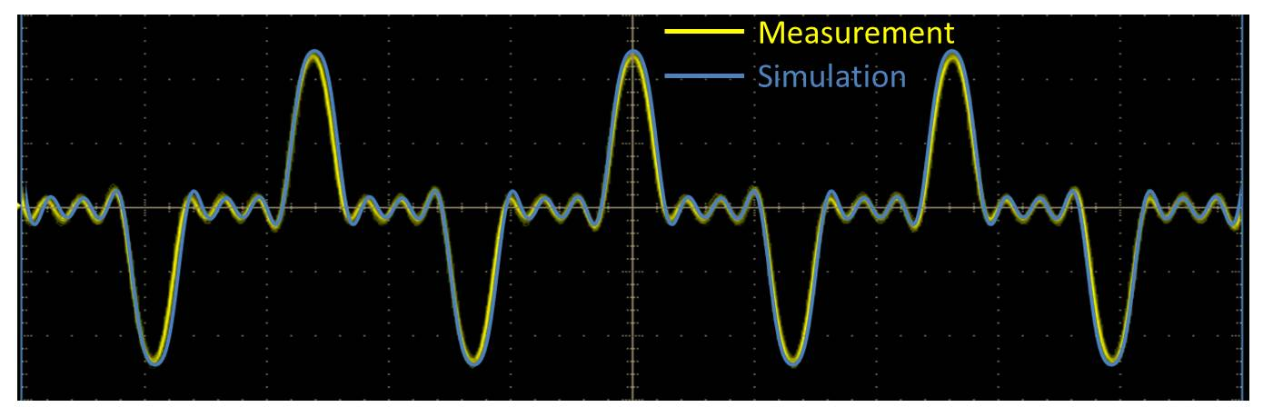
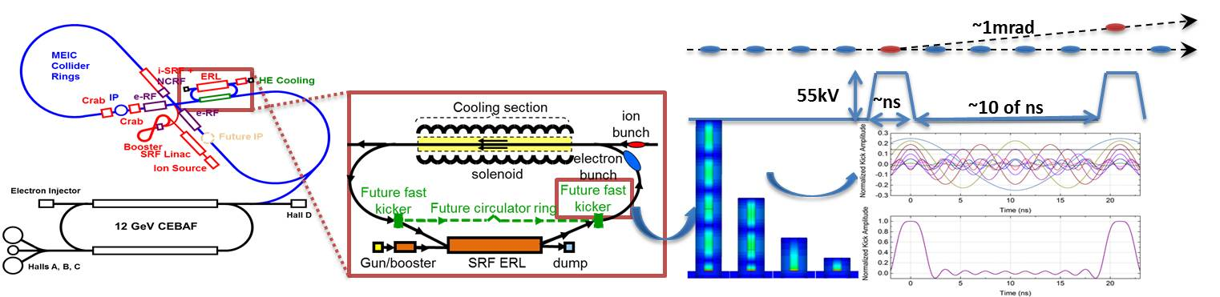
JLEIC Harmonic fast Kicker Development
Y. Huang
Built a half-scale 5-mode copper prototype;
RF bench tests match well with the simulation;
Demonstrated combination of 5 harmonics.
Ph.D thesis of Yulu Huang, IMP

Slide 22
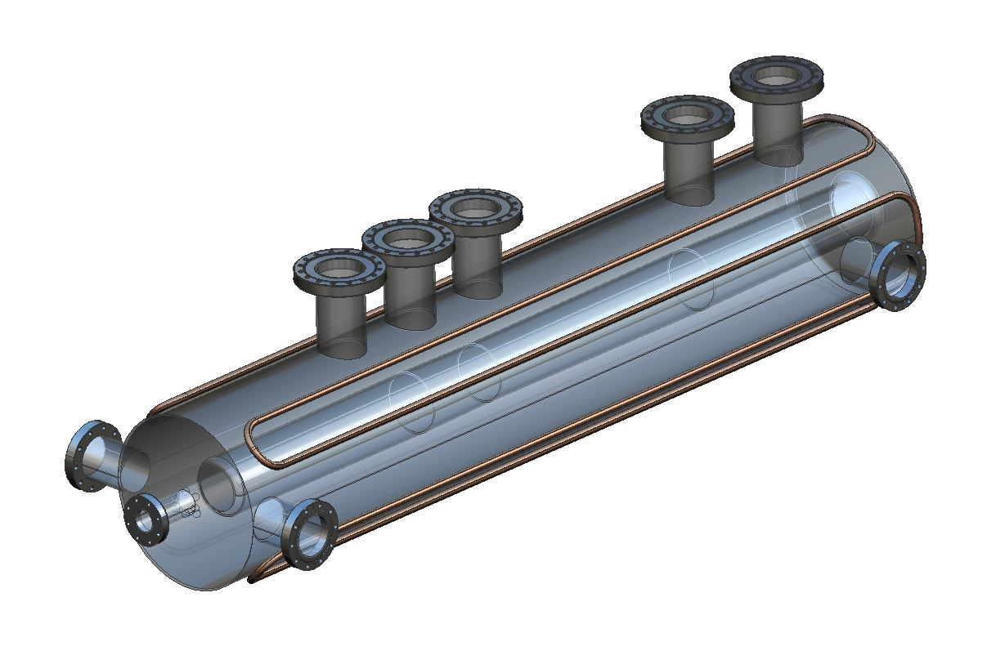
High-power model
Vacuum model concept in progress
Can test in UITF, LERF or ???
Need to settle on a baseline kicking scheme (angle, frequency) to go to the next step.
Eagerly anticipating new postdoc position
Need to study multi-turn effects with magnetized beams
J. Henry

Slide 23




Modular cryostat
Take the best features of previous JLab designs
Modular approach to hold various different cavities
Design suitable for industrial production
Simple concepts, low parts count to reduce costs
Cooler ERL, 5-cell cavities
476.3 MHz Crab cavity
Waveguide damper concept
β=0.6 650 MHz cavity

Slide 24






RF R&D roadmap
2017
2018
2019
2020
2021
 | 1 | 2 | 3 | 4 | 1 | 2 | 3 | 4 | 1 | 2 | 3 | 4 | 1 | 2 | 3 | 4 | 1 | 2 | 3 | 4
RF systems design and specification
952 MHz cavities:
ERL cooler 5-cell
ERL booster 1-cell
Storage ring bunching cavity
Crab cavities (ODU)
Harmonic kicker cavity
Ancillary components (windows, tuners, HOMs, etc.)
Integrated cooler test ?
Modular cryostat
LLRF and Bunch by bunch feedback systems, kickers
📕?
💰
💰
ODU
💰
💰?
NP base
VA funds
FOA?

Slide 25
Conclusions
Storage ring cavities under development, meeting Impedance requirements.
Gap transient mitigation first test looks promising
Cooler ERL Linac and injector under development
Harmonic fast kicker proof of principle model successful, ready for vacuum model
Modular cryostat waiting for attention
Roadmap for base and VA funding, awaiting FOA.

Slide 26
Back up

Slide 27






Transient effects seen from frequency domain
S. Wang
With a uniformly spaced bunch chain, the bunch frequency is same as the RF generator frequency (f_{rf}), hence, the RF cavity of resonance frequency f_{res} is a damped driven oscillator. Two solutions exist:
And the transient solution can be ignored. Hence, we will see only the steady-state solution with driving frequency, f_{rf}, and its harmonics.
With a gap, the frequency spectrum is complicated, the beam spectrum has f_{res} component, which drives the f_{res} oscillation in non-gap time period. At the same time, the continues generator current still produce the steady-state solution of f_{rf} . Because of the small frequency difference with f_{rf} , the sum of the two oscillations exhibits a periodic phase and amplitude variation, the transient effect.
Gap and double shoulders on ends of bunch chain. The spectrum changed, the f_{res} component has a much lower amplitude, hence the transient effect is allevitated.
H=6832, gap = 5%
H=6832, gap = 5%, double shoulder

