Slide 1
Electron Cooling Simulation For JLEIC
He Zhang
JLEIC Collaboration Meeting, 04/03/2017
Newport News, VA

Slide 2
Outline
Two–stage electron cooling scheme for JLEIC
Electron cooling simulation for JLEIC new baseline
Turn-by-turn tracking simulation for electron cooling
Summary

Slide 3
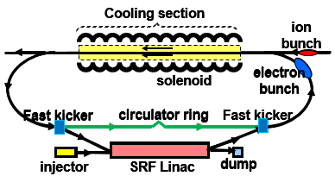
JLEIC Staged Cooling Scheme
Multi-phased scheme takes advantages of high electron cooling efficiency at low energy and/or small 6D emittance $τ_{cool}\sim γ^{2}\frac{Δγ}{γ}σ_{z}ε_{4d}$
Low energy DC cooler (Within state-of-art) at the booster:
Reduce the emittance
2GeV/u ion beam, 1.6 MeV electron beam
High energy bunched beam cooler (needs R&D) at the collider ring:
Maintain the emittance
Up to 100 GeV/u ion beam, 55 MeV electron beam
ERL circulator cooler (Q_{e} up to 3.2 nC/bunch, strong cooling, new baseline)
JLEIC ion complex layout

Slide 4
Outline
Two–stage electron cooling scheme for JLEIC
Electron cooling simulation for JLEIC new baseline
Turn-by-turn tracking simulation for electron cooling
Summary

Slide 5
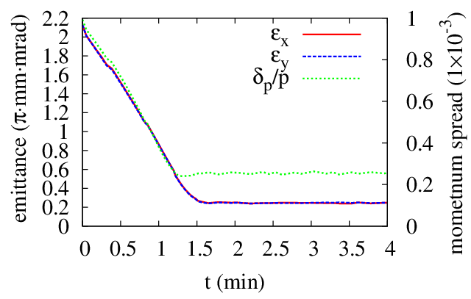
DC Cooling at the Booster
Proton beam:
KE = 2 GeV
Emit = 2.15 mm mrad
dp/p = 0.001
N = 2.8E12
Electron beam:
I = 2 A
T_{tr} = 0.1 eV, T_{s} = 0.1 eV
DC cooler:
L = 10 m
B = 1 T
 |  | IBS | ECOOL | IBS+ECOOL
R_{H} | 1/s | 3.86E-4 | -9.05E-3 | -9.10E-3
R_{V} | 1/s | 3.86E-4 | -9.00E-3 | -8.71E-3
R_{L} | 1/s | 2.27E-4 | -15.3E-3 | -15.3E-3

Slide 6
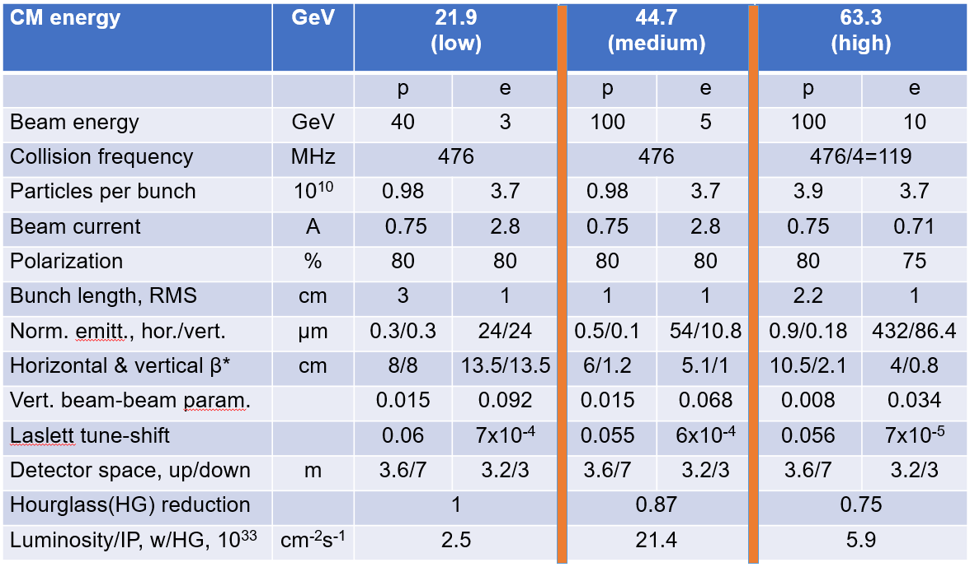
JLEIC New Baseline Parameters

Slide 7
Beam Parameters (CM Energy 63.5 GeV)
Proton beam (CM energy 63.5 GeV):
Energy: 100 GeV
Proton number: 3.9x10¹⁰
Normalized emit. (rms): 1.25/0.25 μm
Beta function in cooler: 60/300 m
Bunch size (rms): 0.835/0.835 mm
Momentum spread: 8x10⁻⁴
Bunch length (rms): 2.5 cm
Cooler parameters:
Length: 2x30 m
B = 1T
Cooling electron beam:
Charge: 2.0 (3.2) nC
Bunch length (total length): 2 cm
Larmor emittance: 19 μm
Transverse temperature: 0.246 eV
Beta function in cooler: 36.67 cm
Momentum spread: 6x10⁻⁴
Longitudinal temperature: 0.184 eV
Radius: 0.835 mm
Length: 2 cm

Slide 8
Electron Cooling (CM Energy 63.5 GeV)
Proton beam (CM energy 63.5 GeV)
Electron beam 2 nC
Cooling rate | 10⁻³ 1/s | -0.280 | -0.961 | -0.537
IBS rate | 10⁻³ 1/s | 3.192 | 0.102 | 0.618
Total rate | 10⁻³ 1/s | 2.912 | -0.857 | 0.081
Electron beam 3.2 nC
Cooling rate | 10⁻³ 1/s | -0.428 | -1.456 | -0.817
IBS rate | 10⁻³ 1/s | 3.192 | 0.102 | 0.618
Total rate | 10⁻³ 1/s | 2.764 | -1.354 | -0.199
In horizontal direction, cooling is about one order weaker than IBS. In the other two directions, cooling is stronger
To find equilibrium:
Apply dispersion at cooler to transfer longitudinal cooling to transverse directions
Apply transverse coupling to transverse horizontal IBS to vertical direction
Increase proton beam emittance
Decrease proton beam current

Slide 9
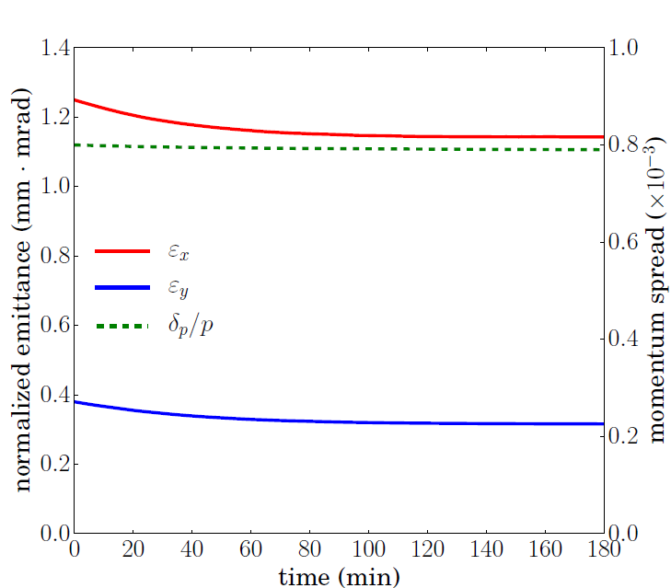
Electron Cooling (CM Energy 63.5 GeV)
Proton beam (CM energy 63.5 GeV):
Energy: 100 GeV
Proton number: 9.975x10⁹ (25%)
Normalized emit. (rms): 1.25/0.38 μm
Beta function in cooler: 60/200 m
Bunch size (rms): 0.835/0.835 mm
Momentum spread: 8x10⁻⁴
Bunch length (rms): 2.5 cm
Dispersion at cooler: 2.0/0.2 m
Transverse coupling: 40%
Electron beam 2.0 nC

Slide 10
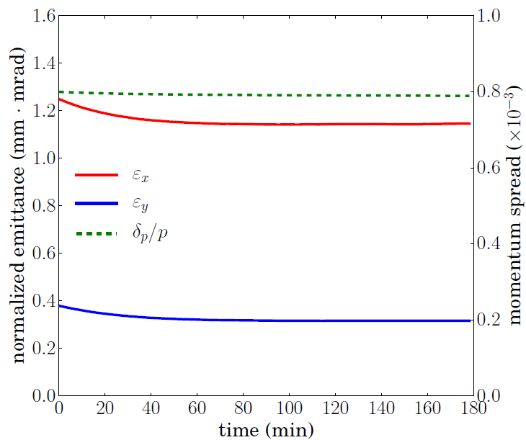
Electron Cooling (CM Energy 63.5 GeV)
Proton beam (CM energy 63.5 GeV):
Energy: 100 GeV
Proton number: 1.482x10¹⁰ (38%)
Normalized emit. (rms): 1.25/0.38 μm
Beta function in cooler: 60/200 m
Bunch size (rms): 0.835/0.835 mm
Momentum spread: 8x10⁻⁴
Bunch length (rms): 2.5 cm
Dispersion at cooler: 2.0/0.2 m
Transverse coupling: 38%
Electron beam 3.2 nC

Slide 11
Beam Parameters (CM Energy 44.7 GeV)
Proton beam (CM energy 44.7 GeV):
Energy: 100 GeV
Proton number: 0.98x10¹⁰
Normalized emit. (rms): 0.5/0.1 μm
Beta function in cooler: 60/300 m
Bunch size (rms): 0.528/0.528 mm
Momentum spread: 8x10⁻⁴
Bunch length (rms): 1 cm
Cooler parameters:
Length: 2x30 m
B = 1T
Cooling electron beam:
Charge: 2.0 (3.2) nC
Bunch length (total length): 2 cm
Larmor emittance: 19 μm
Transverse temperature: 0.246 eV
Beta function in cooler: 36.67 cm
Momentum spread: 6x10⁻⁴
Longitudinal temperature: 0.184 eV
Radius: 0.528 mm
Length: 2 cm

Slide 12
Electron Cooling (CM Energy 44.7 GeV)
Proton beam (CM energy 44.7 GeV)
Electron beam 2 nC
Cooling rate | 10⁻³ 1/s | -3.113 | -7.817 | -3.665
IBS rate | 10⁻³ 1/s | 12.894 | 0.669 | 0.992
Total rate | 10⁻³ 1/s | 9.781 | -7.148 | -2.673
Electron beam 3.2 nC
Cooling rate | 10⁻³ 1/s | -4.708 | -11.787 | -0.554
IBS rate | 10⁻³ 1/s | 12.894 | 0.669 | 0.992
Total rate | 10⁻³ 1/s | 8.186 | -11.118 | -0.455
In horizontal direction, cooling is much weaker than IBS. In the other two directions, cooling is much stronger. Pay attention to longitudinal overcooling.
Apply dispersion at cooler to transfer longitudinal cooling to transverse directions
Apply transverse coupling to transverse horizontal IBS to vertical direction
Increase proton beam emittance
Decrease proton beam current

Slide 13
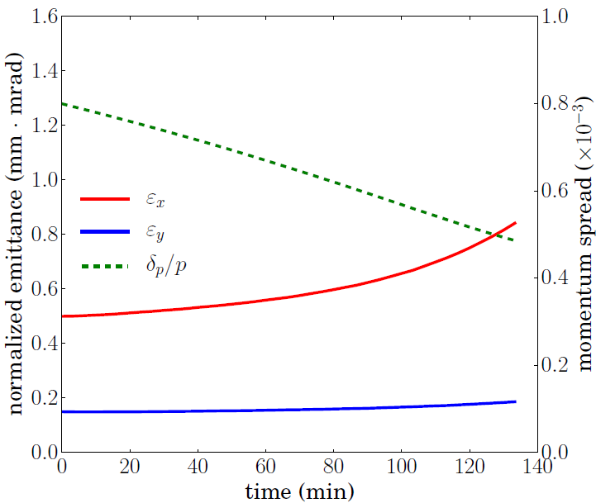
Electron Cooling (CM Energy 44.7 GeV)
Proton beam (CM energy 44.7 GeV):
Energy: 100 GeV
Proton number: 0.539x10¹⁰ (55%)
Normalized emit. (rms): 0.50/0.15 μm
Beta function in cooler: 60/200 m
Bunch size (rms): 0.528/0.528 mm
Momentum spread: 8x10⁻⁴
Bunch length (rms): 1.5 cm
Dispersion at cooler: 1.7/0.35 m
Transverse coupling: 40%
Electron beam 2.0 nC

Slide 14
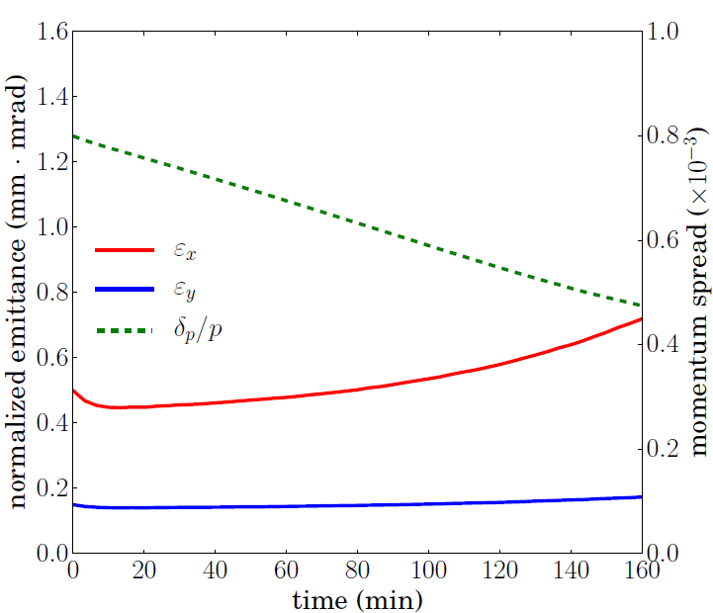
Electron Cooling (CM Energy 44.7 GeV)
Proton beam (CM energy 44.7 GeV):
Energy: 100 GeV
Proton number: 0.804x10¹⁰ (82%)
Normalized emit. (rms): 0.50/0.15 μm
Beta function in cooler: 60/200 m
Bunch size (rms): 0.528/0.528 mm
Momentum spread: 8x10⁻⁴
Bunch length (rms): 1.5 cm
Dispersion at cooler: 1.8/0.4 m
Transverse coupling: 40%
Electron beam 3.2 nC

Slide 15
Outline
Two–stage electron cooling scheme for JLEIC
Electron cooling simulation for JLEIC new baseline
Turn-by-turn tracking simulation for electron cooling
Summary

Slide 16
Compare the Tracking Results of Electron Cooling
RMS dynamic simulation
Create particles w.r.t. the emittances of the ion beam.
Calculate the friction force, which leads to a momentum change (a kick), on each ion.
Calculate the cooling rate: $R=f⋅\sum_{i}{\frac{ΔI_{i}}{I_{i}}}$, where $f$ is the cyclotron frequency, $I_{i}$ is the dynamic invariant for the $i$-th ion.
Calculate the new emittance: $ε=ε_{0}\exp{(R⋅Δt)}$ , where $Δt$ is the time step.
Repeat from step 1.
Turn-by-Turn tracking
Create particles w.r.t. the original emittances of the ion beam.
Calculate the friction force, which leads to a momentum change (a kick), on each ion.
Apply the linear one-turn-map (generated from the tunes) on all the particles
Emittances are calculated statistically from the 6D phase space coordinates of all the particles.
Repeated from step 1.
The turn-by-turn tracking is more “fundamental” than the RMS dynamic simulation. In the following we compare the results of the two methods, to check the accuracy of the RMS dynamic simulation

Slide 17
Beam Parameters (CM Energy 63.5 GeV)
Proton beam (CM energy 63.5 GeV):
Energy: 100 GeV
Proton number: 9.975x10⁹
Normalized emit. (rms): 1.25/0.38 μm
Beta function in cooler: 60/200 m
Bunch size (rms): 0.835/0.835 mm
Momentum spread: 8x10⁻⁴
Bunch length (rms): 2.5 cm
Cooler parameters:
Length: 2x30 m
B = 1T
Cooling electron beam:
Charge: 2.0 nC
Bunch length (total length): 2 cm
Larmor emittance: 19 μm
Transverse temperature: 0.246 eV
Beta function in cooler: 36.67 cm
Momentum spread: 6x10⁻⁴
Longitudinal temperature: 0.184 eV
Radius: 0.835 mm
Length: 2 cm
IBS effect NOT included.
Zero dispersion at the cooler
Proton beam (Gaussian) size larger than electron beam (Beer can) size

Slide 18
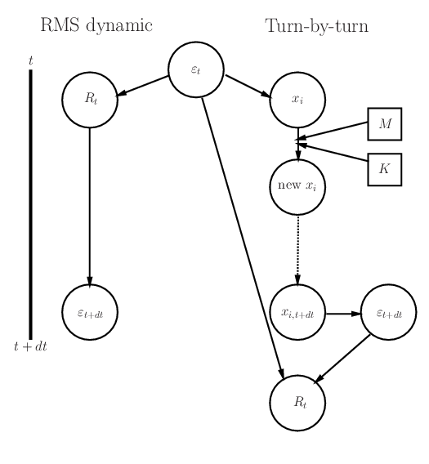
Compare the Tracking Results of Electron Cooling
Tracking 10,000 protons for one second (139,181 turns)
 | $ε_{x}$ μm | $ε_{y}$ μm | $δp/p$ 10⁻⁴ | $δs$ cm
Initial | 1.2499713 | 0.3799988 | 8.0000000 | 2.5000000
RMS ¹ | 1.2496505 | 0.3797225 | 7.9980180 | 2.4993806
Track | 1.2496698 | 0.3797232 | 7.9980328 | 2.4993852
Error | 1.54×10⁻⁵ | 1.74×10⁻⁶ | 1.85×10⁻⁶ | 1.85×10⁻⁶
Err. 1hr ² | 5.70% | 0.63% | 0.67% | 0.67%
 | $R_{x}$ 1/s | $R_{y}$ 1/s | $R_{s}$ 1/s
Initial ×10⁻⁴ | -2.56627 | -7.27271 | -4.95561
Track³ ×10⁻⁴ | -2.41220 | -7.25535 | -4.91862
Error | 0.0639 | 0.0024 | 0.0075
¹ Emittance in RSM dynamic simulation is calculated as $ε=ε_{0}\exp{(R⋅Δt)}$, $R$ is cooling rate, $Δt$ is time step
² Accumulated error in one hour: ${\left(1+Δ\right)}^{3600/Δt}−1$, $Δt$ is time step, $Δ$ is the error for $Δt$.
³ The cooling rate in turn-by-turn tracking: ${(ε}_{f}−ε_{0})/Δt$

Slide 19
Compare the Tracking Results of Electron Cooling
Tracking 10,000 protons for ten second (1,391,803 turns)
 | $ε_{x}$ μm | $ε_{y}$ μm | $δp/p$ 10⁻⁴ | $δs$ cm
Initial | 1.2499547 | 0.3799763 | 8.0000000 | 2.5000000
RMS ¹ | 1.2467795 | 0.3772010 | 7.9811745 | 0.0249412
Track | 1.2466268 | 0.3770856 | 7.9800944 | 2.4937795
Error | 1.22×10⁻⁴ | 3.06×10⁻⁴ | 1.35×10⁻⁴ | 1.35×10⁻⁴
Err. 1hr ² | 4.51% | 11.65% | 4.99% | 4.99%
 | $R_{x}$ 1/s | $R_{y}$ 1/s | $R_{s}$ 1/s
Initial ×10⁻⁴ | -2.54352 | -7.33049 | -4.71193
Track³ ×10⁻⁴ | -2.66595 | -7.63655 | -4.98261
Error | 0.0459 | 0.0401 | 0.0543
¹ Emittance in RSM dynamic simulation is calculated as $ε=ε_{0}\exp{(R⋅Δt)}$, $R$ is cooling rate, $Δt$ is time step
² Accumulated error in one hour: ${\left(1+Δ\right)}^{3600/Δt}−1$, $Δt$ is time step, $Δ$ is the error for $Δt$.
³ The cooling rate in turn-by-turn tracking: ${(ε}_{f}−ε_{0})/Δt$

Slide 20
Compare the Tracking Results of Electron Cooling
Tracking 100,000 protons for one second (139,181 turns)
Tracking 100,000 protons for ten second (1,391,803 turns)
 | $ε_{x}$ μm | $ε_{y}$ μm | $δp/p$ 10⁻⁴ | $δs$ cm
Initial | 1.2499993 | 0.3799999 | 8.0000000 | 2.5000000
RMS ¹ | 1.2496692 | 0.3797223 | 7.9979911 | 2.4993722
Track | 1.2496698 | 0.3797232 | 7.9980018 | 2.4993756
Error | 5.05×10⁻⁷ | 2.42×10⁻⁶ | 1.34×10⁻⁶ | 1.34×10⁻⁶
Err. 1hr ² | 0.18% | 0.88% | 0.49% | 0.49%
 | $ε_{x}$ μm | $ε_{y}$ μm | $δp/p$ 10⁻⁴ | $δs$ cm
Initial | 1.2499853 | 0.3800000 | 8.0000000 | 2.5000000
RMS ¹ | 1.2466963 | 0.3772022 | 7.9800249 | 2.4937578
Track | 1.2466379 | 0.3771630 | 7.9800219 | 2.4937568
Error | 4.69×10⁻⁵ | 1.04×10⁻⁴ | 3.84×10⁻⁷ | 3.84×10⁻⁷
Err. 1hr ² | 1.70% | 3.81% | 0.28% | 0.28%
 | $R_{x}$ 1/s | $R_{y}$ 1/s | $R_{s}$ 1/s
Initial ×10⁻⁴ | -2.64114 | -7.30810 | -5.02295
Track³ ×10⁻⁴ | -2.63609 | -7.28386 | -4.99607
Error | 0.0019 | 0.0033 | 0.0054
 | $R_{x}$ 1/s | $R_{y}$ 1/s | $R_{s}$ 1/s
Initial ×10⁻⁴ | -2.63464 | -7.38990 | -5.00001
Track³ ×10⁻⁴ | -2.68150 | -7.49383 | -5.00078
Error | 0.0175 | 0.0139 | 0.0002

Slide 21
Compare the Tracking Results of Electron Cooling
Previous results are summarized in the tables on the left side, we can see:
The smaller the time step is, the smaller the error we get.
The larger the number of particles is, the smaller the error we get.
If we use step size no more than one second, and number of particles no less than 100,000, the simulation results should be accurate enough (at least for now).
Note that we assume the friction force calculation is correct, and the proton beam still has Gaussian distribution.
Max Error of Emit. For One Step Size
 | N=10,000 | N=100,000
Δt=1s | 1.54×10⁻⁵ | 2.42×10⁻⁶
Δt=10s | 3.06×10⁻⁴ | 1.04×10⁻⁴
Max Accu. Error of Emit. in One Hour
 | N=10,000 | N=100,000
Δt=1s | 5.70% | 0.88%
Δt=10s | 11.65% | 3.81%

Slide 22
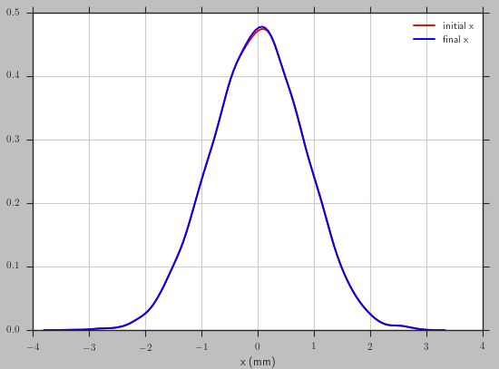
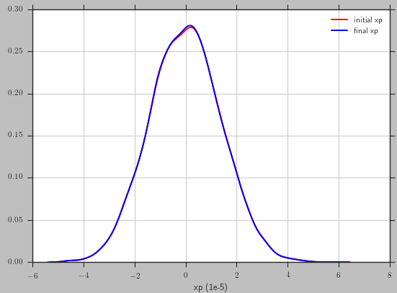
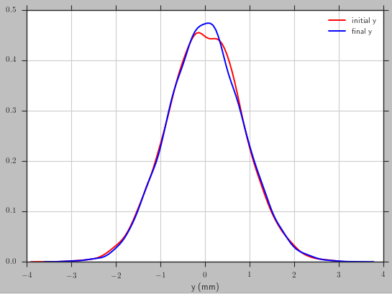
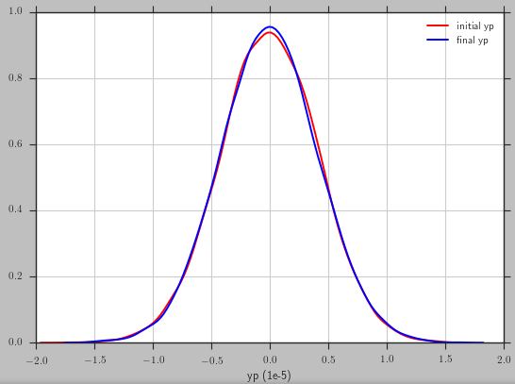
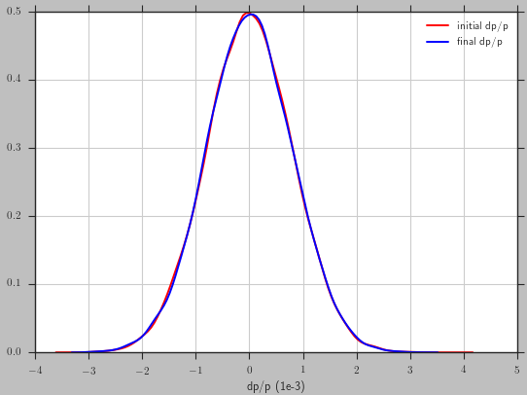
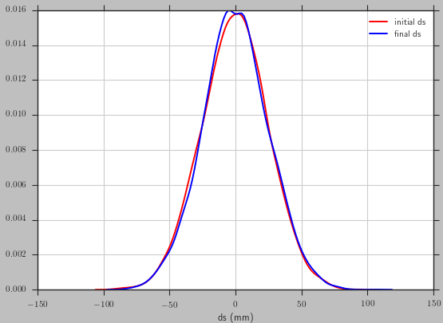
Whether the Gaussian Distribution Remains
x
xp
In ten seconds, the proton distribution is still very close to the original one (Gaussian).
Cannot make a conclusion whether the proton beam will keep the Gaussian distribution longer.
Need to simulate longer time.
Turn-by-turn simulation:
Pros: Straight forward, less approximation.
Cons: Slow (It takes 10 hours in my PC to simulate 10 seconds for 100,000 protons. It will takes a month to simulate one hour.)
Have to go parallel (revise code). Even with cluster machine, the efficiency is still a concern.
y
yp
δp/p
δs

Slide 23
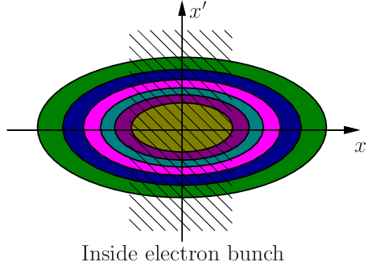
Improve the Model Beam Method
Model beam method:
Summary of the algorithm:
Create sample particles
Apply kicks (IBS & cooling) to each particle
Transfer the particles by applying a random phase advance.
Repeat from the second step
Pros:
Fast (can use large step size)
No assumption of Gaussian distribution
Cons:
In current model, particles outside the electron bunch will not feel the friction force in the whole time step. In fact, due to the betatron oscillations and the synchrotron oscillation, they are inside the electron bunch during a portion of the time step and they should feel a “reduced” friction force.
Need to revise the code to calculate the time averaged friction force
Group the particles by their dynamic invariants. If we have enough sample particles, the average friction force on those with similar dynamic invariants should equal to the time averaged friction force for each of them.

Slide 24
Summary
DC cooling is within the state-of-art
Challenges in the high energy bunched electron cooling for CM energy of 63.5 GeV
High energy bunched electron cooling for CM energy of 44.7 GeV is achievable
Accuracy of the RMS dynamic simulation is good (checked with turn-by-turn tracking simulation).
Improve the model beam method to simulate the evolution of the ion distribution during cooling process

