Slide 1
JLEIC simulations status April 3rd, 2017
Y. Roblin

Slide 2
Scope of Simulations
Intermediate goal is to arrive at what is needed for a good pre-CDR and subsequently CDR
Ion Linac (See talk by Sang-hoon Kim)
Ion Collider Ring
Booster Integration with Ion Linac injection
Electron Ring
Bunched beam Cooler

Slide 3
Simulation Tasks for Ion Collider Ring
Basic simulation of single-particle dynamic aperture and momentum acceptance (completed by G. Wei) DONE
Spin tracking (A.M. Kondratenko et al., talk by V.S. Morozov) DONE
Beam injection, acceleration, and formation (talk by T. Satogata)
Electron cooling simulations (talk by S. Benson)
Crab crossing design and simulations (talk by J. Delayen)
Beam-beam simulations (talk by B. Terzic)
Collective effects and instabilities (talk by R. Li)
Detector solenoid integration study (completed by G. Wei) DONE
Error and multipole tolerances
Strength and alignment error study (completed by G. Wei) DONE
FFQ multipole study (completed by G. Wei) DONE
Local compensation of magnet multipoles
Complete simulation with multipoles, misalignments and detector solenoid
Acceleration with field-dependent multipoles
Dynamics optimization including beam-beam and crab crossing
Beta-squeeze simulation

Slide 4
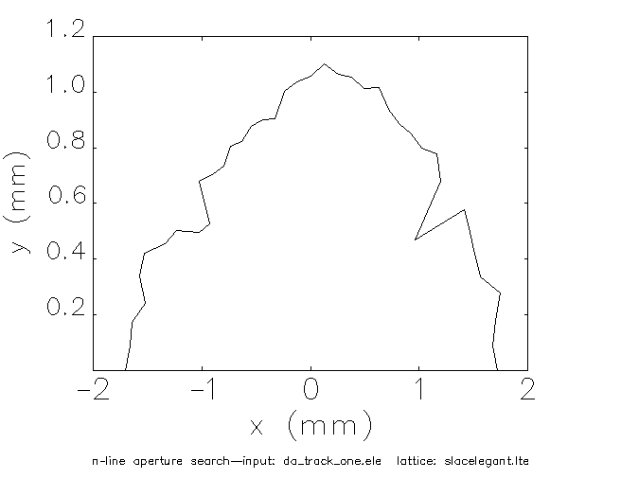
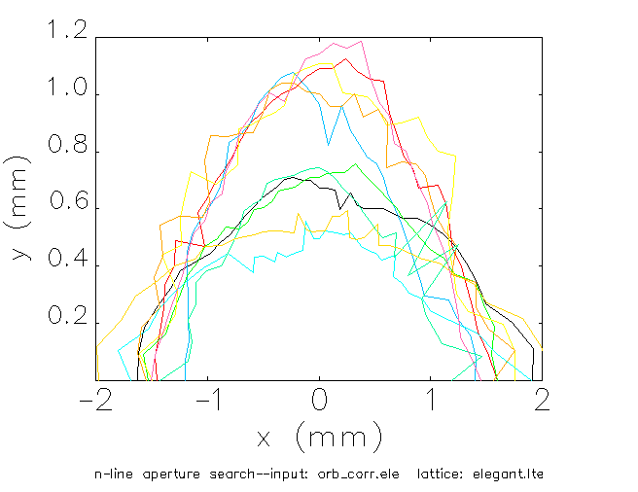
Strength and Alignment Error Study
G. Wei
With error & correction
With error & correction
10 seeds
90 σ
60 σ
100 GeV proton | ex/ey(nor. mm-mrad) | DA origin | DA with error
Case 1, strong cooling | 0.35/0.07 | ~ 90 σ | ~ 60 σ
Case 2, large emittance | 1.2/1.2 | ~ 48 σ | ~ 32 σ

Slide 5
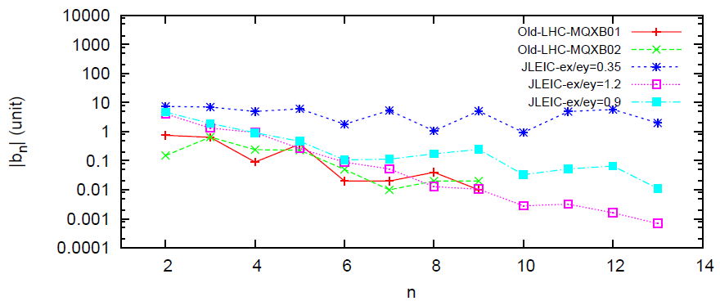
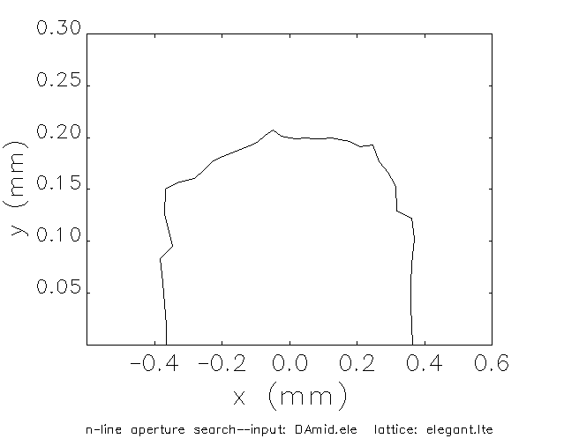
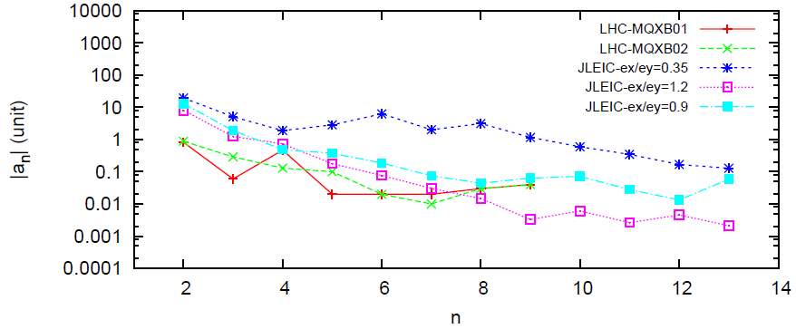
FFQ Multipole Sensitivity Study
G. Wei
DA: 10 σ for 60 GeV proton
& 12 σ for 100 GeV proton
DA
Larger beam emittance with week cooling results in the tighter limit multipole
Survey with 0.9/0.9 mm-mrad of emittance gives a balance between multipole field of IR triplet and dynamic aperture.

Slide 6
Detector Solenoid Compensation Scheme
G. Wei
A scheme:
Two dipole correctors on each side of the IP are used to make closed orbit correction.
Anti-solenoid & skew quads to make decoupling.
4 skew quads with 0.1 meter are enough for each side
: Skew Quadrupole
Notes:
6

Slide 7
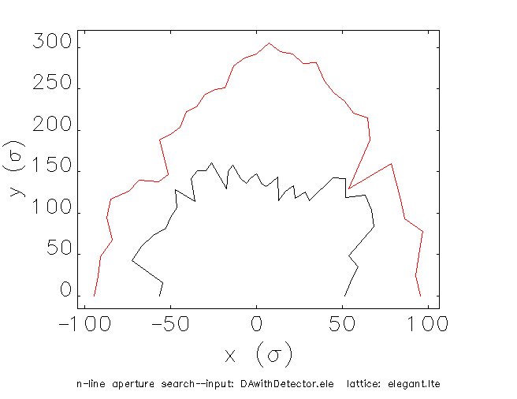
Dynamic Aperture
G. Wei
Red line: bare lattice
Black line: with detector solenoid
Dynamic aperture shrinks to 50 σ, but is large enough considering the final required dynamic aperture of 10 σ

Slide 8
Booster tasks
Imaginary gamma-t lattice with super-ferric magnets (A. Bogacz)
Preliminary studies for space-charge and injection schemes (E. Nissen)
Halo Formation studies in the presence of resonance crossing
Optimization of working point, tunes and DA.
Lean on resources. Hoping to get a postdoc.

Slide 9
Booster Lattice (8 GeV, γ_{t} = 16.8 i )
40
5
BETA_X&Y[m]
DISP_X&Y[m]
0
-5
0
BETA_X
BETA_Y
DISP_X
DISP_Y
275.087
Proton beam energy (total) | GeV | 1.2 - 8
Circumference | m | 275
Straights’ crossing angle | deg | 79.8
Arc length | m | 103 / 85
Straight section length | m | 43
Maximum hor. / ver. β functions | m | 22 / 22
Maximum hor. dispersion | m | 4.3
Hor. / ver. betatron tunes ν_{x,y} |  | 7.87 / 5.85
Hor. / ver. natural chromaticities ξ_{x,y} |  | -6.8 / -4.6
Momentum compaction factor α |  | -3.6 10⁻³
Hor. / ver. normalized emittance ε_{x,y} | µm rad | 1 / 1
Maximum hor. / ver. rms beam size at inj. σ_{x,y} | mm | 5.1 / 5.1
Arc Bends:
L_{b} = 120 cm
B = 3.13 Tesla
bend ang. = 8.12 deg.
Sagitta = 2.1 cm
Straight Quads:
L_{q} = 40 cm
G_{F} = 12.6 Tesla/m
G_{D} = -24.5 Tesla/m
Arc Quadrupoles:
L_{q} = 40 cm
G = 12-65 Tesla/m
Lattice configured with super-ferric magnets
Alex Bogacz
9

Slide 10
Extreme Space-Charge Consideration
Incoherent space-charge tune shift at the injection plateau, where the beam is stored for a long time (10⁵ or more turns).
Present baseline: ΔQ_{sc} = 0.1
More aggressive scenario:
ΔQ_{sc} ≥ 0.3
Q_{x/y} = 7.87 / 5.85
ΔQ_{sc}= 0.1
6
Q_{y}
Resonance crossing and halo formation
Significant fraction of particles in the beam will move across the third-integer and quarter-integer resonance lines → increases the transverse amplitude of particles, leading to halo formation and eventually beam loss.
5.5
7.5
2
3
4
5
Q_{x}
8
Alex Bogacz

Slide 11
Next Step: Extreme Space-Charge Optimization
Mitigation of halo formation and beam loss through comprehensive tracking studies (e.g. SYNERGIA) of resonance crossing in the presence of space-charge and implementation of modern resonance compensation techniques.
Implementation of third-integer resonance crossing correction measures by creating anti-resonances via properly placed pairs of sextupoles . They would correct the stop-band width of these resonances to minimize the amplitude growth and hence beam loss.
Establish the optimum injection energy, working point tunes, maximum current through assessment of the acceptable halo and beam loss.
Alex Bogacz

Slide 12
Simulation Tasks for Electron Ring
Ring Optimization towards small emittance DONE
Chromatic Compensation, DA optimization (talk by Y. Nosochkov) 80% DONE
Field errors, misalignments, multipoles (G .Wei)
Injection Schemes from CEBAF (Lin, Guo) DONE
Injection Optics (Lin, Roblin)
Beam Feedback systems
Beam Abort Systems not pre CDR?
Beam Beam effects, Gear Changing Effects (Roblin, Terzic et al ) in progress
Impedance budget estimates, collective effects (talk by R. Li) in progress
Electron polarization Tracking (F. Lin) 60 % DONE
Polarization related design optimizations (Kondratenko et al)

Slide 13
JLEIC Electron Ring Plan
JLEIC Electron Ring Plan
Topics | Start | End | Weeks |  | Finished | Personal
Ring optimization towards small emittance | 02/01/16 | 08/01/17 |  |  | 80% | Lin
Non-linear dynamics: chromaticity compensation, dynamic aperture, etc. | 02/01/16 | 05/01/17 |  |  | 80% | Lin, Nosochkov
Field errors, misalignment, multipoles, etc. | 05/01/17 | 07/01/17 |  |  |  | Wei, et al.
Path length correction scheme |  |  |  |  | 100% | Morozov, et al.
Injection schemes from CEBAF |  |  |  |  | 100% | Guo, Lin
Injection optics realization | 05/01/17 | 07/01/17 |  |  |  | Lin, Roblin
Beam feedback and abort systems |  |  |  |  |  | H. Wang, Guo, et al.
Beam-beam and gear changing effects | 03/01/17 | 12/01/17 |  |  |  | Roblin, et al.
Impedance budget estimate, single and multiple bunch instabilities | 03/01/17 |  |  |  |  | Li, et al.
Electron polarization design |  |  |  |  | 100% | Lin
Electron polarization tracking | 01/01/16 | 08/01/17 |  |  | 60% | Lin
Polarization-related design optimization | 07/16/17 | 07/15/18 |  |  |  | Kondratenko, et al.

Slide 14
JLEIC Electron Ring Plan
Bunched Beam Cooler tasks
Topics | Start | End | Weeks |  | Finished | Personal
Longitudinal match |  |  |  |  | 90% | C. Tenant
High charge e- injector |  |  |  |  | 80% | F. Hannon
Design the merger |  |  |  |  | 10 % | F. Hannon
Cooling section simulations |  |  |  |  | 60% | H. Zhang
CCR transport |  |  |  |  | 80% | D. Douglas
ERL linac |  |  |  |  | 60 % | D. Douglas
CSR and other collective effects |  |  |  |  | 40 % | C. Tenant, R. Li
S2E simulations |  |  |  |  | 20 % | C. Tenant

Slide 15
Outstanding tasks
Booster
Space charge effects, injection scheme
Ramping, bunch formation.
Collider rings
Electron cloud estimates, other collective effects.
Spin Tracking in electron ring
Injection into e- ring
Beam Beam effects, Gear Changing simulations
Bunched beam cooling optimization

