Slide 1
Polarization Studies
V.S. Morozov, Ya.S. Derbenev, F. Lin, Y. Zhang – Jlab, Newport News, VA D. Barber – DESY, Hamburg, Germany A.M. Kondratenko, M.A. Kondratenko – Zaryad, Novosibirsk, Russia
Yu.N. Filatov – MIPT, Dolgoprudny, Russia
Zgoubi support: F. Meot – BNL, Upton, NY
JLEIC Collaboration Meeting, JLab
April 3-5, 2017
Notes:
F. Lin
1

Slide 2
Outline
Electron polarization
Design strategy
Universal spin rotator
Monte-Carlo simulations of electron polarization lifetime
SLICK/SLICKTRACK
Zgoubi
Ion polarization
Figure-8 concept
Ion polarization control in the ion collider ring
Stability criterion
3D spin rotator
Suppression of imperfection effect on the ion spin
Spin flip
Acceleration of polarized ion beam in the ion collider ring
Lattice
Imperfection effect as a function of energy
Transition energy crossing
Start-to-end simulation of acceleration

Slide 3
Electron Polarization Strategies
Highly vertically polarized electron beams are injected from CEBAF
avoid spin decoherence, simplify spin transport from CEBAF to MEIC, alleviate the detector background
Polarization is designed to be vertical in the JLEIC arc to avoid spin diffusion and longitudinal at collision points using spin rotators
Universal spin rotator (fixed orbit) rotates the electron polarization from 3 to 12GeV
Desired spin flipping is implemented by changing the source polarization
Polarization configuration with figure-8 geometry removes electron spin tune energy dependence, significantly suppress the synchrotron sideband resonance
Continuous injection of electron bunch trains from the CEBAF is considered to
preserve and/or replenish the electron polarization, especially at higher energies
Spin matching in some key regions is considered to improve polarization lifetime
Compton polarimeter provides non-invasive measurements of the electron polarization
Polarization configuration
bunch train & polarization pattern (in arcs)
2.1 ns
476 MHz
Empty buckets
Empty buckets
Spin Rotator
Magnetic field
…
…
…
…
Polarization
IP
Polarization (Up)
Polarization (Down)

Slide 4
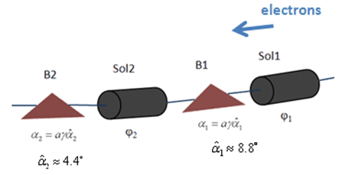
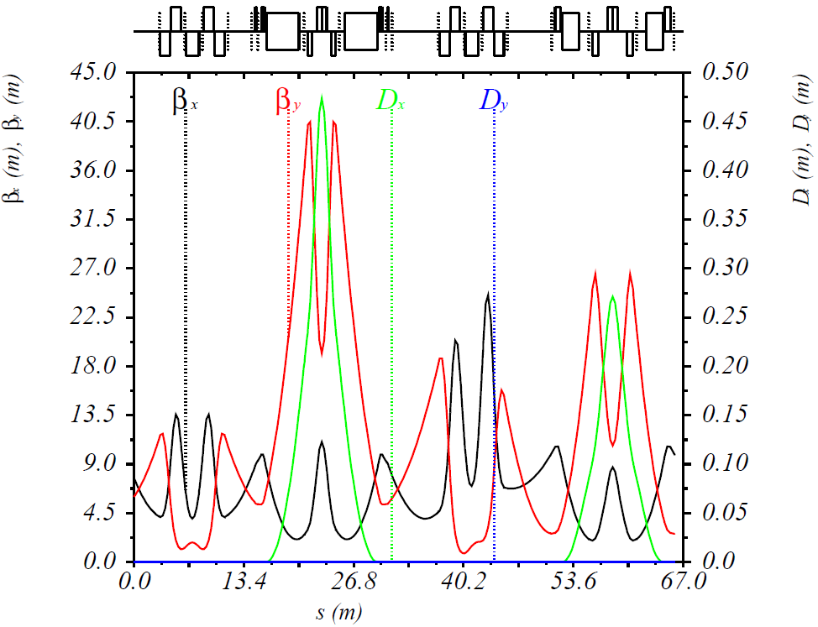
Universal Spin Rotator (USR)
Schematic drawing of USR
Solenoid decoupling & Lattice function
Half
Solenoid
Quad. Decoupling Insert
Half
Solenoid
Arc
IP
P. Chevtsov et al., Jlab-TN-10-026
Parameters of USR for JLEIC
2nd sol. + decoup. quads
1st sol. + decoup. quads
Dipole set
Dipole set
E | Solenoid 1 |  | Arc Dipole 1 | Solenoid 2 |  | Arc Dipole 2
 | Spin Rotation | BDL | Spin Rotation | Spin Rotation | BDL | Spin Rotation
GeV | rad | T·m | rad | rad | T·m | rad
3 | π/2 | 15.7 | π/3 | 0 | 0 | π/6
4.5 | π/4 | 11.8 | π/2 | π/2 | 23.6 | π/4
6 | 0.62 | 12.3 | 2π/3 | 1.91 | 38.2 | π/3
9 | π/6 | 15.7 | π | 2π/3 | 62.8 | π/2
12 | 0.62 | 24.6 | 4π/3 | 1.91 | 76.4 | 2π/3

Slide 5
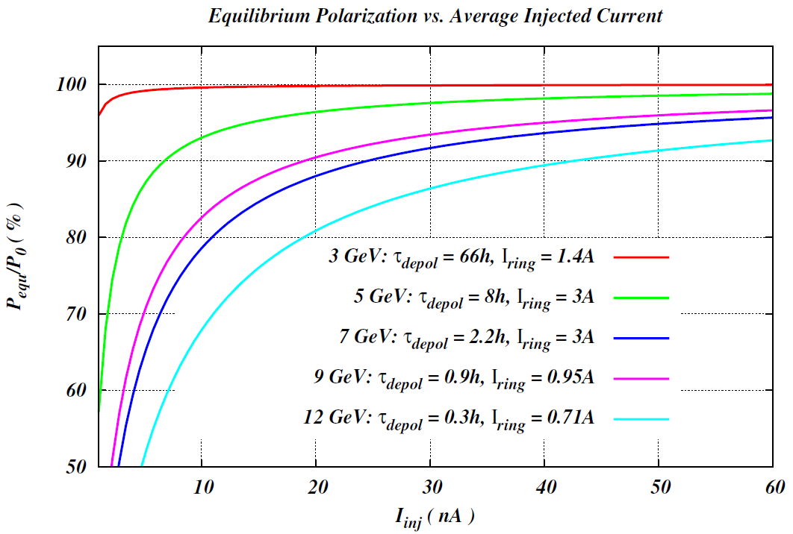
Polarization w/ Continuous Injection
Polarization w/ continuous injection
Equilibrium polarization
A relatively low average injected beam current of tens-of-nA level can maintain a high equilibrium polarization in the whole energy range.

Slide 6
Spin Tune Scan
SLICK/SLICKTRACK allows one to insert a zero length spin tuning magnet to move the spin tune away from zero. Such magnet in the code only rotates the spin, leaving the orbit intact.
Longitudinal field spin tuning solenoid in one straight where the polarization is longitudinal
Only moves the spin tune away from zero
Does not change the spin direction
Breaks the current spin matching condition in the straight
Spin tuning solenoid
e⁻
Magnetic field
Polarization
Spin Rotator
IP

Slide 7
Close Orbit in SLICK/SLICKTRACK
SLICK/SLICKTRACK
Before orbit correction
MAX.ORB.DISTORTN: DXMAX = 13.01533955 MM.
DYMAX = 44.66292770 MM.
DSMAX = 0.19756703 MM.
DEMAX = 0.00201231 MEV.
RMS ORB.DISTORTN: DXRMS = 1.96592282 MM. DXVQRMS = 1.96711965 MM. DXVCRMS = 1.93201011 MM.
AT QUADS DYRMS = 9.13466663 MM. DYVQRMS = 9.08943471 MM. DYVCRMS = 9.08811068 MM.
DSRMS = 0.03628817 MM.
DERMS = 0.00200462 MEV.
DYPRMS = 1.96765921 MRAD
DYABS = 6.16746947 MM.
DYBEND = 22121.34052348 MM.
After orbit correction
MAX.ORB.DISTORTN: DXMAX = 1.70784426 MM.
DYMAX = 0.37412418 MM.
DSMAX = 0.02578462 MM.
DEMAX = 0.00024464 MEV.
RMS ORB.DISTORTN: DXRMS = 0.23823080 MM. DXVQRMS = 0.23807316 MM. DXVCRMS = 0.23333431 MM.
AT QUADS DYRMS = 0.05731394 MM. DYVQRMS = 0.06759153 MM. DYVCRMS = 0.03287557 MM.
DSRMS = 0.00419851 MM.
DERMS = 0.00024370 MEV.
DYPRMS = 0.07774984 MRAD
DYABS = 0.03486573 MM.
DYBEND = 0.29488997 MM.

Slide 8
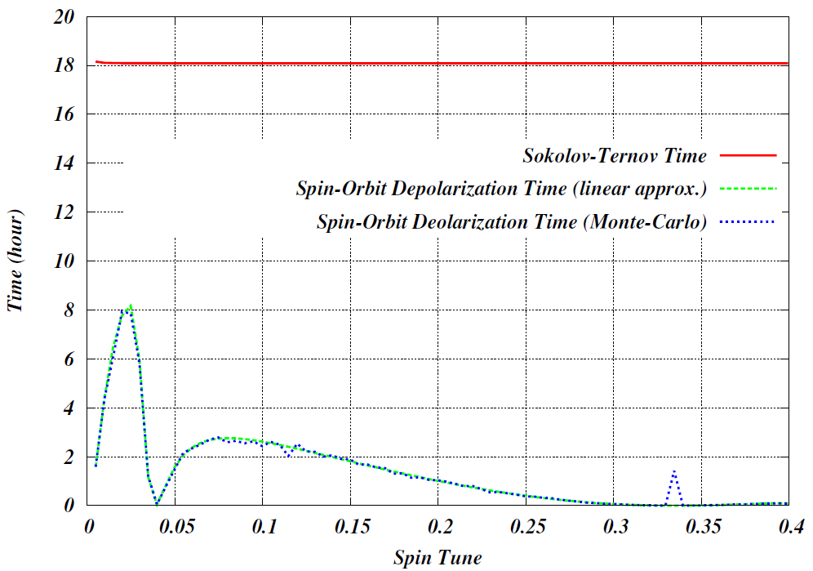
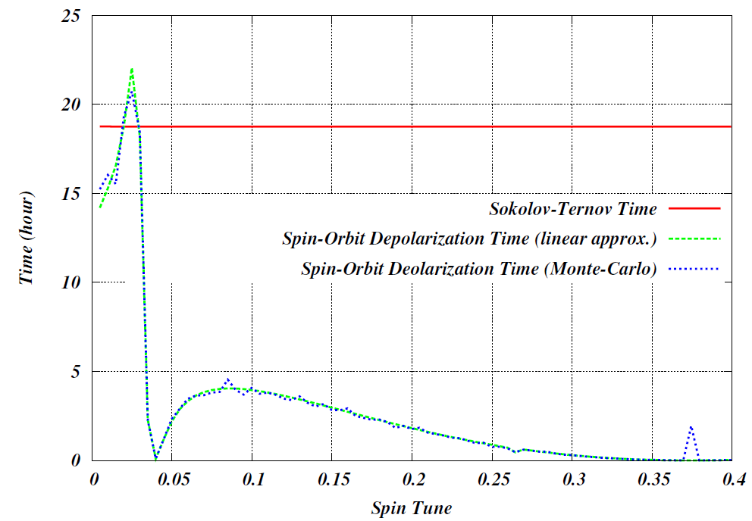
Spin Tune Scan @ 5 GeV
Quadrupole vertical misalignment with a rms value of 0.2mm and dipole roll with a rms value of 0.2 mrad. The orbit is corrected with correctors around the ring.
First order spin resonance occurs when
500 electrons in the Monte-Carlo simulation
Optimum Spin Tune 0.0249
Optimum Spin Tune 0.0267
Baseline design optics
Optimized baseline design optics
Spin-orbit depolarization time increases by a factor of 2.6 in the optimized baseline design

Slide 9
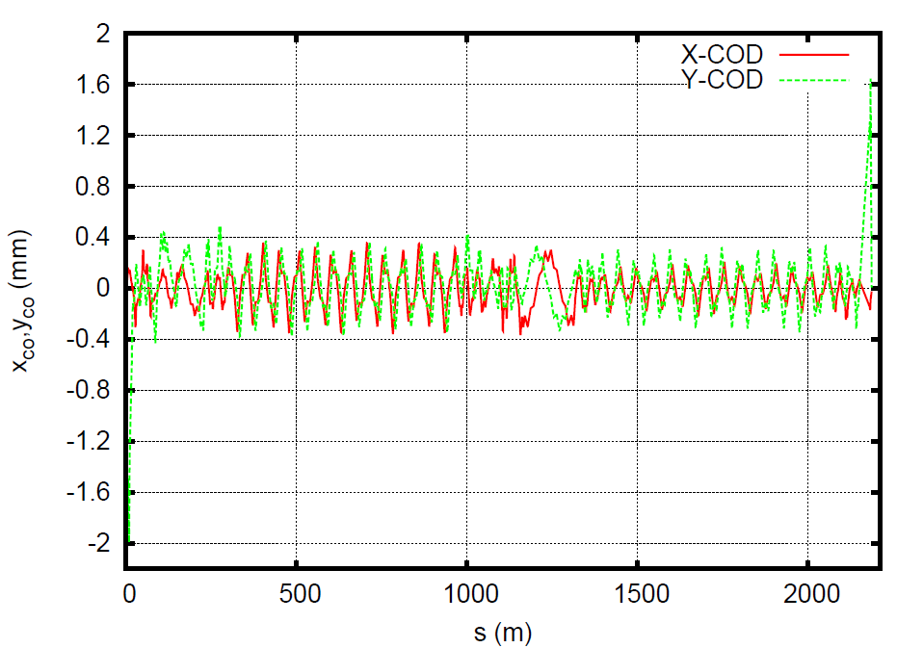
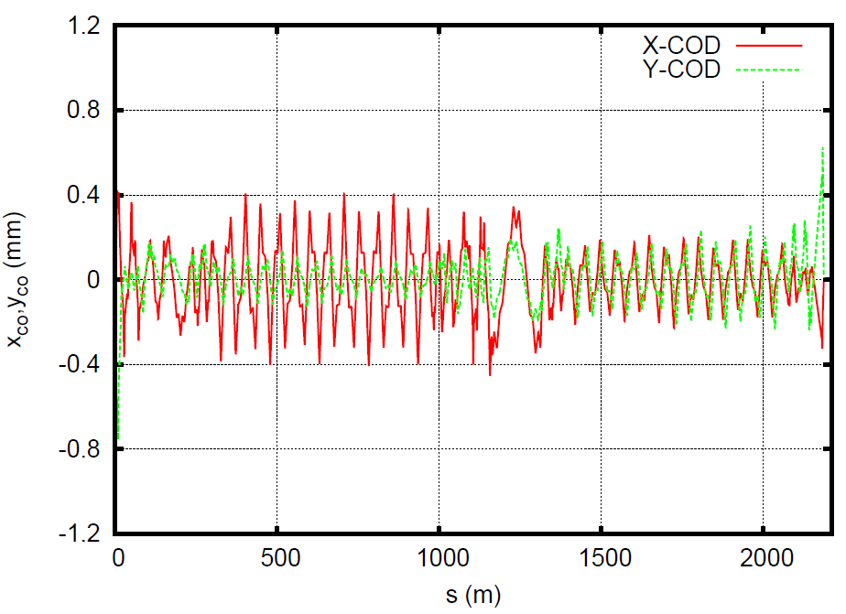
Closed Orbit Distortion in ZGOUBI
Closed orbit distortion due to random quadrupole misalignments
FFQs’ misalignments are included.
FFQs’ misalignments are not included.
This scenario is used for the spin tracking in ZGOUBI using 20 particles.

Slide 10
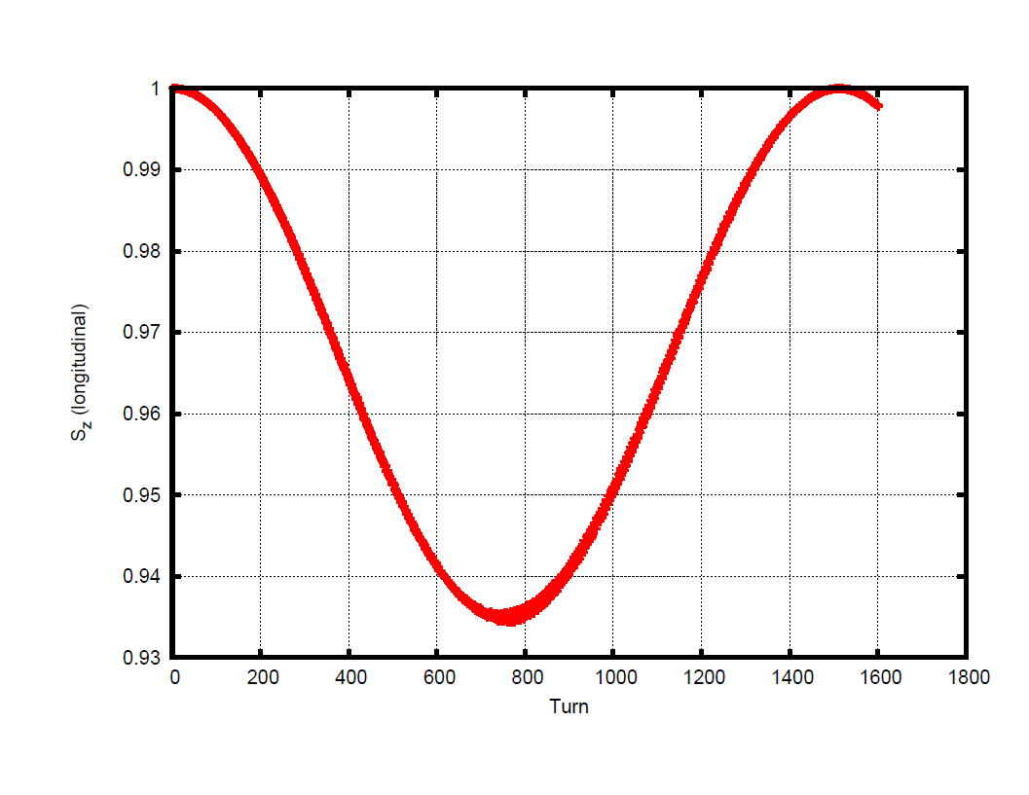
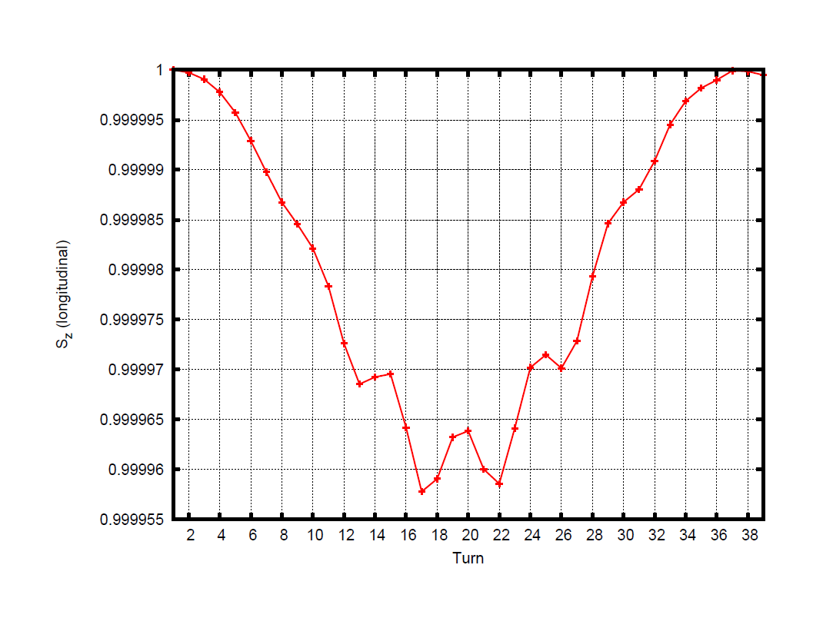
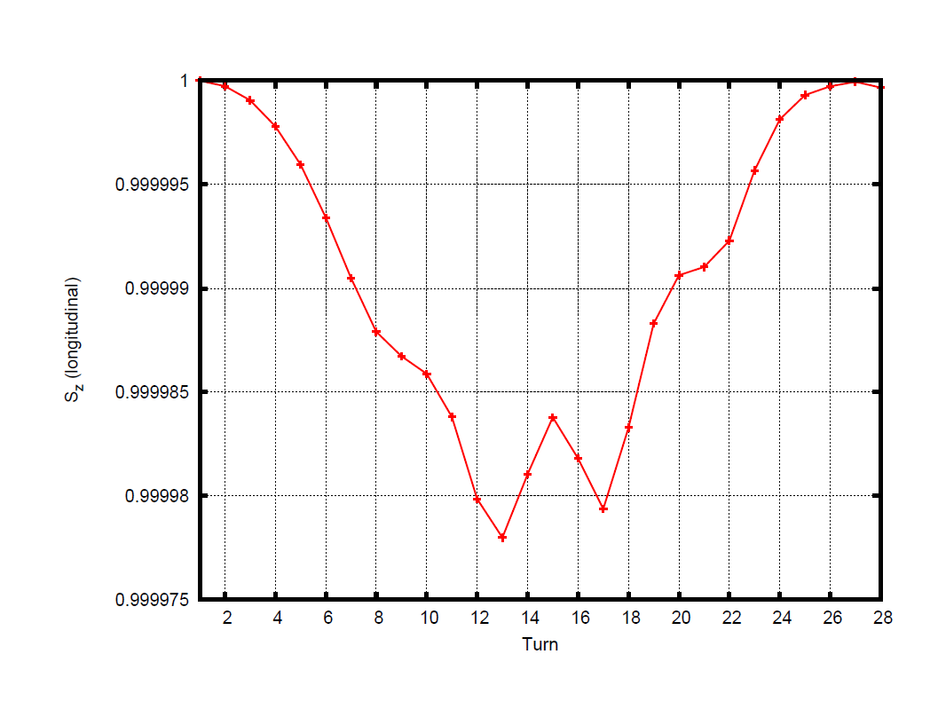
Spin Tune
Longitudinal spin component vs. turn
w/ quads misalignments
w/o spin tune solenoid setting
Spin tune induced by the closed orbit distortion: 6.7×10⁻⁴
Longitudinal spin component vs. turn
w/ quads misalignments
w/ spin tuning solenoid providing a spin precession of 9.6^{ο}
Spin tune induced by the spin tuning solenoid: 0.027
Longitudinal spin component vs. turn
w/ quads misalignments
w/ spin tuning solenoid providing a spin precession of 13.7^{ο}
Spin tune induced by the spin tuning solenoid: 0.038

Slide 11
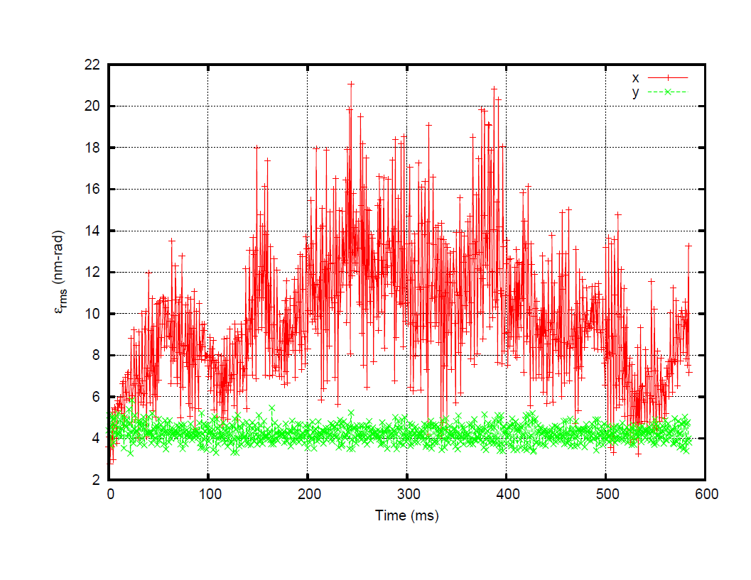
Emittances
Spin tune at 0.027
Spin tune at 0.038
20 particles were used for tracking, ~ 2 days for 7 damping time of ~ 600 ms (80000 turns)
After 7 damping time, the horizontal emittance is close to the analytical value of 9 nm-rad. The non-zero vertical emittance is caused by the coupling of particle motions in the solenoids in the spin rotators, due to the closed orbit distortion.
The emittances in two cases do not change because only spin precession is adjusted by the spin tuning solenoid.

Slide 12
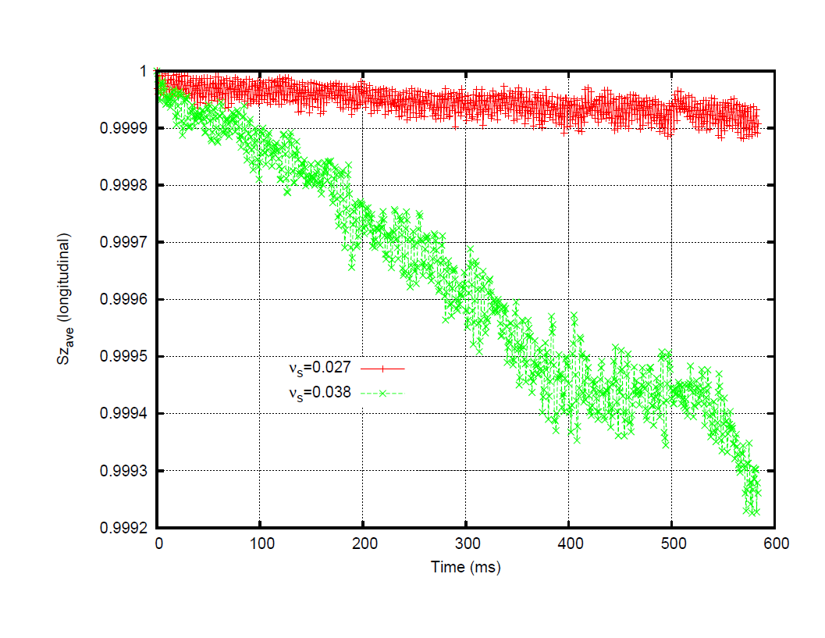
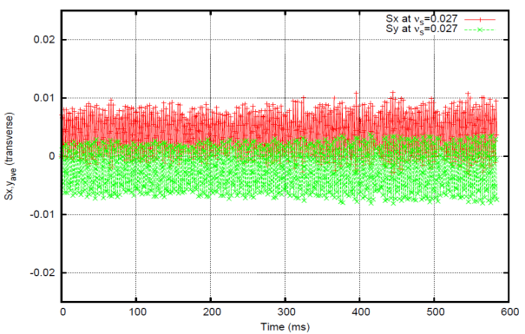
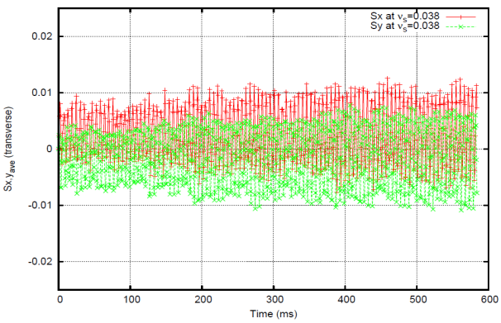
Spin Motion
Three average spin components of 20 particles vs. time (ms)
Qualitatively, simulation results in ZGOUBI agree well with that in SLICK/SLCIKTRACK
Long depolarization time for υ_{s} =0.027, short time for υ_{s} =0.038
Quantitatively, the depolarization time is about 5 times shorter in ZGOUBI than SLCIK/SLICKTRACK, might due to
Large closed orbit distortion in ZGOUBI
Coupling in solenoids due to the closed orbit distortion
~ 7τ_{x,y}

Slide 13
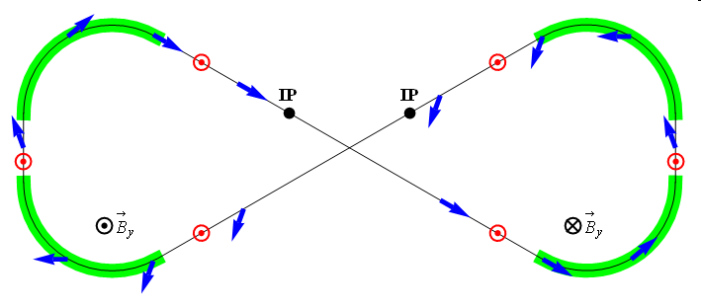
Spin Motion in Figure-8 Ring
Properties of a figure-8 structure
Spin precessions in the two arcs are exactly cancelled
In an ideal structure (without perturbations) all solutions are periodic
The spin tune is zero independent of energy
A figure-8 ring provides unique capabilities for polarization control
It allows for stabilization and control of the polarization by small field integrals
Spin rotators are compact, easily rampable and give no orbit distortion
It eliminates depolarization problem during acceleration
Spin tune remains constant for all ion species avoiding spin resonance crossing
It provides efficient polarization control of any particles including deuterons
It is currently the only practical way to accommodate polarized deuterons
Electron quantum depolarization is reduced due to energy independent spin tune
It makes possible ultra-high precision experiments with polarized beams
It allows for a spin flipping system with a spin reversal time of ~1 s
ν = 0

Slide 14
Zero-Integer Spin Resonance & Spin Stability Criterion
The total zero-integer spin resonance strength is composed of
coherent part due to closed orbit excursions
incoherent part due to transverse and longitudinal emittances
Spin stability criterion
the spin tune induced by the 3D spin rotator must significantly exceed the strength of the zero-integer spin resonance
for proton beam
for deuteron beam

Slide 15
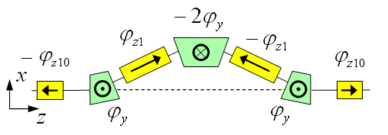
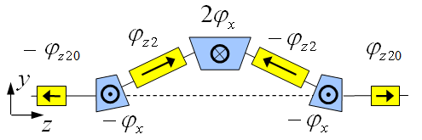
Polarization Control in Ion Collider Ring
3D spin rotator: control of the radial, vertical, and longitudinal spin components
Module for control of the radial component (fixed radial orbit bump)
Module for control of the vertical component (fixed vertical orbit bump)
Module for control of the longitudinal component
3D spin rotator
IP
ions

Slide 16
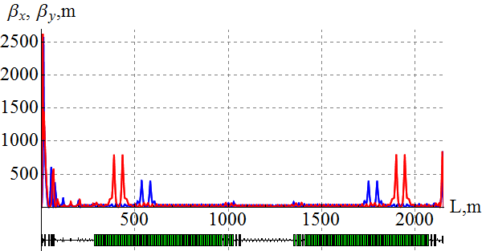
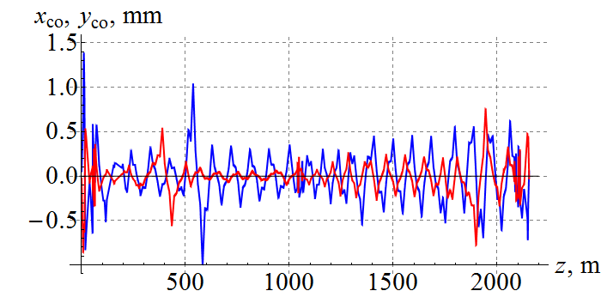
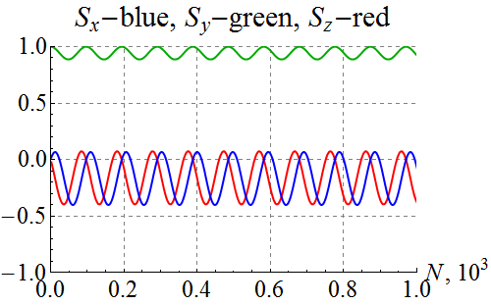
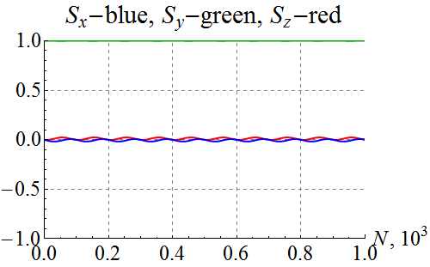
Spin Dynamics in Ion Collider Ring
100 GeV/c figure-8 ion collider ring with transverse quadrupole misalignments
Example of vertical proton polarization at IP. The 1st 3D rotator: ν = 10⁻² , n_{y}=1. The 2nd 3D rotator is used for compensation of coherent part of the zero-integer spin resonance strength
1st 3D rotator for control
2nd 3D rotator for compensation
Zgoubi
without compensation
with compensation

Slide 17
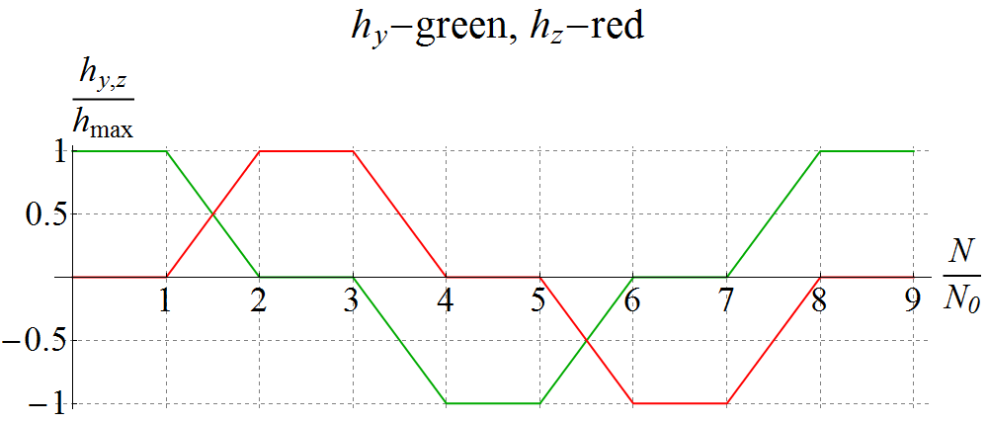
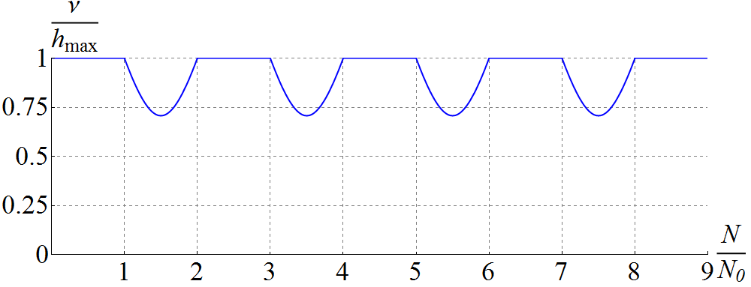
Spin Flipping
Adiabaticity criterion: spin reversal time must be much longer than spin precession period
⇒ τ_{flip} >> 1 ms for protons and 0.1 s for deuterons
Vertical (h_{y}) & longitudinal (h_{z}) spin field components as set by the spin rotator vs time ⇒ Spin tune vs time (changes due to piece-wise linear shape)
Vertical & longitudinal components of proton polarization vs time at 100 GeV/c
$$\vec{P}:↑ → ↓ ← ↑$$

Slide 18
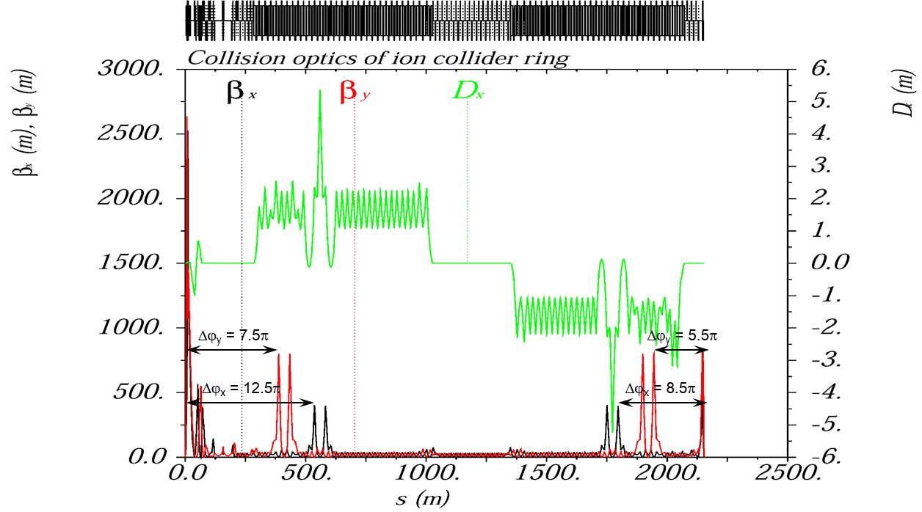
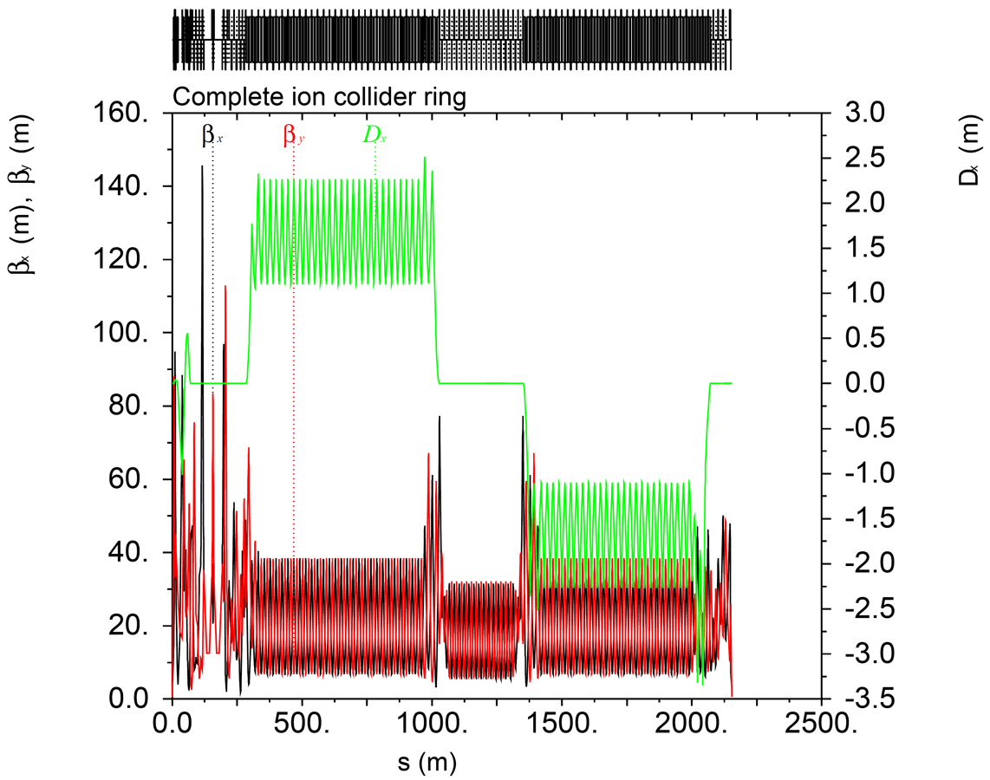
Injection Mode
β* increased by a factor of 30 to (3 m, 0.6 m), β_{max} reduced by a factor of ~26
Betatron tunes: ν_{x} = 24.22, ν_{y} = 23.16

Slide 19
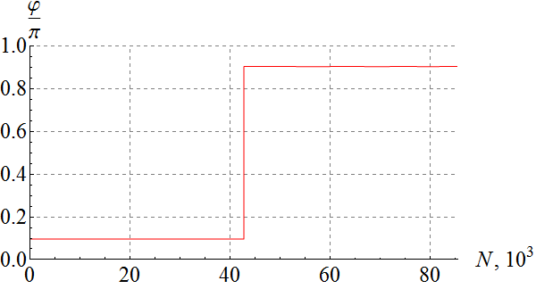
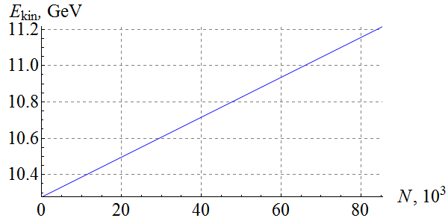
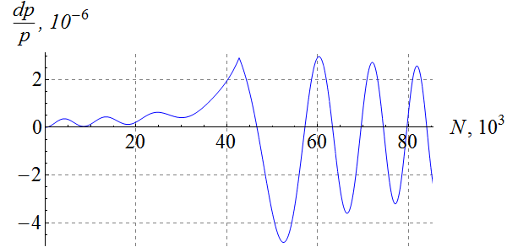
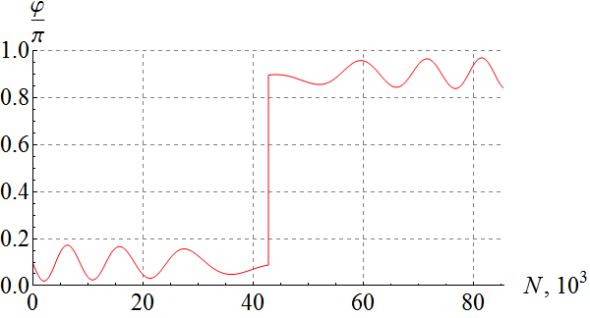
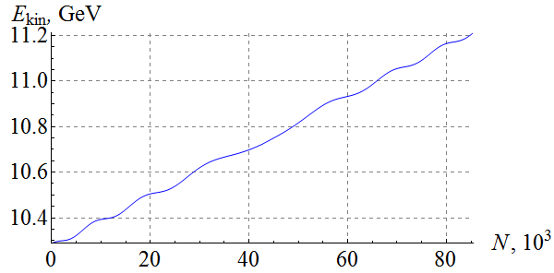
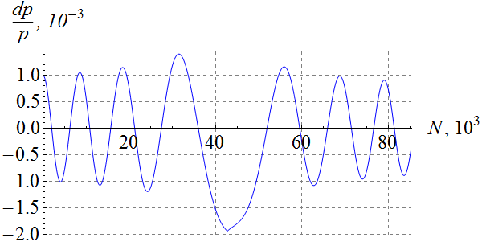
Crossing Scheme: Simple Phase Jump
On-momentum particle
Particle with $Δp/p$ = $1⋅{10}^{−3}$

Slide 20
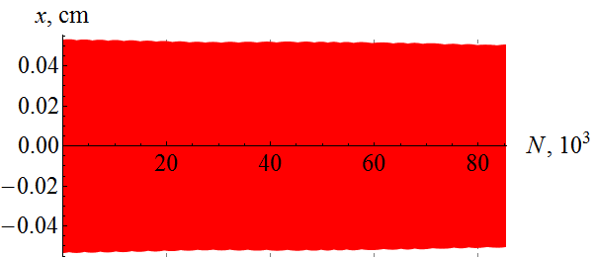
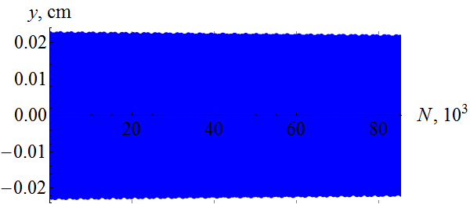
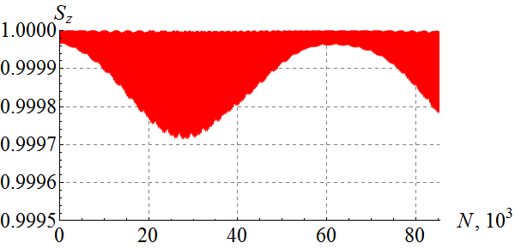
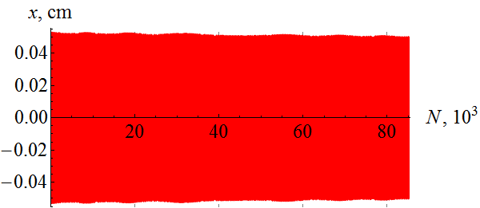
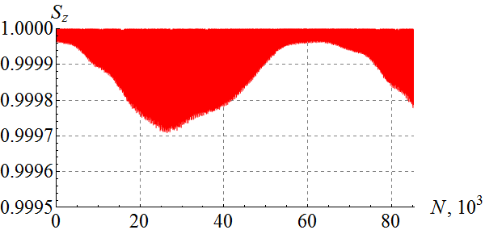
Proton Spin during Transition Crossing
On-momentum particle
Particle with $Δp/p$ = $1⋅{10}^{−3}$

Slide 21
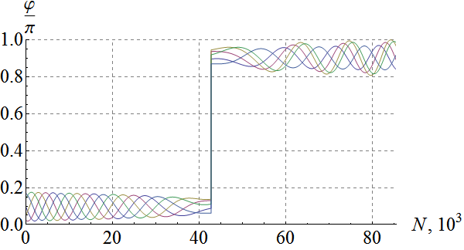
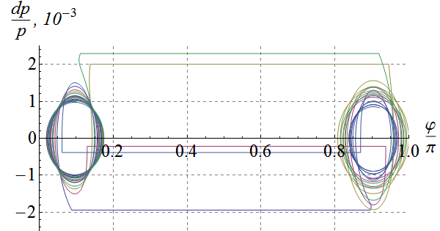
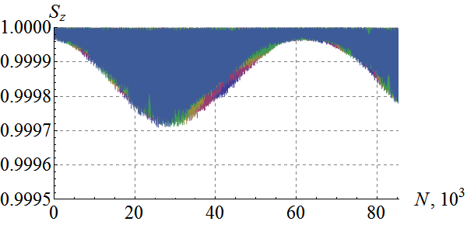
Impact of Synchrotron Phase
On-momentum particle
Five particles uniformly distributed on an ellipse with $Δp/p$ = $1⋅{10}^{−3}$

Slide 22
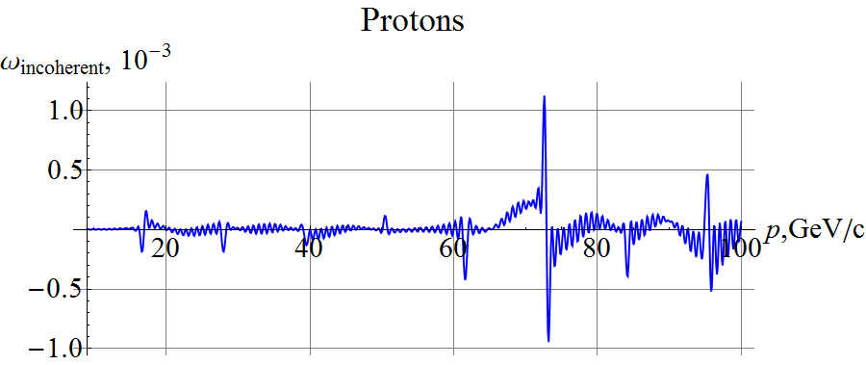
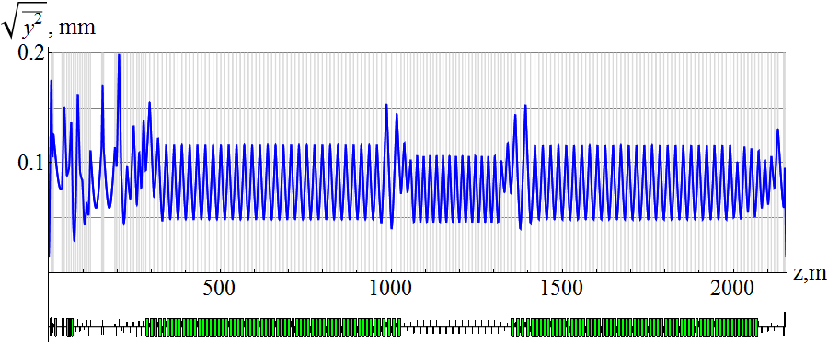
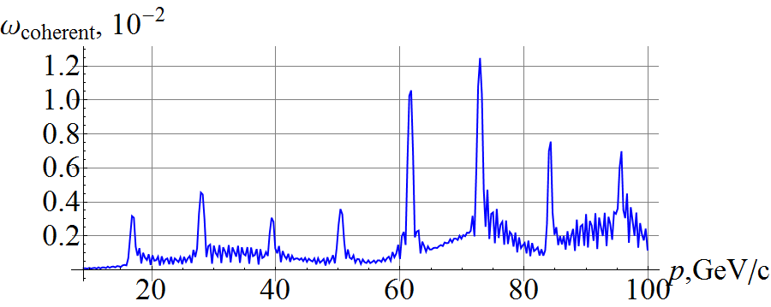
Proton Resonance Strength
Analytically calculated proton incoherent spin resonance strength for $ε_{x,y}^{N}=1 μm$ ⇒ Need a spin tune of $\sim {10}^{−2}$
Analytically calculated proton vertical orbit excursion due to quadrupole misalignments and resulting coherent spin resonance strength

Slide 23
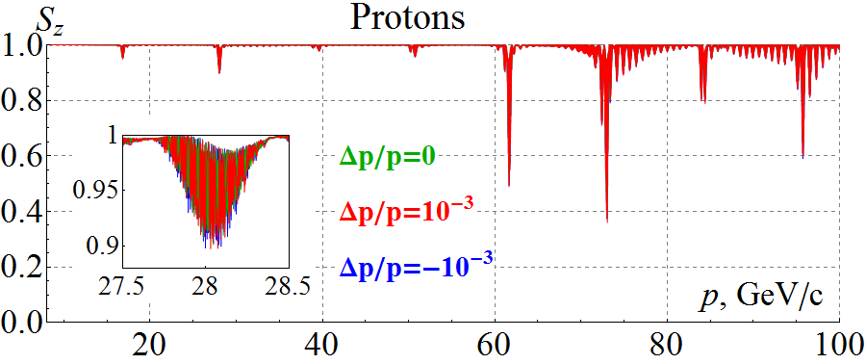
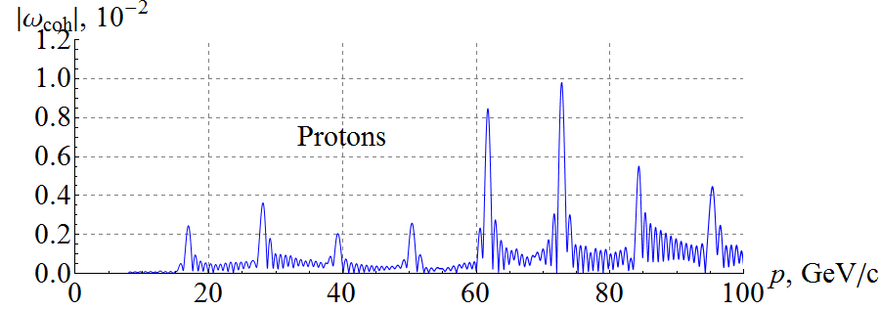
Start-to-End Proton Acceleration
Three protons with $ε_{x,y}^{N}=1 μm$ and ${Δp}/p=0, ±1⋅{10}^{−3}$ accelerated at ~3 T/min in lattice with 100 μm rms closed orbit excursion, $ν_{sp}=0.01$
Coherent resonance strength component
Analytic prediction
Zgoubi simulation

Slide 24
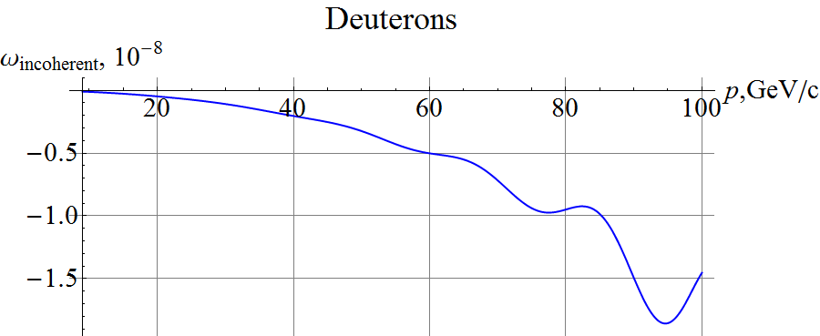
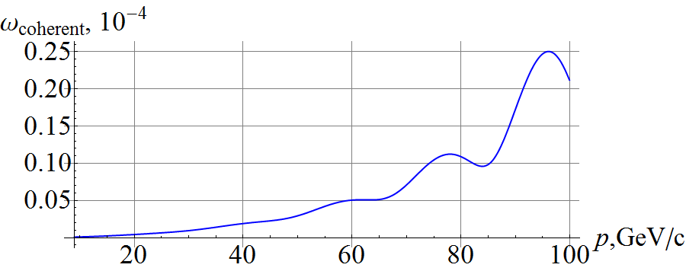
Deuteron Resonance Strength
Analytically calculated deuteron incoherent spin resonance strength for $ε_{x,y}^{N}=0.5 μm$ ⇒ Need a spin tune of $\sim 3⋅{10}^{−3}$
Analytically calculated deuteron vertical orbit excursion due to quadrupole misalignments and resulting coherent spin resonance strength

Slide 25
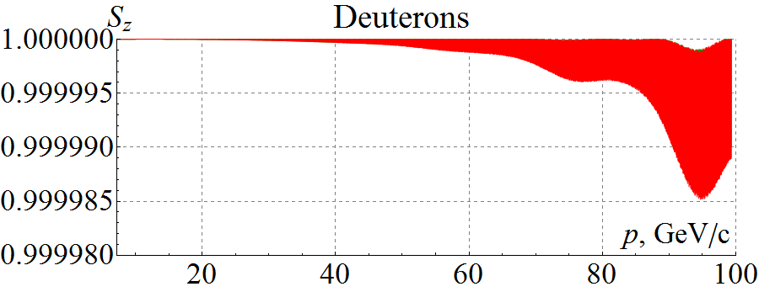
Start-to-End Deuteron Acceleration
Three protons with $ε_{x,y}^{N}=0.5 μm$ and ${Δp}/p=0, ±1⋅{10}^{−3}$ accelerated at ~3 T/min in lattice with 100 μm rms closed orbit excursion, $ν_{sp}=3⋅{10}^{−3}$
Deuteron spin is highly stable in figure-8 rings, which can be used for high precision experiments

Slide 26
Summary and Future Work
Electron polarization design is complete
Electron spin tracking simulations with distorted closed orbit are in progress using SLICK/SLICKTRACK and Zgoubi with good results
Ion polarization control and spin flip in the ion collider ring demonstrated
Start-to-end simulation of polarized ion beam acceleration with transition energy crossing completed
Ongoing and future studies
Electron spin tracking in the presence of coupling and closed orbit distortion
Electron spin matching
Compensation of detector solenoid effect on the ion polarization
Effect of coupling on the ion polarization
Higher-order resonances
Effects of crab crossing, beam-beam interaction, and electron cooling

Slide 27
Backup

Slide 28
Transition Energy Crossing Scheme
Constant acceleration rate
Transition energy jump according to the below picture
RF phase flip at the instant of crossing during the jump
γ
106.6
Δt = 0.612 s
$\frac{Δγ}{2}$ = 0.5
12.45
γ_{tr}
Δγ = 1
8.53
Δt = 60 ms
0
2.4
60
t (s)

Slide 29
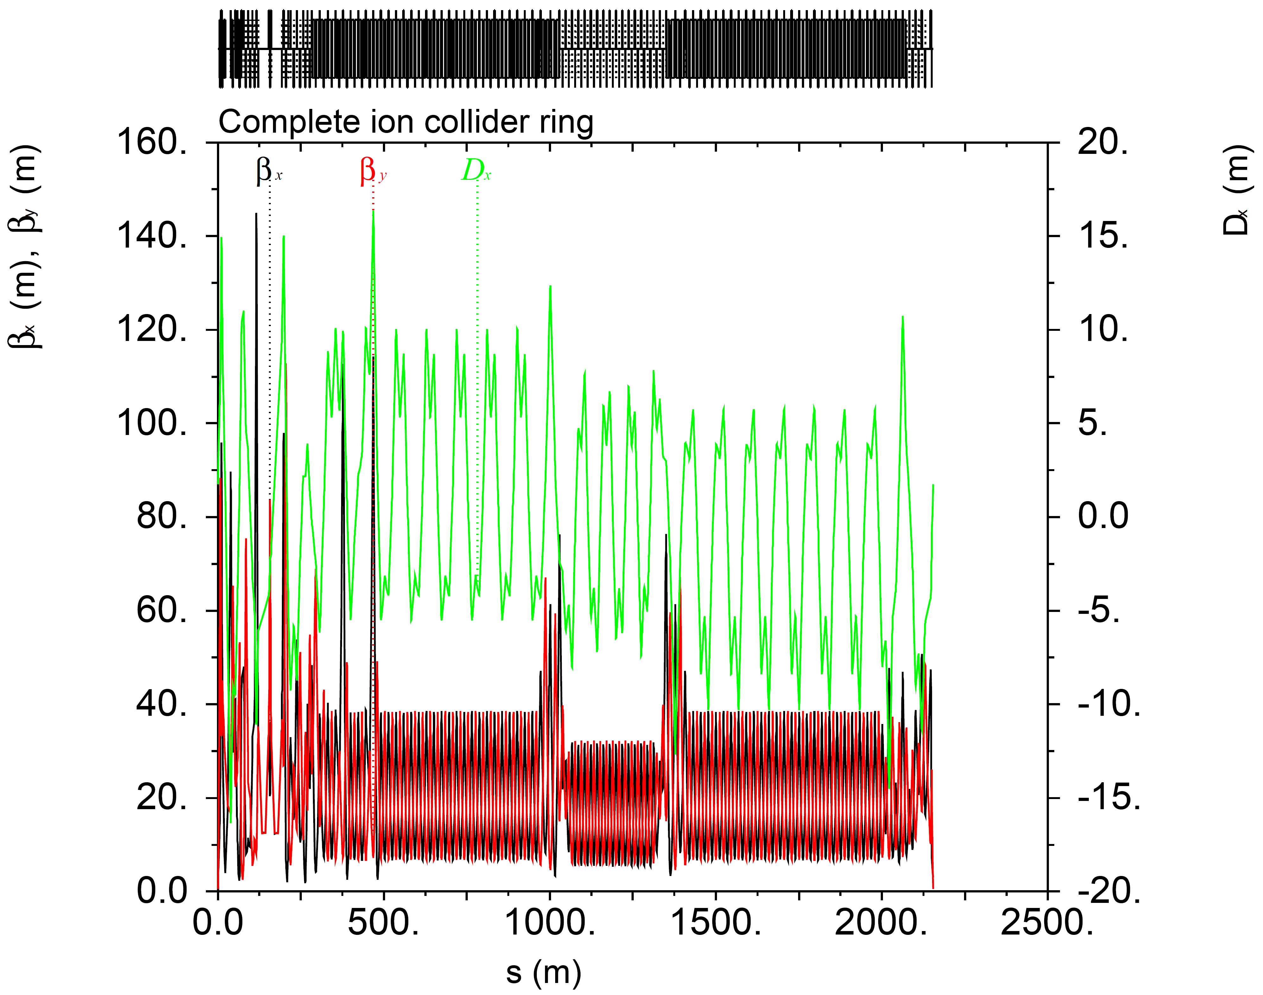
Transition Energy Modification
Scheme by W. Hardt (1974)
Two quadrupole doublets are used in one arc
Horizontal and vertical betatron phase advances between the quadrupoles in each pair are π
Horizontal and vertical betatron phase advances between the pairs are π
The doublets excite dispersion wave around the ring thus modifying the transition energy
The betatron tunes and chromaticities change very little during the jump.
γ_{tr} = 12.453
γ_{tr} = 11.452

Slide 30
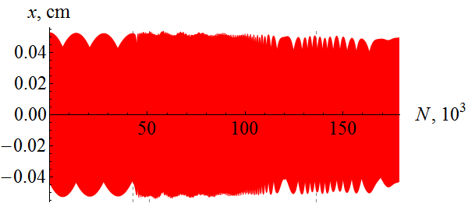
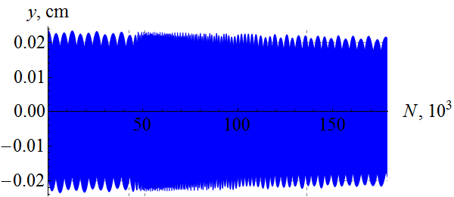
Proton Spin During Crossing
On-momentum particle
Particle with $Δp/p$ = $1⋅{10}^{−3}$

