Slide 1

Cooler Design Studies Status
S.V. Benson on behalf of the Cooler Ring Group
JLEIC Collaboration Meeting
April 3rd, 2015

Slide 2
Cooler Ring Progress
Cooling Physics Progress
Big change to Cooler specification
Cooling partition problem
Status of ERL design
S2E results for ERL
CCR design.
Injection/extraction scheme
The injector
Future work

Slide 3
Cooling Physics
Electron Cooling is essential for achieving the design luminosity, but we are in new territory (pulsed, high energy)
Now have turn-by-turn capability
Working on model beam approach
Working on new cooling formulas from Derbenev thesis
Looking at ways to properly change the cooling partition to match the IBS heating.
Anchoring the code to experiment at IMP
See talks by He Zhang and Geoff Krafft.

Slide 4
Big Change: Baseline is now the CCR
The Circulator Cooler Ring (CCR) is back!
Uses harmonic kicker design to inject and extract from CCR
Micro-bunching instability is now thought to be suppressed
Assumes high charge injector (but can be lower frequency)

Slide 5
Strong Cooler Specifications (Electrons)
Energy 20–55 MeV ¹
Charge 2.0 (3.2) nC
CCR pulse frequency 476.3 MHz
Gun frequency 23.82 MHz
Bunch length (tophat) 2 cm (23°)
Thermal emittance <19 mm-mrad ²
Cathode spot radius 2.2 mm
Cathode field 0.1 T ³
Gun voltage 400 kV
Normalized hor. drift emittance 36 mm-mrad
rms Energy spread (uncorr.)* 3x10⁻⁴
Energy spread (p-p corr.)* <6x10⁻⁴
Solenoid field 1 T
Electron beta in cooler 37.6 cm
Solenoid length 2x30 m ⁴
Bunch shape beer can

Slide 6
Cooler Specifications (protons)
Case 1 – 63.3 GeV center of mass energy
Energy 100 GeV
Particles/bunch 2.0x10¹⁰
Repetition rate 158.77 MHz
Bunch length (rms) 2.5 cm
Normalized emittance (x/y) 1.2/0.6 mm-mrad
Betatron function in cooler 100 m (at point between solenoids)
Case 2 – 44.7 GeV center of mass energy
Energy 100 GeV
Particles/bunch 6.6x10⁹
Repetition rage 476.3 MHz
Bunch length (rms) 1.0 cm
Normalized emittance (x/y) 1.0/0.5 mm-mrad
Betatron function in cooler 100 m (at point between solenoids)
Ion ring lattice may be coupled or dispersed in solenoid. Ion beam may be partially offset from the electron beam.

Slide 7
Electron Cooling (CM Energy 63.5 GeV)
Proton beam (CM energy 63.5 GeV)
Electron beam 3.2 nC
 | Units | x | y | z
Cooling rate | 10⁻³ 1/s | -0.428 | -1.456 | -0.817
IBS rate | 10⁻³ 1/s | 3.192 | 0.102 | 0.618
Total rate | 10⁻³ 1/s | 2.764 | -1.354 | -0.199
In horizontal direction, cooling is about one order weaker than IBS.
To find equilibrium:
Apply dispersion at cooler to transfer longitudinal cooling to transverse directions
Apply transverse coupling to transverse horizontal IBS to vertical direction
Study the possibility of emittance exchange
Increase proton beam emittance
Decrease proton beam current

Slide 8
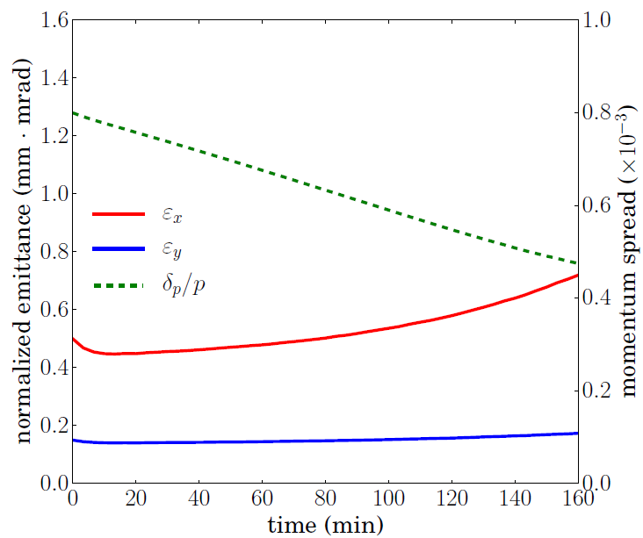
Electron Cooling (CM Energy 44.7 GeV)
Electron beam 3.2 nC
Proton beam (CM energy 44.7 GeV):
  Energy: 100 GeV
  Proton number: 0.804x10¹⁰ (82%)
  Normalized emit. (rms):
  0.50/0.15 μm
  Beta function in cooler: 60/200 m
Longitudinal overcooling reduces the bunch length, which increases the charge density and thus the IBS rate. Transverse equilibrium is broken.
Could decrease RF to keep bunch long.

Slide 9
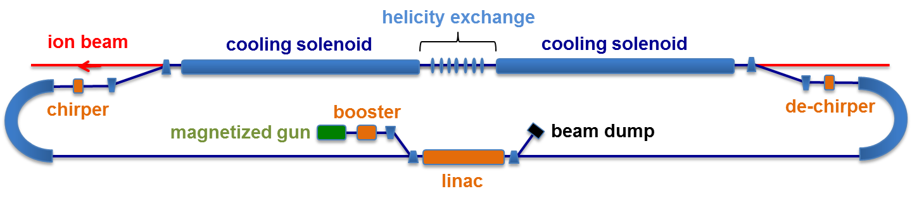
ERL Design Status
Charge is 420 pC at 476.3 MHz
All transport is locally symmetric
Have completed S2E and I2E simulations for ERL design
May want to use two helicity exchanges and four solenoids.
Have not yet included the injection and extraction doglegs.
I2E looks good but we have not been able to produce the initial distribution from injector simulations.
Start of Injector to end simulations

Slide 10
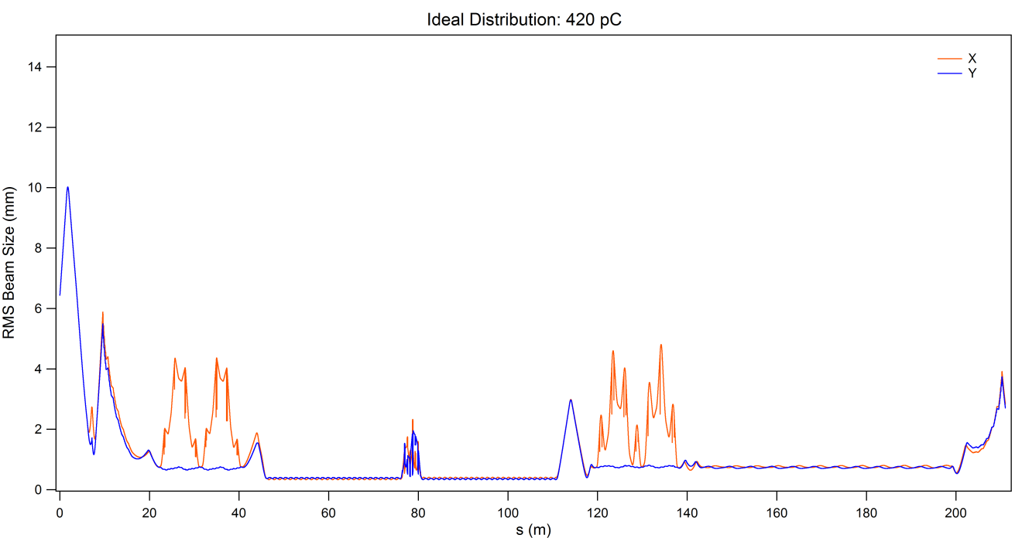
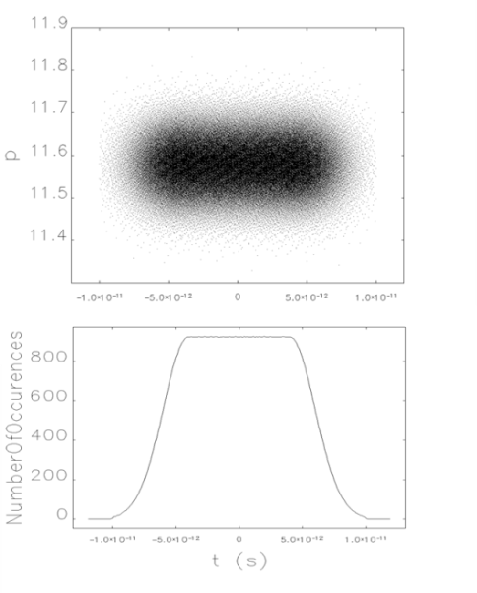
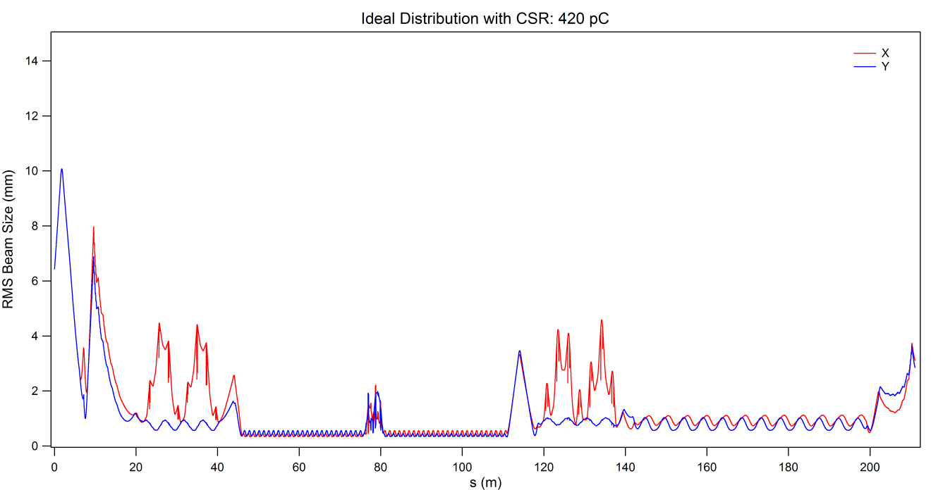
Transverse performance in ERL (Ideal beam)
Start with ideal distribution at booster exit (above).
Find rms beam size vs. distance without (top) and with (bottom) CSR
No re-optimization performed with CSR.

Slide 11
Larmor emittance X2 vs. Distance
We list here the vertical emittance after a round-to-flat transform on the electron beam. The vertical emittance is twice the Larmor emittance
Specification is that the Larmor emittance be less than 19 mm-mrad. So we want the vertical emittance to be less than 38 mm-mrad.
Location | Ideal 420 pC | Ideal 420 pC + CSR | Real 420 pC | Ideal 2 nC
Initial Distribution | 4.0 | 4.0 | 4.0 | 4.0
Merger Exit | 6.01 | 14.48 | 5.43 | 31.92
Linac Exit | 5.74 | 14.18 | 5.58 | 47.18
Arc 1 Exit | 6.06 | 14.63 | 5.60 | 44.84
Solenoid Entrance | 6.04 | 14.51 | 5.52 | 44.89
Arc 2 Exit | 6.92 | 13.19 | 7.95 | 44.38
Linac Exit | 8.87 | 15.57 | 8.11 | 45.83
Big challenge will be preserving the emittance in the injector merger.

Slide 12
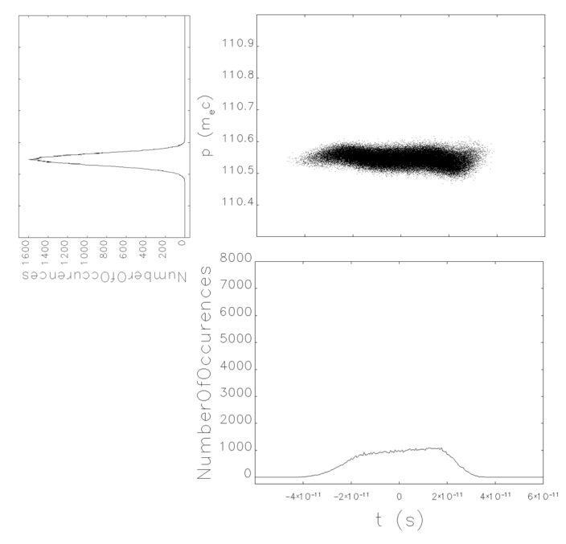
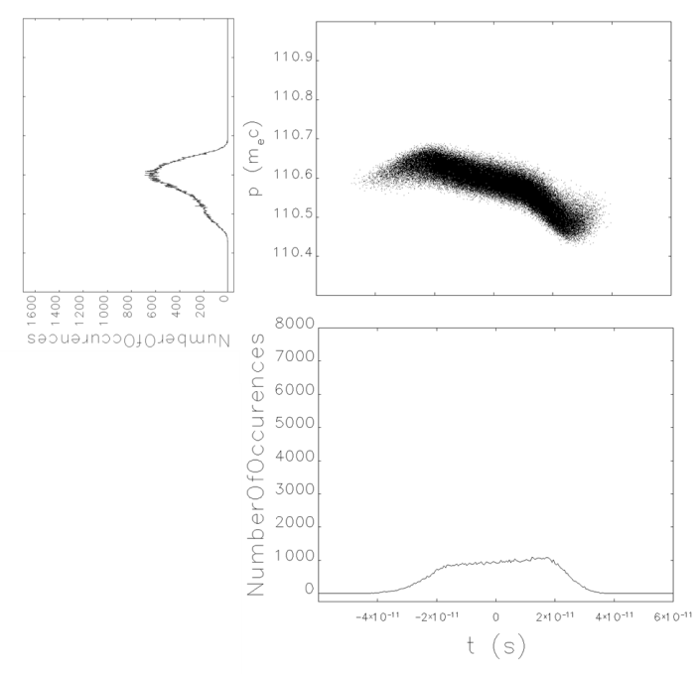
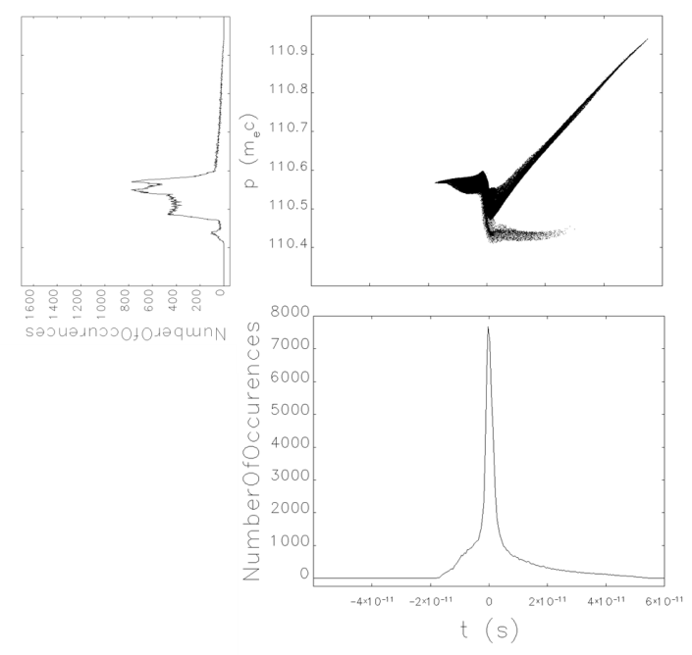
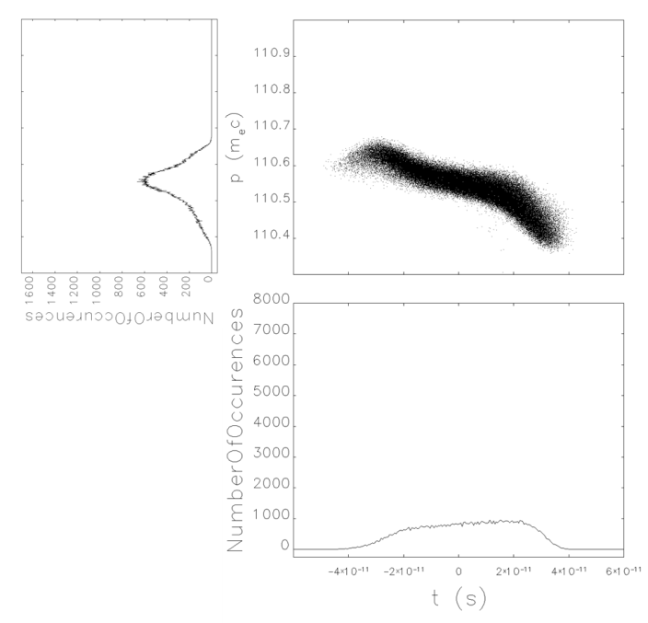
Longitudinal Behavior
420 pC ideal
420 pC ideal w/CSR
420 pC S2E
2 nC ideal

Slide 13
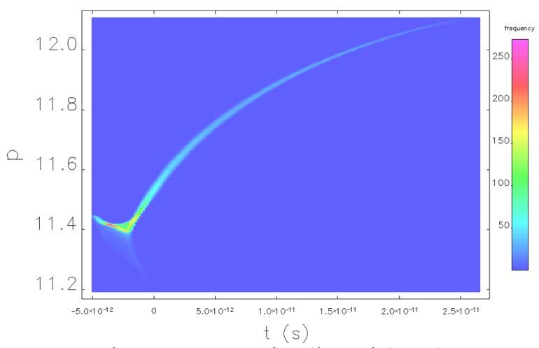
S2E beam after Booster

Slide 14
CSR Design Status
Increased charge enhances space charge and CSR forces, but long pulse raises the possibility of shielding the CSR. MBI looks like less of a problem.
Simulating CCR while designing the injection/extraction region.
Currently using locally asymmetric isochronous arcs. Locally symmetric arc design almost done.
Looking at tools for simulating the system (BMAD, GPT?, Impact?, others?) Want CSR, LSC, and shielding.
Have first cut at Injection/Extraction region.

Slide 15
Longitudinal Match
Use longitudinal match developed for ERL-based cooler (C. Tennant et al., JLAB-TN in preparation)
  off-crest acceleration bunch of modest length
    induce chirp for downstream bunching
    bunch long enough to mitigate space charge, short enough to stay within linac phase acceptance
  debunch, dechirp during transport to cooling system
  rechirp, compress during return transport for energy recovery
  recover bunch of modest length with energy compression of chirp
  Simply replace “ERL cooling system” with CCR
  Invokes isochronous transport, avoids bunch length modulation in CCR
    Mitigate μBI
  Requires transfer of long bunch
    Must be observant of kicker (non)linearity…

Slide 16
Microbunching Instability in CCR
Elegant tracking revealed that the early design of figure-8 CCR for a non-magnetized beam suffers strong MBI (G > 4000/turn)
A semi-analytical Vlasov solver, as an efficient computation tool for characterizing MBI, has been developed and benchmarked.
Locally isochronous arc lattice has been shown to have strong suppression effect on the MBI gain, as verified by both the Vlasov solver and tracking simulations
Magnetized beam, with its large transverse beam size due to angular momentum of the beam, can also enhance the Landau damping of MBI
The current CCR design will have magnetized beam going through locally isochronous arcs, but the total path length is several kilometers.

Slide 17
Microbunching Gain vs. Current and Energy Spread
30 A, 2.4×10⁻³
30 A, 8.0×10⁻⁵
140 A, 2.4×10⁻³
140 A, 8.0×10⁻⁵
Note:
1. Since , small energy spread will push the peak gain
toward short wavelength regime.
2. The calculation includes all CSR and LSC effects.

Slide 18
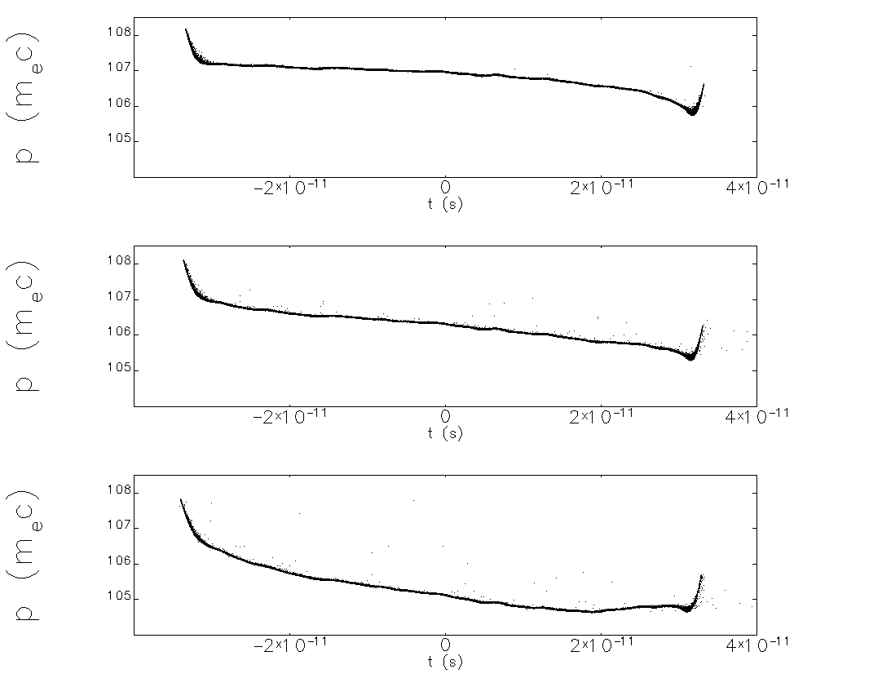
(t,p) Evolution – Zoomed View
5-turns
10-turns
20-turns
Initial bunch assumed to be super-Gaussian profile

Slide 19
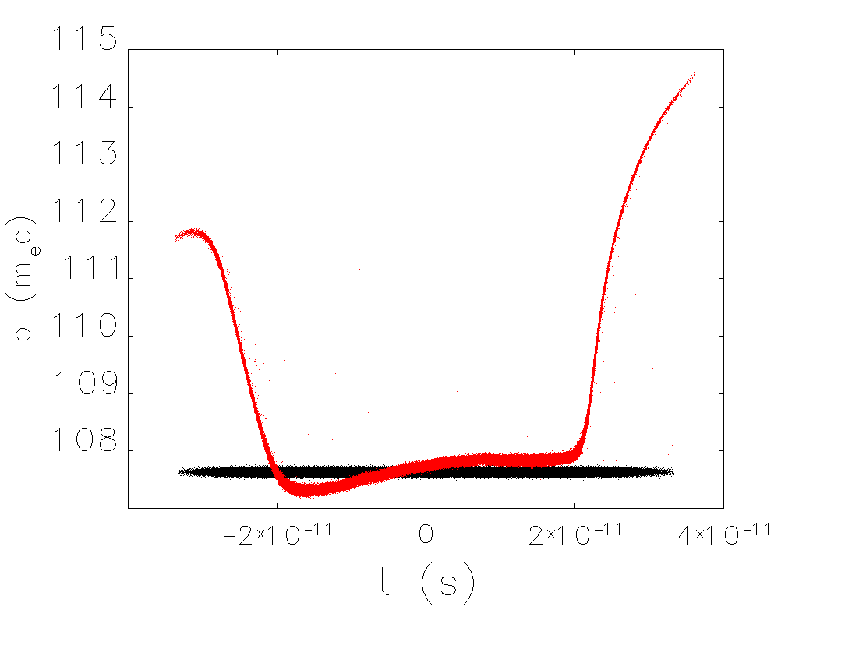
Longitudinal Phase Space: 200 kV
after 20 turns
initial

Slide 20
Exchange System Requirements
Low (55 MeV) energy ⇒ RF kickers give mrad-scale kicks
Assume long bunch so kicks must be compensated
Need –I transform between kickers
Can kick either horizontally or vertically
  horizontal kick ⬄ Lambertson septum
  vertical kick ⬄ conventional septum
Kick converts to displacement through use of “quarter-wave betatron amplifier”, a la CEBAF extraction system
  “amplifier gain” (a.k.a. M₁₂) × kick angle gives spatial split of recirculated, exchanged beams
Δ(x or y) = M₁₂ θ_{kicker} > Nσ + septum thickness + “operational allowance”
Axial symmetry hard to provide internally (“amplifer” requires defocusing ⬄ breaks symmetry); need axial symmetry overall

Slide 21
Notional Layout
Basic concept
Additional “details”
  “pre-kicker” and “post-kicker” in ERL
    suppress bunch length/kicker nonlinearity – driven distortion
  dispersion management in vertical translation
  focusing pattern/optics constraints amongst various kickers
  betatron matching
    various beams (injected, extracted, recirculated) must match to one another when split and merged
    all beams must match to acceptance of ERL, CCR when at start/end of exchanges
  length/height scales
    clearance between CCR recirculation/exchange focusing and dispersion management focusing
circulating CCR bunch trains
CCR
fast kicker
fast kicker
chirper
injected bunch orbit
septum
extracted bunch orbit
dechirper
ERL
vertical dipole
vertical dipole

Slide 22
From Schematic To Design
“Match” ⬄ 8 quad telescope
There is are 2 additional matches in the ERL
  Present optimization adds a wavelength here and there…
  between PREK and vertical step up
    gives ½-wave transform PREK to IK (~¼ wave PREK to S)
  between vertical step down and PSTK
    gives ½-wave transform EK to PSTK (~¼ wave S to PSTK)
Layout:
Use figures from tech note.

Slide 23
From Schematic To Design
“Match” ⬄ 8 quad telescope
There is are 2 additional matches in the ERL
  Present optimization adds a wavelength here and there…
  between PREK and vertical step up
    gives ½-wave transform PREK to IK (~¼ wave PREK to S)
  between vertical step down and PSTK
    gives ½-wave transform EK to PSTK (~¼ wave S to PSTK)
Layout:
Use figures from tech note.

Slide 24
Twiss Parameterization
CCR back leg
ERL to CCR

Slide 25
Injector Design
Current design assumes photocathode embedded in magnetic field.
420 pC design has difficulty producing a flat-top pulse at 5 MeV.
See Riad Suleiman’s talk for progress on experimental study.
CCR design opens the possibility of subharmonic buncher, harmonic cavity linearizer, or even a low frequency injector.

Slide 26
Where Are We and Where Do We Go?
Have to partition the cooling to match IBS.
Can use globally symmetric transport.
Need to simulate CCR with CSR shielding
Need to add space charge to CCR simulations
Need injector design (subharmonic)
Might want to use emittance exchange for either the ion ring or the cooler linac.
Need to look at ion trapping and HOM damping in linac.
Have to study BBU
Need to look at Injection/extraction details (e.g. energy slew, aperture)

Slide 27
BACKUPS

Slide 28
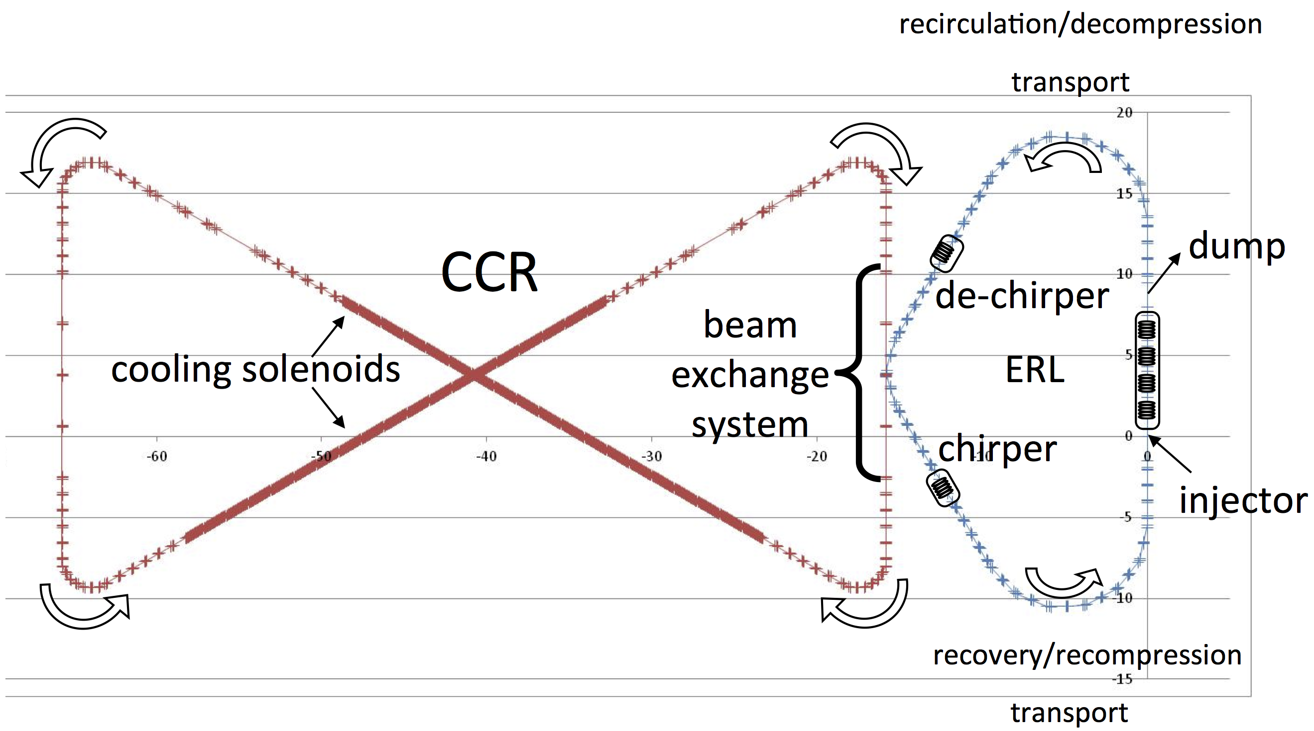
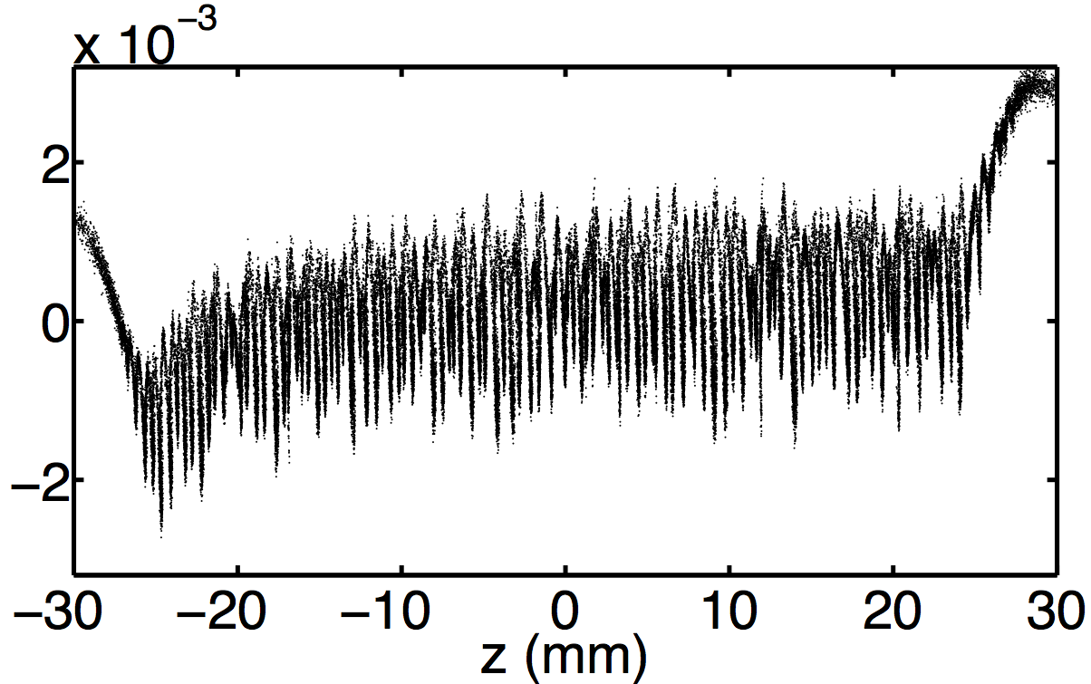
Early design of CCR: non-magnetized beam, non-local-isochronous
single-turn, 3-million particles
δ
λ = 360 μm
Microbunching instability due to (only) CSR can be up to 4000!
λ = 360 μm (1.2 ps)
G(s): amplification factor
of microbunching
Notes:
For the early figure-8 CCR design for non-magnetized beam, Elegant tracking shows the cooling beam is seriously microbunched after just one turn in CCR. The semi-analytical uBI solver shows huge one-turn gain of 4000.

Slide 29
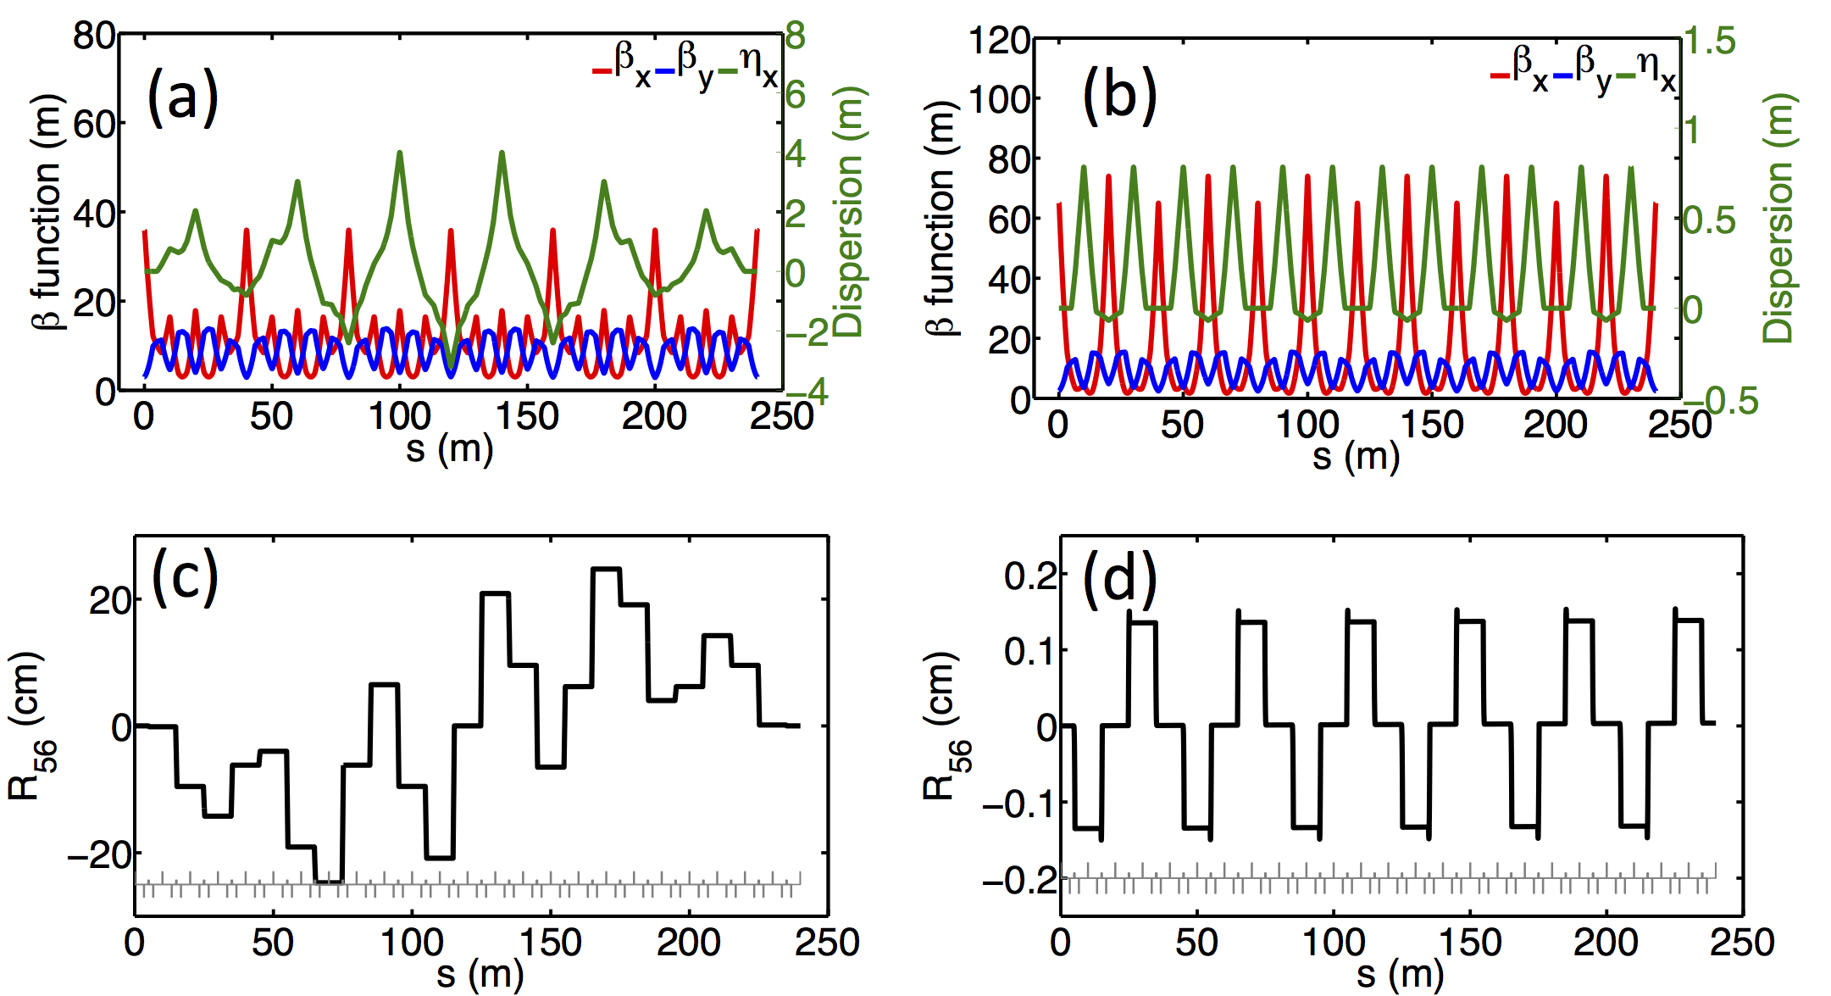
Douglas et al, https://arxiv.org/abs/1403.2318
CSR-immune arc design: non-magnetized beam, local-isochronous
global isochronous
local isochronous
Local isochronicity helps mitigate microbunching instability!
Notes:
Studies of impact of lattice optics on microbunching gain shows that local isochronous lattice can significantly suppress the microbunching amplification. On the left side are the twiss parameters, R56 and uBI gain for the arc with global isochronous lattice, and on the right side are results for arc with local isochronous lattice. For the same bunch parameters, and same lattice layout (but with different magnet setting for global or local isochronisity), the left lattice gives gain up to 1400 while the right lattice gives gain around unity (the red dots are results from Elegant tracking)

Slide 30
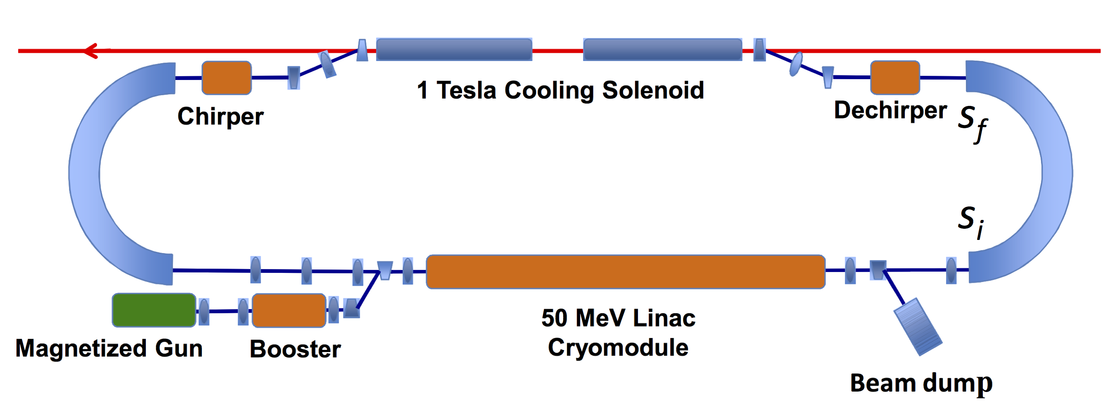
Alternative arc design (ERL): magnetized beam, non-local-isochronous
magnetized
beam
non-magnetized
beam (CCR)
Magnetized beam also suppress microbunching by virtue of
large transverse beam size (enhance Landau damping)!
λ = 300 μm
s_{i}
s_{f}
Notes:
JLEIC cooling design evolves from earlier non-magnetized beam to the present magnetized beam, The magnetized beam has much bigger transverse size than the non-magnetized beam. This larger beam size can help to enhance Landau damping of the uBI. The lower left plot of the gain spectrum shows gain magnitude around unity for
beam transport in one arc of the ERL cooler.
The new CCR will have both isochronous arc and magnetized beam, and both should help to suppress MBI. We need to study the MBI through CCR for 20 turns with the actual cooling beam parameters.

Slide 31
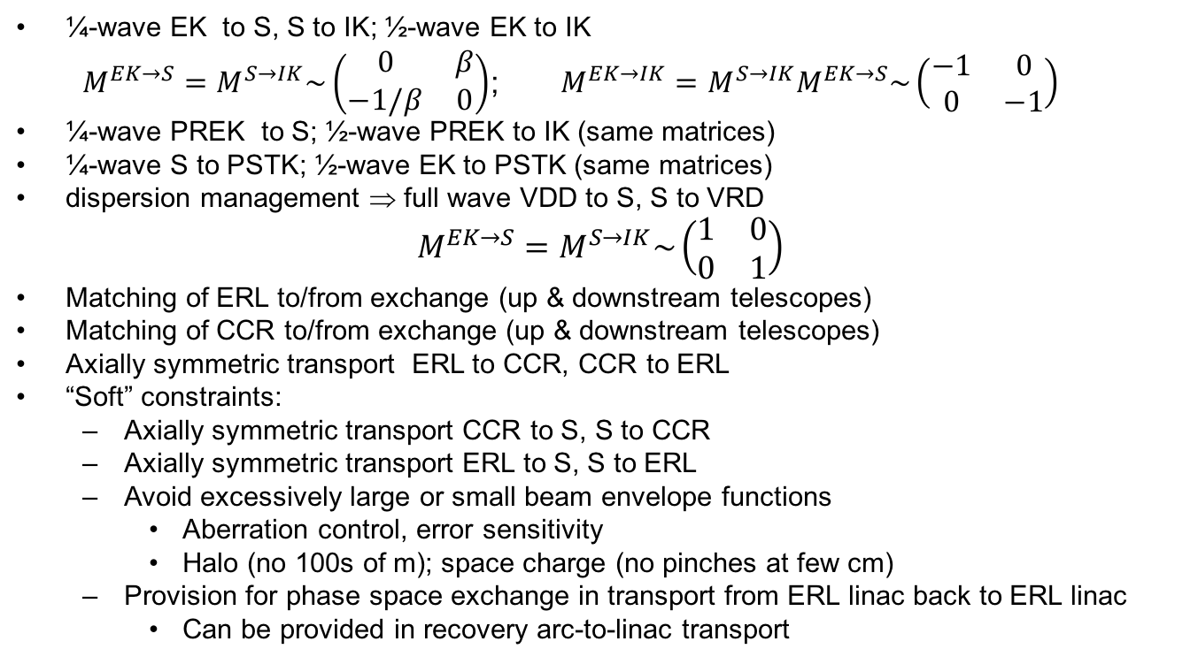
Optics Requirements/Constraints
extraction kicker (EK)
injection kicker (IK)
CCR
pre-kicker (PREK)
septum
post-kicker (PSTK)
ERL
vertical delivery dipole (VDD)
vertical return dipole (VRD)
¼-wave EK to S, S to IK; ½-wave EK to IK
$M^{EK→S}=M^{S→IK}\sim \left(\begin{matrix}0 & β \\ −1/β & 0\end{matrix}\right)$; $M^{EK→IK}=M^{S→IK}M^{EK→S}\sim \left(\begin{matrix}−1 & 0 \\ 0 & −1\end{matrix}\right)$
¼-wave PREK to S; ½-wave PREK to IK (same matrices)
¼-wave S to PSTK; ½-wave EK to PSTK (same matrices)
dispersion management ⇒ full wave VDD to S, S to VRD
$$M^{EK→S}=M^{S→IK}\sim \left(\begin{matrix}1 & 0 \\ 0 & 1\end{matrix}\right)$$
Matching of ERL to/from exchange (up & downstream telescopes)
Matching of CCR to/from exchange (up & downstream telescopes)
Axially symmetric transport ERL to CCR, CCR to ERL
“Soft” constraints:
  Axially symmetric transport CCR to S, S to CCR
  Axially symmetric transport ERL to S, S to ERL
  Avoid excessively large or small beam envelope functions
    Aberration control, error sensitivity
    Halo (no 100s of m); space charge (no pinches at few cm)
  Provision for phase space exchange in transport from ERL linac back to ERL linac
    Can be provided in recovery arc-to-linac transport

