Slide 1
JLEIC Ion Integration Update
https://casa.jlab.org/wiki/index.php/JLEIC-Ion-Integration-Meetings
Biweekly meetings
  Interleaved with simulation WG (more on that this afternoon)
  Meetings have been (somewhat) more regular since start 2017
Task: Integrate JLEIC ion complex activities
  Invitees: Amy (sources), Ed (booster), Vasiliy (collider), Jiquan (bunch formation), Yves (simulations), Rui (instabilities)
  CC: Alex, Fulvia, Mike Spata, Yuhong
  To be added: Brahim/Sang-Hoon/Zach (ANL, ion linac)
Evolved from JLEIC parameter documentation meetings
A demonstrated need to coordinate ion parameters
  end to end parameter consistency
  simulation infrastructure

Slide 2
JLEIC Ion Integration Update
Near-term working group goals:
  Characterize and detail baseline bunch formation scheme
    Confirm parameter calculations from Jiquan (Fall 2016 collab meet)
    Evaluate longitudinal beam parameters and RF requirements
  Document self-consistent beam and lattice parameter sets through ion complex
  Initiate Booster injection simulations with space charge, phase space painting, stripping/charge exchange
    Bound booster injection efficiency ➔ ion source requirements
Longer-term (summer 2017) working group goals:
  Provide input to impedance and instability budget evaluation
    ➔ impedance budget, feedback system requirements (if any)
  Develop and document injector complex accelerator cycle
    ➔ power supply, RF, cooling requirements

Slide 3
Bunch Formation
Jiquan identified several options at Oct 2016 collaboration meet
  Trade off kicker rise time, space charge, splitting, cost, etc
  Preferred “option 1” from this talk was to have 26 booster cycles
    Maintains space charge tune shift at 0.15 through complex
      c.f. FNAL Booster/Main Injector (no cooling, MI slip stacking)
    h=1 booster acceleration to minimize space charge per cycle
    Best option, perhaps only, with 100 MeV booster injection energy
    Requires bunch compression (x3.5) before transfer to collider ring
  Second option was to have 8 booster cycles
    h=7 booster acceleration, 8 booster cycles
    Only workable with 285 MeV booster injection energy
Jiquan Guo

Slide 4
Bunch Formation: Option 1
2. Accumulating coasting beam
4. Accelerate and cool
Step 6/7. Bucket-to-bucket transfer to the collider ring and BB cooling, repeat 26 times (Nh=28)
DC cooler
DC cooler
BB cooler
3. Capture to bucket
5. Bunch compression to ~56m, split into 2 bunches
2x80m gaps
Collider circumference 2252.8m, final harmonic # Nh=3584(7*2^9), booster circumference 281.6m
Eject the used beam from the collider ring, cycle the magnets
Multi-turn injection of polarized ion from linac to booster (non-polarized for heavy ions)
Capture beam into a bucket (~200m bunch length)
Ramp to an intermediate energy (~2.0GeV proton), perform DC cooling, ramp to ~8GeV (proton)
Compress the bunch length to 56m
Bucket-to-bucket transfer the long bunch into collider ring, each bucket 80m (gap between bunches ~24m, ~80ns)
Repeat step 2-6 for 26 times, each cycle ~1 min, total ~25 min
Ramp collider ring to collision energy
Perform binary bunch splitting up to 7 times to harmonic # Nh=3584 (when colliding high energy/low current electron beam, splitting can be reduced to 5 times to Nh=896), perform bunch length compression and BB cooling
Manipulate the beam to create/remove several extra empty buckets (476 MHz) in the gap (Nh=3580-3588 depending on ion energy, as required by beam synchronization).
Project normalized longitudinal emittance back to Booster cooling
Establishes maximum longitudinal emittance, momentum spread required at Booster cooling
Jiquan Guo

Slide 5
Bunch Formation: Option 2
2. Accumulating coasting beam
4. Accelerate to 7.9GeV and cool
Step 5/6. Bucket-to-bucket transfer to the collider ring and BB cooling, repeat 8 times (h=56, each dot refers to two bunches)
DC cooler
DC cooler
BB cooler
3. Capture into 7 buckets
2x40-80m gaps
Collider circumference 2252.8m, harmonic # Nh=3584(7*2^9), booster circumference 281.6m
we need to kick out 2-4 bunches to form the gaps
Eject the used beam from the collider ring, cycle the magnets
Multi-turn injection of polarized ion from linac to booster (non-polarized for heavy ions)
Capture beam into 7 buckets (~28m bunch length for quasi-rectangular beam)
Ramp to an intermediate energy (~2.0GeV proton), perform DC cooling, ramp to ~9GeV (proton)
Bucket-to-bucket transfer the long bunch into collider ring, each bucket 40m (gap between bunches ~12m, ~40ns)
Repeat step 2-6 for 8 times, each cycle ~1 min
Ramp collider ring to collision energy
Perform binary bunch splitting 6 times to harmonic # Nh=3584, perform bunch length compression and BB cooling
If needed, manipulate the beam to create/remove several extra empty buckets (476 MHz) in the gap (Nh=3580-3588 depending on ion energy).
Pros: Less booster cycles, faster injection time
Cons: Lower beam current in ion collider ring, or higher linac energy
Jiquan Guo

Slide 6
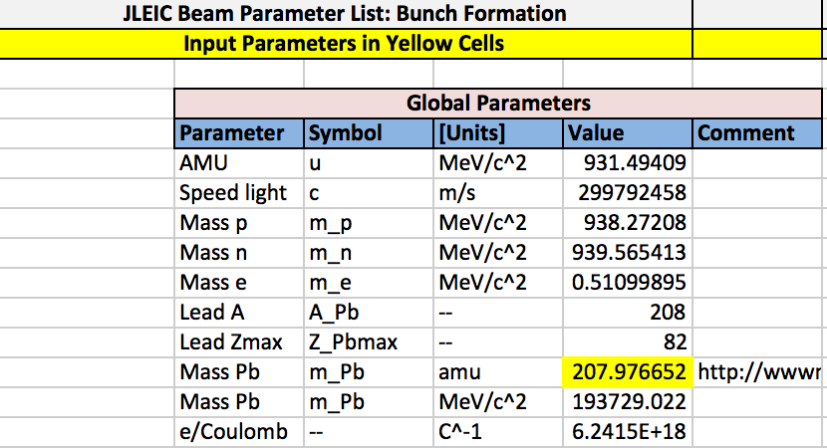
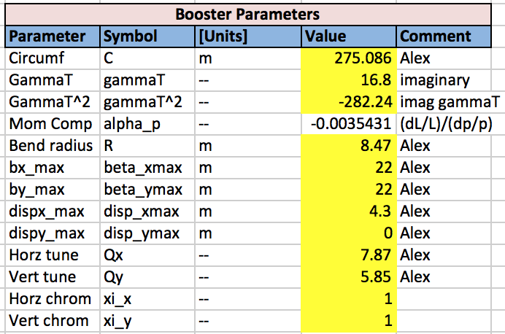
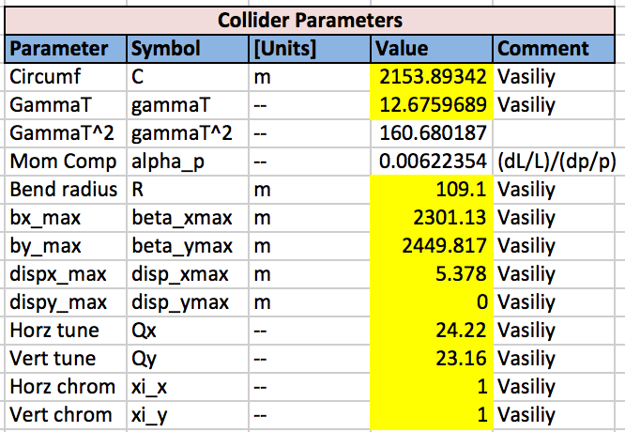
Bunch Formation Spreadsheet

Slide 7
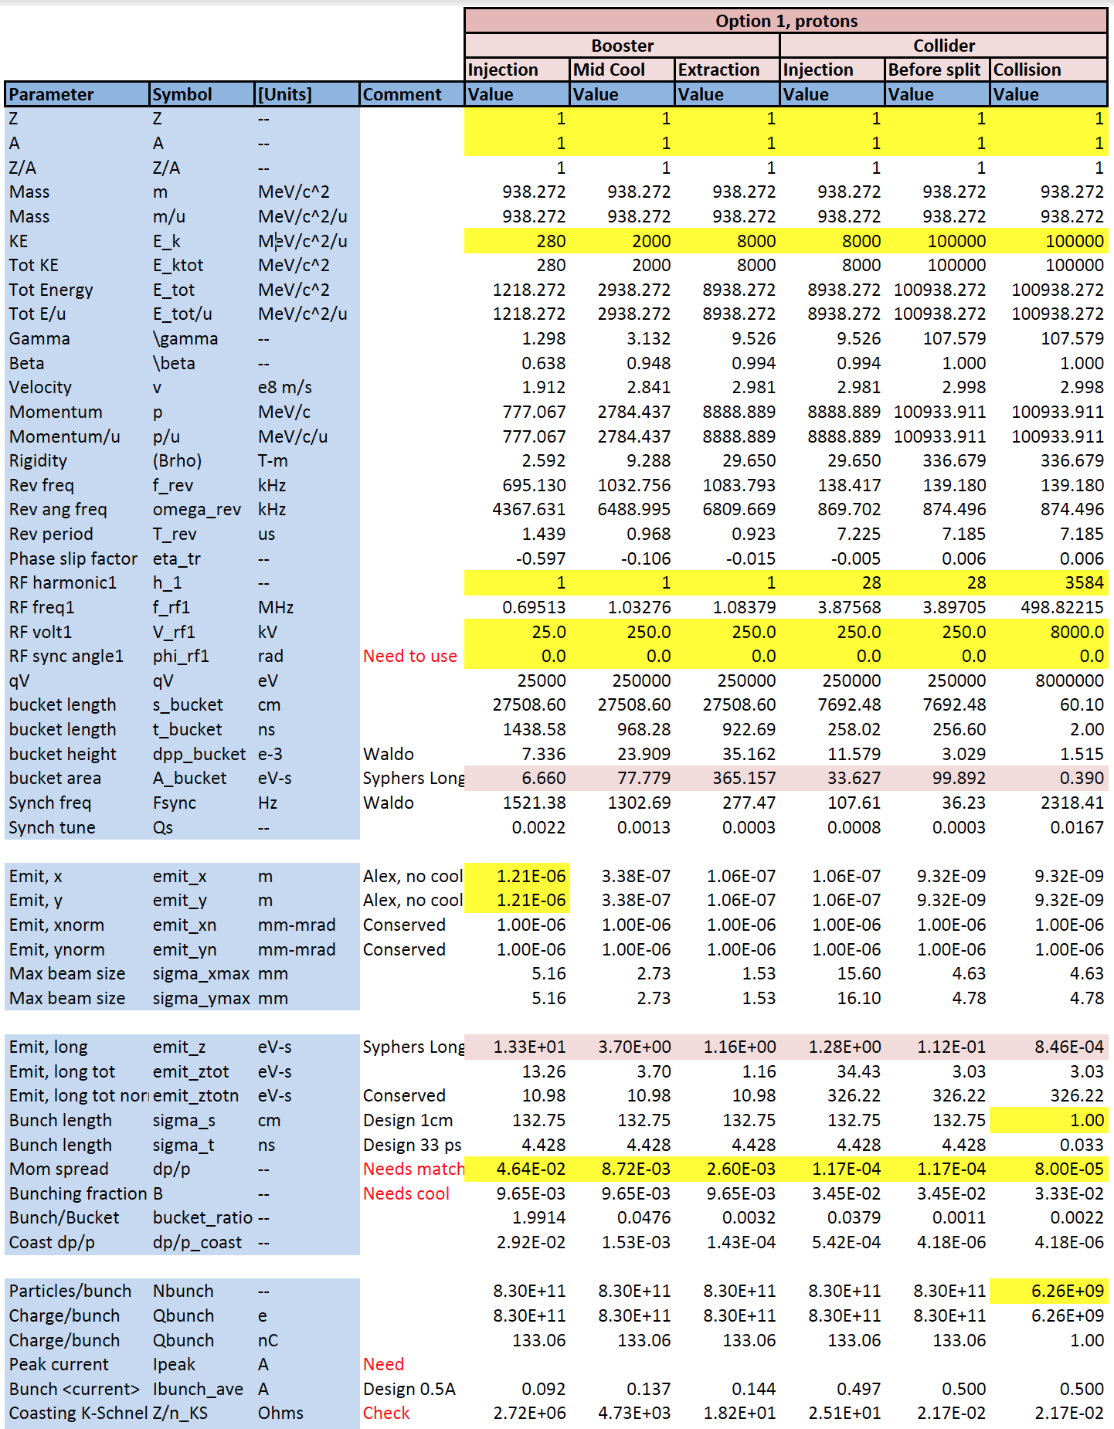

Slide 8
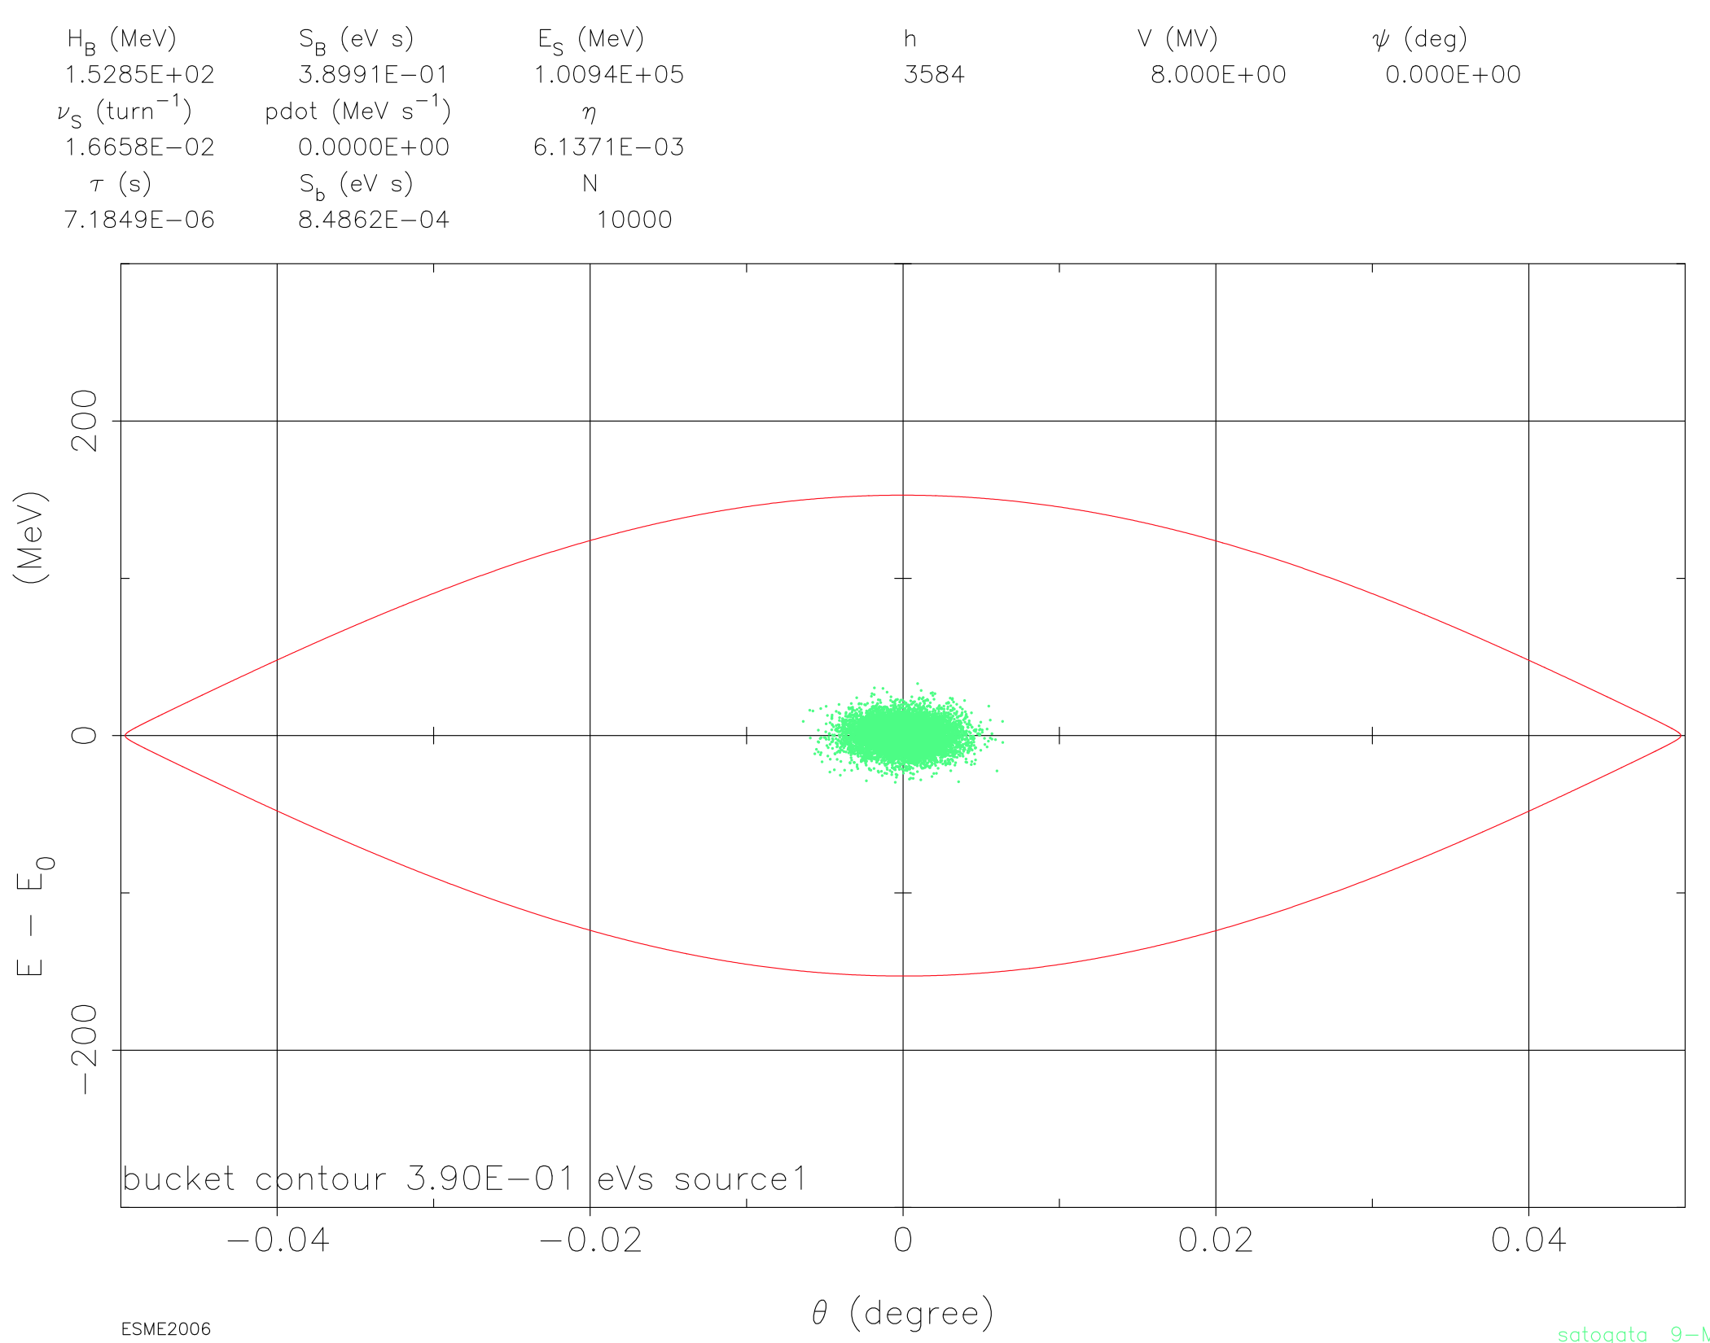
Spreadsheet validation with esme
Bucket height: 150 MeV/100 GeV
= 1.5e-3 OK
Sync tune 1.666e-2 OK
Bucket area: 0.39 eV-s OK
Bunch RMS area: 8.5e-4 eV-s OK
RMS bunch length
(1.72e-3/360 * 2154m)
= 1.0 cm OK
Bucket length = (0.1/360)*2154m=60cm OK
100 GeV collider conditions, 8 MV RF

Slide 9
Bunch Formation and Ramping
Spreadsheets have some utility
  Identify important interface parameters
    Linac to Booster, Booster cooling, Booster to Collider ring
  Document tables for reports (e.g. CDR), website
However many design points are related to dynamics
  Current Booster magnet spec is Bdot=1 T/s
  RF voltage / synchronous acceleration phase
  Longitudinal acceptance, deliverable longitudinal emittance
  Booster momentum aperture
Spot check Booster h=1 longitudinal acceptance
Systematically evaluate ramping

Slide 10
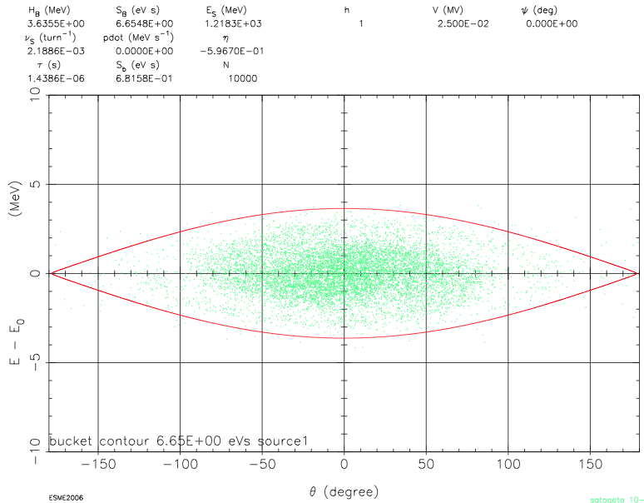
Booster h=1 Injection/Acceleration
V_{rf}=25 kV
Theta_rms=45.77 deg
Erms = 1.19 MeV
σp/p = 0.01!
Bucket area: 6.6 eV-s
Must push σp/p
down at cost of
smaller bucket
and lower RF
voltages
V_{rf}=10 kV is
present h=1
working booster
RF voltage

Slide 11
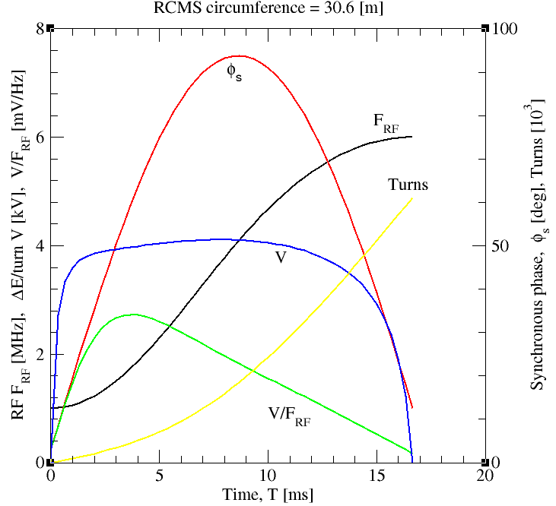
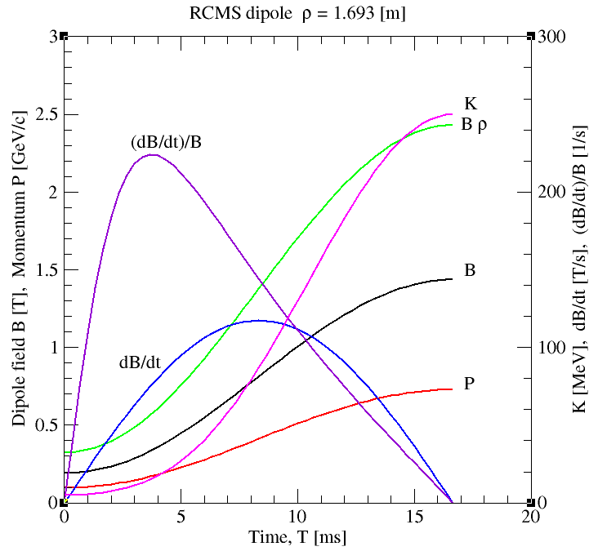
RCMS cycle design (BNL)

Slide 12
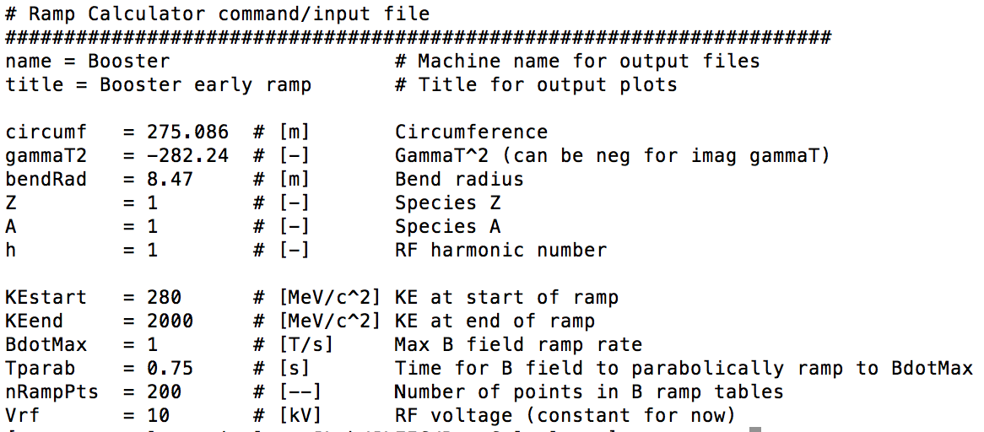
RampCalculator
Todd has started developing a synchrotron ramp design and calculation code
  Extension of existing spreadsheets to full ramp design
  Sigmoid or parabolic/linear/parabolic energy ramp
  Generates longitudinal ramp tables for esme simulations

Slide 13
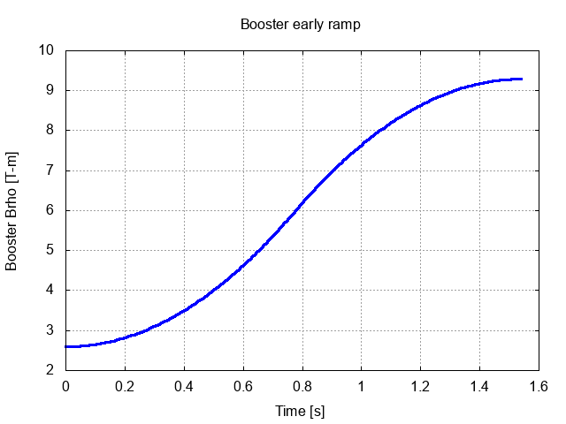
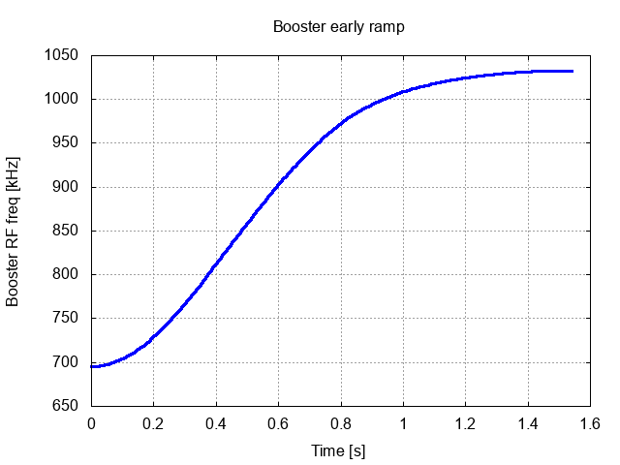
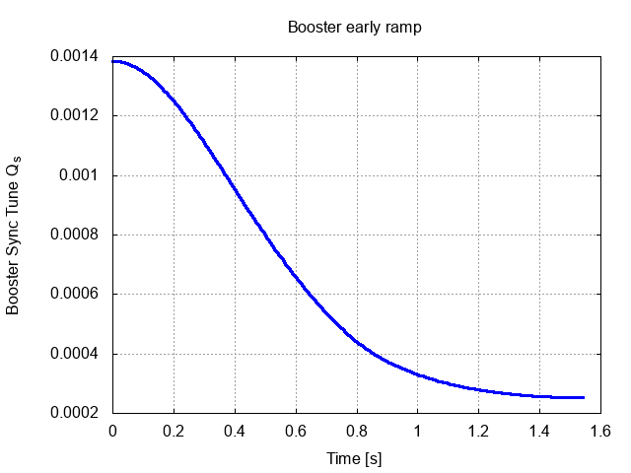
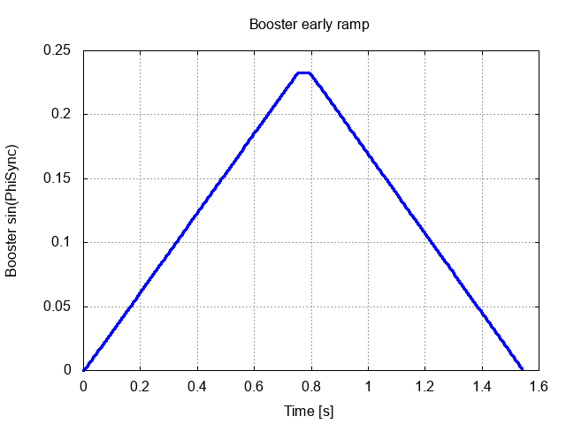
(Some) Booster RampCalculator Plots/Tables
Bdot
RF frequency
Synchrotron tune
RF synchronous phase

Slide 14
Space Charge in the Booster (Synergia)
Injection
  Initial simulations to 300 turns with peak current to check stability
  Detailed injection scheme (6D phase space painting, stripping) will be modeled
  Additional longitudinal simulations with esme space charge (Todd)
Cooling
  Initial stability simulations have been performed
  The effects of cooling need to be added to a full simulation.
Ramping
  Coordinate ramp tables with RampCalculator development
Extraction
  Initial simulations have been run to check stability at top energy
  The effects of all previous phases will be combined into an end to end Booster simulation
Ed Nissen

Slide 15
Space Charge in the Booster (Synergia)
Extraction
Ramping
Energy
Cooling
Injection
Not to Scale
Time
Emittance (m)
Emittance (m)
Emittance (m)
Turns
Turns
Turns
Ed Nissen

Slide 16
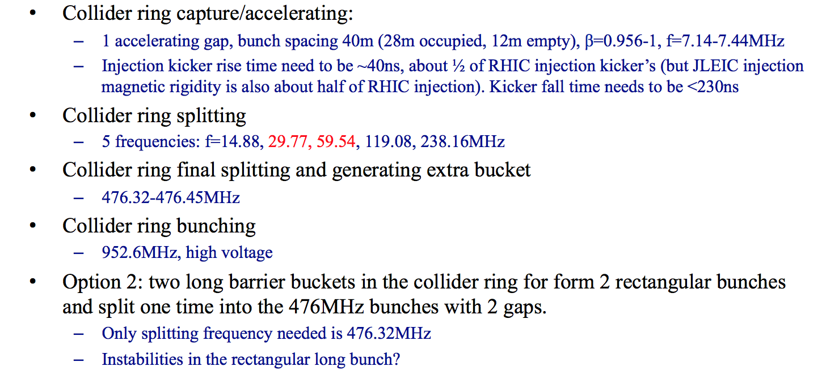
Bunch Splitting
Bunch splitting strategy presented at Fall 2016 collaboration meeting
h=56, Circumference=40.28m*56=2255.75m
h=56, 112, 224, 448, 896
h=1792
h=3584
Quasi-coasting microwave instability?
Randika Gamage

Slide 17
Coasting Beam Instability Model
Updated esme impedance model appeared to be broken
  C.f. Francois Ostiguy at FNAL
BLonD CERN longitudinal code
  Does not apply periodic conditions to coasting beam!
Worked through coasting beam instability theory
Fixed/understood esme impedance concerns
Esme now usable with various longitudinal impedance models
  Broadband, narrow band, space charge, resistive wall
  Coasting beam, debunch/rebunch simulations underway
  o(10Ω) longitudinal broadband impedance still too much
  Randy is documenting this alternative in a thesis chapter
Randika Gamage

Slide 18
Next Steps
Establish reasonable parameters for Booster injection
  Longitudinal phase space painting
  Linac energy spread
  Coordinate with Ed
  Objective: “Realistic” Booster injection RF voltage, momentum spread, longitudinal emittance
Evaluate Booster cycle
  Longitudinal acceptance (synchronous phase) vs ramp rate
  Maintain pause, debunch/rebunch for DC beam cooling
  Optimize with ramp design scripts from BNL RCMS
  Objective: “Realistic” Booster ramp, longitudinal emittance evaluation
  Objective: Confirm Option 1 as baseline or move to h=7 booster capture

Slide 19
============================

Slide 20
Option 3: Binary Booster Bunch Split
2. Accumulating coasting beam
4. Accelerate and cool
Step 6/7. Transfer the bunch train bucket-to-bucket into the collider ring, repeat 24 times, then ramp energy and perform BB cooling
J. Guo
DC cooler
BB cooler
DC cooler
3. Capture to bucket
5. compress bunch to ~56m, split into 32 bunches (~80m train) with 5 stages splitting
Collider circumference 2252.8m, harmonic # Nh=3580-3588 (for different collision energy), booster circumference 281.6m
Eject the used beam from the collider ring, cycle the magnets
Multi-turn injection of polarized ion from linac to booster (non-polarized for heavy ions)
Capture beam into a bucket (~200m bunch length)
Ramp to an intermediate energy (~2.0GeV proton), perform DC cooling, ramp to ~8GeV (proton)
Compress the bunch length to 56m, perform 5 stages binary split and form a 80m train with 32 bunches (bunch reprate 119MHz)
Bucket-to-bucket transfer the 80m bunch train into the collider ring
Repeat step 2-6 cycle for 24 times, leaving a gap of ~14m (5-6 119MHz buckets, ~45ns for kicker rise time) between the 80m trains
Ramp collider ring to collision energy
Perform up to 2 stages binary splitting (no splitting needed for low reprate option with high energy/low current electron beam), perform bunch length compression and BB cooling
Manipulate the beam to create/remove several extra empty buckets (476 MHz) in the gap (Nh=3580-3588 depending on ion energy, as required by beam synchronization).
Pros: Less splitting cavities in the collider ring
Potential problems:
Need to split beam 5 times in each of the 24 cycles
Total gap length is larger, especially if inject kicker rise time is longer than 45ns; may still need longer gap for abort kicker

Slide 21
Option 4: Fewer Bunch Splitting Stages
2. Accumulating coasting beam
Step 6. Transfer the bunch train bucket-to-bucket into the collider ring, repeat 8 times, then ramp energy and perform BB cooling
J. Guo
4. Accelerate and cool
DC cooler
BB cooler
3. Capture to 119MHz bucket
Collider circumference 2252.8m, harmonic # Nh=3580-3588 (for different collision energy), booster circumference 281.6m
Eject the used beam from the collider ring, cycle the magnets
Multi-turn injection of polarized ion from linac to booster (non-polarized for heavy ions)
Capture beam into 112 buckets (119MHz bucket, ~1.8m bunch length), kick out 5-6 bunches to form a gap for extraction kicker rise time
Ramp to an intermediate energy (~2.0GeV proton), perform DC cooling, ramp to ~8GeV (proton)
Bucket-to-bucket transfer the ~270m bunch train into the collider ring
Repeat step 2-6 cycle for 8 times
Ramp collider ring to collision energy
Perform up to 2 stages binary splitting (no splitting needed for low reprate option with high energy/low current electron beam), perform bunch length compression and BB cooling
Manipulate the beam to create/remove several extra empty buckets (476 MHz) in the gap (Nh=3580-3588 depending on ion energy, as required by beam synchronization).
Pros: Much less splitting stages.
Potential problems:
Lower ion collider ring beam current or higher ion linac energy.

Slide 22
The Updated Problem
Jiquan provided an update to a bunch formation scheme in slides on Jun 24 2016 (with an update at this meeting)
h=56, Circumference=40.28m*56=2255.75m
h=56, 112, 224, 448, 896
h=1792
h=3584
Quasi-coasting beam instabilities?

Slide 23
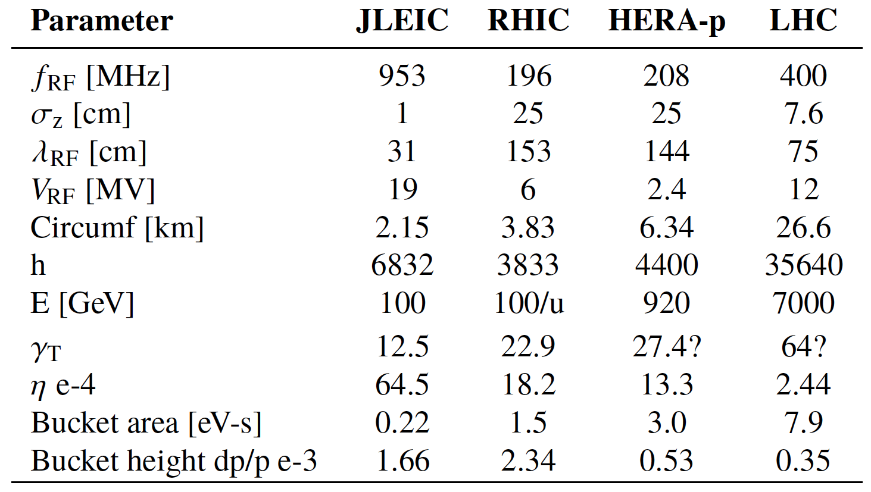
Hadron Collider Comparison

Slide 24
Debunch/Rebunch
The old conventional method for changing the longitudinal structure of the beam is to debunch by cancelling the voltage at the initial frequency, to drift without longitudinal focusing, and to rebunch withanother RF frequency. To minimize emittance blow-up, voltage variations have to be iso-adiabatic over a large dynamic range. Although widely used, this technique presents a number of drawbacks:
  RF voltages must be controlled down to small amplitudes in the presence of beam loading,
  While drifting, the beam is left uncontrolled,
  The full circumference is filled with particles,
  The continuous beam has a very small Δp/p which makes it prone to microwave instability.
Randy is simulating debunch/rebunch at present, including realistic impedances as measured at RHIC
Can be applied to barrier bucket scheme as well: small Δp/p?
(R. Garoby)

Slide 25

9:18 Debunch/Rebunch (no impedance)

Slide 26
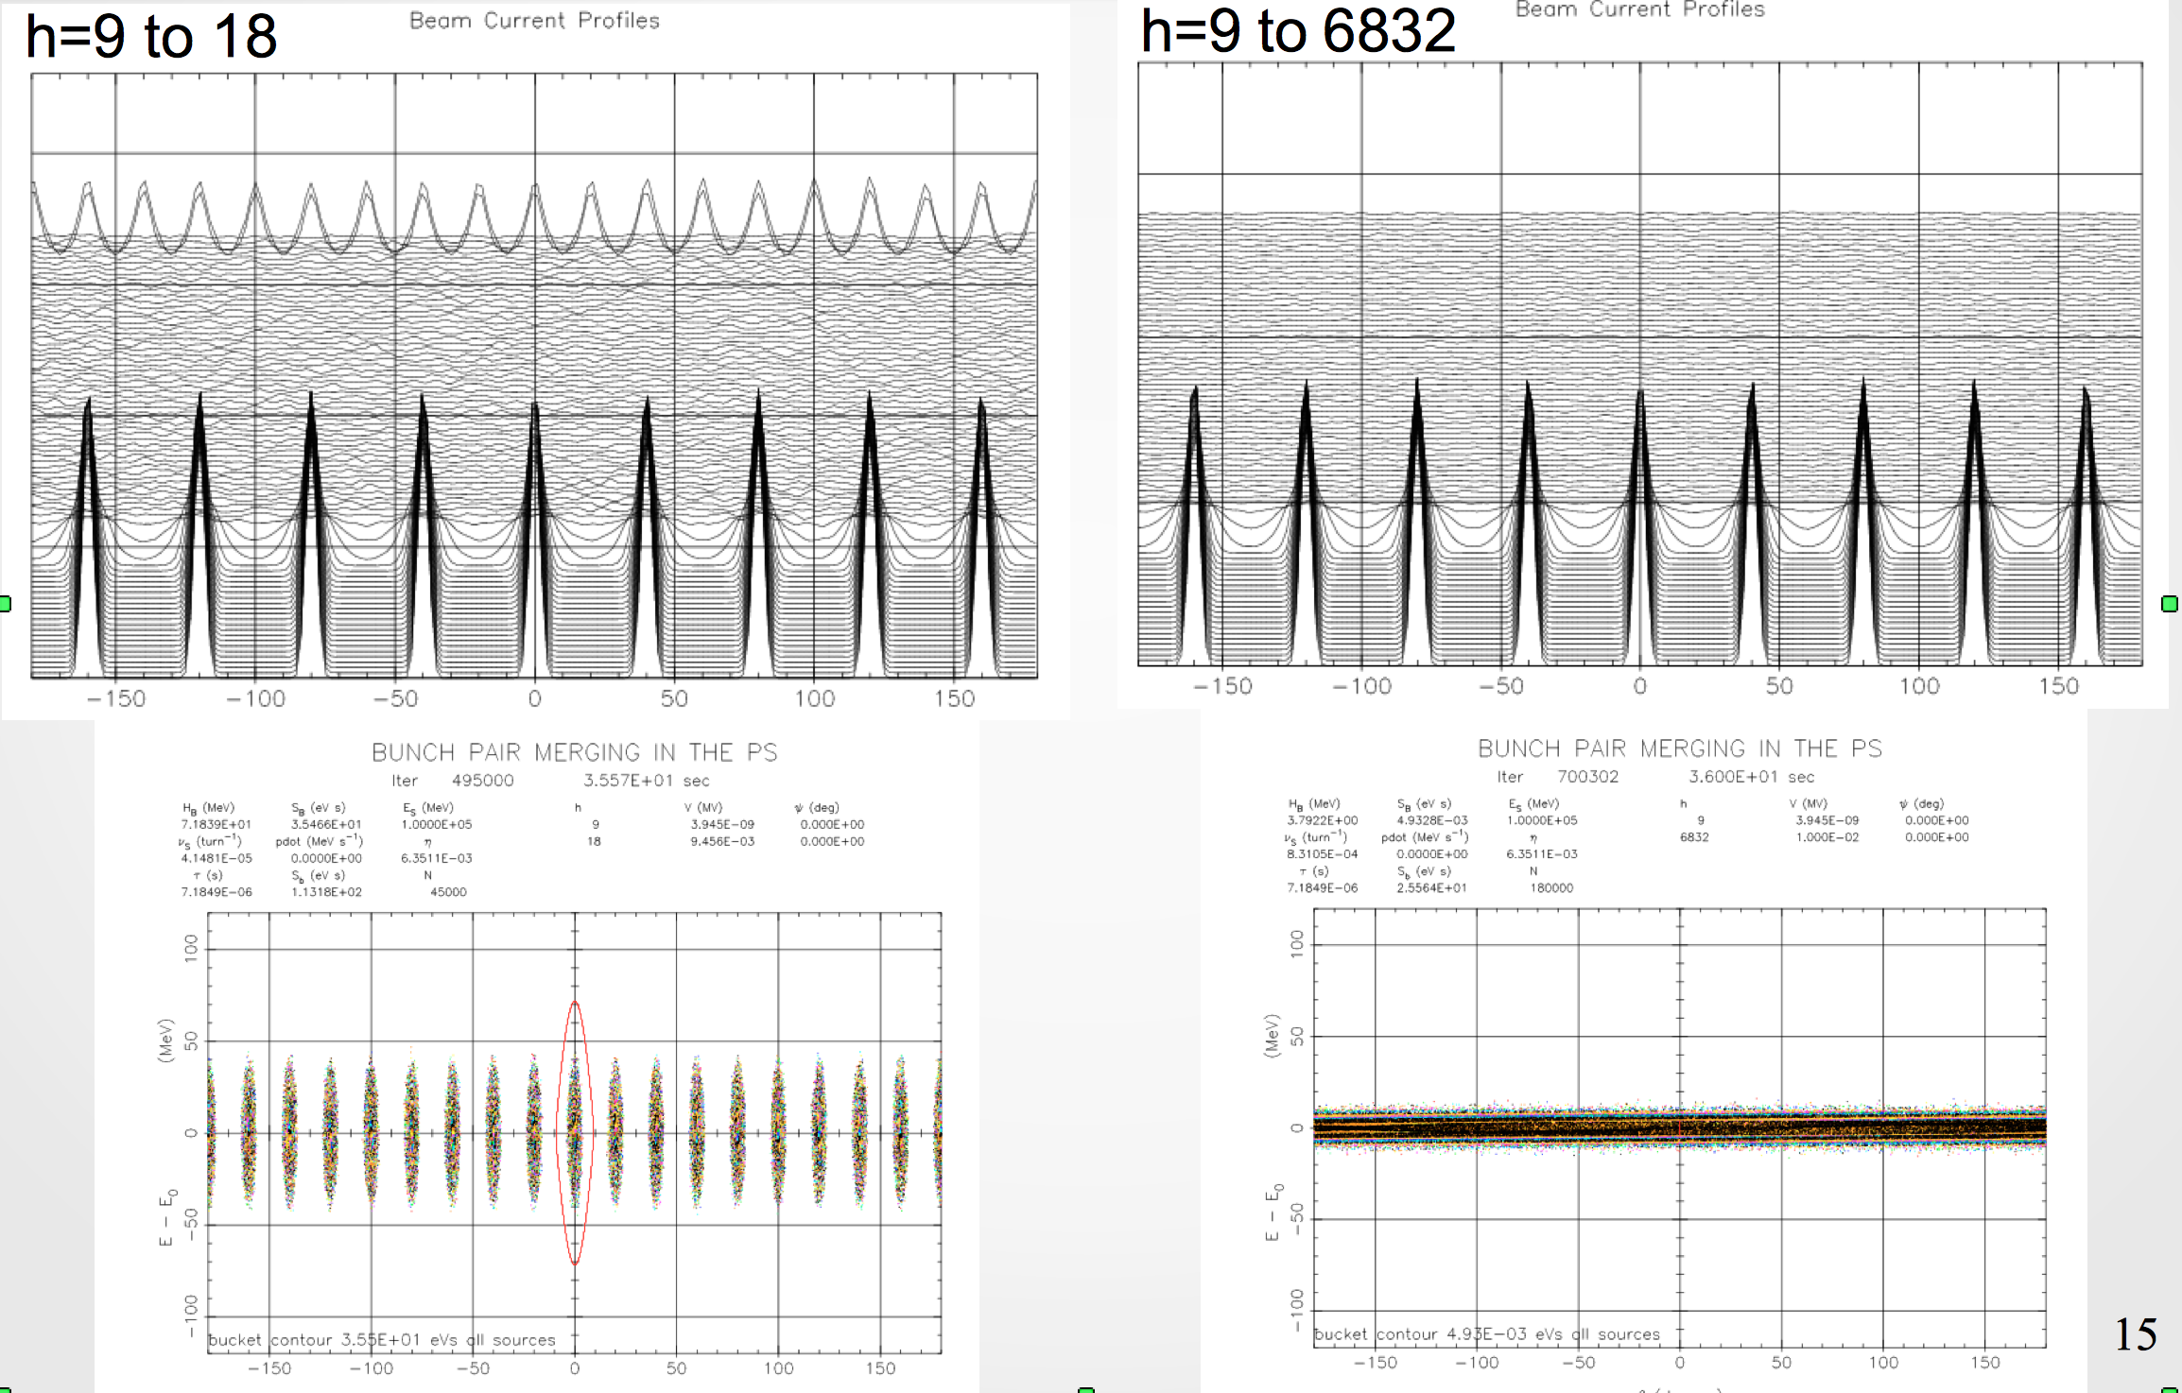
Debunch/Rebunch (no impedance)

Slide 27
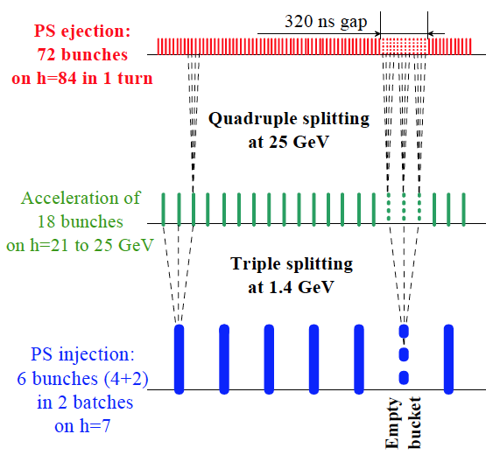
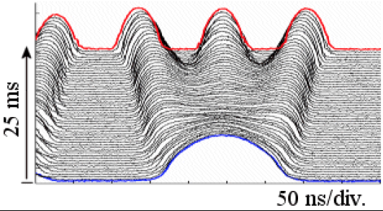
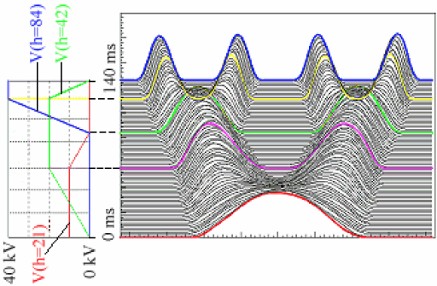
Bunch Splitting
CERN PS splits 6:18 (3x) then 18:36 (2x) then 36:72 (2x)
20 ns/div.
Fig 7.1, LHC design report
Figs 7.3-4, LHC design report

Slide 28
Adiabatic Bunch Splitting
Good 1:2 split
Bad 1:2 split
Have put parameter set into ESME
  Fermilab longitudinal dynamics (only) code
    faster, longitudinally oriented compared to many other codes
  Have running on cluster (e.g. jlabl4) for GA optimizations
  Optimize split times, voltages vs longitudinal emittance growth
  Have source code, support from Francois Ostiguy at Fermilab

Slide 29
Single Split Optimization
Bunch splitting for JLEIC requires several splits
  Each splitting must be reasonably well-optimized
  Even small (few percent) longitudinal emittance growth per split becomes intolerable
Conditions for emittance growth
  Initial longitudinal emittance very small
  Bunch splitting too fast (non-adiabatic)
Parameterize transverse emittance growth in 2:1 split
  Use scaled parameters for universality
  vs initial emittance/bucket size
  vs splitting time/initial synchrotron period
  Used JLEIC first split (h=9 to h=18) parameters
  Plot relative emittance growth vs two “vs” parameters

Slide 30
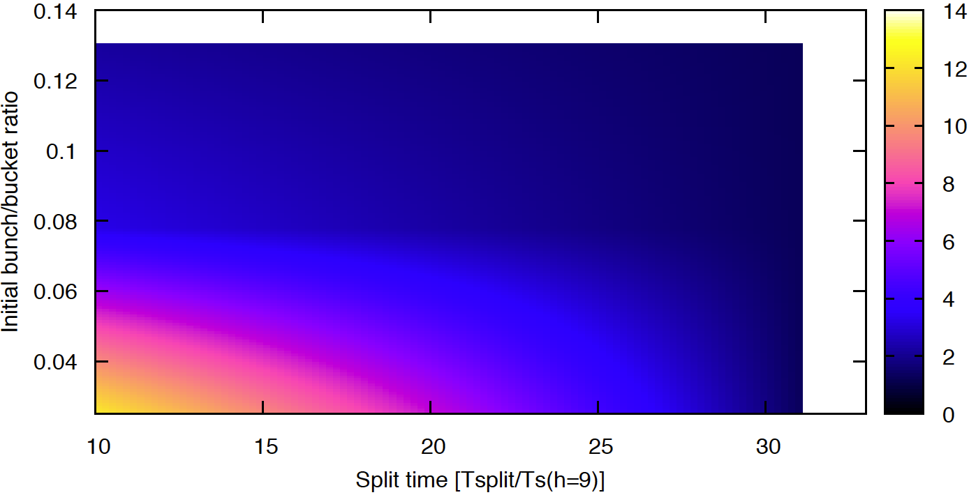
Parameter Scan Results (1)
Region of large emittance growth
  Small split time and/or small initial emittance
  Relative emittance growth: well over 100%

Slide 31
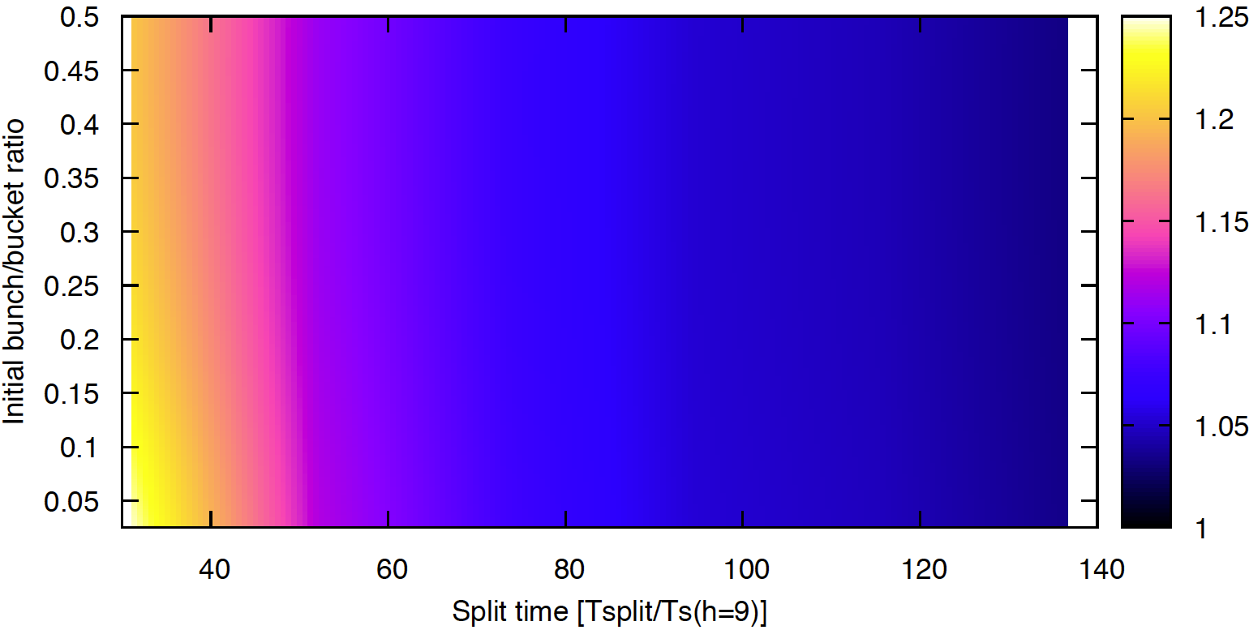
Parameter Scan Results (2)
Region of modest emittance growth
  Requires split time to be 100+ synchrotron periods
  But given that, almost immune to initial bunch size

Slide 32
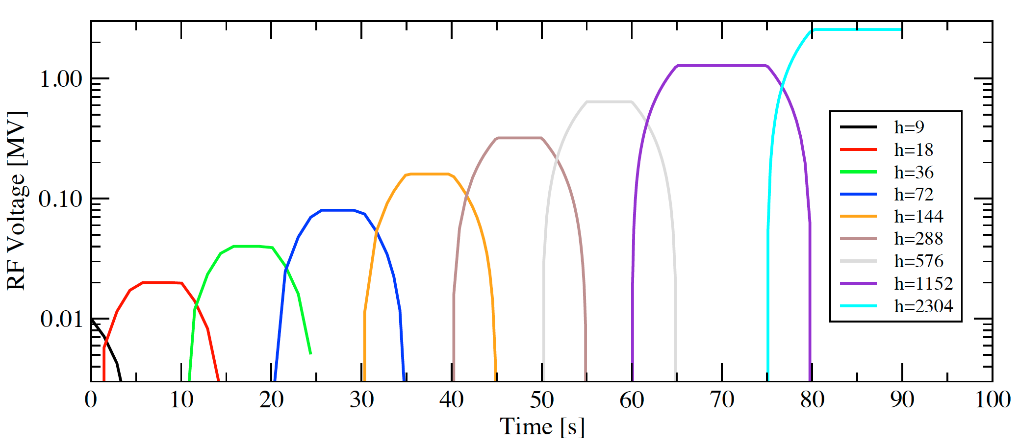
Bunch Split Scaling
Assume bucket area scales as the split
  Initial area is evenly divided into split buckets
  Implies that RF voltage doubles with every split
    E.g. V_{RF,h=18} = 2V_{RF,h=9} for first split
  Synchrotron period scaling is then that synchrotron period halves with every successive split
    T_{s,h=9} = 2 T_{s,h=18}
    Can make splits faster at higher harmonics

Slide 33
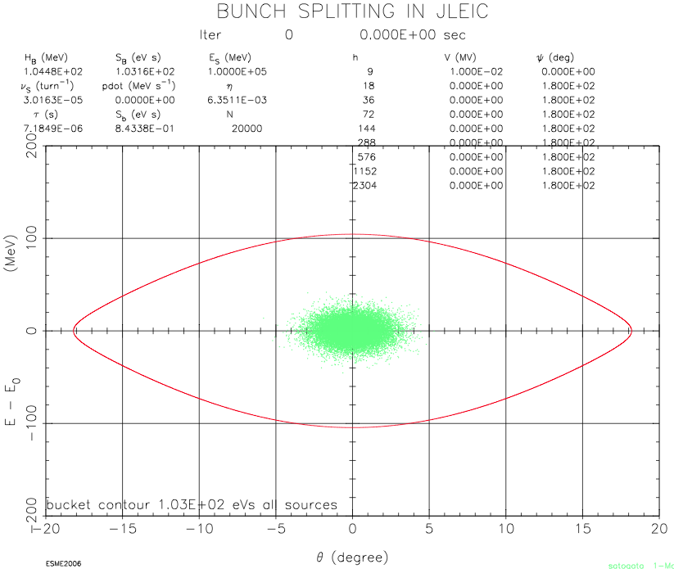
2⁹ Split Simulation: Initial Conditions

Slide 34
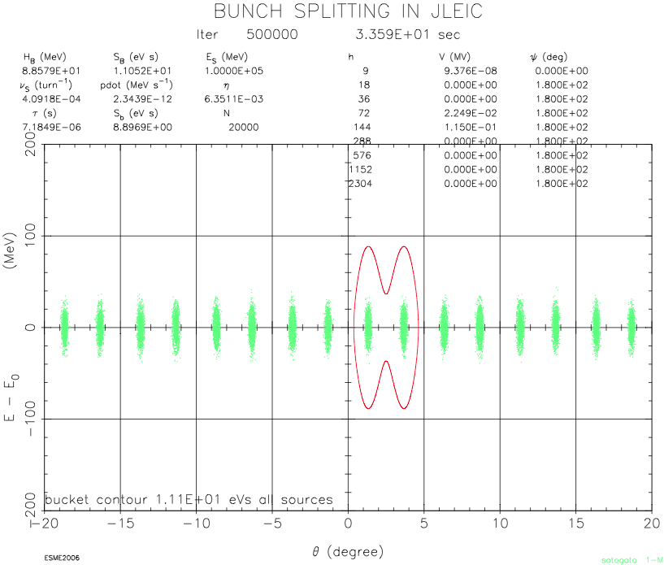
2⁹ Split Simulation: Halfway Through

Slide 35
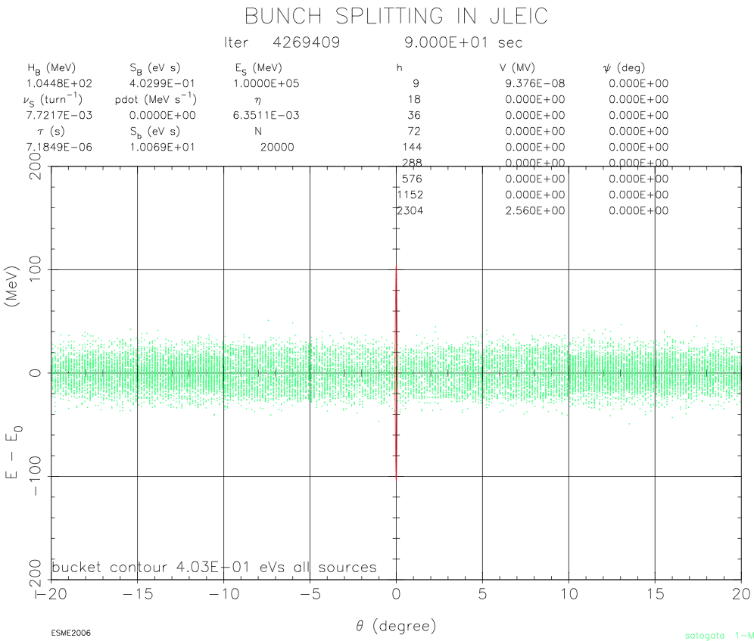
2⁹ Split Simulation: After All Splits

Slide 36
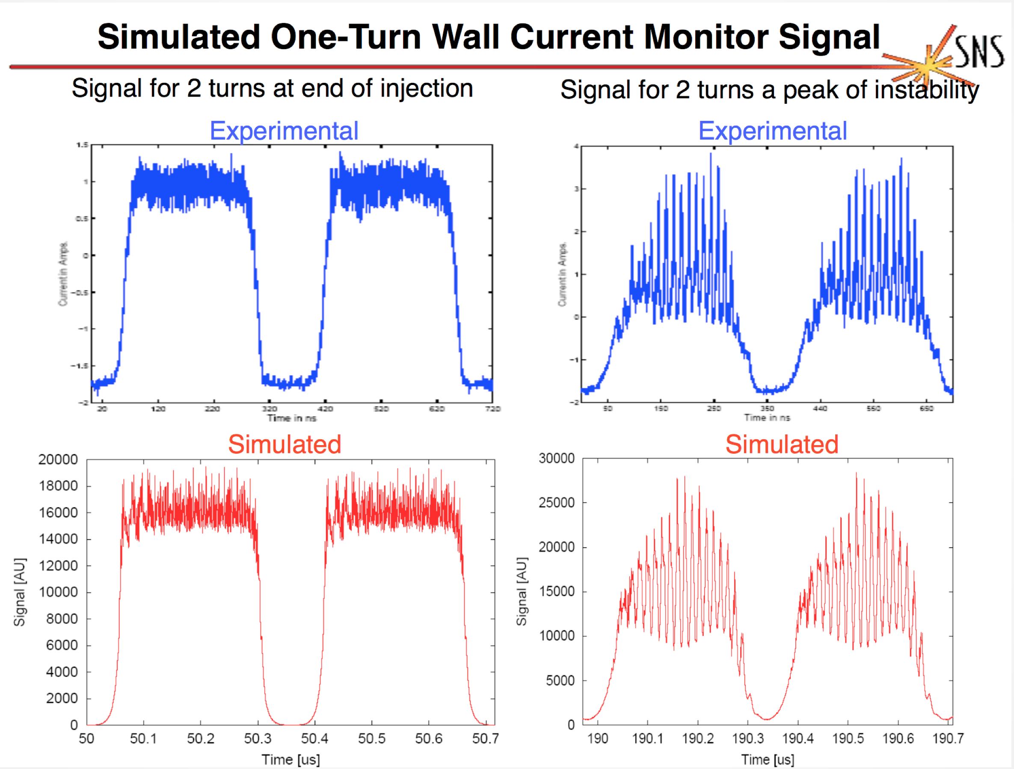
Esme Microwave Instability Simulation
From Chris Beltran’s PhD Thesis, 2004
Impedance-driven longitudinal instability in Los Alamos PSR

