Slide 1
Progress in the Multi-Ion Injector Linac Design
Sang-hoon Kim, B. Mustapha and Z. Conway
Physics Division, Argonne National Laboratory
A. Plastun and P. Ostroumov (Now at FRIB, MSU)
JLEIC Collaboration Meeting, April 3-5, 2017, JLab, VA

Slide 2
Outline
Current Injector Linac Design
Design of the Different Linac Sections
(LEBTs, RFQs, IH-FODO & SRF Linac)
First End-to-End Simulations (Revealing …)
Issues from large emittance of polarized light ions
Possible solutions …
Working Solution
Collimation of Polarized Light Ions at the Source
Updates to the Linac Design
End-to-End Simulations (Re-do)
What’s Next?

Slide 3
Current Injector Linac Design
βG=0.15
βG=0.3
Two RFQs: One for light ions (q/A ~ 1/2) and one for heavy ions (q/A ~ 1/7)
Different emittances and voltage requirements for polarized light ions and heavy ions
RT Structure: IH-DTL with FODO Focusing Lattice
FODO focusing → Significantly better beam dynamics
Separate LEBTs and MEBTs for light and heavy ions
Stripper section for heavy-ions followed by an SRF section
Pulsed Linac: 10 Hz repetition rate with 0.5 ms pulse length

Slide 4
Design of the Different Linac Sections

Slide 5
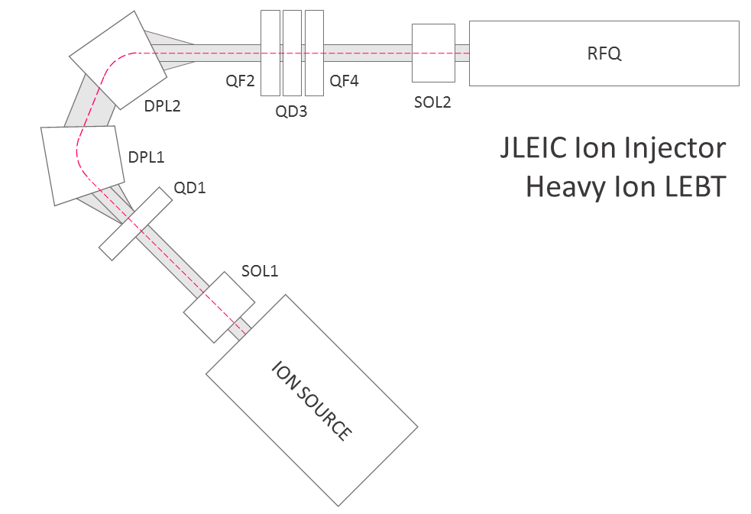
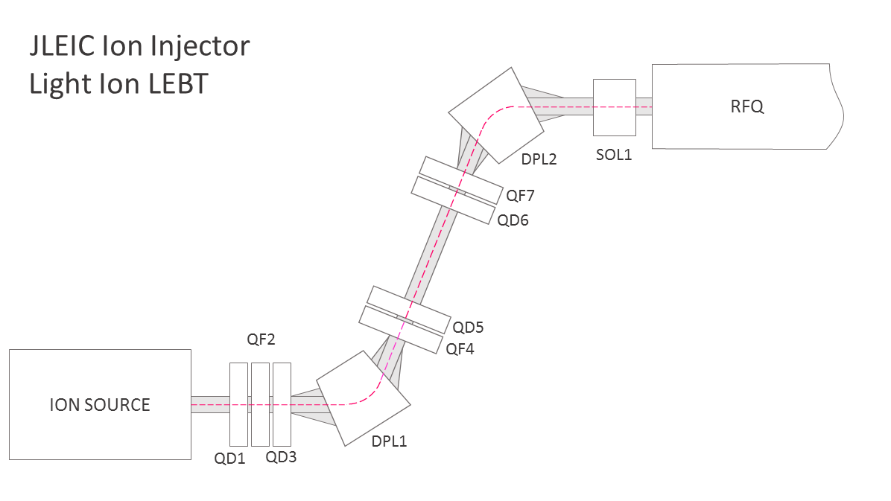
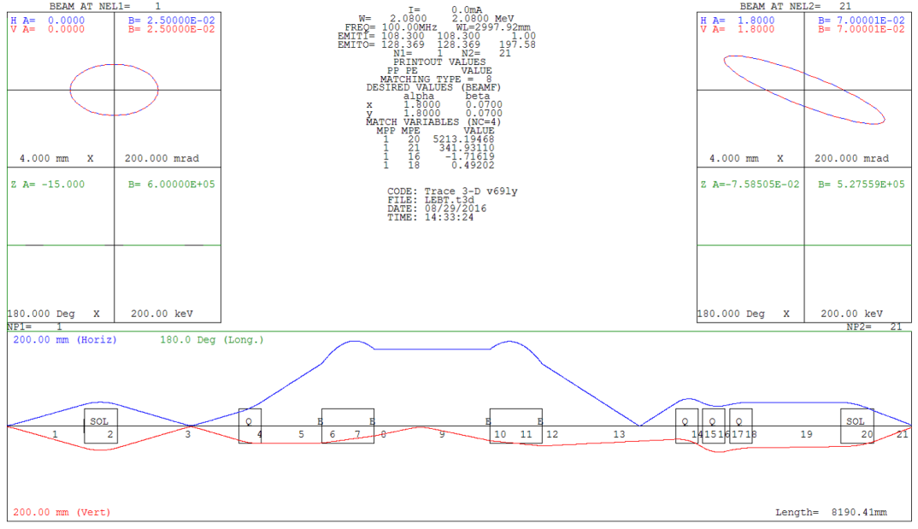
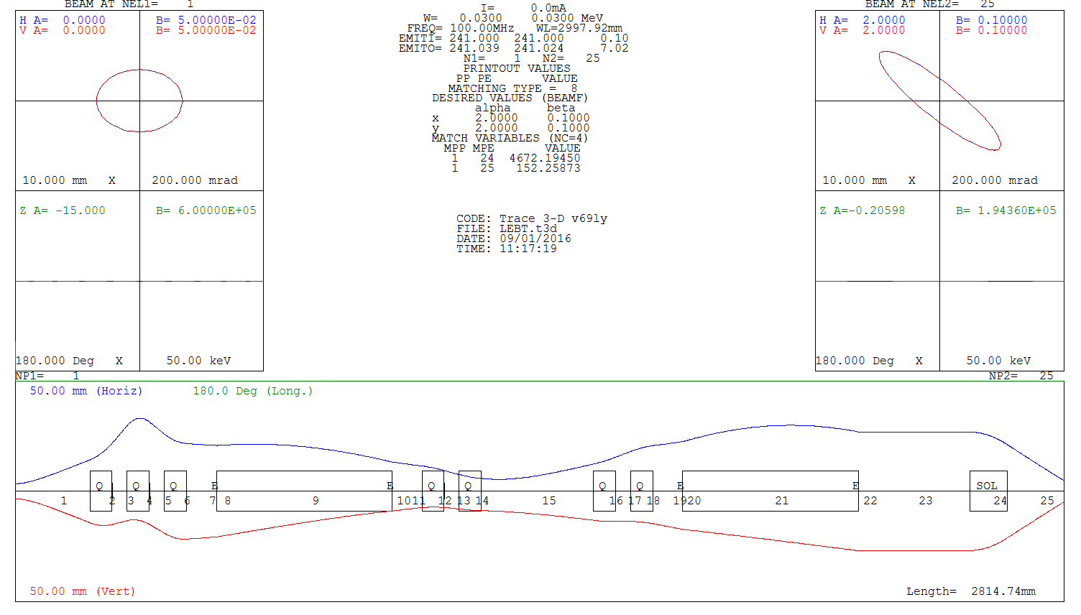
Two LEBTs: From Ion Sources to the RFQs
Similar to CERN Linac3 LEBT Similar to BNL LEBT

Slide 6
Two Separate RFQs for Light Ions and Heavy Ions
2 m
Light-Ion RFQ is designed for polarized beams with 2 π mm mrad normalized transverse emittance
Heavy-Ion RFQ is designed for ion with Z/A ≤ 7 with 0.5 π mm mrad normalized transverse emittance
A/Z ≤ 2, 15 keV/u
Light-I-RFQ
A/Z ≤ 7, 10 keV/u
Heavy-Ion-RFQ
5 m
0.5 MeV/u
Parameter | Heavy ion | Light ion | Units
Frequency | 100 |  | MHz
Energy range | 10 - 500 | 15 - 500 | keV/u
Highest - A/Q | 7 | 2
Length | 5.6 | 2.0 | m
Average radius | 3.7 | 7.0 | mm
Voltage | 70 | 103 | kV
Transmission | 99 | 99 | %
Quality factor | 6600 | 7200
RF power consumption (structure with windows) | 210 | 120 | kW
Output longitudinal emittance (Norm., 90%) | 4.5 | 4.9 | π keV/u ns

Slide 7
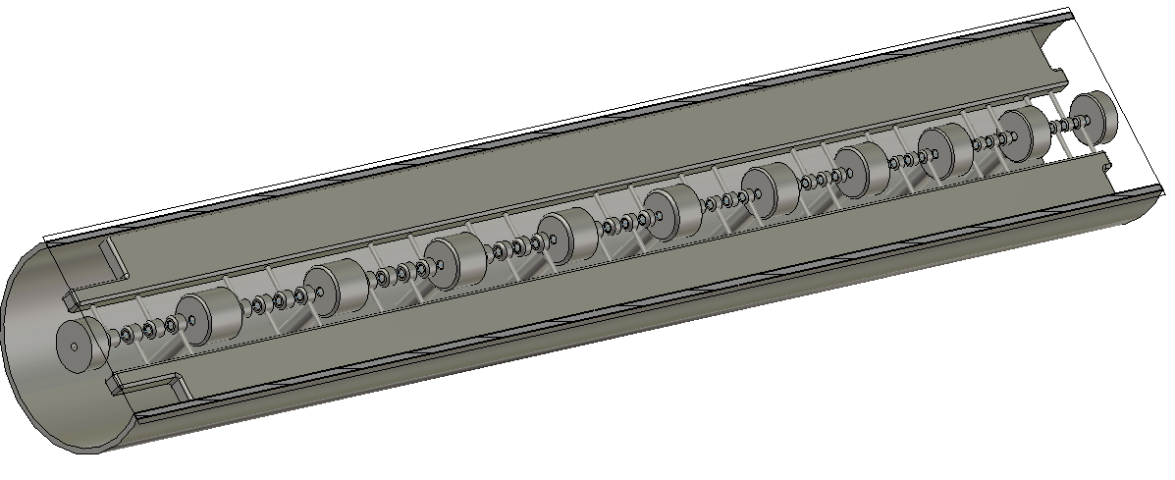
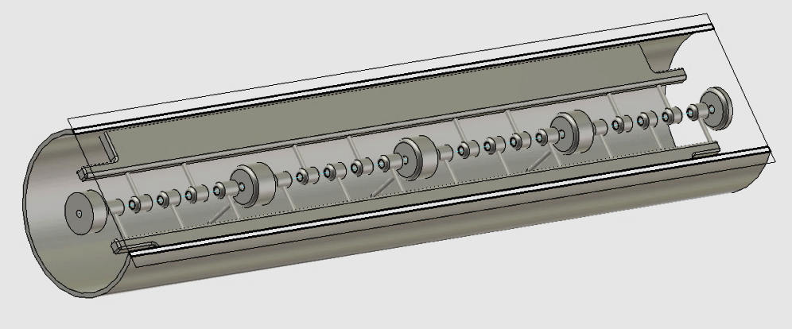
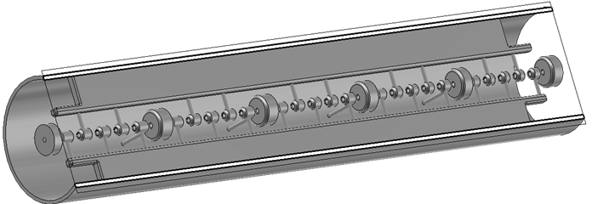
A Common IH-DTL with FODO Focusing Lattice
3 Tanks – 20 Quadrupoles in FODO arrangements
Energy gain: 0.5 – 4.9 MeV/u = 30.5 MeV
Total length: 4.3 + 3.5 + 3.4 m = 11.2 m
Real-estate accelerating gradient: 2.72 MV/m
RF Power losses: 280 + 400 + 620 = 1.3 MW

Slide 8
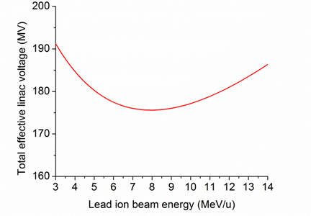
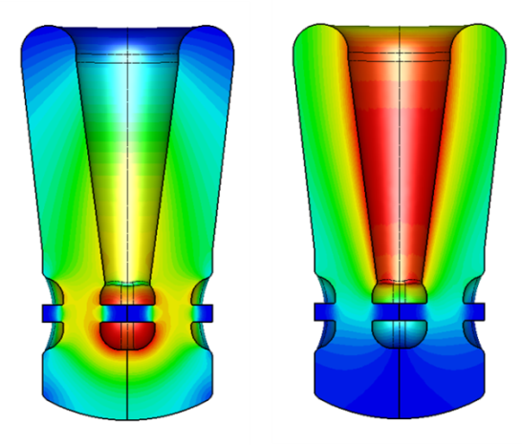
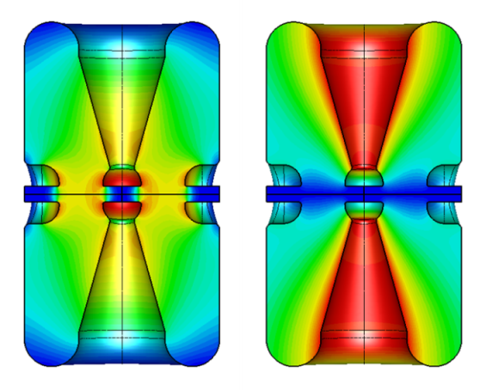
Stripper and SRF Linac Section
²⁰⁸Pb ³⁰⁺
²⁰⁸Pb ⁶²⁺
Stripping Energy & Charge
Stripper (¹²C)
100 MHz
200 MHz
QWR
QWR
QWR
HWR
HWR
Pb, 5 MeV/u
8.7 MeV/u
44 MeV/u
p, 5 MeV/u
135 MeV
QWR Module
HWR Module
@ 8.7 MeV/u: 30+ → 62+ → 44 MeV/u
@ 13.3 MeV/u: 30+ → 67+ → 40 MeV/u
Horizonal orientation of cavities
Parameter | QWR | HWR | Units
β_{opt} | 0.15 | 0.30
Frequency | 100 | 200 | MHz
Length (βλ) | 45 | 45 | cm
E_{PEAK}/E_{ACC} | 5.5 | 4.9
B_{PEAK}/E_{ACC} | 8.2 | 6.9 | mT/(MV/m)
R/Q | 475 | 256 | Ω
G | 42 | 84 | Ω
E_{PEAK} in operation | 57.8 | 51.5 | MV/m
B_{PEAK} in operation | 86.1 | 72.5 | mT
E_{ACC} | 10.5 | 10.5 | MV/m
Phase (Pb) | -20 | -30 | deg
Phase (p/H⁻) | -10 | -10 | deg
No. of cavities | 21 | 14
QWR Design
HWR Design

Slide 9
First End-to-End Simulations
End-to-end simulations are important to study the cumulative effects of the lattice on the beam including realistic beam distributions and emittance growth from space charge and non-linear effects …

Slide 10
Simulation of 2 mA Deuteron Beam in the RT Section
Issues: 15% emittance growth in the RFQ and Beam loss in the IH-DTL

Slide 11
End-to-End Simulations … Revealing
In this case, deuteron beam simulation in the RT section showed a significant emittance growth in the RFQ and some beam loss in the IH-DTL, not observed when simulated separately
→ Design iteration for the light-ion front-end
The main difficulty in the design of the light-ion injector is the large emittances of polarized H-/D- beams from ABPIS type source.
(~ 2*π mm.mrad for 90% of the beam, Ref. V. Dudnikov)
→ much larger beam size than in typical injectors
→ emittance growth and beam loss

Slide 12
Possible Solutions …
Solution #1
Collimate the beam at the source to produce a 2 mA beam with ~ 1 π mm.mrad, selecting only the beam core …
(This is possible, ABPIS source can provide up to 4 mA, Ref. A. Sy).
The original front-end was designed for 2 mA in ~ 2 π mm.mrad. The collimated beam with 2 mA in ~ 1 π mm.mrad will have higher space charge density.
→ Higher injection energy to the RFQ to control space charge effects
Possibly a higher-energy RFQ for light ions injecting to the second DTL tank.
Solution #2
Use polarized H+/D+ instead of H-/D-, H+/D+ sources can deliver higher current in smaller emittance, Ref. V Dudnikov
BUT this may complicate the injection to the Booster (direct injection) …

Slide 13
Implementing Solution #1

Slide 14
Collimation of The Light Ion Beams
Desired vs. Available polarized H-/D- beam parameters (A. Sy & V. Dudnikov)
 | (units) | Desired value | ABPIS⁺ | OPPIS*
Charge state |  | H-/D- | H-/D- | H-/D-
Pulse current | mA | 2 | 3.8 | 4 (0.7)
Pulse length | ms | 0.5 | 0.17 | (0.3)
Polarization | % | 100 | 91 | 85
Emittance | πμm | < 1 | ~2 | ~2
Both ABPIS and OPPIS provide twice the desired current but with twice the desired emittance → Collimation is possible
None of the sources provide the desired pulse length
Collimating the beam should solve the problem of the large beam size, but the total charge per pulse will be reduced
If the pulse length cannot be increased, more linac pulses will be needed to fill-up the booster

Slide 15
Updates to the Linac Design
The light ions injection energy raised from 15 to 20 keV/u
The RFQ bunching section was made longer to capture most/all of the deuteron beam to avoid activation
The current maximum H-/D- beam size in the DTL is 1.2 – 1.3 cm
→ Need a margin for errors
The IH-DTL aperture was raised from 1.3 cm to 1.5 cm
Results – No beam loss for deuterons in end-to-end simulations for the whole linac …
Error simulations are needed to test the robustness of the design and determine its tolerance to errors → may lead to another iteration

Slide 16
End-to-End Simulation of 2 mA Deuteron Beam
No beam loss over the whole linac for 10k particles simulated

Slide 17
End-to-End Simulation of 2 mA Proton Beam
Some beam loss in the RFQ …

Slide 18
End-to-End Simulation of 0.5 mA Lead Beam
Some beam loss in the RFQ …

Slide 19
What’s Next?
Design of the stripper section including effects of energy and angular straggling in the stripper
The effects of energy and angular straggling are reduced with energy – Need to consider with the desired charge state & energy
Error simulations to check the robustness of the design and determine the tolerances
Future R&D Topics
Dynamic vacuum issues, have to do with the injection charge state and interaction with residual gas in the booster.
Beam formation with possible more pulses from the linac – long pulses are better for the operation of a pulsed SRF linac.
Spin tracking and dynamics in the Linac, especially in the solenoids
…

