Slide 1
eRHIC Overview
JLEIC Collaboration Meeting
April 3, 2017
Ferdinand Willeke

Slide 2
Outline
eRHIC Requirements
eRHIC Concept
Accelerator Layout
Luminosity
  IR Design
  Storage Ring Lattice
  Beam-Dynamics Issues
  Cooling
Polarization
  Injectors
Timeline

Slide 3
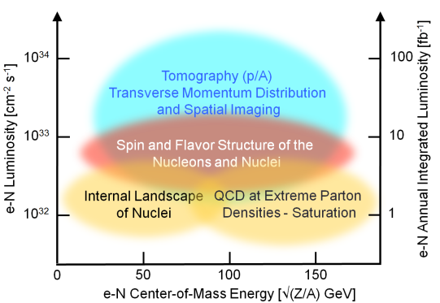
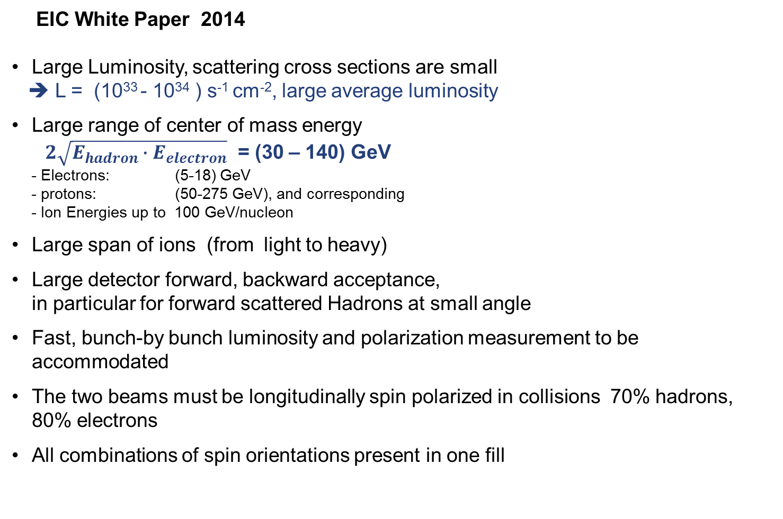
Requirements on an EIC
EIC White Paper 2014
Large Luminosity, scattering cross sections are small
➔ L = (10³³ - 10³⁴ ) s⁻¹ cm⁻², large average luminosity
Large range of center of mass energy
$2\sqrt{E_{hadron}∙E_{electron}}$ = (30 – 140) GeV
- Electrons: (5-18) GeV
- protons: (50-275 GeV), and corresponding
- Ion Energies up to 100 GeV/nucleon
Large span of ions (from light to heavy)
Large detector forward, backward acceptance, in particular for forward scattered Hadrons at small angle
Fast, bunch-by bunch luminosity and polarization measurement to be accommodated
The two beams must be longitudinally spin polarized in collisions 70% hadrons, 80% electrons
All combinations of spin orientations present in one fill

Slide 4
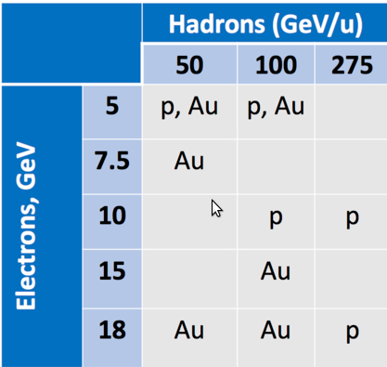
eRHIC Requirements
Species for eRHIC Design
Large luminosity
Center of mass energy between (30-140) GeV
Both Hadron and Electron beams are highly longitudinally spin polarized in collision
Large detector acceptance, in particular for small-angle-scattered hadrons

Slide 5
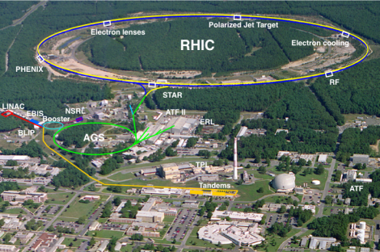
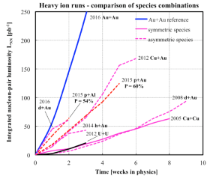
eRHIC uses the Relativistic Heavy Ion Collider RHIC
There will be only relatively small changes to the existing facility and its injector complex; basically same performance parameters are needed
Operating since 1999 with heavy ions and polarized protons
Improving machine luminosity in every run
Unique high energy polarized proton beam collider (60%)
Very successful physics program:
Discovery and detailed study of properties of quark-gluon perfect fluid matter, existing at very origin of the Big Bang
Study of proton spin composition, especially its gluon component
Present plan: to continue A-A and polarized p-p experiments till 2024
Circumference : 3.83 km
Max dipole field : 3.5 T
Energy : 255 GeV p; 100 GeV/n
Species : p to U (incl. asymmetric)
Experiments : STAR, PHENIX

Slide 6
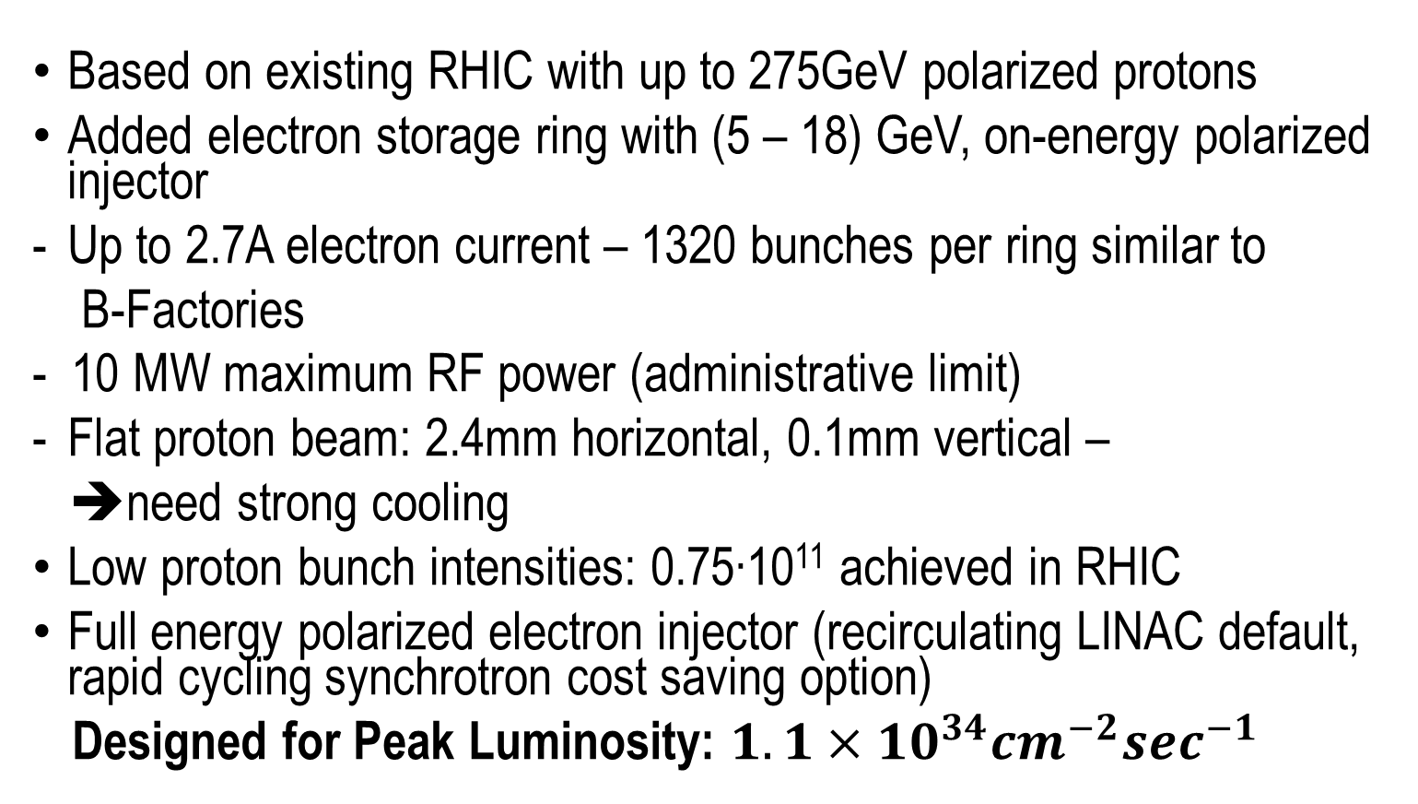
eRHIC Design Concept
Based on existing RHIC with up to 275GeV polarized protons
Added electron storage ring with (5 – 18) GeV, on-energy polarized injector
Up to 2.7A electron current – 1320 bunches per ring similar to
B-Factories
- 10 MW maximum RF power (administrative limit)
Flat proton beam: 2.4mm horizontal, 0.1mm vertical –
➔need strong cooling
Low proton bunch intensities: 0.75∙10¹¹ achieved in RHIC
Full energy polarized electron injector (recirculating LINAC default, rapid cycling synchrotron cost saving option)
Designed for Peak Luminosity: $1.1×{10}^{34}{cm}^{−2}\sec^{−1}$

Slide 7
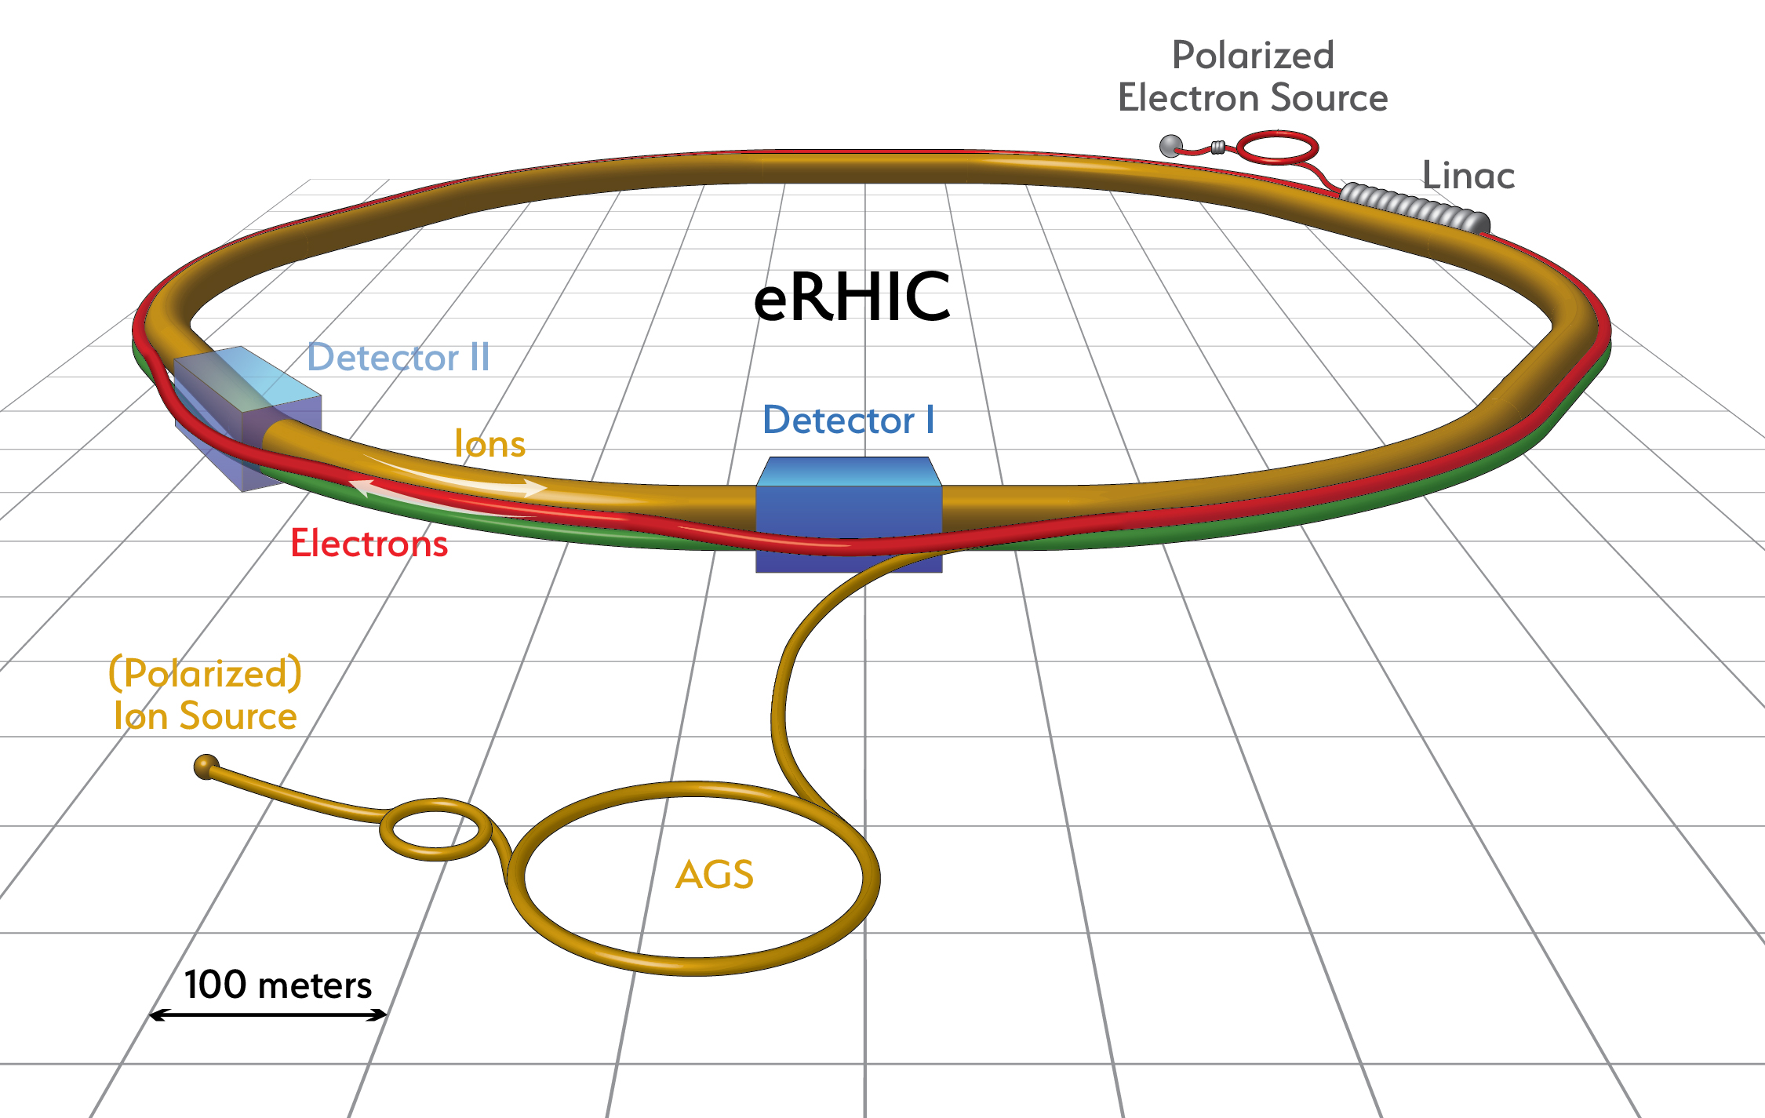
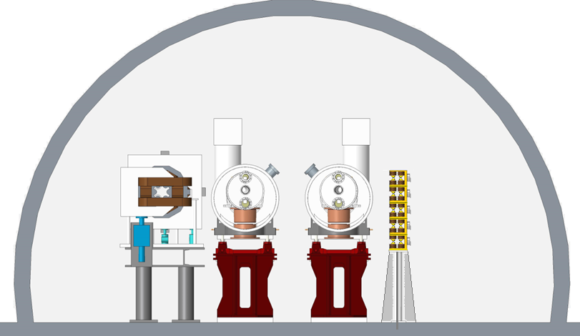

Slide 8
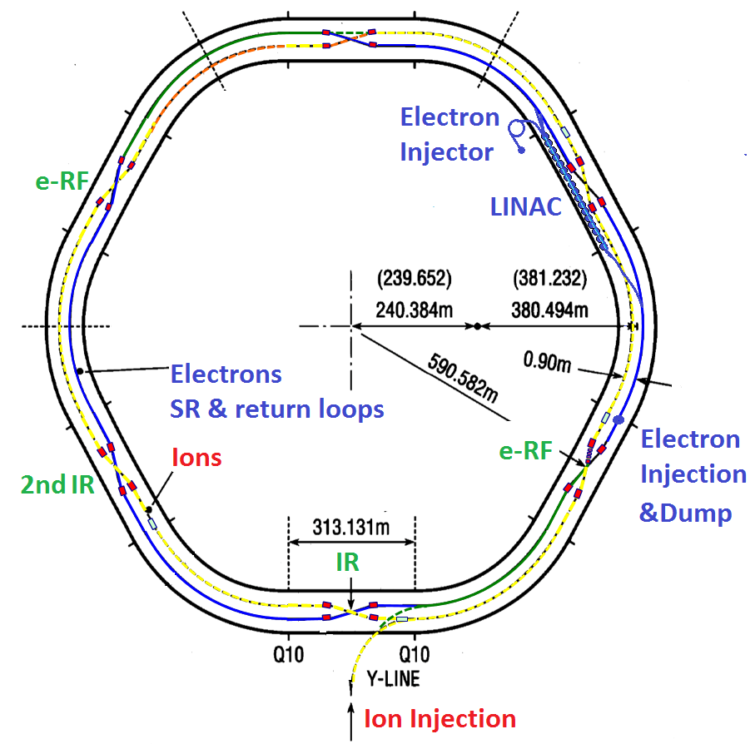
Overall Facility Layout
Issue with large E_{cm} range:
Matching Hadron and e Revolution times for low Hadron energies:
Achieved by:
Increasing the path length for 275 GeV by a combination of going through 4 outer and 2 inner arcs
and using nominal for 50GeV
Plus modifying the entrance into straight sections for fine tuning

Slide 9
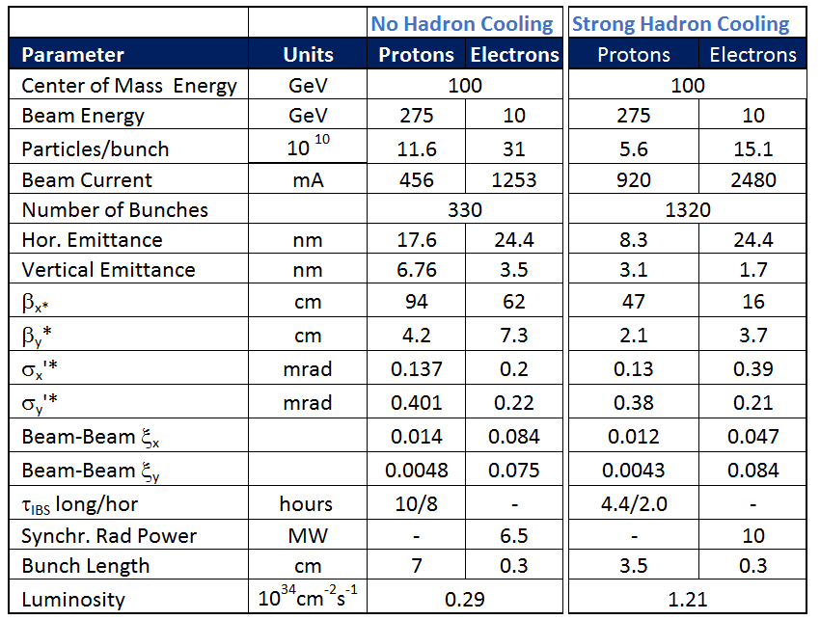
Main Parameters for Maximum Luminosity
E_{p} = 275 GeV, E_{e}= 10 GeV
9

Slide 10
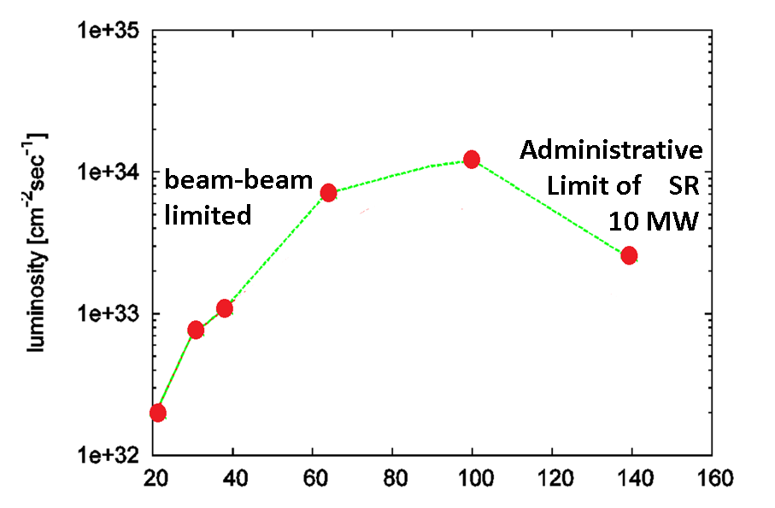
Luminosity vs. Center of Mass Energy
E_{cm} ➔

Slide 11
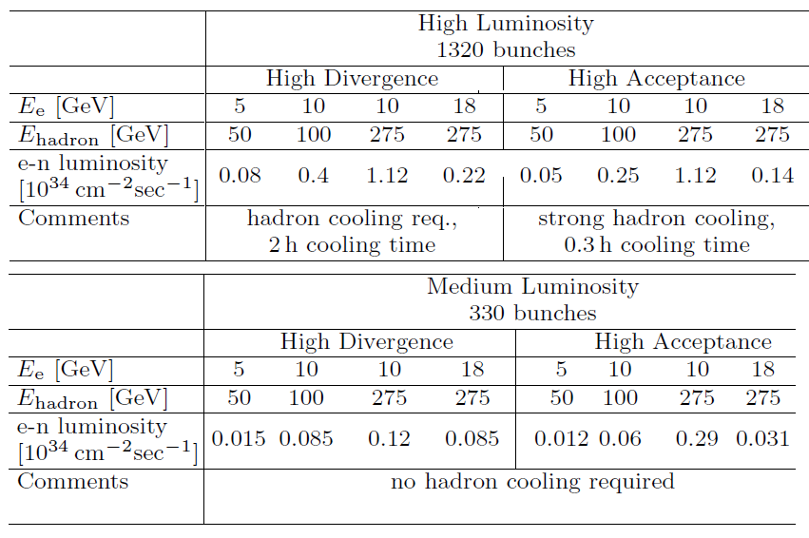
Scenarios for different Species and Energies with and without cooling (for reference)

Slide 12
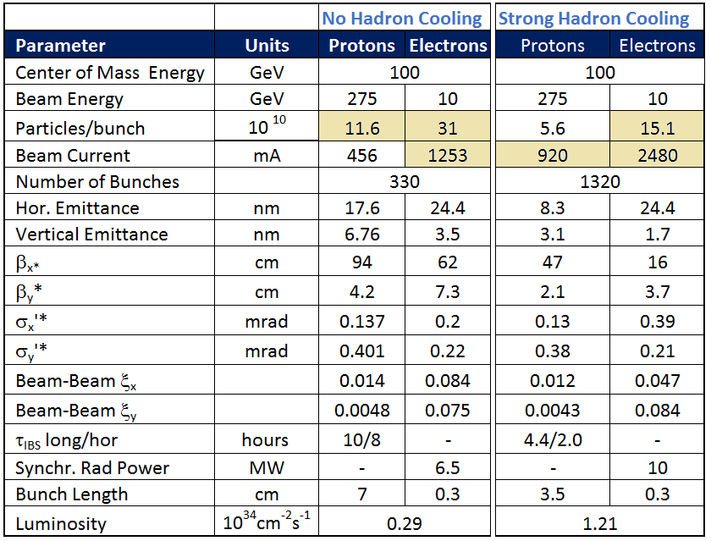
High Beam Current
Electrons
Total Beam Current: up to 2.7 A
Not unprecedented (KEK-B, Super-B), but N_{b}=330
Synchrotron radiation power up to 10 MW
High RF cost: 30 single cell s.c. 560MHz cavities
Peak linear power density < 6 kW/m;
➔ok with Cu beam pipe
Coupled Bunch instability: not fully ruled out
as an issue (Cavity HOMs under study)
Resistive Wall Instability ok
Fast Ion instability growth time manageable
Protons
Total Beam Current up to 920mA
(factor 2 above present RHIC)
Coupled Bunch Instability, ok
e-Cloud: Need Cu coating of RHIC beam pipe + carbon layer for SEY suppression: prototype coater tested
High Bunch Frequency:
➔fast kickers with <10 ns rise times
For injection of electrons and hadrons

Slide 13
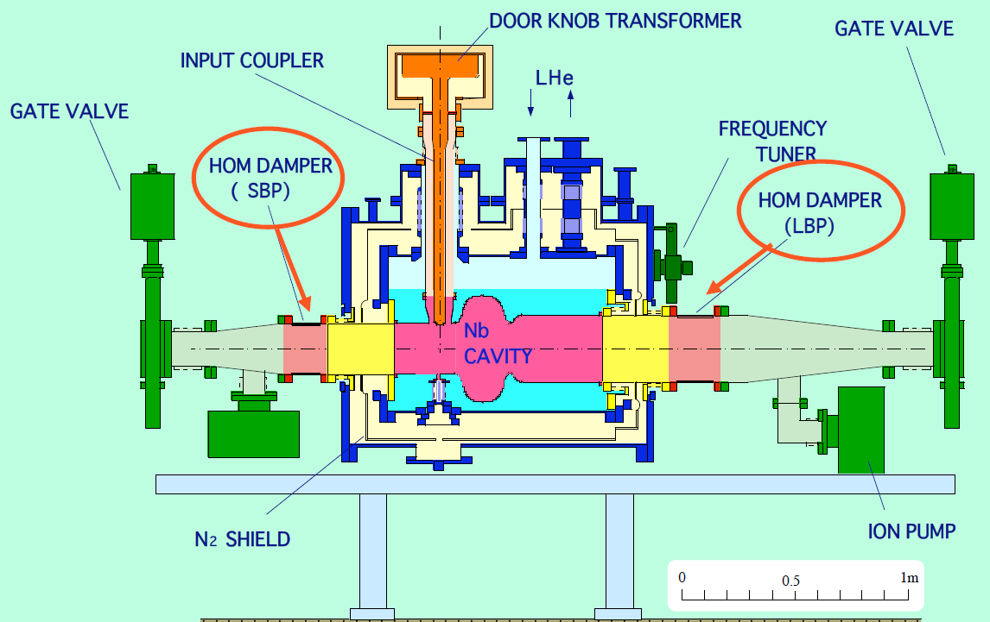
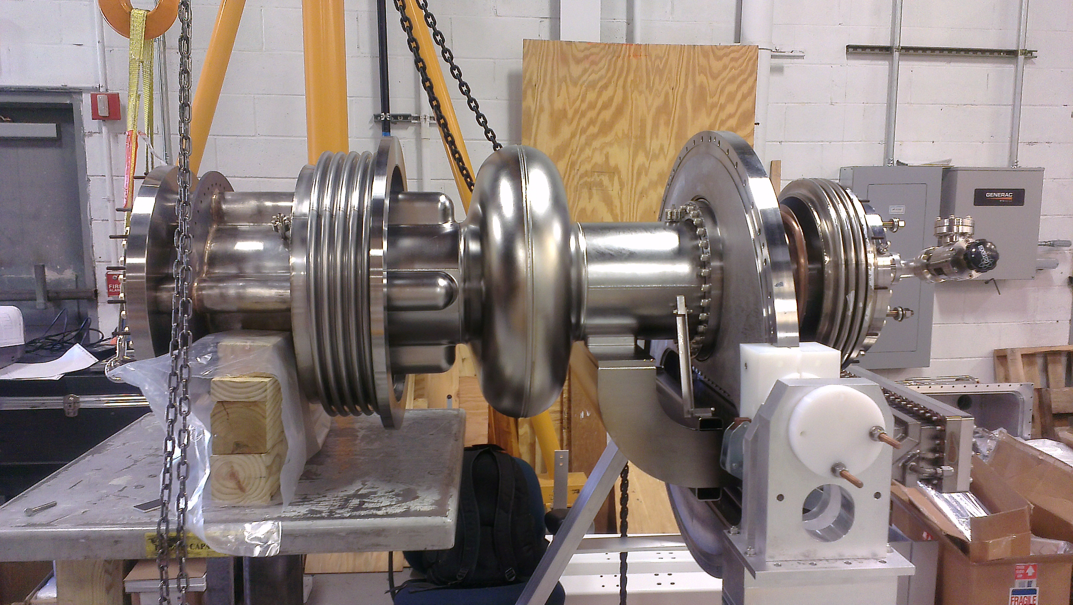
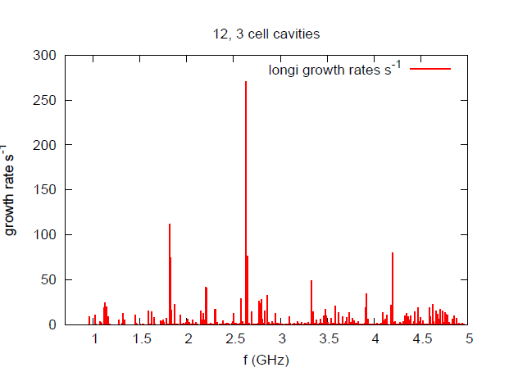
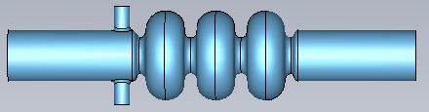
RF Cavity Options
Staged RF installation: 1st 10GeV Operations with optimized coupling for High Intensity Operations, then RF installation for 18GeV but only 200 mA of current
Option 1: KEK-B cavity has been operated successfully
under comparable conditions, semi-commercial
need 15-30 units for 10-18 GeV,
Assuming U = 2MV and P= 400kW➔ $$
Option 2: CESR-B Cavity is successfully operated in several light sources, for example NSLS2, commercially available
Would need 15-30 units for 10-18 GeV,
Assuming U = 2MV and P= 400kW➔ $$
Would have to use coaxial coupler (design completed)
And fix the In-seal, the weak point of the design
Option 3: In-house development of a 3-cell cavity in progress to save cost.
Impedance 12 3-cell units,
Work in progress
All solutions: Broad and narrow band impedance manageable; TMCI ok, Coupled bunch Growth rates < 1kHz

Slide 14
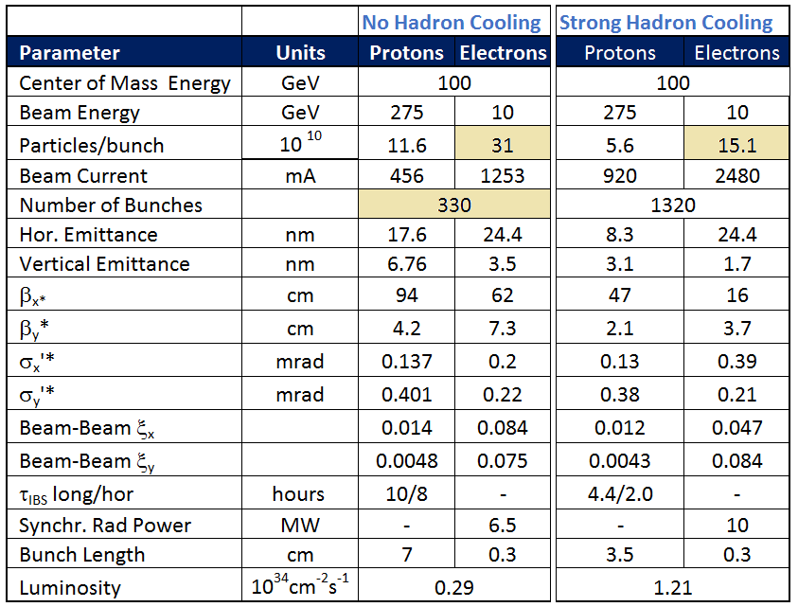
Considerable electron single bunch currents
I_{b} = up to 3.8 mA
I_{e} x I_{eb} = 0.0046 amp² factor ~10 larger than confirmed by B-Factory experience
Concern of heating of vacuum
components (bellows)
➔ needs careful low impedance design
(still to be done)
Single bunch instabilities:
- TMCI ok for typical impedance < 1MΩ,
- microwave instability ok

Slide 15
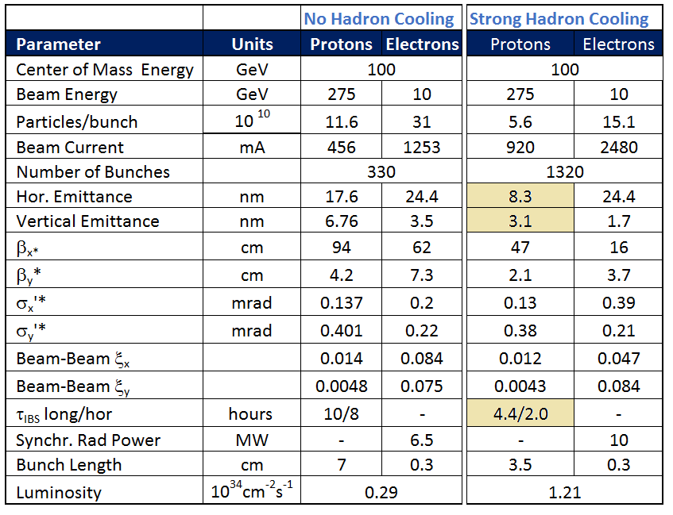
Small Hadron Emittance
L = 1.2∙ 10³⁴cm⁻²s⁻¹ requires
vertical normalized proton emittance:
3.1 μm rad, I_{bp}= 0.7 mA, bunch length 7 cm.
These Hadron beam parameters is subject to strong IBS and can be achieved and maintained only be strong active cooling of the Hadron beams with cooling times in the order of minutes.
MAJOR TECHNICAL CHALLENGE FOR ANY EIC
Cooling time < IBS growth time only 0.5 hours
This exceeds the cooling rates possible with stochastic cooling by several orders of magnitude
Coherent Electron Cooling promises to provide required cooling rates
Novel scheme, never implemented
Proof of principle tests in progress
➔ Need novel cooling schemes to meet this challenge.
Fastest IBS growth for High Acceptance Optics with L~ 10³⁴ τ_{ibs} = 0.3h
(might be able to avoid)
eRHIC Choice is to go with CeC,
but will consider other schemes as well if necessary

Slide 16
Proof of Principle Experiment of Coherent Electron Cooling
Principle
E < E_{h}
V.N.Litvinenko, Y.S Derbenev, Physical Review Letters 102, 114801 (2009).
E_{h}
E < E_{h}
Dispersion section
( for hadrons)
E > E_{h}
E_{h}
λ
Hadrons
Modulator
E > E_{h}
Kicker
High gain FEL (for electrons)
Electrons
➔ cooling of high energy Hadron beams with high band-width; BW: 1THz
cooling times of sec-min to balance strong IBS
16

Slide 17
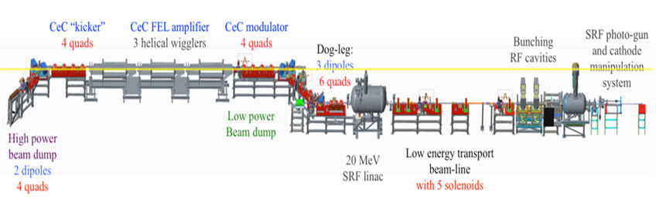
Proof of Principle Experiment
Installed in RHIC IR-2pm
⬅Beam direction
Status:
all hardware components in place,
improvements after first commissioning in 2016 implemented,
recommissioning in progress
Cooling studies planned for FY18

Slide 18
Cooling: Risk Mitigation
Coherent electron cooling is a novel technique
There are number of risks associated with the technical implementation, if not with the principle itself.
Thus there is a risk that strong Hadron cooling will be not available or will be delayed
These risks are mitigated as follows:
A moderate Luminosity solution with 3 ∙10³³ cm⁻²s⁻¹ luminosity would support a compelling physics program
A moderate solution can be upgraded to 5 ∙10³³ cm⁻²s⁻¹ by increasing the number of bunches by factor ~1.7 and the beam current. No cooling would be required and the high beam currents are addressed in the design
Magnetized cooling is equally challenging as its implementation constitutes a considerable risk as though, there are somewhat less concerns about the cooling principle. Implementation is not impossibly but certainly quite expensive.
RHIC is preparing unmagnetized electron cooling as part of FY19-20 low energy operations plan.

Slide 19
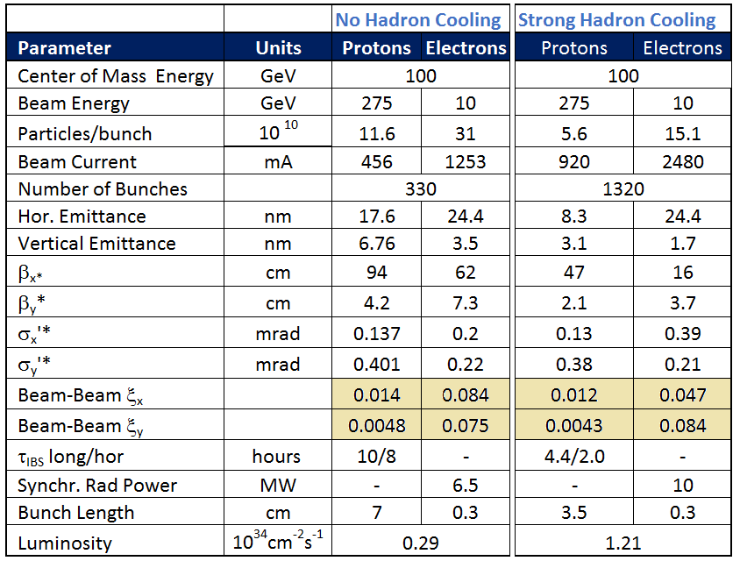
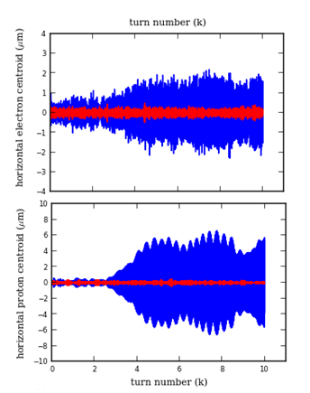
Critical Beam-Beam Parameters Electrons
The beam-beam parameters for eRHIC are ambitiously high
e B-B parameters have been achieved in e+e- colliders (B-Factories)
Choice of eRHIC e Tunes take into account Polarization
Hadron B-B parameters routinely achieved in RHIC
However, HERA operated with lower values, especially in the horizontal plane ξ_{x}=0.03, ξ_{y}=0.05
Occasionally Coherent BB instabilities were observed in HERA
Additional concern Hadron emittance growth (none observed in HERA)
Hadron beam tails and large detector backgrounds
Concern addressed in comprehensive b-b
simulation study (strong-strong; weak strong)
Results so far: Threshold for coherent instabilities factor 2 above operating point, for optimized tunes no or little proton emittance growth
Simulation:
Coherent bb
Instability
Threshold
Red:
N_{p}=10¹¹
stable
Blue N_{p}=3∙10¹¹
unstable
e-Centroid
P-Centroid

Slide 20
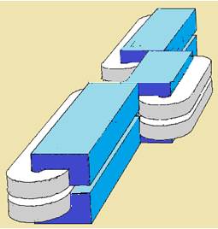
Beam-Beam Parameters Electrons
Large Beam-beam Parameters at 5GeV:
Strong electron Beam-Beam effects require strong radiation damping. Between 5 and 18 GeV τ_{x} changes by a factor 50 without further measures. (11GeV gives KEK-B damping decrement)
➔ With” super-bend” lattice achieve 11 GeV damping time at 5GeV to match KEK-B damping decrement (overcomes as well the E² scaling of beam emittance, helps with polarization)
Radiation Power:
~E²B²
cartoon

Slide 21
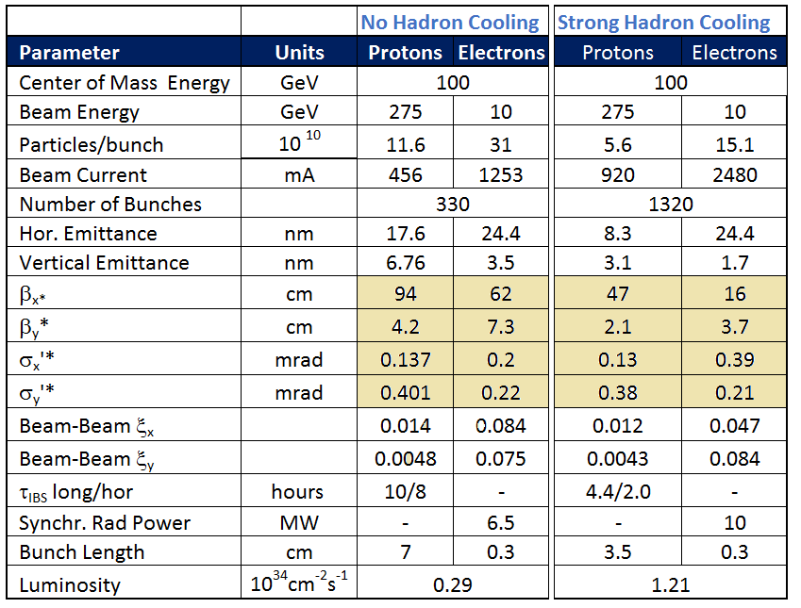
Small beta, IR design

Slide 22
Layout of the Interaction Region
Highly constraint problem:
Focus both beams to small size ➔ large luminosity
Separate the beams quickly to allow for magnets close to the focal point,
Crossing Angle Geometry 22 mrad
Crab cavities to be accommodated in the IR for both beams
Avoid excessive Chromaticity generated in the IR
Shield Electrons from strong focusing and deflection magnets for hadrons
Provide large acceptance for small angle scattered hadrons (close to beam detectors or Roman Pots) is in conflict with small beam size which implies large beam divergence
Large acceptance for entire detector
No accelerator components near the interaction point (+/-4.5 m)
Avoid generation of synchrotron radiation which destroys sensitive detectors and can produce significant backgrounds
Provide acceptance for luminosity measurement and forward neutron detection
Accommodate spin rotators
Accommodate near-beam detector components (Spectrometer magnets, roman pots)

Slide 23
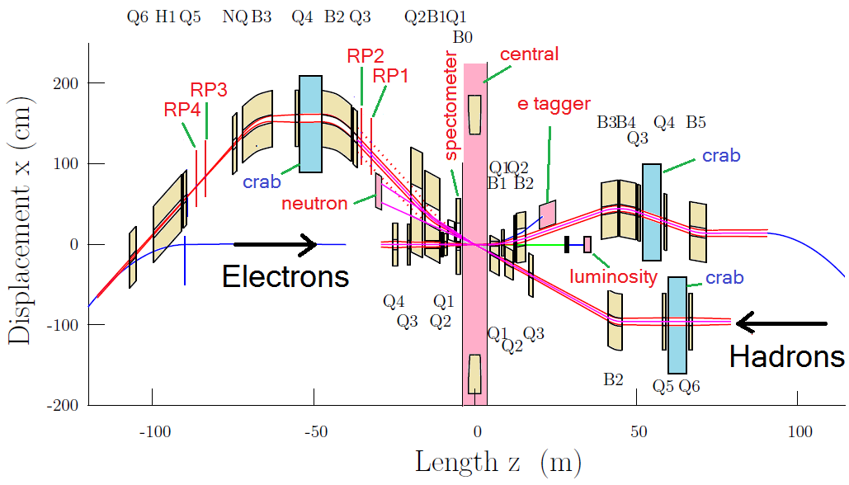
Interaction Region Layout (note distorted scale)
Interleaved arrangement of electron and hadron quadrupoles
22mrad total crossing angle, using crab cavities
Beam size in crab cavity region independent of energy – crab cavity apertures can be rather small, thus allowing for higher frequency
Forward spectrometer (B0) and Roman Pots (R1-R4) for full acceptance

Slide 24
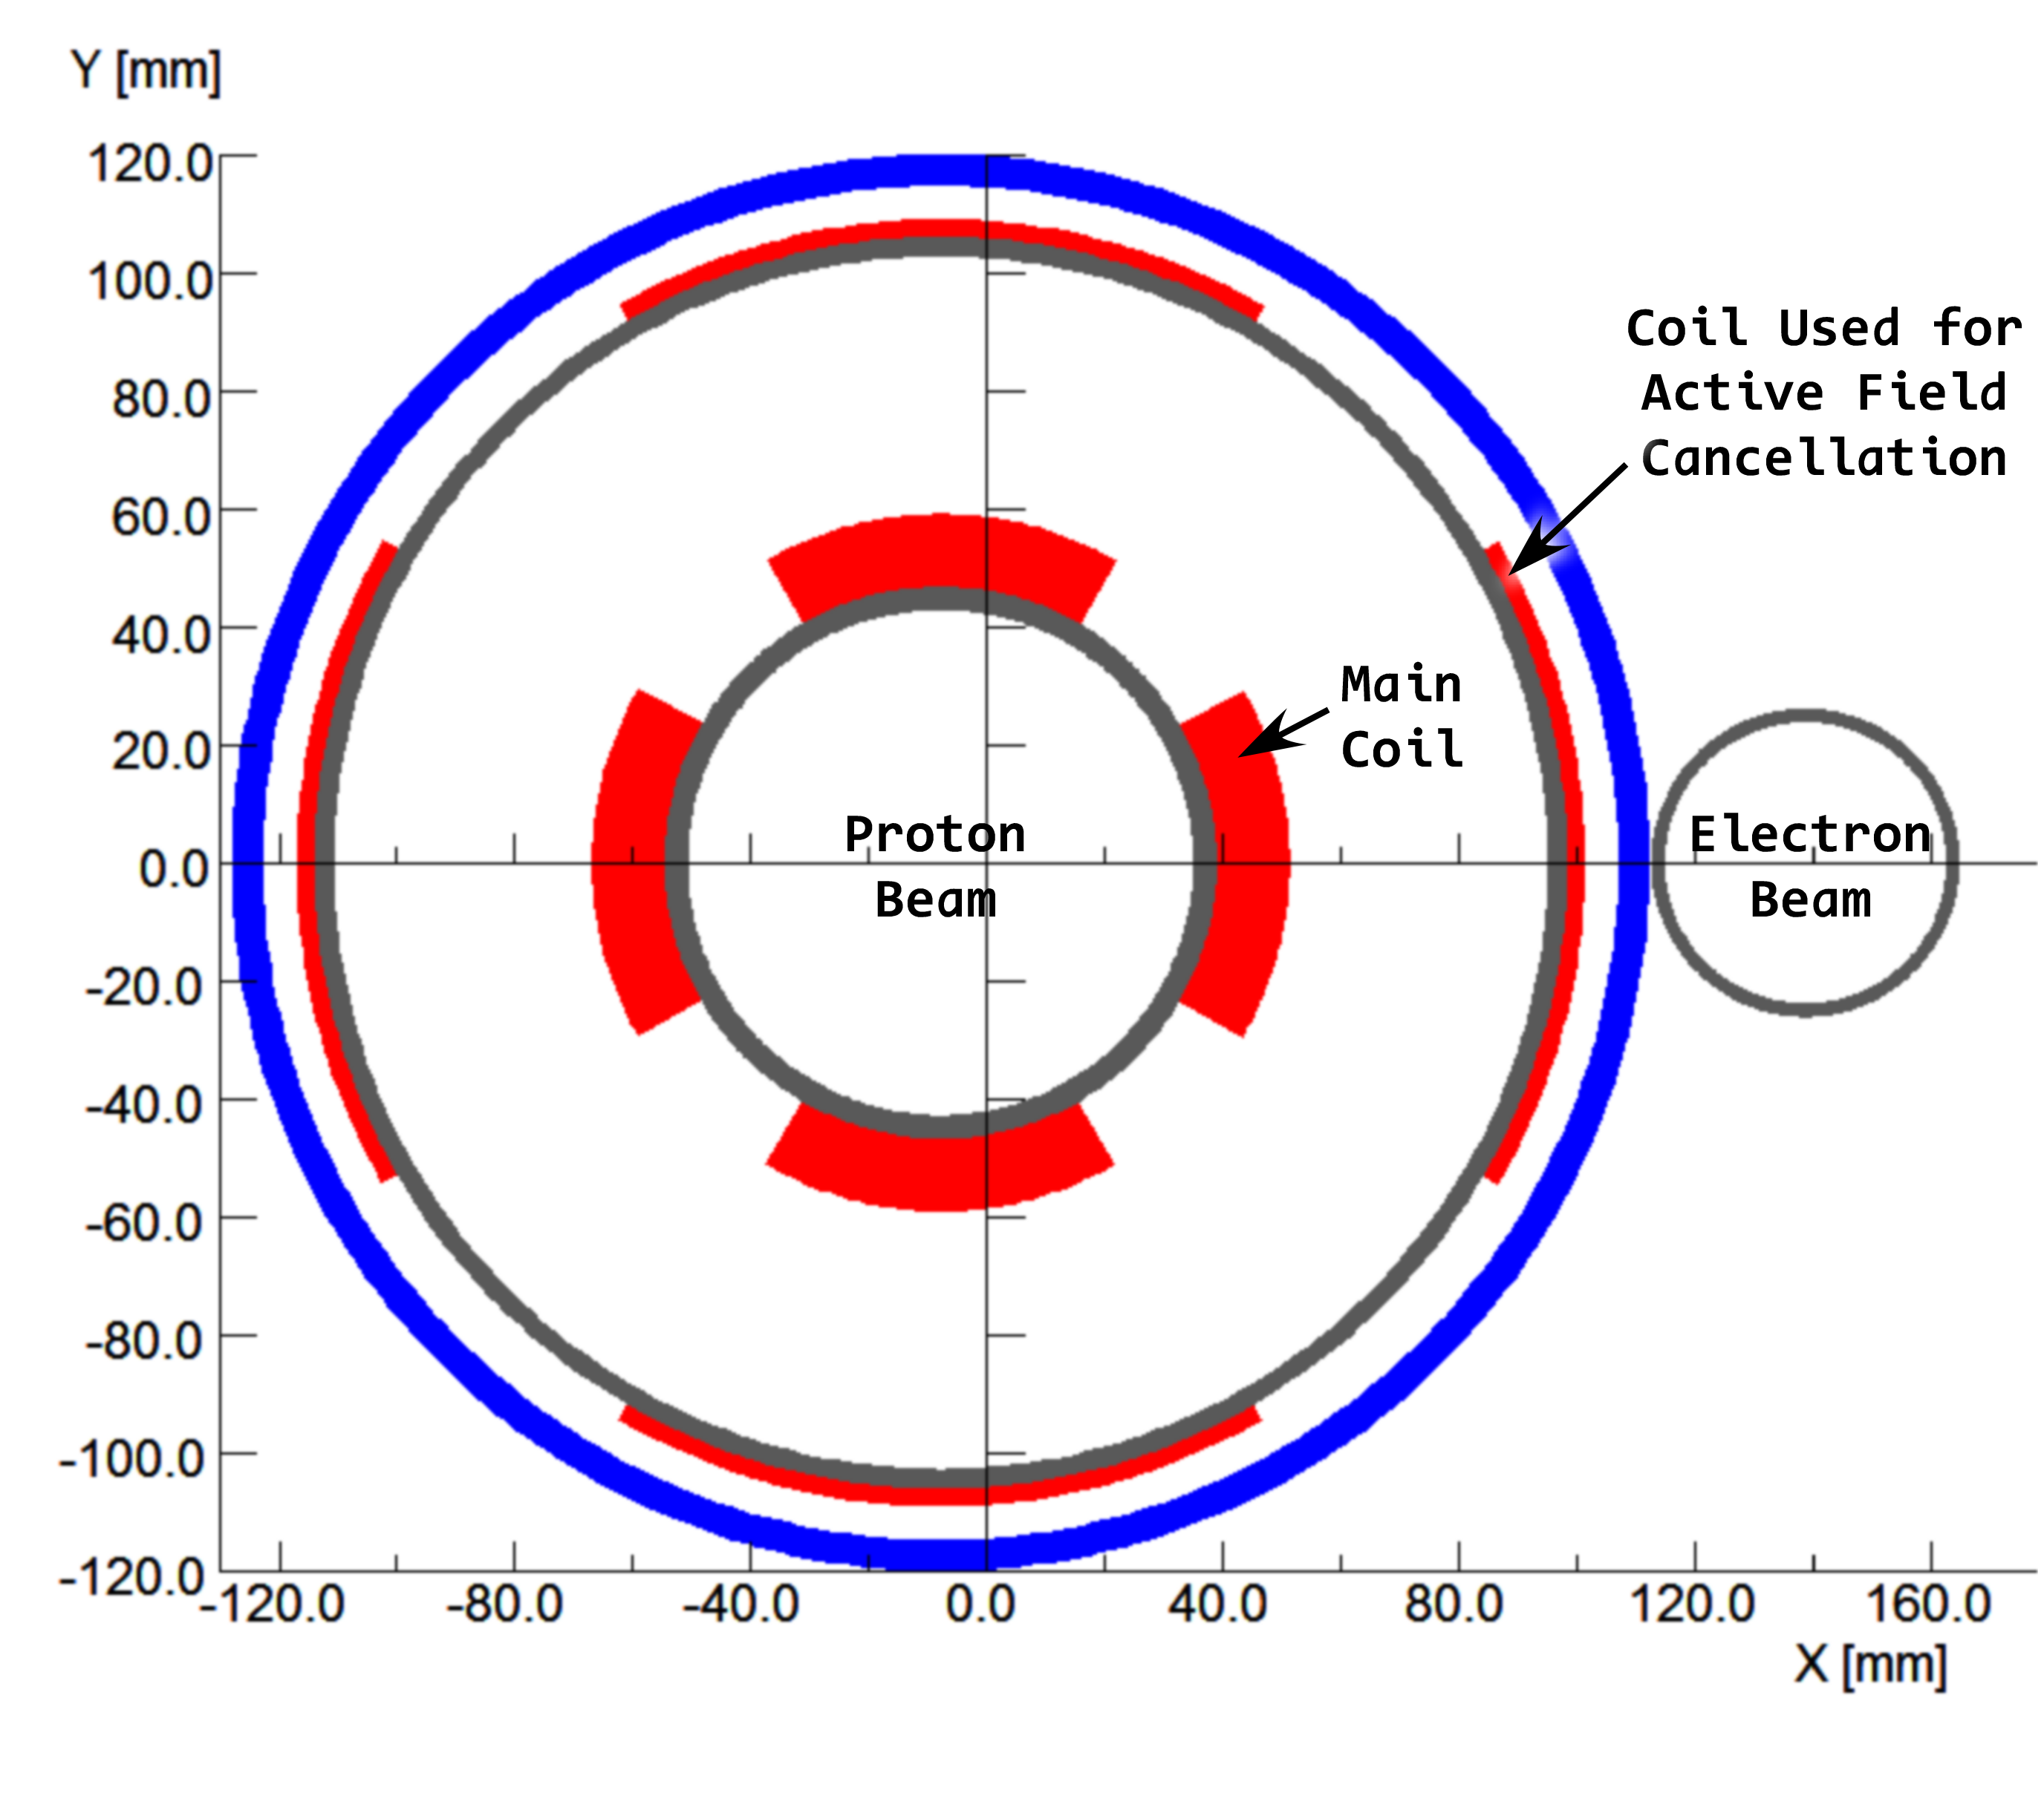
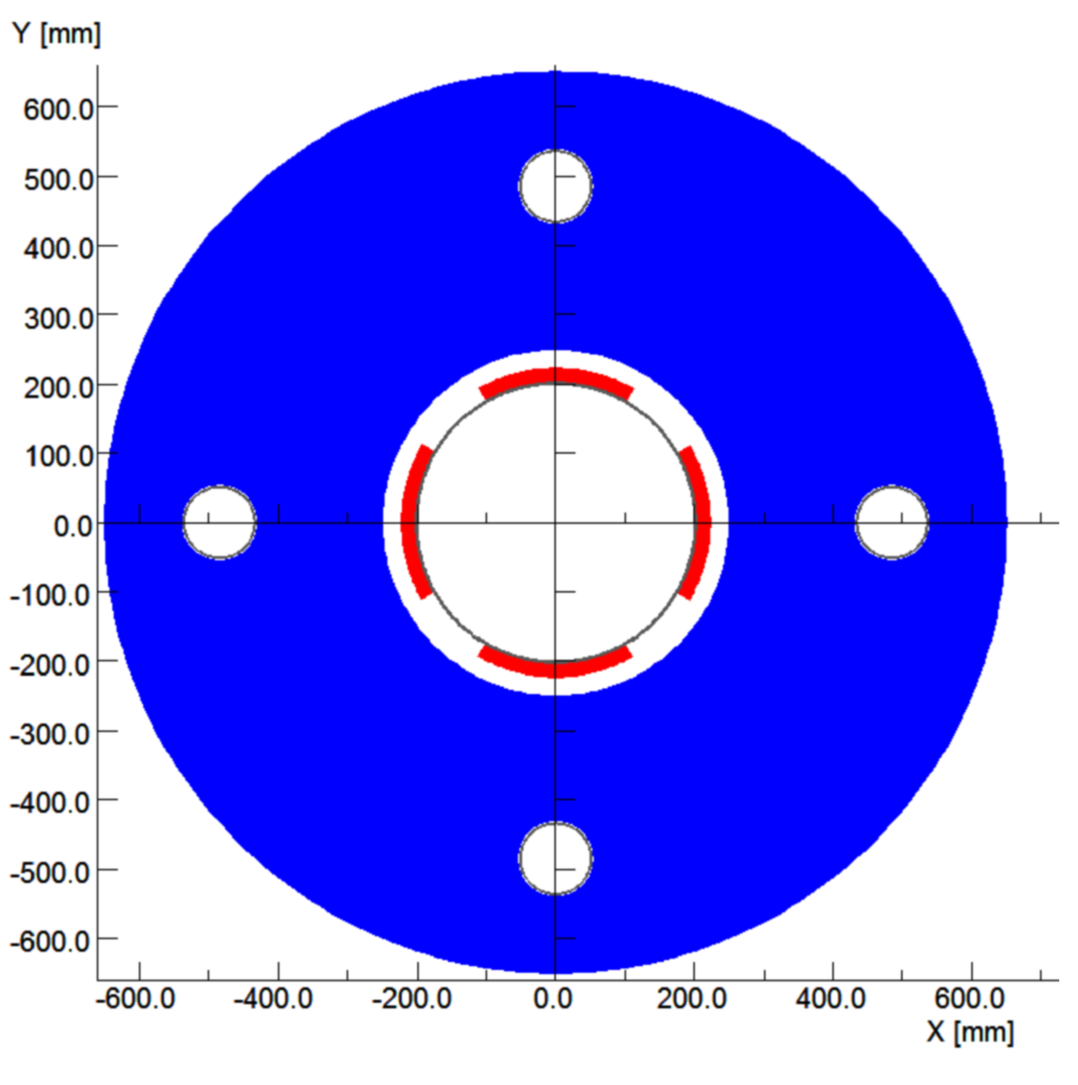
Conceptual Layout of IR Magnets with active shielding
magnets with direct-wound coil including cancelling dipole to shield electron
Hadron superconducting quadrupole with hoses in the return yoke for electrons
Prototype for actively shielded quadrupole Q1 already exists
as part of ILC work
Spectrometer magnet in the Hadron line close to detector: detection of forward scattered Hadron
Generation of dispersion downstream for increased p_{t} acceptance
Conceptual design for super-ferric dipole
With actively shielded pipe for electrons

Slide 25
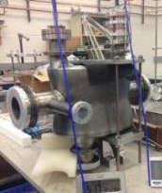
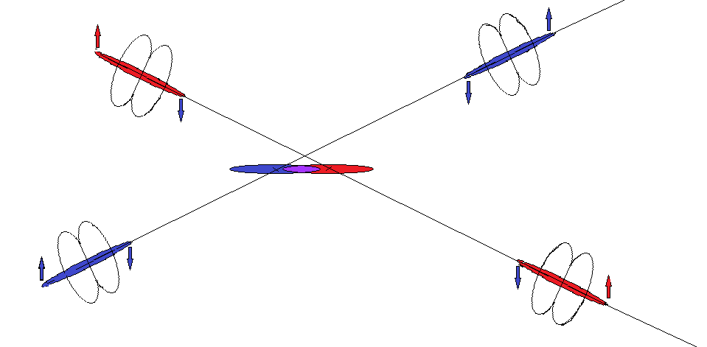
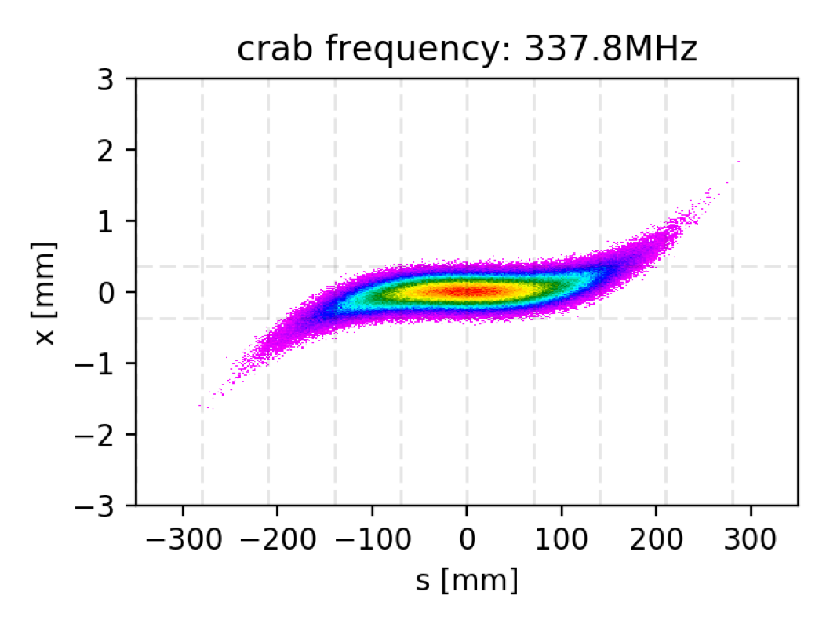
Crossing Angle Geometry and Crab Cavities
Prototype of a double quarter wave length s.c. crab cavity
(father of the prototype to be installed in SPS for the LHC crab cavity test)
Simulation of crabbing and crab cavity effects just started ➔ needs more effort
Example: Results on the quest of Higher Harmonic Crab Cavities
Simulation taking into account
linear BB,
Energy pick up in the cavity
Path length and orbit effects due to dispersion in the crab
Crab dispersion effect
Nonlinear BB with crab: in progress

Slide 26
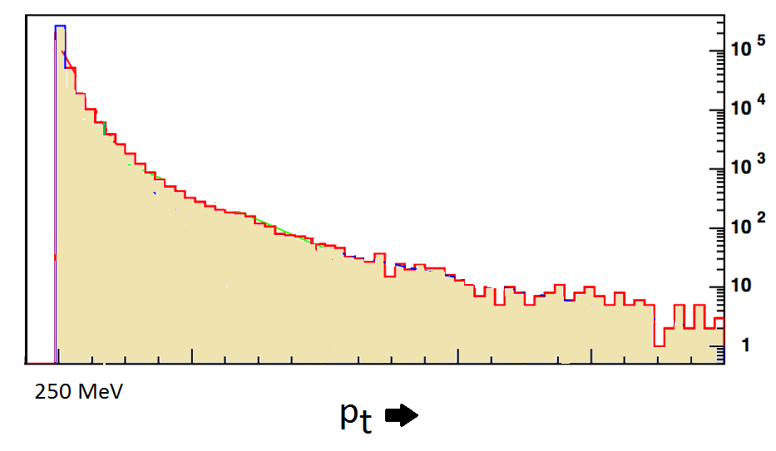
IR Design Related Issues under Development
IR layout and achievable betas and corresponding p_{t} acceptance is work in progress
Close to L = 10³⁴ cm⁻²s⁻¹ solution without active cooling
Beam Optics with lower luminosity and larger p_{t} acceptance to capture protons with p_{t} as small as 200 MeV (need to run only 10% of the time
Solution for chromatic corrections including 2nd order tune shifts and acceptable dynamic aperture is yet to be designed
Need to develop a lattice adequate for electrons
-extreme values of p_{t} of 0.2,1.3 GeV are inside of beam envelope for highest luminosity
-However, cross sections a low p_{t} are very large, so that a limited time (~20%) running at a high acceptance optics (larger beta) with reduced luminosity provides sufficient experimental data
Cross section
HL →
HA →
200 MeV/c
1.3 GeV/c

Slide 27
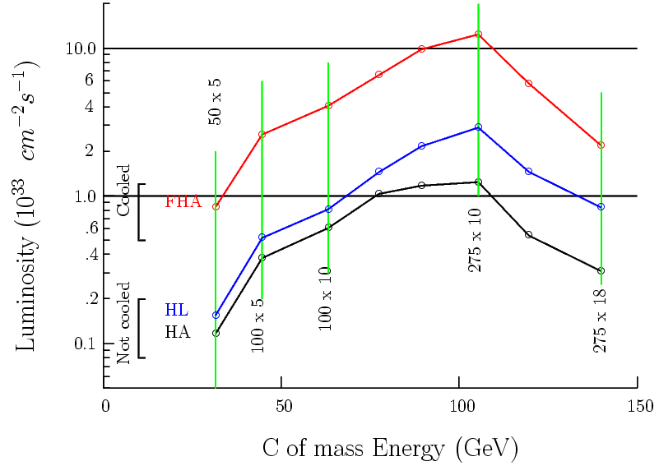
High Luminosity and High p_{t} Acceptance Solutions
Introduction of HL and HA IR optics and running with HA for a limited time (~20%)
Increases the overall “effective luminosity to ~2.3∙10³²cm⁻²s⁻¹ since very low p_{t} has high cross section
* Last minute note: The complication
Of having a HA and a HL luminosity optics is being overcome by smart choices

Slide 28
Beam Polarization
Requirements
The two beams must be longitudinally spin polarized in collisions
70% hadron polarization, 80% electron polarization
All combinations of spin orientations present in one fill
Hadron Polarization
- Polarized protons with P > 60% are already provided by RHIC and its injector chain ➔ no design concern at this point
- H³ Polarization requires additional Siberian snakes from the Blue Ring
Electron Polarization
Sokolov-Ternov either too slow (at 5-18 GeV) or detrimental for spin || B-dipole ➔
- Storage ring requires full energy injection of polarized bunches, no top off
Drives the requirements of the injector chain from source to high energy accelerator
50nC polarized source: SLAC gun: 16 nC 120 Hz, eRHIC 50nC 1 Hz, may need accumulator
superconducting recirculating linac $$ or rapid cycling synchrotron
Storage Ring Polarization
Spin || B-dipole: depolarization by Sokolov-Ternov effect, need exchange bunches every 6 minutes (kick-in / kick out)
Spin Polarization preservation will be based on HERA experience: Spin matching, harmonic orbit control, choice of tunes near integer resonance, ….

Slide 29
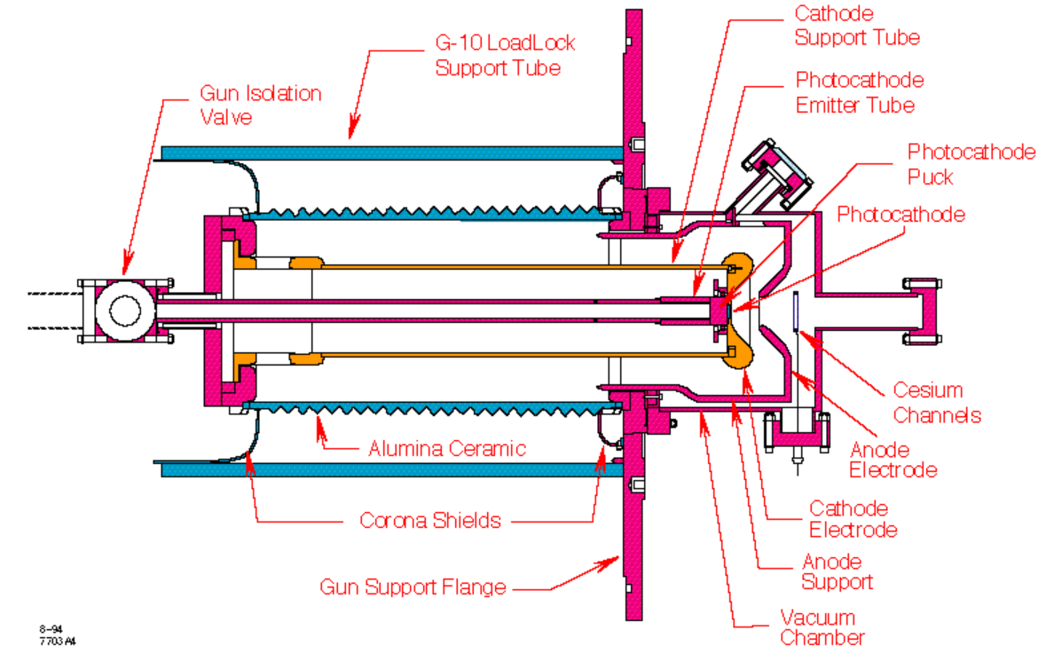
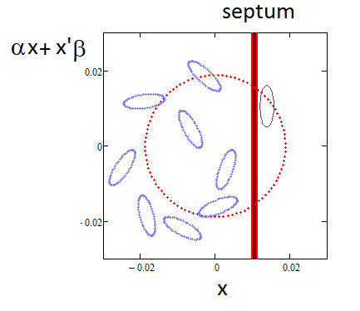
Polarized Electron Source
R&D activity for a polarized source (80%) underway:
Goal 5 nC bunches spaced by 100 ns ➔ 50 mA
For present eRHIC design approach need a 50 nC polarized (80%) electron gun with 1 Hz repletion frequency
SLAC Gun might be a good starting point. It delivered 16nC @120 Hz
In conjunction with a small accumulator ring, it will satisfy the demand
+
However polarized gun designs have been improved since the SLAC gun was developed and operated and these improvement promise
eRHIC inverted gun with large cathode size promises performance of 50 nC within surface charge limit. 50nC beam transport looks ok

Slide 30
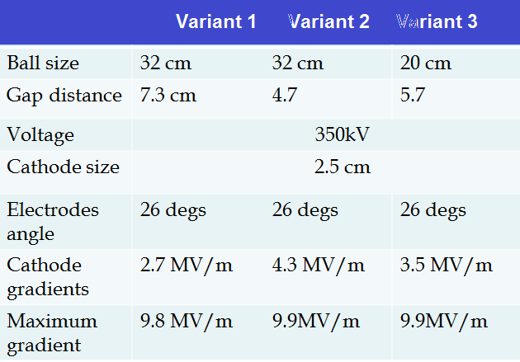
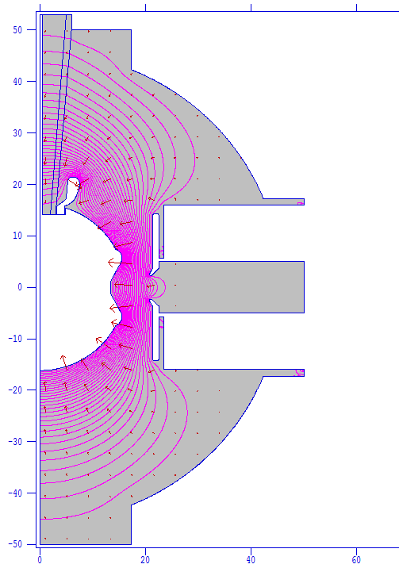
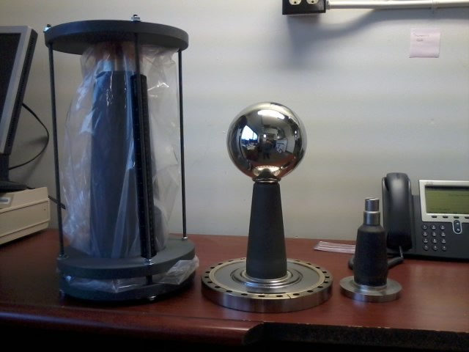
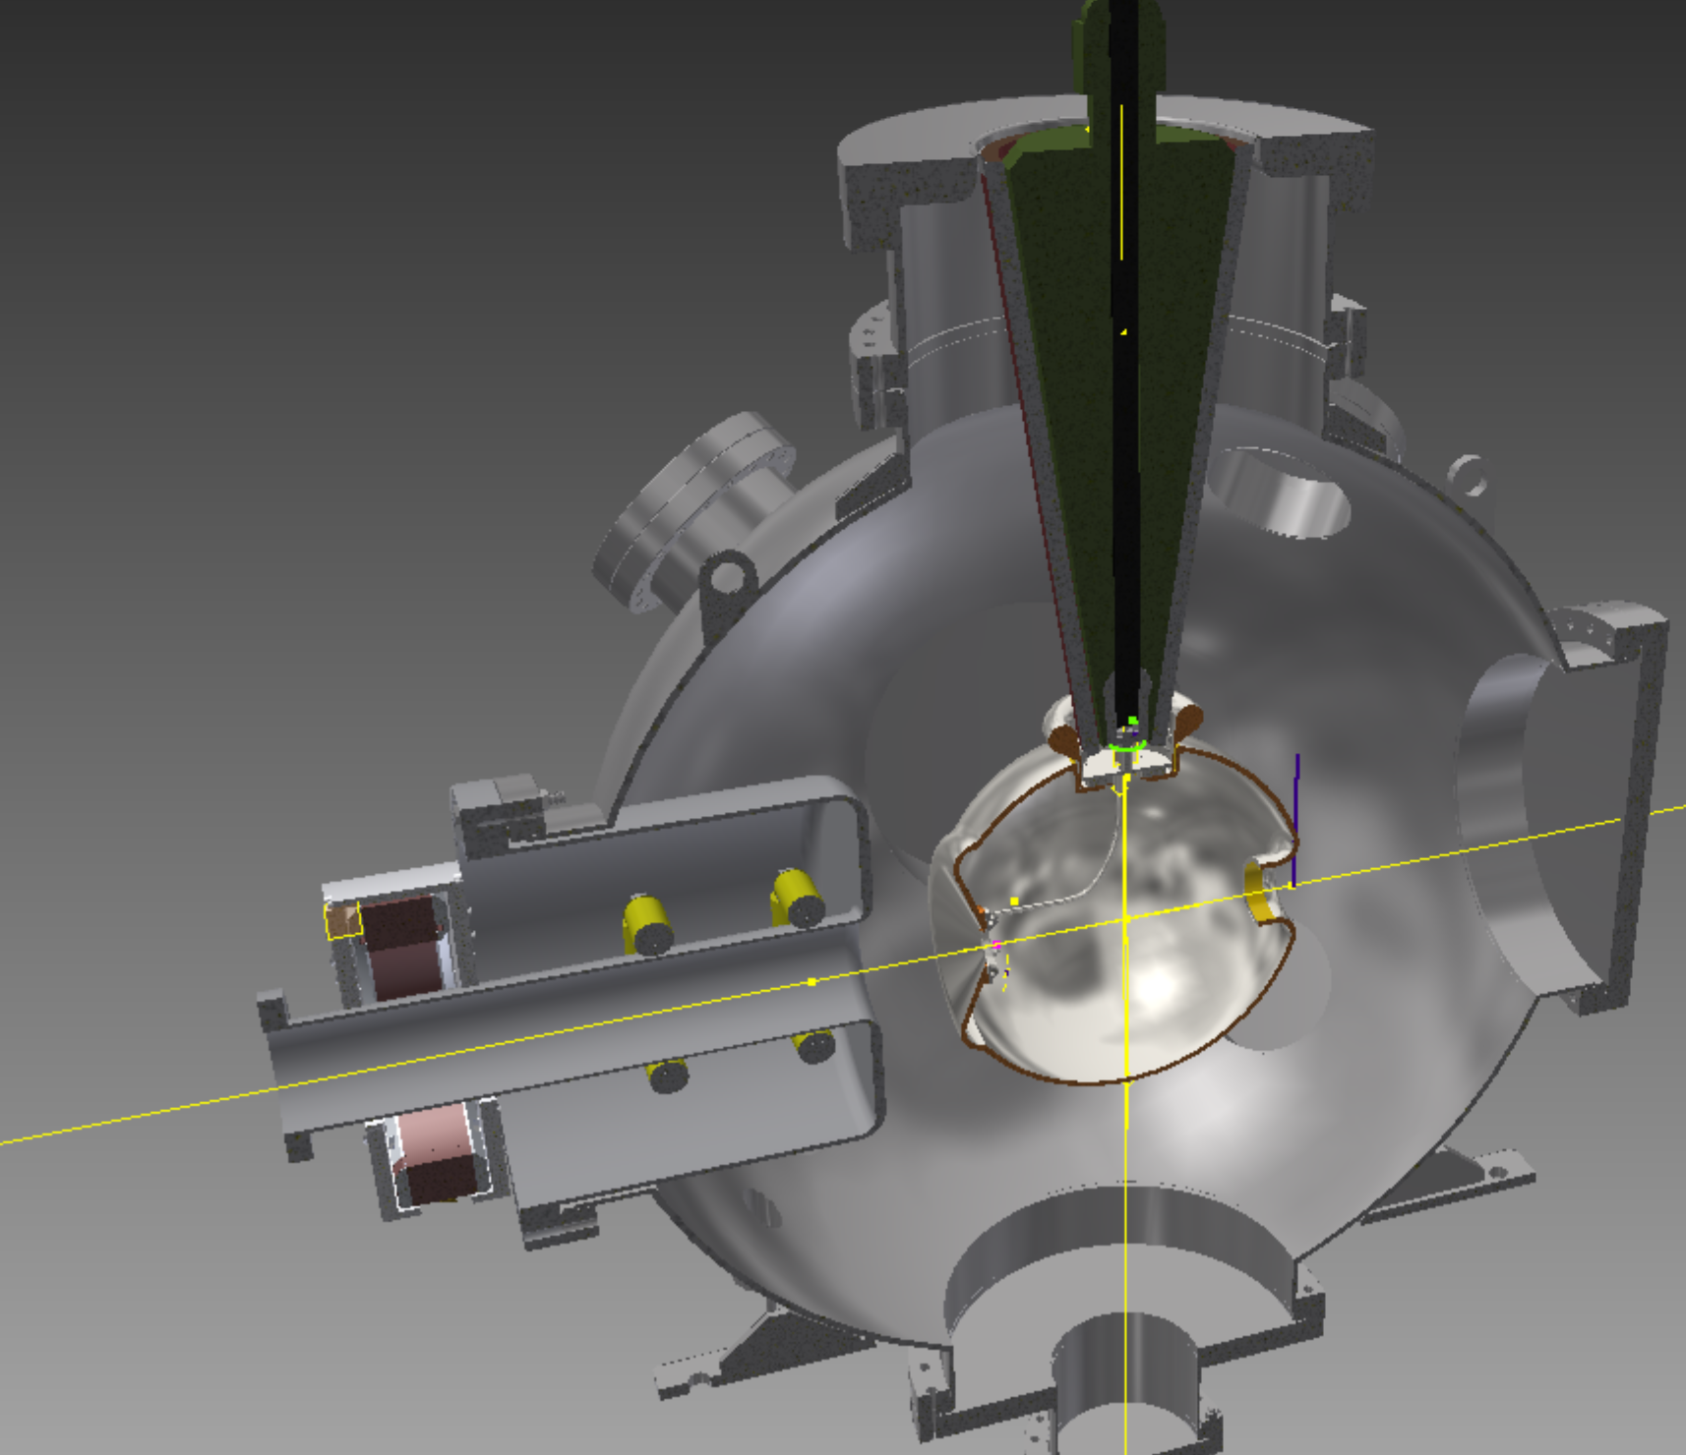
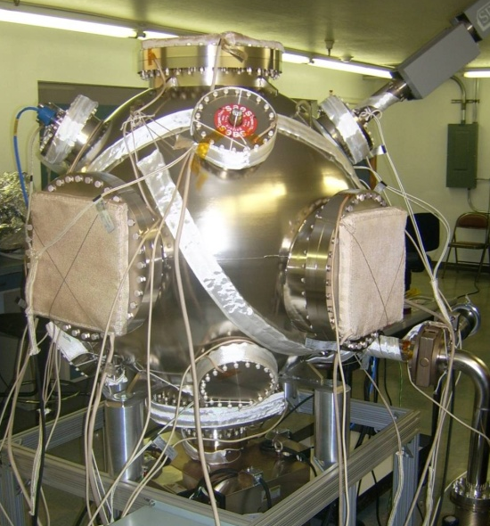
Polarized eGun R&D: Beyond State of the Art Design
Gun Vessel
10⁻¹² torr

Slide 31
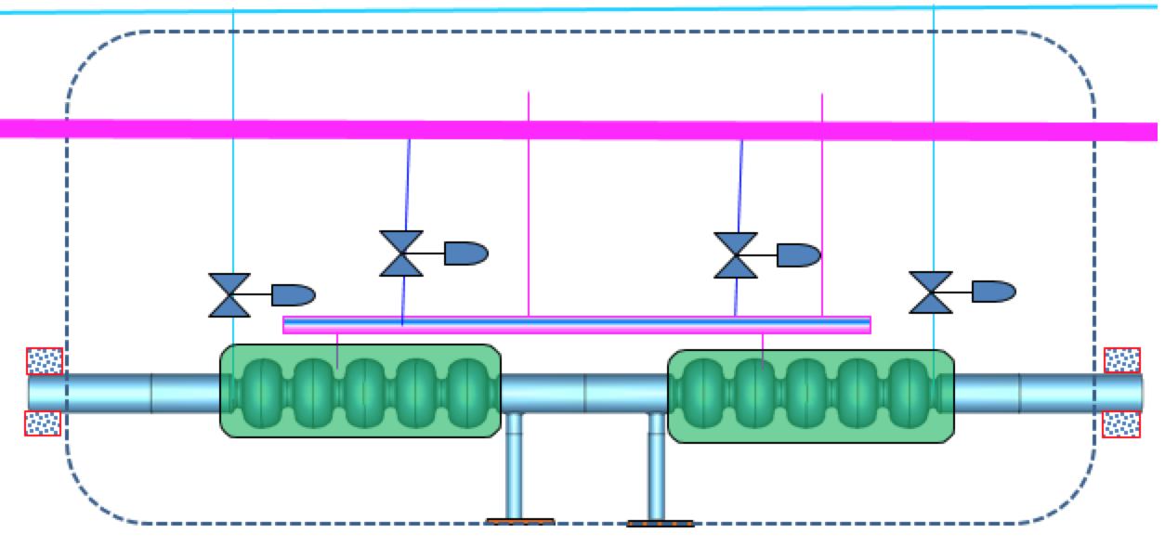
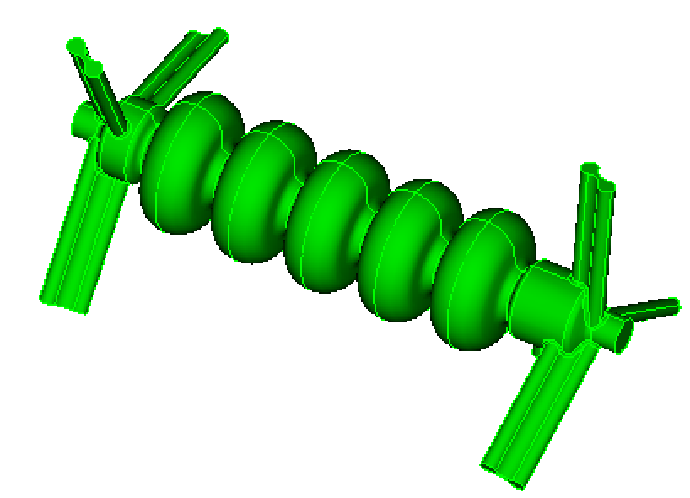
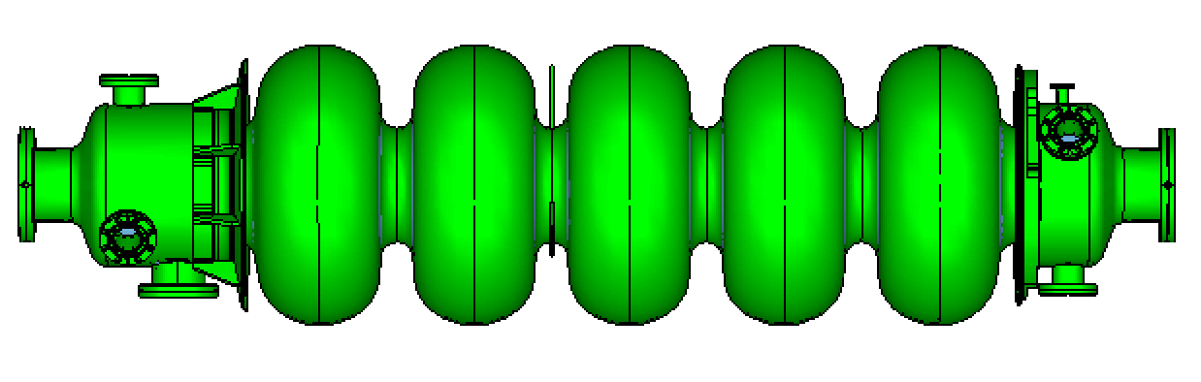
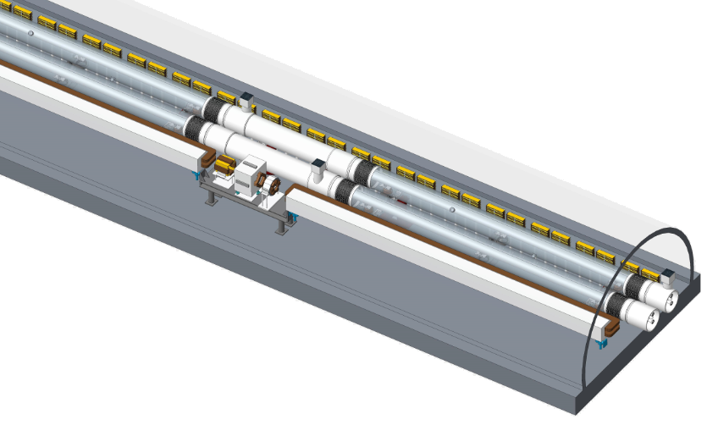
Spin Transparent Electron Acceleration
Straight forward Choice:
Recirculating s.c. LINAC, 647 MHz, 3 GeV, Accelerating gradient: 25MV/m
Rep Rate 1 Hz, single bunch 50 nC
Five re-circulation loops
Challenge to fit in the RHIC tunnel together with
2 RHIC rings and Storage Ring
LINAC beam dynamics has been checked ok Δp/p for SR injection
Energy spread at SR injection manageable
Main Disadvantage of this scheme:
cost, need 120 m of active structure at ~>1M $/m
Plus 250 M$ for five return loops.
Need some waveguide HOM damping to avoid accumulation of beam induced fields
Prototyping of Cu model and Nb cavities and waveguide HOM underway

Slide 32
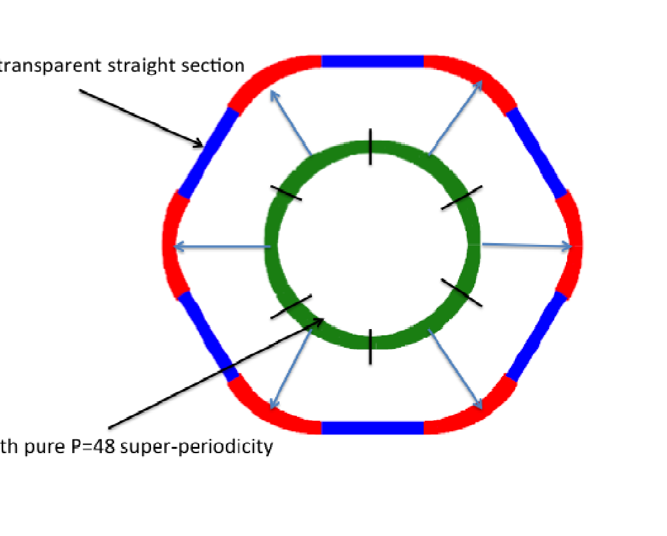
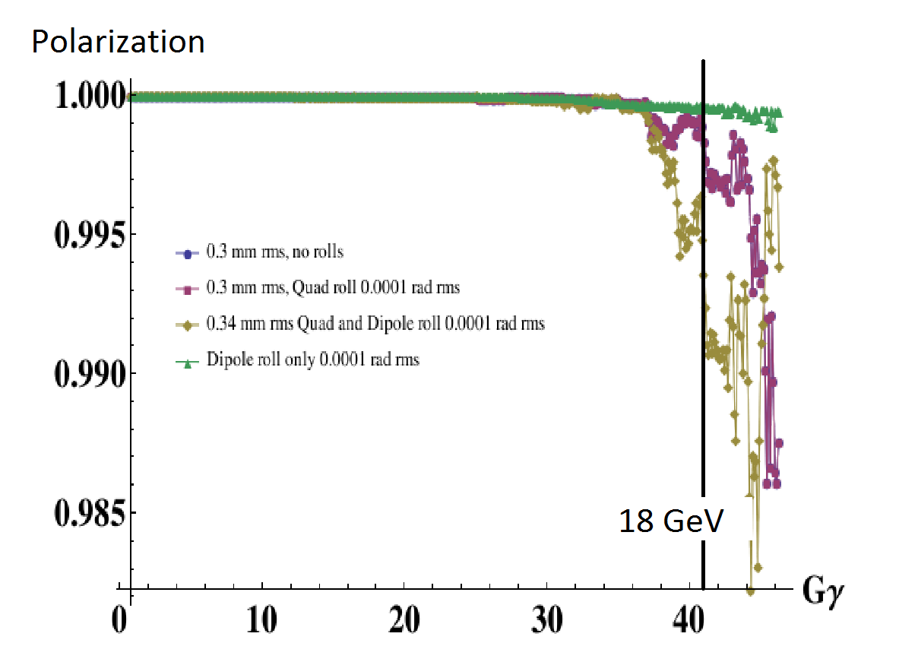
Alternative Spin Transparent Electron Accelerator
Rapid Cycling Synchrotron with Suppressed Intrinsic Spin Resonances due to high 48-fold quasi Symmetry
Costly Linac can be replaced by much cheaper fast cycling synchrotron
If electron polarization can be preserved.
Idea: synchrotron with highly symmetric arcs connected by lattice with unity beam transport
First simulation results without error compensation and 5 ms ramp time encouraging.
Spin Transparent Straight
Spin Transparency simulation

Slide 33
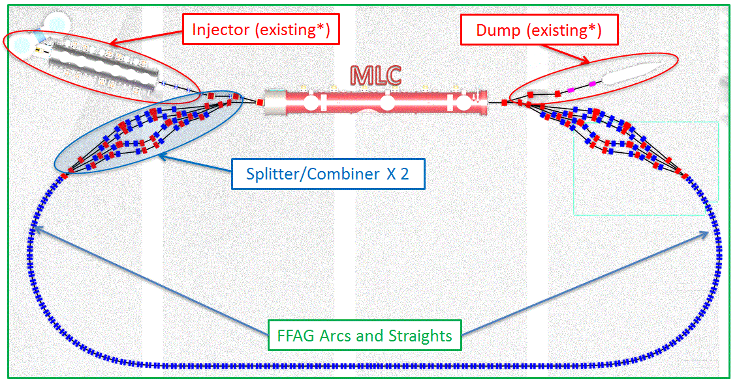
Opportunities for Cost Savings: FFAG Return Loop
FFAG return loop would replace up to 5 return loops in the RHIC tunnel (substantial cost saving for recirculating linac)
Proof of principle experiment under construction at CORNELL University funded by NYS.
CBETA: Energy recovery Linac with four circulations, planned completion of construction : 2020.

Slide 34
Opportunities for Cost Savings: Energy Recovery LINAC based Solution for eRHIC
ERL based solutions for eRHIC had been worked out. In these schemes, electron bunches interact only once with the hadron bunches before they will be decelerated and eventually dumped.
The high luminosity is obtained by extremely small beam size and strong beam-beam interaction experienced by the electrons. The electron beam current can be reduced.
The total electron current is only 50 mA and the synchrotron radiation power and the overall RF power is less than the one of the storage ring solution which constitutes a construction and operating cost saving. This is the main advantage of this option.
Electrons will be accelerated and subsequently decelerated in a (5.5+5.5)- turns recirculating energy recovering superconducting LINAC
This design meets all requirements of the EIC white paper including 10³⁴cm⁻²s⁻¹ luminosities if fast hadron cooling is available.
The disadvantage of the solution is that the full polarized electron current needs to be produced in a polarized gun. This is a significant factor beyond what has been achieved previously. The feasibility of a 50 mA polarized electron source is yet to be demonstrated which is addressed in an aggressive R&D program.

Slide 35
Envisioned eRHIC Time Line
April 2017 Design Choice Validation Review
2017/18: Work out a pre-conceptual design report
2018: eRHIC Design Review
2019: Mission need acknowledged by DOE, critical decision zero (CD-0)
2019-2021: Conceptual design
incl Evaluation of alternates
2021: CD1: site decision
2021-2022: preliminary design project baseline in scope cost, and schedule scope
2022: CD2
2022-2023- Engineering design (final design)
2023: CD-3 Start Construction
2028 CD-4 Completion

Slide 36
SUMMARY
Accelerator based nuclear physics experiments and studies in the field have led to a strong and exciting physics case of the EIC which is acknowledged not only in the Nuclear Physics community but also stirred the interest in the High Energy Physics Community in particular in the Deep Inelastic Scattering Community, as fundamentally new physics could emerge from an EIC physics Program.
The BNL version of the EIC makes use of the existing RHIC accelerator complex, which constitutes more than 2/3 of the cost of such a facility is called eRHIC.
The eRHIC design has evolved recently
- from an ERL based solution
which is quite cost effective but has unresolved technical risks
- to a concept based on an Electron Storage Ring with peak luminosity in excess of
10³⁴cm⁻²s⁻¹ and cm energy ranging between 30 GeV and 140 GeV
The design uses only accelerator components and electron and Hadron beam parameters which have already been demonstrated, but nevertheless reaches the required performance.
Preliminary cost analysis indicates that eRHICcan be constructed for less than 1B$.
In addition, there is a significant cost saving opportunity by using equipment from retired facilities.
An R&D program is underway to explore cost saving technology.
eRHIC promises to be an exciting opportunity for the science in the next 2-3 decades

