Slide 1
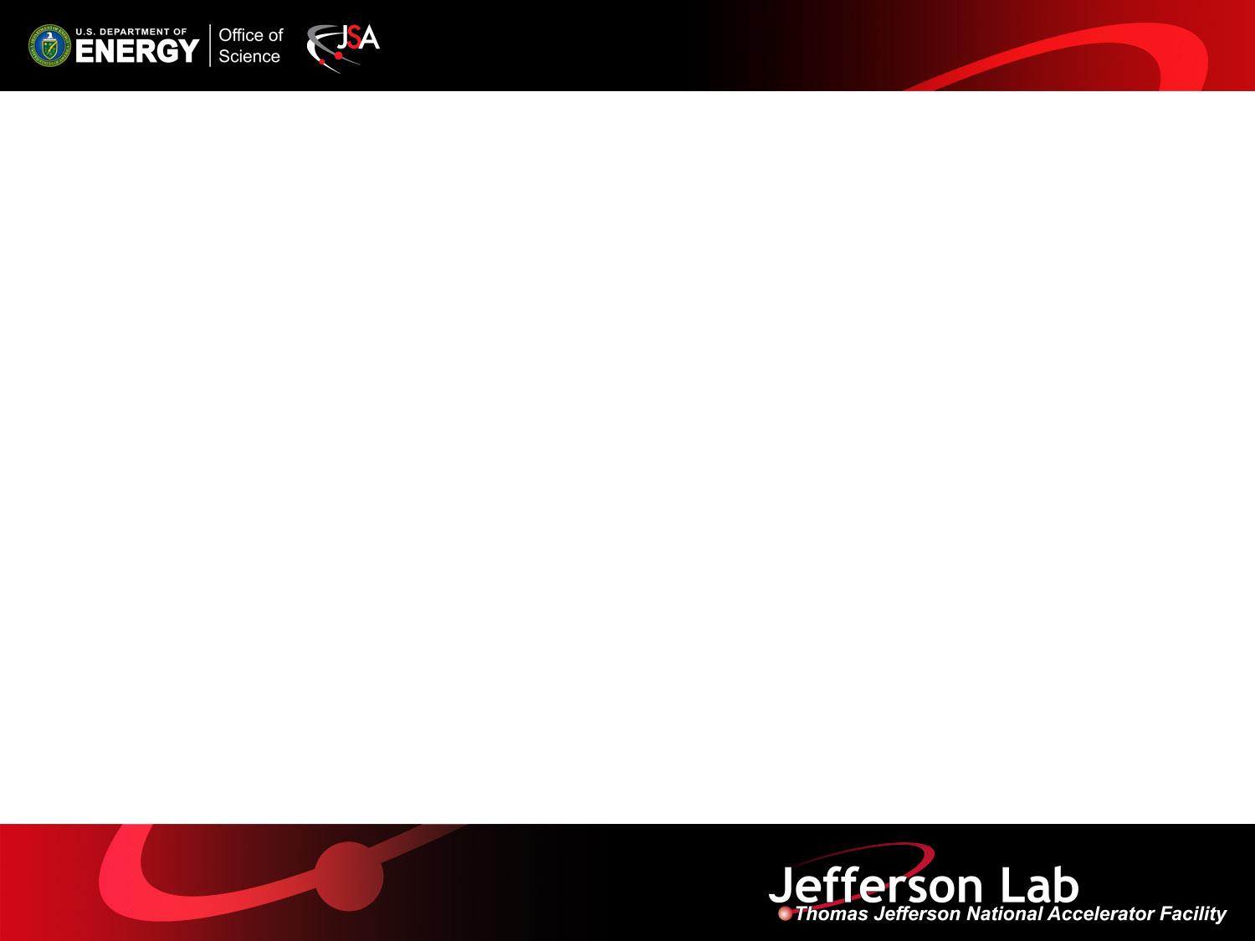
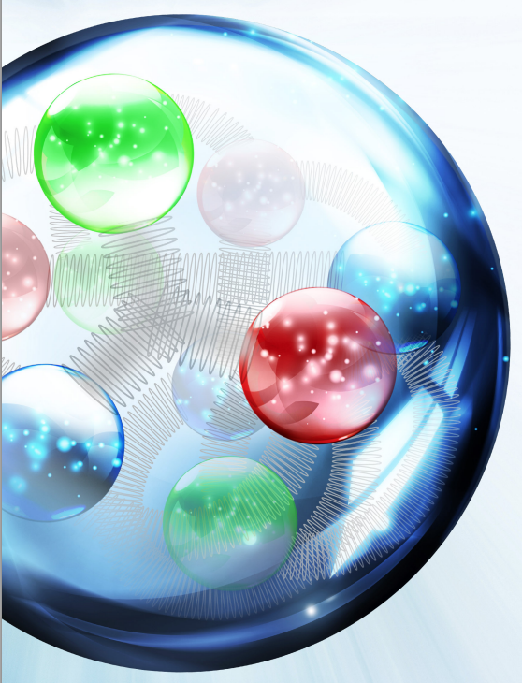

Update on JLEIC Design
Yuhong Zhang
JLEIC Baseline
Design Update
Performance
JLEIC Collaboration Meeting Spring 2017
April 3 – April 5, 2017

Slide 2

JLEIC Layout
8-100 GeV
3-10 GeV
8 GeV
Linac

Slide 3
Strategy for Achieving High Performance
High Luminosity
Based on high bunch repetition rate small bunch charge colliding beams
KEK-B reached > 2x10³⁴ /cm²/s
CEBAF beam already up to 1.5 GHz
New ion complex can be designed to deliver high bunch repetition rate
However new for proton or ion beams
High Polarization w/ Figure-8
All rings are in a figure-8 shape
➔ critical advantages for both beams
  Spin precessions in the left & right parts of the ring are exactly cancelled
  Net spin precession (spin tune) is zero, thus energy independent
  Spin can be controlled & stabilized by small solenoids or other compact spin rotators
Beam Design
High repetition rate
Low bunch intensity
Short bunch length
Small emittance
IR Design
Very small β*
Crab crossing
Damping
Synch. radiation
Electron cooling
Excellent Detection Capability
  Interaction region is design to support
  Full acceptance detection (including forward tagging)
  Low detector background

Slide 4
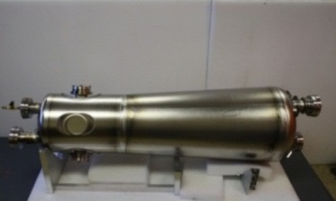
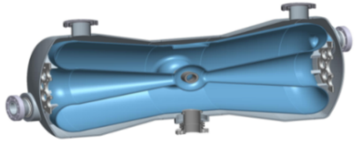
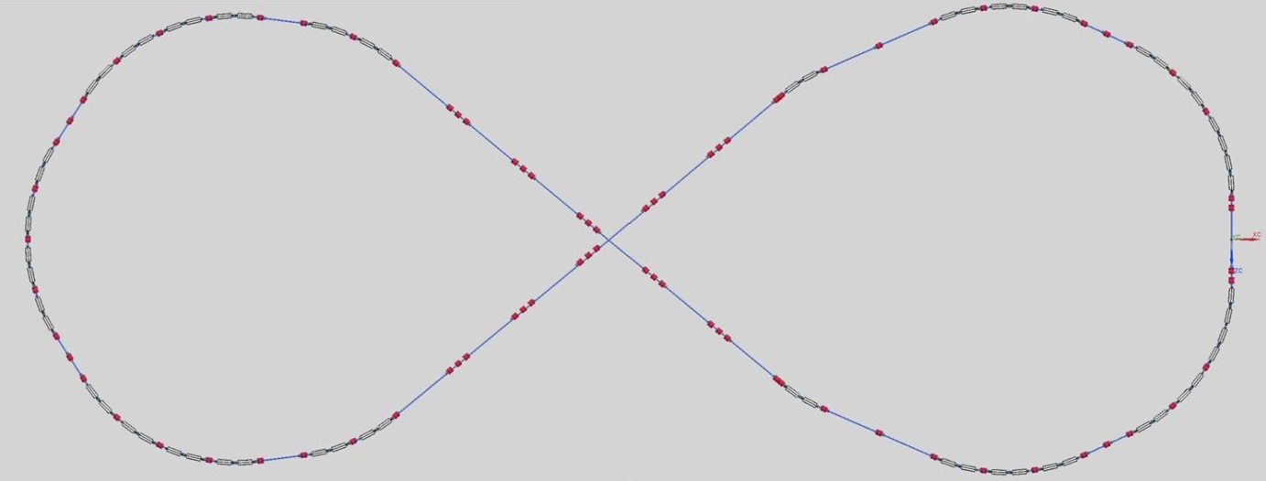
A New Ion Complex for JLEIC
cooling
  Generate, accumulate & accelerate ion beams
  Covering all required varieties of ion species
  Delivering required time and phase space structure for matching with electron beam
ion sources
SRF linac
cooling
collider ring
booster
Ion linac
QWR
HWR
booster
Quarter Wave Resonator
Half-Wave Resonator
RF cavity
kicker
 | Length (m) | Max. energy (GeV/c)
SRF linac |  | 0.2
booster | ~300 | 8
collider ring | ~2100 | 100
Crossing:79.8 deg.
extraction
injection

Slide 5
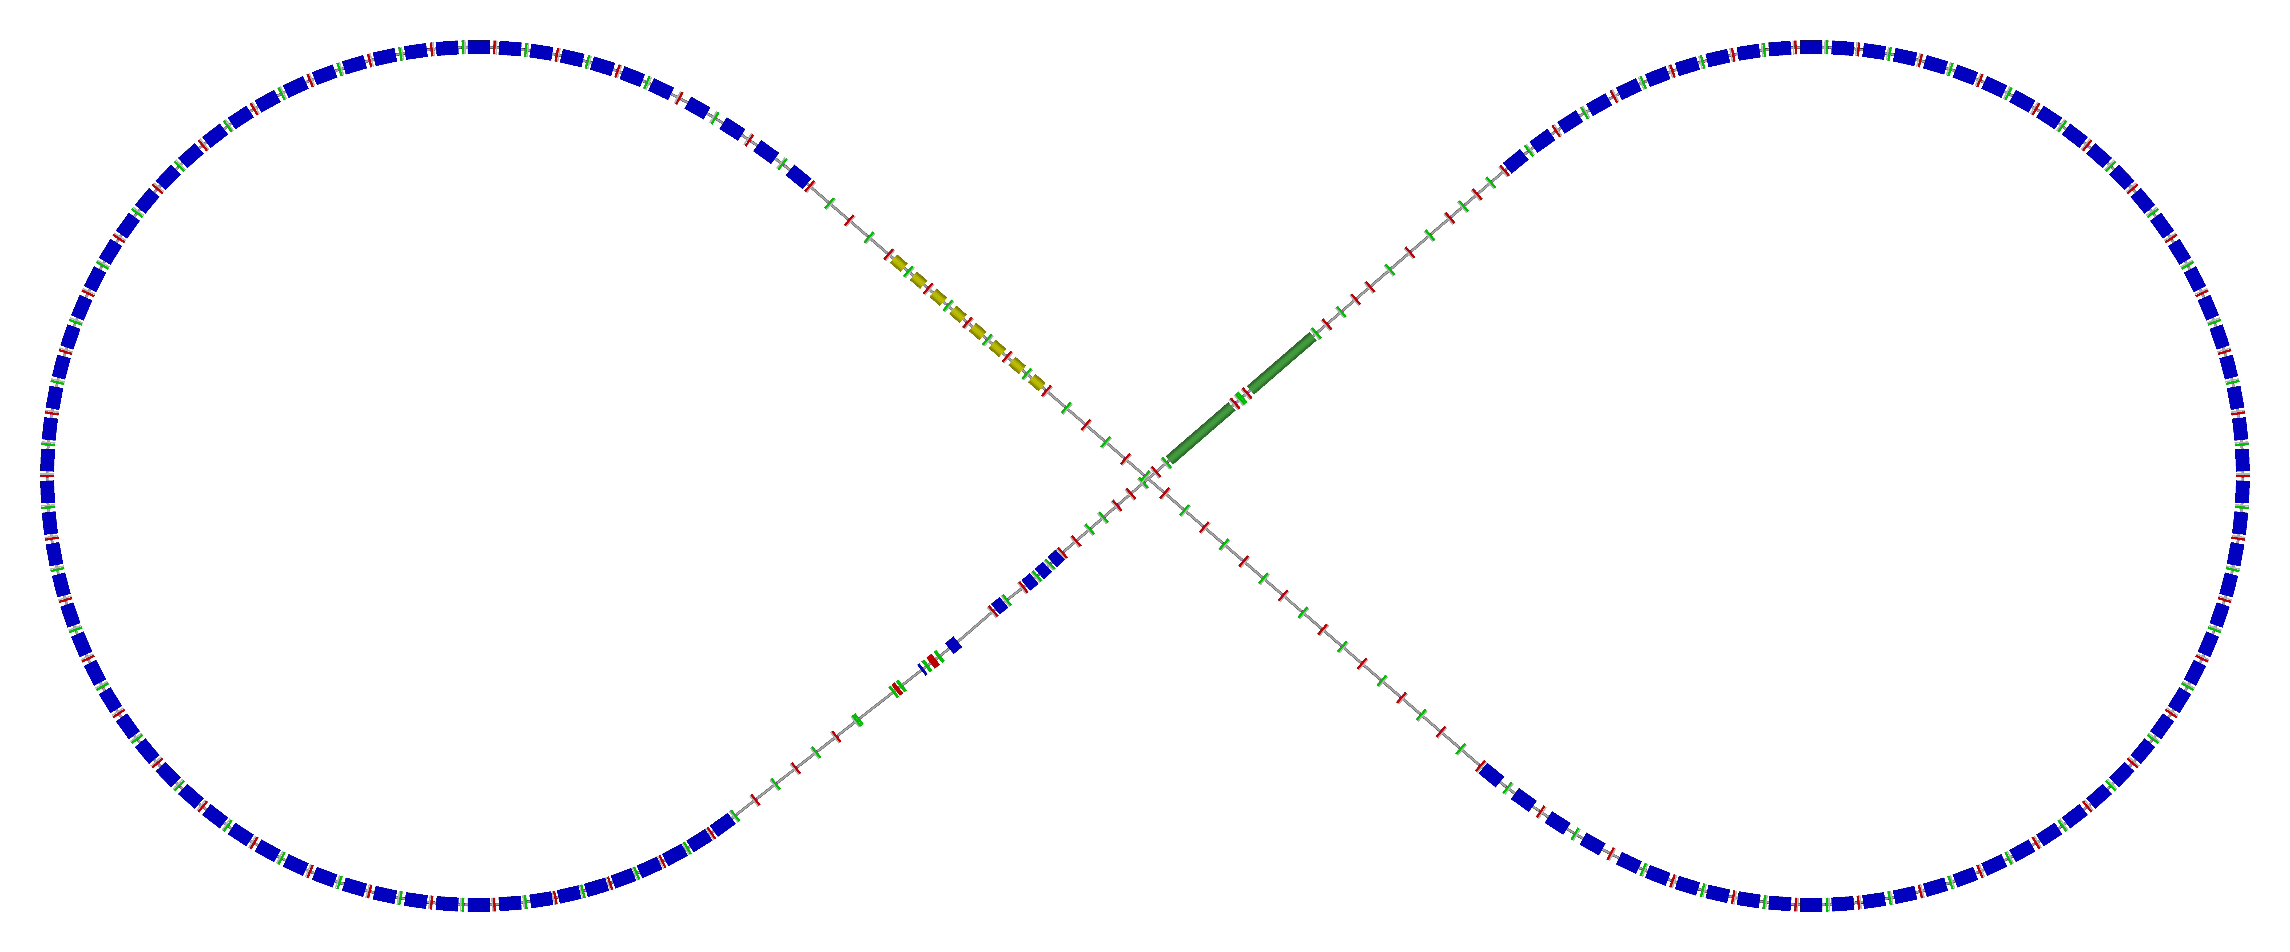
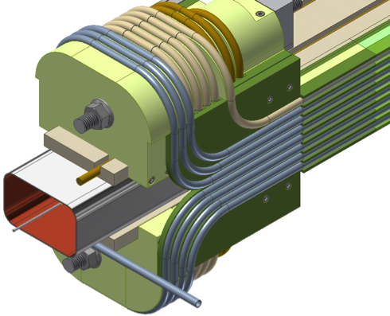
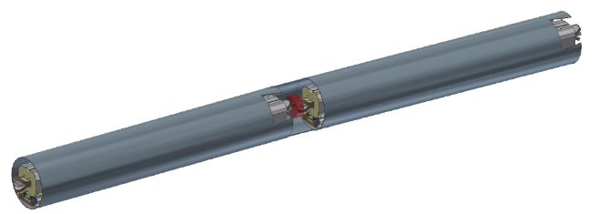
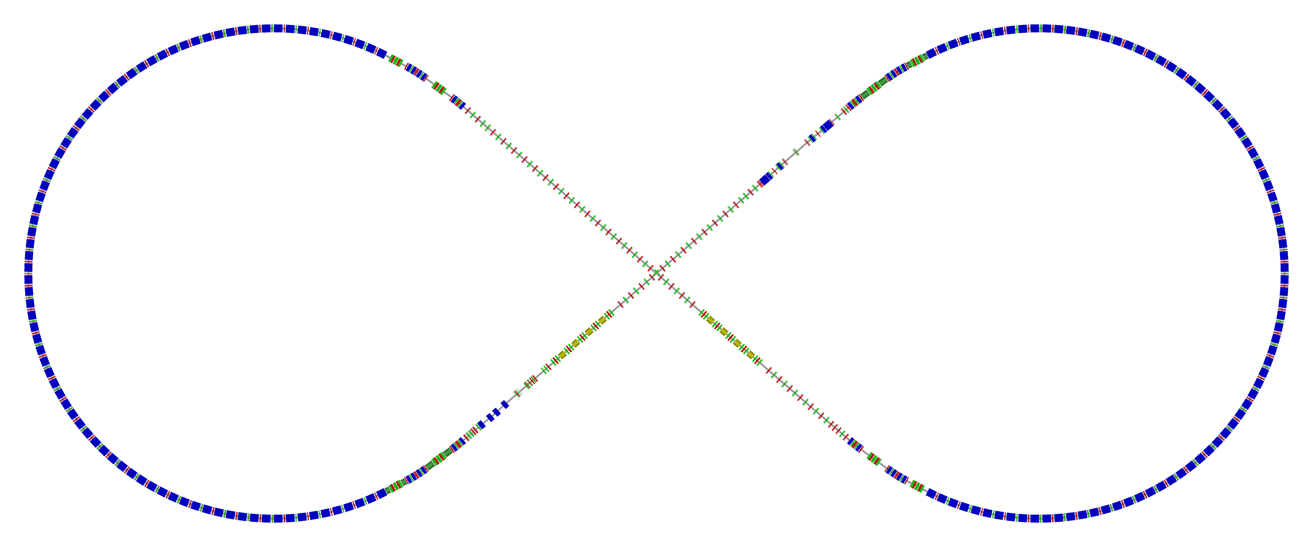
JLEIC Collider Rings
  Ion ring w/ major machine components
  Two rings have same footprint, stack vertically but have a horizontal crossing at IP
  Both rings have a figure-8 shape
  Supports two IPs
  Ion ring: super-ferric magnets (up to 3T)
norm.+SRF
Electron cooling
Arc, 261.7°
81.7°
future 2nd IP
R = 155.5 m
  Super-ferric magnets
ions
IP
  Electron ring w/ major machine components
 |  | p | e
Circumference | m | 2154
Crossing angle | deg | 81.7
Lattice |  | FODO | FODO
Dipole & quad | m | 8 & 0.8 | 5.4 & 0.45
Cell length | m | 22.8 | 15.2
Maxi dipole field | T | 3 | ~1.5
SR power density | kW/m |  | 10
Transition γ_{tr} |  | 12.5 | 21.6
Natural chromaticity |  | -101/-112 | -149/-123
Spin rotator
Spin rotator
CCB
R=155m
81.7°
Future 2nd IP
e⁻
Arc, 261.7°
RF
Spin rotator
RF
IP
Spin rotator
Forward e⁻ detection

Slide 6
High luminosity: Electron Cooling
ion sources
ion linac
BB cooler
DC cooler
Booster
(0.285 to 8 GeV)
collider ring
(8 to 100 GeV)
Ring | Cooler | Function | Ion energy | Electron energy
 |  |  | GeV/u | MeV
Booster | DC | Injection/accumulation of positive ions | 0.11 ~ 0.19 (injection) | 0.062 ~ 0.1
 |  | Emittance reduction | 2 | 1.1
Collider | Bunched Beam | Maintain emittance during stacking | 7.9 (injection) | 4.3
 |  | Maintain emittance | Up to 100 | Up to 55
DC cooling for emittance reduction
BBC cooling for emittance preservation against intra-beam scattering

Slide 7
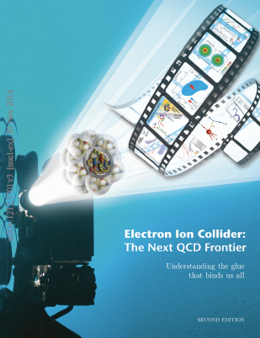
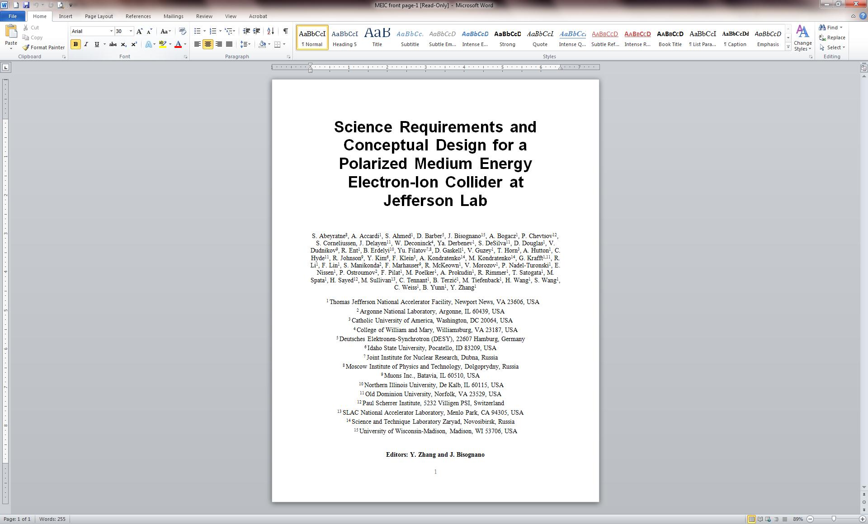
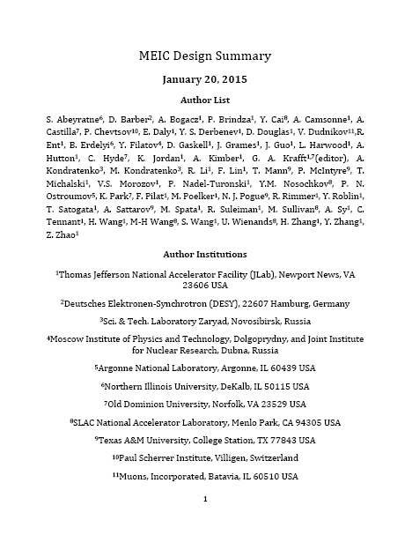
Achieved Design Goals
  Design goals consistent with the EIC White Paper requirements
Energy
  Full coverage of CM energy from 15 to 65 GeV
  Electrons 3-10 GeV, protons up to 100 GeV, ions up to 40 GeV/u
Ion species
  Polarized light ions: p, d, ³He, and possibly Li
  Un-polarized light to heavy ions up to A above 200 (Au, Pb)
Support 2 detectors
Full acceptance capability is critical for the primary detector
Luminosity
  10³³ to 10³⁴ cm⁻²s⁻¹ per IP in a broad CM energy range
Polarization
  At IP: longitudinal for both beams, transverse for ions only
  All polarizations >70%
Upgrade to higher CM energy/lumi. possible
  14 GeV electron, 400 GeV proton, and 160 GeV/u ion
EIC Science White Paper
arXiv:1212.1701
2012
2015
1209.0757
1504.07961

Slide 8
Highlights on Baseline design Update
Since the Last Collaboration Meeting
New electron ring: new magnets, same footprint
  Reaches 12 GeV ➔ 69 GeV CM
  Two optics designs (FODO and TME)
  Same SR (10 kW/m, ~10MW), twice accelerating cavities
Strong cooling is back: need a circulator cooler ring
  1 to 2 A current in cooling channel
  Circulator ring, up to 20 turns, ~100 mA in ERL
Higher stored ion current/bunch intensity: 500 mA ➔ 750 mA
  Up to 50% luminosity increase
  Seems OK with ion injector/DC cooling,
  Bunched cooling needs further study
Smaller beta-star: β*_{y} 2 cm ➔ 1.2 cm
  Up to 67% luminosity increase
  Both detectors achieve “Full-Acceptance” and “High-Luminosity”
  Eliminating difference of “full-acceptance IP” and “high luminosity IP”
Encouraged by Significant progress in ERL cooler design and harmonic fast kicker development
Encouraged by development of ion beam formation scheme
Encouraged by excellent results of dynamic aperture studies

Slide 9
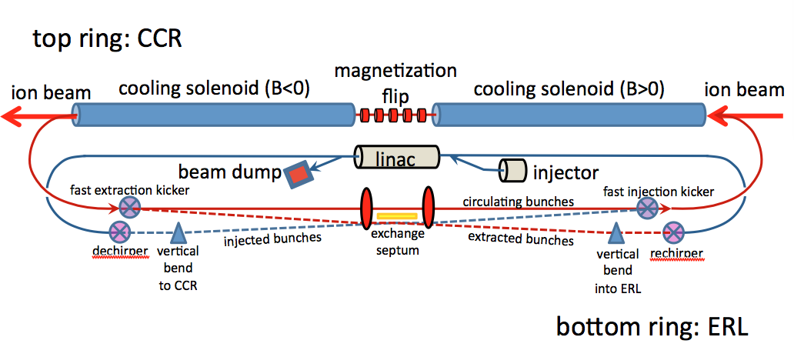
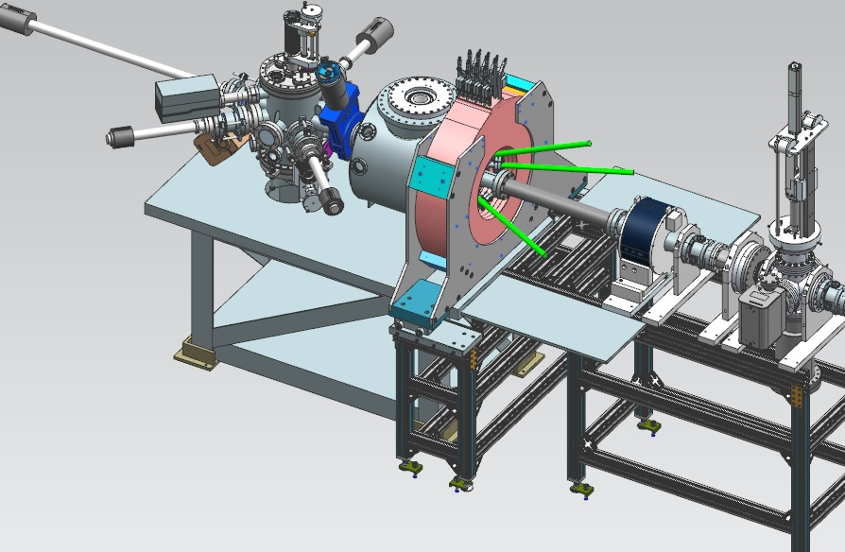
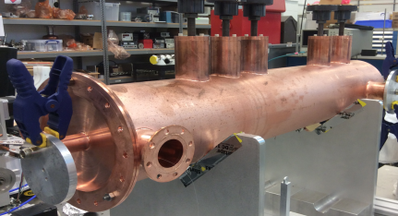
Strong Cooling: Circulator Ring
Circulator cooler ring
ERL ring
Enabling technologies :
Fast kickers, rise time<1 ns
Magnetized source ~75mA
Magnetized source
Electron energy | MeV | up to 55
Bunch charge | nC | Up to 3.2
Turns in circulator ring | turn | Up to 20
Current in CCR/ERL | A | 1.5/0.075
Bunch repetition | MHz | 476
Cooling section length | m | 2x30
Cooling solenoid field | T | 1
Fast kicker

Slide 10
JLEIC Baseline New Parameters
CM energy | GeV | 21.9 (low) |  | 44.7 (medium) |  | 63.3 (high)
 |  | p | e | p | e | p | e
Beam energy | GeV | 40 | 3 | 100 | 5 | 100 | 10
Collision frequency | MHz | 476 |  | 476 |  | 476/4=119
Particles per bunch | 10¹⁰ | 0.98 | 3.7 | 0.98 | 3.7 | 3.9 | 3.7
Beam current | A | 0.75 | 2.8 | 0.75 | 2.8 | 0.75 | 0.71
Polarization | % | 80 | 80 | 80 | 80 | 80 | 75
Bunch length, RMS | cm | 3 | 1 | 1 | 1 | 2.2 | 1
Norm. emitt., hor./vert. | μm | 0.3/0.3 | 24/24 | 0.5/0.1 | 54/10.8 | 0.9/0.18 | 432/86.4
Horizontal & vertical β* | cm | 8/8 | 13.5/13.5 | 6/1.2 | 5.1/1 | 10.5/2.1 | 4/0.8
Vert. beam-beam param. |  | 0.015 | 0.092 | 0.015 | 0.068 | 0.008 | 0.034
Laslett tune-shift |  | 0.06 | 7x10⁻⁴ | 0.055 | 6x10⁻⁴ | 0.056 | 7x10⁻⁵
Detector space, up/down | m | 3.6/7 | 3.2/3 | 3.6/7 | 3.2/3 | 3.6/7 | 3.2/3
Hourglass(HG) reduction |  | 1 |  | 0.87 |  | 0.75
Luminosity/IP, w/HG, 10³³ | cm⁻²s⁻¹ | 2.5 |  | 21.4 |  | 5.9

Slide 11
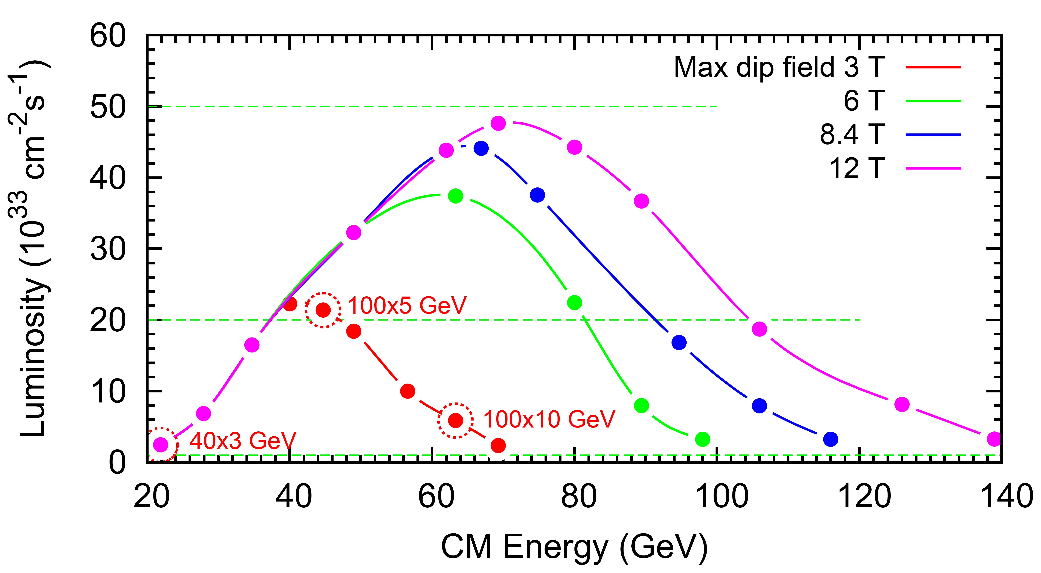
JLEIC e-p Luminosity and Upgrade Potential
Reaching 100 GeV CM energy
Reaching 115 GeV CM energy
Reaching 140GeV CM energy
LHC technology

Slide 12
JLEIC Working Groups and Collaborations
Ion injector complex / parameter development (Todd Satogata)
Ion linac (Brahim Mustapha, ANL)
Ion and electron polarization (Fanglei Lin / Vasiliy Morozov)
Electron cooler design (Steve Benson)
Cooler magnetized electron source (Riad Suleiman)
Simulations / Instability (Yves Roblin/Rui Li)
IR / non-linear studies (Vasiliy Morozov)
Crab crossing / Crab cavity (Vasiliy Morozov / Jean Delayen, ODU)
MDI / detector / Backgrounds (Mike Sullivan, SLAC / Rik Yoshida)
SRF / Fast kicker (Bob Rimmer)
Engineering (Tim Michalski)
Super-ferric magnets (Peter McIntyre, Texas A&M)

Slide 13
Summary
The basis of the JLEIC design
  ring-ring
  high luminosity by high bunch rep-rate,
  high polarization with Figure-8
  full event coverage
has remained constant since 2005
We have plans to deliver a pre-CDR by CD0 and a CDR by CD1
The overall design risk is low in most areas,
Technology demonstrations are needed/desired including
  bunched beam electron cooling
  ERL-Circulator Cooler test facility
  Crab crossing of hadron beams,

