Slide 1



Northern Illinois Center for Accelerator
and Detector Development
Magnetized-Beam Formation and Beam-Beam Kicker for Electron Cooling
Ph. Piot,
FermiLab & Northern Illinois University

Slide 2
Outline
Introduction
Formation & manipulation of magnetized beam
Beam-beam kicker
Outlook & plans

Slide 3
Introduction
This talk discusses interests from our group to carry work related to JLEIC electron cooling
Over the last 3 years we have submitted five proposals
  3 STTRs (1 reviewed but denied funding, 2 returned without review – deemed unresponsive…)
  2 unfunded university proposals to DOE NP
The following slides are essentially exploratory work done in preparation of these proposals and related to synergistic work funded by other sources.

Slide 4
High-Current Magnetized-beam R&D
Two directions
Simulations:
  Beam dynamics
  Emission process
Experiments:
  At Fermilab FAST/IOTA facility,
  Argonne Wakefield Accelerator
  (AWA), and using a standalone
  DC gun at NIU.
Photoemission sources:
  Demonstrate single-bunch performance
  Explore scaling,
  Investigate new concept,
  Develop relevant diagnostics
  Temporal shaping for flat-top e- beam
Development of a high-current gun based on alternative emission mechanism:
  Thermionic emission
  Field-emission

Slide 5
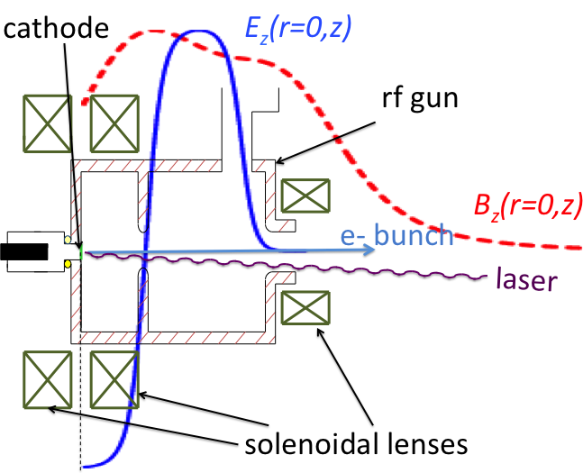
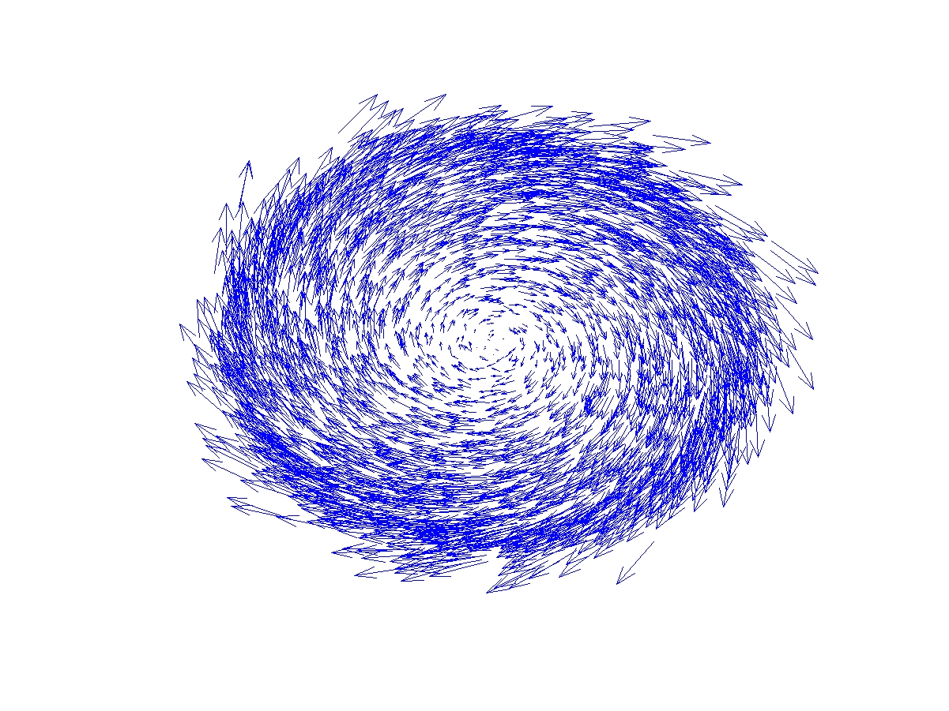
Magnetized beam formation: basics
electrons born in an axial B field CAM
upon exit of solenoid field ( ): CAM becomes purely kinetic.

Slide 6
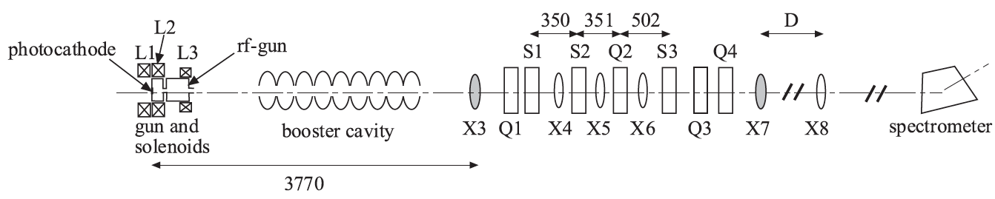
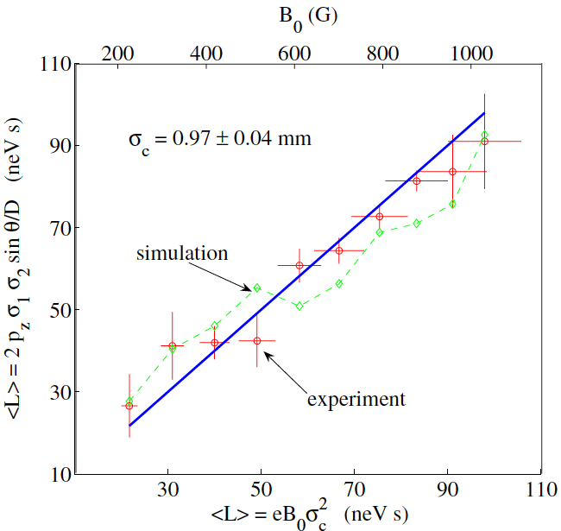
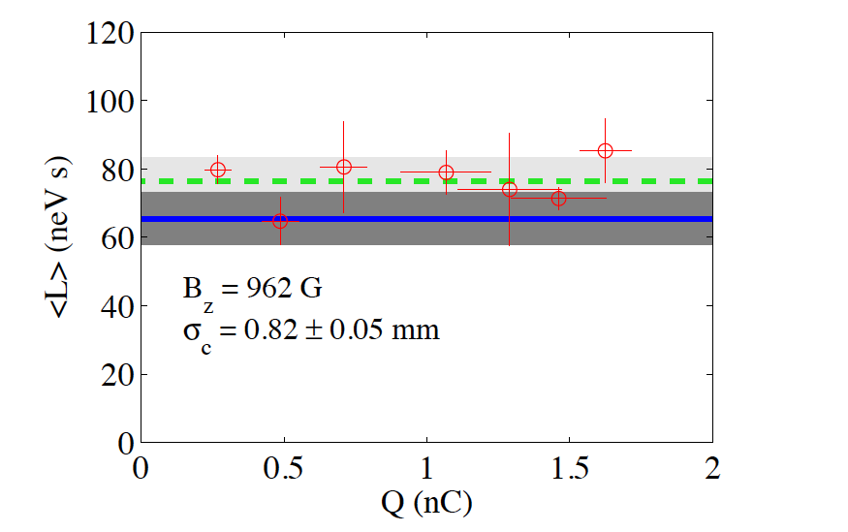
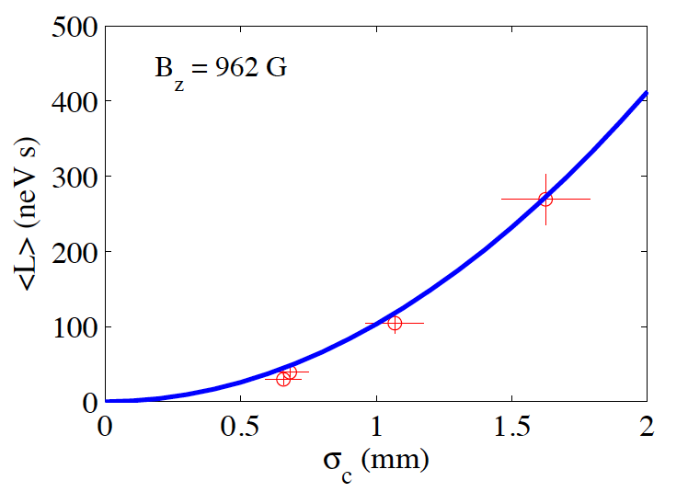
Previous work in an RF photoinjector (A0PI)
Y.-E Sun et al, PRSTAB 7, 123501 (2004)
Weak dependence,
quadratic scaling
with laser spot size
on photocathode.
Y.-E Sun et al, PRSTAB 7, 123501 (2004)

Slide 7
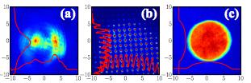
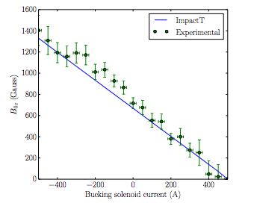
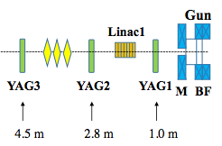

On-going work in collaboration w. AWA (Argonne)
A. Halavanau et al, in preparation (2017);
see also arXiv:1609.01661 [physics.acc-ph]
Generation of very uniform
laser spots on photocathode
using a microlens array (MLA)
orig. UV spot
patterned UV spot
homogen. UV spot
Inferred from measured MAM
experiment
IMPACT-T simulation
Production of multi-beam pattern at AWA witness beamline → could help understand the non-paraxial depen-dence of the CAM

Slide 8
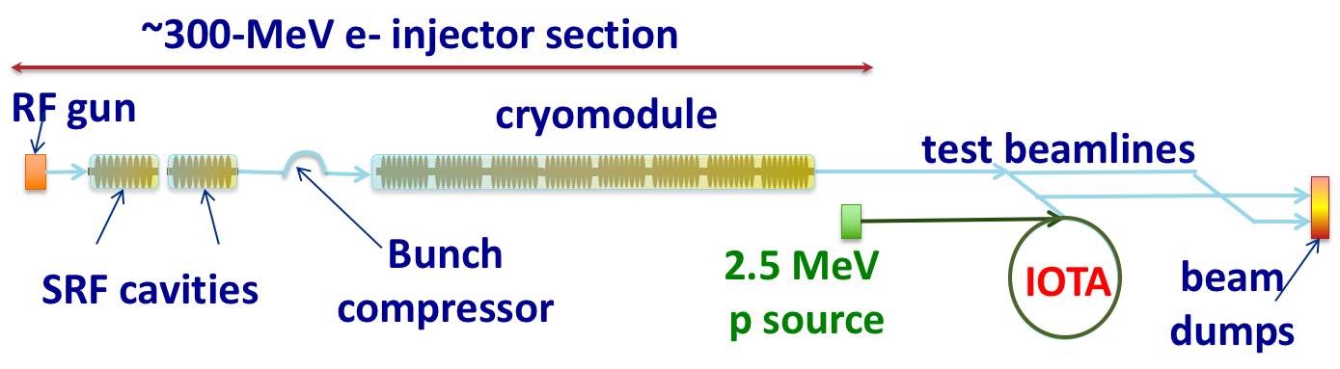
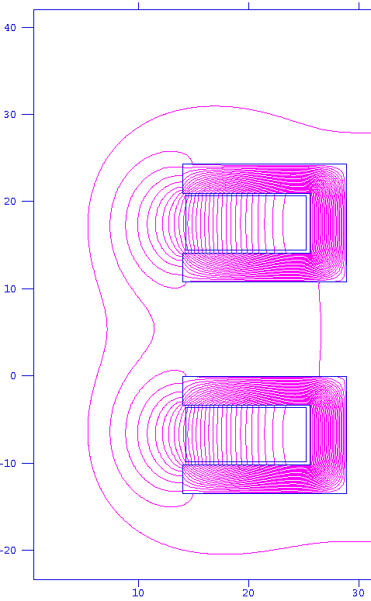
Planned experiment at FAST/IOTA
S. Antipov et al., JINST 12 T03002 (2017)
FAST-IOTA facility complex includes:
  IOTA (integrable-optics test accelerator) ring,
  An electron linear accelerator (that nominally
  serves as an electron injector to IOTA),
  A proton source & injector for IOTA
cathode
B_{max} ~ 0.3T
on cathode

Slide 9
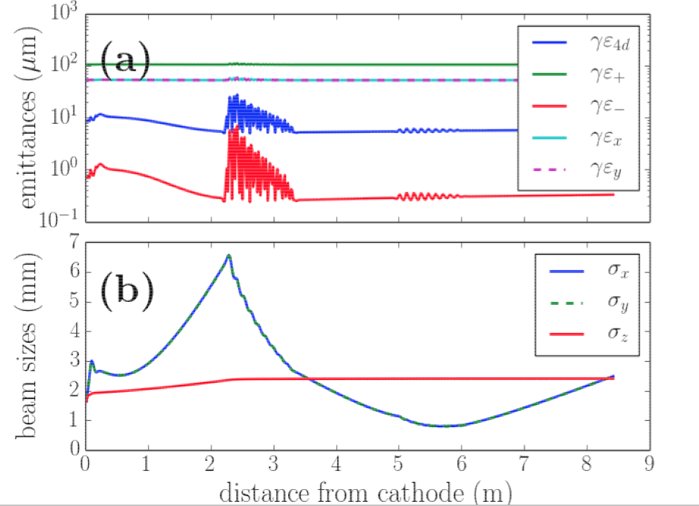
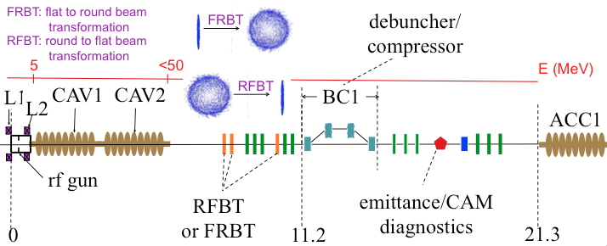
Planned experiments at FAST/IOTA (Summer 17)
P. Piot, IPAC13 (2013)
J. Zhu, et al. PRSTAB 17, 084401 (2014)
Experiment to focus on flat beam generation (after decoupling of magnetized beam with
a skew-quad channel
Characterization of magnetized beams will be a byproduct

Slide 10
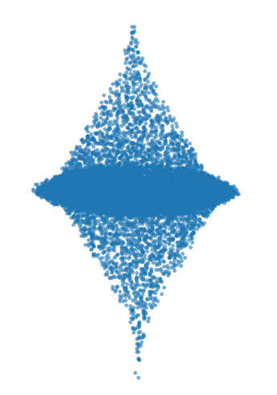
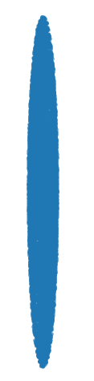

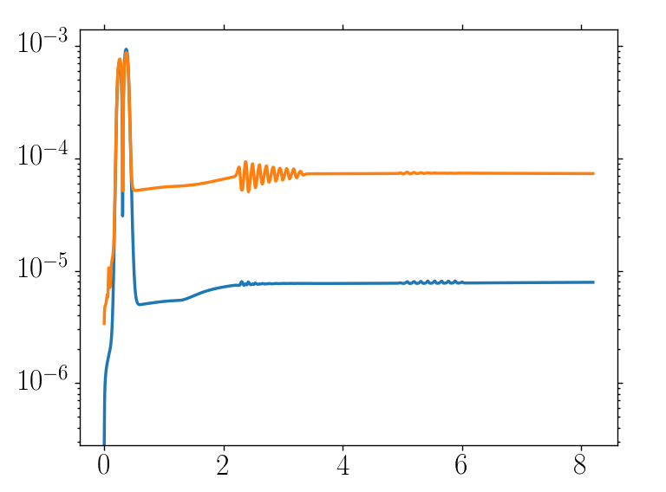
Flat-to-round beam transformation
P. Piot, to be presented at IPAC17
Reverse of flat beam transform:
  Illuminate photocathode with ribbon laser
  Transform into a magnetized beam
Preliminary simulations (IMPACT-T)
At FAST/IOTA produced magnetized beam could be injected in IOTA (R. Li)
mode
converter
emittances (m)
Y. Derbenev, University of Michigan
report UM-HE-98-04 (1998)
distance from photocathode (m)

Slide 11

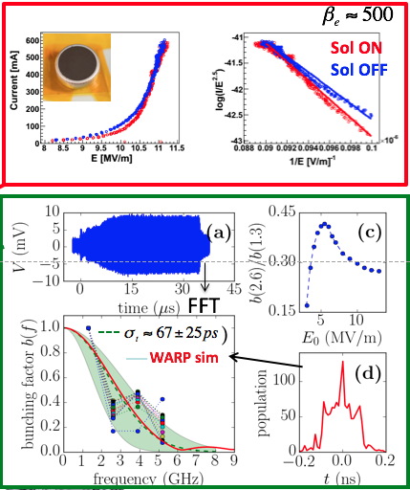
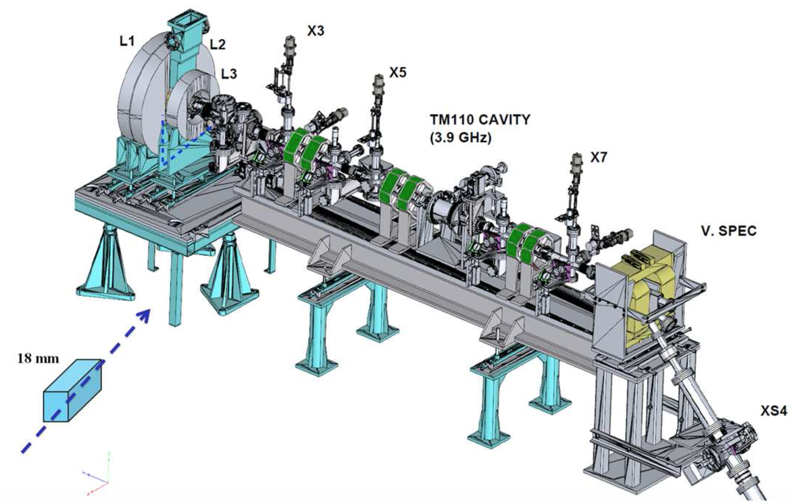
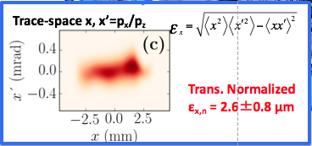
High-current sources
use field emission by placing cathode
in an RF gun (f=1.3 GHz)
different cathodes tested (here CNT)
D. Mihalcea et al., APL 107, 033502 (2015)

Slide 12
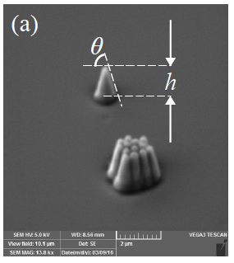
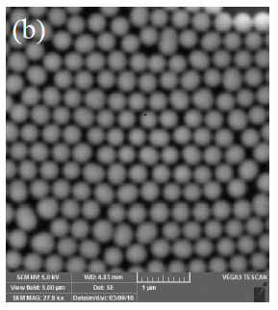
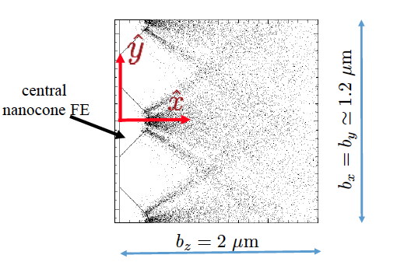
High-current sources (cnt’d)
Collaboration with Argonne Center for Nano Material (CNM) and NIU College of Engineering (EE)
Main issue is proper bunching. Currently
working with Fermilab on a 1+1/2 cell gated
SCRF gun operating at 650 MHz with gate at
1.3 GHz.
Field emission cathode lifetime and
contamination is also an open issue
  activity at NIU to test potential cathode
  in a DC gap over long period of time
  Simulation of field emission (WARP)
[A. Lueangaramwong et al.,
AIP Conf.Proc. 1812 (2017) no.1, 080009)]

Slide 13
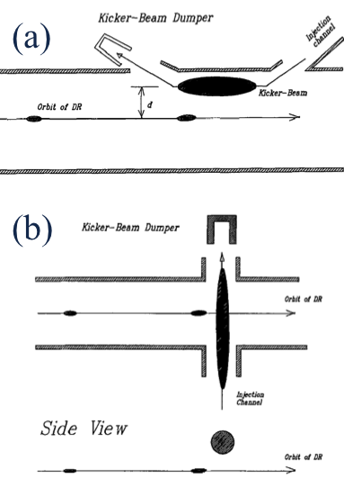
Interests in the Beam-Beam kicker
[V. Shiltsev, NIM AA, vol. 374, 137 (1996)]
Simulations:
  Beam dynamics: degradation of the cooling e- beam, optimization of kicker e-beam parameters
Experiments:
  At AWA using the the two-injector configuration currently used for two-beam acceleration in DWFA

Slide 14
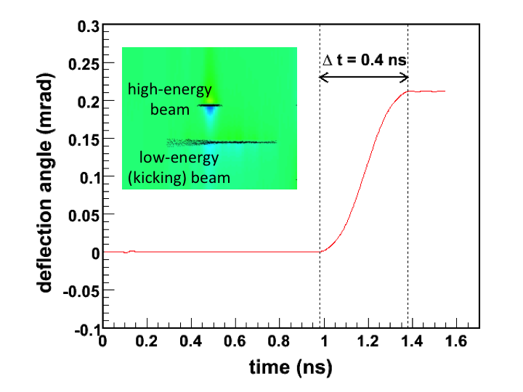
Beam-beam kicker design
Preliminary simulations using
WARP
  1 MeV kicking beam to kick a
  50-MeV cooling beam
  0.4-ns rise time
Cooling beam possibly flat so
that kicking beam would also
need to be flat (+t-shaping?)
Design/test of kicking e-beam
could leverage on e-cooling beam
electron source

Slide 15
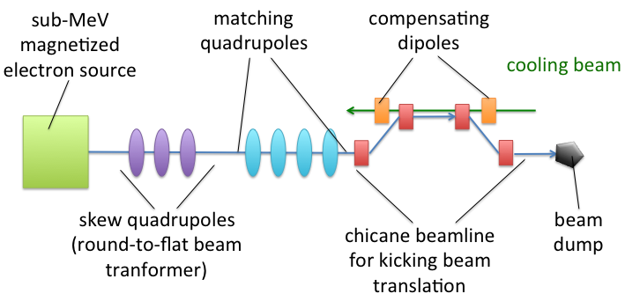
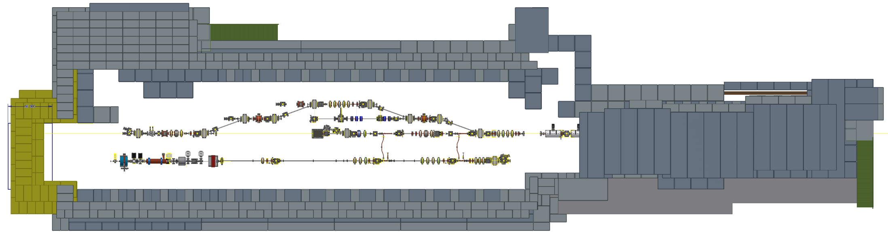
Beam-beam kicker experiment (proposed)
use the witness beam to kick
the drive beam
Drive beam < 50 MeV
witness beam <5MeV

Slide 16
Summary
We are interested in collaborating on JLEIC with primary focus on magnetized-beam formation and beam-beam kicker
So far our work is exploratory and tied to other projects in progress
Several facilities available at Argonne and Fermilab with parameters relevant to the JLEIC e- cooler could be ideal testbeds:
  FAST linac: magnetized beam, longitudinal manipulation of magnetized beam, round-to-flat and flat-to-round beam transformation
  AWA: two beam setup readily available could support test of beam-beam kicker, work on magnetized beam has also been carried out there, also emittance exchanger used for temporal shaping.
  IOTA ring: recirculation of magnetized beam produced in the FAST linac (suggested by R. Li)

Slide 17
Acknowledgements
NIU students: C. Buzard, A. Halavanau, A. Lueangaramwong, O. Mohsen
NIU collaboators: V. Korampally, D. Mihalcea
Argonne National Lab. AWA team: J. Power, W. Gai, M. Conde
The material presented has benefited from informal collaborations with
  Radiasoft: D. Bruhwiler & N. Cook
  Radiabeam: L. Faillace, A. Murokh
  EuclidLab: C. Jing, V. Jabotinsky
The work relies heavily on simulation tools developed at Berkeley (WARP and IMPACT-T/Z).

