Slide 1
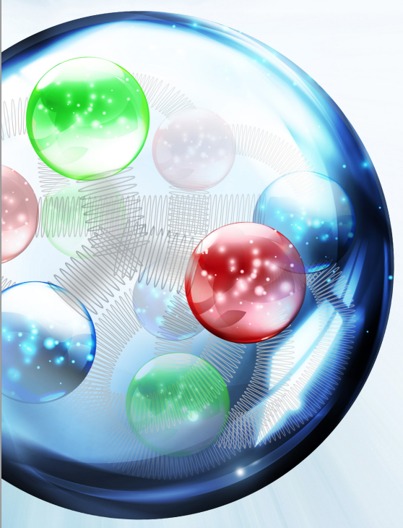
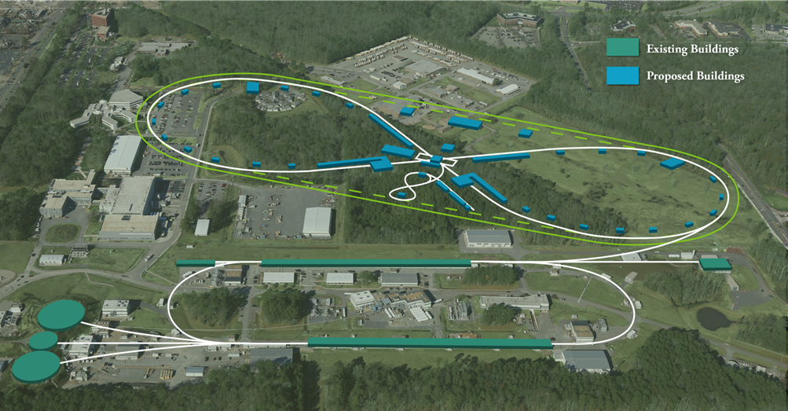
SRF R&D for an Electron-Ion Collider CTE’s SRF 1-3
Bob Rimmer
NP Community Panel Review of the EIC
Rockville, November 29 – December 2 2016

Slide 2
Outline
Major RF systems for JLEIC
Overview
CTEs
SRF1: SRF cavity systems – First priority
Ion ring, e-cooler (ERL, booster and “chirpers”), e-ring
SRF2: Crab cavity system – (see ODU talk) – First priority
SRF3: Modular cryostat – Third priority
CTE Summary
R&D roadmap & opportunities for collaboration

Slide 3
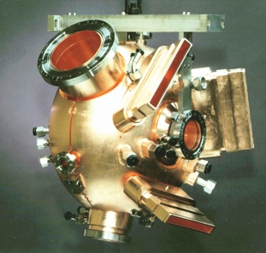
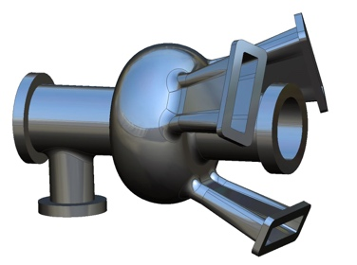
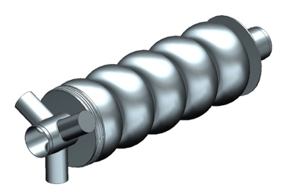
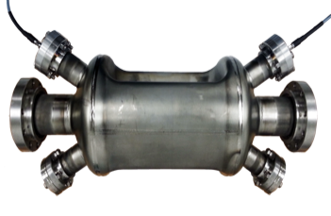
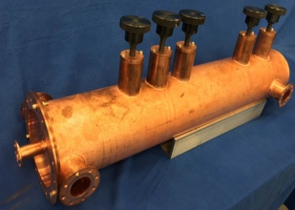
RF cavities for JLEIC
952.6 MHz i-ring
(SCRF)
JLEIC
Collider
Rings
i-SRF +
NCRF
Cooling
952.6 MHz cooler ERL (SCRF)
Crab
IP
e-RF
476.3 MHz e-ring
(NCRF PEP-II)
Crab
e-RF
Future IP
Booster
952.6 MHz booster
(SCRF)
ODU
SRF Linac
Ion Source
952.6 MHz crab
(SCRF)
Electron Injector
Hall D
12 GeV CEBAF
Harmonic Fast kicker for cooling ring
Halls A, B, C
Not including ion acceleration and bunch formation

Slide 4
High level RF parameters
 | Electron ring NCRF |  |  |  | Proton SRF |  | Lead ion
Energy | 4 | 5 | 10 | GeV | 30 | 100 | 40 | GeV/u
Frequency | 476.3 | 476.3 | 476.3 | MHz | 952.6 | 952.6 | 952.6 | MHz
Current | 3.00 | 3.00 | 0.71 | A | 0.50 | 0.50 | 0.50 | A
SR power per ring | 1.08 | 2.65 | 10.00 | MW | - | - | - | MW
Energy Loss per Turn | 0.36 | 0.88 | 14.12 | MV | - | - | - | MV
Vpeak | 1.74 | 3.43 | 20.6 | MV | 11.1 | 42.6 | 40.29 | MV
Syn. Phase | 12.0 | 14.9 | 43.4 | degree | 0.0 | 0.0 | 0.0 | degree
Vgap | 0.58 | 0.57 | 0.62 | MV | 1.23 | 1.25 | 1.22 | MV
Gradient | 1.84 | 1.82 | 2.0 | MV/m | 7.83 | 7.96 | 7.76 | MV/m
Beam Power per Cavity | 361.6 | 441.4 | 303.4 | kW | - | - | -
Forward Power | 409.6 | 495.3 | 363.4 | kW | 69.4 | 71.69 | 68.11 | kW
Cavity Power Loss | 47.84 | 46.73 | 55.37 | kW | 0.6 | 0.6 | 0.5 | W@2K
Reflected Power | 0.19 | 7.18 | 5.04 | kW | 69.42 | 71.69 | 68.11 | kW
Qext | 3.51E+03 | 2.87E+03 | 4.64E+03 |  | 5.20E+04 | 5.20E+04 | 5.20E+04
Optimum Cavity Number | 3 | 6 | 33 |  | 9 | 34 | 33

Slide 5
CTE SRF1
CTE SRF1 “Development of SRF Systems for an Electron-Ion Collider”
Design and development of SRF systems for the ion collider ring, high energy electron cooler ERL and as back-up for the NCRF in the electron ring, at the new JLEIC collider design frequency of 952.6 MHz.
These need to be compact, flexible, high efficiency, strongly HOM damped and cost efficient systems.
Readiness level: now: TRL 3, after TRL 6

Slide 6
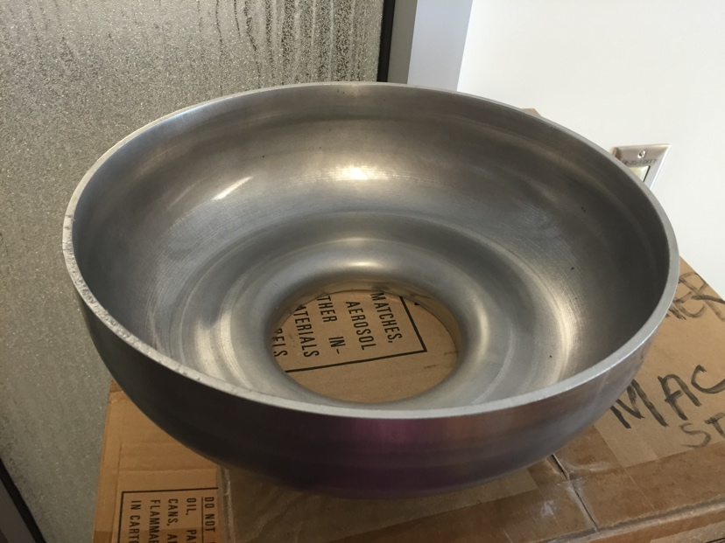
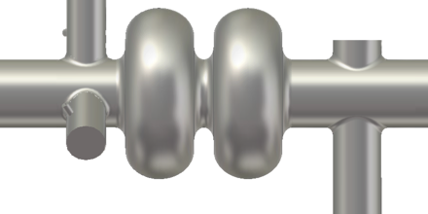
CTE SRF1: Current status
New 952.6 MHz high-current cavity shape developed
1-cell prototype in progress on existing EIC R&D funds
HOM damping schemes under evaluation
Full RF system parameter tables defined
1) 3WG. 2) 3 x coax dampers. 3) enlarged beam pipes (ref) 4) on-cell dampers
Cooler needs 5-cells in the ERL, 1-cells in the injector.
Ion ring might use 2-cells

Slide 7
CTE SRF1:
Initial TRL: TRL3
Existing CESR and KEK-B cavities are POC but do not meet the storage ring space requirements.
ERL cavities at ~200 mA have been designed but not demonstrated.
Features needed for JLEIC cavities have been demonstrated separately (e.g. high power couplers, HOM absorbers)
Simulations are well advanced, first 952.6 MHz 1-cell cavity started.
Proposal deliverables
Complete conceptual designs for each cavity type and RF system
Prototype of each cavity type validated in vertical test
Conceptual designs of couplers, tuners and ancillary components
Take advantage of any new developments (N₂ doping, Nb₃Sn, etc.)
After optimization and integrated testing: TRL6
Total burdened cost:
Labor: $1462k, Non-labor: $1536k, Total: $2998k

Slide 8
CTE SRF2
CTE SRF2 “Development of a Crabbing System for an Electron-Ion Collider”
Design and development of a crabbing system that will accommodate large crossing angles while providing the required high luminosity at the new JLEIC collider design frequency of 952.6 MHz
Readiness level: now: TRL 3, after TRL 6
See J. Delayen’s talk in the university session

Slide 9
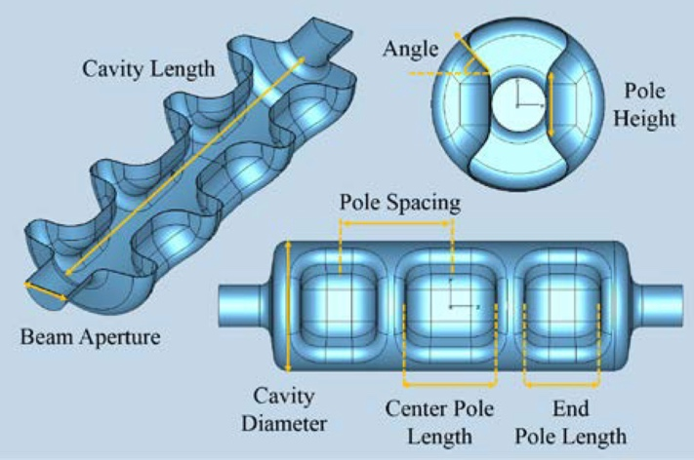
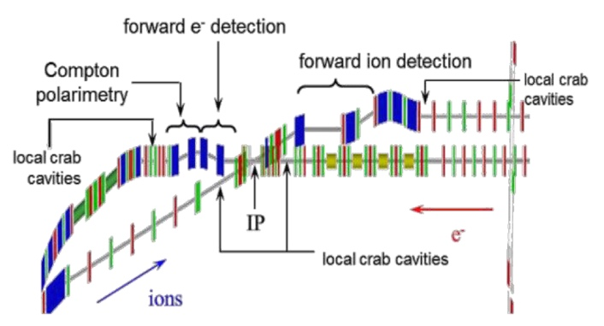
CTE SRF2: Crab cavity system
ODU
Crab cavity locations and design are being optimized by ODU and JLab.
Multi-cell structure is attractive for JLEIC large crossing angle.
Strong HOM damping will be essential. See ODU presentation
Location in IP
“RF Dipole” prototype
Multi-gap concept
ANALYSES OF 476 MHZ AND 952 MHZ CRAB CAVITIES FOR JLAB ELECTRON ION COLLIDER, HyeKyoung Park, A. Castilla, J. R. Delayen, S. U. De Silva, V. Morozov. WEPMR034 Proceedings of IPAC2016, Busan, Korea.
MULTI-CELL RF-DIPOLE DEFLECTING AND CRABBING CAVITY, S. U. De Silva, H. Park, J. R. Delayen. Proceedings of IPAC2016, Busan, Korea. WEPMW022
Notes:
Red Interior Page Design 1

Slide 10
CTE SRF2: Current status
Initial TRL: TRL3
KEK crab cavity system operated with beam.
ODU Proof of principle RFD cavities met voltage and Qo goals at 400, 500 and 750 MHz.
HOM damping scheme is under development.
Multi-gap concept is very promising.
TLR after >TRL 6
Optimized 952.6 MHz cavity design with HOM damping will be demonstrated off-line.
Total burdened cost $2511k

Slide 11
CTE SRF3
CTE SRF3 “Development of a modular cryostat for the various SRF cavities for an Electron-Ion Collider ”
Design and development of a modular “universal” cryostat to house all the various SRF cavities needed for the EIC collider design. These include the ion ring (and possibly e-ring) single cell cavities, single or multi-gap crab cavities, multi-cell cooler ERL cavities, single cell cavities for the cooler ERL booster and “chirper” cavities and any other cryogenic instrumentation or components needed, (e.g. solenoids for magnetized beam transport).
The proposed concept could also house a wide range of different frequencies so could be used for many other applications or projects including in other labs, universities or industry.
Readiness level: now: TRL 4, after TRL 6

Slide 12
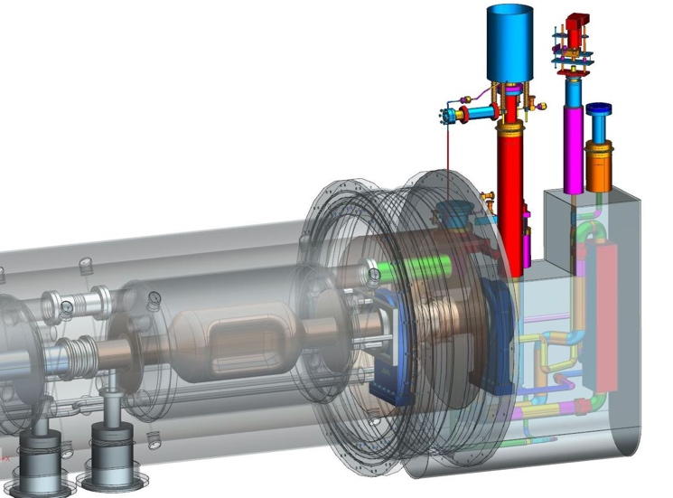
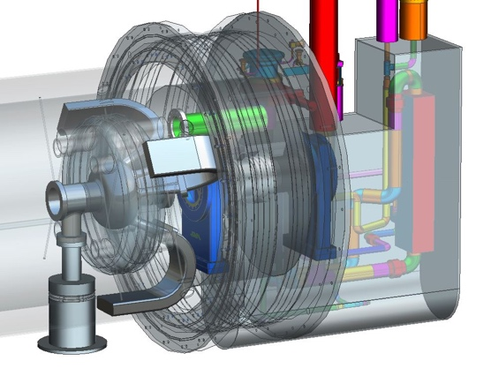
CTE SRF3: Modular Cryostat
Take the best features of previous JLab designs
Modular approach to hold various different cavities
Design suitable for industrial production
Simple concepts, low parts count to reduce costs
Cooler ERL, 5-cell cavities
476.3 MHz Crab cavity
On-cell damper concept
β=0.6 650 MHz cavity

Slide 13
CTE SRF3: Current status
Initial TRL: TRL4
Basic concept is close to SNS and JLab upgrade.
Can accommodate cavities from 476 MHz upwards
Modifications needed for high current CW operation.
MW class CW power couplers.
High power HOM loads and beamline absorbers.
Crab cavities with high power HOM loads.
Simplifications for industrial production, pressure code.
Improvements in microphonics based on operating experience.
TRL after: TRL6
Once adapted to JLEIC requirements and demonstrated in a prototype with these modifications >TRL 6
Using this prototype to validate cavity designs will raise their TRL level also (6>7or 8).
Any new cryostat design is a long lead, high cost item. Highly desirable to develop this as early as possible.
Total burdened cost
Labor: $712k, Non-labor: $787k, Total: $1499k

Slide 14
JLEIC SRF R&D Proposals
R&D Item | Priority | Initial TRL | Final TRL | Performance Period | Burdened Cost
SRF1 – Development of SRF Systems for an Electron-Ion Collider | First | Low | Med | 2017-2019 | $2,998k
SRF2 – Development of a Crabbing System for an Electron-Ion Collider | First | Low | Med | 2017-2019 | $2,511k
SRF3 - Development of a modular cryostat for the various SRF cavities for an Electron-Ion Collider | Third | Med | High | 2018-2020 | $1,499k

Slide 15
CTE Summary
SRF CTE’s aimed at higher risk long lead time items.
SRF technology is essential to any EIC and valuable to many other applications.
These concepts are reasonable extrapolations from existing technology.
Conceptual designs and some prototyping started.
Proposals will push TRL’s up to CDR levels (3,3,4 > 6).
These systems are critical to achieve JLEIC design luminosity.

Slide 16
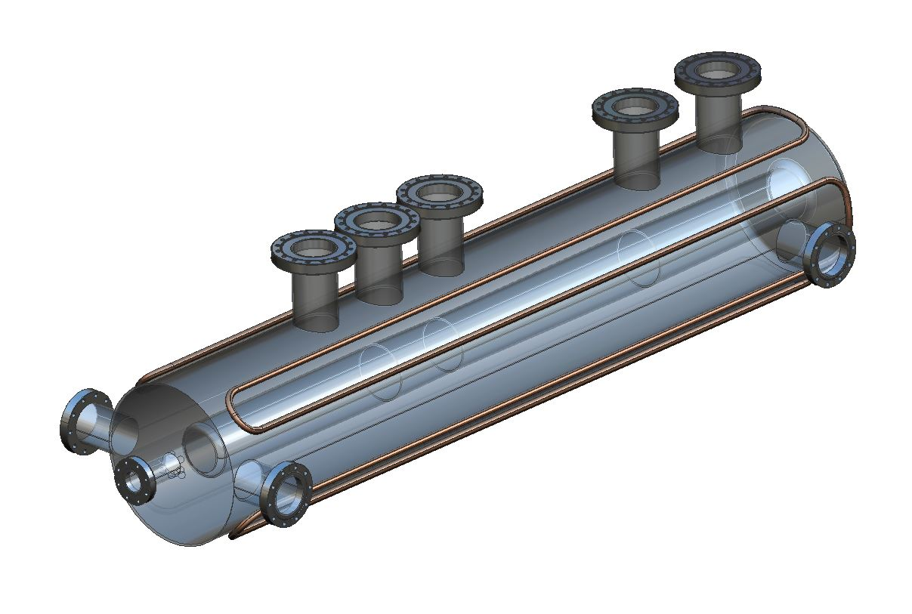
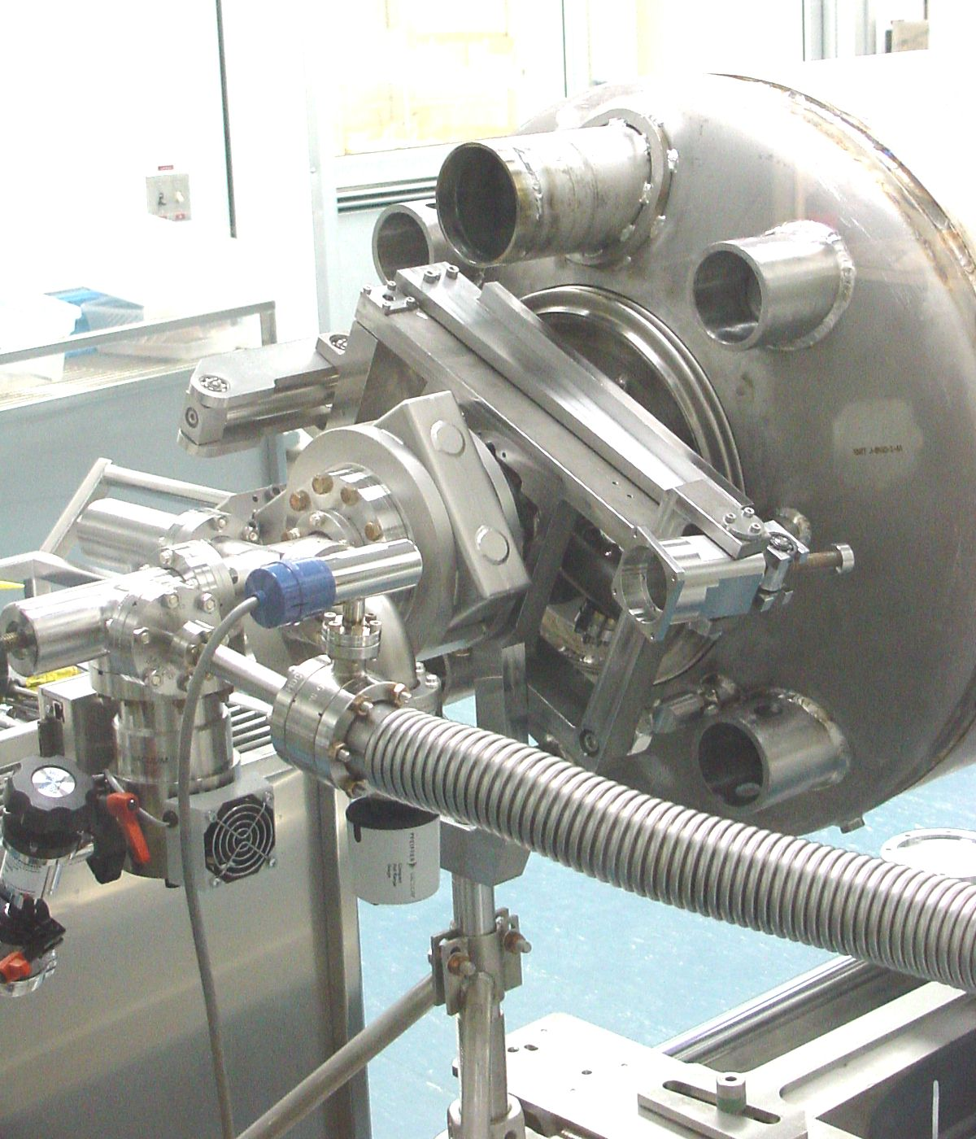
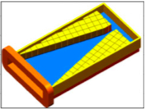
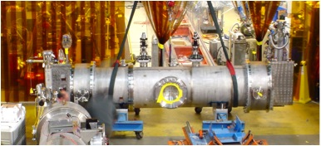
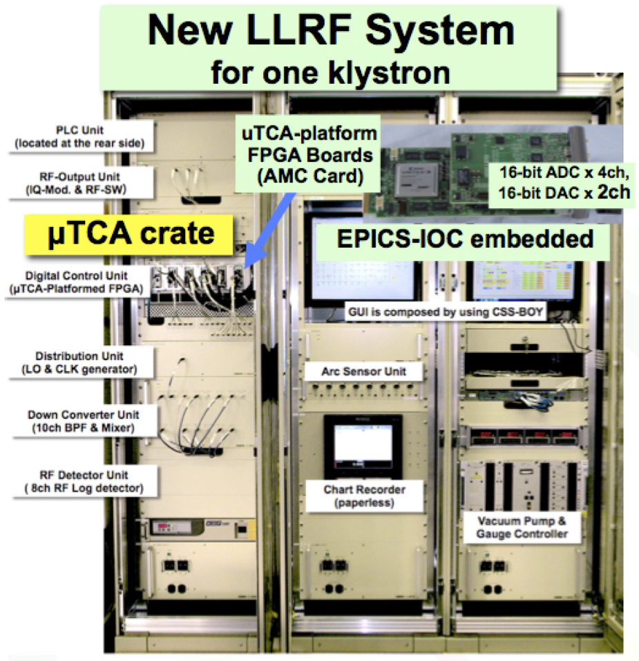
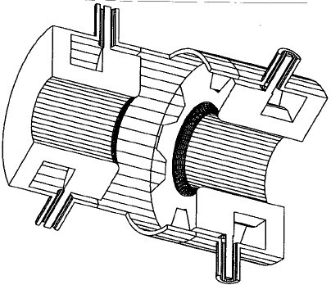
RF R&D roadmap
2017
2018
2019
2020
2021
 | 1 | 2 | 3 | 4 | 1 | 2 | 3 | 4 | 1 | 2 | 3 | 4 | 1 | 2 | 3 | 4 | 1 | 2 | 3 | 4
RF systems design and specification
952 MHz cavities:
ERL cooler 5-cell
ERL booster 1-cell
Storage ring bunching cavity
Crab cavities (ODU)
Harmonic kicker cavity
Ancillary components (windows, tuners, HOMs, etc.)
Integrated cooler test ?
Modular cryostat
LLRF and Bunch by bunch feedback systems, kickers
📕?
💰
💰
ODU
💰
💰?
NP base
VA funds
FOA?

Slide 17
Help wanted!
PEP-II-like RF system modeling (LBNL?)
Standard loops, Robinson Stability, etc.
Comb filter, linearizer, ripple loop, etc.
Transient response/suppression, experiment
PEP-II like bunch-by-bunch feedback systems (SLAC/LBNL/Dimitel?)
Whole system simulation
Electronics (Dimitel?)
Broad-band kickers
Ion linac optimization, design (ANL?)
PEP-II RF equipment refurbishment (SLAC)

Slide 18
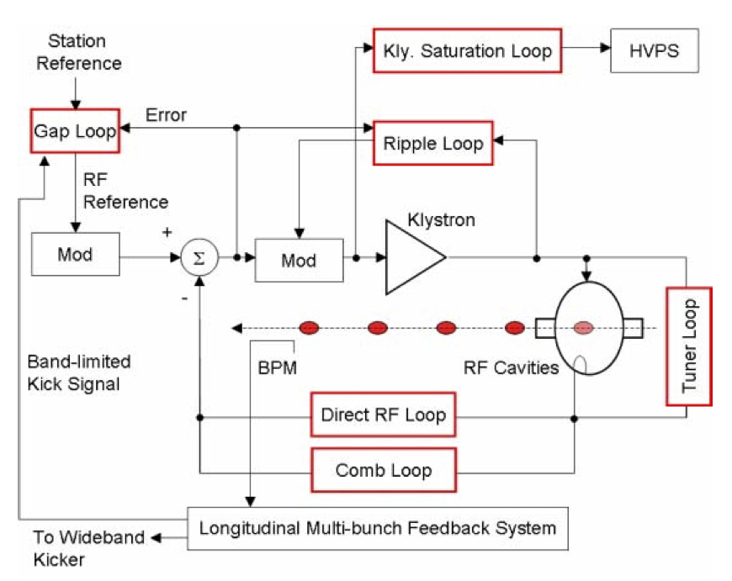
PEP-II type RF system
PEP-II digital LLRF system had many advanced features, which need to be recreated in a current and sustainable hardware platform
“PEP-II RF SYSTEM OPERATION AND PERFORMANCE” , P. McIntosh, et. al., EPAC 2004

Slide 19
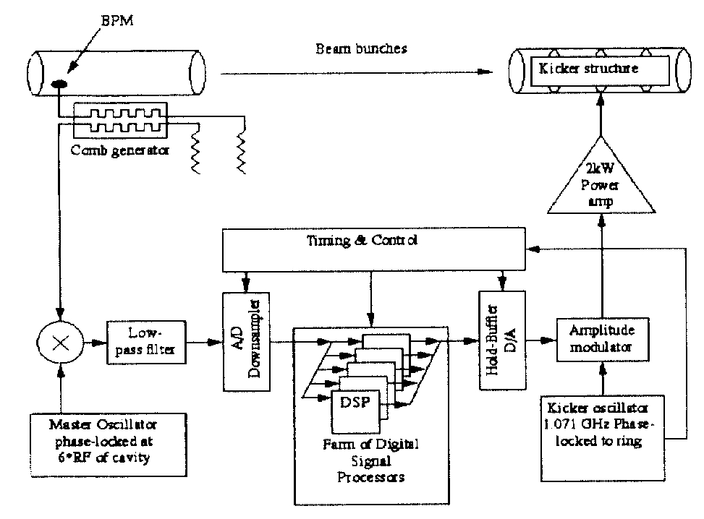
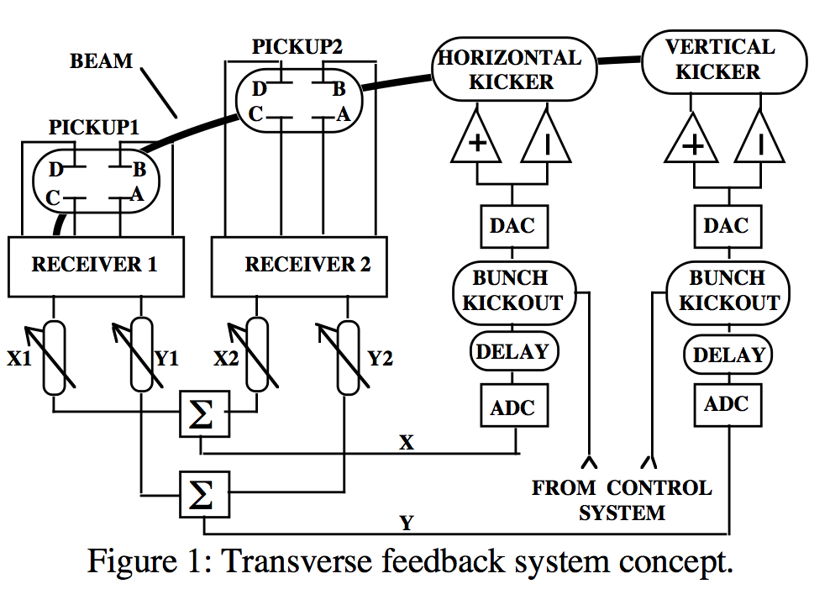
PEP-II type CB feedback systems
PEP-II feedback systems allowed running above threshold
Similar systems are now commercially available
JLEIC needs a high level system design and performance simulation for CDR
Reliable high-power kickers are needed
Figure 2: Longitudinal Feedback system concept

Slide 20
Path forward
Much work to do to be ready for CDR
Upcoming FOA offers opportunities for teaming on critical technologies
Some things that were new for PEP-II are now commercially available
Some things just need to be implemented on current and sustainable platforms
Need help in developing high level specifications and simulations for CDR
Hope to benefit from expertise in other labs and industry to make a strong design

Slide 21
Back up

Slide 22
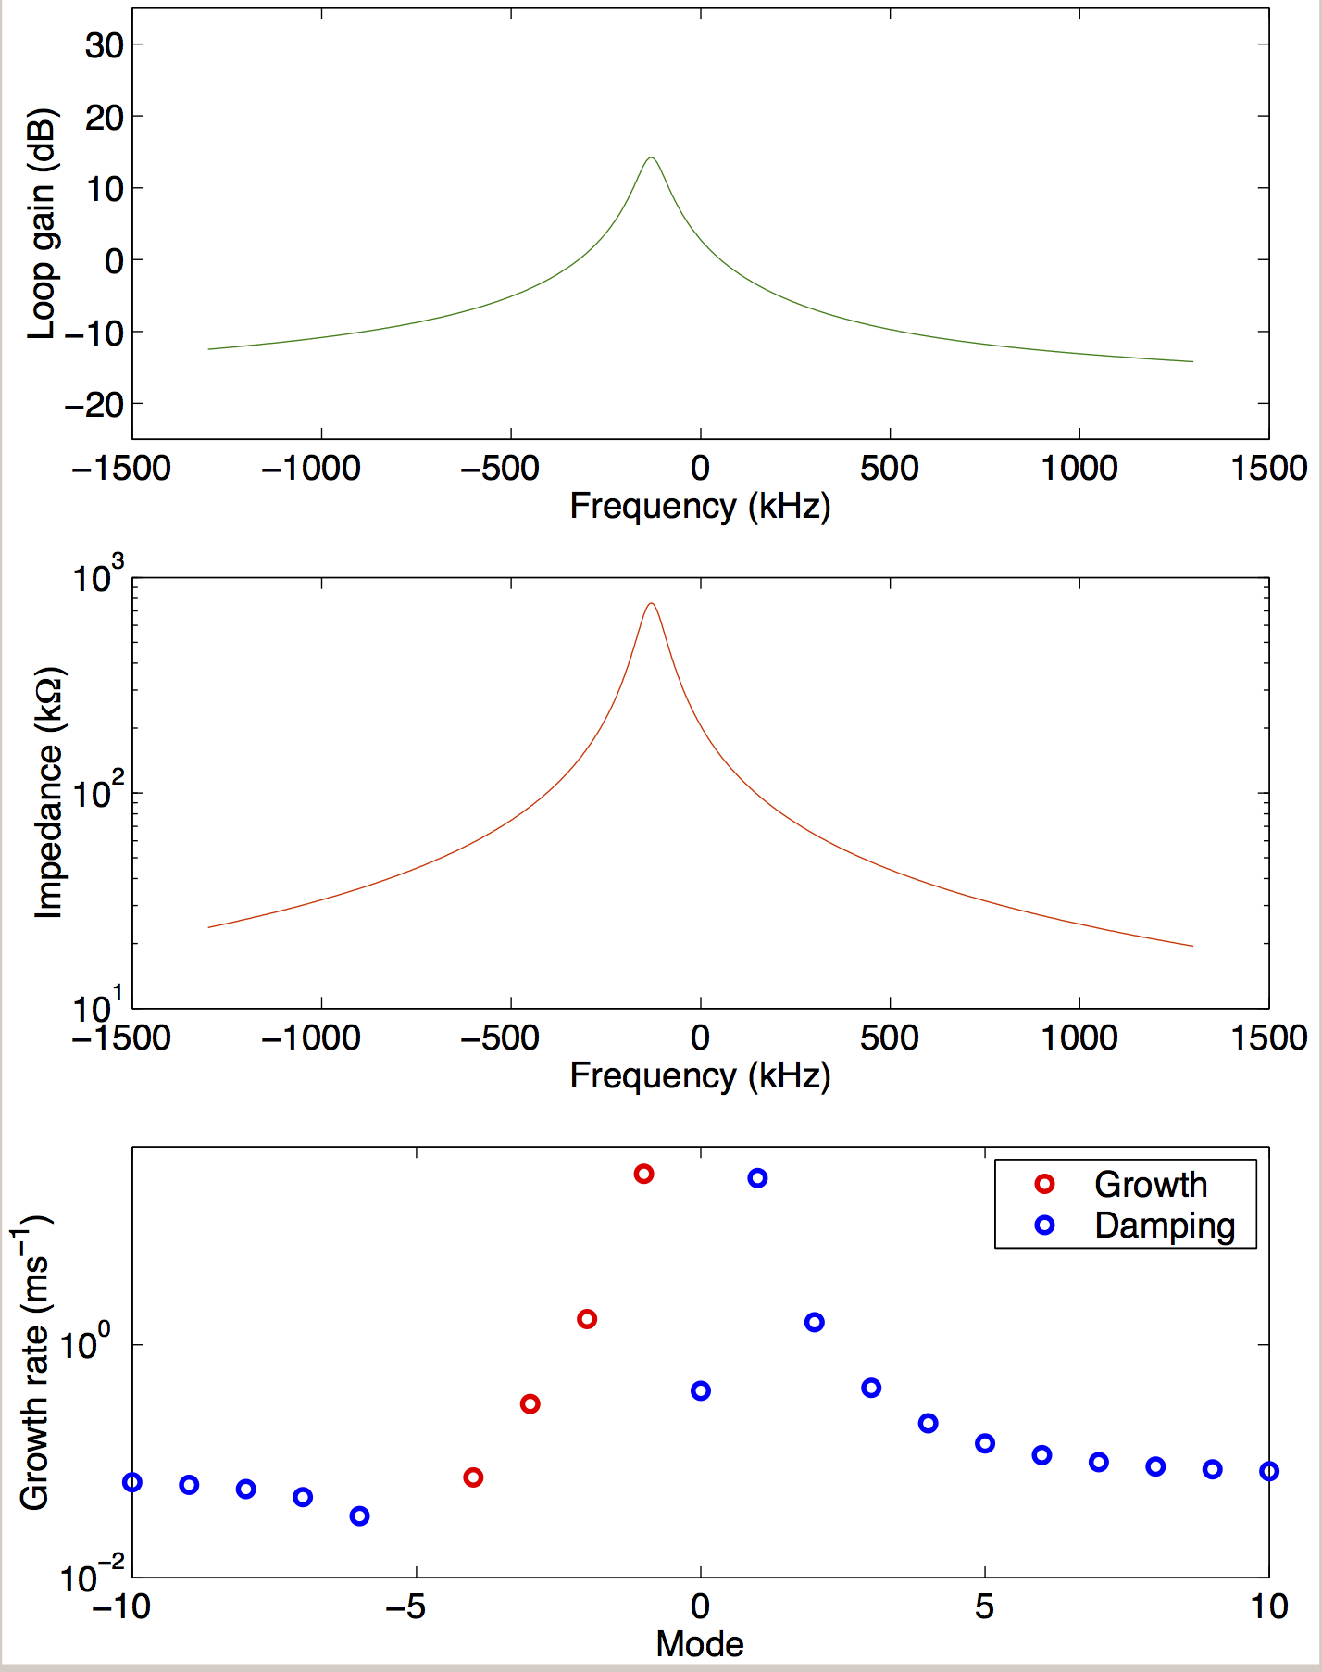
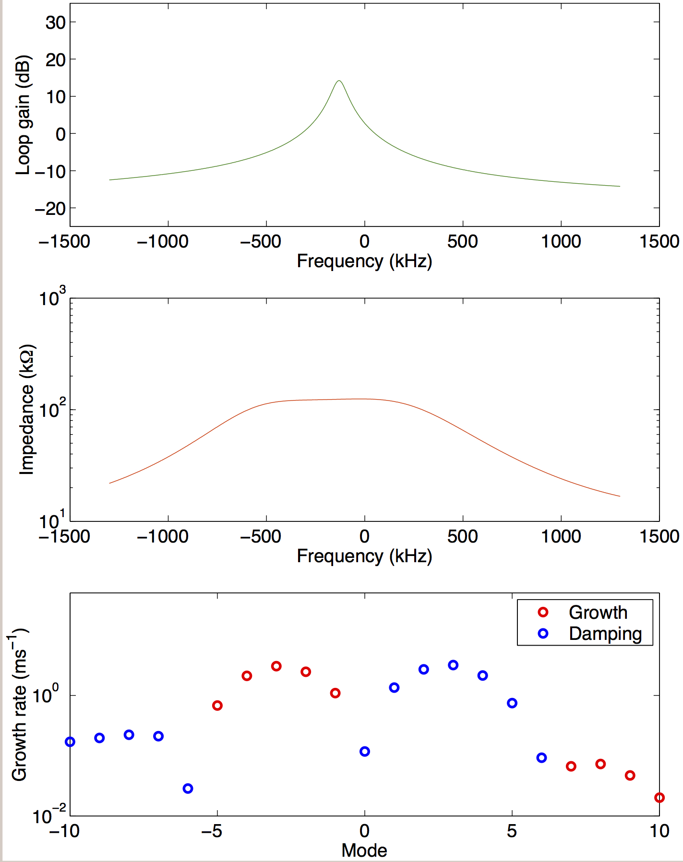
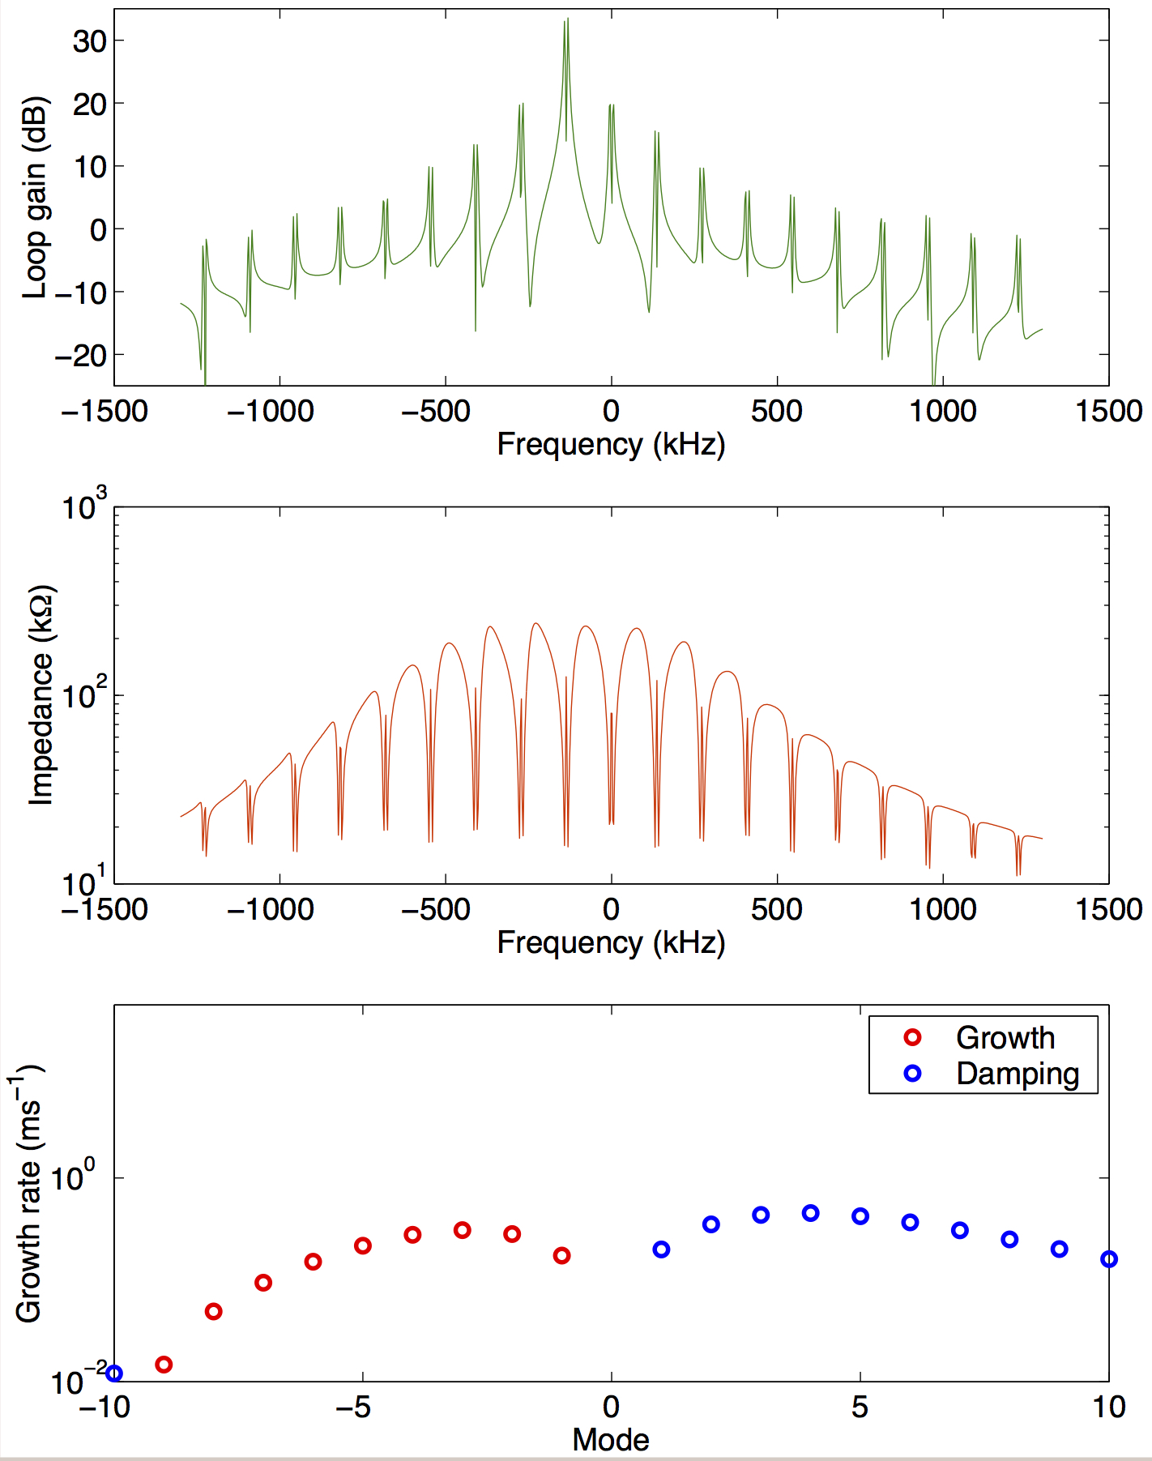
PEP-II type RF system
PEP-II type digital LLRF system must have additional loops for comb filter, klystron equalization and ripple, low mode LFB, gap loop, saturation loop, etc.
Beam loading compensation for Super B-factories, Dmitry Teytelman, PAC05
Cavity detuned for beam loading
Direct loop on
Comb loop on

Slide 23
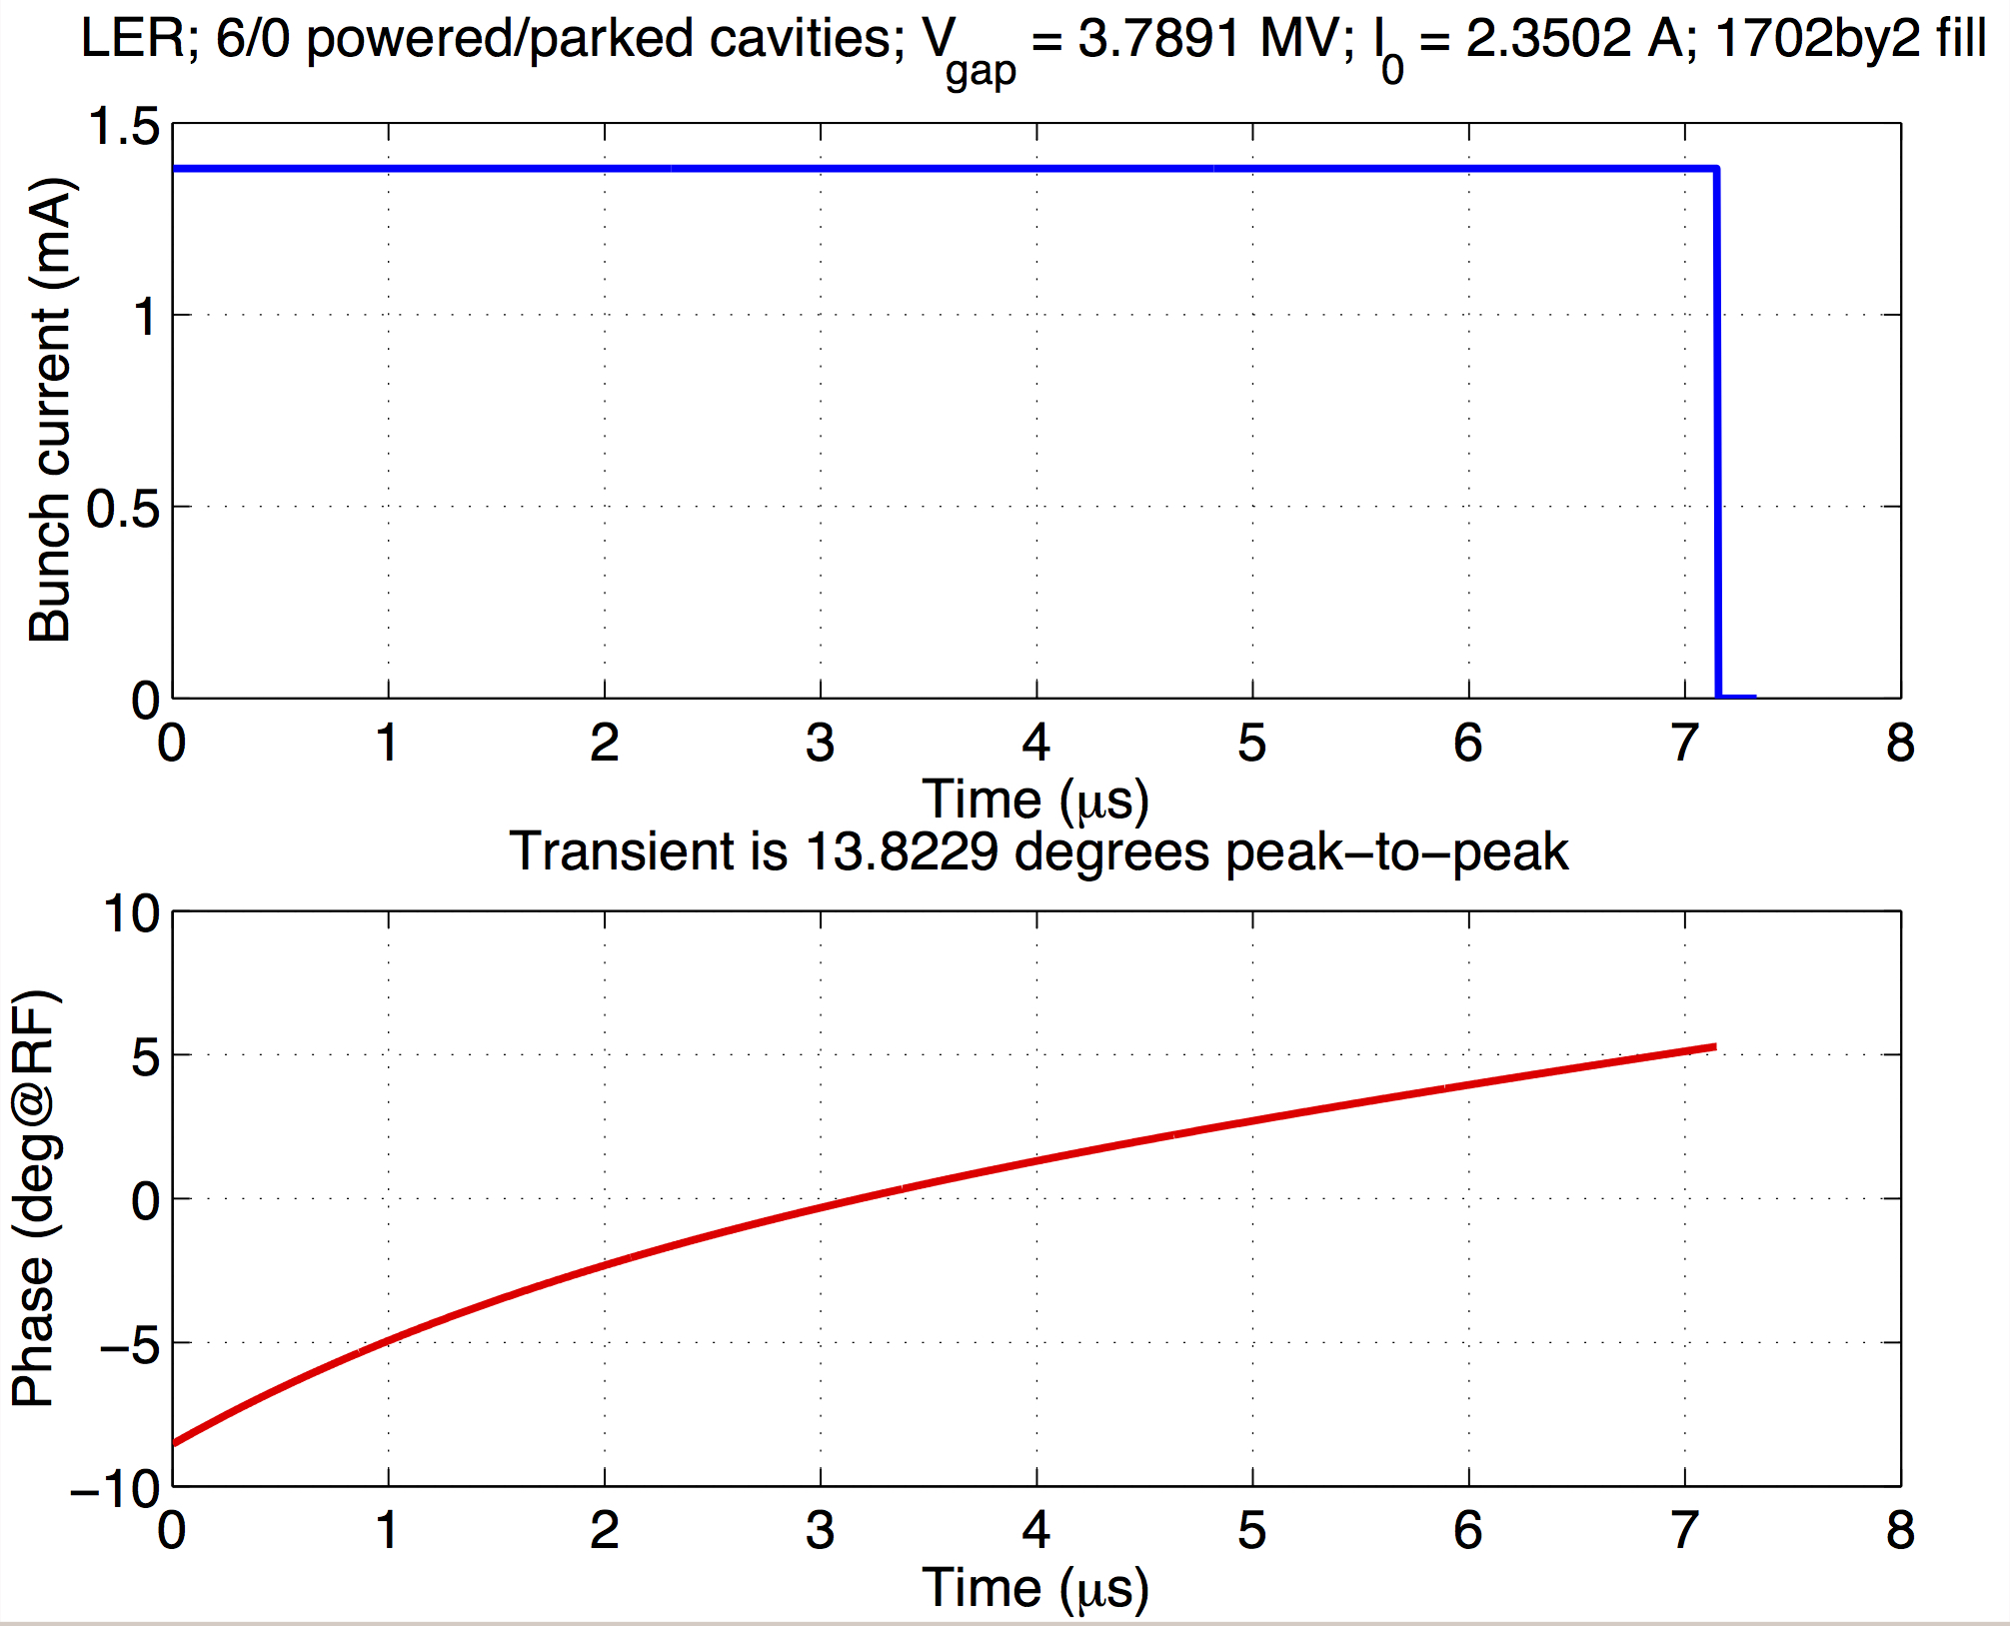
PEP-II type RF system
RF transient from gap is strong, cannot be cancelled by klystron power alone. Need to develop and mitigation strategies, test in rings like BEPC-II or ALS
Beam loading compensation for Super B-factories, Dmitry Teytelman, PAC05

