Slide 1
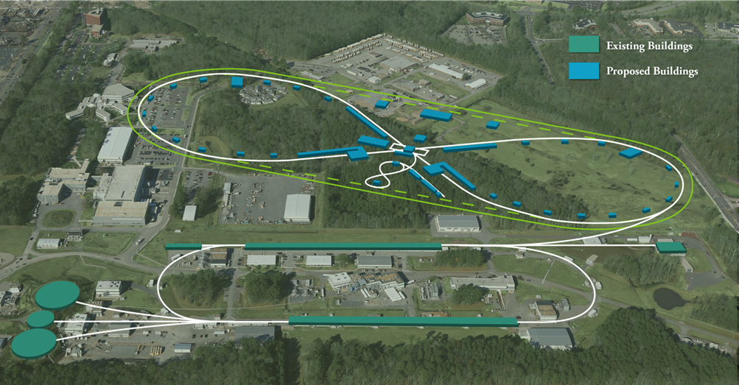
JLEIC SC Magnet Working Group Meeting
Tim Michalski
JLEIC Spring 2017 Collaboration Meeting
April 5, 2017

Slide 2
Plan for the Meeting
The plan for this meeting - “Working Group”
Ask questions
Discussion is encouraged
Objective: Identify how and where to engage collaboration partners towards JLEIC SC Magnet priorities.
Texas A&M University ARL
LBL – Berkeley Center for Magnet Technology
BNL – Superconducting Magnet Division

Slide 3
Agenda
Prioritized List of SC Magnet Activities
Tasks for SC Magnet Activities
Funding and timing
How and when to engage resources

Slide 4
SC Magnet R&D
MAG1: Superferric 3T, Fast Ramping, Short Prototype
MAG4: IR, Compact, Large Aperture, High Radiation Magnets
MAG2: Alternate Technology SC 6T Ramping Magnets

Slide 5
Superferric 3T, Fast Ramping, Short Prototype
Further analyses which support a robust magnet design
Discussion/Agreement at delivery of prototype winding is a need to have a list of analyses which demonstrate the design capability.
Analyses must be agreed to up front
The method of analysis, equations, and source justification must be done in advance
Acceptance criteria/factor of safety defined in advance
Assessment of ramping and “dynamic effects” on SC magnets and conductor
Eddy currents
Persistent currents
Coupling between conductor strands
Current sharing between conductor strands
AC losses
Snap back
Radiation Load – radiation damage, heat load
Magnet Cycles – fatigue consideration
DFMEA

Slide 6
Superferric 3T, Fast Ramping, Short Prototype
Develop 3T Model Dipole Cold Mass – TAMU
125m CICC Development/Fabrication
Fabrication of beampipe and coil supports (G11)
Field return steel
Outer shell
He cooling channels (in return steel)
Modification of winding fixtures/tooling
Diagnostics and sensors
Testing of Cold Mass at Temperature Across Operational Range
Definition of test requirements / test plan
Selection of test facility
Adaptation of cold mass/test setup
Test equipment, controls, data acquisition
Quench protection / controls
Data reduction/analysis
Re-test, as required/desired

Slide 7
Recommendations from December, 2015 Review
Comments from the previous review are still valid.
The cold mass alone is not sufficient to retire the risk. It is possible a significant portion of the technical risk could be reduced based on cold test results. Plan to test cold mass at temperature and ramping.
Cost risk can only be retired after feedback to/from the actual industrial firms that will make the magnets. Data being gathered now.
Certain risks, such as field quality, can also be reduced by further modeling and optimization. Expect this to be done after acquiring data from prototype testing.
Several issues must be addressed prior to committing to construction of a cold mass prototype dipole magnet.
Assemble mockup flux return to test pre-loading
Fabrication of CIC cable, drawing sheath on long-length CIC cable using real superconductor. Nearing completion of 125m assembly.
Validate splice design. Concept design, needs to be prototyped.
Repeat of mockup winding tests using actual cable to evaluate parameters for bend tooling, QC conductor placements. Short length trial done – needs some tooling mods.
And possibly further modeling of impact of iron properties different from present assumptions.

Slide 8
Recommendations from December, 2015 Review
The committee recommends an intermediate stage to address the following.
Calculations are mandatory before authorizing the prototype for the CIC cable.
It should be shown that Cu-Ni is a valid pressure boundary using ASME code for liquid helium temperatures. Done
The calculation needs to be made showing that the Cu-Ni tube stays within code stress limits during the pressure increase in the tube during a quench for the final magnet’s tube length Done
The stability of the conductor should be calculated showing that a local quench point should recover the superconducting state because of the exposure to flowing liquid helium, essentially the Stekly Criteria for cable in conduit. Maximum peak temperature should be defined and justified.
In calculating winding peak temperatures, the following times should be allowed for:
Time to reach quench detection voltage threshold
Time for electronics to react and fire quench heaters
Time for quench heaters to heat up to a high enough temperature to propagate quench
The committee recommends having another review prior to funding the cold mass fabrication task.

Slide 9
IR Magnets Compact, Large Aperture, High Rad
Optimization of IR layout and magnet parameters
Clarify the magnet operational limits and design constraints for different technologies.
Assess which magnet and accelerator parameters may be adjusted in an effort to provide the best valued design solution while supporting performance and reliability objectives. Iterative feedback between magnet designers and accelerator physicists is required in order to identify the best (cost & performance) regime.
Modeling of designs to confirm that the resulting IR magnet requirements can be met (field, field quality, space constraints etc.)
Conceptual design of IR magnets to meet design requirements (magnet, mechanical, quench protection, thermal and radiation load, DFMEA, other system effects)
Develop a prototype plan suitable to bring the design to a technology readiness level
Fabrication of the IR magnet prototype(s)
Procurement of conductor, coil and structure components
Cable fabrication and insulation
Coil fabrication (1 practice, 2 production, and 1 spare)
Structure pre-assembly and instrumentation
Final assembly, test and evaluation of the IR magnet prototype(s)

Slide 10
Alternate SC Technology 3T/6T Ramping Magnets
Ion Collider Ring Magnet:
Technical and cost analysis of Cos(θ) superconducting magnets with operational parameters relevant to ion collider
Optimal design parameters (aperture, length and curvature) for a current-dominated superconducting magnet and corresponding machine lattice
6T Conceptual designs of collider magnet
6T Engineering designs of a prototype collider magnet and associated cost estimate
Booster Ring Magnet:
Review of performance achieved in previous R&D involving fast ramping magnets relevant to JLEIC
Optimal design parameters (aperture, length and curvature) for a current-dominated superconducting magnet and corresponding machine lattice
Conceptual designs of 3T booster magnet
3T Engineering design of a prototype booster magnet and associated cost estimate
Other system effects
Risk assessment (Design FMEA)

Slide 11
Funding and Timing
Funding/Timing
3T SF Dipole
FOA
JLab can work on analyses list and test plan
IR Magnets
FOA/?
JLab needs to start on layout and modeling now
6T (3T) Alternate Technology
LDRD/?
JLab developing proposal now

Slide 12
JLab Immediate Tasks
4 Activities SC Magnet
Developing list of supporting analyses required for the 1.2m, 3T, fast ramping CICC model dipole with TAMU
Developing a test plan and supporting diagnostics for testing 1.2m, 3T, fast ramping CICC model dipole
Documenting SC magnet design parameters
Develop a plan for IR Magnet Development – define staff to support

Slide 13
How and When to Engage Resources
Texas A&M ARL
3T SF Dipole and CICC Fabrication
3T SF Dipole supporting analyses – interface with Probir at JLab
CICC based IR Magnet designs
LBL – Berkeley Center for Magnet Technology
6T Cos-Theta
IR Magnet designs – look for areas to tie in expertise and efficiency (e.g. conductor vs aperture vs field, quench analysis)
Potential test site for 3T SF Dipole
LBL LDRD (how to use effectively)
Brookhaven – SC Magnet Division
Focus on IR Magnet area of design
Potential test site for 3T SF Dipole
IR Magnet Task Force – JLab, BNL, TAMU, LBL
IR magnet retreat
FNAL
Potential test site for 3T SF Dipole

