Slide 1
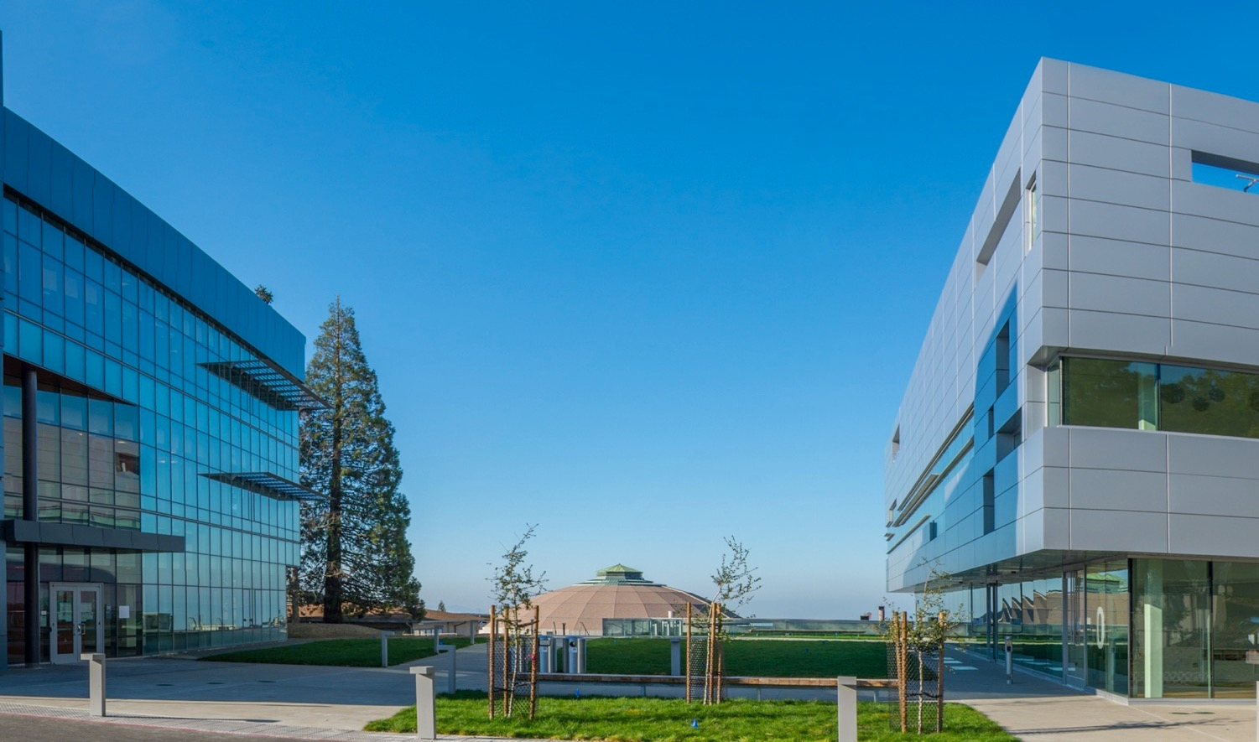
Potential Berkeley Lab accelerator phyics contributions to an Electron-Ion Collider
John Byrd
JLEIC Collaboration Meeting, JLab
3-5 April 2017

Slide 2














Berkeley Lab Accelerator Technology and Applied Physics Division
James Symons
Associate Laboratory Director for Physical Sciences
Wim Leemans
Division Director
Administrative Support
Budgets and Finance
Business Development and Proposals
Communication
Diversity and Inclusion
Environment, Health, & Safety
Human Resources
Outreach and Education
Soren Prestemon
Division Deputy,
Technology
Eric Esarey
Senior
Scientific
Advisor
Asmita Patel
Division Deputy,
Operations
Advanced Light Source Accelerator
Physics
Berkeley Lab Laser Accelerator (BELLA) Center
Berkeley Accelerator & Instrumentation
(BACI)
Accelerator
Modeling
Fusion Science &
Ion Beam Technology
Special Projects
Berkeley Center for Magnet Technology
(ATAP and Engineering)
U.S.
Magnet Development Program
Fernando Sannibale,
Head
Christoph Steier, Deputy
Wim Leemans, Head
Eric Esarey, Deputy
John Byrd, Head
Derun Li, Deputy
Jean-Luc Vay, Head
Ji Qiang, Deputy
Thomas Schenkel, Head
Peter Seidl, Deputy
John Corlett, LCLS-II
Soren Prestemon, Head
Ross Schlueter, Deputy
Stephen Gourlay, Program Director
Potential testbed for some concepts
Formerly Center for Beam Physics
New integrated program for all things magnetic

Slide 3
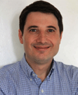
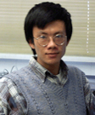
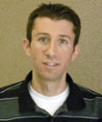
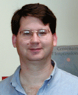
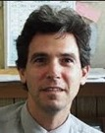

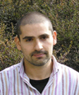
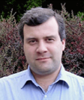
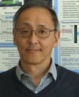
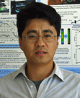

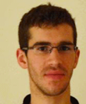

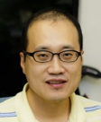
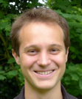
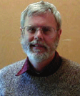
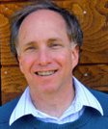
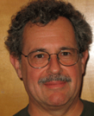
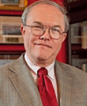



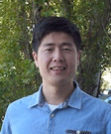

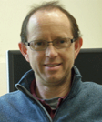


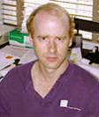


Accelerator Modeling Program
Jean-Luc Vay (lead)
Ji
Qiang (deputy)
Chad
Mitchell
Greg
Penn
Rob
Ryne
Lucky
Cortez
Carlo
Benedetti
Stepan
Bulanov
Hiroshi
Nishimura
Changchun
Sun
Scientific Staff
ATAP Collab.
Admin.
Support
BELLA
BELLA
ALS
ALS
Kilean Hwang
Rémi
Lehe
Olga Shapoval
Jaehong Park
Maxence
Thevenet
William
Fawley
Alex
Friedman
Miguel
Furman
Brendan
Godfrey
Postdocs
Affiliates
LBNL/SLAC
LLNL
LBNL
U. Maryland
Guillaume Blaclard
Patrick
Lee
Zhicong
Liu
Chuwen Luo
Yue
Tao
David
Grote
Axel
Huebl
Manuel
Kirchen
Steven
Lund
Students
U. Paris-Saclay
LLNL
U. Dresden
U. Hamburg
Michigan State U.
Jean-Baptiste Viout
Liu
Xinyao
Ziyi
Yu
Imen
Zememi
Master
Students
Talk by Jean-Luc Vey on Wed. PM
Notes:
Berkeley has a lot to offer with a unique collection of tools

Slide 4
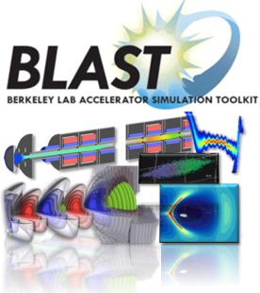
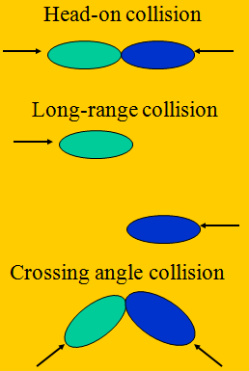
Berkeley Lab Accelerator Simulation Toolkit
BeamBeam3D: A Parallel Colliding Beam Simulation Code
Some key features of the BeamBeam3D
Multiple-slice model for finite bunch length
New algorithm -- shifted Green function -- efficiently models long-range collisions
Parallel particle-field based decomposition to achieve perfect load balance
Lorentz boost to handle crossing angle
Arbitrary closed-orbit separation
Multiple bunches, multiple collision points
Linear transfer matrix + one turn chromaticity
Conducting wire, crab cavity, e-lens compensation model
Feedback model
Impedance model
http://blast.lbl.gov
Talk by Ji Qiang on Wed. PM

Slide 5

Mission statement:
Serve as a Center of Expertise for Magnetic Systems Science and Engineering, through integration of design, fabrication and implementation of complex magnetic systems in support of the DOE Office of Science mission.
See Gianluca Sabbi for details
Operated jointly by the
Accelerator Technology and Applied Physics Division
And the
Engineering Division
Lawrence Berkeley National Laboratory

Slide 6
Broad Areas of Strength in Magnet Technology
Magnetic systems:
  Long, sustained, history of expertise in PM and resistive magnet systems
  Strong analysis capabilities
Superconducting accelerator magnets:
  Long, sustained history of innovation in high-field magnets
  Vertically integrated expertise in superconducting magnet technology (materials, analysis, design, fabrication, test)
Magnet testing
  Development of novel magnetic measurement systems
  Development of novel diagnostics
  Facilities for PM, EM, and SC magnet testing

Slide 7
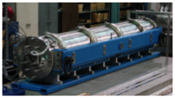
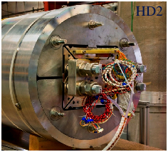
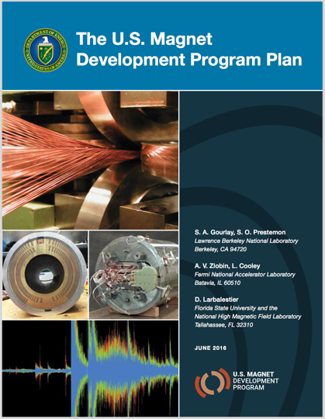
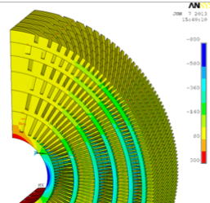
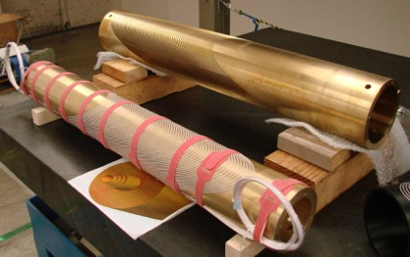
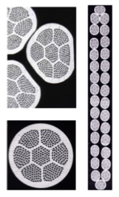
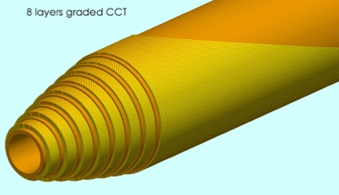
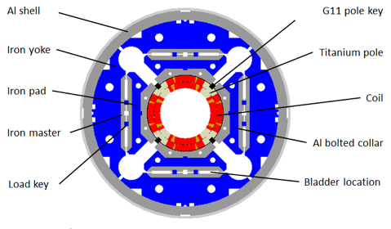
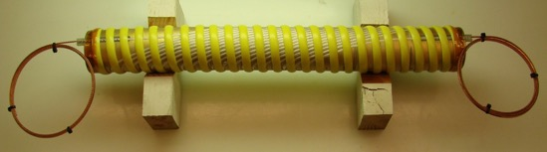
An internationally recognized program in advanced superconducting magnets for High Energy Physics
HEP
Superconducting Magnet Program
LHC Accelerator Research Program
HEP Stewardship Funding
See Gianluca Sabbi for details
Bi-2212 6/1

Slide 8
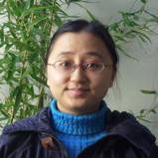
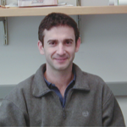
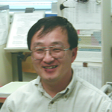
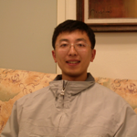
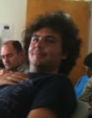
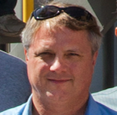
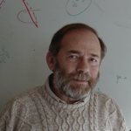
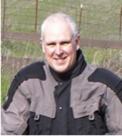
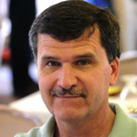
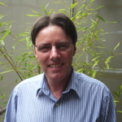
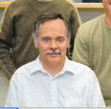
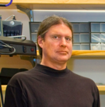

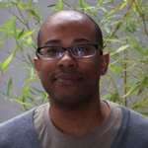

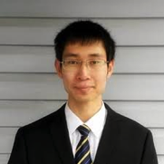
Berkeley Accelerator Controls and Instrumentation Team
ATAP
ENG
Tianhuan Luo
Stefano De Santis
Derun Li
Gang Huang
Daniele Filippetto
John Byrd
Max Zolotorev
Emeritus
John Staples
Steve Virostek
Alan DeMello
Larry Doolittle
Russell Wilcox
Qiang Du
Kerri Campbell
Postdocs
Students
Yawei Yang
Serena Persichelli
Tina Stoddard
Zhilong Pan
Yilun Xu
Qi Chen

Slide 9
Proposed program: Berkeley Accelerator Controls & Instrumentation (BACI)
We have identified 3 areas where Berkeley Lab has competitive advantage and opportunities
Advanced RF Design and Engineering
  CW Normal conducting cavities and RF structures
  RF measurement and characterization
  Beam impedance modeling and measurement
Ultrahigh Precision Controls
  RF controls
  Femtosecond synchronization
  Controls for complex systems
High Dynamic Range Beam Instrumentation
  Beam orbit feedback systems
  Beam loss measurement and control
  Femtosecond electron beams

Slide 10
Our RF Capabilities
RF design and construction capabilities
  EM structure designs (general)
    RF cavities, kickers, crabbing cavities, BPMs and Linacs
  Engineering , mechanical design, fabrication, assembly and system integration (ED)
    Thermal and stress analyses (FEA)
  Numerical modeling and simulations
    Impedance and wakefield
    HOM damping
    RF coupler design
  Low power RF measurements
  High power RF measurements and testing (APEX and ALS)
  RFQ accelerators
    Beam dynamics design
  Collaboration (domestic and international)

Slide 11
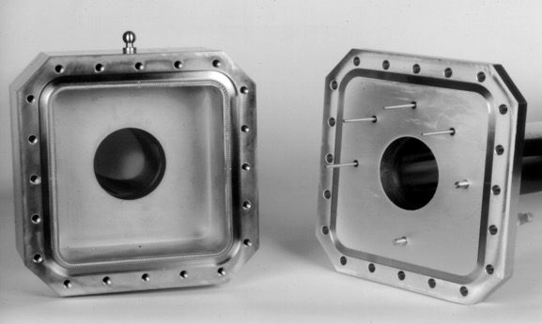
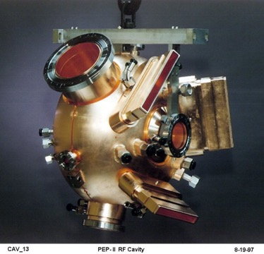
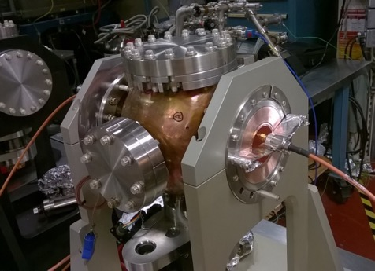
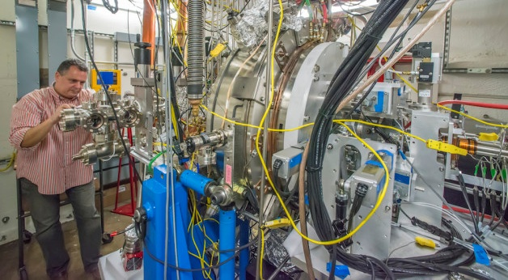
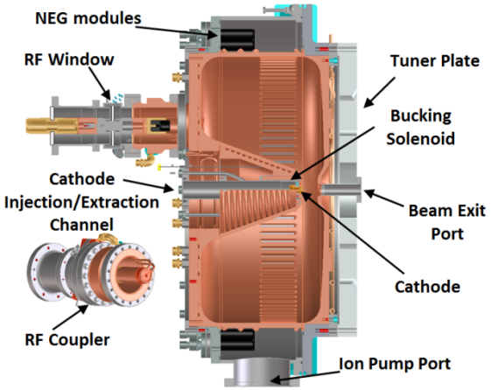
Our Contributions
RHIC Schottky Cavity at BNL
PEP-II Cavity at SLAC
3rd Harmonic Cavity at the ALS

Slide 12




We design and built innovative RF cavities for MAP/MOCE
Under US MAP program (formerly NFMCC Collaboration)
we have designed and built 805 MHz cavities for Muccol and 201 MHz cavities for Mucool and MICE
MICE Production Cavity/module
805 MHz cavity with Be windows
MICE Prototype Cavity
805 MHz modular cavity

Slide 13

We Have Expertise in RFQ Design and Construction
Installation of PXIE RFQ at Fermilab (2015)

Slide 14






We have designed & built six RFQs, they all work !
LBNL has designed and built five RFQs
RFQ1 - Bevatron
RFQ2 – CERN
RFQ3 – BNL Injector
RFQ4 – LBNL Proton
RFQ5 - SNS
RFQ6 (CW) – FNAL PXIE

Slide 15
EIC Synergistic Accelerator Physics Activities at Berkeley
LCLS-II
  Beam dynamics design of linac using IMPACT. (J. Qiang)
  Beam dynamics of injector.
LHC/LHC-HL
  Beam-beam study of crab cavities
  Electron cloud studies using Posinst/WARP
ALS/ALS-U
  Evaluation of single/multibunch collective effects.
IOTA (FNAL)
  Development of new tools for understanding beam dynamics
  Analysis of high current electron lens/current.

Slide 16
EIC Synergistic Accelerator Technology Activities at Berkeley
LCLS-II
  Berkeley Lab responsible for state-of-the-art LLRF controls for SC linac (w/Jlab).
  Design of high brightness photocathode gun (<1 mA). Next generation gun design in progress.
ALS/ALS-U
  Design of multibunch feedback systems for 500 MHz bunch pattern.
  Digital RF controls
  Impedance study for ALS-U
  Fast injection/extraction kickers
APS/APS-U
  Digital RF controls
  Fast orbit feedback system

Slide 17

Berkeley Lab has become leaders in digital RF control
We’ve collaborated on many projects
  LCLS-II
  LCLS-I
  Fermi@Elettra
  ALS
  SNS
  ….

Slide 18


ALS and ALS-U in numbers
Parameter | Units | ALS | ALS-U
Electron energy | GeV | 1.9 | 2.0
Horiz. emittance | pm | 2000 | ~50
Vert. emittance | pm | 30 | ~50
Beamsize @ ID center (σ_{x}/σ_{y}) | mm | 251 / 9 | <10 / <10
Beamsize @ bend (σ_{x}/σ_{y}) | mm | 40 / 7 | <5 / <7
bunch length (FWHM) | ps | 60-70 (harmonic cavity) | 120-200 (harmonic cavity)
RF frequency | MHz | 500 | 500
Circumference | m | 196.8 | ~196.5

Slide 19


Scope of ALS-U
Replacement of the existing triple-bend achromat storage ring with a new, high-performance storage ring based on a multi-bend achromat.
Addition of a low-emittance, full-energy accumulator ring in the existing storage-ring tunnel to enable on-axis, swap-out injection using fast magnets.
Upgrade of the optics on existing beamlines and realignment or relocation of beamlines where necessary.
Addition of three new undulator beamlines that are optimized for novel science made possible by the beam’s high coherent flux.
Existing ALS ring
New ALS-U ring
New accumulator ring

Slide 20


A New ALS Longitudinal Feedback Kicker Cavity has been designed and commissioned
ALS longitudinal bunch-by-bunch feedback kicker requires a 250 MHz bandwidth.
Heavily damped pillbox cavity. Introduced in DAΦNE, used also on BESSY II, Diamond. f_{res}= 1.4 GHz, with an R/Q≈80 we can get a R_{s}= 400 Ω, doubling existing kicker.
(BESSY II)
(ALS)

Slide 21
Swap-out with a full-energy accumulator
Traditional off-axis injection
On-axis swap-out injection
(initially proposed by M. Borland)
Stored Beam
Stored Beam
Fast Kicker
requires larger
apertures
can use smaller
apertures
Injected Beam
  Swap-out enables:
  Stronger-focusing MBA lattices with smaller dynamic apertures
  Round beams - more useful shape and reduced emittance growth
  Vacuum chambers with small round apertures → Improved undulator performance
  Swap-out with full energy accumulator enables:
  Bunch train swap-out and recovery of the stored beam current
      Lower demand on the injector
      Very small (~nm) injected emittance
      More flexibility in fill patterns
Injected Beam
Only ALS-U and APS-U plan to include swap-out
Notes:
Better Pictures

Slide 22


ALS-U Injection/Extraction Kicker
The ALS upgrade requires a sub-10 ns rise time kicker for implementing the necessary on-axis swap-out injection scheme.
50-cm long stripline module (4 modules to achieve 3.5 mrad).
Extremely reduced transverse dimensions change the usual design/assembly methodology. Much higher “resolution” in mechanical details needed. Beam proximity amplifies coupling impedance issues.
ALS Test Kicker
8 mm
35 mm
6 mm
9 mm
6 mm
Installation: February 2017.
Will be injection kicker with the smallest aperture (I believe)
ALS-U

Slide 23
Berkeley Lab Contributions to Magnet Development
R&D plan adjusted to include the review guidance and recent discussions
Some (minimal) Lab funding is available to get started on highest priorities
Fast ramping 3 T dipoles for the ion booster
  CIC dipole: explore feasibility of testing short model at LBNL: test goals, system requirements and supporting analysis
  Cosθ alternative: provide performance and cost expectations based on results from relevant past developments
Dipoles for the ion collider:
  Develop a preliminary cosθ design for 6 T, to provide performance and cost estimates addressing the DOE review guidance
IR Magnets:
  In collaboration with the accelerator physics group, select optimal design points for different assumptions (conductor, temperature)
  Develop R&D plan in response to the DOE review recommendations

Slide 24
Summary
Berkeley Lab is committed to helping with the EIC.
We have a strong local advocate in Barbara Jacek, the Nuclear Sciences Division Director.
We have developed several capabilities from past experience with high current storage rings such as PEP-II, ALS, ILC damping rings, etc. that can be helpful for EIC.
  Strong accelerator physics combined with high performance modeling
  Specialized RF design
  High precision digital RF control
We would like to volunteer to host a future EIC Collaboration Meeting
Berkeley Lab are partners-of-choice for almost all DOE accelerator projects.

Slide 25
Thank You

