Slide 1
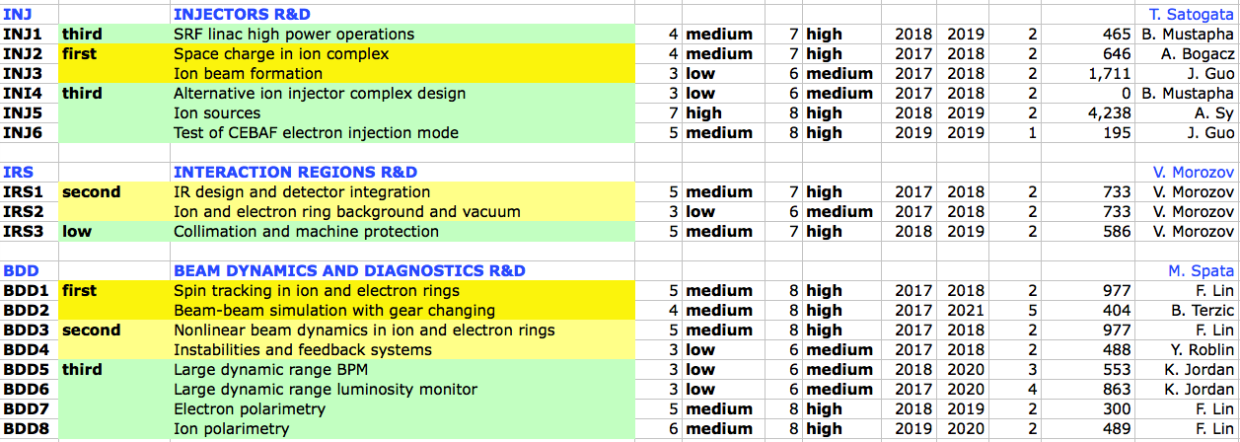
JLEIC R&D Review: Other R&D
Cooling, SRF, Magnets, Physics discussed elsewhere
Other CTE areas in Fulvia’s original R&D review presentation
First I discuss these, then broader implications for other R&D from table and summary in R&D report from Feb 2017

Slide 2
INJ2: Booster Space Charge
JLEIC Booster injection is space charge dominated
Laslett tune shift for design parameters ~0.15
Conventional DC cooling limited by SC limit
Proton single-turn injection limited by SC
Ion multi-turn injection limited by ion source performance
Leverage existing tools and experience
e.g. FNAL Booster, CERN PS Booster SC limit studies
SC tracking with realistic superferric magnet multipoles
Synergia is preferred tool, c.f. FNAL Booster
Design resonance compensation schemes, multi-turn ion injection scheme

Slide 3
INJ2: R&D Plan
Add superferric multiples to Synergia design lattice
Modeling of realistic errors from TAMU TOSCA models
Include symmetry-driven structure resonances
Produce loss maps and frequency map analysis
Evaluate halo formation due to resonance crossing
Evaluate growth times with/without cooling
Evaluate lattice design for resonance correction
Linear/nonlinear chromatic control
Optimization for high-intensity injection/acceleration

Slide 4
INJ3: Ion Bunch Formation
JLEIC luminosity concept requires short ion bunches
Many modest-intensity (~1e10 p) bunches for 0.75 A
Acceleration velocity, f_{rev} swing requires lower h, f_{rf}
Approaches for ion bunch (re)formation
Preferred: Multiple adiabatic bunch splits
Alternative: Barrier bucket “debunch”, rebunch
Notes:
eRHIC concept: 8 cm sigma_z with about 1.5e11, a bit more aggressive than we are

Slide 5
INJ3 R&D Plan: Barrier Bucket
Impedance models are also fundamental to this effort
Smaller RF requirements, less impedance, but higher uncertainty
Develop barrier bucket models
BLonD/ESME for cross-code verification
Estimate impedance requirements/thresholds
Inverse problem to FNAL bunch compression, high intensity
Consult with barrier bucket experts
Determine feasibility of study at existing facility
Experimental comparison to model development

Slide 6
INJ6: Test of CEBAF as JLEIC Injector
Proposed JLEIC injection scheme
1497/22 MHz trains with pulse length 3.7 us
Interval 10s of ms to match storage ring damping time
Pulsed transient beam power 5.5 MW (1 MW each pass)
Provides 15 min fill time at 3 GeV with longest damping time
Pulsed beam transients a problem unless addressed
Beam loading/droop exceeds 2e-3 arc momentum acceptance
Substantial risk in LLRF control, injector performance
LLRF feedforward can be tested in C100/R100 digital LLRF
Existing digital controls can be modified
Possible tests in CEBAF, injector R100, UITF with new QCM

Slide 7
Report R&D Priorities: High
Report Table 1: (somewhat) prioritized list of R&D activities
High / Medium / Low priorities
Sub-priority C: correlated to most important identified R&D concepts
The panel assigned very high priority to tests of CEBAF in injector mode for JLEIC
Identifier | Title | JLab Priority | Panel Priority | Panel Sub-Priority
BDD1 | Spin tracking in ion and electron rings | First | High
BDD2 | Beam-beam simulation and gear changing | First | High | C
INJ6 | Test of CEBAF injection mode | Third | High | C
IRS1 | IR design and detector integration | Second | High

Slide 8
Report R&D Priorities: High
Spin “likelihood of success appears rather high”
Risk mainly arises vs investment and NSAC EIC goal needs
JLEIC performance is more limited by SR power
Noted assumption of CEBAF as full-energy injector
JLEIC requirement quite different than CEBAF ops
“An early demonstration of JLIEC injector mode operation would mitigate this risk entirely”, a “significant technical risk”
Large section of CTE feasibility (III.B) discussed simulations
Gear changing/crabbing/beam-beam collaboration encouraged
Raised to level of highest priorities in report

Slide 9
Report R&D Priorities: Medium
Identifier | Title | Our Priority | Panel Priority
BDD3 | Nonlinear beam dynamics | Second | Medium
BDD4 | Instabilities and feedback systems | Second | Medium
BDD5 | Large dynamic range BPM | Third | Medium
INJ2 | Space charge in ion complex | First | Medium
INJ3 | Ion beam formation | First | Medium
IRS2 | Ion and electron ring background and vacuum | Second | Medium
The committee agreed with some of our self-assessments on medium-priority R&D items
Booster space charge (INJ2) and ion beam formation (INJ3) lowered a bit
Short JLEIC hadron bunches not specifically critiqued
Opportunity for hadron BPM diagnostic development (LDRD?)

Slide 10
Diagnostics and Feedback

Slide 11
Report R&D Priorities: Low
Identifier | Title | Our Priority | Panel Priority
BDD6 | Large dynamic range luminosity monitor | Third | Low
BDD7 | Electron polarimetry | Third | Low
BDD8 | Ion polarimetry | Third | Low
INJ4 | Alternative ion injector complex design | Third | Low
INJ1 | SRF linac high power operations | Third | Low
INJ5 | Ion sources | Third | Low
IRS3 | Collimation and machine protection | Third | Low
The committee agreed with our self-assessments on nearly all low-priority R&D items
Exception: CEBAF injection mode (INJ6) ➔ high
Exception: Large dynamic range BPM (BDD5) ➔ medium
Polarized ³He source separately identified as common high priority

Slide 12
Charge Element III High Level
Three major items fall into “other R&D”
These can be interpreted as “musts” from the R&D report
High-bandwidth feedback (instability/impedance input)
Gear changing synchronization and simulations
CEBAF as a JLEIC injector

Slide 13
Table 1 R&D Priorities: JLEIC

