Slide 1
Challenges in the eRHIC IR Magnet Design
Brett Parker

Slide 2
eRHIC IR Magnet Challenges: Presentation Plan
Brief introduction (physics & accelerator drivers).
Outline a basic list of eRHIC IR magnet issues.
Review these issues in the historical context of R&D progress we have made to date.
Examine more closely a few of the more interesting examples from the zoo of eRHIC IR magnets.
Conclude with some thoughts for our next steps.

Slide 3
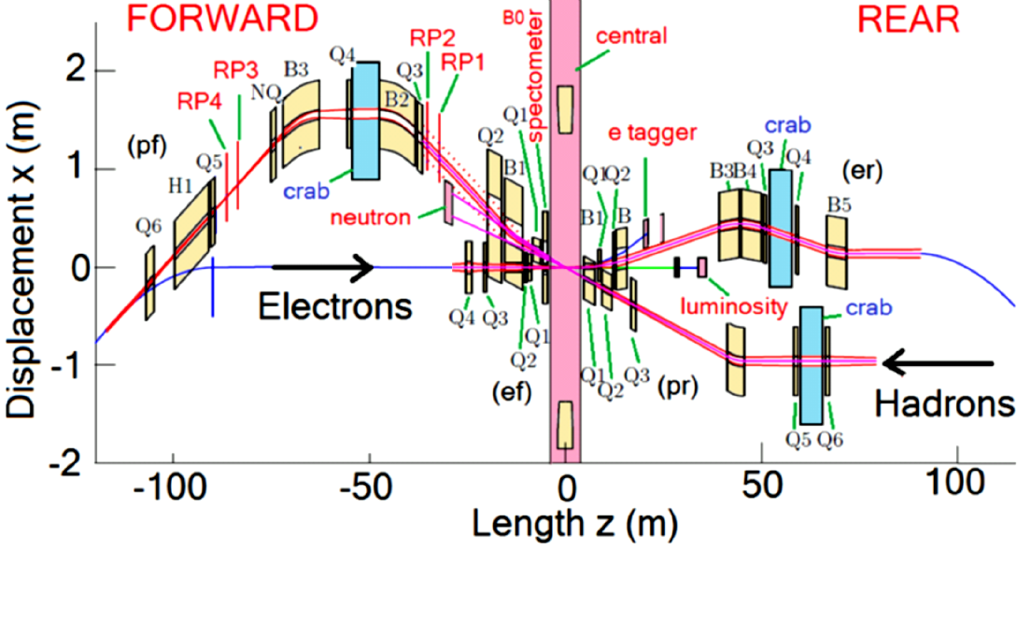
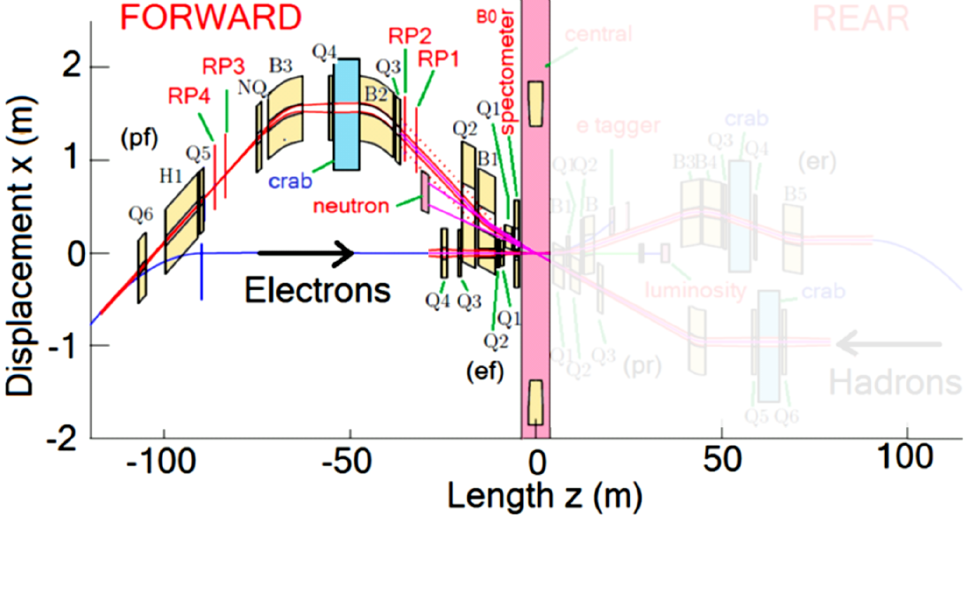
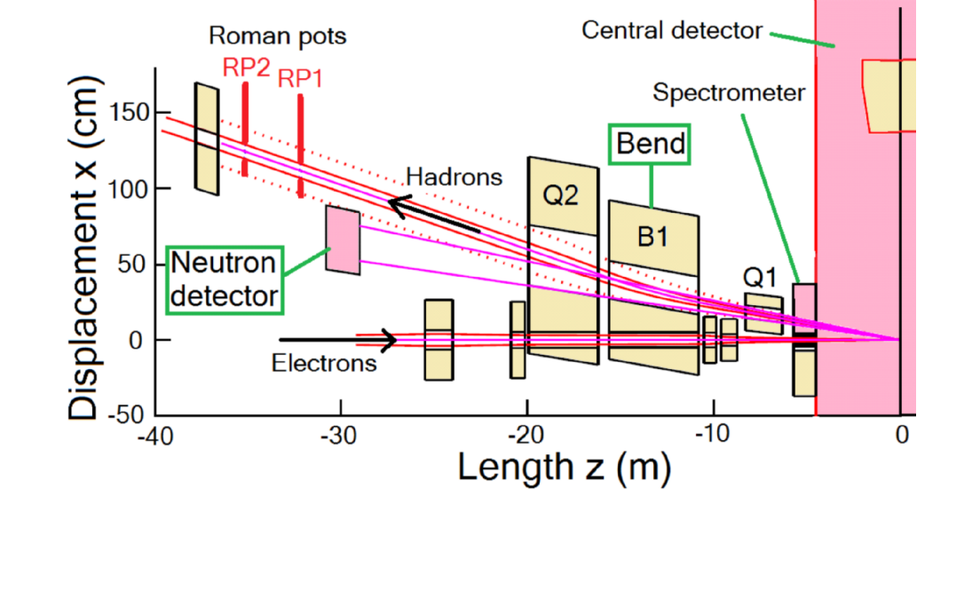
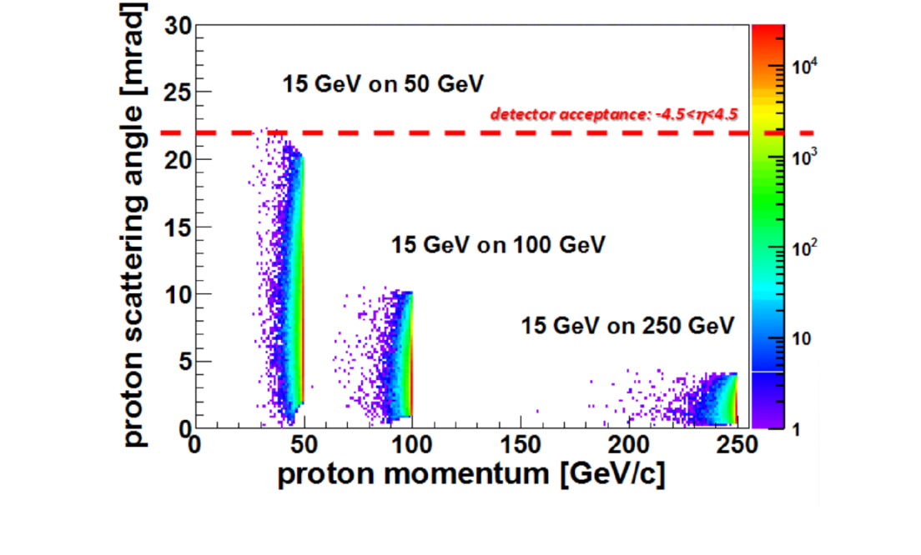
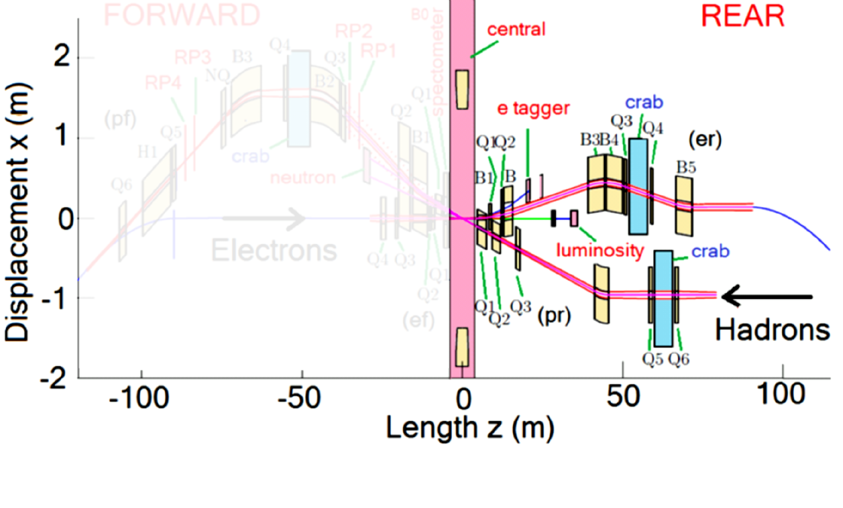
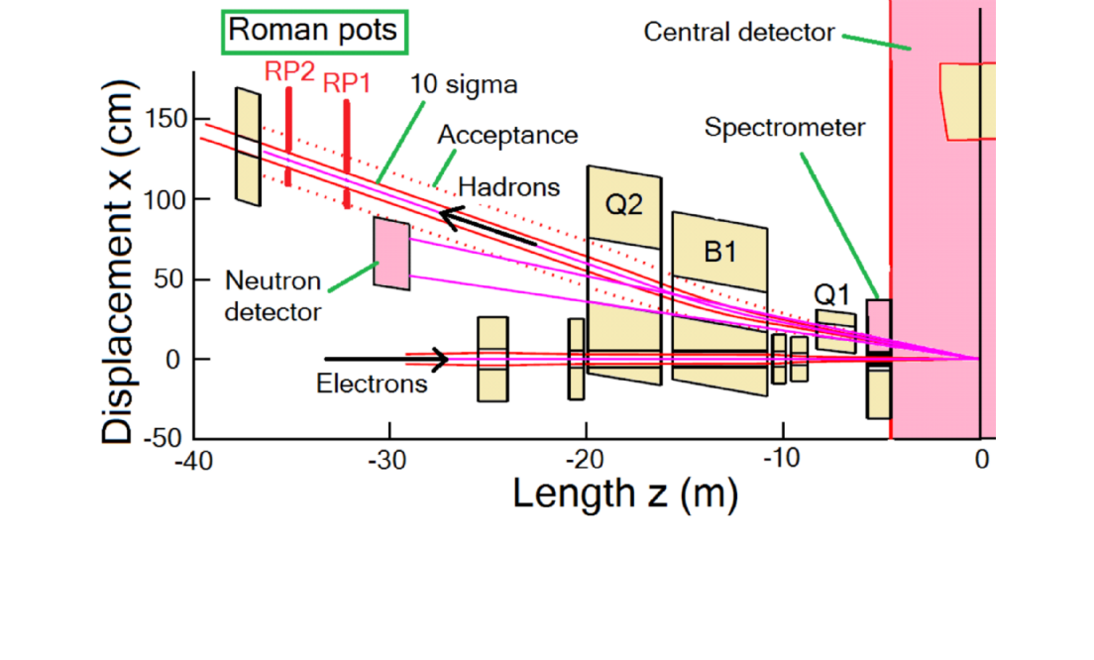
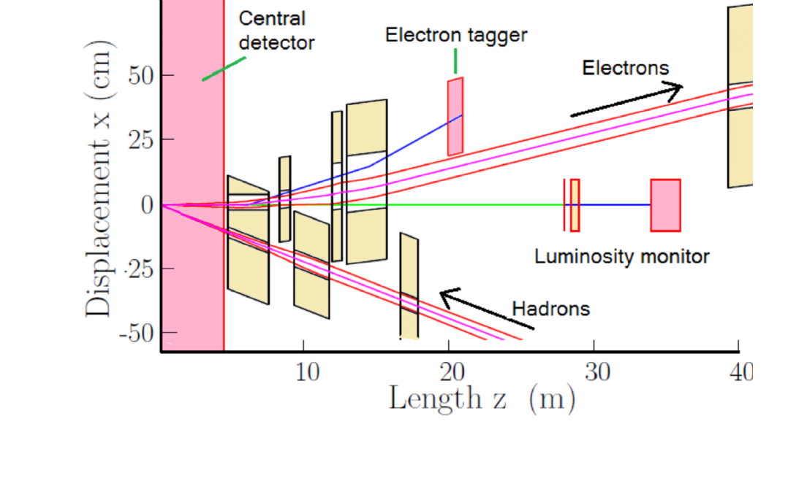
eRHIC Ring-Ring IR Layout
REAR
Forward hadron magnets have large apertures; the electron magnets have smaller apertures.
“B0”
Weak Bends
“B0”
BH-γs
“ZDC”
“ZDC”
Pair conversion with vertical spectrometer
Rear side hadron magnets have smaller apertures; the electron magnets have larger apertures.
22 mrad total crossing angle
22 mrad total crossing angle
22 mrad total crossing angle
We use large hadron magnet apertures to pass the charged particles not detected inside B0 on through to the Roman Pots RP1 and RP2.
Not shown here are two Roman pots RP3 and RP4 that are after the crab cavities and located in a low-beta, high-dispersion section.
For eA physics, B0, B1 bends separate forward charged particles and 4 mrad neutron cone; we need large hadron magnet apertures with large coil fields... from which the electron beam must be shielded.
Rear hadron apertures are much smaller than on the forward side.
Electron rear side has separation bends for tagger and lumi monitor.
Ring-Ring IR geometry has ±4.5 m detector space with crab crossing.
Magnets quite different forward/rear due to physics requirements.
Ring-Ring IR geometry has ±4.5 m detector space with crab crossing.
Magnets quite different forward/rear due to physics requirements.
The side with the outgoing hadron and incoming electron beams is denoted the forward side (neutron and charged particle detectors).
The side with the incoming hadron beam is denoted the rear side.
Outgoing electron beam, rear side, has e-tagger and lumi monitor.
Physics example: Kinematic regions for DVCS protons that must be detected in either a spectrometer (B0) or downstream Roman Pots.
Bob Palmer is heading an effort to develop and validate an IR design for our eRHIC ring-ring based accelerator concept.
Initial efforts were to develop an IR design for a linac-ring scenario.
“B0”
“ZDC”
22 mrad total crossing angle
For eA physics, B0, B1 bends separate forward charged particles and 4 mrad neutron cone; we need large hadron magnet apertures with large coil fields... from which the electron beam must be shielded.
Initial efforts were to develop an IR design for a linac-ring scenario.

Slide 4
Basic List of eRHIC IR Magnet Issues
Magnet Zoo: Just within ±20m of the IP we need 12 different styles of superconducting magnets, most of which require closely spaced, double apertures or low-field shielded regions.
We want to avoid having to create unique tooling for each style.
A few of these magnets, i.e. on the forward hadron side, must have very large apertures with relatively strong quad gradients or strong dipole guide fields.
Large coil fields/coil dimensions make external field shielding difficult.
We should consider a range of coil and yoke topologies/schemes.
We can benefit greatly by investing in shielding R&D (test facility).
Even when we can use a “traditional solution for magnetic shielding,” i.e. cutting holes in magnetic yokes to get reduced field regions, some of the resulting yokes are monster sized.
With limited resources, we must then carefully consider what R&D prototypes are needed to validate performance goals (test facility).

Slide 5
Need a Flexible Magnet Production Technique.

Slide 6
Winding the SuperKEKB
b₅ Cancel Coil
25 September 2013
Coil design to cancel a rapidly
changing non-linear external field
component; for more information see the first
backup slide at the end of this presentation.
B. Parker, et.al., "THE SUPERKEKB INTERACTION REGION CORRECTOR MAGNETS,"
Contribution TUPMB041 to Proceedings of IPAC2016, Busan, Korea, May 2016, pp. 1193-1195.
B. Parker, et.al., "SUPERCONDUCTING CORRECTOR IR MAGNET PRODUCTION FOR SUPERKEKB,"
Contribution THPBA07 to Proceedings of PAC2013, Pasadena, CA USA, pp. 1241-1243.
B. Parker, et al., “Direct Wind Superconducting Corrector Magnets for the SuperKEKB IR,”
Contribution WEEPPB013, to IPAC12, New Orleans, USA, May, 2012.
Electron Ion Collider − eRHIC

Slide 7
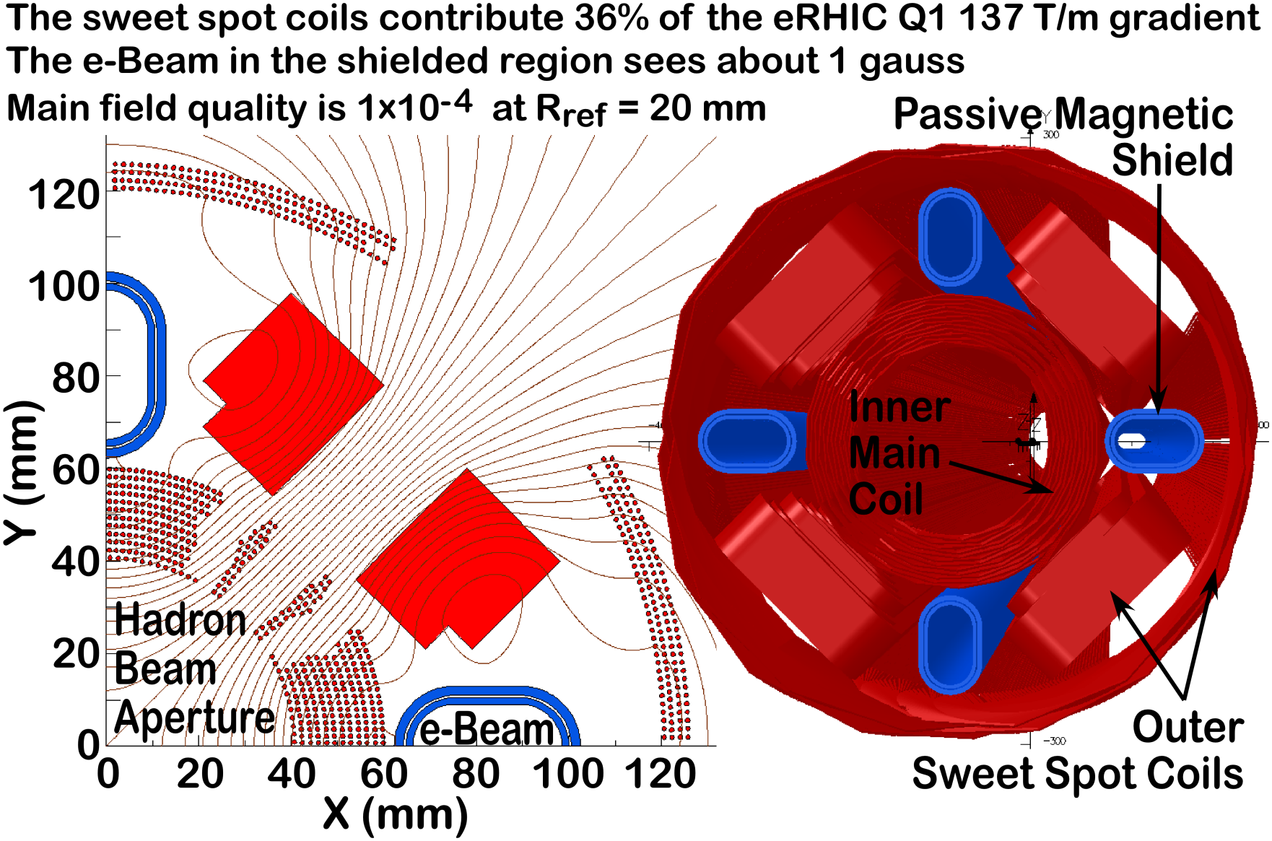
eRHIC Linac-Ring IR “Sweet Spot” Magnets†
6.2 T Field @ Main Coil
Only a few Gauss here
†Brett Parker, "SWEET SPOT DESIGNS FOR INTERACTION REGION SEPTUM MAGNETS," Contribution TUPMB042
to Proceedings of IPAC2016, Busan, Korea, May 2016, pp. 1196-1198.

Slide 8
A Prototype Dipole Sweet Spot Test Magnet
BNL Direct Wind R&D
At present time we are almost finished with production of a 1 m long dipole sweet spot coil prototype.
The field is around 4.5 T in the main aperture where the eRHIC hadron beam goes but should be of order a few gauss inside the shielded region for the electron beam.
Coil pattern used for the inner coil is shown to the right.
When this prototype is complete, it becomes a facility for testing different magnetic shielding configurations.

Slide 9
eRHIC Magnet R&D Accomplishments and Work Presently In Progress
Have successfully upgraded Direct Wind machine to handle 1.6 mm cable for more than twice capacity of the previous 1 mm cable (i.e. design with single strand wire and 1 mm or 1.6 mm cable).
Now able to make large diameter coils with half as many cable layers.
The dipole Sweet Spot coil nearing its completion has coil sizes comparable to the Ring-Ring requirements and the prototype is designed to be operated at even higher field.
So we gain direct experience with large coils and 1.6 mm dia. cable.
For the R&D prototype, inner/outer coils independently powered; we can run in both Sweet Spot and the active cancellation configurations.
We can provide a wide range of field strengths and varieties of field configurations over the “Sweet Spot test region.”
Opportunity to test passive magnetic/superconducting shield designs as well as Direct Wound, corrector-like active compensation schemes.

Slide 10
Need Special Coil and New Yoke Configurations.

Slide 11
What Changes with Ring-Ring Vs Linac-Ring
Sweet Spot coils are well matched to Linac-Ring requirements because both the crossing angle and electron beam apertures are small (i.e. need to use space close to main coil but this is easier to do if we only need reduced field over a small region).
For Ring-Ring both the electron beam emittance is larger and we pay more of a penalty with large betas and chromaticity; we must use large aperture superconducting electron IR quads, interleaved with hadron magnets, rather than using warm quads further from the IP in the warm region beyond the hadron quads.
Fortunately with the present eRHIC Ring-Ring 22 mrad total crossing angle, we can now fall back on previous work for the ILC final focus where we have produced and tested compact actively shielded coil configurations.

Slide 12
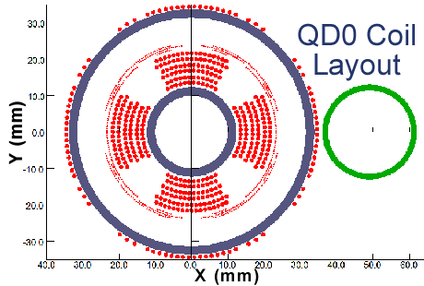
Design for Compact Superconducting Magnet Used in the ILC 14 mr Layout.
14 mr crossing angle via compact self-shielded QD0 coil windings.
Extracted beam passes just outside coil into separate focusing channel.
Cryostat to fit within limited space inside detector at L* = 4.1 m.
Incoming Beam
Outgoing Beam
Off
On
QD0 with active shield off/on

Slide 13
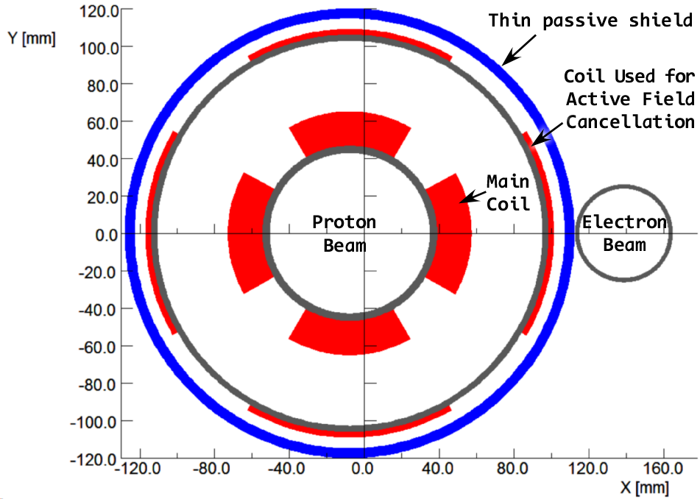
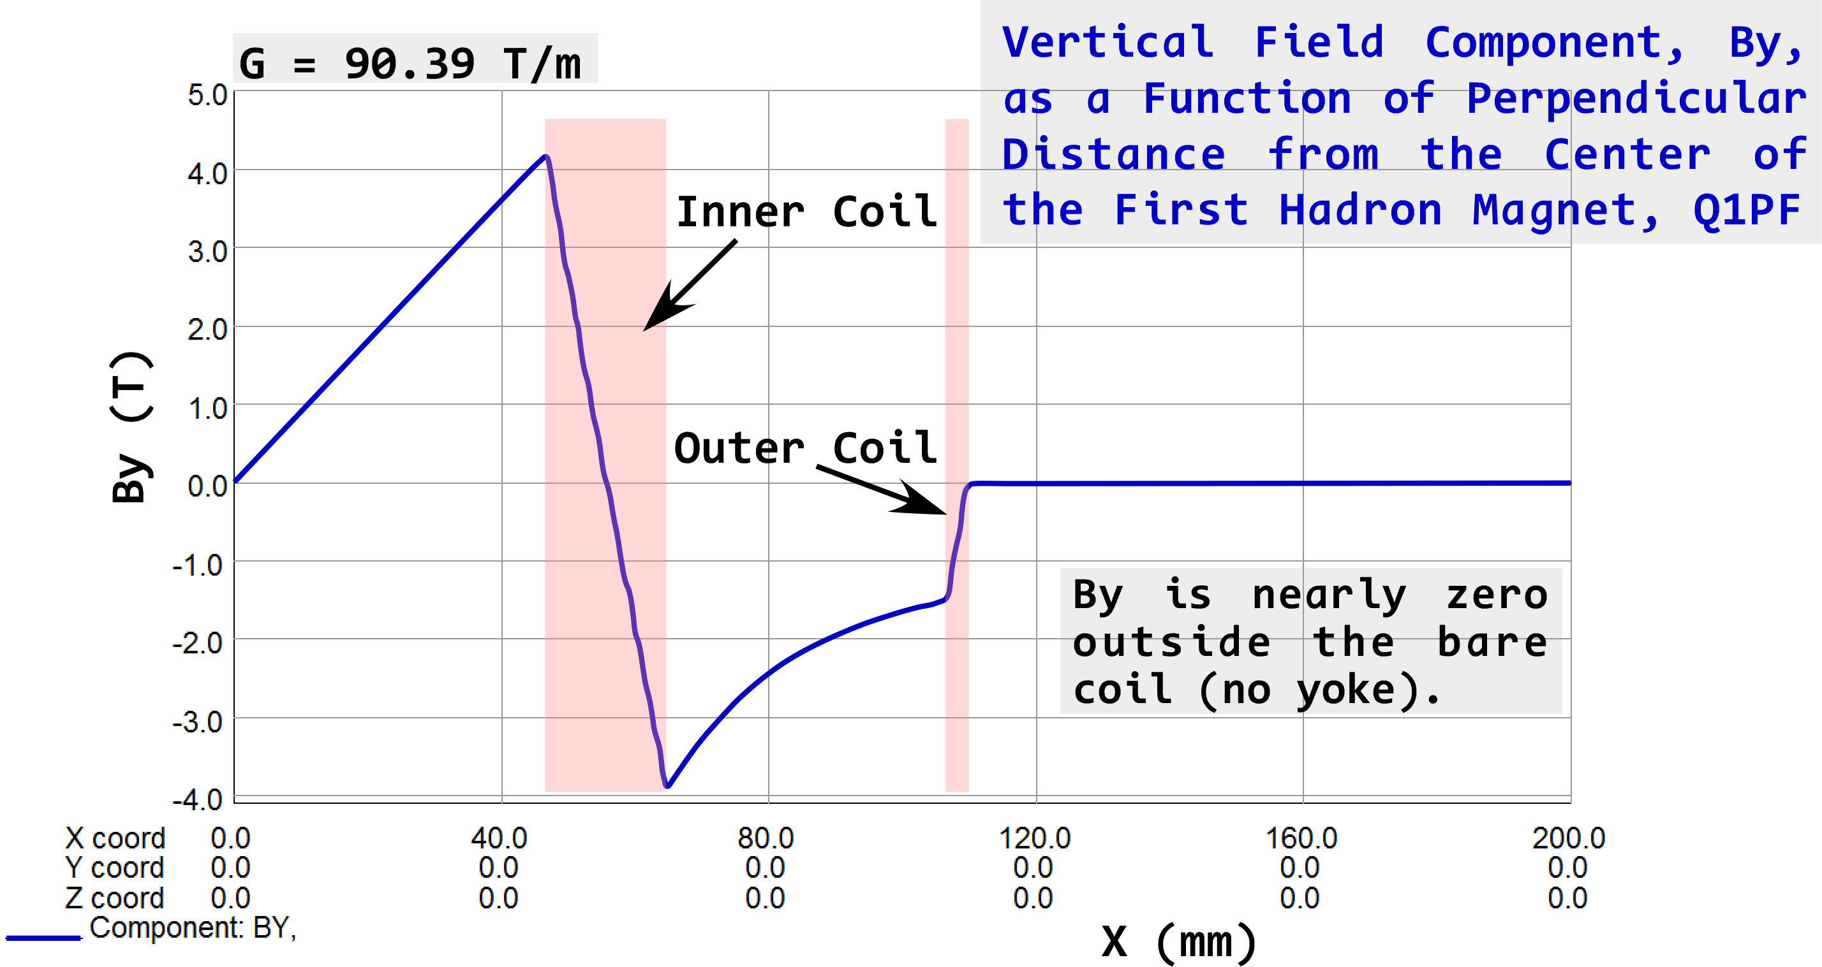
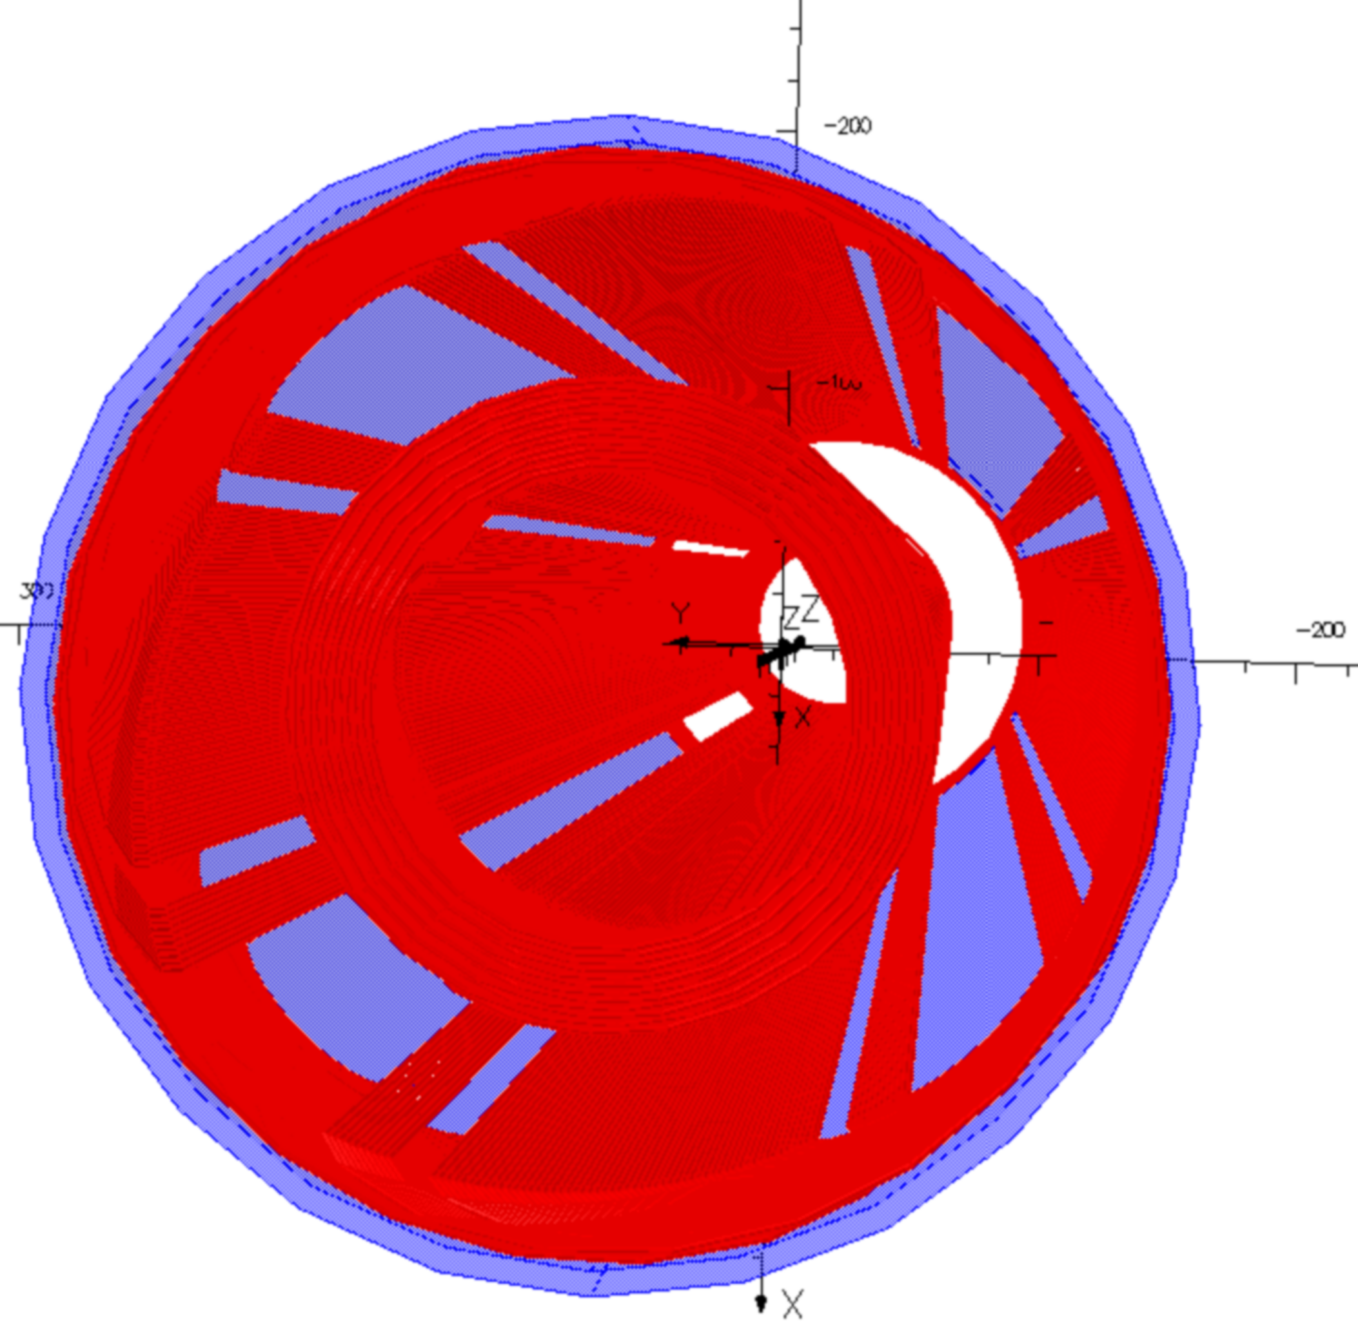
Q1PF, First Forward Side Proton Quad
3D calculation done for bare coils, run in series.
3D End View
Q1PF, active external field cancelation coil.
90 T/m gradient, clear bore is 86 mm ID.
Peak field about 4.5 T with essentially zero external field outside body of the bare coil.
Small cancellation undershoot/overshoot near the coil ends is handled via the use of a thin passive magnetic shield.

Slide 14
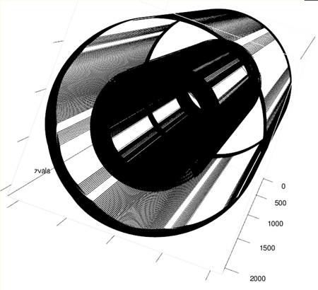
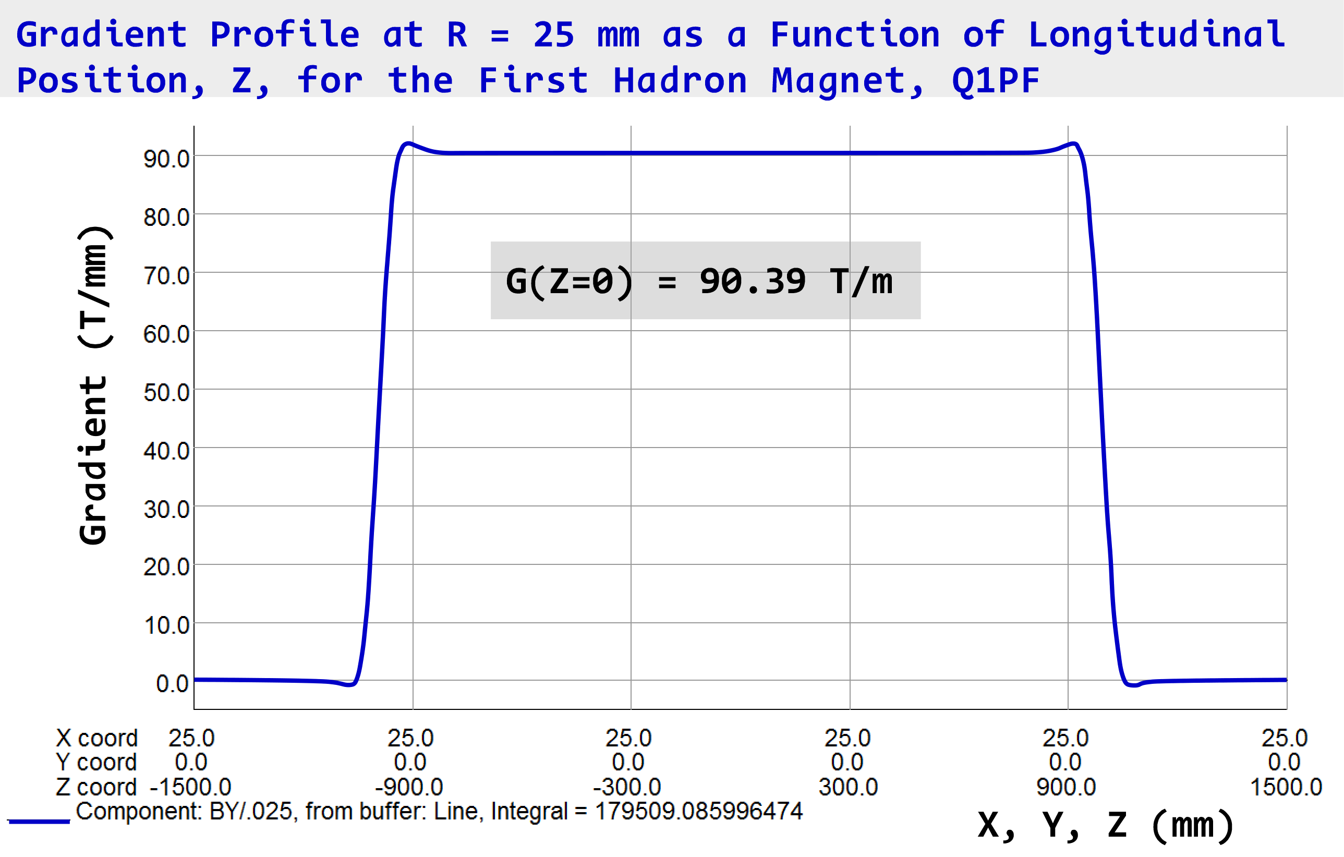
Q1PF, First Forward Side Proton Quad
3D Side and End Views
(additional 5 mm thick passive shield is shown as translucent)
First pass Q1PF coil design has a slight mismatch with inner/outer coil ends that yields a small cancellation over/under shoot.
This can be improved when we re-optimize the coil ends and total pattern lengths.
3D calculation done for bare coils, run in series.

Slide 15
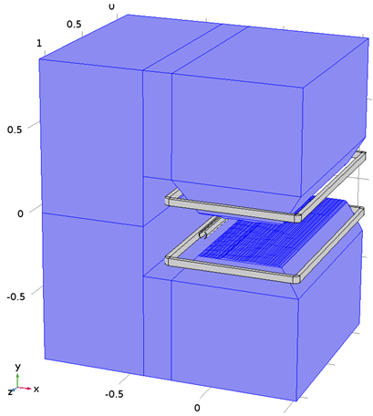
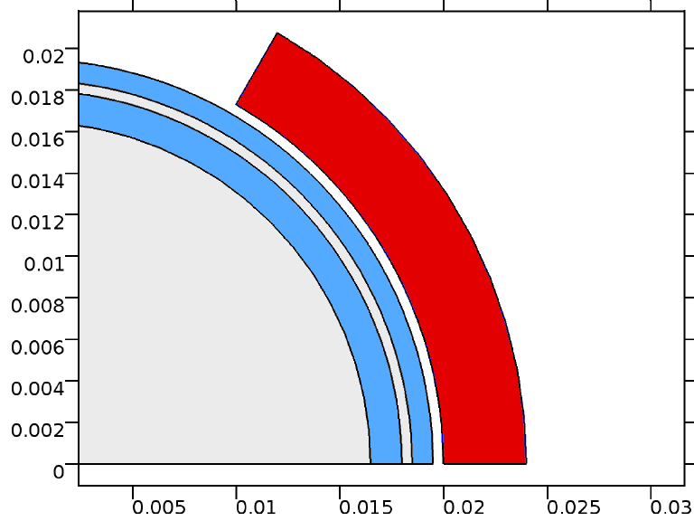
B0 Spectrometer Dipole Concept
B0 Shielded Region Detailed View
(m)
Warm Yoke
Cancel coil keeps inner passive shield from saturating
Superconducting Racetrack coil
Y (mm)
Passive shields
Region for protons, neutrons and forward charged particles
Coil
(m)
Dipole Cancel Coil
x (mm)
B0, a Superferric C-magnet.
1.7 T Field, 1.3 m long.
Gives access for detectors.
Use a Direct Wind dipole cancel coil to buck most of main field and then use passive shielding inside.
Electrons
Model by H. Witte
3D View
(m)

Slide 16
Lets View Some of the Monsters in the Zoo.

Slide 17
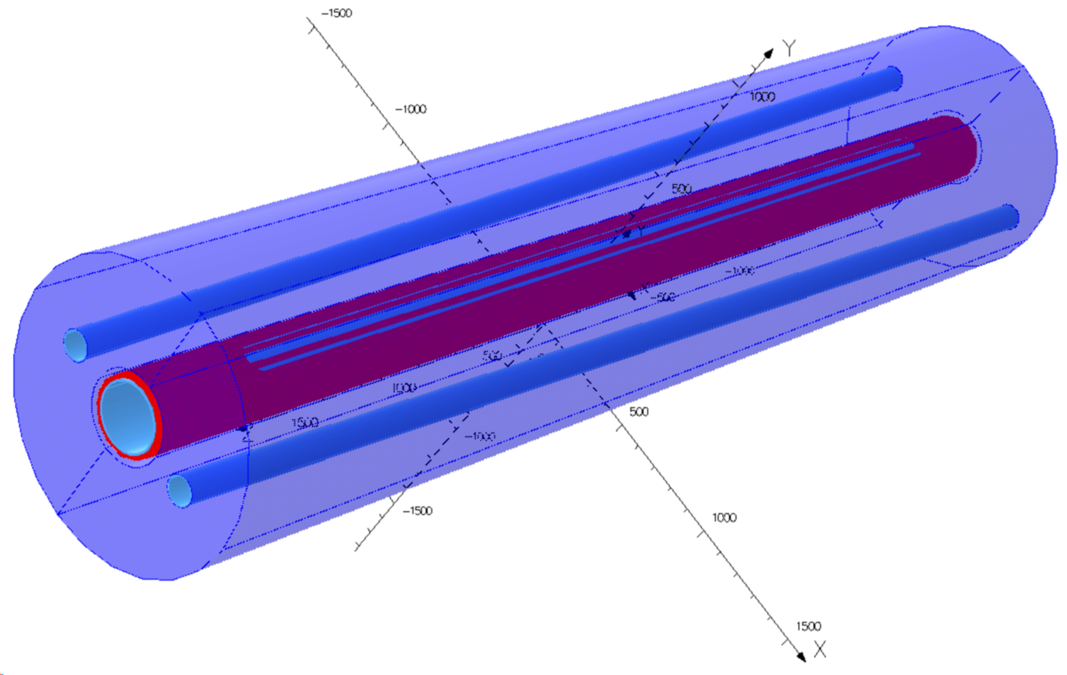
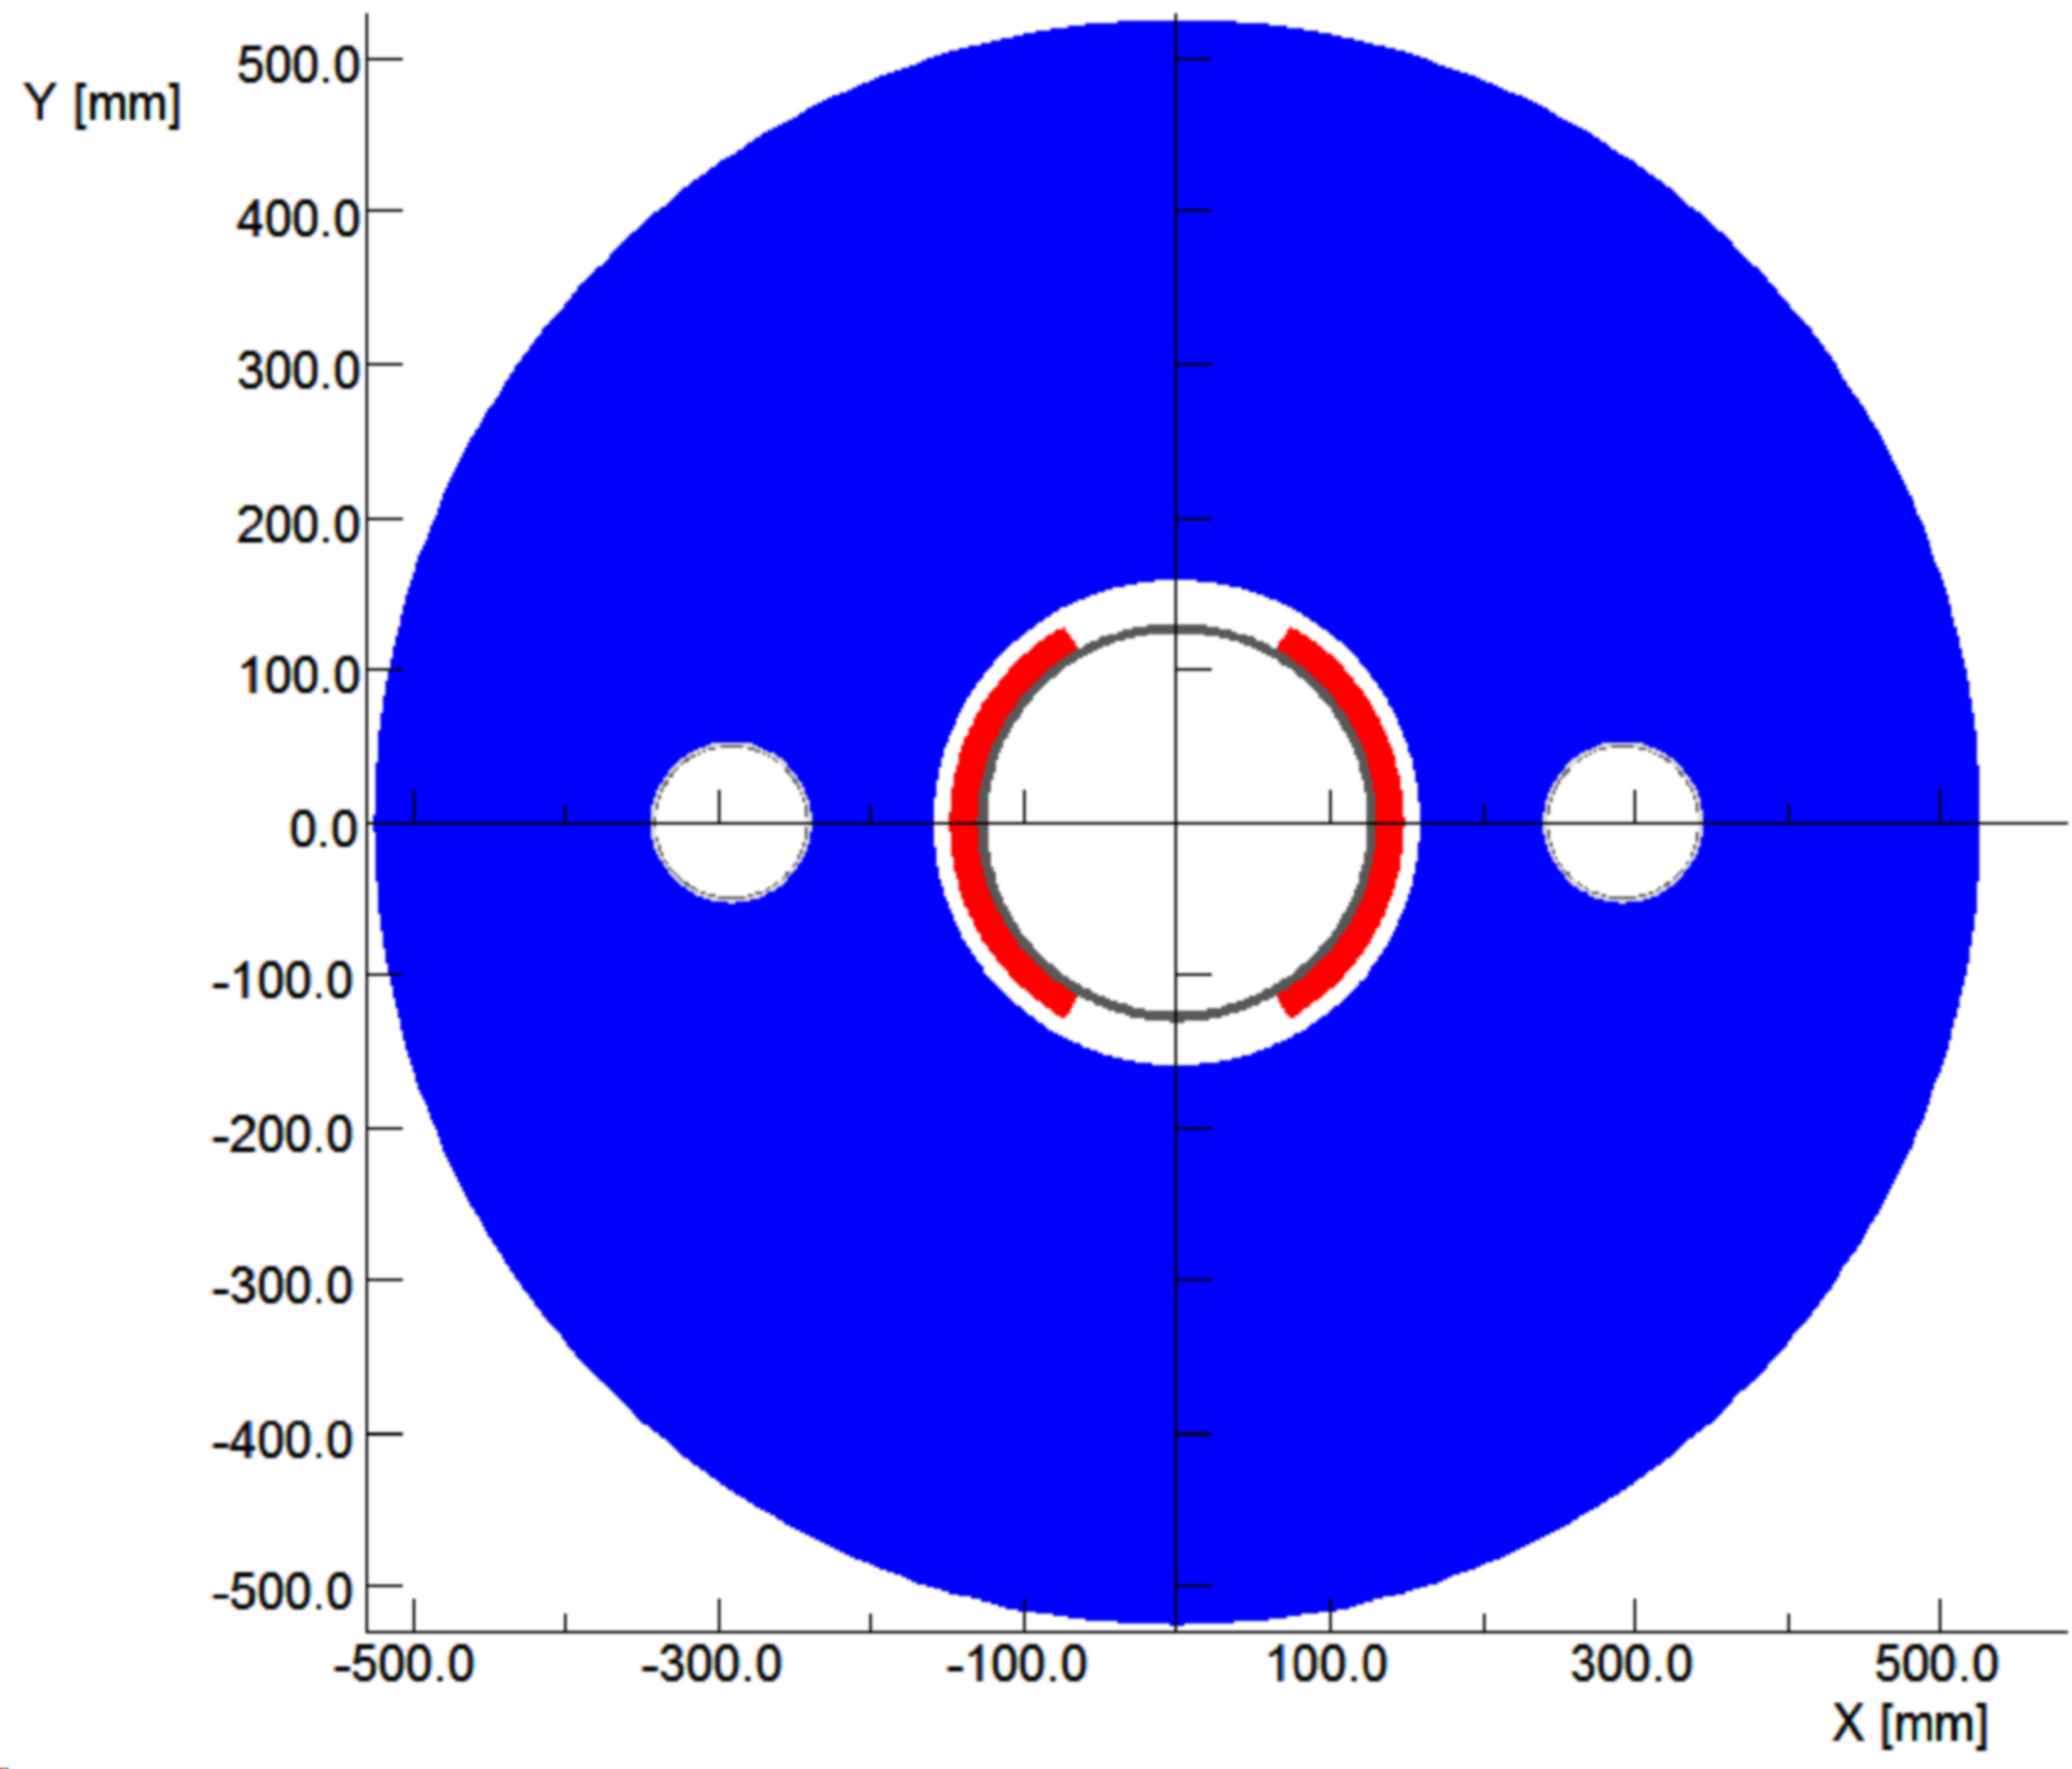
B1PF, Forward Side Proton Dipole
B1PF can use same 1.6 mm cable as the BNL Sweet Spot R&D prototype.
3D Oblique View
Protons
(IP end shown)
(yoke is shown translucent)
250 mm ID Clear Bore
Roughly 250 gauss field in cutout can be handled by additional passive shielding.
Electrons
Unlike the original Linac-Ring design (10 mrad x-ing), the 3.5 T B1 Ring-Ring dipole (22 mrad x-ing), does not seem to require either Sweet Spot or Active Cancellation coils and a simple yoke cutout suffices for the electron beam.
B1 seems like a simple extrapolation, but with 4.8 m length and 1.05 m OD it does not fit in a BNL test dewar (horizontal test??).

Slide 18
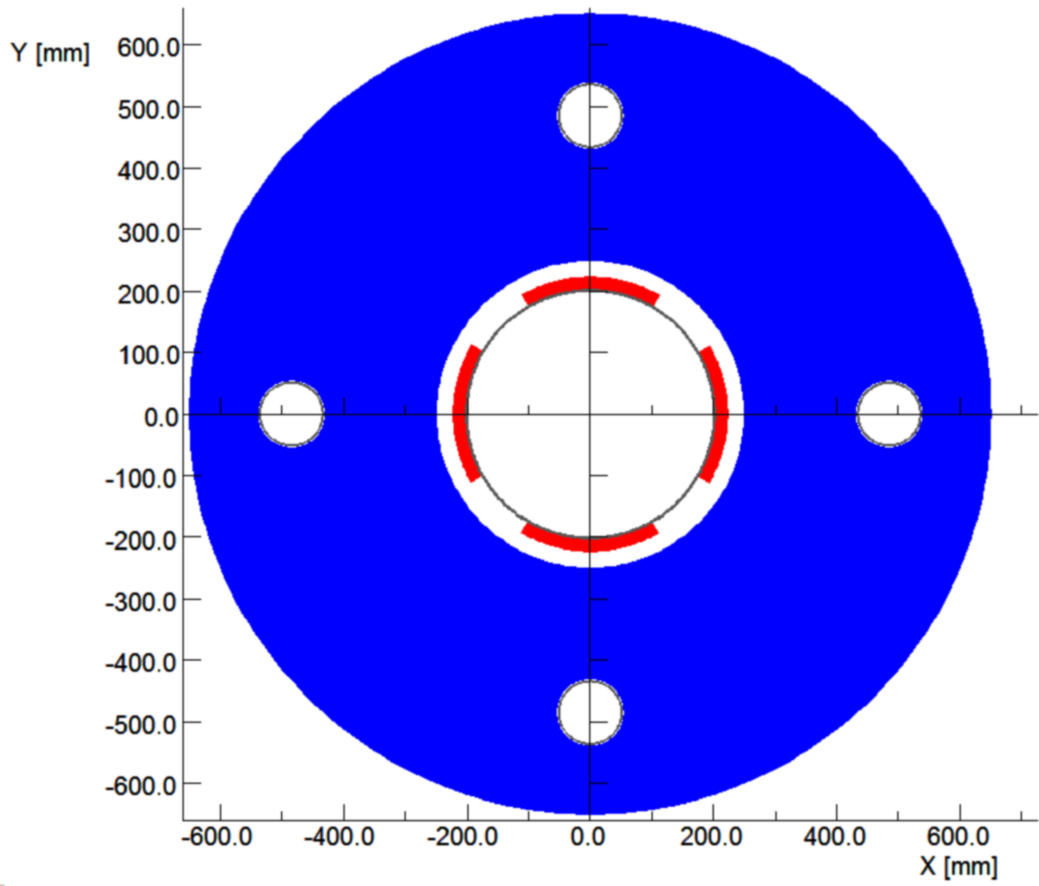
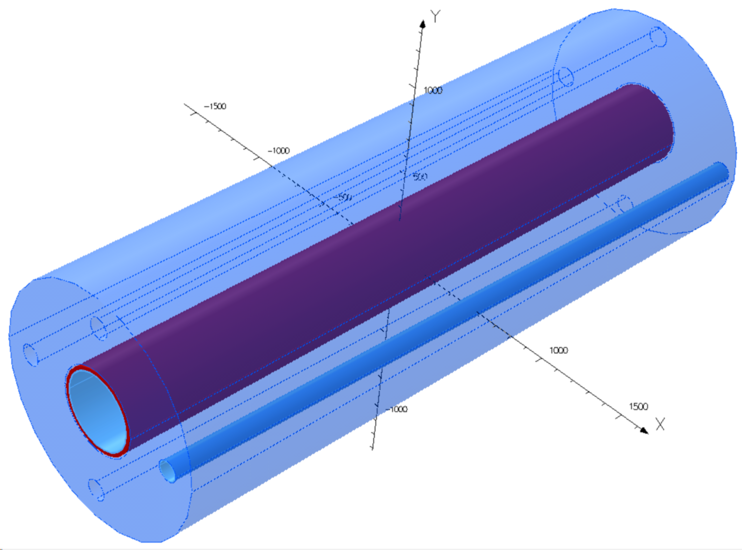
Q2PF, Forward Side Proton Quadrupole
Q2PF can use same 1.6 mm cable as the BNL Sweet Spot R&D prototype.
Protons
3D Oblique View
(IP end shown)
400 mm ID Clear Bore
(yoke is shown translucent)
Electrons
At 17.9 T/m gradient, Q2PF can use a yoke cutout for e-beam.
But like B1PF, it is a monster with 3.72 m length and 1.3 m OD yoke, so it also does not fit in existing BNL vertical test dewars.
We can always put it in a cryostat and do a horizontal test, but this seems a very expensive way to make/test any prototypes.

Slide 19
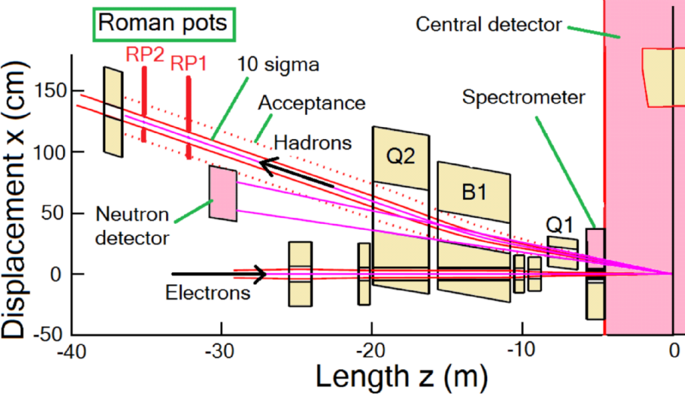
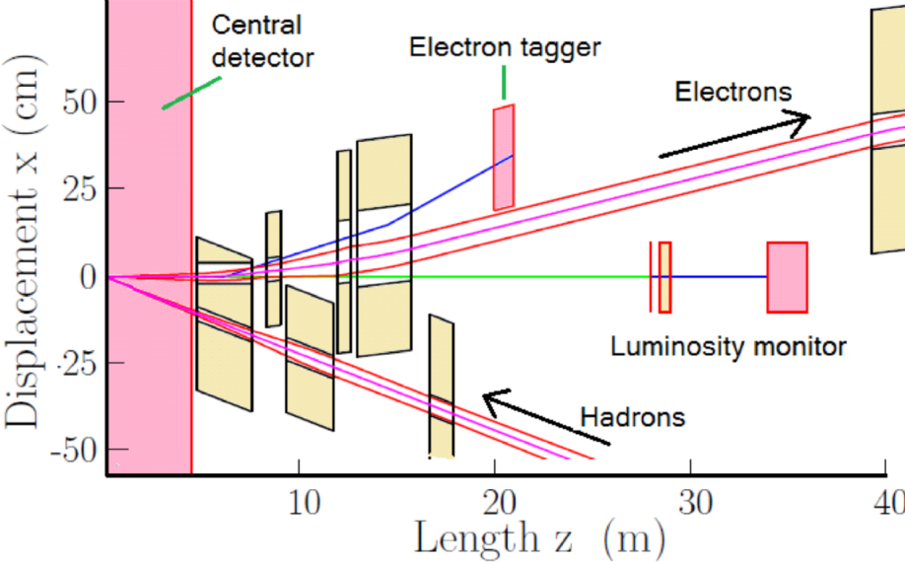
Other Ring-Ring IR Magnets are not Monsters
FORWARD
Rear side hadron magnets do not need large apertures and their coil peak fields are modest.
And the electron IR dipoles and quadrupoles coil peak fields are much less than those of their hadron counterparts.
The main challenge, which then applies to all of the IR magnets, is how best to accommodate them, with closely spaced side-by-side, apertures in common cryostat structures.
Monsters
Warm quads
REAR
0.2 T Dipoles
Small aperture hadron quads

Slide 20
Look at Some Modest Next Steps

Slide 21
What (Should) Happen Next
The Ring-Ring IR magnet parameters discussed here are only recently frozen during preparation for our Ring-Ring technical design review that is yet to be held this week.
So there is a fair amount of work yet to be done to carefully go though the design details for all the Ring-Ring IR magnets.
Soon we will be ready to wind the last coil set for the Sweet Spot dipole R&D prototype and can then complete its assembly with its yoke in a vertical cryostat.
Once this dipole is in operation, we will have the capability to carry out a rich test program with tests of different passive magnetic shielding solutions as well as superconducting active and passive shielding.

Slide 22
And What Could be Points of Common Interest?
I am not presently familiar with the details of JLEIC IR magnets but from this slide, sent to me today by C. Montag, I do see some things of special interest.
I am familiar with the work developing this CIC conductor and have long been interested in using it in some IR magnet designs... especially for the LHeC project being studied at CERN.
While a top goal of the present eRHIC Ring-Ring design study is to “reduce risk,” we should also consider ways in which using novel technology in a few key magnets might be helpful to improve both the accelerator and experimental detector physics performance.
BNL has relevant experience in these areas, along with design work on a Force Neutral Anti-Solenoid for the ILC QD0 Final Focus and the BEPC-II and the SuperKEKB (i.e. locally cancel Belle-II detector field) anti-solenoids.

Slide 23
Backup Slides

Slide 24
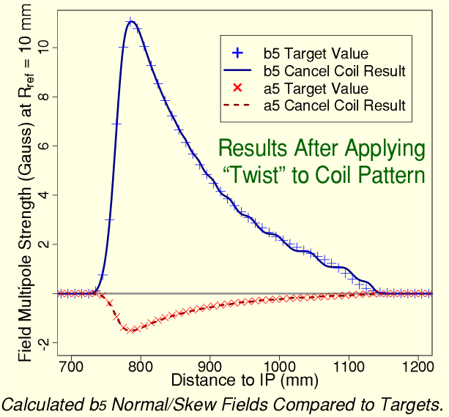
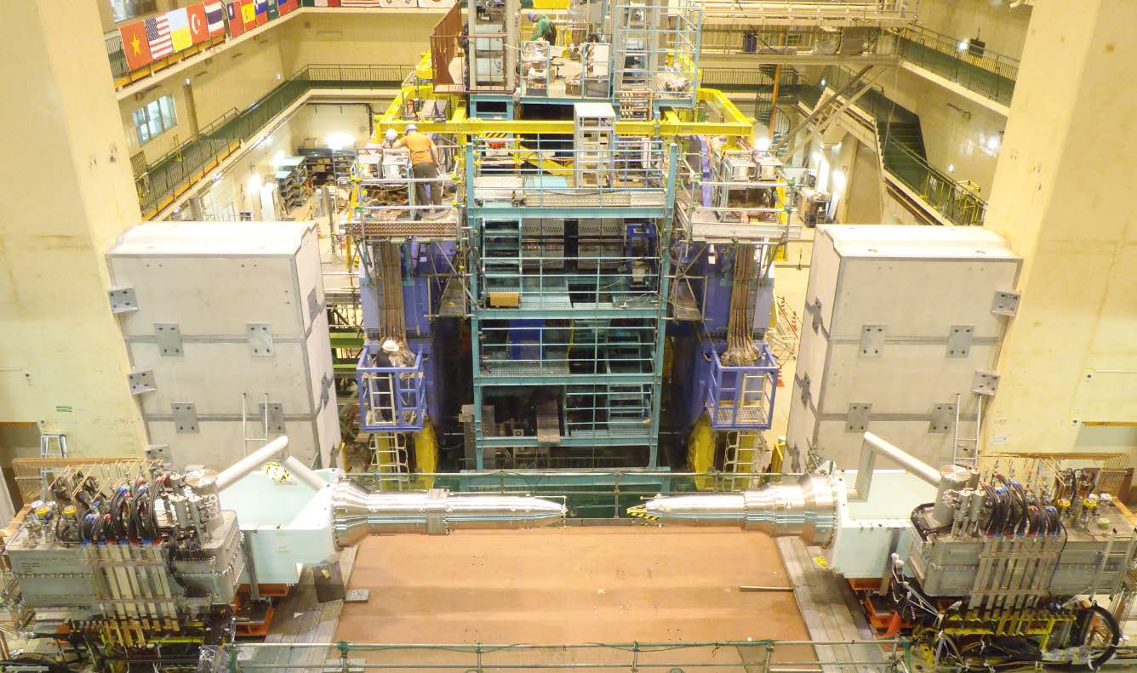
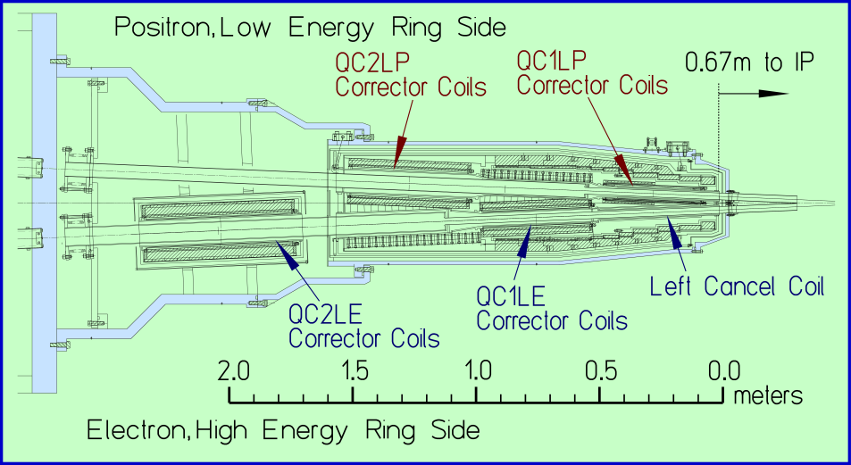
SuperKEKB Interaction Region Corrector Magnets
Belle−II Detector
SuperKEKB IR Magnets
35 correction coils and 8 cancel coils are integrated with the main IR quadrupole and must fit within very limited available space.
The first IR quadrupoles have no magnetic yoke and create external field at nearby beam.
The cancel coil shown during winding on an earlier slide has to match a rapidly changing non-linear field in order to cancel it out.
All of the SuperKEKB corrector coils were wound for KEK using the computer controlled Direct Wind technology developed at BNL.
Electron Ion Collider − eRHIC

Slide 25
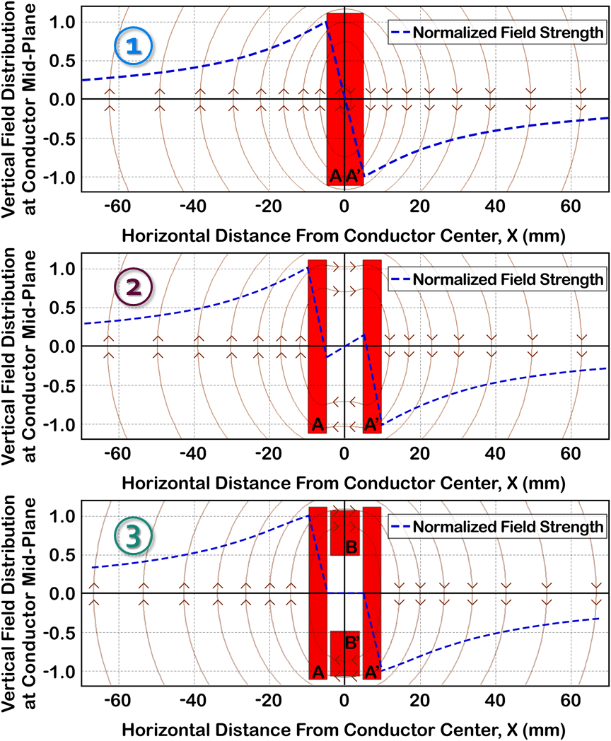
The Sweet Spot Coil Principle
The magnetic field reverses on opposite sides of a given conductor. So somewhere inside the conductor there is a field zero.
If we now separate the conductor block into two parts, we see that there is a region of low field strength about a central Sweet Spot, zero-field crossing point.
In the low field region in the immediate vicinity of the Sweet Spot, we can place additional magnetic shielding without the shielding becoming overly saturated.
Note if a simple split coil geometry leaves too much field to be handled via a thin passive shield, we can further reduce the magnitude of the field in the vicinity of the Sweet Spot by placing some conductor above and below the desired low field region.

Slide 26
SuperKEKB QCS Anti-Solenoids for Compensating the Belle-II Detector Field (Slide from Norihito Ohuchi, KEK)

