Slide 1

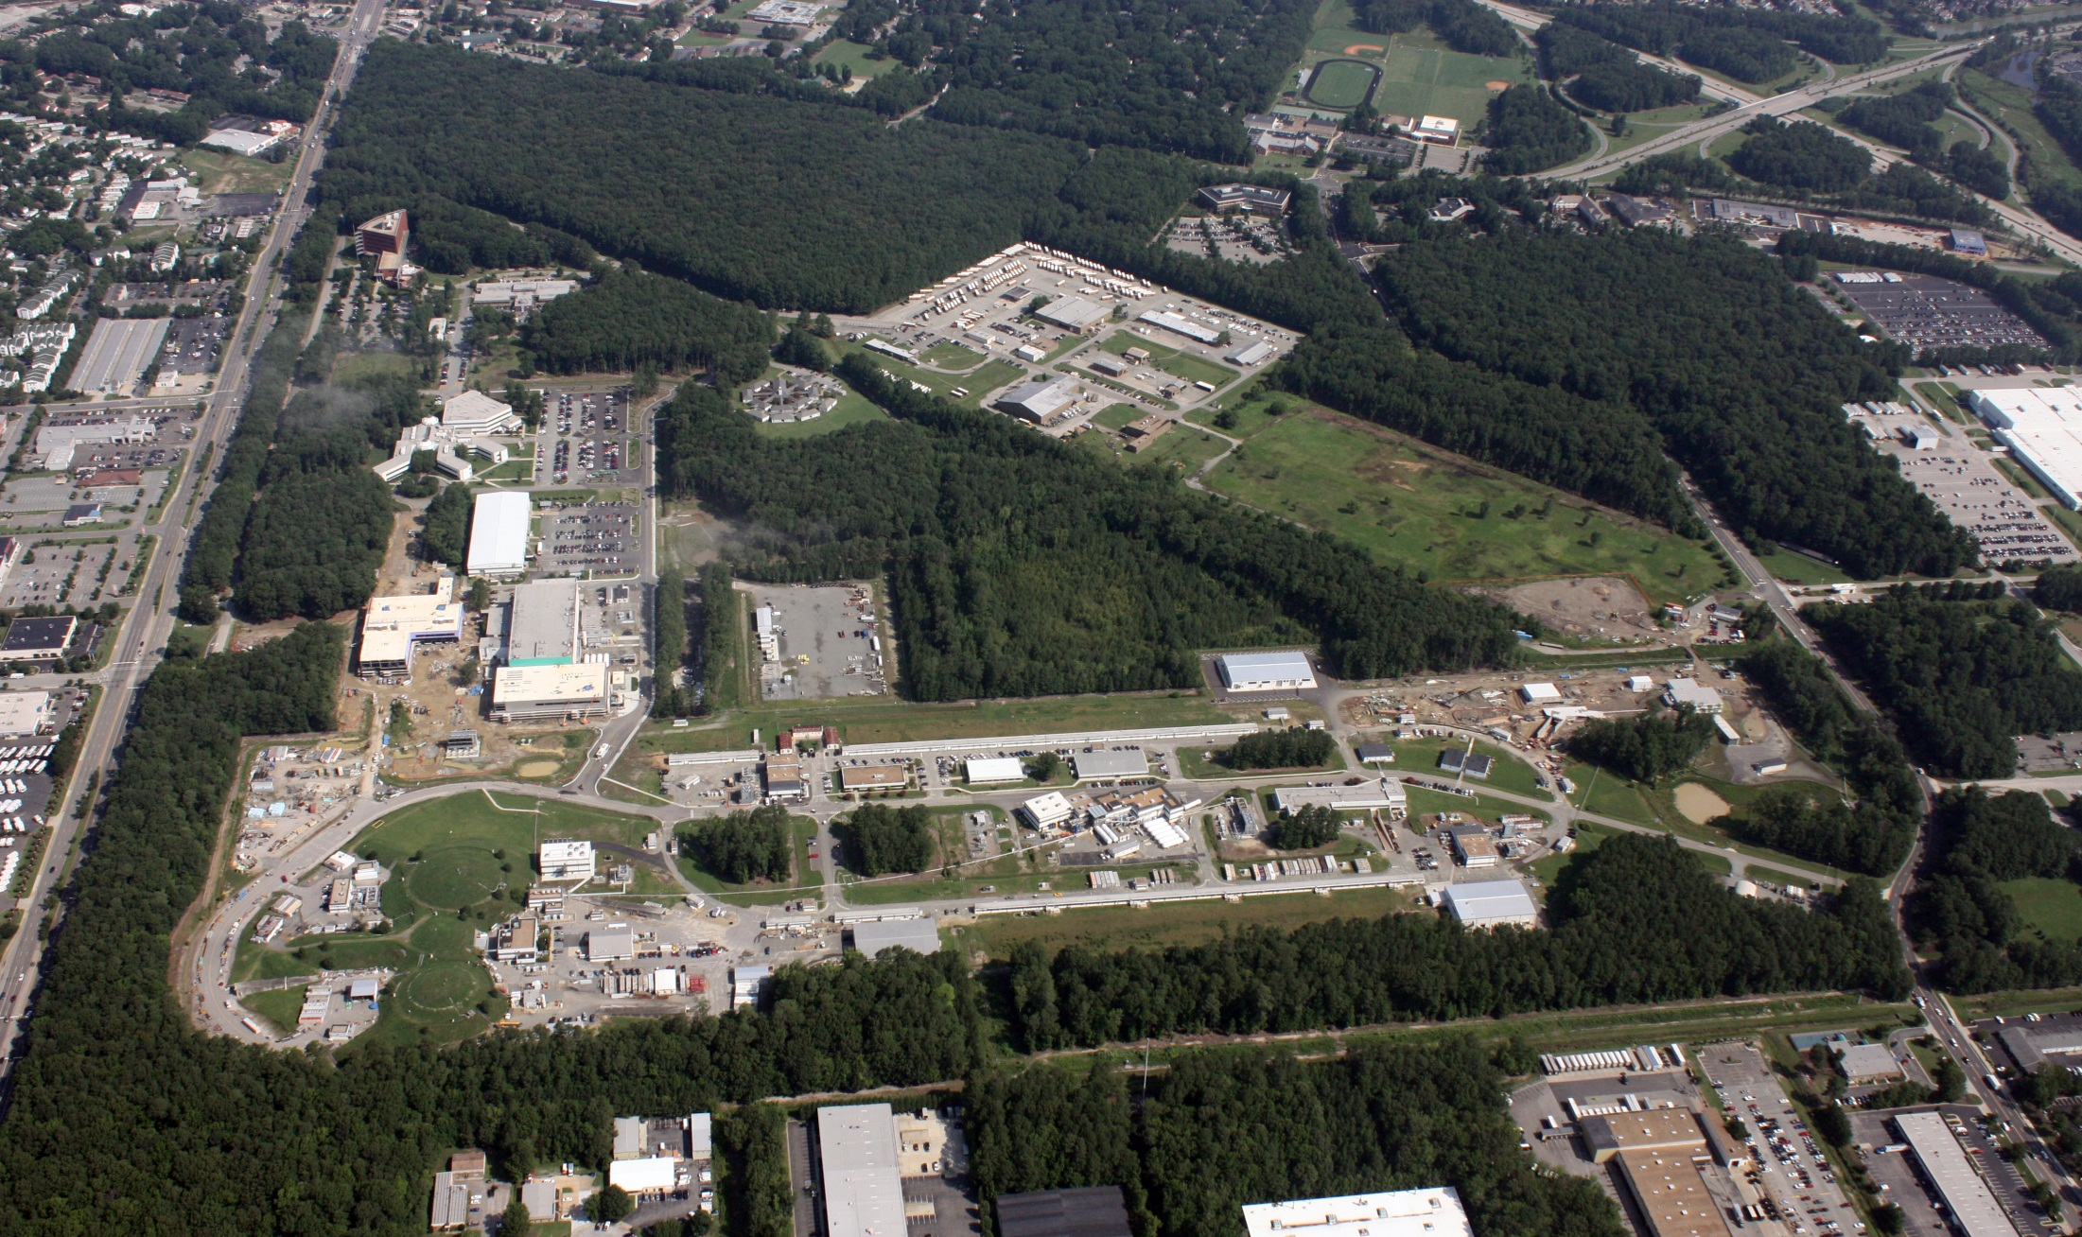
Trends in Computing
Amber Boehnlein

Slide 2
Outline
Intention of this talk is to open dialog
Take-Aways
  Major shifts under way in computing for science
  Multi-Disciplinary collaborations can have big pay offs
Outline
  A bit about me&Jlab Scientific Computing
  A bit about the missing ‘Computing’ participants
  What’s Trending
  Computing in DOE and NSF
  The development of Multi-Disciplinary collaborations between the Light Sources and ‘Computing folks’
  A few gaps/observations gleaned from yesterday’s talks and discussion
  Input from you—what do you see as the gaps?
  How can we get a plan together to address some of those gaps

Slide 4
Scientific Computing At JLAB
Physics computation –Large Scale Parallel Computing
  Lattice QCD: Jlab known for Science; software; hardware
  Accelerator Simulation
Experimental computing in the halls is coordinated by Physics Division
  Physics Division Staff key developers
Scientific Computing group in IT supports
  Hardware: Disk; Tape; Compute clusters;
  Runs key services: the batch system
  Provides in-house tools: eg monitoring and workflow
  Provides technical support and expertise, especially for parallel computing
IT provides cyber security, networking and desktops

Slide 5
Computing Invitees
Our idea for this workshop was to have folks who bridge between computing and domain science so that we could help translate between what you need and want and what can be done to achieve that.
  They all had to cancel do to weather
  They have the talks and have been able to listen to some of the talks.
Kyle Cramner NYU & ATLAS
  DIANA-HEP (http://diana-hep.org)
Nick D’Imperio: Computational Science Lab BNL
David Skinner: NERSC LBNL
Hari Krishnan: LBNL Data Analytics and Visualization Group
  CAMERA project

Slide 6
Trends
Exascale on the horizon
  Democratization of compute resource or continued ‘income inequality’?
Trend towards heterogeneous computing environment continues
  Mix of HPC, local, commercial cloud and academic grid/cloud-automation
  Cost models will be developed
  Hide some complexity from the ‘consumer’ will expose others
Data issues are getting more attention
  Management, formats, transfer, storage
  Attribution, cataloging, curation, ownership
Anticipating complicated workflows
  Link generalized specific purpose frameworks
  combine multiple data sources (experiment/observational/simulated) and analytics programs
Use of machine learning and advanced analytics is maturing
  Targeting towards different forms of automation and automated tuning augmenting human intelligence
More exploration of analytics platforms and tools developed by industry--likely to see people using tools that work for them rather everyone agreeing to use something that they all hate.
Most of these have been mentioned in one way or another at this workshop

Slide 7
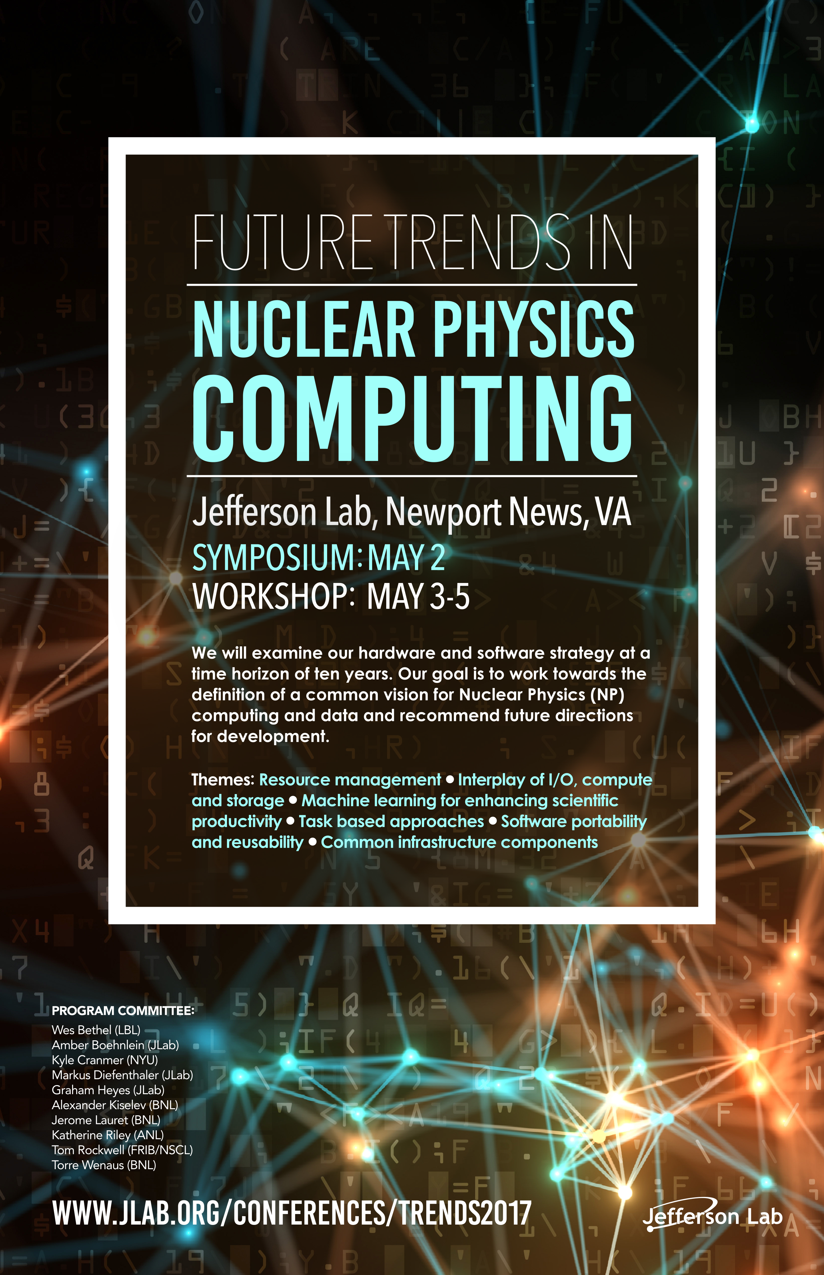

Slide 8
Computing in DOE&NSF
DOE Office of Advanced Scientific Research (ASCR)
  Four facilities
  Exascale Computing Project $1B over 7 years
    Joint with NNSA
    Hardware
    Software
    Application areas
  Research Programs
    Collaborative application development (SciDAC)
    Applied Math
    Advanced Computing Platforms & related topics
    Data management and analytics
    Visualization frameworks
    Workflows and frameworks
    Network research
    Collaboration tools
NSF—Computer, Information Science, and Engineering
  XCEDE & Blue Waters
  Collaborative development projects
  Focus on Advanced Analytics and Data

Slide 9
Multi- Disciplinary Collaboration
Light and Neutron sources are important part of DOE complex
Facility data management support often “Get your data off my disks within two weeks or less”
Rough Timeline to change (US only—some parallel efforts globally)
  2009: LDRD at LBNL—Development of algorithms for beamlines
  2010: LCLS operations
  2011: Facility computing folks self-organize-information exchange; joint seminars
  2012: Computing included in BES Detector workshop
    Data rates increasing from new detectors
  2013ish: LDRDs at most labs for data management from select beam lines to local HPC facilities
  2014: Pilot demonstration projects—LCLS-NERSC-ESNET Photon Speedway
  2015: Self-organized group recognized by facility directors
  2015: Algorithm LDRD->Camera Project $10.5M over three years
  2016: LCLS-NERSC collaboration: Application for ECP $10M/four years
Note: Some of us love plans. I really love plans. But sometimes pilots and just doing some small scale useful work and talking to your colleagues for an hour every month is a most excellent plan

Slide 10
A few observations
There are clearly ‘community’ Computing needs
  And some of them are being addressed-PARTONS, for example
  As there is no ‘collaboration’, policies, priorities etc. are a moving target
Data cataloging and attribution is a facility issue.
Public distribution of data (within limits of Open Data Policy) is a policy issue
Visualization looks like an area that could use some attention.
  Astrophysics put videos in their papers, not stamp collections
  Not underestimating the difficulty—all the more reason to start sooner rather than later.
Combining data sets (and their errors) looks like a fruitful topic for collaboration
MC tuning—Human Augmented Automation? Standard Tunes?
Workflows—building the complex machine—maybe a little early.
There are some little ‘c’ computing needs
  infrastructure, allocations, disk and computer time
  Software repository
  reference samples that can be used across groups?

Slide 11
Don’t Ask; Don’t Get
What your observations and questions?
What your priorities?
What do you think are the gaps?
How do we sustain a dialog?
How do we make the connections to ASCR and NSF researchers in Computer Science, Applied Math, Data Managment

