Slide 1
CLARA
Micro-services architecture for distributed data analytics
Vardan Gyurjyan (gurjyan@jlab.org)

Slide 2
Overview
Scientific data challenges
Modern software solutions
Micro-services architecture
Flow-based reactive programming
How this applies to TMD/GPD extraction project

Slide 3
Science Data 3V Expansion
Unprecedented growth of data
Volumes
Data at rest is growing exponentially.
EOS: 1Exabyte in 10 years.
LHC: 12-14 Petabyte/year. In 2023 400Petabyte/year.
SKA: 22Exabyte/year in 2023
Velocities
Data acquisition rates, as well as new data producing devices are in rise.
LHC: 1.5GByte/sec
SKA: 700Terabyte/sec
Varieties
Plethora of data formats, data structures and data types

Slide 4
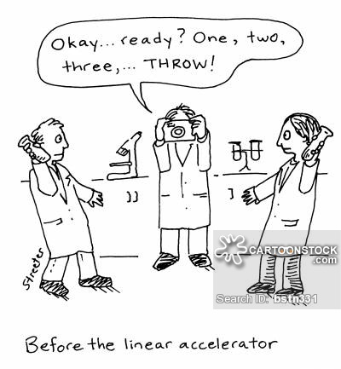
That is a good news
We need more data to confirm and/or generate a new knowledge.
We need more diverse data.
Correlating multiple data sources can lead to interesting insights of all.
We need more and easy access to the data.
We need to communicate data not the publication.

Slide 5
Then we realized…
Existing scientific data processing architectures will have difficulties handling future data volumes and data distribution.
DOE Exascale Initiative
Commercial data processing engines are well advanced (Apache Hadoop, Spark, Storm, etc.). Can we adopt them for our needs?

Slide 6
Yes but…
Data/software characteristics | Science data | Social media data
Origin | Distributed with computing | Distributed with no computing
Format | Diverse | Quasi uniform
Processing unit | File | File
Processing steps | Multiple | Limited (map, reduce)
Language | Old/trusted | Modern
Heritage code | Yes | No

Slide 7
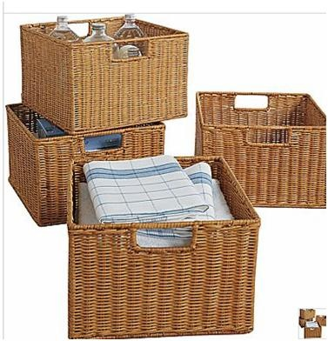
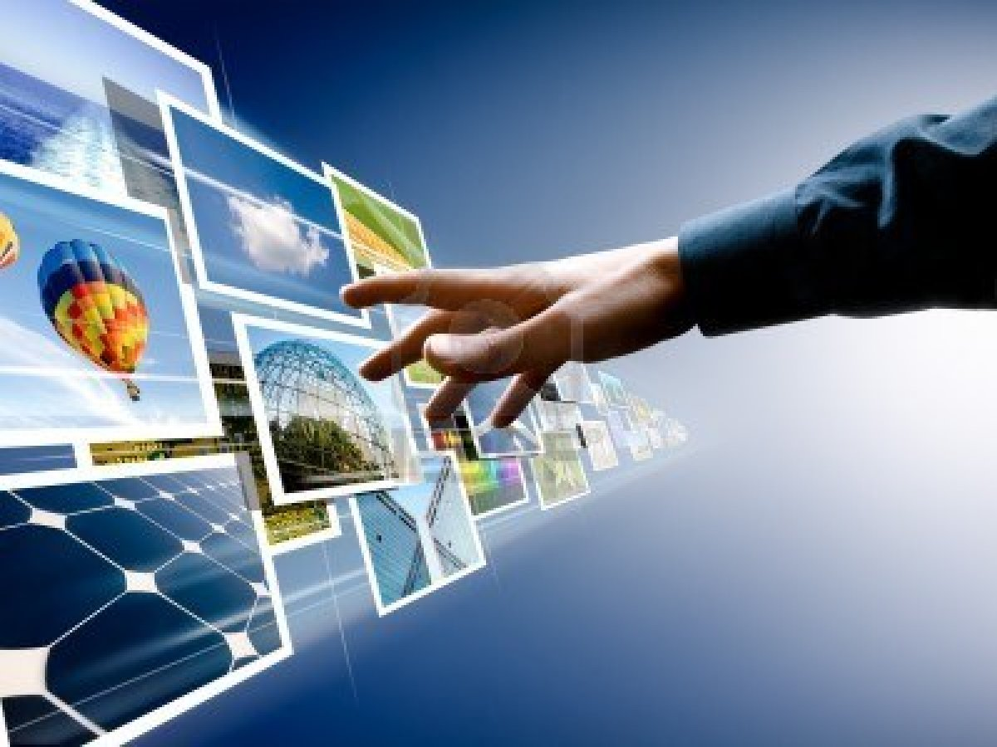
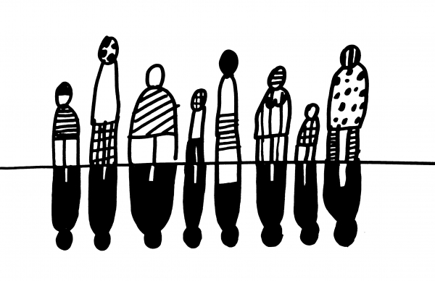
We need a new approach….
To store, access and process data
Optimize data migration
Bring application to data (as much as it is possible)
Data location and format agnosticism
Data instream processing
File based processing
In stream processing
Say NO to data-format racism !
We all are bytes

Slide 8
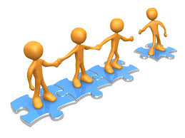
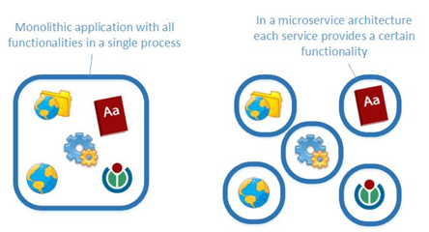
CS architectures to help
Micro-services architecture (SOA)
Flow based reactive programming (FBP)

Slide 9
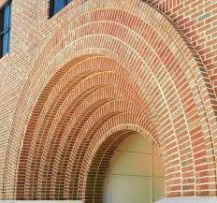
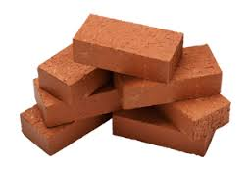
Micro-services
Micro-services architecture
Software application is composed of interlocking software bricks called services. Services are linked to each other by the transient data.
Applications execute according to the rules of data flow instead of sequential series of instructions (lines of code), written to perform a required algorithm.
Services migrate to build an application close to data.
Handful of software bricks can be used to build variety of data processing applications
Mobile and talkative

Slide 10
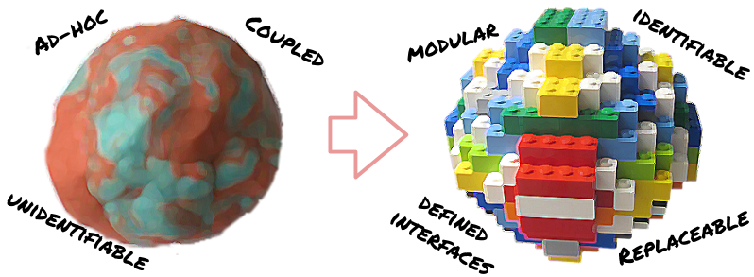
Micro-services: Advantages
Application is made of components that communicate data
Small, simple and independent
Easier to understand and develop
Less dependencies
Faster to build and deploy
Reduced develop-deploy-debug cycle
Easy to migrate to data
Scales independently
Independent optimizations
Improves fault isolation
Eliminates long term commitment to a single technology stack.
Easy to embrace new technologies

Slide 11
FBP
Glue between micro-services
How they connect to achieve computational goals
Makes application truly distributed
A
B
B reacts on message
Named inputs
Sync/Async message passing
{ A calls B } v.s. { A message B }

Slide 12
FBP: Advantages
Concurrency and parallelism are natural.
Code can be distributed between cores and across networks.
Data flow networks are natural for representing process.
Message passing gets rid of the problems associated with shared memory and locks.
Data flow programs are more extensible than traditional programs.
Fault tolerant

Slide 13
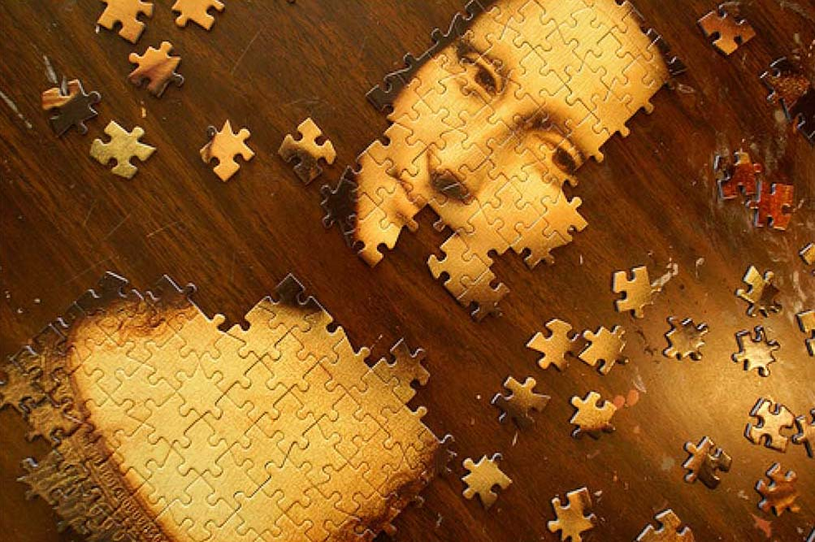
CLARA implements SOA and FBP
Application is defined as a network of loosely coupled processes, called services.
Services exchange data across predefined connections by message passing, where connections are specified externally to the services.
Services can be requested from different data processing applications.
Loose coupling of services makes polyglot data access and processing solutions possible (C++, Java, Python, Fortran)
Services communicate with each other by exchanging the data quanta.
Thus, services share the same understanding of the transient data, hence the only coupling between services.

Slide 14
CLARA architecture
Orchestration Layer
Local Registration
Local Registration
DPE
DPE
SC
SC
SC
SC
S
S
FE
S
S
S
S
Registration
gateway
security
Local Registration
Local Registration
DPE
DPE
SC
SC
SC
SC
S
S
Service Layer
S
S
S
S
Service Bus (xMsg)

Slide 15
CLARA Service
Service Engine
Service Container
Service Container
SE
SE1
SE
SE
SE1
One request at a time
Multiple simultaneous requests
C++ engine : https://claraweb.jlab.org/clara//docs/quickstart/cpp.html
Java engine : https://claraweb.jlab.org/clara//docs/quickstart/java.html
Python engine: https://claraweb.jlab.org/clara//docs/quickstart/python.html

Slide 16
CLARA Data Processing Environment
Service Container 1
Service Container 2
SE1
SE
SE
SE
SE1
SEn
SE1
Registration
Admin
Service Container n
SE1
SEn
Data processing Environment

Slide 17
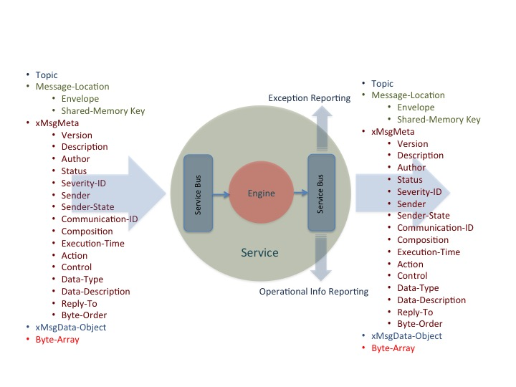
Transient data quanta
Data driven, data centric design.
The focus is on transient data event modifications. Advantage over algorithm driven design is that a much greater ignorance of the data processing code is allowed (loose coupling).

Slide 18
Application Examples
S1
S2
S3
S4
S1 + S2 + S3 + S4;
S3 + S5 + S6;
S5
S6
F1
F2
S1 + S2 + S3;
while( S3 == ”needs calibration") {
F1 + F2 + S3;
}
S3 + S4 + S6;
S1
S2
S3
S4
S6

Slide 19
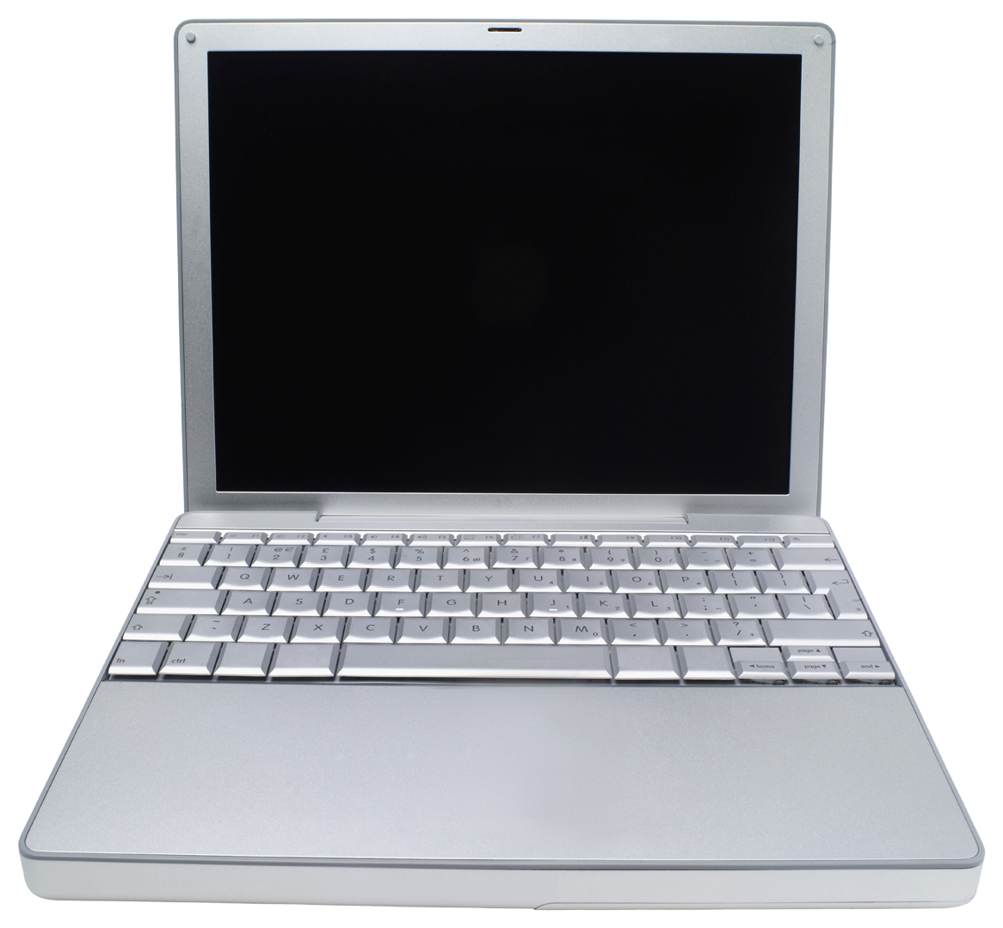
CLARA Distributed Data Provisioning
Data Center 1 (e.g. JLAB)
Data Center 1
Distributed Client Layer
Data Bus N (e.g. EBCMD grid)
Data Bus 1 (e.g. raw data)
Data Bus 1
Service Bus (CLARA services)
Data Bus N
Data communications
Service Bus
User
Front-End
Data Center 2
User
Front-End
Data Center 2
CLARA FE hosts:
Meta-data Database
Data Server
Application Server
Web Server (JNLP support)
Data Visualization Server
Application Design, Service upgrade
Data Center N
CLARA Cloud
Data Center N

Slide 20
CLARA Distributed File Storage System
CDFS Master
DPE
File Metadata DB
Key = File Name
Value= DPE Info
Heartbeat/2sec.
Available local SSD/HHD
Available memory
Stored Files
File name
Status:
Active
Passive-hot
Passive-cold
Passive-ready-remove
Metadata of the
Dataset to be
processed
Control via SSH
Stage
Promote
Demote
Remove

Slide 21
CLAS12
Experimental and Simulated Data
CLARA Data Bus
Glossary
Data processing services. Scaling up to Cn cores.
Data passage/link between services
Service control messages
Service configuration
Knowledge feedback
IO services
In memory data queue (ring-buffer)
Computing resource boundaries
Data-processing environment | CLARA DPE
CLARA DPE Farm Node_{N}
Cn
1
R
CLARA Data Bus
EBCMD
Table
1
Cn
CLAS12 Simulation and Reconstruction Multi-Node Application
CLARA DPE
MC
S₁
MC
S_{N}
EBCMD
Extraction
Service
1
Cn
EC
HT
TOF
TT
PID
DST
Cloud Computing Resources
EC
Event
Generator
HT
TOF
Cloud Node_{N}
CLAS12 Reconstruction Multi-Node Application
Assumptions
TT
STAT
EBCMD
Extraction
Service
CLARA Data Bus
JLAB Computing Resources
σ_{R}
_{Calculation}
_{Service}
σ_{B}
_{Calculation}
_{Service}
SF
_{Calculation}
_{Service}
GPD-TMD
_{Calculation}
_{Service}
Some other experiment
reconstruction program
Simulated data Reconstruction
PID
Model
Parameterization
W
Cn
1
CLARA DPE
CLARA DPE
Other Experiment and/or Research Facility Computing Resources
STAT
CLARA DPE
R
σ_{R}
_{Extraction}
_{Service}
σ_{B}
_{Extraction}
_{Service}
SF
_{Extraction}
_{Service}
GPD-TMD
_{Extraction}
_{Service}
W
W
EBCMD
W
W
EBCMD
Extraction
Service
CLARA DPE
Assumptions
CLARA DPE
Cooked,
DST
EBCMD
Table
EBCMD
Table
EBCMD
Table
EBCMD
Table
Reconstructed Data
CLARA Data Bus

Slide 22
Conclusion
CLARA can be used to build distributed TMD/GPD extraction, analysis, collaboration, and data provisioning system.
Data streaming
Data migration optimization
Heritage code reuse
Correlational and predictive studies
Increased collaboration
First public web server 1993 at CERN: http://info.cern.ch/hypertext/WWW/TheProject.html
Here goes the list of TMD/GPD CLARA based data servers…,
the first WDW data and application server URLs

