Slide 1
Charge-Asymmetric Lepton Scattering as a Probe of Hadronic Structure
Andrei Afanasev
The George Washington University, Washington, DC, USA

Slide 2
Plan of talk
Radiative corrections for charged lepton scattering
Two-photon exchange effects
T-violation
Summary

Slide 3
Elastic Nucleon Form Factors
Based on one-photon exchange approximation
Two techniques to measure

Slide 4

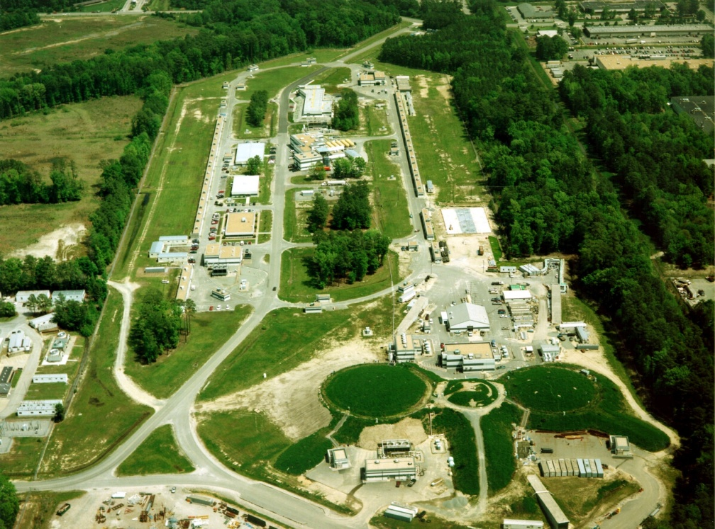
Measuring Proton Form Factors
The ratio GEp/GMp obtained by the recoil polarization technique
(Punjabi et al. (2005) (filled blue circle), Puckett et al. (2012)
(filled red squares) and Puckett et al. (2010) (filled black triangles))
compared to ratio obtained by the Rosenbluth
technique (green open points).

Slide 5
Ge/Gm Ratio: Polarization vs Rosenbluth

Slide 6
Complete radiative correction in O(α_{em} )
Radiative Corrections:
Electron vertex correction (a)
Vacuum polarization (b)
Electron bremsstrahlung (c,d)
Two-photon exchange (e,f)
Proton vertex and VCS (g,h)
Corrections (e-h) depend on the nucleon structure
Meister&Yennie; Mo&Tsai
Further work by Bardin&Shumeiko; Maximon&Tjon; AA, Akushevich, Merenkov;
Guichon&Vanderhaeghen’03:
Can (e-f) account for the Rosenbluth vs. polarization experimental discrepancy? Look for ~3% ...
Log-enhanced for light leptons (a,c,d)
Main issue: Corrections dependent on nucleon structure
Model calculations:
Blunden, Melnitchouk,Tjon, Phys.Rev.Lett.91:142304,2003
Chen, AA, Brodsky, Carlson, Vanderhaeghen, Phys.Rev.Lett.93:122301,2004

Slide 7
Separating soft 2-photon exchange
Tsai; Maximon & Tjon (k→0); similar to Coulomb corrections at low Q²
Grammer &Yennie prescription PRD 8, 4332 (1973) (also applied in QCD calculations)
Shown is the resulting (soft) QED correction to cross section
Already included in experimental data analysis for elastic ep
  Also done for pion electroproduction in AA, Aleksejevs, Barkanova, Phys.Rev. D88 (2013) 5, 053008 (inclusion of lepton masses is straightforward)
ε
q₁→q
q₂→0
Q²= 6 GeV²
δ_{Soft}
Lepton mass is not essential for TPE calculation in ultra-relativistic case;
Two-photon effect below 1% for lower energies and Q²<0.1GeV²

Slide 8
General Analysis of ep->ep
(including 2-photon exchange)
Reaction e(1/2,λ₁)+p(1/2,h₁)->e(1/2,λ₂)+p(1/2,h₂) => 16 possible helicity combinations
Parity:
  8 amplitudes
  Time-reversal:
  =>6 amplitudes
  Independent helicity amplitudes:

Slide 9
Short-range effects
(Chen,AA, Brodsky, Carlson,Vanderhaeghen)
Two-photon probe directly interacts with a (massless) quark
Emission/reabsorption of the quark is described by GPDs
Phys.Rev.Lett.93:122301,2004; Phys.Rev.D72:013008,2005

Slide 10
Quark-Level Calculations
AA, Brodsky, Carlson, Chen,
Vanderhaeghen,
Phys.Rev.Lett.93:122301,2004; Phys.Rev.D72:013008,2005
Kivel, Vanderhaeghen, PRL 103 092004 (2009)

Slide 11
Results for cross section measurements
New correction brings results of Rosenbluth and polarization techniques into agreement (data shown are from Andivahis et al, PRD 50, 5491 (1994)

Slide 12
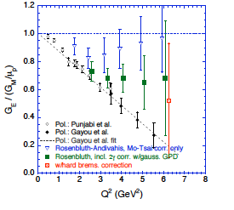
Updated Ge/Gm plot
AA, Brodsky, Carlson, Chen, Vanderhaeghen,
Phys.Rev.Lett.93:122301, 2004; Phys.Rev.D72:013008, 2005
Review: Carlson, Vanderhaeghen, Ann.Rev.Nucl.Part.Sci. 57 (2007) 171-204
Significant part of the discrepancy is removed by the TPE mechanism
Verification coming from
  VEPP: PRL 114 (2015) 6, 062005
  CLAS: PRL 114 (2015) 6, 062003
  OLYMPUS: PRL 118 (2017) 092501
Recent review: A. Afanasev, P. Blunden, D. Hassell, B. Raue, https://arxiv.org/abs/1703.03874, Prog.Nucl.Part.Phys. June 2017.

Slide 13
Electron/Positron Ratios
Recent results from CLAS, VEPP and OLYMPUS
  Prior results analyzed, eg, in E. Tomasi-Gustafsson, M. Osipenko, E. A. Kuraev, and Yu. Bystritsky, Phys. Atom. Nucl. 76, 937 (2013), arXiv:0909.4736
For new discussion, see A. Afanasev et al., https://arxiv.org/abs/1703.03874, Prog.Nucl.Part.Phys. June 2017.

Slide 14
2γ-exchange Correction to Parity-Violating
Electron Scattering
γ
γ
x
Z⁰
Electromagnetic
Neutral Weak
Parity violating terms due to (2gamma)x(Z⁰) interference should be added:
AA, C.E. Carlson, Phys.Rev.Lett. 94 (2005) 212301

Slide 15
Two-boson box for Parity-Violating Electron Scattering
(as presented by C. E. Carlson)
Parity violation with positrons?
High current and polarization is a challenge

Slide 16
Proton radius puzzle
Slide credit: Miha Mihavilovic, JLAB Seminar, March’17

Slide 18
Helicity-Flip in TPE; estimate of inelastic contribution
New dynamics from scalars (σ, f-mesons). No pseudo-scalar contribution for unpolarized particles
Scalar t-channel exchange contributes to TPE (no longer setting m_{lepton} to zero!)
No information on coupling is available. Need model estimates.
Theory analysis by AA, Koshchii, Phys.Rev. D 94, 116007 (2016).
Can be studied directly in the ratio of μ+ and μ- cross sections

Slide 19
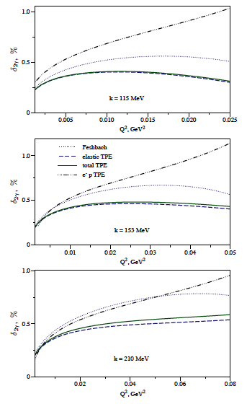
Inelastic+Elastic
Tomalak, Vanderhaeghen, arXiv:1512.09113Eur. Phys. J. C 76, no. 3, 125 (2016)
Both inelastic and elastic contributions included
Elastic TPE dominates, Inelastic ~ 10⁻⁴ effects;
TPE for electrons is about twice larger than for muons.

Slide 20
MUSE Prospectives
MUSE:
Experiment preparation underway in PSI and MUSE collaborating institutions
The effort on the radiative corrections aims at proper accounting of the
radiative effects, that appear to show significant difference between electron and muon scattering (Afanasev, Strauch, Bernauer, Koshchii)
Radiative corrections shown to be <1% for muons; included in MUSE analysis
Two-photon effects can be studied directly in the ratio of μ+ and μ- cross sections

Slide 21
RadCor for MUSE
Radiative corrections show significant difference between electron and muon scattering in MUSE, must be properly accounted for
Radiative corrections calculated to be about 1-1.5% for muons and varies from -4% to +3% for electrons
  Uncertainties mainly from acceptances, need to include in detector simulations (Monte Carlo generator of radiative events was developed for MUSE) . Theory uncertainties <0.1% (muons), <0.5% (electrons)
Two-photon exchange <1% (electrons), <0.5% (muons), ~0.01%(inelastic excitations)
Two-photon effects can be studied directly in the ratio of μ+ and μ- , e⁺ and e⁻ cross sections; TPE cancel in the sum of particle+antiparticle cross sections

Slide 22
Single-Spin Asymmetries in Elastic Scattering
Parity-conserving
Observed spin-momentum correlation of the type:
where k_{1,2} are initial and final electron momenta, s is a polarization vector
of a target OR beam
For elastic scattering asymmetries are due to absorptive part of 2-photon exchange amplitude
Parity-Violating

Slide 23

Normal Beam Asymmetry in Moller Scattering
Pure QED process, e⁻+e⁻→e⁻+e⁻
  Barut, Fronsdal , Phys.Rev.120:1871 (1960): Calculated the asymmetry in first non-vanishing order in QED O(α)
  Dixon, Schreiber, Phys.Rev.D69:113001,2004, Erratum-ibid.D71:059903,2005: Calculated O(α) correction to the asymmetry
SLAC E158 Results [Phys.Rev.Lett. 95 (2005) 081601]
An(exp)=7.04±0.25(stat) ppm
An(theory)=6.91±0.04 ppm

Slide 24
Quark+Nucleon Contributions to Target Asymmetry
Single-spin asymmetry or polarization normal to the scattering plane
Handbag mechanism prediction for single-spin asymmetry of elastic eN-scattering on a polarized nucleon target (AA, Brodsky, Carlson, Chen, Vanderhaeghen)
Only minor role of quark mass
Data coming from JLAB E05-015
(Inclusive scattering on normally polarized ³He in Hall A)

Slide 25
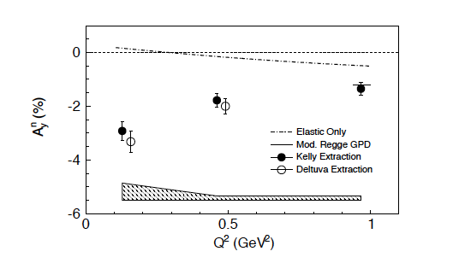
Single-spin Asymmetries at JLAB
Polarized target (He3) JLAB E-05-015 (Zhang et al, Phys. Rev. Lett. 115, 172502 (2015))
Recoil polarimetry (proton): possible but challenging due to systematic corrections

Slide 26
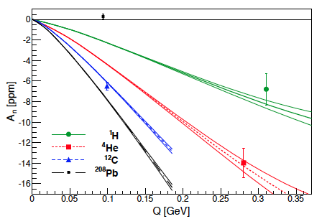
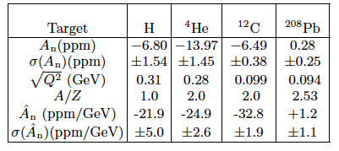
Transverse Beam Asymmetries on Nuclei
(HAPPEX+PREX)
Abrahamyan et al, Phys.Rev.Lett. 109 (2012) 192501
  Good agreement with theory for nucleon and light nuclei
  Puzzling disagreement for ²⁰⁸Pb measurement; if confirmed, need to include additional electron interaction with highly excited intermediate nuclear state, magnetic terms, etc (= effects of higher order in α_{em} ). Interesting nuclear effect! Experimentally, need additional measurements for intermediate-mass targets (e.g., Al, Ca, Fe)
Comparing with positrons can settle the puzzle

Slide 27

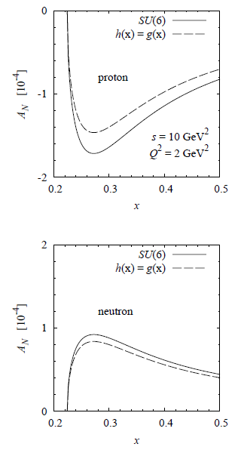
Two-Photon Exchange in inclusive DIS
Theory: Afanasev, Strikman, Weiss, Phys.Rev.D77:014028,2008
  Asymmetry due to 2γ-exchange ~1/137 suppression
  Addional suppression due to transversity parton density => predict asymmetry at ~10⁻⁴ level
  EM gauge invariance is crucial for cancellation of
  collinear divergence in theory predictions
  Hadronic non-perturbative ~1% vs partonic 10⁻⁴
Prediction consistent with HERMES measurements who set upper limits ~(0.6-0.9)x10⁻³ : Phys.Lett.B682:351-354,2010

Slide 28


Work by Andreas Metz and collaborators
Important: Inclusive asymmetries from TPE, coupling to the same quark vs different quarks A. Metz, D. Pitonyak, A. Schafer, M. Schlegel, W. Vogelsang, J. Zhou, Phys.Rev. D86 (2012) 114020
SIDIS: Schlegel, Metz, arXiv:0902.0781
Emphasized sin(2φ) effect for SIDIS arising from two-photon exchange
Target asymmetry:

Slide 29
Experiment in JLAB Hall A
Katichet al., Phys.Rev.Lett. 113 (2014)022502
  Shows per-cent level asymmetry in ³He↑(e,e′)X
  Presents an issue for analysis for TMD extraction from T-odd asymmetries in SIDIS

Slide 30
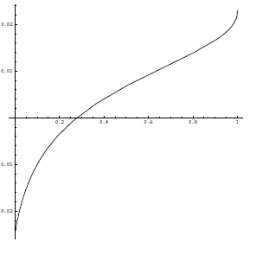
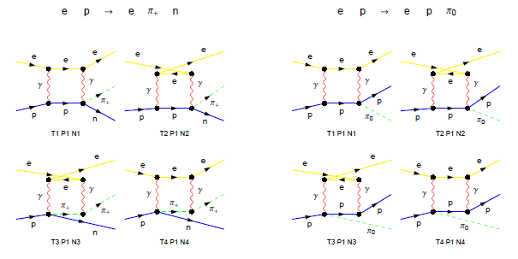
Two-Photon Exchange in Exclusive
Electroproduction of Pions
Standard contributions considered, e.g., AA, Akushevich, Burkert, Joo,
Phys.Rev.D66:074004,2002 (Code EXCLURAD used for data analysis)
Additional contributions due to two-photon exchange, calculated by AA, Aleksejevs, Barkanova, arXiv:1207.1767, PRD88 (2013) Calculated in soft-photon approximation
1+δ
ε
Calculated ε-dependence of TPE correction.
Q²=6 GeV², W=3.2 GeV, E_{e}=5.5 GeV .
Shows ±2% variation with ε.

Slide 31
TPE vs T-violation
Single-spin asymmetries in inclusive DIS may be caused by
  Effects beyond Born approximation
  Violation of time-reversal symmetry
The effects can be separated using positron vs electron comparison
  TPE effects are charge-odd
  T-violation is time-even
First suggested by Tsai
Important Note: if CPT is a good symmetry, then constraints on CP-violation in leptonic sector is <10⁻⁶. But higher-order QED loops will also produce C-even SSA (three-photon exchange) at a level of 10⁻⁴.
Possible experiment with e⁺/e⁻: Looking for T-violation in lepton scattering at sub-percent level.

Slide 32
Summary
Electron-positron asymmetries provide model-independent measurement of effects beyond Born approximation: an important tool for precision probes of hadronic structure
  Elastic ep- and eA-scattering
  Inelastic scattering: DIS, SIDIS, DVMP
  Parity violation: need high currents and polarization
  T-violation in lepton scattering: SSA technique works up to ~10-4, limitation due to higher-order QED loops (three-photon exchange)

