Slide 1
High current polarized electron source for future eRHIC
Erdong Wang
on behalf of electron source group
Brookhaven National Laboratory

Slide 2
Outline
eRHIC polarized electron source introduction
The strategy of reaching high current and high charge
High current high charge DC gun considerations
Lifetime estimation
Progressing

Slide 3
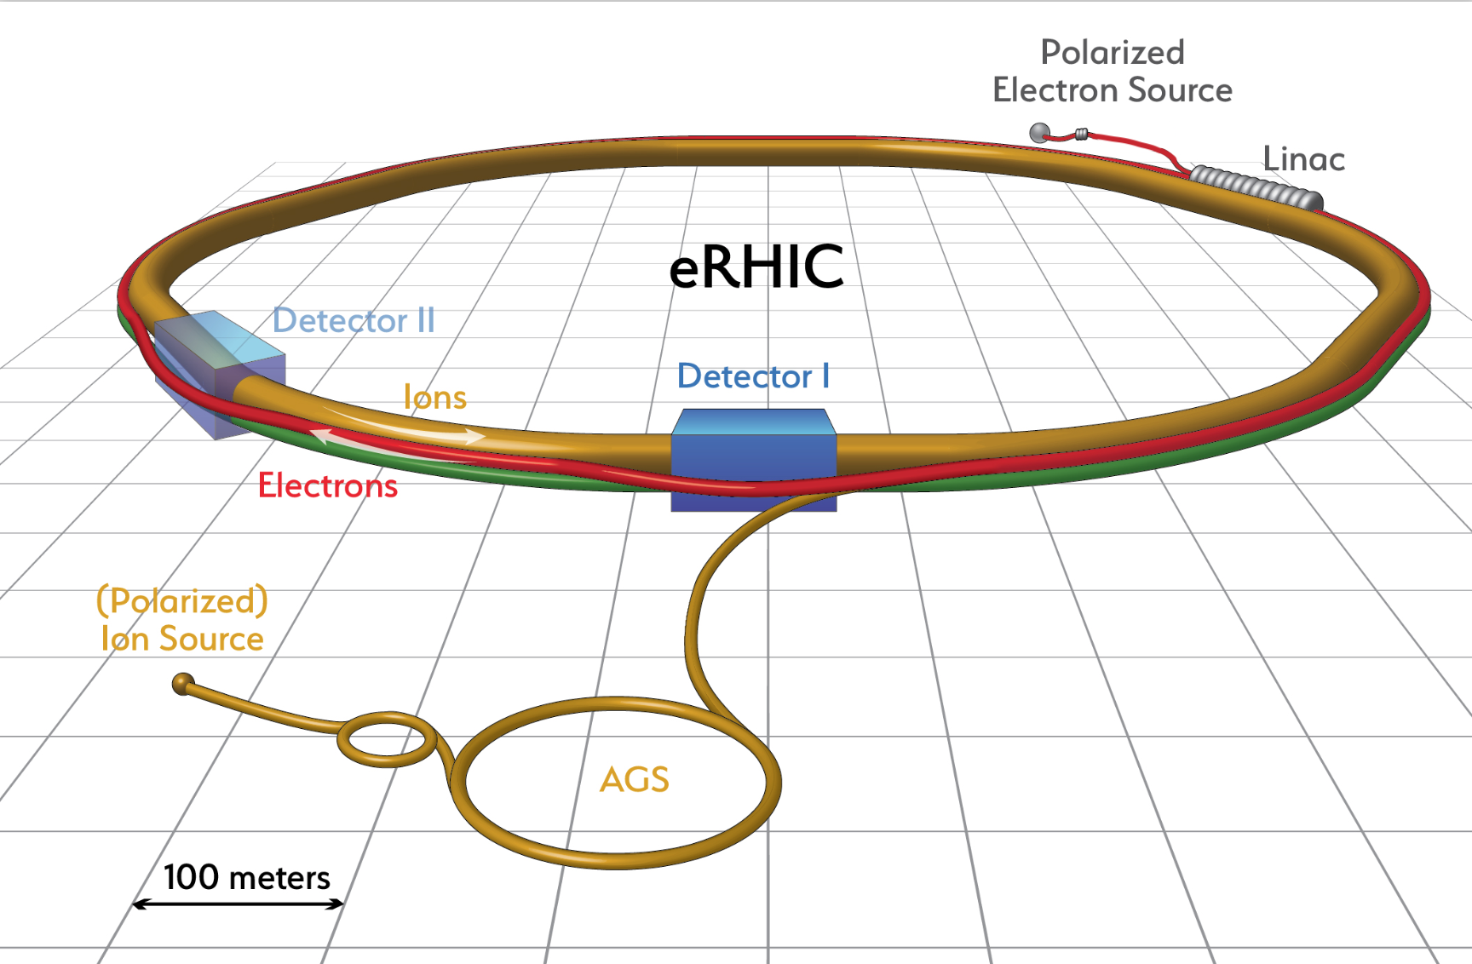
RR-eRHIC pre-injector specifications
No R&D needed!
Low repetition rate, high charge
1Hz for 50 nC
5 bunches 1 Hz for 10 nC with accumulate in storage ring; Or bunch train for smaller charge.
Short bunch length
3~6 ps (< 2 mm) for 2.856 GHz Linac
High peak current

Slide 4
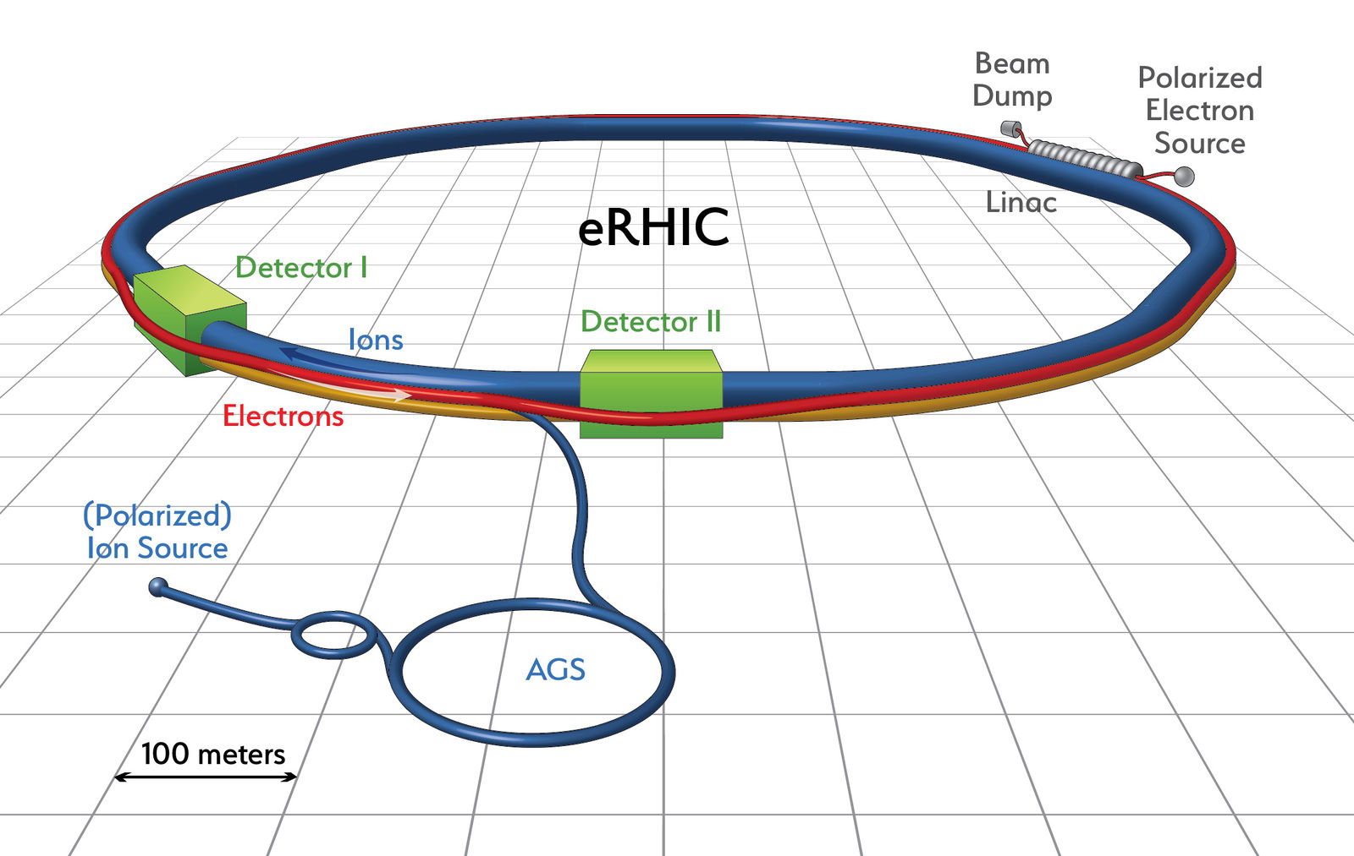
LR-eRHIC pre-injector specifications
ERL based Linac-Ring eRHIC: Requires a very high current and high charge polarized electron gun.
eRHIC parameters
 | e
Energy, GeV | 18
Bunch charge, nC | 5.3
Beam current, mA | 50
Rms nor. Emittance, µm | 64
Polarization,% | 80
Luminosity,cm⁻²s⁻¹ | 1.2X10³³
Upgradable to,cm⁻²s⁻¹ | 10³⁴
The high current, high charge polarized electron source needs to be demonstrated.

Slide 5
Risk consideration
Either high bunch charge up to 16nC achieved by the SLAC (High peak current, low average current)
Or a high average current, such as that up to 4mA reached by the Jlab. (Low peak current, high average current)
What we need?
High average current: 50mA; High Bunch charge:5.3nC; Long lifetime
We propose to use 8 inverted JLab type guns and combine the beam together.
  8 guns combining mechanism.
  Build this gun quickly in about one year.
  Use proven technology.
  High charge (5.3nC) and high current (6.4mA) are still very challenge.

Slide 6
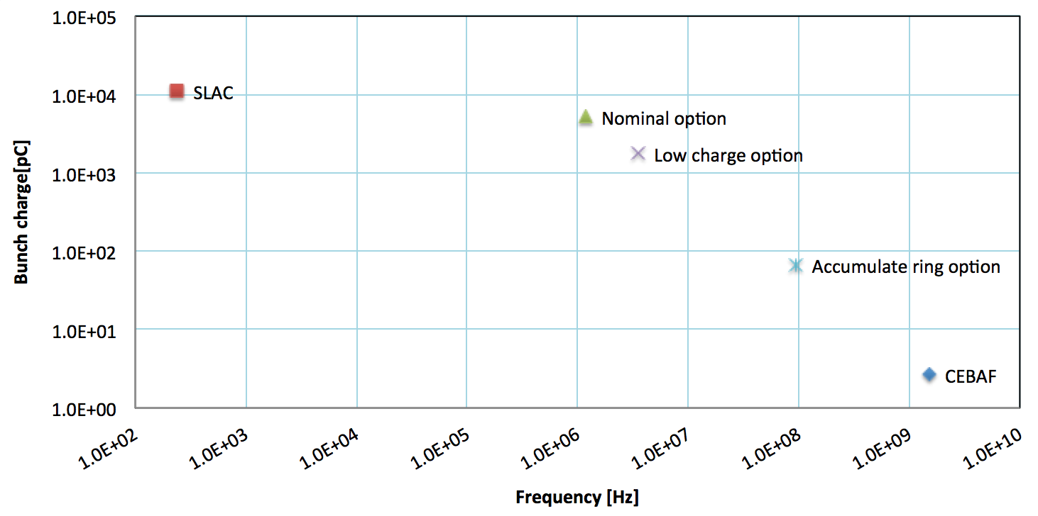
Strategy of schemes choosing
5.3 nC
1.8 nC
67 pC

Slide 7
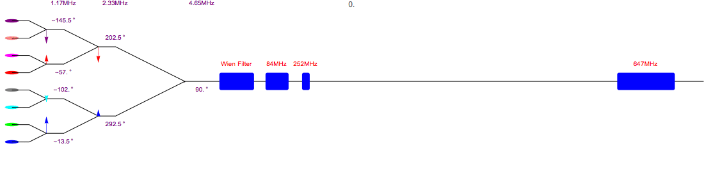
8 Gun combiner scheme
Each gun average current= 50/8=6.25mA
Bunch charge=5.3nC
Frequency each gun=9.3/8=1.16MHz

Slide 8
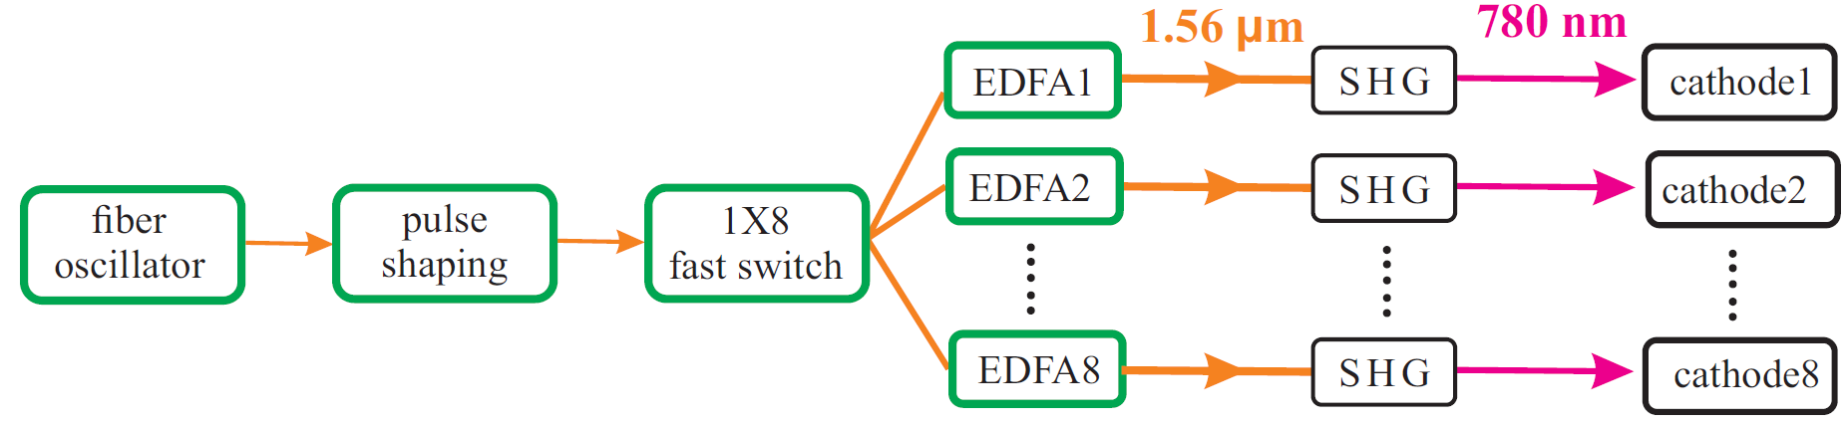
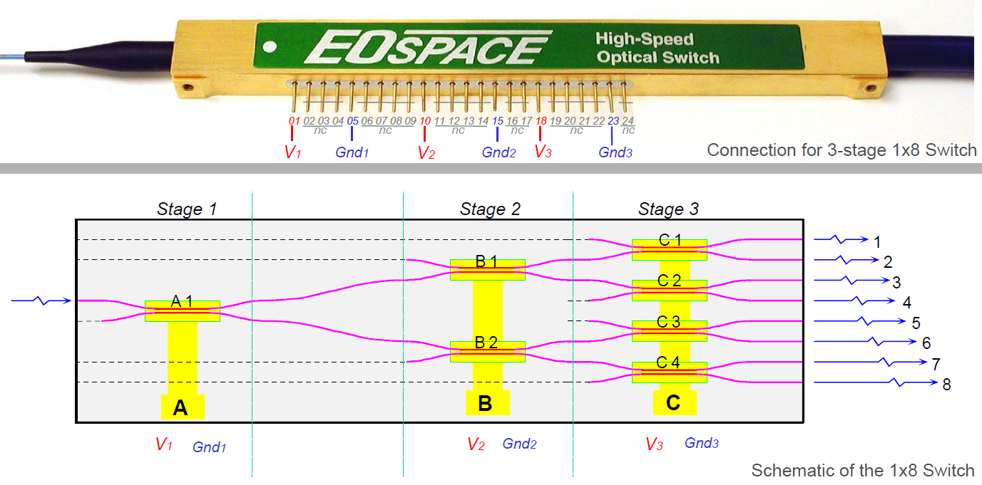
Fiber Laser for Multiple DC Guns
Fiber Laser for Multiple DC Guns
Repetition rate (MHz):
1.16 MHz x 8 = 9.3 MHz
IR power on cathodes: 5 W x 8 = 40 W
IR average power: 10 W x 8 = 80 W
1→8 switch by ultrafast EOM switch
Switch time: ~10 ns
Crosstalk: < -20 dB → -35 dB

Slide 9
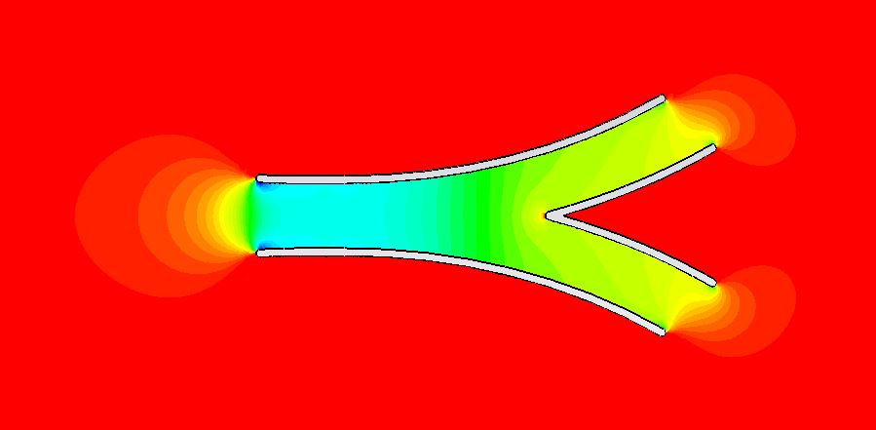
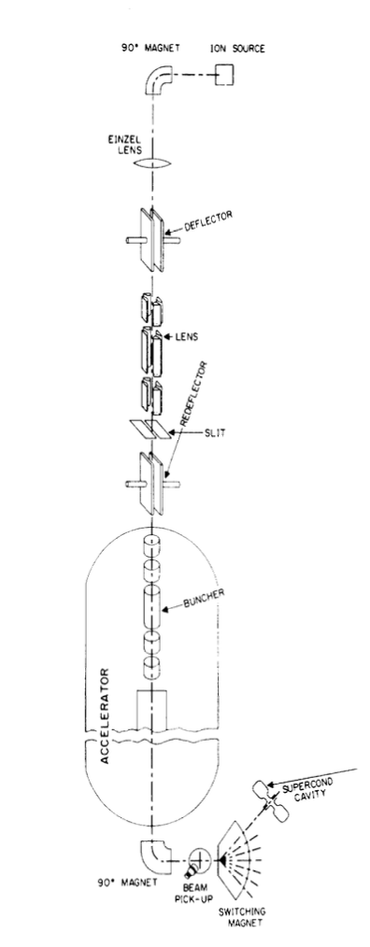
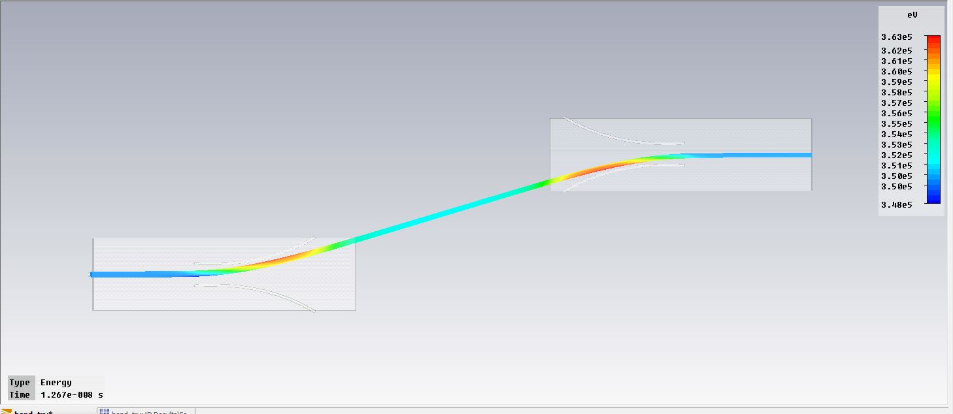
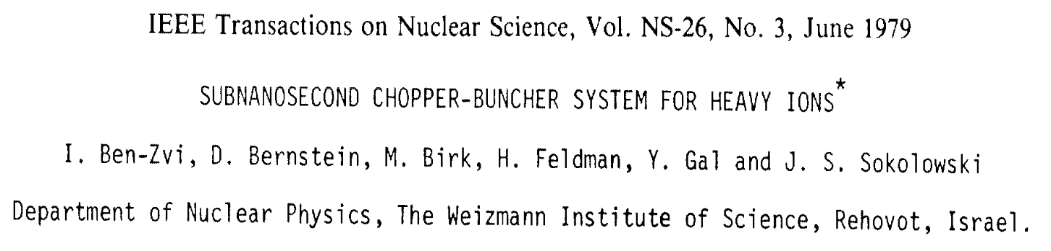
Coil-plates RF deflector
RF deflector:
Resonant circuits which are tuned with a resonating inductor and a pair of tunable external capacitors in parallel with the deflection plates.

Slide 10
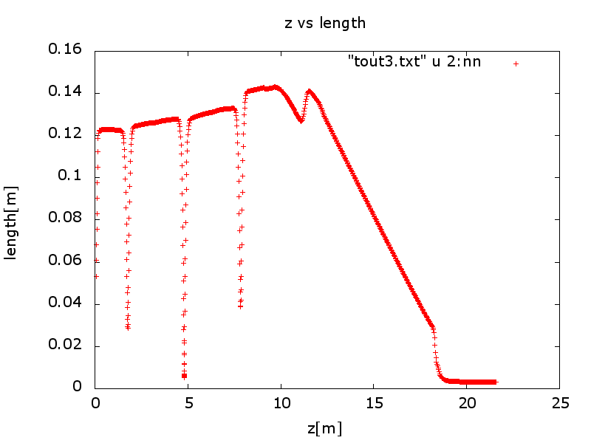
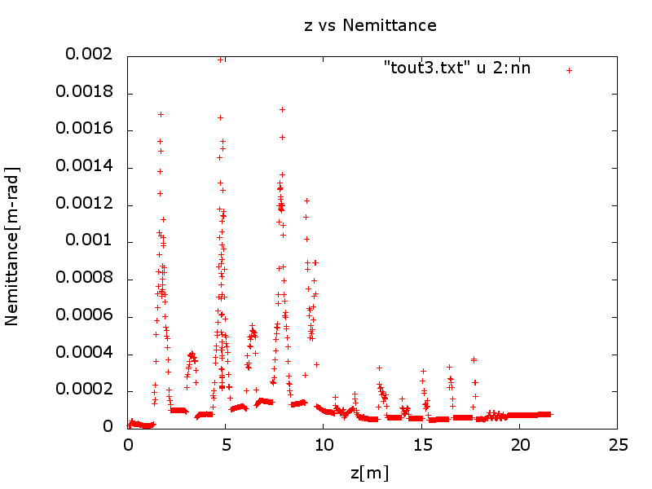
Eight guns beamline arrangement
Eight guns need 19 deflectors.
Each deflector bends the beam about 10 degree, then use dipole bending to beam 80 more degree.
After beam combined, it will be rotated the spin and compression and boost the energy.

Slide 11
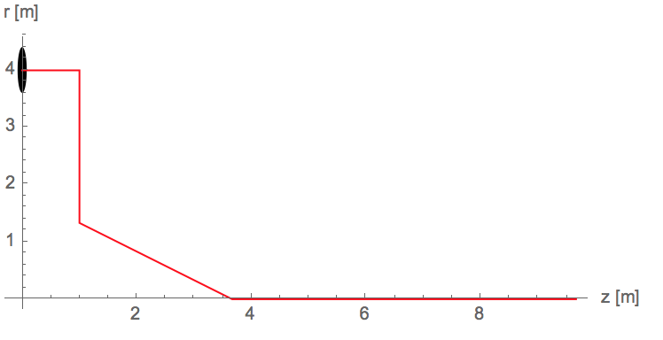
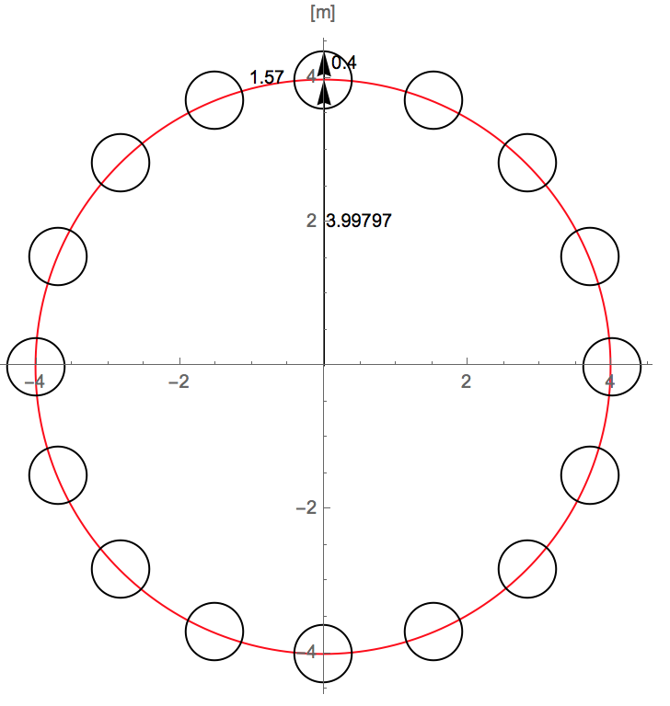
Alternative 8 Gun combiner scheme
Use rotatable magnetic field combiner.
Reduce the drift length, reduce the energy spread from space charge.
Fast switch to other 8 guns if one gun fail.
Simulation considered the rotation factor.

Slide 12
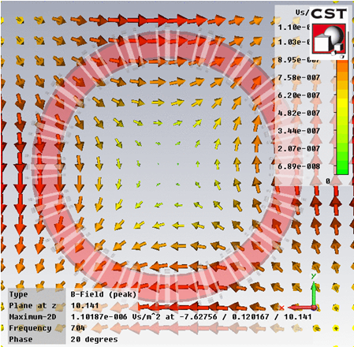
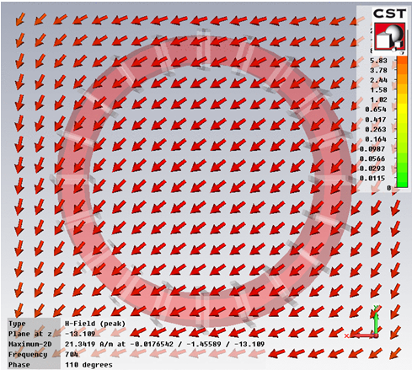
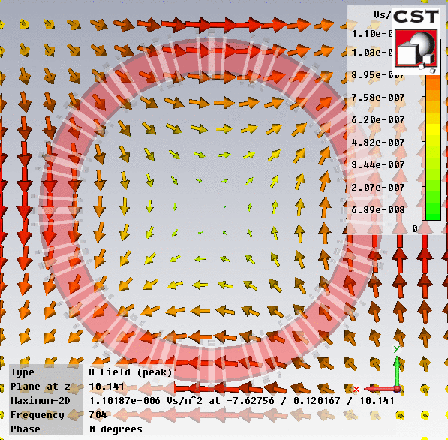
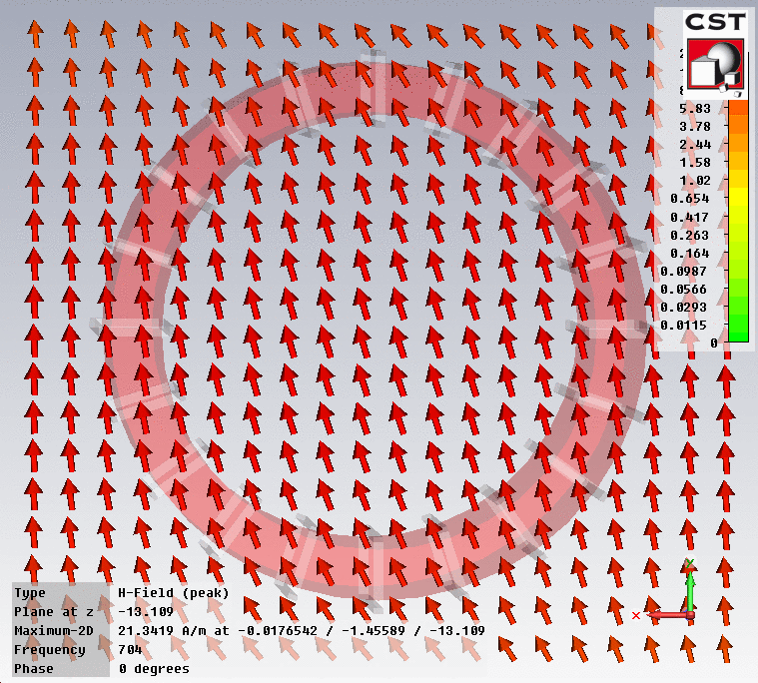
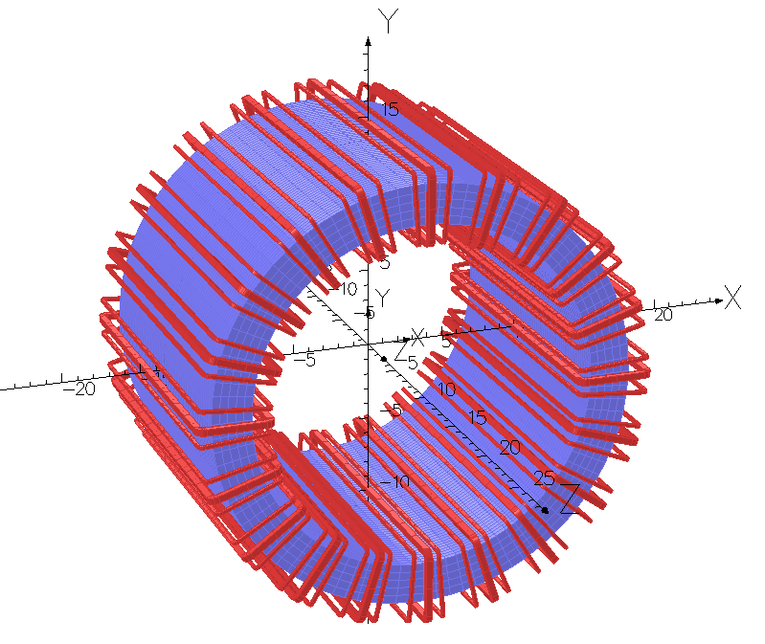
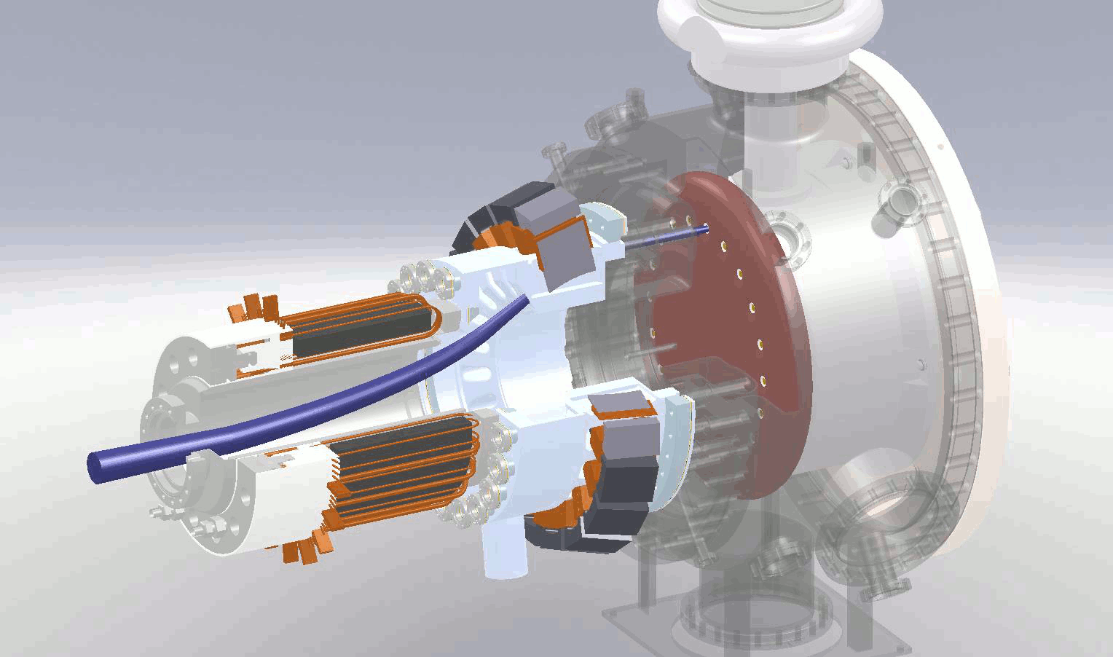
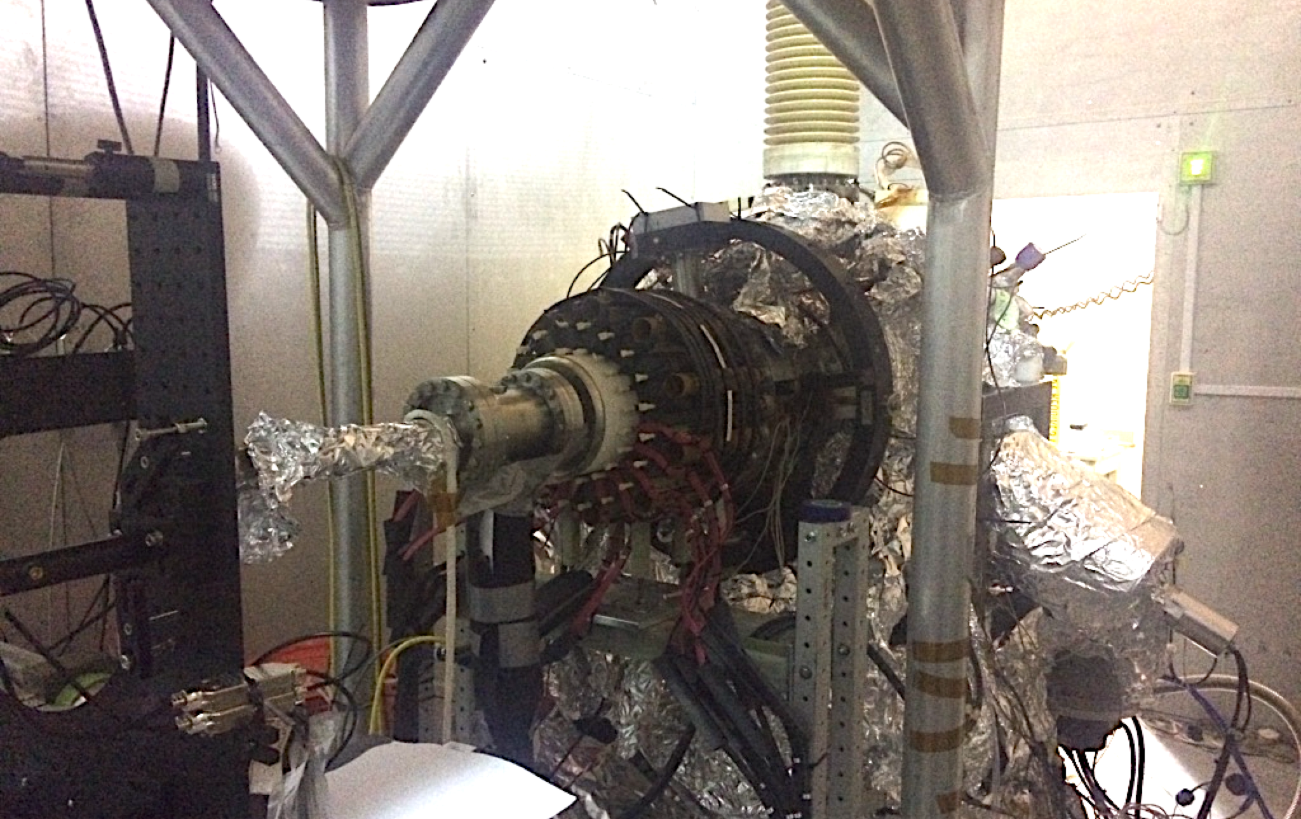
Rotatable field combiner
Bending the beam by dipole; Equalize the focusing by quadrupole.
Two coils were tested at 650 kHz last year.
For higher beam energy and 1.1 MHz, more R&D needed

Slide 13
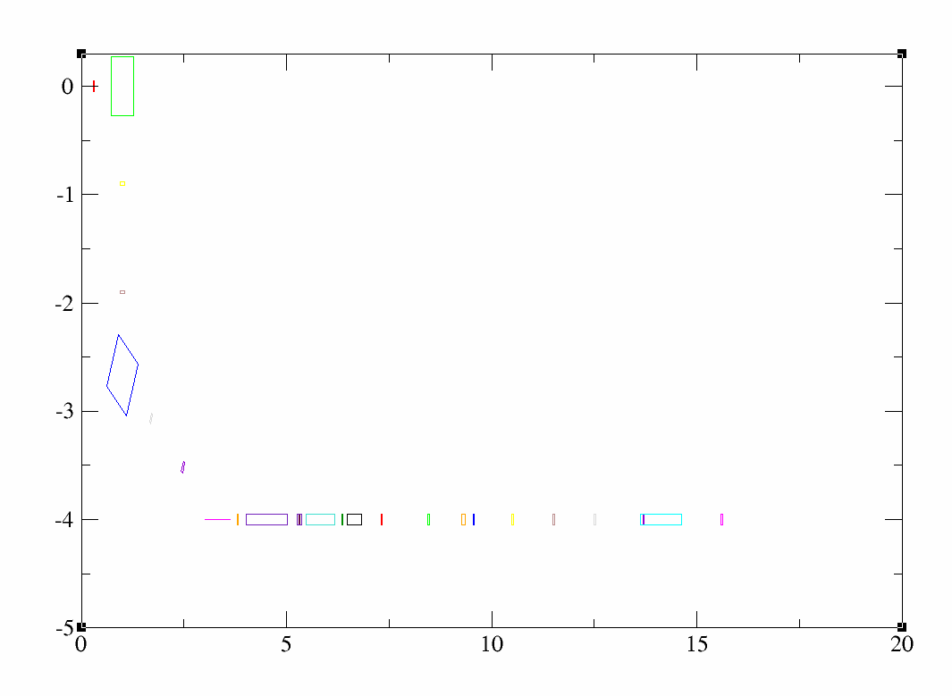
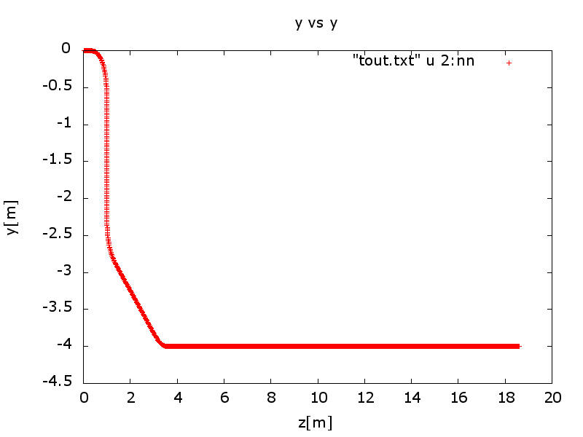
Beamline arrangement
Beam bend 90 deg and then bend back 60 deg into rotatable magnets.
Spin rotator change longitudinal spin to transverse.
Two bunching cavities compress the bunch length.
Two booster cavities to increase energy to 20 MeV.

Slide 14
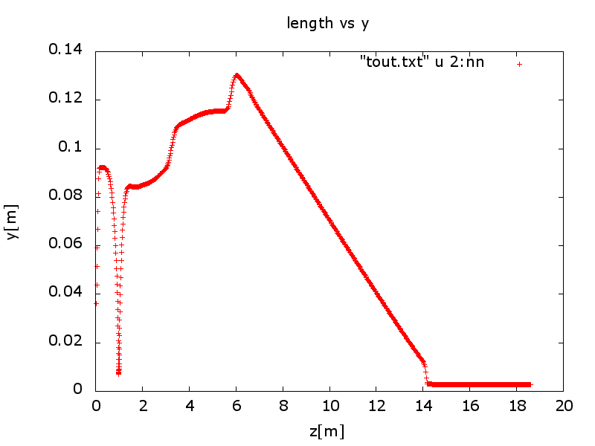
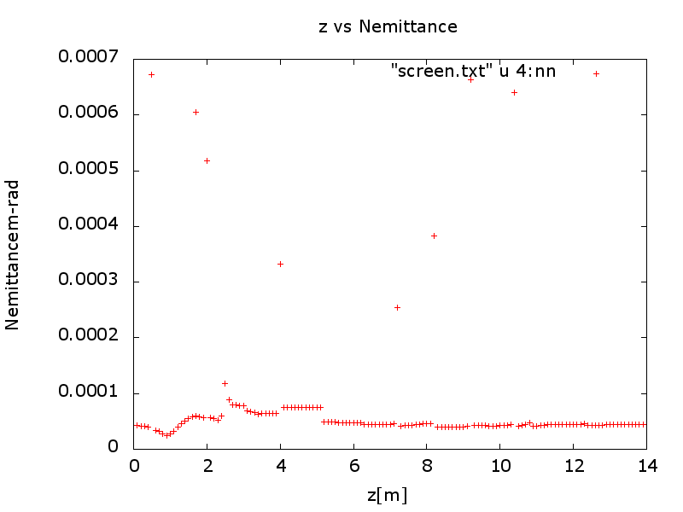
GPT simulation results
rms bunch length 9.7ps
Normalized transverse emittance:
Emitt_x=45.1 mm-mrad
Emitt_y=45.6 mm-mrad
Bunch length 3mm
Fine tune the combiner quads and dipole can make both same.

Slide 15
Prolong the cathode lifetime
  Larger Laser Size
  Reduces space-charge emittance growth
  Suppresses surface charge limit
  Increase charge lifetime
  Laser Position on Photocathode and Active Area
  Avoid ion back bombardment range
  Reduce beam halo
  Higher Gun Voltage: (Difficult to do in a short term)
  Less ions are created
  Reduce space-charge emittance growth
  Increase QE by Schottky Effect
  Better vacuum
  Reduces the ions
  Reduces the molecules desorption

Slide 16





Estimate charge lifetime
In DC gun, ion back bombardment is dominated the GaAs photocathode lifetime.
Ion generation by the e-beam:
Differential equation describe the surface bond damage:
In constant current case, QE decay:
Charge lifetime:
B is the bond density times the area
The charge lifetime is proportional to the cathode size and inverse proportional to the F.
F: The number of ions generated by 1C electrons

Slide 17
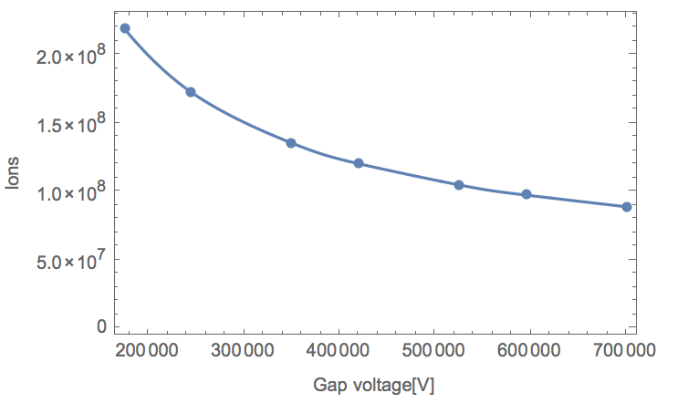
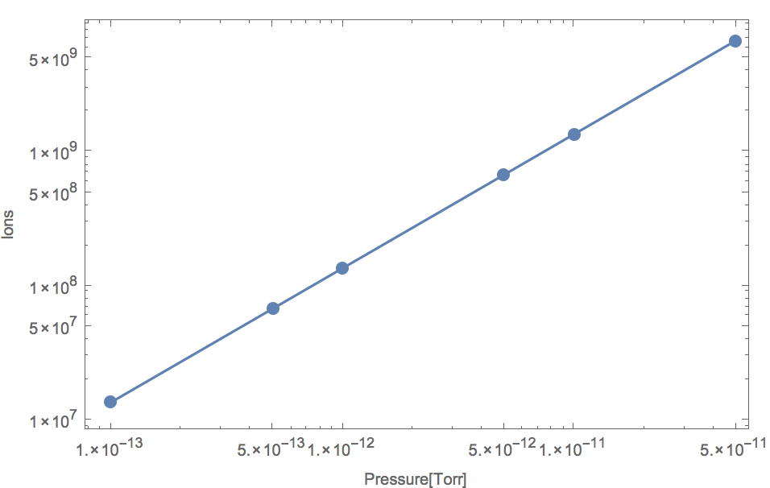
Quantities the charge lifetime
Charge lifetime is proportional to the area, inverse proportional to the pressure, increase by enhance the voltage.

Slide 18
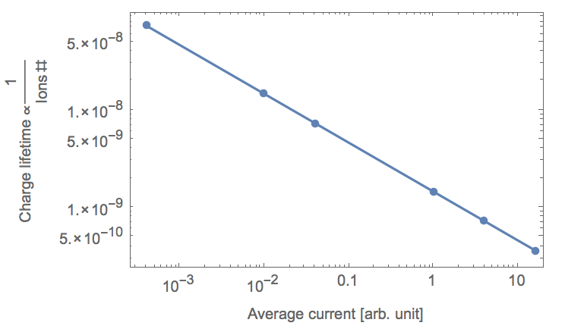



If we have beam loss?
Without RF booster cavities, the downstream ions will be blocked by the biased anode. The beam loss generated desorption gas will go back to dc gap.
With constant peak current, beam loss is proportional to average current.
S(P)=m P
S(P)=m Log[P]
With constant average current, how is the charge lifetime changed by the bunch charge?

Slide 19
Ion back bombardment simulation
GPT simulation: considering space charge, electron-H2 scattering.
Only consider the ions generated from the DC gap.
Assuming no ions came from downstream due to anode bias.
Procedure:
First run the electron beam from cathode.
Generates ions by function of electron energy and position.
Assume initial ion momentum equal to H momentum (ideal gas distribution)
Simulation the ion back and stop at the cathode

Slide 20
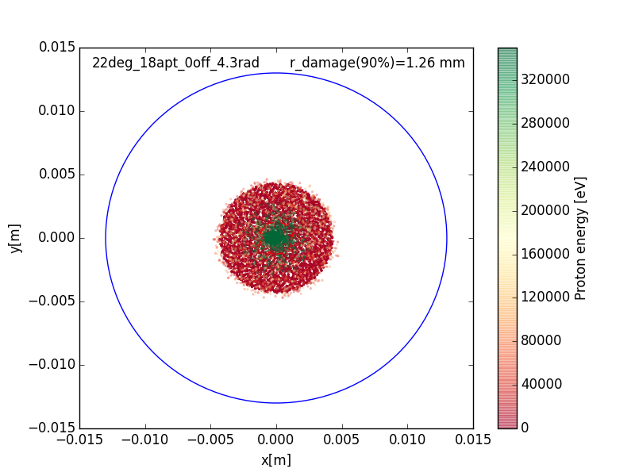
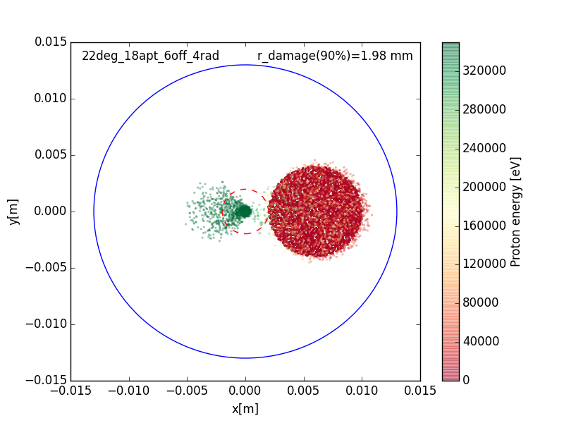
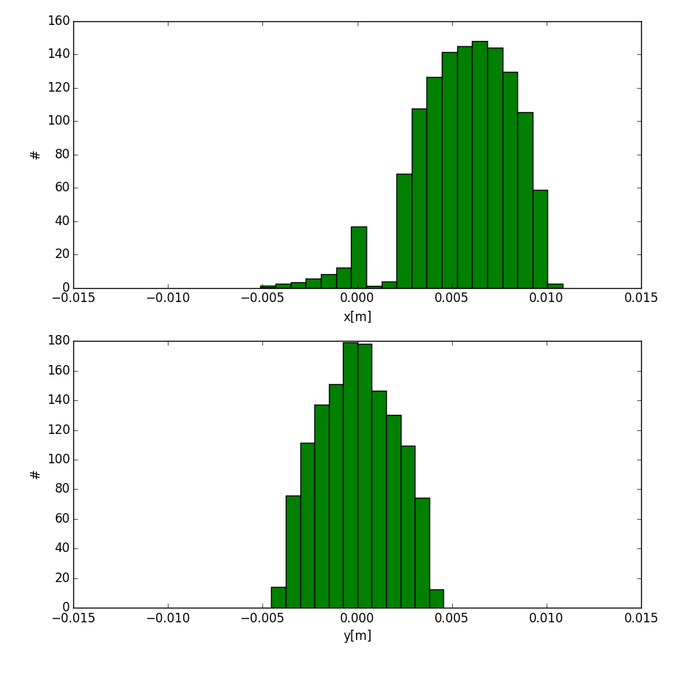
Ions distribution on the cathode
The activated cathode spot is covered by a large number of low energy ions.
The center of the cathode area receives most of the ions with high energy, resulting in much higher power density.
The over focusing of high energy ions are always distributed on opposite direction of laser spots

Slide 21
Determine the cathode size
Item 1 and 2 requires large cathode size
2~3mm for the cathode’s offset.
7~9mm for the diameter of the cathode’s illuminated spot. 2~3 mm to the edge.
Total cathode size should be 24.5~27 cm in diameter.
D_offc D_edge
D_laser
We need a large cathode size high voltage DC gun with cooling capability.

Slide 22
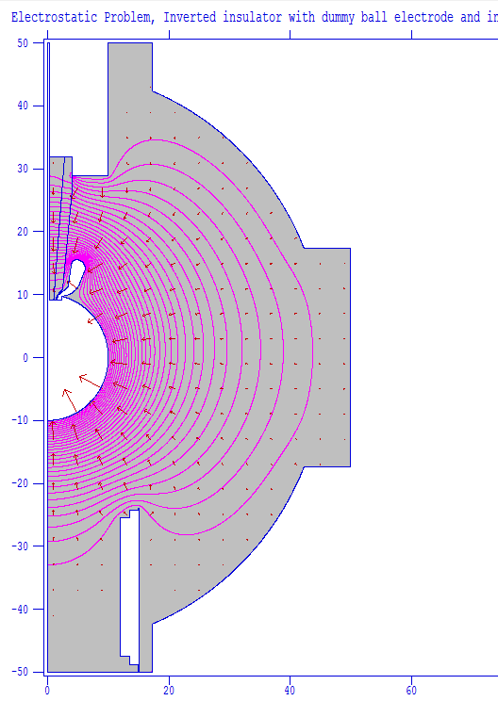
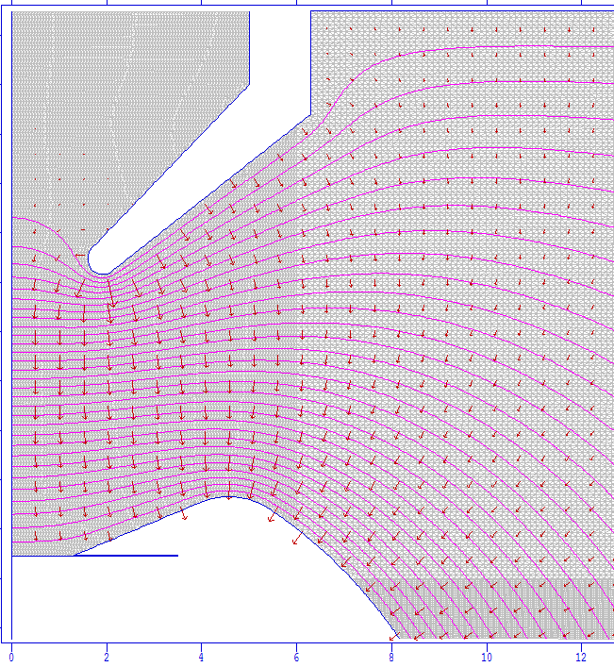
BNL large cathode inverted gun
 | Inverted gun (LR)
Ball diameter | 20 cm
Chamber diameter | 80 cm
Gap distance (lg) | 5.7 cm
Voltage | 350 kV
Cathode size | 4.98 cm²
Electrodes angle (α) | 22 degs
Cathode gradients | 3.8 MV/m
Maximum gradient | 9.9 MV/m
Anode diameter (la) | 1.8 cm
Pumping speed | 35000 L/s
Space charge limit | Up to 45 A
Anode bias | 3000 V
la
lg
lc
α

Slide 23
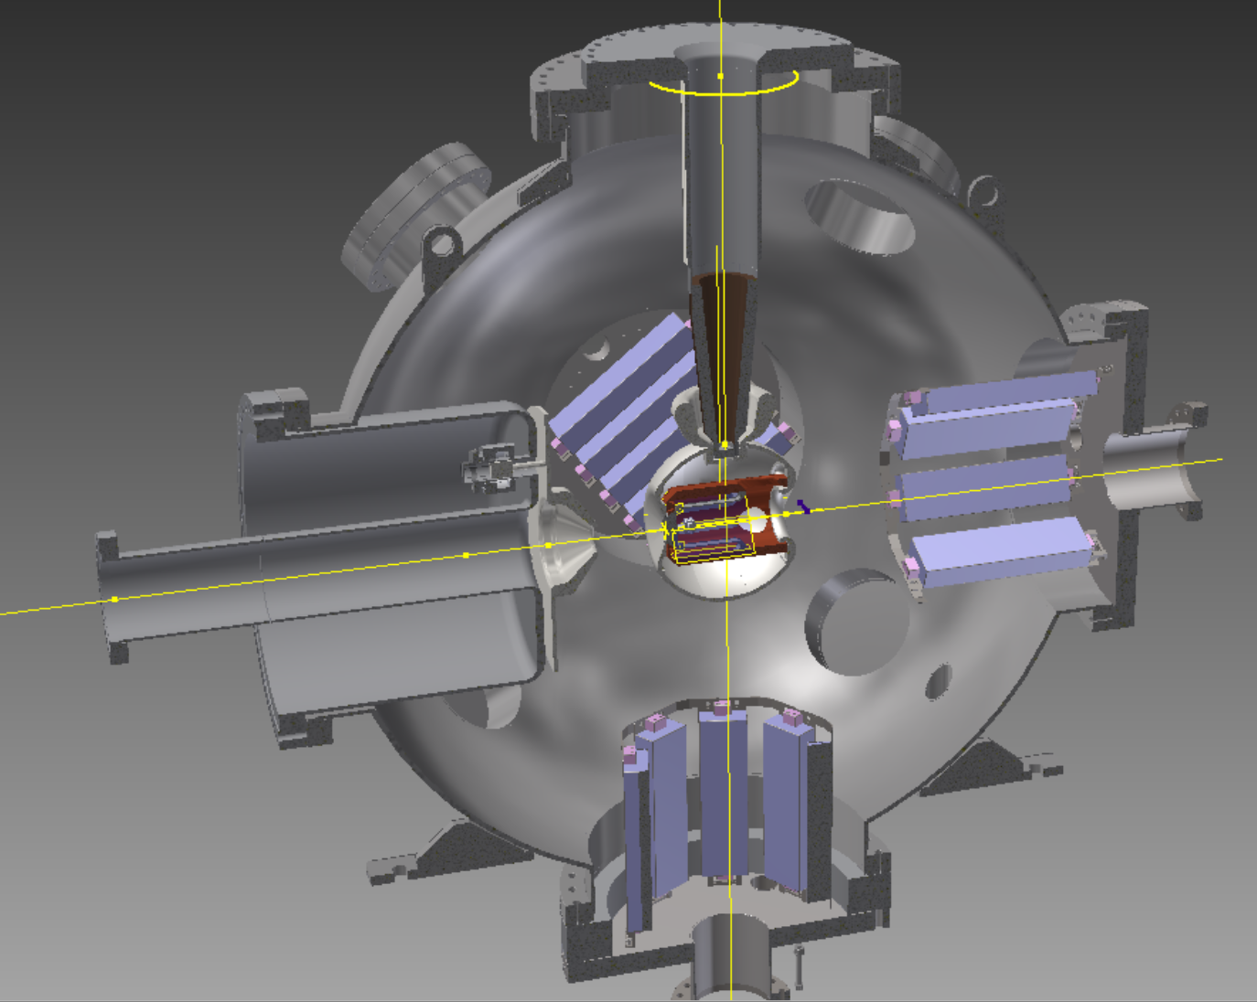
polarized gun R&D and fabrication
The polarized gun R&D goal:
High average current (6~50 mA), high bunch charge (5.3 nC) large cathode inverted gun for L-R eRHIC source.
High bunch charge (50 nC) for R-R eRHIC source.
Sub-R&D items:
Achieve and measure XHV
High power laser
Ion back bombardment
Surface charge limit measurement
Lifetime as the function of charge
Beam halo reduction studies
Cathode cooling
BNL 1ST inverted gun in fabrication

Slide 24
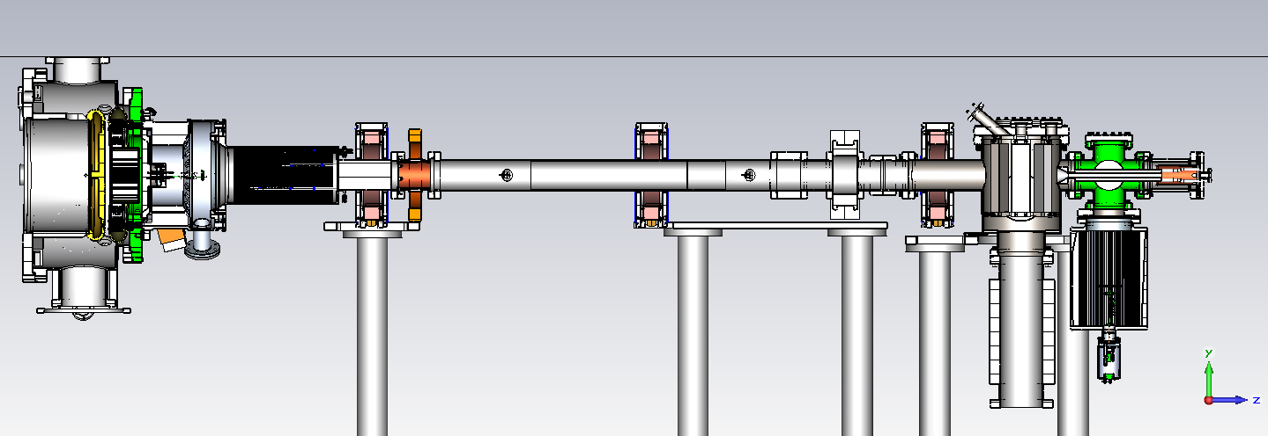
Gatling gun upgrade
NEG
TSP
BPM
FCT
Ion pump
TSP+ion
25500L/sec NEG+TSP pump
Gatling gun is upgraded : extend the beamline, add more diagnostics, improve the vacuum, redesign the HV feedthru.
Gun high voltage conditioning achieved 100kV ,meets our goal.

Slide 25
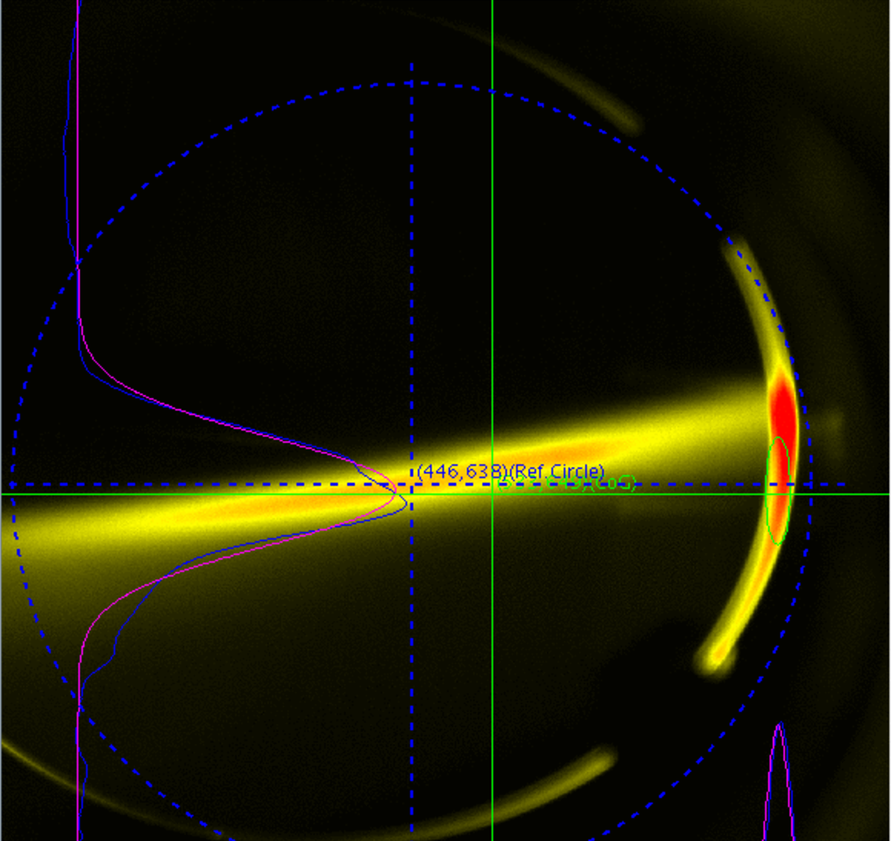
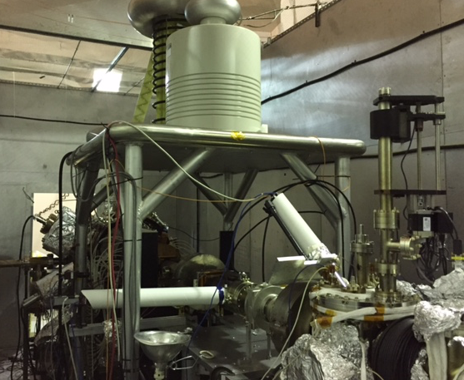
Gatling gun beam test
 | Now | check
Gun vacuum[torr] | <1*10⁻¹¹ | ✔
High voltage [kV] | 100 | ✔
Diagnostics | FCT, retractable YAG, BPM,FC | ✔
Current [uA] | 3uA stable/haven’t try higher current | In progress
Beamline vacuum[torr] | <1.2*10⁻¹¹ | ✔

Slide 26
Summary
BNL eRHIC need either high charge polarized electron source for R-R version or High charge/high current for L-R version.
A high current beam combining beamline were studied for L-R polarized electron source
We modeled the ion back bombardment induced charge lifetime. And simulated the ion back bombardment in DC gun.
A large prototype gun was optimized, designed and in fabrication right now.
We are running a beam test at Gatling gun for testing the beamline and cathode charge lifetime decay model.

Slide 27
Thanks for your attention!

Slide 28
Back up

Slide 29
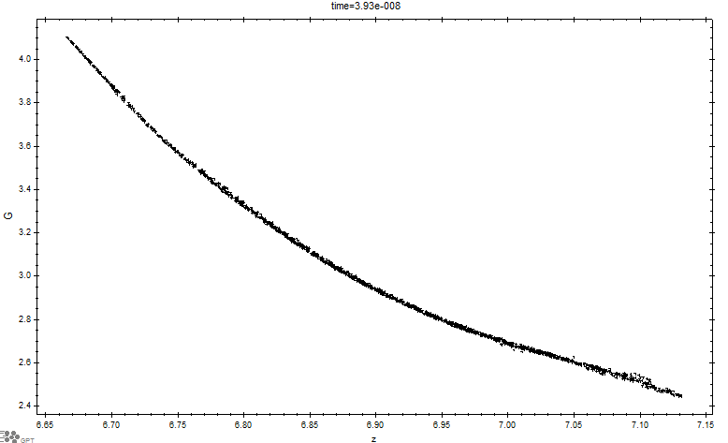
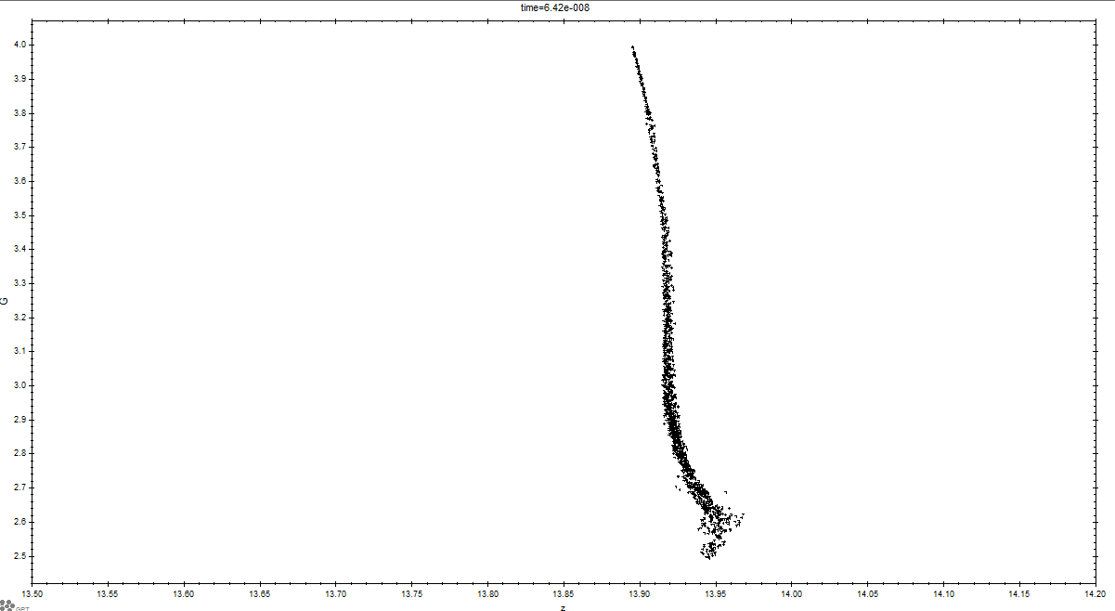
Ballistic compression
rms bunch length 9.7ps
Initial bunch length: 1.4 ns

Slide 30
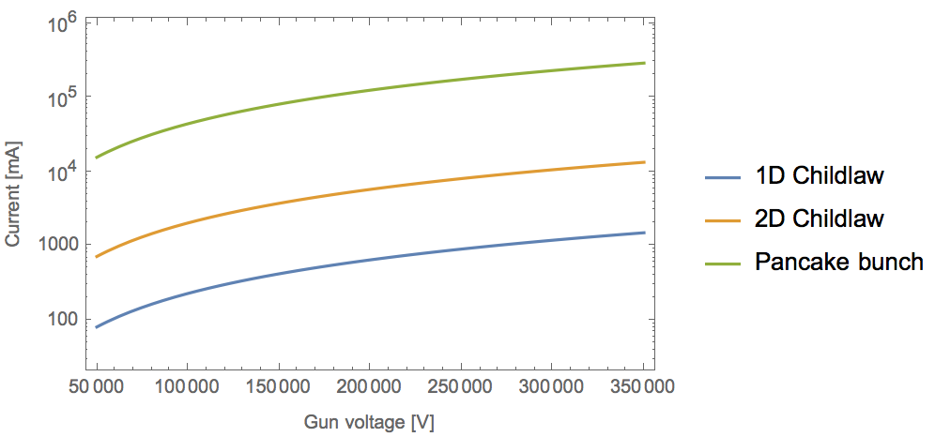
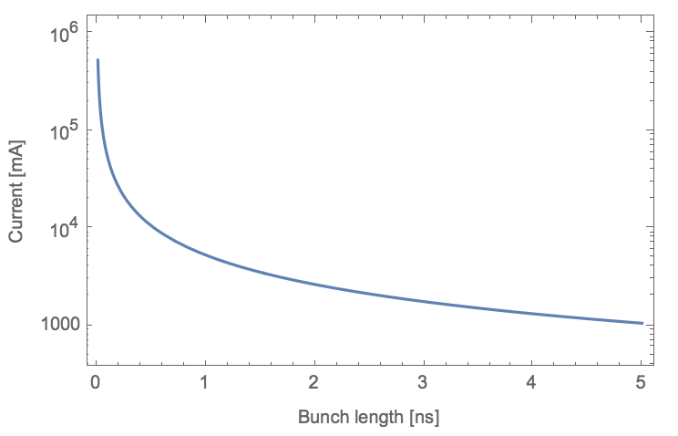
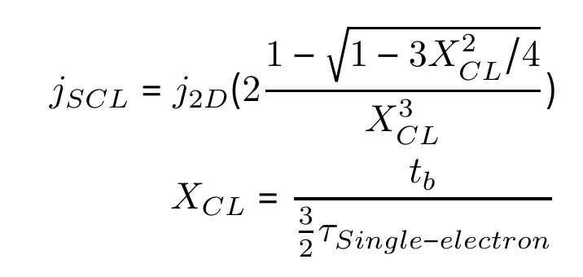
Space charge consideration
Maximum current density that can be transport across voltage gap:
Child Law 1D (r>>d):
Child Law 2D:
Pancake bunch:
Radius: 4 mm
eRHIC

Slide 31
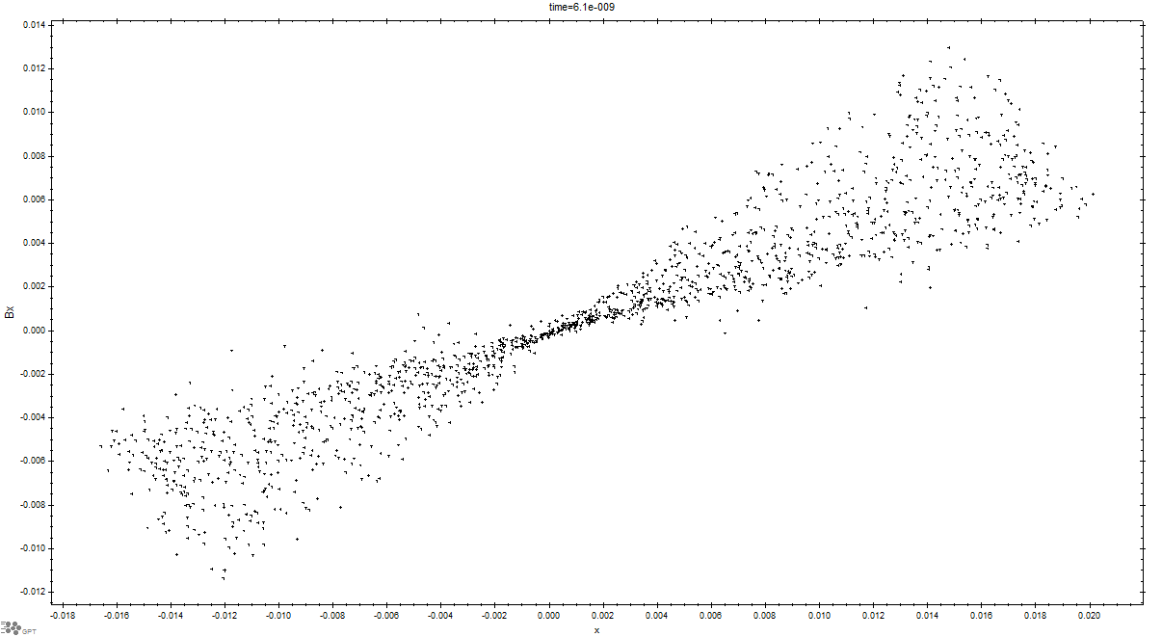
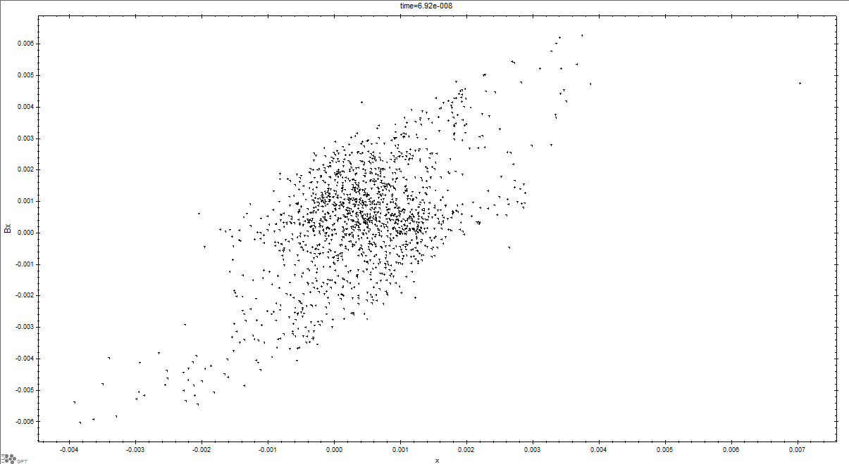
Beam Transverse normalized Emittance
Gun exit
Normalized transverse emittance:
Emitt_x=45.1 mm-mrad
Emitt_y=45.6 mm-mrad
Fine tune the combiner quads and dipole can make both same.
After boosted

Slide 32
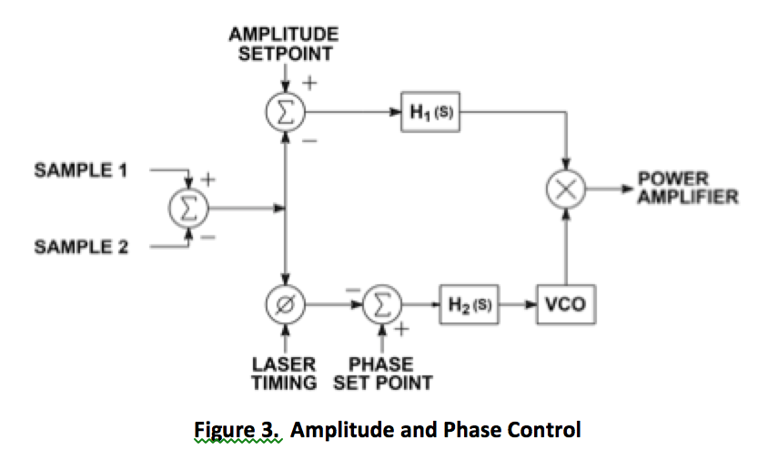
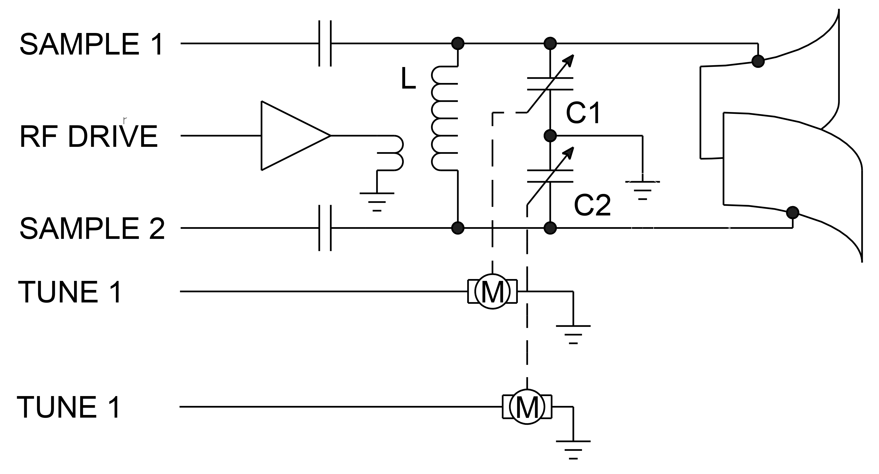
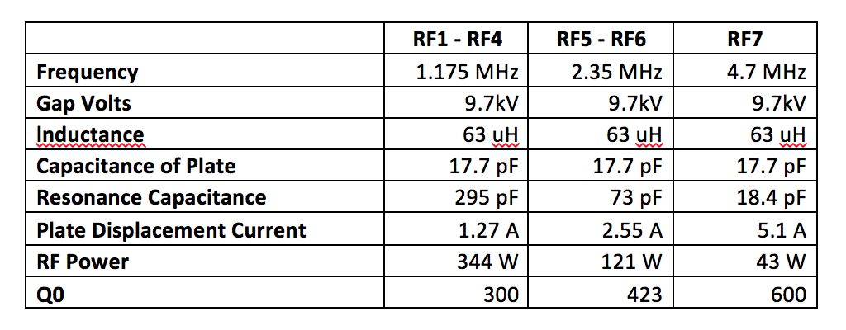
Deflector

