Slide 1
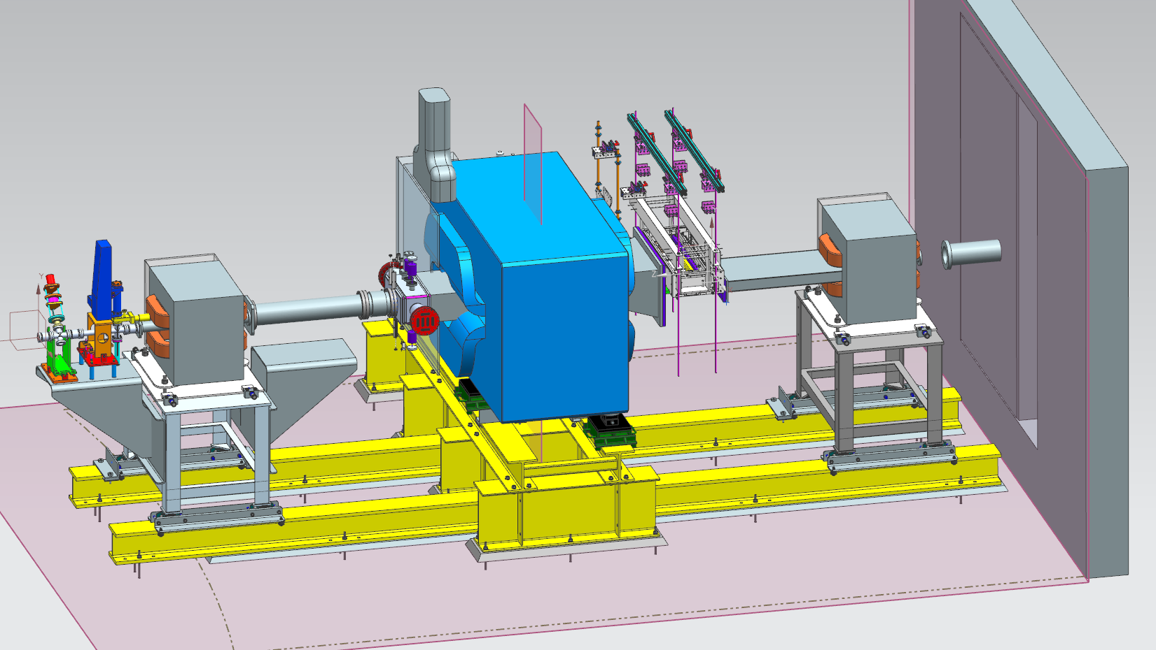
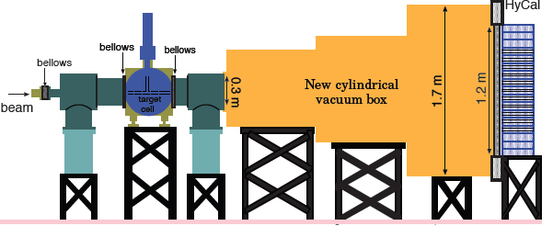
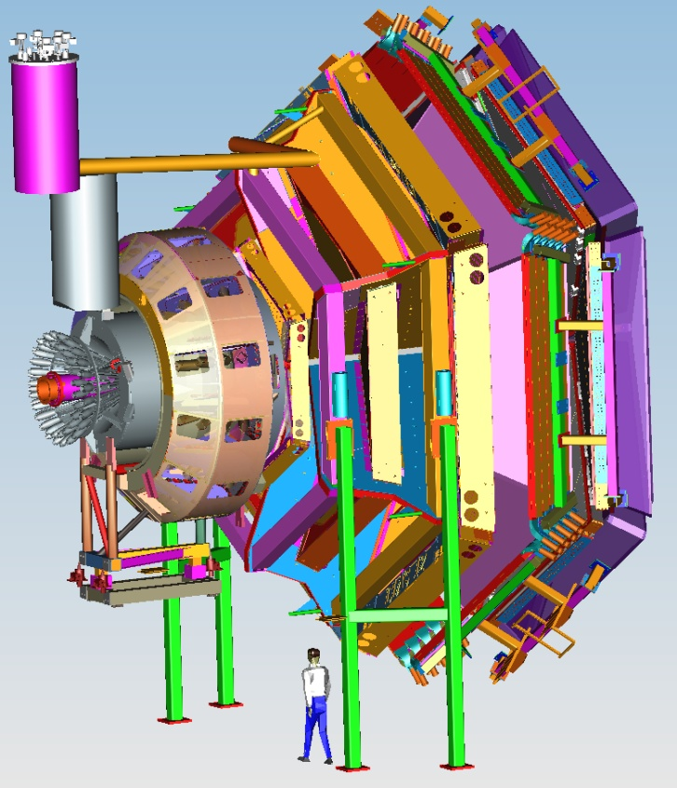



Status of Hall B
CLAS12
Volker D. Burkert
CLAS Collaboration Meeting
March 28 - 31 , 2017

Slide 2
Hall B Overview
12 GeV upgrade project nearly complete, CD4B Review May 10/11.
  All base detector construction, readout & slow controls - developed
  Torus assembly complete – magnet is superconducting and ramped up to 3800 A (I_{Design}=3770 A).
  Solenoid magnet in final assembly at ETI – shipping to JLab scheduled for May’17
Successful CLAS12 run 2/3-2/5 demonstrating the DOE Key Performance Parameter
  Event reconstruction, calibration/commissioning effort making excellent progress using data from KPP and cosmic rays for detector calibration
CLAS12 upgrades with collaboration driven equipment
  Central Neutron Detector, Forward Tagger addressing ERR, MM & RICH in final assembly stage
Solid flow of PhD theses, publications in refereed journals and conference talks
  168 PhD theses completed on CLAS results (33 in progress)
  184 science papers + 39 technical papers published in refereed journals
  Many entrances in recent RPP (PDG) editions are based on CLAS data (e.g. N*’s)
  >2,050 talks at conference (>1150 invited)
Non-CLAS experiments
  Proton Radius experiment – 2016 completed (>100% of goal) – analysis underway
  Heavy Photon Search – 2015/16 data – awaiting first results from low energy run
CLAS12 engineering & physics runs scheduled for October –December 2017

Slide 3

Technical Scope
CLAS12
Hall B
Forward Detector (FD)
TORUS magnet
HT Cherenkov Counter
Drift chamber system
LT Cherenkov Counter
Forward ToF System
Pre-shower calorimeter
E.M. calorimeter
Forward Tagger
RICH detector
Central Detector (CD)
Solenoid magnet (1)
Silicon Vertex Tracker
Central Time-of-Flight
Central Neutron Det.
  - MicroMegas
Beamline
Photon Tagger
Shielding
Cryo Target
Moller polarimeter
Polarized Targets
MM
CND
FT
Number of readout channels : 111, 832
RICH
https://www.jlab.org/Hall-B/clas12-web/

Slide 4
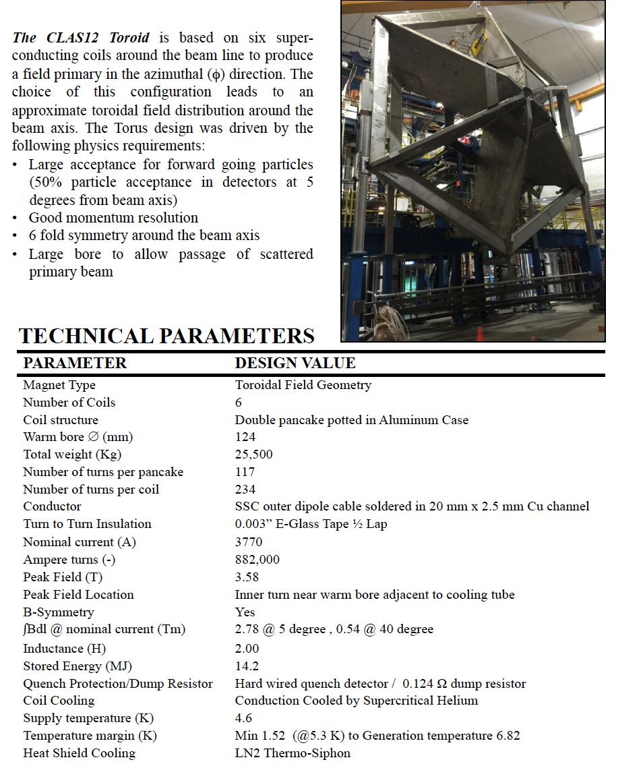
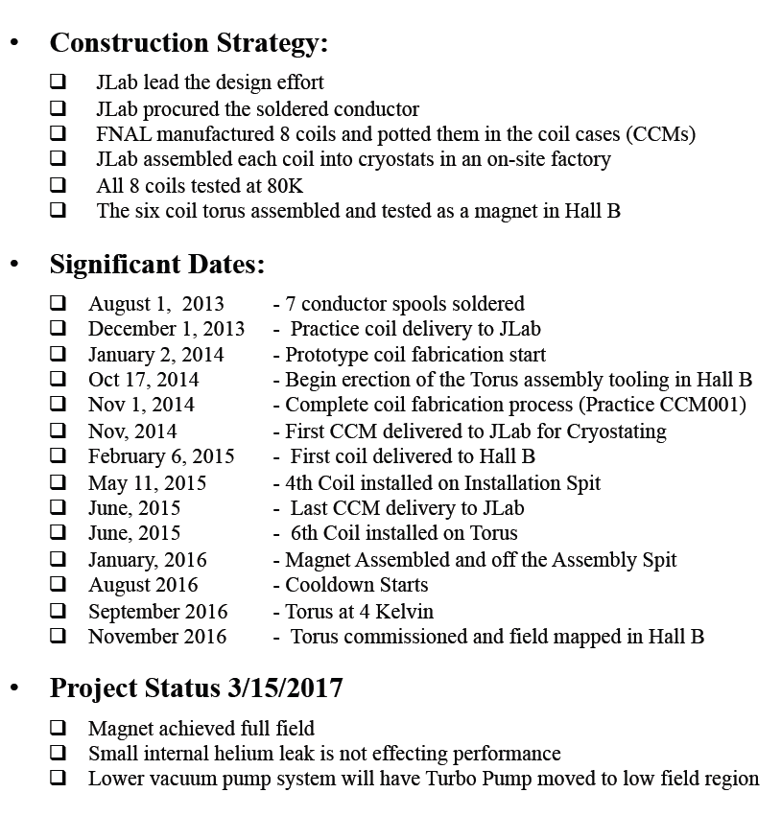
CLAS12
Torus Magnet
Hall B
3/29/17
CLAS collaboration meeting, JLab 03/28-31
4

Slide 5
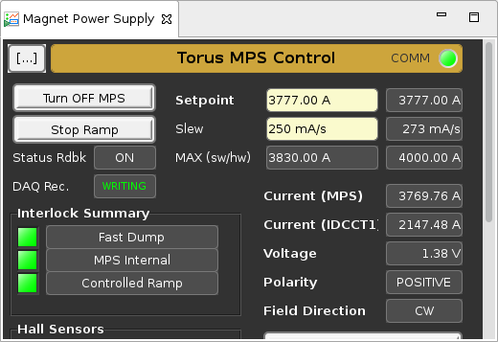
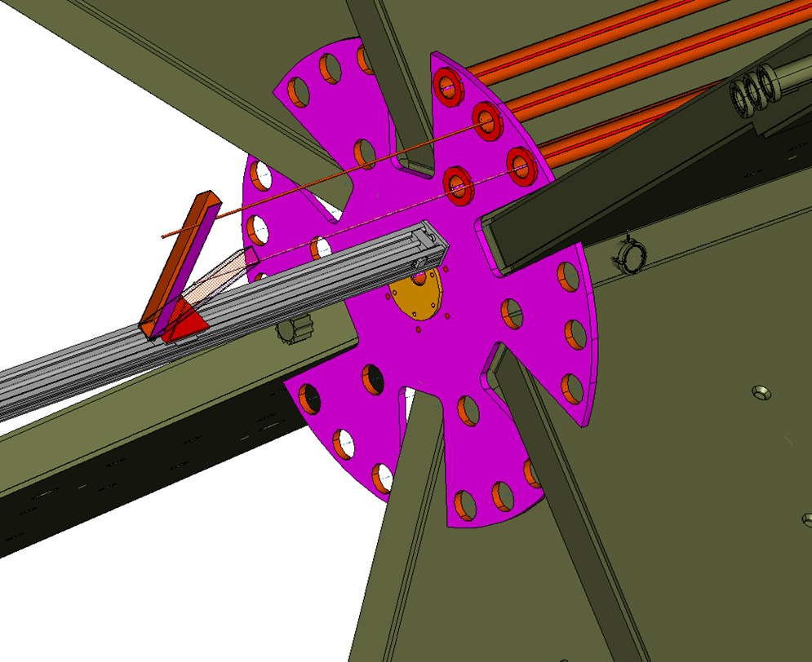
Torus magnet operational
CLAS12
Hall B
11/4/2016
D
A
C
B
Analysis of magnetic field measurements ongoing

Slide 6
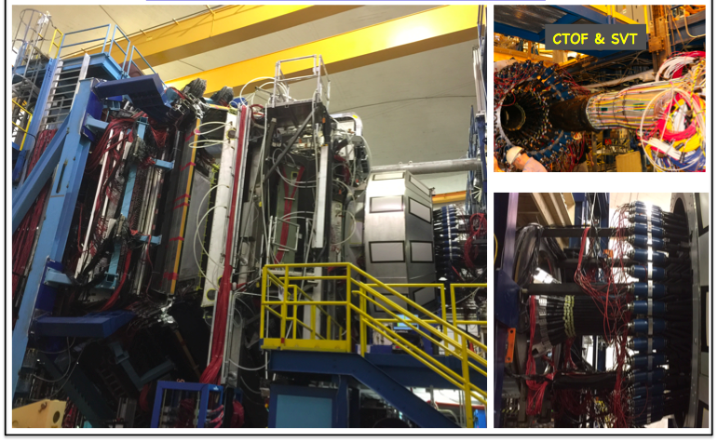
CLAS12
Equipment for KPP
Hall B
CLAS12
02/03/2017

Slide 7

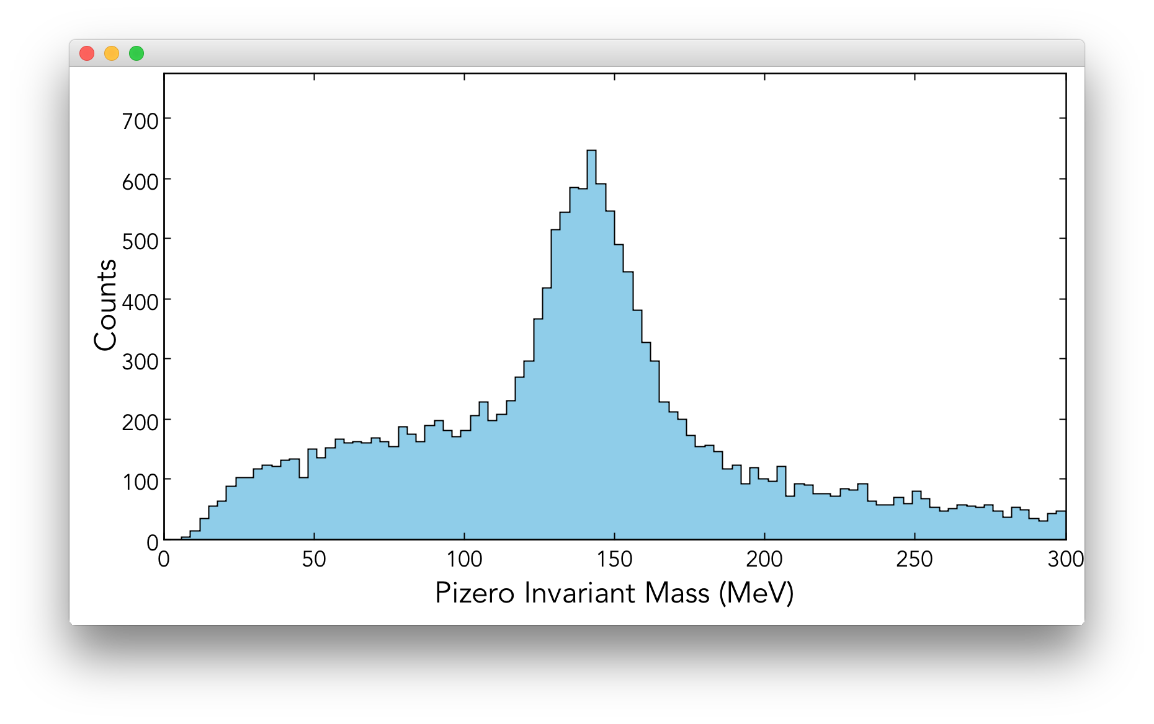
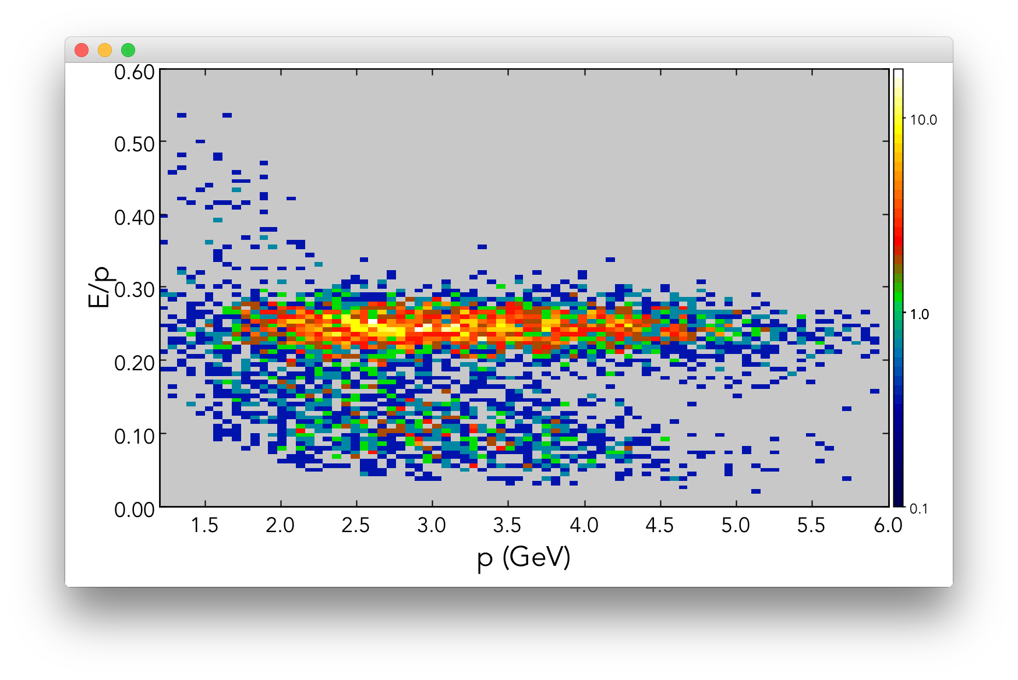
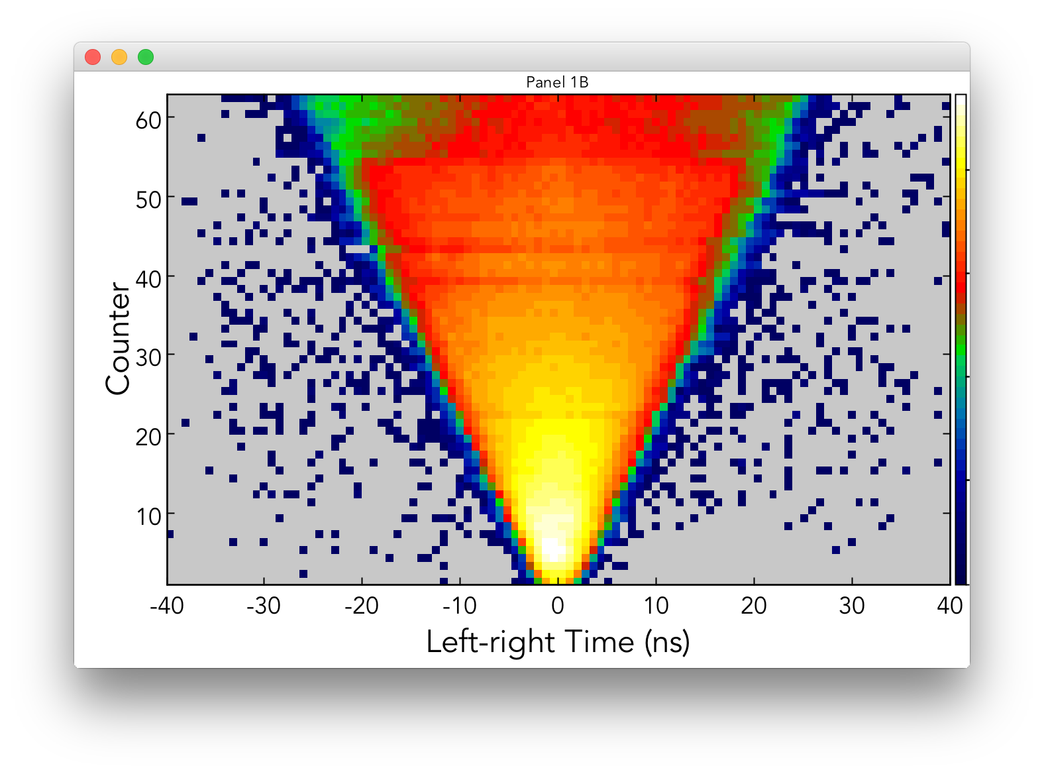
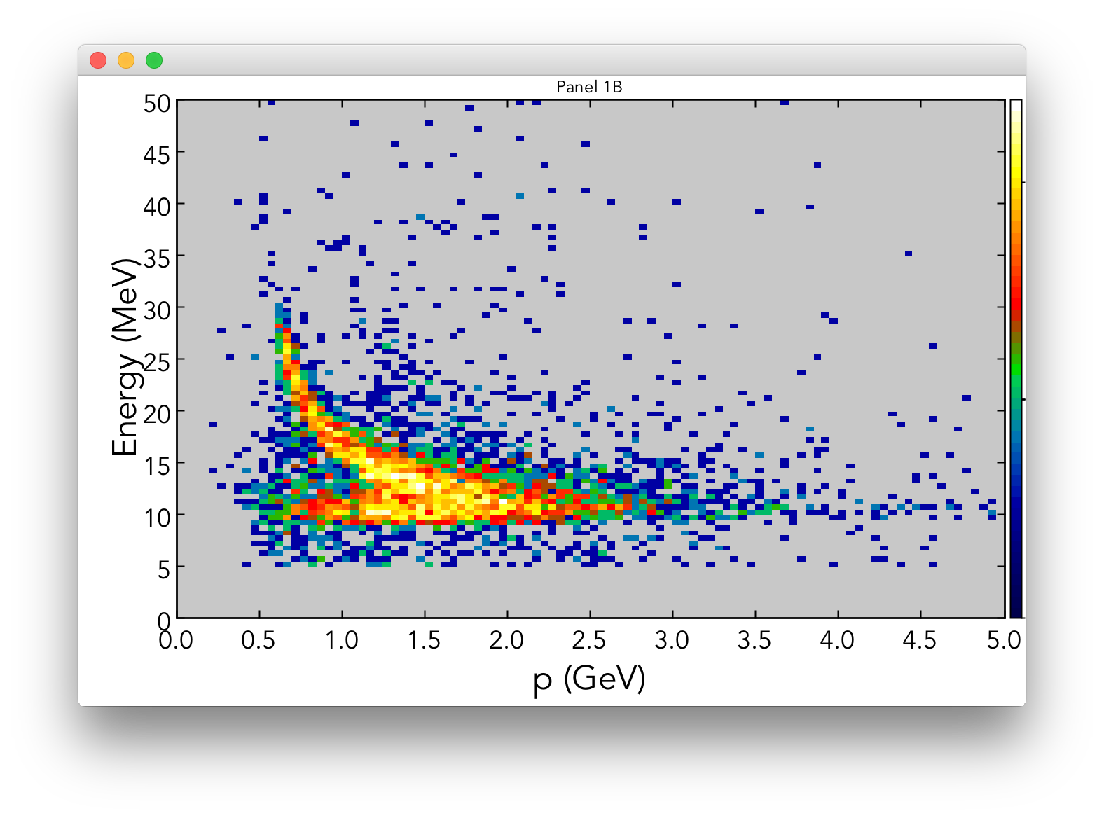
Calibration of KPP data
CLAS12
Focus on forward detectors: ECAL, FTOF, DC
  ECAL (PCAL+EC): energy calibration) based on pions
  FTOF: gain, attenuation length, effective velocity, left-right timing offsets completed, first iteration of time walk, paddle-to-paddle in progress
  DC: first iteration of T0 and time-to-distance calibration
Great opportunity to test procedures, identify issues & improve algorithms
Limitations due to single sector DC
Alternative procedure to calibrate detectors in all sectors being developed
2 photon invariant mass
ECAL sampling fraction
FTOF panel 1B
FTOF panel 1B

Slide 8
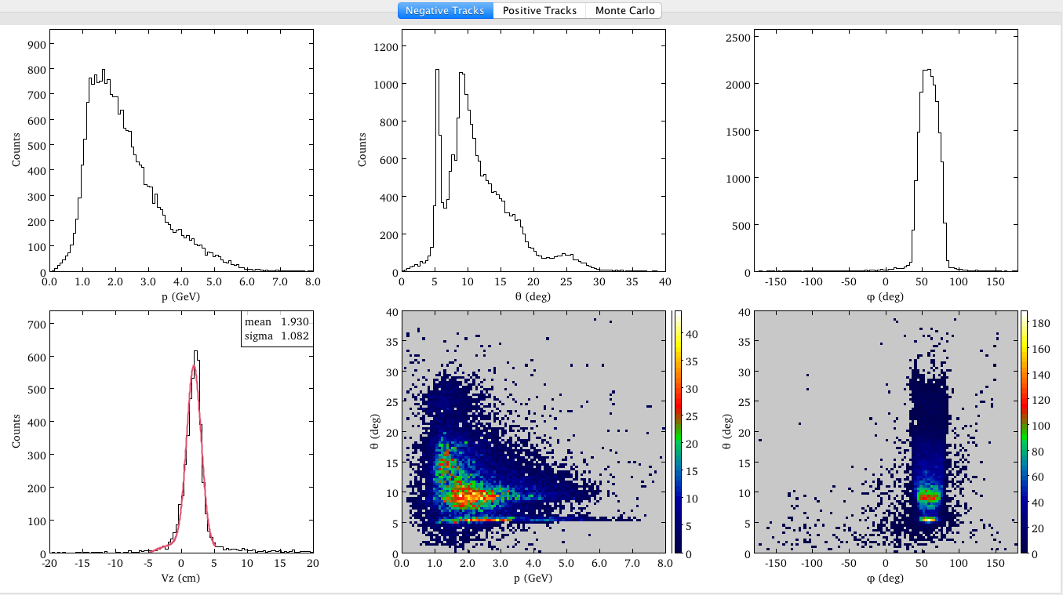
Tracking in Forward Detector
CLAS12
E_{e}=6.4 GeV, calorimeter trigger in S2 only, negative tracks outbending, no solenoid field
Out-of-time-hits
rejection
Missing one superlayer in Region-1
z-vertex
Sector-2 tracking
momentum spectrum

Slide 9
Tracking in Forward Detector
CLAS12
Background segment
rejection

Slide 10


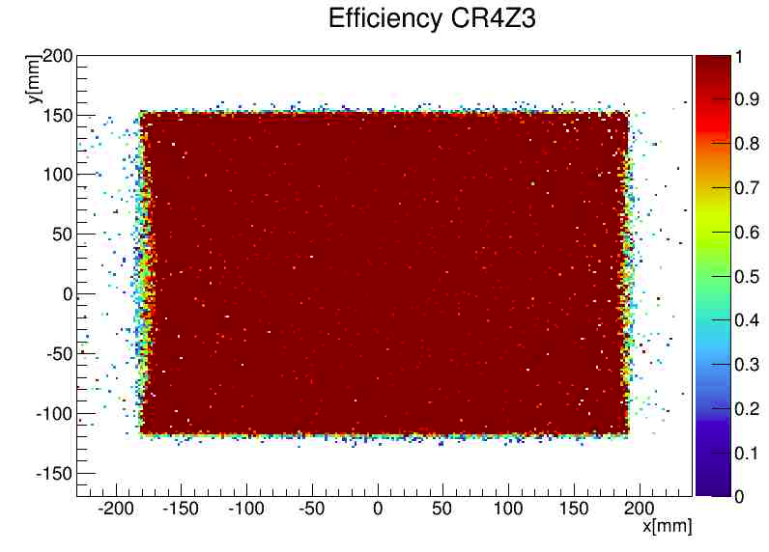
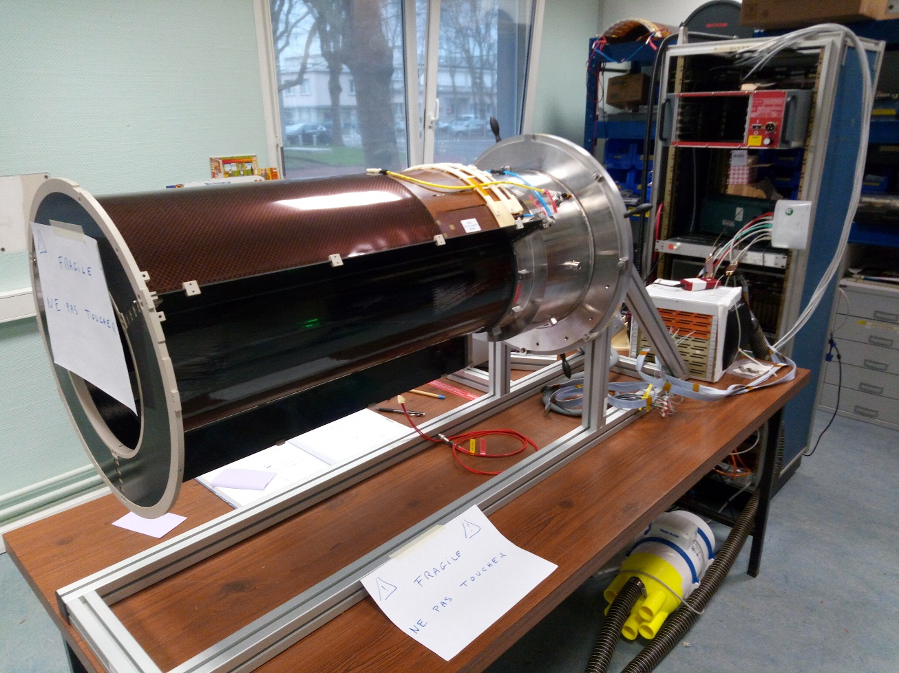
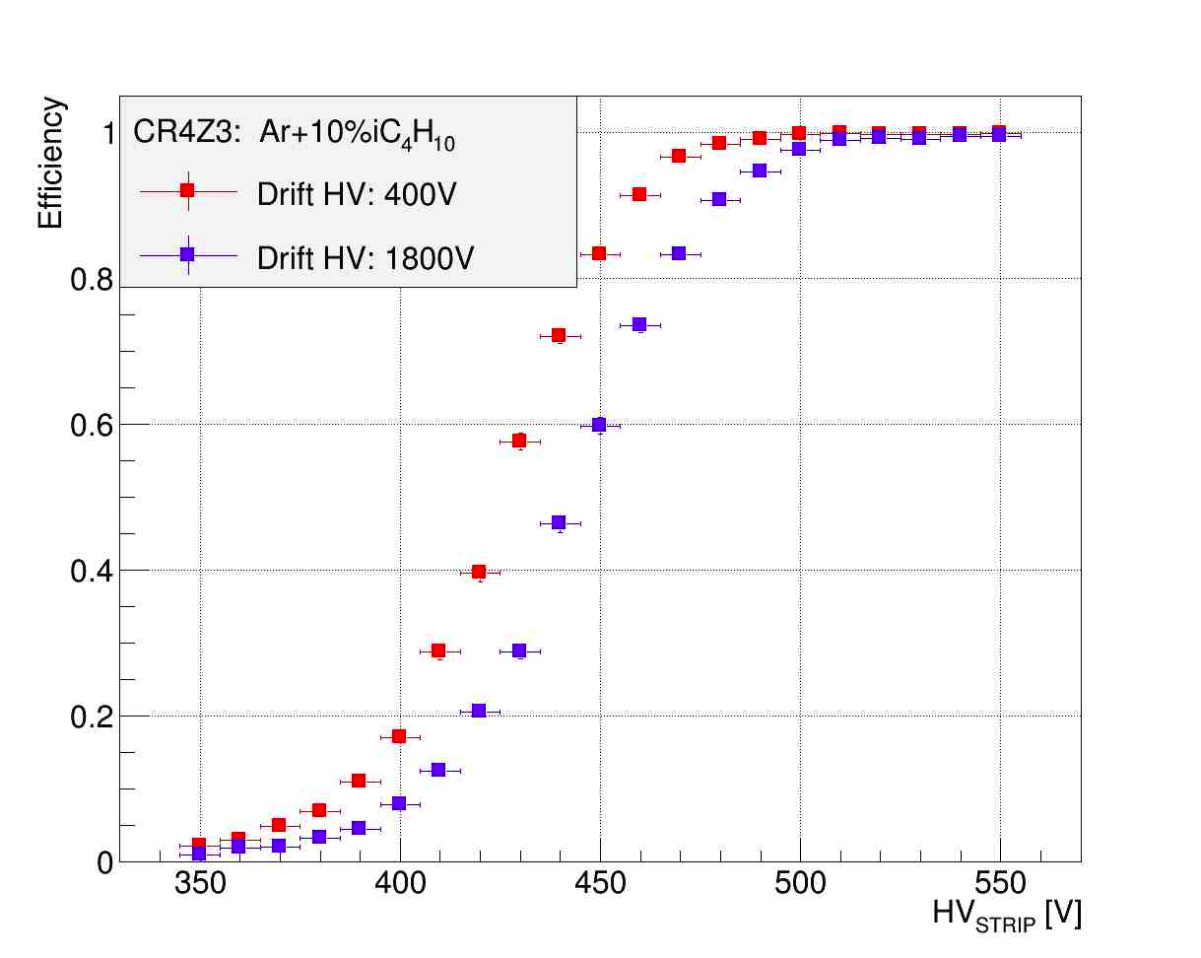
Micromegas Vertex Tracker
Mechanical structure for the B6 configuration is ready.
75% of tiles constructed and are being tested.
Detectors will be delivered and integrated with SVT in early June.
MVT B6 structure with CR6
Efficiency test for an inner tile of MVT

Slide 11
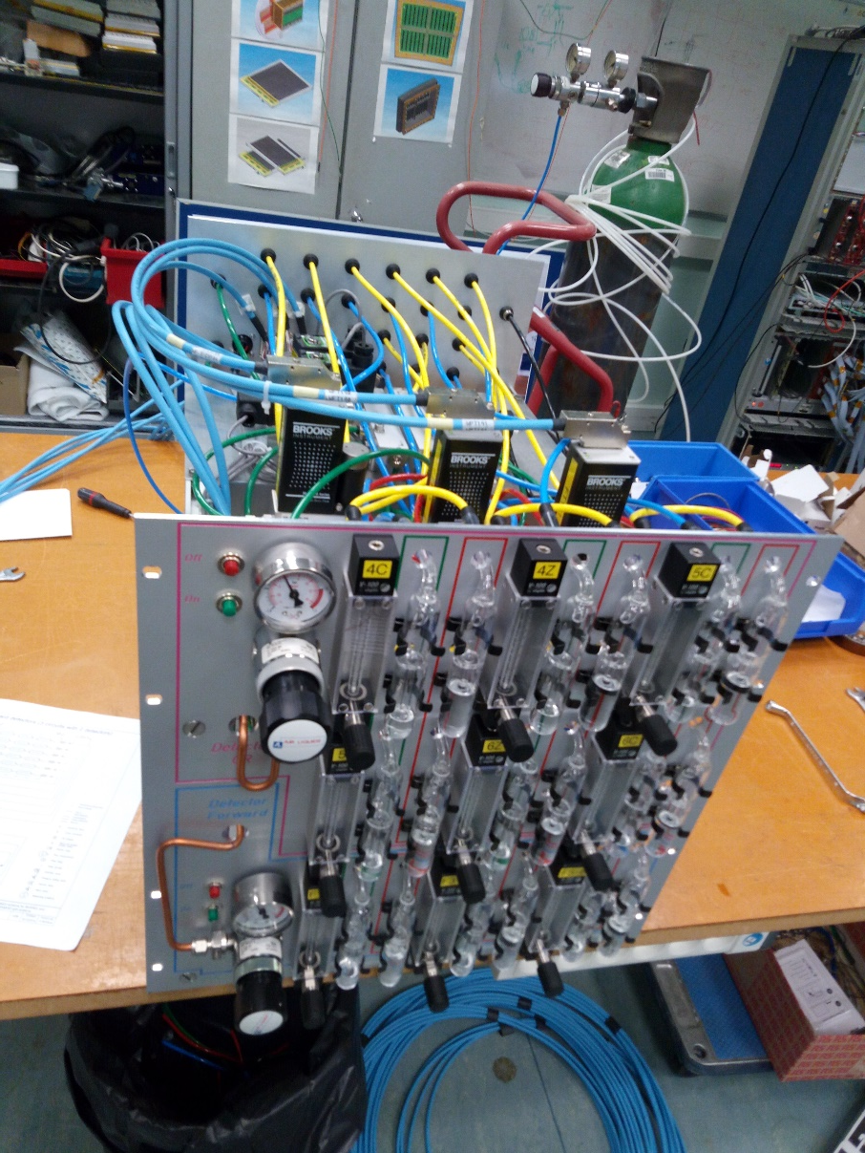
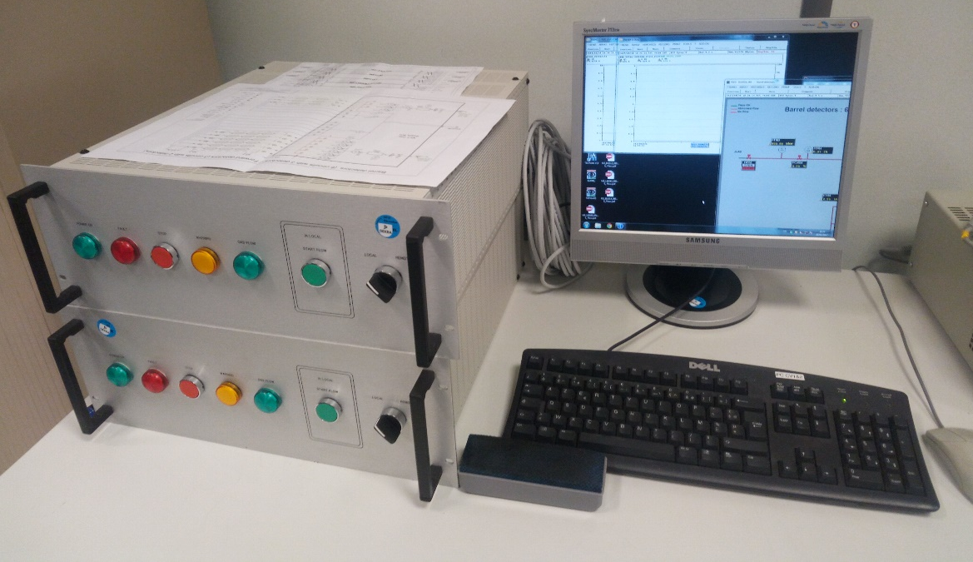
Micromegas Gas System
Gas distribution rack done and tested.
The control rack with PLC is being tested with the distribution gas .
In June, everything will be ready to receive the gas.
MVT barrel and forward gas control rack
MVT distribution gas rack under test

Slide 12
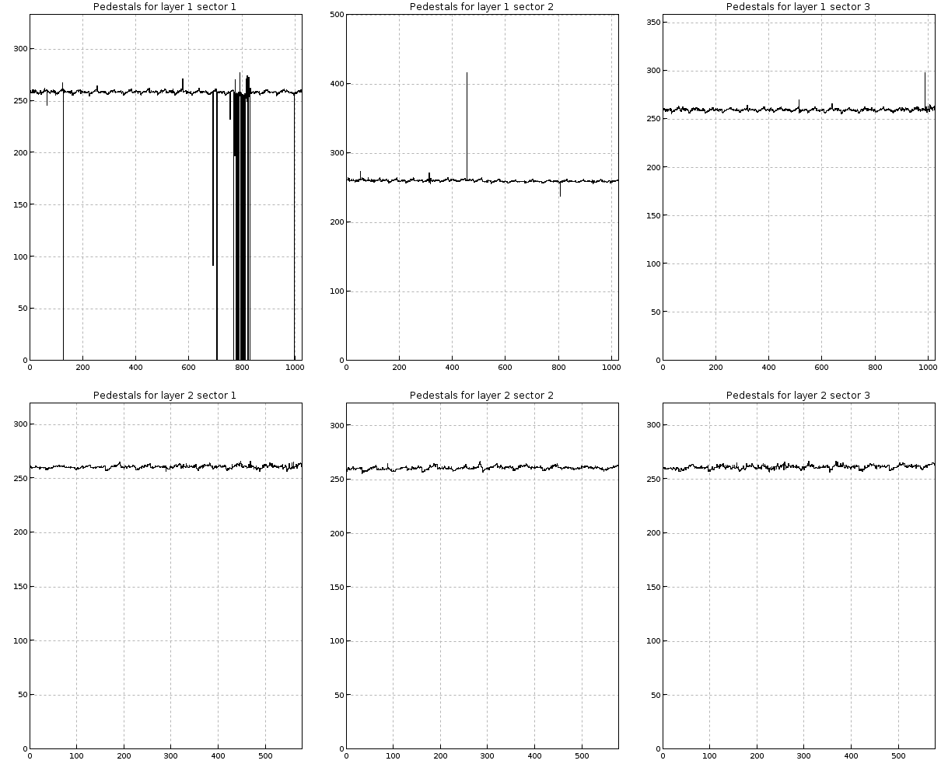
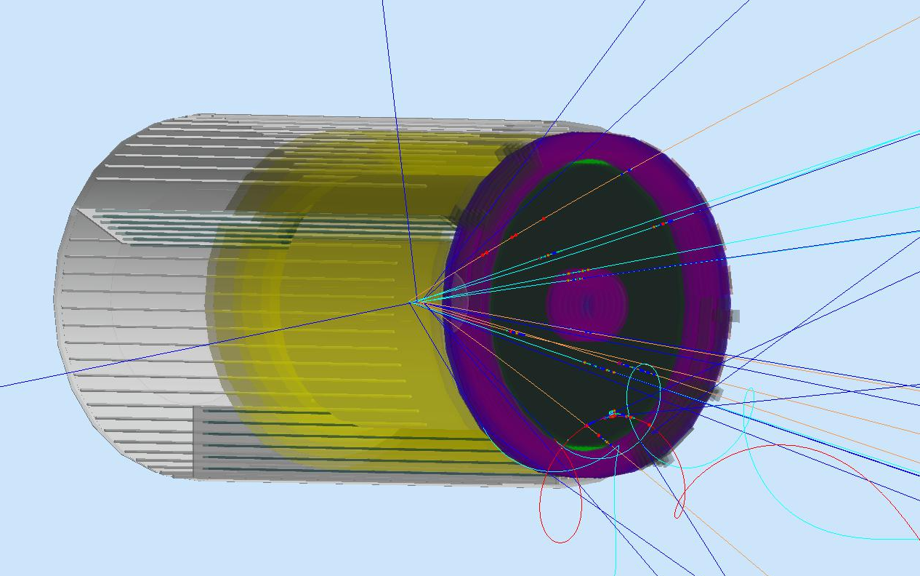
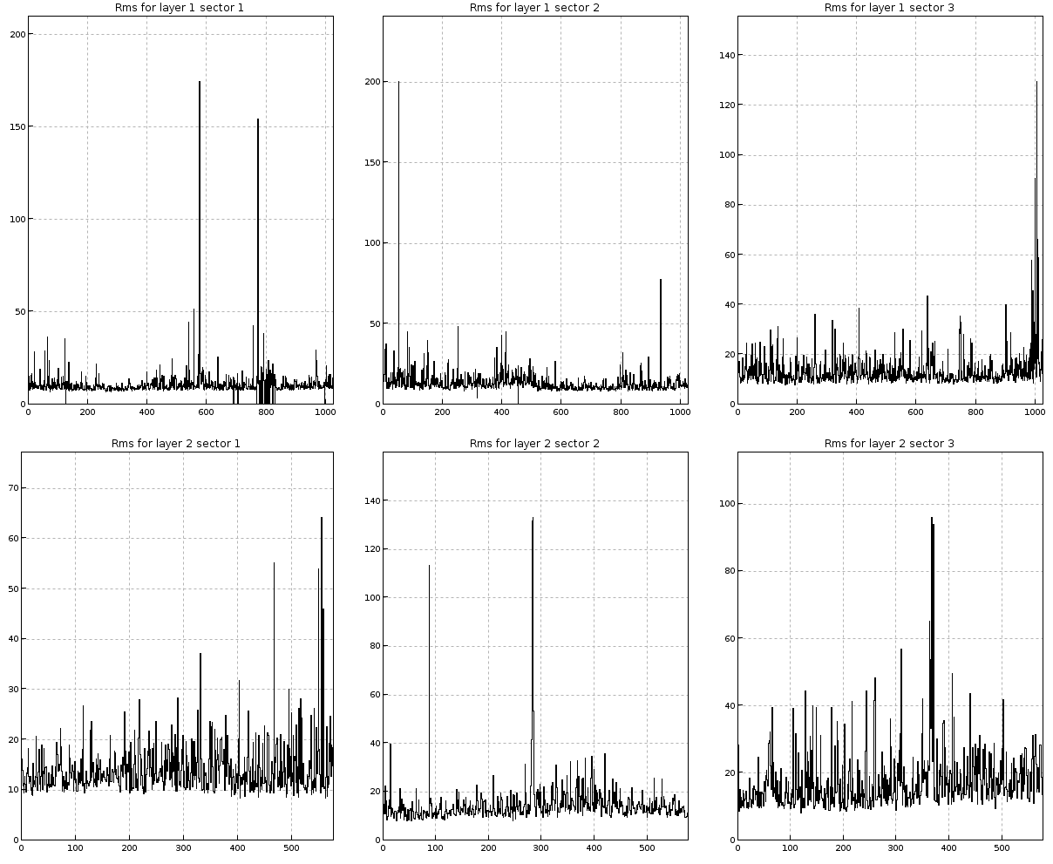
Calibration system + GEMC
Calibration code nearly complete.
Monitoring and calibration code will be merged to coatjava in April.
MVT in GEMC
MVT Calibration system
Hit processing routine
Hit process routines improved for micromegas (FTT and MVT) in GEMC
Next step: Implement B6 configuration
Notes:
Cliquez sur Insertion puis En-tête/Pied pour saisir les champs « Evènement – Date » et « Service » ; puis cliquer sur Appliquer partout.

Slide 13

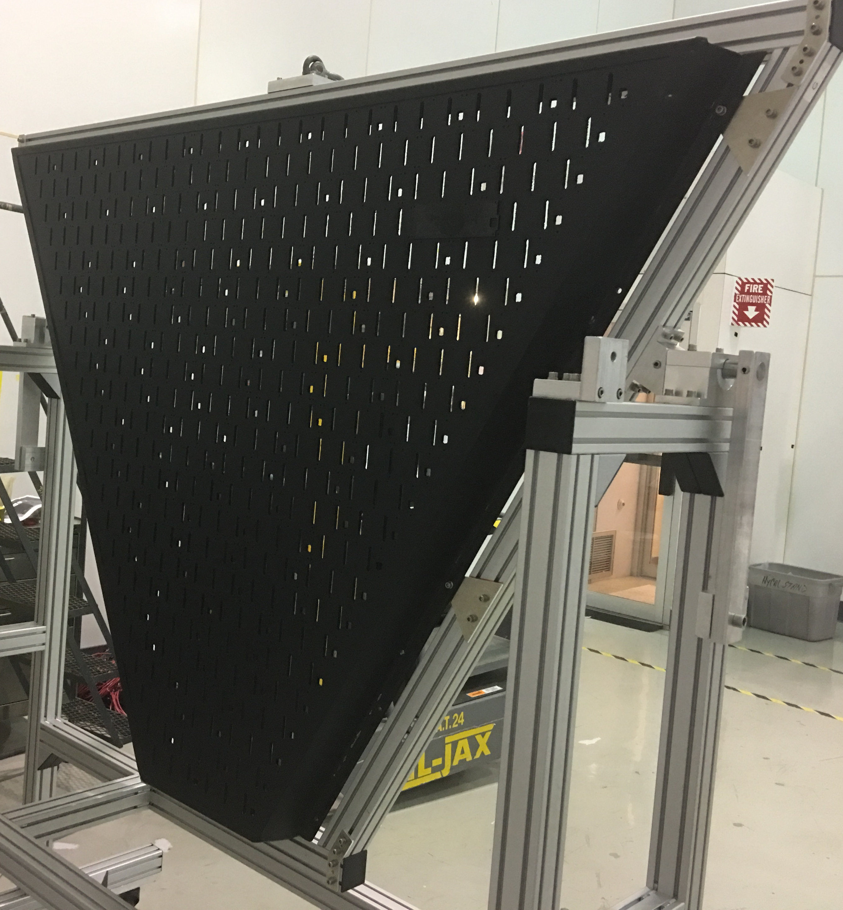
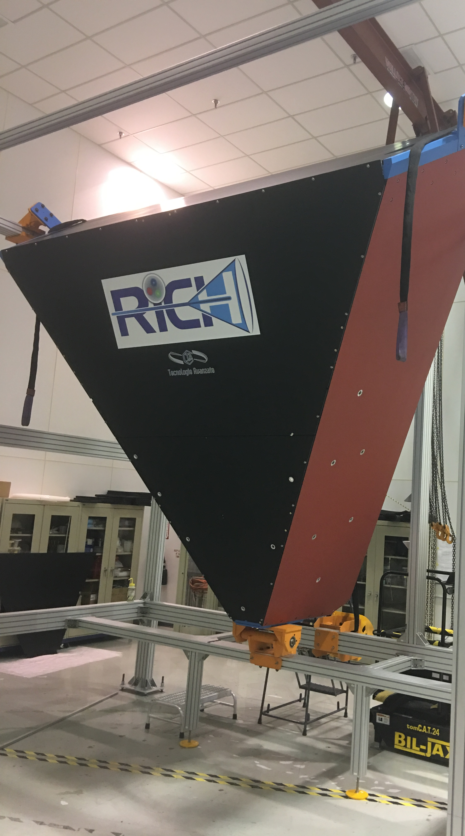
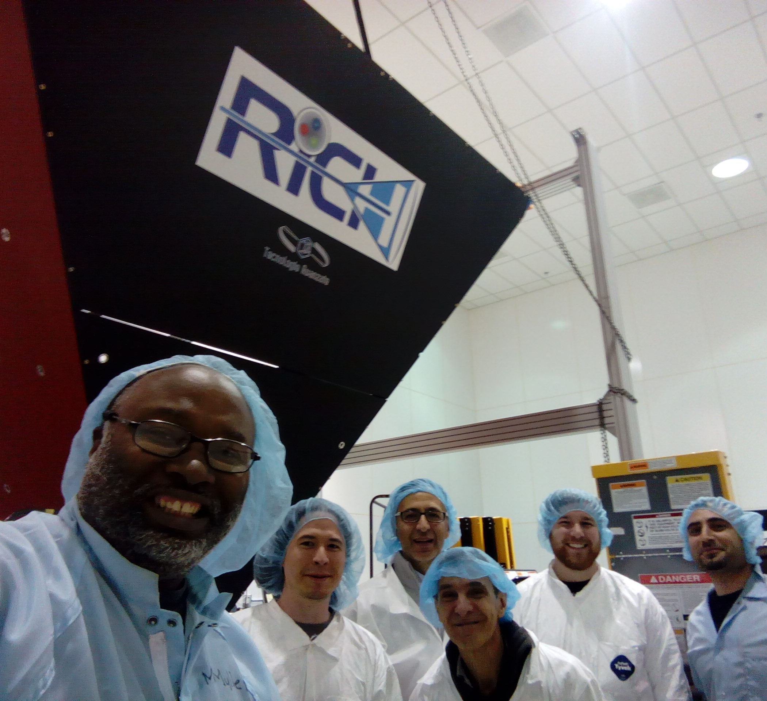
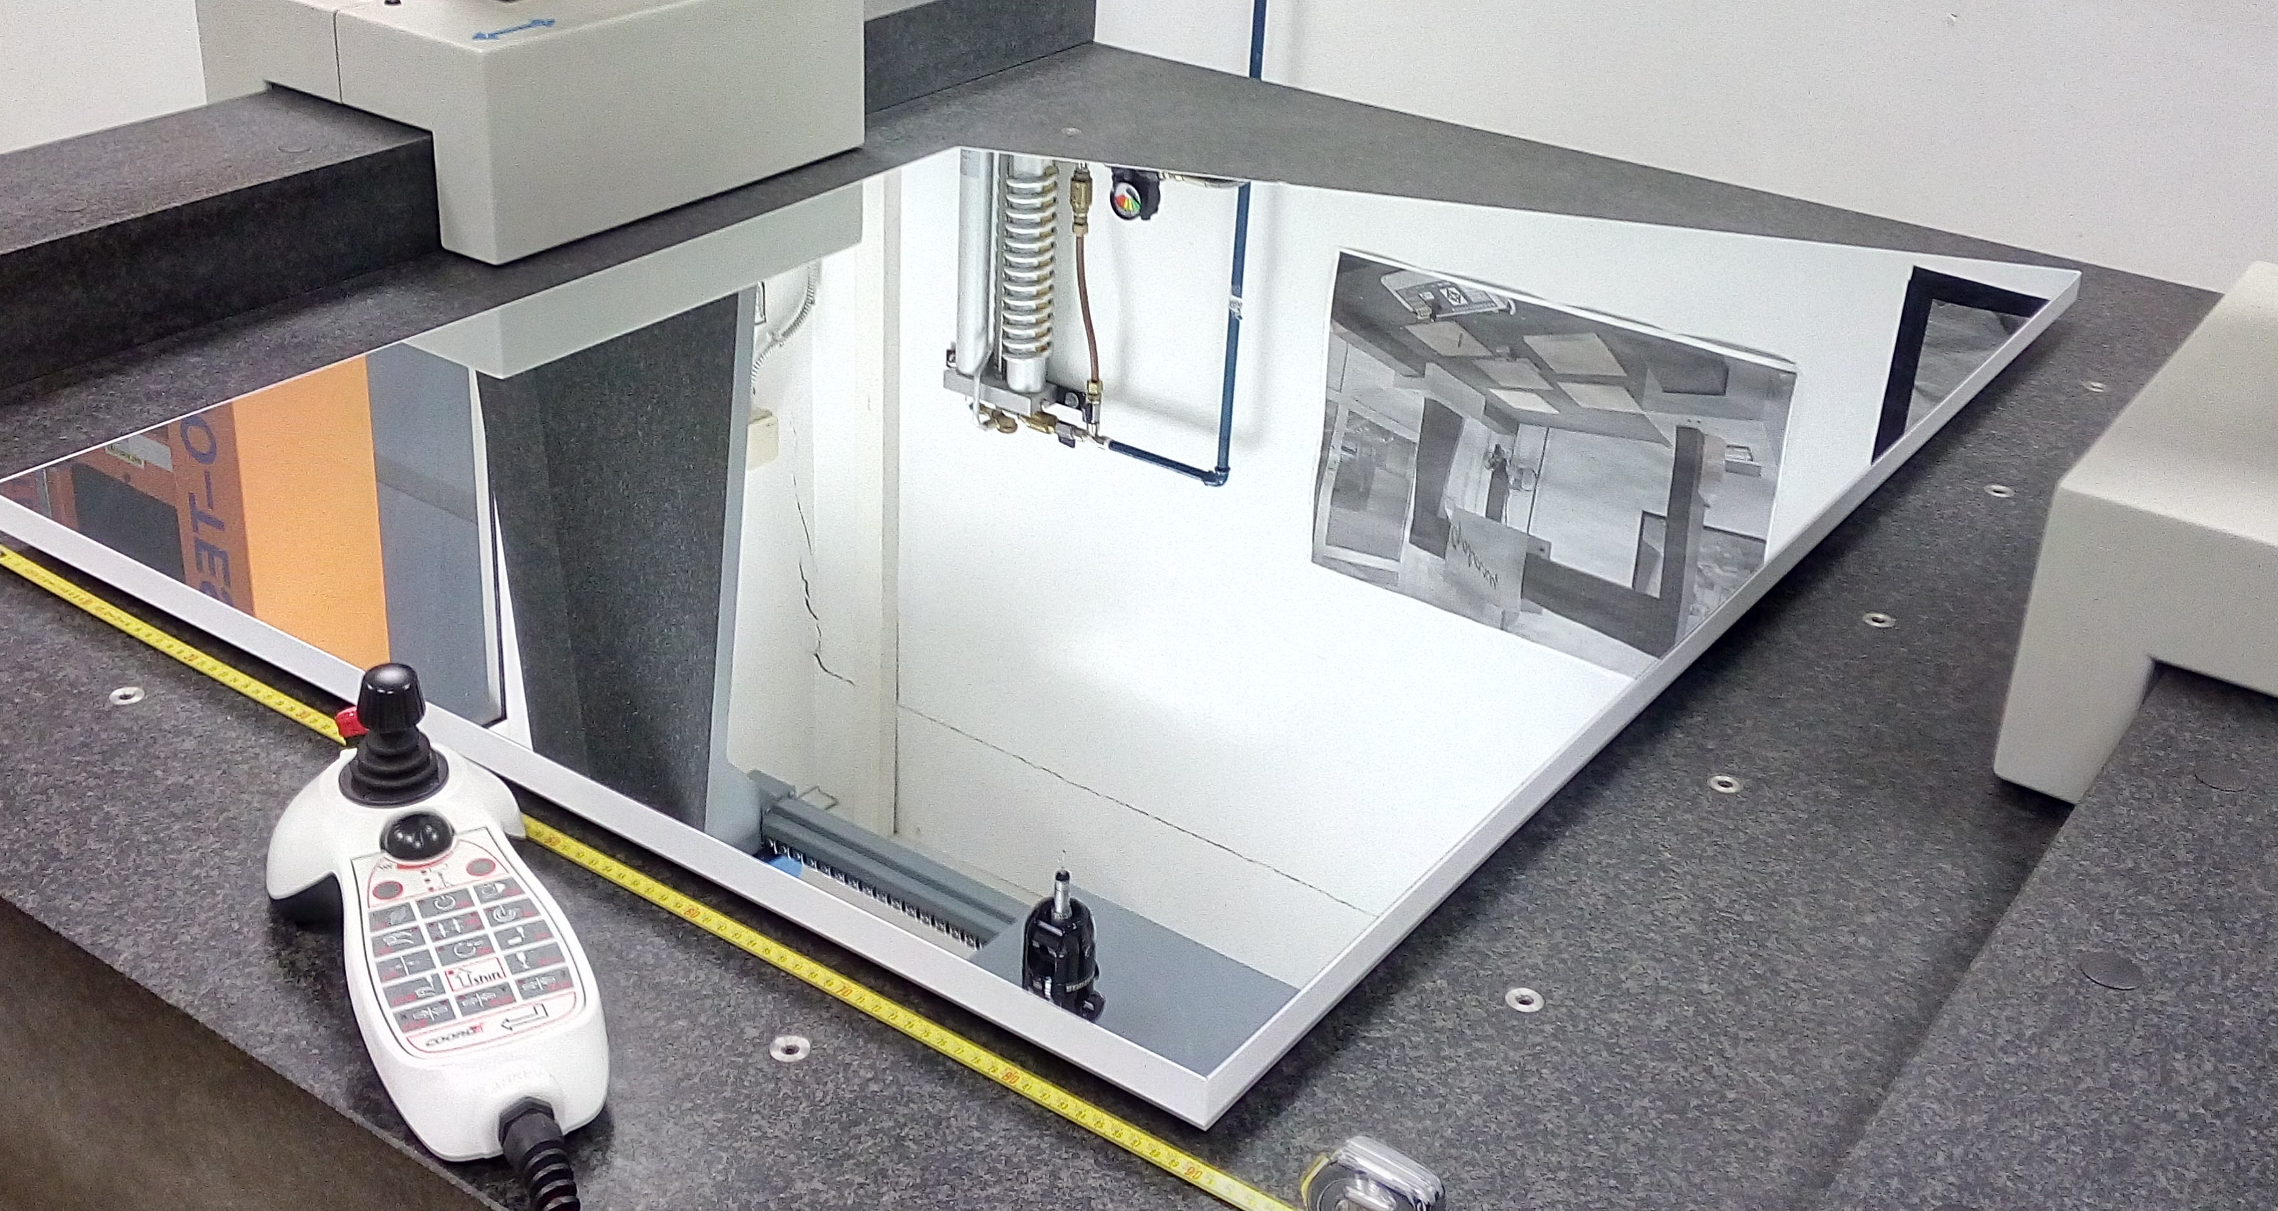
CLAS12
RICH Detector
Mechanical structure
- Assembling at JLab ongoing with help of DSG
Support structure for the electronics panel
arrived to Jlab
Spherical mirrors:
- All 10 mirrors received and accepted
- Back to vendor to build support and alignment structure
Electronics panel with support ready at Jlab
Planar mirrors:
- 3/5 lateral mirrors accepted
- 2 front mirrors in production
RICH structure assembled at Jlab!
3/29/17
CLAS collaboration meeting, JLab 03/28-31
13

Slide 14
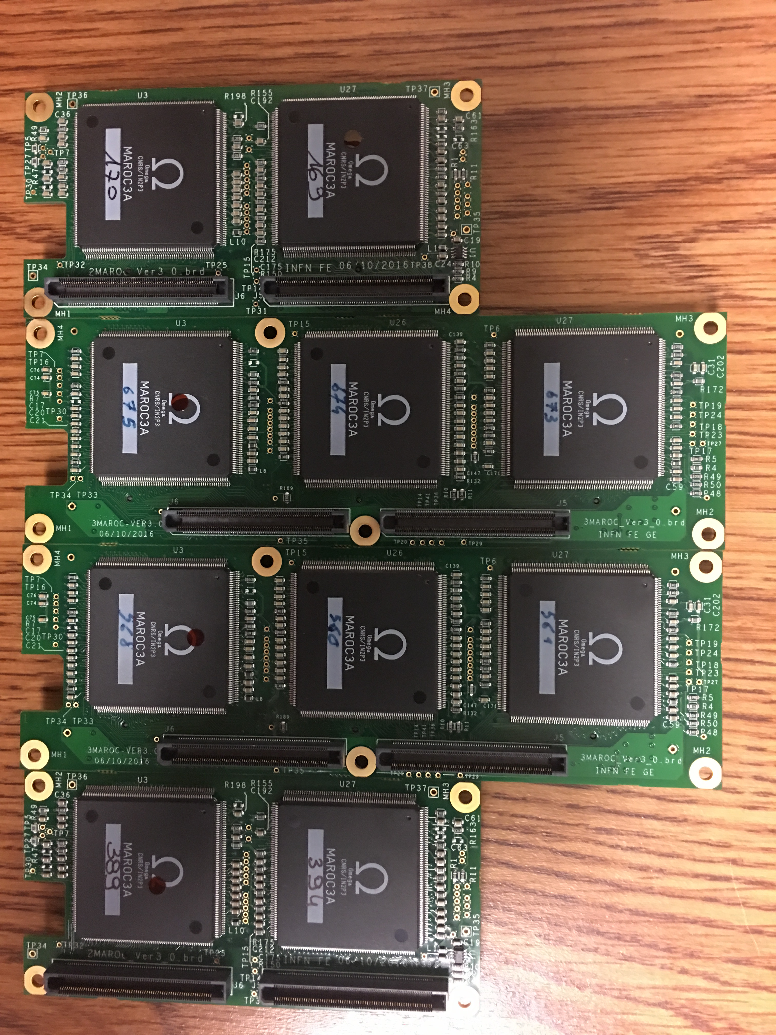
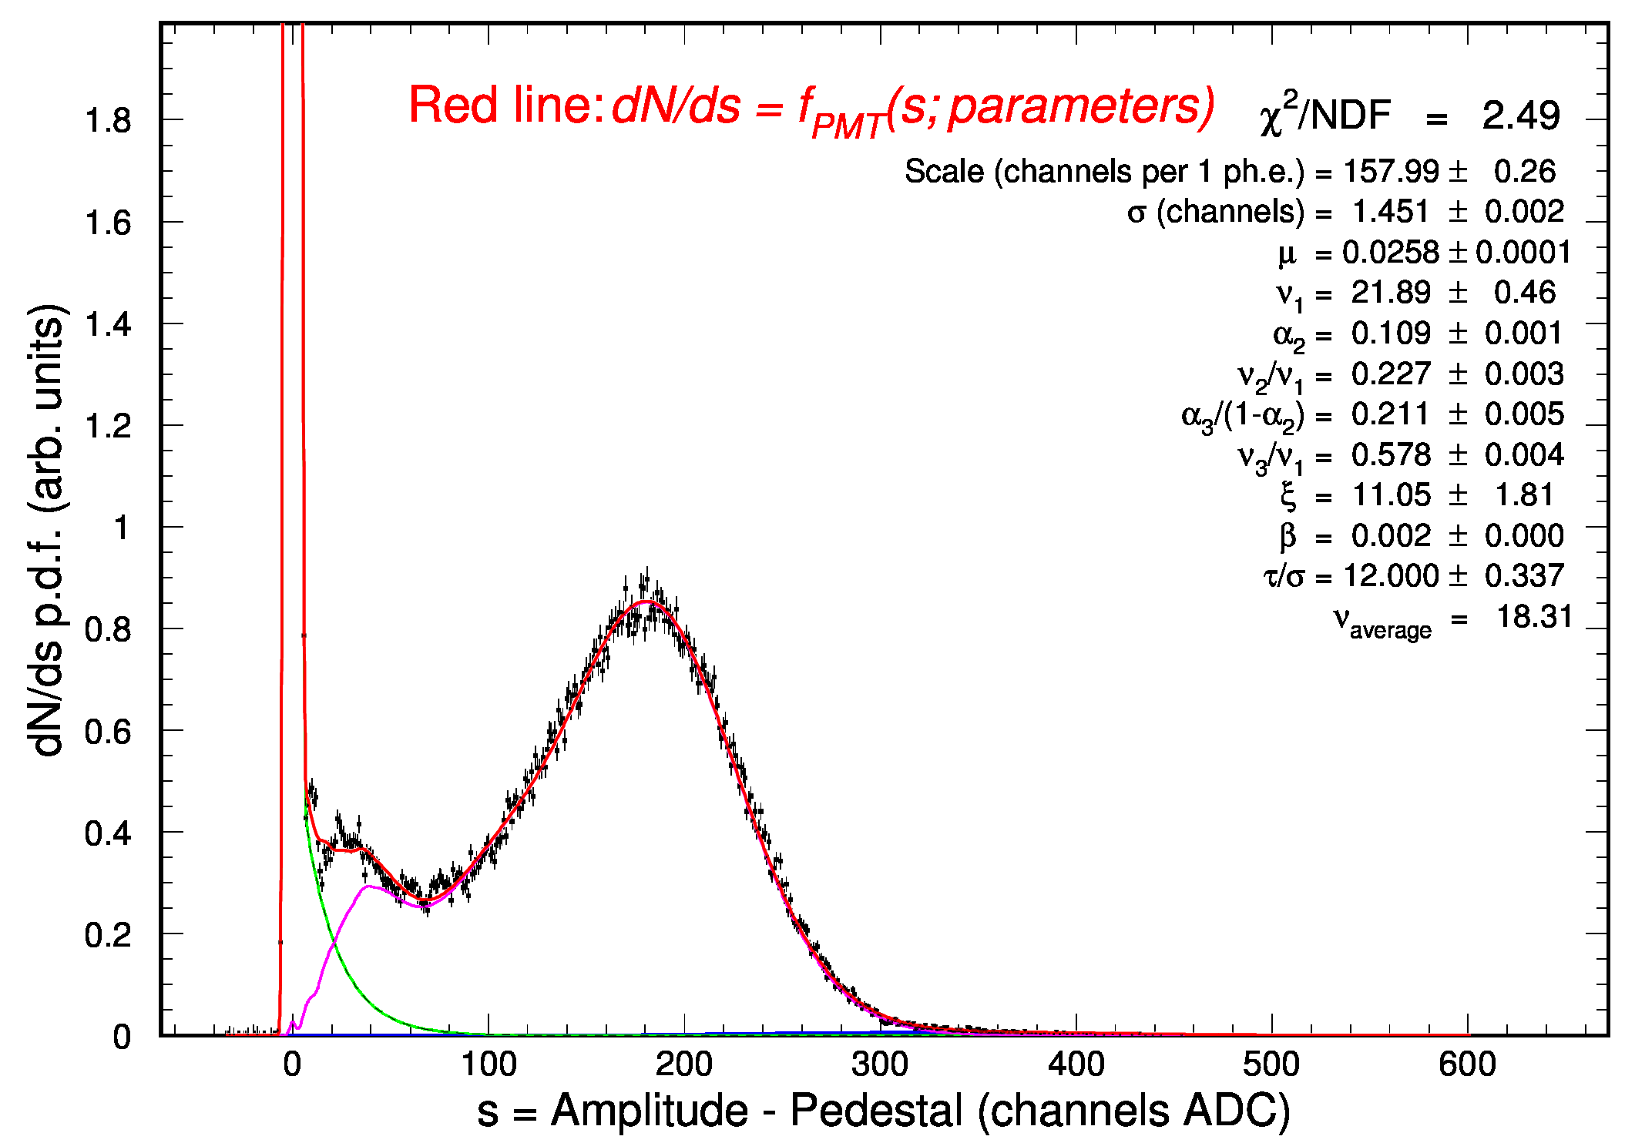
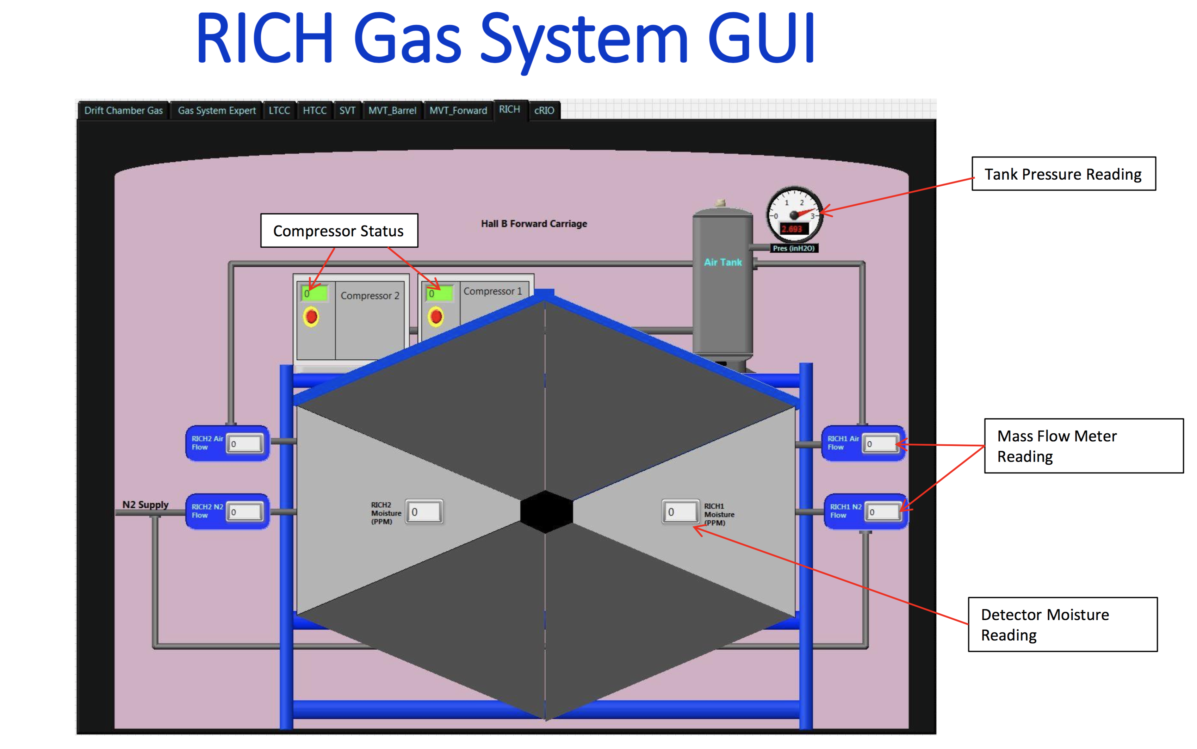
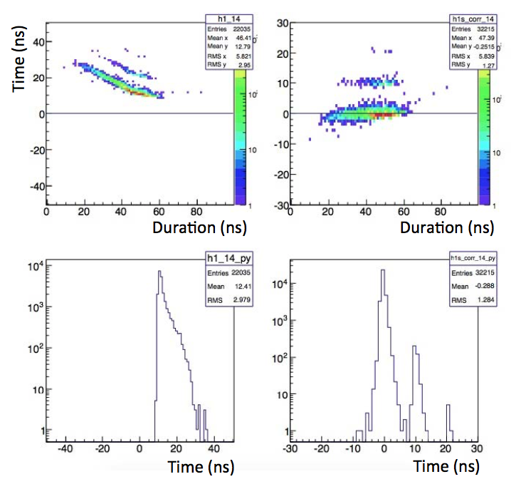
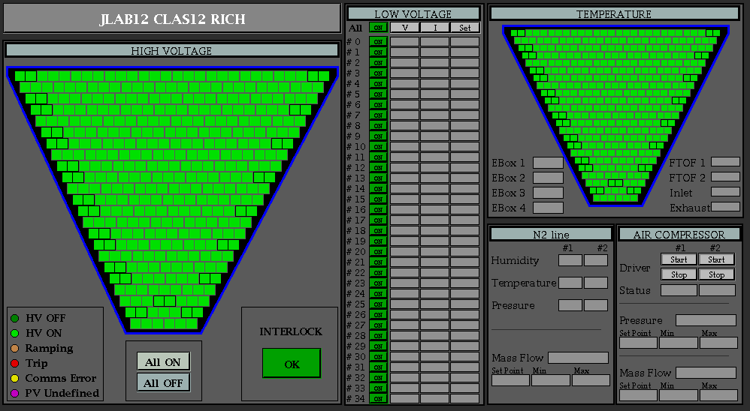
CLAS12
RICH Detector
Aerogel:
Received over 75% of the minimum required
quantity of 3cm tiles
- 2cm layer production started
Electronics:
All electronics front-end boards are at JLab
Acceptance tests done at the company
- Electronics boards characterization ongoing
- σ(ped)/1phe ~ 1%
One photoelectron spectrum
taken with new front-end
Digital time walk correction
Slow Control design ongoing
On schedule for the installation in Hall B in September 2017
3/29/17
CLAS collaboration meeting, JLab 03/28-31
14

Slide 15

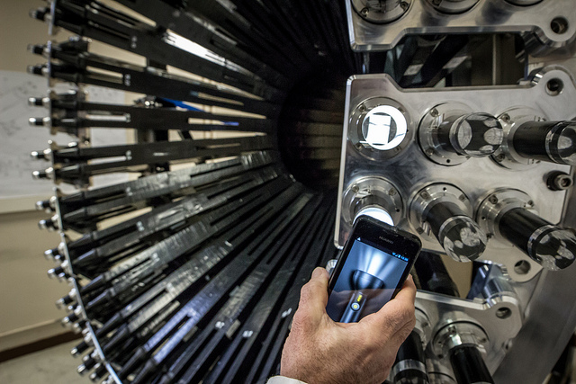
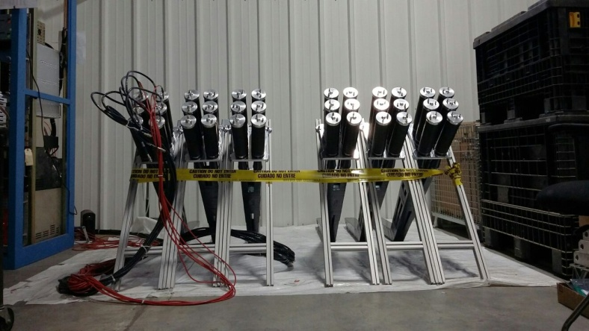
Central Neutron Detector
CLAS12
Recent achievements:
Construction completed
Detector at JLab (ESB building) since 6/2015
HV calibrations of PMTs completed
Cosmic data analysis: σ_{t} ~150 ps for all blocks
Assembly in mechanical structure done in Orsay
Cosmic rays tests at JLab using CLAS12 electronics, confirmed Orsay results for time resolution
June 2016: Ancillary Equipment ERR
Calibration, monitoring, simulation and reconstruction software 90% complete
v_{eff} , time offsets calibrations demonstrated at calibration challenge (12/2016), ADC calibration and attenuation length near completion
GEMC digitization undergoing improvements
CND @ Orsay
CND @ JLab
Plan for 2017:
Installation in the CD after solenoid magnet commissioning (09 ‘17)

Slide 16
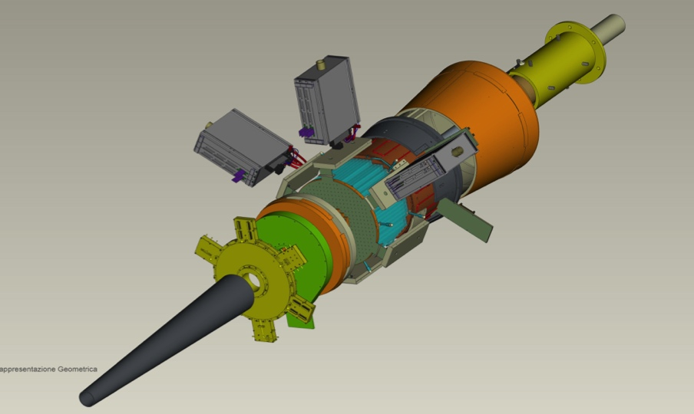
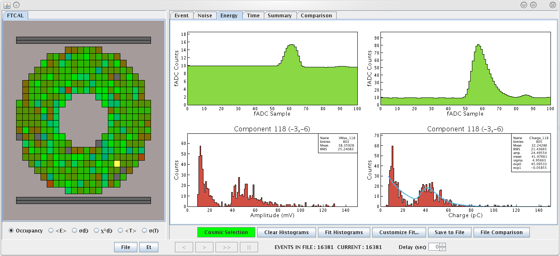
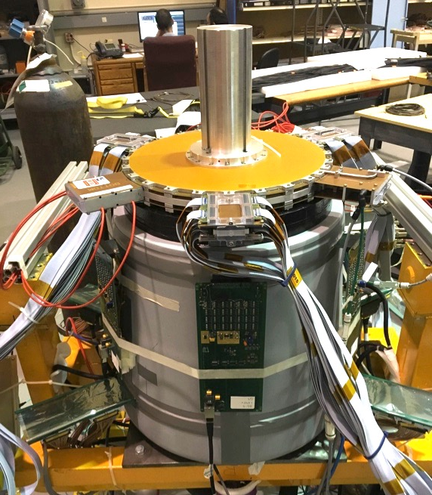
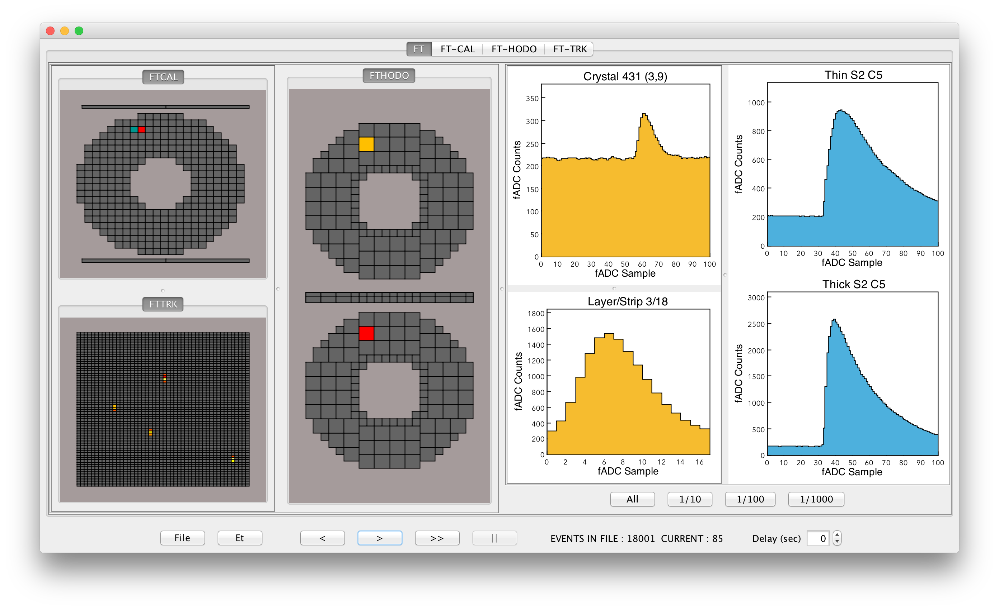
Forward Tagger (FT)
CLAS12
Hall B
Detect electrons at small angle to perform quasi-real photo-production experiments.
Calorimeter: electron energy/momentum
  Photon energy (ν=E-E’), Polarization ε⁻¹ ≈1 + ν²/2EE’
PbWO₄ crystals with APD/SiPM readout
Scintillation Hodoscope: veto for photons, Scintillator tiles with WLS
Tracker: electron angles, polarization plane, MicroMegas detectors
Calorimeter
Tracker
Scintillation Hodoscope
First calibration w/ cosmics
Hardware interlocks in preparation by DSG
FT-Cal final assembly in May
FT checkout in June (in EEL)
Installation in CLAS12 in July
Implementation of R/O in CLAS12 DAQ in summer
FT-Cal + FT-Hodo reconstruction implemented in COATJAVA3.0.
FT-Trck in progress
Cosmics in the FT
FT-Cal+FT-Hodo+FT-Trck cosmic test at JLab
HV/LV GUI
FT monitor

Slide 17

PRad Analysis Status
Hall B
Development of a GEANT4 based simulation code, including detectors realistic geometry, resolutions and beam line elements, has been finalized.
Physics analysis in progress:
  z-vertex reconstruction is finalized for both ep --> ep and ee --> ee from ¹²C and H₂ targets;
  normalized experimental yields for ep --> ep and ee --> ee are extracted for the ~50% of 1.1 GeV runs;
  the ratio shows good stability vs. run number for physics runs;
Moeller events

Slide 18

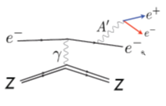
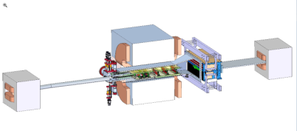
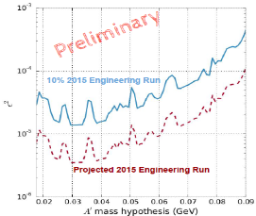
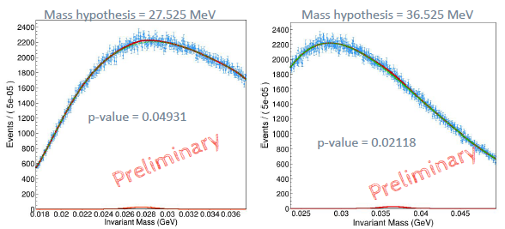
HPS Physics Results
Hall B
e-
Physics
If DM is light and produced in the Big Bang, Nature needs a new force, e.g. a heavy photon (A’)
A’s could mediate dark matter annihilations and its interactions with our matter
HPS looks for an electro-produced A’ decaying to e⁺e⁻
HPS identifies A’s with invariant mass and separated vertices
Limits on ε², m_{A’}
First Limits are based on the unblinded 10% of 2015 data
* Ready to unblind the full data set in ~1-2 weeks
* HPS can deliver physics
talk by N. Baltzell

Slide 19
Hall B – Run Groups
Hall B
Proposal | Physics | Contact | Rating | Days | Group | New equipment | Energy | Run Group | Target
E12-06-108 | Hard exclusive electro-production of π⁰, η | Stoler | B | 80 | 139 | RICH (1 sector) Forward tagger | 11 | A F. Sabatié | liquid H₂
E12-06-108A | Exclusive N*->KY Studies with CLAS12 | Carman |  | (60)
E12-06-108B | Transition Form Factor of the η’ Meson with CLAS12 | Kunkel |  | (80)
E12-06-112 | Proton’s quark dynamics in SIDIS pion production | Avakian | A | 60
E12-06-112A | Semi-inclusive Λ productiuon in target fragmentation region | Mirazita |  | (60)
E12-06-112B | Colinear nucleon structure at twist-3 | Pisano |  | (60)
E12-06-119(a) | Deeply Virtual Compton Scattering | Sabatie | A | 80
E12-09-003 | Excitation of nucleon resonances at high Q² | Gothe | B+ | 40
E12-11-005 | Hadron spectroscopy with forward tagger | Battaglieri | A- | 119
E12-11-005A | Photoproduction of the very strangest baryon | Guo |  | (120)
E12-12-001 | Timelike Compton Scatt. & J/ψ production in e+e- | Nadel-Turonski | A- | 120
E12-12-007 | Exclusive φ meson electroproduction with CLAS12 | Stoler, Weiss | B+ | 60
E12-07-104 | Neutron magnetic form factor | Gilfoyle | A- | 30 | 90 | Neutron detector RICH (1 sector) Forward tagger | 11 | B K. Hafidi | liquid D₂ target
E12-09-007(a) | Study of partonic distributions in SIDIS kaon production | Hafidi | A- | 30
E12-09-008 | Boer-Mulders asymmetry in K SIDIS w/ H and D targets | Contalbrigo | A- | 56
E12-09-008A | Hadron production in target fragmentation region | Mirazita |  | (60)
E12-09-008B | Colinear nucleon structuer at twist-3 | Pisano |  | (60)
E12-11-003 | DVCS on neutron target | Niccolai | A | 90
E12-11-003A | In medium structure functions, SRC, and the EMC effect | Hen |  | (90)
Beam time partial sum |  |  |  | 765 (1355) | 229
Experiment ending with A or B are run group experiments approved by the CLAS collaboration. They are running parallel to the experiments with same experiment number. Experiments ending with (a) and (b) take data with both run groups.

Slide 20
Hall B – Run Groups
Hall B
E12-06-109 | Longitudinal Spin Structure of the Nucleon | Kuhn | A | 80 | 185 | Polarized target RICH (1 sector) Forward tagger | 11 | C S. Kuhn | NH₃ ND₃
E12-06-109A | DVCS on the neutron with polarized deuterium target | Niccolai |  | (60)
E12-06- 119(b) | DVCS on longitudinally polarized proton target | Sabatie | A | 120
E12-07-107 | Spin-Orbit Correl. with Longitudinally polarized target | Avakian | A- | 103
E12-09-007(b) | Study of partonic distributions using SIDIS K production | Hafidi | A- | 80
E12-09-009 | Spin-Orbit correlations in K production w/ pol. targets | Avakian | B+ | 103
E12-06-106 | Color transparency in exclusive vector meson production | Hafidi | B+ | 60 | 60 |  | 11 | D
E12-06-117 | Quark propagation and hadron formation | Brooks | A- | 60 | 60 |  | 11 | E | Nuclear
E12-06-113 | Free Neutron structure at large x | Bueltman | A | 42 | 42 | Radial TPC | 11 | F | Gas D₂
E12-14-001 | EMC effect in spin structure functions | Brooks | B+ | 55 | 55 | Pol. LiH target | 11 | G | _{LiH}
TOTAL CLAS12 run time (approved experiments) |  |  |  | 1466 (2118) | 631
Proposal | Physics | Contact | Rating | Days | Group | Equipment | Energy | Group | Target
C12-11-111 | SIDIS on transverse polarized target | Contalbrigo | A | 110 | 110 | Transverse target | 11 | H | HD
C12-12-009 | Transversity w/ di-hadron on transvere target | Avakian | A | 110
C12-12-010 | DVCS with transverse polarized target in CLAS12 | Elouadrhriri | A | 110
All CLAS12 transverse target proposals |  |  |  | 330 | 110
E12-11-006 | Heavy Photon Search at Jefferson Lab (HPS) | Jaros | A | 180 | 180 | Setup in alcove | 2.2, 6.6 | I | Nuclear
E12-11-106 | High Precision Measurement of the Proton Charge Radius | Gasparian | A | 15 | 15 | Primex | 1.1, 2.2 | J | H2 gas
Beam time request from CLAS12 C1 experiments + non-CLAS12 experiments |  |  |  | 525 | 305
Beam time from approved CLAS12 experiments (from previous table) |  |  |  | 1466 (2118) | 631
Beam time for Hall B experiments table 1 + table 2 (incl. 110 days of C1 approved exp.) |  |  |  | 1991 (2643) | 936

Slide 21
Hall B – Run Groups
Hall B
Proposal | Physics | Contact | Rating | Days | Group | Equipment | Energy | Group | Target
E12-16-010 | A search for Hybrid Baryons in Hall B with CLAS12 | D’Angelo | A- | (100) | 100 | Forward Tagger | 6.6, 8.8 | K Confinement & Strong QCD | lH2
E12-16-010A | Nucleon Resonances in exc. KY electroproduction | Carman | A- | (100)
E12-16-010B | DVCS with CLAS12 at 6.6 and 8.8 GeV | Elouadrhiri | A- | (100)
Total Beam time of Run Group K |  |  |  | 100 (300) | 100
Beam time of approved & C1 approved CLAS12 experiments from table 1 + table 2 |  |  |  | 1991 (2643) | 936
Beam time for Hall B experiments table 1 + table 2 + table 3 |  |  |  | 2091 (2943) | 1036
Proposal Count | Experiment Days | Run Groups | RG days | Compression
37 | 2943 | 11 | 1036 | 0.35
In the BOAW we expect experiment schedule:
- 35 weeks per year ≈ 35/2 = 17.5 PAC weeks = 122.5 PAC days
- With 0.8 Hall multiplicity => 122.5 x 0.8 = 98 PAC days
- To run 2943 PAC days of individual experiments = 30 years
- Run 2943 PAC days as run groups = 1036/98 = 10.5 years

Slide 22
Scheduling considerations
Hall B
Assuming all ERR reviews have been passed and beam time requested
Experiment with hydrogen target to run first to understand detector responses, calibrations
Provide all Run Groups with significant amount of data during first 5 years
=> schedule ~50% of total approved Run Group days
Scientific ratings by the PAC
Schedule High Impact experiments early (PAC41)
Compatibility with energies used in other Halls
Benefit to collaboration
Operating luminosity
Jeopardy process
Final scheduling done in NPES committee

Slide 23
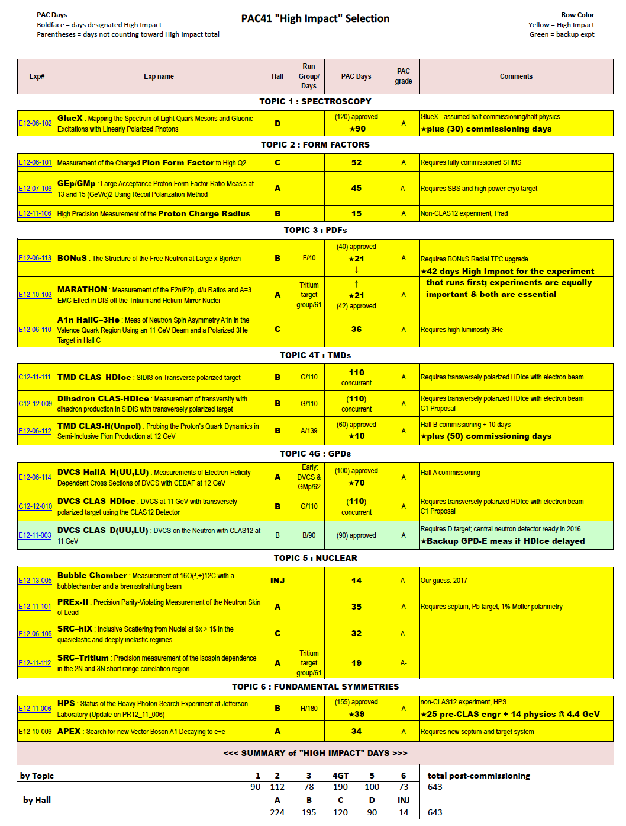
PAC41 - High Impact Experiments
Hall B High Impact (H.I.) experiments: 195 PAC days
PRad: 15
HPS: 39
----------------------------
BONUS: 21 ^{(*)}
HDIce: 110
TMD(p): 10
DVCS(d): 90 ^{(**)}
^{(*)} : 42 if it runs before ³H/³He
^{(**)} : H.I. if HDIce delayed

Slide 24

Possible RG Schedule (straw man)
Run Group | Days | 2016 | 2017 | 2018 | 2019 | 2020 | 2021 | 2022 | Remain
All Run Groups | 1036^{#)} | 30 | 15 | 95 | 105 | 105 | 105 | 105 | 456
HPS | 180* | 15 |  | 35 | 10 | 10 | 10 | 10 | 90
PRad | 15* | 15 |  |  |  |  |  |  | 0
CLAS12 Comm |  |  | 3 15 |  |  |  |  |  | 0
RG-A + RG-K (proton) | 239* |  | 10 | 20/15 25 |  | 35 | 20 |  | 114*
RG-B (deuteron) | 90* |  |  |  | 40 |  |  |  | 50*
RG-F (BoNuS) | 42* |  |  |  | 21 |  |  |  | 21
RG-C (NH₃) | 120 |  |  |  | 35 | 25 |  |  | 60
RG-C-b (ND₃) | 65 |  |  |  |  | 35 |  |  | 30
RG-E (Hadr.) | 60 |  |  |  |  |  | 35 |  | 25
RG-H (Transv. Target) | 110* |  |  |  |  |  | 40 | 20 | 50
RG-D (CT) | 60 |  |  |  |  |  |  | 40 | 20
RG-G (LiD) | 55 |  |  |  |  |  |  | 35 | 20
^{#)} incl. RG-H

Slide 25
Summary
CLAS data continue to deliver important science in many areas.
HPS experiment successfully took data at 2.3 GeV: first results presented. PRad experiment to measure proton radius completed, analysis underway.
CLAS12 base detectors and beam line equipment used in successful KPP run.
Data from KPP run currently employed for detector calibration & event reconstruction.
Superconducting Torus magnet ramped up to 3800 A (design 3770A) without quench.
Delivery of Solenoid magnet expected early May 2017.
Ancillary detector construction finished or well advanced – on track for use in engineering run.
Preparations for the fall run are well underway

Slide 26
The KPP run was a big accomplishment of CLAS12
Now we need to channel the energy to be ready for science
The effort of the entire collaboration is needed!

Slide 27
Additional slides

Slide 28
Hall B
Physics Publications in refereed Journals
 | HSWG | DPWG | NPWG | ALL
2000 | - | 1 | 1 | 2
2001 | 2 | 3 | - | 5
2002 | 3 | - | 1 | 4
2003 | 7 | 4 | 1 | 12
2004 | 3 | 3 | 4 | 10
2005 | 7 | 3 | 2 | 12
2006 | 8 | 4 | 3 | 15
2007 | 7 | 2 | 3 | 12
2008 | 4 | 6 | 2 | 12
2009 | 8 | 7 | 4 | 19
2010 | 4 | 2 | 4 | 10
2011 | 3 | 1 | 4 | 8
2012 | 6 | 3 | 2 | 11
2013 | 8 | 6 | 2 | 16
2014 | 5 | 6 | 1 | 12
2015 | 4 | 5 | 3 | 12
2016 | 7 | - | - | 7
2017 | 1+1 | 5 |  | 6+1
SUM | 87+1 | 61 | 37 | 184+1
5
10
15
publ
subm.
updated 1 Mar 2017

Slide 29
Physics Publications by Run Groups
e1(a – f) 26
e1-6 12
e2 8
e1-dvcs 7
e5 1
e6 3
e8-Bonus 2
eg1 14
eg1-dvcs 6
eg2 4
eg3 1
eg4 1
eg5-TPE 2
eg6
TOTAL: 88
g1 14
g2 5
g3 4
g5 2
g6 3
g7 3
g8 2+1
g9 2
g10 7
g11 23
g12
g13 1
g14
PRIMEX 1
TOTAL: 67+1
Total: 184+1
Advanced Analysis
E1-E8 9
EG1 6
EG2 2
E1-DVCS 3
EG1-DVCS 1
G1-G11 8
TOTAL: 29
updated 1 Mar 2017

Slide 30
CLAS PhD Theses
Completed: 168 In progress: 33
updated 12 Dec 2016
15
10
5
10
9
2
7
4
14
12
9
6
7
5
8
10
17
10
13
13
11
0
1
1999
2000
2001
2002
2003
2004
2005
2006
2007
2008
2009
2010
2011
2012
2013
2014
2015
2016
2017

Slide 31
Conference Presentations
Total: 2054
150
100
50
203
106
17
45
59
62
92
93
94
80
170
21
114
113
108
132
137
133
121
154
0
1998
1999
2000
2001
2002
2003
2004
2005
2006
2007
2008
2009
2010
2011
2012
2013
2014
2015
2016
2017
Source: CSC
updated 2 Mar 2017

Slide 32
International Collaboration
  Armenia:
  - Yerevan Physics Institute, Yerevan
United States of America:
Argonne National Laboratory, Argonne, Il
California State University, Dominguez Hills, CA
Canisius College, Buffalo, New York
- Carnegie Mellon University, PIttsburgh, PA
- Catholic University of America, Washington, DC
- College of William and Mary, Williamsburg, VA
Christopher Newport University, Newport News, VA
Duquesne University, Pittsburgh, PA
- Fairfield University, Fairfield, CT
Florida International University, Miami, FL
Florida State University, Tallahassee, FL
George Washington University, Washington, DC
- Idaho State University, Pocatella, ID
James Madison University, Harrisionburg, VA
Mississippi State University, Starkville, MS
- Norfolk State University, Norfolk, VA
- Ohio University, Athens, OH
- Old Dominion University, Norfolk, VA
- Rensselaer Polytechnic Institute, Troy, NY
- Stony Brook University,
- Temple University, Philadelphia, PA
- Thomas Jefferson National Facility, Newport News, VA
- University of Connecticut, Storrs, CT
- University of New Hampshire, Durham, NH
- University, of Richmond, Richmond, VA
- University of South Carolina, Columbia, SC
University of Virginia, Charlottesville, VA
Virginia Polytechnic Institute and State University, Blacksburg, VA
Chile:
- Universidad Tecnica Federico Santa Maria, Valparaiso
France:
Orsay University, IN2P3, Paris
CEA Saclay, IRFU, Paris
Germany:
Institut f. Kernphysik, Jülich
Justus-Liebig-University Giessen, Giessen
Italy:
INFN - LNF, Frascati, Roma
- Università di Genova,INFN, Genova
Università di Ferrara, Ferrara
INFN - Pavia, Universita di Pavia
- INFN - University di Roma Tor Vergata, Roma
INFN - Sezione.di Torino, University di Torino
Republic of Korea:
- Kyungpook National University, Daegu
Russian Federation:
- MSU, Skobeltsin Institute for Nuclear Physics, Moscow
- Lomonsov Moscow State University, Moscow
Institute for Theoretical and Experimental Physics, Moscow
Spain:
- University of the Basque Country, Bilbao
United Kingdom:
- Edinburgh University, Edinburgh
- Glasgow University, Glasgow
47 Institutions, 03/2017
3/29/17
CLAS collaboration meeting, JLab 11/01-04
32

Slide 33
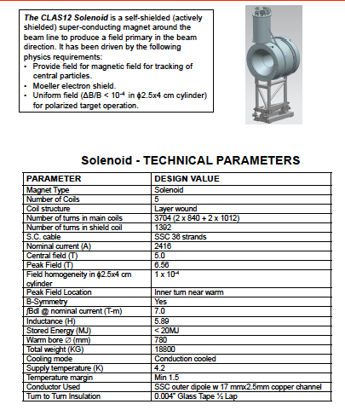
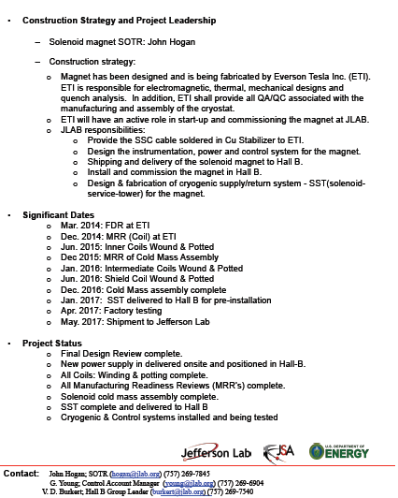
Solenoid Magnet
CLAS12
Hall B

