Slide 1
Preparation of the CLAS12 First Experiment Status and Time-Line
Latifa Elouadrhiri
Jefferson Lab
CLAS Collaboration – CLAS12 Workshop
Jefferson Lab
March 28-31, 2017

Slide 2
Outline
CLAS12 Technical Design
KPP Run
Engineering/Physics Run Preparation
Summary

Slide 3
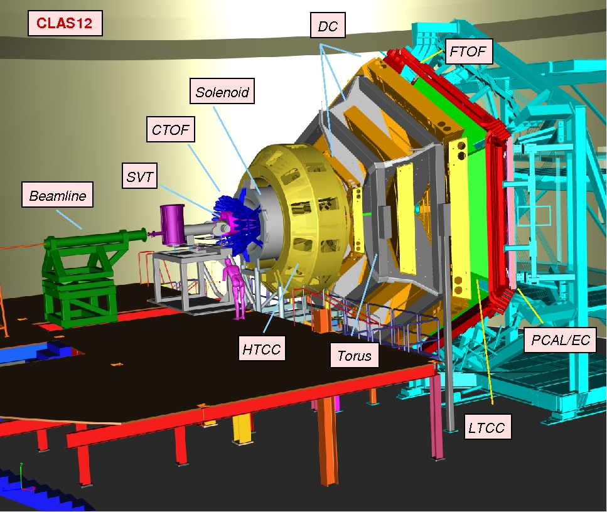
CLAS12 Technical Scope
Optimized for exclusive and semi-inclusive reactions
Large coverage in ϑ and φ angles
Small angle capabilities
Capable of operating at luminosity of
10³⁵ cm⁻²s⁻¹
Particle ID up to high momentum for e⁻/π⁻, π/K/p, γ/πº separation
Good momentum & angle resolution for use of missing mass techniques
Operate Polarized Target

Slide 4
CLAS12 – Baseline Equipment
Forward Detector (FD)
TORUS Magnet
HT Cherenkov Counter
Drift Chamber System
LT Cherenkov Counter
Forward TOF System
Pre-shower Calorimeter
E.M. Calorimeter
Central Detector (CD)
SOLENOID Magnet
Silicon Vertex Tracker
Central TOF System

Slide 5
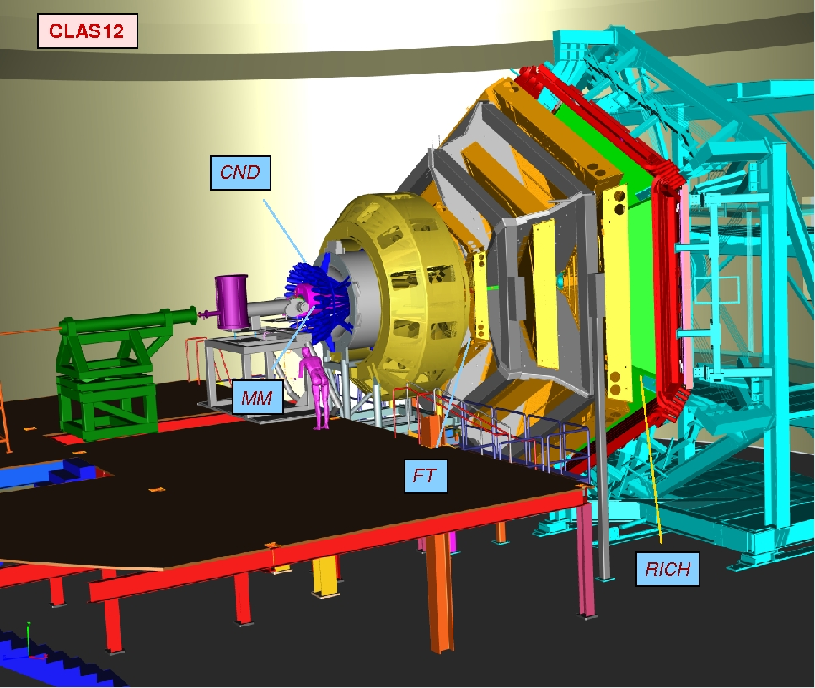
CLAS12 - Upgrade Equipment
Forward Detector (FD)
TORUS Magnet
HT Cherenkov Counter
Drift Chamber System
LT Cherenkov Counter
Forward TOF System
Pre-shower Calorimeter
E.M. Calorimeter
Central Detector (CD)
SOLENOID Magnet
Silicon Vertex Tracker
Central TOF System
- Central Neutron Detector
MicroMegas
Forward Tagger
RICH detector
Polarized target
Upgrade Detectors
Forward Tagger (FT)
Ring-Imaging Cherenkov Counter (RICH)
Micro-Megas Detector (MM)
Central Neutron Detector (CND)

Slide 6
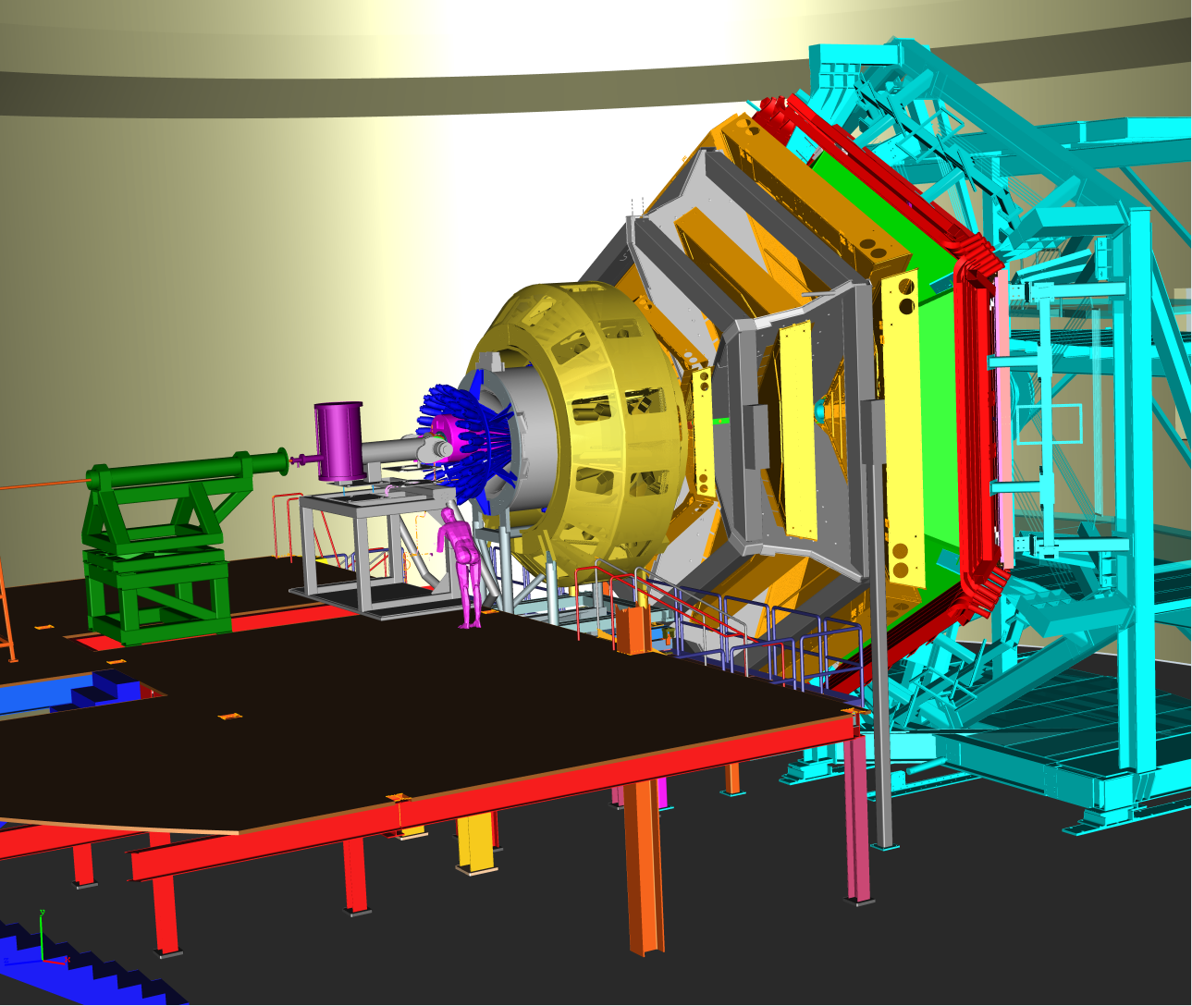
CLAS12 Technical Specifications
 | Forward Detector | Central Detector
Angular Range
Tracks | 5º → 35º | 35º → 125º
Photons | 3º → 35º
Resolution
δp/p | 1% @ 5 GeV | < 5%
δθ | 1 mrad | 10 – 20 mrad
δφ | 3 mrad | 5 mrad
Photon Detection
Energy | > 150 MeV | n.a.
δθ | 4 mrad @ 1 GeV | n.a.
Neutron Detection
N_{eff} | < 70% (EC+PCAL) | 10%
Particle ID
e/π | Full range | n.a.
π/p | < 6 GeV | < 1.5 GeV
π/K | < 3 GeV | < 0.7 GeV
K/p | < 5 GeV | < 1.0 GeV
π⁰, η → γγ | Full range | n.a.
CLAS12:
CEBAF Large Acceptance Spectrometer 12 GeV

Slide 7
CLAS12 KPP Configuration
KPP configuration:
Do not wait for the solenoid arrival, fully assembled forward detector, SVT and CTOF installed upstream of the target (CTOF on a temporary support) and run with ~100 times lower luminosity (e.g. 5 nA beam on a 0.5 mm thick ¹²C target)
Detector operational: events recorded with a > 2 nA electron beam at > 6 GeV beam energy (3 passes)
KPP Demonstration:
Detector running for 8 hours recording data from all subsystems.
Screenshots of beam status and/or accelerator e-log.
Plots showing relative timing of calorimetry, time-of-flight, and Cherenkov detectors.
Event displays showing correlated particle hits in the Forward Detectors.
Plots of reconstructed particle trajectories showing target position.
Particle identification plots using signals from calorimetry and Cherenkov detector.

Slide 8
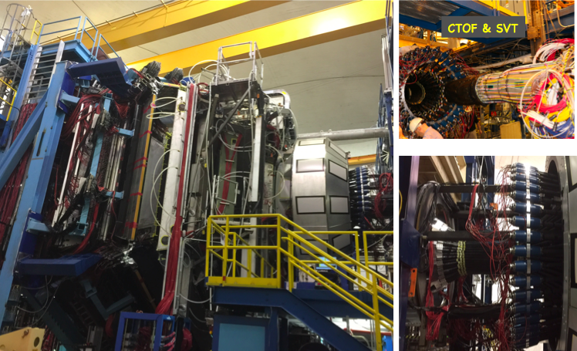
KPP Run Success!!
KPP – Run Period Feb. 3 – Feb. 6, 2017. Data taking with the full detector readout:
-Beam current: 5 nA electron beam - Target: 0.5 mm carbon wire - Torus: 50% B-field
-Trigger:
Hit-based trigger, ORed from 6 sectors
FADC-based trigger, ECAL INNER cluster finding with different thresholds
Production runs
& calibration runs
Reverse polarity
Torus Field = 0
DC (HV and Threshold scans)
Random trigger2
Different trigger threshold
2 type of trigger
2 target positions
Low luminosity run

Slide 9
CLAS12 Engineering/First Experiment Run
Engineering/First Experiment configuration:
The entire CLAS12 is operational
Engineering October/November 2017, followed by Physics data taking
Run at 2.2 GeV (1 pass) and 11 GeV (5 passes) with LH2 target
Commission at low luminosity using loose trigger configuration
Study detector performance as a function of luminosity, define luminosity limits – the goal is L=10³⁵ cm⁻² sec⁻¹ (75 nA beam on 5 cm long LH₂ target)
Record data for physics analysis
Perform special runs (e.g. alignment ...)

Slide 10
Timeline
TASK |  |  |  |  | 2016 |  |  | 2017
 |  |  |  |  | Oct. | Nov. | Dec. | Jan. | Feb. | Mar. | Apr. | May | June | July | Aug. | Sept | Oct. | Nov. | Dec.
SIMULATION
RECONSTRUCTION
CALIBRATION
EXP. SCHEDULE
New release with full central detector (MM)
New release with full central detector
Ready for KPP
Ready for Physics
KPP Run
Engineering Run
Coordinated Calibration
Challenge
Full Chain Test

Slide 11
Extend KPP Strategy to the engineering Run
Full Chain Complete from simulation to cosmic data taking to documentation
Commissioning plan revised
CLAS12 first experiment final configuration simulation complete
SC Torus and Solenoid ready and field maps produced
All detectors and corresponding electronics ready
DAQ/Trigger firmware and hardware ready
Beam polarization
Experiment normalization
Online monitoring for shift taker and for experts
Online reconstruction, fully tested ready
Data base complete with detector calibration
Detector alignment
Offline data processing and offline shift training
Offline data calibration ready and exercised on calibration challenge
Event selection framework completed and tested on KPP and simulations
Final data processing to general DST
Skimming to produce DST for the first specific experiments
Analysis note based on KPP data Ready

Slide 12
THANK YOU for Successful KPP run
Looking forward to successful engineering run and the start of physics data taking!

