Slide 1
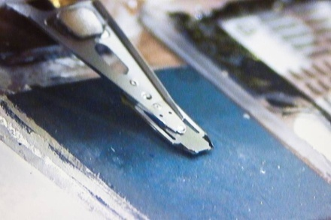




Near-Field Nonlinear Microwave Microscopy of Bulk Nb Surfaces
Tamin Tai, Behnood G. Ghamsari, Steven M. Anlage
Department of Physics
Center for Nanophysics and Advanced Materials
University of Maryland
17 July, 2012
dBm
Funding from
Department of Energy / High Energy Physics
Office of Naval Research
Maryland Center for Nanophysics and Advanced Materials

Slide 2
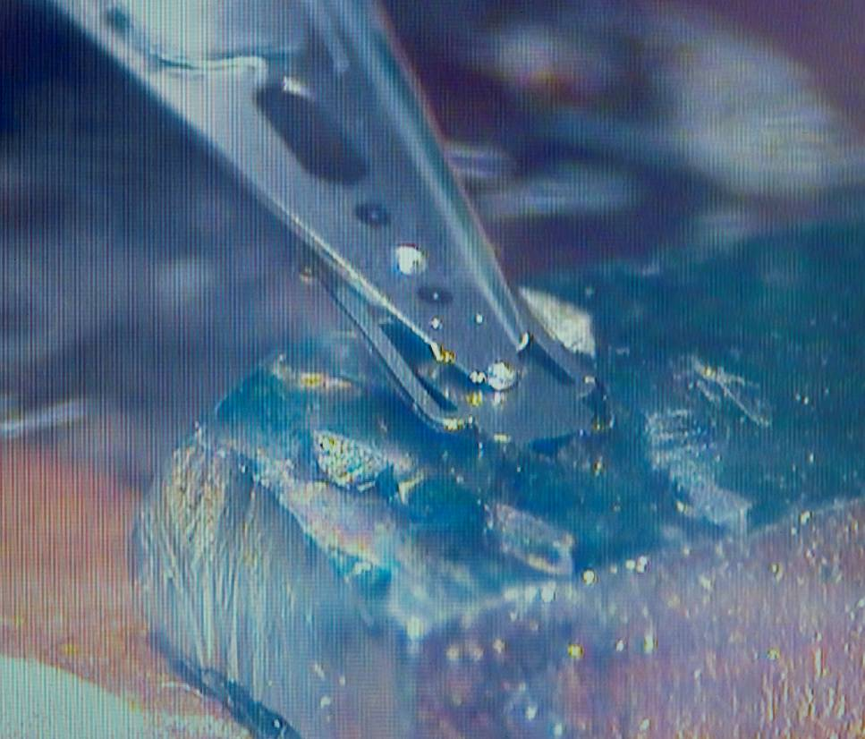
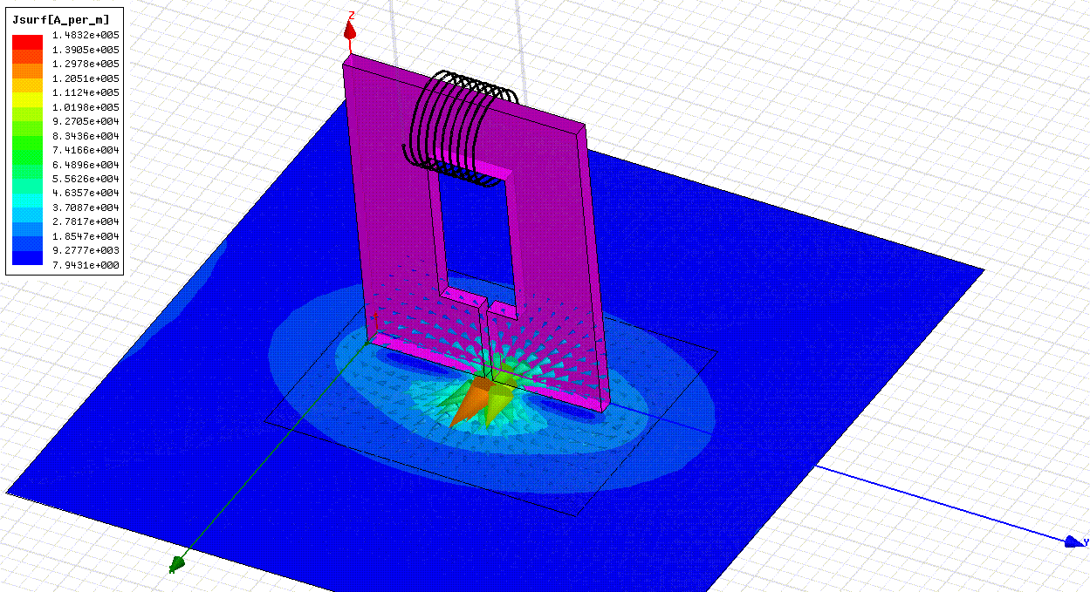
Objective: Identify microscopic defects that cause breakdown of SRF cavities
Method:
1) Examine coupons with intense, localized B_{RF} in the superconducting state
2) Measure locally-produced harmonic generation from defects
3) Scan the probe and image the response
Low Pass Filter
Microwave Source
Spectrum
Analyzer
v_{3f}
High Pass Filter
V_{f} ⁺
V_{3f} ⁻
Bulk Nb
P_{3f} resolution limit
Nonlinear Superfluid Response:
Superconductor
1 μm
Thin Film
Notes:
This simulation uses the key dimensions of the probe, and shows that the peak induced currents are large and concentrated on sub-micron scales.
The P_3f varies by orders of magnitude before the linear response properties (like surface resistance) begin to show any change. The superconductor is sending a message about its ultimate failure mode through its nonlinear response.

Slide 3
Quantifying the Nonlinear Response of Superconductors
Schematically, we expect:
J_{NL} (A/m²)
Intrinsic Nb
Dislocation tangle
Hydrogen-poisoned Nb
NbO_{x} corrosion
Josephson weak link
Ta inclusion
P_{3f} resolution limit
Defects with the smallest J_{NL} will dominate the local P_{3f} generation
Notes:
The microscope, by design, finds the most defective material (smallest J_NL) through its nonlinear response (P_3f).

Slide 4
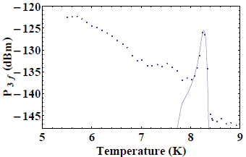
Harmonic Generation in Superconducting Thin Films
Most of our work so far is on thin films…
Films are flat, smooth, reproducible, produce strong signals
Candidate Nonlinear
Sources:
♦ Superfluid nonlinearity
  as T -> T_{c}
♦ Vortex / Anti-vortex
  pair creation and
  motion
Nb thin film (50 nm)

Slide 5
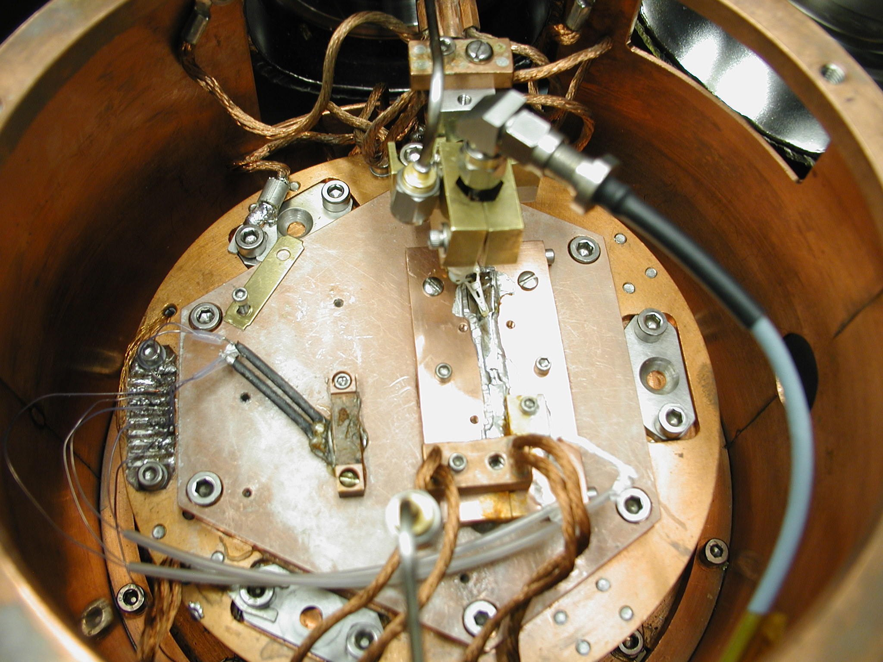
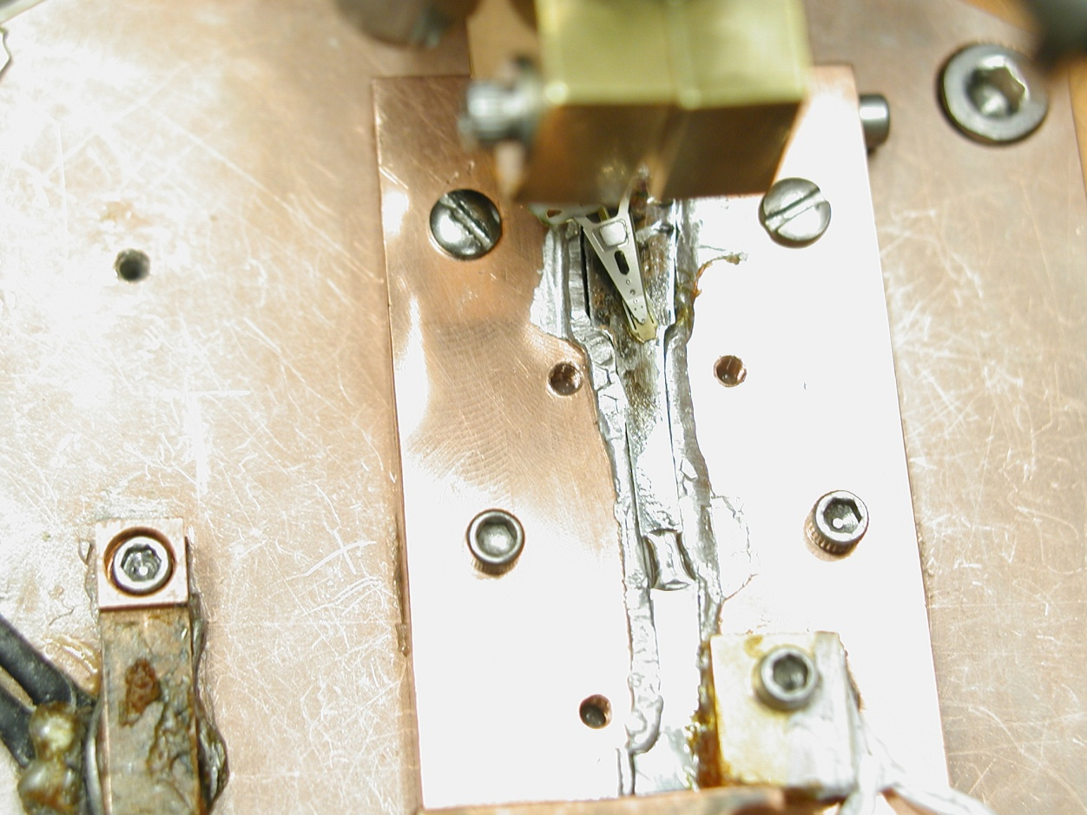
Bulk Nb sample
From Tom Bieler,
Mich. State Univ.
Probe
Weld

Slide 6
Local Harmonic Response from Bulk Nb
Stronger Nonlinear Response
Write-head probe
nonlinearity
Spectrum Analyzer Noise Floor
Stronger Induced Currents
Notes:
This is third harmonic power vs. fundamental input power. At low input power we see a noise-limited response. Above Tc we see a nonlinear response from the probe at high power. The onset of nonlinear response is temperature dependent – larger excitation levels are required to create nonlinear response at lower temperature. The slope of the nonlinear response increases with decreasing temperature. The third harmonic power saturates and begins to decrease at high power, suggesting that we are destroying superconductivity. The onset and extrapolated SC destruction fields both show a critical-field-like temperature dependence.

Slide 7
Local Harmonic Response from Bulk Nb
Stronger Nonlinear Response
Increasing
induced
current
Spectrum Analyzer Noise Floor
What is the role of local heating in these measurements?

Slide 8
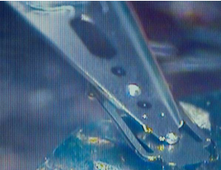
Work in Progress
Fiducial Samples:
Ta inclusions in Nb Film
Nb
Substrate
Tamin Tai, Behnood Ghamsari talks in Thin Films and New Ideas Workshop on Thursday

Slide 9
Conclusions
Achieved local harmonic generation from bulk Nb surfaces under SRF operating conditions
Mechanisms of harmonic generation at low temperatures not yet quantitatively understood
Work in progress to:
Measure magnitude of B_{RF} vs. distance from probe
Measure P_{3f}(x,y) in artificial Ta-in-Nb-matrix samples
Image local RF critical field around defects
Suggestions are welcome:
What is the most critical defect to examine?
What mechanisms are responsible for the observed harmonic generation?

Slide 10
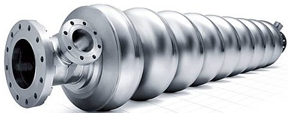
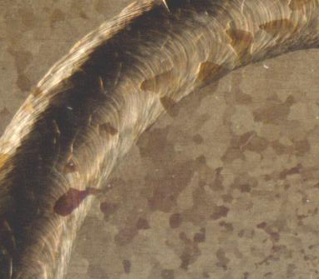
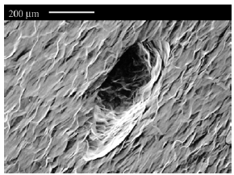
Motivation For Our Experiment
Grain
Boundaries
welds, oxidation,hydrogen poisoning
welds, oxidation,hydrogen poisoning
500 x 200 μm pit
T. Bieler
Mich. State Univ.
Scanning at T < T_{c}
P_{3f}(x)
Nb film
or bulk Nb
scan
J_{NL}(x)
Magnetic probe
J
Defect 1
Position x
Defect 2
crystal grain boundary

Slide 11
Phase-Sensitive Harmonic Measurements:
Vector Network Analyzer in Frequency Offset Mode (VNA-FOM)
Measures

Slide 12
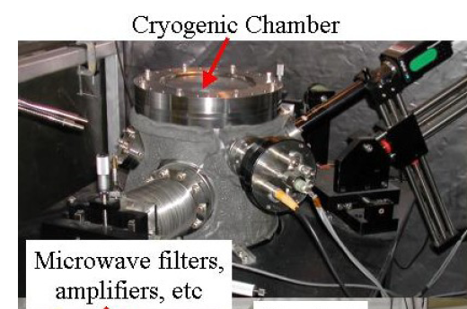
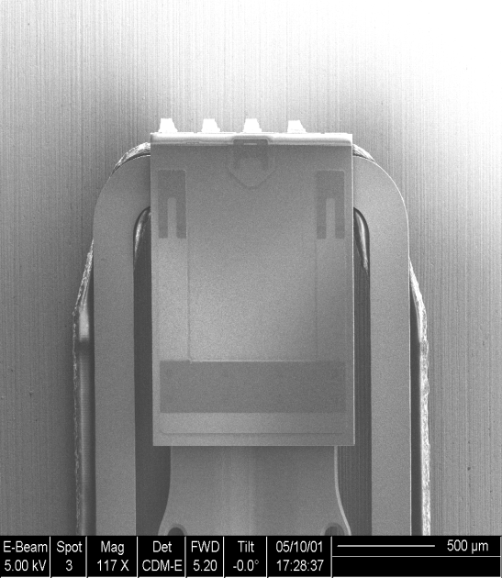
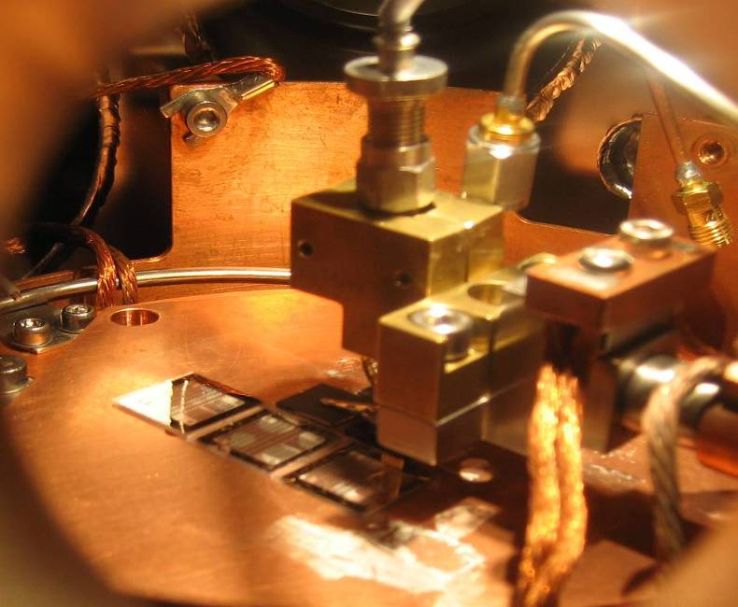
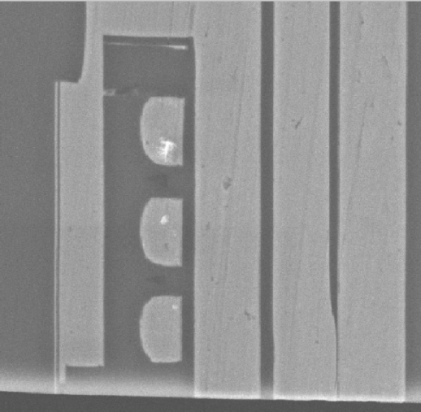
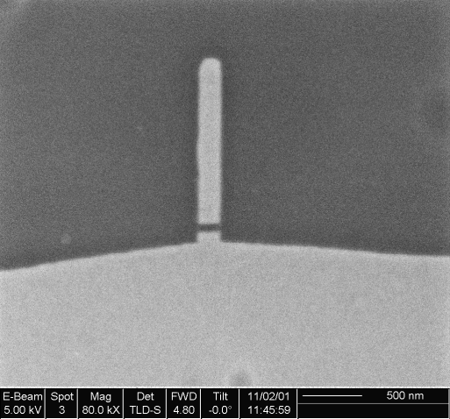
Experimental Setup
Cross-section (right figure)
Au bond pads to reader and writer
Read/Write
Head
Air bearing
surface
Thickness
(~1.2 mm)
Inside Chamber
Suspension
Cu coils
Permalloy shields
μ
~2
m
Write Pole
2 μm
Read Sensor
Probe Assembly
RF Magnetic Fields
Air bearing surface

Slide 13
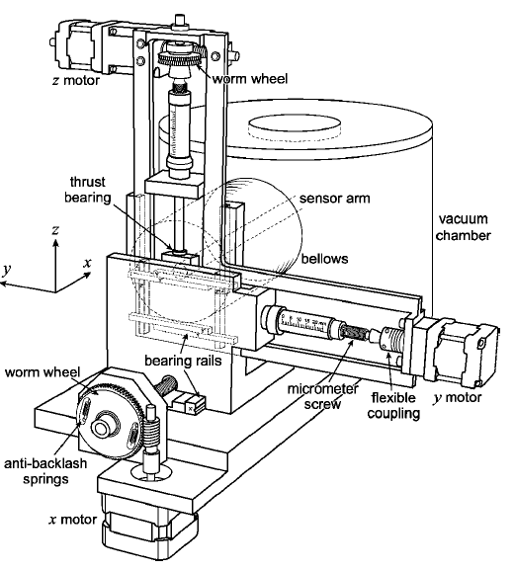
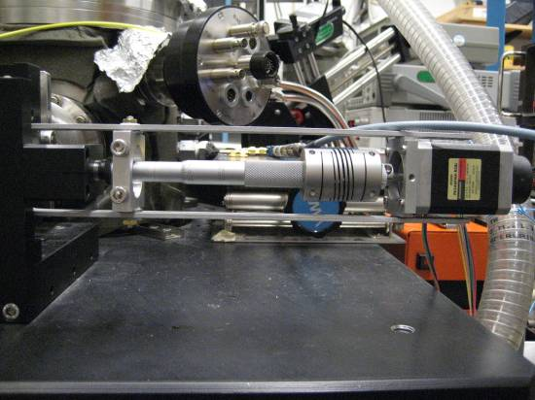
Recent Work-I
Fabrication for Standard Samples
Bulk Nb sample

Slide 14
Power Dependence (P3f –Pf)

Slide 15
Power Dependence (P3f-Pf)

Slide 16
Power Dependence (P3f-Pf)

Slide 17
P3f (T)
Excitation Freq: 5.44 GHz
10 dBm

Slide 18
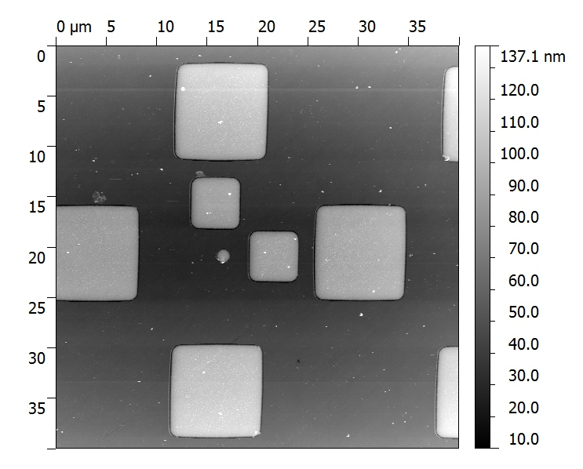
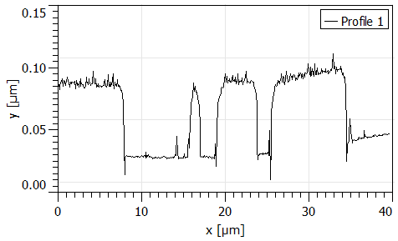
AFM IMAGE
~50 nm height difference
Ta is rougher
Ta
Nb
Height Profile along the Yellow Line

Slide 19
SEM IMAGES
There is a PMMA/MMA on the top of the film

Slide 20
MgB₂ Film (200 nm) P_{3f} Imaging
Phase Mapping
degree
T=15 K
P_{3f} (dBm)
μm
μm
μm
Temperature Mapping
K
μm
Excited Power: 16 dBm
Excited Frequency: 5.33 GHz
Step size: 10 μm.
μm
μm

Slide 21
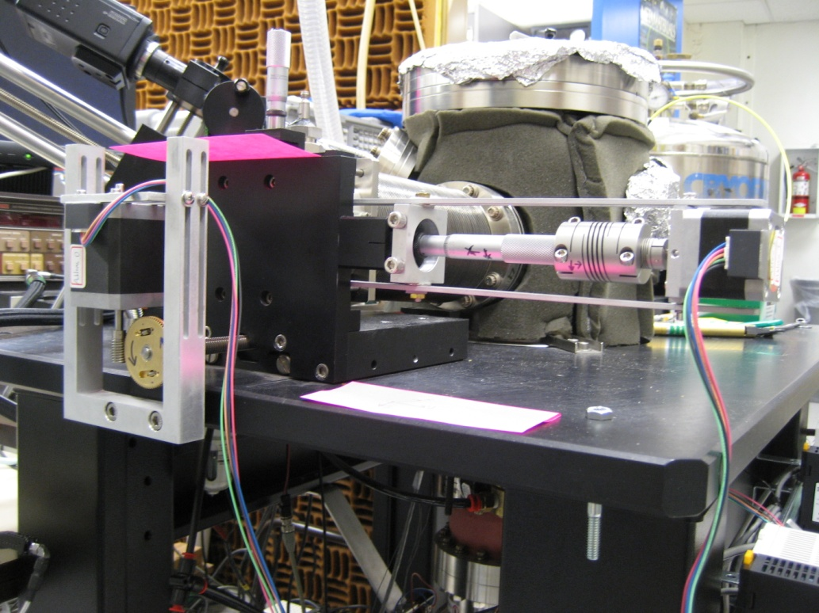
Scanning System of the Microscope
Capability of scanning mode:
Contact mode
R. B. Dinner, REVIEW OF SCIENTIFIC INSTRUMENTS 76, 103702 2005
Y-axis: 1 full step of the motor= 0.5 μm
X-axis: 1 full step of the motor=50 nm
Z-axis: Under Construction
Motor of Y axis
Motor of X axis

Slide 22
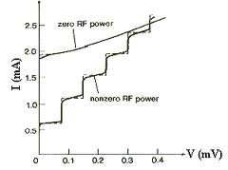
Recent Work
Determine how large field is applied on the surface
I⁺
P_{f}
I⁻
V⁺
V⁻
Nb film
Al₂O₃
Voltage source model
Substrate

Slide 23
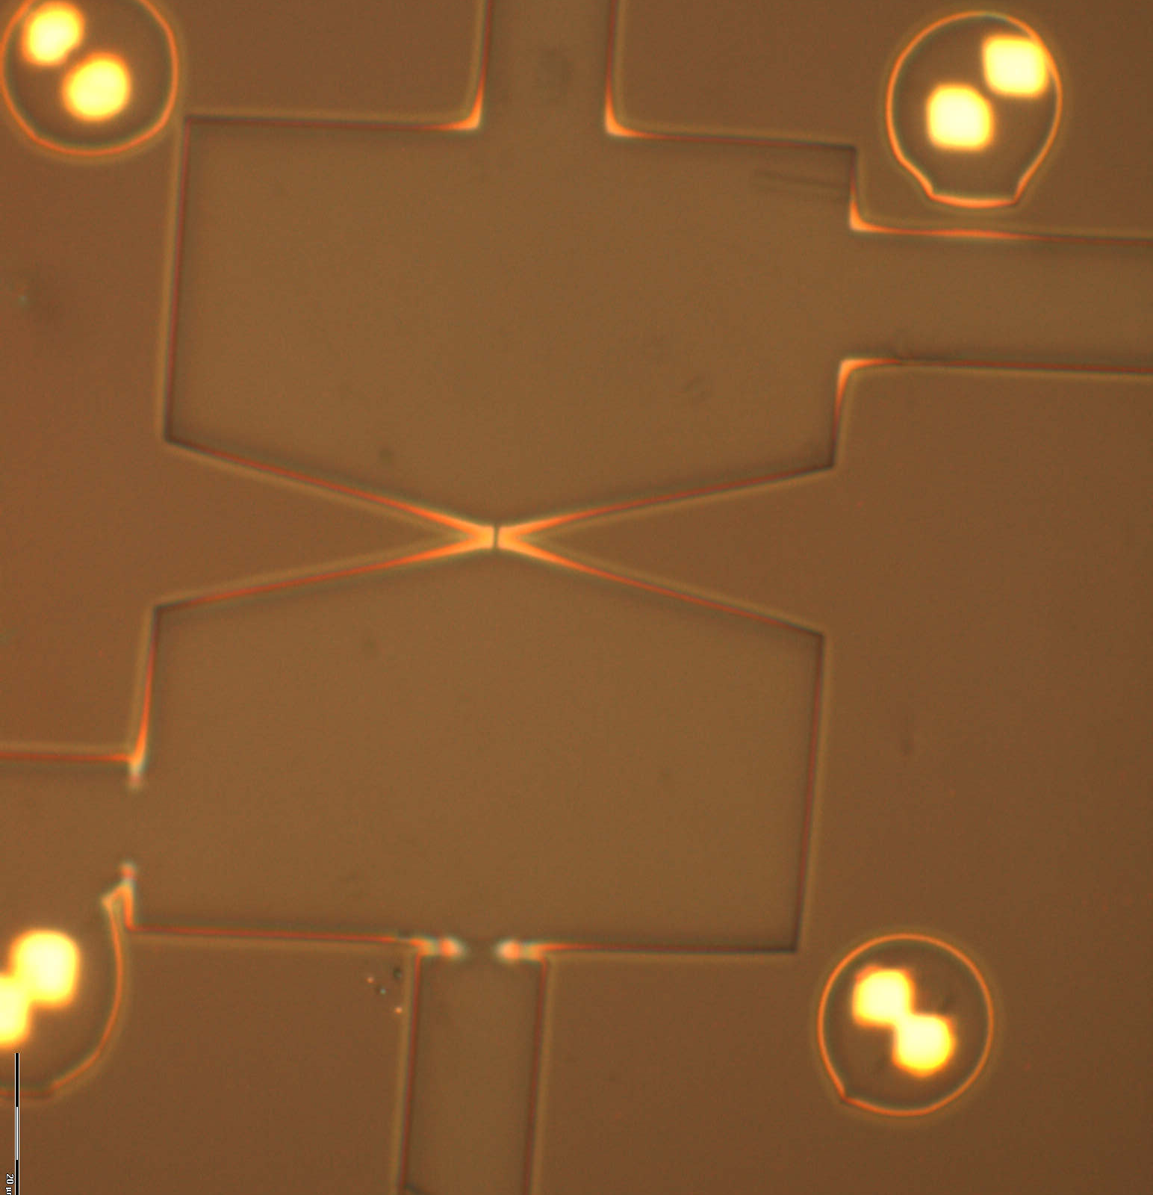
Determine |B_{RF}| from Shapiro steps
on Nb Josephson weak link
Nb
Josephson Weak Link
Nb

Slide 24
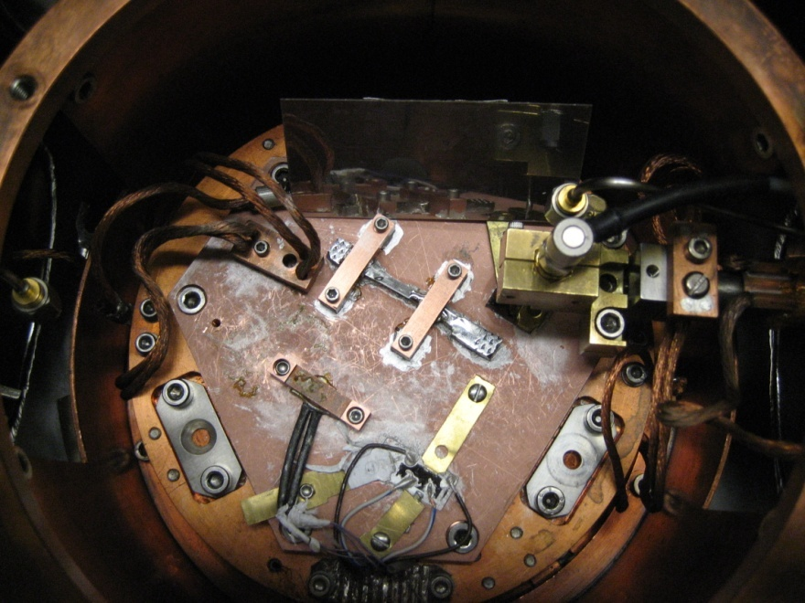
Challenges for Measurements on Nb bulk materials
Head Gimbal Assembly (HGA)
Top surface of bulk Nb (thickness: 0.1 inch)
Pit on Nb
Copper cold plate
Temperature of cold plate reaches 4.2K but Nb surface remains warmer.
Rough sample surface on bulk Nb make the probe far away from sample surface.

Slide 25
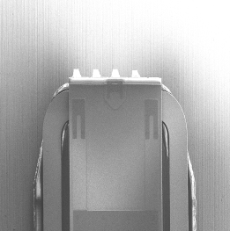
Can we get microwave signal to the write head?
Measured Input Impedance of Write Head
Network Analyzer
Impedance Matched to 50 Ω
Au bond pads to writer
Seagate Longitudinal Head
Pole gap ~ 100 nm
Coil turns 6 ~ 8

Slide 26
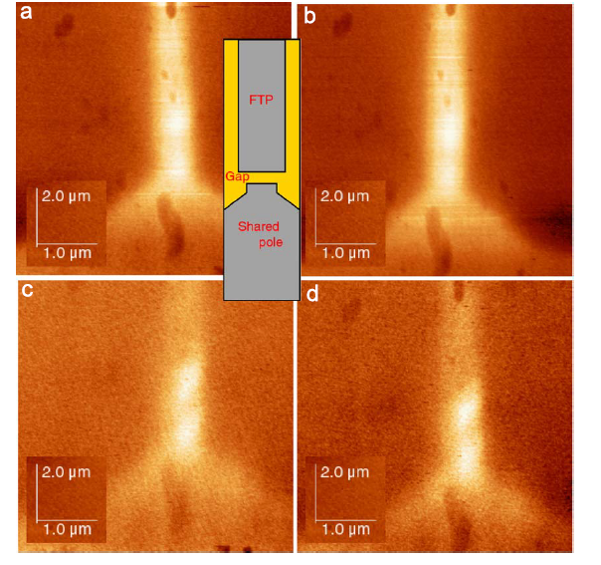
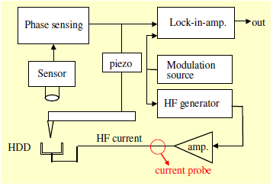
Field Image from Hard-Disk Writer Poles by the technique of High-Frequency MFM
w_{c} :
200 MHz
500 MHz
AC-phase
HF-MFM signal
Ref. w_{m}
w_{m}
w_{c}
1 GHz
2 GHz
U.Hartmann; Journal of Magnetism and Magnetic Materials 322 (2010) 1694–1696

Slide 27
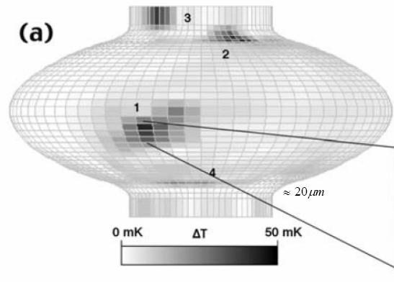
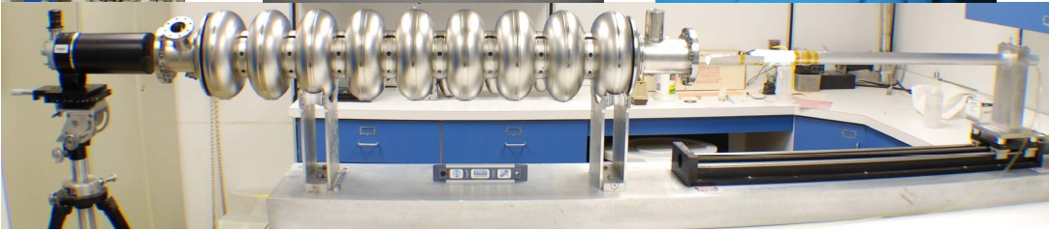
Quenching and Localized Defects on Nb SRF Cavities
These defects can lead to hot spots on accelerator cavity within operating frequency region (1-2 GHz)
However, many defects are benign. How to distinguish the ‘good’ ones from the ‘bad’ ones?
Grain
Boundaries
welds, oxidation, hydrogen poisoning
500 x 200 μm pit
T. Bieler
Mich. State Univ.
http://www.helmholtz-berlin.de/events/srf2009/programs/tutorials_de.html

Slide 28
Approach to Identifying Critical Defects
GOAL: To establish links between microscopic defects and
the ultimate RF performance of Nb and MgB₂ at cryogenic temperatures
APPROACH:
Near-Field Microwave Microscopy*
1) Stimulate Nb with a concentrated-in-space and intense RF magnetic field
Drive the material into nonlinearity (e.g. nonlinear Meissner effect)
    Why the NLME? It is very sensitive to defects…
Measure the characteristic field scale for nonlinearity: J_{NL}
4) Map out J_{NL}(x,y) → relate to previously-characterized defects
*S. M. Anlage, V. Talanov, A. Schwartz, "Principles of Near-Field Microwave Microscopy," in Scanning Probe Microscopy: Vol. 1,
edited by S. V. Kalinin and A. Gruverman (Springer-Verlag, New York, 2007), pages 215-253.

Slide 29

Nonlinear Near-Field Microscopy of Superconductors
P_{3f} : NLME Nonlinearities
P_{input}
coaxial probe
K(x,y)
loop
Superconductor
Current distribution
geometry factor
sample surface
Induce high μ₀K ~ 200 mT (B_{c} of Nb)
K(x,y) sharply peaked in space
► Better spatial resolution
D. Mircea, S. Anlage, Phys. Rev. B 80, 144505 (2009) + references therein

Slide 30
What do We Learn About the Superconductor?
P_{3f}(x)
J_{NL}(x)
Position
x
Defect 1
Defect 2
P_{3f}
Phys. Rev. B 72, 024527 (2005)

Slide 31
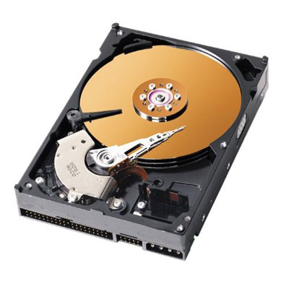

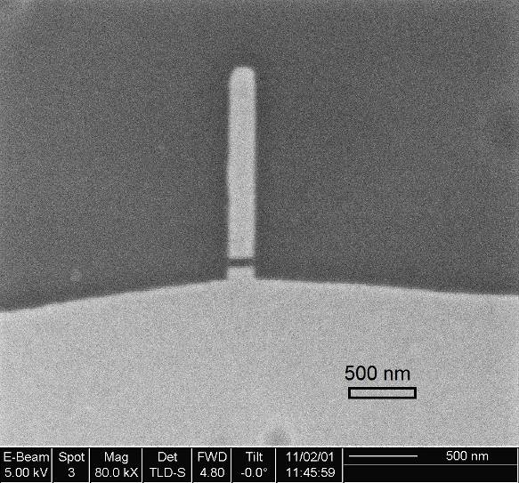
How to Generate Strong RF Magnetic Fields?
Magnetic recording heads provide
strong and localized B_{RF}
Magnetic Write Head
Cu coils
Permalloy shields
Side View
~2
μ
m
Write Pole
SEM picture of the magnetic write head gap
2 μm
Read Sensor
RF Magnetic Fields
Air bearing surface
Bottom View
B_{RF} ~ 1 Tesla (in gap)
Gap
Lateral size ~ 100 nm x few-100 nm
Permalloy
Reference: IEEE Trans Magn. Vol . 37, No. 2 pp.613-618 2001

Slide 32
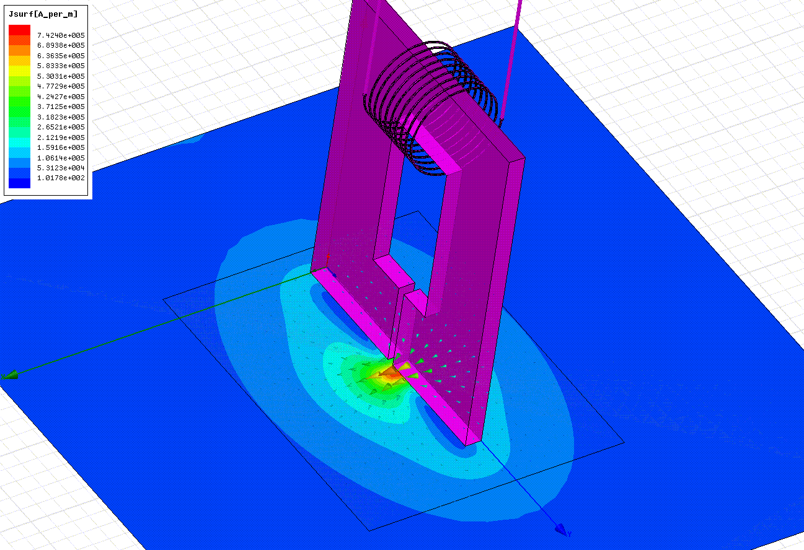
Surface Currents under Magnetic Write Head
HFSS Simulation
Frequency: 4.5 GHz
Probe-sample separation: 200 nm
Pole gap: 100 nm
Excitation: 50 mA
3 μm
μ₀ K_{max} ~ 933 mT

Slide 33
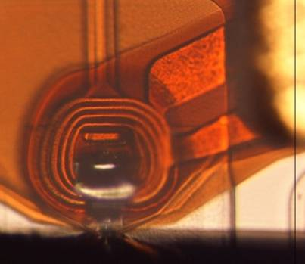


Experimental Setup
We need high B_{RF} and strongly localized field distributions
Goals: B_{RF} ~ 200 mT
Lateral size ~ 100 nm
RF Coil
on slider
Superconductor
Probe
Head Gimbal Assembly (HGA)
Superconducting
Film
T. Tai, et al. IEEE Trans. Appl. Supercond. 21, 2615 (2011)

Slide 34
MgB₂ (thickness: 50 nm) Nonlinear Measurement
Measured at a fixed location
Strong nonlinearity
saturates at low-T
T_{c} ~36 K
Noise floor
Peak expected:
Intrinsic NLME
Samples from Prof. Xiao-Xing Xi, Temple University

Slide 35
Intrinsic Nonlinear Meissner Effect Near T_{c}
Near T_{c} the superfluid density is very sensitive to small perturbations
Nb
MgB₂
Γ=1*10⁵ A³/m² ;T_{c}=9.5 K (δT_{c}=0.03K)
λ(cutoff) = 312 nm
J(cutoff) = 2.1*10¹¹ A/m²

Slide 36

Temperature Depend Third Harmonic Response measurements at a fixed location
Nb (thickness 50 nm)
Noise floor of Spectrum Analyzer
P_{3f}(T) at low temperatures consistent with:
Current loops involving Josephson weak links
Creation and motion of Josephson vortices
In MgB₂, perhaps also Josephson coupling between σ and π bands
    << Leggett mode >>
L_{π}
L_{σ}
L_{JJ}

Slide 37
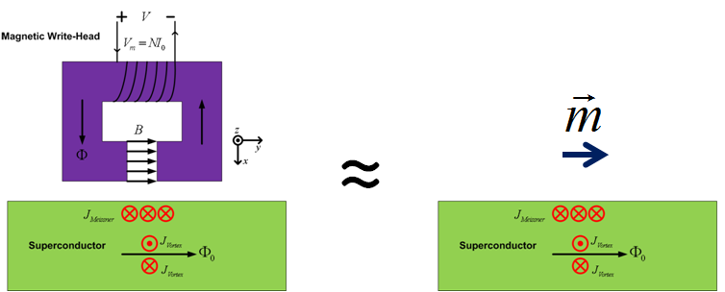
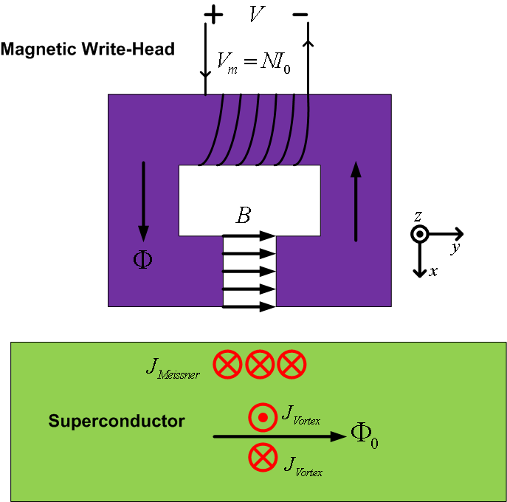
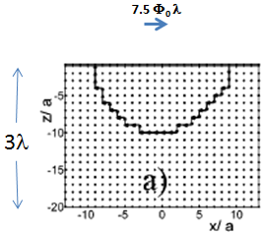
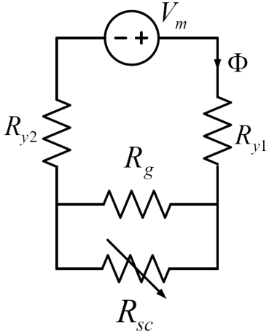
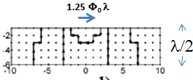
RF Vortex Modeling
a ~ ξ
Lattice London
Calculation
G. Carneiro, PRB 69, 214504 (2004)

Slide 38
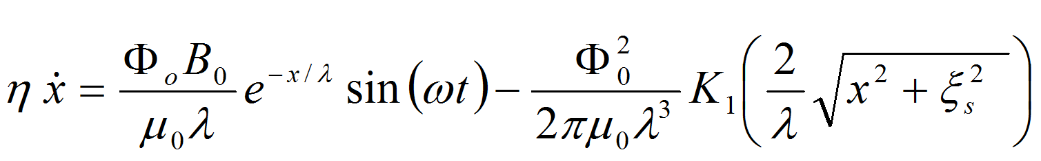
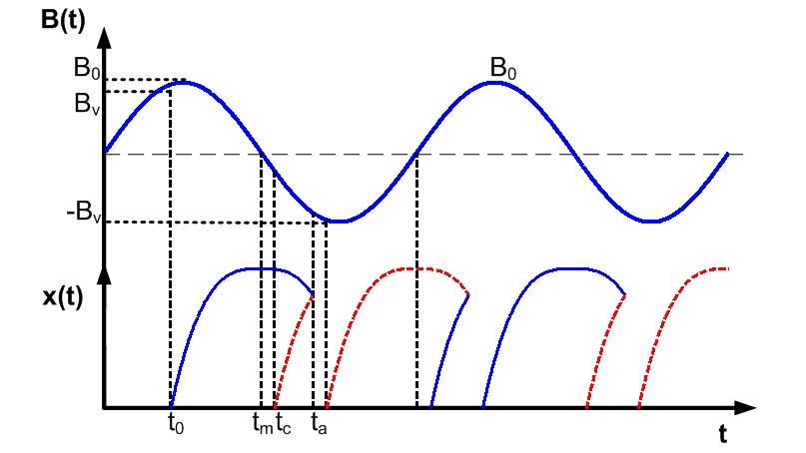
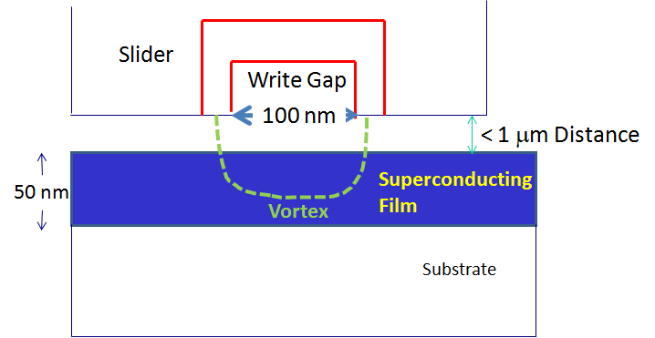
RF Vortex Modeling
Vortex semiloop dynamics
A. Gurevich and G. Ciovati, Phys. Rev. B, 77, 104501(2008)
Predict V_{3f} (magnitude and phase)
as a function of:
RF field strength,
Temperature

