Slide 1
Niobium tube specification and procurement for seamless forming
Andy Hocker & Lance Cooley
SRF Development Department and
Superconducting Materials Department
Fermilab

Slide 2
Main points which will be addressed
Batch of seamless RRR Nb tubes on order from ATI Wah Chang
“DESY-sized:” 150 mm OD, 3.0 mm thick
4 tubes of length 1700 mm
Enough material for four 3x3-cell cavities
DESY facility not currently available, possibly next summer – assist SBIR efforts?
“KEK-sized:” 130 mm OD, 3.5 mm thick
2 tubes of length 1800 mm, 3 tubes of length 800 mm
Some number of single-cell cavities to be made for R&D, then N x 3-cells, possibly even a 9-cell with new tooling?
KEK facility available this August/September
New spec under development – discussion!
Limited R&D funds – SBIR push

Slide 3
Present tube specification
Purity and mechanical properties extend from sheet specification, i.e.:
RRR 300
ASTM 6 grains
Similar hardness and mechanical properties
95% recrystallized
Tube specification to ASTM B394
Mostly affects dimensional tolerance and finish
Fabrication methods are flexible
Back and forward extrusion followed by flow forming
Deep drawing from plate (for single-cell tube length)
Spinning (for single-cell tube length)

Slide 4
Past experience with the first U.S. tubes (3x3)
2 Black Labs / Wah Chang / Dynamic Flow Forming tubes (13 µm grains) were formed into 5 x 3-cell + 1 x 2-cell at DESY during 2009-2010
Two of the 3-cells had microcracks and were not leak-tight
Three of the 3-cells went to JLab for welding into 9-cell
Subsequent 9-cell suffered from FE in VT, now scheduled to be EP’d
R. Rimmer to update??

Slide 5
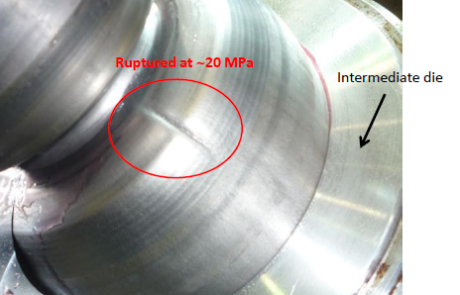
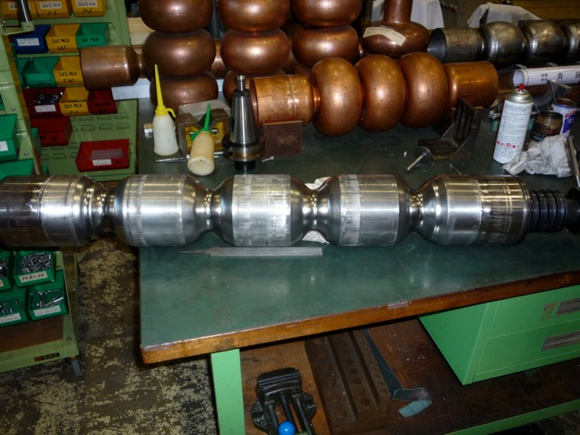
Recent activity at KEK
KEK working with a new tube vendor for ~1 year
Initial trials – some creasing due to imbalance between axial and radial deformations, requires adjustments to the balance of hydraulic pressures at intermediate stage
New single-cell capability and automation in 2012
From T. Tajima, Jan 2012

Slide 6
How to proceed from here?
FNAL tubes will be available for collaboration
Tube R&D is a must (but small chance of funds)
Deep-draw ingot slice, plus ECAE, plus flow forming to length?
Bi-metal tubes are of interest for cost savings and stability
Explosive bonded tubes (Ohio State / Nutec) or plates
Goals remain:
Improve yield at equivalent cost and performance by reducing problematic welds
Iris welds are acceptable
Build up enough statistics to evaluate feasibility as an industrial process

