Slide 1
Recent progress with VEP at Cornell
Fumio Furuta
Cornell University
July 17, 2012

Slide 2
Motivation
Vertical Electro-Polishing for high gradient cavity R&D.
VEP has the Following Benefits:
  No acid circulation.
  No rotary acid seals.
  No sliding electrical contact.
  No cavity vertical/horizontal position control fixtures.
  Simplifies the acid plumbing/containment.
  Lower capital equipment cost.
7th SRFMW

Slide 3
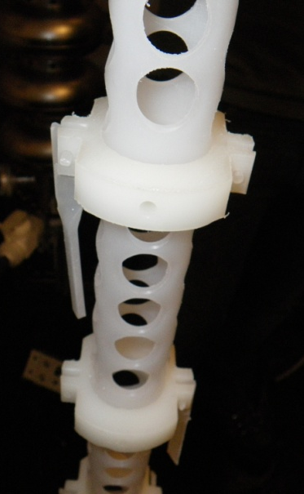
Parameters
Parameters
Cathode | aluminum >99.5%
Stir-tube | PVDF
Paddles | PVDF
Seals | FEP encapsulated O-ring
End group | PTFE, HDPE
Electrolyte | 24 liters/9-cell
Electrolyte composition | 10:1 (H₂SO₄: HF)
Maximum use | 9g/L dissolved Nb
Current | 150 Amperes
Voltage | 14 Volts
Temperature | 15 to 19 C
Stir-tube transparency | >50%
Stir frequency | 1 Hz
EP removal rate (ave.) | ~0.3um/min.
Al-cathode
Stir-tube
pivot
1Hz
puddle
7th SRFMW

Slide 4
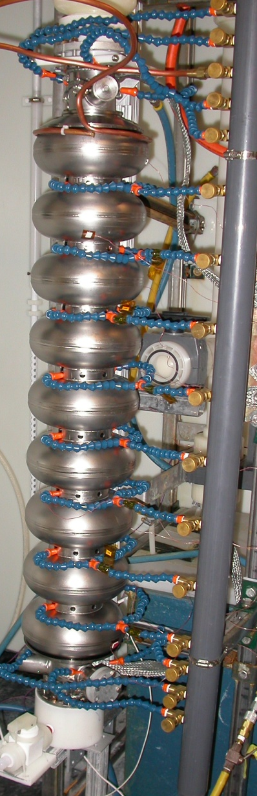
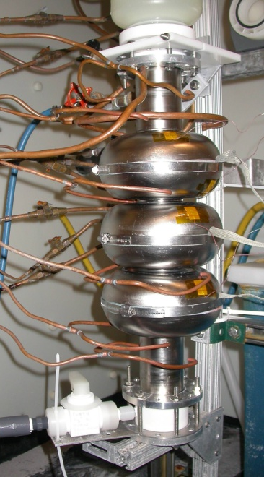
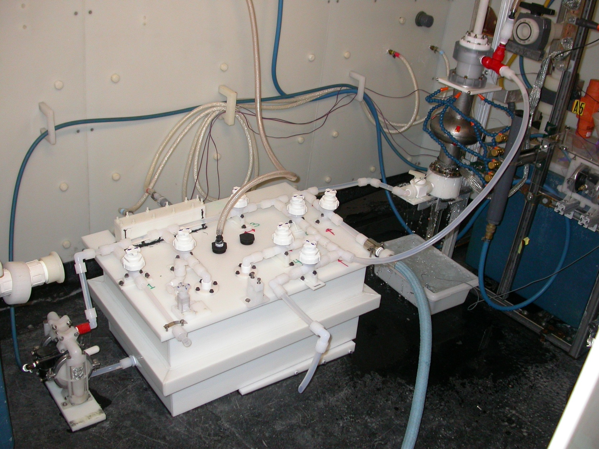
VEP set up
Images
Re-entrant 3-cell
TESLA single + new EP acid bath
New bath is available for
All single and multi cell cavities.
Easy EP acid mixing.
EP acid circulation during VEP process.
TESLA 9-cell
7th SRFMW
F. Furuta -Recent progress with VEP at Cornell
4

Slide 5
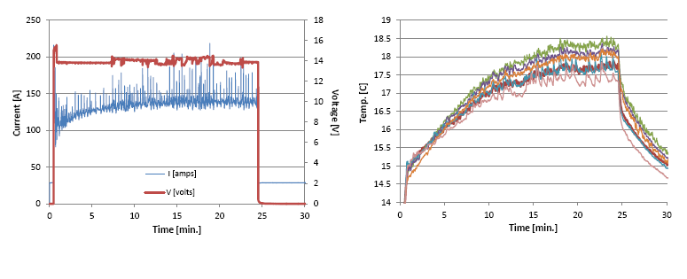
VEP log
Voltage, Current
Temp. (cell outside)
VEP log, ACCEL9
7th SRFMW

Slide 6
Analysis on VEP removal
Analysis on the previous VEP results at Cornell, the final VEP removal of less than 10um seems promising for high gradient ~40MV/m.
>Single cells are NR1-2, NR1-3, AES1-002, AES1-006, Re-entrant(60mm).
>9-cells are A9, A10, AES5, Re-entrant(70mm).
>Cavity treatment: Bulk VEP (140~300um) + hydrogen degas + micro VEP + 110CBake.
>Some cavities tumbled to remove defects.
>*HNO₃ in electrolyte, 8ml/3.5L.
>**EP after degas was replaced by 100nm oxypolish.
7th SRFMW

Slide 7
ACCEL9 + minimized VEP(5um)
The first VEP’ed ILC 9-cell cavity achieved ILC’s BCD spec.
TESLA 9-cell, 2K
7th SRFMW

Slide 8
ACCEL10 + minimized VEP(5um)
Eacc max =27.8MV/m, Qo =1.27e10, at 2.0K
Limited by quench, No detectable radiation.
TESLA 9-cell, 2K
7th SRFMW

Slide 9
Analysis on VEP removal (2)
>Single cells are NR1-3, AES1-002, AES1-006, Re-entrant(60mm).
>9-cells are A9, A10, AES5, Re-entrant(70mm).
>Cavity treatment: Bulk VEP (140~300um) + hydrogen degas + micro VEP + 110CBake.
>Some cavities tumbled to remove defects.
>*HNO₃ in electrolyte, 8ml/3.5L.
>**EP after degas was replaced by 100nm oxypolish.
7th SRFMW

Slide 10
Comparison w/ horizontal EP
KEK low loss single cell + horizontal EP.
*All cavity was processed by KEK’s CBP.
*Quench limitation only.
7th SRFMW

Slide 11
VEP’ed 9-cell status
7th SRFMW

Slide 12
Summary
Fumio 23Jan12
We have successfully demonstrated capability of VEP for high gradient ~40MV/m with TESLA 9-cell cavity.
Minimizing final VEP removal is key to success.
Next step are
  Reproducibility & yield test.
  Improve Qo curve more flat.
  Cavity shape dependence (Re-entrant, KEK Low Loss).
  Understanding and optimization of VEP process.
  R&D on mirror-like finish CBP + VEP.
  R&D on coin sample cavity.
7th SRFMW
F. Furuta -Recent progress with VEP at Cornell
12

