Slide 1
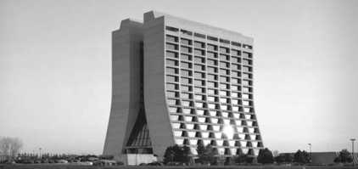
Superconducting Materials Department
Using resistivity measurements to track uptake of hydrogen as a function of material working
Alexander Dzyuba and Lance Cooley
Fermi National Accelerator Laboratory
(Superconducting Materials Department)
7th SRF Materials Workshop - July 16, 2012

Slide 2
Motivation
How this works??
How this works??
Variation within first 100 nm of :
“hydrogen (hydrides) + oxygen+ vacancies + dislocations ”
Leads to a particular Q vs E
H uptake could kill the cavity:
Hydrogen is loaded by EP, BCP and CMP
Niobium hydrides could be formed during cooling down to 2K
Hydrides are normal conducting inclusions – lossy
Hydrides plastically deform Nb lattice – premature flux penetration?
How much H do we load?
2) Does the cold-work enhance an uptake?

Slide 3
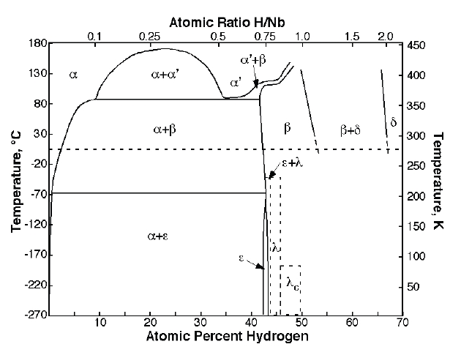
Results. Proof of the principle
after EP
before EP
F. D. Manchester and J. M. Pitre, in Phase Diagrams of Binary Hydrogen Alloys(2000)
ΔE~0.07eV
Resistance is meaningful to track
hydrogen upload.

Slide 4
Results. Hydrides formation at 77K/48h
- SEM data confirms formation of large dendritic objects
(hydrides or ice?).
- These objects don’t survive under SEM

Slide 5
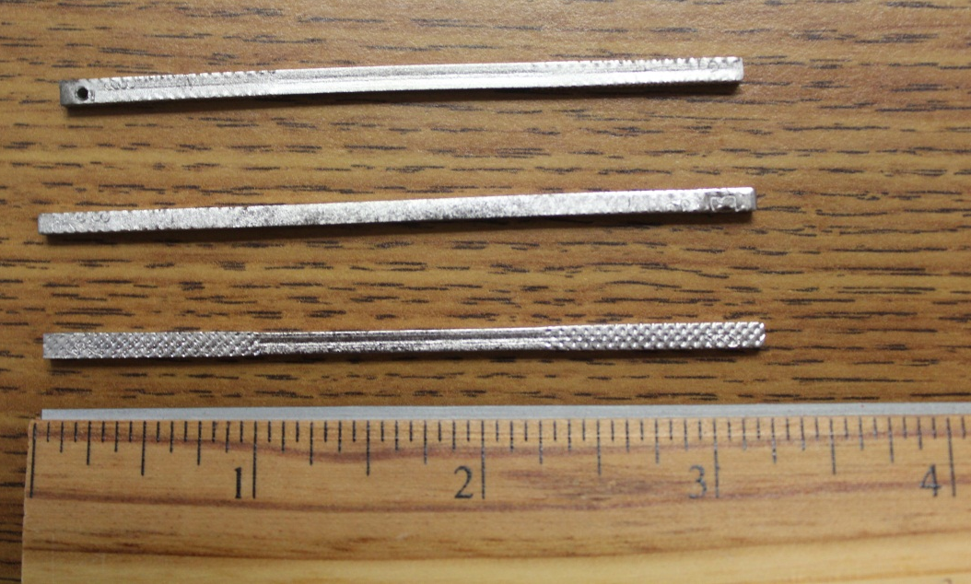
Results. Samples description
16 Nb bars (2x2x75 mm³) were cutout from the sheet
measure ρ1
Elongation in the Instron
(strain: 0%, 12%, 35%,50%)
measure ρ2
Electropolishing
(removal: 20um, 80um, 140um,180um)
measure ρ3
$$\frac{\text{ρ}\text{3−}\text{ρ}\text{2}}{\text{0.65}\text{μΩ}\text{∙}\text{cm}\text{/}\text{at}\text{\%}} −hydrogen uptake$$

Slide 6
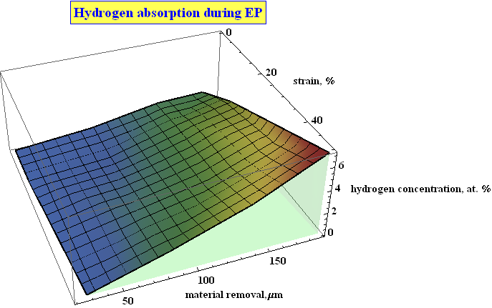
Results. H upload during EP
Both residual deformation and amount of material removal increase H concentration in the Nb.

Slide 7
HT bake anneals dislocations
effect depends on the ε
HT bake dissolves oxide layer
7nm of Nb₂O₅ - estimate

Slide 8
Acknowledgments:
D.Hicks, D.Ford, H.Padamsee, C.Thompson and R.Schuessler
Research is supported by Fermi Research Alliance, LLC
under Contract No. DE-AC02-07CH11359 with the United States Department of Energy

Slide 9
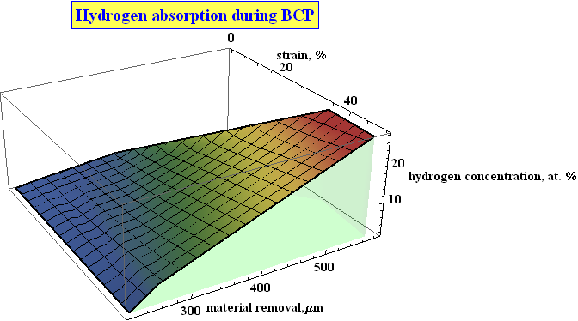

Slide 10
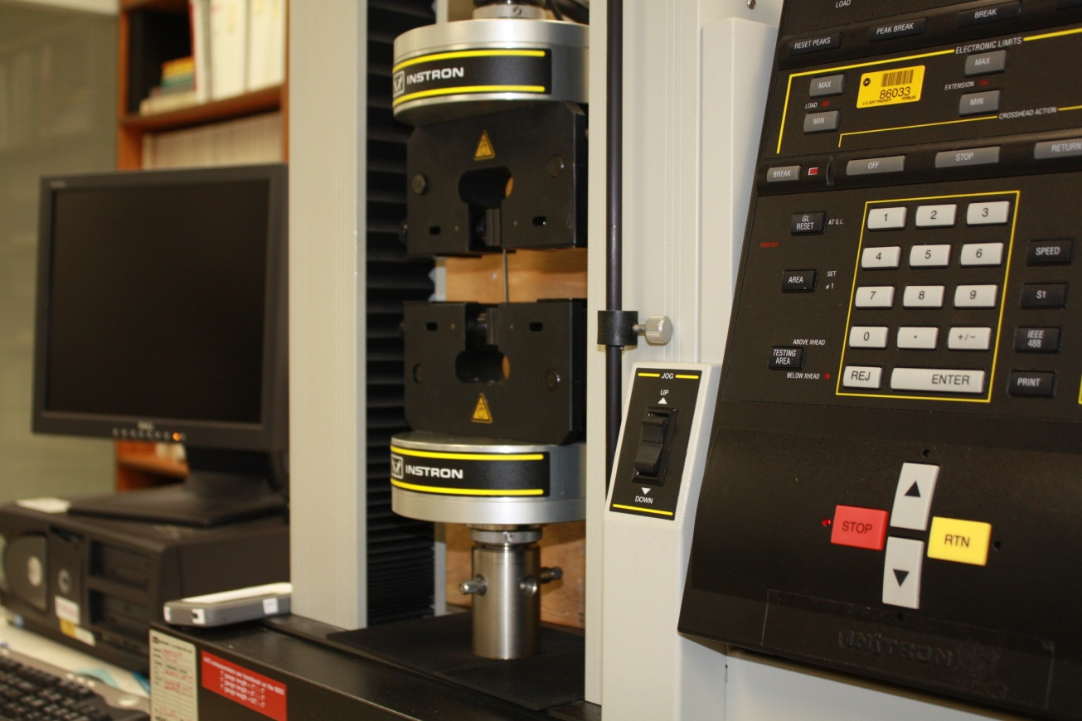

Slide 11
Baseline cavity processing:
150um EP
High temperature bake
20um EP
High Pressure Rinse + Alcohol rinse
(Low Temperature Bake)
Water rinse
Half cells formation/ welding

