Slide 1
Raw Materials Specifications and
Material Batch History
(Niobium sheets used to make 9-cell cavities)
Lance Cooley
Head, Superconducting Materials Department, Fermilab
With assistance from: Marianne Bossert, Alex Dzyuba, Mike Foley, Camille Ginsburg, Chuck Grimm, Donna Hicks, Alex Romanenko, Allan Rowe, and Rob Schuessler
Special thanks to: Tony Nelson (Wah Chang), Michael Pekeler (RI), and John Rathke (AES)

Slide 2
Main points which will be addressed
We now have enough statistics to re-evaluate:
  Does raw material condition affect later processing?
  Are our specifications effective for getting what we want?
Conclusion #1: Residual cold work in sheets may increase variability in final cavity results
  100% recrystallization for 35 MV/m, not so for 25
  Pockets of cold work sensitize cavity cells to chemical attack, which may increase process variability
Conclusion #2: Build better vacuum ovens
  Vendors optimize one process to meet market demand
    Tweaks are limited to the final anneal (vendor or later)
    Buy cheap sheets according to the common process
  In principle, residues of forming and processing can be removed by annealing (and thus are absent in LG sheets?)
    800 °C not hot enough, 1000 °C is too dirty

Slide 3
Cavity test results, by material batch – First Test

Slide 4
Cavity test results, by material batch – Best Test

Slide 5
Mechanical property summary
Hardness
Tensile ||
Tensile ⊥
RRR
(Spec is off chart)
Elong ⊥
Elong ||
Yield ||
Yield⊥

Slide 6
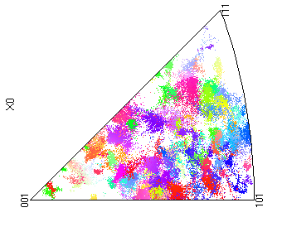
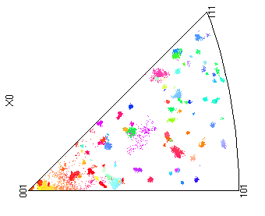
Cold work → surface DL clusters → local attack
High tensile strength
Low tensile strength
EBSD, looking down at the sheet surface
A. Romanenko

Slide 7
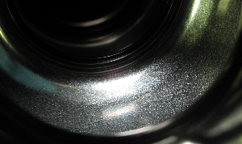
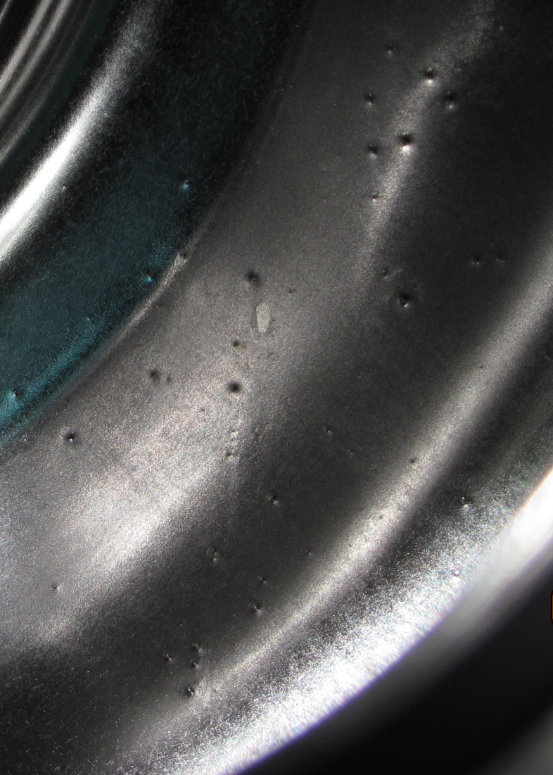
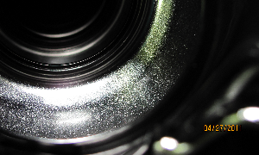
What might happen downstream?
After 10 µm BCP (by vendor)
and before EP
After 30 µm EP
by FNAL at ANL
After tumbling, this reached 32 MV/m…

Slide 8
More annealing? (Large grain?)
EP + 800°C 3h
½ cell cut-out
A
A
B
B
C
D
RF side
F
E
C
D
After 100 µm EP
2.8 mm (all pix)
Sample E
E
F
RF side (all pictures)
A. Dzyuba

Slide 9
Conclusions and discussion points
Cavity performance spread shifts up and narrows with first-to-best processing – this doesn’t seem to occur as much for sheet batches with higher Hv, Y, T, and lower elongation
  Statistically bad sheet → bad cell → bad cavity that won’t respond to repeated processing…
  We want maximum flexibility in the processing steps, so that a statistically bad process can be repaired by a later good process.
Microscopy gave plausible reason why: Retained pockets of cold work might lead to pitting or contamination
  Dislocation tangles → local attack → pits
  Dislocation tangles → high local contamination → hot spot
  Annealing fixes this problem, but 800 °C is clearly not hot enough (not shown: contamination for 1000 °C)
    How hot is hot enough? 1000? 1100? 1400? Titanium?
    My hunch: need > 1100 °C
      Remove carbon (Ellingham diagram: CO wins thermodynamically)
      Carbon is known to decorate linear defects, which should retard their mobility

Slide 10
Comparison of specifications
 | ASTM B393 | FNAL 371073C | XFEL /007
RRR | 260 (ice point) | 300 (RT) | 300 (RT)
Trace impurities (ppm by mass) | N,C < 30; O < 40; H < 5; Ta < 1000 | C,N,O < 30; H<5; Ta < 1000 | C,N,O< 10; H<2; Ta < 500
% Recrystallized | 90 | 95 | 100
Grain size (ASTM) | 5; none < 4 | 6; none < 4 | 6; none < 4
Hardness, Hv | < 60 avg., 75 max | < 50 avg; 60 max | < 60 avg.
Yield Strength (MPa) | 50 < Y | 50 < Y < 75 | 50 < Y < 100
Tensile Strength (MPa) | 95 < T | 95 < T < 140 | 140 < T
Elongation* | 30% | 35-40% | 30%
Surface (R_{A}, R_{T} in µm) | 1.6, 25, 6% flat | 1.5, 25, 2-6% | 1.6, 15, 1 mm
Note |  | EBSD | Bend test
*Longitudinal vs. transverse shall not vary by more than 20%

